Slide 1

Overview of WP13 activities
Genoa, October 2024
Thibaut Lefevre on behalf of WP13

Slide 2
Beam instrumentation for new hardware configuration
New hardware :
Larger aperture, higher field quadrupole magnets
  New cryogenic directional Stripline beam position monitors with higher resolution
Radiofrequency deflecting cavities
  New intra-bunch diagnostic to measure beam crabbing and transverse instabilities (50ps time resolution needed)
New absorbers for neutral particles requiring new luminosity monitors
Notes:
EVM curve to be updated by Giovanna

Slide 3
Beam instrumentation for improved beam parameters
Increasing the bunch and beam intensity (2.310¹¹ protons per bunch)
  Development of non-invasive transverse beam profile monitor
    Beam Gas Ionization monitor
    Beam Gas Curtain monitor using on beam induced fluorescence
  Development of beam halo monitors
  Upgrade of Beam loss monitoring system
Notes:
EVM curve to be updated by Giovanna

Slide 4
Overview WP 13 tasks
Task | Description | Equipment code
WP 13.1 | Beam loss monitors | BLM
WP 13.2 | Beam-gas curtain monitor | BGC
WP 13.3 | Beam position monitors | BPM
WP 13.4 | Luminosity monitors | BRANQ
WP 13.5 | High-bandwidth BPM | BPW
WP 13.6 | Synchrotron light diagnostics | BSR
WP 13.7 | Beam-gas ionisation monitor [new technology baseline] | BGI

Slide 5
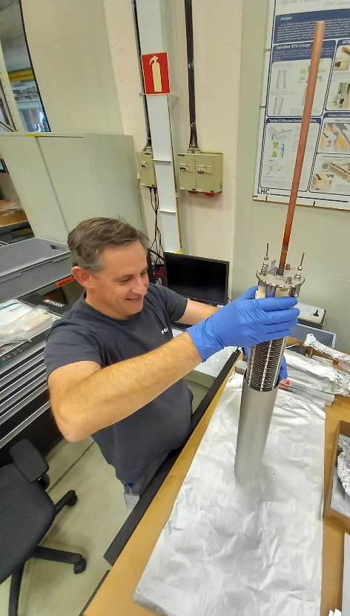
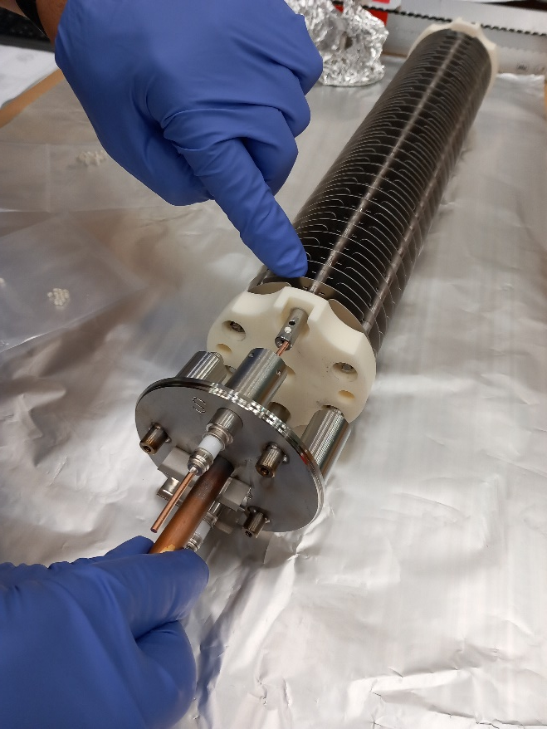
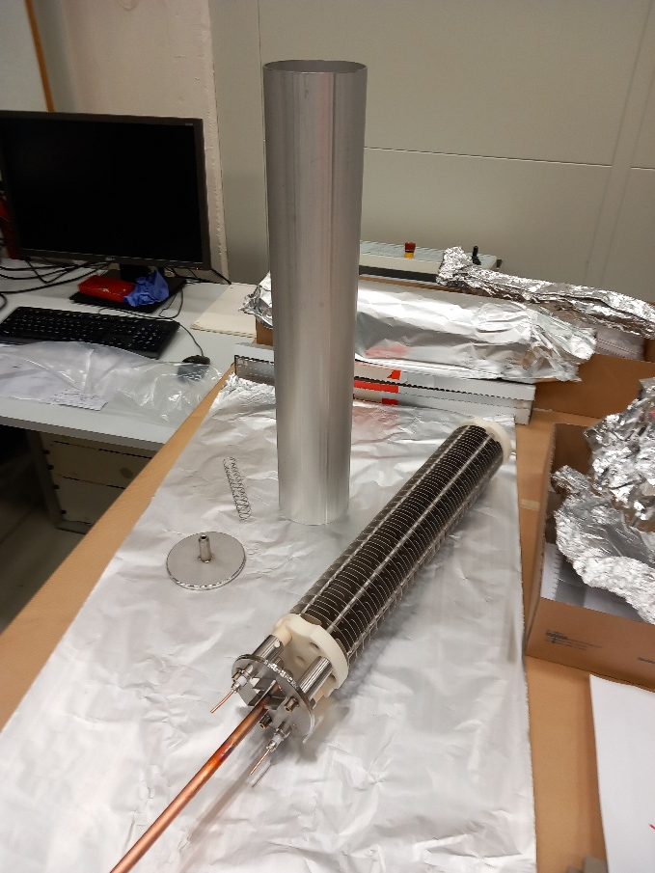
Task 13.1 Beam Loss Monitor Ionisation Chamber (IC) Production
HL-LHC requires extension of existing BLM coverage with many new ICs
Large-scale production being prepared
  1000 to produce for LS3, of which 200 for HL-LHC.
  Prototyping with CERN groups EN-MME and TE-VSC

Slide 6
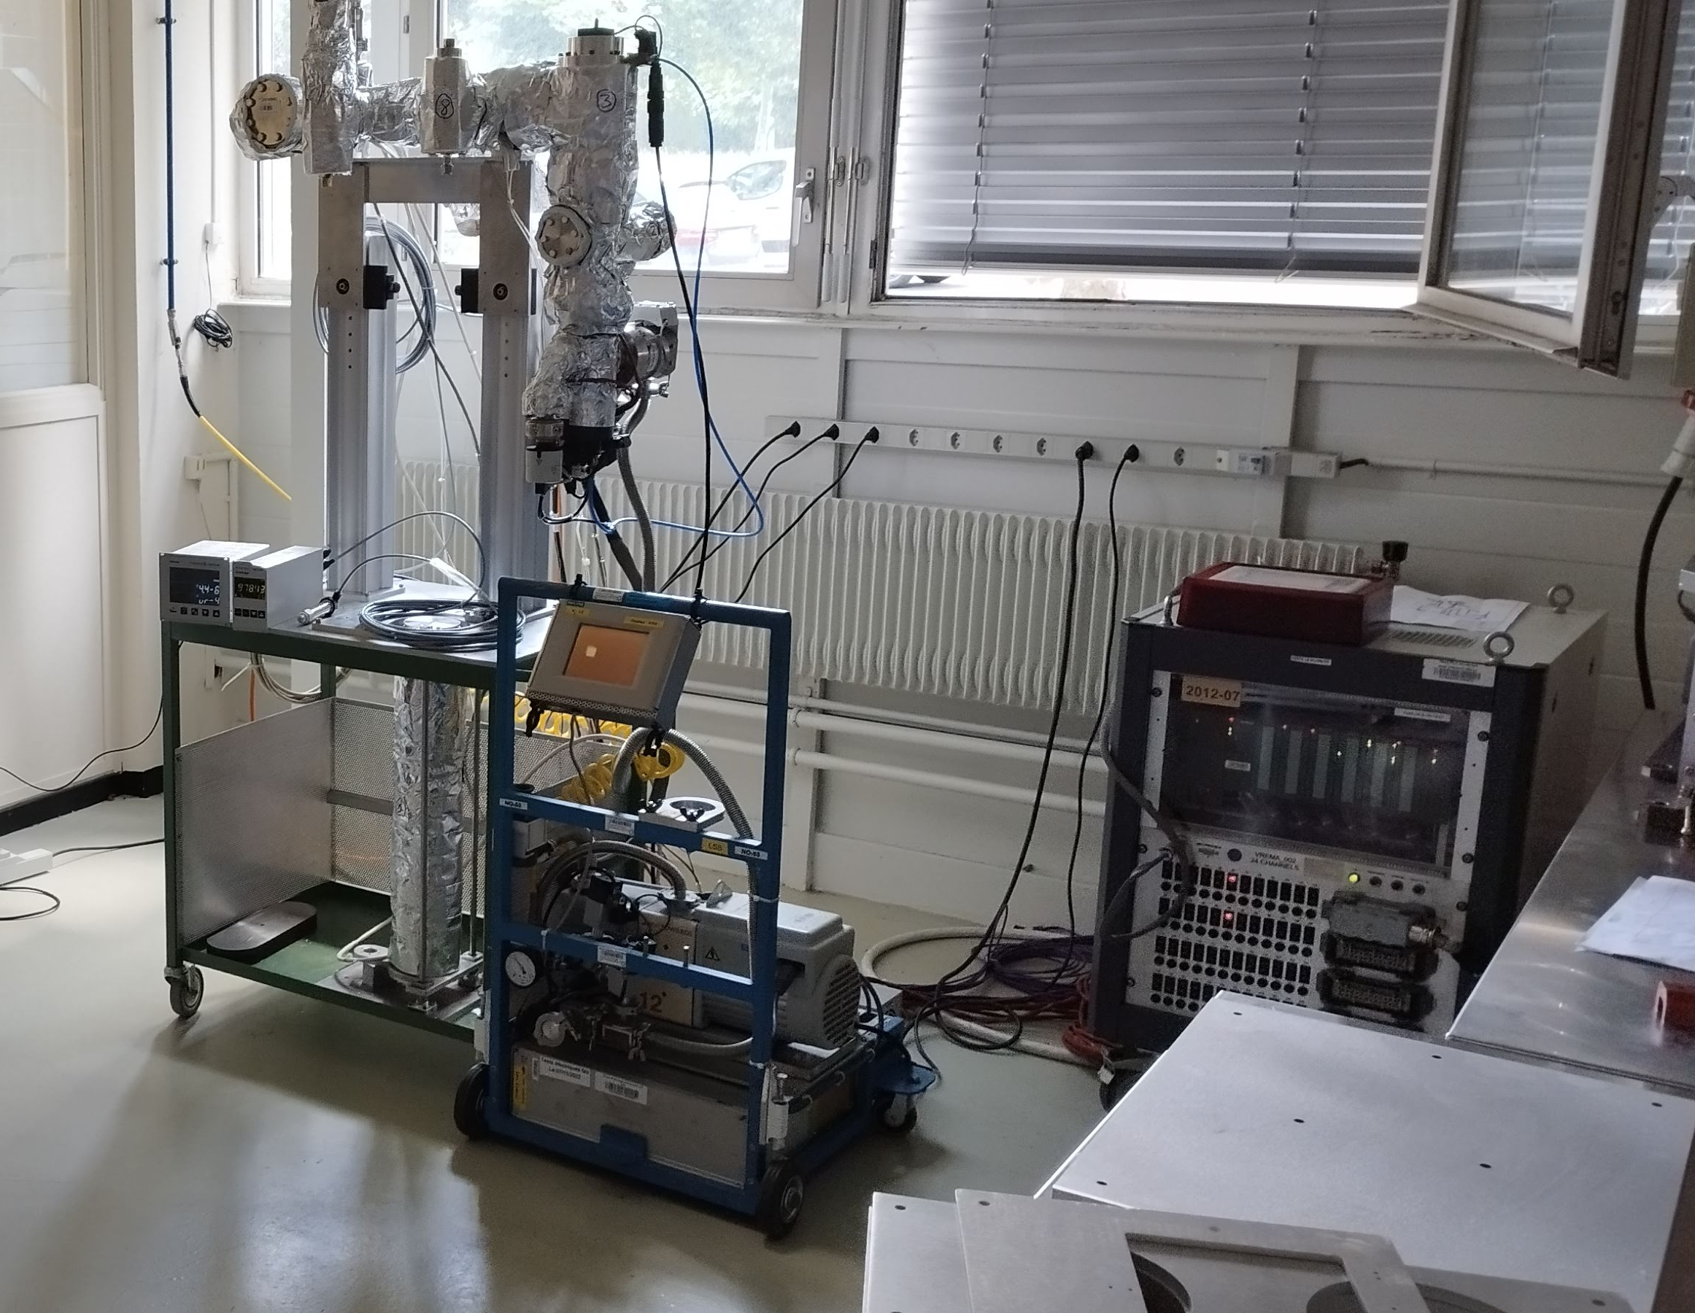
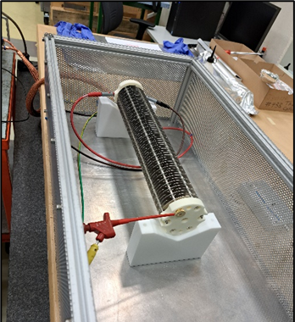
Task 13.1 Beam Loss Monitor Ionisation Chamber (IC) Production
New test-stands for bakeout and gas filling as well as electrical validation
Measuring leakage current < 1pA
BLM filling and bakeout stand
BLM electrical resistance test stand

Slide 7
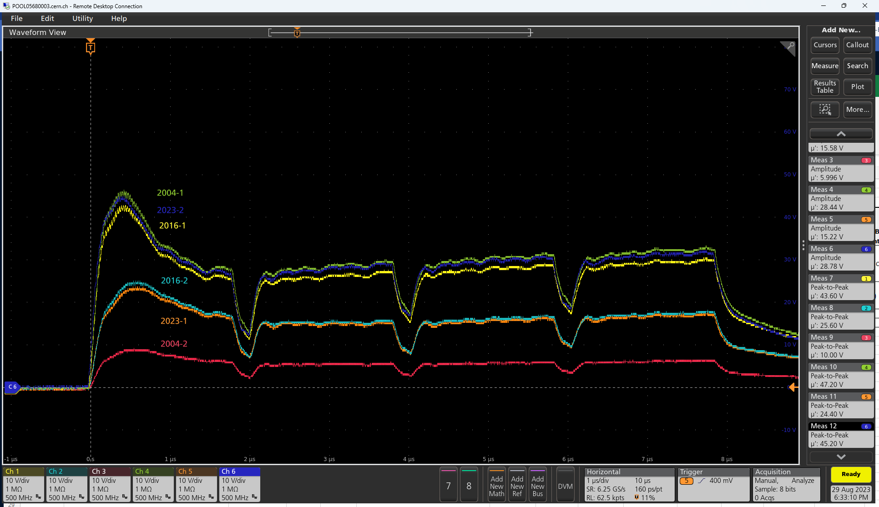
Task 13.1 Beam Loss Monitor Ionisation Chamber (IC) Production
Successful preliminary tests of new prototypes in HiRadMat
  Two CERN-produced prototypes installed next to beam dump
  Comparison of beam loss signals for the previous production lots (2008, 2016, 2023) show acceptable dispersion
4x42 high intensity bunches on a BLM cluster in HiRadMat (August 2023)

Slide 8
Task 13.1 Beam Loss Monitor Ionisation Chamber (IC) Production
Successful preliminary tests of new prototypes in HiRadMat
  Two CERN-produced prototypes installed next to beam dump
  Comparison of beam loss signals for the previous production lots (2008, 2016, 2023) show acceptable dispersion
4x42 high intensity bunches on a BLM cluster in HiRadMat (August 2023)
Talk by Gerhard for IC production status and strategy

Slide 9
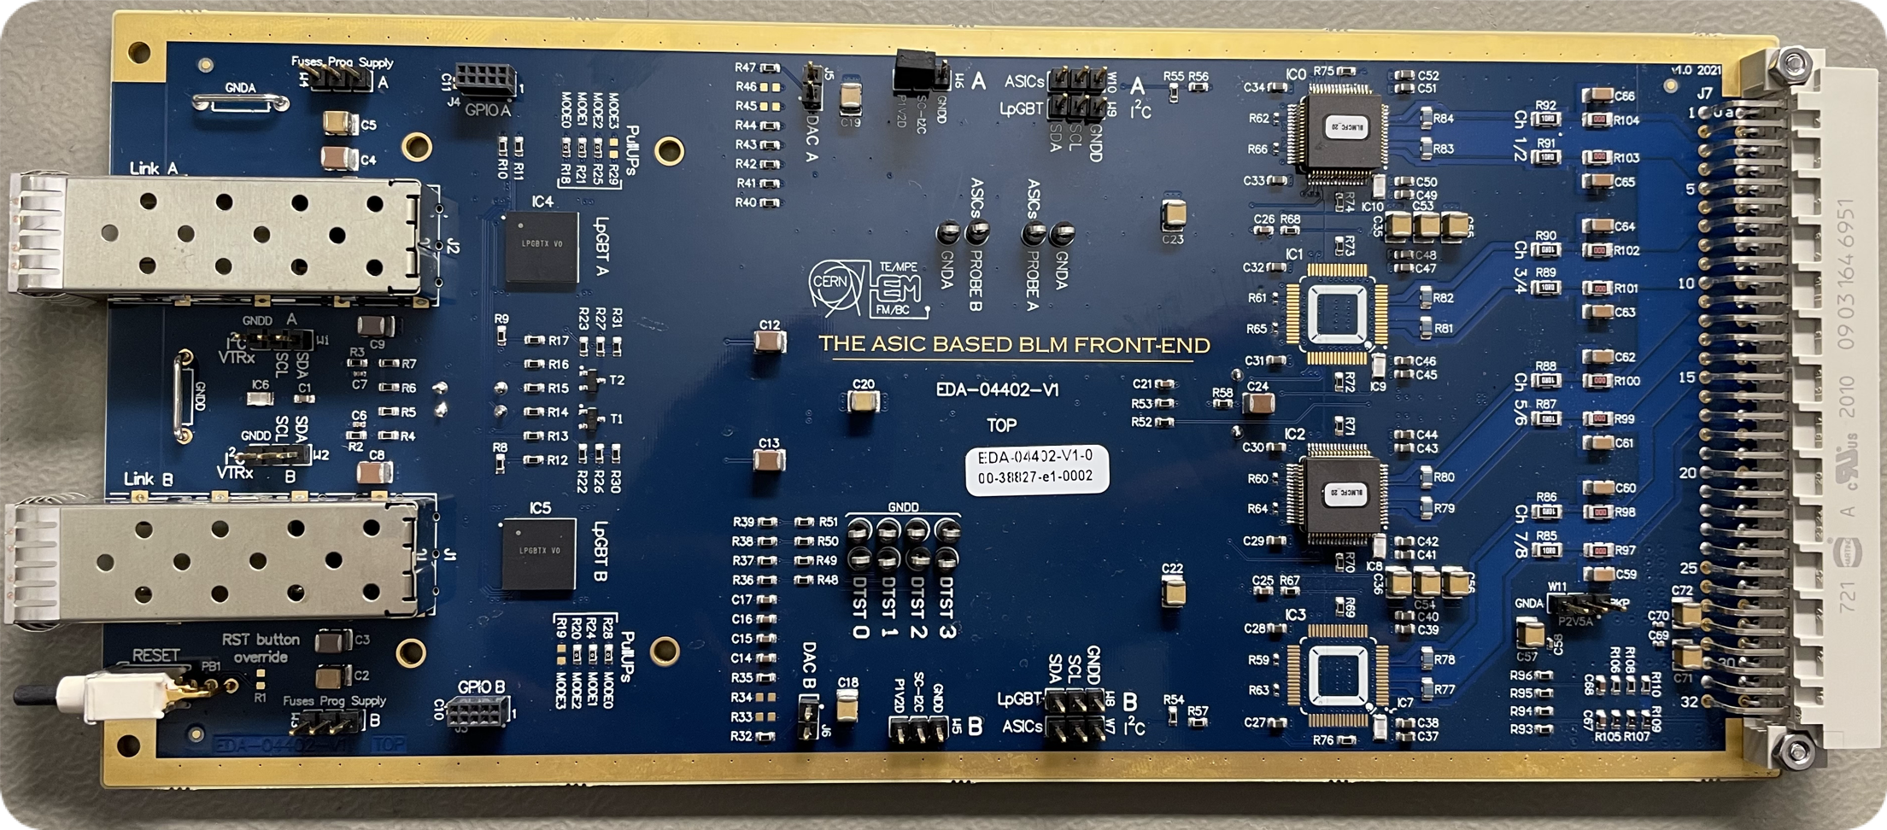
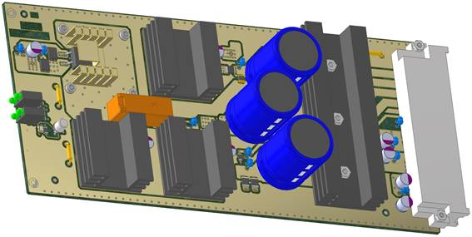
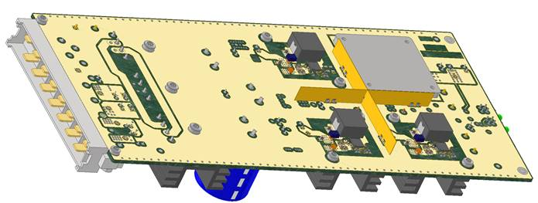
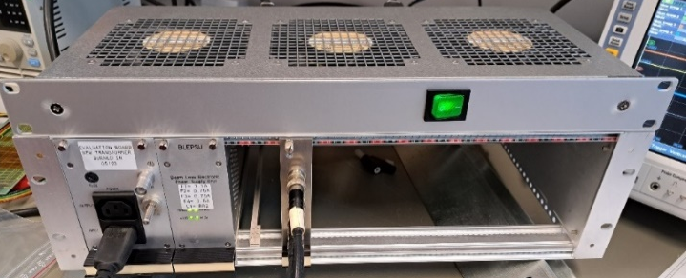
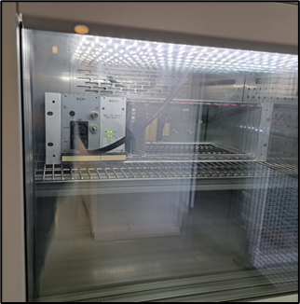
Task 13.1 Beam Loss Monitor DAQ
New Rad-Hard card Front-End to allow reduced cable lengths and improve S/N ratio
  First deployment at strategic locations during LS3 to complete and validate development in parallel to the current electronics
  Full electronics deployment during LS4 as part of the Consolidation project
  BLM ASIC production completed in 2024, VTRx and LpGBT under production with EP-ESE
New rad-hard power supplies
  Necessary for radiation resistance and replacing obsolete systems
  Developed in common for BLMs and BPMs, in collaboration with EP-ESE and BE-CEM with likely CERN-wide usage
  v3 based on bPOL (rad-hard ASIC)
  Recent v4 prototype validation completed*, optimised for tunnel environment
  All tests and validations completed, e.g.
    @CHARM/CERN (reached ~ 1500 Gy accumulated)
    Climatic chamber (150h stress-test up to 100°C)
2 x SM-VTRx
2 x LpGBT
4 x BLMASIC
New BLEIC card with application-specific IC (ASIC) so fewer componants
3D models of BLEPSU v4
3-D models of BLEPSU v4
Setup for CHARM & Climatic chamber
Set-up for CHARM and climatic test-chamber
*https://edms.cern.ch/item/EDA-03919-V4-0/0

Slide 10
Task 13.1 Beam Loss Monitor DAQ
New Rad-Hard card Front-End to allow reduced cable lengths and improve S/N ratio
  First deployment at strategic locations during LS3 to complete and validate development in parallel to the current electronics
  Full electronics deployment during LS4 as part of the Consolidation project
  BLM ASIC production completed in 2024, VTRx and LpGBT under production with EP-ESE
New rad-hard power supplies
  Necessary for radiation resistance and replacing obsolete systems
  Developed in common for BLMs and BPMs, in collaboration with EP-ESE and BE-CEM with likely CERN-wide usage
  v3 based on bPOL (rad-hard ASIC)
  Recent v4 prototype validation completed*, optimised for tunnel environment
  All tests and validations completed, e.g.
    @CHARM/CERN (reached ~ 1500 Gy accumulated)
    Climatic chamber (150h stress-test up to 100°C)
2 x SM-VTRx
2 x LpGBT
4 x BLMASIC
Talk by Christos on HL BLM system development
Talk by Sara on Beam loss limitations and proposed changes
New BLEIC card with application-specific IC (ASIC) so fewer componants
3D models of BLEPSU v4
3-D models of BLEPSU v4
Setup for CHARM & Climatic chamber
Set-up for CHARM and climatic test-chamber
*https://edms.cern.ch/item/EDA-03919-V4-0/0

Slide 11
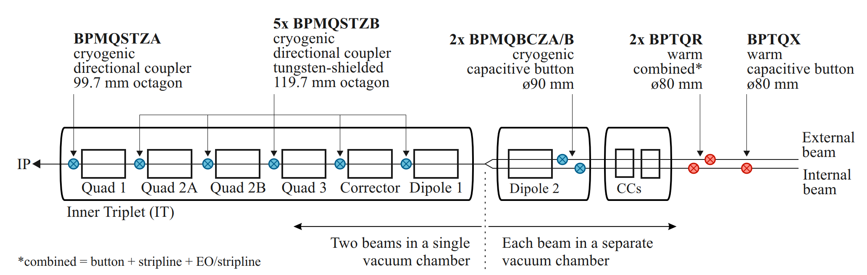
Task 13.3 - New Beam Position Monitors (BPMs) - Overview
44 new BPMs to be built and installed for HL-LHC baseline
  Cryogenic ‘directional’ couplers (with 2 variants) in the triplets
    Stripline pickups sensitive to beam direction for the cryogenic combined beam sections
  Cryogenic capacitive button BPMs
    In the dual aperture separation dipole cryostats

Slide 12
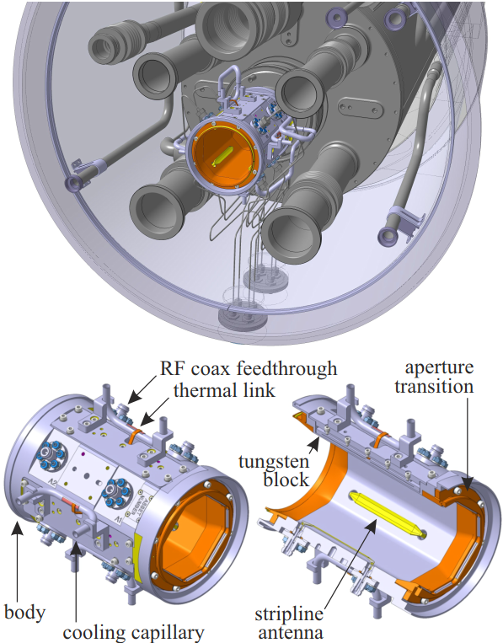
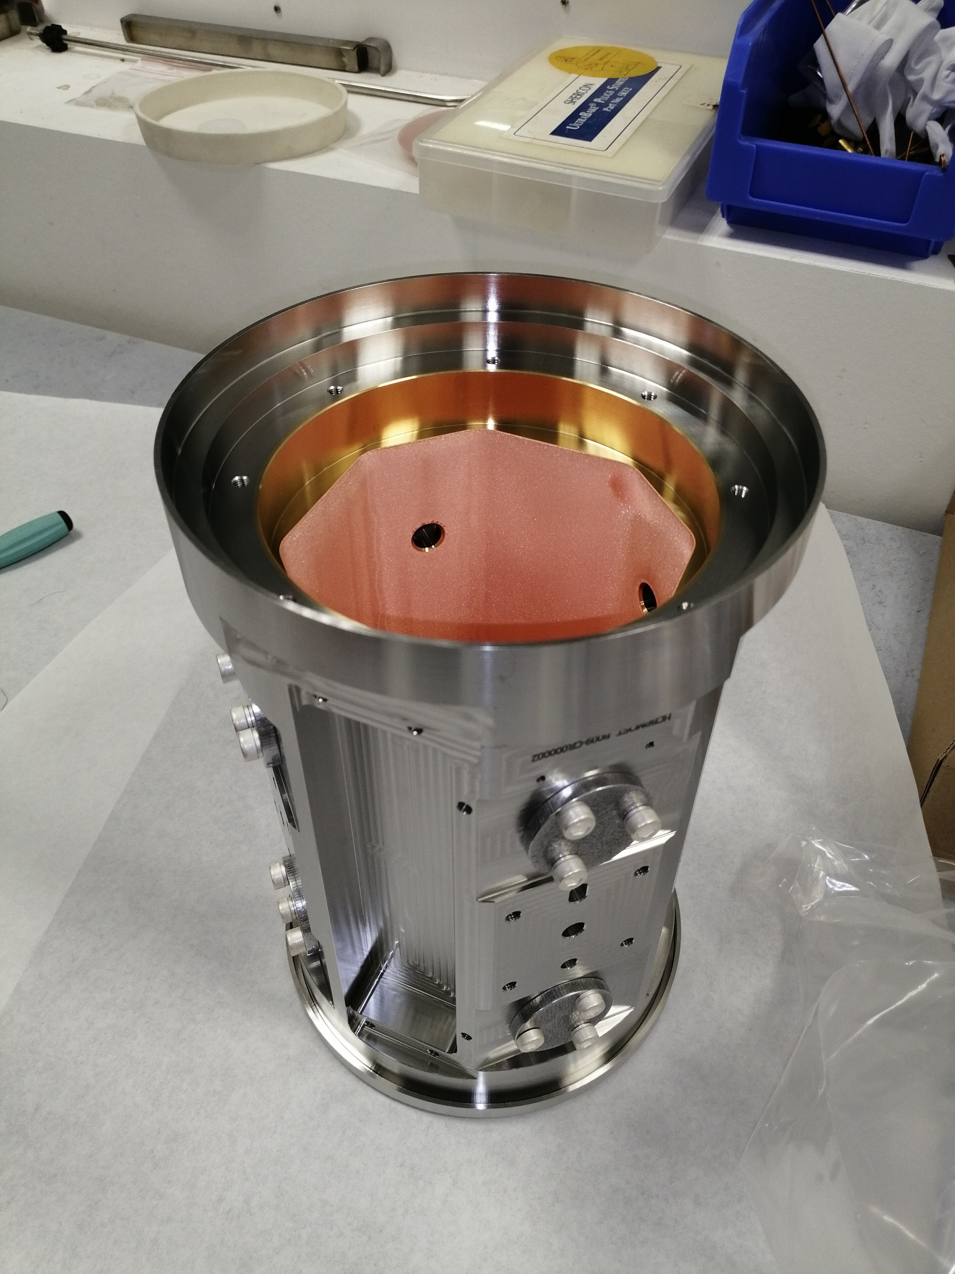
Task 13.3 - New BPMs between Q1 to Q5
Design
  Octagonal body with copper transitions
  Gold, copper and aCarbon coated
  Integrated tungsten absorbers with active cooling
Status of cryo-BPM body production
  In-house Production (MME/VSC)
    Design frozen following Production Readiness Review in October 2022
    5 pre-series bodies have been successfully produced
    Coatings and cooling tube integration ongoing
    Series of 33 units plus spares in production
    Cryo-cable integration and installation access in progress
  Procurement for 558 cryogenic SiO2 RF cable
Coated pre-series body at CERN

Slide 13
Task 13.3 - New BPMs between Q1 to Q5
Design
  Octagonal body with copper transitions
  Gold, copper and aCarbon coated
  Integrated tungsten absorbers with active cooling
Status of cryo-BPM body production
  In-house Production (MME/VSC)
    Design frozen following Production Readiness Review in October 2022
    5 pre-series bodies have been successfully produced
    Coatings and cooling tube integration ongoing
    Series of 33 units plus spares in production
    Cryo-cable integration and installation access in progress
  Procurement for 558 cryogenic SiO2 RF cable
Talk by Emma for status of BPM body production
Coated pre-series body at CERN

Slide 14
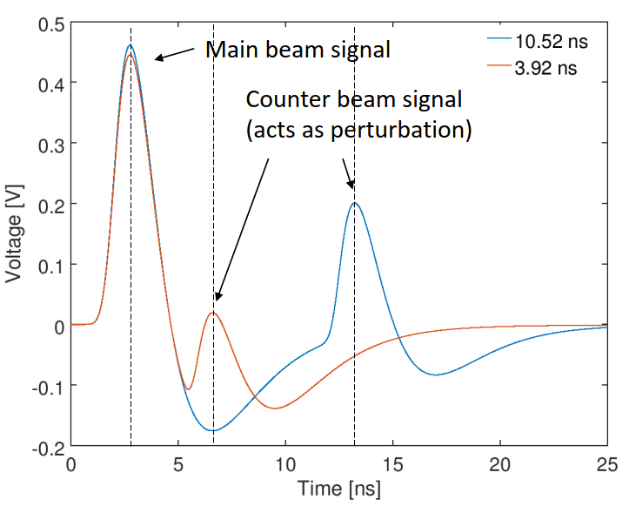
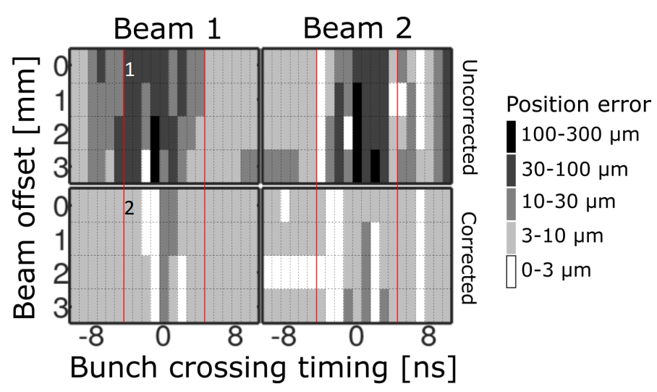
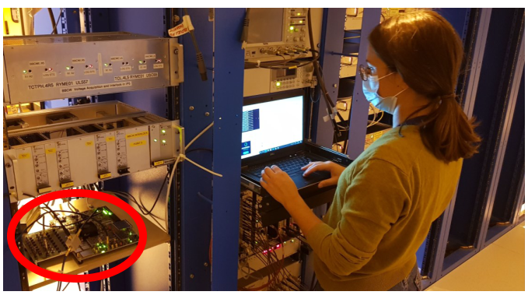
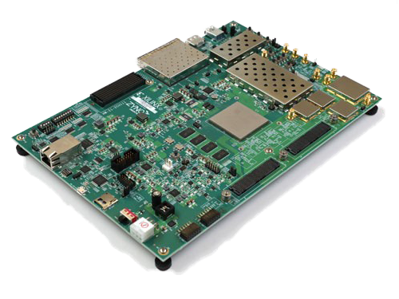
Task 13.3 - New BPM acquisition electronics in IP1/5
Good progress with development of proof-of-principle data acquisition system
  Based on a commercial evaluation board with a state-of-the-art RFSoC chip
  Large amount of beam data acquired during a dedicated MD in 2022; Results presented at IPAC 2023. Now sent to peer-reviewed journal
  Integration into CERN controls infrastructure (Linux, FESA, timing etc.) tested and further developed now in close collaboration with CTTB SoC project (led by Irene Degl’Innocenti)
Procurement of RFSoC in progress
Custom analogue and digital front-end extension boards under design
https://www.ipac23.org/preproc/doi/jacow-ipac2023-thpl089/index.html
https://www.ipac23.org/preproc/doi/jacow-ipac2023-thpl119/index.html

Slide 15
Task 13.3 - New BPM acquisition electronics in IP1/5
Good progress with development of proof-of-principle data acquisition system
  Based on a commercial evaluation board with a state-of-the-art RFSoC chip
  Large amount of beam data acquired during a dedicated MD in 2022; Results presented at IPAC 2023. Now sent to peer-reviewed journal
  Integration into CERN controls infrastructure (Linux, FESA, timing etc.) tested and further developed now in close collaboration with CTTB SoC project (led by Irene Degl’Innocenti)
Procurement of RFSoC in progress
Custom analogue and digital front-end extension boards under design
Talk by Michal on the expected performance of BPM in IP1/5
https://www.ipac23.org/preproc/doi/jacow-ipac2023-thpl089/index.html
https://www.ipac23.org/preproc/doi/jacow-ipac2023-thpl119/index.html

Slide 16
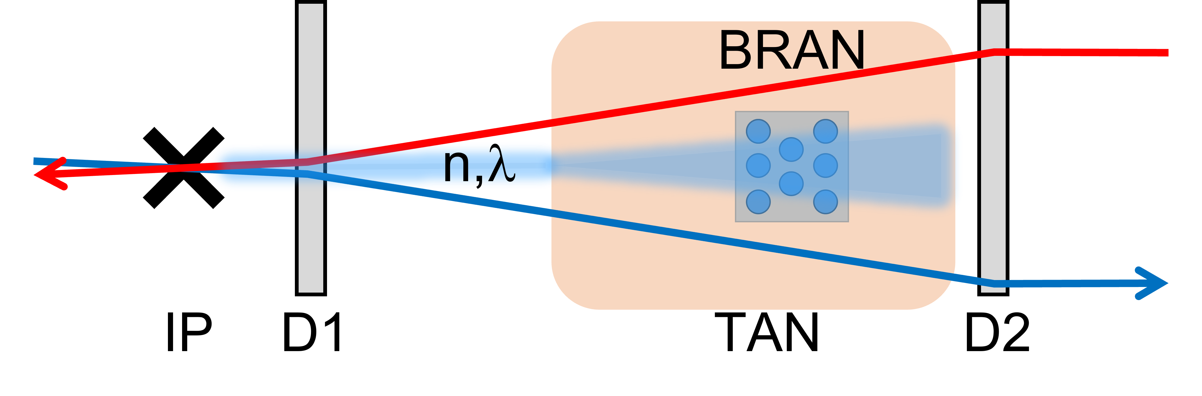
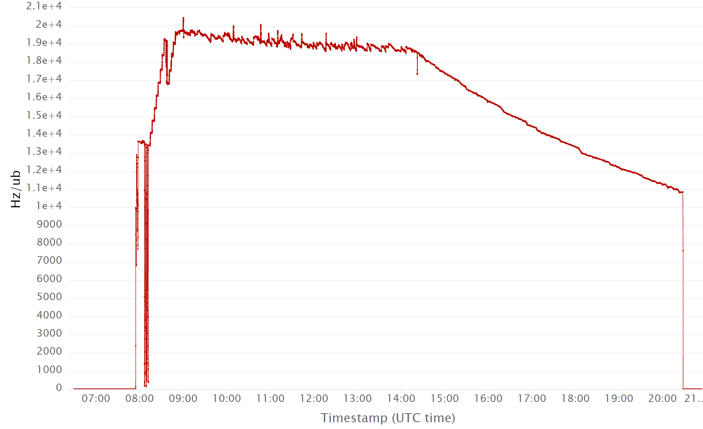
Task 13.4 - New luminosity monitors for IP 1/5
Provides a relative luminosity measurement for LHC experiments
  Used for optimising collision rates and
  Cross-checking the absolute monitors in each experiment
  Detects the electro-magnetic showers in the TAXN
New design for HL
  Based on Cherenkov radiation produced in fused silica rods
  Four prototypes installed in IR1/5. New firmware and data acquisition system
  Recent tests with beam in the LHC confirm wide luminosity range to 2x10¹⁴ µb/Hz and very good resolution
Future plans for the final HL version
  Based on the same SiO₂ bars, adapted to the new TAXN absorber and optimised for full HL intensity
Luminosity monitor concept and schematic
  Yang et al. ‘Optical transmission characterization of fused silica materials irradiated at the CERN Large Hadron Collider’, NIM A 1055, 168523 (2023)
BRAN-D 1R, Fill 9072, 16/7/2023, full 2.1e04 lumi range.

Slide 17
Task 13.4 - New luminosity monitors for IP 1/5
Provides a relative luminosity measurement for LHC experiments
  Used for optimising collision rates and
  Cross-checking the absolute monitors in each experiment
  Detects the electro-magnetic showers in the TAXN
New design for HL
  Based on Cherenkov radiation produced in fused silica rods
  Four prototypes installed in IR1/5. New firmware and data acquisition system
  Recent tests with beam in the LHC confirm wide luminosity range to 2x10¹⁴ µb/Hz and very good resolution
Future plans for the final HL version
  Based on the same SiO₂ bars, adapted to the new TAXN absorber and optimised for full HL intensity
Luminosity monitor concept and schematic
Talk by Stefano on the final design of the BRAN in TAXN
  Yang et al. ‘Optical transmission characterization of fused silica materials irradiated at the CERN Large Hadron Collider’, NIM A 1055, 168523 (2023)
BRAN-D 1R, Fill 9072, 16/7/2023, full 2.1e04 lumi range.

Slide 18
Task 13.5 - High Bandwidth BPM (BPW)
Measuring intra-bunch motion with high bandwidth and high sampling rate
  With the goal to provide a better instrument than the classical Head-Tail monitor (Stripline BPM, hybrid Δ/Σ and fast sampling oscilloscope)
A full electro-optical BPM developed with Royal Holloway University of London since 2016
Hybrid solution being investigated using commercial electro-optical modulators and time stretch techniques (short laser pulses)
Technology review to be organized in December 2024

Slide 19
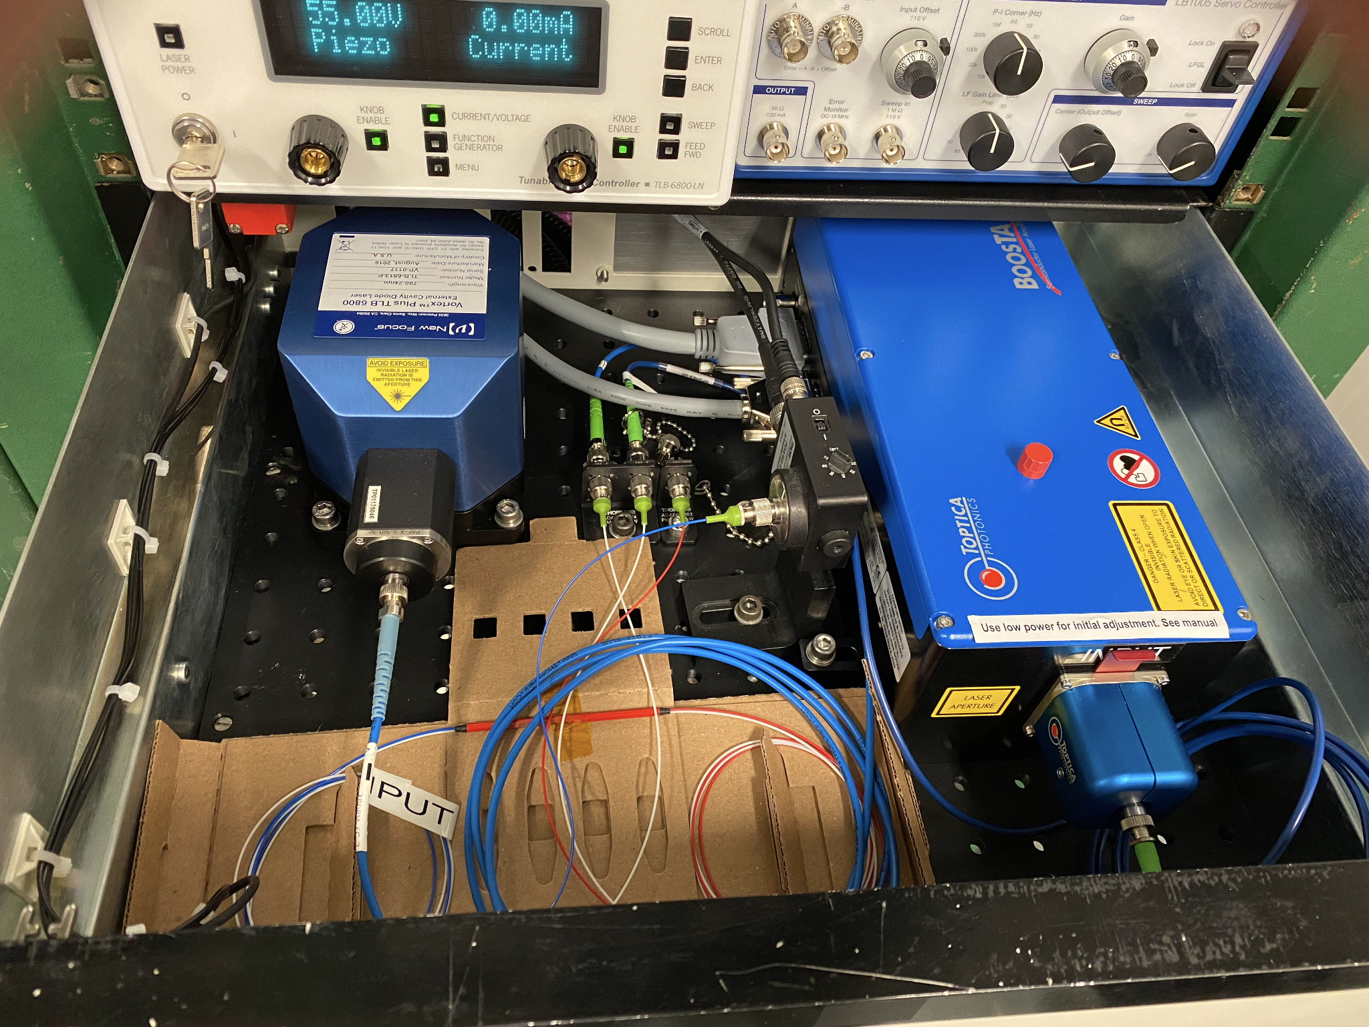
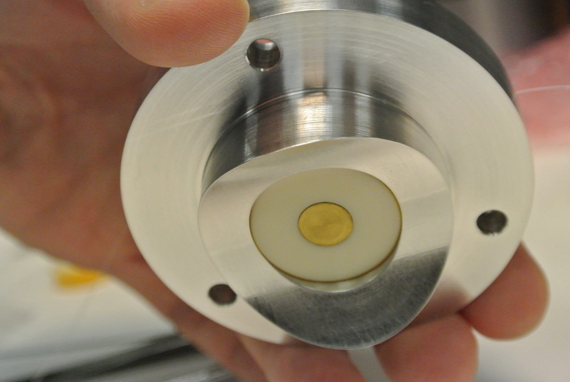
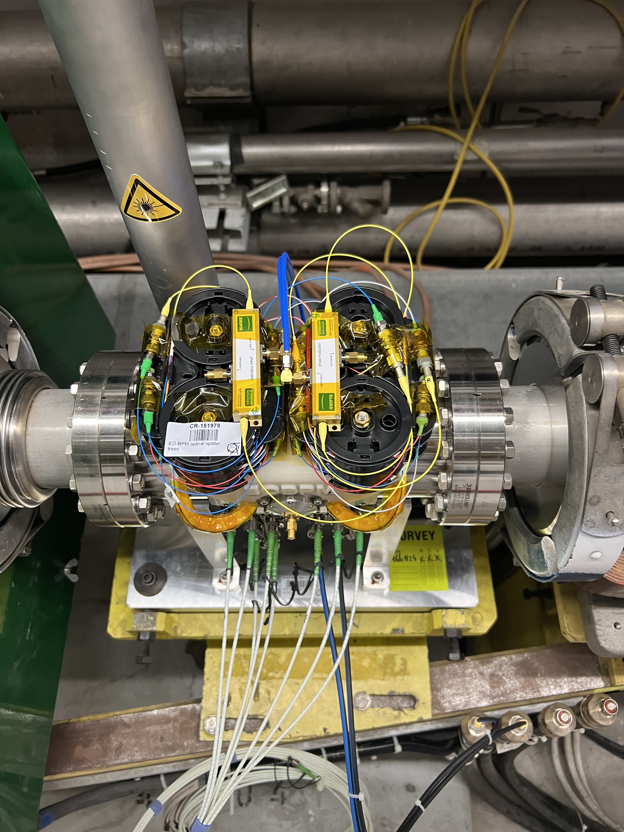
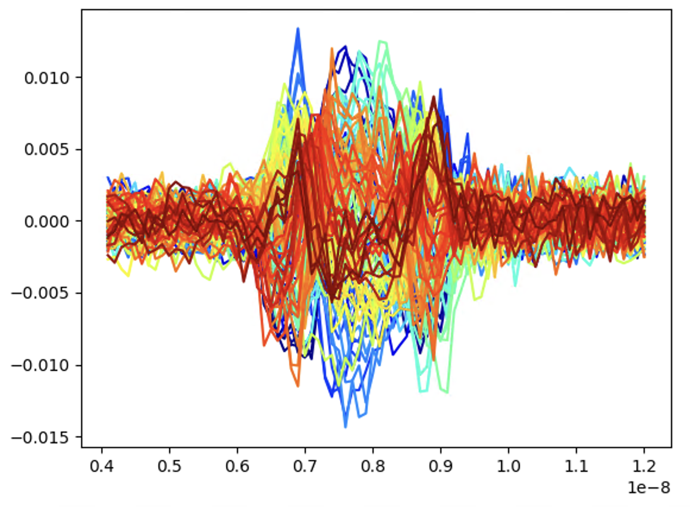
Task 13.5 - High Bandwidth BPM (EOBPM)
780nm DC Laser Source
  Electrode signal encoded on a laser beam passing through a fiber-based E-O waveguide manufactured by UK industry
  Example of beam injection oscillations of proton bunch at 26GeV@SPS
Measured time resolution better than 50ps using a 33GHz, 250MSa/s oscilloscope @ CLEAR

Slide 20
Task 13.5 - High Bandwidth BPM (EOBPM)
780nm DC Laser Source
  Electrode signal encoded on a laser beam passing through a fiber-based E-O waveguide manufactured by UK industry
Talk by Max on the latest results of EO BPM tests in SPS
  Example of beam injection oscillations of proton bunch at 26GeV@SPS
Measured time resolution better than 50ps using a 33GHz, 250MSa/s oscilloscope @ CLEAR

Slide 21
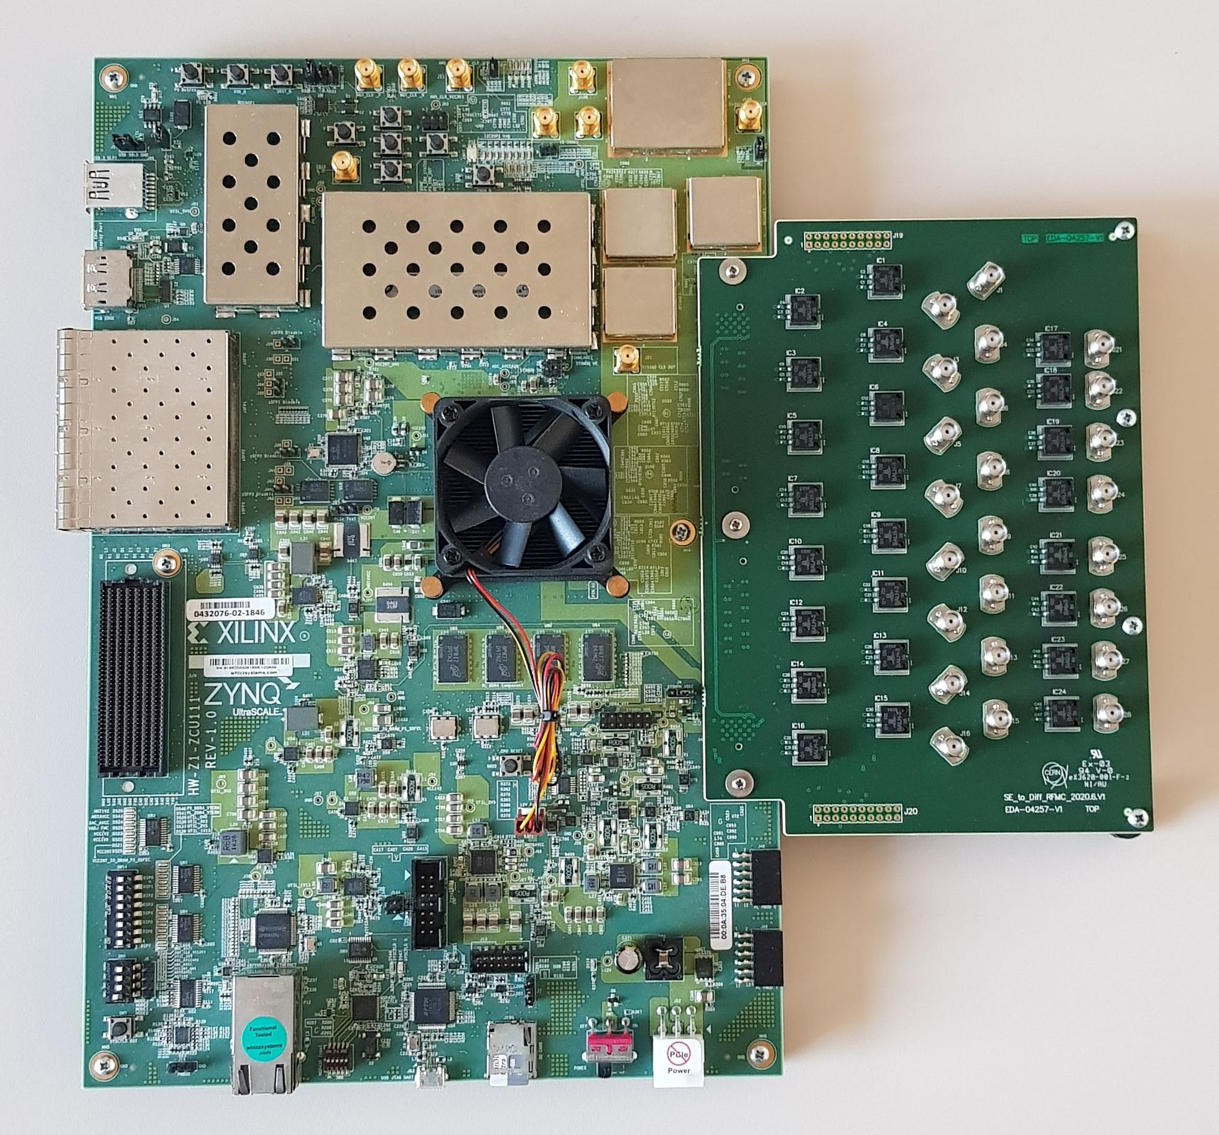
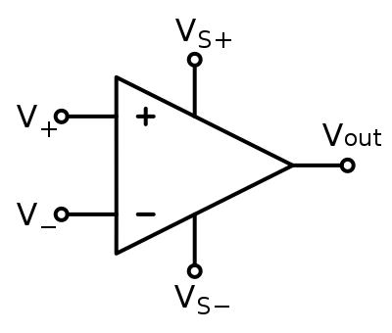
Task 13.5 - High Bandwidth BPM (EOMTS)
Electro-Optical Modulator Time-Stretch acquisition system with >40GHz and >100GSa/s
Located in Surface building
40MHz - 50fs
1550nm laser
3ns
40GHz E-O
Modulator
PM Fiber transport down
to the tunnel’s equipment
H⁻
H⁺
LHC Stripline
BPM
1st time stretch stage
40 MHz
beam signals
Laser encoding
1ns
Photon detection and DAQ
Laser-encoded beam signal
Optical Fiber back
to surface building
RFSoC at 5GSa/s
Located in Tunnel
Photodiode
20ns
2nd time stretch stage

Slide 22
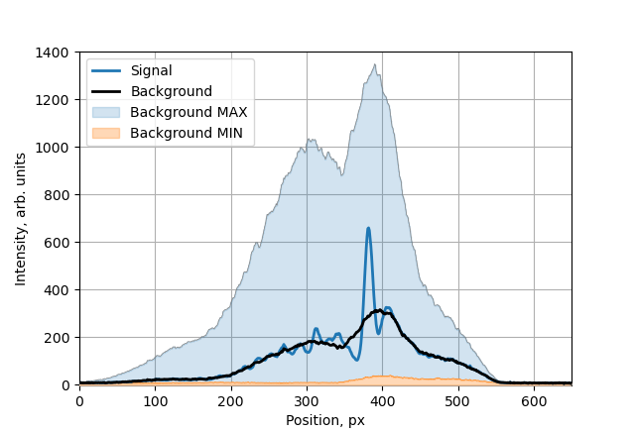
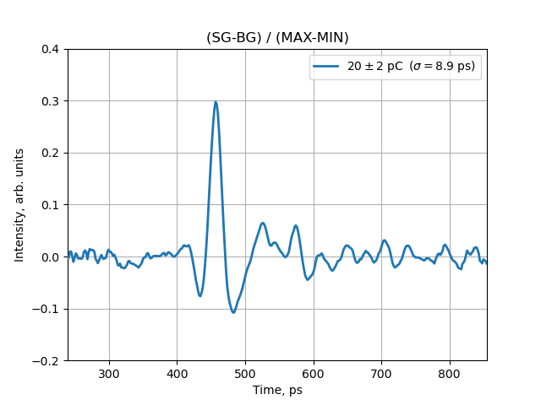
Task 13.5 - High Bandwidth BPM (EOMTS)
Initial results at CLEAR show very high potential with pulse response < σ = 10 ps
See: A. Schlögelhofer, invited talks @ IBIC 2024 Beijing

Slide 23
Task 13.5 - High Bandwidth BPM (EOMTS)
Initial results at CLEAR show very high potential with pulse response < σ = 10 ps
Talk on reviewing process for high bandwidth pick-up technology
See: A. Schlögelhofer, invited talks @ IBIC 2024 Beijing

Slide 24
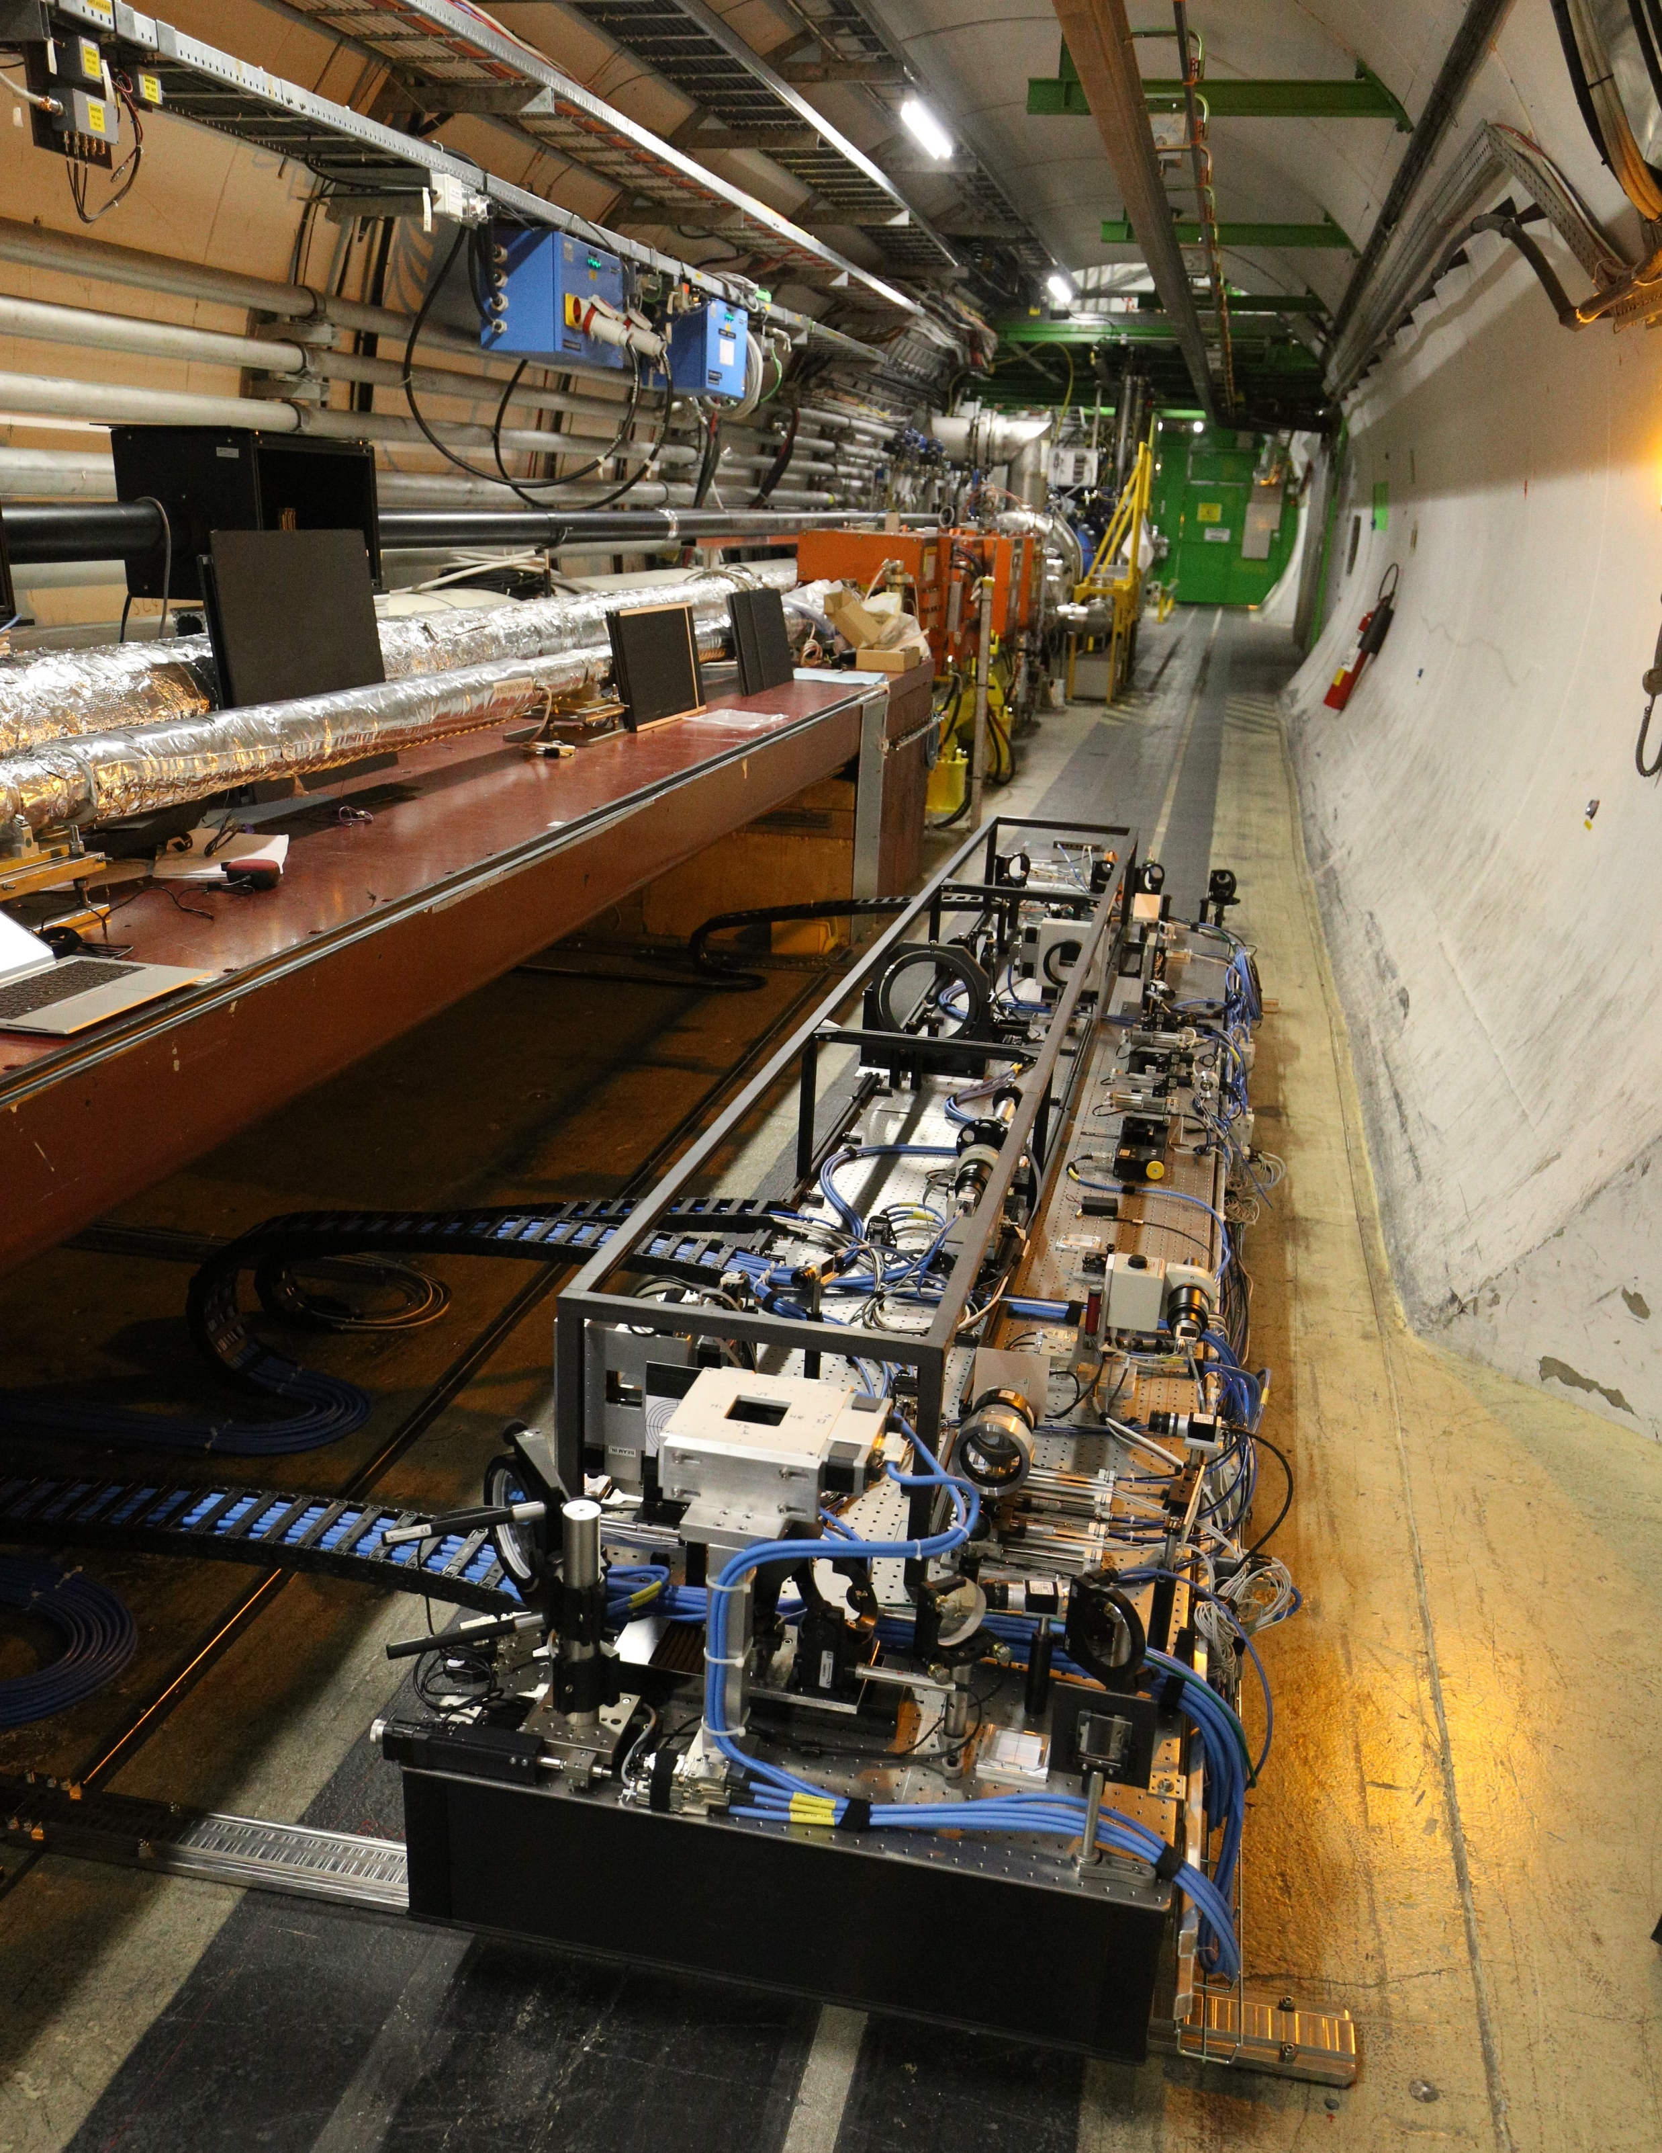
Task 13.6: Synchrotron light diagnostics (BSR)
Beam Halo monitoring with a SR Coronagraph
  Built in collaboration with KEK and installed on BSR
  Detailed simulations using SRW software showed fundamental limitation with source diffraction
    Suggesting HL specification (10e-5 contrast) not achievable with this instrument, ultimate reach to be confirmed by experiment
  Commissioning and tests resumed in 2024
    See the talk by Jan in the afternoon
Options for Beam Halo measurement
  New working group launched in 2024 to review specifications and study alternatives options
    See presentation by Federico in the afternoon
Beam halo review scheduled for December 2024

Slide 25
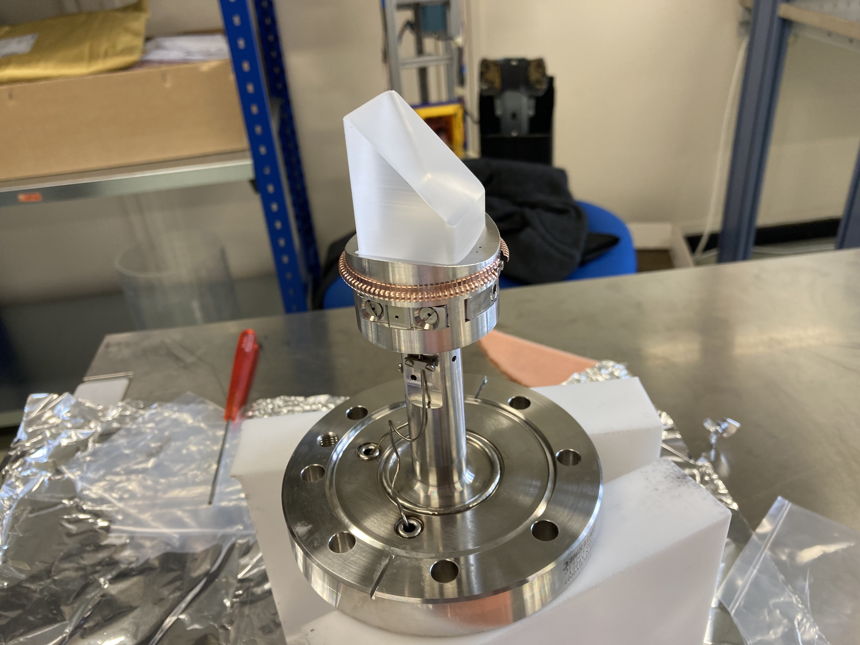
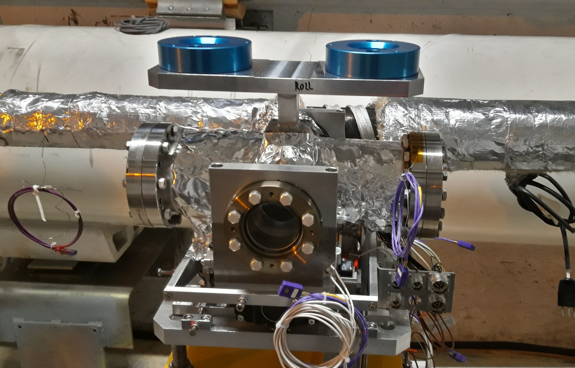
Task 13.6: Synchrotron light diagnostics (BSR)
New SR light extraction tank with mirror (BSRTM)
  Installed in LHC 4L, equipped with new mirror design, proved to be ok w.r.t. to impedance since 2022
New SR extraction mirror and new extraction tank in IR4L

Slide 26
Task 13.7 - Beam Gas Ionisation (BGI) monitor
Non-destructive transverse beam profiles with continuous bunch-by-bunch measurements throughout the acceleration cycle.
  Following the BGV/BGI review in Oct. ’22 the BGI became the HL-LHC baseline
BGI detects ionization electrons produced by beam-gas interactions
Beam profile is measured by counting the number of detector ionisation electrons
https://medipix.web.cern.ch/technology-chip/timepix3-chip

Slide 27
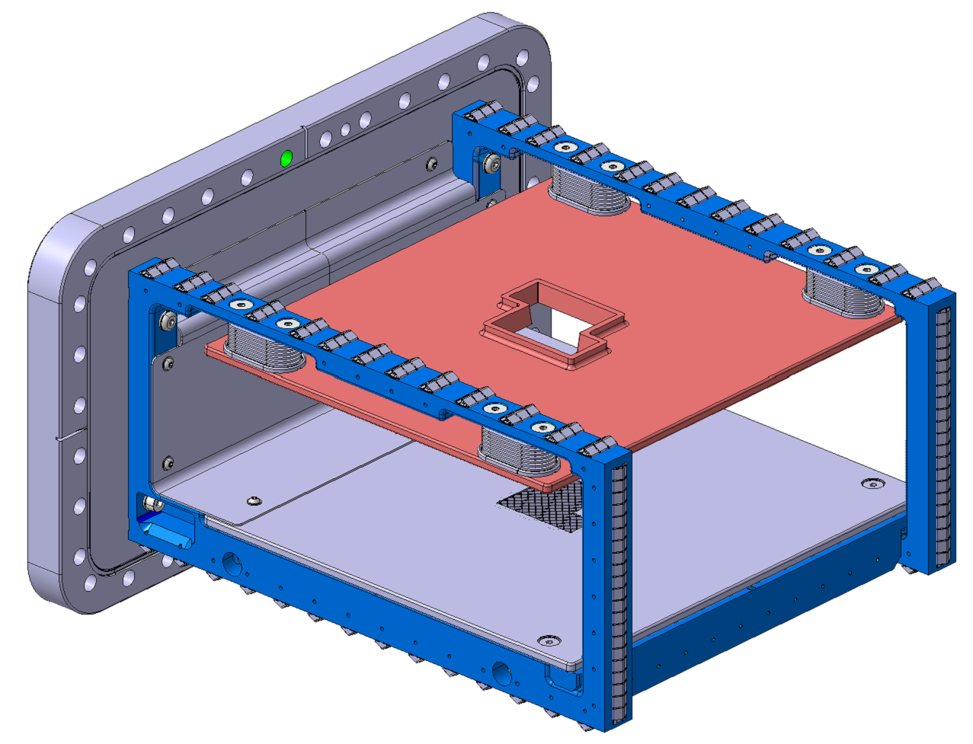
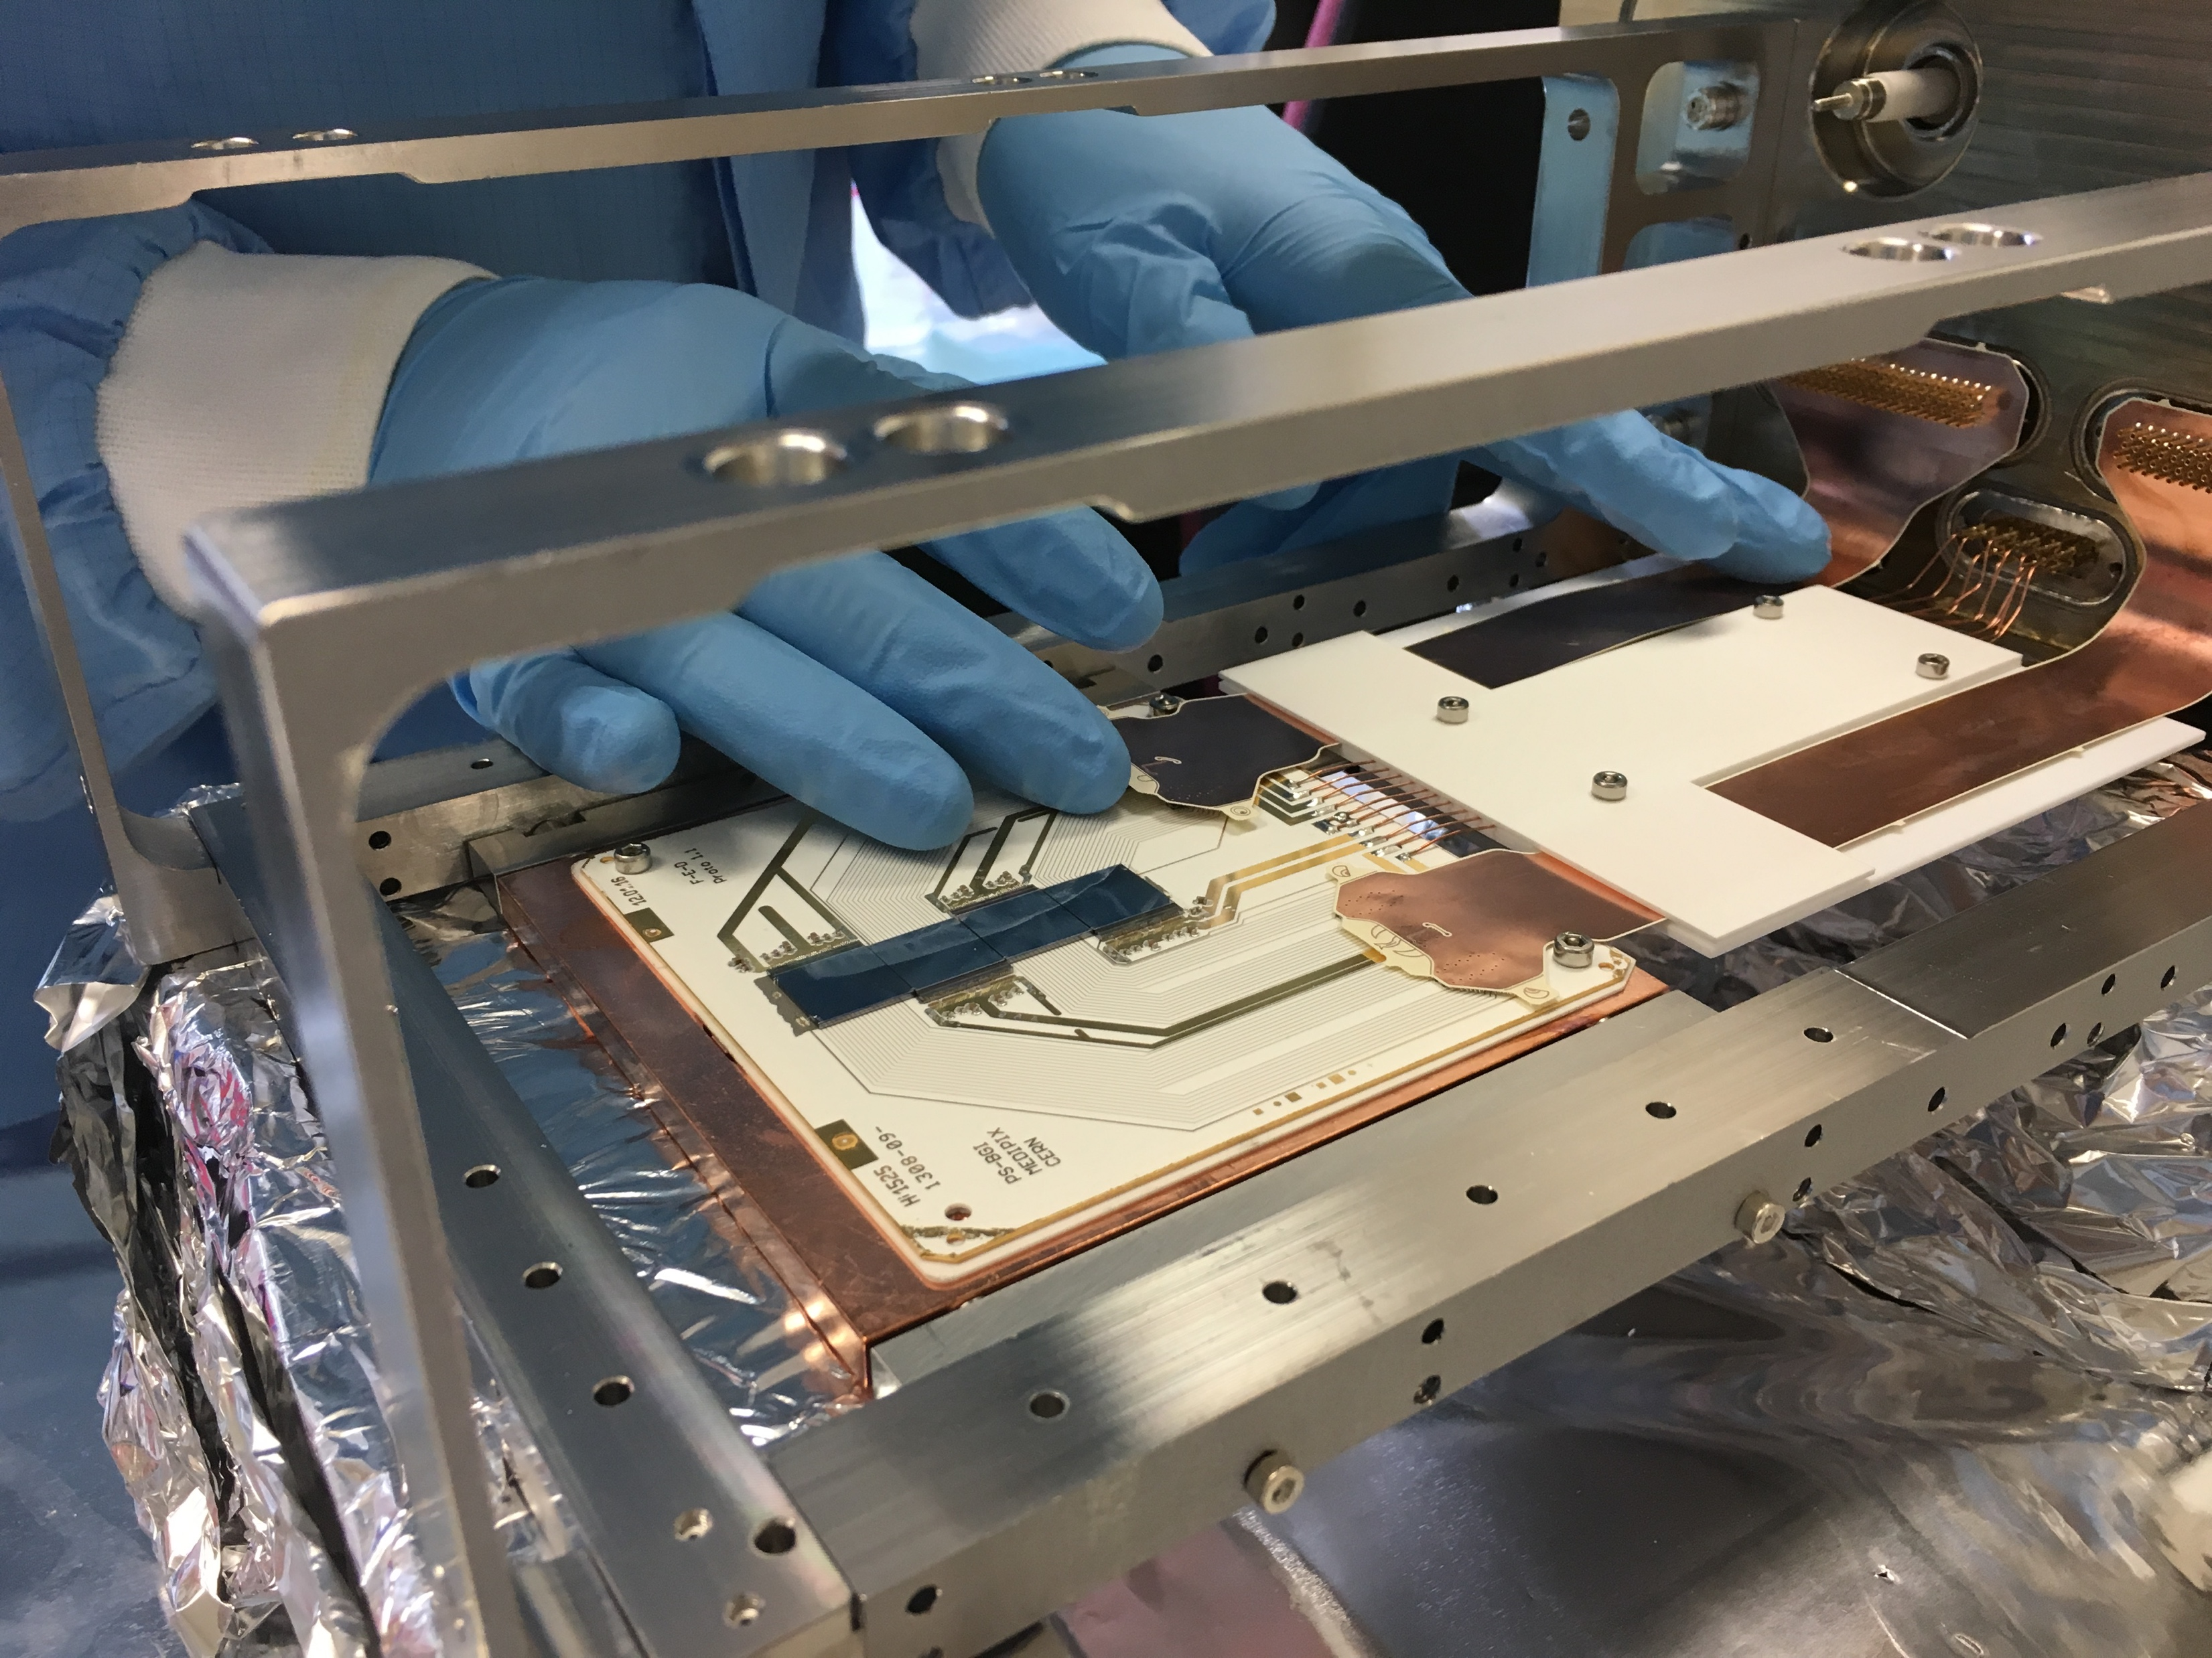
Task 13.7 - Beam Gas Ionisation (BGI) monitor
  HL-LHC device is developing from the instrument built for LIU-PS, installed in LS2 and the SPS-CONS instrument installed during YETS 23/24
Rectangular CF vacuum flange
Ion trap
Cathode
(-30kV)
Faraday cage

Slide 28
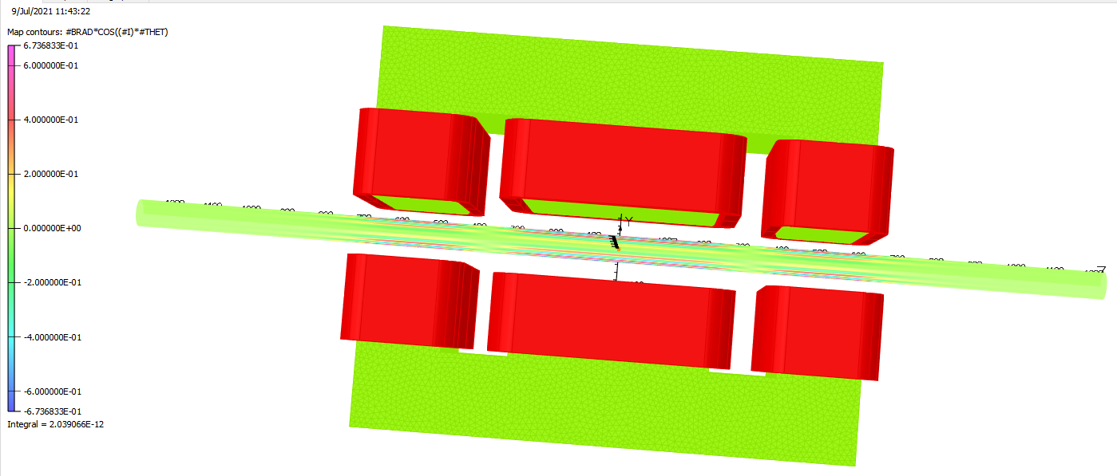
Task 13.7 - Beam Gas Ionisation (BGI) monitor
Even bigger Challenges for HL BGI
Need to reduce the impedance further (and sensitivity to electromagnetic interference due to shorter bunches)
Smaller beam size require higher magnetic field (minimum of 0.6 T)
Talk by James
Preliminary electromagnet design - 0.6T self-compensating dipole magnet [D.Bodart (TE-MSC)]

Slide 29
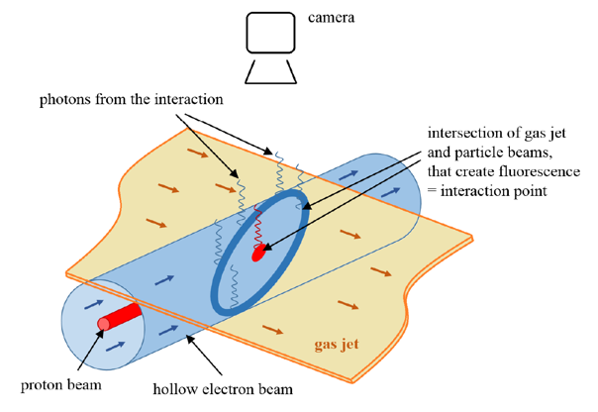
Task 13.2 - Beam Gas Curtain monitor
Collaboration between CERN, UNILIV and GSI
Part of HL-UK2 collaboration framework – In-kind from UNILIV
Designed as a beam overlap monitor between protons/ions and Hollow Electron Lens
Image the fluorescence of a gas (curtain) jet interacting with the beams

Slide 30
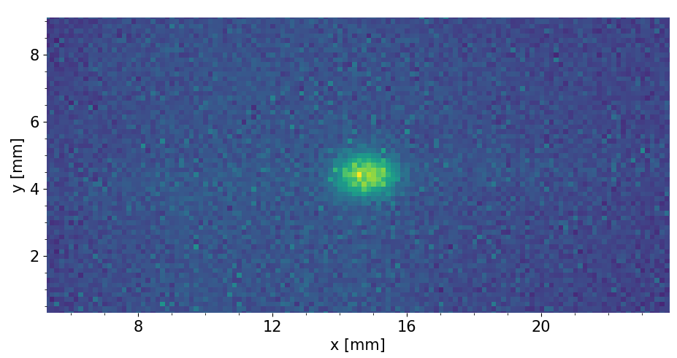
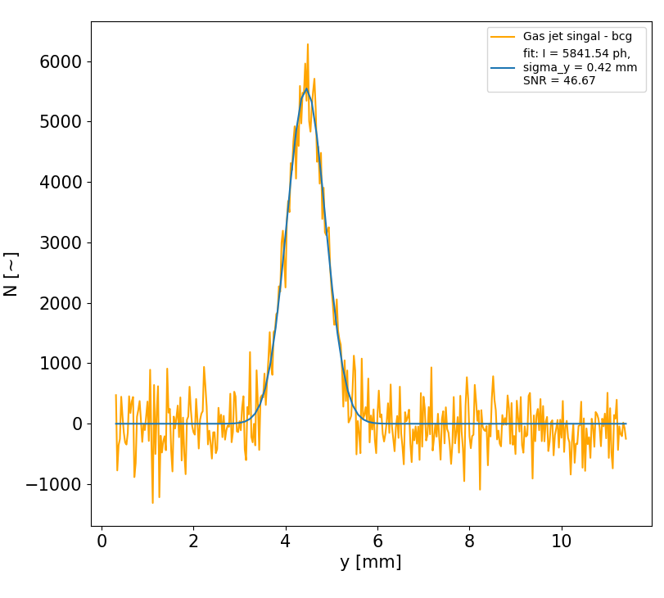
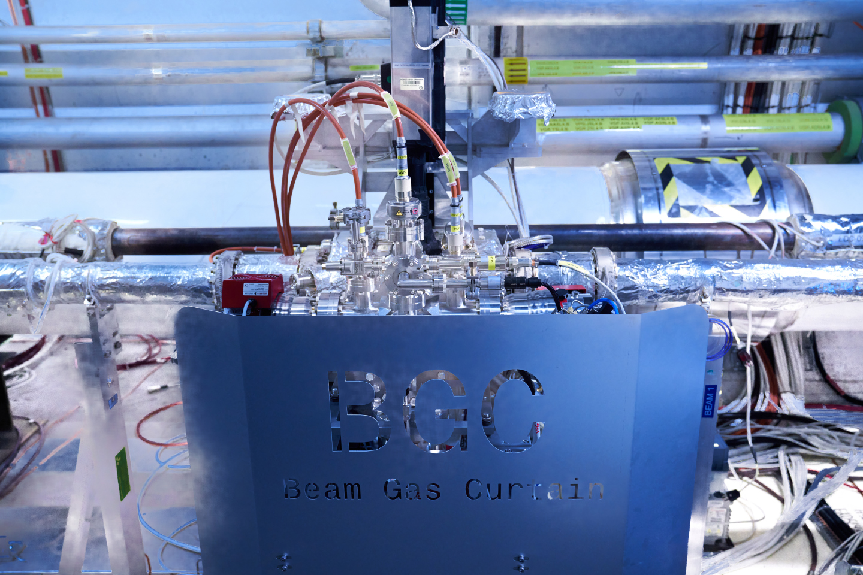
Task 13.2 - Beam Gas Curtain monitor
BGC tested successfully on the Hollow Electron test-stand at CERN in 2023
BGC measurements in LHC look very promising in 2023 with heavy ions
In 2024 systematic measurements with protons at injection and top energies
  Measuring the spatial resolution of the monitor with cross-calibration against other monitors
  Assess the usefulness of the monitor for emittance monitoring in LHC
Invited talk by Hao Zhang at IBIC 2024 – Talks by Daniele and Ray later this afternoon
Gas Jet
Beam size

Slide 31
Summary
Excellent progress made in the large scale production of BLMs and BPMs
  Critical cold BPM manufacture is back on-schedule despite the end of the Russian in-kind contribution – first Cryo BPM to be delivered to TE-VSC in Q1 2025
  BLM ionization chamber also back under control following urgent reverse-engineering and prototyping
Exciting results from beam tests on newly developed technologies
  On-going performance assessment of halo monitor and high bandwidth pick-up
  Successful tests made with the BGC, both for hollow electron beams and as a profile monitor in the LHC are being continued
Some decisions to be taken in coming months:
  Production strategy for series BLM ionization chambers
  Beam halo monitoring – review of specifications and technologies in December 2024
  High-bandwidth pickup technology review in December 2024
Global emittance monitoring review (BGI and BGC) by mid 2025 – for now we follow up both options (integration work and cabling requests)

Slide 32





Collaboration partners

Slide 33
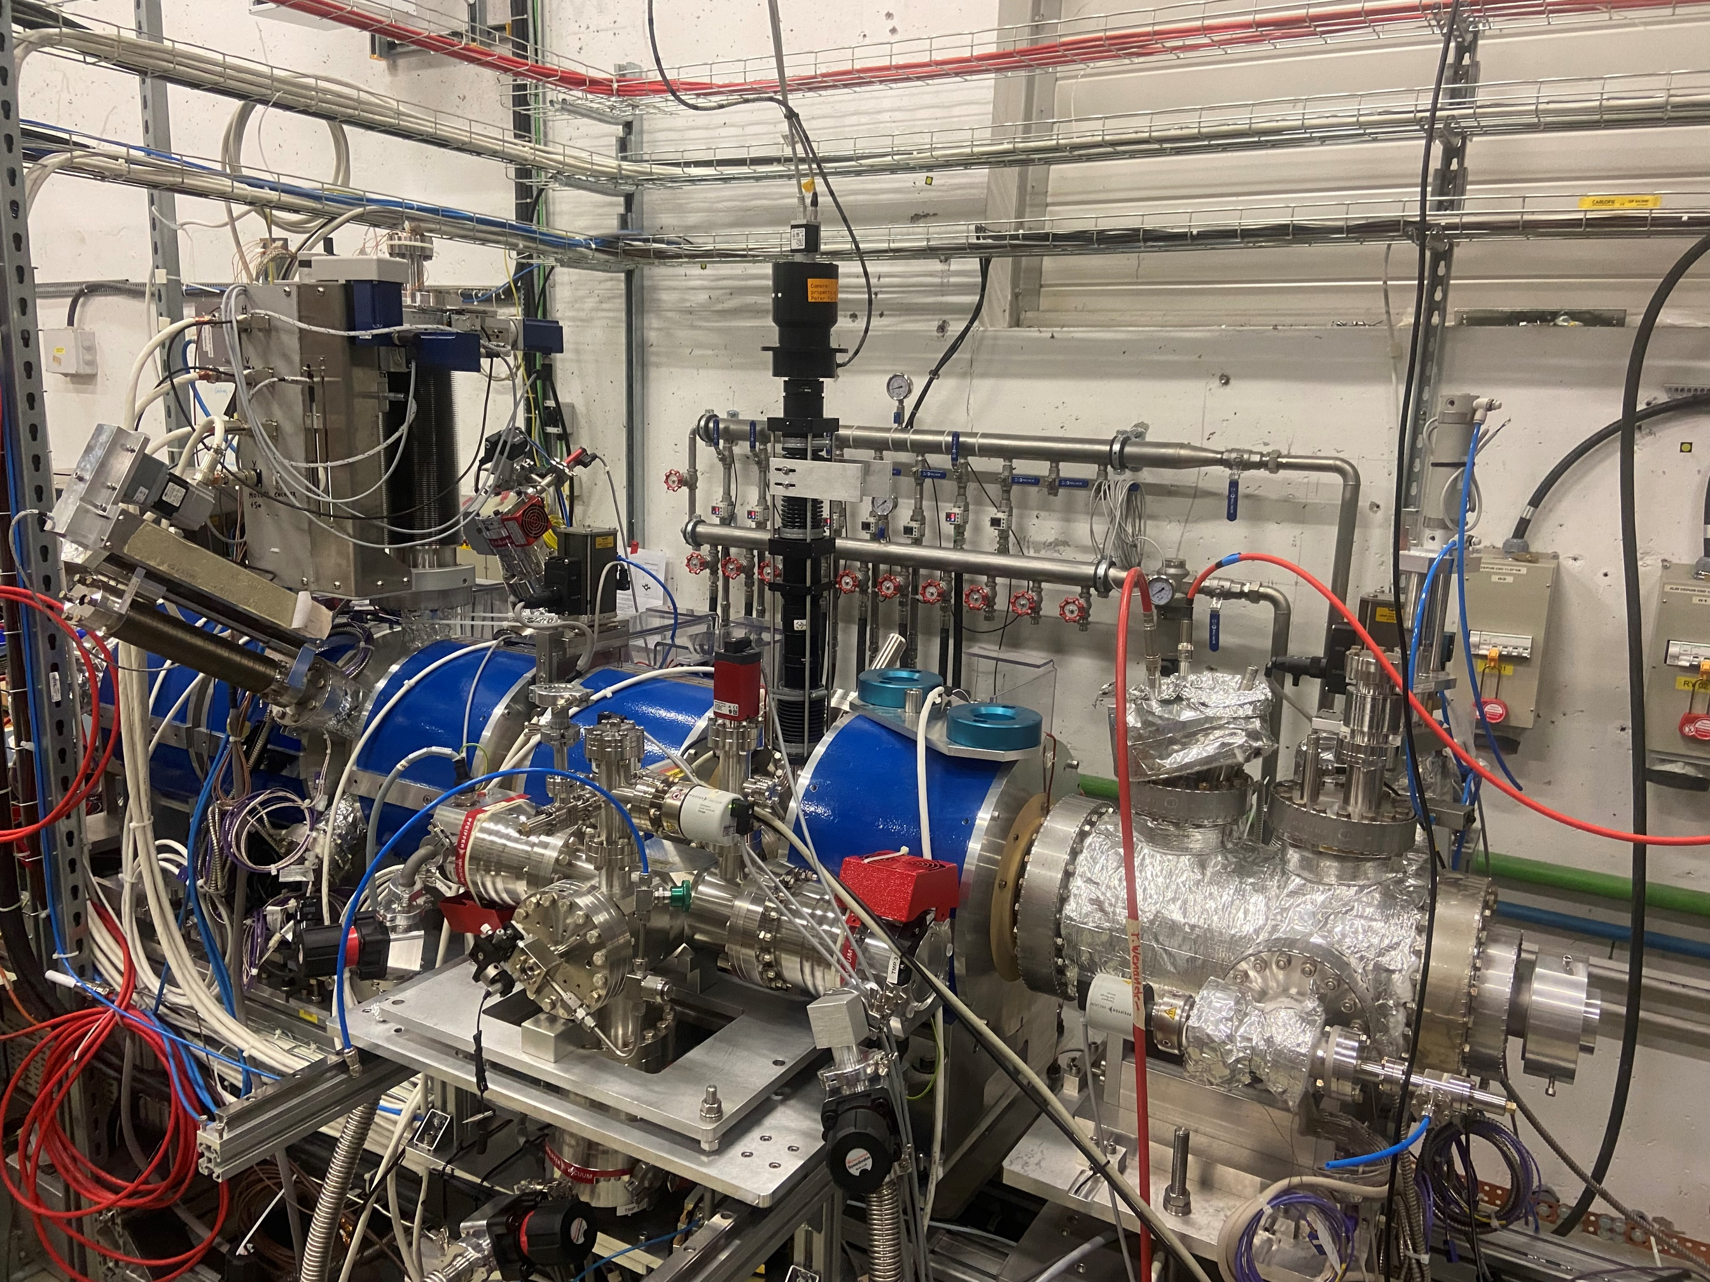
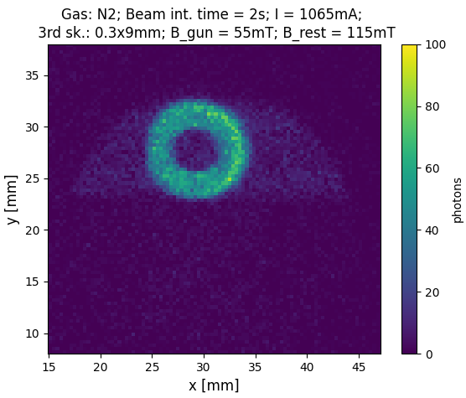
Beam Gas Curtain monitor
BGC v3 installed in October 2022 on Electron Beam Test Stand (EBTS), operated until December 2022
Hollow Electron Beam observed with Nitrogen and Neon gas

Slide 34
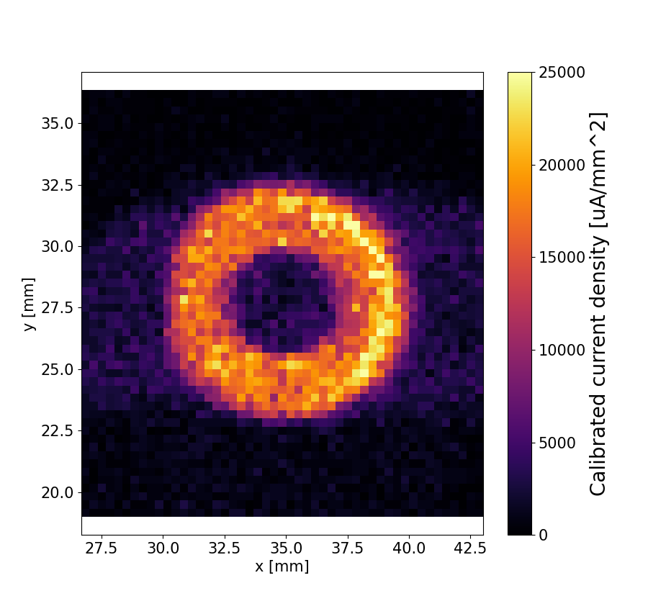
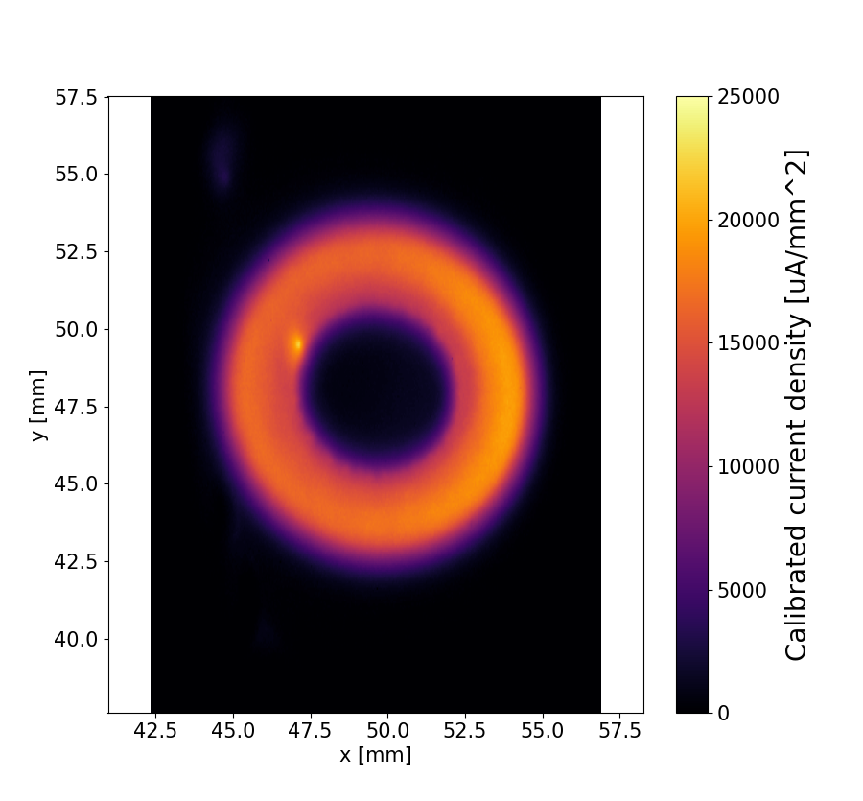
Beam Gas Curtain monitor
BGC
Gas: N2, Integration time: 2s
OTR
Integration time: 2.5ms
Beam
1.1 A, 100us
Size agrees within 0.1mm
General distribution shape agrees
BGC higher noise, as it is designed to measure DC beam

