Slide 1
Expected performance of the new BPM system in IP1/5
M. Krupa for HL-LHC BPM team
14th HL-LHC Collaboration Meeting, Genoa, 09/10/2024

Slide 2
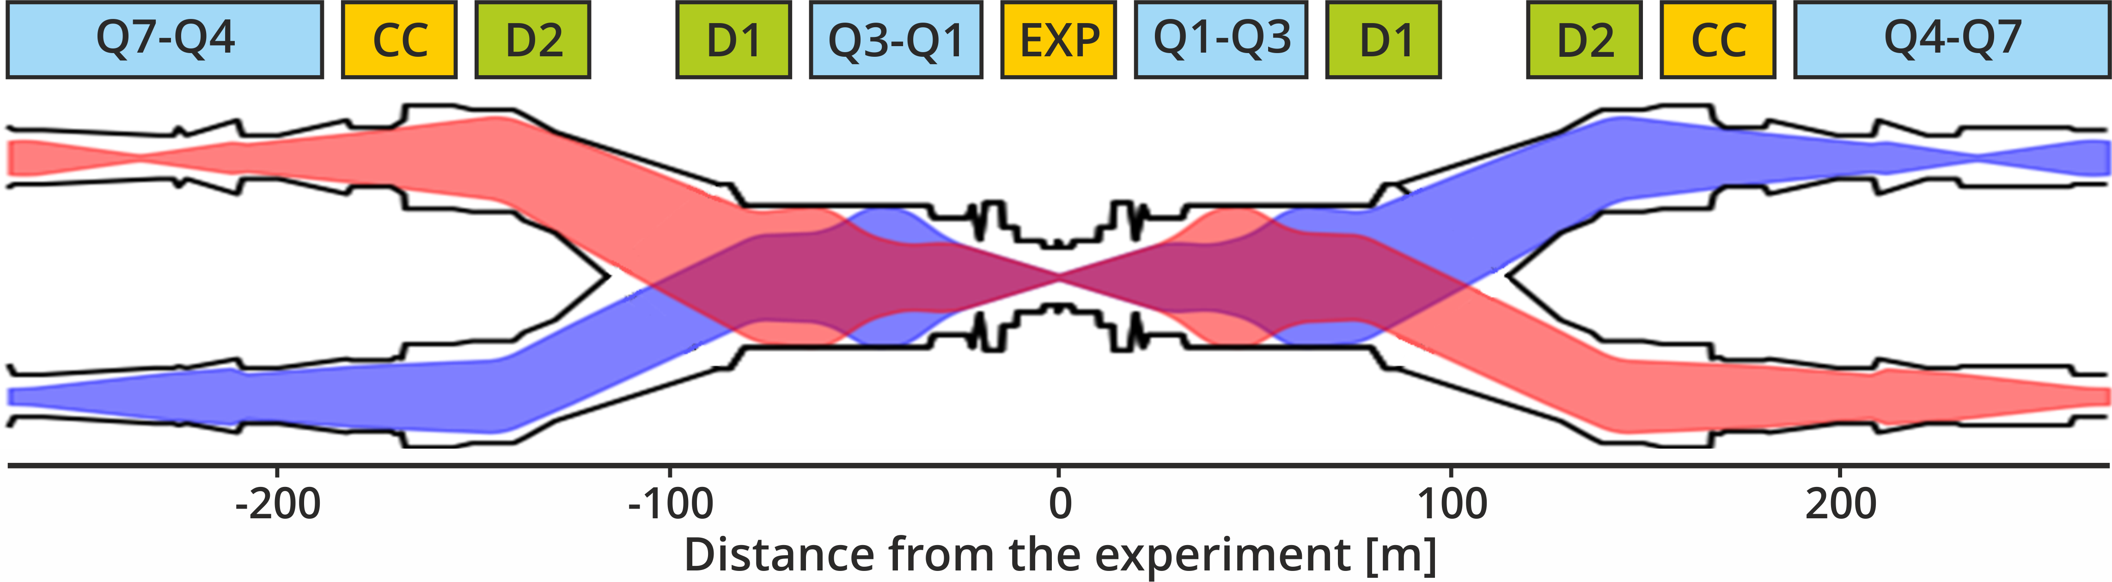
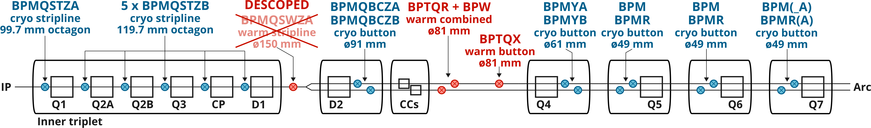
BPMs for HL-LHC IP1/5
Beam 1
Beam 2
New pick-ups
New electronics
New pick-ups
Old electronics
New pick-ups
Non-BPM
electronics
Existing pick-ups
Existing electronics

Slide 3
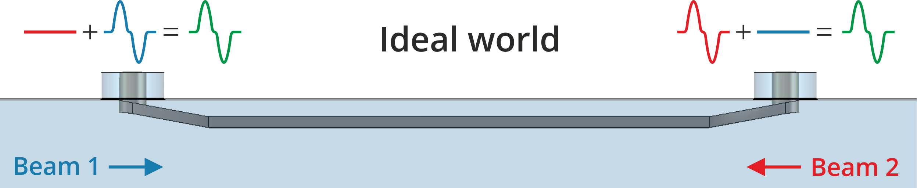
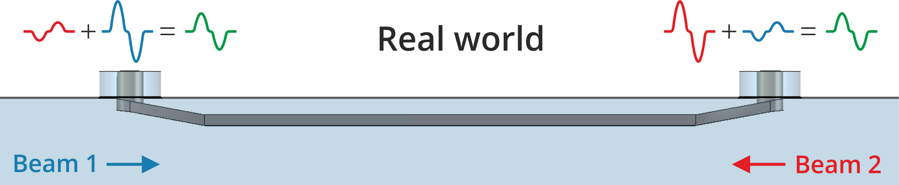
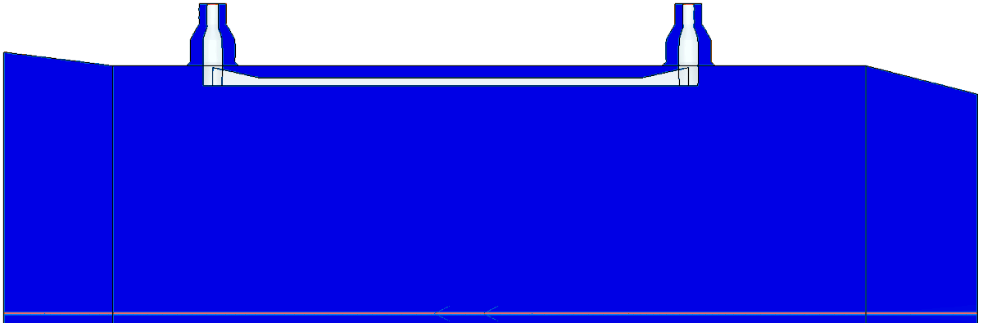
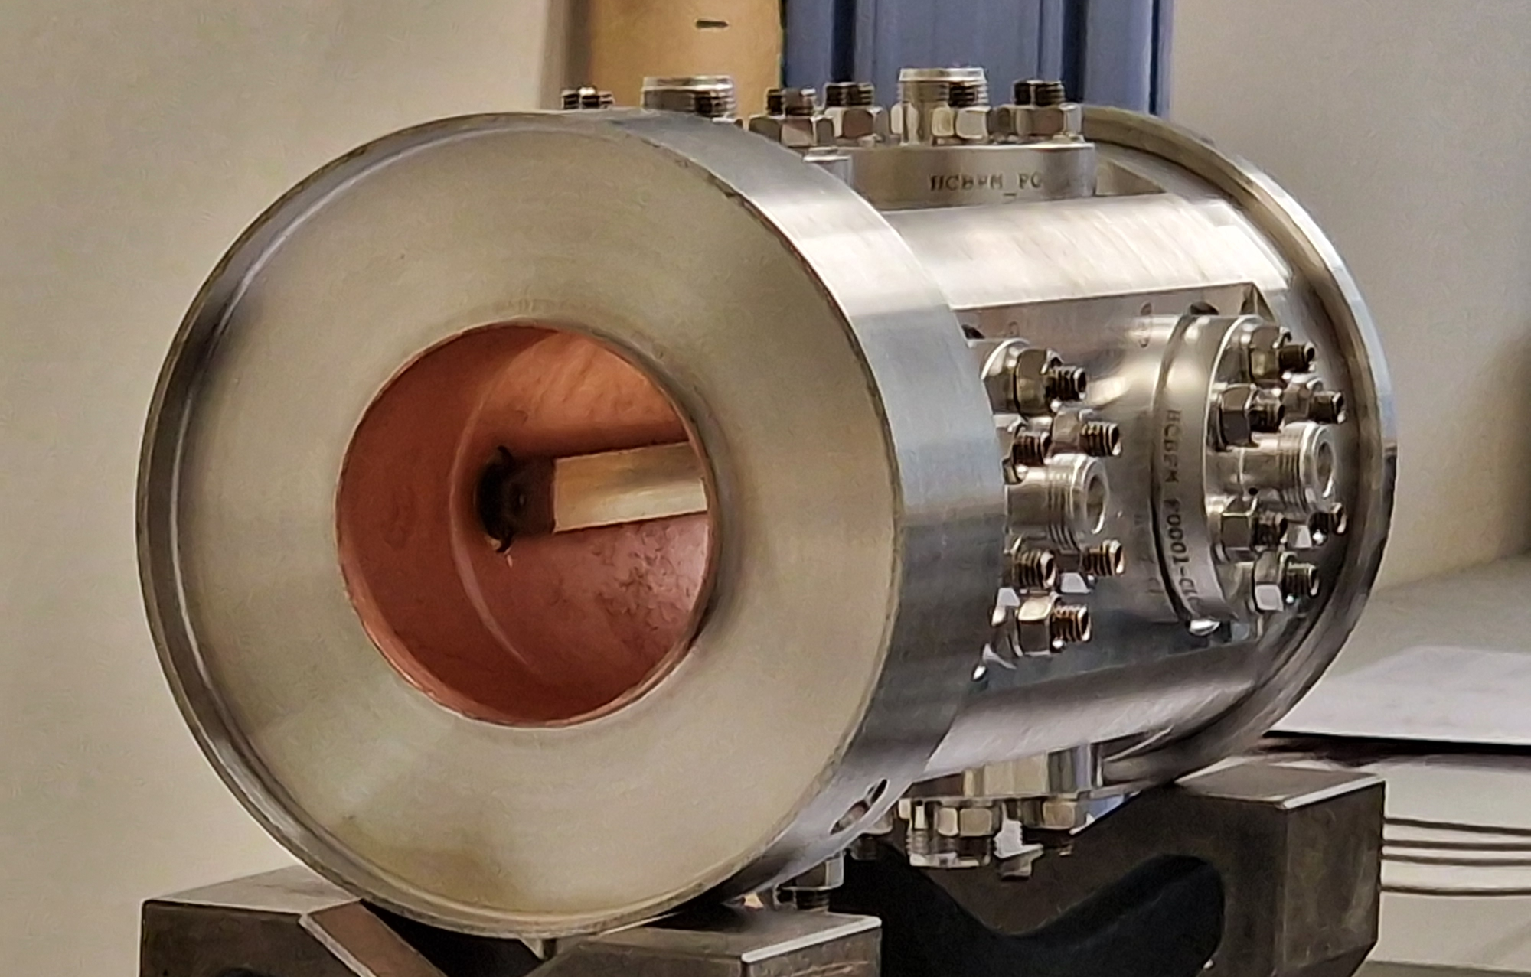
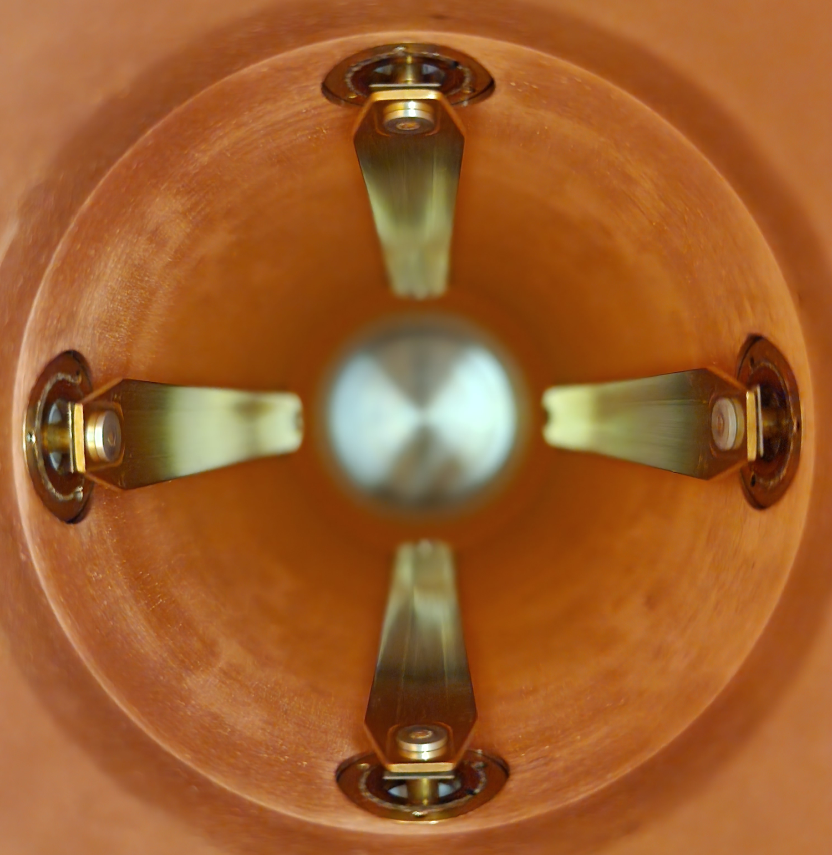
Stripline BPMs
BPMs closest to the collision point see both counter-rotating beams
In a stripline BPM the signal is seen mostly at the upstream ports
  Residual signal at the downstream port increases measurement error for the other beam
  Optimal performance reached with electromagnetic simulations and manufacturing studies
  Improved by installing the BPMs far from the beam-beam crossing locations
HL-LHC goal directivity ~ 26 dB (broadband)

Slide 4
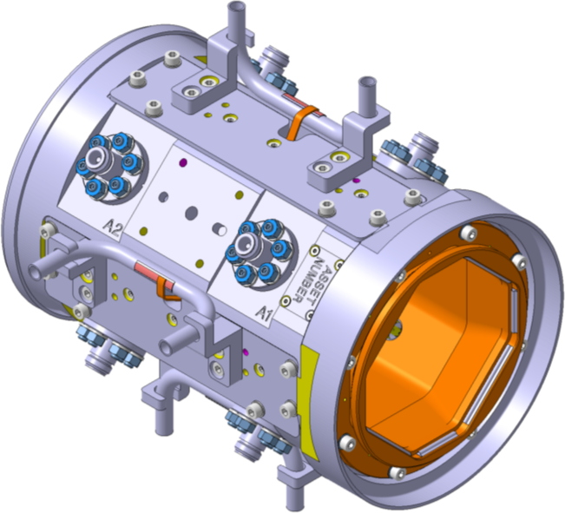
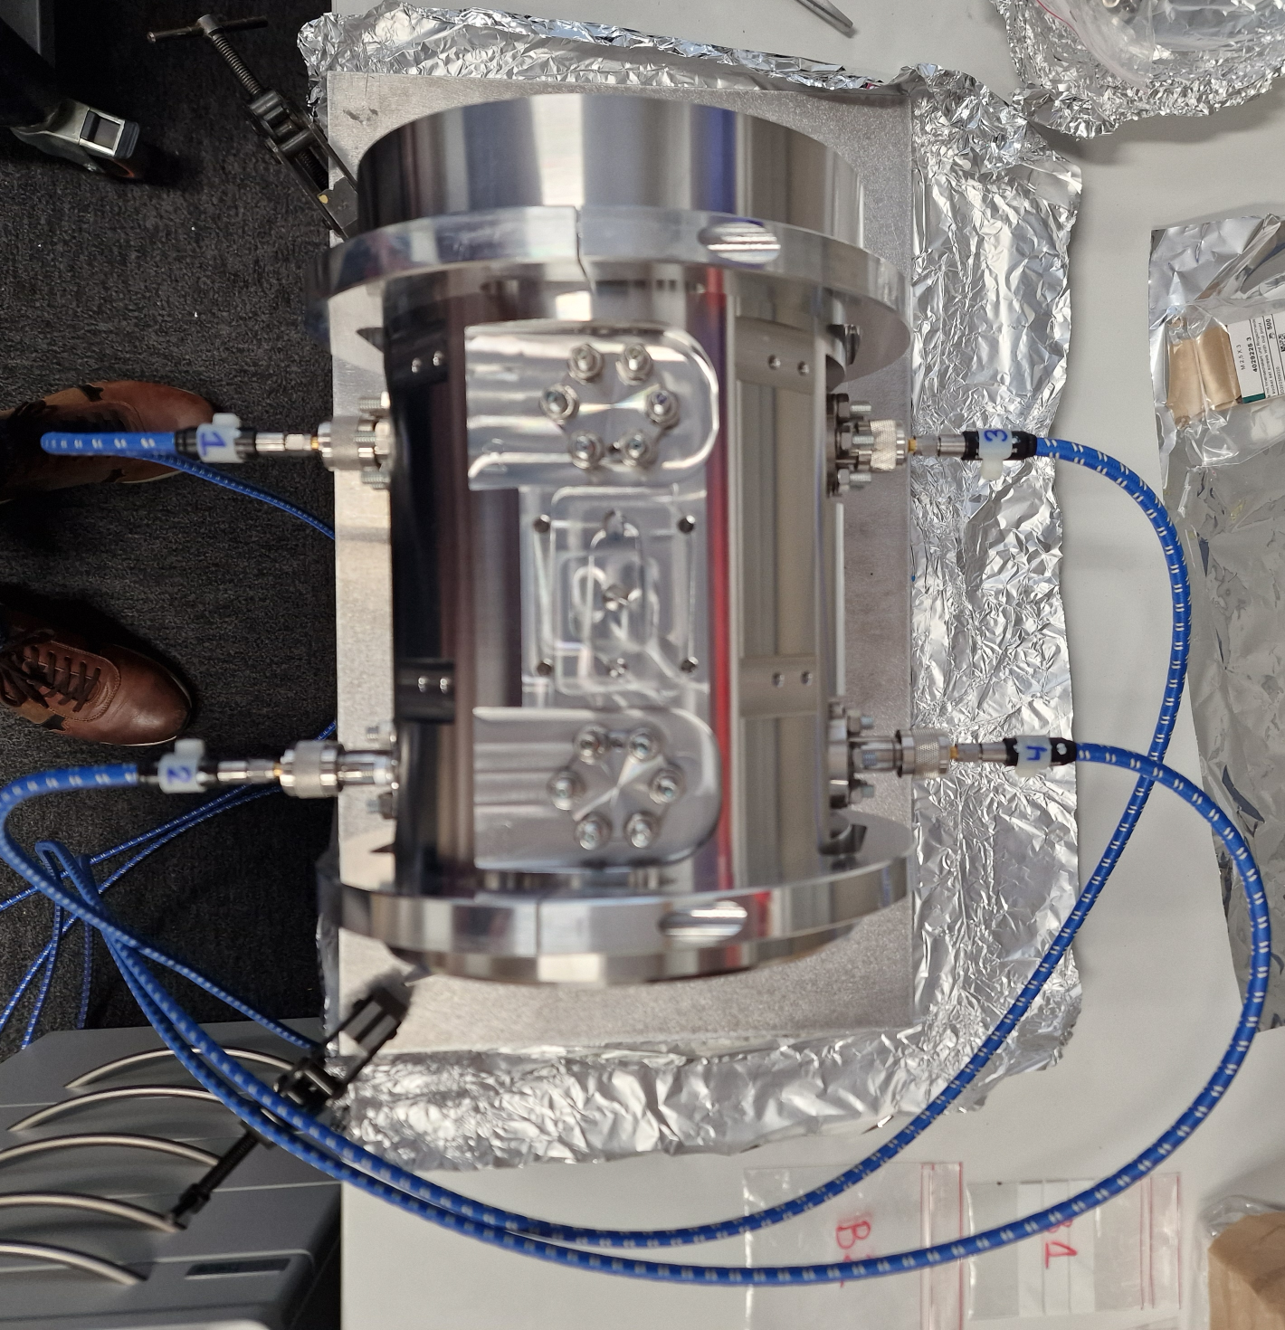
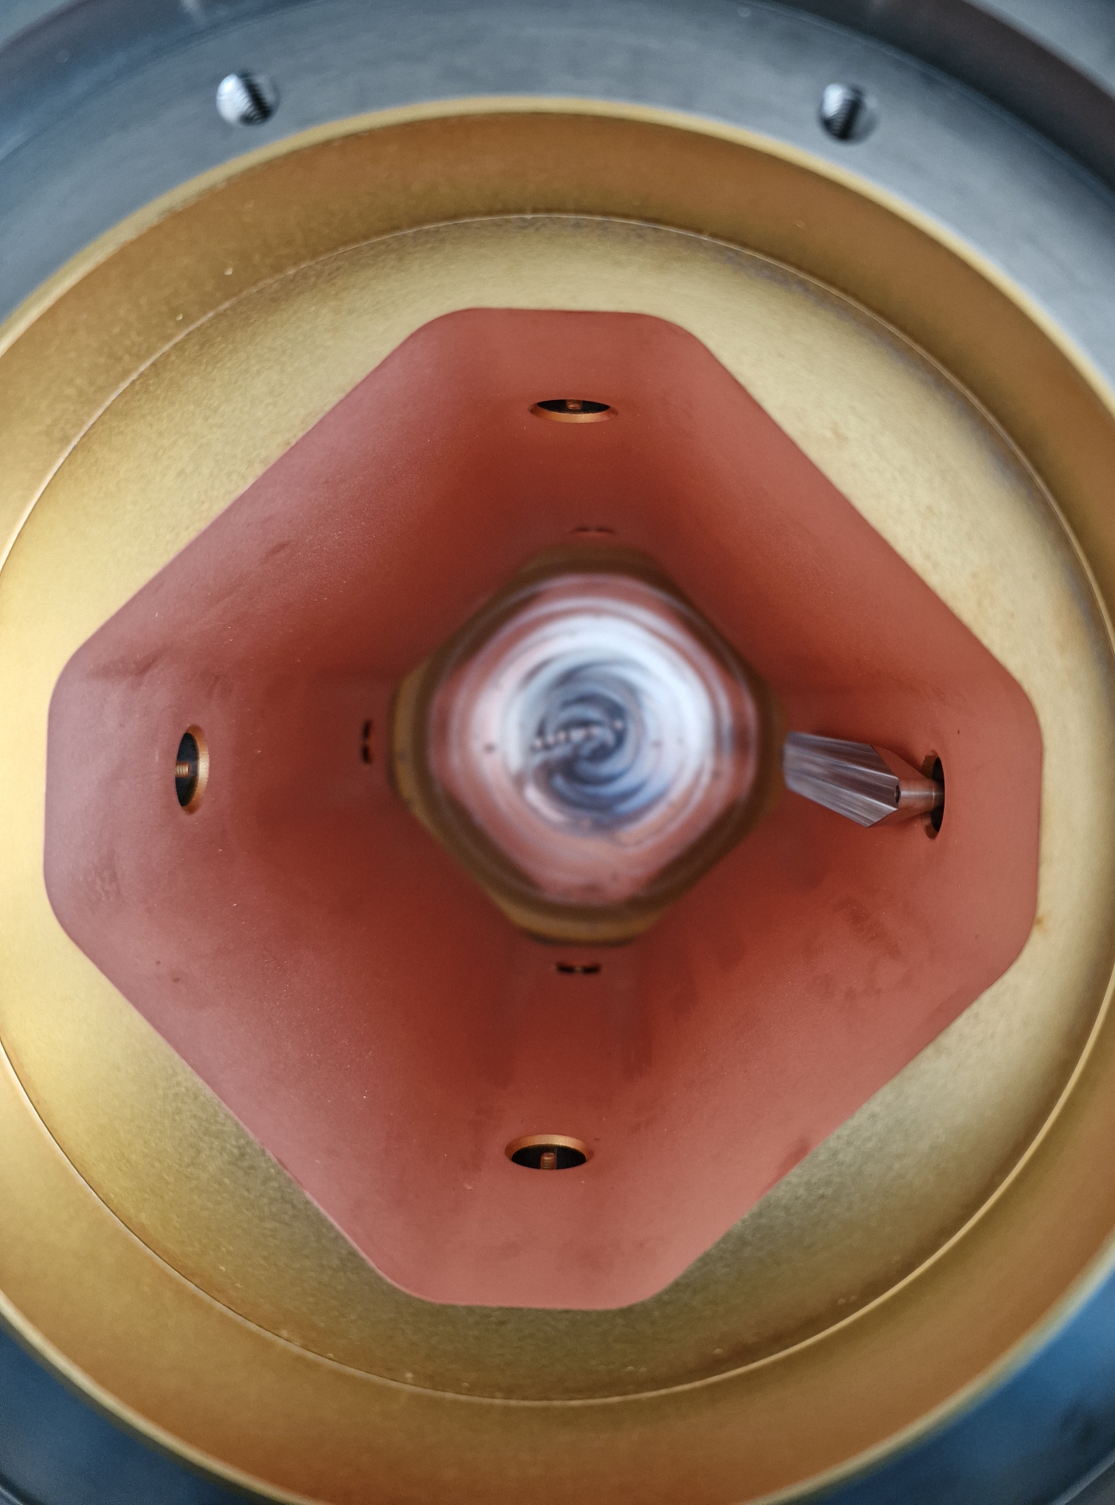
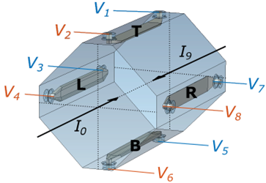
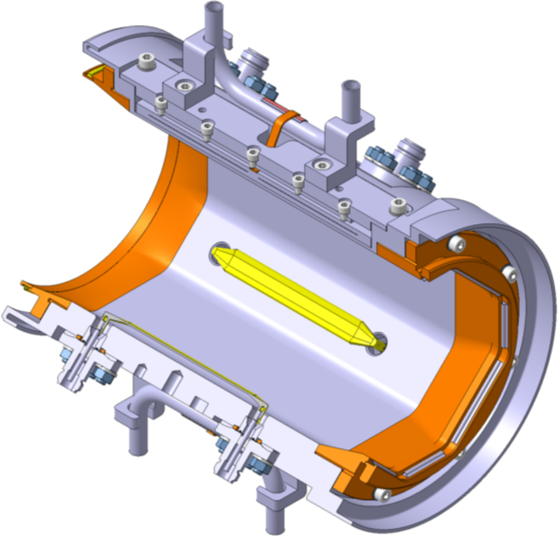
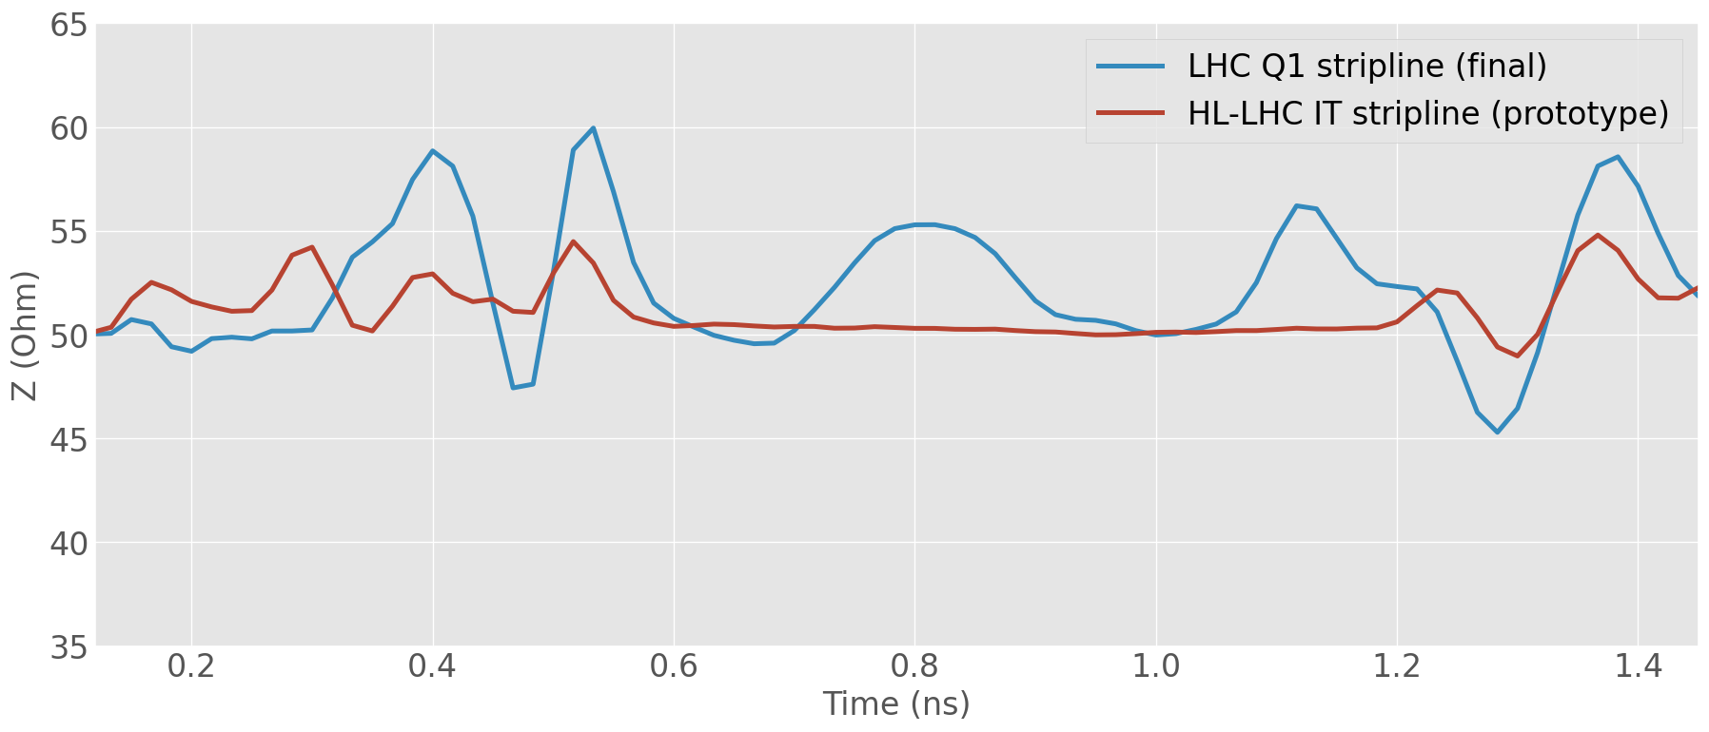
HL-LHC stripline BPMs
3D models
from CATIA
EM simulation
model from CST
Pre-series assemblies for tests
Most complex LHC BPMs to be ever built
EM design objective: characteristic impedance of the electrode as close as possible to 50 Ω
  Significant improvement over the existing LHC stripline BPMs
  Excellent work by design (SY-BI & EN-MME), machining (EN-MME) and coating (TE-VSC) teams
Will be improved
Feedthrough
Electrode

Slide 5
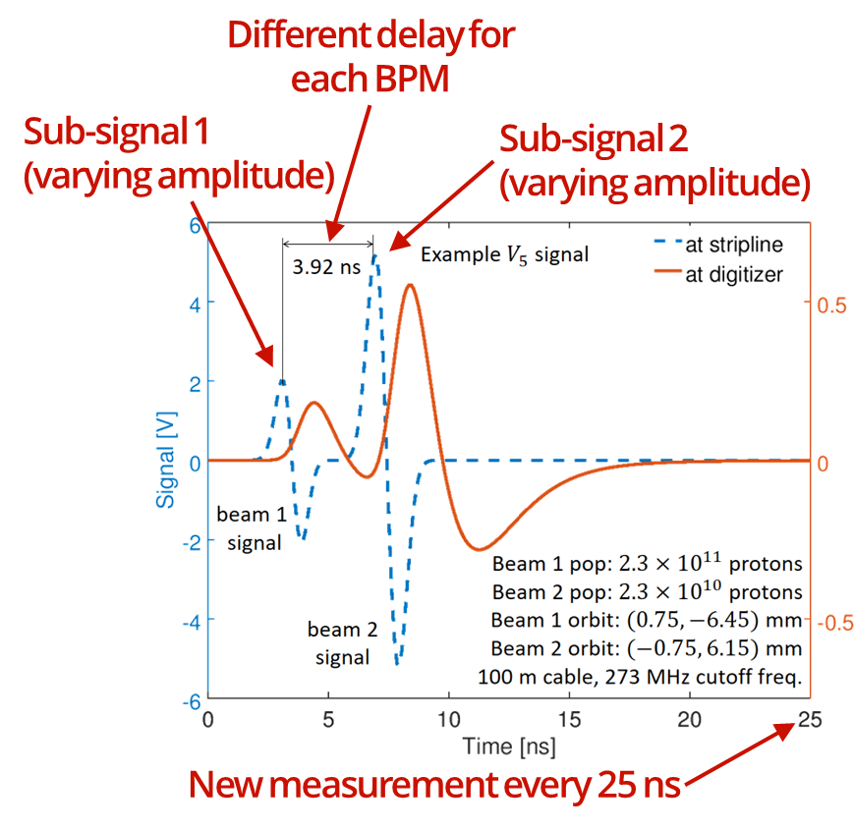
Signals
Each BPM measures both counter-rotating beams and produces 8 wideband (DC-6 GHz) analogue signals
At each bunch passage, a signal composed of 2 sub-signals associated with the two beams is generated
  Measurement of the total signal energy within 25 ns
  Advanced signal processing to remove the energy of the “unwanted” beam
    Reference measurements with one isolated bunch per beam needed at the start of each fill
  In corner cases, the signal to be corrected for is larger than the signal to be measured
Calculating the position of each bunch requires precise measurements and processing of the 8 BPM output signals in “real” time
BPM location | Beam-beam delay [ns]
Q1 | 3.92
Q2A | 3.92
Q2B | 6.82
Q3 | 9.72
CP | 10.52
D1 | 7.36

Slide 6
Measurement modes
Closed orbit (AKA asynchronous orbit)
  Average position of all bunches published at 25 Hz (used by the orbit feedback)
  Aiming for a possibility to configure a higher publishing rate (50 – 100 Hz)
Bunch-selection orbit (AKA synchronous orbit)
  Average position of a user-selected subset of bunches published at the same rate as the closed orbit
  Aiming for several (~ 4) independent masks that can be used at the same time
Bunch-by-bunch turn-by-turn trajectory (AKA capture)
  Turn-by-turn positions of selected bunches published as an array after all data is acquired
  Aiming for 1M bunch-turns (8 times more than in the LHC)
Expert raw waveform acquisition
  Analogue signals generated by the BPM + analogue front-end
  For debugging and expert analysis
Postmortem
  Turn-by-turn average position of all bunches over the final ~1000 turns
  As implemented in the LHC
On-demand postmortem
  Same as above but can be triggered (independently) on demand

Slide 7
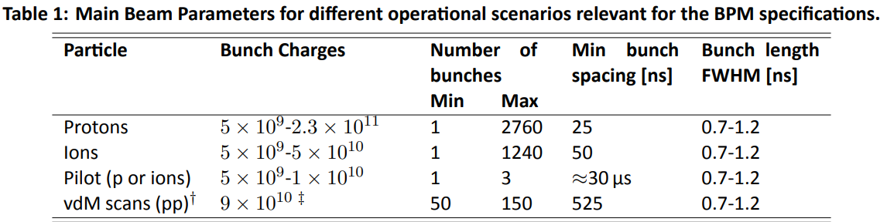
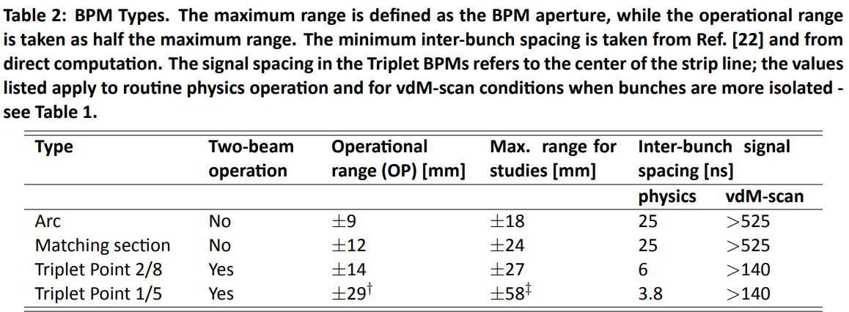
The challenge of designing a BPM system for HL-LHC IR1/5
Larger BPM aperture (50% less sensitivity to beam displacement)
Better precision requested (5x)
Increased maximum bunch intensity (~1.5x)
Need to correct the beam cross-talk (not done in the LHC)
Very high power of the signals – significant impact on cables and electronics!
Why using existing BPM systems was excluded:
  WBTN (existing LHC system) – thermal drifts, insufficient precision
  DOROS (high-precision system for collimators) – lack of some requested functionalities, e.g. bunch-by-bunch, turn-by-turn measuremetns
  CONS (future LHC system) – lower foreseen performance
 | BPM output (1 electrode) | After 100 m CMC50 coax
Single pilot bunch at min displacement | 1.1 Vpp negligible PWR | 0.64 Vpp negligible PWR
Full nominal beam at max displacement | 807 Vpp 74 W | 432 Vpp 22 W
Max displacement increases the power by factor ~10
Power scales with the sqrt of the ratio of filled bunches
57 dB dynamic range in input signal amplitude

Slide 8
HL-LHC BPM architecture
24 HL-LHC BPMs in total
RFSoC SOM
Asynchronous nearly-direct digitization
Electronics out of radiation
Very long cables (100 – 350 m)
Analogue front-end
DDR4 RAM
Programmable Logic
Filtering
Signal level control
Online calibration
Gain control
BPM
8x SiO2 cables
+
8x long CMC50 cables
8x ADC
(14 bit, 5 GS/s)
Digital Signal Processing
Fixed attenuators
Offline calibration
8x DAC
(16 bit, 10 GS/s)
Offline calibration
BST core
Digital carrier
Memory map
White Rabbit Network
WREN
BST
Fibre SFP
Processing System
SSD storage
FEC-OS Linux
FESA-on-SOC
GMT over CMW
CCC
CCR
Orbit feedback
Technical Network
Ethernet SFP
Concentrators
DDR4 RAM

Slide 9
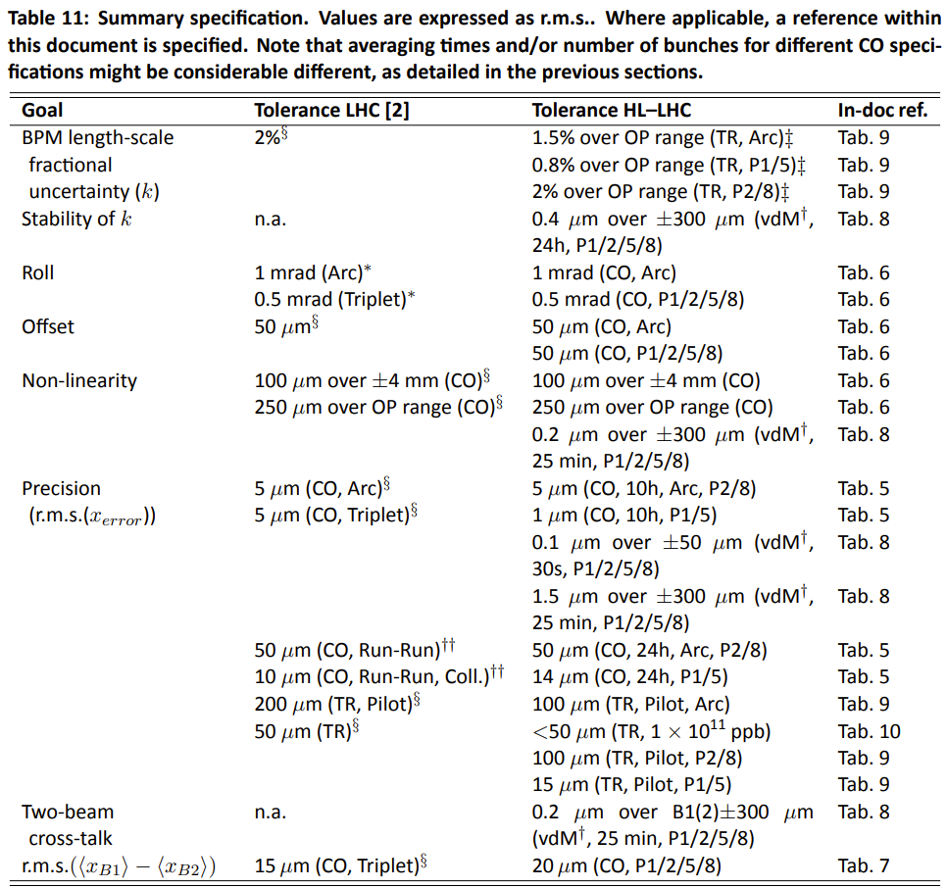
Conceptual specification
Conceptual specification for the entire LHC BPM system in the HL-LHC era prepared by optics experts (BE-ABP), operations (BE-OP), and the experiments
  EDMS 2387369
  The main LHC BPM system will not be consolidated before LS4
Overall, three different use cases:
  Optics experts require precise (i.e. good resolution) turn-by-turn bunch-by-bunch trajectory over a very wide beam position range - TR
  Operations require precise orbit with good long-term stability - CO
  Experiments require extremely accurate, precise, linear and stable orbit for the Q1 measurements over a small beam position range - vdM

Slide 10
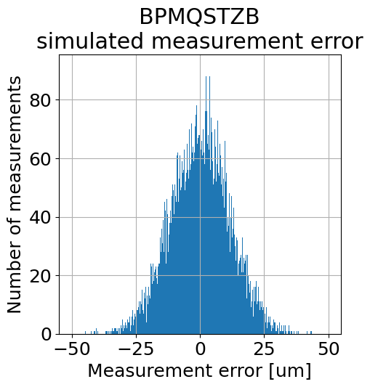
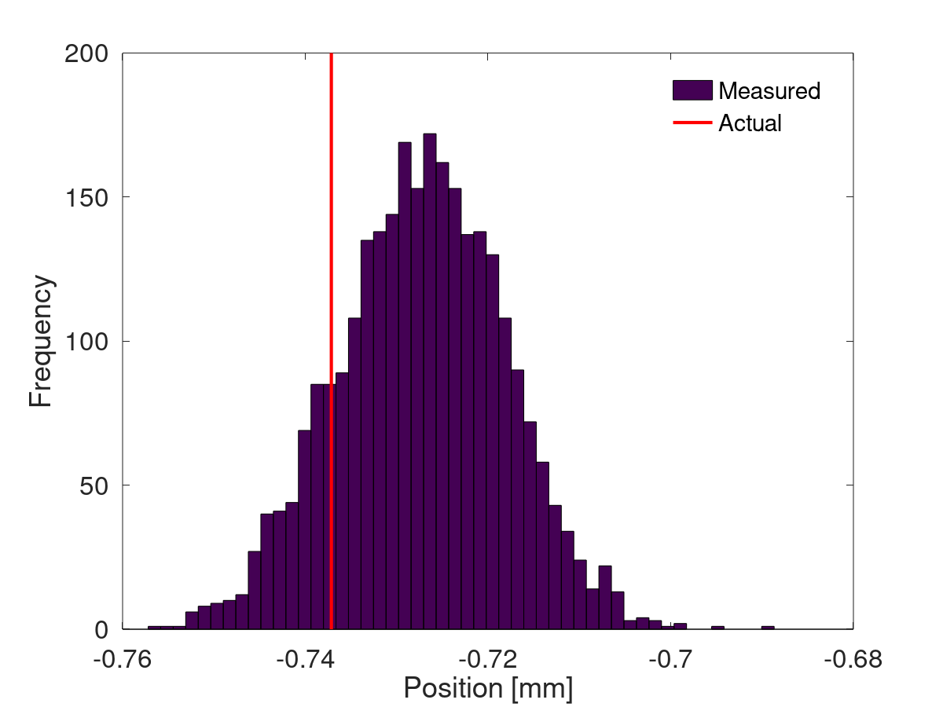
Precision (resolution)
RMS: 11.5 μm
Sensitivity to the beam displacement defined by the BPM aperture: ~ 3.3-3.9 % / mm
Optics team request BPM resolution of 15 μm, i.e. signal change of 0.05% must be detected (66 dB dynamic range required)
Resolution of the acquisition system is limited by the noise (or dynamic range) of the analogue front-end and the digitizer
  68 dB DR for the ADC with 40 MHz digital signal processing
  Noise of the analogue front-end about 6 dB below the ADC quantization noise
We expect to provide the resolution required for optics measurements but with little margin!
Resolution of the orbit measurements scales with sqrt(number of turns x number of bunches)
  ~ 1000 for 2760 bunches measured at 25 Hz
RMS:
10 μm (LHC)
~ 12 μm (HL-LHC)
LHC measurements

Slide 11
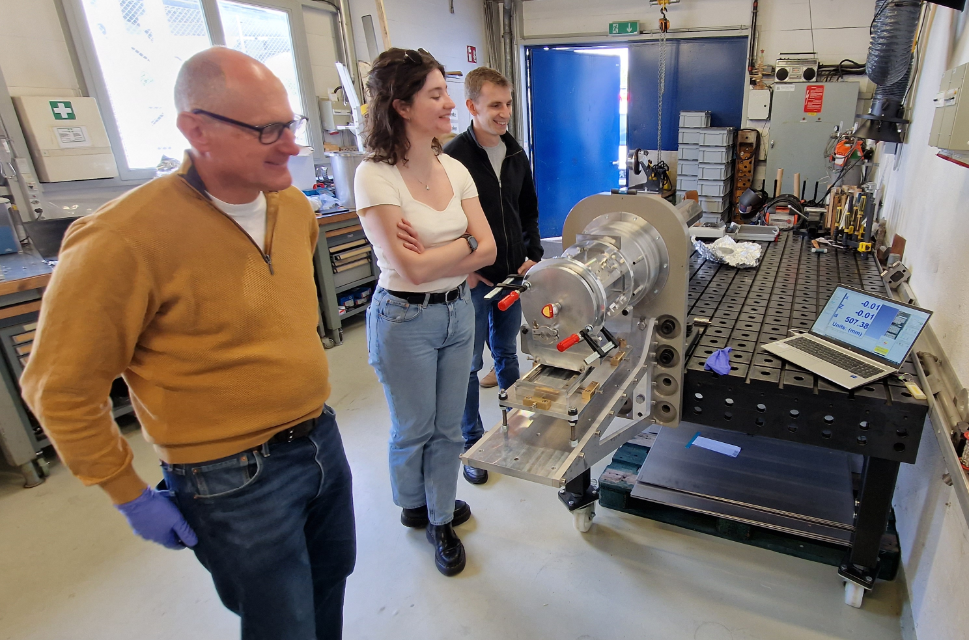
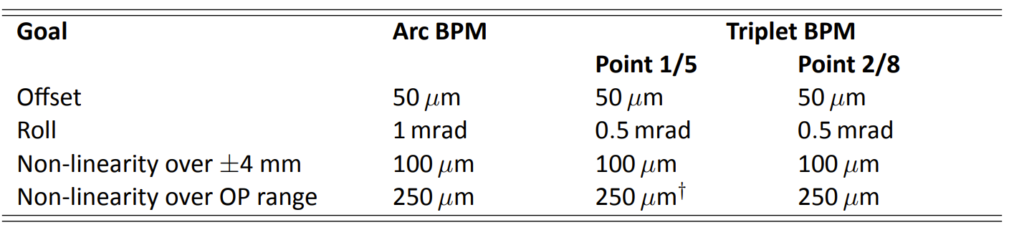
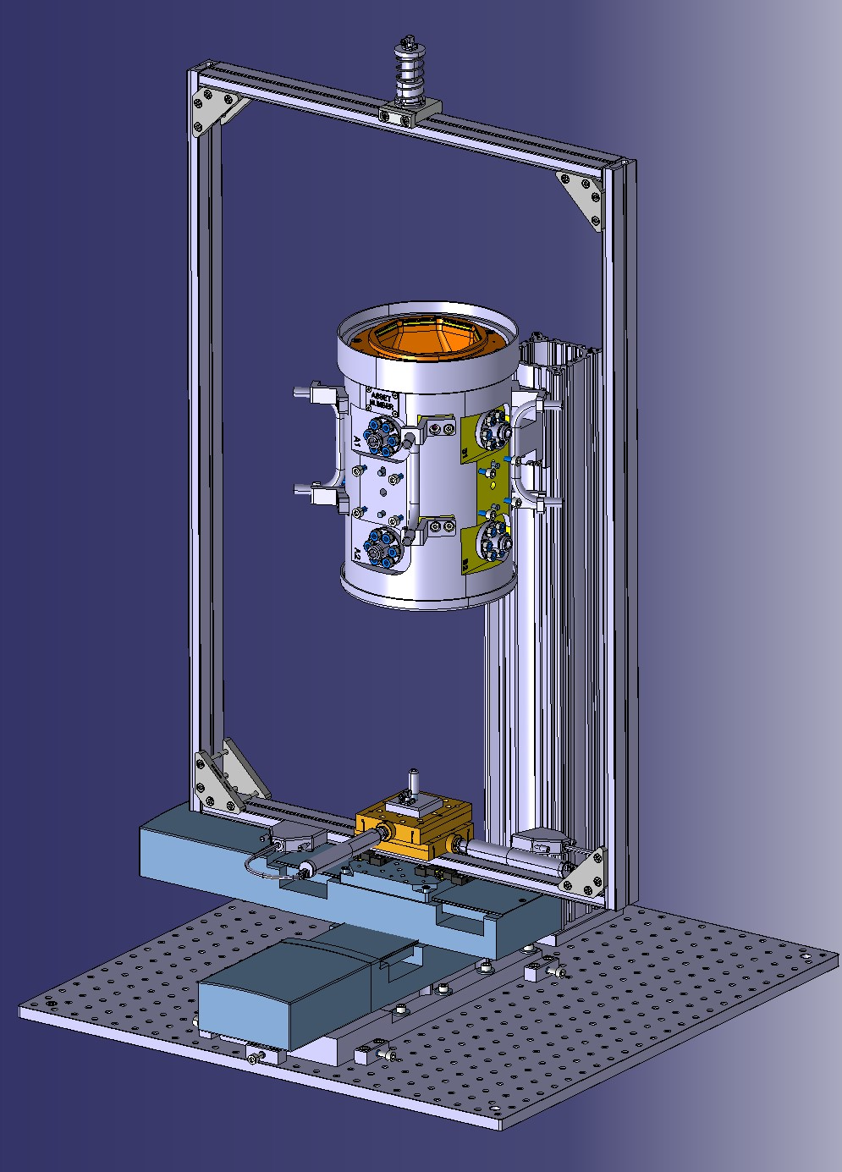
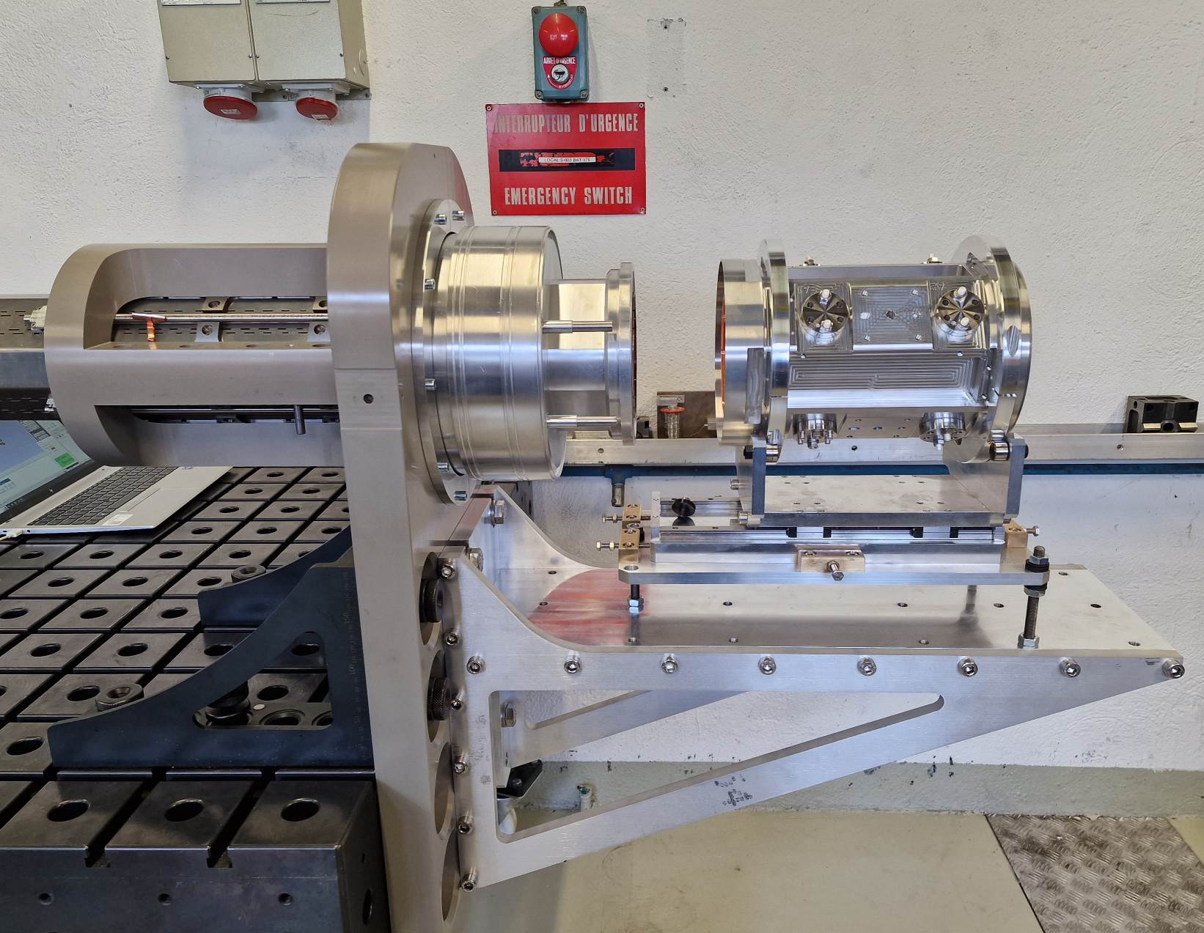
Accuracy – BPM pick-up offset and roll
Electric – asymmetry between the opposing electrodes (production and assembly tolerances)
  Measured on a special stretched-wire test bench after full BPM assembly
  Expected accuracy: ±50 μm
Mechanical – imperfect alignment and installation
  Measured and controlled during BPM installation
  Installation on the beam screen tested with the vacuum (TE-VSC) and survey (BE-GM) teams
  Expected accuracy:
    ±25 μm against the beam screen interface
    ±0.5 mm (known to ±0.1 mm) against the magnet reference axis

Slide 12
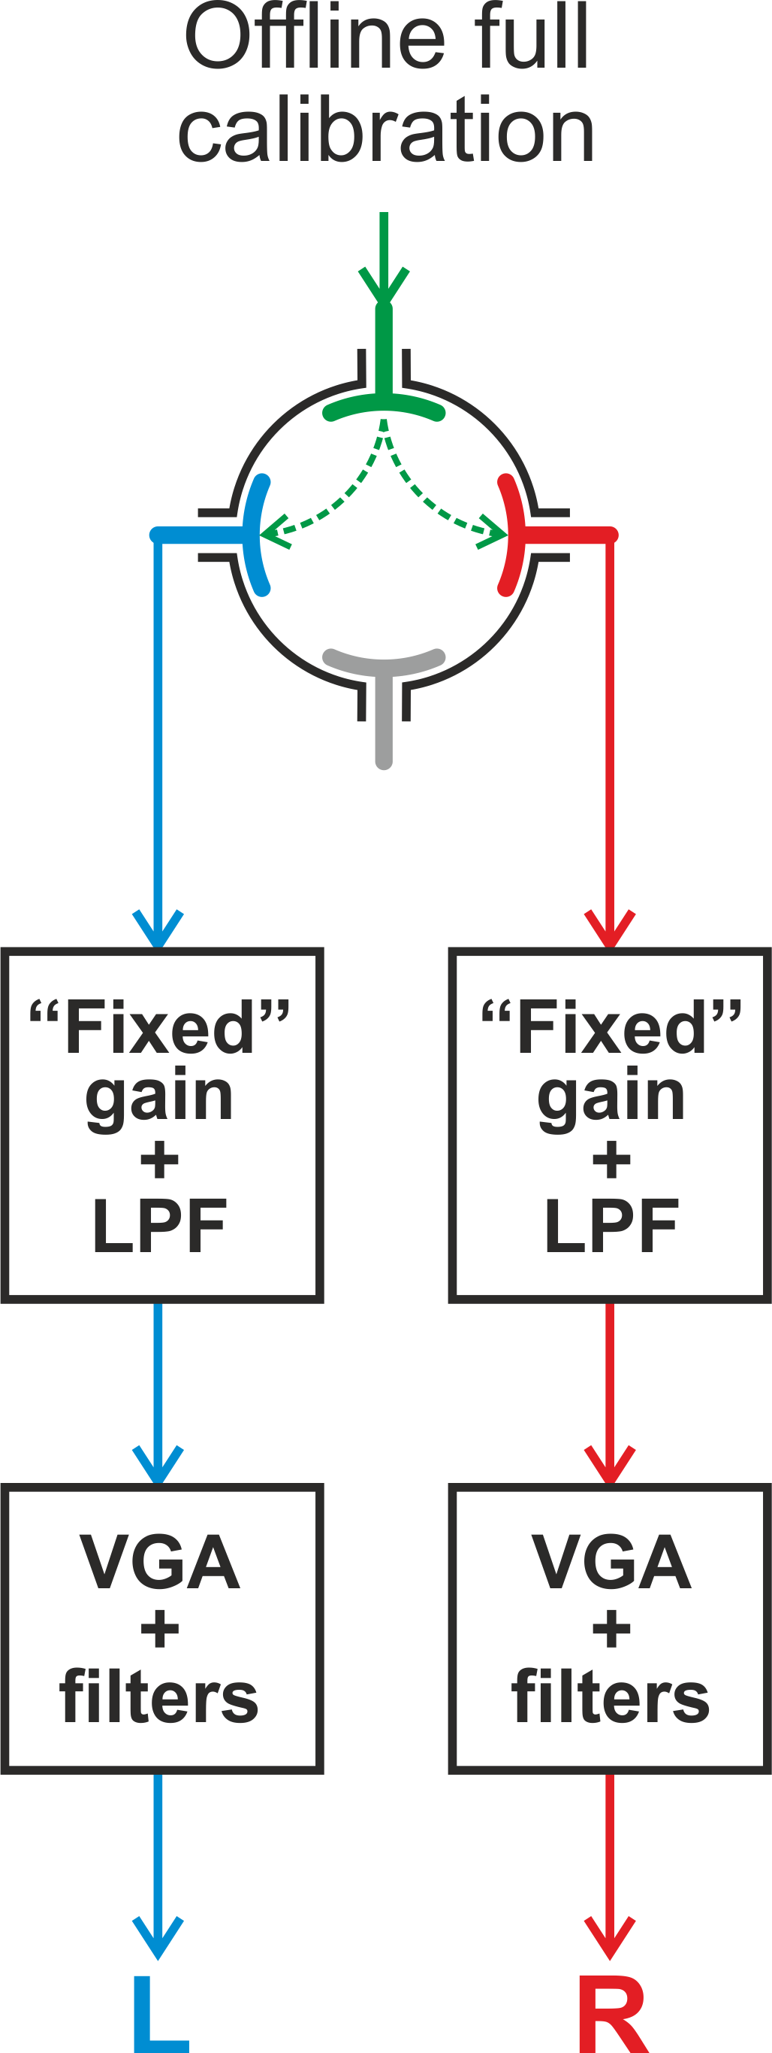
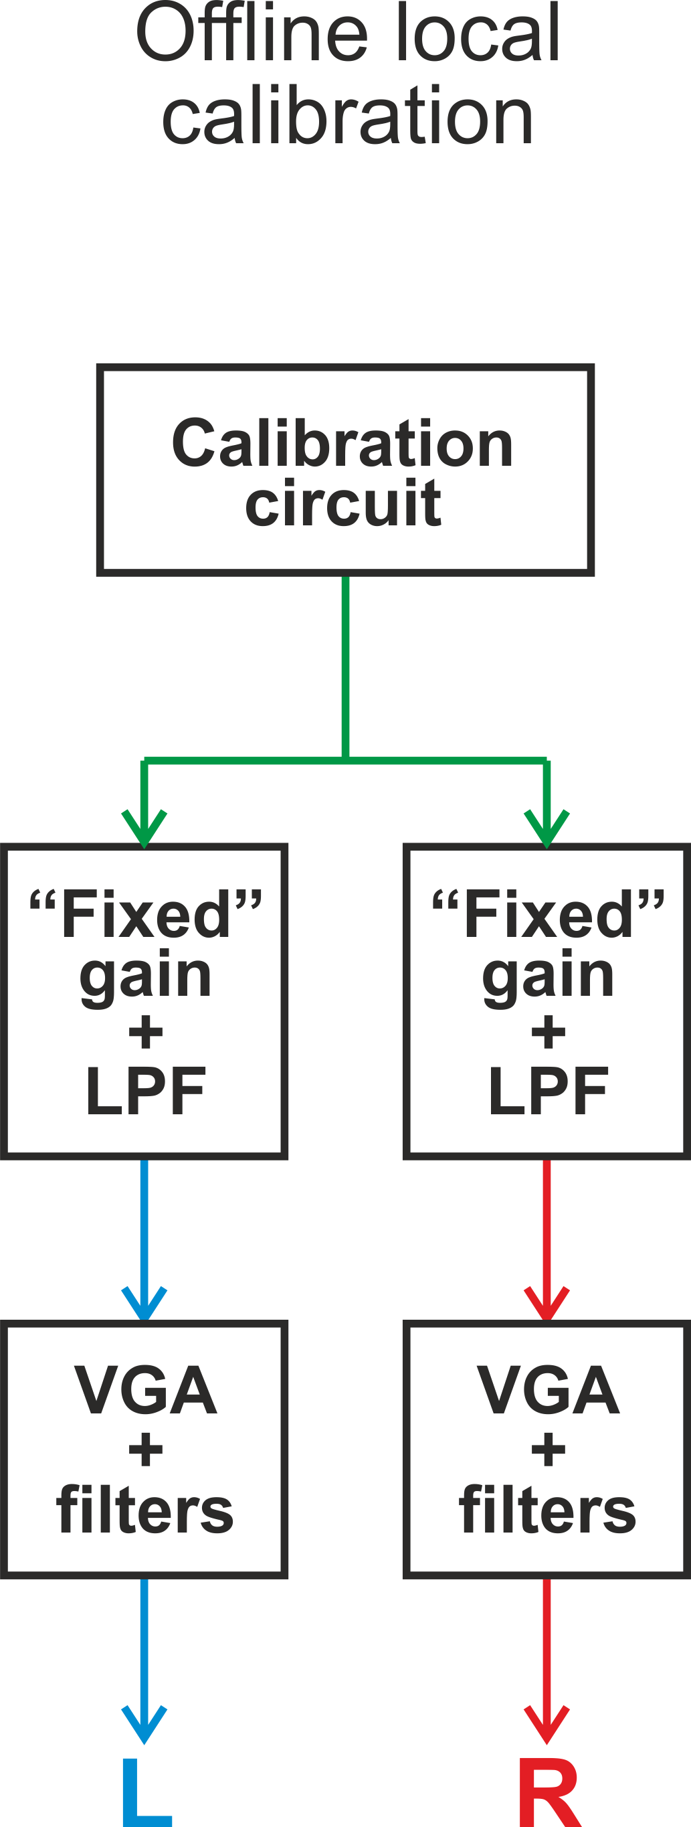
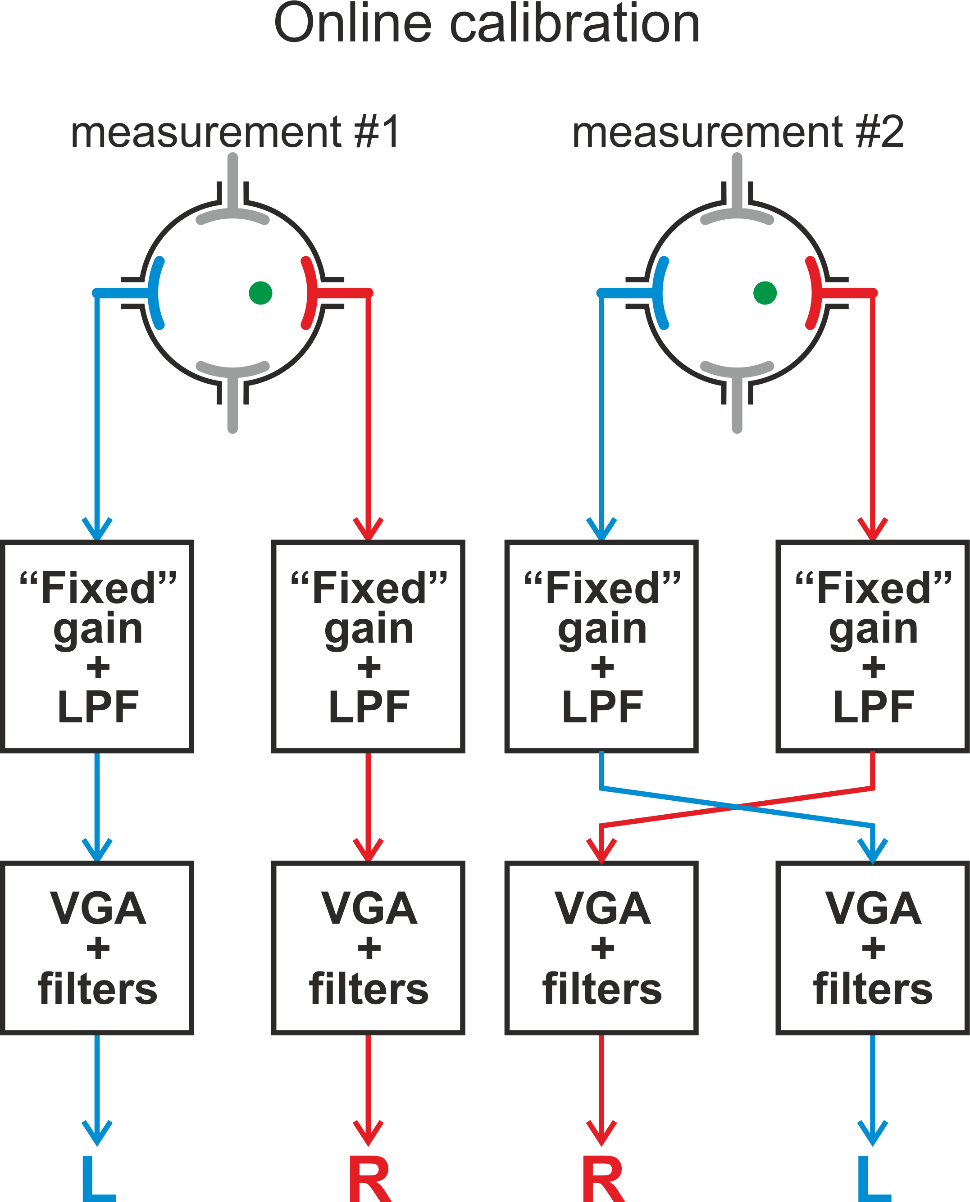
Accuracy - electronics offset
Uneven attenuation / gain between the two opposite channels (e.g. horizontal positive and horizontal negative) is equivalent to an erroneous beam displacement
3 types of calibration methods foreseen
  Online (with beam) for “fast” drift correction – crossbar switching like light sources or DOROS
  Offline local (without beam) for “slow” drift connection – sending a known signal through the front-end electronics
  Offline full (without beam) for checking cables – sending a signal to the BPM, cross-coupling to the adjacent electrodes, measuring the asymmetry

Slide 13
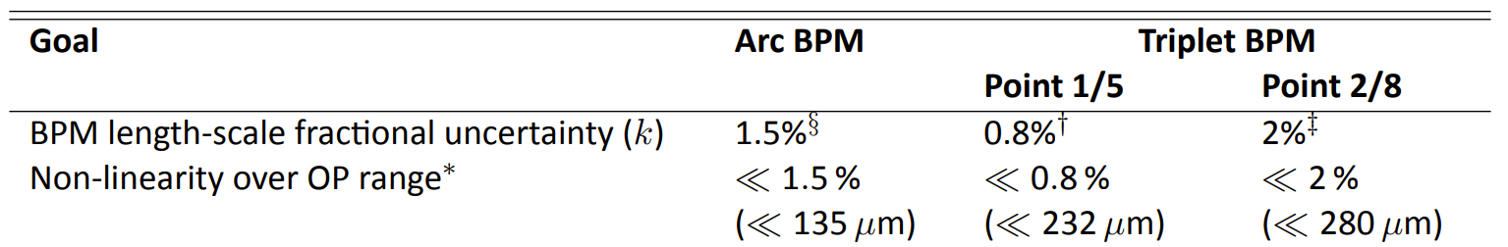
Accuracy - linearization
Signals generated by BPM pick-ups have a non-linear dependance on the beam displacement
  Very strong effect for large displacements
  Must be corrected in 2D
Acquisition electronics also feature some nonlinearities – to be mitigated by precise gain control and calibration
Optics
VdM
Orbit

Slide 14
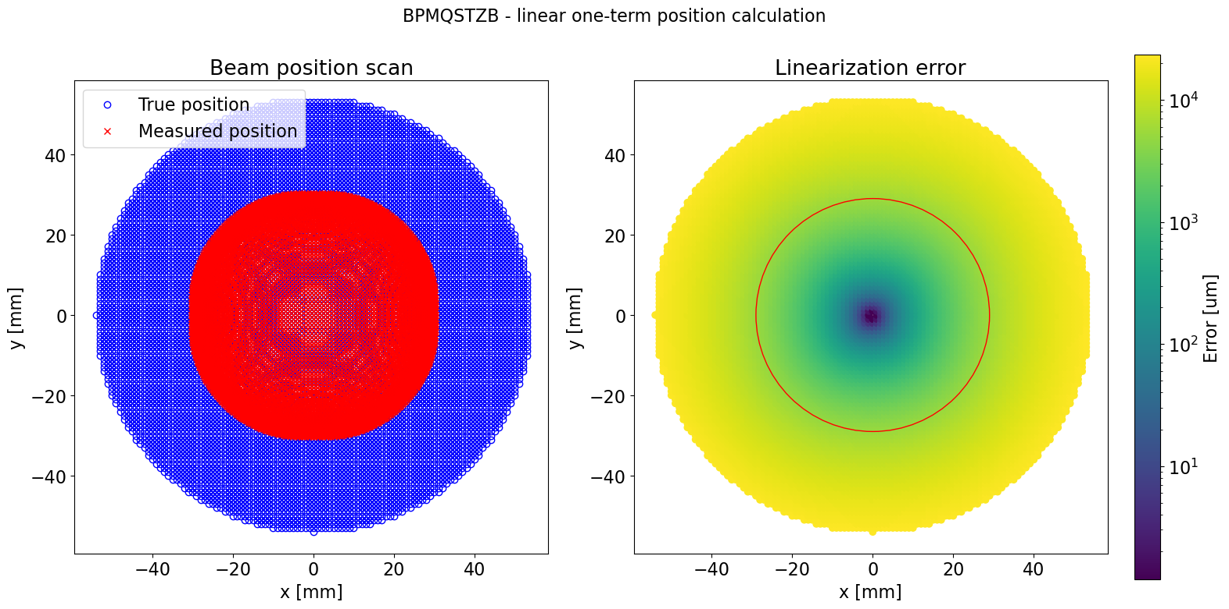
Accuracy - linearization
Max error in ±(half radius) range: 5.4 mm
Max error in VdM range: 1.2 μm

Slide 15
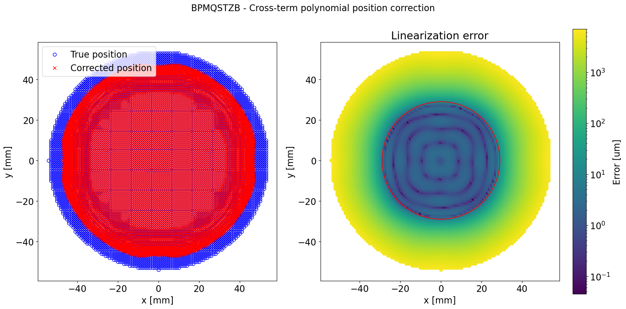
Accuracy - linearization
7th order cross-term polynomial w/ 17 non-zero coefficients
LHC BPMs: 5th order cross-term polynomial w/ 6 non-zero coefficients`
Max error in ±(half radius) range: 10 μm
Max error in VdM range: 0.9 μm

Slide 16
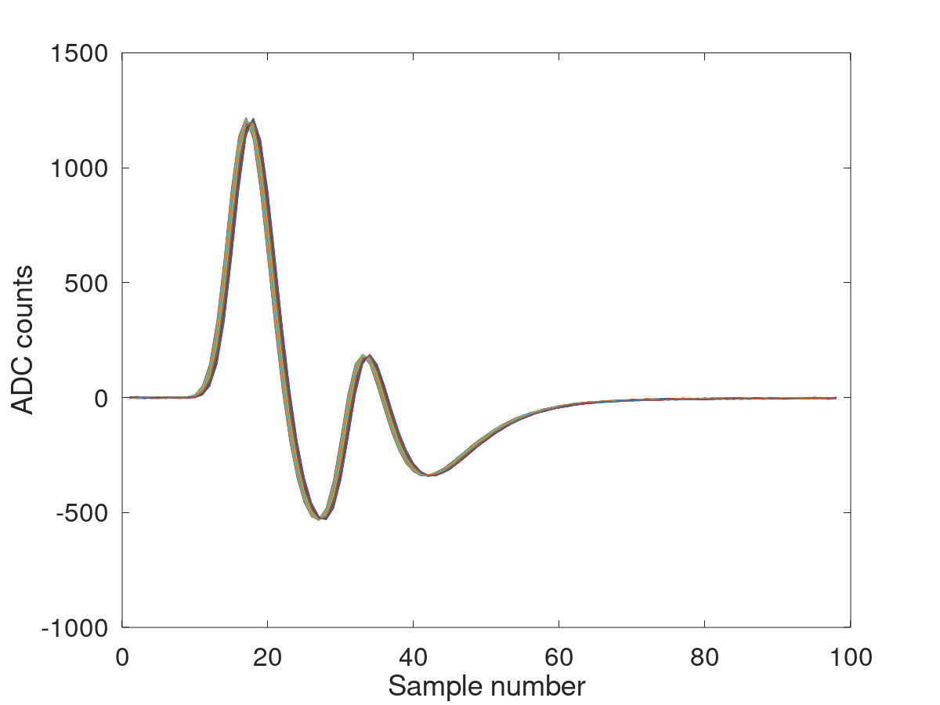
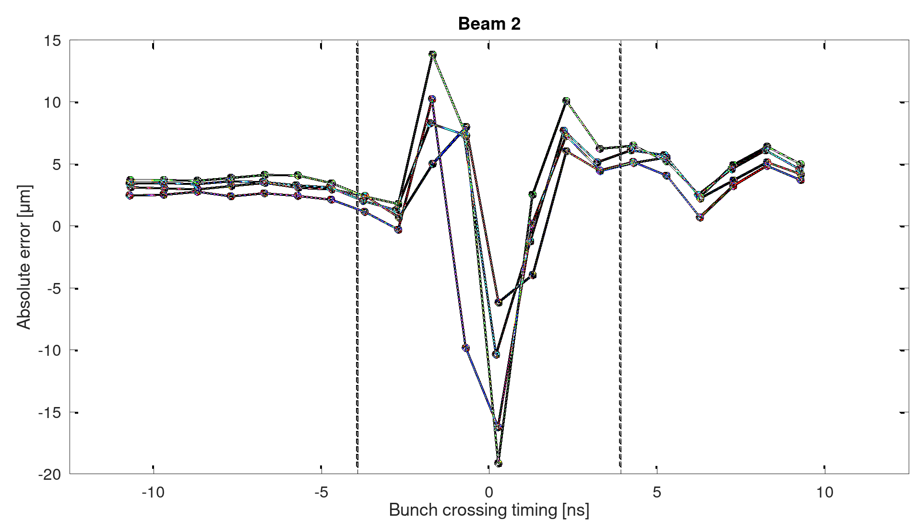
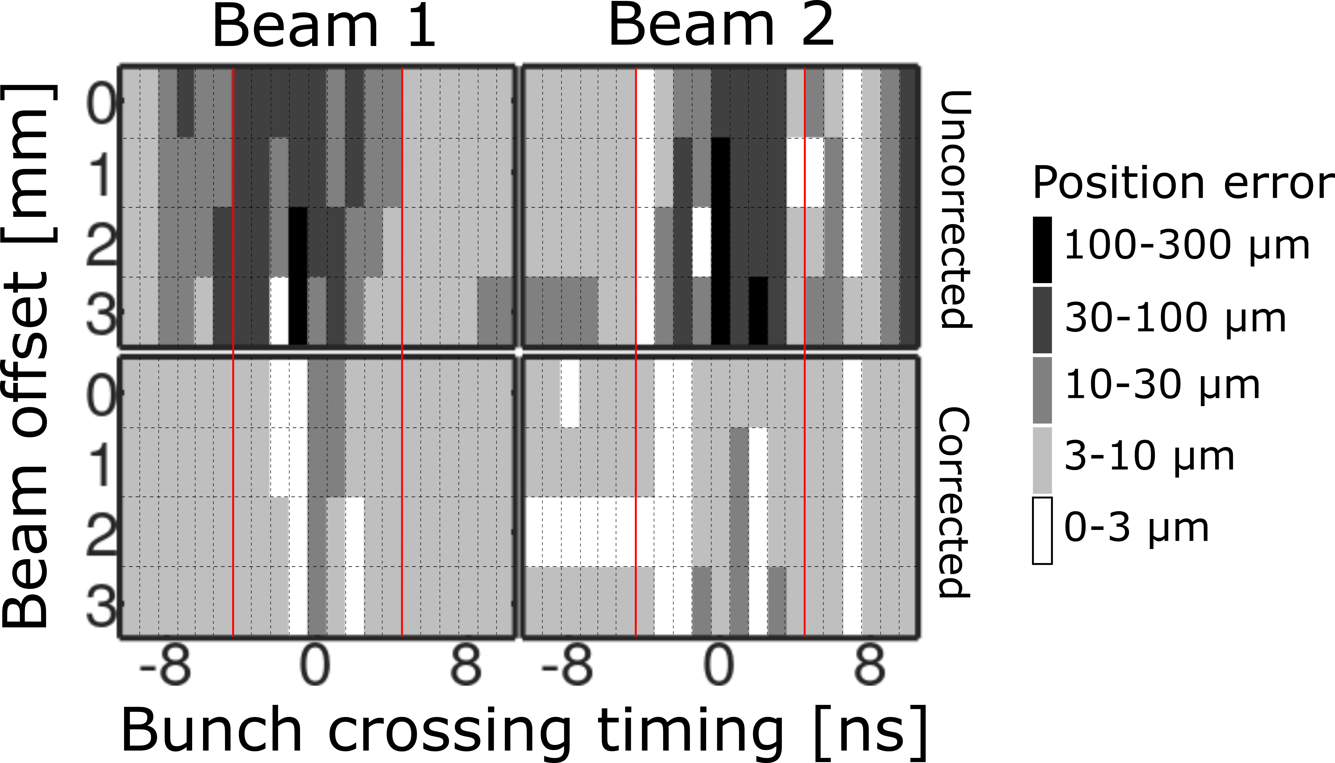
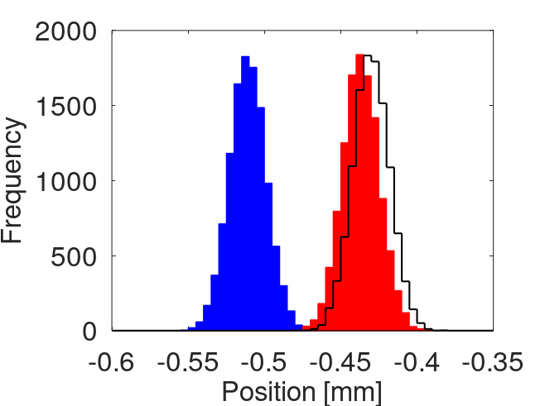
Beam-beam compensation
Various digital signal processing methods investigated
Most promising so far: “Power Compensation Algorithm” developed in collaboration with University of Oxford
  Prerequisites: known beam-beam delay; reference waveform measurements at the beginning of each fill
  Details: EDMS 2669844
Disclaimer: for high-accuracy measurements (e.g. optics measurements, van der Meer scans, special MDs) we recommend using filling patterns where the two beams don’t cross each other in the IT (i.e. 550+ ns bunch spacing)
Beam 1 signal
Beam 2 signal

Slide 17
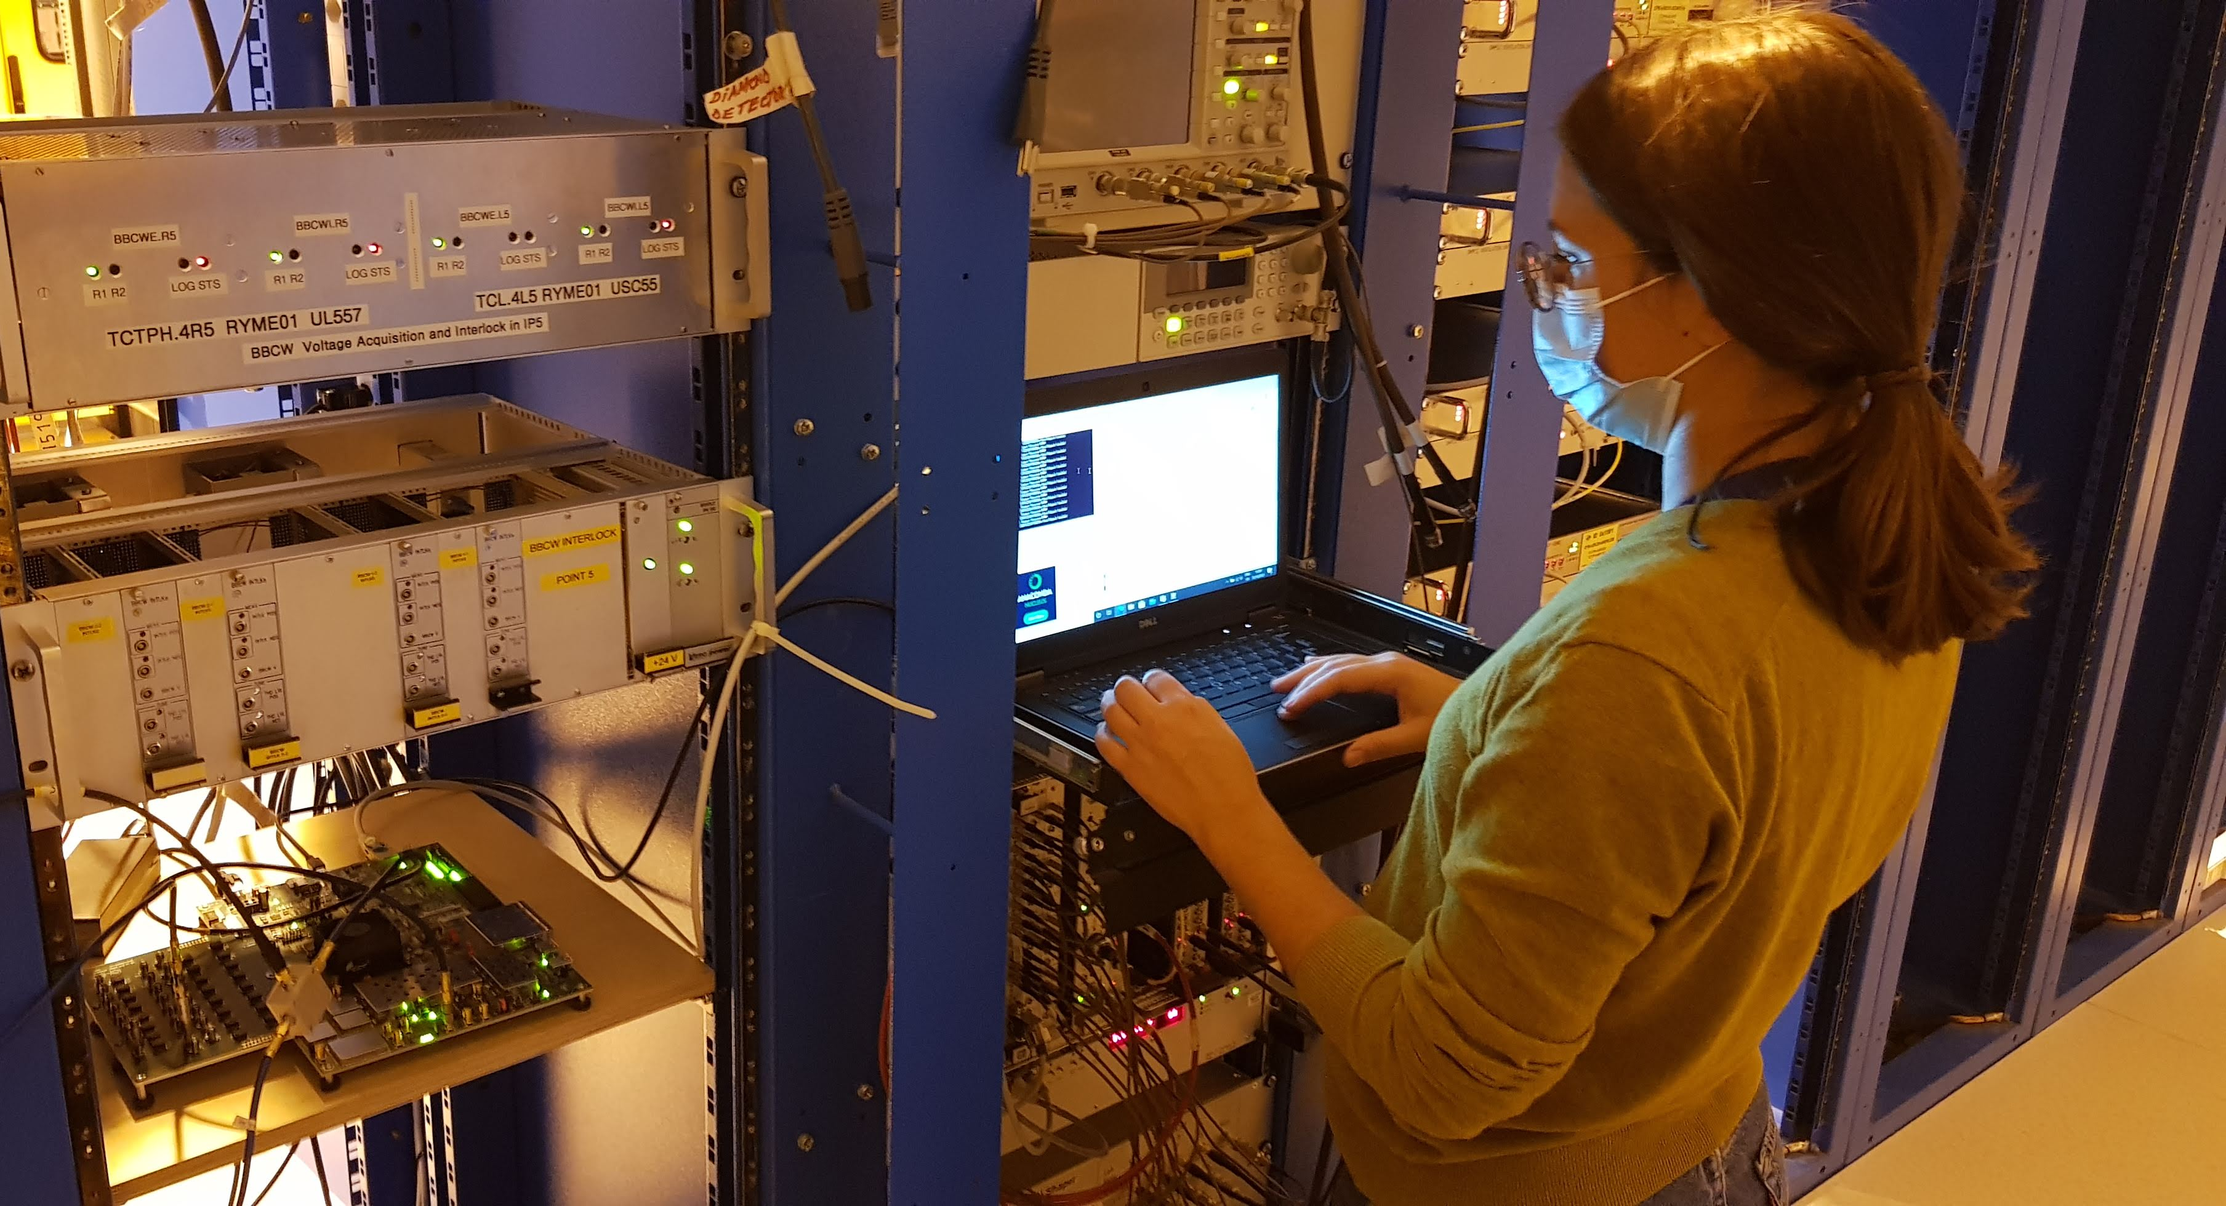
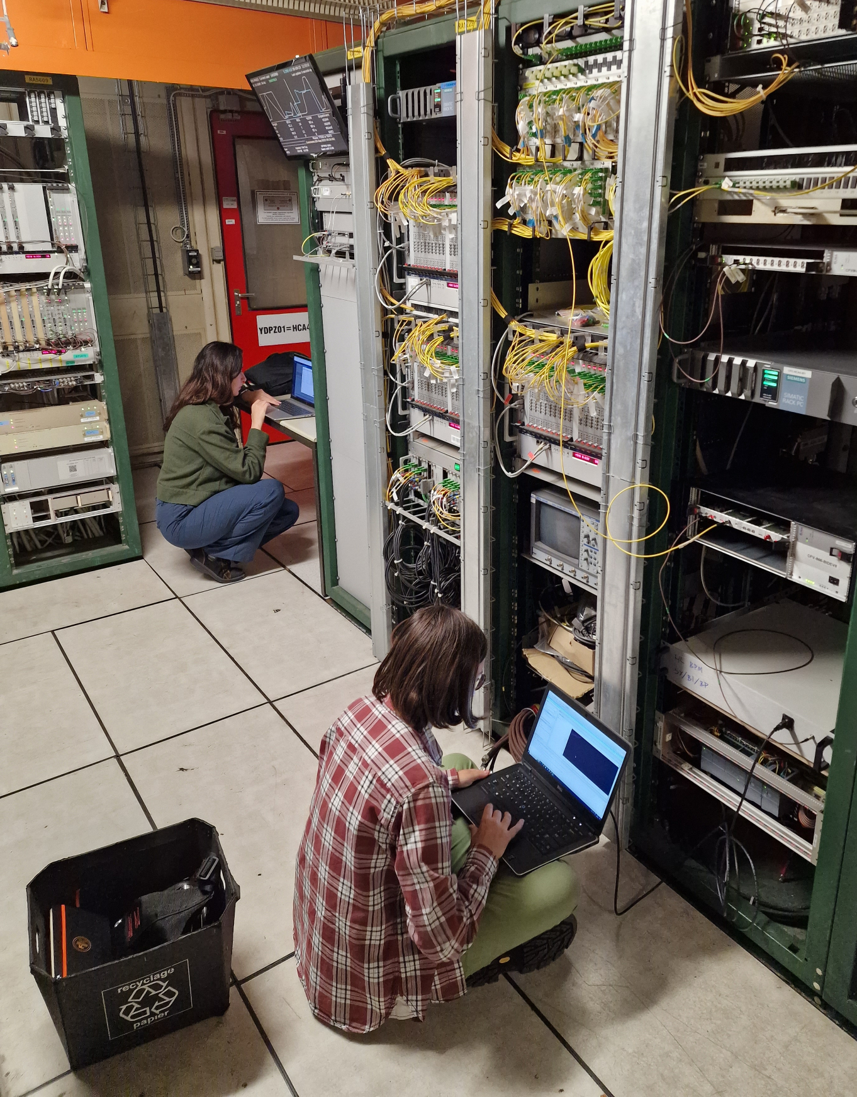
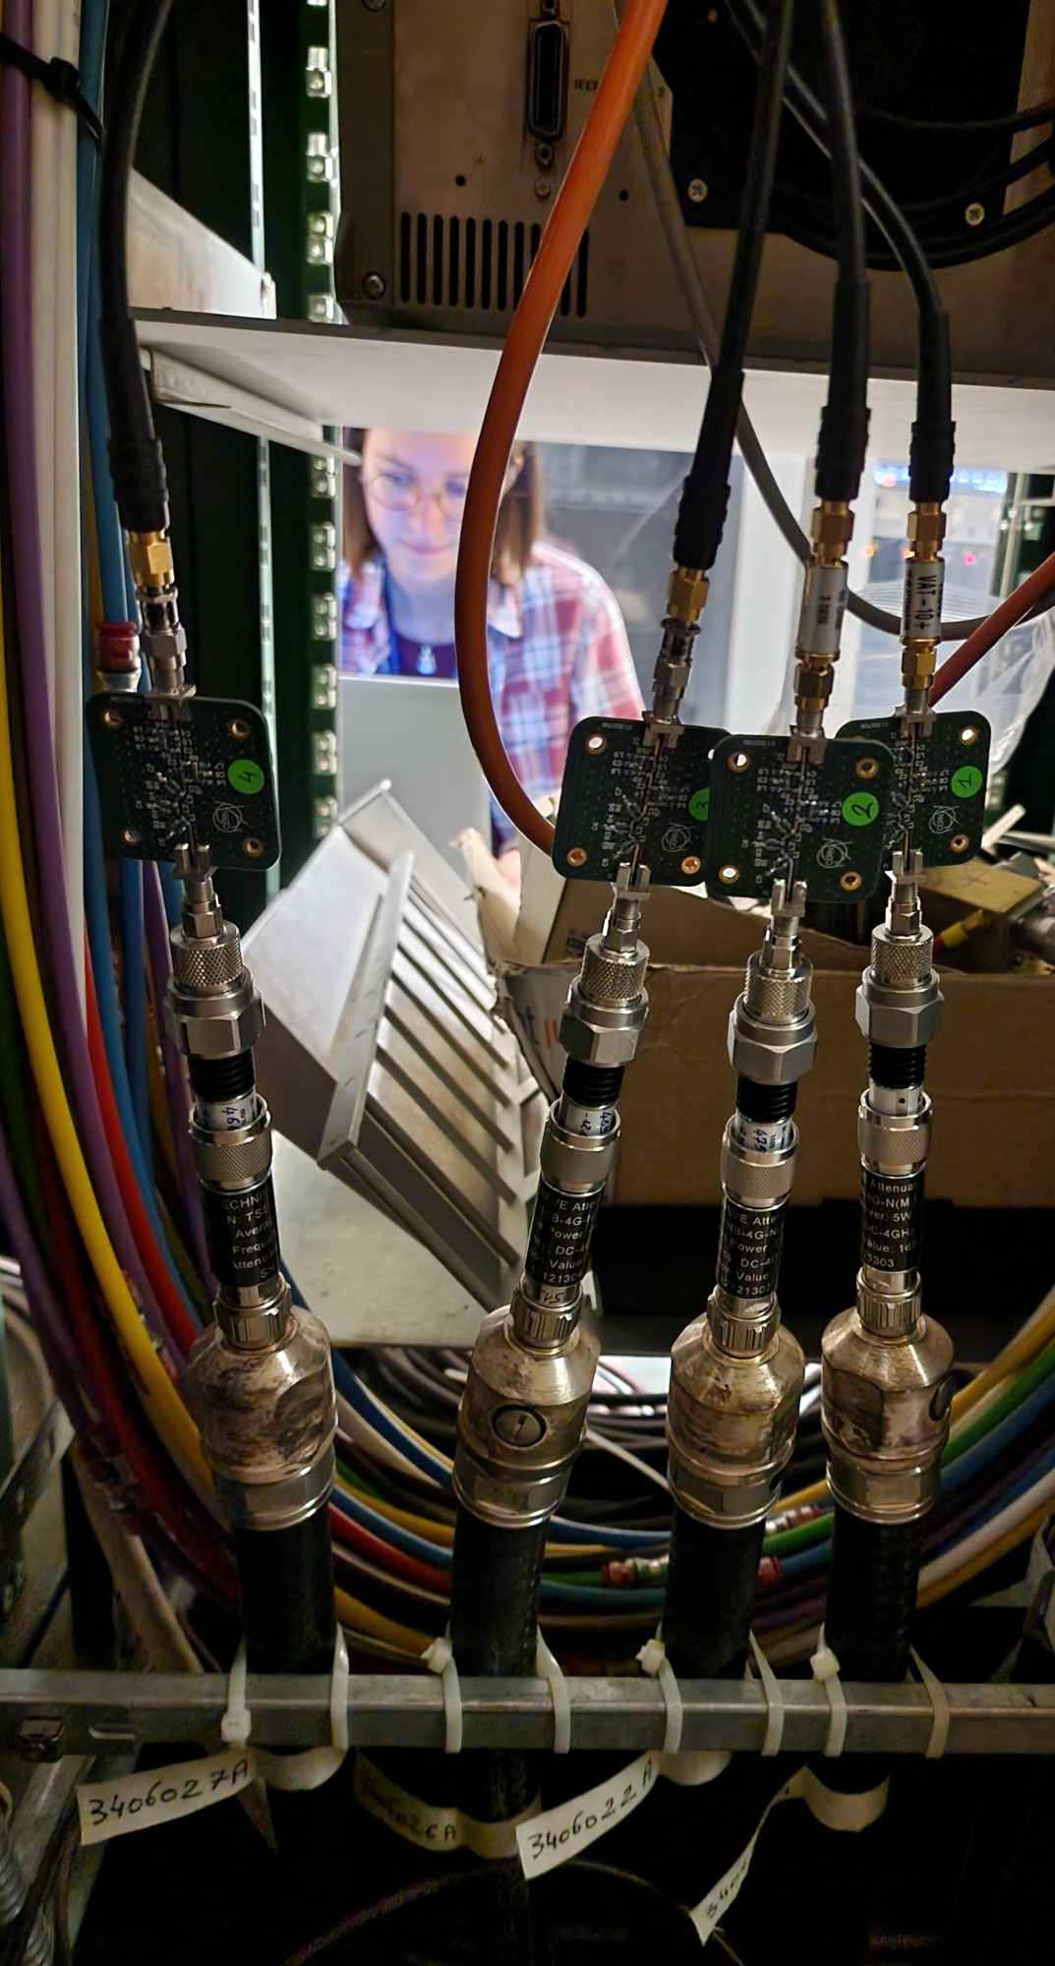
Testing with beam
Already tested:
  Dedicated MD with RF cogging (variable beam-beam delay), orbit steering, bunch length control – proof that the Power Compensation Algorithm works
  Raw waveform capture (in LHC, SPS, and AWAKE) for resolution estimation and signal processing developments – proof that the RFSoC technology is suitable for beam position measurements
Planned by end of 2024:
  Continuous acquisition, “light” processing, publishing, and logging of uncorrected orbits throughout the LHC cycle – proof of the possibility of integrating the RFSoC technology with the CERN controls infrastructure
Planned in 2025:
  Test of prototype analogue front-end – proof of achievable noise levels (i.e. precision) and linearity
Planned in 2026:
  Test of the first pre-series system with “light” online signal processing – proof of full system integration
Planned in ~2029:
  Commissioning in AWAKE (similar quantities as in HL-LHC)

Slide 18
External dependencies
We rely on the availability of Beam Synchronous Timing (BST) – through the existing network (considered legacy after LS3) or through the White Rabbit + WREN solution
  BST needed for precise bunch-by-bunch measurements
  Without timing, the system will work in degraded mode (e.g. no counter-beam compensation, no capture etc.) – useful for commissioning
We rely on the availability of and support for FESA on SoC and FECOS on SoC
  Very motivated Task Force recently established, chaired by the lead digital electronics engineer of HL-LHC BPMs
For compatibility with the existing tools, the new system must look like any other LHC BPM (same API with extra features)

Slide 19
Timeline
RFSoC SOM procurement in 2024-25
Electronics production 2025-26
  Proof-of-concept and prototype units available for measurements with beam – additional dedicated MD time might be valuable
Gateware, firmware and software development – ongoing, will last until the end of beam commissioning
Installation – after EN-EL cabling campaign in LS3
NB. we will produce the same system for AWAKE and potential deployment in LHC IP2/8 (through LHC CONS)

Slide 20
Summary and outlook
Cutting edge BPM system under development for HL-LHC ITs
  Extremely-high-quality BPM pick-ups produced at CERN
  Modern approach: nearly-direct digitization in radiation-free areas
  Expected performance is mostly in line with the specification
  Development and test campaign progressing as foreseen
Points to be aware of:
  Very high max power of the signal for the corner case defined in the conceptual specification
    It might become necessary to put a safety limit on the max number of bunches at max displacement
  Alignment to within 50 μm of the design position not possible
  Unclear if the demanding requirements of the experiments (VdM) can be realistically satisfied
  Some large procurement still remains to be completed
  Integration with CERN controls infrastructure will be commissioned with beam in AWAKE before LHC Run 4

Slide 21
Thank you for your attention

