Slide 1
Final design of the luminosity monitor in TAXN and experience with prototype detector during Run3
W. Andreazza, E. Balci, D. Belohrad, N. Chritin, S. Mazzoni, M. Nieto, F. Sanda and K. Zertova, CERN
14th HL-LHC Collaboration Meeting, Genoa, 7-11 October 2024

Slide 2
BRAN
Beam Rate of Neutrals measures rate of collision products i. e. relative luminosity.
Use case:
BRANs are installed since Run 1 on both sides of all LHC experiments
“Standardized, simple, fast and robust machine luminometers are provided to set up the machine for physics and optimize its performance based on counting rates”, BRANs functional specs, EDMS 347396, 2004

Slide 3
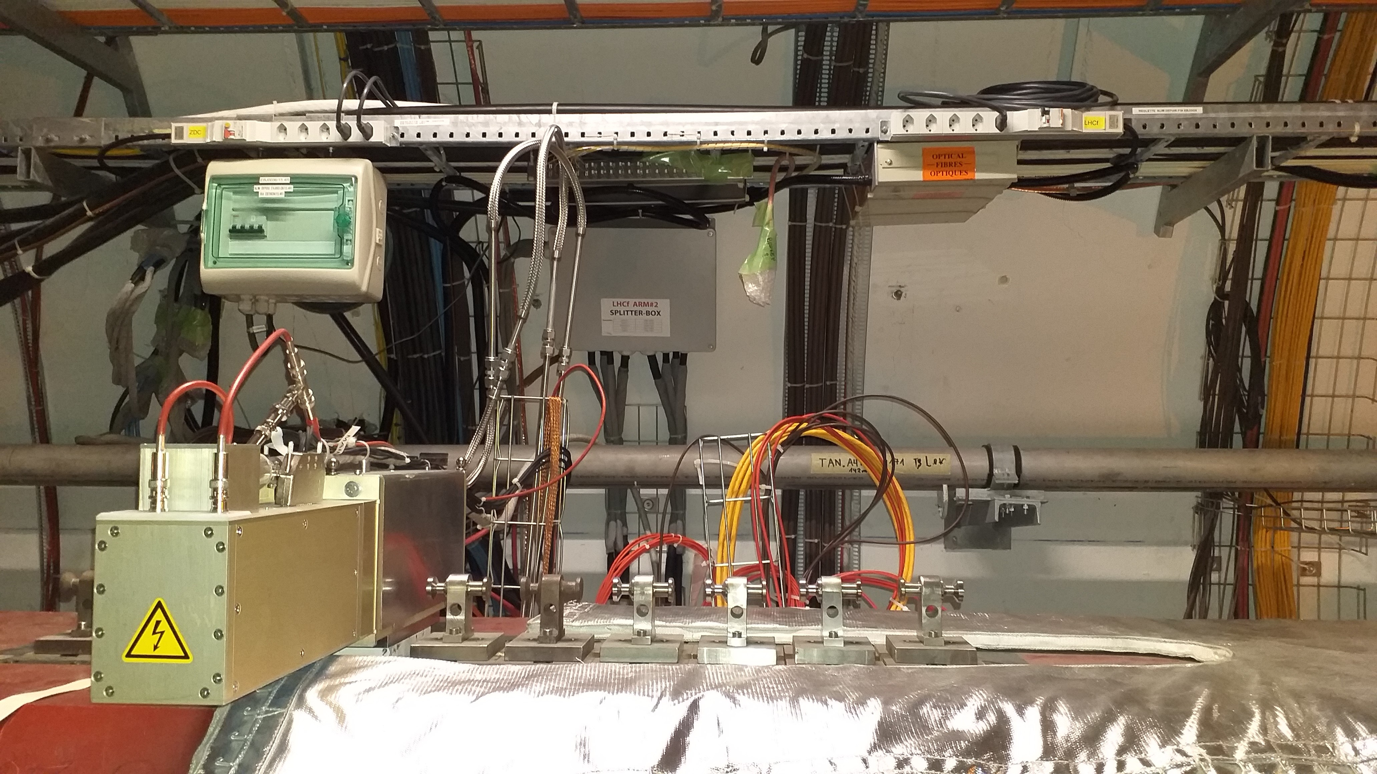
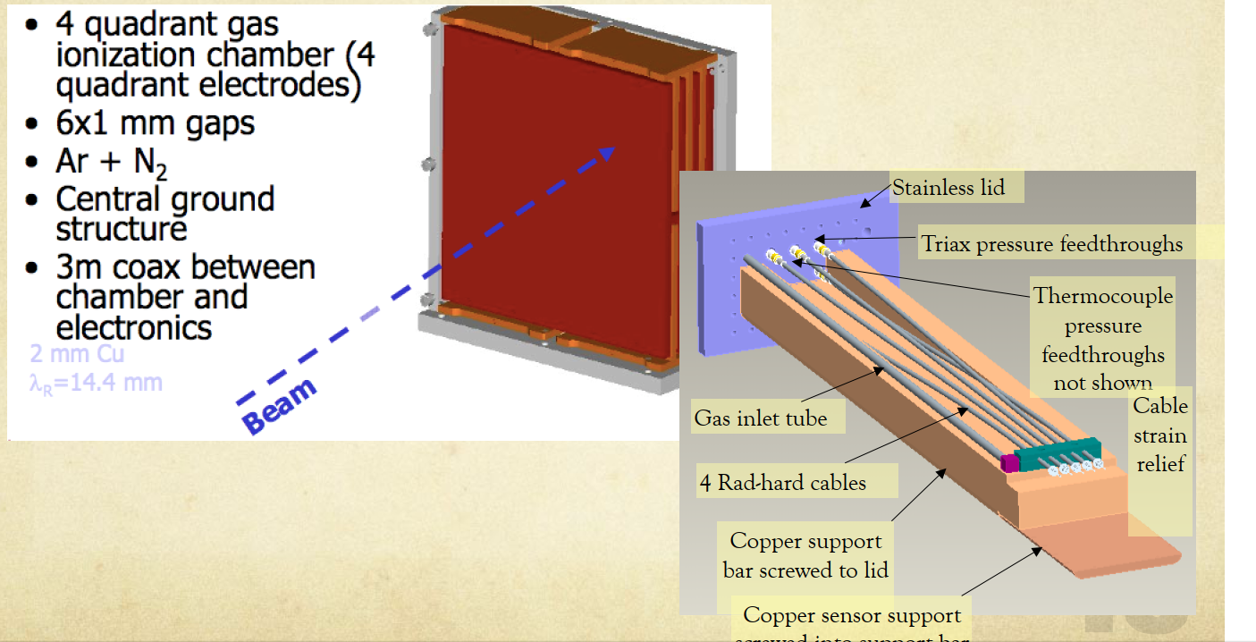
BRAN types
BRAN-A: based on fast ionization gas chambers, developed by LBNL.
Installed in IP1 & 5 during LHC Runs 1 & 2.
Replaced by D-type during in 2022 (1R, 5L) and 2023 (1L, 5R)

Slide 4
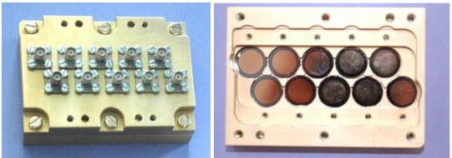
BRAN types
BRAN-B: based on CdTe detector, installed in point 2 & 8. Damaged by radiation. Replaced by C-type

Slide 5
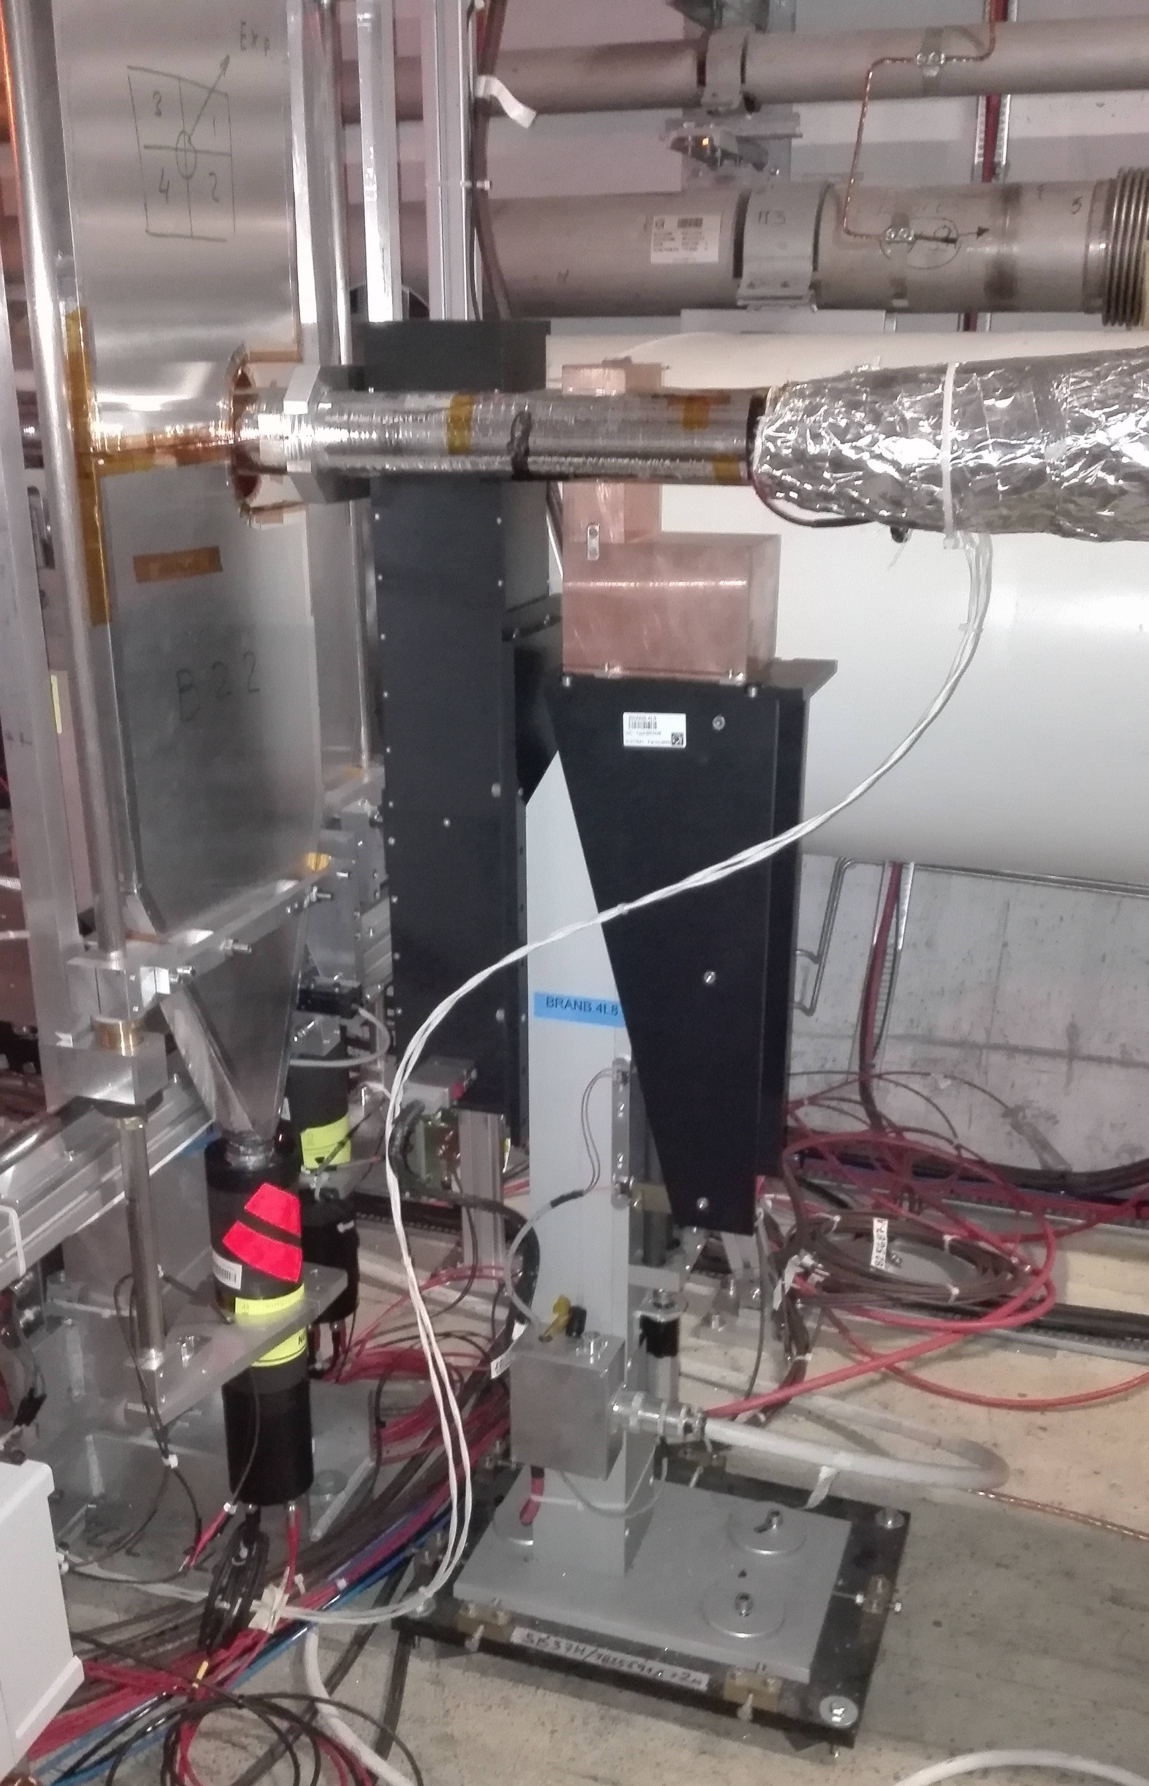
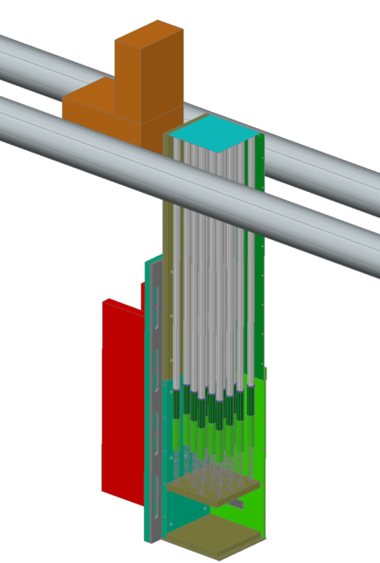
BRAN types
BRAN-C: based on Cherenkov radiation. Installed during Run 2 in IP2 & 8
Operational.
E. Bravin, S. Jakobsen

Slide 6
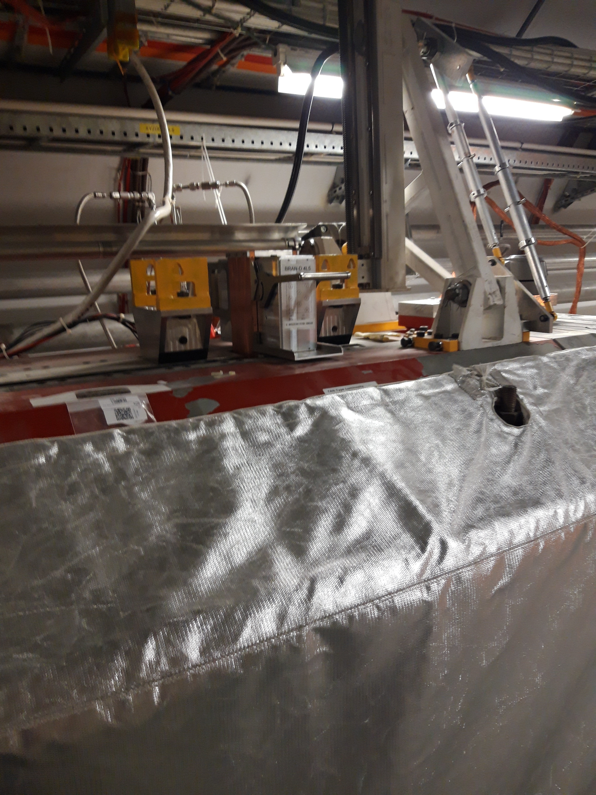
BRAN types
BRAN-D: based on Cherenkov radiation. Installed during Run 3 in IP 1 & 5
Operational.
D-type serves two purposes:
  operational BRAN for LHC Run 3
  prototype for high lumi BRAN-E due to new absorber and lumi levels
E. Bravin, M. Palm

Slide 7
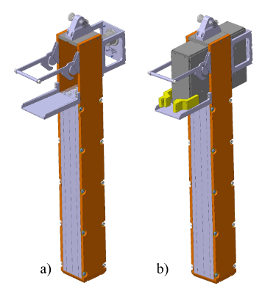
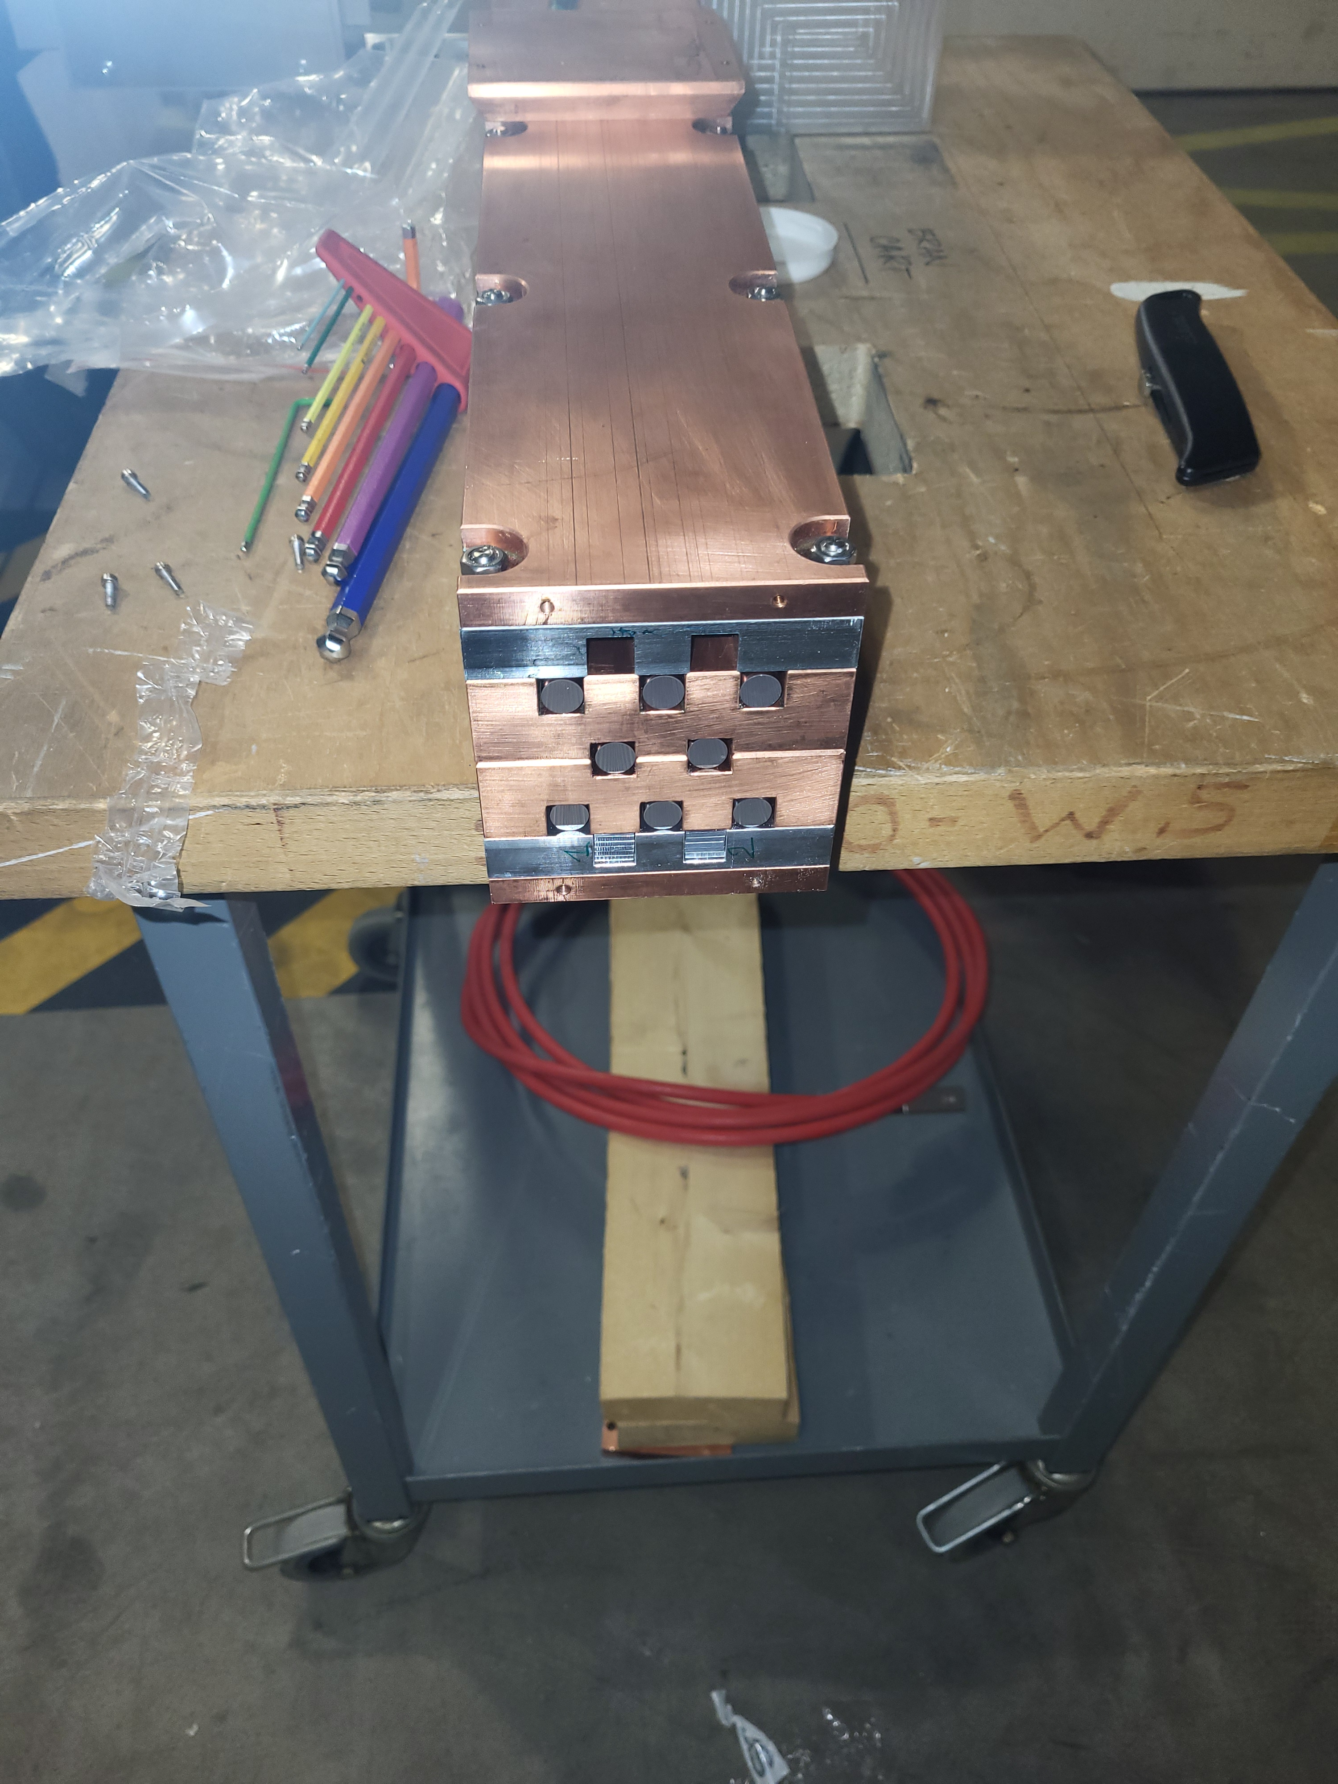
BRAN-D design
Detection of Cherenkov radiation produced in ultra-pure Silica rods by hadronic showers produces in the Target Absorber of Neutrals (TAN)
Eight 603 mm x 10 mm dia Suprasil 3302, low OH, no H2 in a copper enclosure (100 x 100 mm). Material selected after irradiation studies perform during LHC Run 2*.

Slide 8
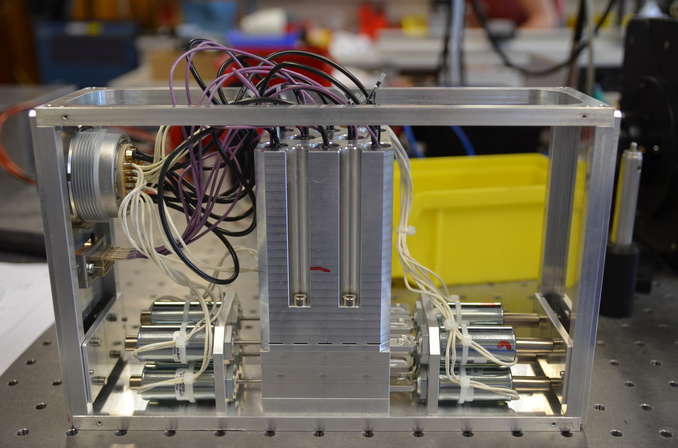
BRAN-D design
Eight PMT Hamamatsu R2496 (one per rod). Peak QE @ 420 nm, 1.5 kV supply (individually controlled by 12 channel ISEG card).
Optical transmission controlled by aperture limitation: two movable slit / hole strips: 100% - 10% - 1%
Strips moved by push / pull solenoids (eg LEDEX 195205-230, push, 24V intermittent duty)
Fast (de-)installation of PMT box. Budget force 70 N (push / lift?). Lever allows to overcome force budget for connectors (110 N mating, 95 N unmating for LEMO)
Weight approx. 3.5 kg

Slide 9
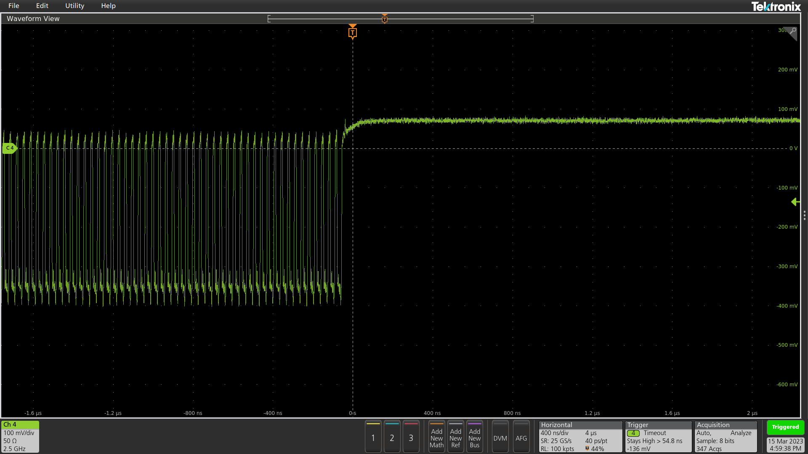
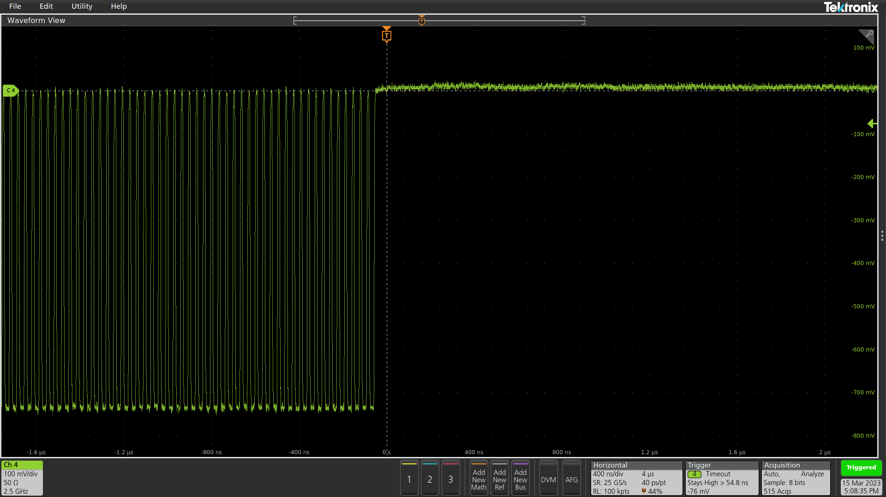
BRAN-D design
New 8-channel variable gain / offset amplifier in US gallery:
  50 ohm in / out
  variable gain up to +/- 8 mA FS max (62.5 V/A) to compensate for loss of transmissivity of rods
  DC to 500 MHz BW, with 250 MHz LPF
New amplifier design should reduce tail effect after pulse trains
Less prone to oscillations

Slide 10
BRAN-D design
FW performs digital LF ( approx. 600 Hz) noise subtraction (Abort gap offset compensation)
Output is a 3564 x 64 signed bits vector in two exclusive user-selectable operating modes
  Integrating: cumulation of individual samples over N turns then integration
  Counting: number of samples in the bunch slot exceeding a given threshold per turn (low luminosity)
FESA class and GUI ‘BRAND’. Calibrated data are produced in FESA (proportionality and offset for each mode)

Slide 11
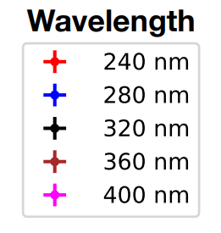
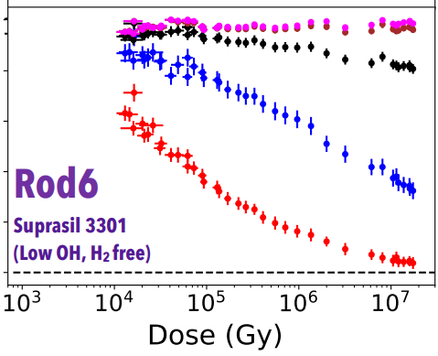
BRAN-D design
During Run 2: study on transmissivity: “Optical Transmission Characterization of Fused Silica Materials Irradiated at the CERN Large Hadron Collider”, S. Yang et al. NIMA (2023)
Suprasil 3301/02 show rapid decrease of transmissivity. Unclear from data where the stabilisation is expected (> 10⁷ Gy )
Visible transmissivity not affected
Proportionality of signal to rate of collision one of study goal of prototypes

Slide 12
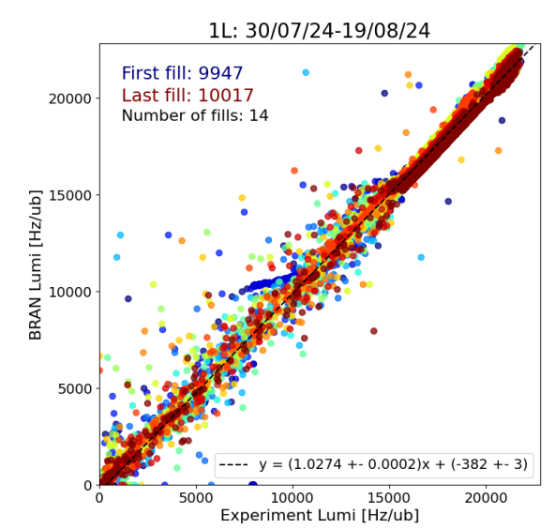
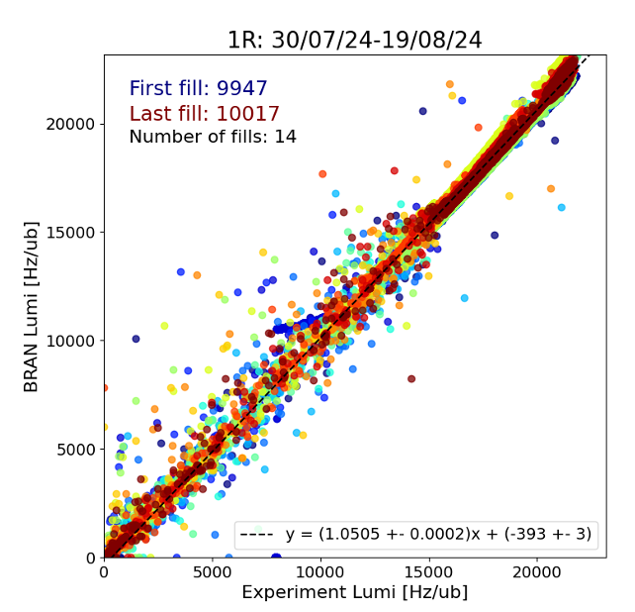
BRAN-D performance
Systematic analysis of linearity, SNR, proportionality of signal to rate of collision) between 1.4.24 and 2.9.24 by K. Zertova
Good linearity (ATLAS)

Slide 13
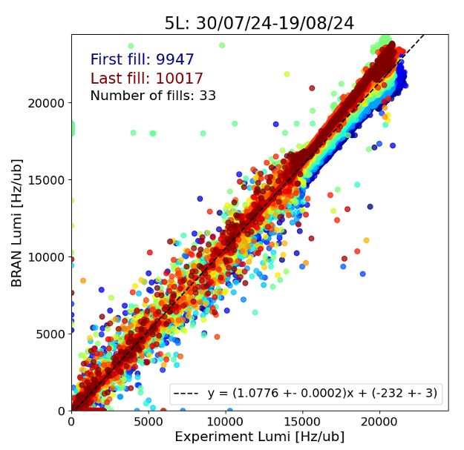
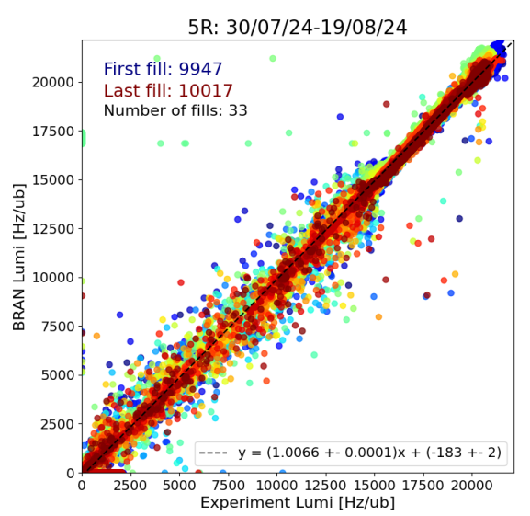
BRAN-D performance
Systematic analysis of linearity, SNR, proportionality of signal to rate of collision) between 1.4.24 and 2.9.24 by K. Zertova
Linearity OK (CMS). 5L: worst proportionality to exp. lumi

Slide 14
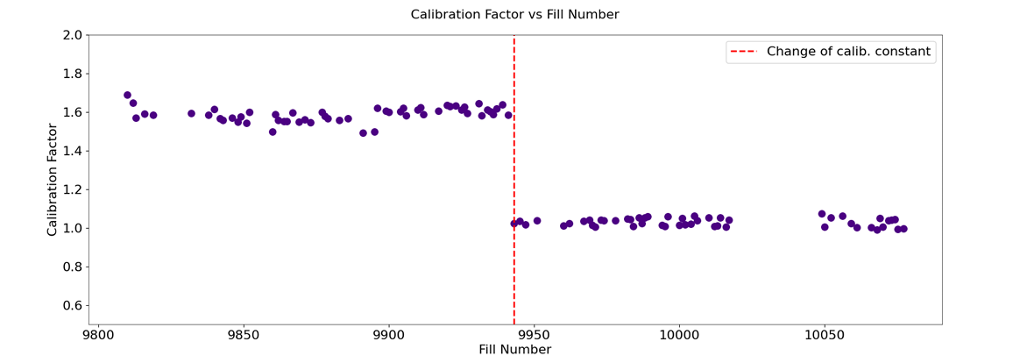
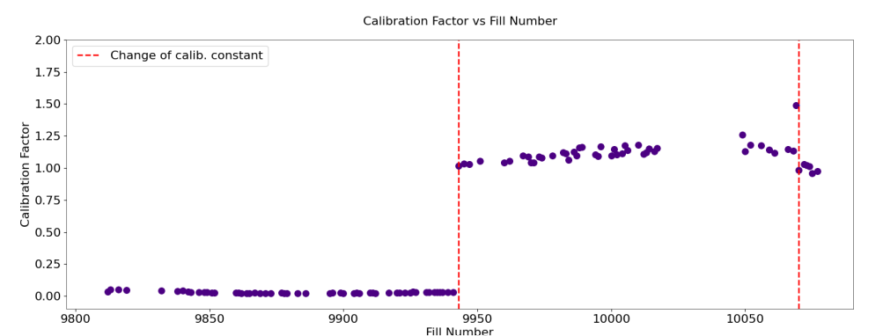
BRAN-D performance
Proportionality (against experiments): fair for 5R (top), worst for 5L (below), not fully understood

Slide 15
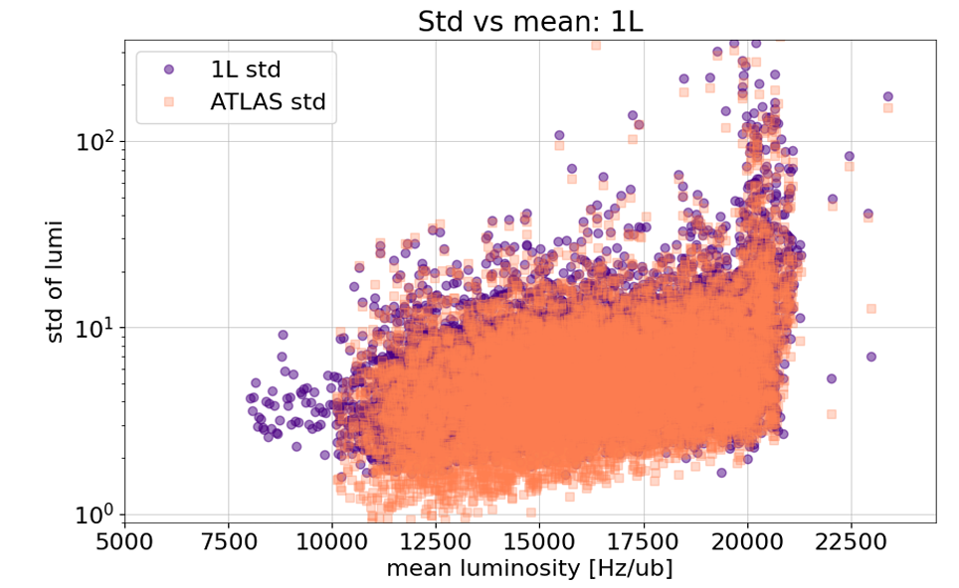
BRAN-D performance
Noise analysis: std. dev of lumi vs experiments. Typical plot, BRAN systematically noisier than experiments. Higher noise at 20 kHz/ub not understood (levelling?)

Slide 16
BRAN-D performance
Overall good linearity during run 3 so far.
proportionality (= transmissivity of Suprasil bars) not fully understood but so far SNR still OK for BRAN operation
Noise level allows for +/- 5% (nominal), limit for +/- 1% (nice to have)
NO faulty PMT throughout Run 3 so far (integrated luminosity up to 190 fb⁻¹)
promising for BRAN-E version!

Slide 17
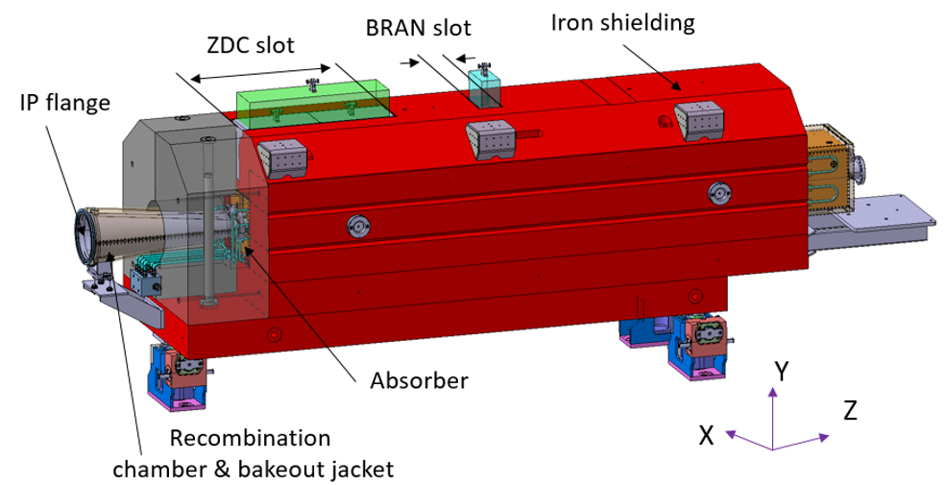
BRAN-E
BRAN-E will be hosted inside TAXN.
New material budget (ZDC before BRAN): normalized dose?
New space envelope according to EDMS 2349145 (‘taxn INTERFACES TO bran & zdc ’)

Slide 18
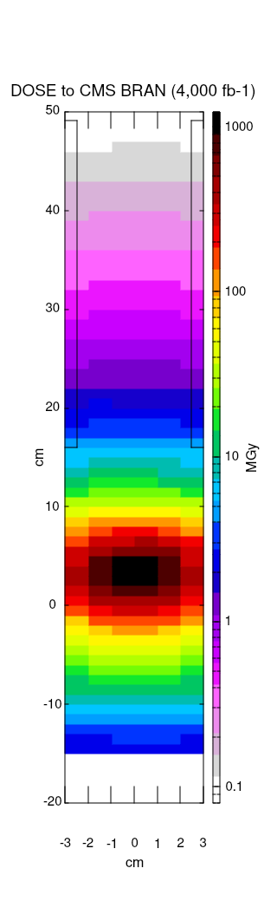
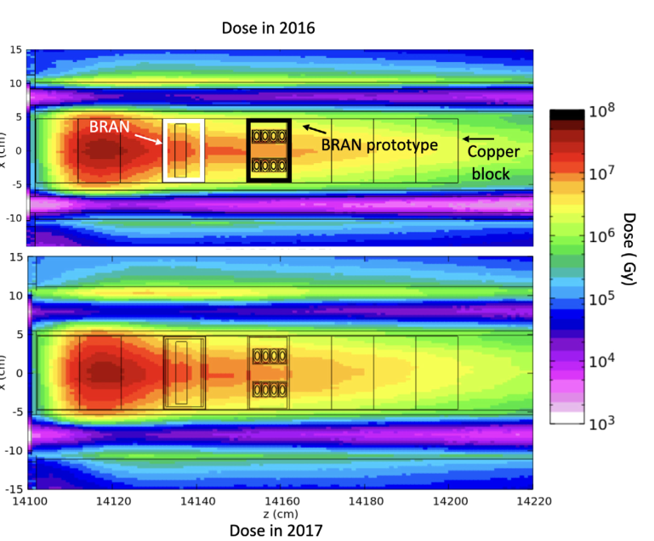
BRAN-E
Same order of magnitude normalized dose in TAN and TAXN BRAN positions
Runs 4 & 5: excess of 500 MGy to bars
Replace with spares when performance declines.
BRAN-D: 20 MGy per 50 fb-1 (2017) :
500 kGy/fb⁻¹
BRAN-E: order of GGy per 4000 fb-1:
250 kGy/fb⁻¹
F. Cerutti and M. Sabate Gilarte

Slide 19
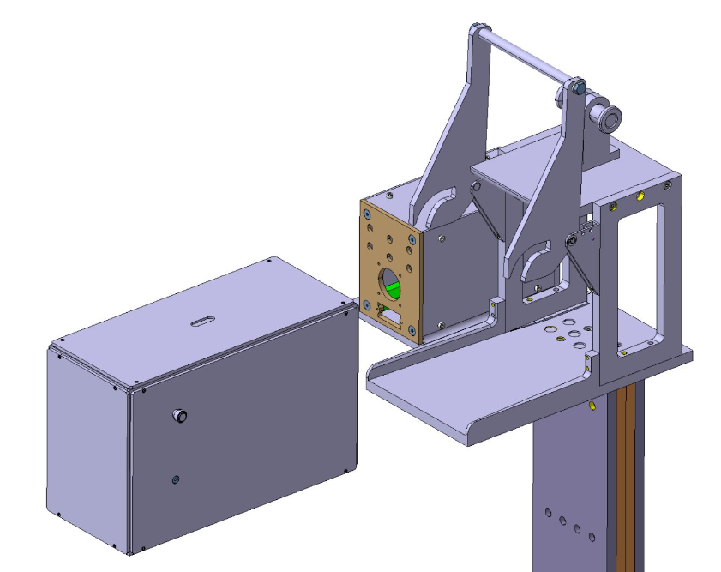
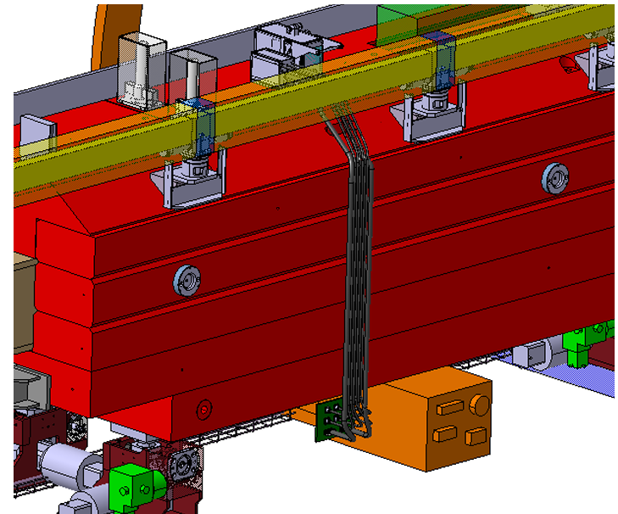
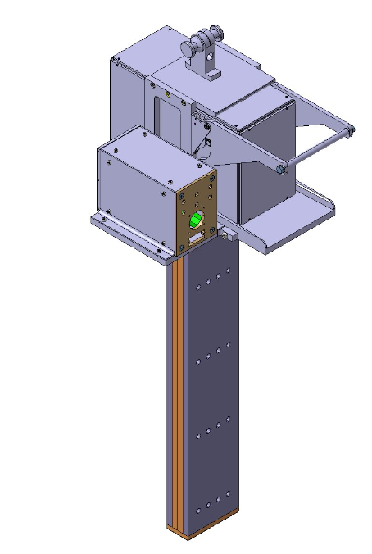
BRAN-E
New design by MME until end 2024
Same concept: fast (de-)installation of PMT box. Decided to drop robotic manipulation.
Cables routing from passage side to new UAs (shorter path)

Slide 20
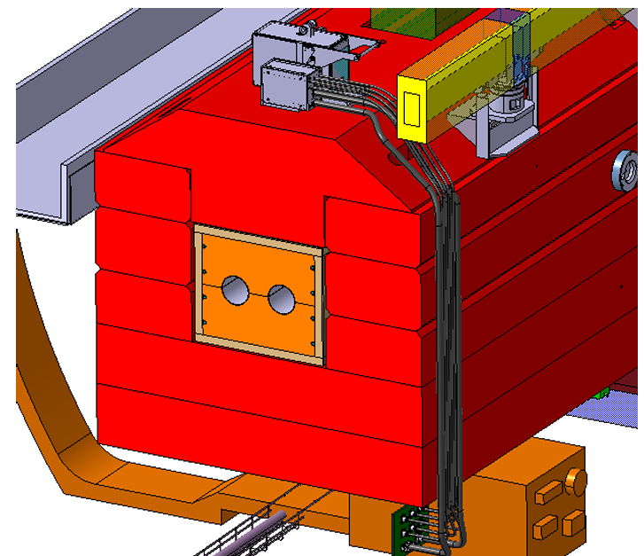
BRAN-E
Conflict with Wire position system solved.
WPS harness moved longitudinally to allow (de-) installation of PMT box
cable routing foreseen below WPS to patch panel below TAXN
Patch panel to UA: need low EMI cable tray! Differential signal transmission foreseen

Slide 21
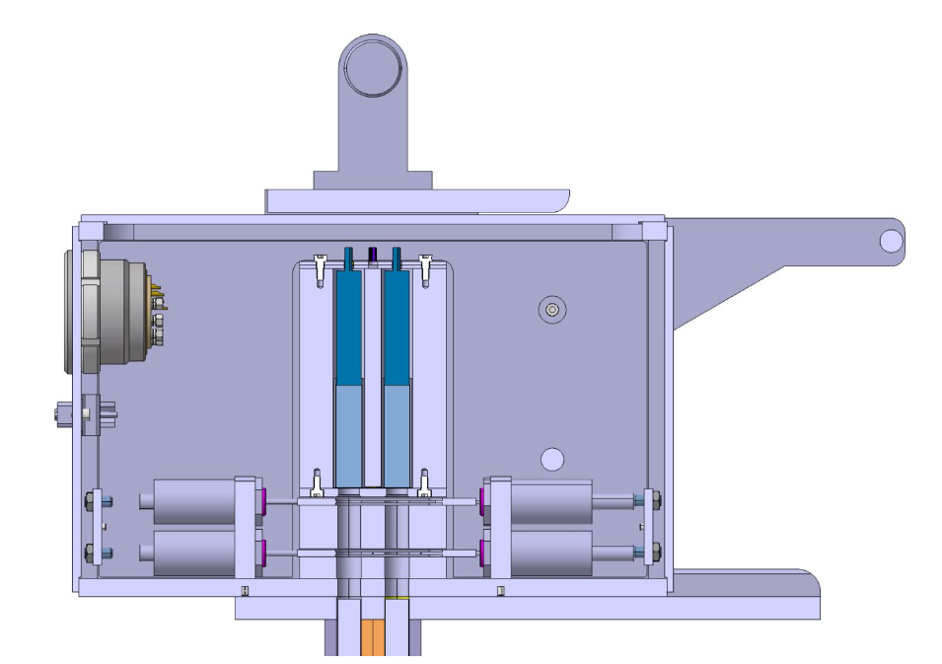
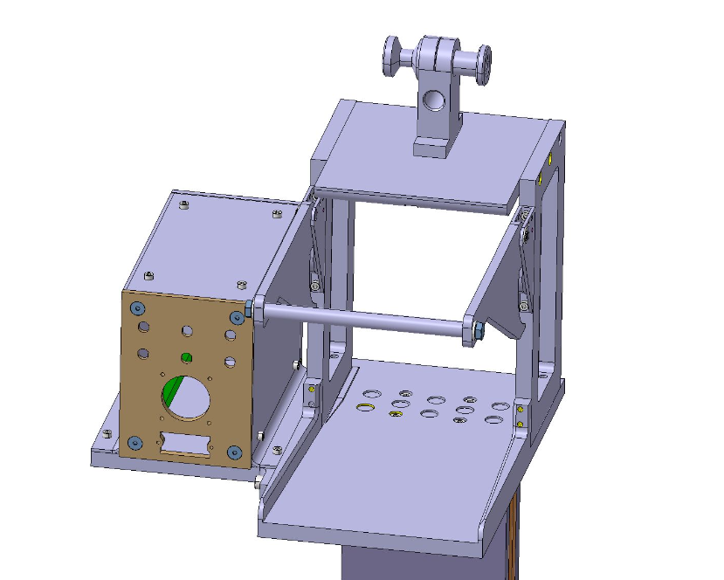
BRAN-E
Due to good performance of PMTs (no faults so far) and new 6-channel HV power supply (CAEN), decided to go for 8 > 6 channels per monitor. Possibly keep slots for irradiation studies.
We’ll add switches for position of attenuation masks (not present in BRAN-D). Also drop hi-lo sensitivity channels

Slide 22
Summary
Overall good performance of BRANs during LHC run 3. Need to keep track of faults and continue studying optical / UV transmissivity evolution with dose.
No faults due to radiation exposure, confirms goodness of design for Run 4
BRAN-E design well advanced, to be finalized by end of 2024. Design evolution being followed within WP8 (Thanks Francisco), TREX.
Some components already procured, production and remaining procurement will start in 2025.

Slide 23
Thanks for your attention

