Slide 1

Reviewing high bandwidth BPM technologies
Genoa, October 2024
Thibaut Lefevre on behalf of WP13

Slide 2
Task 13.5 - High Bandwidth BPM (BPW)
Measuring intra-bunch motion with high bandwidth and high sampling rate (beam crabbing and instability monitoring)
  With the goal to provide a better instrument than the classical Head-Tail monitor

Slide 3
Current Head-tail monitoring in LHC
Stripline BPM, hybrid Δ/Σ, long cables and fast sampling oscilloscope

Slide 4
Current Head-tail monitoring in LHC
Stripline BPM, hybrid Δ/Σ, long cables and fast sampling oscilloscope
Improved DAQ using better performing oscilloscope

Slide 5
Current Head-tail monitoring in LHC
Stripline BPM, hybrid Δ/Σ, long cables and fast sampling oscilloscope
Improved DAQ using better performing oscilloscope
Bandwidth limited by Stripline and Hybrid
10GSPS / 10bit oscilloscope (more budget limitations)
Memory limited to hundreds of turns

Slide 6
HL acceptance criteria for High bandwidth PU’s
Approved in 2021 https://edms.cern.ch/document/2369610/1.2
  High dynamic range
  Two levels of performance criteria
Parameter Description | Value | Unit
Pilot Bunch Intensity | 5×10⁹ | Charges
Nominal Bunch Intensity | 2.2×10¹¹ | Charges
Key performance criteria
Target performance criteria
Criterion | Value | Units
Single bunch, single pass resolution at bunch centre for pilot bunch intensity | 100 | um
Single bunch, single pass resolution at bunch centre for nominal bunch intensity | 10 | um
Precision¹ of the measurement for nominal bunch intensity | 10 | um
Long term stability² of the offset for nominal bunch intensity | 50 | um
High frequency cut-off (-3dB) | 5 | GHz
Low frequency cut-off (-3dB) | ≤ 1 | MHz
In-band (between -1dB low and high cut-off roll-off) response variation | ≤ 1 | dB
Time resolution for single bunch, single pass measurement | 50 | ps
Acquisition length for a single bunch measurement on successive turns | > 1000 | turn
Minimum time between two successive measurements | 25 | ns
Criterion | Value | Units
Single bunch, single pass resolution at bunch centre for pilot bunch intensity | 50 | um
Single bunch, single pass resolution at bunch centre for nominal bunch intensity | 5 | um
Precision¹ of the measurement for nominal bunch intensity | 5 | um
Long term stability² of the offset for nominal bunch intensity | 20 | um
High frequency cut-off (-3dB) | 10 | GHz
Low frequency cut-off (-3dB) | ≤ 500 | kHz
In-band (between -1dB low and high cut-off roll-off) response variation | ≤ 1 | dB
Time resolution for single bunch, single pass measurement | 25 | ps
Acquisition length for a single bunch measurement on successive turns | 10000 | turn
Minimum time between two successive measurements | 25 | ns

Slide 7
Acceptance criteria for High bandwidth PU’s
Approved in 2021 https://edms.cern.ch/document/2369610/1.2
  High dynamic range
  Two level of performance criteria
Parameter Description | Value | Unit
Pilot Bunch Intensity | 5×10⁹ | Charges
Nominal Bunch Intensity | 2.2×10¹¹ | Charges
Analogue Bandwidth 10GHz
Time resolution 25ps
Position sensitivity 10um
Measuring all bunches (40MHz)
Towards larger number of turns acquired
Key performance criteria
Target performance criteria
Criterion | Value | Units
Single bunch, single pass resolution at bunch centre for pilot bunch intensity | 100 | um
Single bunch, single pass resolution at bunch centre for nominal bunch intensity | 10 | um
Precision¹ of the measurement for nominal bunch intensity | 10 | um
Long term stability² of the offset for nominal bunch intensity | 50 | um
High frequency cut-off (-3dB) | 5 | GHz
Low frequency cut-off (-3dB) | ≤ 1 | MHz
In-band (between -1dB low and high cut-off roll-off) response variation | ≤ 1 | dB
Time resolution for single bunch, single pass measurement | 50 | ps
Acquisition length for a single bunch measurement on successive turns | > 1000 | turn
Minimum time between two successive measurements | 25 | ns
Criterion | Value | Units
Single bunch, single pass resolution at bunch centre for pilot bunch intensity | 50 | um
Single bunch, single pass resolution at bunch centre for nominal bunch intensity | 5 | um
Precision¹ of the measurement for nominal bunch intensity | 5 | um
Long term stability² of the offset for nominal bunch intensity | 20 | um
High frequency cut-off (-3dB) | 10 | GHz
Low frequency cut-off (-3dB) | ≤ 500 | kHz
In-band (between -1dB low and high cut-off roll-off) response variation | ≤ 1 | dB
Time resolution for single bunch, single pass measurement | 25 | ps
Acquisition length for a single bunch measurement on successive turns | 10000 | turn
Minimum time between two successive measurements | 25 | ns

Slide 8
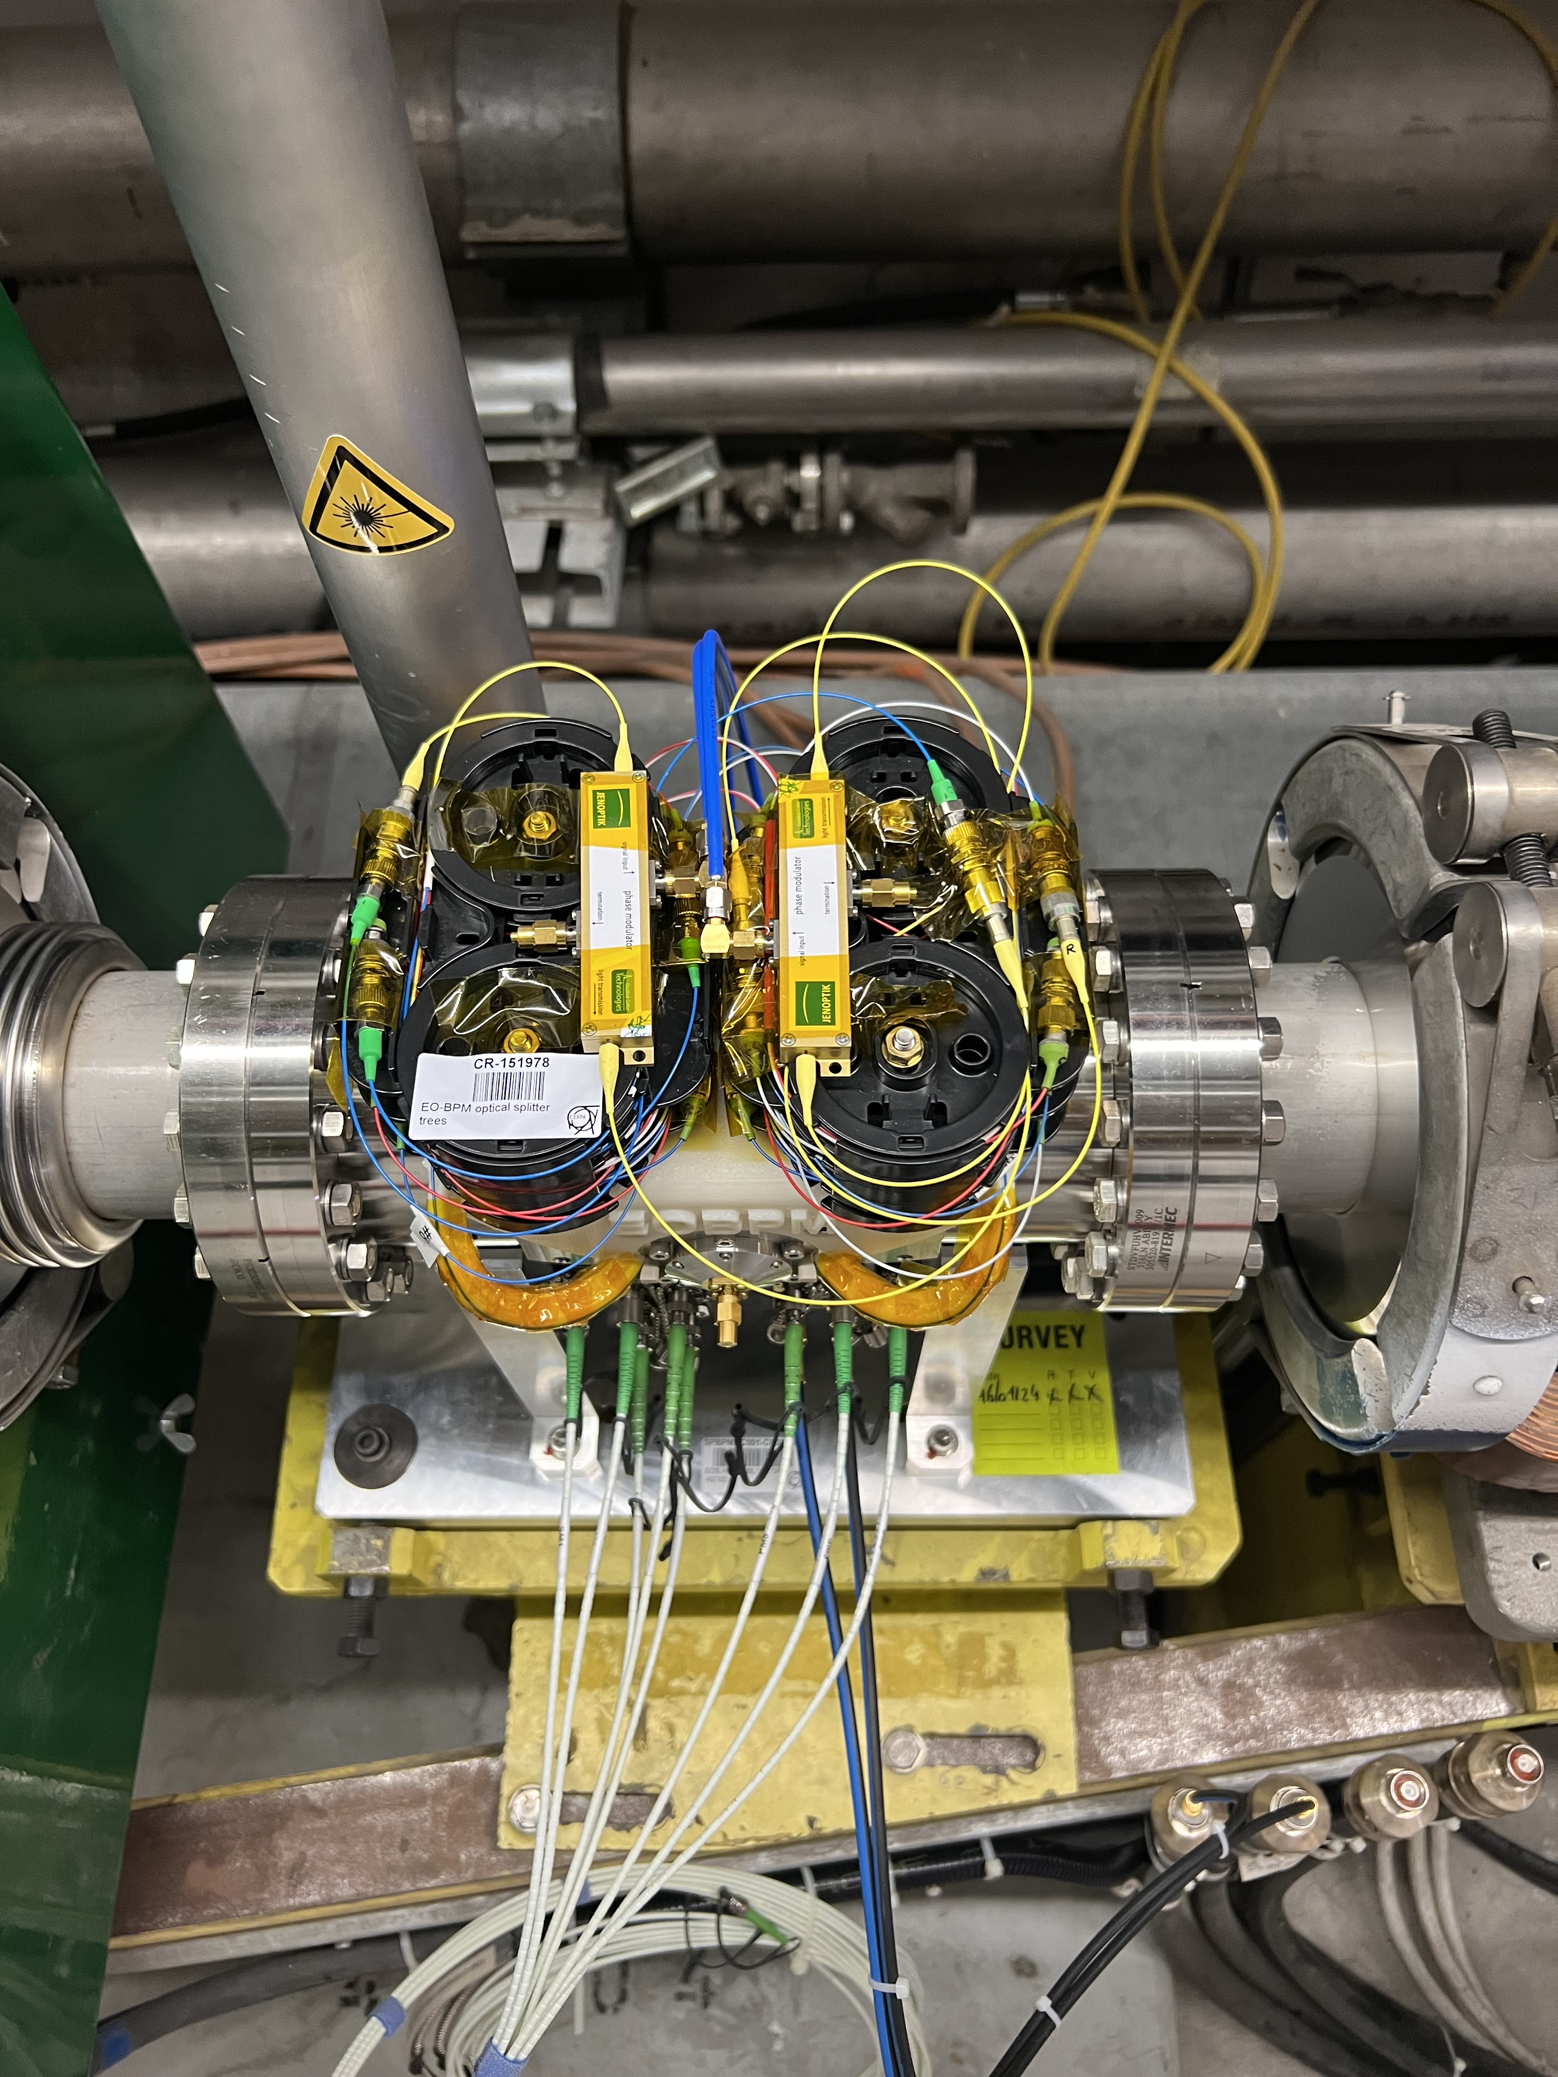
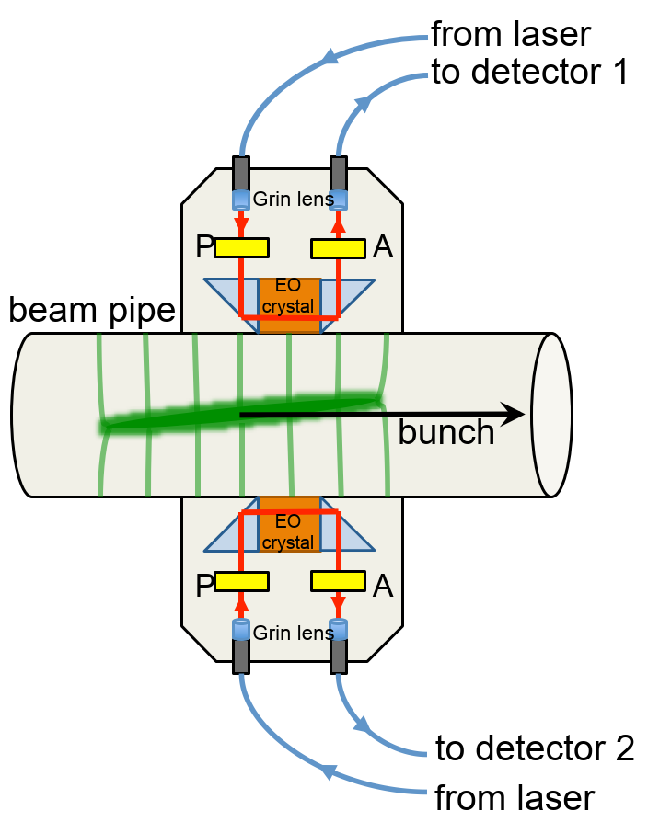
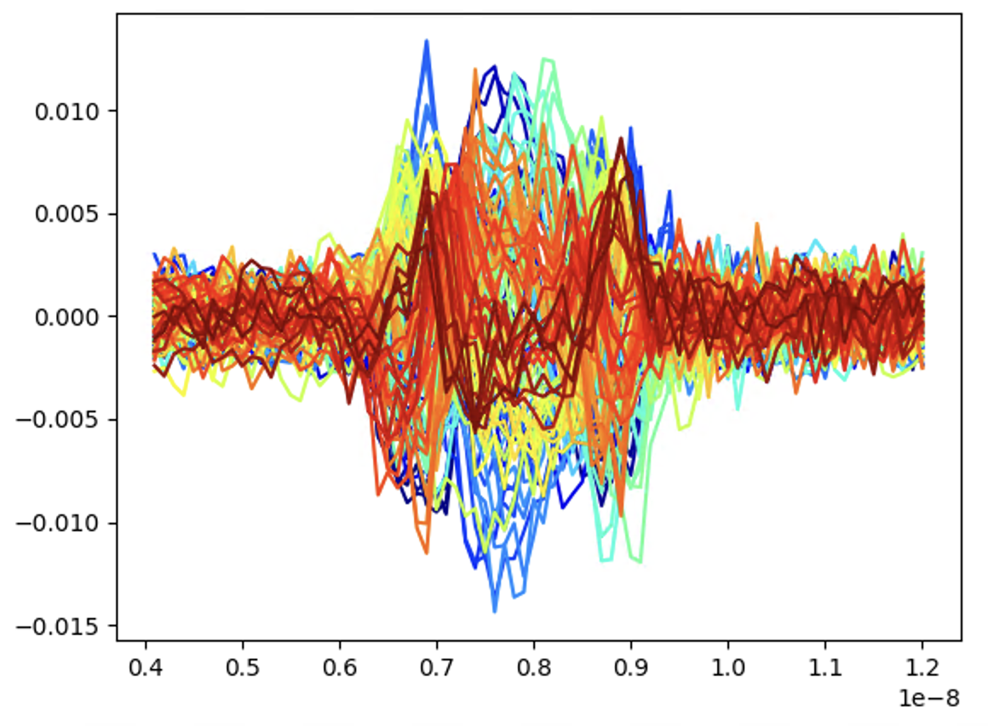
High Bandwidth BPM development plans
Developing full E-O Pick-Ups (started in 2016)
  Encoding the time varying beam signals onto a laser using birefrigent crystal (Lithium Niobate)
  Replacing cables by optical fibers
  Relying on fast detectors and fast oscilloscope
DC Laser
Talk by Max
Fast photo-detectors
Oscilloscope

Slide 9
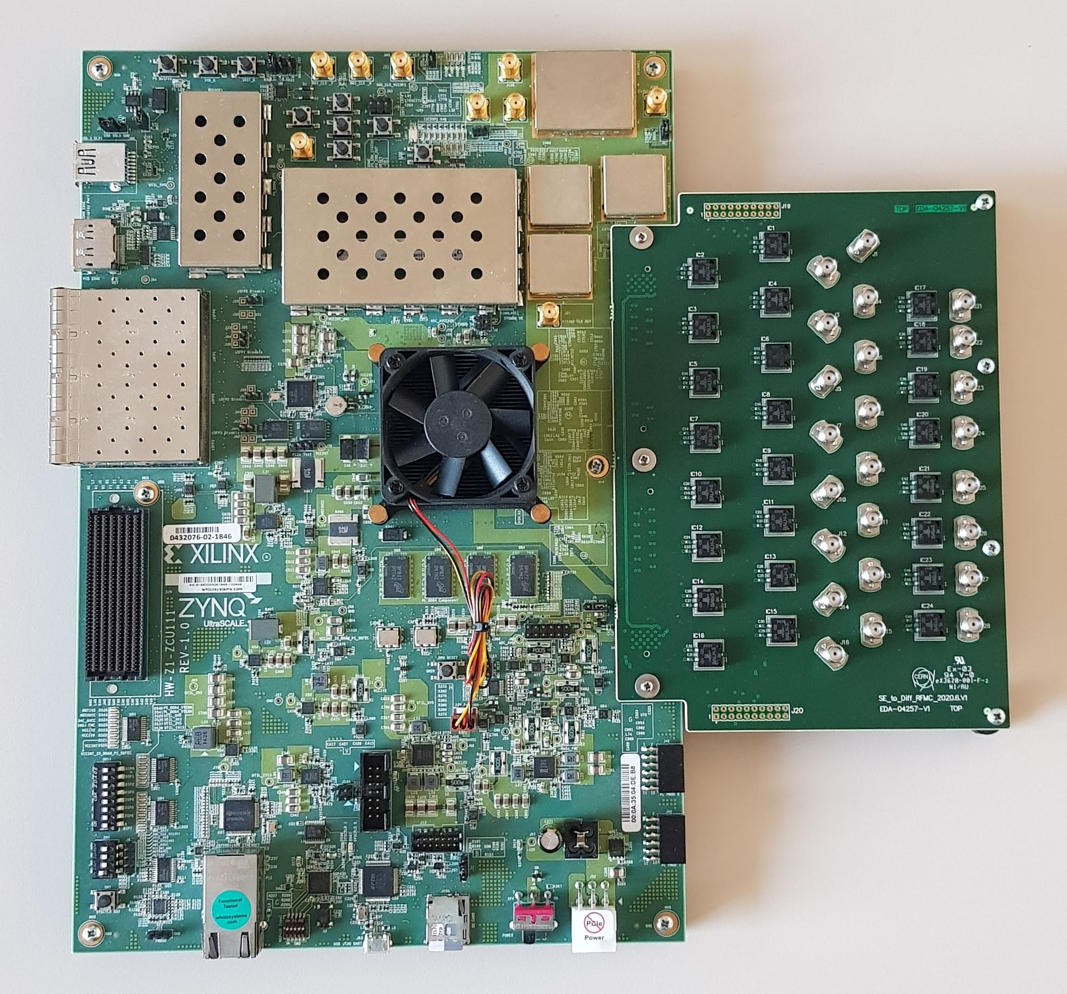
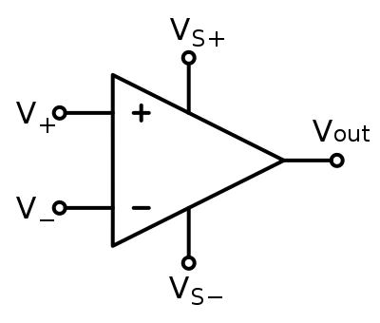
High Bandwidth BPM development plans
Developing Electro-optical Time stretch techniques
  Keeping EM BPM (i.e. stripline), possibly better performing one (higher bandwidth)
  Using electro-optical modulator to encode electrical beam signals on laser beam – optical fiber transmission
  Using chirped laser pulses to use time stretch techniques to improve the DAQ system (better and cheaper)
1ns
40MHz - 50fs
1550nm laser
3ns
40GHz E-O
Modulator
PM Fiber transport down
to the tunnel’s equipment
H⁻
H⁺
LHC stripline
BPM
1st time stretch stage
40 MHz
beam signals
Laser encoding
Located in gallery
Photon detection and DAQ
1ns
Laser-encoded beam signal
Optical Fiber back
to surface building
RFSoC at 5GSa/s
Photodiode
20ns
Located in Tunnel
2nd time stretch stage

Slide 10
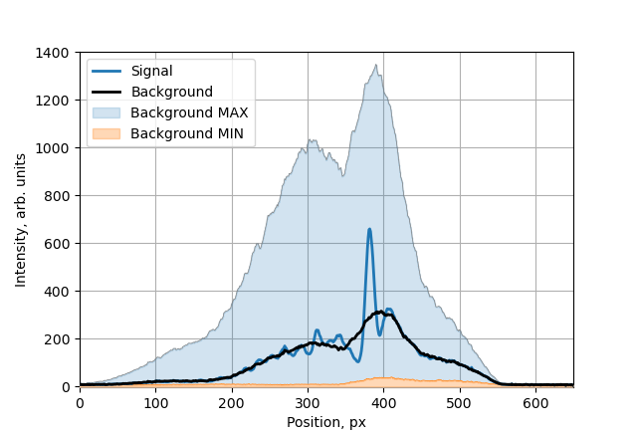
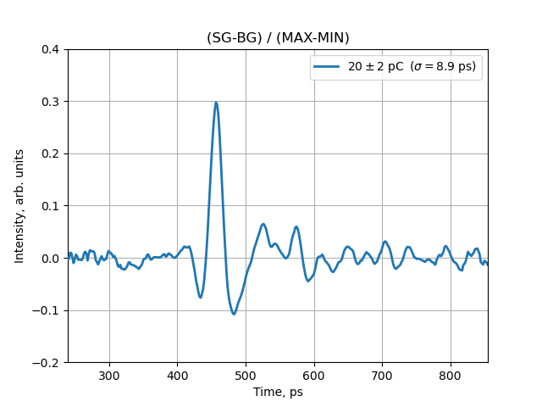
High Bandwidth BPM development plans
Developing Electro-optical Time stretch techniques
  Proof of concept test performed at CLEAR in 2024 using Time stretch at 780nm wavelength
  Validation test to be performed in 2025 on LHC stripline pick-up using Time Stretch at 1550nm (to assess the performance of longer stretching)
See: A. Schlögelhofer, invited talks @ IBIC 2024 Beijing

Slide 11
Reviewing the High bandwidth PU technology
Hilumi LHC high bandwidth BPM review – December 2024
The main goal of the review is to assess the performances and limitations of the different technologies that can be considered for high bandwidth intra-bunch position monitoring in the LHC, especially for time domain crab cavity diagnostics. The panel will review the monitor’s architecture and implementation, including both the pick-up’s design as well as its control and read-out system. The panel will be asked to assess the performance of the proposed solutions with respect to the monitor acceptance criteria (https://edms.cern.ch/document/2369610/1.2). They shall also highlight the main risks for a successful deployment of the system in the LHC during the Long Shutdown 3 (LS3), including both budget and schedule considerations.

Slide 12
Reviewing the High bandwidth PU technology
Hilumi LHC high bandwidth BPM review – December 2024
Charge Questions:
1- Does the proposed monitor’s architecture satisfy the functional specifications ?
2- Is the strategy proposed to solve the technical issues or unknowns well defined and in line with an implementation during LS3 ?
3- Are the pros and cons of the different technical solutions all well addressed ?
4- Are there changes to be considered to the functional specifications that would increase the chance of success ?
Proposed talks :
Overview of Head-tail monitoring in LHC
Overview of the HL high bandwidth functional specifications and constrains for installation
EO PU development status and plans
EM Stripline development status and plans
Time stretch EO modulators acquisition system development and plans
WP13.6 BPW – High frequency BPM project budget and schedule

Slide 13
Summary
WP13 worked on an exciting R&D program towards the development of improved high bandwidth BPM
As we are entering the final phase of the project, a technology choice must be made
Review in December 2024 will allow to identify the best system design and prepare for its implementation during LS3.

