Slide 1
Beam halo monitor – coronagraph study
Jan Pucek, D. Butti, G. Trad, E. Bravin, S. Burger, F. Roncarolo
HL-LHC collaboration week in Genoa, October 2024

Slide 2
Outline
Coronagraph – principle
BSRH status
  Current layout
  Demonstration of modes
  Important parameters
First MD (May)
  Results
Second MD (September)
  Preliminary results
Conclusions + Outlook

Slide 3
Coronagraph – principle

Slide 4
Coronagraph – principle
1. Telescope – two lenses
2. Telescope with occulter
Occulter to block the ”core”
Aperture – creates diffraction
Aperture
3. Coronagraph
Telescope provides an image of an object
In case of measuring low intensity tails, the occulter is not sufficient – diffraction created at the aperture will disturb the image
Coronagraph is an “enhanced” telescope that uses “field” lens to image the aperture on the Lyot’s stop – blocking the diffraction of the aperture
Lyot’s stop
Field lens to image the aperture onto the “eyepiece” lens

Slide 5
BSRH status

Slide 6
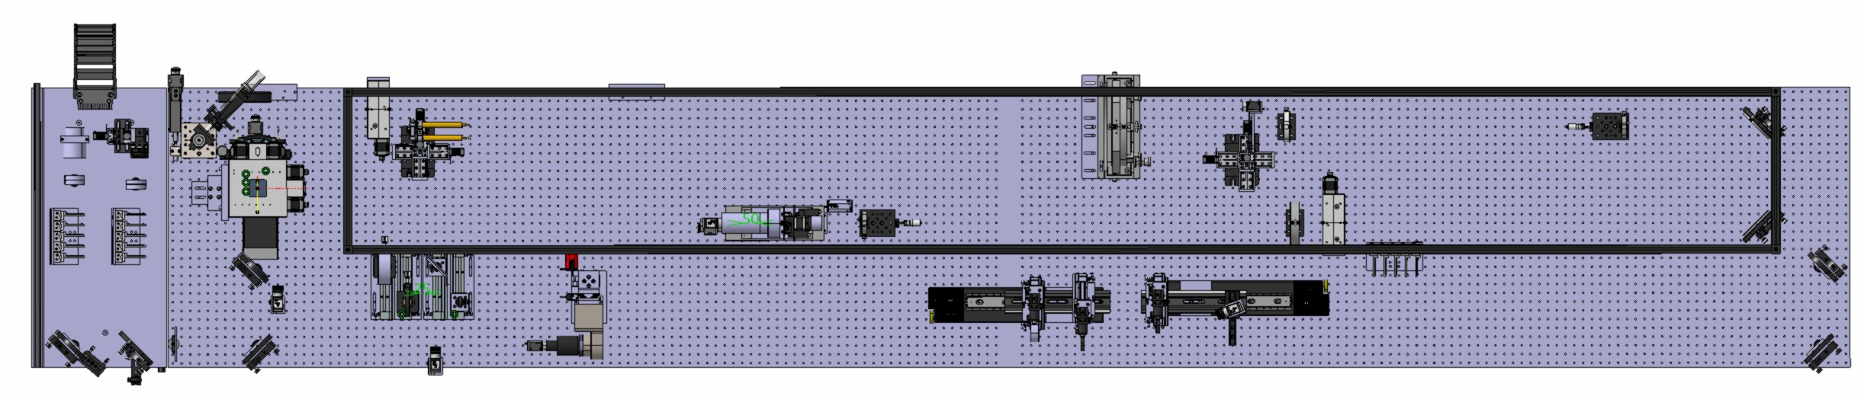
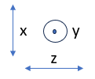
Current layout – Beam 2
Occulter (masks)
Readout camera
Lyot’s stop
Light in
Possible configurations:
Regular telescope – imaging the SR
Telescope with occulter – masking the core enables longer exposure time/gain
Coronagraph – diffraction from the beam mirror can be mitigated

Slide 7
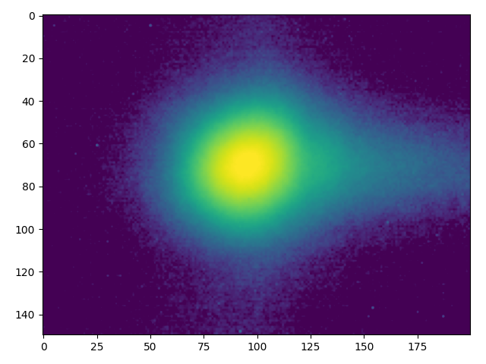
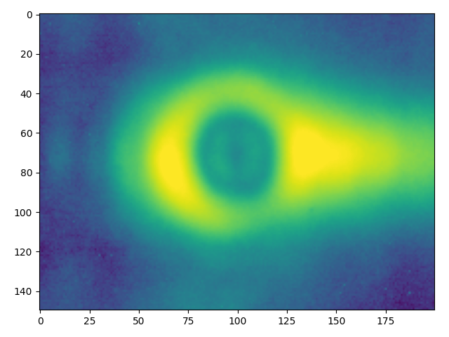
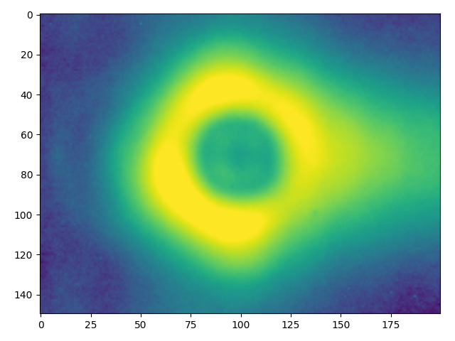
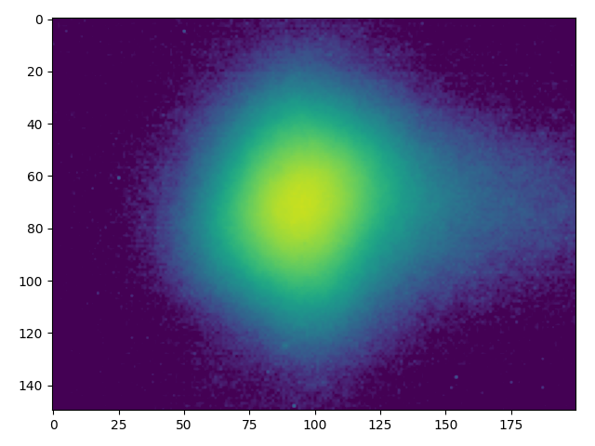
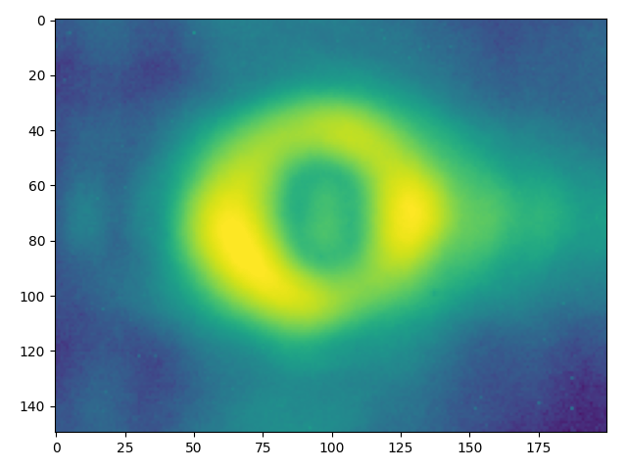
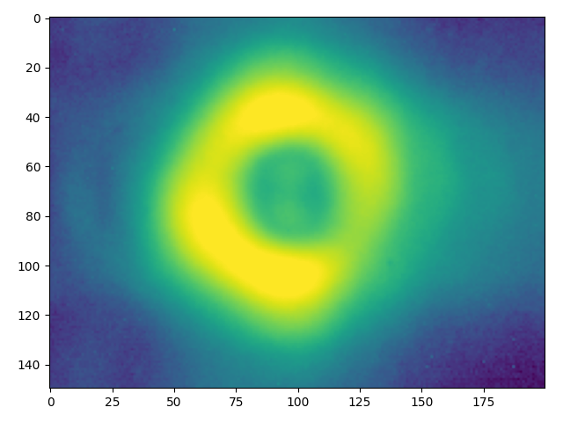
Demonstration of modes
1
Possible configurations:
Regular telescope – imaging the SR
Telescope with occulter – masking the core enables longer exposure time/gain
Coronagraph – diffraction from the beam mirror can be mitigated
2
2
1
Low 𝜀
High 𝜀
3
3
Z-axis in log scale

Slide 8
“Gating”
The camera coupled to the intensifier has the ability to be gated
gate signal
bunch
time

Slide 9
Important parameters (prepare, carry out, analyze MD)
Wire scanners BWS:
  ß_{y} = 418.23m
  ß_{x} = 185.15m
Coronagraph BSRH:
  ß_{y} = 366.63m
  ß_{x} = 193.8m
Primary collimators TCP (V):
  ß_{y} = 71.49m
  ß_{x} = 148.43m
For ε_{N} = 2.5um rad
σ_{y} = 386 um
σ_{x} = 257 um
σ_{y} = 362 um
σ_{x} = 263 um
σ_{y} = 160 um
σ_{x} = 230 um

Slide 10
First MD (May)
Analysis and Results

Slide 11
MD overview
Procedure:
Injection: Nominal, 5x Pilot, Nominal, 5x Pilot at ε = 2.5 um (nominal HL-LHC)​
Scrape the beam to 3𝜎, blow up pilots to artificially create Halo
Measure the distributions with BWS and BSRH (while testing different instrument settings)
Changing the beam and the instrument + few machine related problems, gave us direction for 2nd MD
Saved over 12 000 datapoints, only ~2000 in steady condition (1 blow-up scan in V plane)

Slide 12
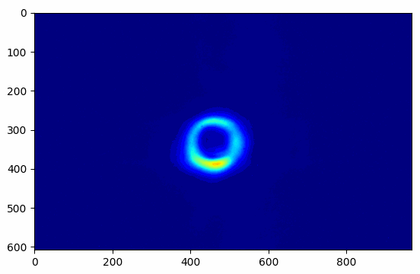
BSRH – data video
Important to notice: Unstable position of the distribution→ changing the integration limits of the HALO
Our suspition is that it was caused due to coherent beam centroid oscillations induced by the ADT

Slide 13
Analysis procedure
BWS
  Fit data with a Gaussian distribution (obtain the center of the distribution)
  Calculate the integration limits
  Normalize the data by the FBCT measurement
  Integrate the data to obtain the charge in the halo region
BSRH
  Create projections from the 2D image
  Fit the projections outside the mask with a Gaussian distribution (obtain the center of the distribution)
  Calculate the integration limits
  Normalize the data with the charge-to-count scaling factor (w_{q})
  Integrate the data to obtain the charge in the halo region

Slide 14
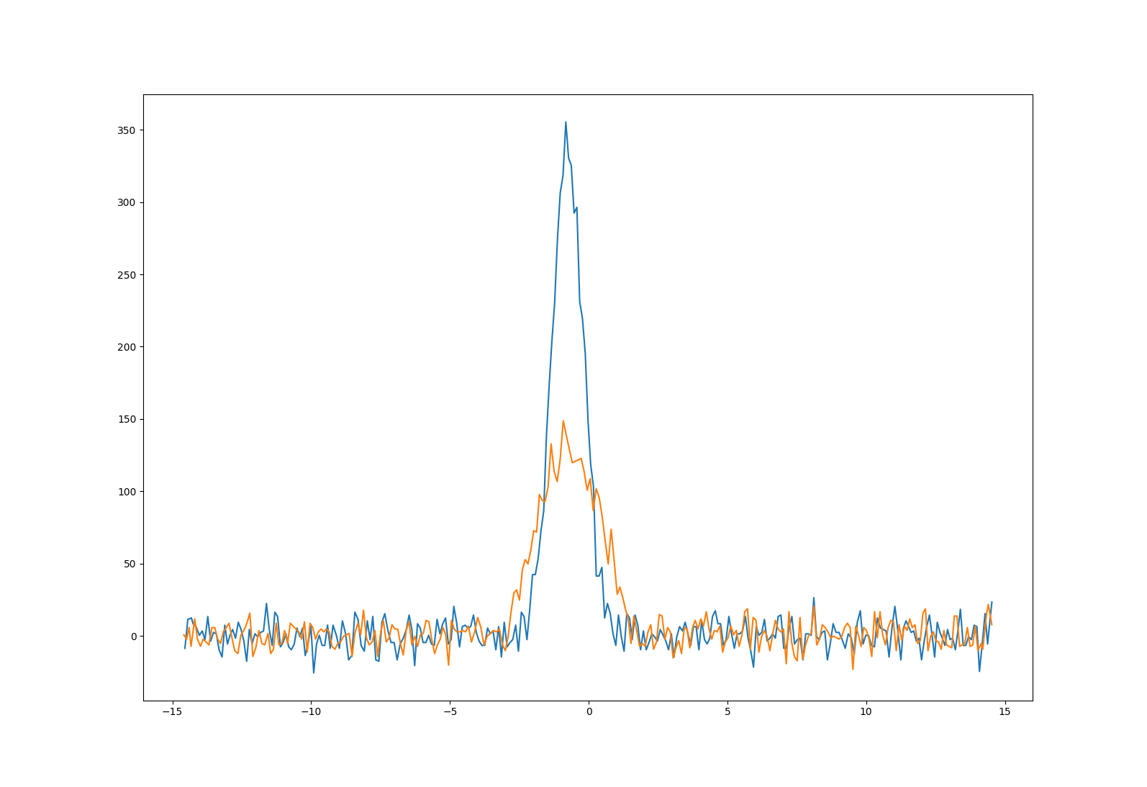
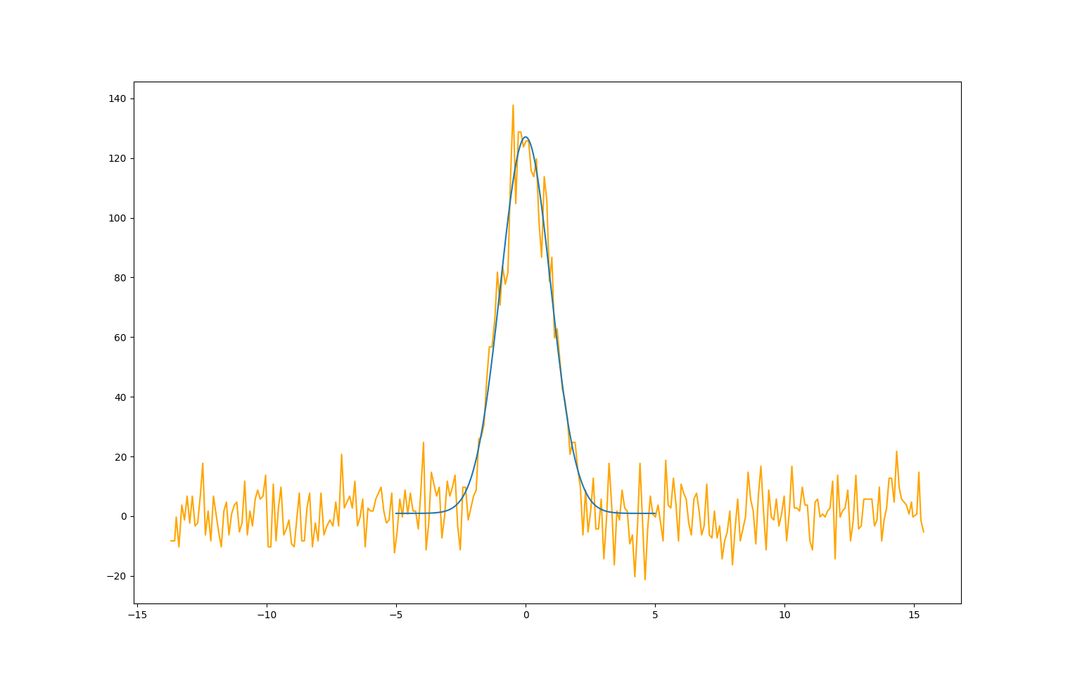
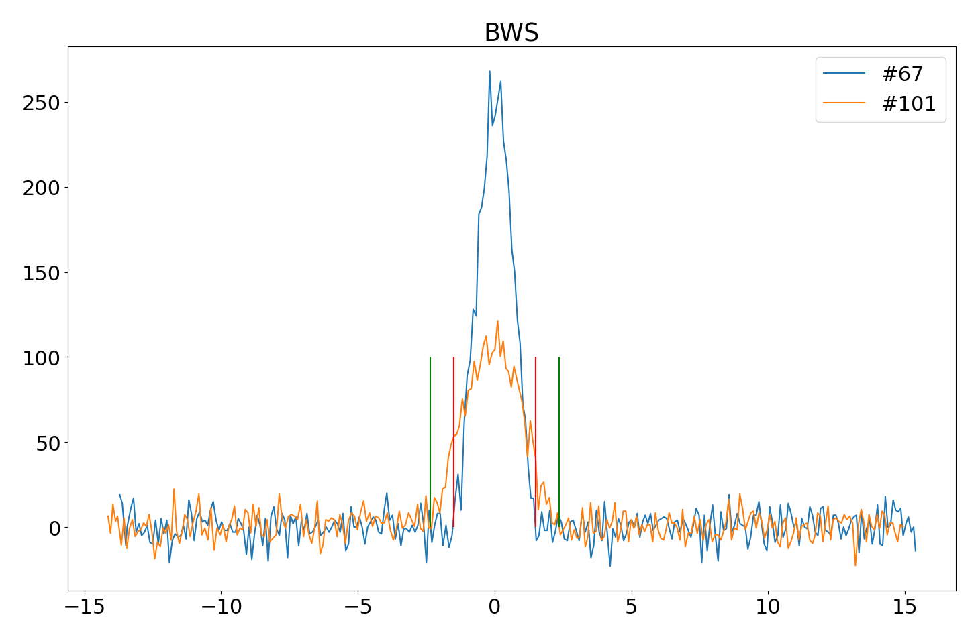
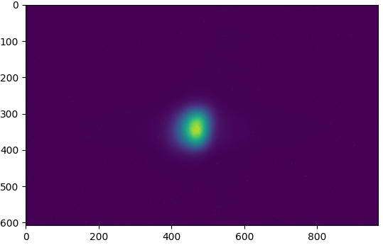
Illustration of the analysis procedure
BWS
Integration region
Raw data
Gaussian Fit
BSRH
Raw data
Projection + Fit
Scaling factor
Integration region → Charge in halo

Slide 15
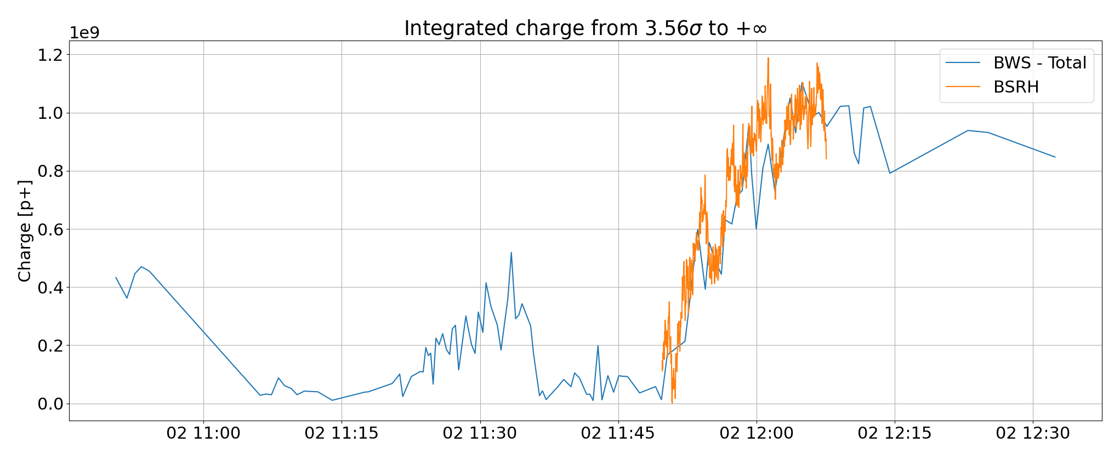
Results – summary plot
Blow-up
Scraping
Blow-up
ADT stopped
Scraping
Measurement in V plane only!
Another MD was dedicated to verify the performance with respect to the functional specifications
+ increase the resolution of the BWS

Slide 16
Results
BWS – raw data to charge scaling done at beginning (with FBCT),kept constant
+ no bg substraction
BSRH – charge scaling done once at beginning without occulter,then kept constant
+ bg substraction = last point of scraping used as 0
The two instruments agree in absolute and relative measurement (total charge outside 3.5𝜎_{r}), one division on the graph = 2e8 p⁺
Blow-up
ADT stopped
Measurement in V plane only!

Slide 17
Second MD
Overview
Preliminary results

Slide 18
MD overview
Procedure:
  Injection: 20x Pilots (𝜀 = 2.5 um rad), 4x Pilot (high 𝜀), 4x Pilot (low 𝜀)
  Measure the PSF and magnification of the BSRH, increase the PMT gain of the BWS
  Scrape the beam (to obtain the background light yield), blowup individual pilots to provide limits of the charge resolution in the region from 4.7 to 6.7 𝜎
  Acquired 17 000 measurements, with at least 2 scans per plane, ~12 000 measurements to be analysed!
Analysis:
  The same analysis performed as with the previously acquired data

Slide 19
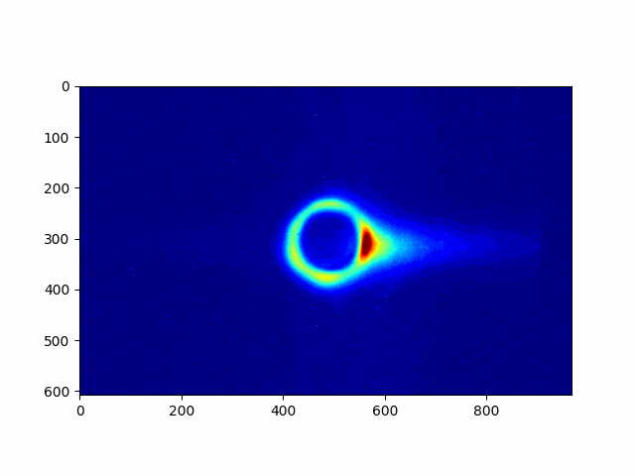
BSRH - video
More stable?
High octupole settings and different chromaticity

Slide 20
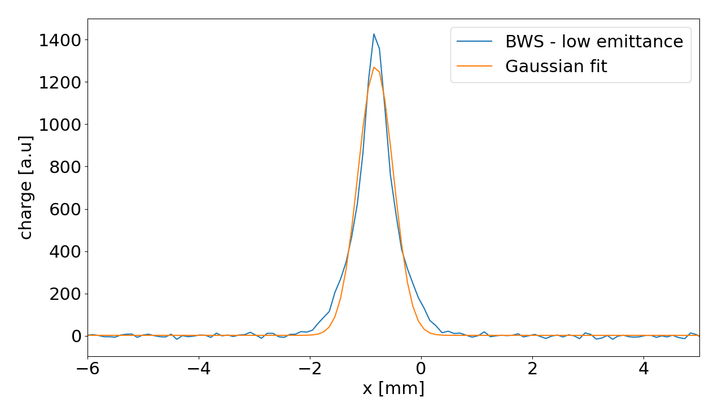
Preliminary results
Setup (alignment, occulter change etc.) of the BSRH was fast+easy, used experience from 1st MD
Measured magnification and PSF (under the assumption of profiles being Gaussian)
  In H: magnification = 0.589 (pixel size= 19.9 um/px), 𝜎_{PSF} = 438 um
  In V: magnification = 0.514 (pixel size = 22.8 um/px), 𝜎_{PSF} = 453 um
Measured charge scaling
  This seems to be problematic – changes with the gate length, for n_{b} > 5: w_{q} = 44.5 p⁺/count
  Currently under discussion with the manufacturer of the image intensifier
Low emittance ones are not Gaussian (from BWS)
From target measured ~350 um

Slide 21
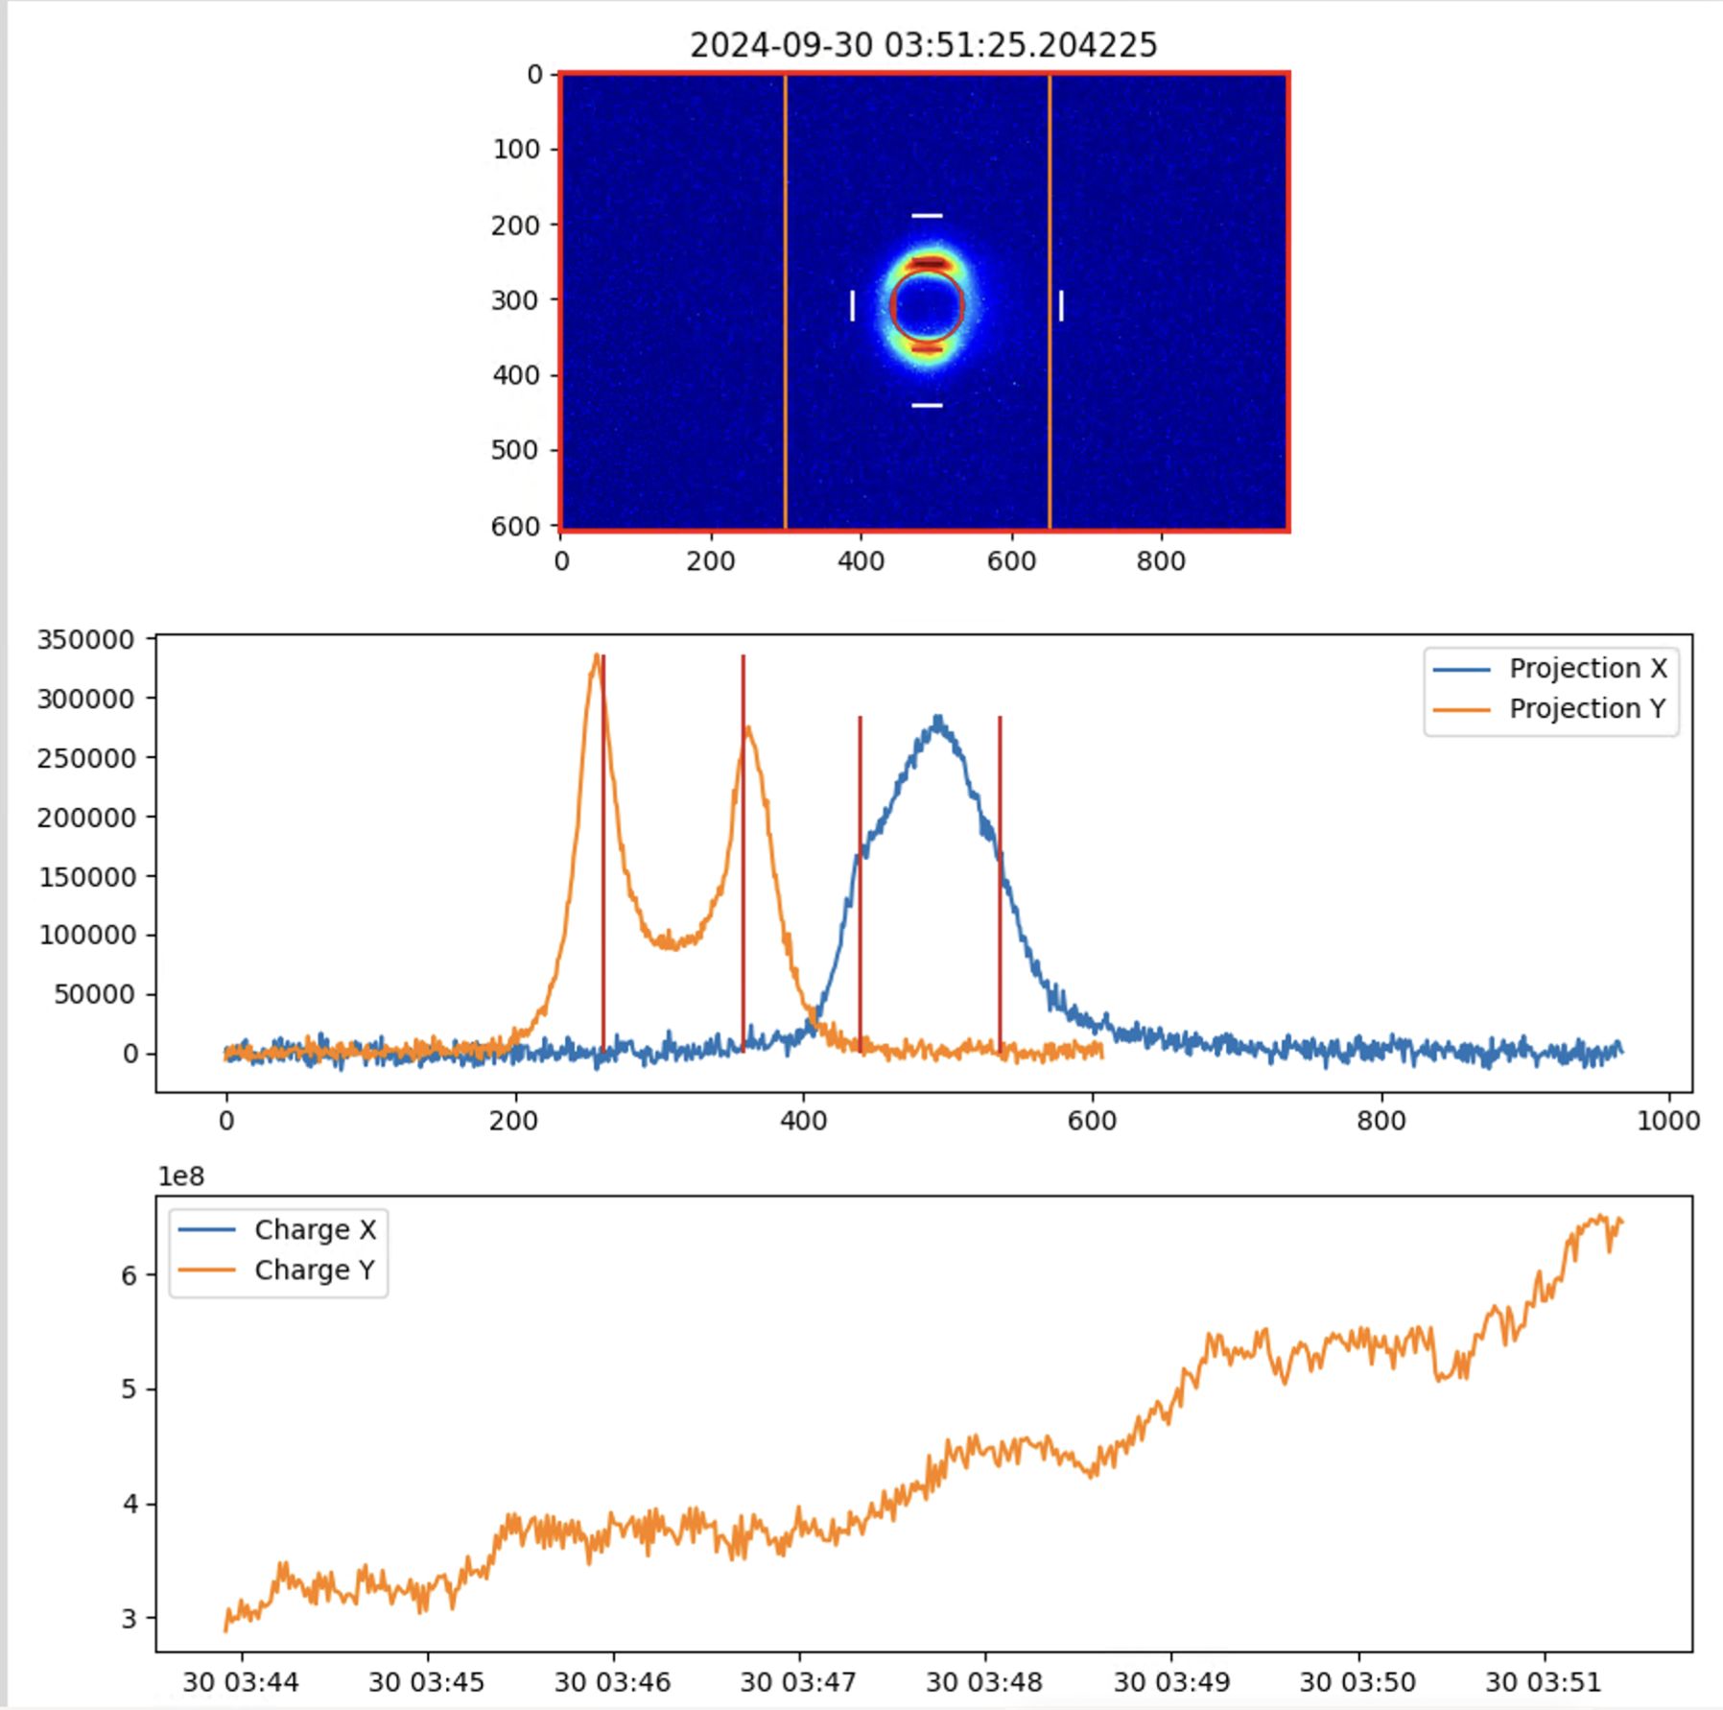
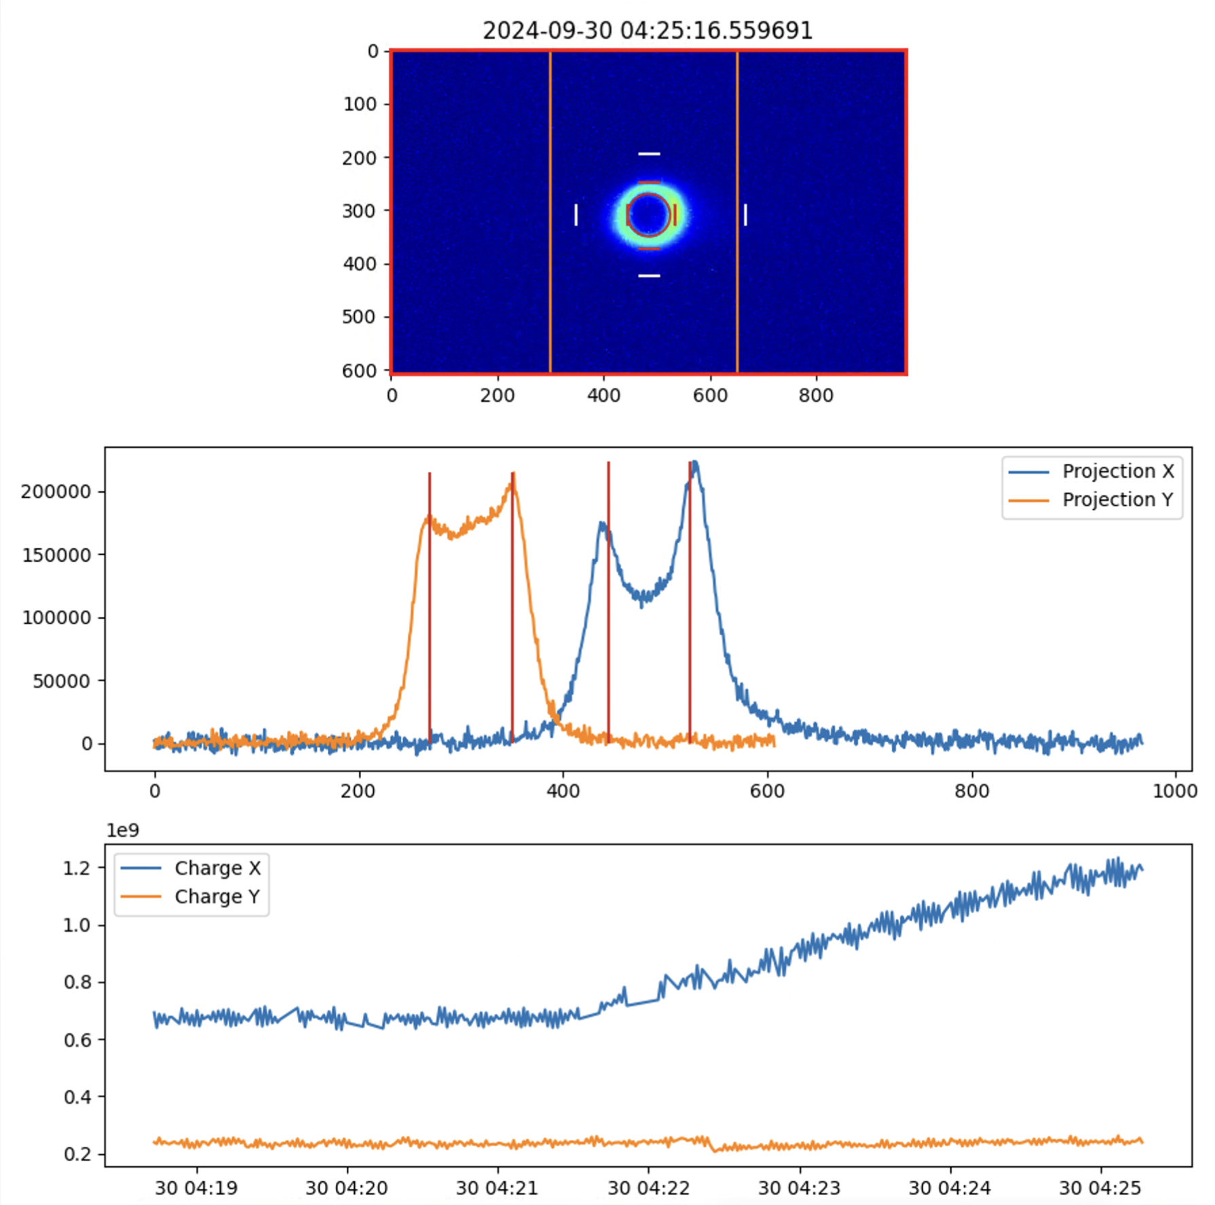
Preliminary results
Single pilot blowup in V
Single pilot blowup in H
BSRH results must be compared to BWS and FBCT → in progress

Slide 22
Two MDs in short
After a challenging first MD data analysis, we identified that:
  Correcting for beam position oscillations to consistently determine beam halo boundaries
  Calibrating BSRH raw images vs FBCT
are two essential ingredients to prove agreement between BWS and BSRH
During second MD a real-time analysis of each scan gave inputs for the following ones
  Complete analysis ongoing

Slide 23
Conclusions
Same trend measured with BWS and BSRH – agreement within ≈1e9
  Issue: Assess BG without scrapping
The image intensifier is the limitting piece of equipment (by design, additional gating problems in case the system is made operational)
Coronagraph is complex – could the measurement be performed using occulted BSRT?
Next steps:
  Analyse all the data from the second MD
  Study the gains in case of second SR extraction line
  Provide a solution to the intensity problem
  Review of Beam Halo Monitor (provide decision on used technology)

Slide 24
Thank you for your attention

Slide 25
Backup

Slide 26
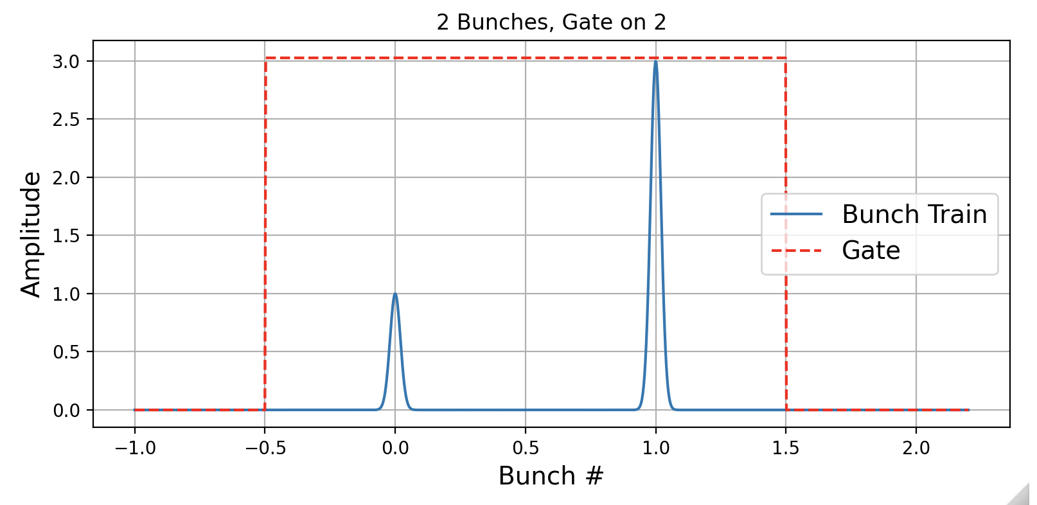
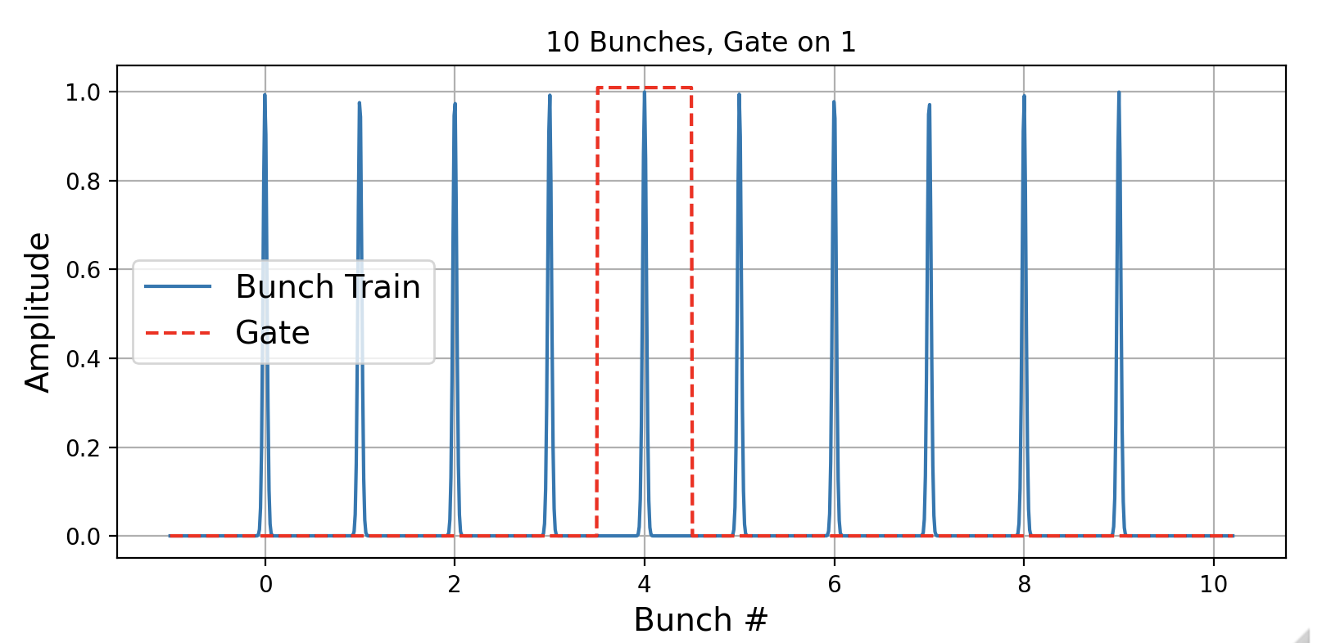
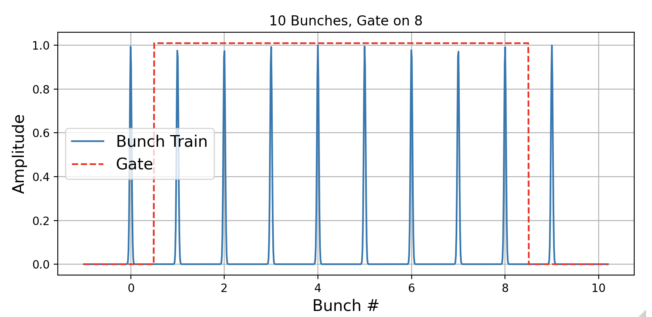
Gating example
MD1
MD2

Slide 27
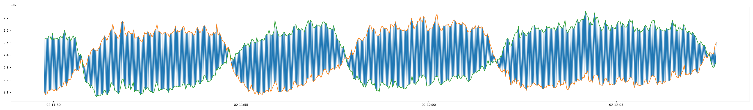
BSRH intensity problem
±10% intensity oscillation due to finite capacitance of the intensifier – only possibility is to calculate the moving average (or provide different engineering solution)

