Slide 1

Update on the Beam Gas Ionisation (BGI) Profile Monitor
14th HL-LHC Collaboration Meeting
Genoa - 9th October 2024
J. Storey, W. Andreazza, D. Bodart, H. Bursali, G. Cabrera, W. Devauchelle,
G. Le Godec, S. Jensen, J. Joul, G. Khatri, M. Mclean, C. Pasquino, M. Teresa Ramos Garcia
Thanks to: M. Navarro Baeza, C. Fleisig, S. Gibson, M. Gonzalez Berges, S. Jackson, S. Levasseur, T. Lefevre, H. Sandberg, G. Schneider, R. Veness, C. Vollinger

Slide 2
Outline
Introduction
  Functional Specification
  Principle of Beam Gas Ionisation (BGI) Profile Monitor
BGI Design Studies
  Field Cage & Ionisation Electron Detector
  Impedance Studies
  Magnet
  Integration
  Expected Performance
PS & SPS BGI Experience & Implications for LHC BGI Design
  Performance of the PS & SPS BGI’s
  Technical Issues: Readout Architecture & EMI
Milestones & Timeline

Slide 3
Functional Specification
Independent measurement of transverse beam profile evolution throughout the acceleration cycle.
Original functional specification “Measurement of the Beam Transverse Distribution in the LHC Rings (LHC-B-ES-0006)”, reviewed at “LHC Beam Size Measurement Review” (Oct. 2019.)
Specifications for HL-LHC:
Beam measurements (average over all bunches)
Accuracy (systematic error) < 5%;
Precision / reproducibility of about ~1%;
Frequency > 10 Hz.
Bunch-by-Bunch measurements
Precision / reproducibility of about ~1%;
Frequency < 1 min. for all bunches.

Slide 4
Principle of Operation
Beam ionises residual gas;
Ionisation electron accelerated & transported by electromagnetic fields onto detector;
Electron detector = Timepix3(/4) Hybrid Pixel Detector.

Slide 5
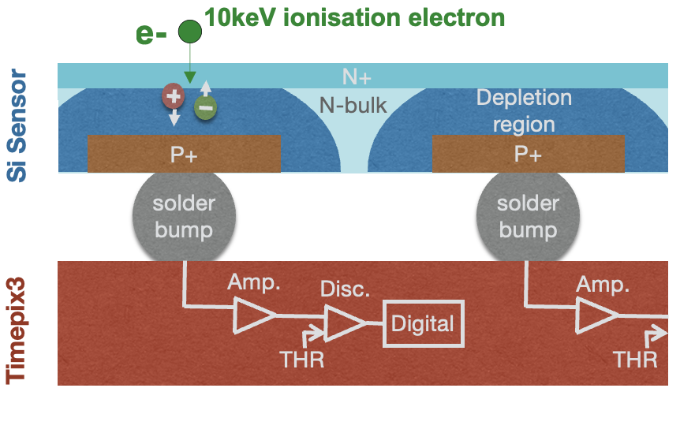
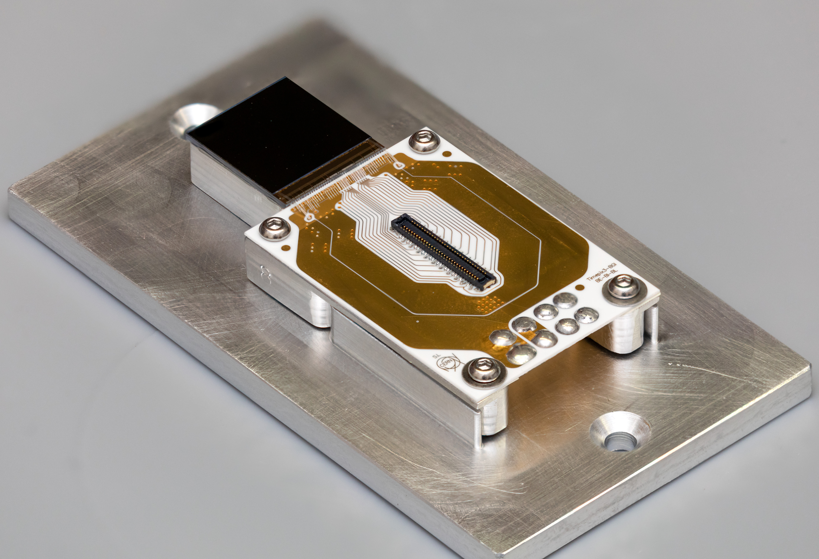
Ionisation Electron Detection with Timepix3/4
Timepix3(/4) Hybrid Pixel Detector optimized for 10 keV electron detection inside the beam pipe
Charge > Threshold → Event, consisting of:
Pixel position → Where (σ_{position}< 16 um)
Time of Arrival (ToA) → When (σ_{time}=1.6 ns / 200 ps for TPX4)
Time-Over-Threshold (ToT) → ~Energy
Single electron detection & digitisation directly inside the beam pipe.
Ref. Medipix Collaboration

Slide 6
Beam Profile Measurement
Measure beam profile by counting the number of ionisation electrons detected in each column.
Refs. IBIC 2017, IBIC 2019, IBIC 2021

Slide 7
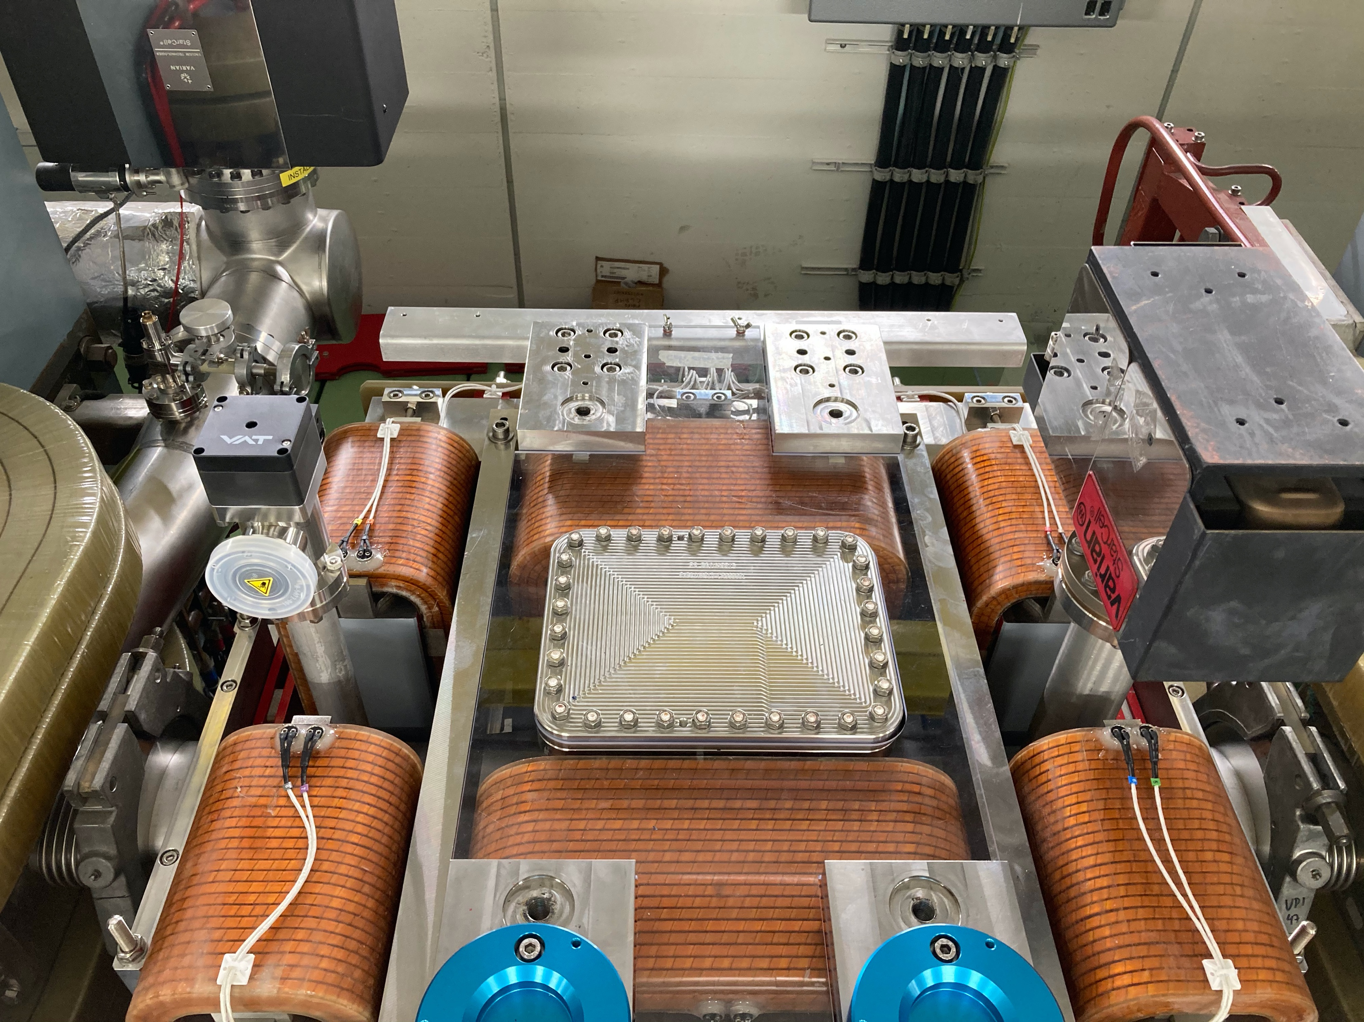
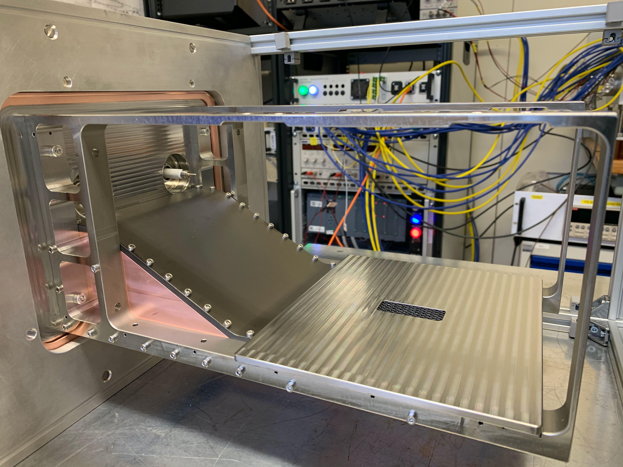
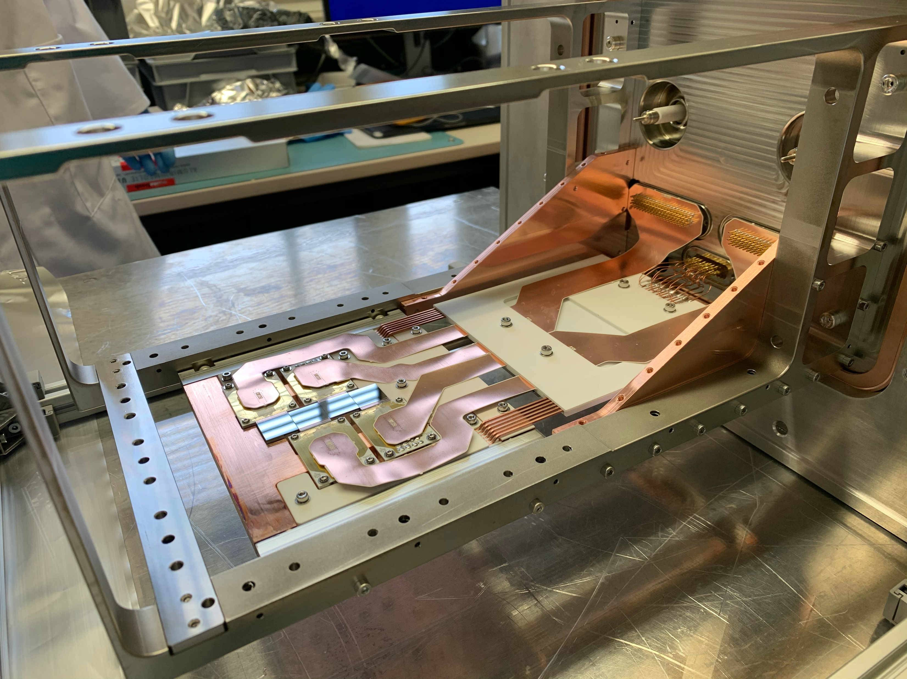
Existing BGI’s based on Timepix3
PS BGI-Horizontal & BGI-Vertical profile monitors installed in LS2
SPS BGI-Horizontal installed during YETS 23/24, SPS BGI-Vertical to be installed YETS 24/25
PS BGI-Vertical
Field cage + Faraday cage
UHV compatible Timepix3 electronics

Slide 8
LHC BGI (2007-2018): MCP/Optical Based
BGI’s were originally installed in the LHC, but removed in 2017/18 due to damage to the instruments caused by beam induced heating.
Original design based on detection of ionisation electrons with a Microchannel Plate (MCP) + Phosphor Screen + Optics + Intensified Camera.
Technical Limitations:
Impedance no problem for beam, but 260W power into instrument;
Inhomogeuous ageing of MCP / Phosphor / Intensitifed camera
Performance Limitations:
Distortion to measured profile at E>4 TeV;
Not an independent measurement, due to need to cross-calibrate with BWS to remove optical aberations (PSF of optics).

Slide 9
HL-LHC BGI: Timepix Based
Compact design based on direct detection of ionisation electrons inside the beam pipe with a Timepix HPD. Electrons guided to detector with 0.6T magnetic field.
Technical Limitations (HL BGI solution):
Impedance no problem for beam, but 260W power into instrument; → Compact low impedance design with active cooling.
Inhomogeuous ageing of MCP / Phosphor / Intensitifed camera. → Replaced with Timepix3/4 HPD.
Performance Limitations (HL BGI solution):
Distortion to measured profile at E>4 TeV; → Higher strength guiding magnetic field.
Not an independent measurement, due to need to cross-calibrate with BWS to remove optical aberations (PSF of optics).→ Direct detection inside beam beam pipe (no optics.)

Slide 10
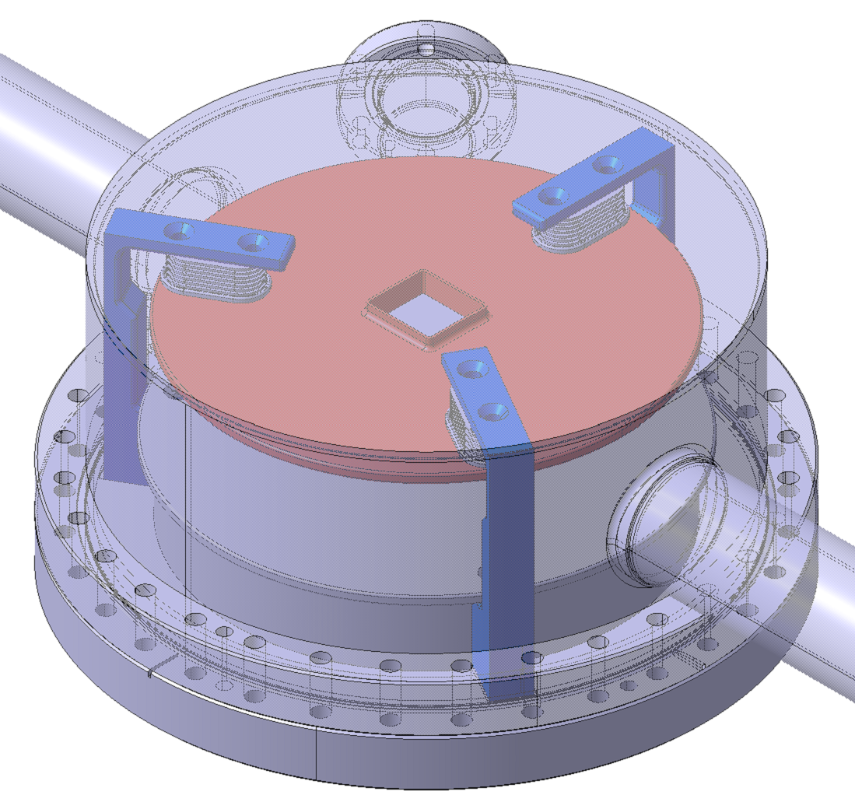
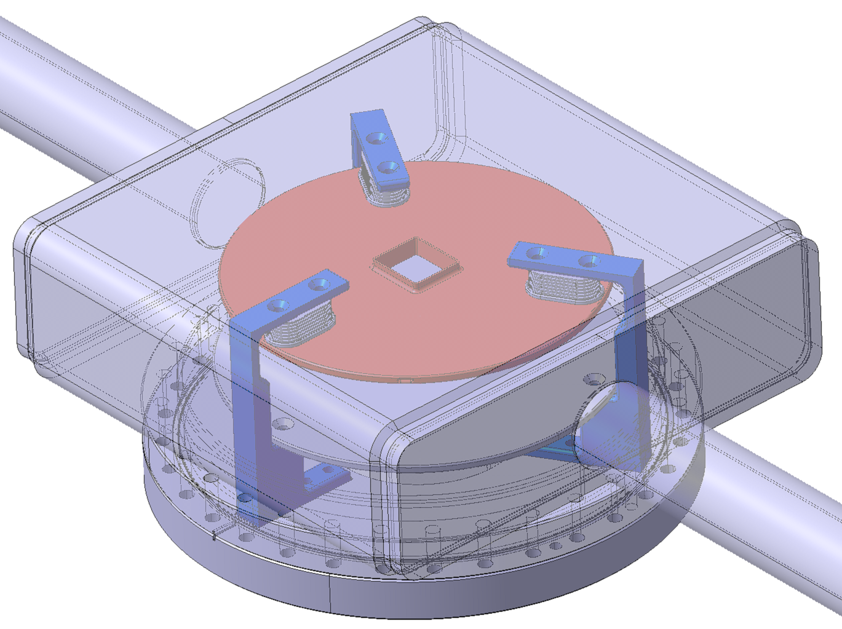
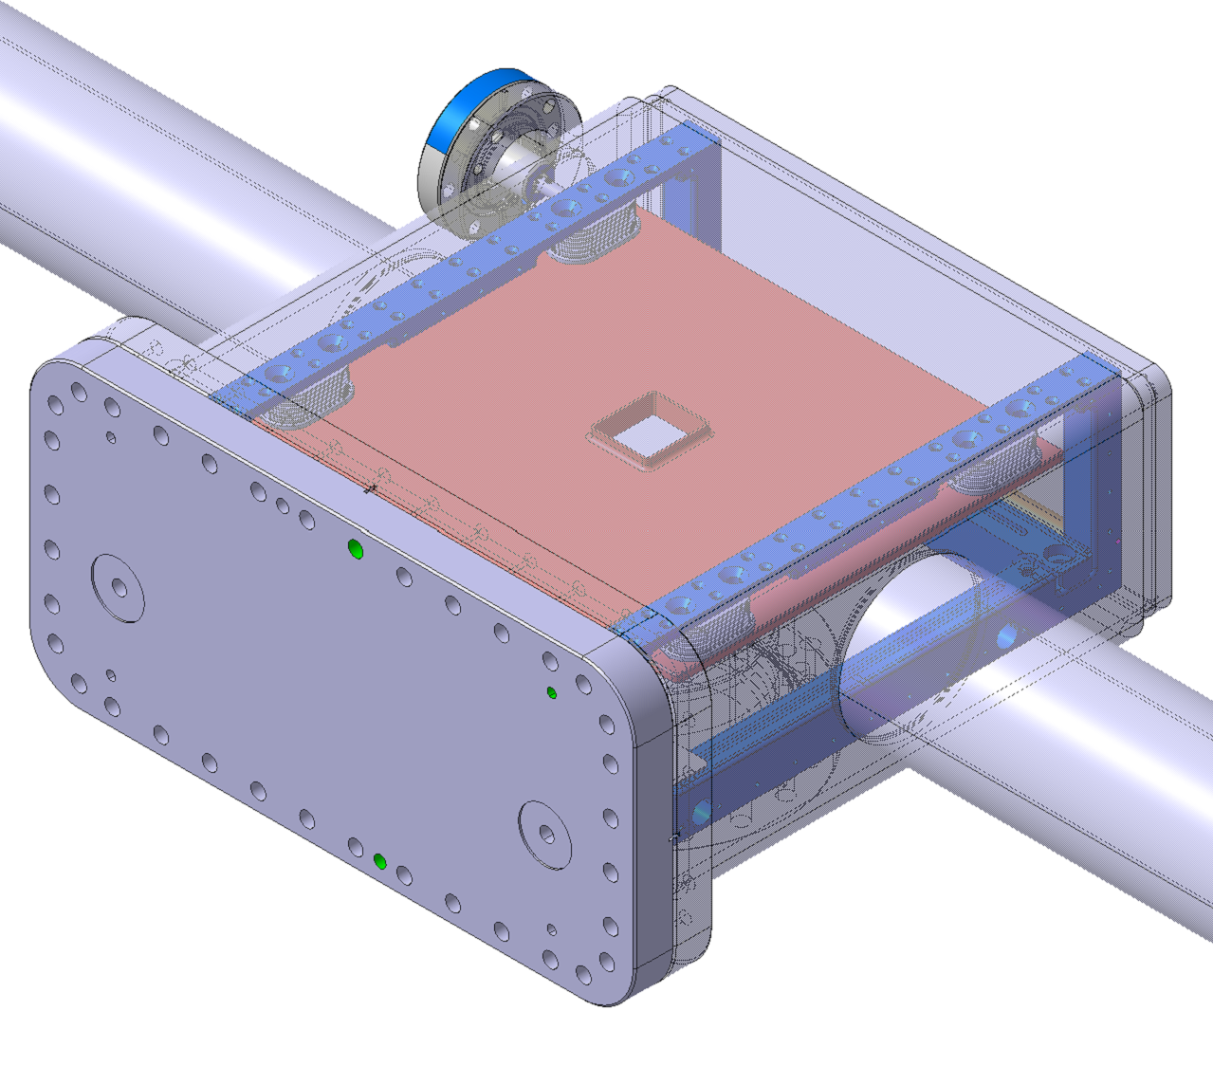
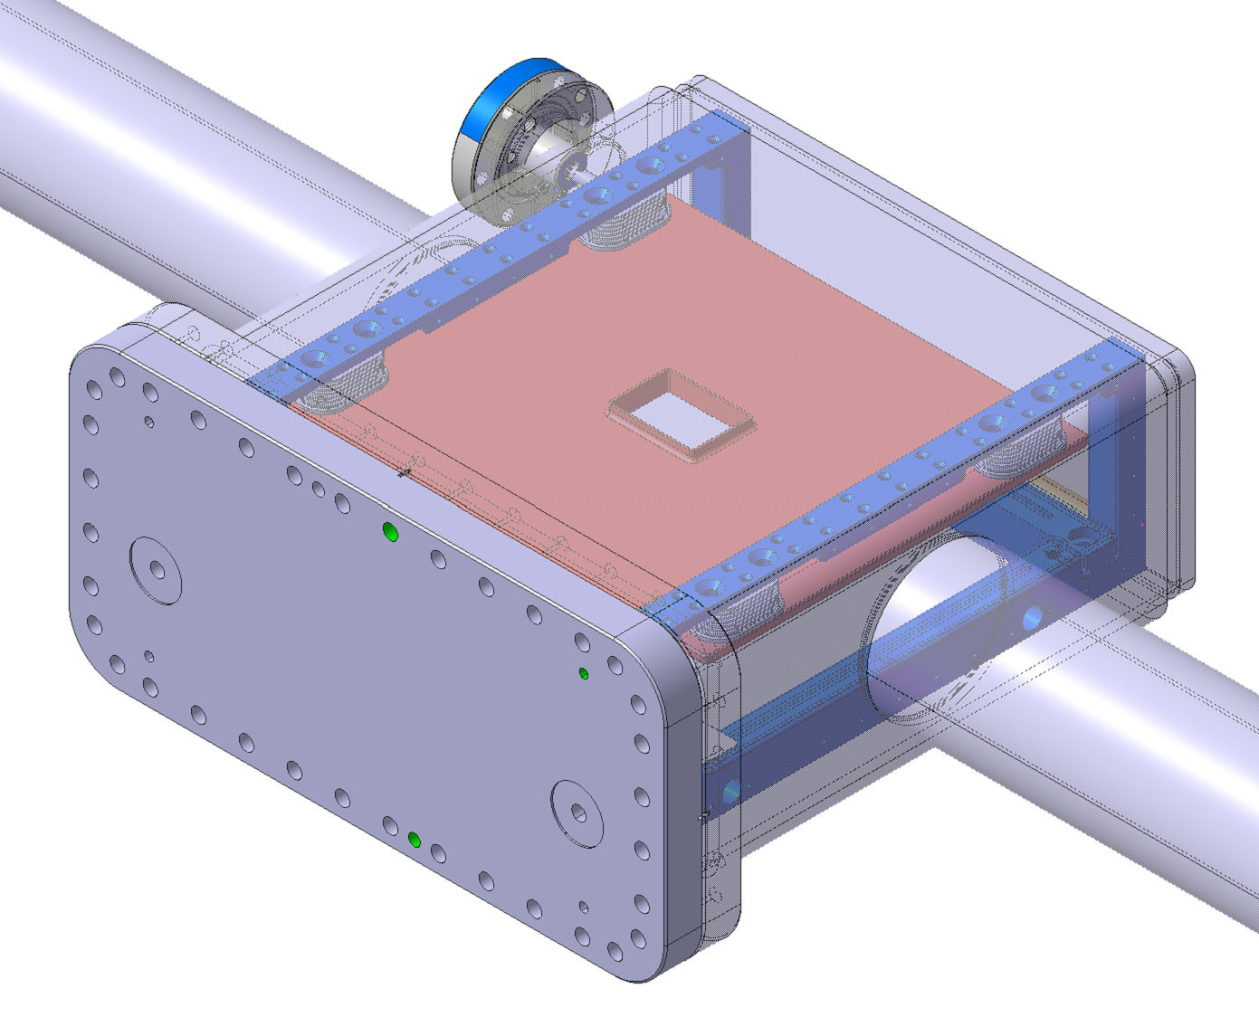
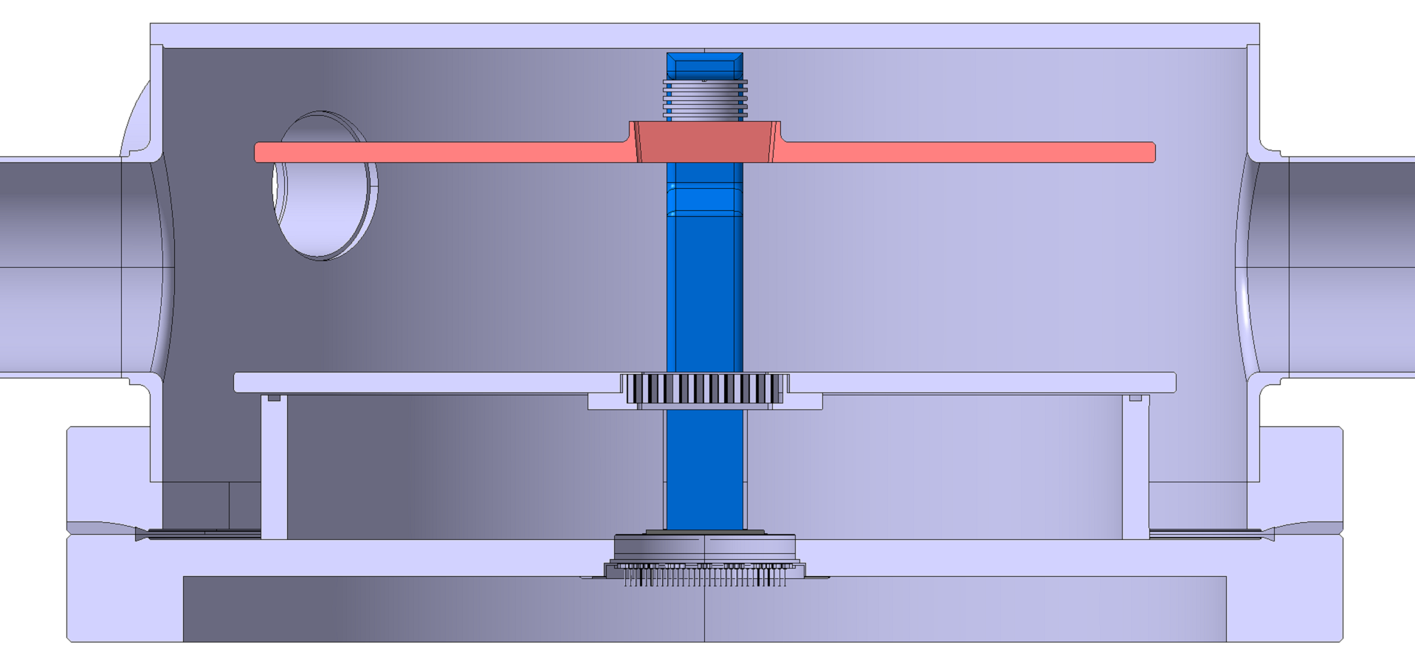
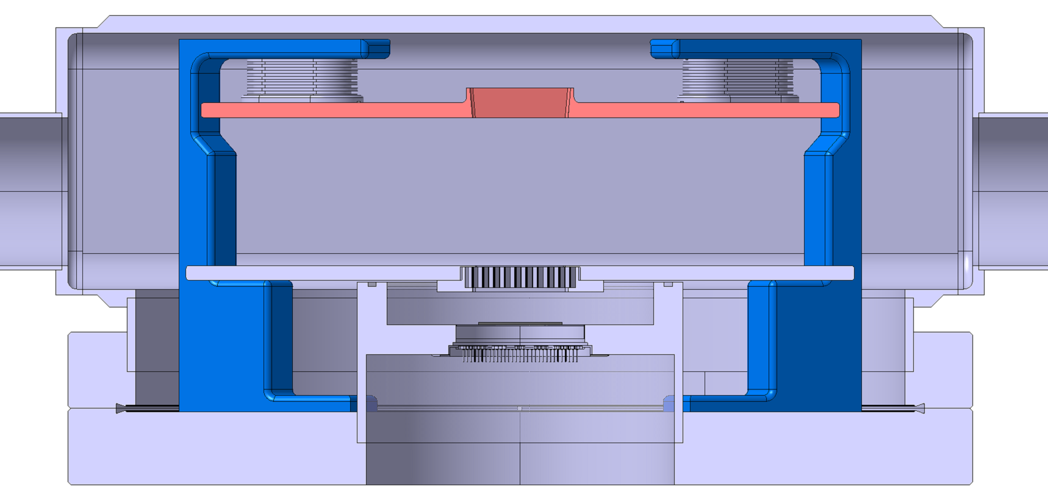
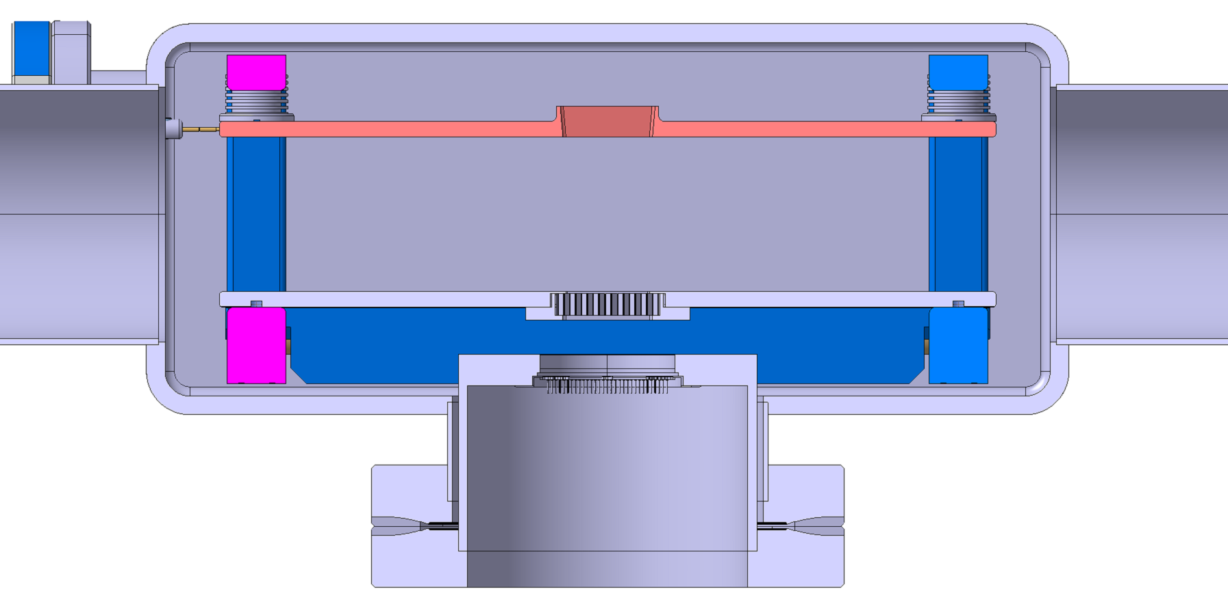
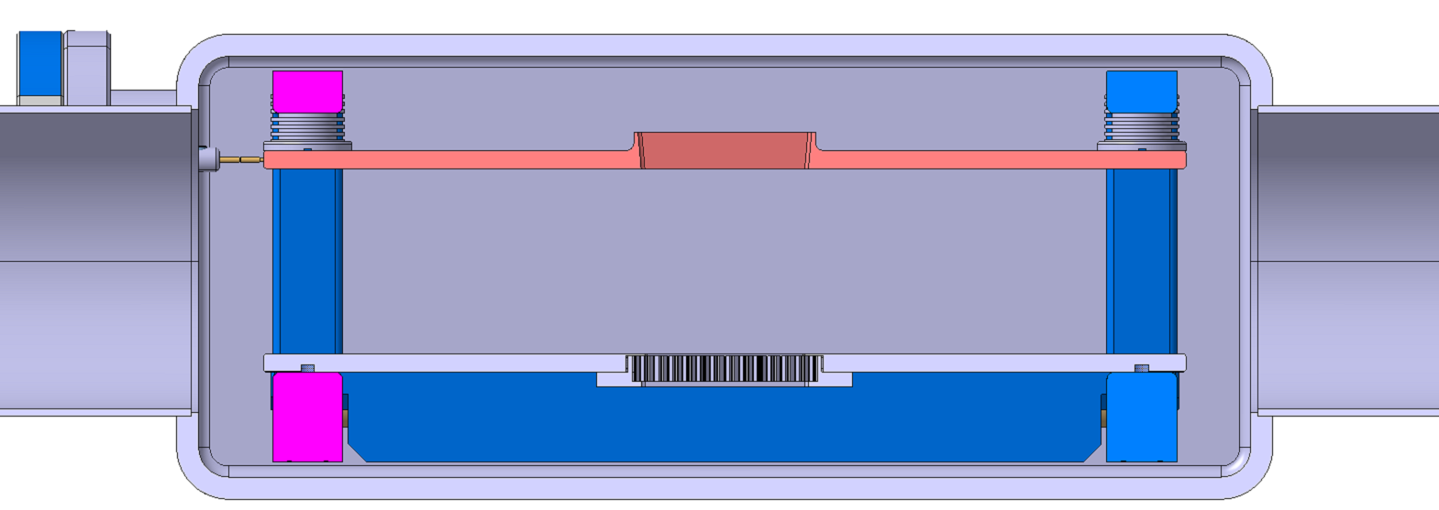
HL-LHC BGI Design Studies
Circular Flange |  | Rectangular Flange
Circular chamber | Rectangular chamber | Rectangular chamber | Rectangular chamber
Timepix4 | Timepix4 | Timepix4 | Timepix3 or 4
1
2
3
4
Ref. M. Teresa Ramos Garcia, HL-LHC BGI Design Review

Slide 11
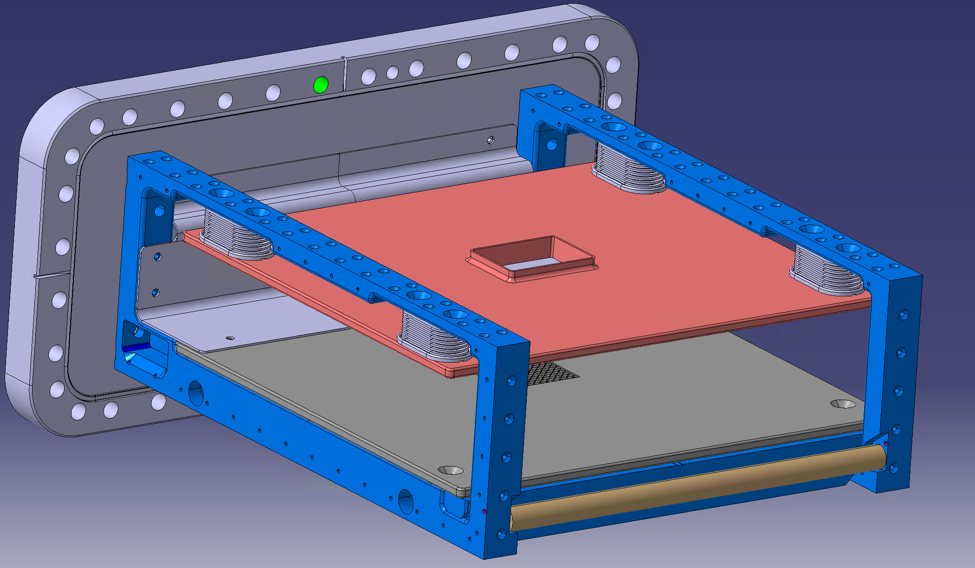
HL-LHC BGI Instrument Design
Instrument mounted on rectangular flange
Cathode with ion trap (-30kV)
Baseline evolution of PS & SPS BGI design.
Familar design with known, but hopefully improvable, limitations.
Beam aperture restriction = 50 mm.
Compatible with both Timepix3 & Timepix4.
beam
Faraday cage for Timepix electronics
RF damping rods

Slide 12
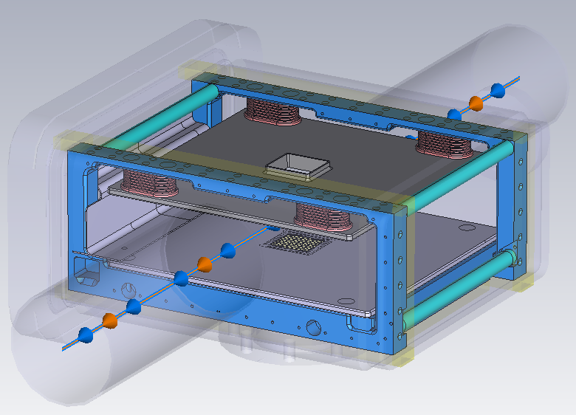
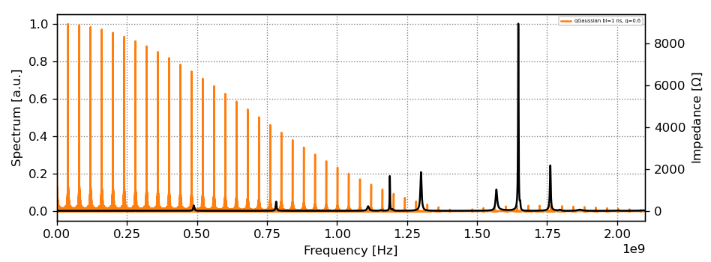
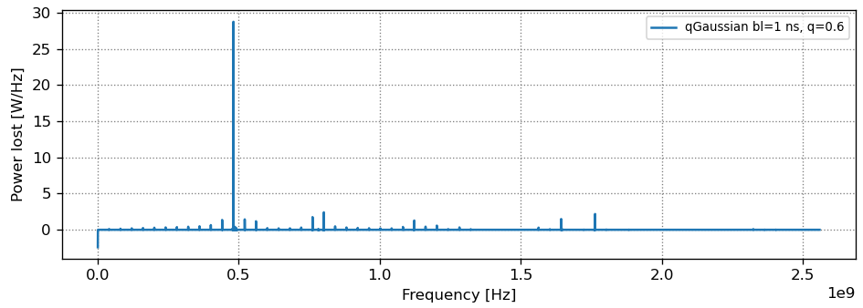
Impedance Studies
Best design so far:
Stainless steel cathode;
Damping rods;
Cathode 200 x 200 mm.
Power loss -> 65.7 W
Longitudinal impedance & power loss okay.
Optimisation ongoing.
Ref. Hikmet Bursali, HL-LHC BGI Impedance Study

Slide 13
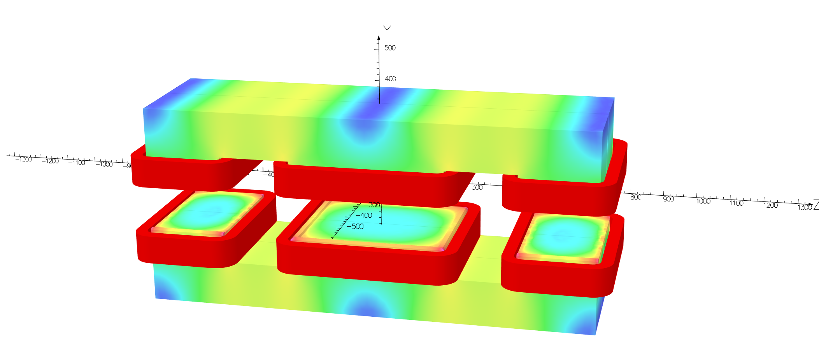
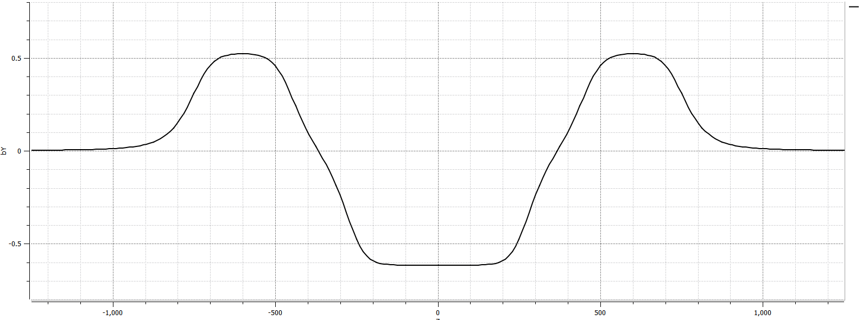
0.6T Magnet - New Triplet Dipole
BGI design presented at HL BGV/BGI Review in Oct. 2022 based on new self-compensating triplet dipole magnet.
Separate power convertors (Polaris 2P) for Main & Corrector fields.
Recommendation of reviewers to investigate:
Permanent magnet solution;
Reducing number of (costly) power convertors.
LHC BGI magnet
Corrector field
Main field (0.6T)
Corrector field
B field along the beam axis
Ref. HL-LHC BGI Magnet Review, Dominique Bodart

Slide 14
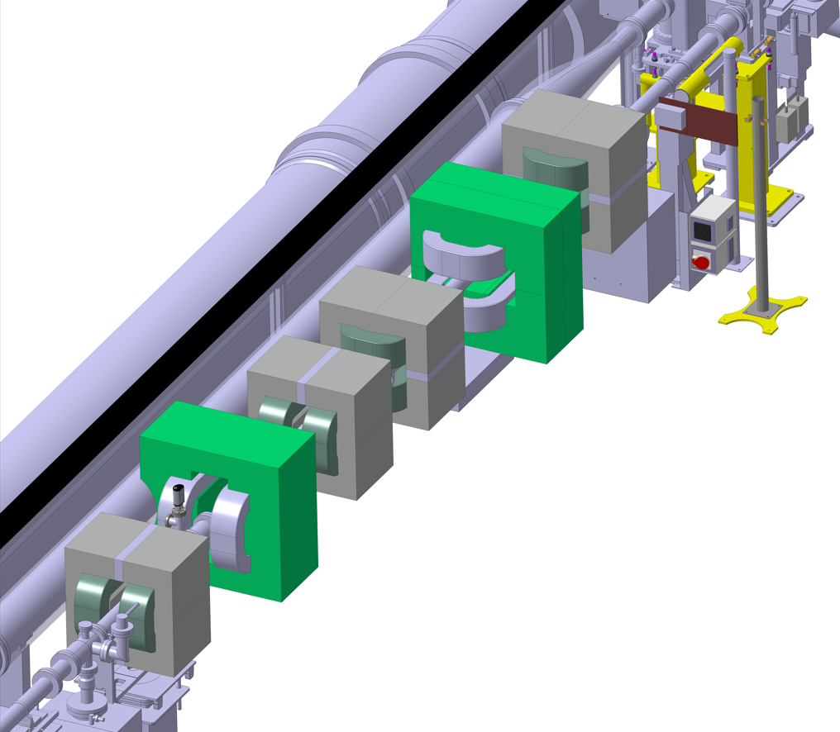
0.6T Magnet - New Dipole + MDX Correctors
Permanent Magnet
Designs studied by TE-MSC;
Instrument integration very challenging;
Not pursued.
Current Solution: New Dipole + MDX Correctors
New 0.6T main dipole magnet for instrument;
Correction with exisiting MDX magnets;
Possibility to re-use existing power convetors;
Significant potential budget saving.
MDX Corrector
New 0.6T dipole magnet
MDX Corrector
Ref. HL-LHC BGI Magnet Review, Dominique Bodart

Slide 15
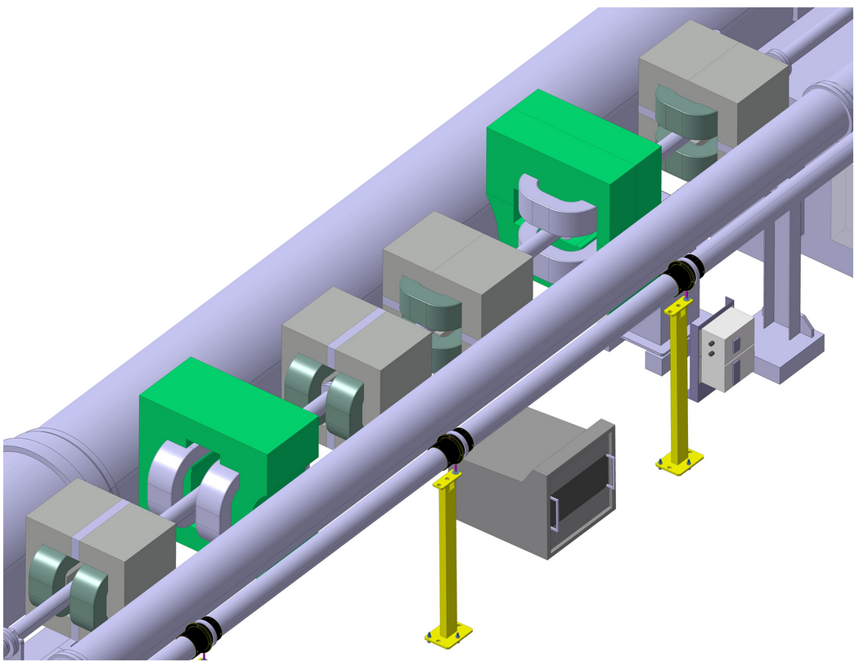
Integration at Pt.4
5L4 - BGI-Horizontal & Vertical on B1
5R4 - BGI-Horizontal & Vertical on B2
Ref. Miguel Navarro Baeza, Integration Study of the BGI in the HL-LHC machine IP4

Slide 16
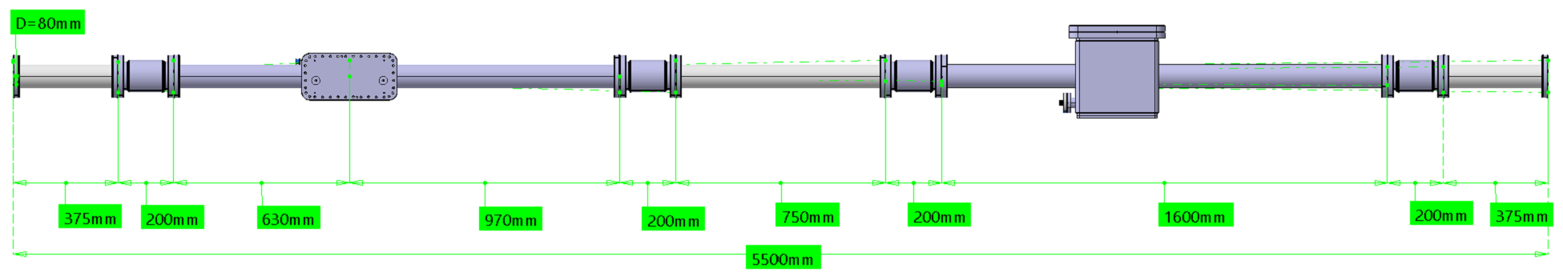
Integration at Pt.4
Proposed integration layout
BGI-Horinzontal
BGI-Vertical
Installation planning with TE-VSC:
Reconfiguration of vacuum components to take place at beginning of LS3, initially with drift tubes in place of the BGI instruments;
Installation of BGI instruments later in LS3.
Ref. Chiara Pasquino, HL-LHC WP15 Integration Meeting

Slide 17
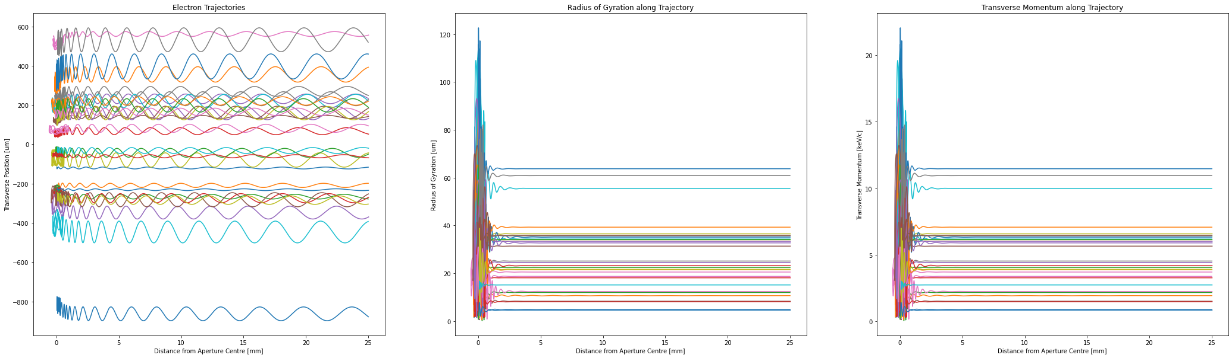
Expected Performance: Precision & Accuracy
Simulation Workflow:
Electrostatic simulation of field cage with CST Studio;
Simulation of ionisation electron formation & transport to electron detector with Virtual-IPM.
For each simulation calculate residual = true beam size – measured beam size.

Slide 18
Expected Performance: Precision & Accuracy
Statistical error ( precision )
= standard deviation of residual distribution
Systematic error ( accuracy )
= mean of residual distribution
e.g. single measurement with 2000 ionisation electrons → 2 % statistical error.
Negligeable systematic error due to field cage, space charge, Timepix3 pixel pitch.

Slide 19
Expected Performance
Performance estimates for beam profile measurements with residual gas pressure of 1x10⁻¹⁰ mbar ( no gas injection ) & assuming same ionisation electron detection efficiency as PS BGI instrument:
HL-LHC protons
Average beam size: Integration window = 0.5 ms → 5000 e⁻ → Precision = 1%
Bunch-by-bunch beam size: Integration window = 1 s → 5000 e⁻ → Precision = 1%
Accuracy < 2 %
HL-LHC Pb82+
Average beam size: Integration window = 0.05 ms → 5000 e⁻ → Precision = 1%
Bunch-by-bunch size: Integration window = 100 ms → 5000 e⁻ → Precision = 1%
Accuracy < 2 %
Expected performance meets functional specificition.

Slide 20
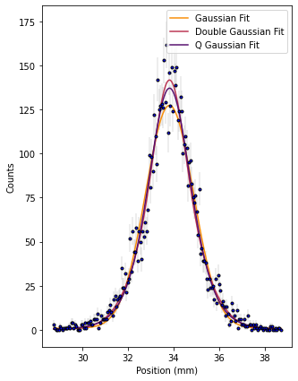
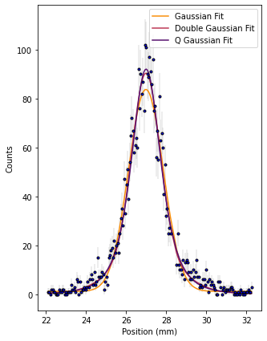
Accuracy of PS BGI Measurments
In practice - how well does performance meet expectation?
Example: Measurment of LHC-type beam at flat top with both PS BGIs (1.9 ms int.), without gas injection.
PS BGI-Horizontal
PS BGI-Vertical
Ref. Clara Fleisig, JAPW23

Slide 21
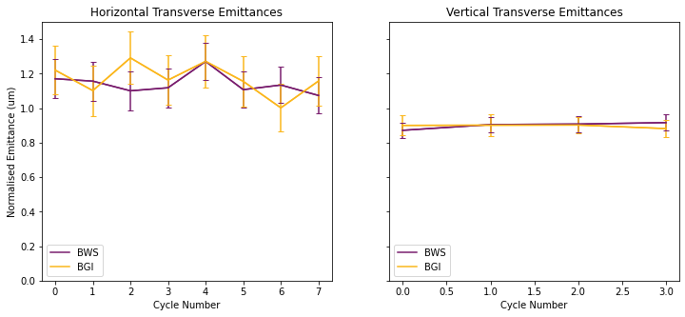


Accuracy of PS BGI Measurments
Measure at same moment in the cycle with the Beam Wire Scanners (BWS)’s & then compare the emittance measured by the BGI and BWS:
$$Δ_{over all cycles}=0.0±0. 2 um$$
$$Δ_{over all cycles}=0.02±0.07 um$$
Emittances measured by the BGI and BWS are in agreement, as expected from the Virtual-IPM simulation.
Ref. Clara Fleisig, JAPW23

Slide 22
Technical Issues
Timepix3 based BGI instruments are not yet operational.
Two main issues: 1) Processing of Timepix3 data; 2) EMI of SPS BGI Timepix3.
Recent CERN internal review - “PS & SPS BGI Review”.
(Selected) Review Panel Recommendations:
“Fully support proposal to move [Timepix data] processing from SoC towards a powerful server computer.” → This is the architecture originally planned for the LHC BGI.
“EMI issues are a significant problem, and we note that the project is taking this seriously and requesting outside expertise from the EMC forum.” → Highly relevant to the LHC BGI and needs to be solved.

Slide 23
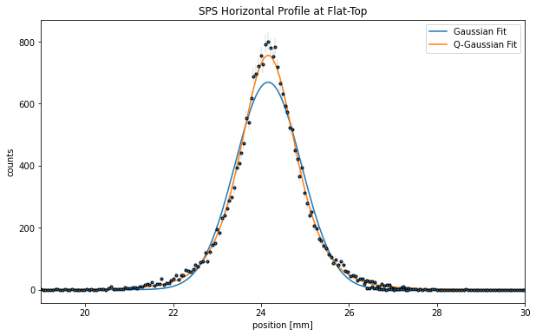
SPS BGI: Results after YETS 23/24
Measurment of single LHC bunch (LHC4) at flat-top
Integration window = 2 ms;
Recorded 24,000 electrons in this integration window.
Fit results
Gaussian:
sigma: 0.751 +/- 0.006 mm
reduced chi^2 = 15.6
q-gaussian:
sigma = 0.589 +/- 0.004 mm
q = 1.374 +/- 0.008
reduced chi^2 = 5.8
Looks promising...

Slide 24
Loss of Communication with Timepix3 during LHC25 & AWAKE Cycles
Background - Timepix3 data readout
Data from Timepix3 is readout on 8 x differential pairs (“dataouts”) @640 MHz.
Header (“comma”) sent periodically by Timepix3 on each dataout link.
Problem
During LHC25 & AWAKE cycles synronisation with the dataout links is lost (i.e. comma is not recovered) → can’t readout the data.
Communication is recovered after reconfiguring the Timepix3’s.
Cause
Suspect EMI problem is causing the Timepix3 to reset.

Slide 25
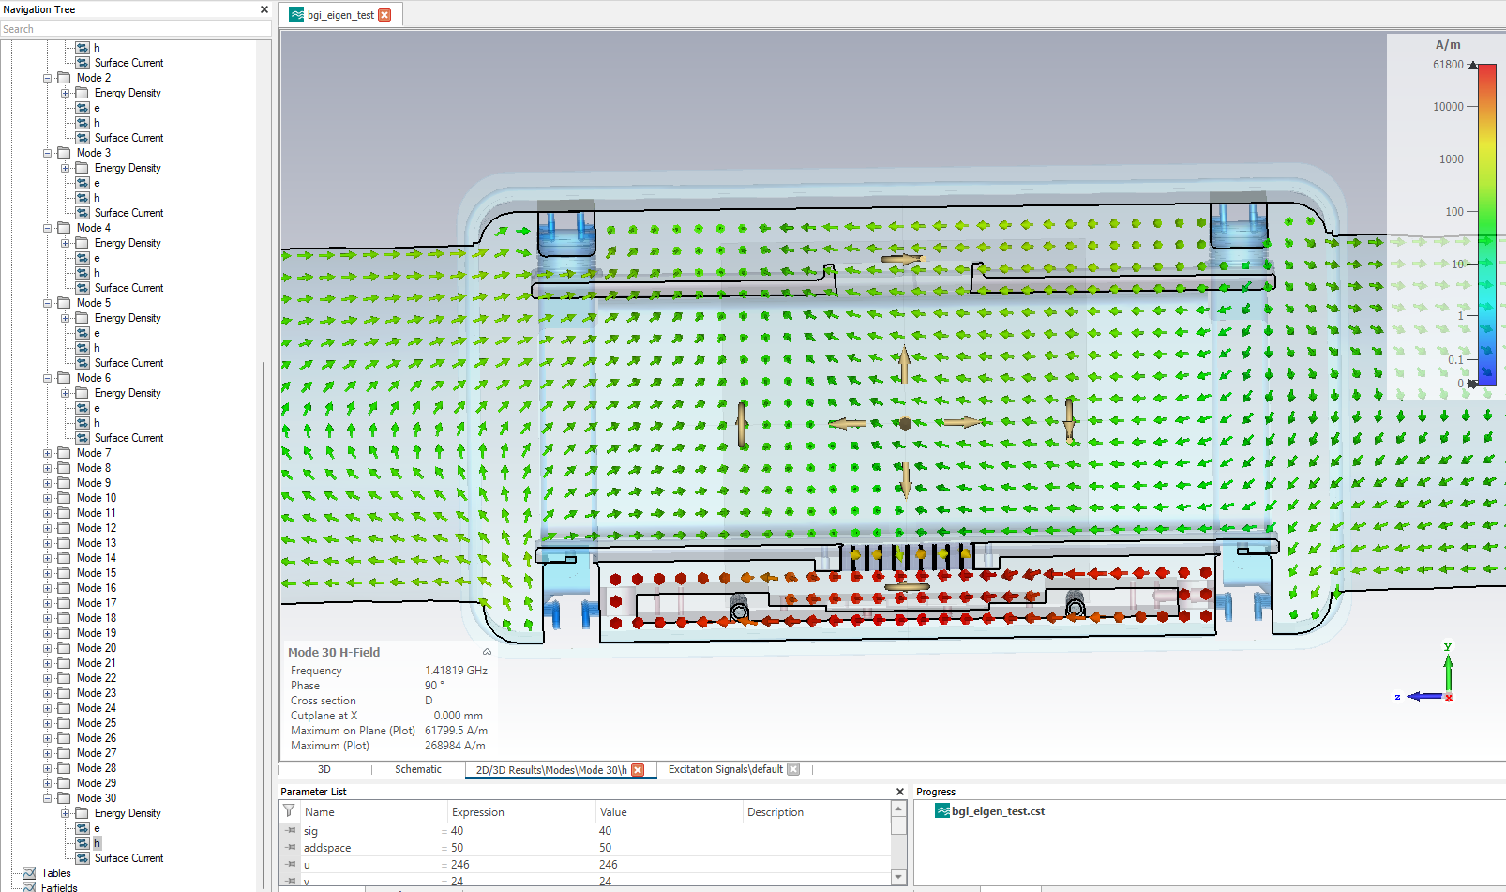
SPS BGI EMI Studies
Current Investigations:
Beam based measurments ( what cycles perturb Timepix3 & when. )
Measurments at the ATS EMC lab.
Improve Faraday cage design for the SPS BGI-Vertical, which will be installed during YETS 24/25.
Clue = Communication lost during AWAKE cycle immediately after bunch rotation, at which time:
Bunch length reduced to 0.9ps → Higher frequencies in the power spectrum enhanced;
Higher frequencies pass through Faraday cage & perturb electronics(?)
CST Simulation of SPS BGI eignemodes. Strong mode at 1.4 GHz inside Faraday cage (Study by Hikmet Bursali)

Slide 26
Milestones & Timeline upto LS3
Milestone | Date
Engineering specification for BGI readout system | End of 25
Installation of SPS BGI-Vertical with improved Faraday cage | YETS 24/25
Installation of new infrastrure at Pt.4 & Timepix3 BLM | YETS 24/25
Global emittance monitoring review | Mid-2025
Installation of prototype HL-LHC BGI instrument | YETS 25/26

Slide 27
Summary & Outlook
The HL-LHC BGI has the potential to provide independent, non-destructive bunch-by-bunch transverse beam profile measurements throughout the accleration cycle.
Building on experience of PS and SPS BGI developments.
Design status:
Mechanical design & integration well advanced;
Impedance & beam induced heating under control;
Magnet design optimised to reduce cost.
Top priority is to solve EMI issue in the SPS.

Slide 28
Thanks!

