Slide 1

Recap. of failure cases for round and flat optics
Cédric Hernalsteens, Daniel Wollmann, TE-MPE
WP7
14th HL-LHC Collaboration Meeting, Genoa, 7-10th October 2024

Slide 2
Outline
Fast failure cases, machine parameters and assumptions
CLIQ spurious discharge
Quench heater spurious discharge
Crab cavity failure cases
Conclusions

Slide 3
Fast failures
Failures: events leading to uncontrolled beam losses
  Protection from ultra-fast failures (damage limit reached within 3 turns) relies on passive absorbers
  Protection from fast failures (damage limit reached within 10ms – 100 turns) relies on dedicated interlocks
Machine protection critical loss level for fast failures: 1 MJ deposited in IR7 within 10ms. This is a conservative assumption for machine protection. The exact damage limit for the collimation system depends on many factors.
Key quantitative parameters:
  time from failure onset to critical loss level (expressed in machine turns)
  time from failure detection to critical loss level must provide sufficient margin (machine turns) to safely dump the beam
  time from failure detection to beam dump is known

Slide 4
Machine parameters
HL-LHC v1.6 sequences with round (15.0 cm) and flat optics (7.5 cm / 18.0 cm)
Regular (6.7) and relaxed (8.5) collimation settings are compared
Simulations performed with xsuite (and compared to MAD-X)
 | Beam parameters
Beam energy | 7 TeV
Beam stored energy | 674 MJ per beam
Bunch intensity | 2.2e11 p⁺/bunch (2736 bunches)
Beam emittance | 2.5 μm
TCP settings | 6.7 sigma and 8.5 sigma
Half crossing angle at IP1-5 | 250 μrad
Landau octupoles | Both polarities compared
Transverse distribution with halo

Slide 5
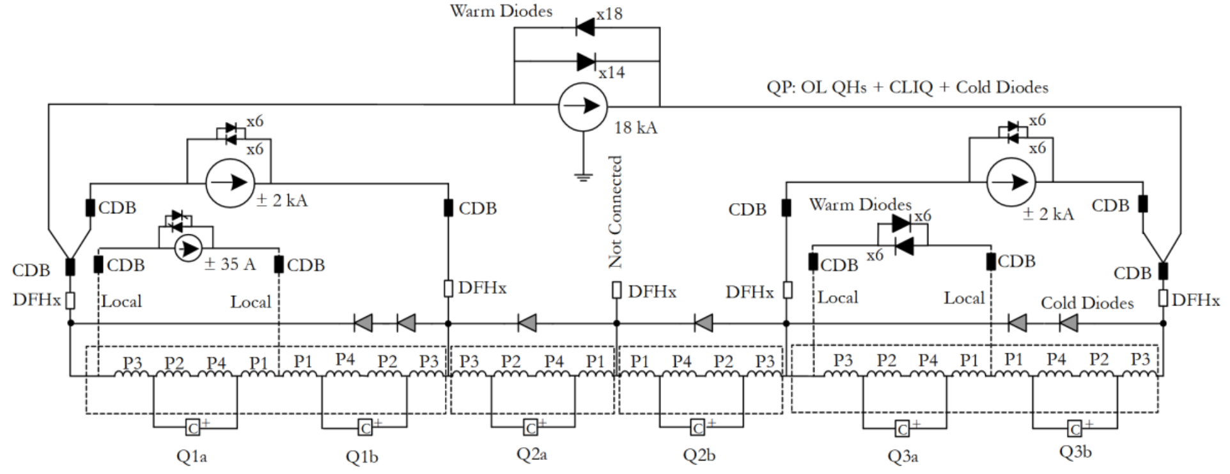
CLIQ connection scheme

Slide 6
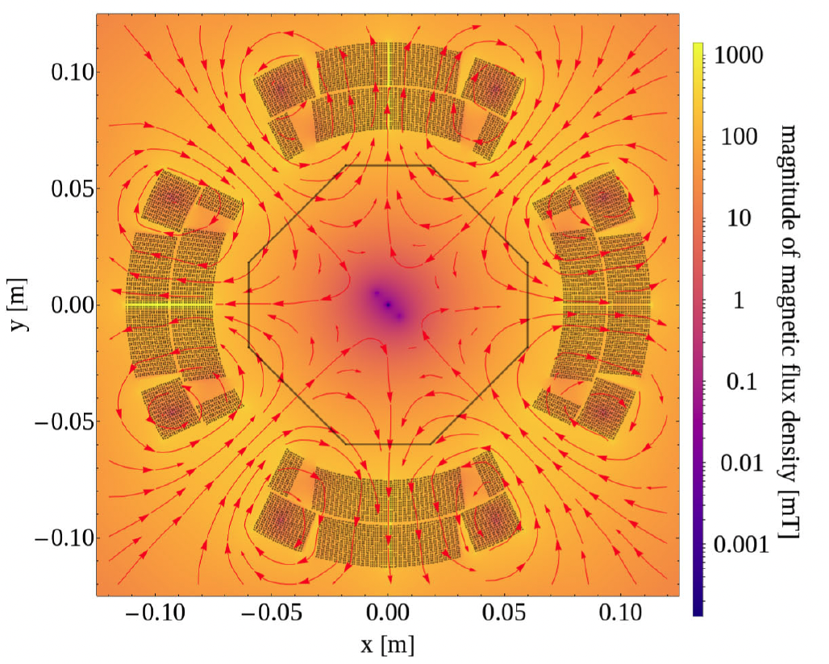
CLIQ and impact of magnet protection on the beam
Quench protection system will trigger a beam dump before firing CLIQ and/or QHs
  Interested in the spurious discharge failure mode
Baseline connection scheme features the same connection for all magnets
Baseline connection
Impacts of flat optics:
Larger β-function in one plane
Crossing bump affects feed-down
Field dominated by a skew-octupolar component
LEDET/SIGMA simulations (E. Ravaioli) – Difference w.r.t main field after 5ms

Slide 7
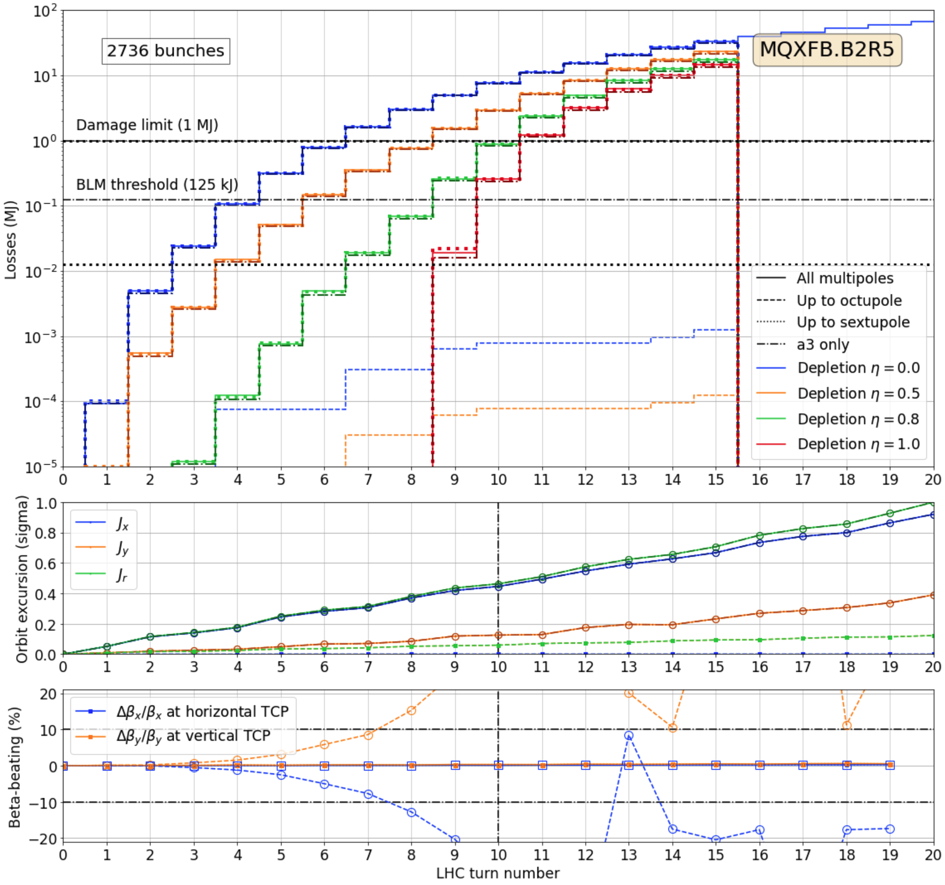
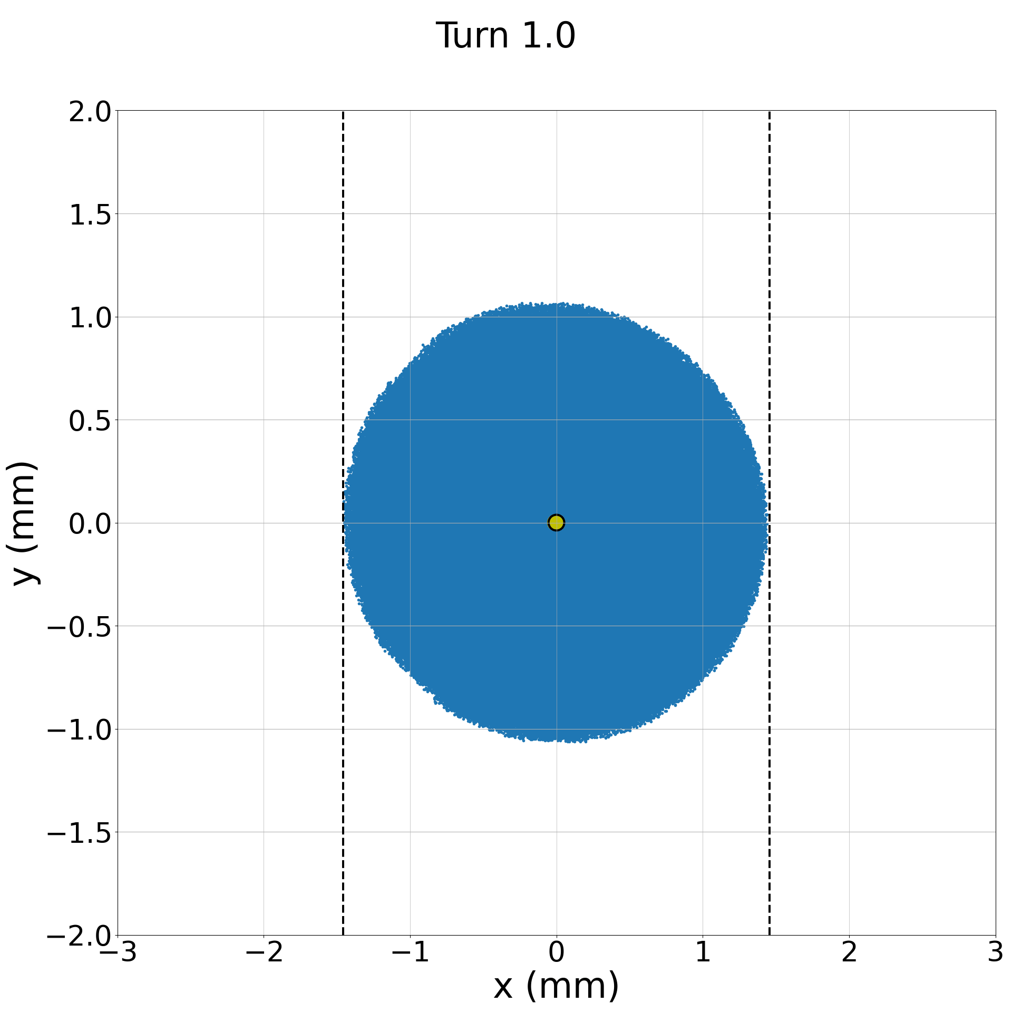
CLIQ discharge beam losses – Round optics
Beam losses cannot be explained by orbit shift alone
Beam losses tracked to effect of skew octupolar field generated by the CLIQ discharge leading to a loss of DA
TCP.D6L7 (vertical)

Slide 8
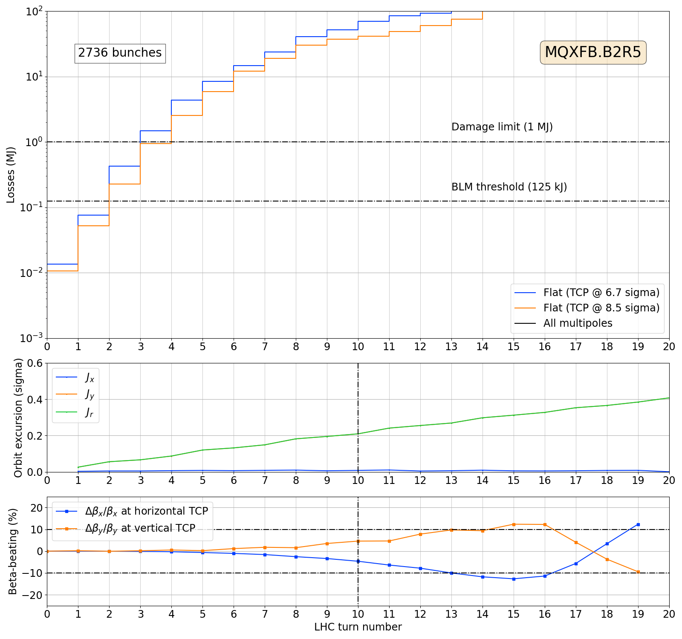
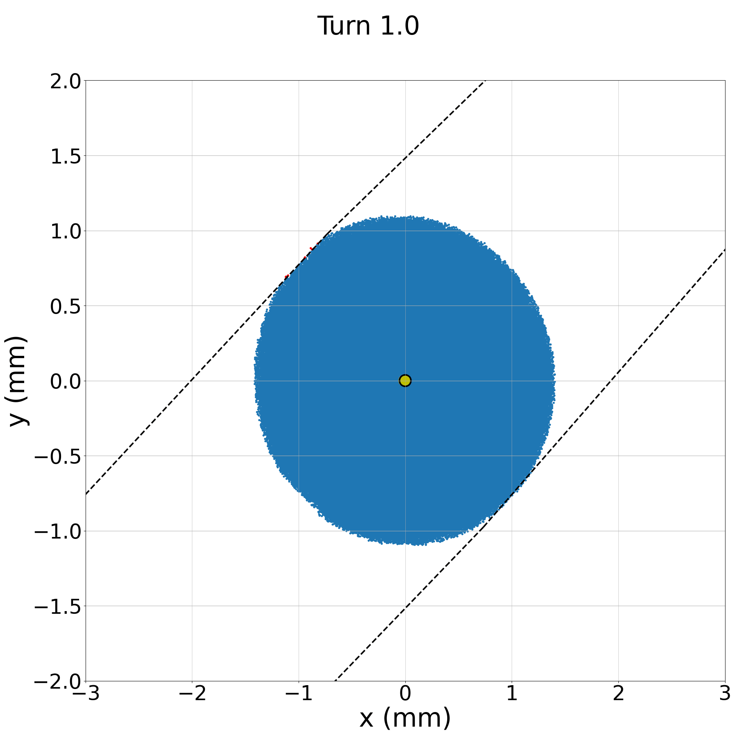
CLIQ discharge beam losses – Flat optics
Orbit drift and beta-beating reduced compared to round optics despite the beam loss dynamics being faster!
Beam losses reach critical loss level
(1 MJ) within 3 turns!
Dedicated interlock would react only within 5 turns

Slide 9
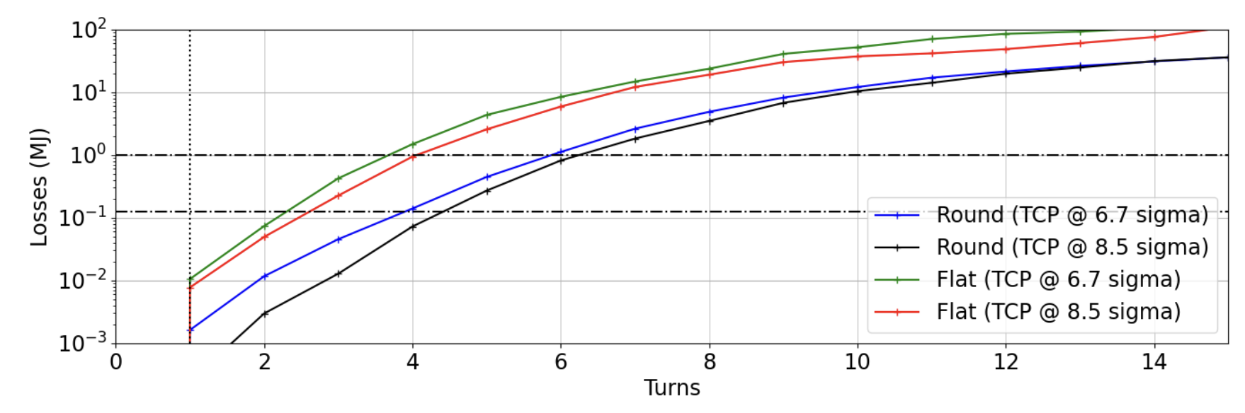
CLIQ discharge beam losses
MQXFB.B2R5
Onset of failure
Critical losses for round optics
Critical losses for flat optics

Slide 10
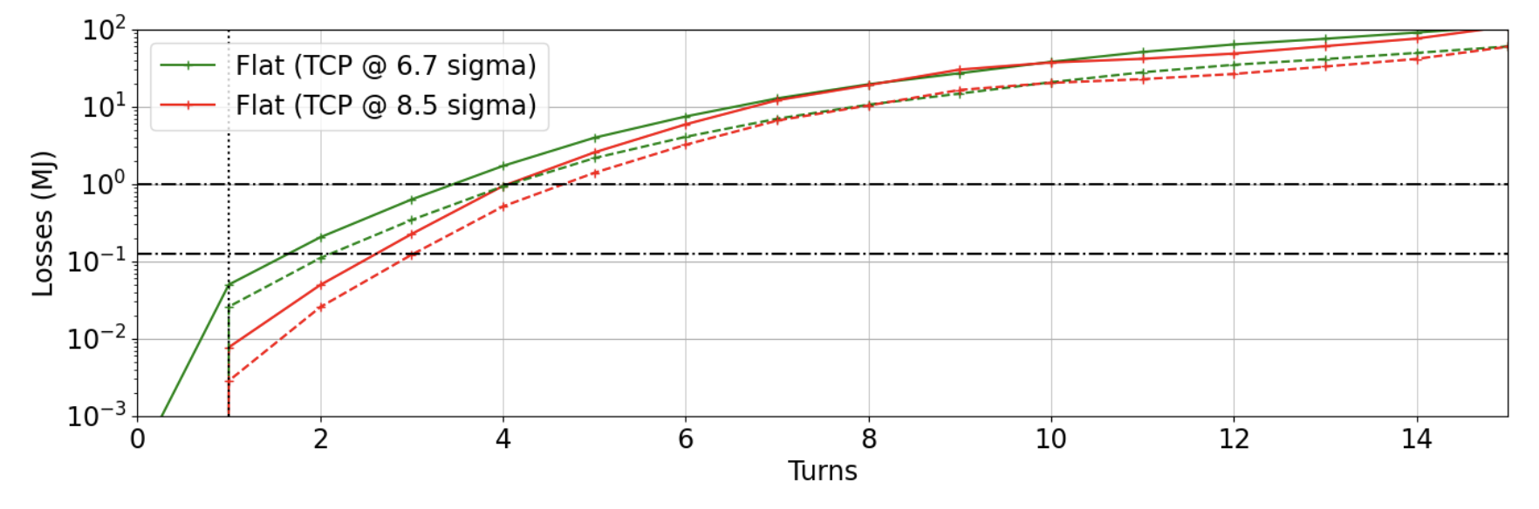
CLIQ discharge beam losses
MQXFB.B2R5
Intensity at EOL: 1.2e11 ppb

Slide 11
CLIQ - Criticality and interlocking
Protection is assured by a fast dedicated interlock
  See T. Podzorny, PDSU-CLIQ/DQHDS interlocking via BIS concentrator (Thursday morning)
For round optics, the design (and measured) reaction time prevent reaching the critical loss limit (1 MJ), 50 us margin
Onset to damage margin | 450 μs
Measured detection time | 120 μs
Propagation via BIS from P1 to P6 | 100 μs
LBDS synchro. | 89 μs
Extraction | 89 μs
Margin | 50 μs
Onset to damage margin | 270 μs
Measured detection time | 120 μs
Propagation via BIS from P1 to P6 | 100 μs
LBDS synchro. | 89 μs
Extraction | 89 μs
Margin | -130 μs
For flat optics, under conservative assumptions, the critical loss level is exceeded
Losses up to 7 MJ in the collimation system by the time the beam is dumped

Slide 12
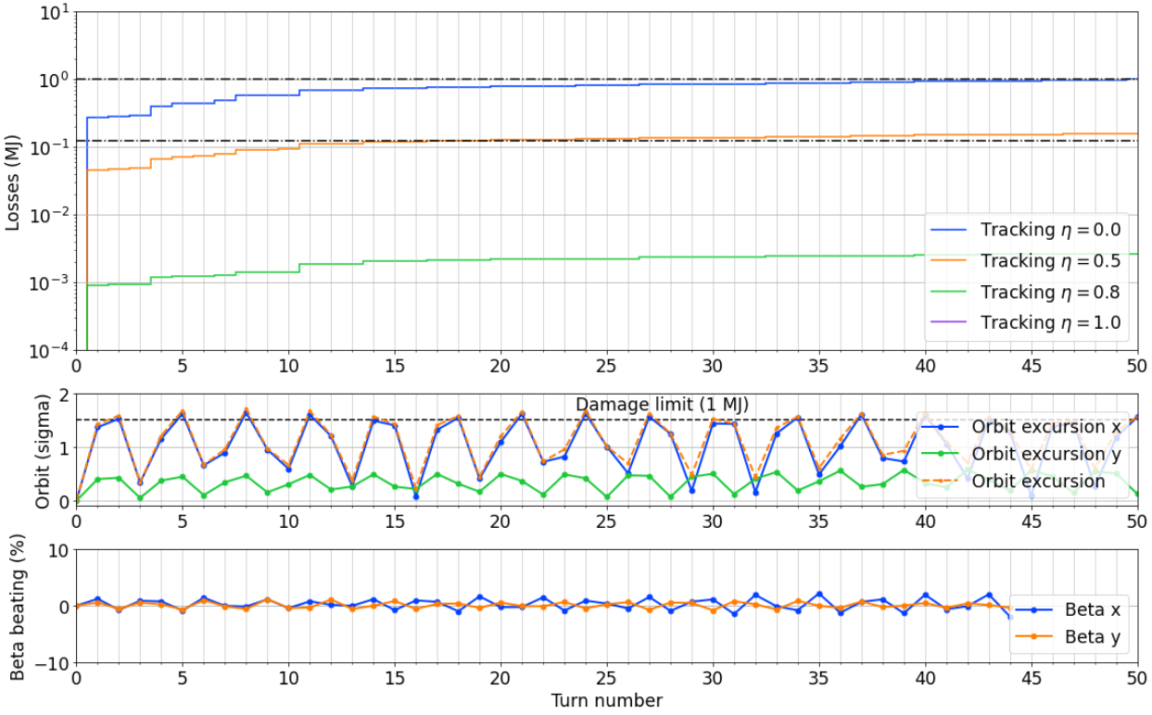
Quench heaters impact on the beam
Effects of QH fired on circulating beams routinely observed for LHC main dipoles. Very fast current rise (30 us) leads to orbit oscillation before beams are dumped.
Larger impact expected for HL-LHC due to amplification from beta-functions. Connection schemes were optimized to reduce the dipolar components. However, firing all QH from the triplets would lead to a > 30 sigma kick.
For round and flat optics, the most critical circuit remains the D1. Critical loss levels reached after ~40 turns.
  Sufficient time for BLMs and BCCM to provide diverse redundancy interlocking.
The spurious triggering, for all magnets (triplets, D1 and D2), is interlocked by the QPS with direct connection to the BIS
D1 – Single QH circuit (worst case)

Slide 13
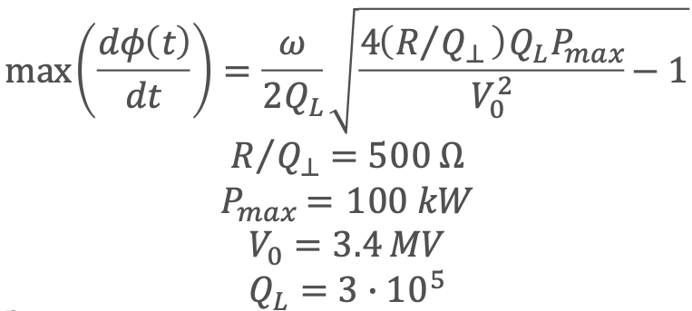
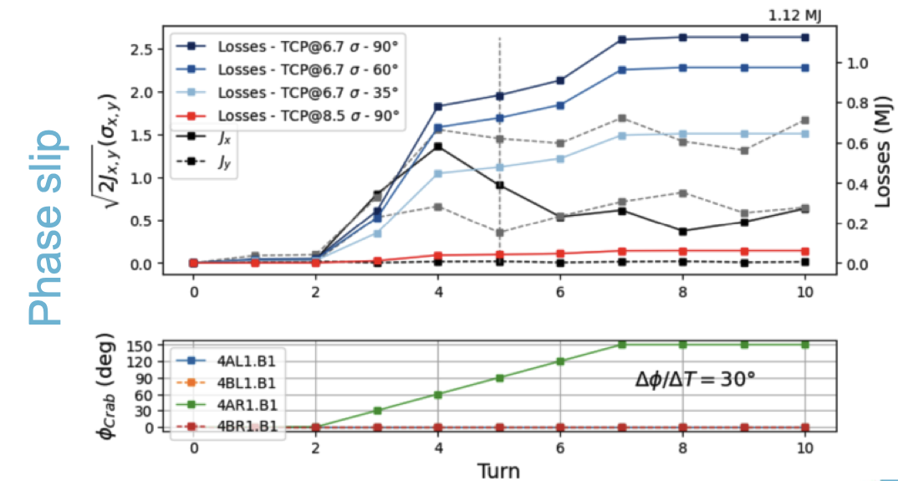
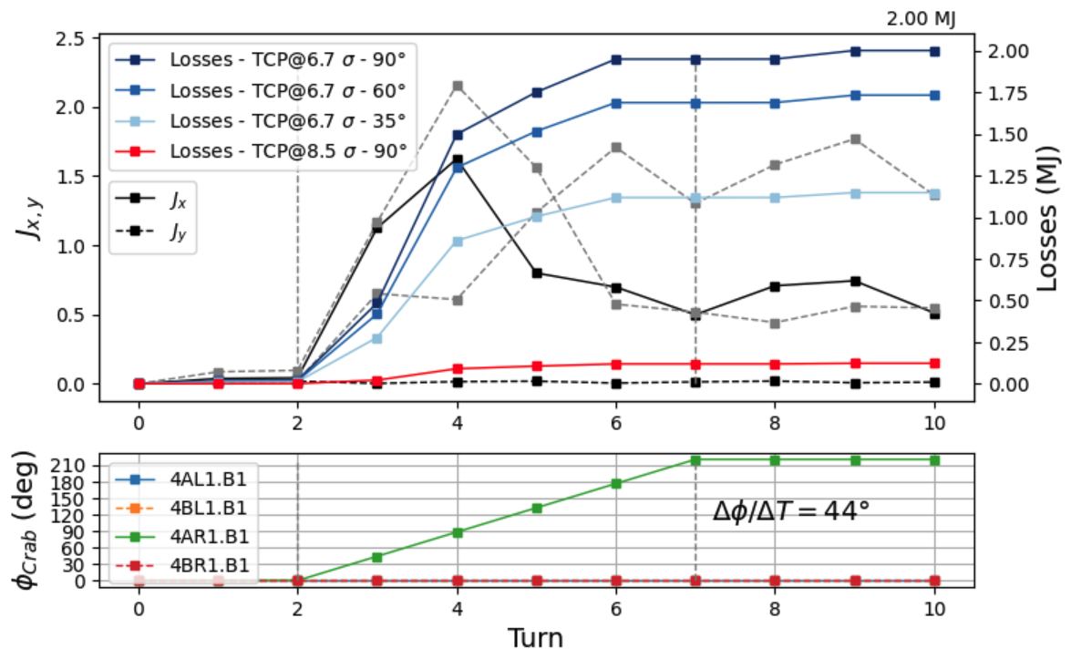
Crab cavity failure cases - Phase slip
Phase advance from CC to TCP should be limited to avoid exceeding the 1 MJ limit (within 3 turns) defined for machine protection
  Assuming theoretical limit for the maximum phase shift per turn (44 degrees): lower than 35 degrees
  Using estimate from SPS test stand experience (30 degrees): lower than 60 degrees
Round optics
1.12 MJ
2.0 MJ

Slide 14
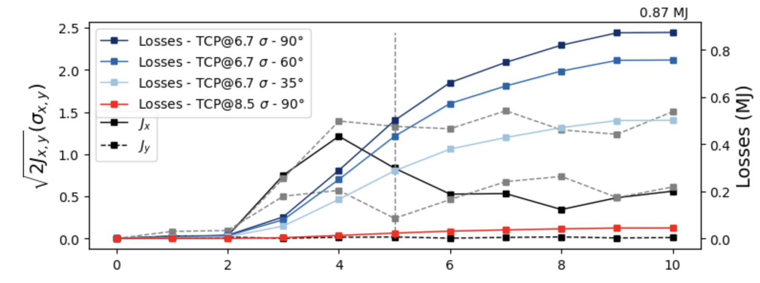
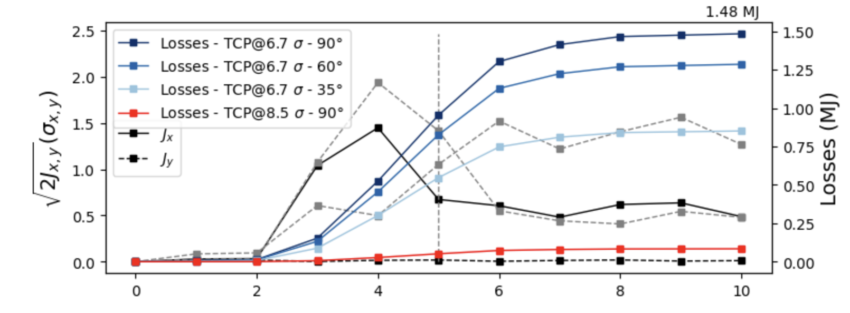
Crab cavity failure cases - Phase slip
For flat optics the situation is improved
  Assuming theoretical limit for the maximum phase shift per turn (44 degrees): up to 35 degrees
  Using recent estimate from SPS test stand experience (30 degrees): no limitation
Flat optics
0.87 MJ
1.48 MJ

Slide 15
CC failures
Maximum theoretical phase shift per turn of 44 degrees
  Simulation results identified the phase slip case as most critical, orbit shift by 1.6 sigma within two turns after the start of the failure → up to 2 MJ lost after 10 turns.
  Mitigation: phase advance from CC to TCP must be lower than 35 degrees to remain below the 1 MJ within 3 turns
  Experience from the SPS test stand indicated that the phase shift per was further limited to 30 degrees (system tripped)
Criticality is reduced by the flat optics (VH)

Slide 16
Conclusions
Fast failures have been reviewed for round and flat optics with xsuite
Protection against CLIQ spurious discharge
  Enssured by a dedicated fast interlock acting ensuring beam extraction within 400 us after the onset of the failure
  Round optics: losses remain below 1 MJ
  Flat optics: losses up to 7 MJ
Protection against quench heaters spurious discharge is ensured by a dedicated interlock
  Most critical case is D1
  Still sufficient margin for flat optics
Most critical crab cavity failure mode is phase slip
  Protection is ensured by limiting the maximum allowed phase advance between the CC and the TCP to 35 degrees
  Situation slightly more favorable for the flat optics

Slide 17
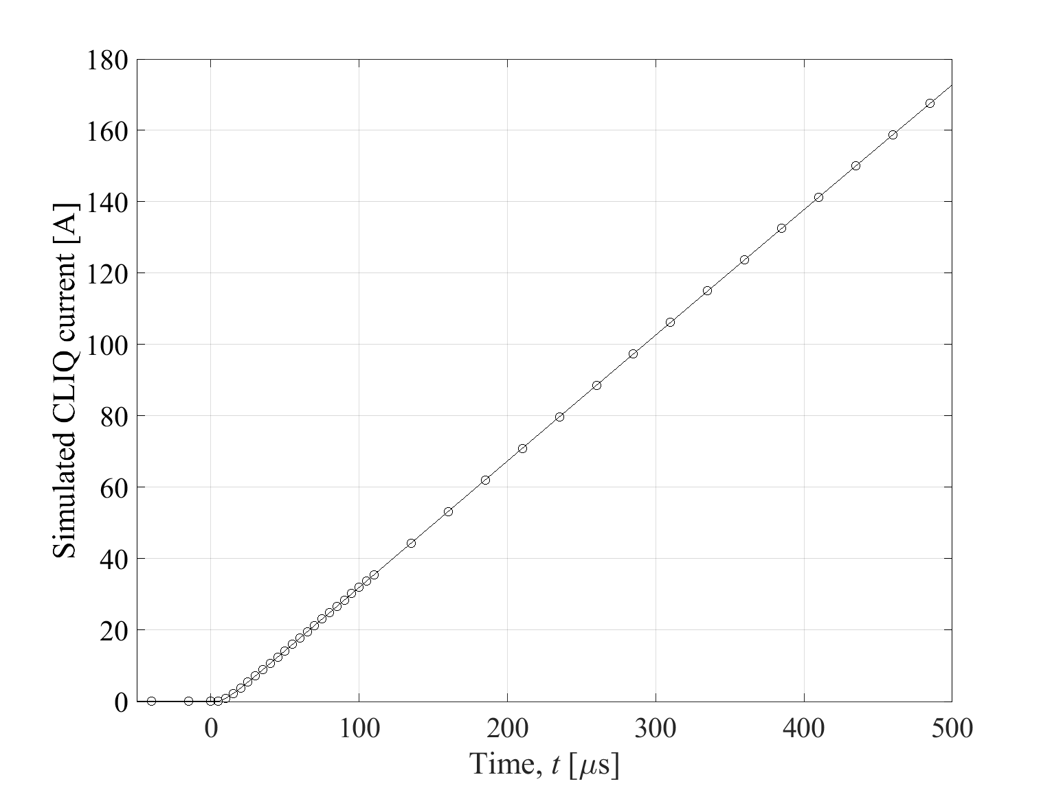
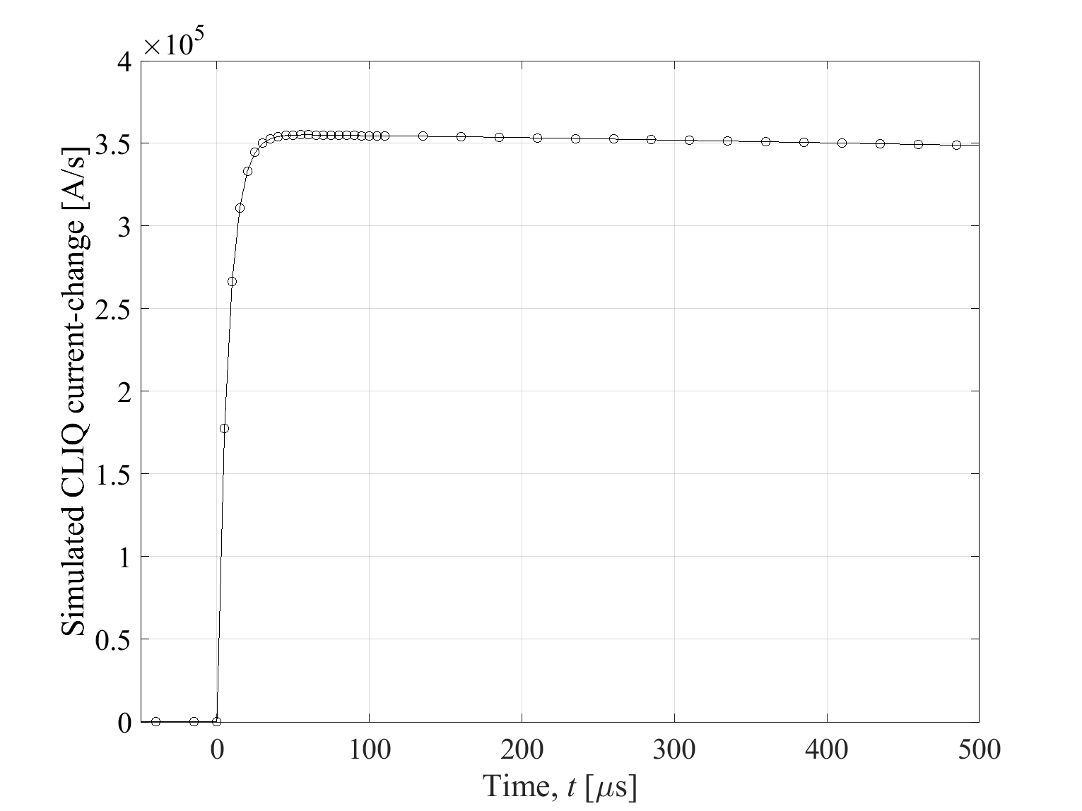
CLIQ current and dI/dt
Rise-time shown below for the first 5 turns
Time-dependent multipolar fields are modeled in tracking simulations
LEDET simulations (E. Ravaioli)

