Slide 1

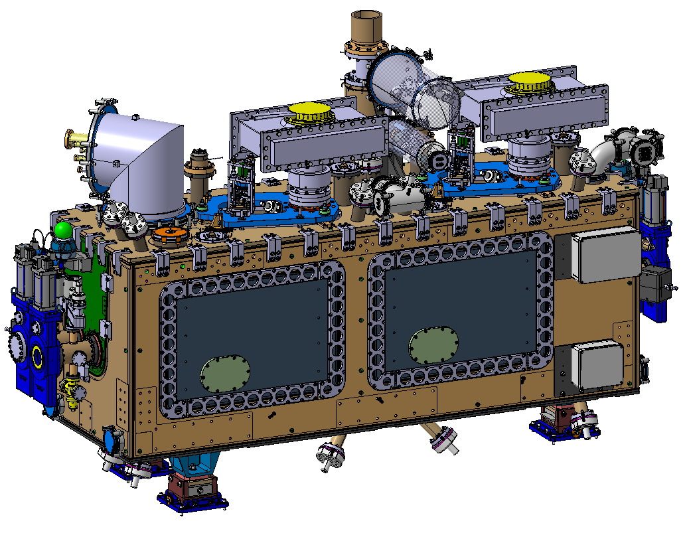
RFD-SPS Cryomodule Repair
Overview and Highlights
Simon Barrière, Joanna Święszek – CERN
on behalf of the HL-WP4 team
14th HL-LHC Collaboration Meeting – Genoa, Italy – 09th October 2024

Slide 2
Outlook
The RFD cryomodule and the NC
Strategies for repair & challenges
Calculations & numerical simulations
Repairs activities
Conclusion

Slide 3
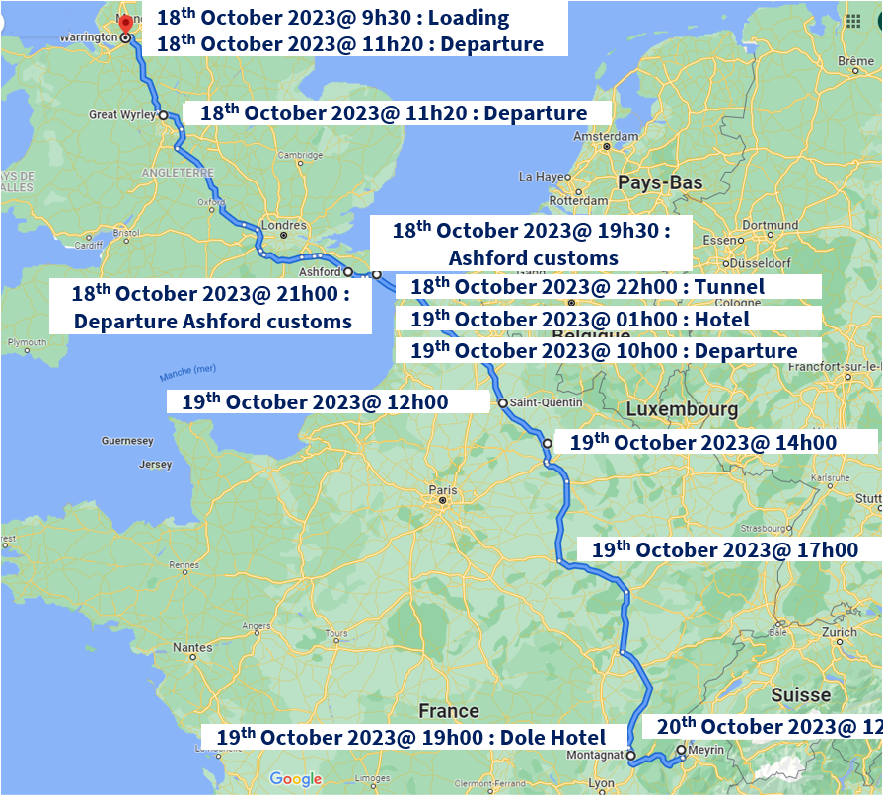
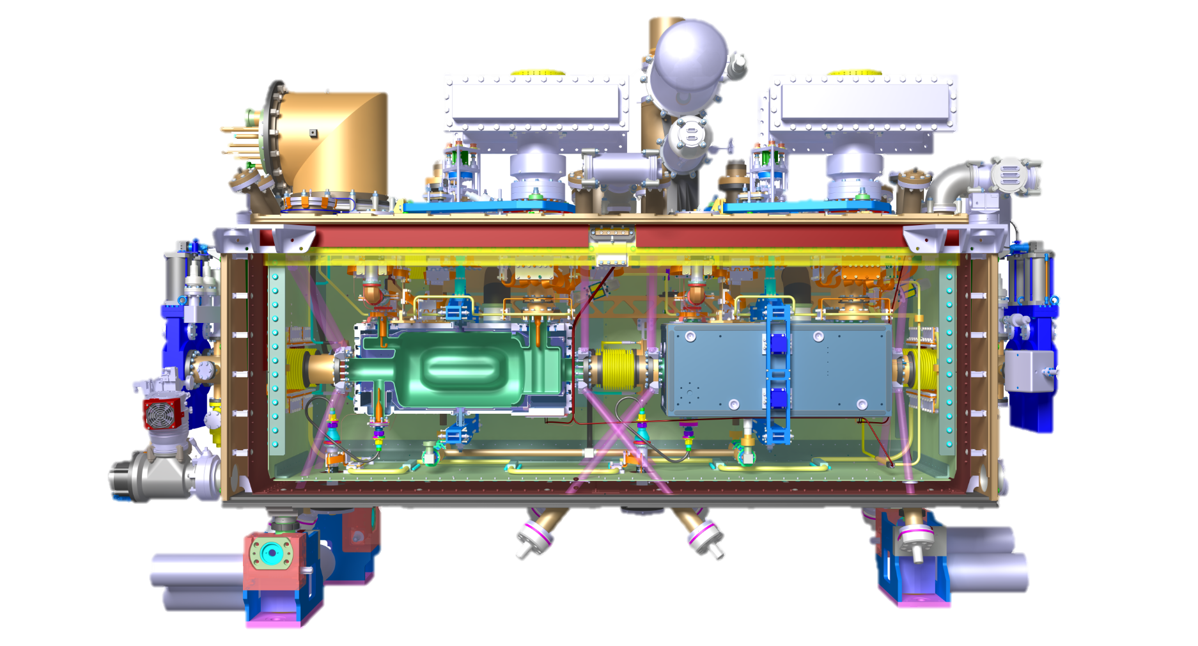
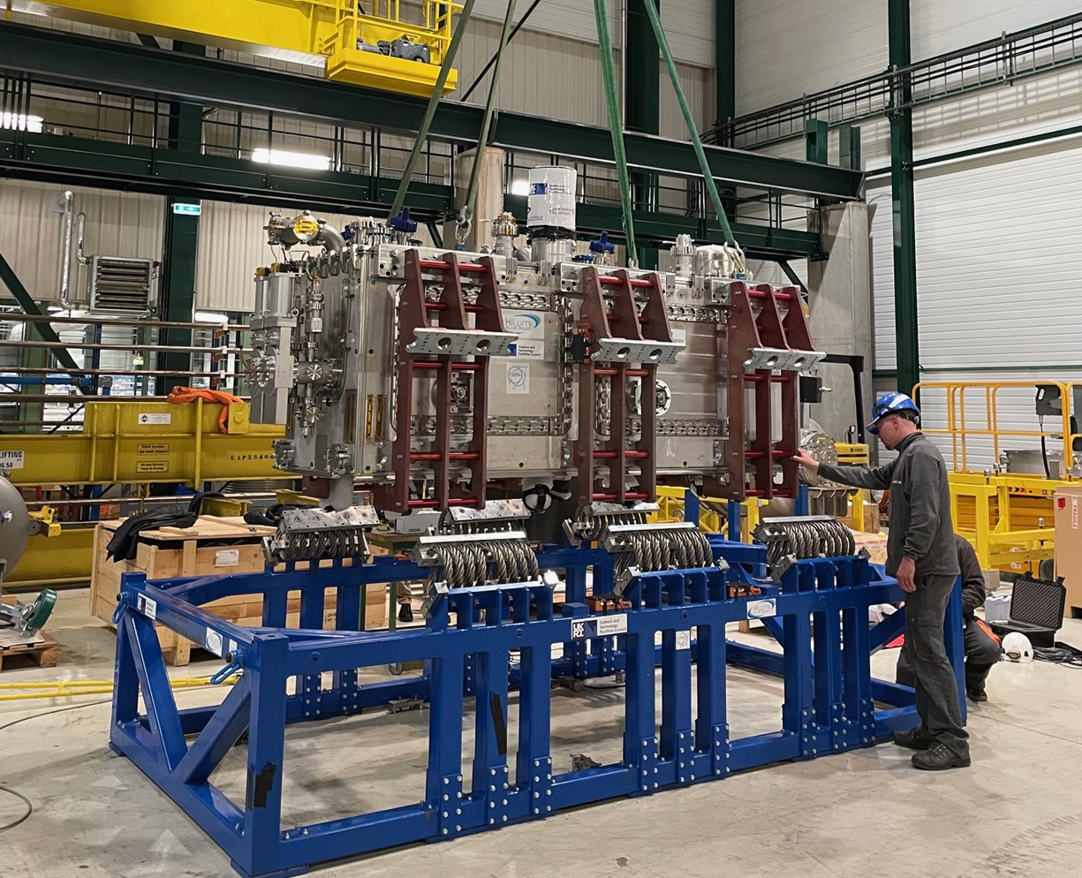
The RFD-SPS cryomodule
First RFD version crab cavities cryomodule (prototype for SPS tests)
Assembled in UK-STFC Daresbury Laboratory
Transport to CERN in Oct. 2023
See presentation by Kurt Artoos (Thursday PM)
  23 Oct. 2023 @ CERN

Slide 4
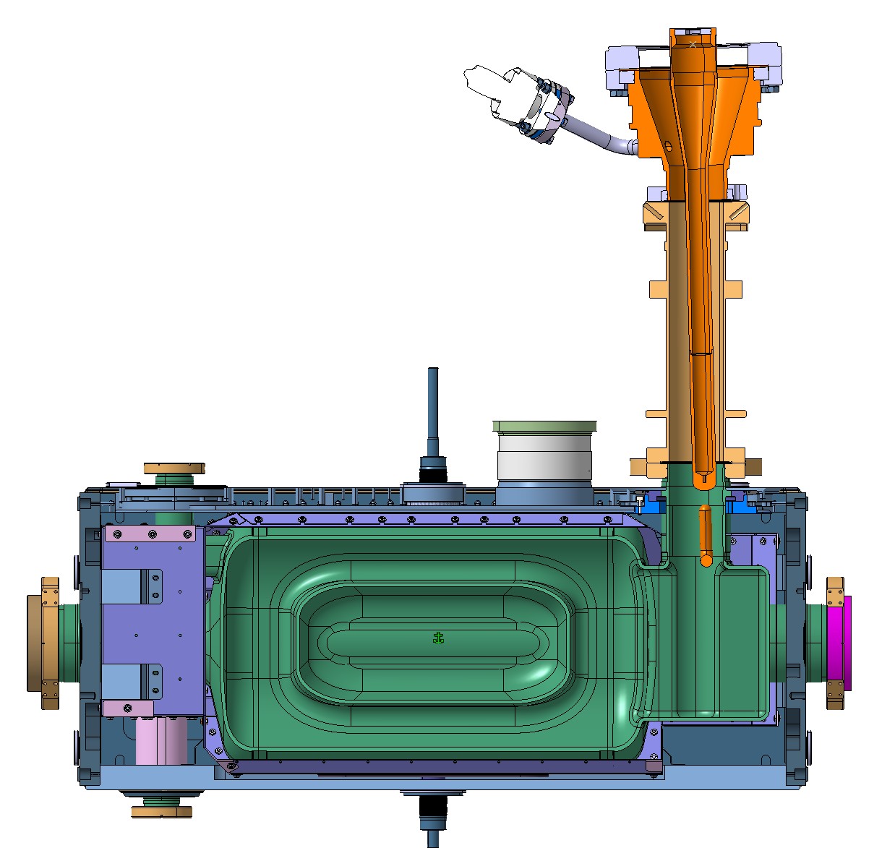
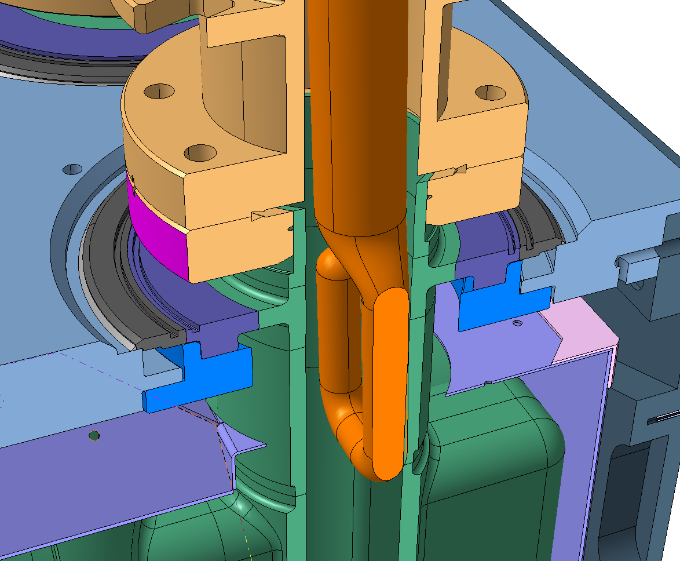
The NCs
During reception checks, two critical NC have been identified (consequence of clash between vacuum vessel top plate and FPC plate during assembly, see Edward Jordan’s talk this afternoon)
Cavity 1
Tilt of the FPC
+ FPC short circuit on cavity wall
Cavity 2
Tilt of the FPC
+ Vacuum Leak on Copper body
*confirmed by survey measurement, RF checks & X-rays
Theoretical clash = 0.5 mm
(hook on cavity wall)

Slide 5
Strategy for repair
Very limited access inside the cryomodule, making tooling installation difficult
Need to remove the cavity support plates: delicate operation, load transfer of the cavities step-by-step and with real-time position and strains monitoring
Following discussion and recommendations from all the experts involved (RF, manufacturing, vacuum & alignment) and considering that straightening FPC body represent a risk of critical damage that could jeopardize cryomodule and cavities cold test, the following plan has been agreed between STFC and CERN:
  1 : Cavity #2 FPC leak repair (no straightening)
  2 : Cold test of the cryomodule (Cavity #2)
  3 : Cavity #1 FPC straightening
  4 : Cold test of the cryomodule (Cav #2 + Cav #1)

Slide 6
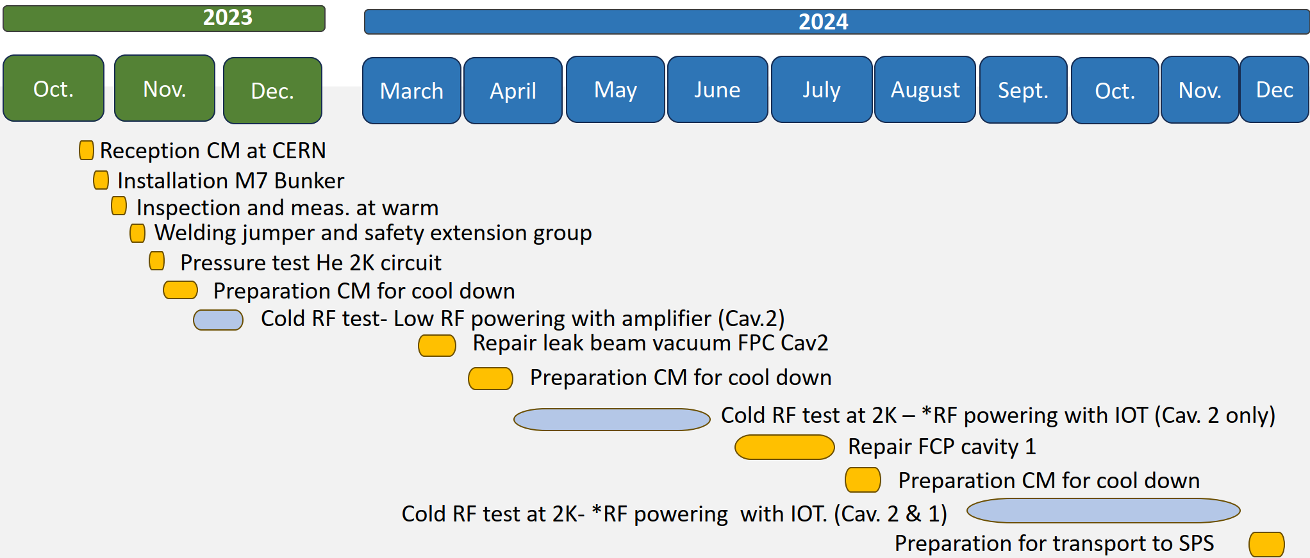
Planning
Two windows of repair to match planning of cold testing in SM18
~4 months window for design, calculation & fabrication of tooling

Slide 7
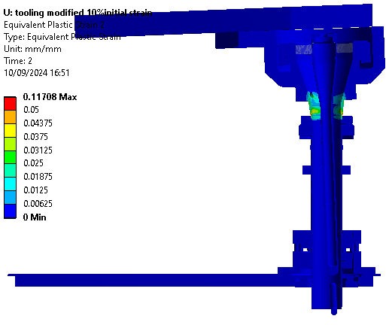
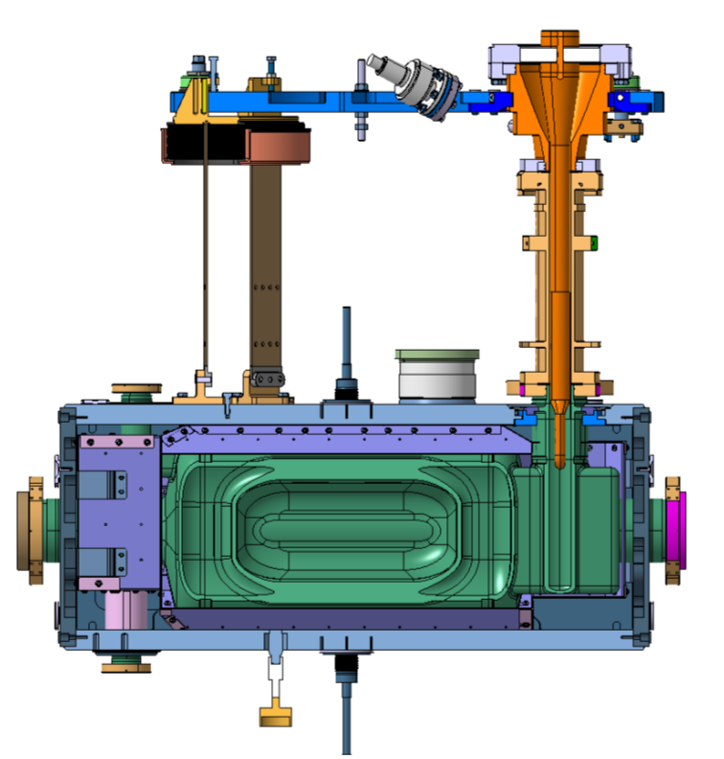
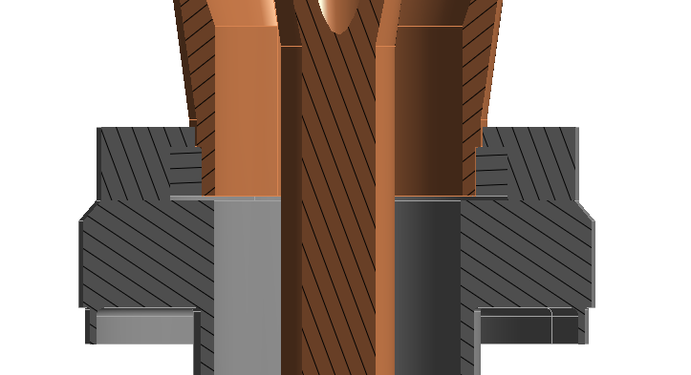
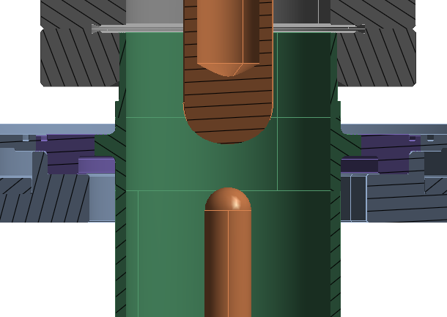
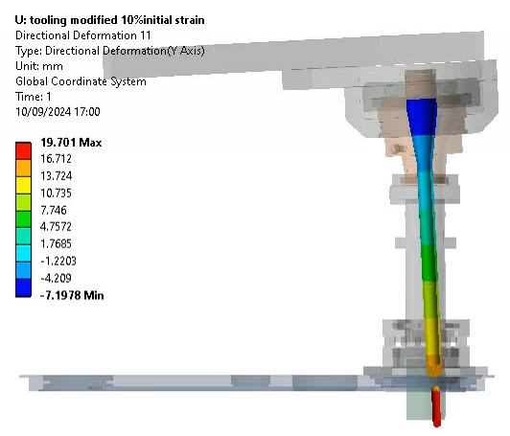
Repair principle, simulations
Simulation scope:
Define the most appropriate repair method
Understand system behavior and critical parameters,
no stress on ceramic feedthrough!
Design the tools (material, stiffness, force, etc.)
Applying straightening force
Brazed Cu
Rotating around the weakest point
Plastic deformation of the copper body
Brazed Nb
rigid body motion of the antenna
Simulations outcome:
Rigid tooling to fix the FPC double tube to He tank, to avoid deforming cavity port.

Slide 8
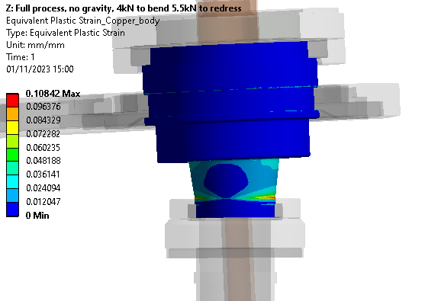
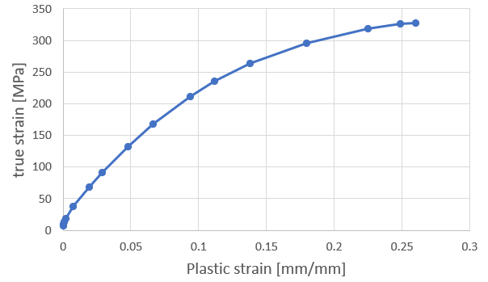
Modelling challenges and unknowns
Simulation scope:
Estimate the maximum force to be applied → input for the tooling design
What is the root cause of the antenna deformation?
physical collision
permanent deformations in plastic domain
Strain hardening
Material hardening due to the plastic deformation
strain hardening for 10% of plastic strain
Simulations outcome:
Assumption: the antenna position shifted only due the physical impact
~10% plastic strain introduced in the copper body
max straightening force of 6.2 kN was defined, used for tooling design
Is the antenna position shifted to due the impact or misalignment, or both?
What is the initial state of the material?
WE DO NOT KNOW IT IN ADVANCE
Several scenarios were simulated

Slide 9
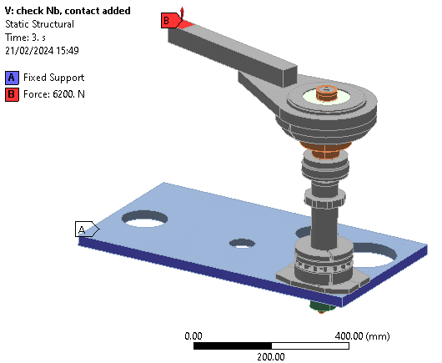
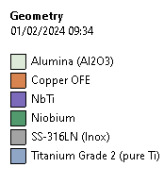
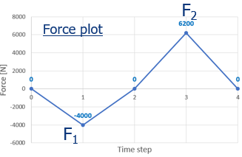

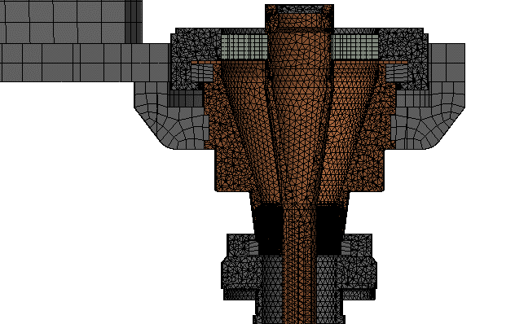
Numerical model and methods
Simulation methods:
Simulating initial copper strain hardening: applying “impact” force to obtain pre-deformed shape and more realistic local change of copper properties
Analysis done in 4 steps
Introductory analysis
Simulating the initial impact on the FPC copper body
Applying bending force F₁ (downwards)
Springback (realizing the force)
Getting pre-deformed shape and copper material hardening for the redressing analysis
Different initial strain hardening is simulated
F2>F1
Actual simulation of the FPC antenna redressing
Applying counter force F₂ (upwards)
Springback
Estimate the force needed to deform back
Material model:
all copper parts are initially in full annealed state;
multilinear isotropic hardening defined;
elastic perfectly plastic model used for other parts
Mesh heavily refined in the copper body region undergoing plastic deformations.

Slide 10
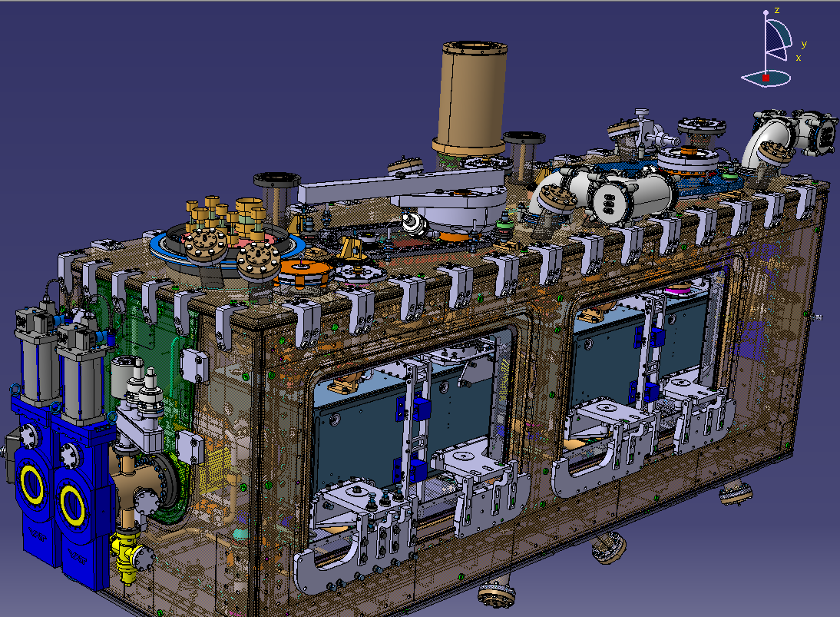
The Tooling
3 main functions:
Transfer the weight of the cavities to the vacuum vessel without additional stress
Fix in position the cavities during straightening
Allow progressive and safe straightening of the copper body while protecting potential highstress zones
Courtesy
Pierre Minginette (CERN)
Details procedure & drawings for tooling assembly and mechanical activities (EDMS 3120529)
Discussed and approved with STFC team (diagnostics, procedure, design of tooling)

Slide 11
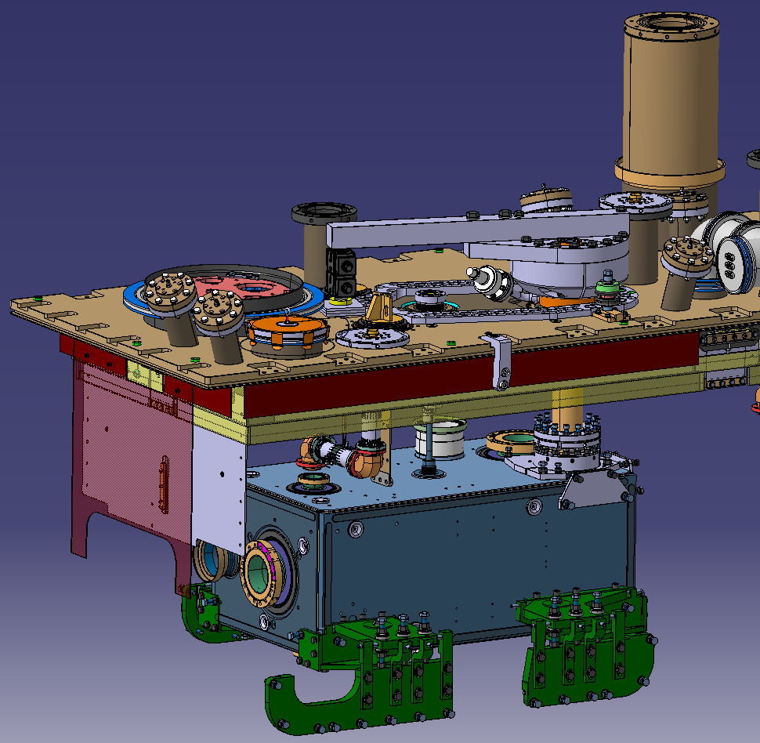
The Tooling
Courtesy
Pierre Minginette (CERN)
III- Straightening lever
(oriented w.r.t. antenna deformation axis)
II- Base locking shell to lock the FPC double tube
I- Support of cavity on vacuum tank
For leak repair of Cavity 2, only this bottom support is needed

Slide 12
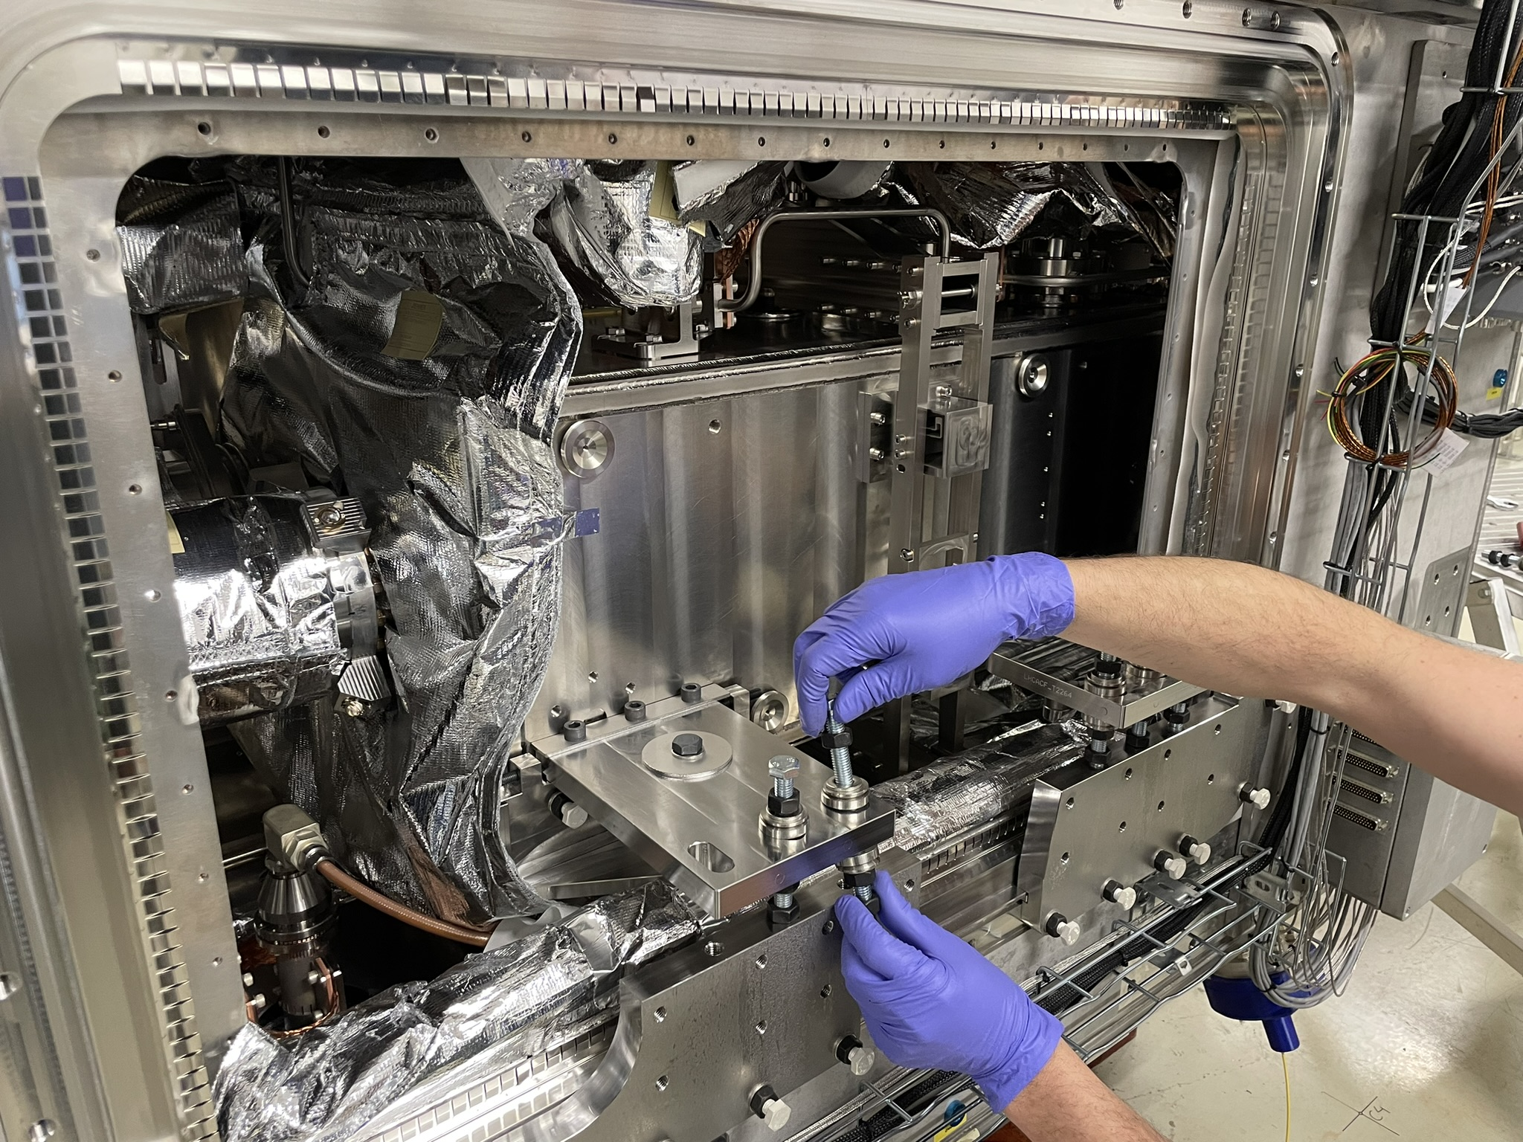
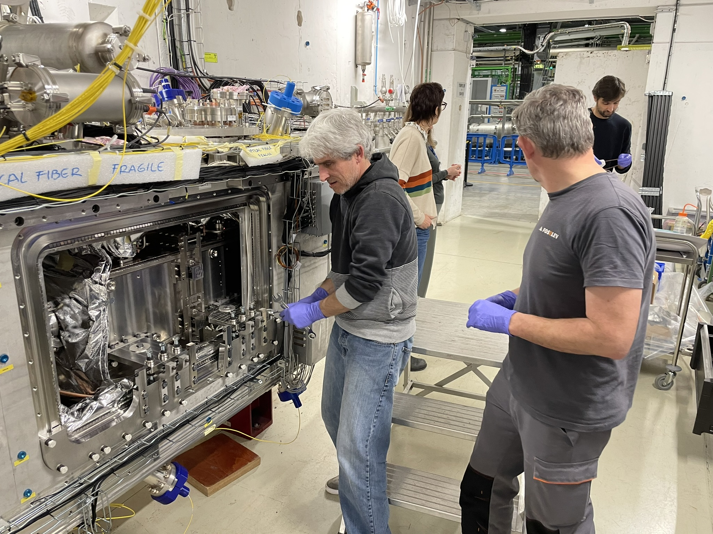
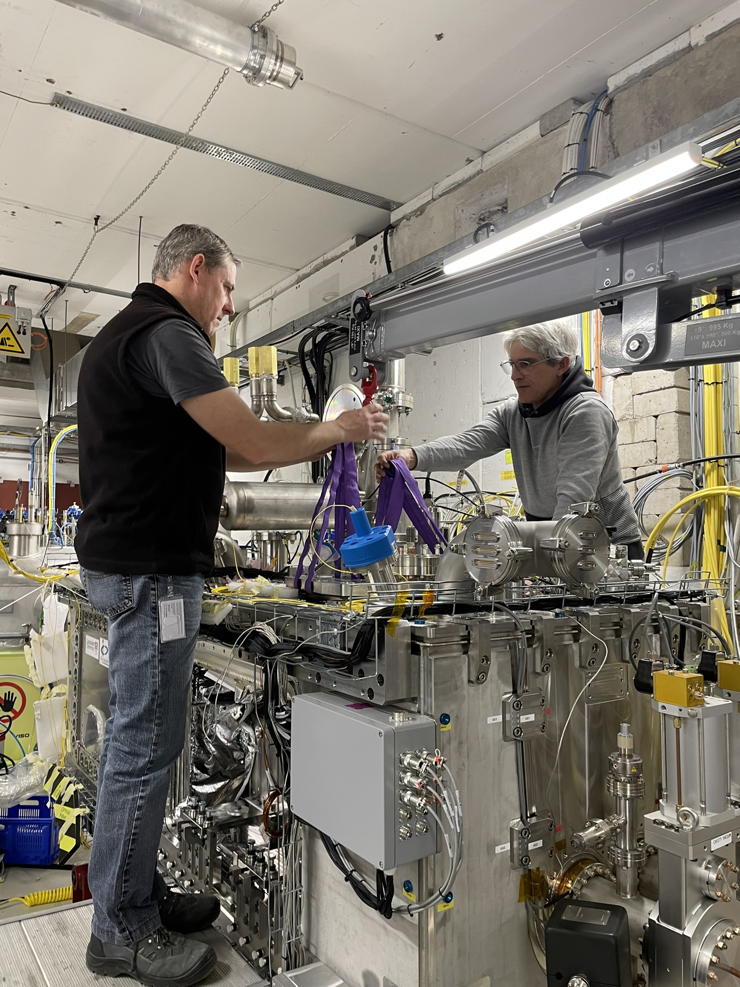
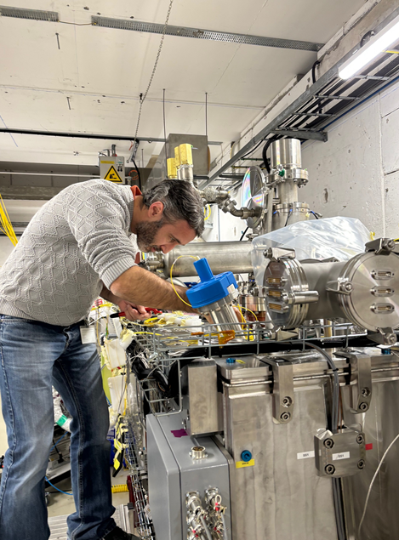
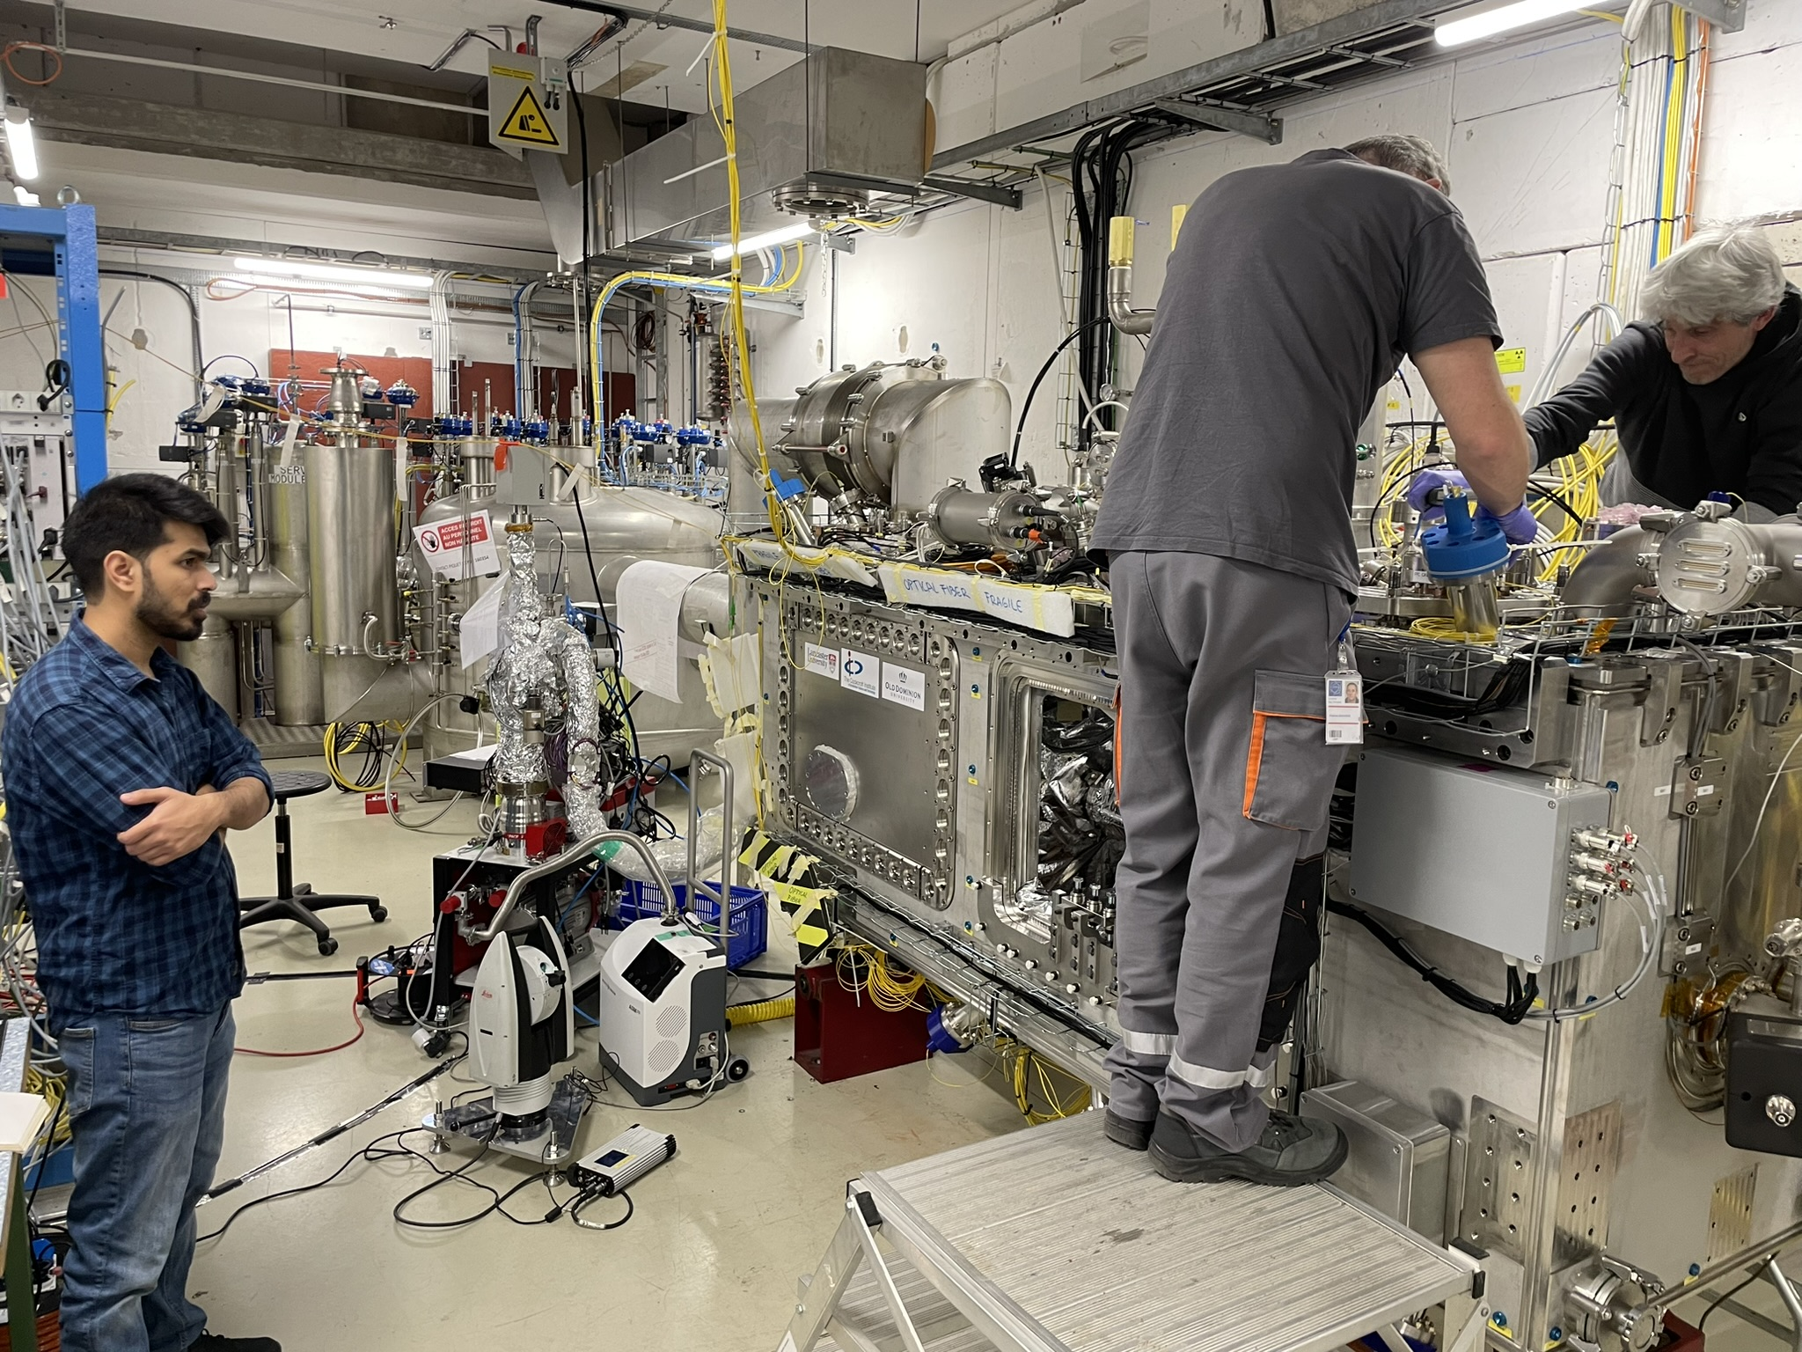
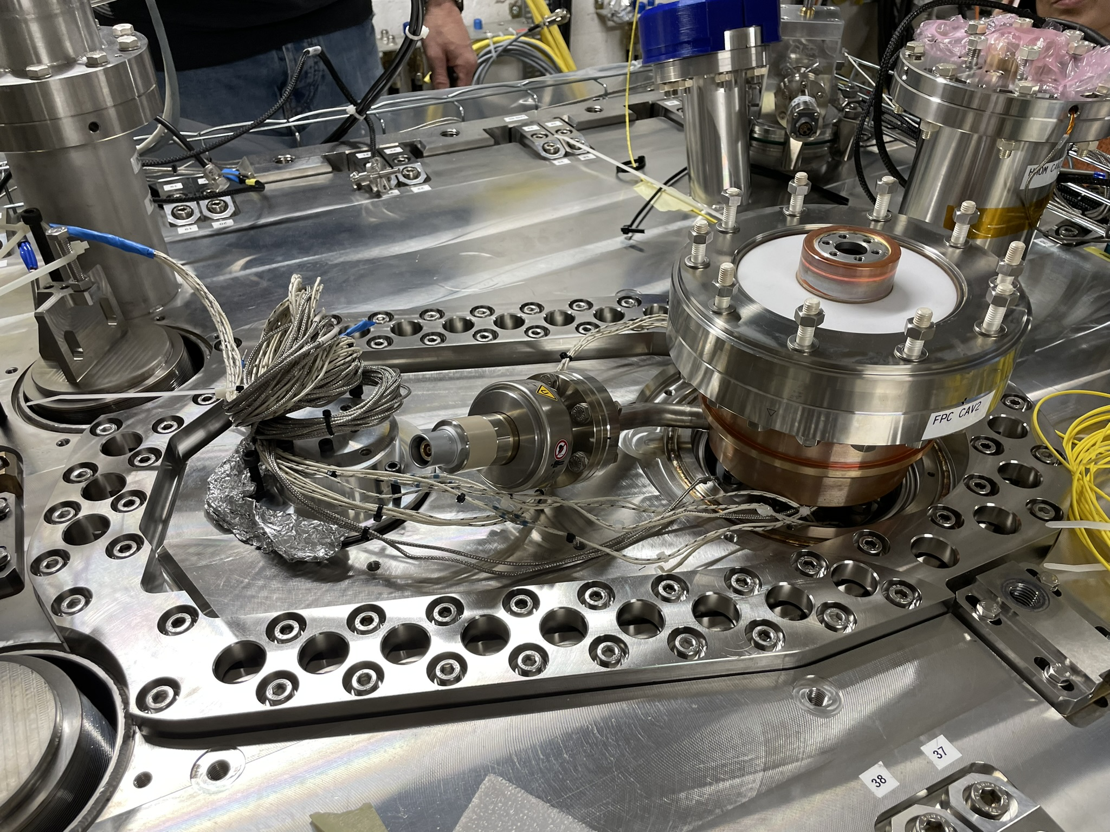
Repair of Cavity #2 FPC (Leak)
  Removal of cavity supporting plate
Hands gymnastics to access this zone
  Doors removed & installation of tooling
  Check of position and torques
  Leak repair
  Live monitoring (survey) of cavity and FPC during all activities
  Access to leak zone (FPC copper body)
Leak closed, allowing cold test of C2 (see presentations this morning)

Slide 13
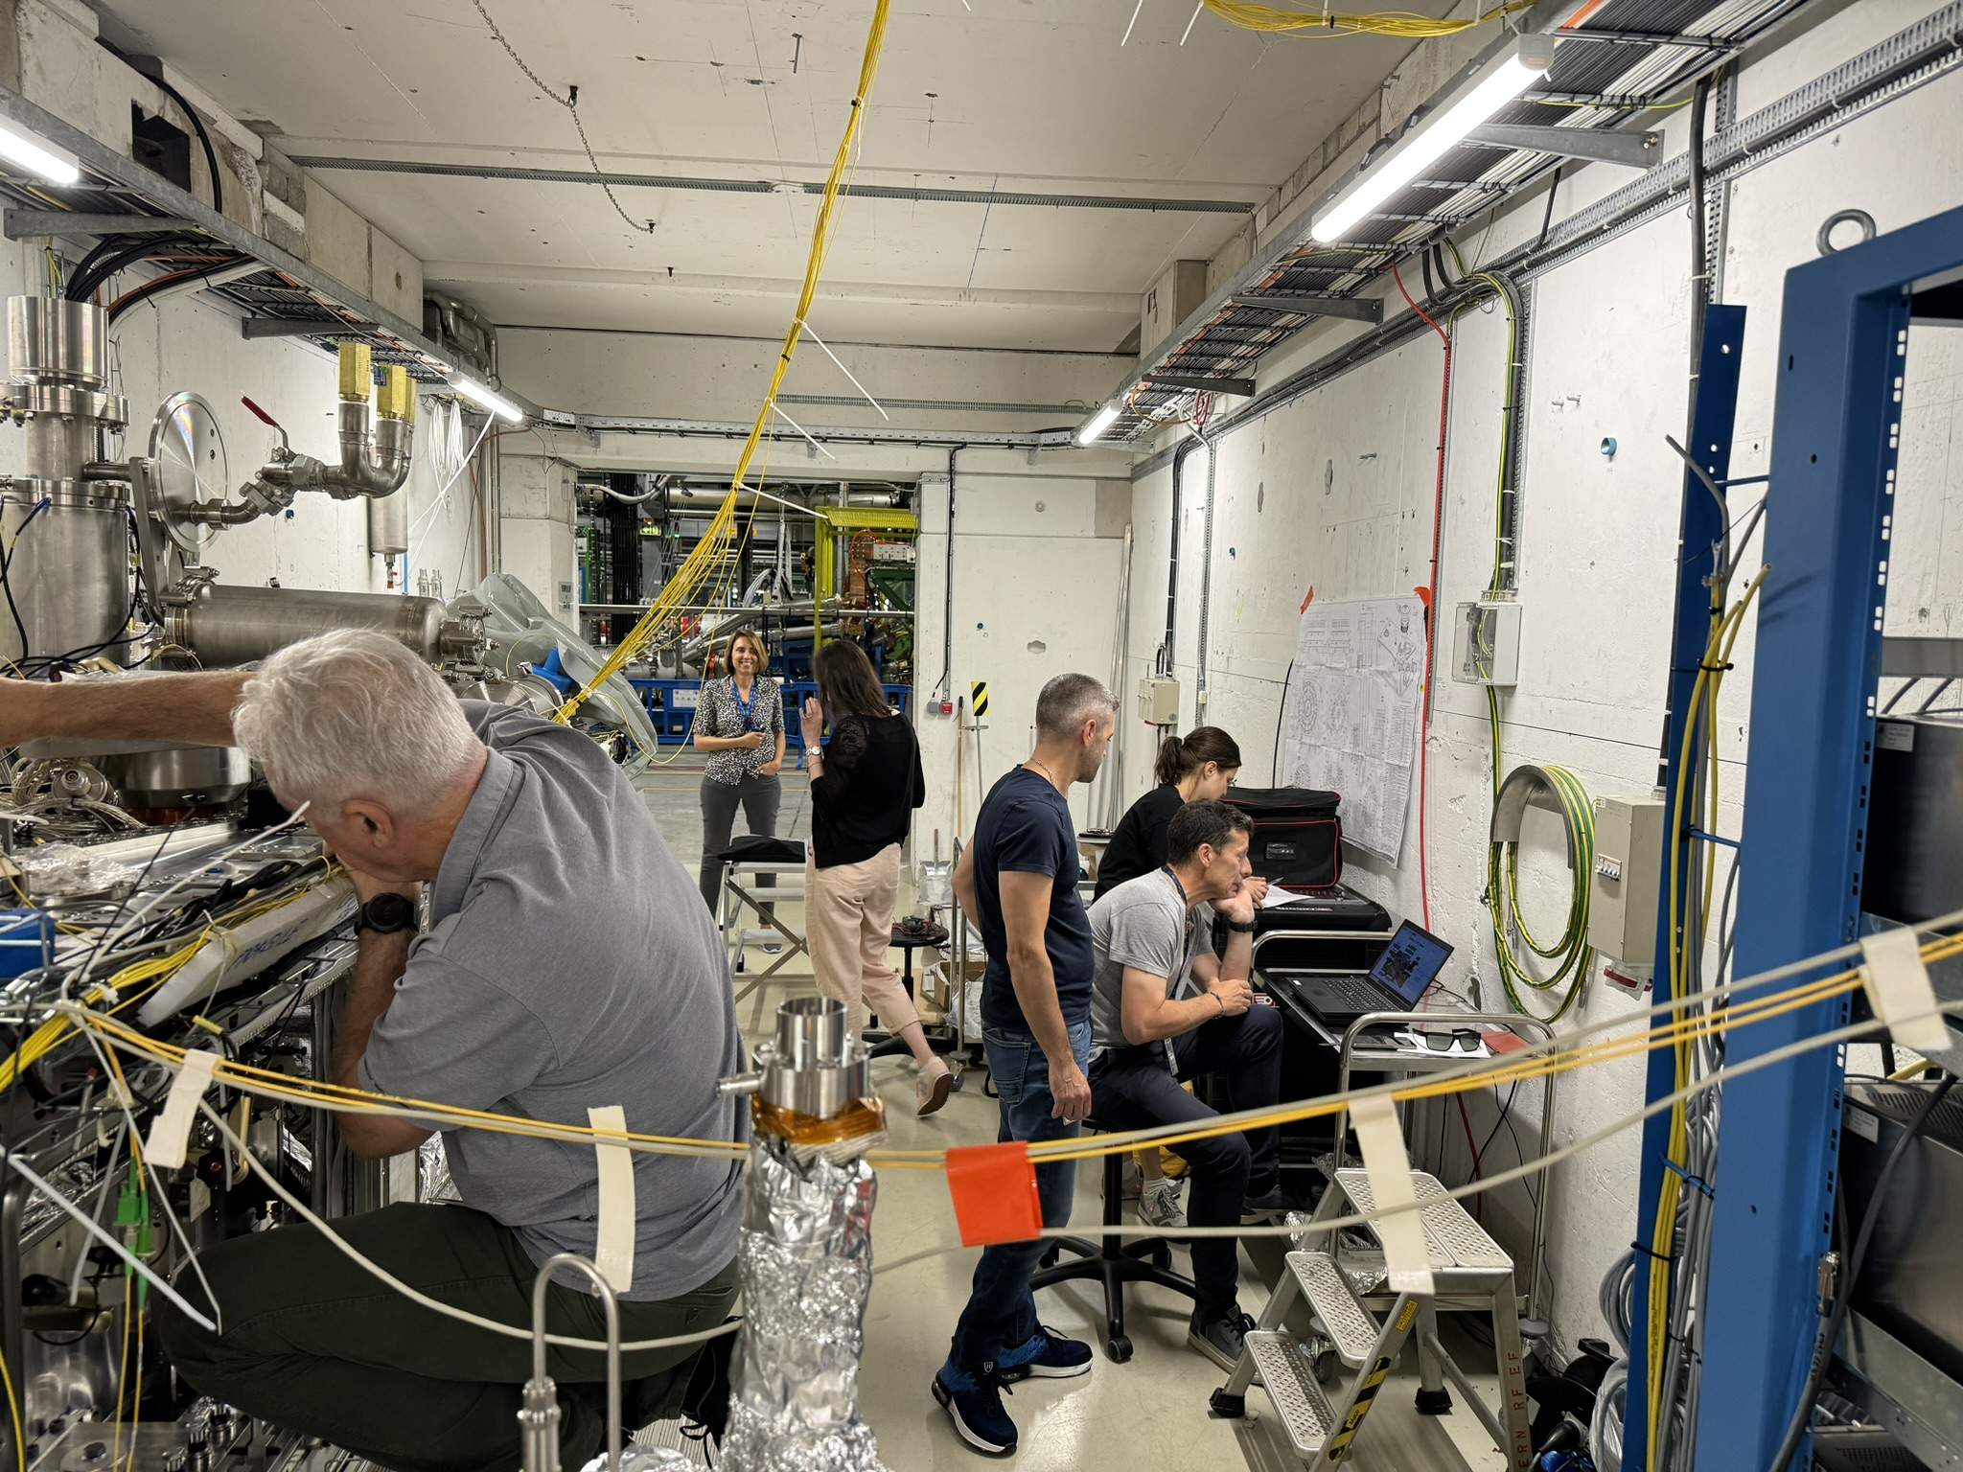
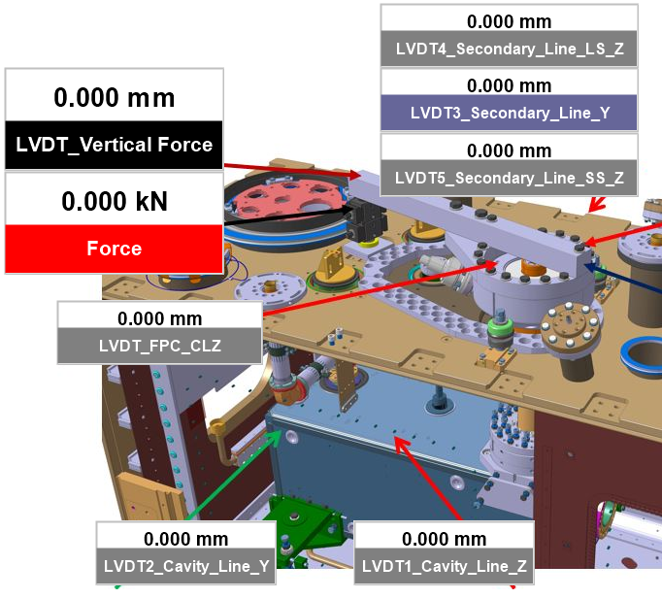
Repair of Cavity #1 FPC (Straigthening)
Comparisons between calculations & measurements of paramount importance (force vs displacement vs strains)
After installation of tooling (similar procedure as Cavity 2), test set-up installed and straigthening in 3 steps
LVDT set up

Slide 14
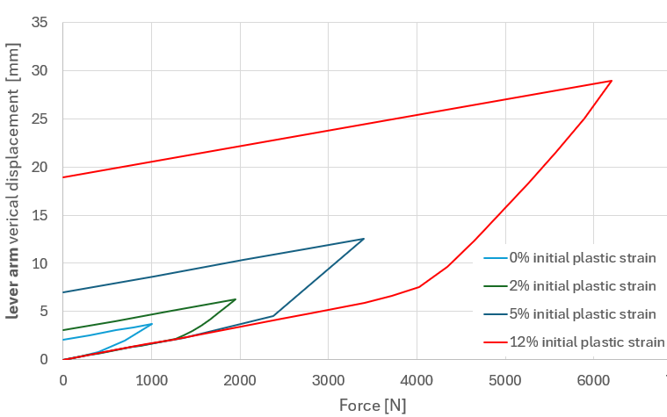
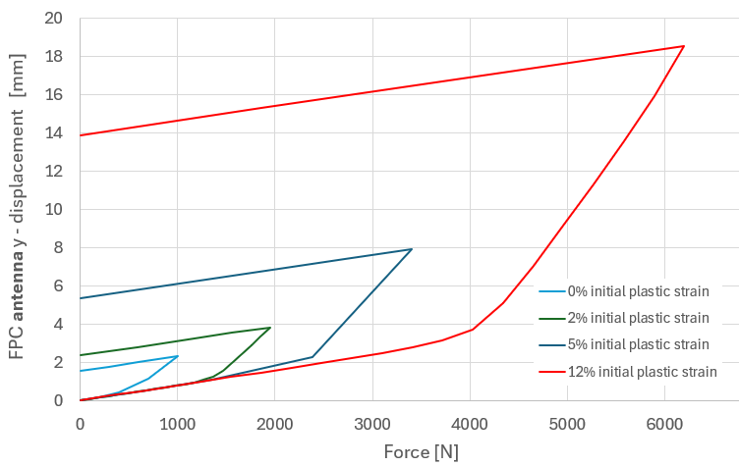
Simulation predictions
Simulation scope:
Find a correlation between lever arm displacement/force and antenna displacement, considering initial strain hardening in the material.
By applying different “collision” force, different copper hardening is obtained.
Simulations outcome:
Force/displacement plots for different initial hardening scenario.
Force vs lever arm's displacement
Force vs antenna's displacement
different levels of residual plastic strain in FPC copper body
Strategy:
Measuring force and lever arm’s displacement
Superposing measurement curves on the simulation curves
Comparing sims and measurements to indicate the initial hardening of FPC copper body
Choosing a curve for estimation of the antenna’s displacement
Antenna's displacement estimated through simulations, not possible to measure
Heavily relying on simulations!

Slide 15
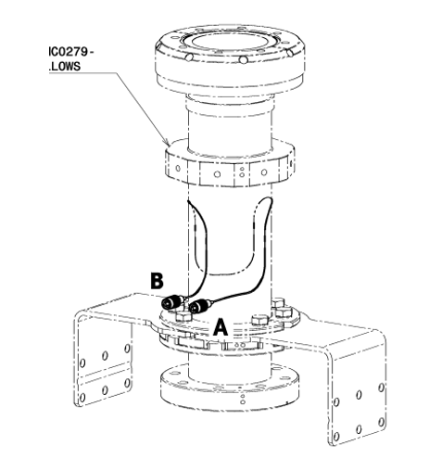
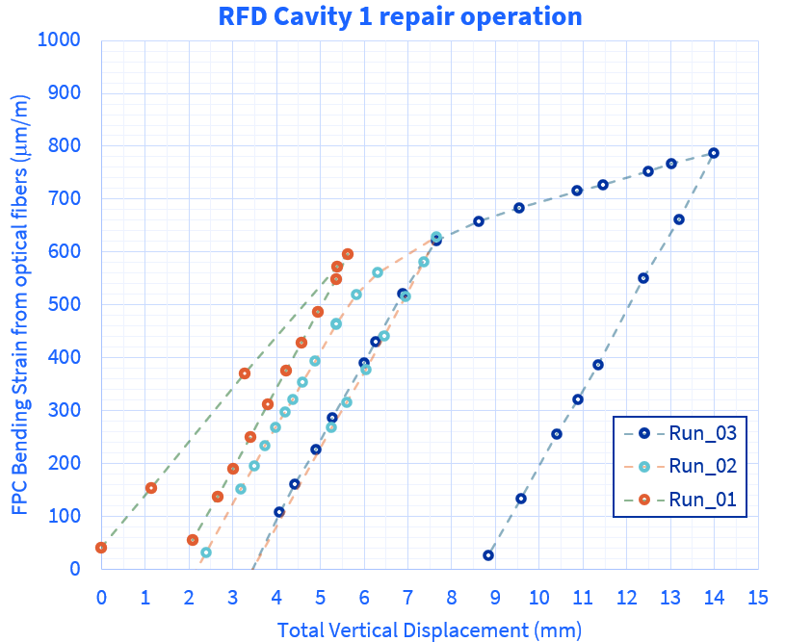
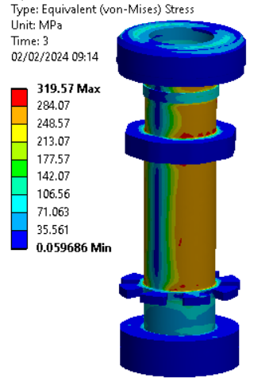
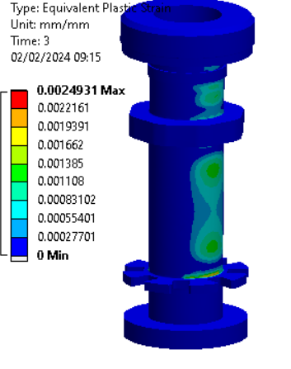
Straightening strategy and limitations
Simulations outcome and general recommendations:
calculated force is to be applied incrementally
electrical checks done simultaneously when applying the force, and after realizing the force
springback effect should not be neglected
Straightening actions divided in 3 steps:
real time model benchmarking: sensors checking, strain comparison, system response
BUT !
with each step we are hardening material even more
Run 1: test
Run 2: test
Run 3: final straightening action
Simulations outcome:
limiting component is FPC tube: 0.2% of plastic strain in the FPC tube if applying 6.2 kN force
careful monitoring of the FPC tube strain
Presence of strain gauges - very useful!
Measurements done by Michael Guinchard & David Thuliez

Slide 16
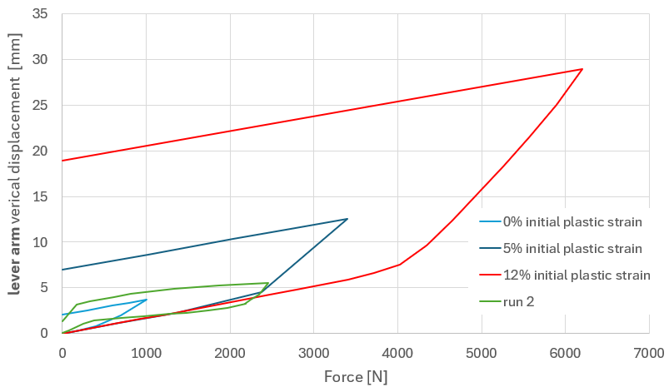
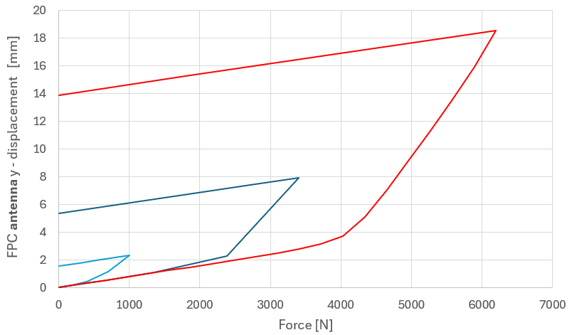
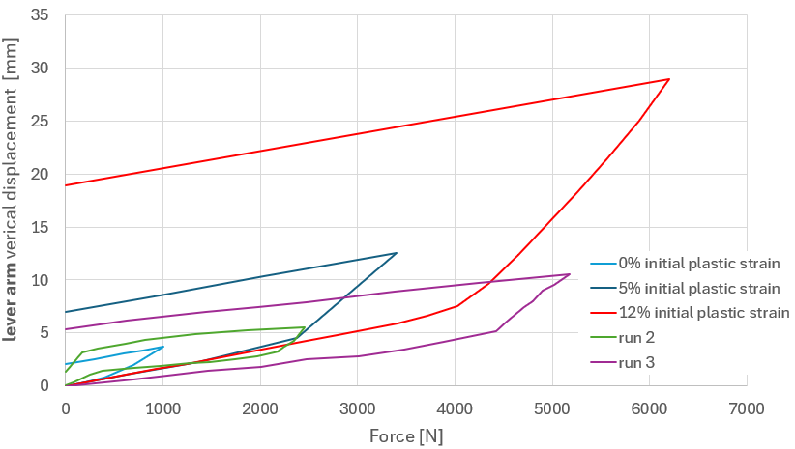
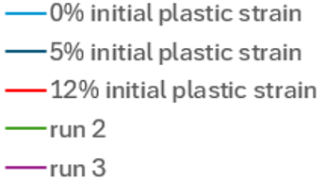
Simulations & Measurement
Force vs lever arm's displacement
Force vs antenna's displacement
RUN 3:Permanent antenna displacement (after springback)
Run 1: apply a force to test structure response, closing gaps in contacts, tool put in place
RUN 2: permanent antenna displacement (after springback)
  Applied force: 1 kN
Run 2: apply a force to test structure response, springback slope, hardening level
Run 3: apply a displacement corresponding to the straightening objective set
  Applied force: 2.5 kN
  Following “5% initial plastic strain” curve
  Springback slope confirmed
  Estimated displacement of the FPC hook: 1mm
  Applied displacement: 10.5 mm
  Measured force: 5.2 kN
  ~15% plastic strain, strain hardening after run 2
  Estimated displacement of the FPC hook: 3.6 mm
  Approaching admissible stress limit for the FPC tube

Slide 17
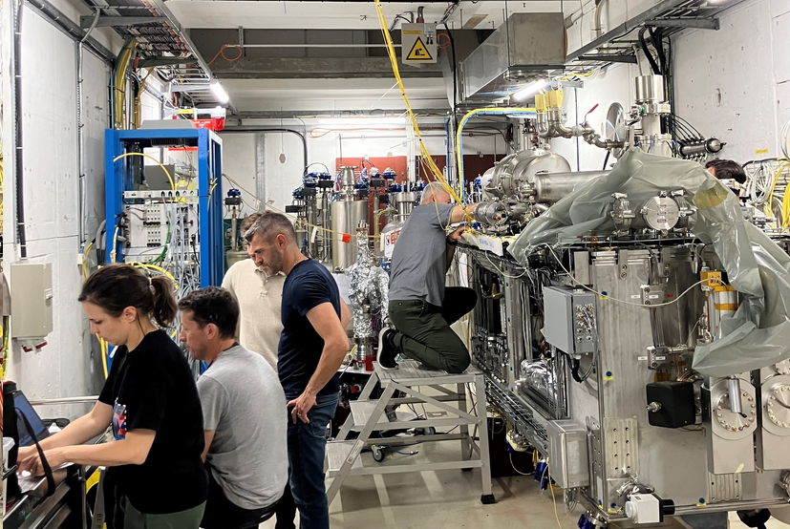
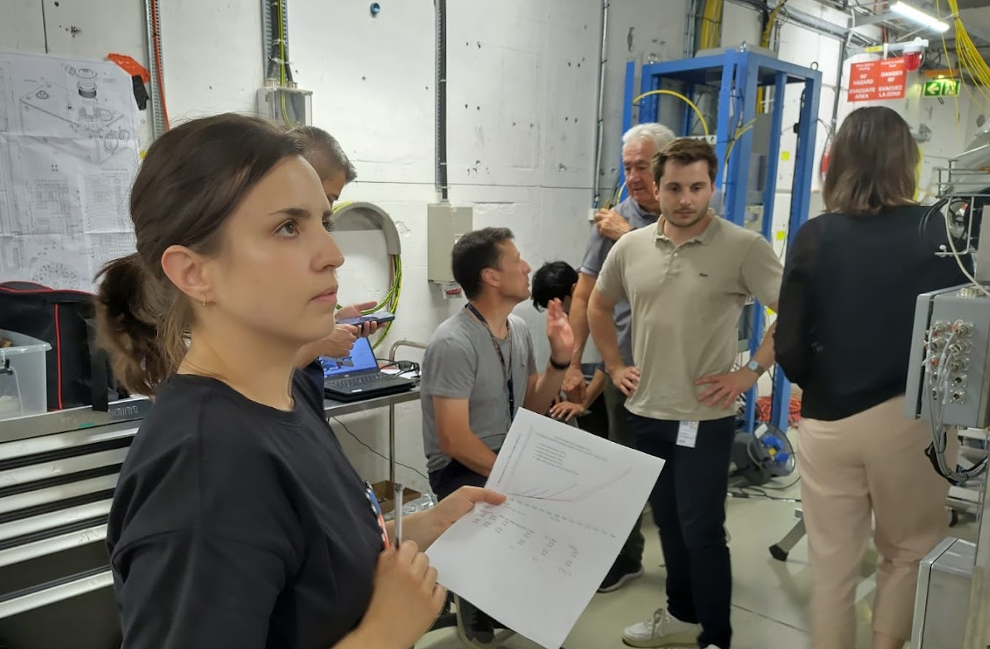
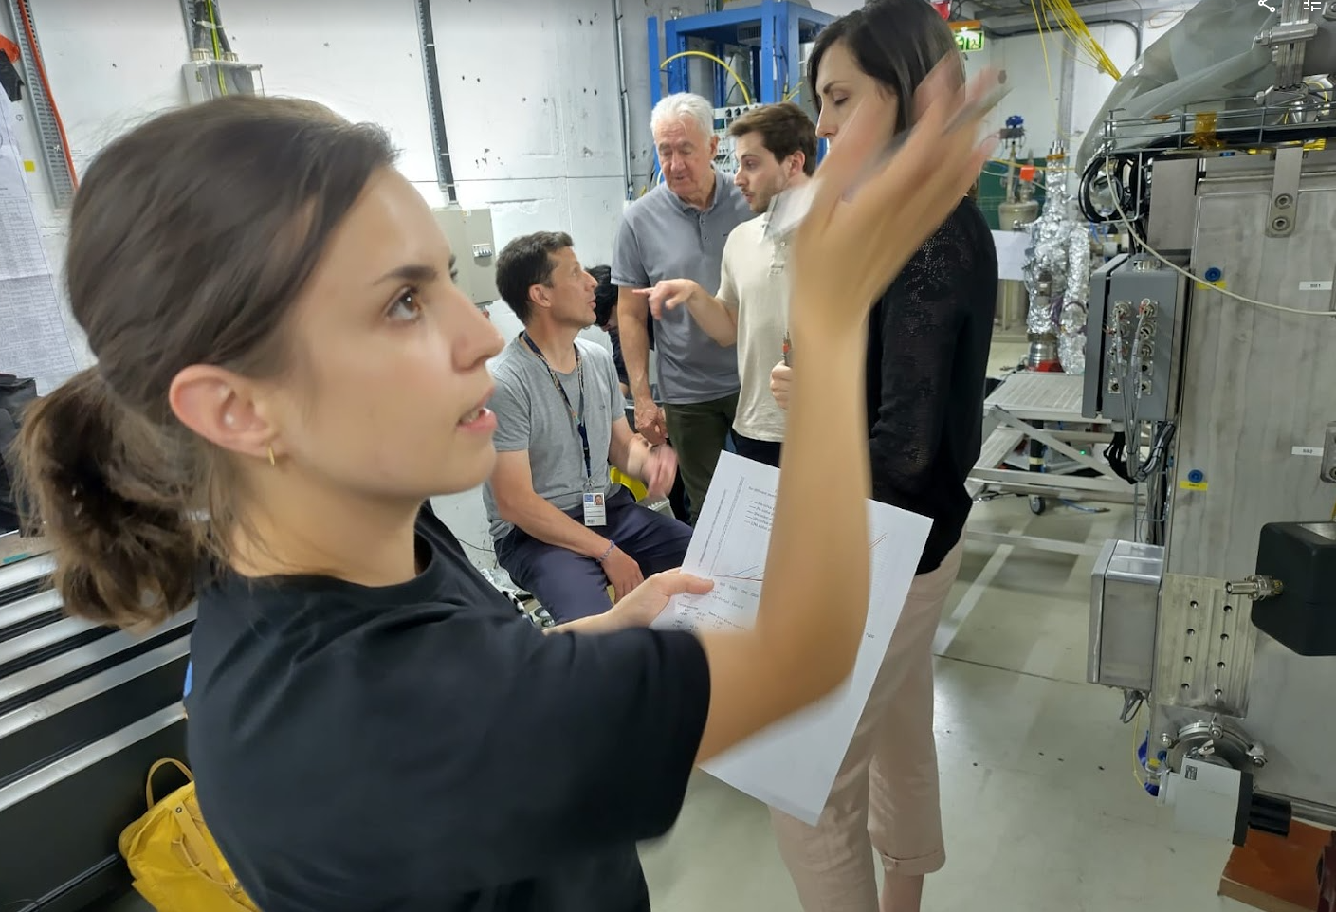
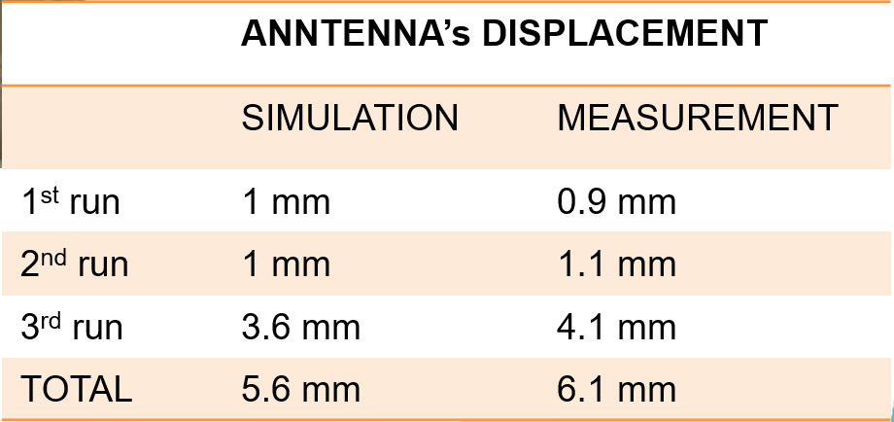
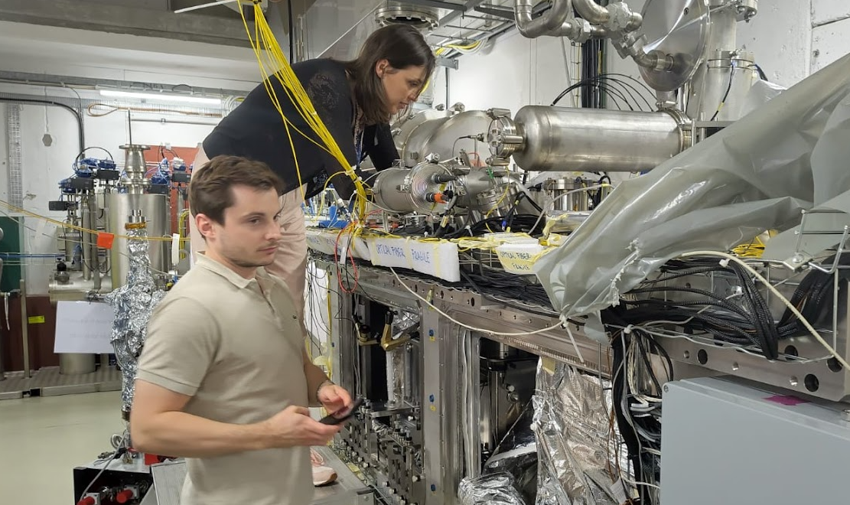
Results
?
?
?
?
 | ANNTENNA’s DISPLACEMENT
 | SIMULATION
1st run | 1 mm
2nd run | 1 mm
3rd run | 3.6 mm
TOTAL | 5.6 mm
Laser tracker measurement and FSI Validation
Praneeth Sarvade
Vivien Rude
Teddy Capelli
Very good coherence between simulation prediction and final measurements!
Antenna’s tip was permanently moved by 6.1 mm
FPC copper body was plastically deformed

Slide 18
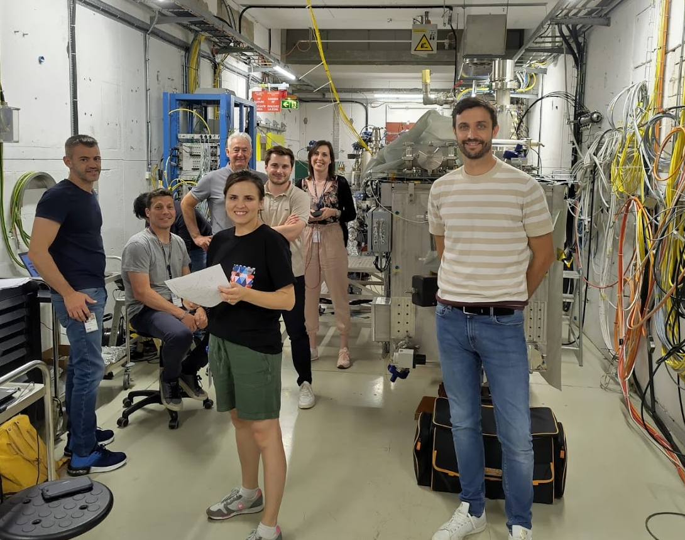
Results

Slide 19
Conclusion
Following the identification of the two non-conformities on the FPC, a repair plan has been defined by CERN in collaboration with STFC.
Advanced simulations have been performed to:
  create representative model (including hardened copper), define repair steps.
  identify stress regions in the cavities during repair;
  give input on tooling design & parameters;
The two cavities have been repaired following defined procedures; all operations went smoothly thanks to a massive effort from different teams.
Root causes are being identified and related NCR in preparation, hold points added in the assembly procedures.

Slide 20
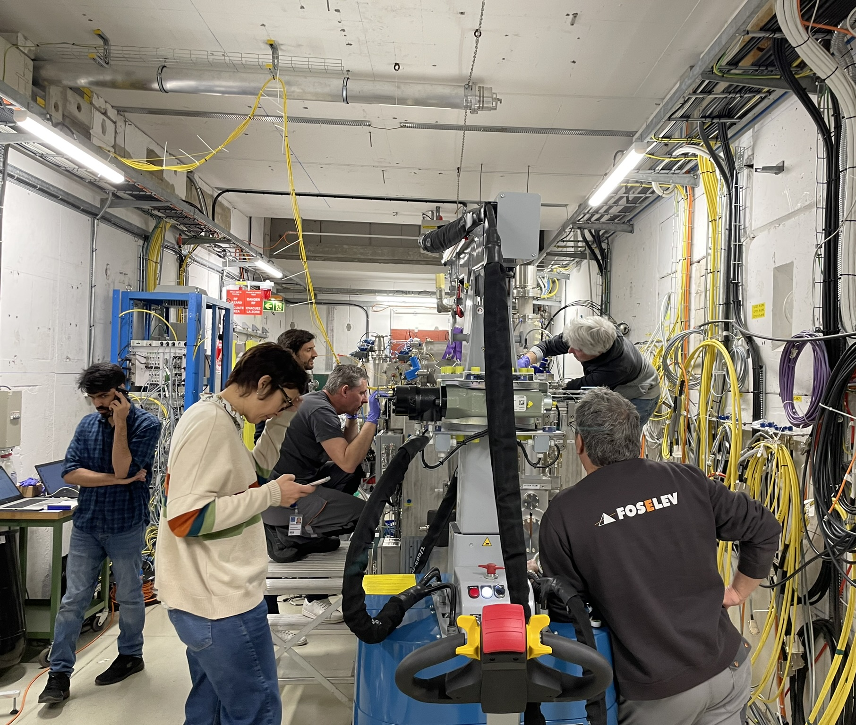
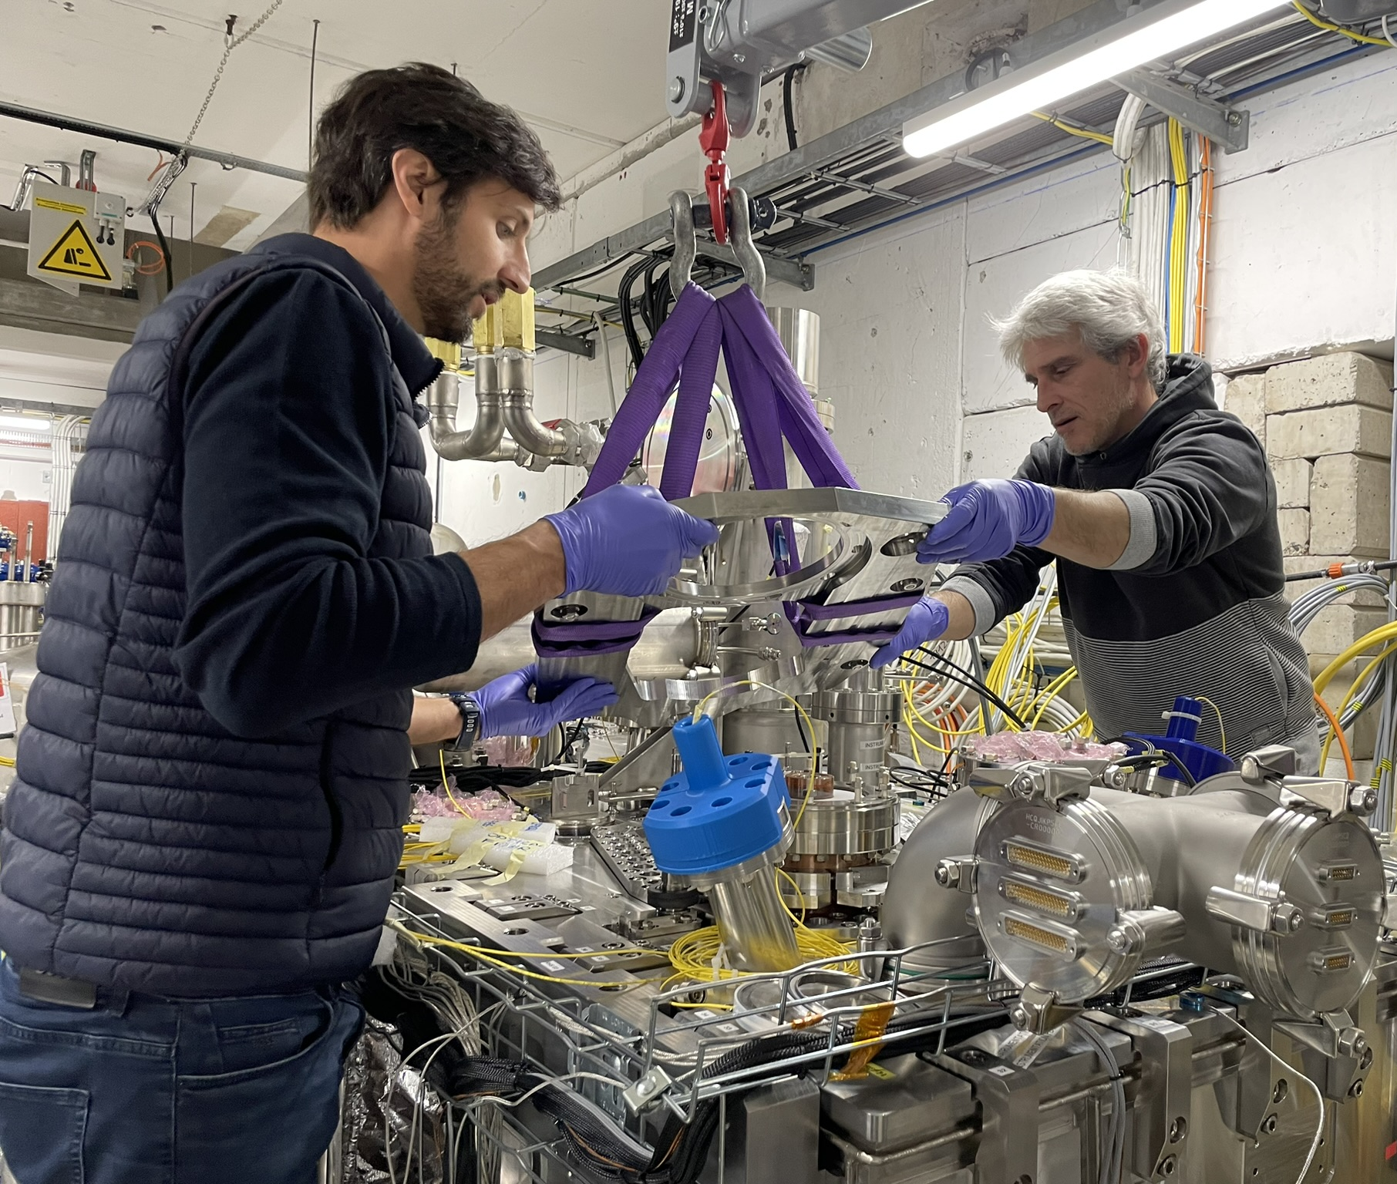
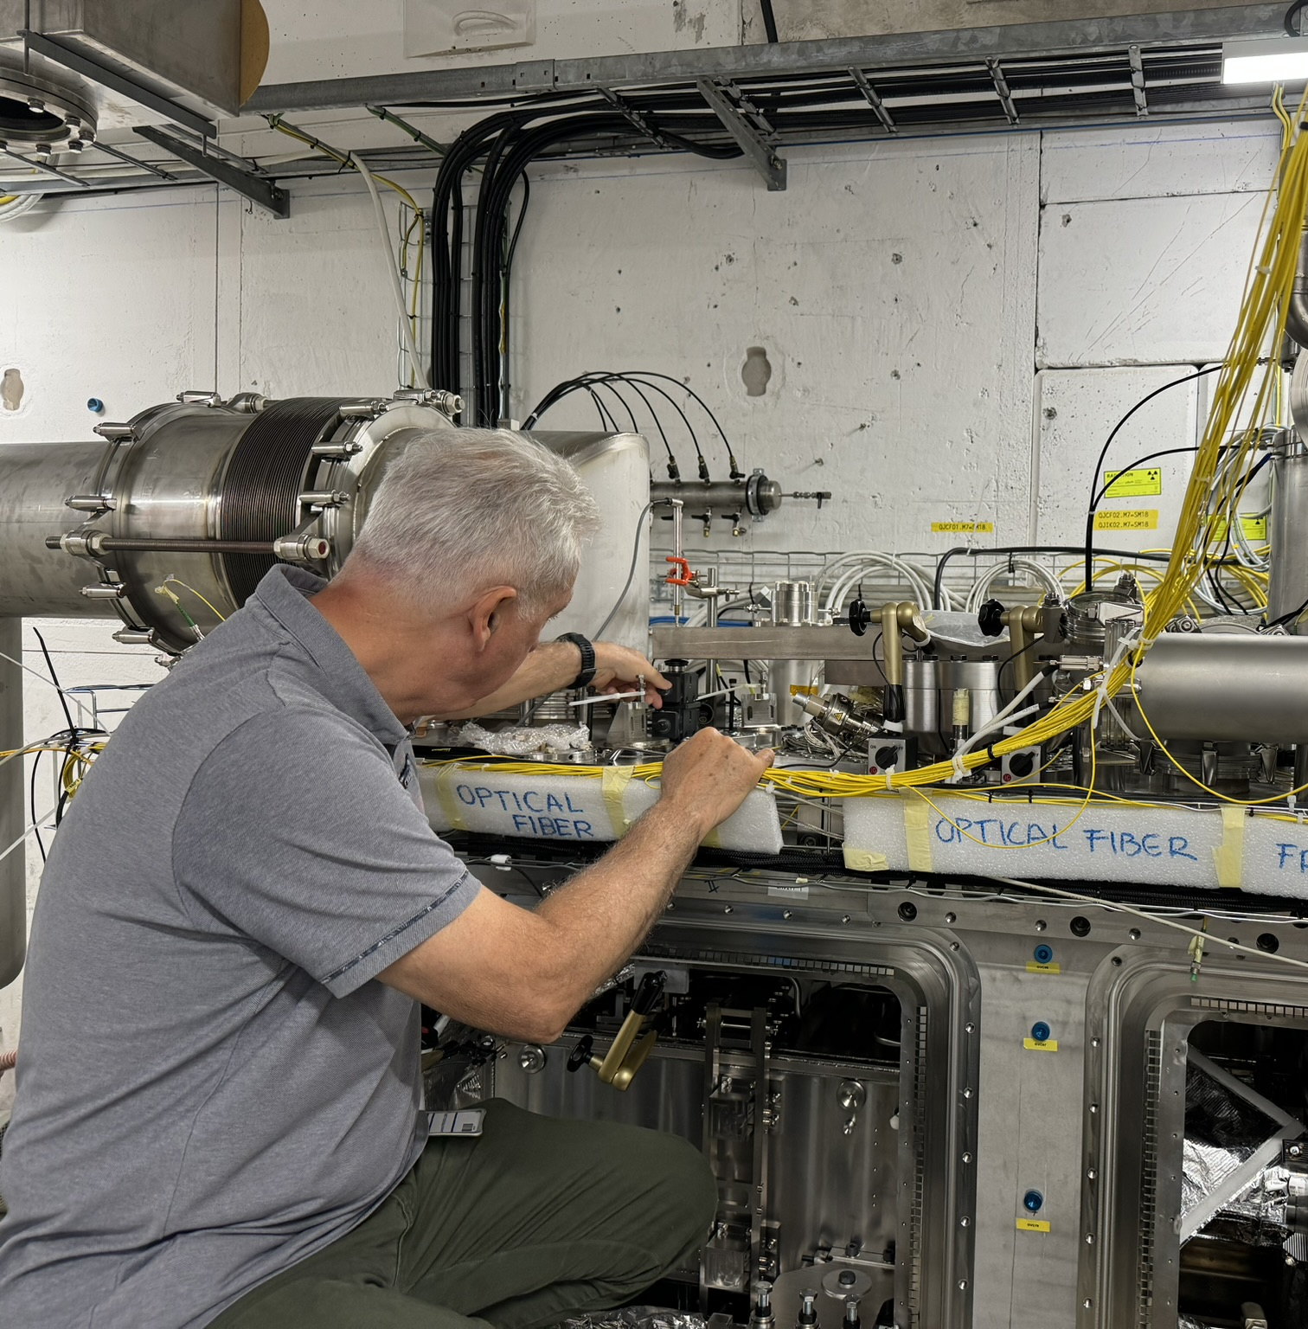
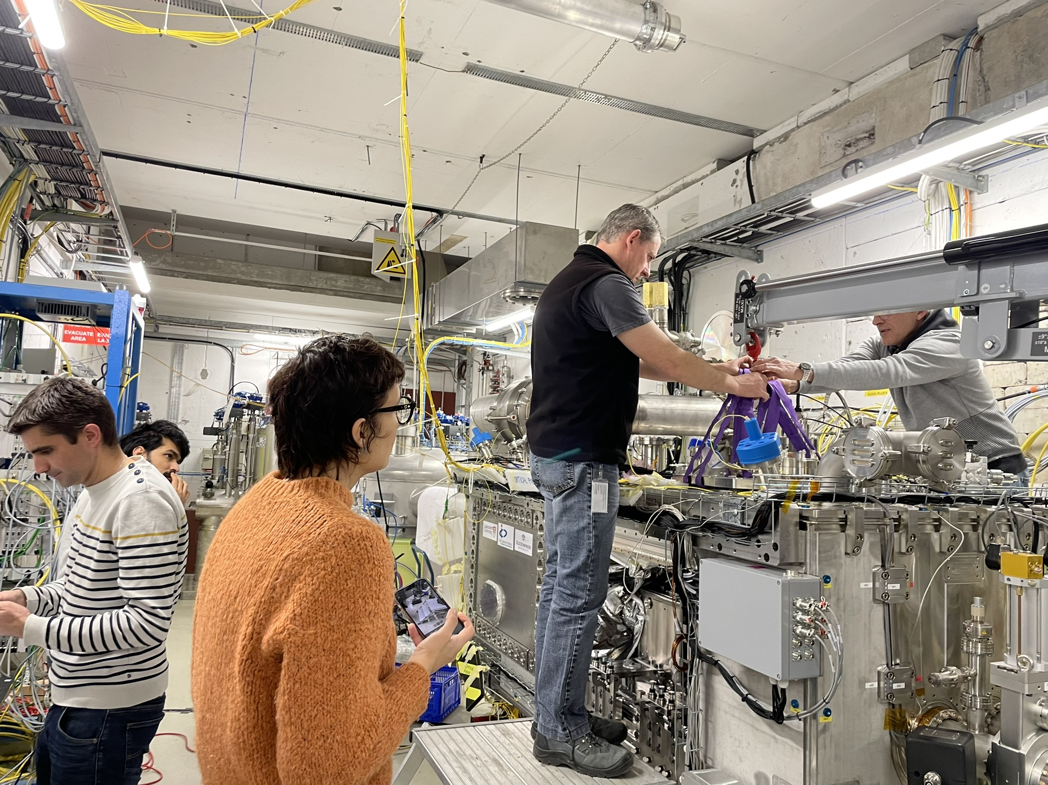
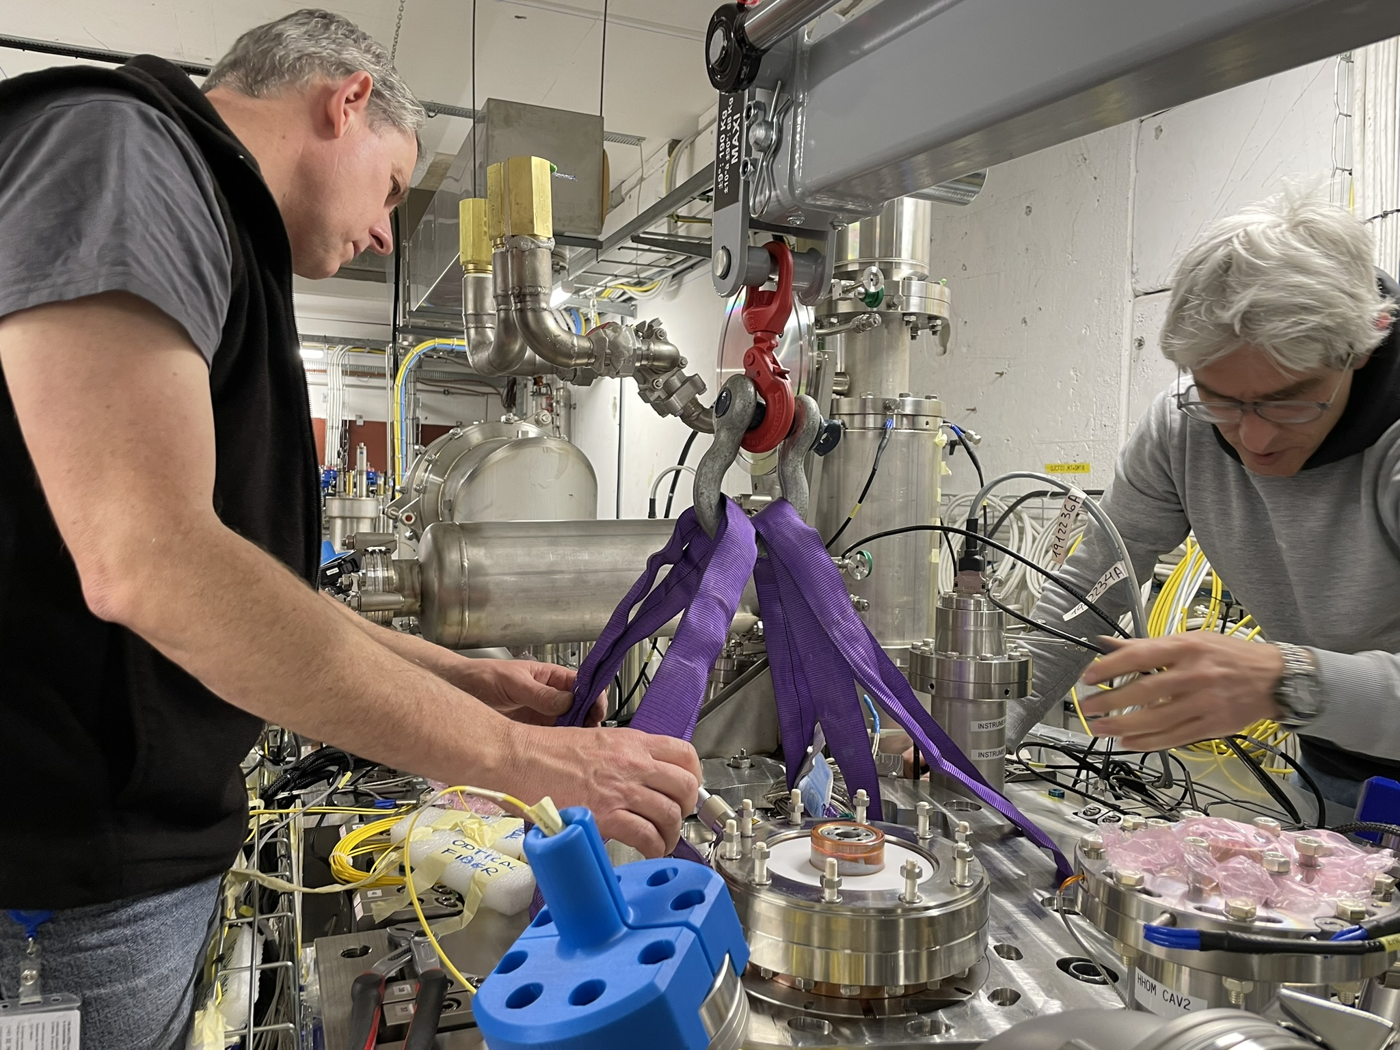
Thank you!

Slide 21


Slide 22
Back-up slides

Slide 23
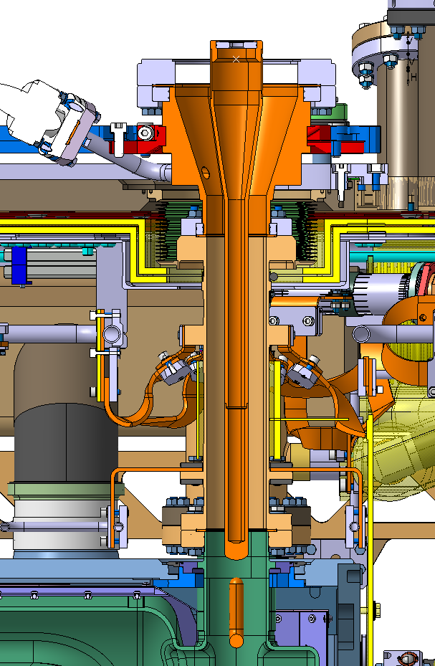
First observations
Courtesy T. Capelli
Preliminary RF checks perfomed by E. Montesinos and his team showed a problem on FPC of cavity #1
A measure of electrical continuity between inner and outer conductor of the FPC showed a contact between the conductors
Visually, the top flange FPC look tilted WRT the surrounding elements
A similar but smaller deformation is also visible on FPC cavity #2 but without electrical short and no undesired behaviour noticed during RF checks. This bending is very likely to have caused the vacuum leak.
α°

Slide 24



FSI Measures – V.Rude
Courtesy T. Capelli
A measure of both the top FPC flange and the lower FPC outer pipe flange (Plane + axis for both) show a deviation as described on the sketches bellow :
CAVITY 1
Equivalent total angle = ~1.6°
Top flange plane
Top flange cylinder used to build axis
Fig .5
Measured using laser tracker – V.Rude
CAVITY 2
Equivalent total angle = ~0.7°
Lower plane FPC outer pipe flange
Lower flange cylinder used to build axis
Fig .6
Measured using laser tracker – courtesy V.Rude

Slide 25




Radiographic measures – A.Porret
Courtesy T. Capelli
X-ray confirms our preliminary observations :
  The hook isn’t bended
  The deviation starts from the top
Set up preview - courtesy A.Porret
3D modelling of the deviation
Result of radiographic measure (see full results in EDMS 2995980)- courtesy A.Porret
Theoretical clash = 0.5mm
(Hook/cavity wall)

Slide 26


Run 1: Simulations & Measurement
Measuring force and lever arm’s displacement
Superposing measurement curves on the simulation curves
Choosing the curve for estimation of the antenna’s displacement
Antenna's displacement obtained through simulations
Permanent antenna displacement (after springback)
Run 1: apply a small force to test tooling and structure response
  Applied force: 1kN
  tooling adjustments, contact sliding, actual deformations difficult to estimate
  Estimated displacement of the FPC hook: ~1mm
  Contact removed

Slide 27

Run 2: Simulations & Measurement
Measuring force and lever arm’s displacement
Superposing measurement curves on the simulation curves
Choosing the curve for estimation of the antenna’s displacement
Antenna's displacement obtained through simulations
Permanent antenna displacement (after springback)
Run 2: apply a force to test structure response, springback slope, hardening level
  Applied force: 2.5 kN
  Measured displacement:
  Following dark blue curve – 5% plastic strain
  Estimated displacement of the FPC hook: 1mm
  Springback slope confirmed

Slide 28

Run 3: Simulations & Measurement
Measuring force and lever arm’s displacement
Superposing measurement curves on the simulation curves
Choosing the curve for estimation of the antenna’s displacement
Antenna's displacement obtained through simulations
Permanent antenna displacement (after springback)
Run 3: apply a displacement corresponding to the straightening objective set
  Applied displacement: 10.5 mm
  Measured force: 5.2 kN
  ~15% plastic strain, strain hardening after previous tests
  Estimated displacement of the FPC hook: 3.6 mm
  During this test, we approached the admissible stress limit for the FPC tube

