Slide 1
Experience on NCRs and future expectations
Julien DEBEUX (CERN) on behalf of HL-LHC WP4
14th HL-LHC Collaboration Meeting – Genoa (Italy) – 08/10/2024

Slide 2
Introduction
Outline
  Brief reminder on NCRs for HL-LHC WP4
  NCRs spotted during RFD-SPS CM fabrication, assembly and reception
  Conclusions + few words about LHC Series
Not part of this presentation
  Manufacturing of CRAB cavities
  NCRs linked to FPCs
Talk of E. Jordan: “RFD NCRs & future mitigation”
Talk of J. Swieszek and S. Barriere:
“RFD-CM Repair overview and highlight”

Slide 3
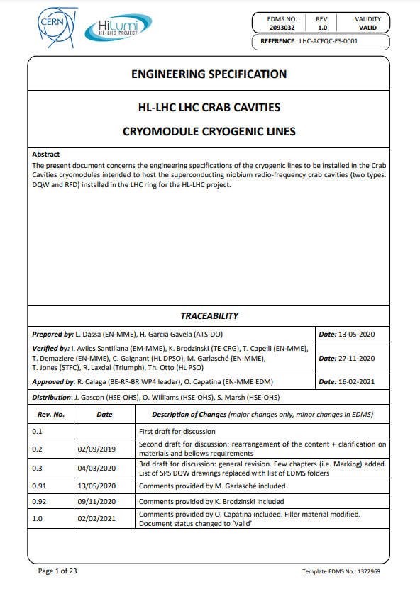
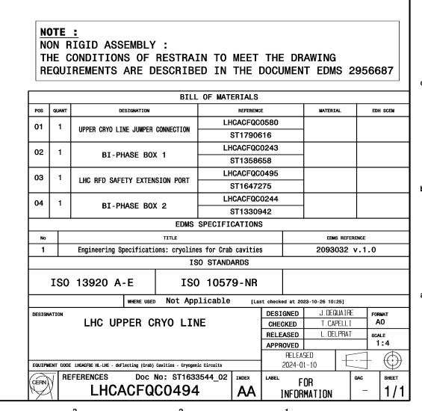
NCRs for HL-LHC WP4
Nonconformity → Non fulfilment of a requirement
  Requirements are specified in Engineering specifications, drawings, procedures, standards, etc.
Courtesy of H. Garcia Gavela: EDMS 2894857

Slide 4
NCRs for HL-LHC WP4
Useful links and documents:
  HL QA training for WP4 (H. Garcia Gavela): EDMS 2894857
  NCR Process: EDMS 1499015
  NCR Process for Collaborations: EDMS 2149457
  NCR Template: EDMS 1501109
  Launching NCR using EDMS: EDMS 1908145
Main contacts:
  HL-Quality contact for WP4: G. Prica, H. Garcia Gavela
  Standards and specifications: L. Dassa
  Manufacturing quality / Welding activities: J. Debeux, M. Benahmed

Slide 5
NCRs for HL-LHC WP4
Persons to be contacted in case of Nonconformity on the HL-LHC WP4 Cryomodule
 | Non-critical |  | Critical
 | 1 or 2 | 3 | 4 or 5
Standards and specifications | L. Dassa |  | O. Capatina
Transport engineering and Tuner | K. Artoos |  | O. Capatina
General Design - Test - RF compliance | N. Valverde |  | R. Calaga
General Design - Design & calculations | T. Capelli |  | O. Capatina
Manufacturing & assembly & Welding & Logistics | J. Debeux / S. Barriere | M. Garlasche
Materials | C. Santos Maldonado | I. Aviles | S. Sgobba
Survey | V. Rude | M. Sosin | H. Mainaud
Vacuum compliance | G. Bregliozzi
Cryogenic compliance | L. Delprat/K. Brodzinski
Cleanroom & RF cavity compliance | N. Valverde |  | R. Calaga
RF Tests | K. Turaj |  | R. Calaga
Low level RF | G. Hagmann |  | R. Calaga
RF Controls | A. Butterworth |  | R. Calaga
RF Power compliance | E. Montesinos
Beam dynamics compliance | N. Mounet | R. Tomas
HL Quality | G. Prica | H. Garcia Gavela
Integration, installation | G. Cipolla | P. Fessia/M. Modena
HL safety | C. Gaignant |  | T. Otto
Transport and handling on site | M. Perez Ornedo | C. Bertone
Safety conformity | D. Tshilumba/L. Dassa |  | S. Marsh
Configuration | M. Zerlauth
EDMS 3014549
Who (from CERN) should sign the NC will depend on the component/system/domain and the level

Slide 6
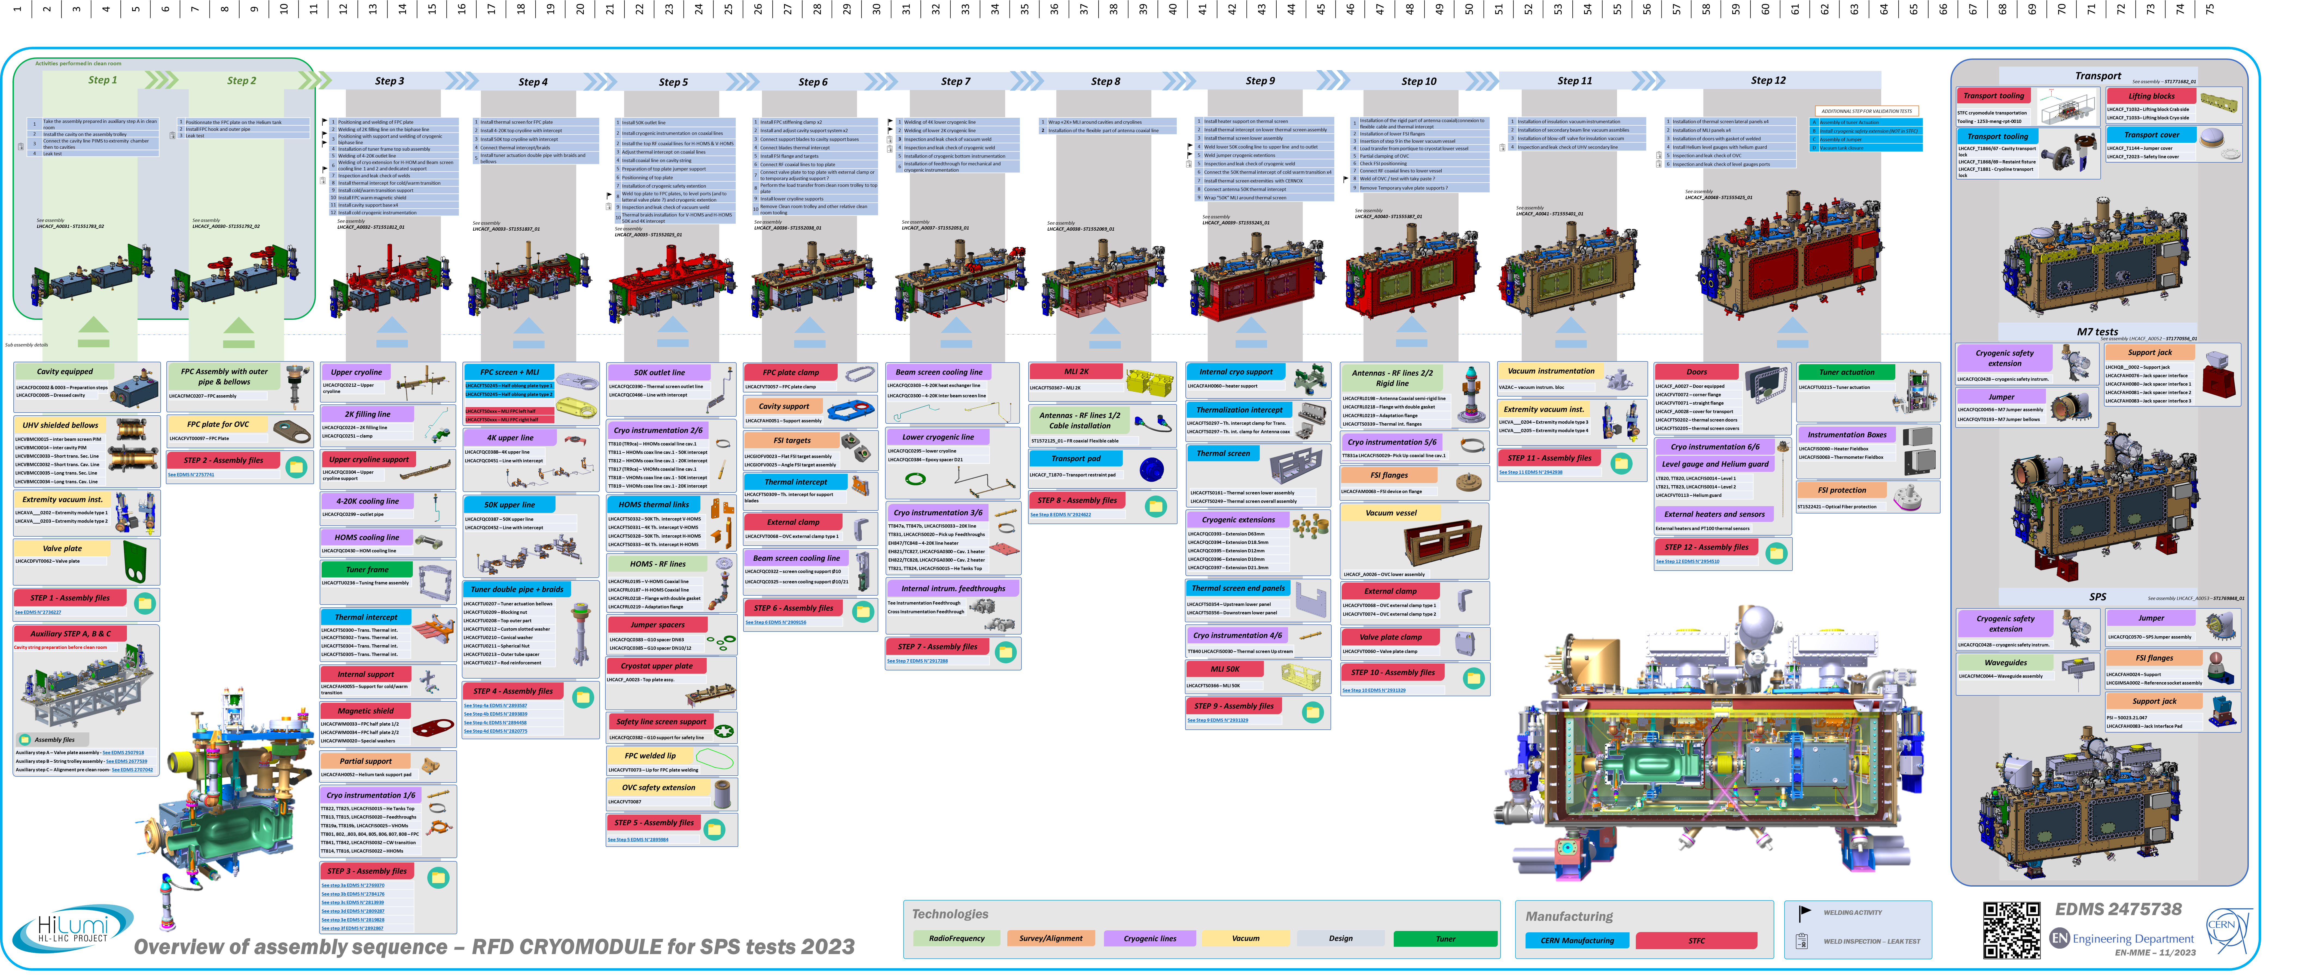
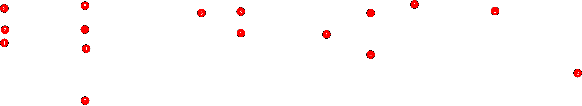
Overview of NCRs for RFD SPS
2
Between 30 to 35 NCRs reported on EDMS
12 main steps of assembly, ~1300 items (~900 drawings), etc.

Slide 7
NCRs during RFD-SPS CM fabrication, assembly and reception
Bellows and base materials

Slide 8
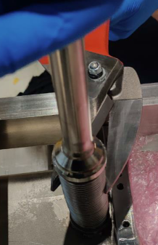
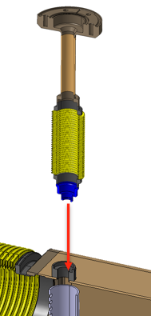
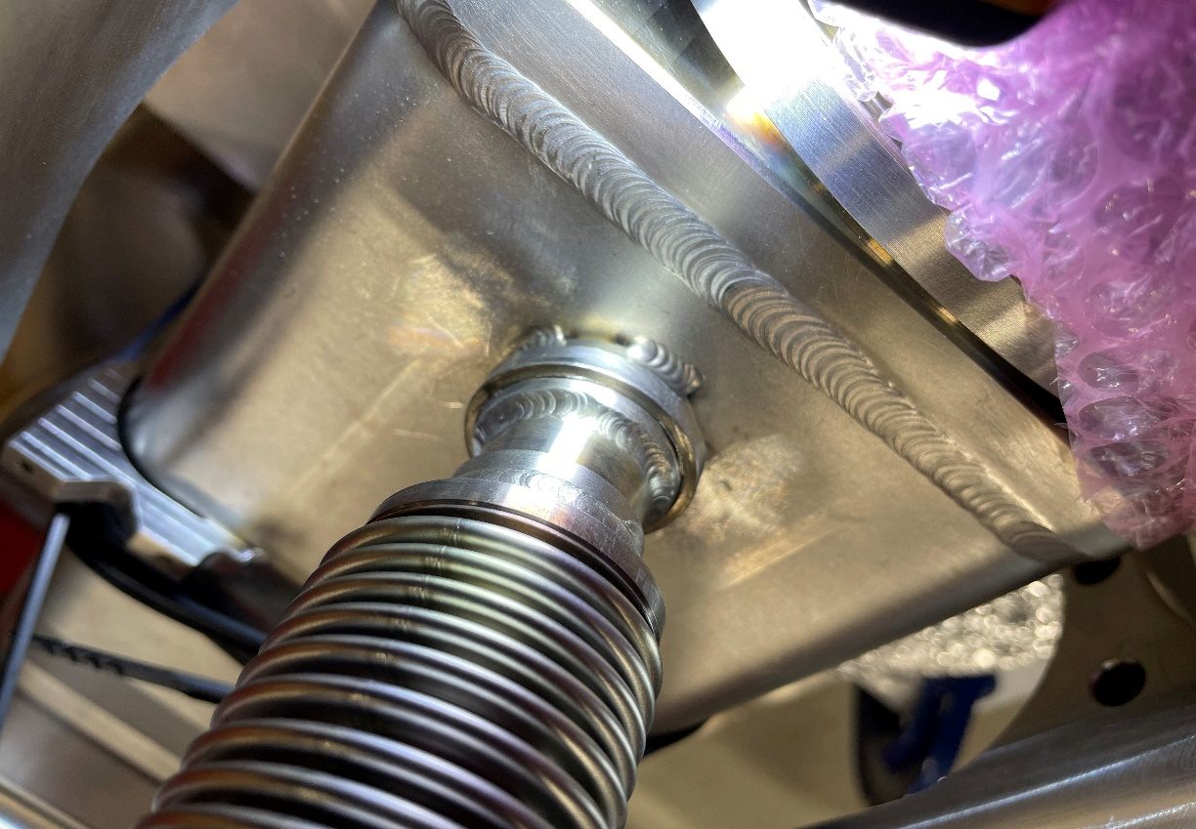
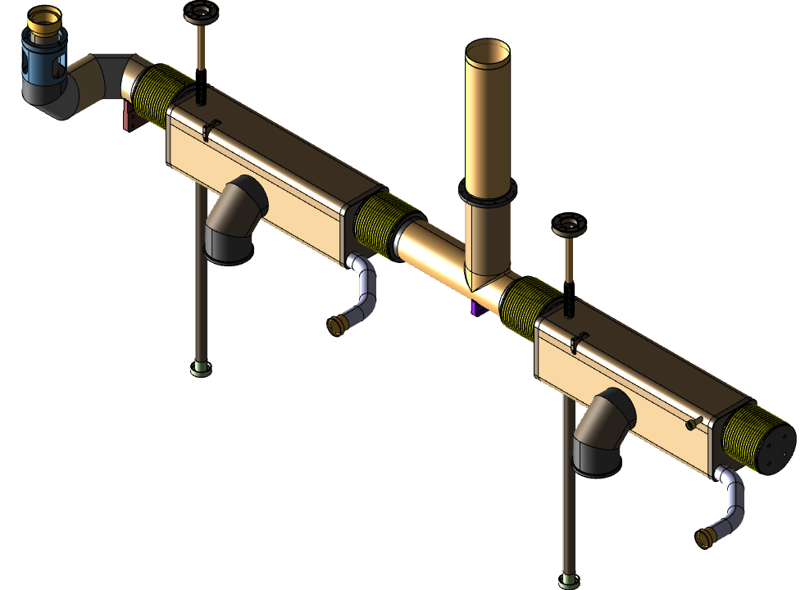
NCRs spotted during RFD-SPS CM Components fabrication
~10 NCRs in total
Bellows
The NCRs are linked to:
  2-ply bellows
  Design and Test Pressure
  Dents
  Base material
  Dimensional aspect
Biphase boxes – Level Port Bellows
Bellows proposal from subcontractor
Approval focused on dimensions and base material
Essentially discussed / approved by mail
Info on «2-ply» missed during discussions

Slide 9
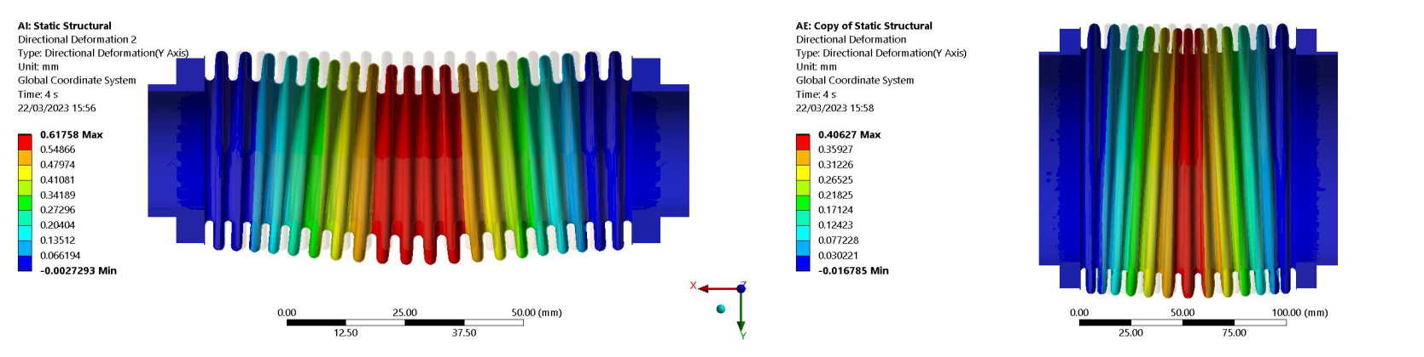
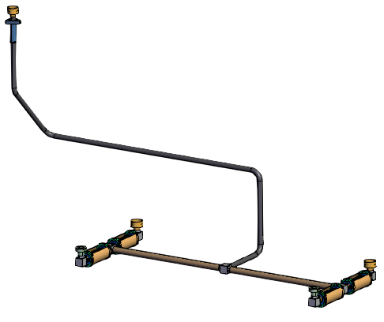
NCRs spotted during RFD-SPS CM Components fabrication
~10 NCRs in total
Bellows
The NCRs are linked to:
  2-ply bellows
  Design and Test Pressure
  Dents
  Base material
  Dimensional aspect
Bellows for cryogenic lines
Design pressure is 2.1 barg and test pressure is 2.7 barg.
The supplier used a design pressure of 1.8 barg based on test pressure 2.7 barg + coefficient of 1.5 ; while the actual coefficient in CERN Specification is 1.25.

Slide 10
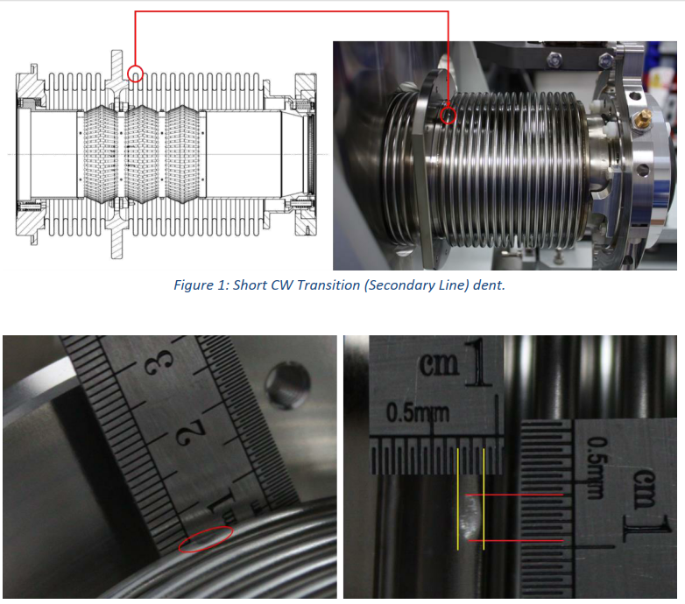
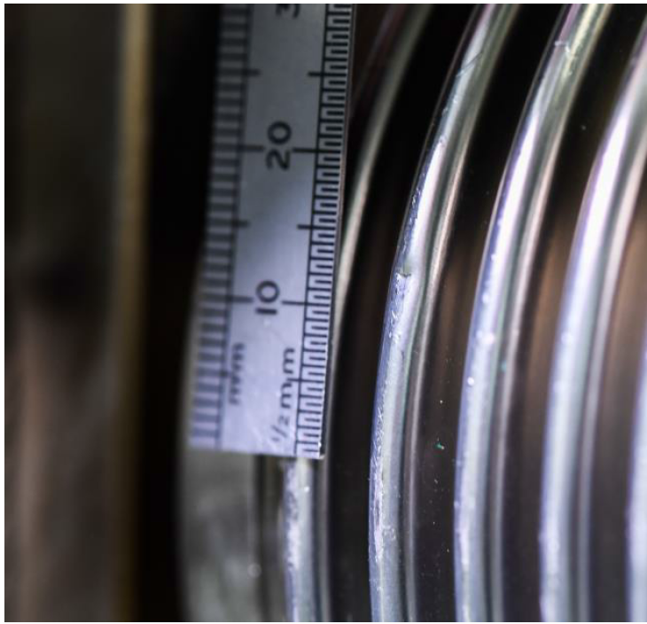
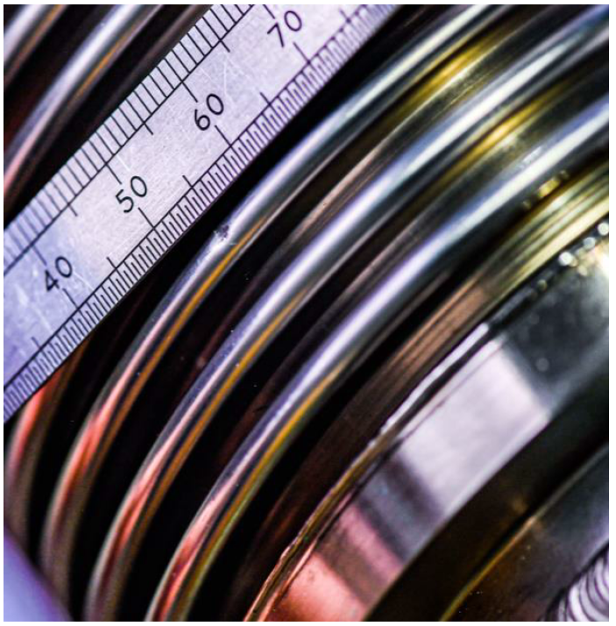
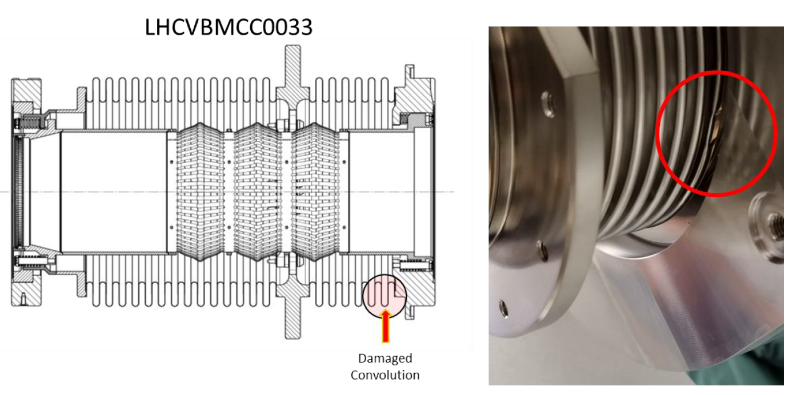
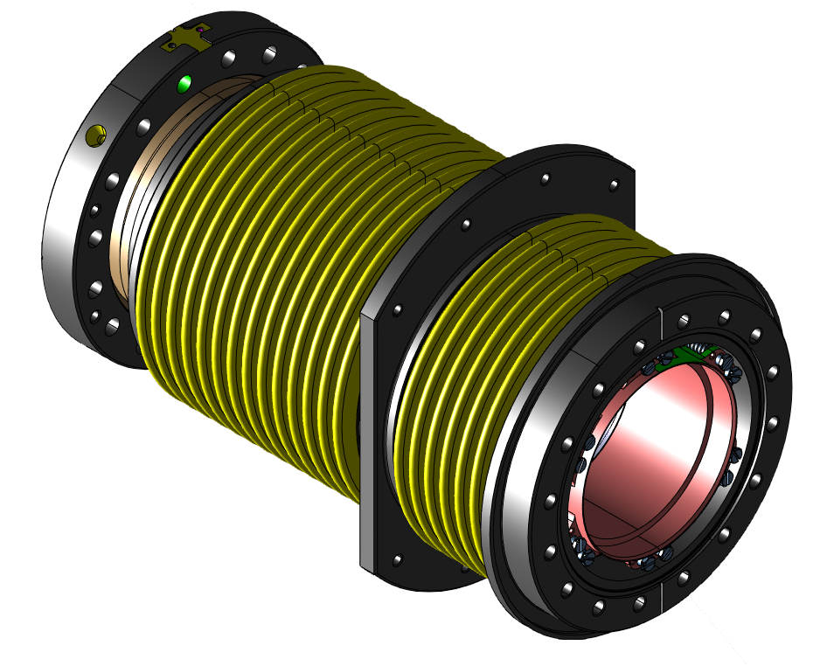
NCRs spotted during RFD-SPS CM Components fabrication
~10 NCRs in total
Bellows
The NCRs are linked to:
  2-ply bellows
  Design and Test Pressure
  Dents
  Base material
  Dimensional aspect
Bellows for cryogenic lines and CWT

Slide 11
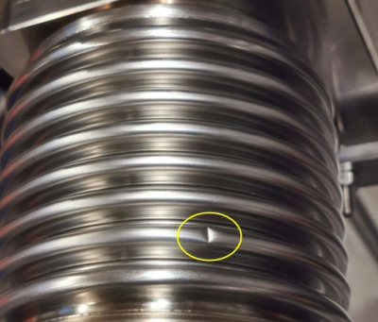
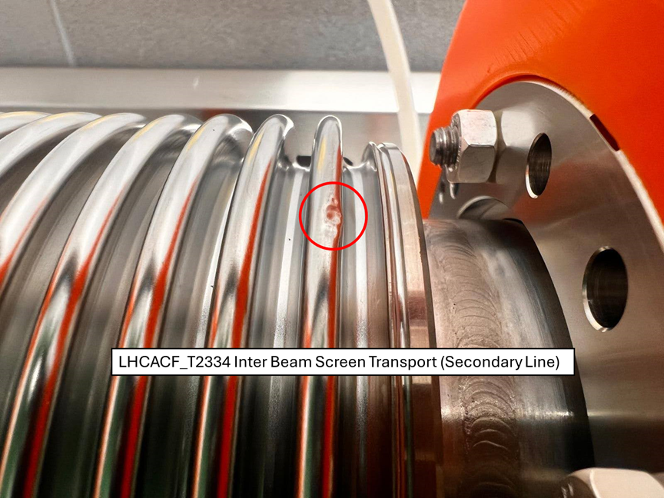
NCRs spotted during RFD-SPS CM Components fabrication
Parallel with LHC Series (RFD Biphase & DQW PIMs)
!
!
Notes:
Expliquer les causes des dents.
Activités liée au transport / manipulation pour le PIMs.

Slide 12
NCRs spotted during RFD-SPS CM Components fabrication
~10 NCRs in total
Bellows
The NCRs are linked to:
  2-ply bellows
  Design and Test Pressure
  Dents
  Base material
  Dimensional aspect
Cryogenic lines bellows, blade support and tuner bellows
Collars in EN 1.4429 2D Forged instead of 3D Forged
Convolutions in EN 1.4404 (EN 10088-2) instead of EN 1.4435 (EN 10028-7)
Missing Cobalt assessment or Cobalt content >0.3%
No magnetic permeability values given
No inclusion content reported

Slide 13
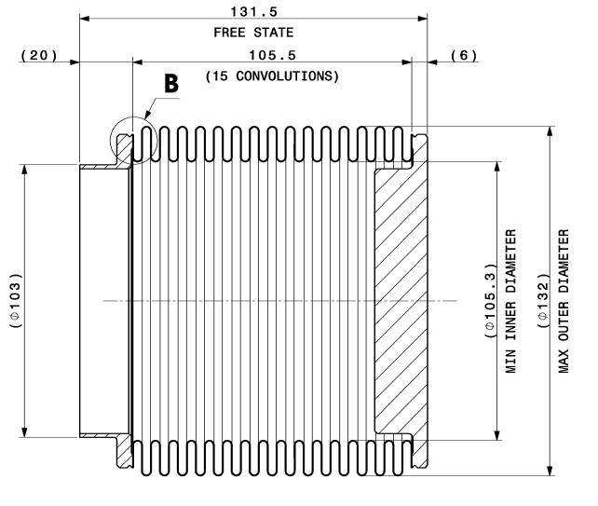
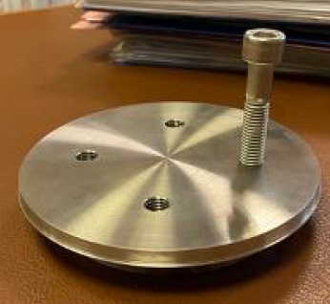
NCRs spotted during RFD-SPS CM Components fabrication
~10 NCRs in total
Bellows
The NCRs are linked to:
  2-ply bellows
  Design and Test Pressure
  Dents
  Base material
  Dimensional aspect
Cryogenic line bellows (extremity bellows)
The total length of the bellows is shorter than required (118.6mm instead of 131.5mm)
The number of convolutions is lower than mentioned on drawing
Holes of blank extremity collar not perpendicular

Slide 14
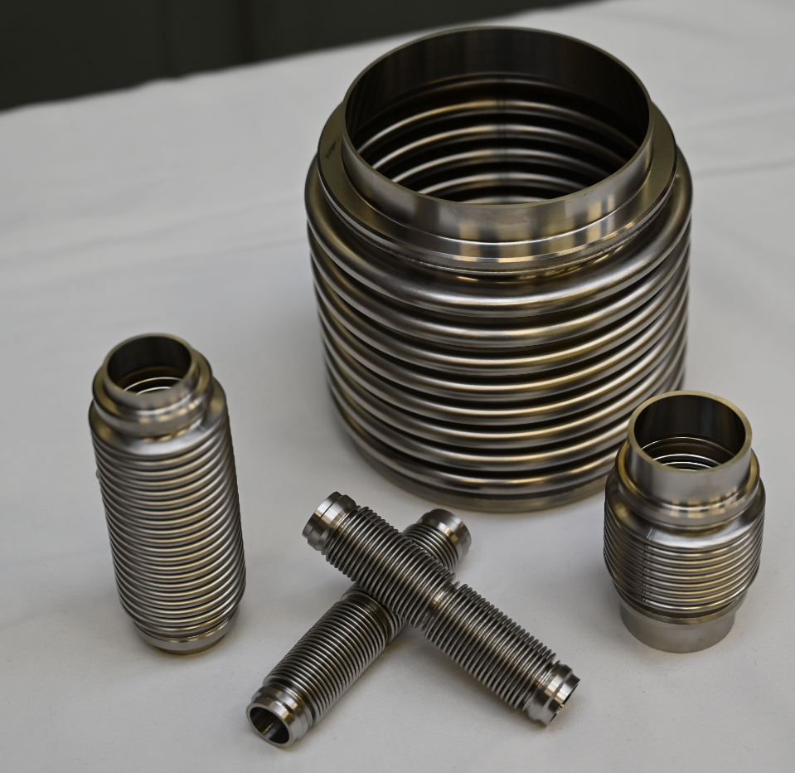
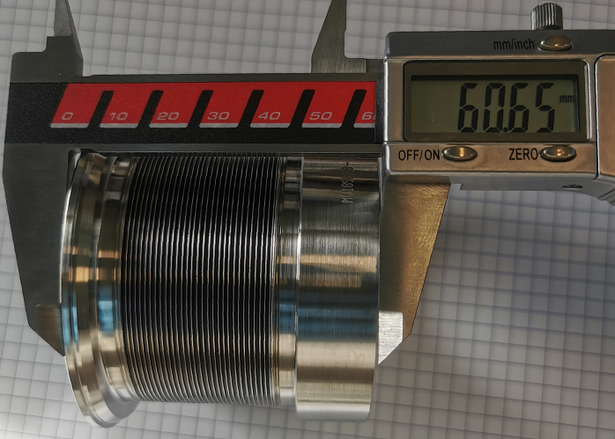
NCRs spotted during RFD-SPS CM Components fabrication
~10 NCRs in total
Bellows
The NCRs are linked to:
  2-ply bellows
  Design and Test Pressure
  Dents
  Base material
  Dimensional aspect
LHC SERIES
Update of Engineering specifications
Single sourcing for each type of bellows, then dispatched to the collaborations:
  Cryogenic bellows: KOMPAFLEX AG
  Tuner and blade support bellows: MEWASA AG

Slide 15
NCRs spotted during RFD-SPS CM Components fabrication
Base material
~8 NCRs in total
The NCRs are linked to:
  Material standard
    ASME / ASTM vs EN standards
    EN standards for pressure applications (PED harmonized)
  Material grades or properties
    Grade of austenitic stainless steels (EN 1.4429)
    Welding filler material (W Z 18 16 5 NL)
    Magnetic permeability
  Cobalt content
    Cobalt content not mentioned in the certificates
    Values are above the limit
Evaluation thanks to PMA
Evaluation by experts
Evaluation with destructive testing
Non-destructive measurements
Measurements at CERN
Tracking in EDMS 2798791
➔ For LHC Series: Update of specs and drawings, procurement strategy, improvement of QA/QC

Slide 16
NCRs during RFD-SPS CM assembly
Welding

Slide 17
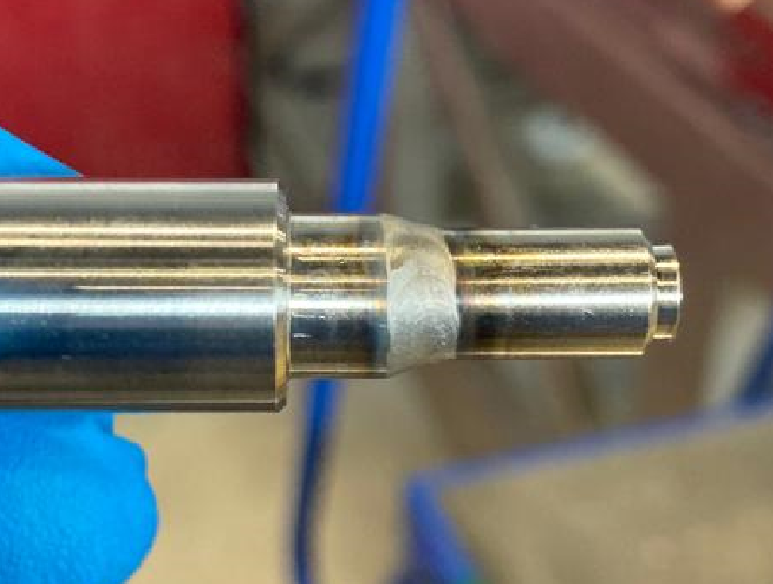
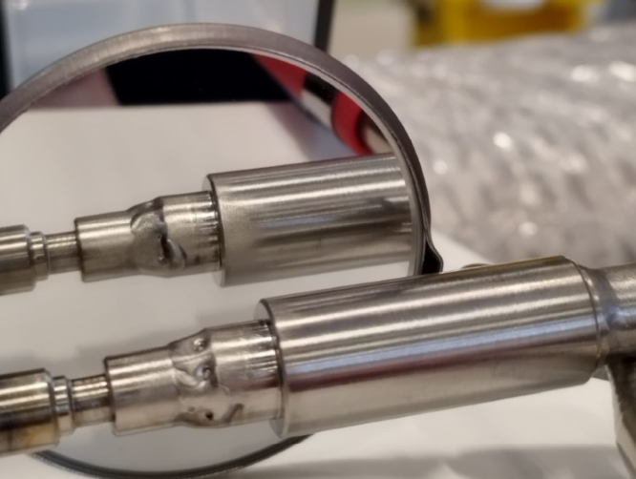
NCRs during RFD-SPS CM assembly
Orbital welds on beam screen lines

Slide 18
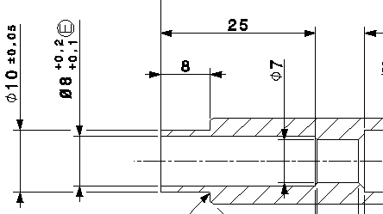
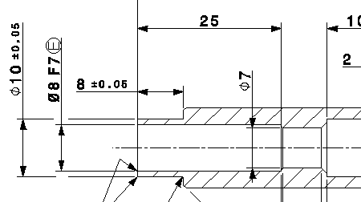
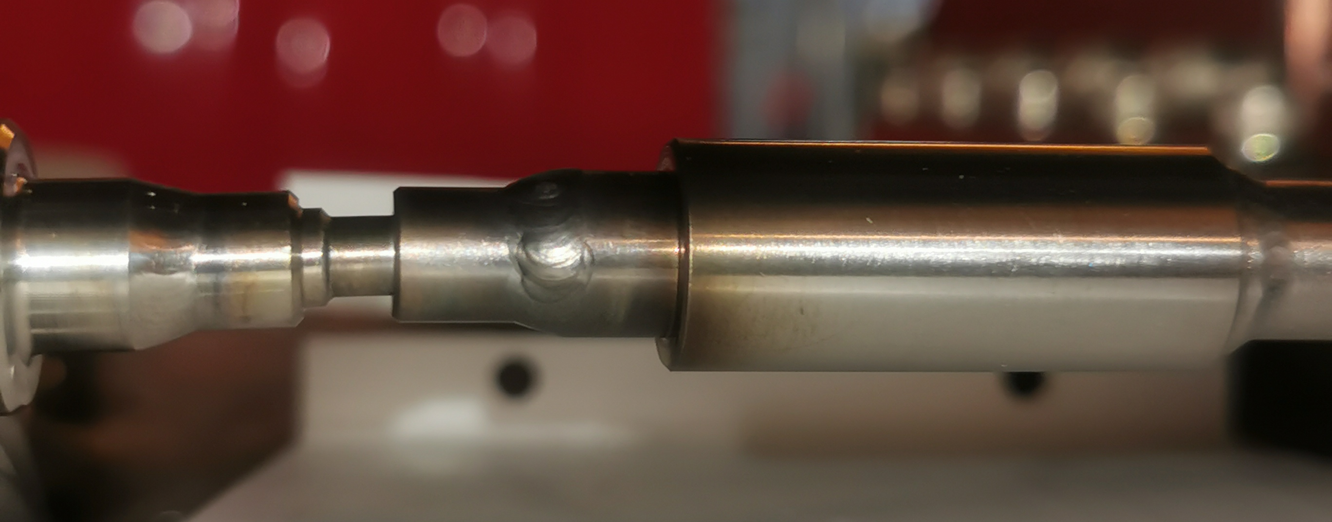
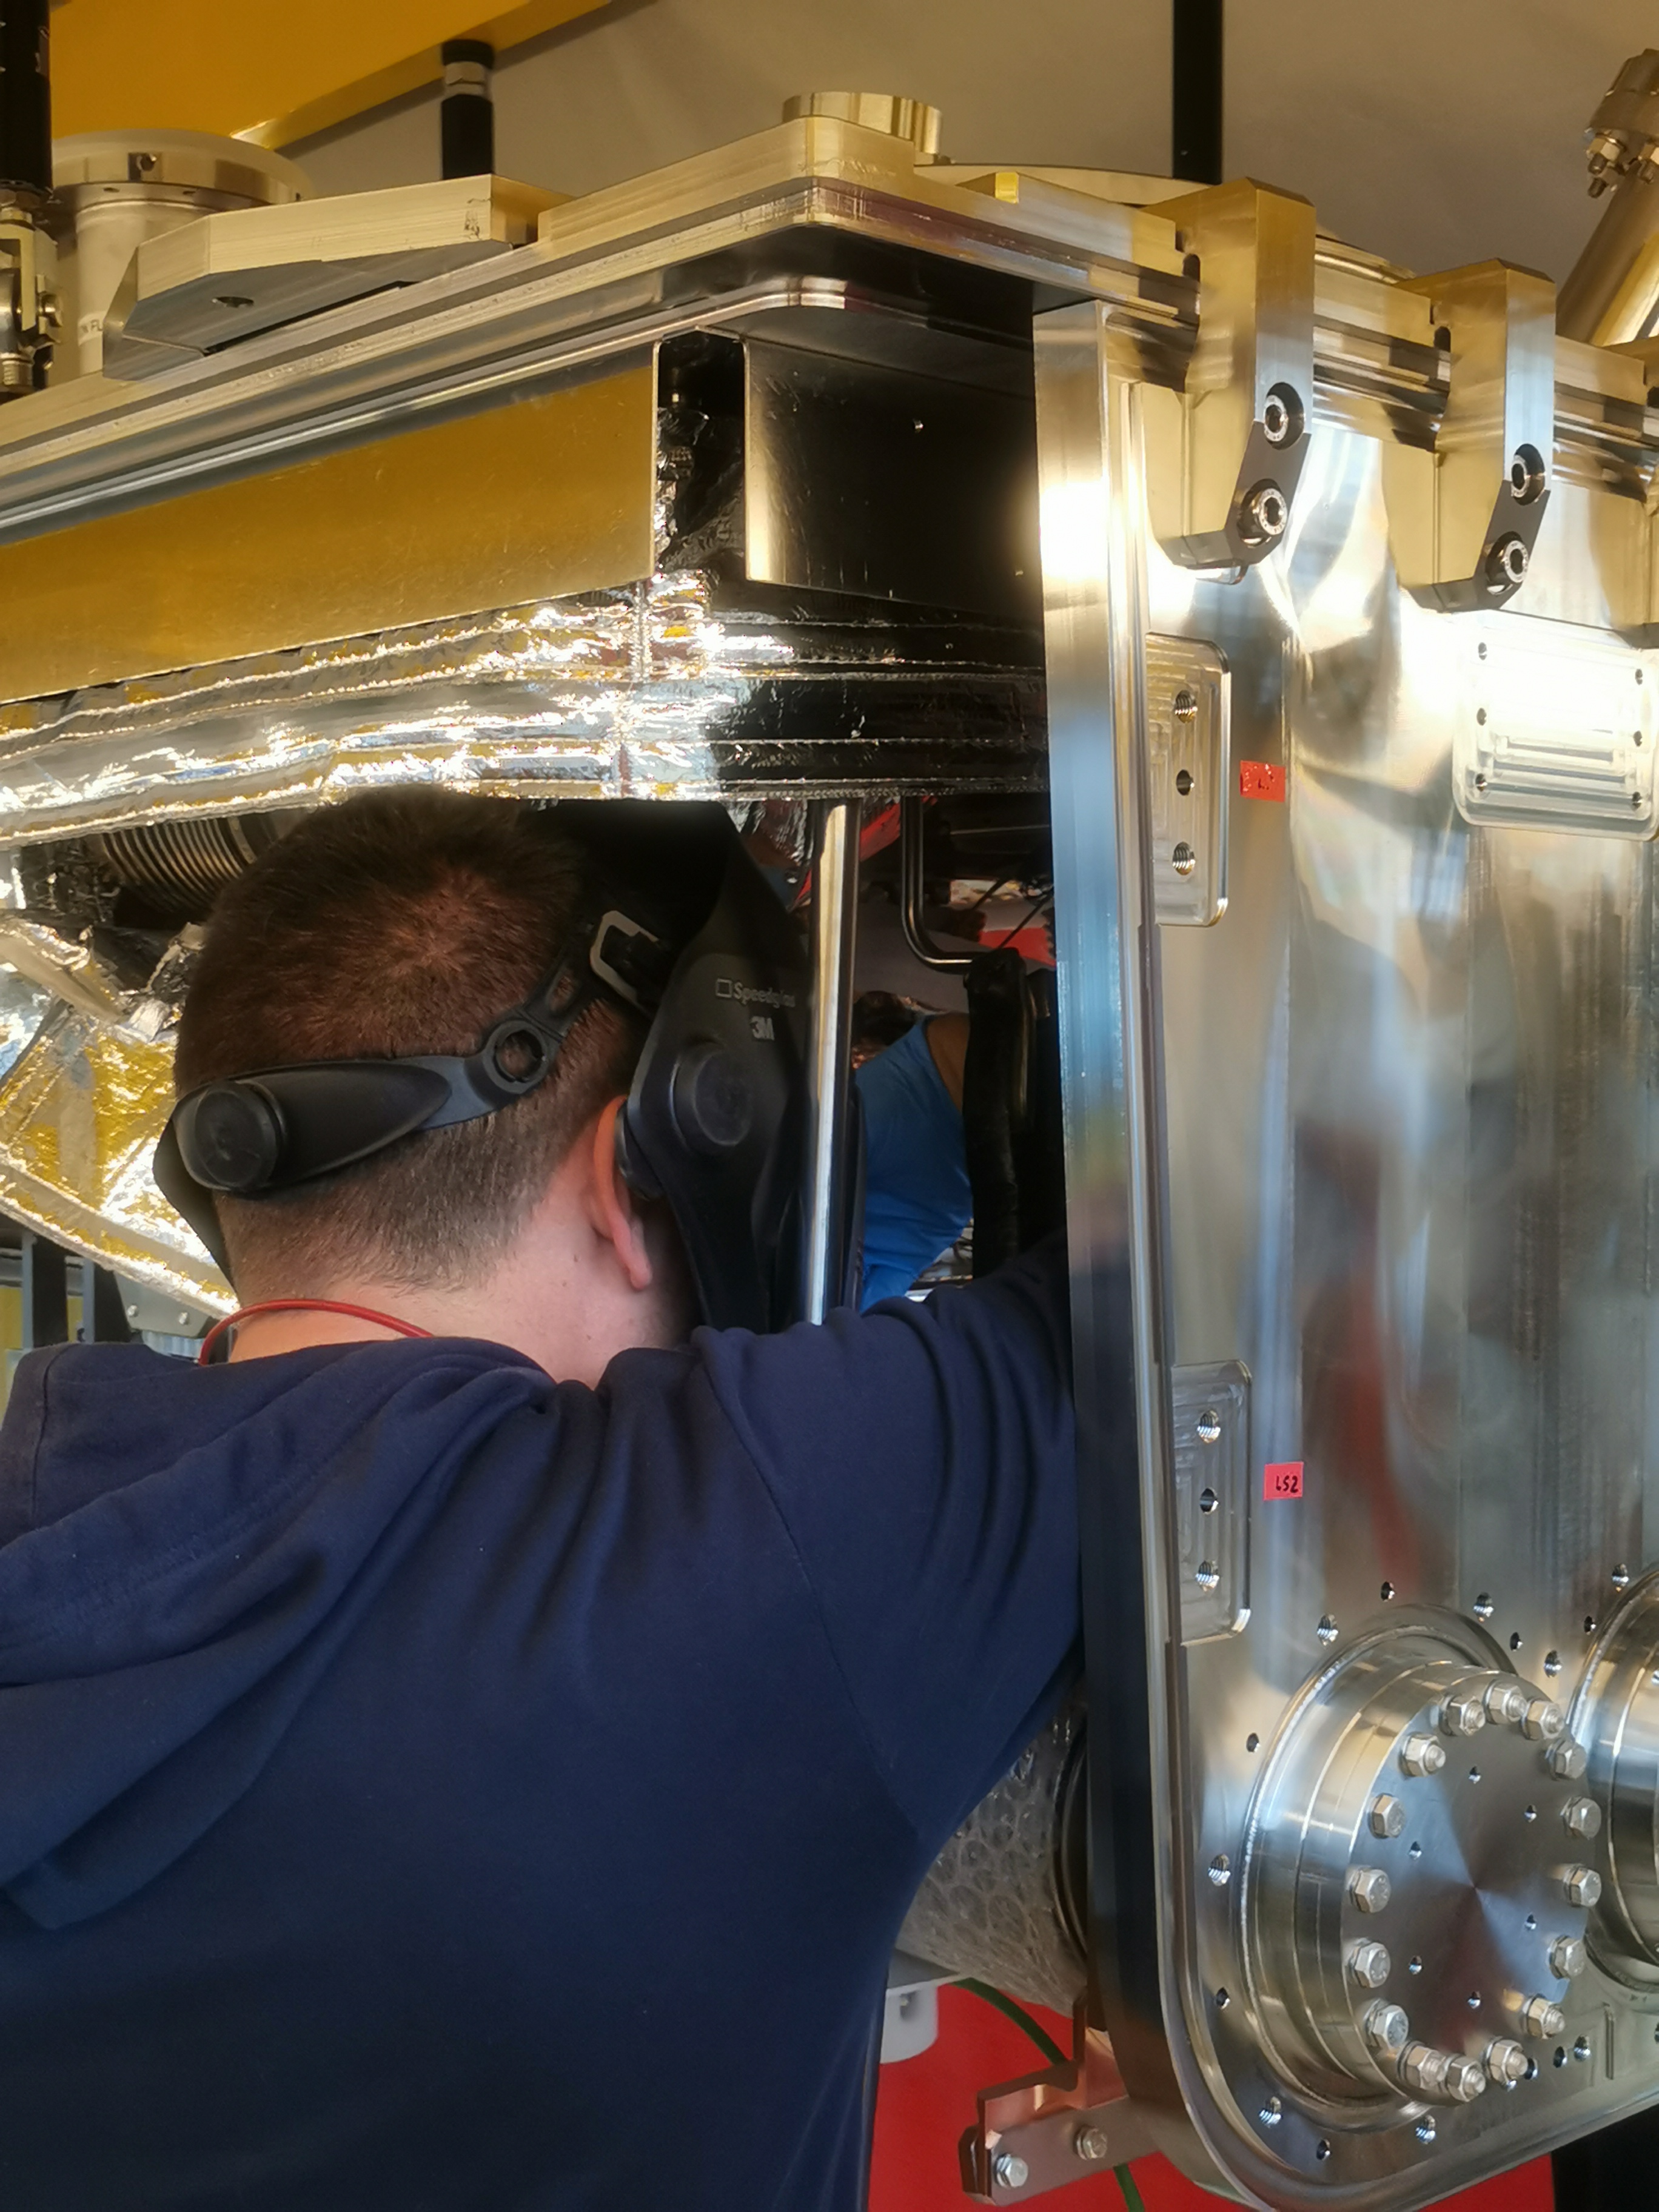
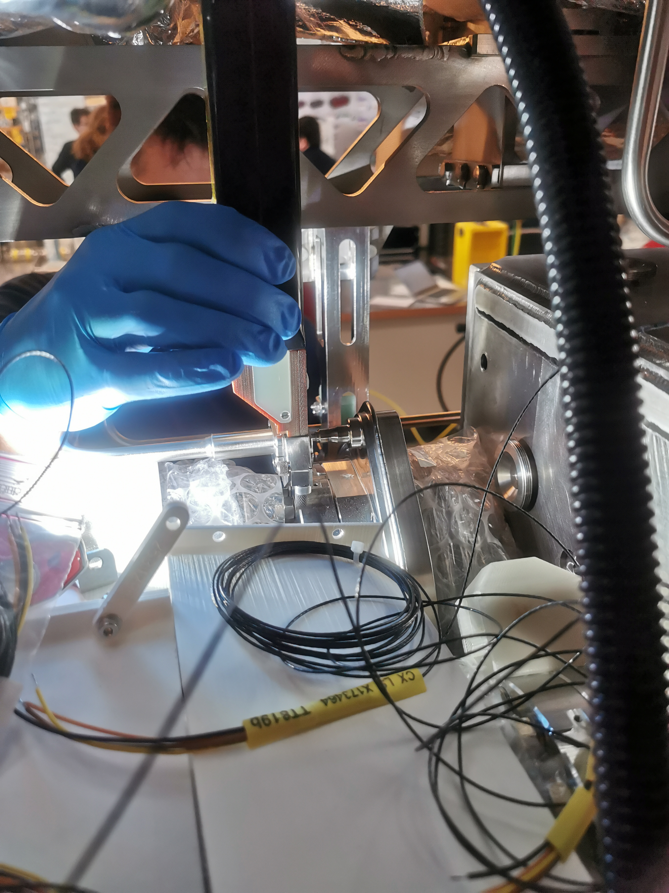
NCRs during RFD-SPS CM assembly
Orbital welds on beam screen lines
Potential root causes:
  Tolerances of the parts
  Limited access
  Difficulty of execution
  Backing gas set-up
  Actions:
  STFC and CERN performed together the repair
  Knowledge transfer between the teams
  Modifications of the design drawing
  Qualification of the welder for repair operation

Slide 19
NCRs during RFD-SPS CM assembly

Slide 20
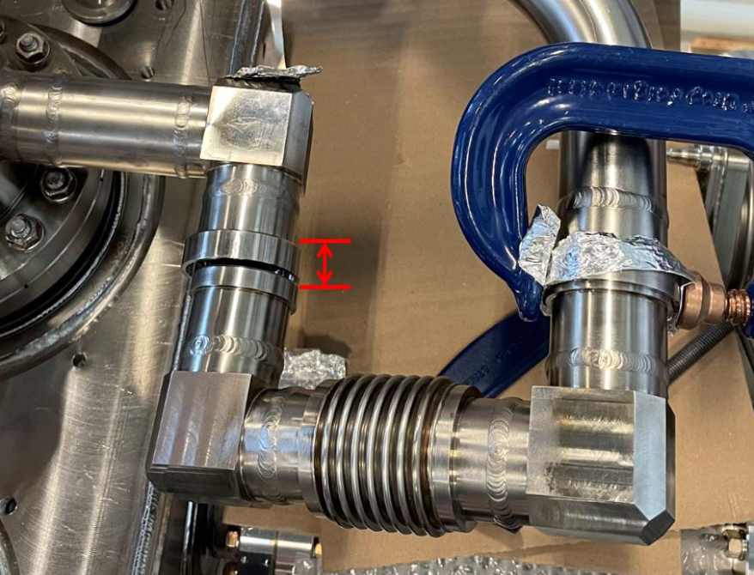
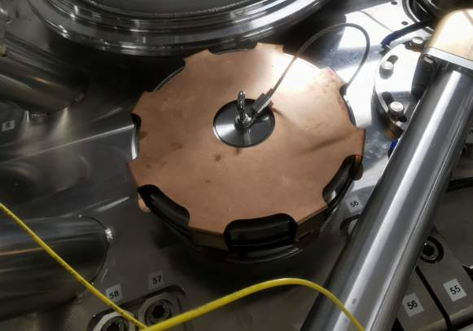
NCRs during RFD-SPS CM assembly
Other NCRs
Dimensional control (Blade support assy, OVV, WMS, biphase line, etc.)
Clash / Matching during assembly (HOM Cooling line, RF Coax line, etc.)
Blow-off valve (insulation vacuum)
➔ Evolution of assembly procedure, Engineering Specs, safety components, etc.

Slide 21
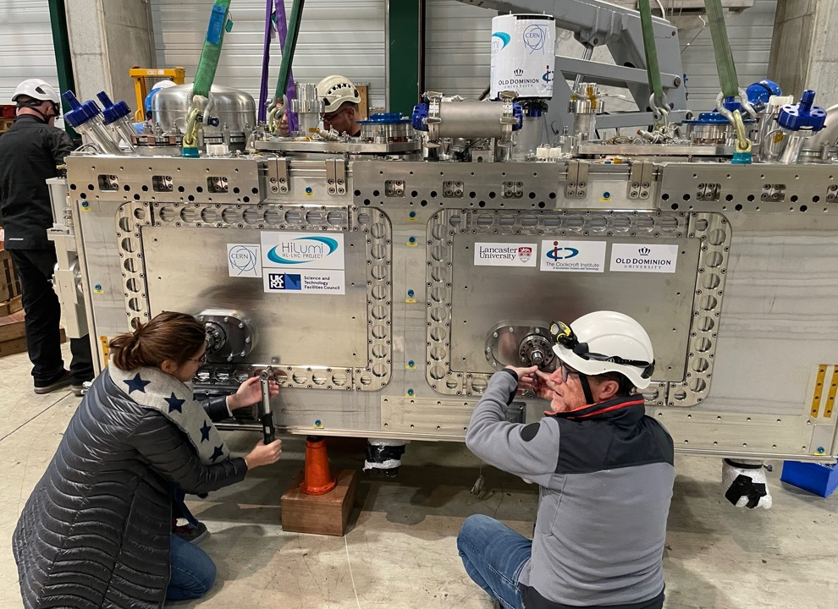
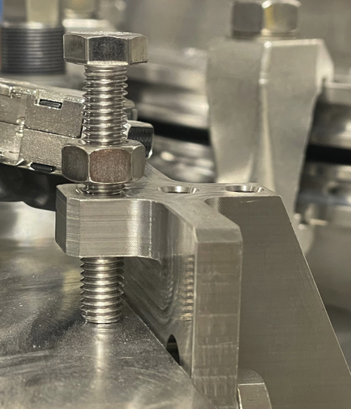
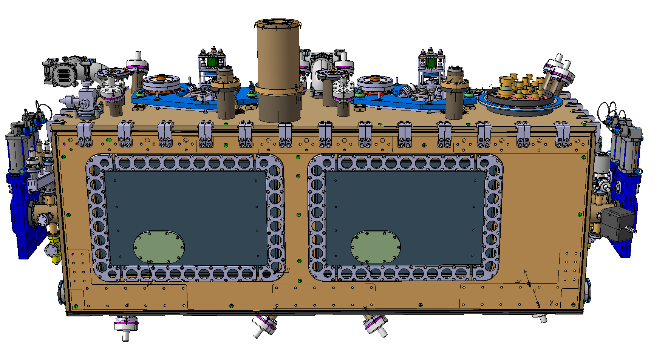
NCRs during RFD-SPS CM Reception
Other NCRs
Tightening checks:
  Lateral doors: 1 door not OK (1/4 of a turn missing)
  Cavity support system:
    1 FPC connection partially OK
    Top blade connection: locking screws not OK
  Cryogenic transport lock: Loose
  Tuner Thermal Intercept: Connexion to double pipes or braids partially OK
Courtesy of T. CAPELLI

Slide 22
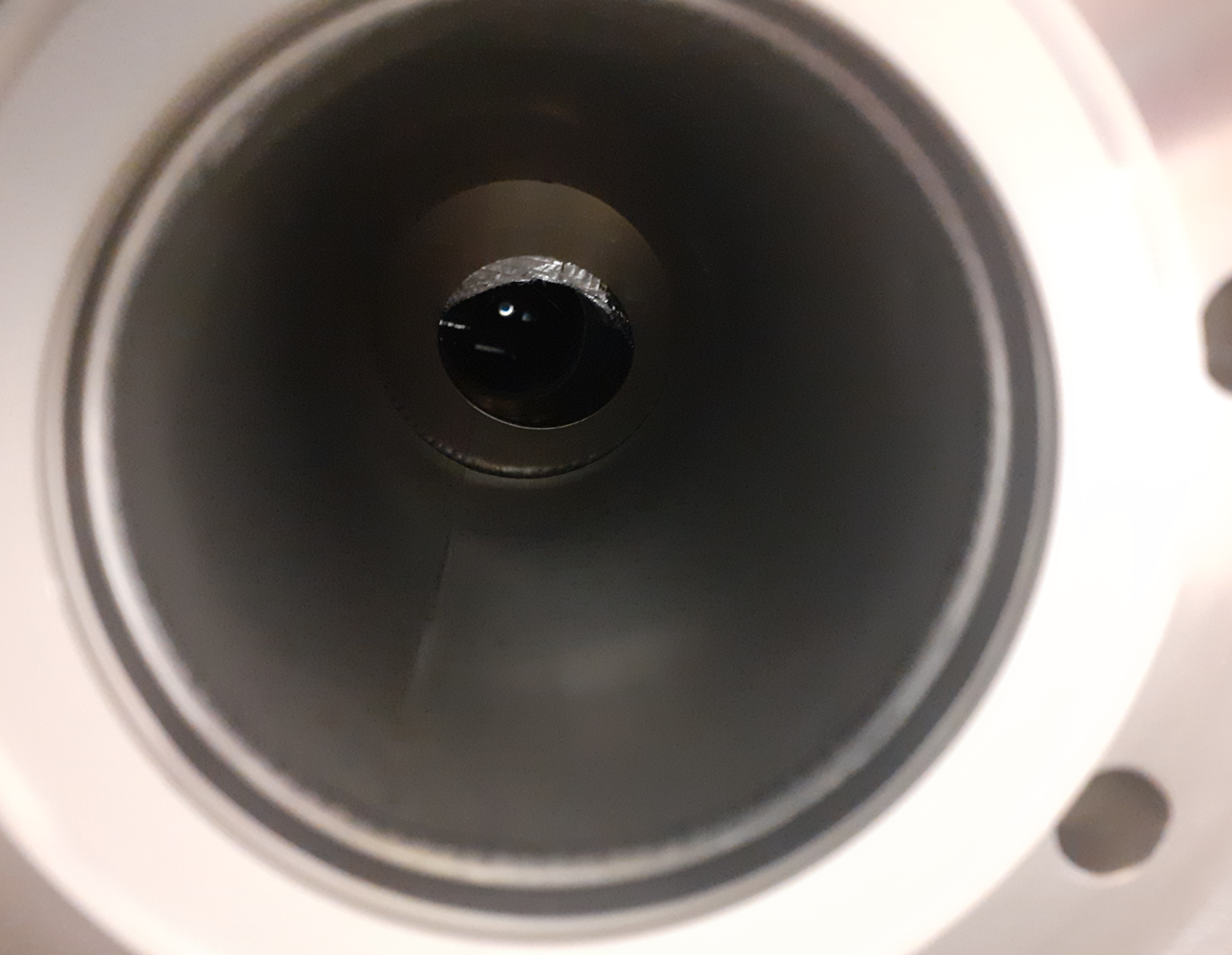
NCRs during RFD-SPS CM Reception
Other NCRs
FSI checks:
  4 lower FSI were obstructed by MLI
Cryo instrumentation:
  Labels removed / replaced
  Heaters not installed / checked
MLI
Reflector
Courtesy of T. CAPELLI

Slide 23
Conclusions and perspectives
RFD-SPS Prototype:
  This prototype phase was highly instructive, also for QA-QC activities.
  Some difficulties to deliver and review quality and manufacturing documents in time, with a rigorous respect of approval process.
Concerning requirements:
  To prepare LHC Series, the Eng. Spec and drawings were updated.
  ➔ Few Deviation Permit Requests have been already prepared.
Concerning NCRs:
  Important step during drafting NCRs: Root causes, preventive and corrective actions and implications
➔ For LHC Series:
All the requirements shall be respected, any deviation must be traced and approved before continuing the production.

Slide 24
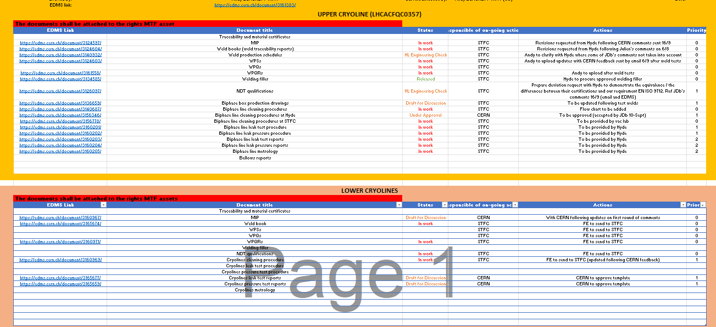
Conclusions and perspectives
CERN:
  A new welding and quality engineer hired in April 2024 (Myriam Benahmed)
Collaborations with STFC / TRIUMF:
  Good use of HL QA tools
  Efficient raw material procurement strategy
  Transparency, respect of reviewing processes (from the procurement specification drafting)
  Some QA tools have been implemented

Slide 25

Thank you !
Any questions ?

Slide 26
Back-up slides

Slide 27
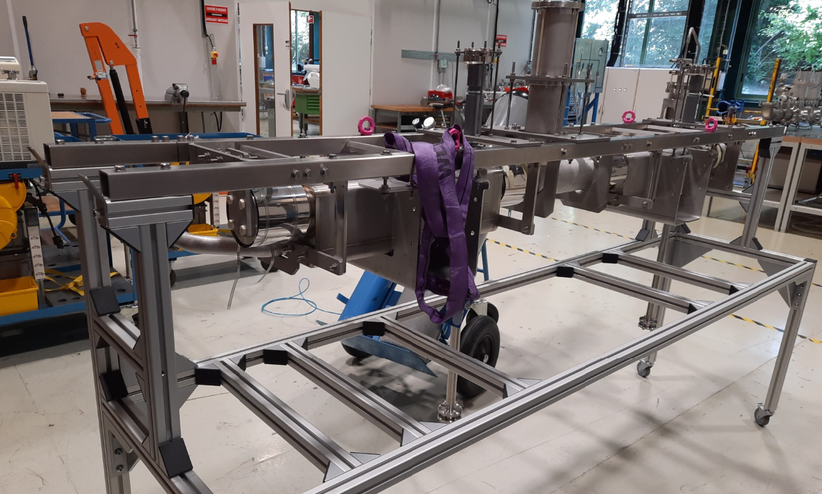
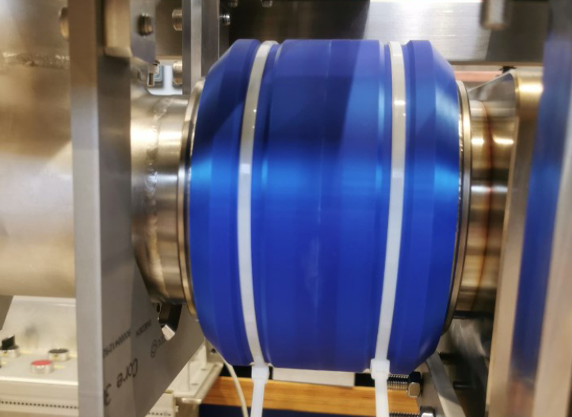
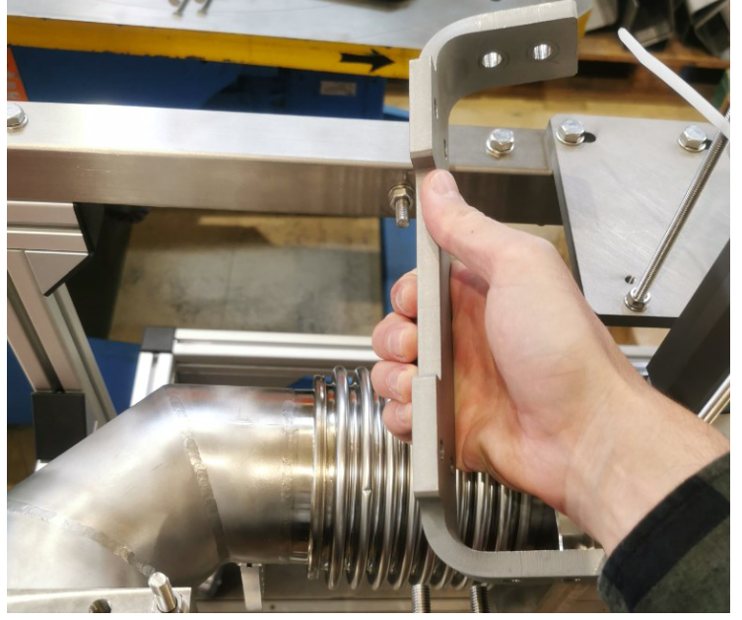
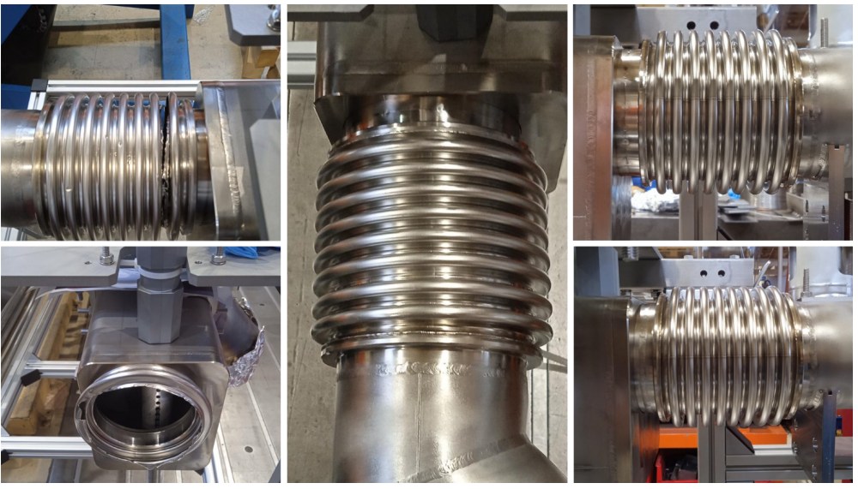
Back-up slides

