Slide 1

TRIUMF - CERN Steering Committee
CERN Comments
Marco Garlaschè on behalf of CERN WP4 Team
14th HL-LHC Collaboration Meeting – Genoa – 10th October 2024

Slide 2
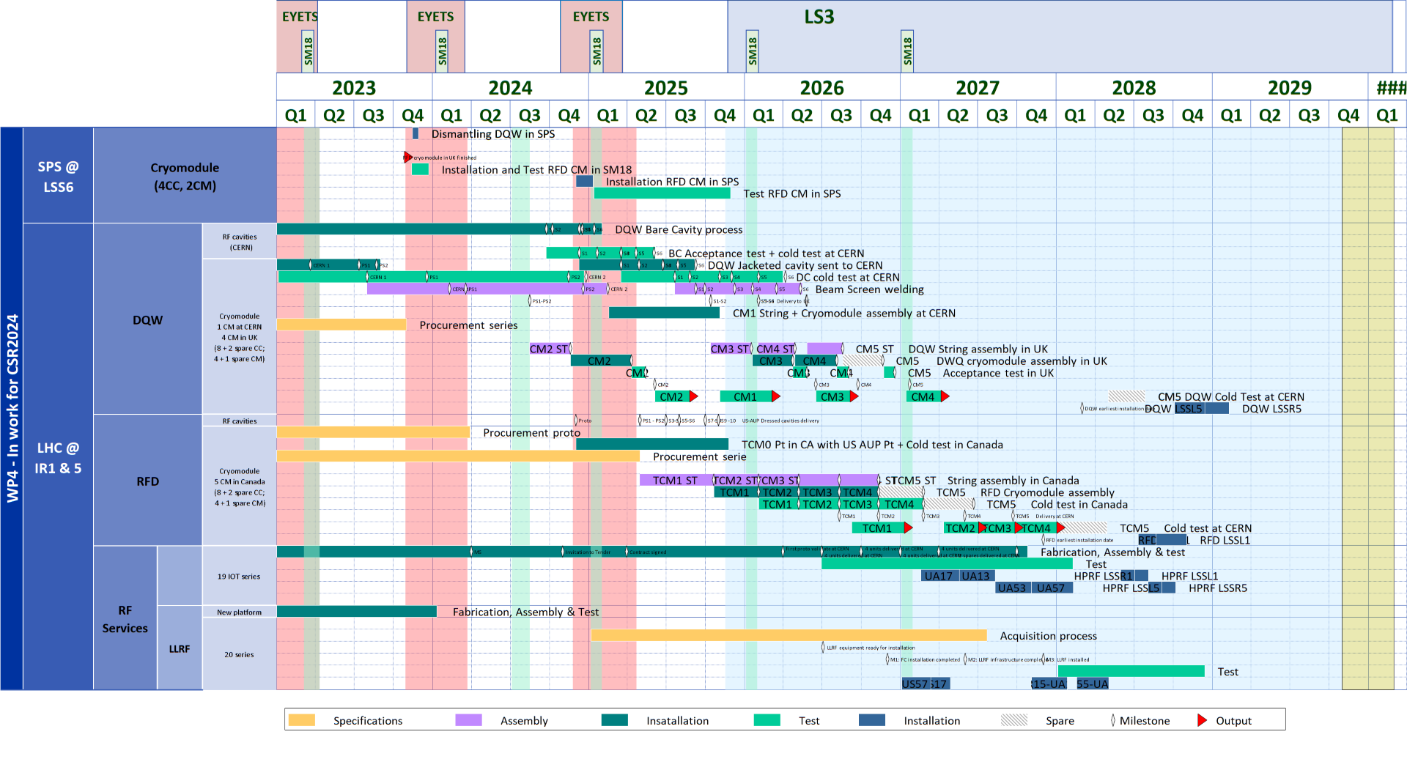
Reminder on WP4 Master Plan - RFD CM
Three types of ‘Deliverables’:
Info : CERN Specifications
Info : Design Packages (components, CM)
Hardware (Part Exchange) and related handling/assembly procedures

Slide 3
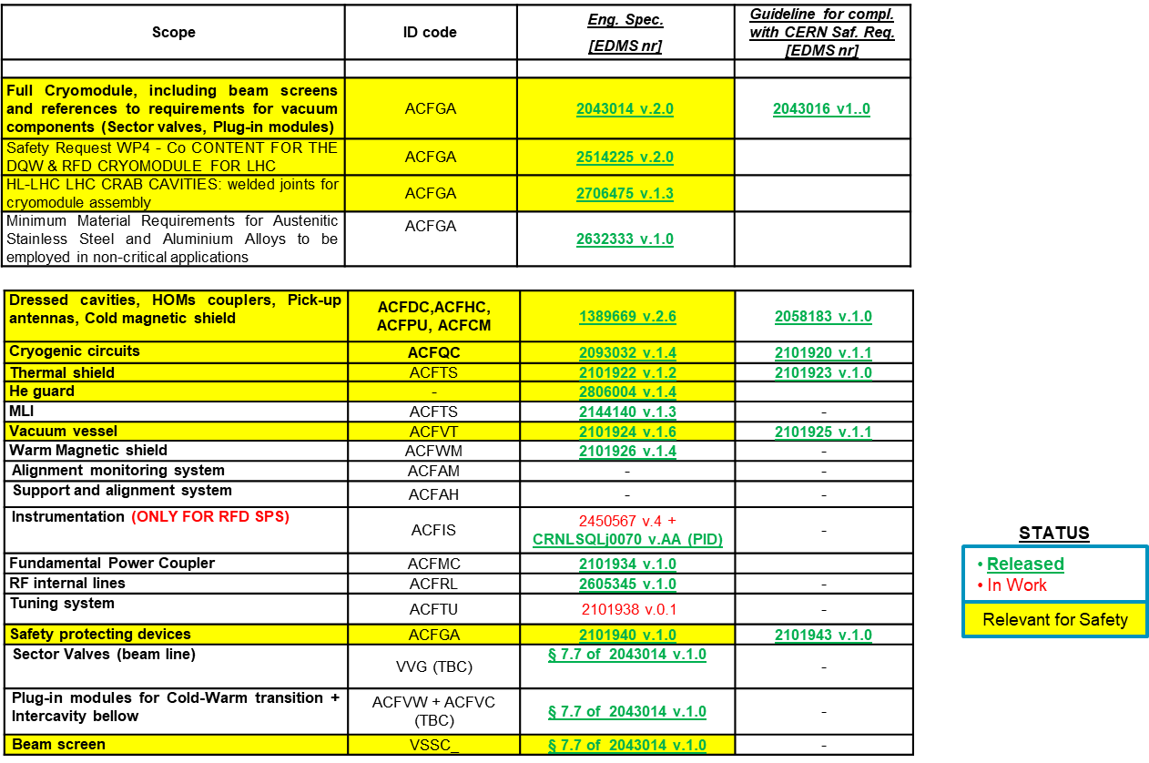
Cryomodule & Components Specifications
CRYOMODULE
COMPONENTS
For all released : no modifications foreseen. (DevReqs)
Instrumentation : deemed less critical for TRIUMF supply
Tuning : modif.s following UK RFD CM

Slide 4
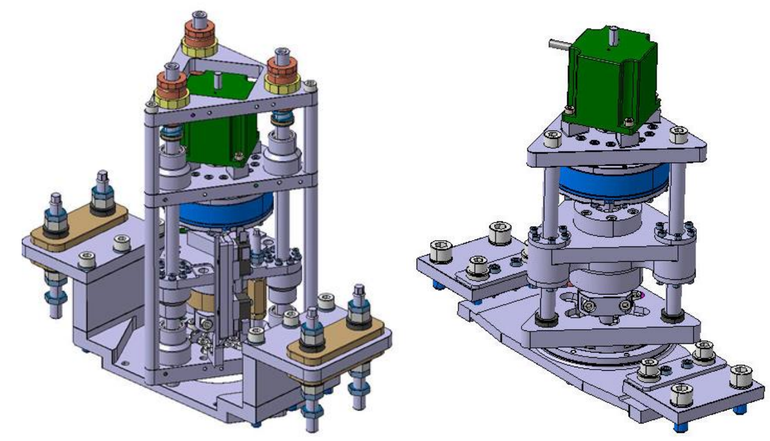
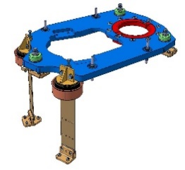
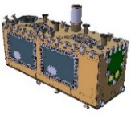
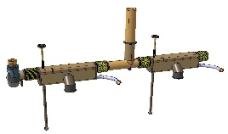
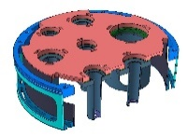
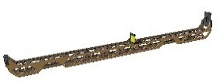
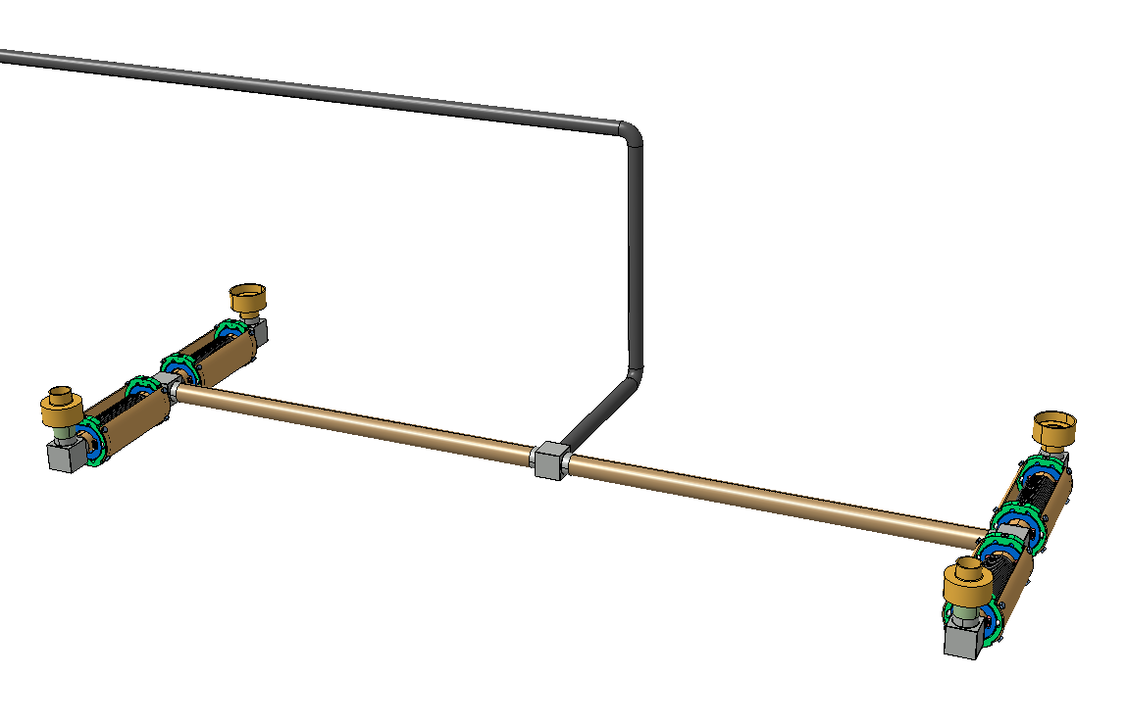
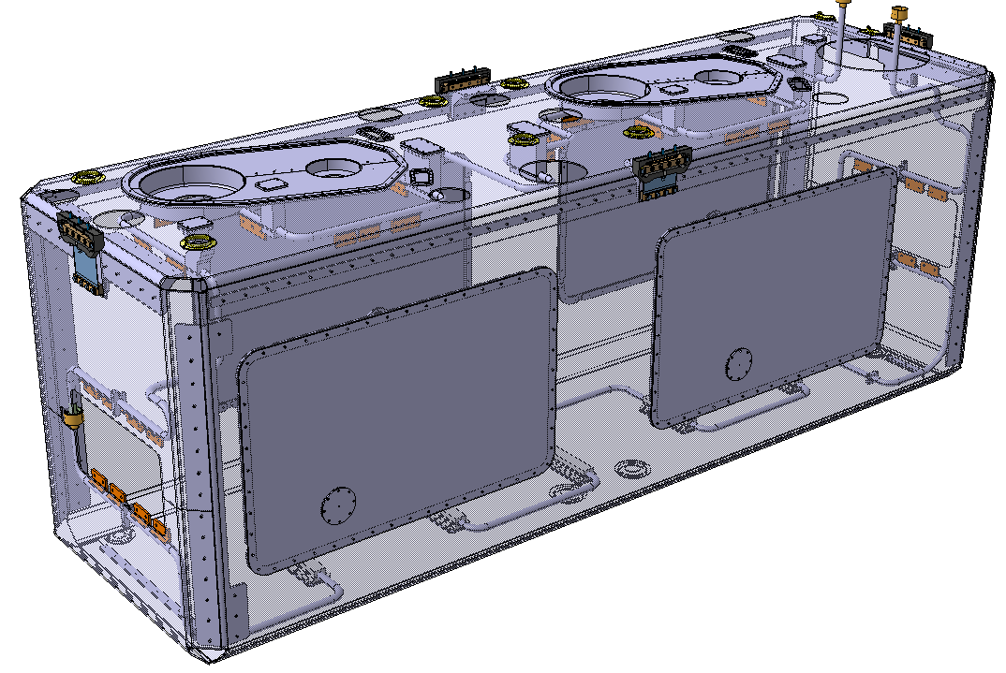

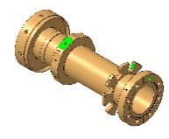

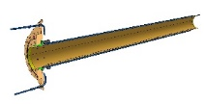
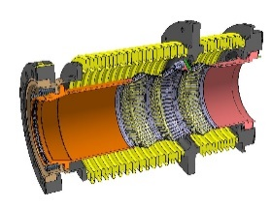
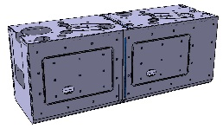
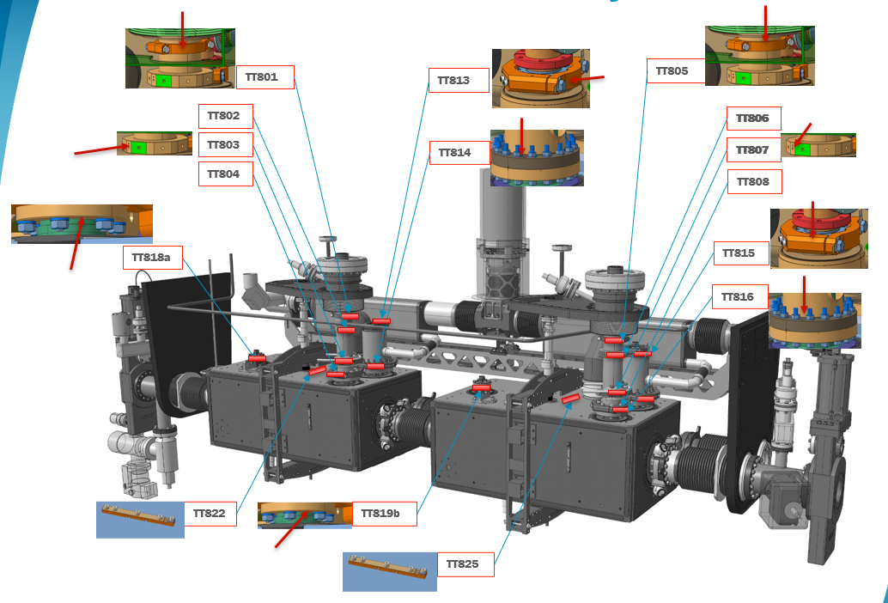
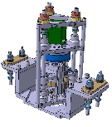
CERN Design
Drawing packages status for the cryomodules :
Status of drawing folders for cryomodule internal components :
 | Status
OVC & internal support | ✓
Cryogenic lines, jumper, and cryogenic supports | ✓
Thermal screen, MLI blankets 2K/50K, thermal intercept | ✓
RF coaxial lines, FPC, FPC outer pipe | ✓
UHV vacuum equipment | ✓
Magnetic shield | ✓
Mechanical and cryogenic instrumentation | ✗ (Q4 2024)
Ref EDMS Doc 2730814
Status drawing folders for cryomodule external components :
 | Status
Cryogenic safety extension* | ✗ (Q1 2025)
Tuner actuation* | ✗ pending
FSI heads | ✓
Rooting of cable for LHC integration (2 configurations) | ✓
Mechanical and cryogenic instrumentation | ✗ (Q4 2024)
Drawing & BOM for STEP of assembly – Step 1->5 | ✓
Drawing & BOM for STEP of assembly – Step 6->12 | ✗ (Q1 2025)
* Improvement of the original design

Slide 5
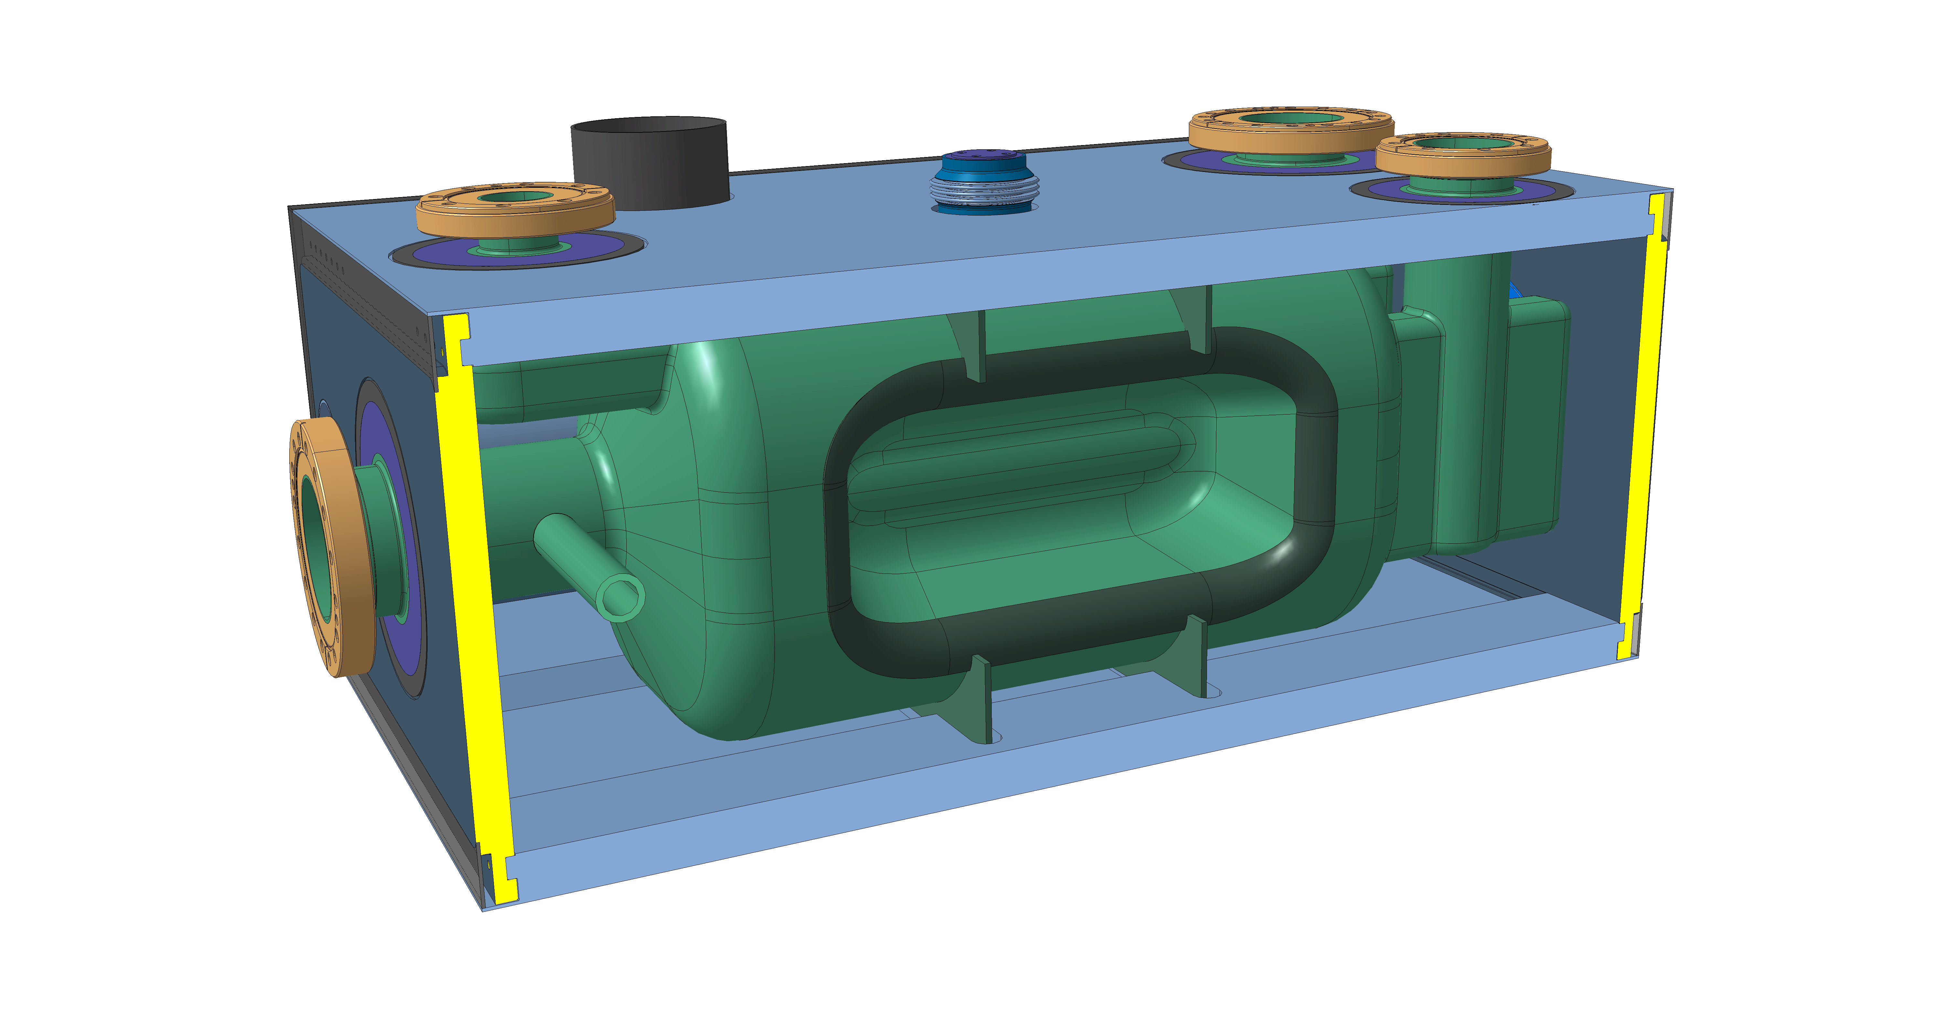
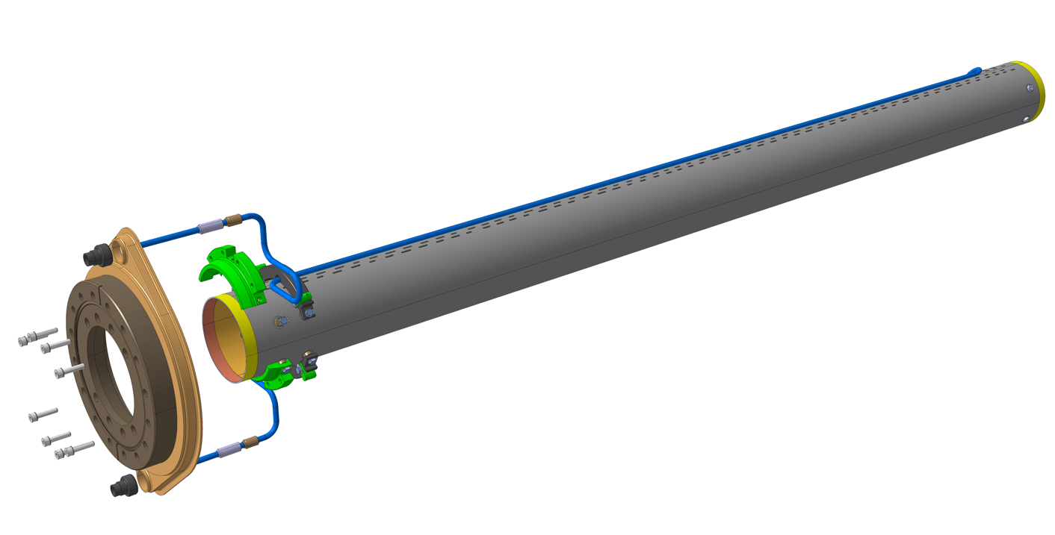
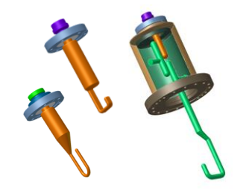
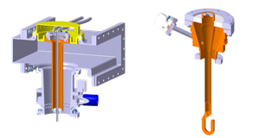
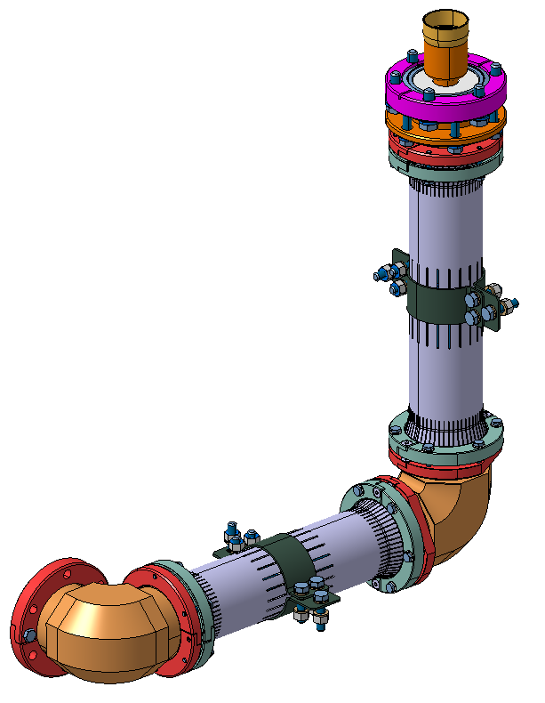
CERN Contr. : Hardware - RFD (TCM0 &) Series
Ref. Part Exchange UK-CAN : EDMS 2508819 + Amnd Add5 of P095
Delivered or ready to be delivered
Delivery in line with requirements as per Master Plan and TRIUMF TCM0+series Strategy
Component |  | Status & Estimated Delivery Date
Jacketed Cavities (Bare Cavity + Cold Magnetic Shield + Helium Vessel) |  | N.A.
Beam Screens |  | All Series: Ready
Full set of HOMs and HF-HOMs & Feedthroughs (High Order Modes Suppressors) |  | N.A. (See presentation by S. Barrière)
DQW FPC (Fundamental Power Coupler) |  | Delivery in line with requirements as per Master Plan See presentation by S. Barrière
RF Internal Coaxial Lines |  | 2x RFD cryomodule: Q1-2025 3x RFD cryomodules: Q3-2025
PIMS (Interconnections for string assembly) |  | 1x RFD cryomodule: 2 PIMS shipped, 4 PIMS ready 4x RFD cryomodules: Q3-Q4 2024

Slide 6
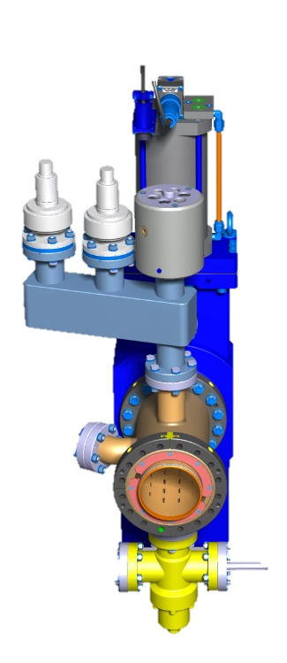
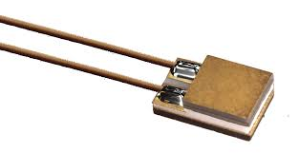
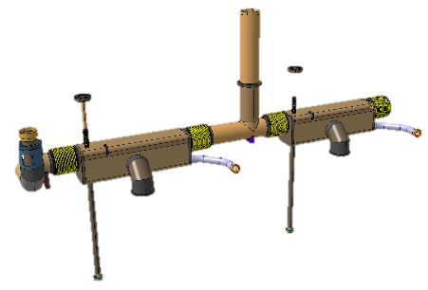
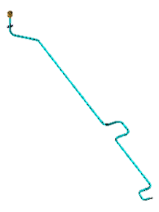
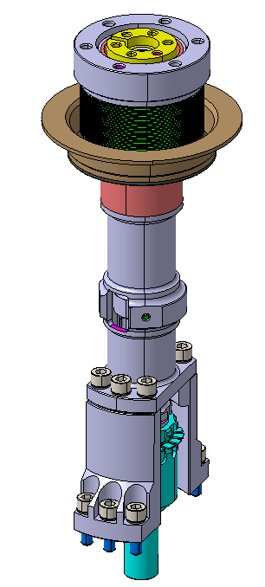
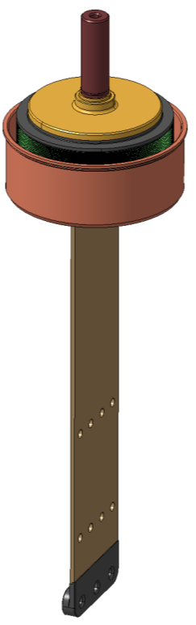
CERN Contr. : Hardware - RFD (TCM0 &) Series
Component |  | Status
Vacuum Modules & Gate Valves |  | 5x RFD cryomodules: Delivered to Canada
Cryogenic Instrumentation |  | Discussions ongoing (full list & responsibility for each done, procurement ongoing) Delivery : ref. prez. Delprat / Gahier
Expansion joints for Cryogenic Lines* |  | Ready for all DQW & RFD cryogenic lines
RFD Upper & Lower Cryogenic Lines* |  | 1x RFD cryomodule: Shipped 4x RFD cryomodules: beg Q2-2025
Tuner Double Tubes* |  | 1x RFD cryomodule: end Q1-2025 4x RFD cryomodules: late Q2 & Q3-2025
Blades for Cavity Support System, instrumented * |  | 1x RFD cryomodule: end Q1-2025 4x RFD cryomodules: late Q2 & Q3-2025
*Amendment to initial Part Exchange
NEXT : Part Exchange Compt Delivery Conditions
Notes:
Discussion on cryolines subcomponents? (tubes , extrusions,..)

Slide 7
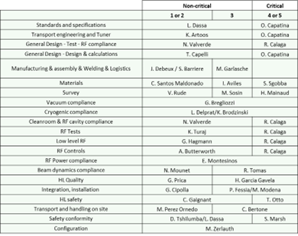
Aside Information and Technical Deliverables … CERN Contr. : Tech. Support
Tech. Support on specific topics during CM manufacturing:
Feedback on activities : QA, fabrication (welding, outsource)…
Tech. documentation of Collab : Check ass.y and test procedures, techSpecs for prod
Coaching & shadowing for assembly of components under CERN responsibility
CERN Reference people for topic / component / activity :
Bob Laxdal – project lead
Devon Lang – fabrication, assembly, alignment
Ben Matheson – Design
James Keir – fabrication, assembly, vacuum
Oliver Law – Engineering
Bhalwinder Waraich – clean assembly
Zhongyuan Yao – cavity and cryomodule testing
Corresponding TRIUMF Engineering & Project Structure is known by CERN
But a more explicit version would be useful, in terms of specialized technicians/operators reference :
Alignment, and metrology
Instrumentation assy (Mech & Cryo)
Vacuum and its procedures (leak checks, cleaning)
Qualified welder
CM assy

Slide 8
General Comments
Compliance of final products to CERN Specifications
Special attention to:
compliancy with CERN Safety Rules and Normative. Implicit within CERN Tech Spec.
mismatch between CERN Spec requirements & Drawings VS. translations by collabs (read ISO vs. ASME).
Collaboration is responsible to abide to these ( → DevReqs, PMAs, …)
CAUTION: We don’t have same ability to derogate, between preSeries <> LHC series.
Further complexity, due to TRIUMF strategy of TCM0+series for many products
Hardware
Part Exchange Items are well agreed and production in schedule. It is time to focus on details (part ‘’flow’’)
First invoice in the pipeline
CERN WP4 is fully ready to support TRIUMF with any further procurement and production which is deemed critical (normative, technologies,…)
Passage of Information & Coaching by CERN
2 days visit to CERN
Specific planning defined

Slide 9
Cern Feedback/Expectations
On Planning
Masterplan was agreed
New proposal incompatible even with delayed LS3 installation
A lower-level CM detailed planning is needed, to avoid lag time for components and info (first steps in this direction are done).
Extremely important for setting CERN hold points and interventions
On QA
Good interaction with TRIUMF
(see presentations of Luca and Julien for technical points) → some missing points
  Inhouse welding & corresponding QA
  Processes : greenlight of Degreasing samples, assembled PIMs by CERN
On TRIUMF project structure
Manpower & ref. persons on specific activities to be officialised:
  Welding engineer : (Oliver)
  Alignment, and metrology
  Instrumentation assy (Mech & Cryo)
  Vacuum and its procedures (leak checks, cleaning)
  Qualified welder + CM assy
On Partial delivery of equipment form CERN
  Most ready
  Highest priority given to TRIUMF production
  Discussion for specific equipment unavailable for Apr 2025 : needs to be agreed asap
  Further part Exchange for Tuner?

