Slide 1

RF power for crab cavities & challenges
eric.montesinos@cern.ch reporting on behalf of many colleagues that have worked out the topic
Credits to Sebastien Calvo, Luciano Ciampo, Frederic Killing, Gino Cipolla, Nuria Valverde for all the illustrations of this talk
14th HL-LHC Collaboration Meeting, Genoa (Italy), 7-10 October 2024

Slide 2
Mandate for the talk of this meeting
Hi Eric, I write down some bullet points that come to my mind - not fully a mandate and I let you how to structure it
It is not essential that you cover all the point neither - what you feel would be useful for an audience
Couplers
Experience with FPCs for the SPS-DQW, SPS-RFD & series production including RF conditioning - this doesn't have to be detailed by some kind of recap of choices, issues during the last years
Issues related to HOMC & FA including RF lines, adapters, pins - more like an RF lessons learned on what could go wrong for future CMs
High Power RF stations
HPRF - context of using the IOT, some experience from SPS-DQW and improvements for the series design
Recent experience from RFD module and what to expect from conditioning for the future series including what/when we are going to send to Canada (SSPA, IOT ?)
Series production with industry - next steps, POC, acceptance tests, ...
Finally, is there a future for SSPA at 400 MHz?
Many thanks and I know the above is way too much to ask but I know you can give us a snapshot for the future
Rama

Slide 3
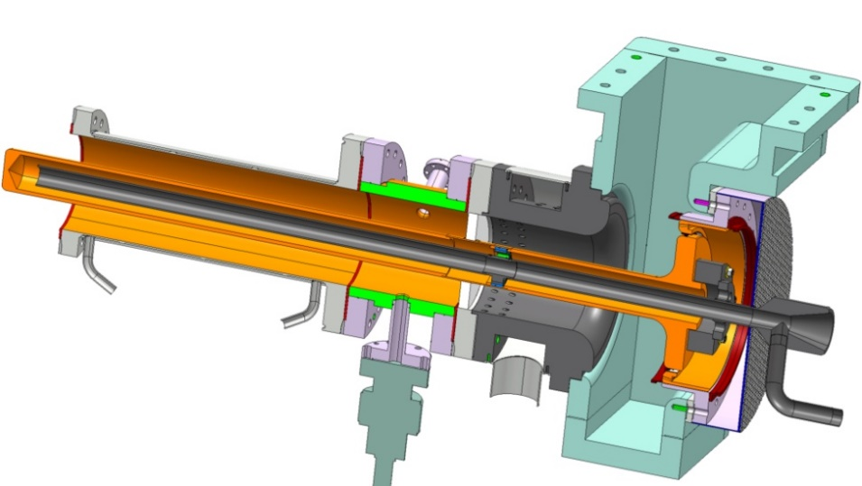
Experience with FPCs (including RF conditioning)
Fundamental Power couplers are coupling the RF from the RF power source to the cavity
The window, in case of high average RF power, that is usually an AL₂O₃ ceramic, ensures the vacuum integrity of the cavity
It is often Titanium sputtered on the vacuum side to avoid electrostatic discharge and to reduce Secondary Emission Yield to reduce the sensibility to multipacting
With the Crab project, we took advantage of the SPL coupler design, and we matched it to Crab requirements
This helped us to start quicker the production phase
We applied the SPL plug and play WG concept that enables RF matching and reduced mechanical stress to the ceramic

Slide 4
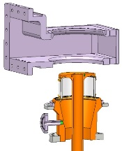
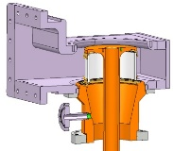

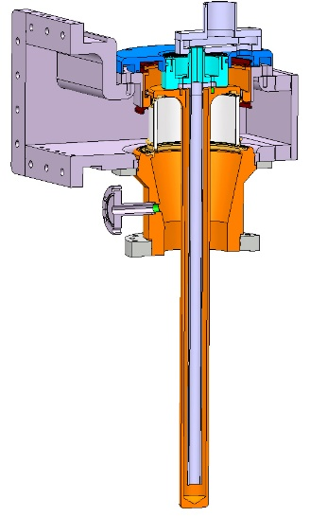
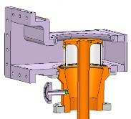
Experience with FPCs (including RF conditioning)
Fundamental Power couplers are coupling the RF from the RF power source to the cavity
The window, in case of high average RF power, that is usually an AL₂O₃ ceramic, ensures the vacuum integrity of the cavity
It is often Titanium sputtered on the vacuum side to avoid electrostatic discharge and to reduce Secondary Emission Yield to reduce the sensibility to multipacting
With the Crab project, we took advantage of the SPL coupler design, and we matched it to Crab requirements
This helped us to start quicker the production phase
We applied the SPL plug and play WG concept that enables RF matching and reduced mechanical stress to the ceramic
1.
2.
3.
‘Plug and Play’ waveguide with matching step and DC capacitor included
  Connect the waveguide to the body line
  Insert the contacts ring
  Final assembly of air cooling system
  No doorknob, reduced height, with no mechanical stress to the ceramic
4.

Slide 5
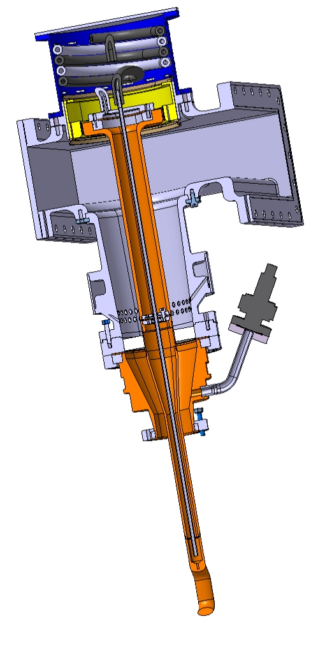
Experience with FPCs (including RF conditioning)
Except the coupling elements, all other devices are identical
  Only bulk material for all vacuum side items
  Body with conical line for high power capability (calculated up to 1 MW)
  AL₂O_{3,} 99.6 % purity, 25 mm thickness disk ceramic, antenna from bulk copper, outer flange Titanium
  Air outer line with cyclotronic© air cooling system to avoid arcing
  Coaxial to WG without doorknob
  DC polarization to block multipacting
  Water cooled antenna as the hook has been calculated critical (very small geometry with respect to the requested CW power)
  Only the two coupling elements are different, everything else is identical

Slide 6

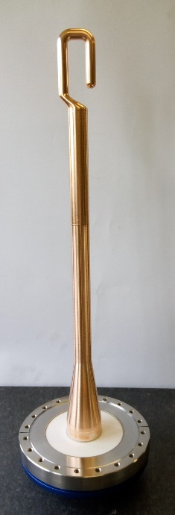
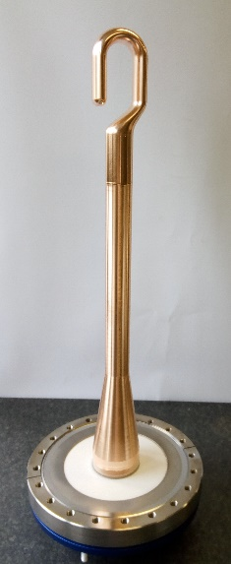
Experience with FPCs (including RF conditioning)
Except the coupling elements, all other devices are identical
  Only bulk material for all vacuum side items
  Body with conical line for high power capability (calculated up to 1 MW)
  AL₂O_{3,} 99.6 % purity, 25 mm thickness disk ceramic, antenna from bulk copper, outer flange Titanium
  Air outer line with cyclotronic© air cooling system to avoid arcing
  Coaxial to WG without doorknob
  DC polarization to block multipacting
  Water cooled antenna as the hook has been calculated critical (very small geometry with respect to the requested CW power)
  Only the two coupling elements are different, everything else is identical
RFD
DQW

Slide 7
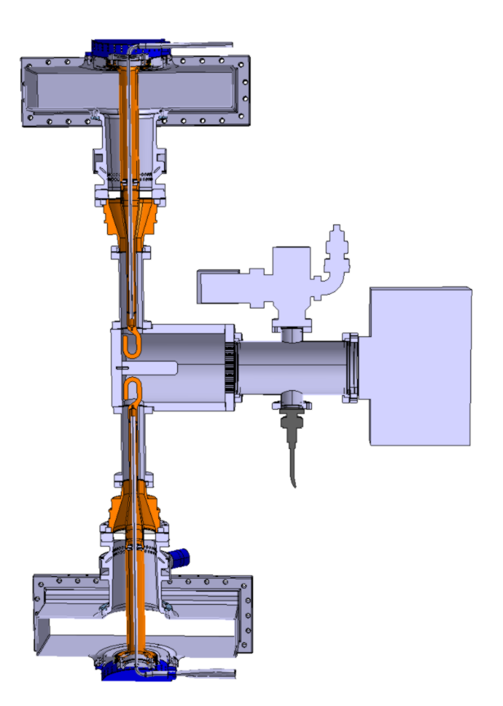
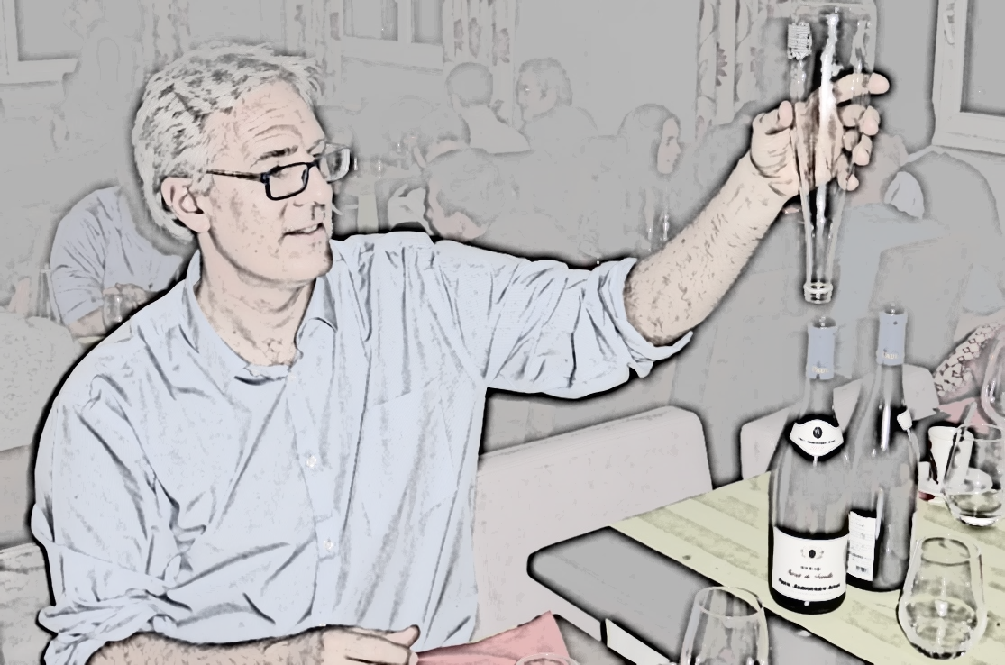
Experience with FPCs (including RF conditioning)
Within the framework of Crab, the couplers are always assembled onto a test box to be RF processed (or RF conditioned)
Due to its coupling element, the hook, the length of the outer line of the test box cannot be the same as the one that will be used with the cavity
The outer line is then not RF processed, this will have to be done with the final configuration
With the crab project we first constructed stainless steel test boxes, from bulk block, and we also successfully constructed Aluminium test boxes, also from bulk block, that is a great news as allowing to have several test boxes for a reasonable cost, and then keeping the FPCs under vacuum until the assembly on cavity

Slide 8
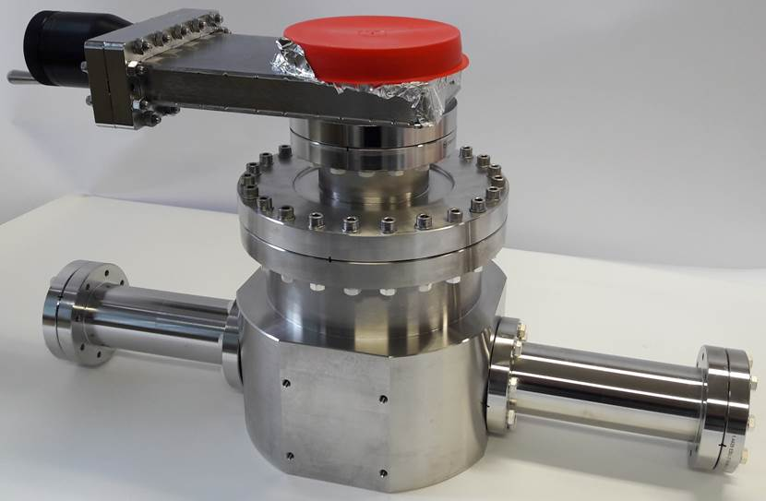
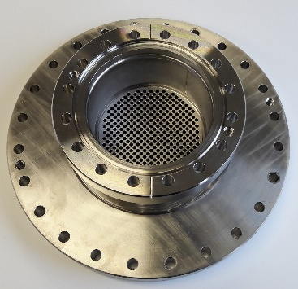
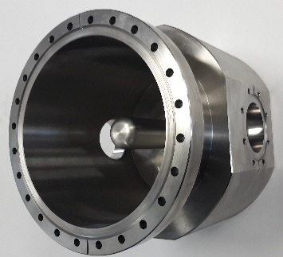
Experience with FPCs (including RF conditioning)
Within the framework of Crab, the couplers are always assembled onto a test box to be RF processed (or RF conditioned)
Due to its coupling element, the hook, the length of the outer line of the test box cannot be the same as the one that will be used with the cavity
The outer line is then not RF processed, this will have to be done with the final configuration
With the crab project we first constructed stainless steel test boxes, from bulk block, and we also successfully constructed Aluminium test boxes, also from bulk block, that is a great news as allowing to have several test boxes for a reasonable cost, and then keeping the FPCs under vacuum until the assembly on cavity

Slide 9
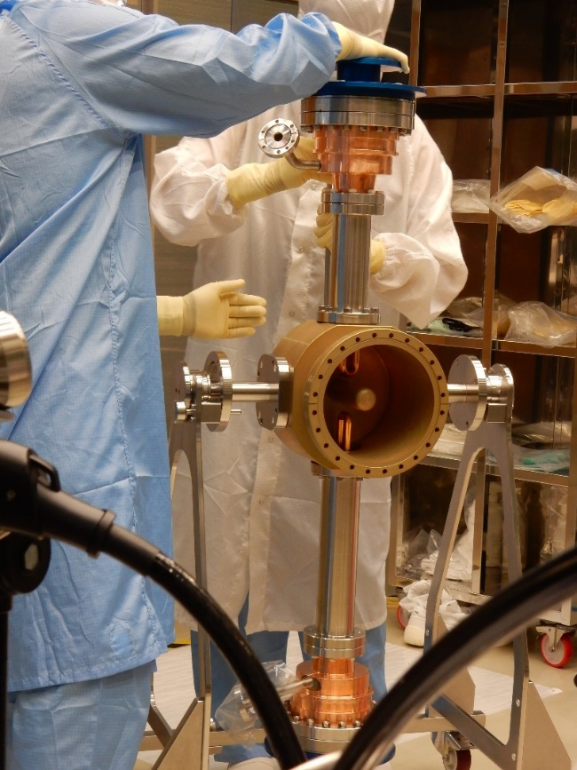
Experience with FPCs (including RF conditioning)
Within the framework of Crab, the couplers are always assembled onto a test box to be RF processed (or RF conditioned)
Due to its coupling element, the hook, the length of the outer line of the test box cannot be the same as the one that will be used with the cavity
The outer line is then not RF processed, this will have to be done with the final configuration
With the crab project we first constructed stainless steel test boxes, from bulk block, and we also successfully constructed Aluminium test boxes, also from bulk block, that is a great news as allowing to have several test boxes for a reasonable cost, and then keeping the FPCs under vacuum until the assembly on cavity

Slide 10
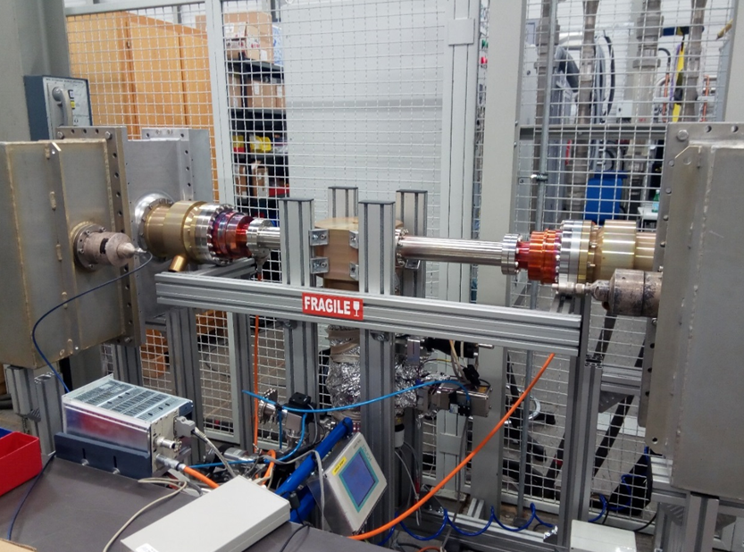
Experience with FPCs (including RF conditioning)
Within the framework of Crab, the couplers are always assembled onto a test box to be RF processed (or RF conditioned)
Due to its coupling element, the hook, the length of the outer line of the test box cannot be the same as the one that will be used with the cavity
The outer line is then not RF processed, this will have to be done with the final configuration
With the crab project we first constructed stainless steel test boxes, from bulk block, and we also successfully constructed Aluminium test boxes, also from bulk block, that is a great news as allowing to have several test boxes for a reasonable cost, and then keeping the FPCs under vacuum until the assembly on cavity

Slide 11
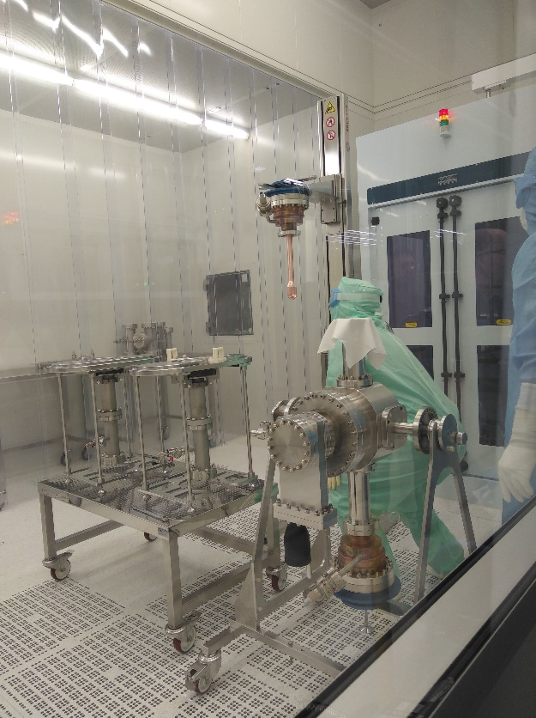
Experience with FPCs (including RF conditioning)
Within the framework of Crab, the couplers are always assembled onto a test box to be RF processed (or RF conditioned)
Due to its coupling element, the hook, the length of the outer line of the test box cannot be the same as the one that will be used with the cavity
The outer line is then not RF processed, this will have to be done with the final configuration
With the crab project we first constructed stainless steel test boxes, from bulk block, and we also successfully constructed Aluminium test boxes, also from bulk block, that is a great news as allowing to have several test boxes for a reasonable cost, and then keeping the FPCs under vacuum until the assembly on cavity

Slide 12
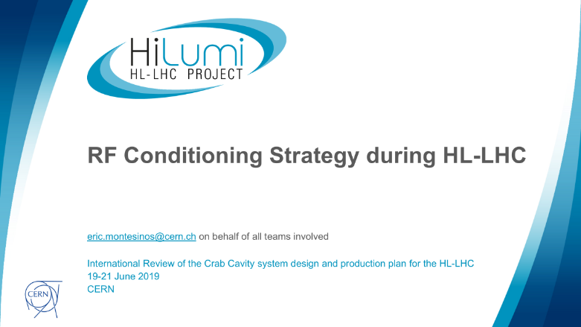
Experience with FPCs (including RF conditioning)
The RF process is the one successfully experienced since 1998 with all CERN’s FPCs
  Always start with short pulses
  Increase the power level under vacuum control
  Repeat until CW
It is the same process and electronics we already deployed all over the world
  CERN, SOLEIL, ESRF, APS, BNL, LAL, KEK
  Always a long process and we have to be cautious
  With this approach, we have not broken any CERN coupler since 1998...
International Review of the Crab Cavity system design and production plan for the HL-LHC
RF Conditioning Strategy during HL-LHC
19-21 June 2019
CERN

Slide 13
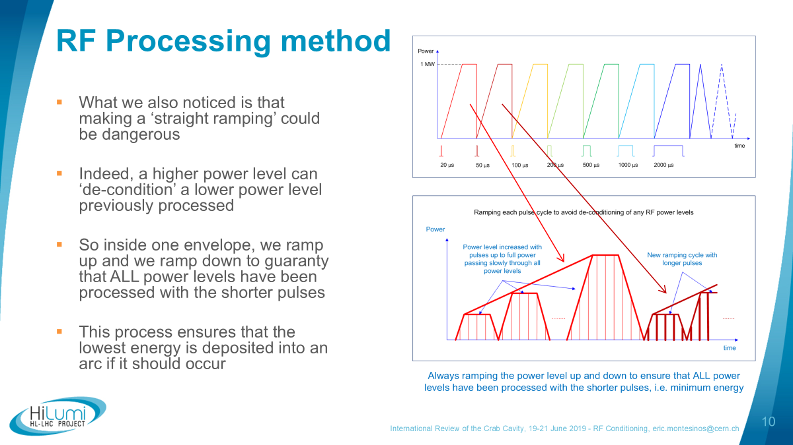
Experience with FPCs (including RF conditioning)

Slide 14
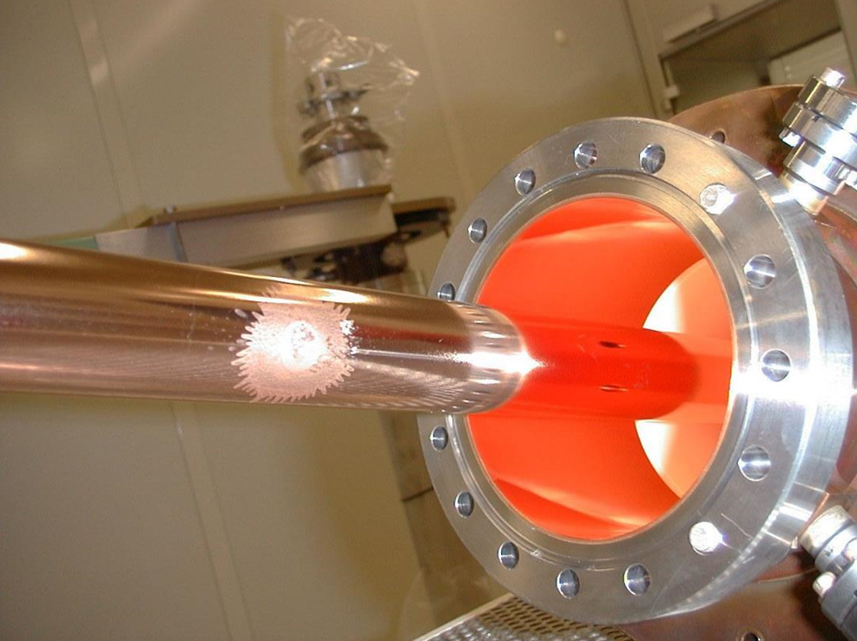
Experience with FPCs (including RF conditioning)
When we tried to be quicker (with previous project – LHC coupler)
Thanks to the fact that we are always using bulk material we were able to continue to operate that coupler, otherwise it would have been catastrophic
A new modern automated system is being prepared by LLRF team keeping the same strategy

Slide 15
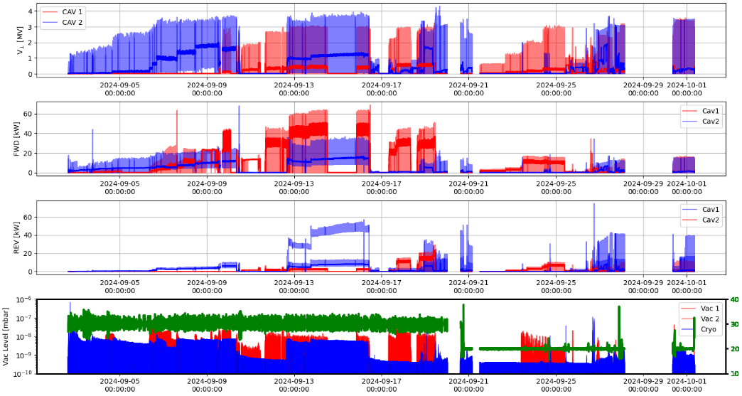
Experience with FPCs (including RF conditioning)
Courtesy Rama Calaga
It took us quite some time to process the couplers, between two to four weeks
We start off tune, to process the coupler alone, and we move on tune to process the coupler and the cavity
With RFD #1, we discovered that a circulator was mandatory, without it, we had a resonance between the cavity of the tube and the crab cavity itself
Fortunately (for transmission lines reasons explained last year – coax versus WG with respect to full reflection) we have it in the final scheme of the HL-LHC
Despite FPCs have been misaligned, the field have been achieved, which is also a very important outcome of the RFD test
Cavity #2 recovered very quickly, this is a very good news to learn that cavities have a very good memory of the RF processing!
The fantastic news is that FPC #1 was able to take multiple x 10 kW (keep in mind the thickness of the ceramic that is key for the robustness of the FPC…)

Slide 16
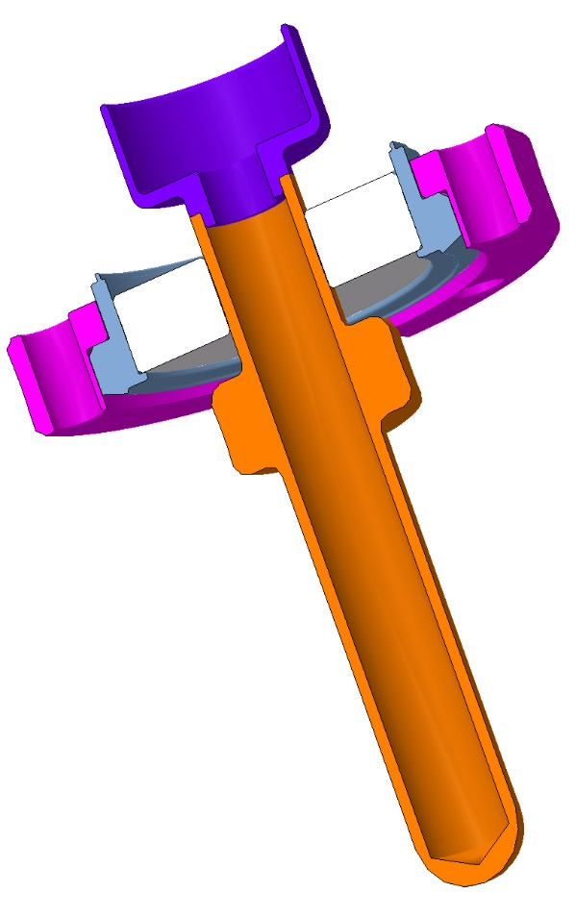
Issues related to HOMC…
…more like a lessons learned on what could go wrong for future CMs
It has been a very long and difficult item to design
We had several versions (4) before having a robust enough item that enables to make the 2K vertical test
Finally, it seems that apart from some production difficulties and cleanliness issues during construction, all HOM couplers and field antennas by themselves are doing ok

Slide 17
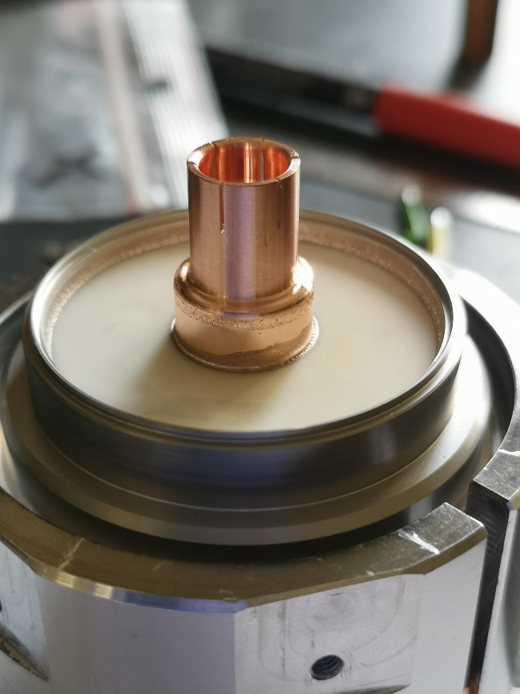
Issues related to HOMC…
…more like a lessons learned on what could go wrong for future CMs
It has been a very long and difficult item to design
We had several versions (4) before having a robust enough item that enables to make the 2K vertical test
Finally, it seems that apart from some production difficulties and cleanliness issues during construction, all HOM couplers and field antennas by themselves are doing ok

Slide 18
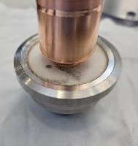
Issues related to HOMC…
…more like a lessons learned on what could go wrong for future CMs
Not yet really a lesson learnt, more a work in progress to improve the processing and anti-dust preparation of RF ancillaries, as well as standardize
Issues are presence of oxides, drying stains, BCP residues, welded/brazed joints emitting large amounts of particles
Actions taken are adding degreasing step after BCP to avoid BCP residues, modification of the BCP tooling to avoid acids in contact with the brazed joint, modification of the rinsing and drying procedure in cleanroom to avoid oxidation of copper antennas

Slide 19
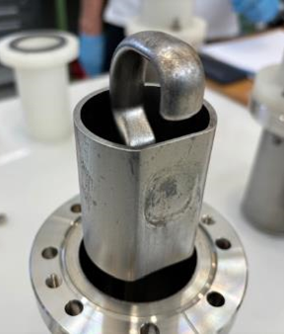
Issues related to HOMC…
…more like a lessons learned on what could go wrong for future CMs
Not yet really a lesson learnt, more a work in progress to improve the processing and anti-dust preparation of RF ancillaries, as well as standardize
Issues are presence of oxides, drying stains, BCP residues, welded/brazed joints emitting large amounts of particles
Actions taken are adding degreasing step after BCP to avoid BCP residues, modification of the BCP tooling to avoid acids in contact with the brazed joint, modification of the rinsing and drying procedure in cleanroom to avoid oxidation of copper antennas

Slide 20
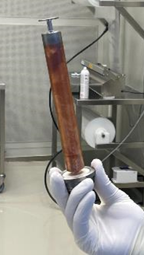
Issues related to HOMC…
…more like a lessons learned on what could go wrong for future CMs
Not yet really a lesson learnt, more a work in progress to improve the processing and anti-dust preparation of RF ancillaries, as well as standardize
Issues are presence of oxides, drying stains, BCP residues, welded/brazed joints emitting large amounts of particles
Actions taken are adding degreasing step after BCP to avoid BCP residues, modification of the BCP tooling to avoid acids in contact with the brazed joint, modification of the rinsing and drying procedure in cleanroom to avoid oxidation of copper antennas

Slide 21
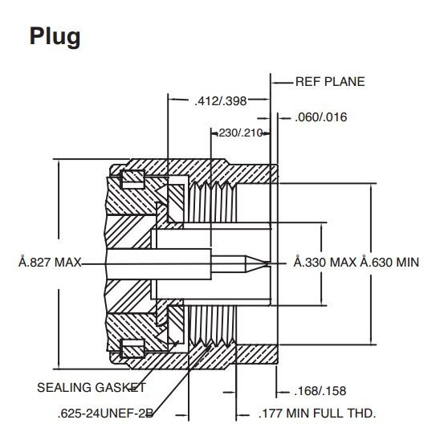
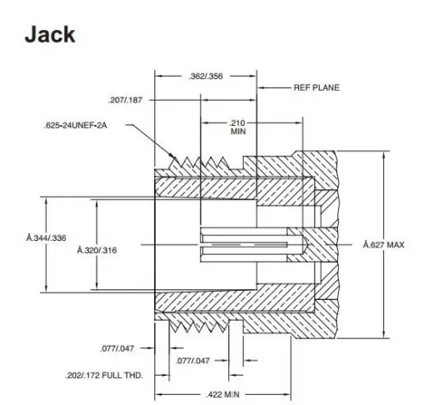
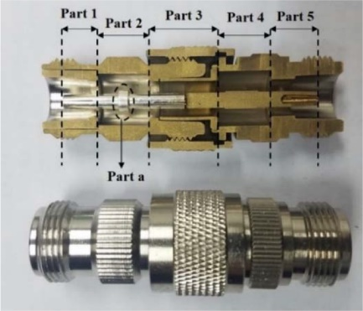
Issues related to HOMC…
…more like a lessons learned on what could go wrong for future CMs
The lines and adapters were more of a concern, and more specifically the RF contacts of the lines and adapters
We identified several places with an RF contact in rotation
This is an incorrect design by definition, but it is even worse in the case of a cold system
The outcome is that we overtighten the connector thinking that we improve the RF contact
This is wrong, we damage the connector that even if it is ok for the first test, will be bad later
Only sliding contacts are now being implemented in our lines and adapters to cure the problem

Slide 22
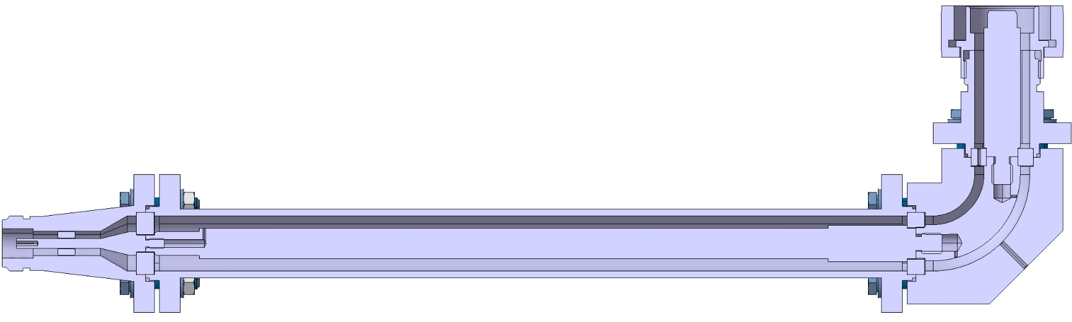
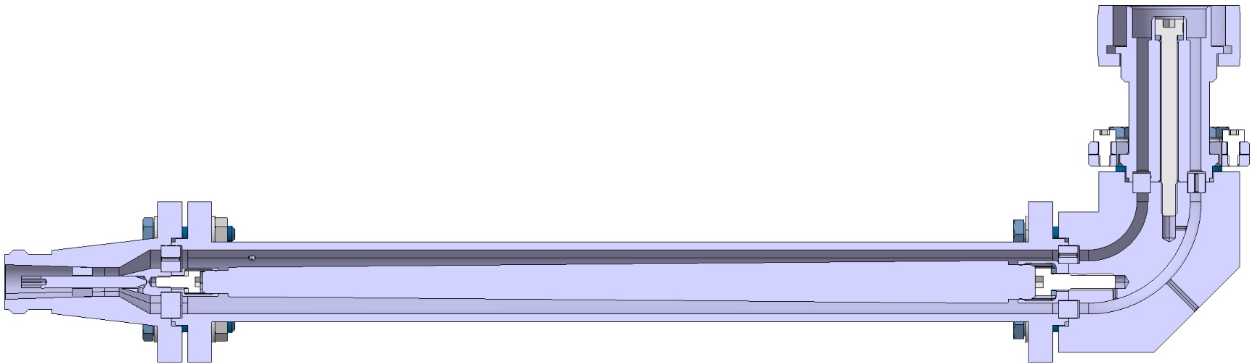
Old version of 10/16 adapter
New version of 10/16 adapter

Slide 23
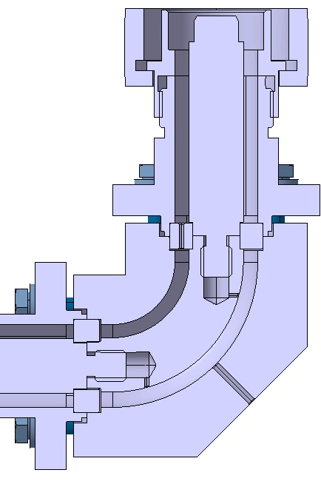
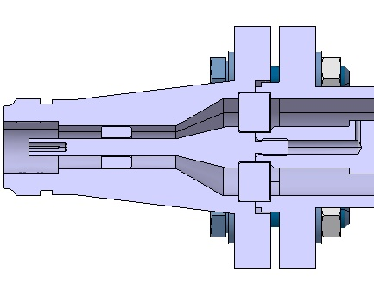
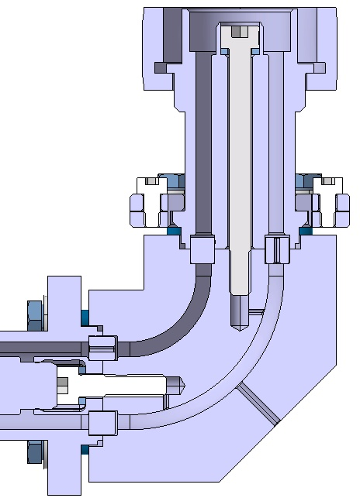
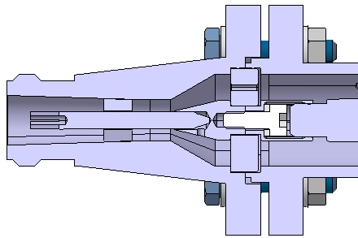
Old version of
10/16 adapter
New version of
10/16 adapter

Slide 24
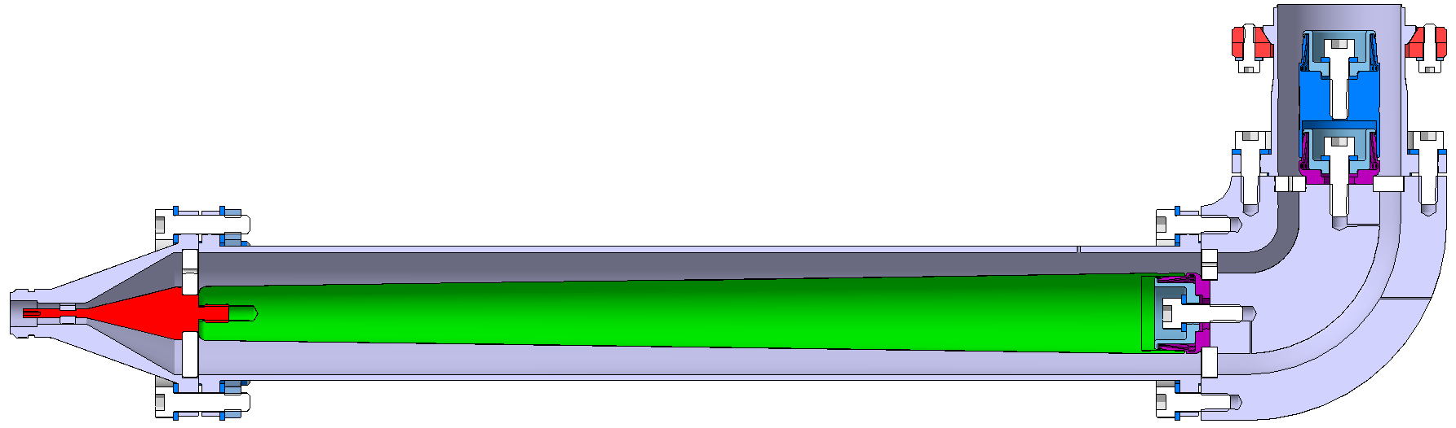
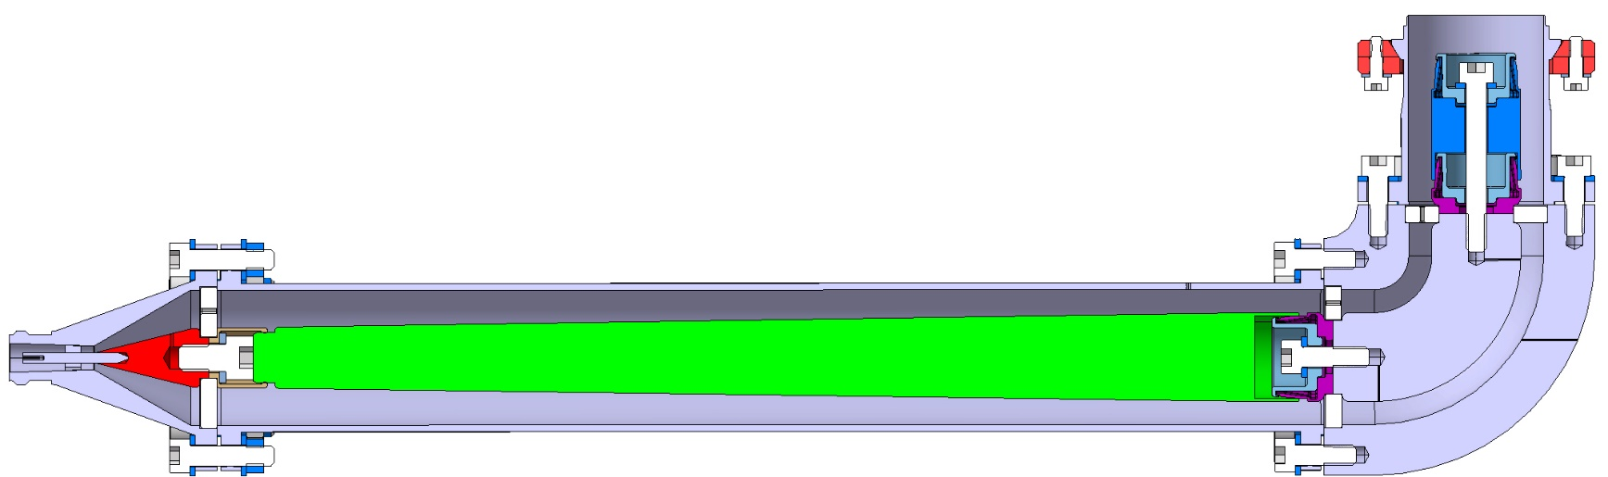
Old version of 25/40 adapter
New version of 25/40 adapter

Slide 25
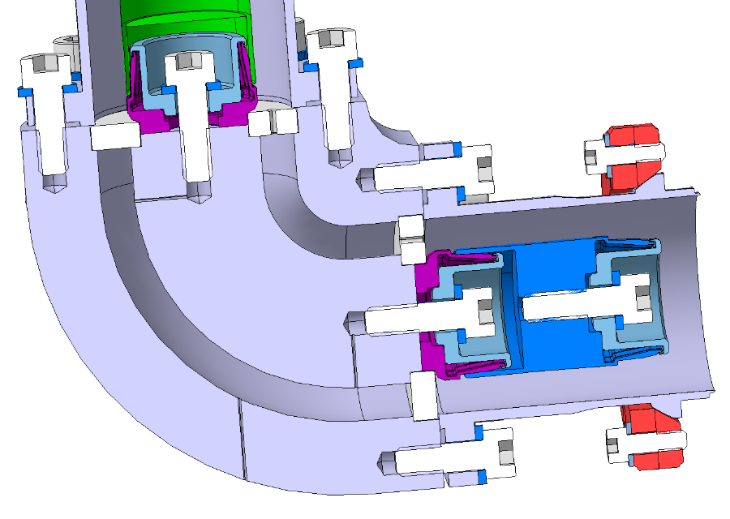
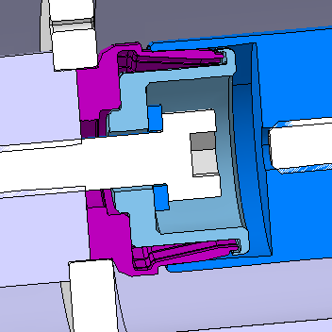
Issues related to HOMC…
Wrong surface for RF contact
Because of a too long inner line, the RF contact was taking place on the wrong place
Overtightening gave the impression that all was ok, but in fact it was deforming the line inducing a bad contact during the next assembly or during the next warm up cool down cycle
Correct location for RF contact

Slide 26
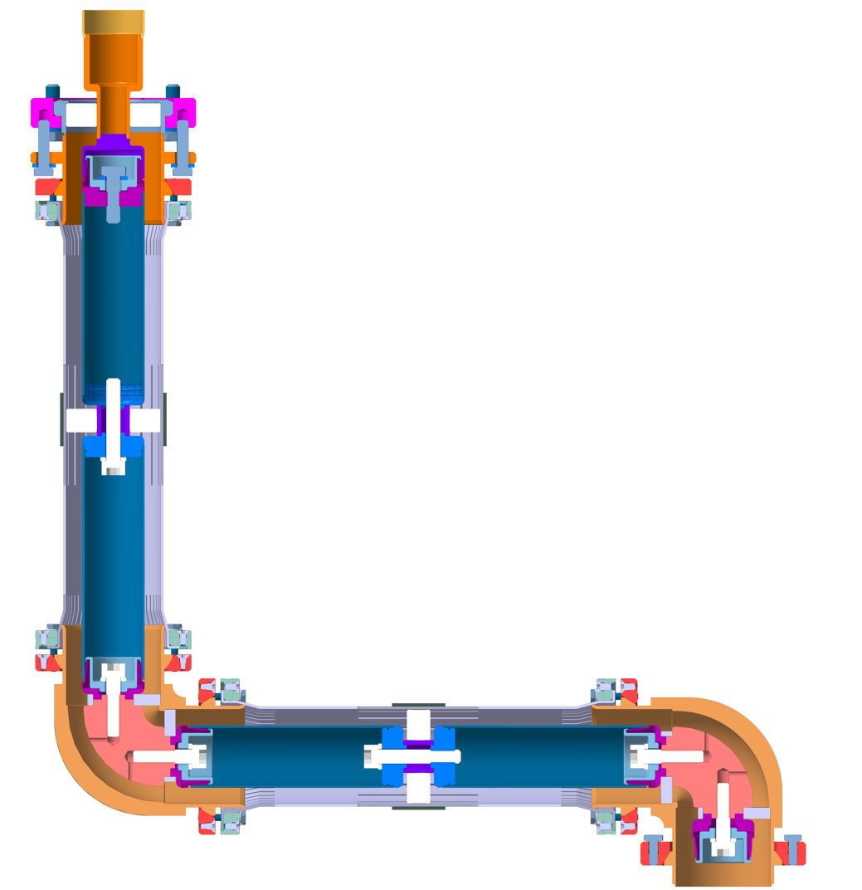
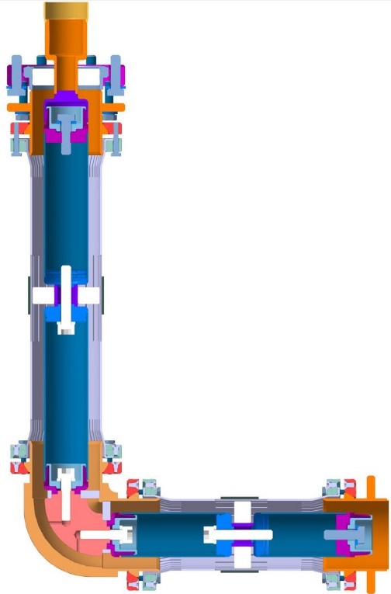
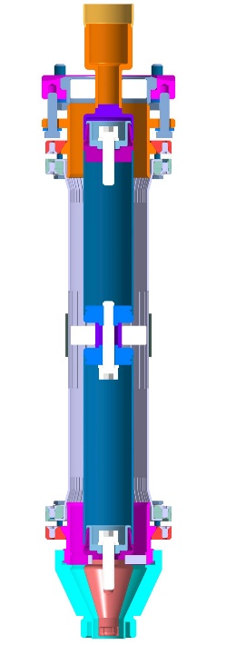
LHCACFRL0198
LHCACFRL0261
LHCACFRL0195

Slide 27
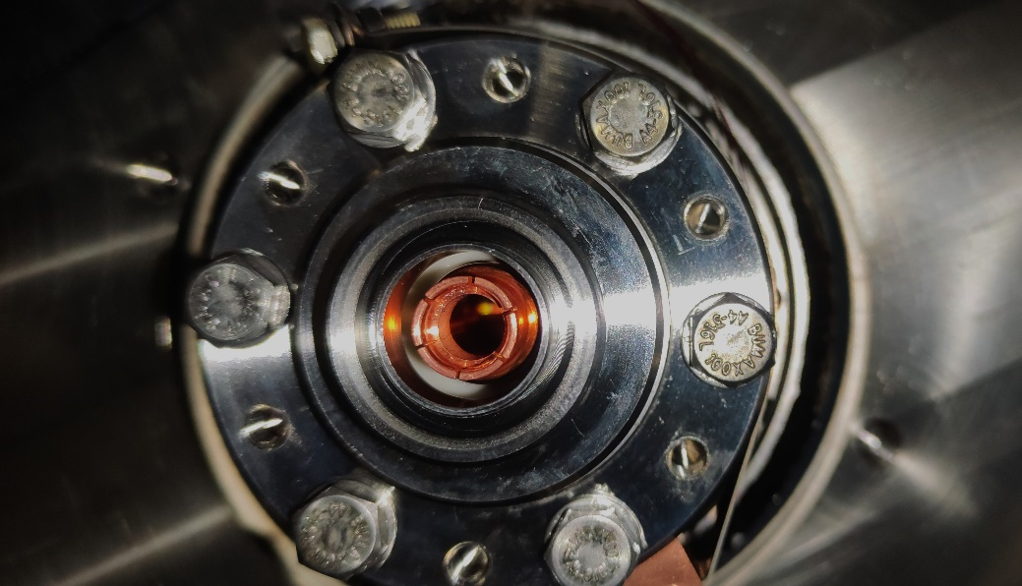
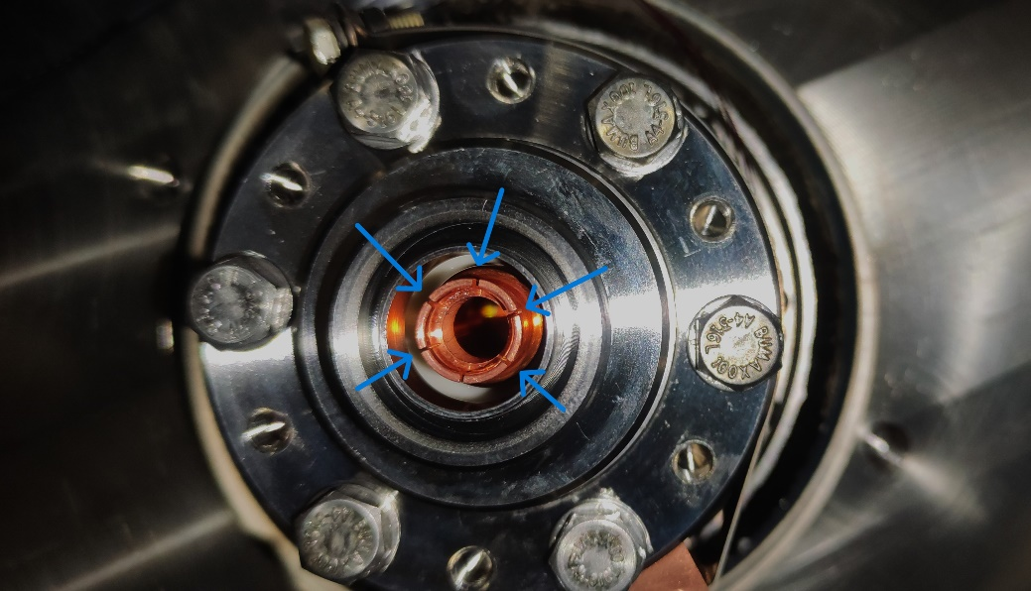

Slide 28
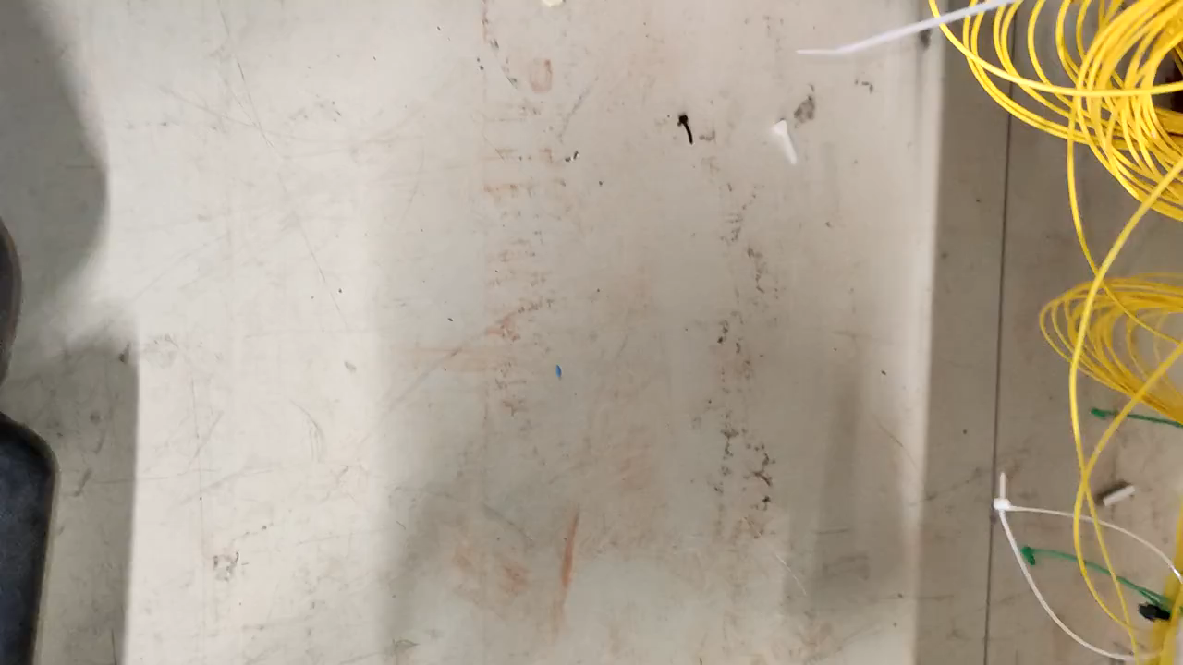

Slide 29
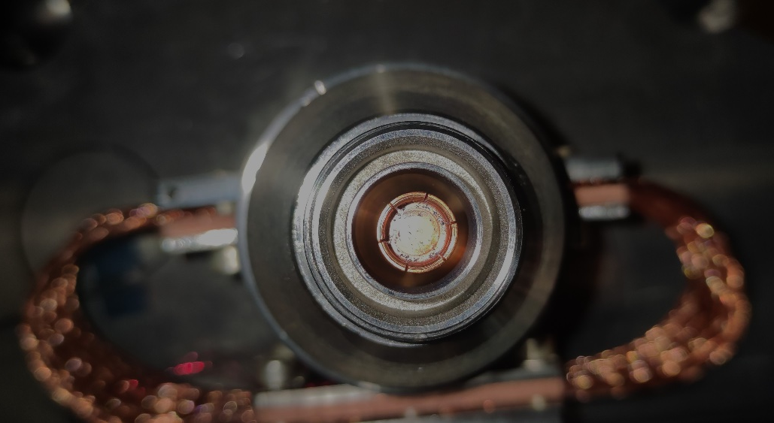
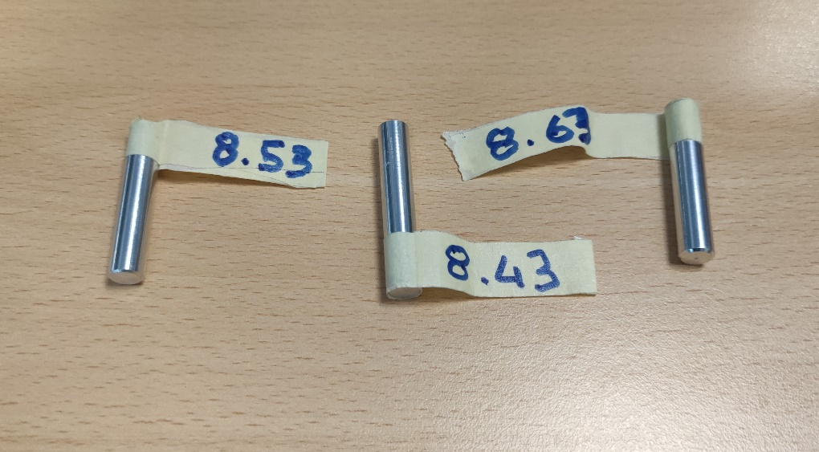
So please, never tighten an RF connector over the specified limit, even better, all our connectors could be tightened by hands only
The very good news here is that the feedthroughs have survived the massive overtightening we applied to them, demonstrating their robustness

Slide 30
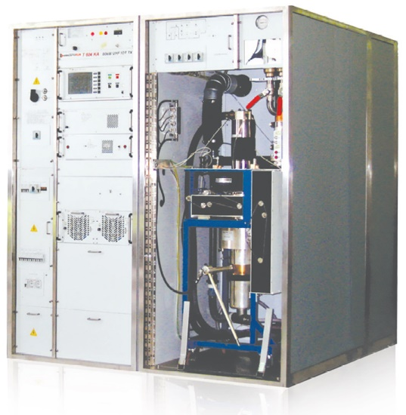
Recent experience from RFD
and what to expect from conditioning for the future series including what/when we are going to send to Canada (SSPA, IOT ?)
We have three power stations at CERN available for the Crab project
We are constructing a fourth one, a Proof Of Concept (POC) that will be the basis for the Invitation to Tender detailed Technical Specification
By the end of 2024, we will then have four power stations
Two will be operated in the SPS for the RFD test and for FPC processing
One will be sent to Canada
The POC will be moved to SM18 if needed

Slide 31
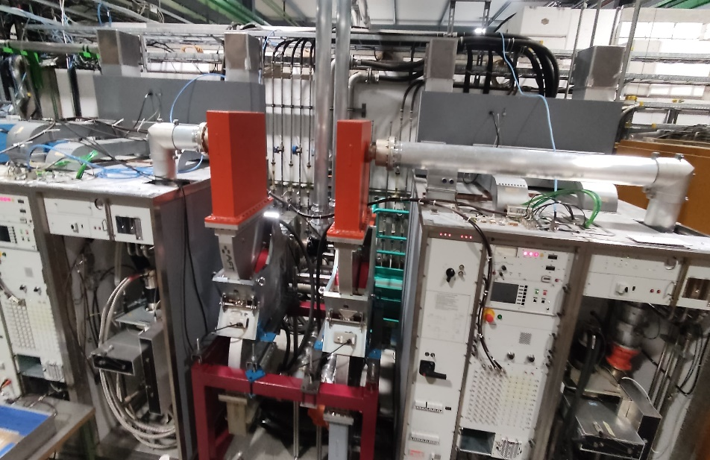
Recent experience from RFD
and what to expect from conditioning for the future series including what/when we are going to send to Canada (SSPA, IOT ?)
What we recently discovered is that a circulator is needed between the power station and the cavity
Circulators we installed in SM18 are for far oversized as being LHC spares with power ratings up to 350 kW
As we will buy circulators for HL Crab, two prototypes will be ordered, one will be sent to Canada Q4 2025
A new portable RF processing is also being finalized, and will be sent to Canada
Still some details (but Devil is in the details) to be sorted out (240 VAC 50 Hz versus 110 VAC 60 Hz for example)

Slide 32
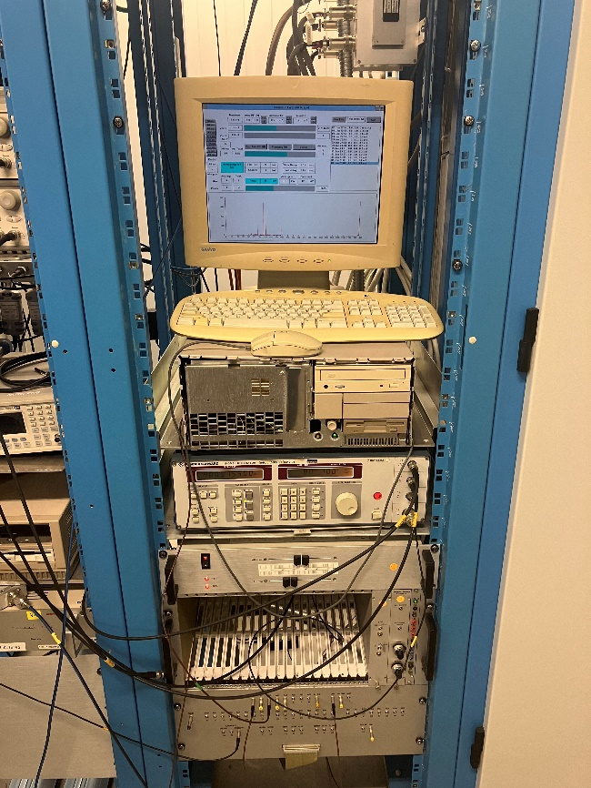
Recent experience from RFD
and what to expect from conditioning for the future series including what/when we are going to send to Canada (SSPA, IOT ?)
What we recently discovered is that a circulator is needed between the power station and the cavity
Circulators we installed in SM18 are for far oversized as being LHC spares with power ratings up to 350 kW
As we will buy circulators for HL Crab, two prototypes will be ordered, one will be sent to Canada Q4 2025
A new portable RF processing is also being finalized, and will be sent to Canada
Still some details (but Devil is in the details) to be sorted out (240 VAC 50 Hz versus 110 VAC 60 Hz for example)

Slide 33
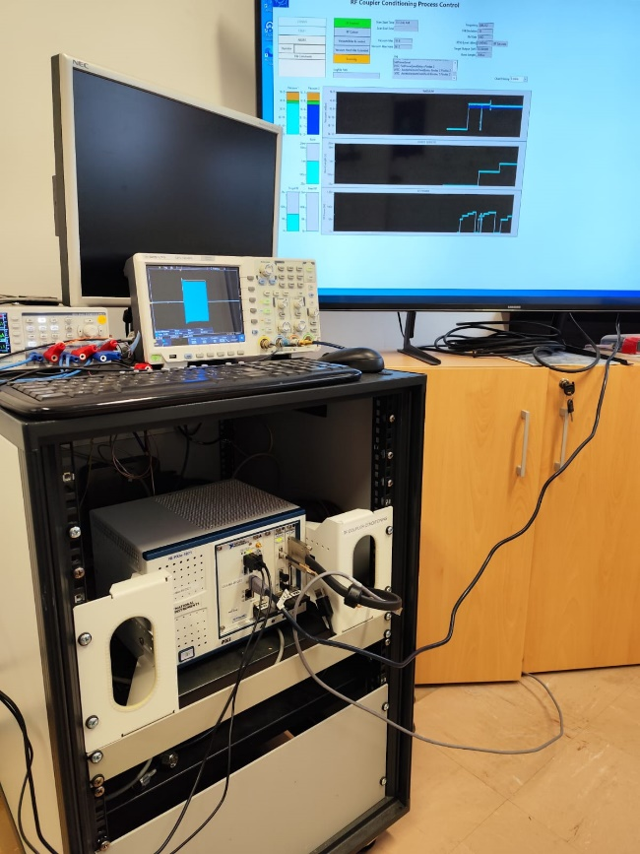
Recent experience from RFD
and what to expect from conditioning for the future series including what/when we are going to send to Canada (SSPA, IOT ?)
What we recently discovered is that a circulator is needed between the power station and the cavity
Circulators we installed in SM18 are for far oversized as being LHC spares with power ratings up to 350 kW
As we will buy circulators for HL Crab, two prototypes will be ordered, one will be sent to Canada Q4 2025
A new portable RF processing is also being finalized, and will be sent to Canada
Still some details (but Devil is in the details) to be sorted out (240 VAC 50 Hz versus 110 VAC 60 Hz for example)

Slide 34


Monotonous Driver
There is key parameter that we identified with the first SPS test that is the linearity and the monotonous behaviour of the transmitter
We will not be able to do a lot with respect to the IOT
The driver could be pre-adjusted to compensate the tube
What we recently discovered with the RFD test is that the Driver was not having a monotonous behaviour
From all this, we decided to make a separate purchase, with its own specific specification, under preparation

Slide 35





Slide 36

U-shape in RF power lines

Slide 37



Series production with industry
Surface
100m
Underground
P5 - CMS
P1 - ATLAS
4 RF galeries

Slide 38

Series production with industry

Slide 39

Series production with industry
Each gallery will host 4 HPRF stations,
each composed of
Transmitter (HV cubicle + trolley + IOT)
RF coaxial transmission lines
Circulator
Circulator’s dummy load
RF waveguides
In total
16 + 4
16 sets + spare items
16 + 2
16 + 2
16 sets + spare items

Slide 40

Series production with industry
Transmitter
Driver
IOT
Trolley
HV cubicle (including controls)

Slide 41

Circulator
Load
Water cooling of the coupler
Air cooling of the coupler
Supporting system

Slide 42

Series production with industry
next steps, POC, acceptance tests, ...
Next step is, now that we acquire a lot of experience thanks to BA6 tests over the past years and SM18 tests this year, the preparation of the contracts
Tubes and trolleys contract have been approved by last Finance Committee, this is a very important milestone
Market Survey for Cubicle is being launched
MS for circulators is being launched
Request for quotes of all other items are in preparation (drivers, coaxial lines, waveguide, loads for circulators)

Slide 43

Series production with industry
next steps, POC, acceptance tests, ...
POC (Proof Of Concept) of a very simplified Cubicle, but correctly defined to our needs, is almost completed, tests should start before the end of the month
This will allow for a very well defined detailed technical specification regarding the Cubicle
In addition, we will test a new mono-cavity output circuit for the IOT, designed by Thales in the framework of a collaboration for the Crab IOT

Slide 44

Series production with industry
next steps, POC, acceptance tests, ...
POC (Proof Of Concept) of a very simplified Cubicle, but correctly defined to our needs, is almost completed, tests should start before the end of the month
This will allow for a very well defined detailed technical specification regarding the Cubicle
In addition, we will test a new mono-cavity output circuit for the IOT, designed by Thales in the framework of a collaboration for the Crab IOT

Slide 45

Finally, is there a future for SSPA at 400 MHz?
The answer is yes of course, there is a future for SSPA at 400 MHz
during the last CWRF2024 workshop, several colleagues have reported studies on GaN transistors, that will certainly replace LDMOS with a better power density and a better efficiency
Combining systems have evolved over the last decade, allowing for a large number of inputs to one output in a single stage, that was a prerequisite for moving from SSA to SSPA
So, for all about up to 100 kW, SSPA will certainly be an option to consider
Accelerator-Industry Co-Innovation workshop, CERN, May 2022, SSPA at CERN

Slide 46

Finally, is there a future for SSPA at 400 MHz?
The answer is yes of course, there is a future for SSPA at 400 MHz
during the last CWRF2024 workshop, several colleagues have reported studies on GaN transistors, that will certainly replace LDMOS with a better power density and a better efficiency
Combining systems have evolved over the last decade, allowing for a large number of inputs to one output in a single stage, that was a prerequisite for moving from SSA to SSPA
So, for all about up to 100 kW, SSPA will certainly be an option to consider
Accelerator-Industry Co-Innovation workshop, CERN, May 2022, SSPA at CERN

Slide 47

Finally, is there a future for SSPA at 400 MHz?
The answer is yes of course, there is a future for SSPA at 400 MHz
during the last CWRF2024 workshop, several colleagues have reported studies on GaN transistors, that will certainly replace LDMOS with a better power density and a better efficiency
Combining systems have evolved over the last decade, allowing for a large number of inputs to one output in a single stage, that was a prerequisite for moving from SSA to SSPA
So, for all about up to 100 kW, SSPA will certainly be an option to consider
Accelerator-Industry Co-Innovation workshop, CERN, May 2022, SSPA at CERN

Slide 48

Finally, is there a future for SSPA at 400 MHz?
The answer is yes of course, there is a future for SSPA at 400 MHz
during the last CWRF2024 workshop, several colleagues have reported studies on GaN transistors, that will certainly replace LDMOS with a better power density and a better efficiency
Combining systems have evolved over the last decade, allowing for a large number of inputs to one output in a single stage, that was a prerequisite for moving from SSA to SSPA
So, for all about up to 100 kW, SSPA will certainly be an option to consider
Accelerator-Industry Co-Innovation workshop, CERN, May 2022, SSPA at CERN

Slide 49

Finally, is there a future for SSPA at 400 MHz?
The answer is yes of course, there is a future for SSPA at 400 MHz
during the last CWRF2024 workshop, several colleagues have reported studies on GaN transistors, that will certainly replace LDMOS with a better power density and a better efficiency
Combining systems have evolved over the last decade, allowing for a large number of inputs to one output in a single stage, that was a prerequisite for moving from SSA to SSPA
So, for all about up to 100 kW, SSPA will certainly be an option to consider
Accelerator-Industry Co-Innovation workshop, CERN, May 2022, SSPA at CERN

Slide 50

Finally, is there a future for SSPA at 400 MHz?
But perhaps not yet there for all specific accelerator applications…
Indeed, during the same last CWRF2024 workshop, several colleagues have reported breakages of transistors when fast transients occur
This could also be one of the reasons of our failures with the SPS transistors system that we have
If these transients are short enough, they could be damaging the transistors directly linked to the cavity, despite being protected with a circulator
And there is a remaining question: obsolescence? Of course, one can think of buying a lot of transistors, but then, what about lifetime under storage?
Accelerator-Industry Co-Innovation workshop, CERN, May 2022, SSPA at CERN

Slide 51

Finally, is there a future for SSPA at 400 MHz?
But perhaps not yet there for all specific accelerator applications
Indeed, during the same last CWRF2024 workshop, several colleagues have reported breakages of transistors when fast transients occur
This could also be one of the reasons of our failures with the SPS transistors system that we have
If these transients are short enough, they could be damaging the transistors directly linked to the cavity, despite being protected with a circulator
And there is a remaining question: obsolescence? Of course, one can think of buying a lot of transistors, but then, what about lifetime under storage?
Accelerator-Industry Co-Innovation workshop, CERN, May 2022, SSPA at CERN

Slide 52
Conclusion
The main lesson learnt is that real life tests are mandatory
We are really very grateful to Rama and Ofelia that have defended the SPS tests and the SM18 tests
These were so important for us to discover the many details that could make such a system failing
Not an exhaustive list
feedthrough design
spacers in 6-1/8 coaxial lines
U-shape in coaxial lines
need of circulators to avoid tube cavity and Crab cavity coupling effect
conditioning process
linearity of HPRF

Slide 53

Rama Calaga, a very special boss
US Particule Accelerator School Prize, prestigious Prize
  1997, Daniel Boussard (Group Leader who hired me at CERN in 1992) that was saying (from how I remember it) ‘accelerators will be with superconducting cavities or will not be…’, incredibly visionary
  (not in my line management, 2011, Jean Delayen)
  2022, Rama Calaga, with who I have the pleasure to work with! (on Crab… and on many other topics)
1968

Slide 54
My sincere thanks to
HL management, always positive, always supportive, never micromanaging, which was really appreciated, thank you very much to Oliver and Markus for instilling such a good spirit
All WP4 members and all CERN community that helped us with the many difficulties that occurred all along the last decade working on the Crab project
The members of my team that worked hard to fix the many troubles that occurred when moving from power point to real life
A special Thank You to Ofelia and Rama for their constant support

Slide 55
Simplicity is the ultimate sophistication
Leonardo Da Vinci (500+ years ago)
They did not know it was impossible, so they did it
Mark Twain

