Slide 1
Engineering Specifications for HL-LHC WP4: status and open discussion
Luca Dassa
EDMS 3171436 V1
14th HL-LHC Collaboration Meeting, 7th -10th 2024 (Genova)

Slide 2
Outline
Why the specifications?
Strategy for HL-LHC WP4
Status of the specifications
Some feedbacks and remarks
NCRs
Documentation / Quality FU
Open discussion

Slide 3

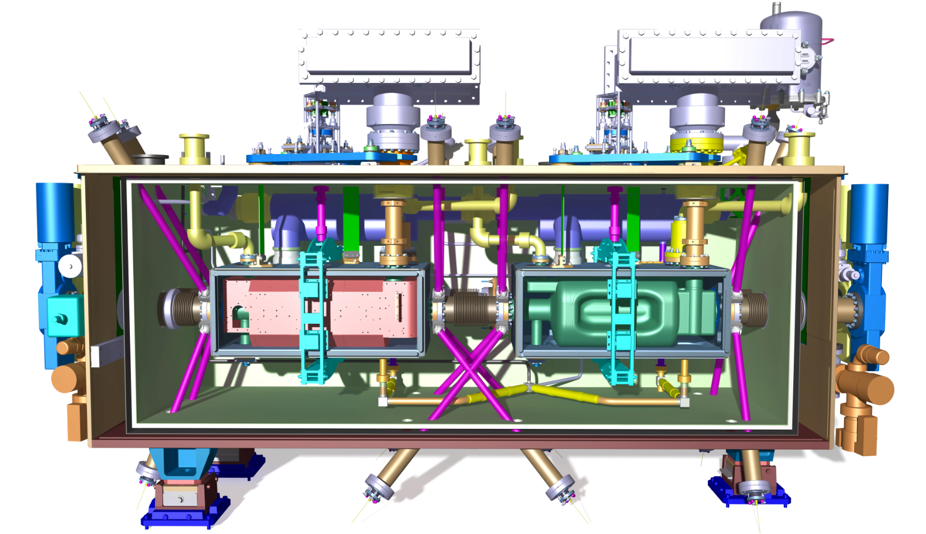
Why specifications?
Functional requirements
CERN rules
Technical requirements
ESRs (Safety requirements)
Safety file (technical documentation for compliance)
LHC compatibility
CERN Procedures
Different actors
Acceptance criteria
Quality
Manufacturer is the responsible for safety
Traceability
…
See my talk at the “International Review of the Crab Cavity system design and production plan for the HL-LHC’’ on June, 19th -21st 2019 (CERN)

Slide 4
Strategy for HL-LHC WP4
CERN WP4 is manufacturer of the cryomodule
The cryomodule shall be designed and manufactured in accordance with the Essential Safety Requirements of PED 2014/68/EU.
CERN establishes the technical documentation
CONTENT:
Refers to the corresponding Engineering Specification
Demonstrate the compliance with CERN Safety Rules, ESR by ESR
Intended for CERN internal use and for HSE, available for consultation
2 main documents for the cryomodule
engineering specification
guideline for compliance with CERN safety rule
+
2 main documents per relevant component:
engineering specification
guideline for compliance with CERN safety rule
CONTENT
translates the HL-LHC needs into functional and technical requirements
lists the required documentation
complies with ESRs
Respect of engineering specification
=
compliance with CERN requirements (safety included)
Ad-hoc agreements with Collaborating Entities based on described strategy

Slide 5
Cryomodule & Components Specifications
Scope | ID code | Eng. Spec. [EDMS nr] | Guideline for compl. with CERN Saf. Req. [EDMS nr]
Full Cryomodule, including beam screens and references to requirements for vacuum components (Sector valves, Plug-in modules) | ACFGA | 2043014 v.2.0 | 2043016 v1..0
Safety Request WP4 - Co CONTENT FOR THE DQW & RFD CRYOMODULE FOR LHC | ACFGA | 2514225 v.2.0
HL-LHC LHC CRAB CAVITIES: welded joints for cryomodule assembly | ACFGA | 2706475 v.1.3
Minimum Material Requirements for Austenitic Stainless Steel and Aluminium Alloys to be employed in non-critical applications | ACFGA | 2632333 v.1.0
CRYOMODULE
Dressed cavities, HOMs couplers, Pick-up antennas, Cold magnetic shield | ACFDC,ACFHC, ACFPU, ACFCM | 1389669 v.2.6 | 2058183 v.1.0
Cryogenic circuits | ACFQC | 2093032 v.1.4 | 2101920 v.1.1
Thermal shield | ACFTS | 2101922 v.1.2 | 2101923 v.1.0
He guard | - | 2806004 v.1.4
MLI | ACFTS | 2144140 v.1.3 | -
Vacuum vessel | ACFVT | 2101924 v.1.6 | 2101925 v.1.1
Warm Magnetic shield | ACFWM | 2101926 v.1.4 | -
Alignment monitoring system | ACFAM | - | -
Support and alignment system | ACFAH | - | -
Instrumentation (ONLY FOR RFD SPS) | ACFIS | 2450567 v.4 + CRNLSQLj0070 v.AA (PID) | -
Fundamental Power Coupler | ACFMC | 2101934 v.1.0
RF internal lines | ACFRL | 2605345 v.1.0 | -
Tuning system | ACFTU | 2101938 v.0.1 | -
Safety protecting devices | ACFGA | 2101940 v.1.0 | 2101943 v.1.0
Sector Valves (beam line) | VVG (TBC) | § 7.7 of 2043014 v.1.0 | -
Plug-in modules for Cold-Warm transition + Intercavity bellow | ACFVW + ACFVC (TBC) | § 7.7 of 2043014 v.1.0 | -
Beam screen | VSSC_ | § 7.7 of 2043014 v.1.0 | -
COMPONENTS
STATUS
Released
In Work
Relevant for Safety
No further versions are expected!

Slide 6
Some remarks on specifications
Actual version of specifications:
Implemented feedbacks from prototypes
Structured approach improved for cryomodule specification
Homogeneity improved for component specifications: materials; filler metals; leak test inspectors; NDT inspectors; non-standard welded joints…
Links between drawings and specifications updated
Drawings + specifications:
exigent, however defined and proved framework for procurement and manufacturing

Slide 7
Some general remarks
Cavities, some HOMs and cryogenic lines are pressure equipment
Rules independent from the WP4 shall be respected (defined at CERN and within HL-LHC)
CERN remains the manufacturer, the responsible entity in term of safety
Do not underestimate welded/brazed joints and related qualifications, for the components and for the cryomodule assembly. Qualifications, tests, documentations are requiring a not negligeable effort.
Some additional measurements/tests (i.e. for NCRs) may be needed to confirm acceptability of an equipment: see thickness distribution on cavities => we expect comprehension and flexibility

Slide 8
NCRs
NCRs are meant to learn from the issue and determine corrective and preventive actions
NCRs for RFD proto: about 50 (2x WMS, 4xOVC, 3xTS, 15xCryoL, 12xDrCav, 13x CryomAsm…)
NCRs cavities production: 86
NCRs for series CMs:
  STFC: 1 (1xWMS)
  TRIUMF: 8 (7xCryoL by CERN; 1xOVC)
  CERN: 11 (1xOVC; 6xCryoL; 1xWMS; 3xTS)
Privilege the Deviation Request tool

Slide 9

Documentation / Quality FU
Quantity of documentation: manpower shall be allocated to it
Quality of documentation is important (date, author, status…)
MTF shall be correctly prepared and regularly filled
Documentation shall be reviewed and approved at the correct time
Approval shall be tracked in EDMS (even after an email exchange)
Hold points shall be respected. Some hold-points require the presence of CERN members: inform us in advance.
STFC and AUP colleagues have already gained experience gained TRIUMF colleagues are at the beginning of the experience.
LS2 performed according to the principle of prioritising safety first, then quality and then the schedule, and all of these criteria were met. (Fabiola Giannotti, Annual Report 2019)

Slide 10
Time for open discussion
Anything missed in the specs? What about a spec for the instrumentation?
Drawing & specifications? Any incoherence spotted?
What about the feedback you receive day-by-day from CERN on spec use?
Any question on applicable safety policy?
Any difficulties on outsourcing? Which are the feedbacks from suppliers?
What about documentations? Is this preventing you from respecting deadlines? What about quality and quantity?
Is the Deviation Request tool helping you?
Any comments on NCRs (use, approval…)?

Slide 11
Thank you…

Slide 12
Updates with respect to the previous versions (1)
Name | ID code | Engineering Specification | STATUS | Modifications
Cryomodule | ACFGA | EDMS 2043014 v.2.0 | New version released on 16/02/2024 after circulation and update | 4.2: Table 3: simplified and clarified 4.3.4 and 4.3.5: Clarification on cryogenic cycles Section 8 of the old version removed (sections renumbered) Section 13.4.8: clarifications on pressure tests Section 14.3: clarification on the cool-down tests at 77K Minor modification on section 18 (incoterm removed) Minor modification to the requirements for the High power RF conditioning in SM18 Section related to the Installation in the HL-LHC machine removed
Cryogenic circuits | ACFQC | EDMS 2093032 v.1.4 | Minor modifications; new version released on 13/02/2024. | Clarification added to Section 3.3.5 on pressure test. Section 3.2.3: reference [14] replaced with correct EDMS number.
He guard | ACFQC | EDMS 2806004 v.1.4 | Minor modifications; new version released on 13/02/2024. | Clarification added to Section 3.5.3 on pressure test.
Thermal shield | ACFTS | EDMS 2101922 v.1.2 | Minor modifications; new version released on 13/02/2024. | Section 3.2.8: material list for braids uploaded Section 3.2.10: bolt minimum strength reduced. Section 3.3.4: clarification for pressure test procedure
Vacuum vessel | ACFVT | EDMS 2101924 v.1.6 | Minor modifications; new version released on 13/02/2024. | Section 2.4.8: bolt minimum strength reduced.
Warm Magnetic shield | ACFWM | EDMS 2101926 v.1.4 | Minor modifications; new version released on 13/02/202. | Section 2.6 (cleaning) modified to be in agreement with specifications of other cryomodule components.
Fundamental Power Coupler | ACFMC | EDMS 2101934 v.1.1 | Minor modifications; new version released on 13/02/2024. | Pressure test removed

Slide 13
Updates with respect to the previous versions (2)
Name | ID code | Guideline for compl. with CERN Safety Req. | STATUS | Modifications
Cryomodule | ACFGA | EDMS 2043016 v.1.0 | New document, released on 10/04/2024
Cryogenic circuits | ACFQC | EDMS 2101920 v.1.1 | Minor modifications: new version released on 14/02/2024. | Minor modifications to Section 3.3 (relaxation of requirements for VT personnel) Section 3.4: references for the unconventional welded joints updated Flexible hoses requirements removed.
Thermal shield | ACFTS | EDMS 2101923 v.1.0 | New document, released on 10/04/2024
Vacuum vessel | ACFVT | EDMS 2101925 v.1.1 | Minor modifications: new version released on 14/02/2024. | Minor modifications to Section 3.1 (adapted to new material requirements) Minor modifications to Section 3.2 (relaxation of requirements for VT personnel)
Safety protecting devices | ACFGA | EDMS 2101943

