Slide 1


RFD Industrial Production Challenges
Manuele Narduzzi - FNAL
14th HL-LHC Collaboration Meeting – Oct 7th – 10th, 2024

Slide 2
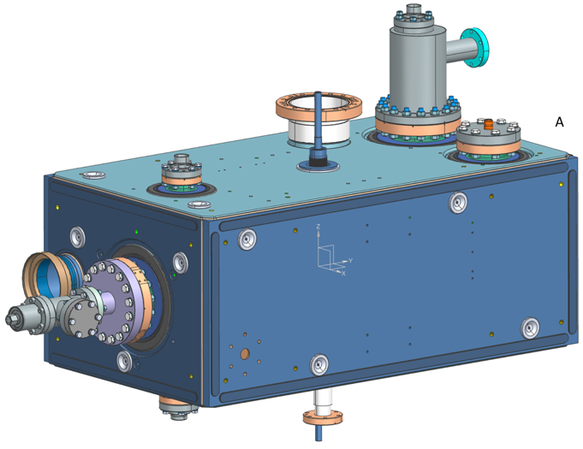
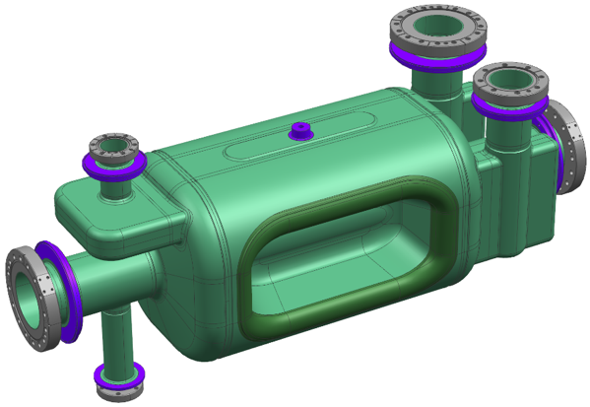
Outline
Fabrication & Processing Challenges at ZRI
Production and QA/QC status
Summary

Slide 3


Fabrication & Processing Challenges at ZRI*
Recap
Achieving the tight tolerances remains an issue and it’s driving the schedule
HPR & BCP are challenging due to the Crab geometry
QA documents are still not fully approved and contingent on qualifications
Logistics and international shipping requires considerable coordination
ZRI* as Zanon Research and Innovation srl

Slide 4
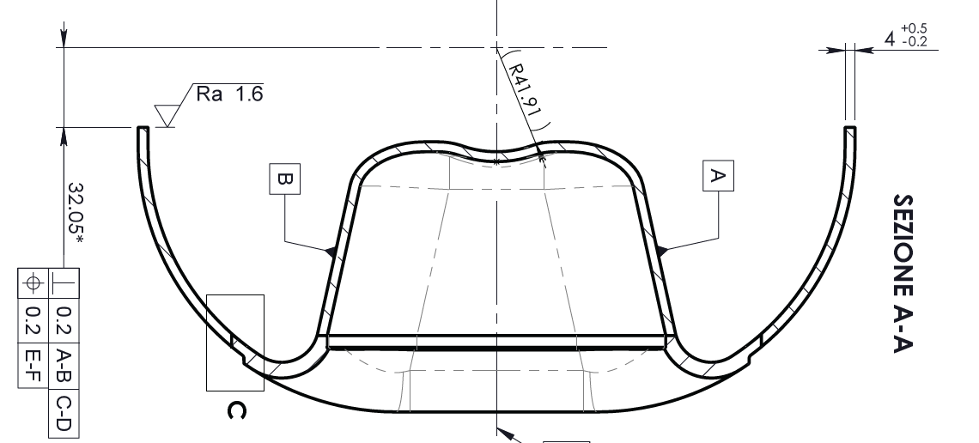
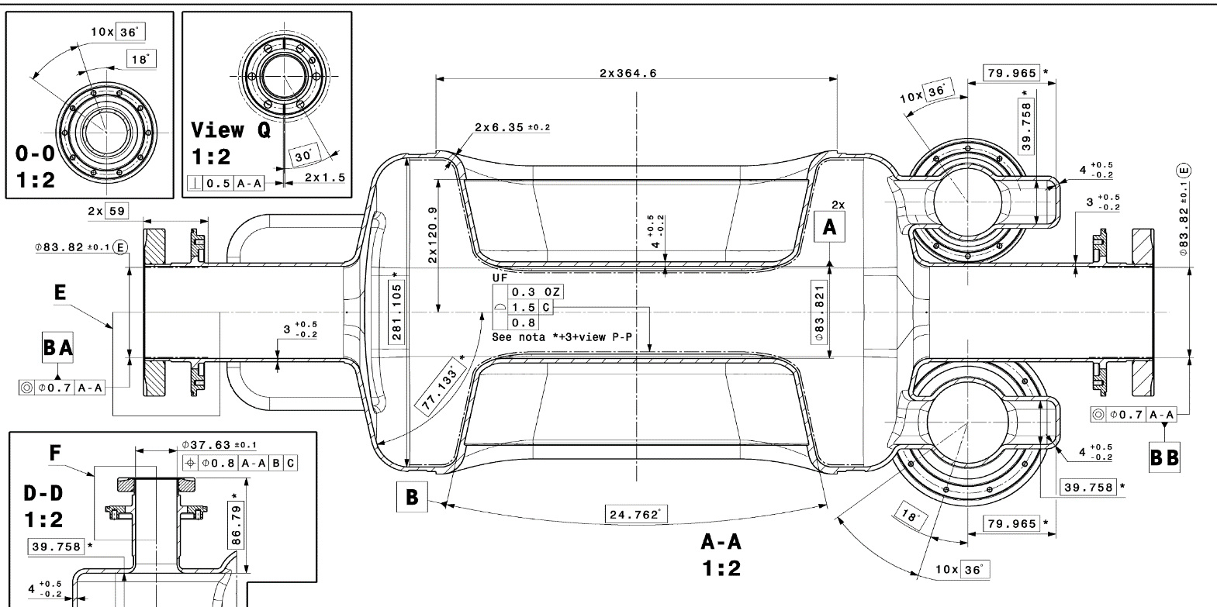
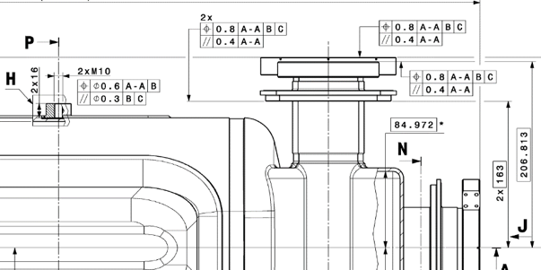
Fabrication & Processing Challenges at ZRI*
RFD Bare Crab Cavities: Manufacturing Challenges
RFDs required sub-mm tolerances for manufacturing and EBW of complex parts:
  Mechanical tolerances on stamped/coined subcomponents (poles & waveguides)
  Complex EBW between Half Main Body sub-components & Waveguides Boxes - End Caps
  Alignment between End Groups-Main Body during final EBW
1
2
1
3
2
2
3
3
2
Manufacturing is still facing difficulties for the technological limits/ available resources
*Zanon Research and Innovation srl

Slide 5
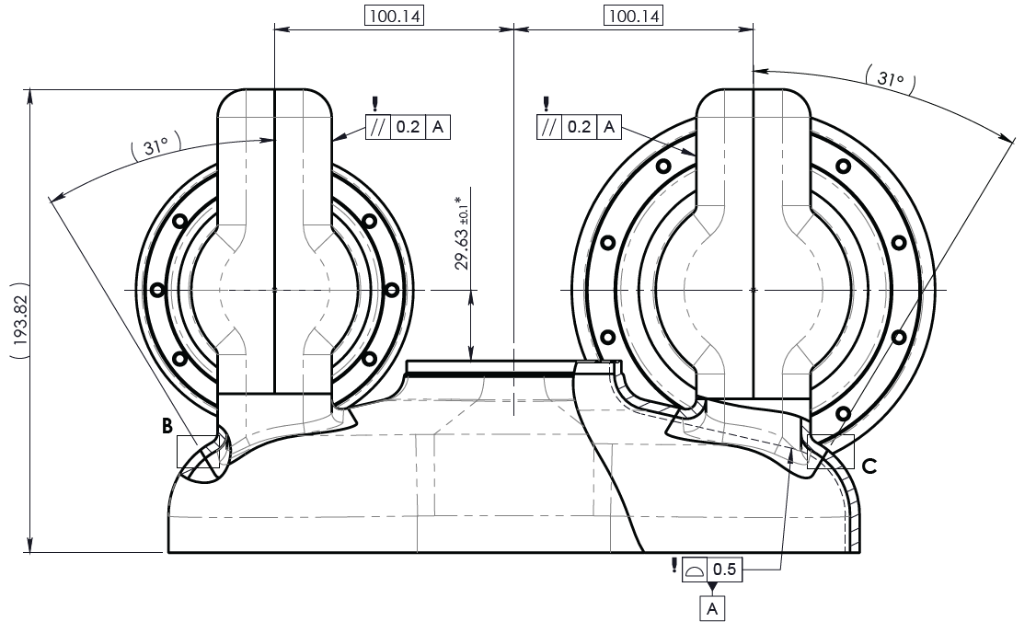
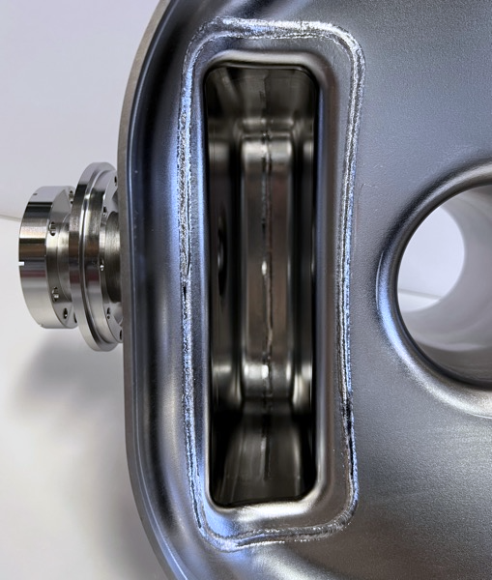
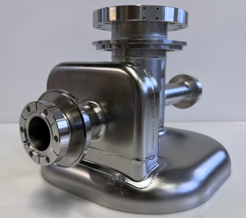
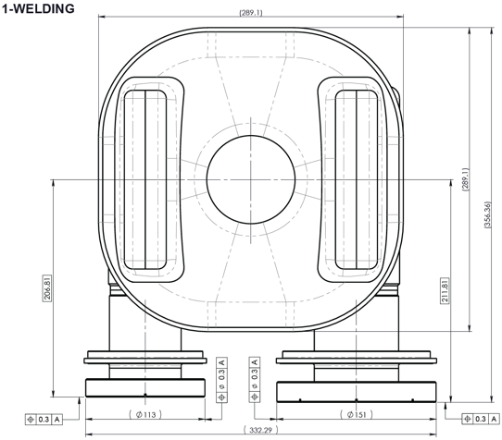
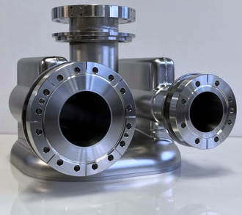
Fabrication & Processing Challenges at ZRI
2b- EBW between Waveguides Boxes - End Caps
  Complex EBW between Waveguides boxes and End Caps
    parallelism better 0.2mm + positioning within 0.3mm
  Variable radii welds to keep shape accuracy below 0.5mm
  ZRI refined the EBW and CNC tooling after numerous tests
  ZRI is still improving EBW results on series RFD, even after a lot of experience

Slide 6
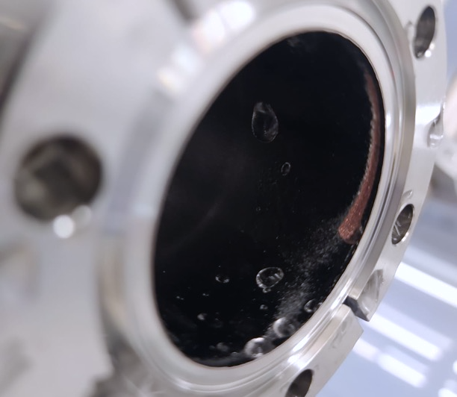
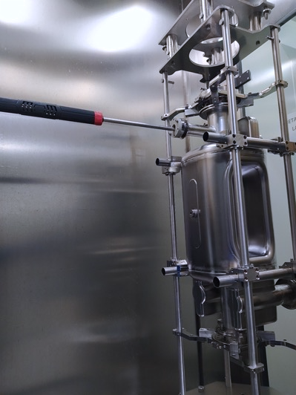
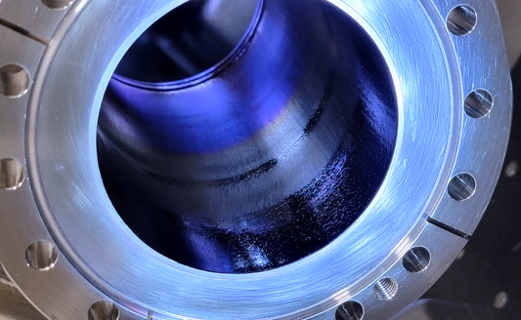
Fabrication & Processing Challenges at ZRI
RFD Bare Crab Cavities: Processing Challenges
The RFDs processing, due to the RFD Crab geometry, involved great effort at ZRI:
Updated rotational BCP machine → after over-etching issues discovered on NRFDP001
Implementation of manual HPR on cavity ports → to improve the cavity performances
Optimization of automatic HPR parameters → to avoid oxidation on beam ports
Over-etching on NRFDP001
Manual HPR on RFD ports
Oxidation after automatic HPR
HPR improvements and over-etching issues due to BCP are causing delays

Slide 7
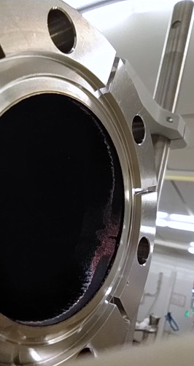
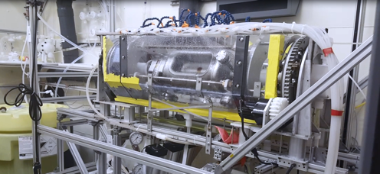
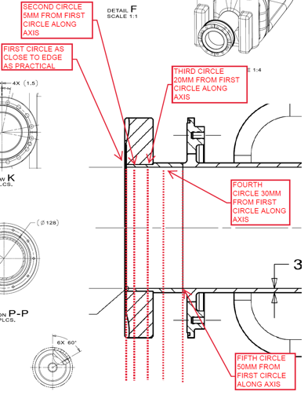
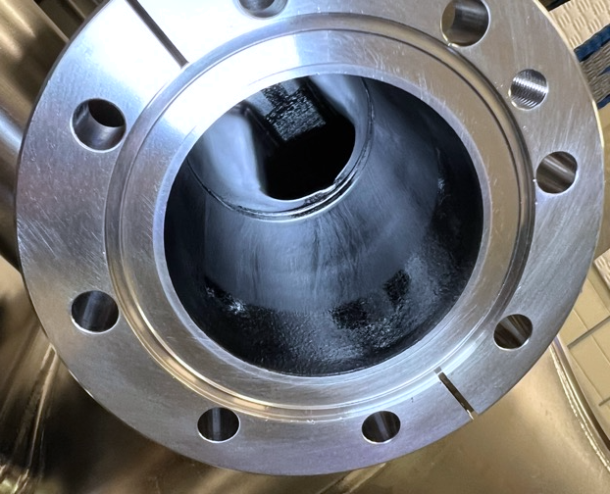
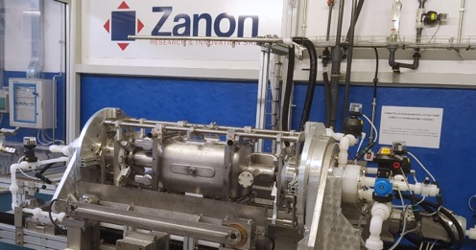
Fabrication & Processing Challenges at ZRI
1- Update Rotational BCP machine
Excessive etching on all ports, during the 3rd rotational BCP of NRFDP001 at ZRI, damaged the
V-HOM & Pick-Up ports (exposing the brazing alloy).
BCP procedure at ANL vs ZRI: powerful waterjet cooling at ANL while water misting at ZRI
CMM and Visual Inspection performed at JLAB to collect data on available cavities:
  BCP at ANL → uniform removal; BCP at ZRI → up to 435µm removed vs 220µm targeted
  VT of inner ports’ surfaces: smoother for RFDP002 vs rougher on pre-series
Exposed Cu after BCP
ANL vs ZRI cooling during BCP
CMM data captured at JLAB
BCP streaks on inner surface
Rotation BCP at ZRI updated with improved cooling, successfully tested.

Slide 8
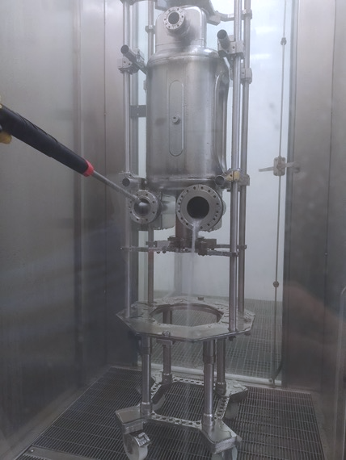
Fabrication & Processing Challenges at ZRI
2- Implementation of manual HPR on cavity ports
HPR performed at ZRI on NRFD01 → poor performances during VTA at JLAB
HPR at JLAB on NRFD02 → success, using manual rinsing of the ports (before automatic HPR)
ZRI reprocessed NRFD01 using manual HPR of ports → Particle count decrease considerably
Imminent cold test at FNAL will provide final feedback on updated ZRI processing
Position | Particle count (previous HPR) | Particle count (updated HPR)
V-HOM Beam tube | 190 | 9
Pick-Up Flange | 57 | 6
V-HOM Flange | 51 | 7
H-HOM Flange | 106 | 8
FPC Flange | 73 | 10
FPC Beam Tube | 222 | 3
Zanon updated the HPR procedure using manual HPR on all the ports following JLAB experience

Slide 9
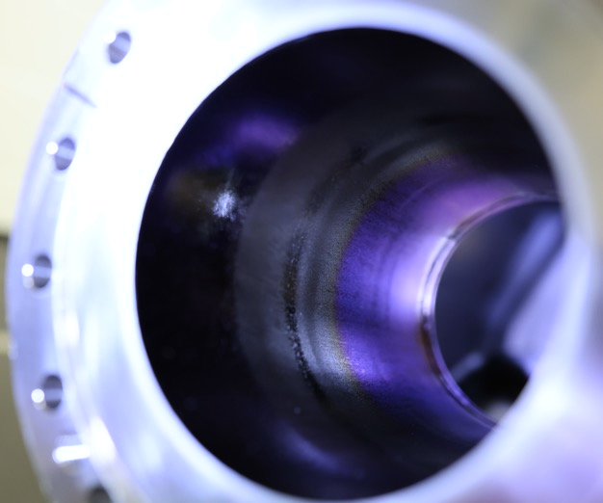
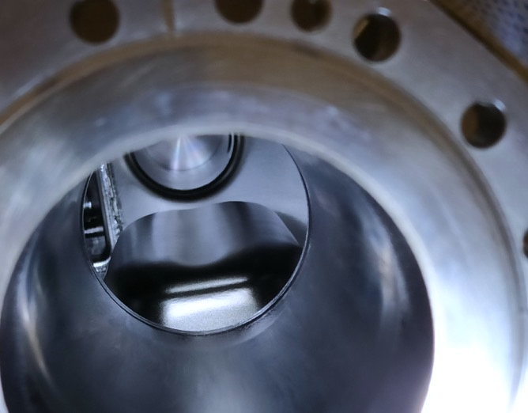
Fabrication & Processing Challenges at ZRI
3- Optimization of automatic HPR parameters
A blue-ish oxide layer on Beam Ports of NRFD01 noticed at JLAB (HPRed only at ZRI)
ZRI HPR procedure was targeted for an upgrade after tests on JLAB (only) HPRed cavities:
  Upward/downward constant speed: benefits? Avoid stationary waterjet & increase rinsing time
Updated HPR paramenter + port manual HPR → expecting to increase NRFD01 VTS results
Oxidation after first HPR at ZRI
No oxidation after improved HPR procedure
ZRI updated the automatic HPR parameter, driven by JLAB positive results. Imminent VTS

Slide 10
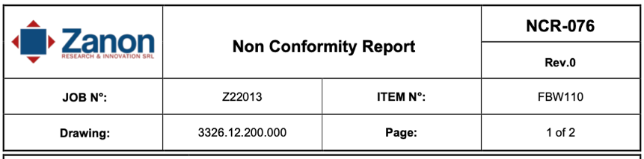
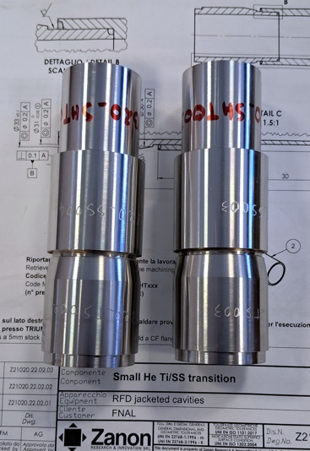
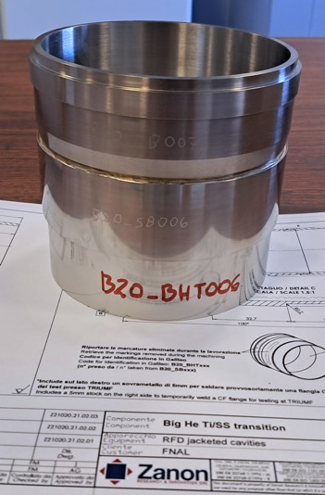
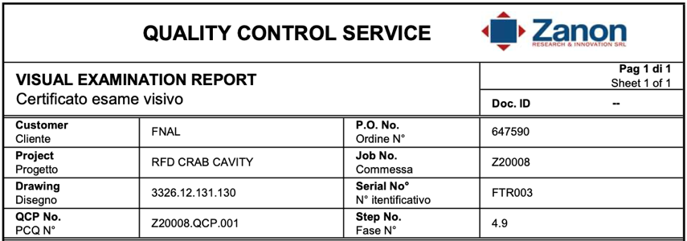
Fabrication & Processing Challenges at ZRI
RFD Crab Cavities: QA/QC Approval Challenges
The RFDs manufacturing at ZRI required continuous QA/QC follow-up and approval (AUP & CERN):
QA requirements feedback from industry → uncommon requests for Pressure Equipment Cat 1
Feedback and approval on ZRI QCRs and NCRs → AUP & CERN joint effort to minimize delays
Brazed Joints approval → Shear testing and UT of Ti/SS joints for He tanks is ongoing
NCR and QCR examples from ZRI
Small and Big TI/SS transitions in qualification
QA/QC approval requires a significant effort from AUP and CERN to minimize delays

Slide 11
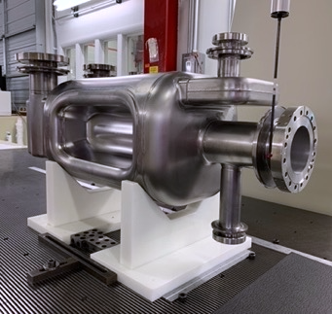
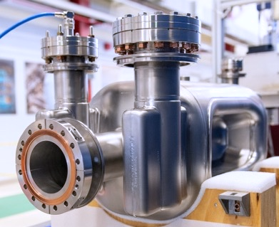
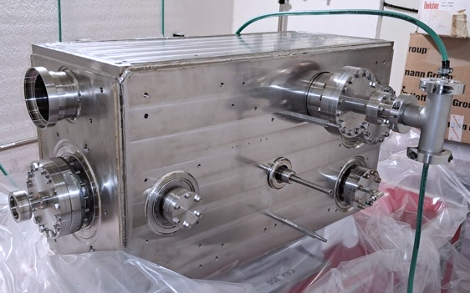
Production status
Summary of contracts between AUP and industry (ZRI)
12x AUP Pre-series + Series Bare RFDs manufacturing and processing:
  NRFD01 has been re-processed to remove oxide layer at ZRI, qualification in VTS (FNAL) in Nov 2024
  NRFD02 qualified via cold tests at both JLAB and FNAL, finalizing QA/QC
  NRFD03/04 undergoing EBW/ trim-tuning at ZRI, NRFD05-12 subcomponents ready for welding, some QA pending
10x AUP Series Jacketed RFDs production:
  manufacturing of subcomponents ongoing, imminent installation of He Tank onto NRFD02, pending some QA approval
2x AUP Prototypes Bare RFDs manufacturing and processing
  NRFDP002 exceeded functional requirements, processed at ANL. NRFDP001 damaged after reprocessing at ZRI.
1x AUP Prototype Jacketed RFD production:
  RFDP002 has been successfully jacketed at ZRI, waiting for VTA qualification w/wo ancillaries at JLAB by beg. 2025
Production is challenging but under control, schedule is tight. QA/QC need to be finalized

Slide 12
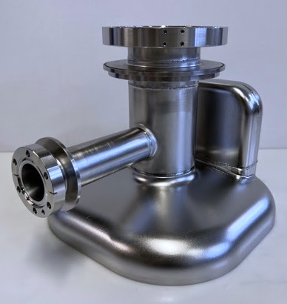
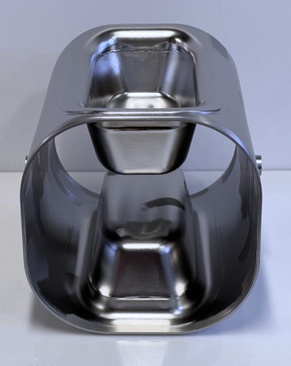
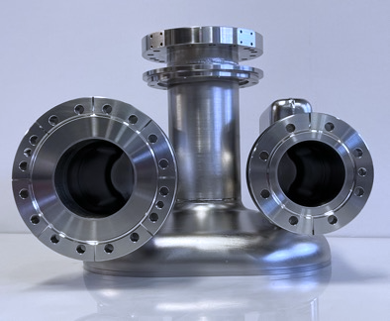
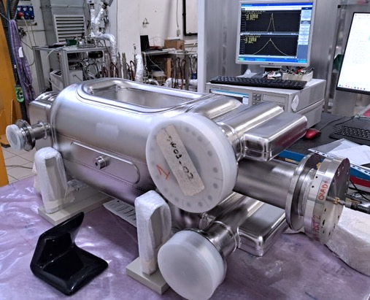
Fabrication and QA/QC Status
AUP RFD bare pre-series production (ZRI)
2 x Pre-series RFDs (PO 647590) manufactured and processed at ZRI:
NRFD01 recently reprocessed at ZRI to remove blue-ish oxide layer. VTS at FNAL in Nov 2024
NRFD02 qualified in JLAB/FNAL cold tests (see A. Castilla talk), imminent jacketing at ZRI
Finalizing QA/QC in MTF for final endorsement of bare cavities
NCR about excessive removal from BCP at ZRI has been approved by WP4
Both cavities need frequency ”correction” before Jacketing (to reach the update target)
NRFD01: VTS in Nov 2024 at FNAL. NRFD02 imminent jacketing at ZRI

Slide 13
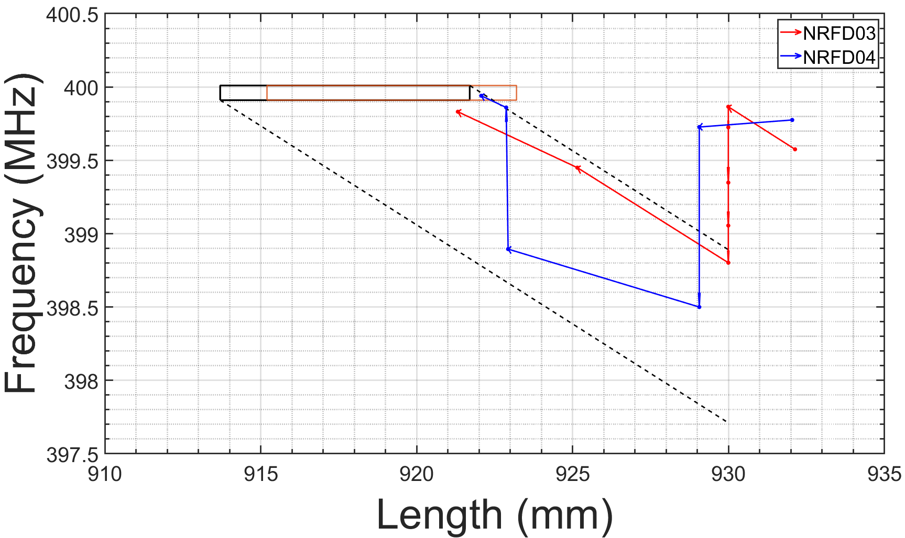
Fabrication and QA/QC Status
AUP RFD series production (ZRI)
10 x Series bare cavity are undergoing manufacturing at ZRI
NRFD03 final EBW imminent.
NRFD04 in last stage of trimming, EBW will follow after NRFD03.
Theoretical status before EBW
NRFD05 & 06:
  Ongoing CNC of main bodies to be ready for trim tuning
  Imminent EBW of Waveguides Boxes onto End Caps
NRFD07– 12:
  Subcomponents mostly ready to start welding
Automatic UT (C-scan) of brazed joints required to finalize QA docs
Cavity length limits before EBW
Cavity length limits after EBW
Series bare cavities is advancing. Priority on NRFD03-5. Tight schedule for QA/QC approval

Slide 14
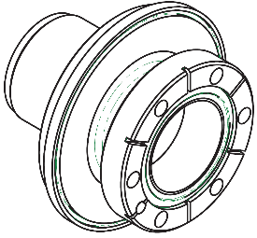
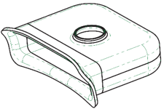
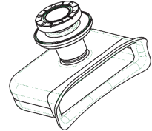
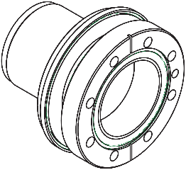
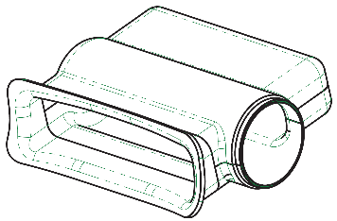
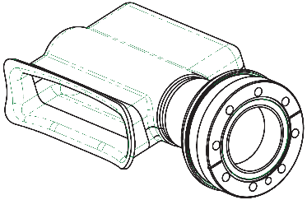
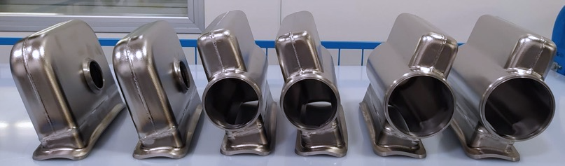
Fabrication and QA/QC Status
AUP RFD series production (ZRI)
V-HOM, FPC and H-HOM waveguides, respectively

Slide 15
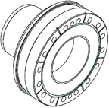
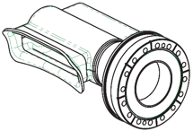
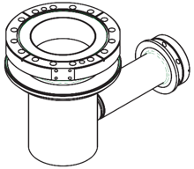
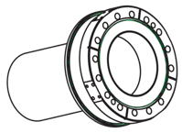
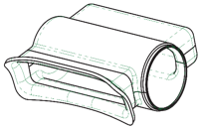
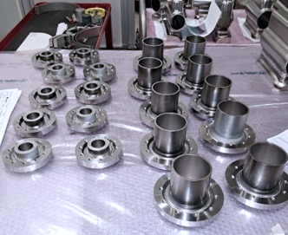
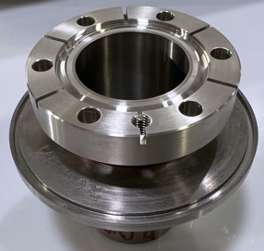
Fabrication and QA/QC Status
AUP RFD series production (ZRI)
Example of CNC machined extremities.
Beam Axis tube ready for welding with pick-up extremity

Slide 16
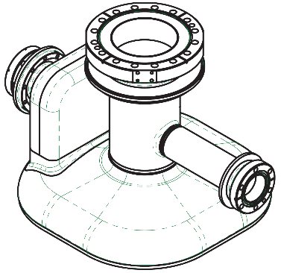
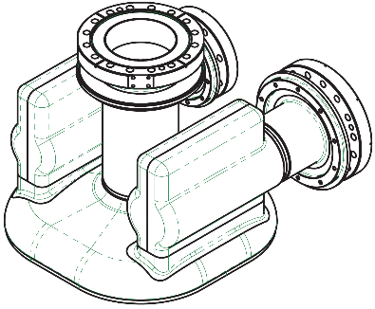
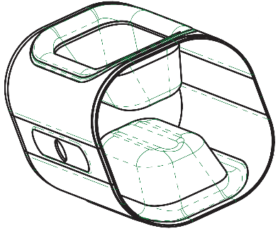



Fabrication and QA/QC Status
AUP RFD series production (ZRI)

Slide 17




Fabrication and QA/QC Status
AUP RFD Prototypes qualification (ZRI)
2 x RFD bare cavity prototypes (NRFDP001/002):
Manufactured at ZRI (PO 647590) according to HL-LHC WP4 specs
ZRI developed: fabrication dwgs, manufacturing & EBW tooling, procedures
QA /QC exercised as series production on CERN EDMS* (MTF)
QCs, Inspections & VTS tests procedures established at FNAL and JLAB
VTS qualification: exceeded functional requirements w/wo ancillaries
→ see A. Castilla’s talk
NRFDP002 has been successfully jacketed as RFDP02
NRFDP001 won’t be jacketed but used for testing the revised BCP
Rotational BCP and processing performed at ANL and ZRI
confidential
Prototypes paved the way for Series manufacturing & processing

Slide 18



Fabrication and QA/QC Status:
AUP RFD Jacketed Series Cavities (ZRI)
PO 681514/ 705071 placed for jacketing and processing Series cavities
All materials available at ZRI (Br Schnorr washers required loong procurement)
  ZRI is finalizing the raw materials and bellows certificates
Fabrication drawings have been approved, QA documentation is undergoing revision at ZRI
Bi-metallic transition, brazed Ti/SS joints, in qualification at CERN
Complex assembly procedure with minimal forgiveness: no issues
Glove box and internal rotating qualified after RFDP02: no frequency shift after welding!
Manufacturing of jacketed RFDs is advancing constrained by QA and qualification approval

Slide 19



Fabrication and QA/QC Status:
Open QA/QC Issues
Series bare cavities manufacturing is bound by UT C-scans of brazed joints Nb/SS
  Final review of QCRs, NCRs, cold tests reports by CERN
Jacketing of series cavities is constrained to:
  Approval of raw material certificates (such as magnetic shield screws material in 316F)
  Approval of QA docs (welding and brazing book in particular)
  Qualification of Ti/SS Brazed joints

Slide 20
Summary & Conclusion
The manufacturing and welding technologies are being pushed to their limits.
Significant effort is needed for Processing at ZRI, with improvements in BCP and HPR expected to qualify in the next cold tests.
Continuous monitoring is essential to address technological challenges in manufacturing, processing, and QA/QC.
Logistics require careful coordination.
All materials have been procured per approved specifications, though some certs need revision.
Series bare cavity manufacturing is progressing well, with forming issues solved, while UT C-scans for Nb/SS brazed joints are still pending.
RFDP02 has successfully validated glove box welding, showing no frequency shift during the welding of He Tank walls to the cavity.
Final qualification of Ti/SS brazed joints and QA document approval are needed to complete the jacketed cavities.

Slide 21
Thanks for the attention!
Notes:
Add Slide transition to production.

Slide 22

Fabrication & Processing Challenges at ZRI
Bare RFD Crab Cavity fabrication strategy at ZRI
Transition
V-HOM
Racetrack
V-HOM
Waveguide
Transition
H-HOM
H-HOM
Waveguide
Beam Axis Extr.
Antenna
Extr.
Beam Axis Extr.
Corner
Pole
FPC
Waveguide
Half Main Body
End Cap
Transition
FPC
Deep drawing of thick Nb sheets (4mm to 6.35mm); CNC machining and EBW interfaces as ZRI know-how
CNC of transitions from Nb blocks & beam pipes from Nb tubes
Notes:
Not sure about this “old” slide. I can put in the back-ups.

Slide 23
QA/QCRs handling during fabrication (2):
process between AUP & CERN
CERN is the “manufacturer” for AUP RFDs cavities (subject to PED)
More than 3,000 reports for 10x full dressed cavities.
CERN: reviews and approves documentation prior to manufacturing:
  Fabrication drawings and Manufacturing Procedures (MIPs, WPQRs, WPSs, BPQRs and BPSs)
  NDTs, welders and brazing operators' certificates
  Raw material certificates and UT reports
AUP: uploads and releases all QCRs in EDMS / MTF except the ones in point 3.
CERN reviews and releases the following QCs:
  Bare Cavities: Freq. + CMM after EBW (before BCP). UT thickness (after last BCP). Cold RF tests + RGA.
  Jacketed Cavities: PT + LT of both He Tanks and 2nd Beam Pipe + Cold RF tests + Frequency at 2K + RGA.
  Dressed Cavities (JC + ancillaries): Cold RF tests + Frequency at 2K+ RGA after VTS
  reviews and closes all the critical NCRs
“Approval Process MTF-EDMS for AUP RFD Crab Cavities and ancillaries” (EDMS 2896383)

Slide 24



Fabrication & Processing Challenges at ZRI
1- Mechanical tolerances on stamped/coined subcomponents
  Poles and Waveguides, formed from the series Nb batch, showed non-repeatable results:
    Same Nb supplier, same Nb sheet, same tooling, operators and pressing machine…→ Different results
    Ex: ZRI adopted a 2-step Pole forming: better results due to friction reduction (confirmed by CERN sims)
    Similarly, the waveguides required multiple coining steps to get to the shape and thickness requirements
All the sub-components are available at ZRI for series production
Unacceptable Poles
Acceptable Poles from same Nb.
Arduous WGs coining
Poles forming validated via Forming Limit Diagram failure criteria
Courtesy of CERN
Initial forming
Trimming “crown” wrinkles
Greasing + Final Coining
  Forming of RFD subcomponents is approaching the technological limits

Slide 25






Fabrication & Processing Challenges at ZRI
2a- Complex EBW between Half Main Body sub-components
  Shape accuracy of whole inner surface is required to be < 0.4mm after EBW
  Variable radii and thicknesses EBW required careful fixtures design, machining and assembly
  ZRI know-how, extensive R&D and months of tests yield to improved results

Slide 26





Fabrication & Processing Challenges at ZRI
3- Alignment between End Groups-Main Body during final EBW
  RFD required sub-mm alignment between End Caps and Main Body after final EBW
C
H
A
I
  Matching EBW interfaces machined from CMM data:
    Concentricity between datums H-A-I (achieved 0.5-0.8mm)
    Rotational constraints provided by datum C
CNC machining and EBW required special fixtures, years of R&D and trials

