Slide 1



RFD Pre-series Testing
A. Castilla, N. Huque, P. Owen – Jefferson Lab
S. De Silva, J Delayen - ODU
M. Narduzzi, C. Narug, L. Ristori - FNAL
14th HL-LHC Collaboration Meeting. – Oct. 7th–10th 2024

Slide 2
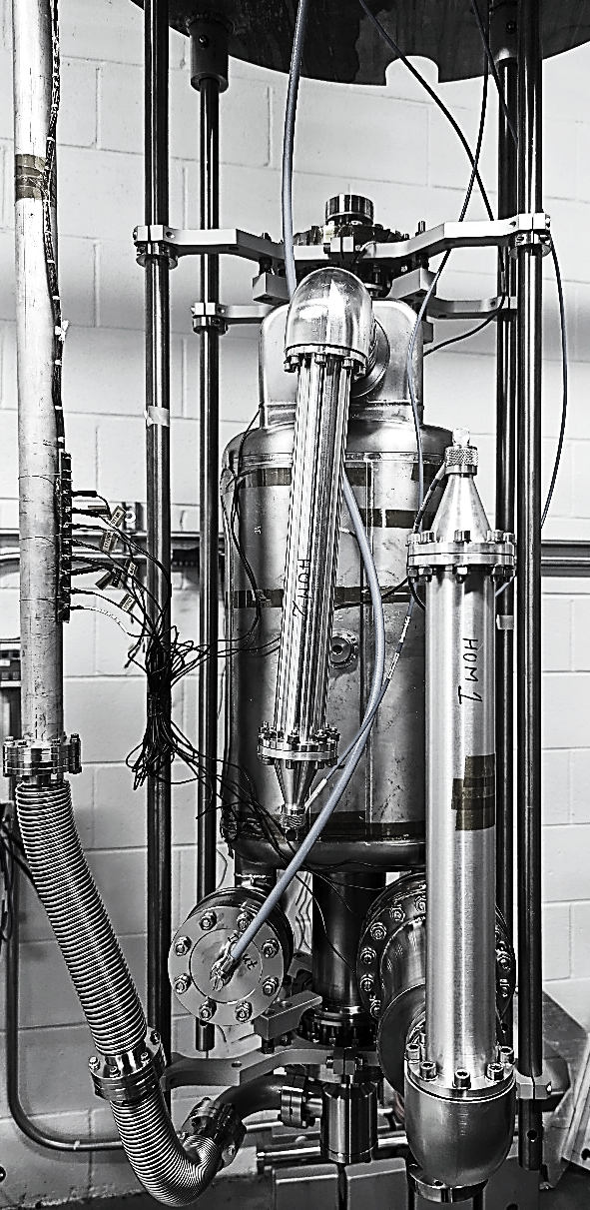
Outline
Recap:
  Prototypes:
    Summary
    Lessons learned
  Test Prep. Workflow
Pre-series:
  Testing
  Procedures reviews
  Preparation status
Path forward
Summary

Slide 3
Prototypes: Lessons Learned
Performance degradation due to bad seal (hardware/procedure updated)
  CF leak seals were fixed with the correct hardware
  RF-leakage on the HHOM connection degraded the test performance
    Procedure update mitigates dated hardware
    Updated hardware will be used for the production cavities
Early field emission onset, mitigated with:
    Hardware update (i.e. standardized sets of nuts/bolts and gaskets)
    Refining procedures (HPR and assembly)
HHOM RF contact is critical for performance on the dressed cavities

Slide 4
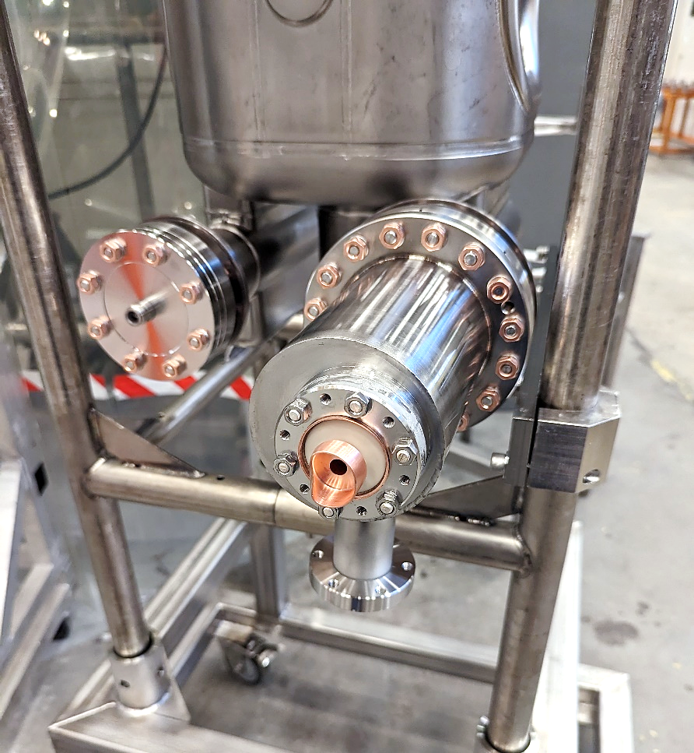
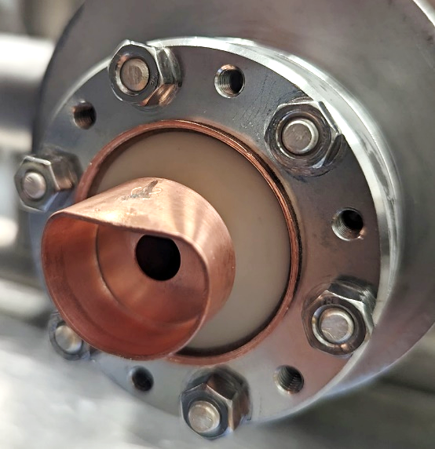
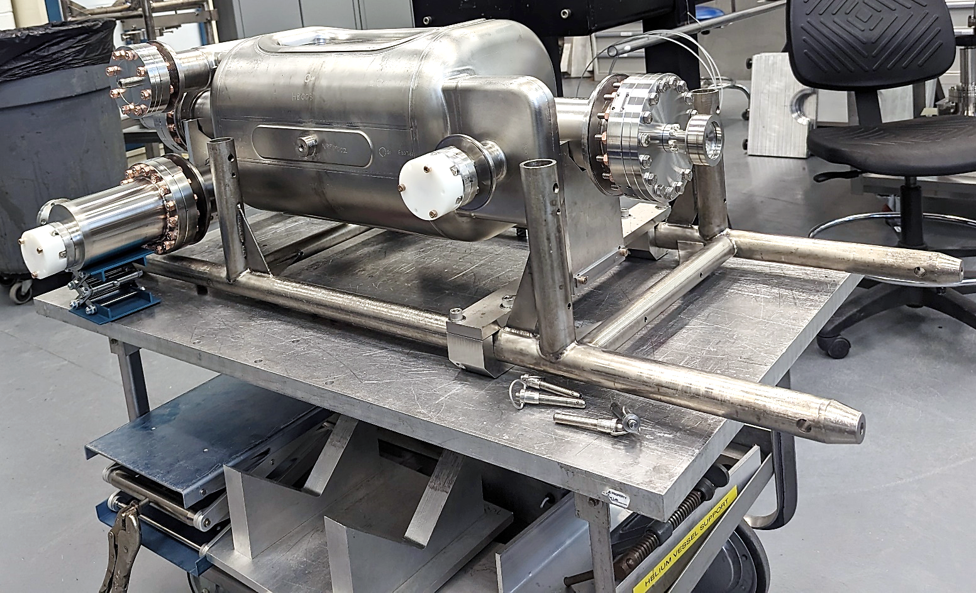
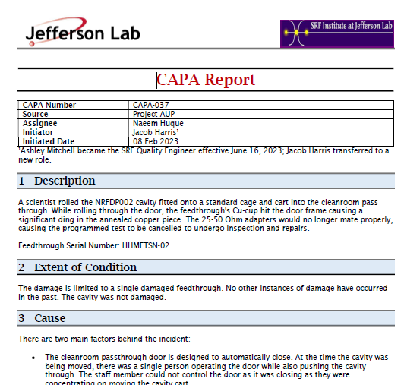
Procedures Updated: Lessons Learned
Corrective and Preventive Action (CAPA) triggered by HOM feedthrough hitting door frame during cavity transfer in test preparation, new procedure effective:
  Feedthrough protectors on from cleanroom assembly until 120C bake
  2 person rule when moving through doors

Slide 5
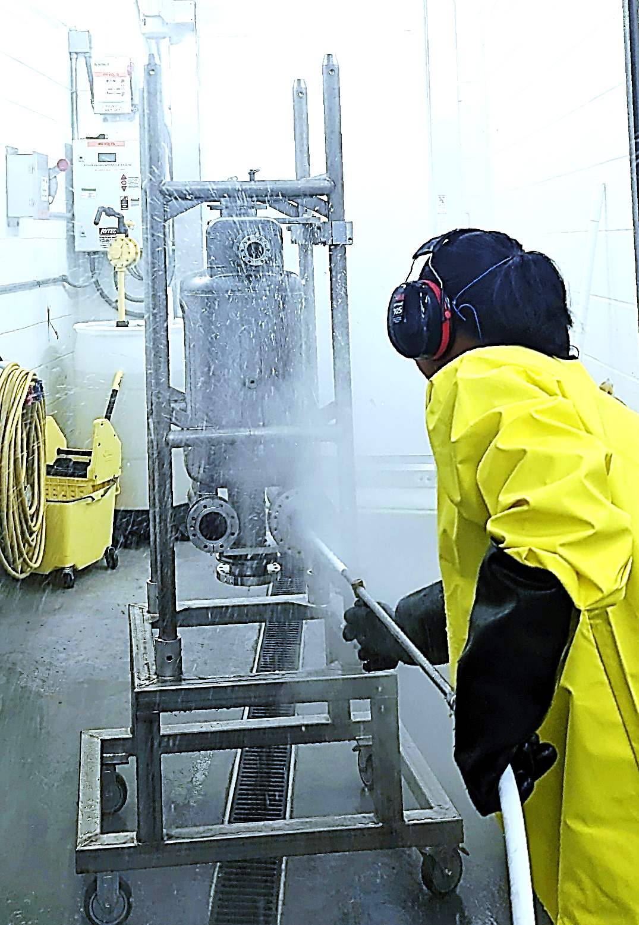

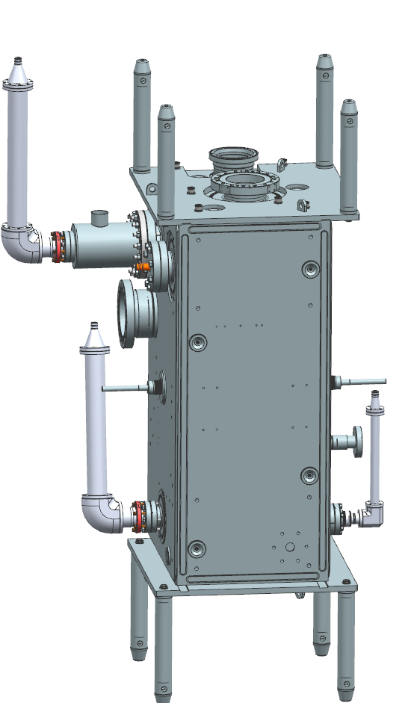
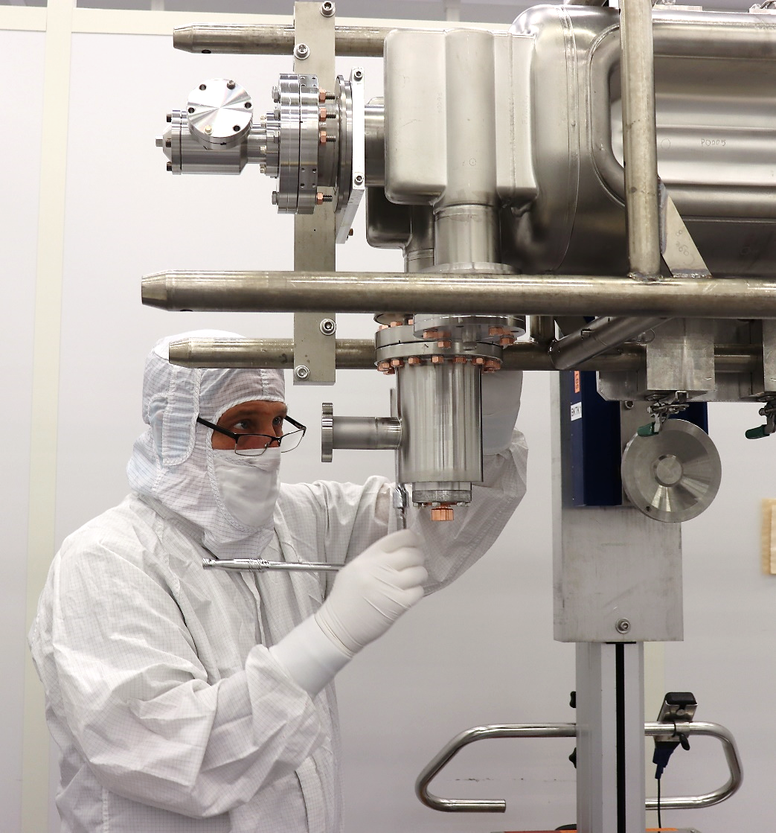
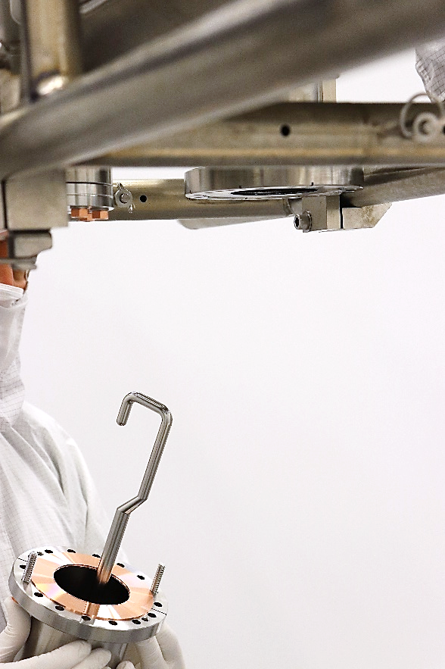
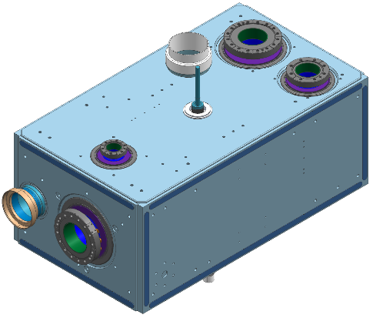
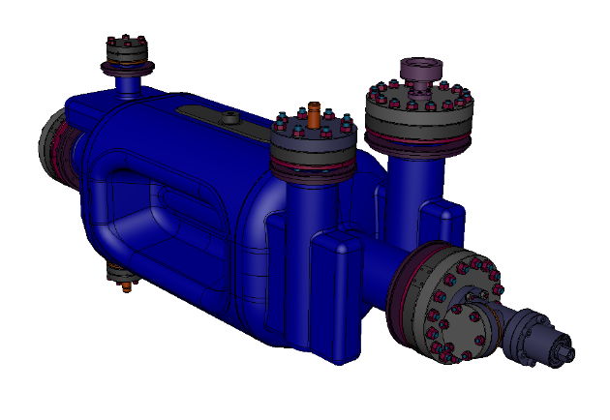
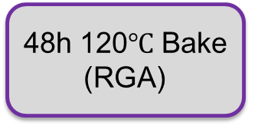
Processing for Performance Test
Degreasing
48h 120$℃$ Bake (RGA)
Cooldown
Hand rinsing
No active B-field compensation
Port rinsing
Leak check (RGA)
Test
Assy. from below
High Pressure Rinsing
Cleanroom Assembly

Slide 6
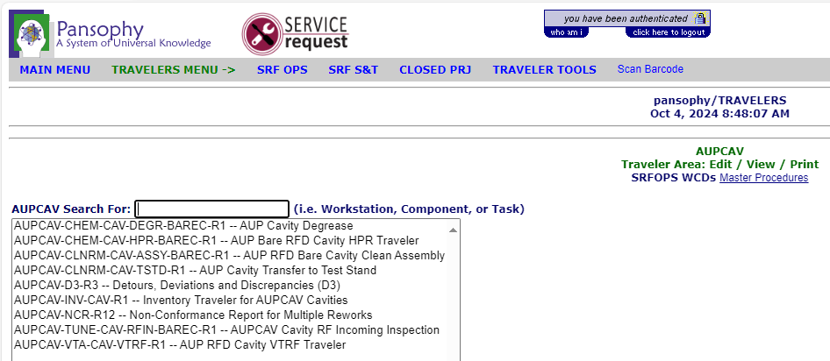
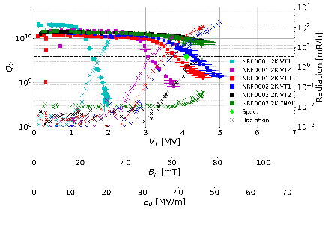
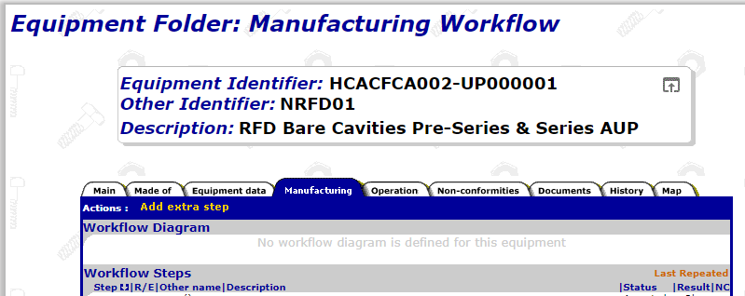
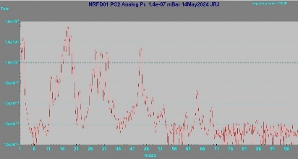
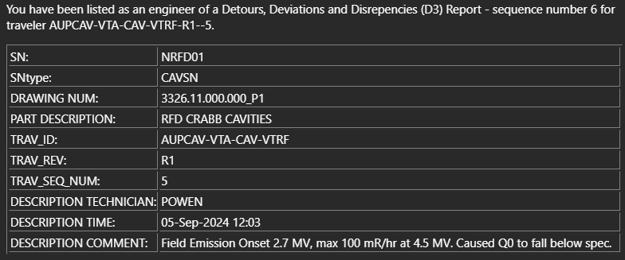
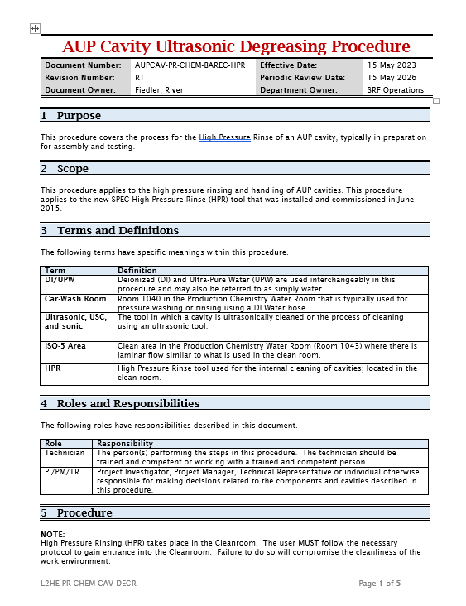
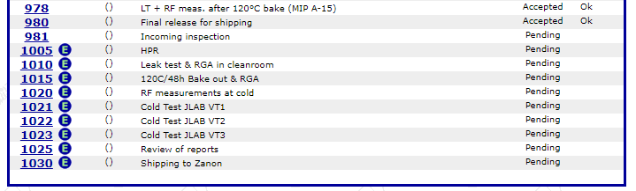
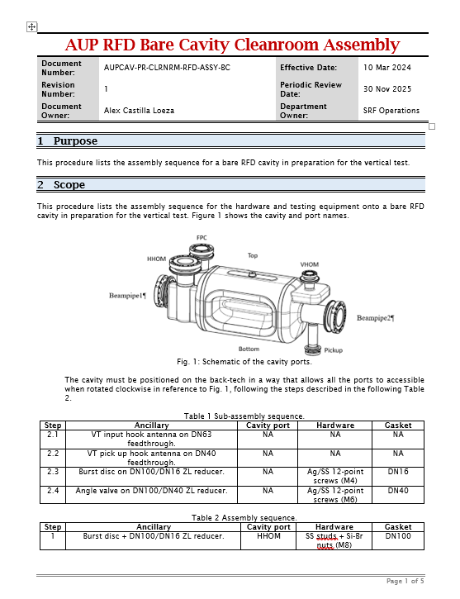
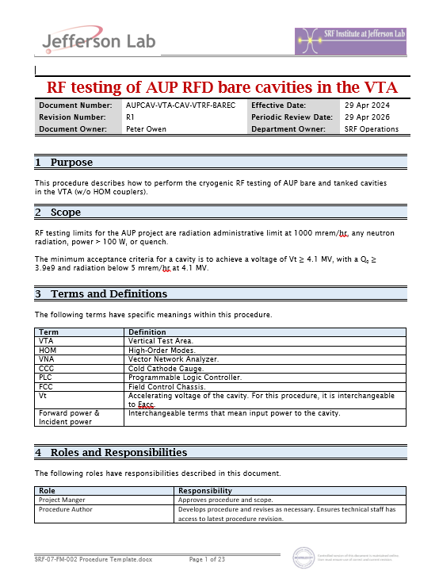
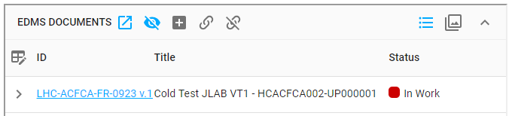
Ongoing QA/QC
Travelers and procedures are placed in our internal systems and propagated as reports to MTF for CERN’s evaluation

Slide 7
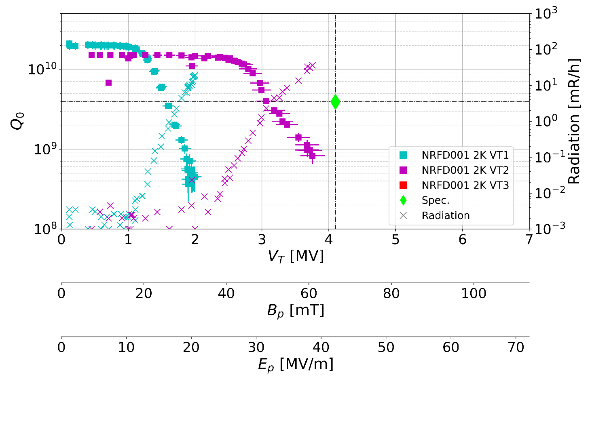
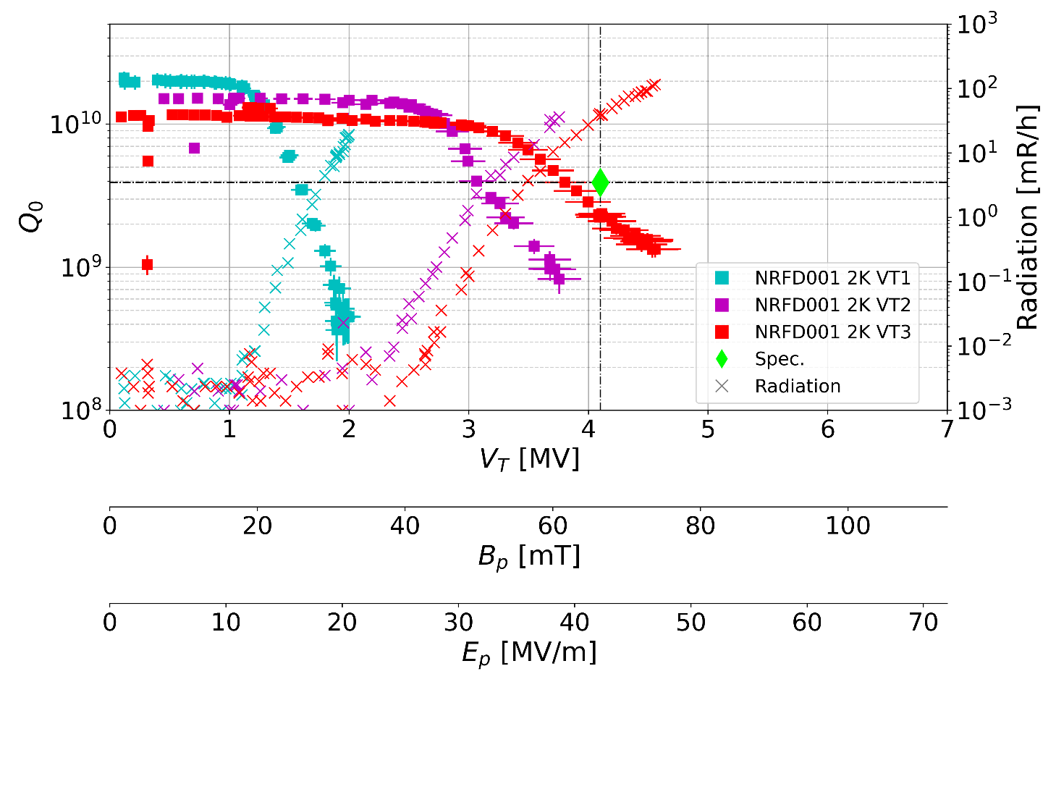
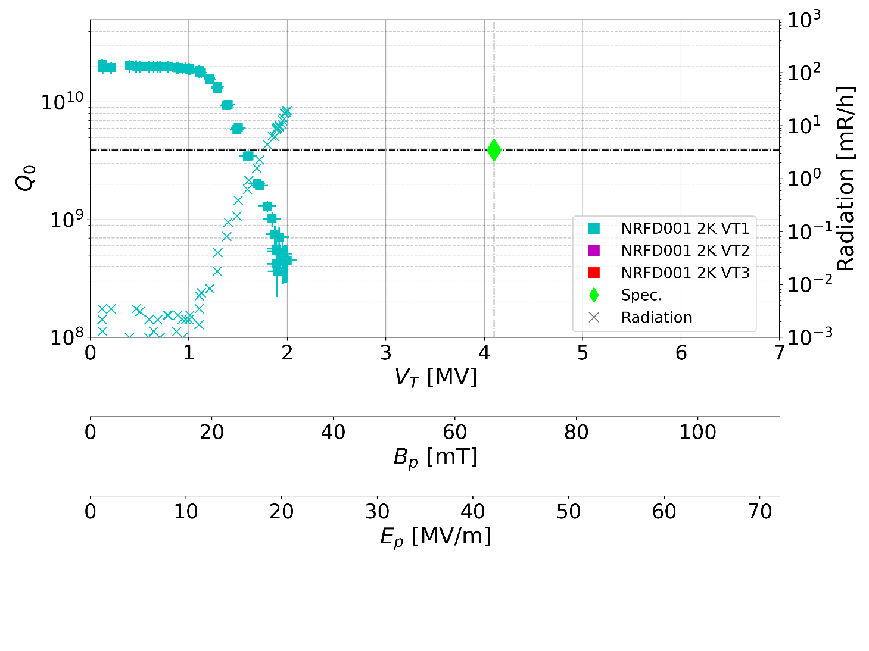
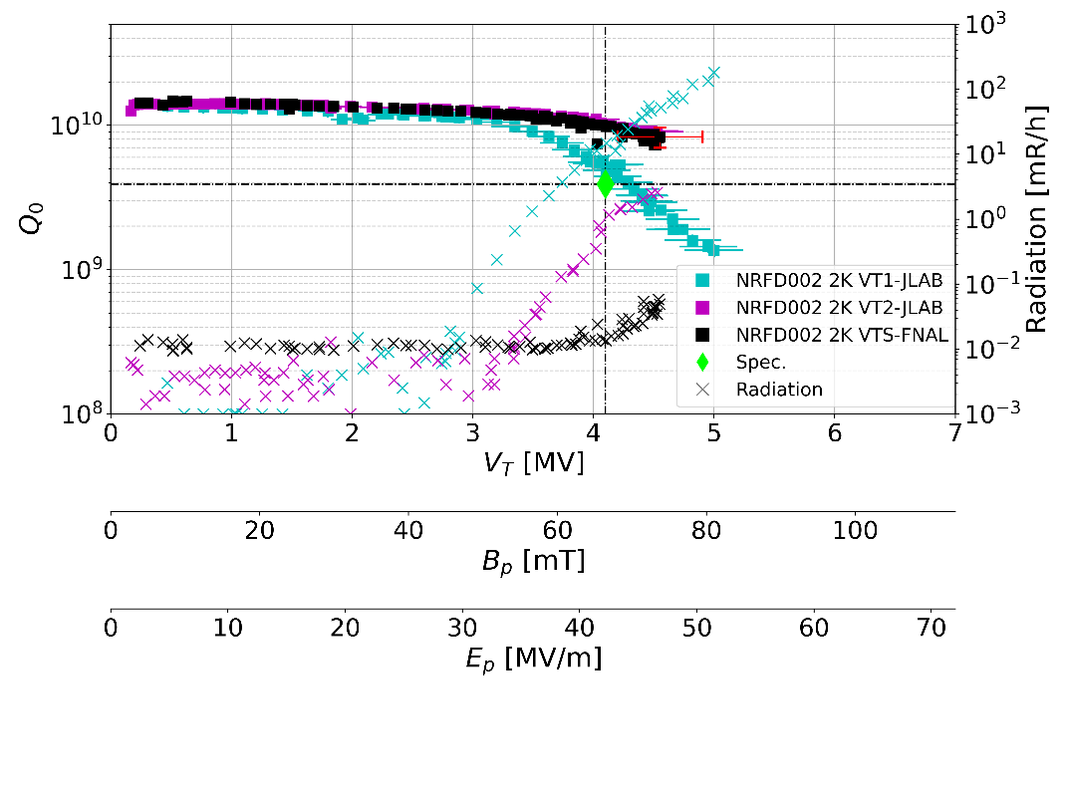
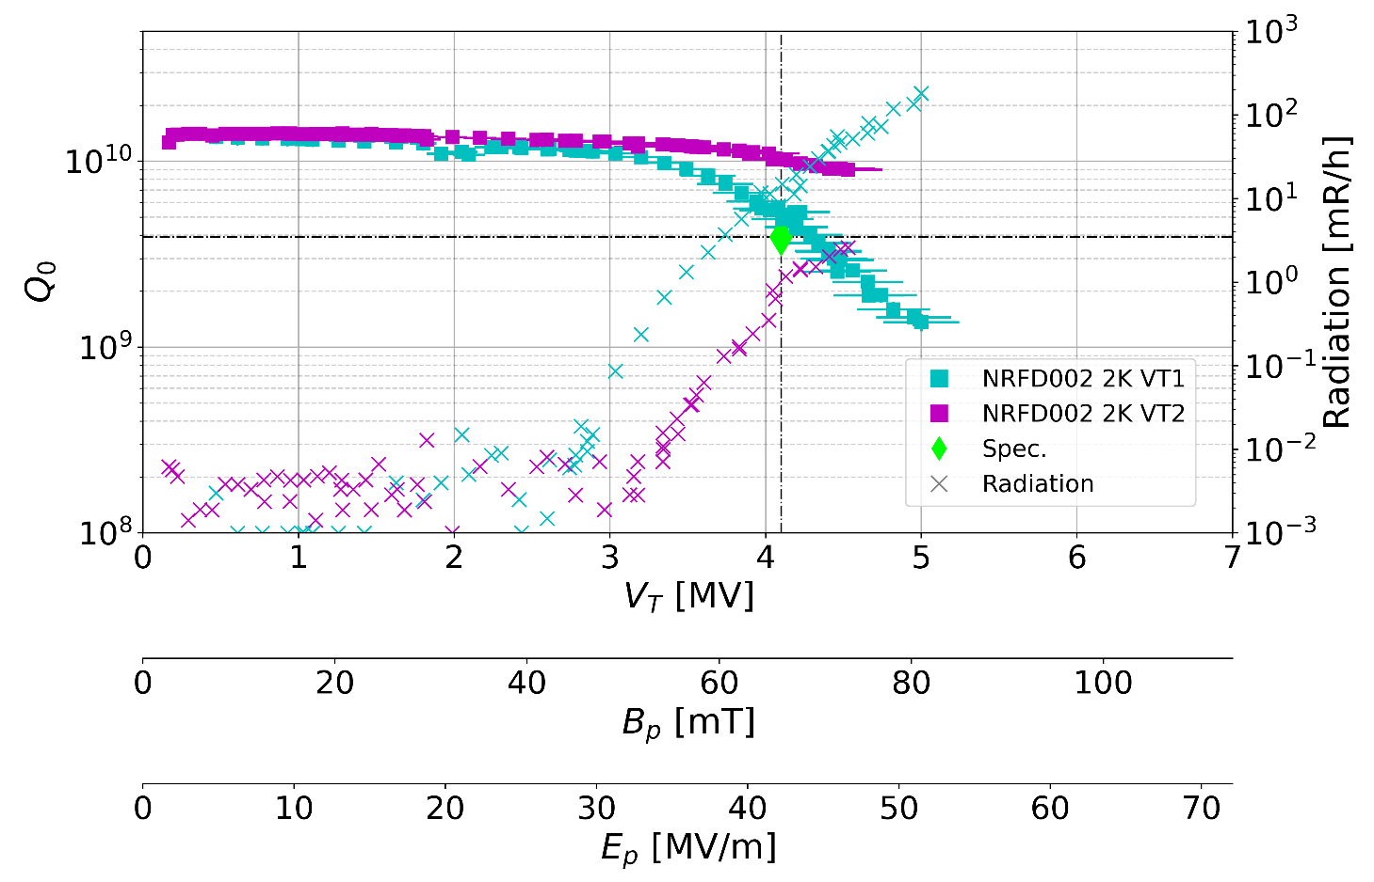
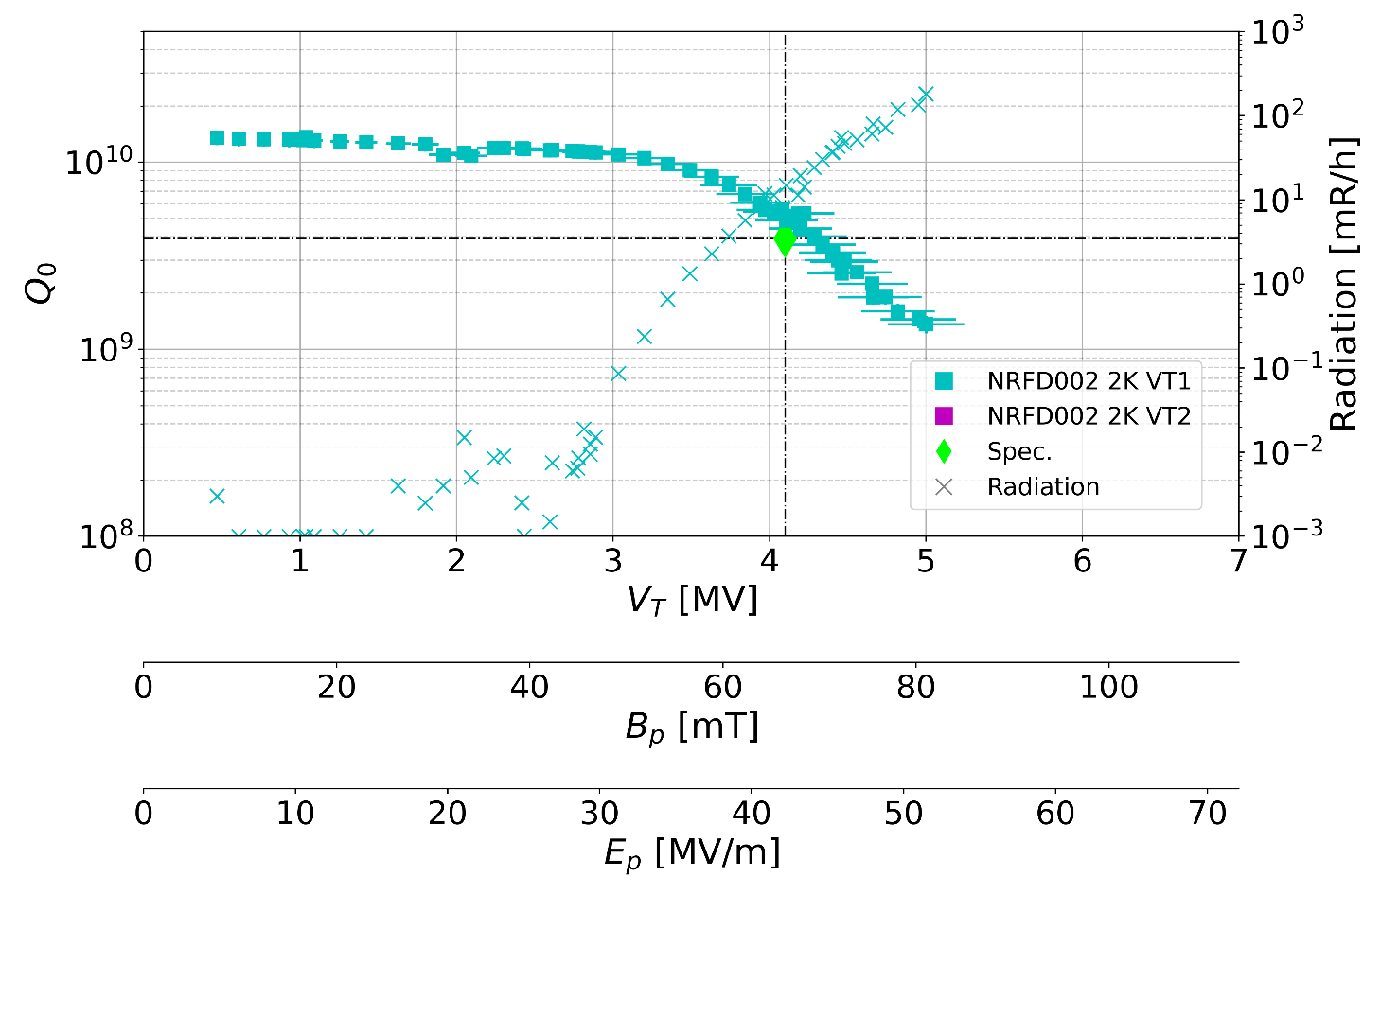
Pre-series Preparation & Performance
NRFD01
NRFD02
Admin. Limit 4.5 MV
Test Date | Cavity SN | Max Voltage [MV] | Q0 at 4.1MV | Low field Q0 | Comments
04/30/24 | NRFD01 | 2 | NA | 2.10E+10 | FE onset @1.2MV, power limited to 1.9 MV
05/14/24 | NRFD02 | 5 | 4.10E+09 | 1.44E+10 | FE onset @2.85MV, administrative level @5MV
05/20/24 | NRFD01 | 3.76 | NA | 1.51E+10 | FE onset @2.4, power limited to 3.76 MV
06/14/24 | NRFD01 | 4.5 | 2.20E+09 | 1.12E+10 | FE onset @2.7MV, administrative level @4.5MV
Test Date | Cavity SN | Max Voltage [MV] | Q0 at 4.1MV | Low field Q0 | Comments
04/30/24 | NRFD01 | 2 | NA | 2.10E+10 | FE onset @1.2MV, power limited to 1.9 MV
05/20/24 | NRFD01 | 3.76 | NA | 1.51E+10 | FE onset @2.4, power limited to 3.76 MV
Test Date | Cavity SN | Max Voltage [MV] | Q0 at 4.1MV | Low field Q0 | Comments
04/30/24 | NRFD01 | 2 | NA | 2.10E+10 | FE onset @1.2MV, power limited to 1.9 MV
05/20/24 | NRFD01 | 3.76 | NA | 1.51E+10 | FE onset @2.4, power limited to 3.76 MV
06/14/24 | NRFD01 | 4.5 | 2.20E+09 | 1.12E+10 | FE onset @2.7MV, administrative level @4.5MV
Test Date | Cavity SN | Max Voltage [MV] | Q0 at 4.1MV | Low field Q0 | Comments
04/30/24 | NRFD01 | 2 | NA | 2.10E+10 | FE onset @1.2MV, power limited to 1.9 MV
Test Date | Cavity SN | Max Voltage [MV] | Q0 at 4.1MV | Low field Q0 | Comments
04/30/24 | NRFD01 | 2 | NA | 2.10E+10 | FE onset @1.2MV, power limited to 1.9 MV
05/14/24 | NRFD02 | 5 | 4.10E+09 | 1.44E+10 | FE onset @2.85MV, administrative level @5MV
05/20/24 | NRFD01 | 3.76 | NA | 1.51E+10 | FE onset @2.4, power limited to 3.76 MV
06/12/24 | NRFD02 | 4.5 | 1.00E+10 | 1.40E+10 | FE onset @3.2MV, administrative level @4.5MV
06/14/24 | NRFD01 | 4.5 | 2.20E+09 | 1.12E+10 | FE onset @2.7MV, administrative level @4.5MV
08/26/24 | NRFD02 | 4.5 | 1.00E+10 | 1.40E+10 | FE onset @4.2MV, administrative level @4.5MV
Test Date | Cavity SN | Max Voltage [MV] | Q0 at 4.1MV | Low field Q0 | Comments
04/30/24 | NRFD01 | 2 | NA | 2.10E+10 | FE onset @1.2MV, power limited to 1.9 MV
05/14/24 | NRFD02 | 5 | 4.10E+09 | 1.44E+10 | FE onset @2.85MV, administrative level @5MV
05/20/24 | NRFD01 | 3.76 | NA | 1.51E+10 | FE onset @2.4, power limited to 3.76 MV
06/12/24 | NRFD02 | 4.5 | 1.00E+10 | 1.40E+10 | FE onset @3.2MV, administrative level @4.5MV
06/14/24 | NRFD01 | 4.5 | 2.20E+09 | 1.12E+10 | FE onset @2.7MV, administrative level @4.5MV
Chemistry for both cavities at ZRI
NRFD01’s 1st assy. at ZRI + fast bleed at JLab
NRFD01’s 2nd & 3rd assys. at JLab
NRFD02: all assemblies at JLab & last test at FNAL

Slide 8
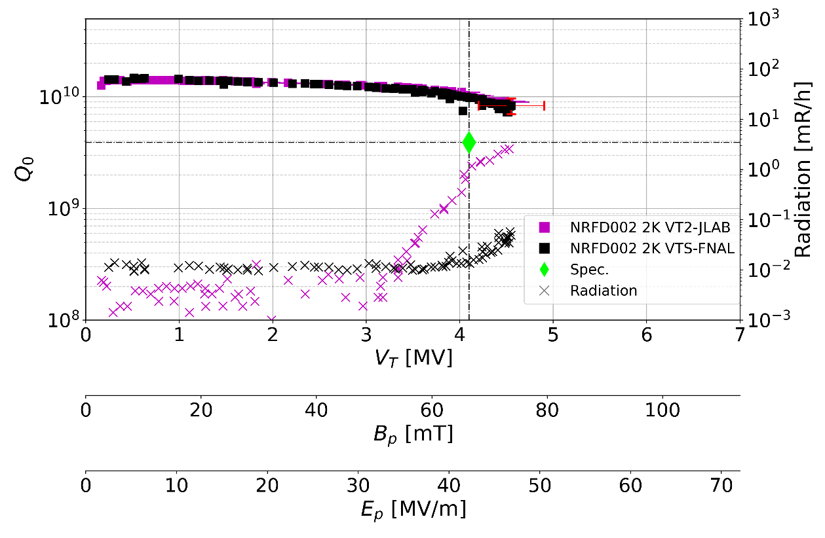
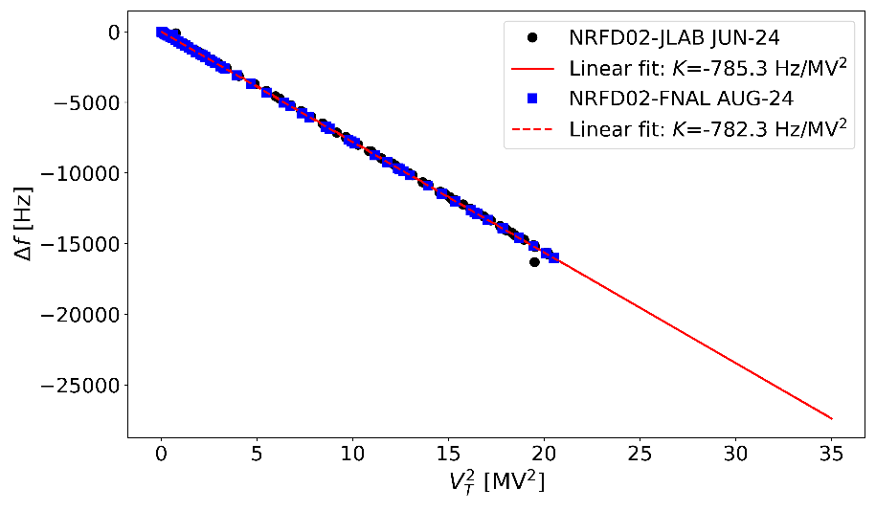
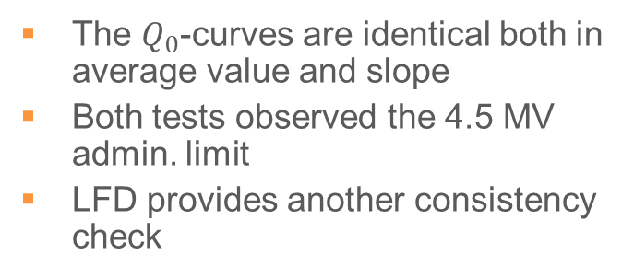
Benchmarking Test-stands
An important achievement for the project, was to demonstrate that:
  We still can have suppressed FE* test beyond the specification
  Cavity processing for test is consistent over several iterations (including handling and shipping)
  FNAL & JLab test stands are interchangeable
Admin. Limit 4.5 MV
The $Q_{0}$-curves are identical both in average value and slope
Both tests observed the 4.5 MV admin. limit
LFD provides another consistency check
*this will be further corroborated with more tests

Slide 9
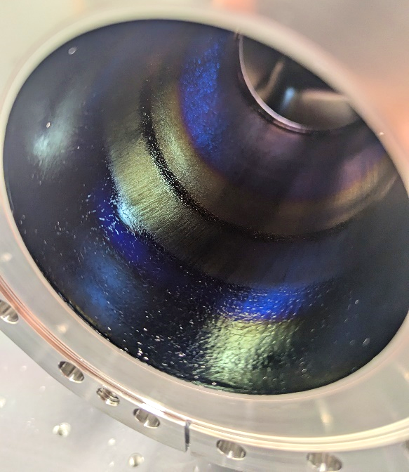
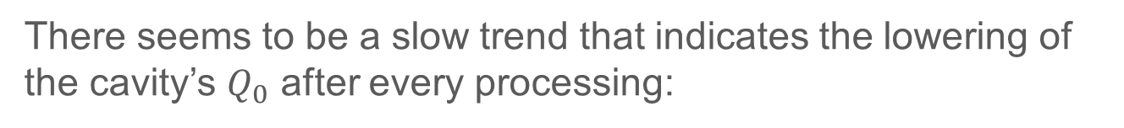
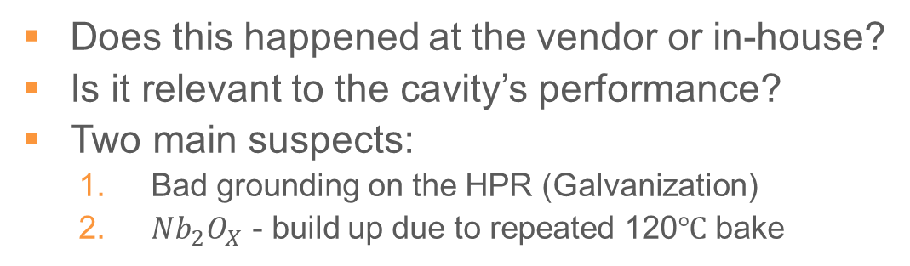
NRFD01 – Blueing [1/2]
There seems to be a slow trend that indicates the lowering of the cavity’s $Q_{0}$ after every processing:
1
2
3
Very clear boundaries in both beampipes, similar location
Does this happened at the vendor or in-house?
Is it relevant to the cavity’s performance?
Two main suspects:
  Bad grounding on the HPR (Galvanization)
  ${Nb}_{2}O_{X}$ - build up due to repeated 120$℃$ bake

Slide 10
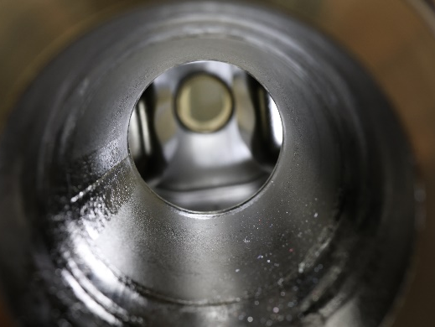
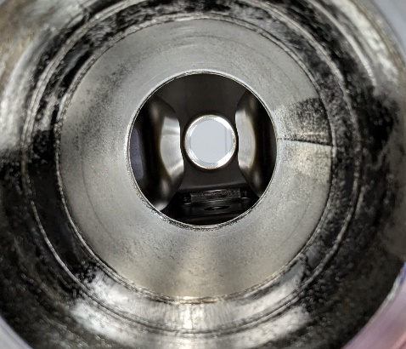
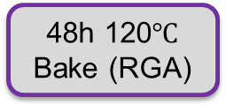
NRFD01 – Blueing [2/2]
Using the LARP prototype to test our procedure:
Visual
Degreasing
48h 120$℃$ Bake (RGA)
Visual
Port rinsing
Leak check (RGA)
Pre-processing
High Pressure Rinsing
Cleanroom Assembly
Post-processing
No coloration present prior to the test cycle
No visible change in the surface after standard cycle
Visual

Slide 11
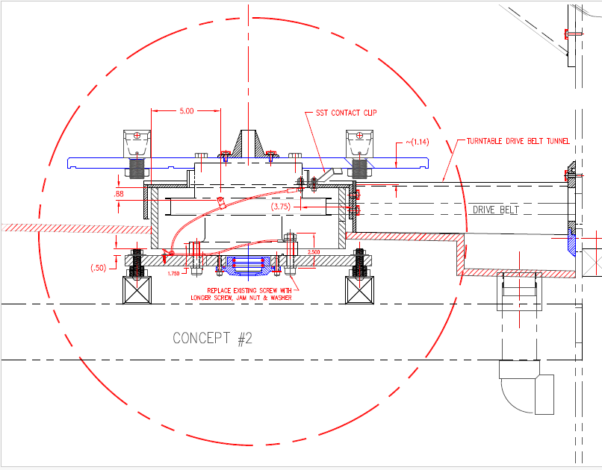
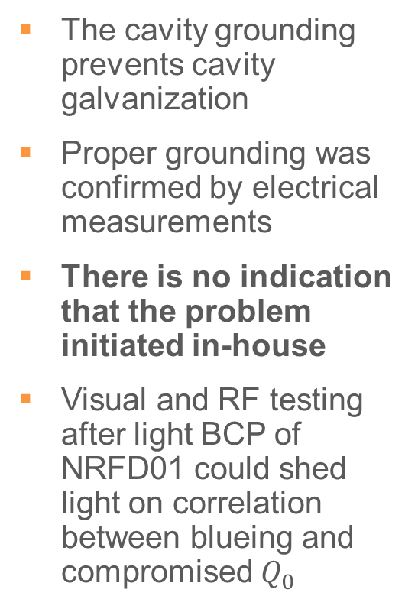
HPR - Grounding
Cage fixing points
The cavity grounding prevents cavity galvanization
Proper grounding was confirmed by electrical measurements
There is no indication that the problem initiated in-house
Visual and RF testing after light BCP of NRFD01 could shed light on correlation between blueing and compromised $Q_{0}$
Turning table
Grounding path

Slide 12
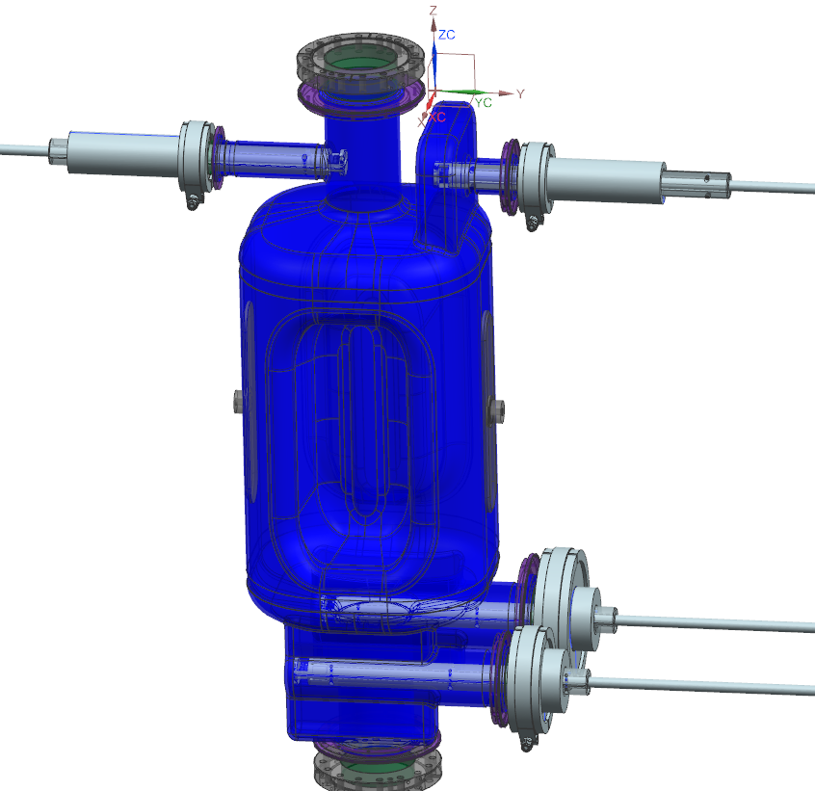
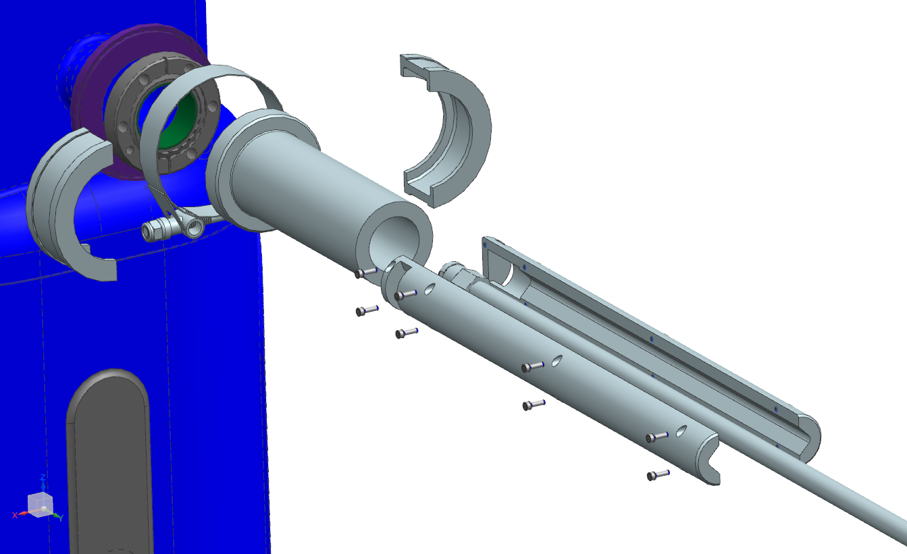
Tooling: e.g. Hand port rinsing
Side ports are virtually hidden from the high pressure rinse jet
Custom tooling designed to safely and thoroughly clean the side ports manually
New tooling and hardware to reduce FE

Slide 13
Tooling Heat Map
Tool | Design | Procurement | Manufacturing | Qualification | Ready
Rolling cart
Holding fixture (Bare cavity)
Holding fixture (Tanked/Dressed cavity)
Port rinsing tool
Cleanroom lifters (2x) |  |  |  |  | ETA: Oct 2024
Lifting interface tool |  |  |  |  | ETA: Oct 2024
Testing cage |  |  |  |  | ETA: Oct 2024
Dedicated Test stand |  |  |  |  | ETA: Oct 2024
Hardware kits (CERN)
Adequate advance on tooling and procurement to keep the projected schedule, reduce technical risks, and boost cavity performance
Critical Path
Done
Ongoing
Pending
On hold
NA

Slide 14
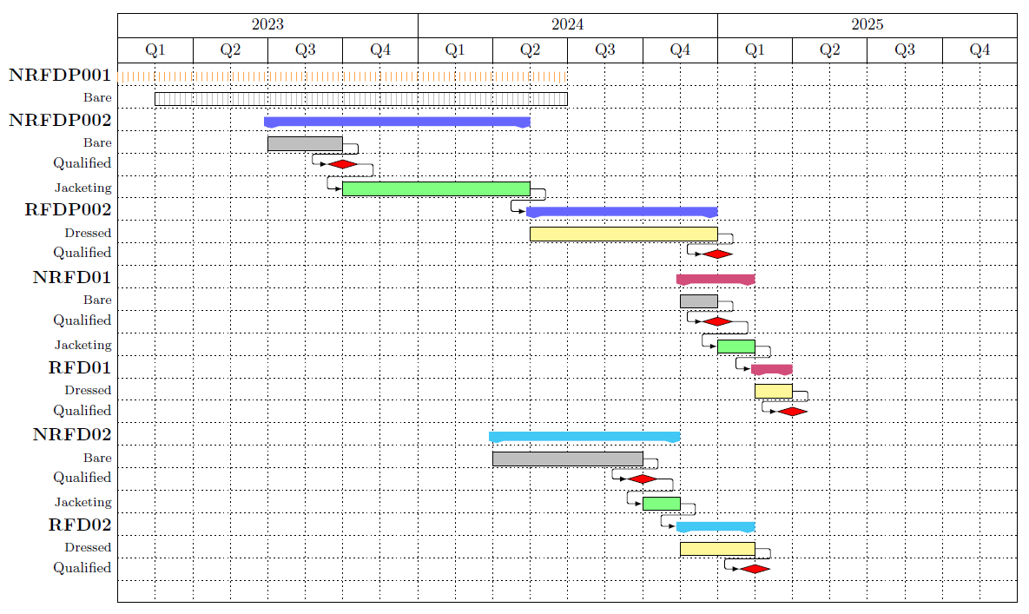
Schedule [1/2]
Past
Next
5 “low-tempo” weeks at FNAL
JLab cryo-shutdown JUN-DEC 2024

Slide 15
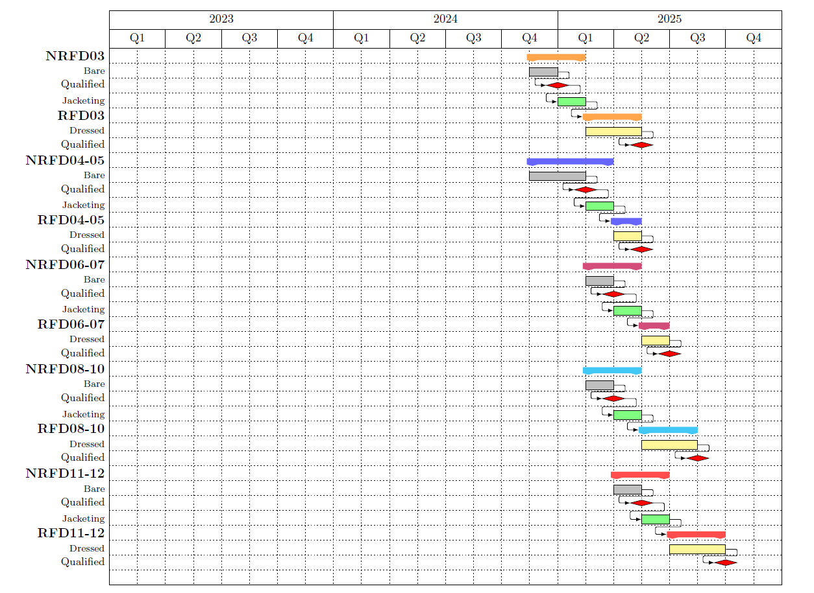
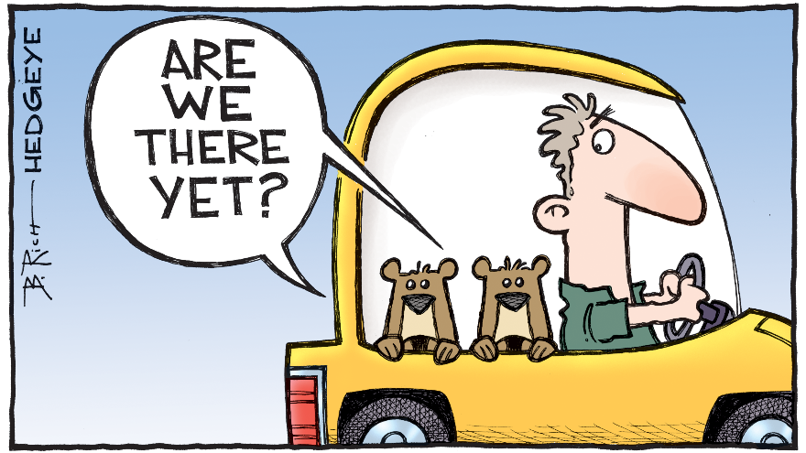
Past
Next
JLab cryo-shutdown JUN-DEC 2024

Slide 16
Summary
Prototypes: Key lessons learned involve improving collaboration and communication between the vendor and the laboratories performing the work to maintain a tight QA
NRFD02 Tests: Consistent, beyond-specification results at both JLab and FNAL demonstrate the robustness required for the production phase. Suppressed FE results that will be carefully benchmarked
NRFD01: Will reinforce confidence on our procedures
Testing Resilience: Despite challenges such as safety stand-downs and cryogenic shutdowns, significant testing has been successfully completed at both JLab and FNAL. The built-in redundancy between these institutions will be essential
Tooling & Schedule: While some tooling is on the critical path, we are closely monitoring the schedule to ensure timely progress
Looking Ahead: 2025 will be a busy year for the AUP and WP4, and we are ready for the challenges and opportunities that lie ahead

Slide 17

Thanks!

Slide 18
Backups

Slide 19
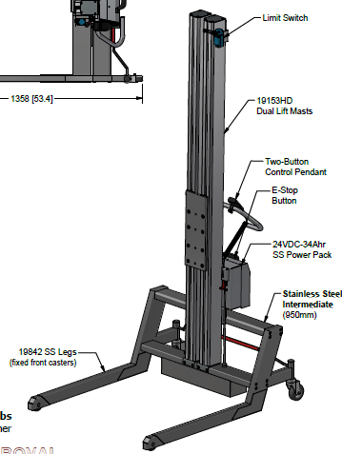
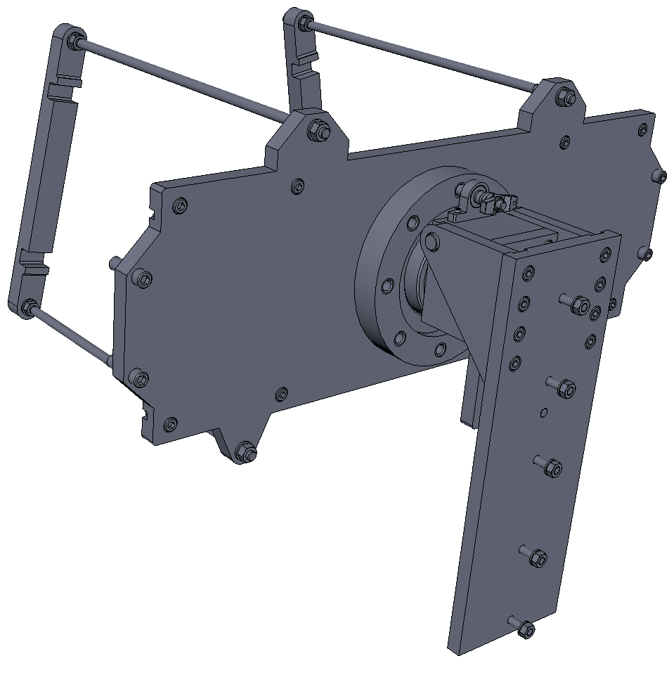
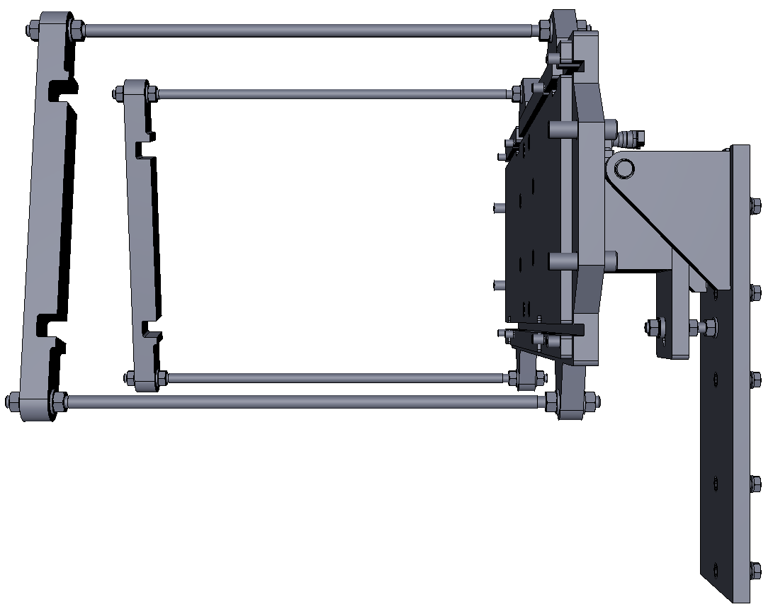
Tooling: Cleanroom activities
Procured 2 cleanroom compatible lifters capable of lifting the cavities (similar to those used at FNAL) at the necessary distance to install in the HPR cabinet (ETA: OCT 2024)

Slide 20
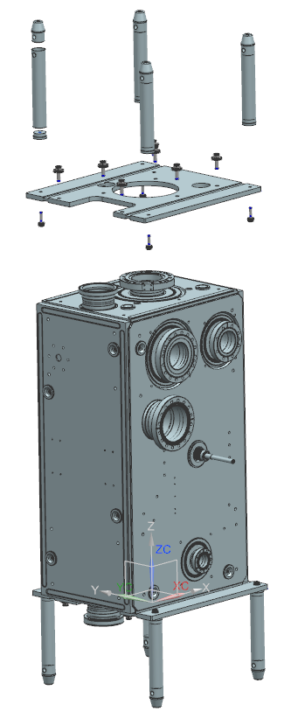
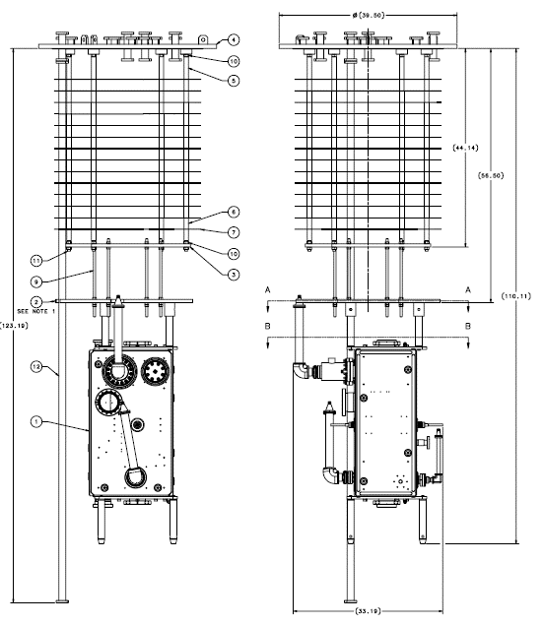
Tooling: Dressed cavity
Interface fixtures
Dedicated Test stand
Designed compatible interfaces to our facilities and procured a dedicated spare test stand to allow for parallel cavity preparation and testing

Slide 21
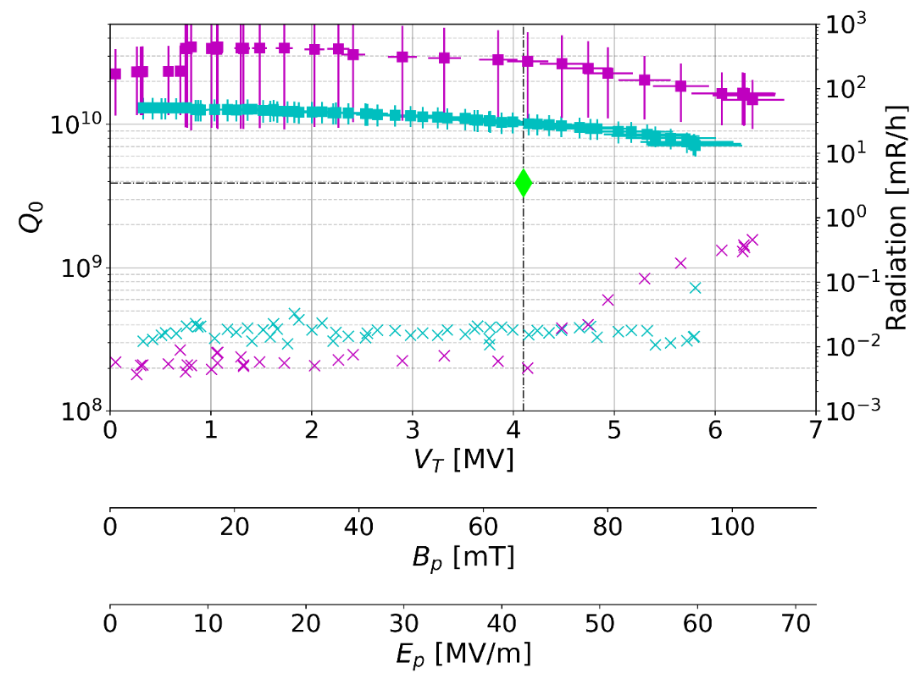


Pre-series vs Prototypes
Prototypes
Pre-series
Suppressed FE test demonstrated at FNAL & JLab for both bare and bare cavity + HOMs for the prototypes
Constant improvement of preparation and performance demonstrated on the pre-series
New tooling and hardware to provide better results

Slide 22


Project Experience on Testing RFDs [1/2]
On average, there is a tight distribution across all the different RFDs throughout the project’s history, with a couple of excursions here & there, but well understood

Slide 23


Project Experience on Testing RFDs [2/2]
Target freq. updated for the production cavities

