Slide 1




DQW Series Cavities Tests in SM18
Amelia Edwards on behalf of HL-LHC WP4
14th HL-LHC Collaboration Meeting - Genoa - 7th-11th October 2024

Slide 2


Outline
Status Oct 2023:
DQW Cavities
CERN
DQW1
DQW2
RI
DQW2
Bare
DQW1
Jacketed
Dressed
Bare
Jacketed
Dressed
Bare
Bare
Jacketed
Jacketed
Dressed
Dressed
  Updated status 2024
  Test results by cavity:
    RI DQW2
    RI DQW1
    CERN DQW1
  HOM Measurements
  Notes on current issues
  Summary
Amelia Edwards
14th HL-LHC Collaboration Meeting - Genoa -
7th-11th October 2024

Slide 3
Status 2024:
DQW Cavities
CERN
DQW1
DQW2
RI
DQW2
Bare
DQW1
Jacketed
Dressed
Bare
Jacketed
Dressed
Bare
Bare
Jacketed
Jacketed
Dressed
Dressed
Amelia Edwards
14th HL-LHC Collaboration Meeting - Genoa -
7th-11th October 2024

Slide 4
Oct 2023
CERN DQW1 Dressed & RI DQW1 Jacketed
Tests since HL-LHC Meeting 2023:
Dec 2023
RI DQW2 Dressed - Validated!
Feb 2024
RI DQW1 Dressed
Mar 2024
CERN DQW1 Dressed
Apr 2024
RI DQW1 Dressed
Jun 2024
RI DQW1 Dressed & CERN DQW1 Dressed
Aug 2024
CERN DQW1 Jacketed
Amelia Edwards
14th HL-LHC Collaboration Meeting - Genoa -
7th-11th October 2024
Sep 2024
CERN DQW1 Dressed

Slide 5
Total Duration: 6 weeks
3 Weeks
1 Week
1 Week
1 Week
Cleanroom
Preparation for test
Post-Test
Cold Testing
HPR
Clean room assembly
Leak Test
RGA
Cleaning
HOM Preparation
Pieces preparation
RGA
Bakeout*
RGA
Adapters Installation
Diagnostics installation
Transfer to insert
Leak Test
RF Checks
Cavity venting
RF Measurement
Warm up
RGA
Q0 vs Temperature
Thermal cycle
RF Measurements
Cold HOM
Measurements
Calibration
RF Conditioning
Cool down
Amelia Edwards
14th HL-LHC Collaboration Meeting - Genoa -
7th-11th October 2024
Notes:
So finally to review the whole cold test and just to reinforce here we have been able to optimize the process to reduce the test time by 2 weeks.

Slide 6
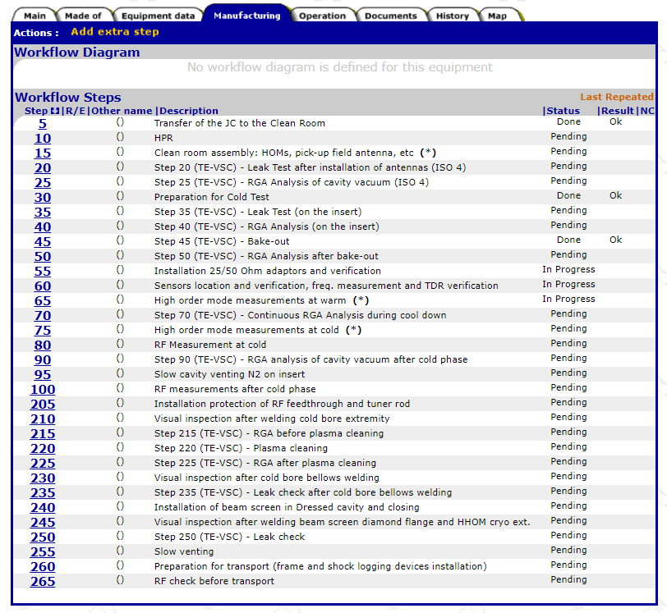
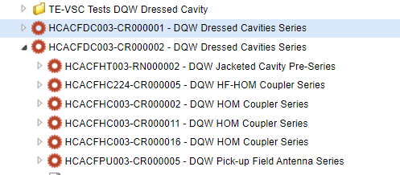

Documentation
Dressed Cavity
Jacketed cavity
Magnetic Shield
Bare Cavity
HF-HOM
HOM Feedthrough
HOM 1
HOM2
HOM3
Field Antenna
HOM Feedthrough
HOM Feedthrough
HOM Feedthrough
HOM Feedthrough
Many assets to be managed!
Each cold step stage is documented
For dressed cavity minimum 26 documents created
Documentation structure actively used
NCRs created and tracked
Collaborative effort also with TE-VSC
Amelia Edwards
14th HL-LHC Collaboration Meeting - Genoa -
7th-11th October 2024
Notes:
And VERY importantly all of the stages are documented for each cavity test

Slide 7
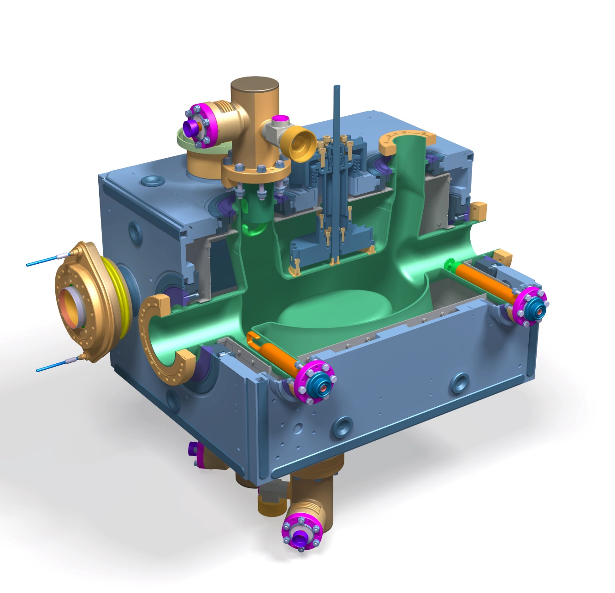
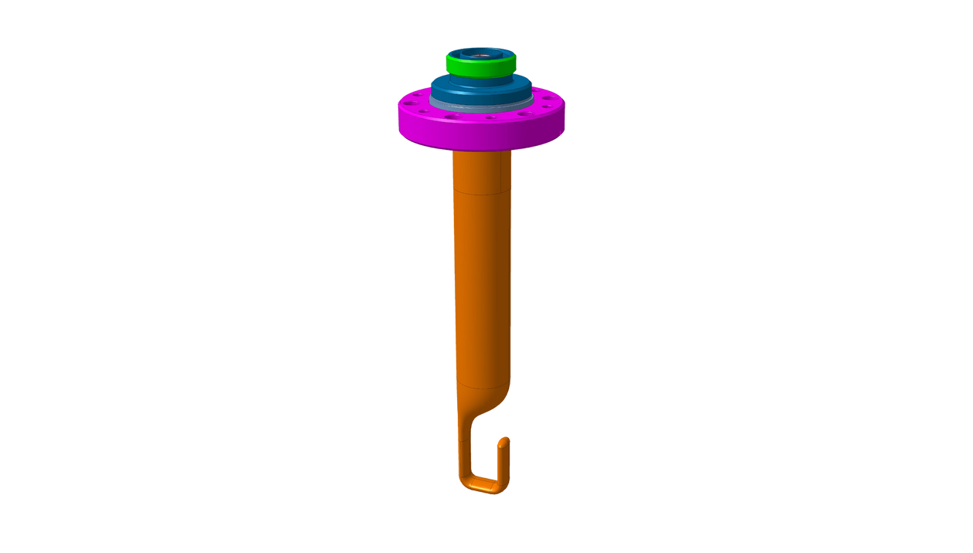
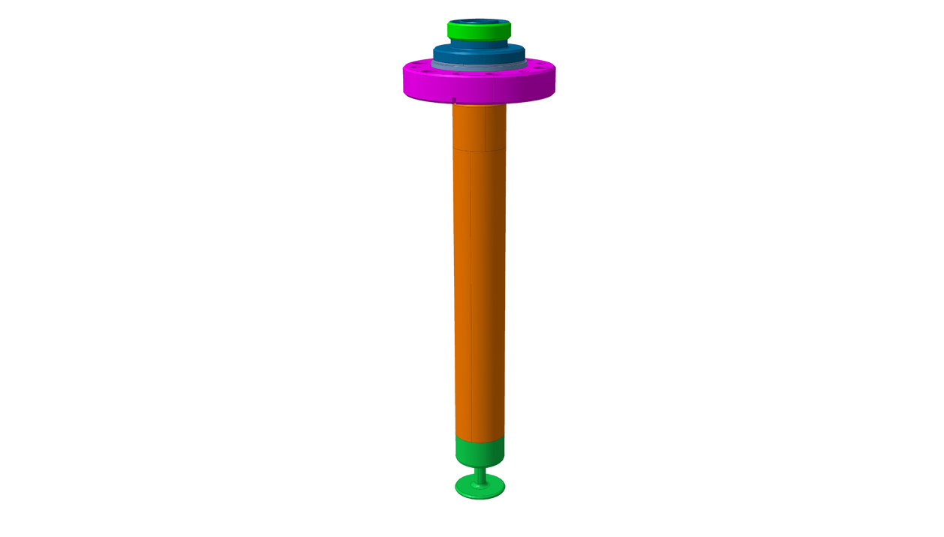
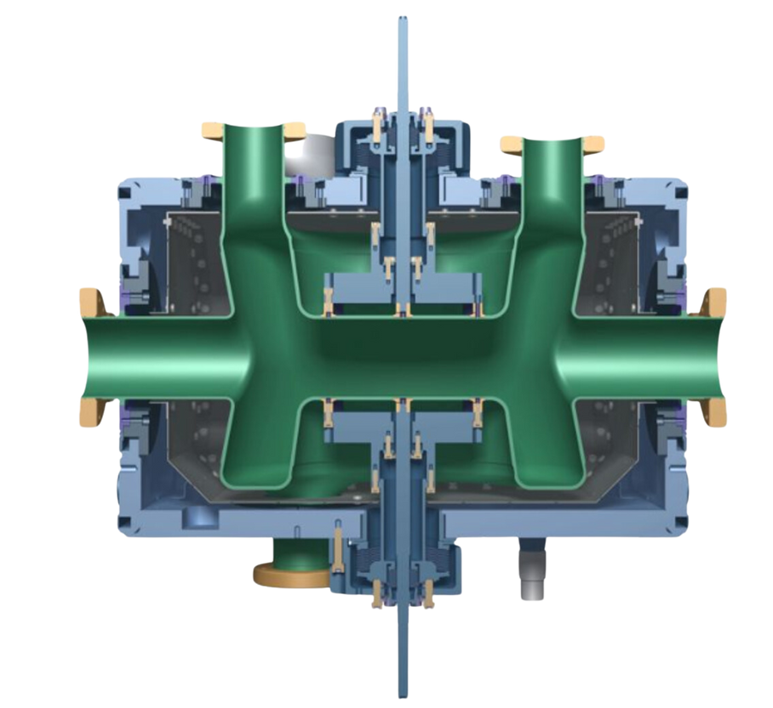

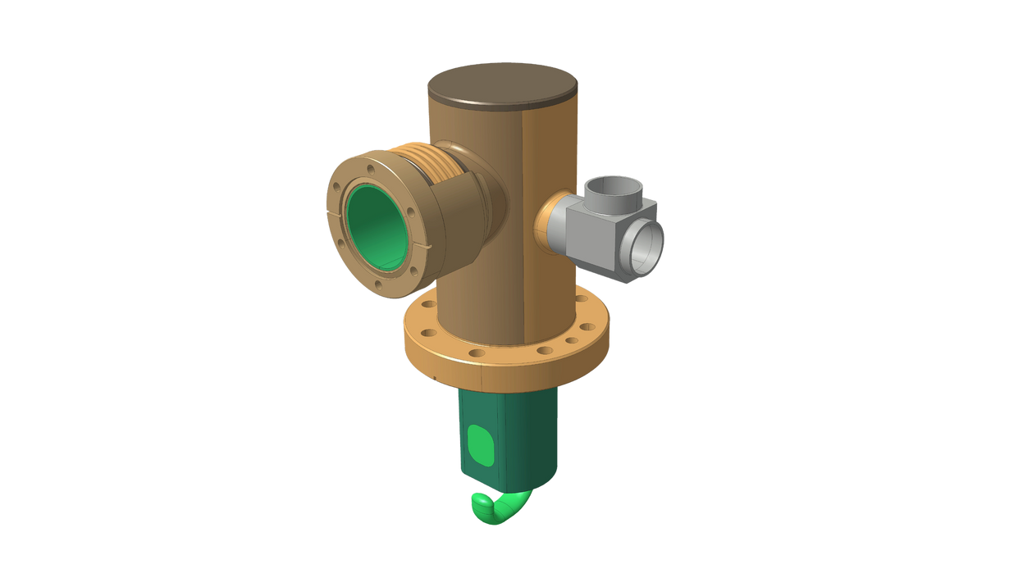
Recap:
Test configurations
Dressed Cavity
Jacketed Cavity
x3
Amelia Edwards
14th HL-LHC Collaboration Meeting - Genoa -
7th-11th October 2024

Slide 8
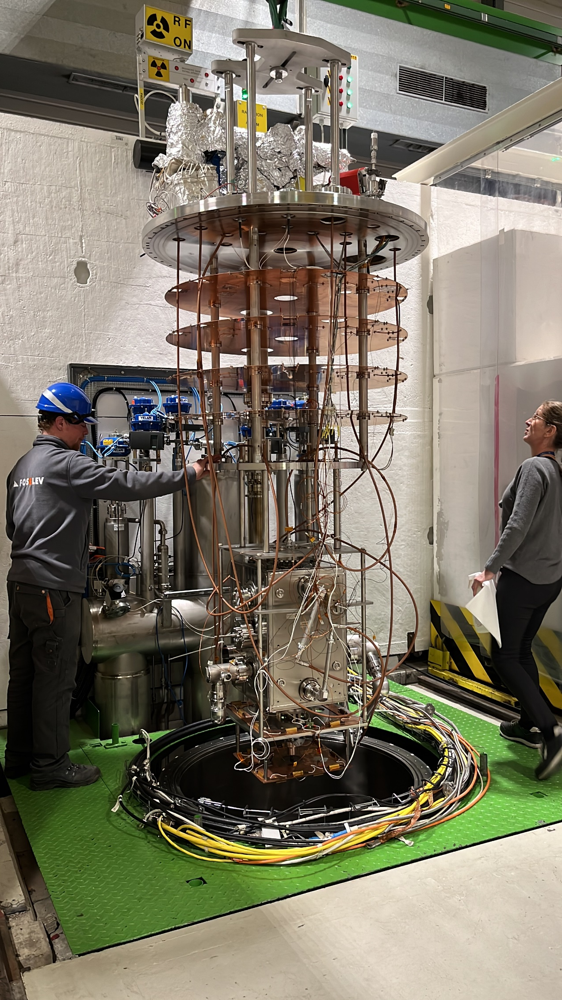
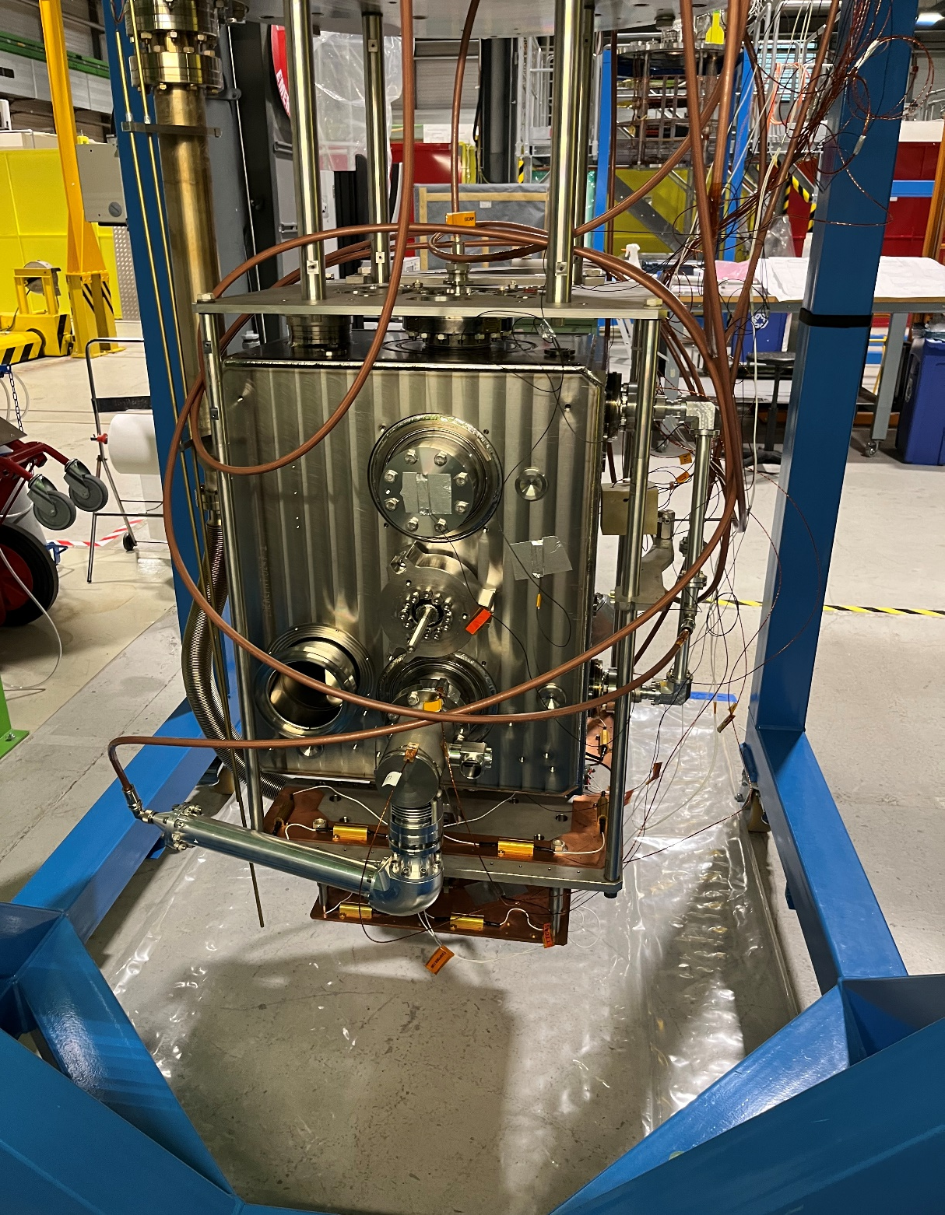
Test configuration
Amelia Edwards
14th HL-LHC Collaboration Meeting - Genoa -
7th-11th October 2024

Slide 9
Recap: Dressed Cavity Specification
From EDMS 2488213 & 1389669
Cavity frequency @2k (MHz) | 400.79 ± 0.15
Deflecting Voltage @2K - Dressed cavity (MV/M) | ≥ 4.1
Q0 @2K, 4.1MV/M | 3e9
LFD (Hz/MV²) | < 400
Field Antenna Power @ 400MHz (W) | 1
HOM power @ 400MHz (W) | ≤ 6.7
P dyn @2K, 4.1MV/M (W) | ≤10
Amelia Edwards
14th HL-LHC Collaboration Meeting - Genoa -
7th-11th October 2024
…Also, requirement to measure HOM frequencies and impedances at 2K

Slide 10
Test Results by Cavity:
RI DQW2
Amelia Edwards
14th HL-LHC Collaboration Meeting - Genoa -
7th-11th October 2024

Slide 11

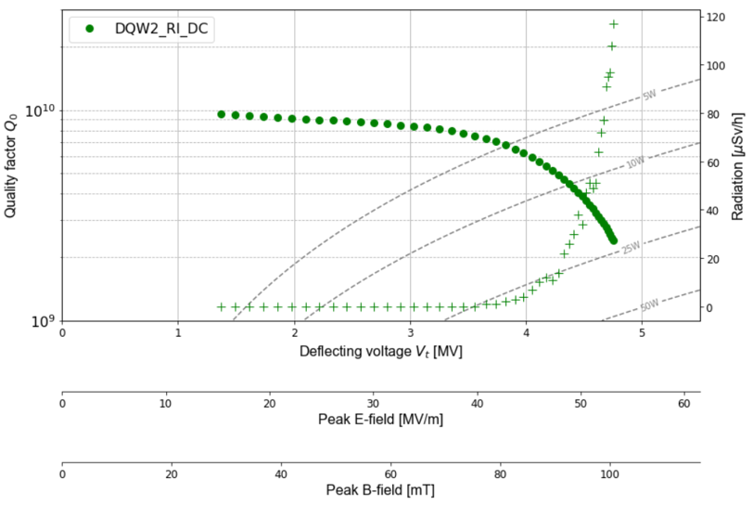
RI DQW2 - Dressed Cavity Test
  First dressed cold test of this cavity
  Surpassed target of 4.1MV
  Maximum field 4.75MV/M
  Higher order modes measured at cold and meet impedance criteria
RI DQW2 Dressed Cavity - 1st Cold Test | RI DQW2 Dressed Cavity - 1st Cold Test
Frequency (MHz) | 400.789
Deflecting Field (MV) | 4.1
Q0 @ 4.1MV | 5e9
LFD (Hz/MV²) | -196.871 ± 0.561
Amelia Edwards
14th HL-LHC Collaboration Meeting - Genoa -
7th-11th October 2024
Notes:
Add star @4.1, 3e9, 10W line

Slide 12
Test Results by Cavity:
RI DQW1
Amelia Edwards
14th HL-LHC Collaboration Meeting - Genoa -
7th-11th October 2024

Slide 13
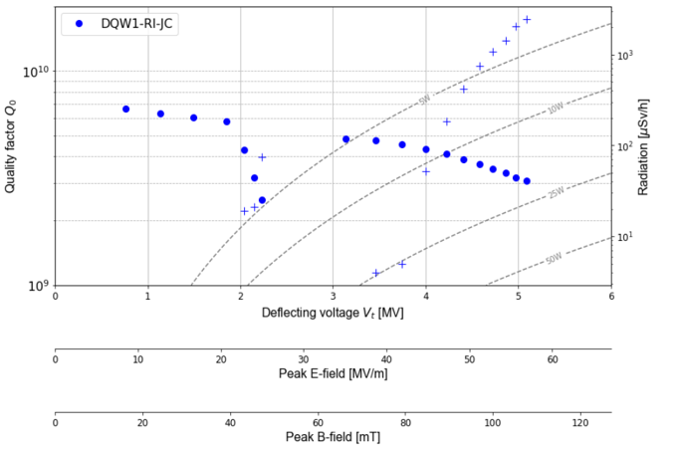
RI DQW1 - Jacketed Cavity Test
  First jacketed test of this cavity
  Maximum field 5.0MV/M
  Test stopped due to radiation
RI DQW1 Jacketed Cavity | RI DQW1 Jacketed Cavity
Frequency (MHz) | 401.036
Deflecting Field (MV) | 5.0
Q0 @ 4.1MV | ~3.8E9
LFD (Hz/MV²) | -237.67 ± 0.209
Amelia Edwards
14th HL-LHC Collaboration Meeting - Genoa -
7th-11th October 2024
Notes:
This cavity was chosen for BCP because jacketed performance is the worst from preseries

Slide 14
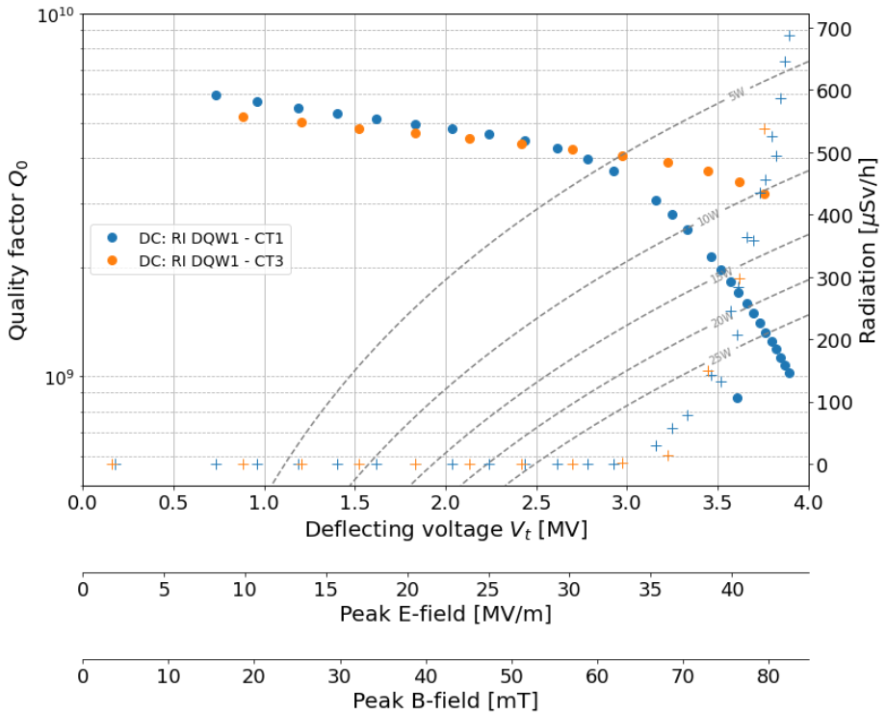
RI DQW1 - Dressed Cavity Tests
  Three dressed tests so far
  Field is not limited due to cavity at 5MV was reached during jacketed test
  During 2nd test, leak appeared at 4.5K so no RF test was done.
  During 1st & 3rd test, maximum field was 3.9MV & 3.75MV respectively
  Quench-like behavior in both tests
  Radiation onset similar
Next steps..... BCP completed
& re-test imminent
Notes:
BCP applied to RI#1 because we considered it to have the "worst" performance
It was very close to spec even as bare
Both cavities tested in V4 cryostat so radiation is comparable

Slide 15
RI DQW1 - Dressed Cavity Test Summary
RI DQW1 Jacketed Cavity | RI DQW1 Jacketed Cavity | RI DQW1 Dressed Cavity | RI DQW1 Dressed Cavity | RI DQW1 Dressed Cavity
 | Oct 23 | Feb 24 | April 24 | June 24
Comment | Passed! | Spec. not achieved | Leak at 4.5K, No RF test | Spec. not achieved
Frequency (MHz) | 401.036 | 401.016 | N/A | 401.015
Deflecting Field (MV) | 5.0 | 3.9 | N/A | 3.75
Q0 @ 4.1MV | ~3.8E9 | 9.6e8 @ 3.9MV | N/A | 3.2e9 @ 3.75MV
LFD (Hz/MV²) | -237.67 ± 0.209 | -216.73 ± 0.47 | N/A | -268 ± 0.99

Slide 16
Test Results by Cavity:
CERN DQW1
Amelia Edwards
14th HL-LHC Collaboration Meeting - Genoa -
7th-11th October 2024

Slide 17
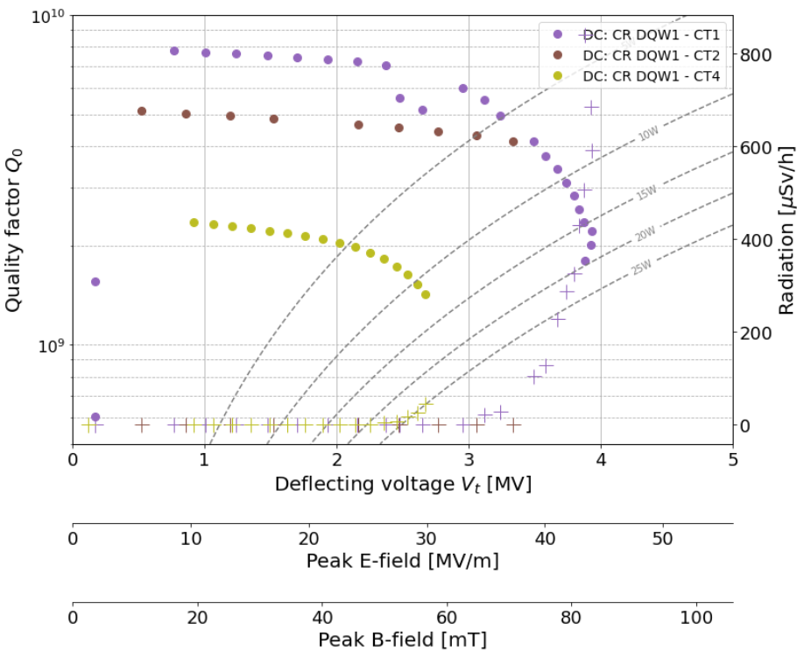
CERN DQW1 - Dressed Cavity Tests
  By 14th Hl-LHC meeting there has been x5 dressed tests....
  After several dressed tests the jacketed test was repeated to re-validate the cavity
May 2023
CERN DQW1 Dressed
Oct 2023
CERN DQW1 Dressed
Mar 2024
CERN DQW1 Dressed*
Jun 2024
CERN DQW1 Dressed
Aug 2024
CERN DQW1 Jacketed
Sep 2024
CERN DQW1 Dressed
Notes:
1st test – purple
2nd test – brown
3rd test – no RF, leak
4th test – green
5th test – results not processed yet
Add radiation onto this plot!

Slide 18
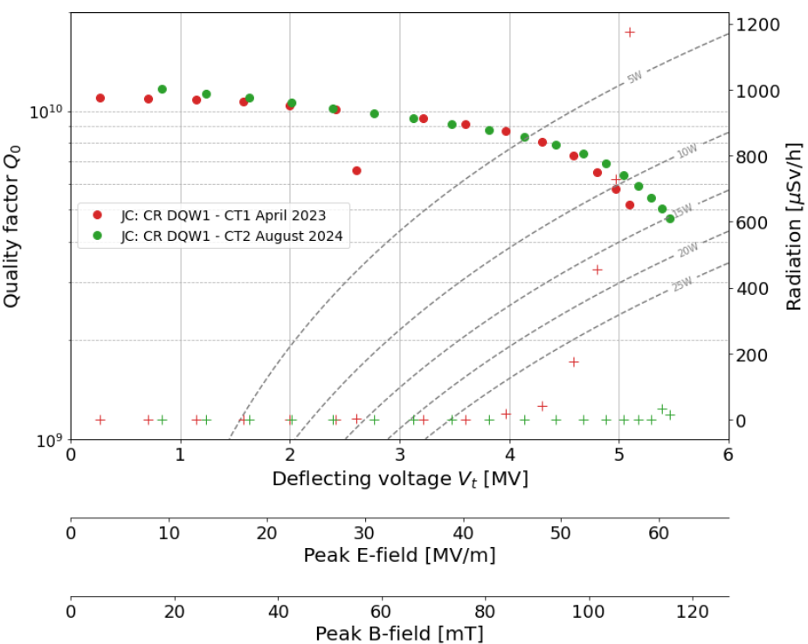
CERN DQW1 - Jacketed Cavity Tests
  Two jacketed tests of this cavity
  Second jacketed test was performed ~1 year later after several (unsuccessful) dressed cold tests
  Maximum field 5.4MV/M
  First test stopped due to radiation
  Second test - filed is limited by thermal quench behavior
  For second test, radiation onset begins at higher field level - possibly due to cleaner surface after many iterations of rinsing?
  Performance very similar between tests and Q0 of cavity retained

Slide 19

CERN DQW1 - Dressed Cavity Test Summary
CERN DQW1 Jacketed Cavity | CERN DQW1 Jacketed Cavity | CERN DQW1 Jacketed Cavity | CERN DQW1 Dressed Cavity | CERN DQW1 Dressed Cavity | CERN DQW1 Dressed Cavity | CERN DQW1 Dressed Cavity | CERN DQW1 Dressed Cavity
 | Oct 23 | Aug 24 | May 23 | Oct 23 | Feb 24 | June 24 | Sept 24
Comment | Passed! | Passed! *Superfluid leak | Field Limited | Quench before field emission | Leak @4.5K No RF | Field Limited | TBD
Frequency (MHz) | 400.70 | 400.69 | 400.69 | 400.67 | N/A | 400.68 | …
Deflecting Field (MV) | 5.1 | 5.4 | 3.9 | 3.5 | N/A | 2.7 | …
Q0 @ 4.1MV | 5.1e9 | 4.7e9 | 6.0e9 @ 3.9MV | 3.7e9 @3.5MV | N/A | 1.43e9 @ 2.7MV | …
LFD (Hz/MV²) | -221 ± 0.15 | -268 ± 0.19 | -232 ± 0.18 | -230 ± 0.62 | N/A | -216 ± 0.149 | …
Notes:
Highlight this test as it is a different result from others

Slide 20
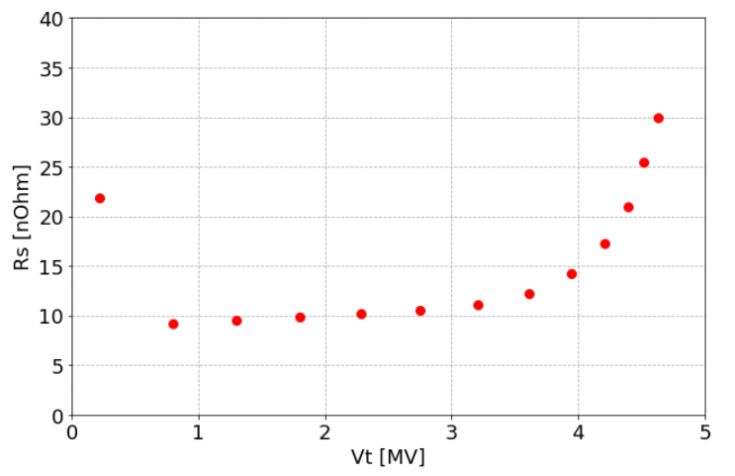
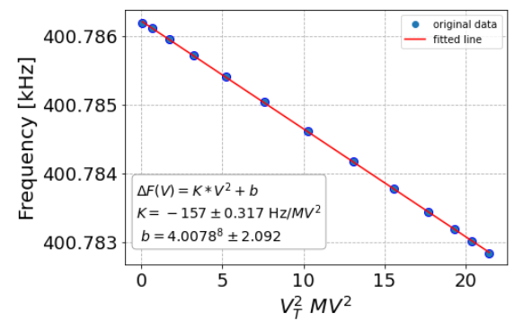
RI DQW2 - Dressed Cavity Test
Surface Resistance
Lorentz Force Detuning
Amelia Edwards
14th HL-LHC Collaboration Meeting - Genoa -
7th-11th October 2024
Notes:
Add star @4.1, 3e9, 10W line

Slide 21
HOM Measurements
Amelia Edwards
14th HL-LHC Collaboration Meeting - Genoa -
7th-11th October 2024

Slide 22
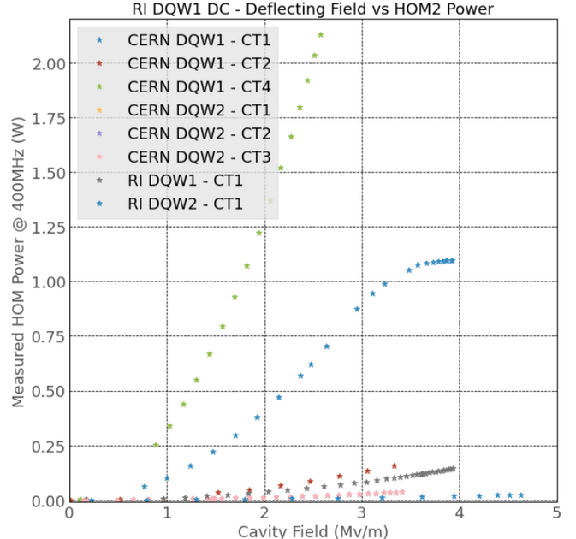
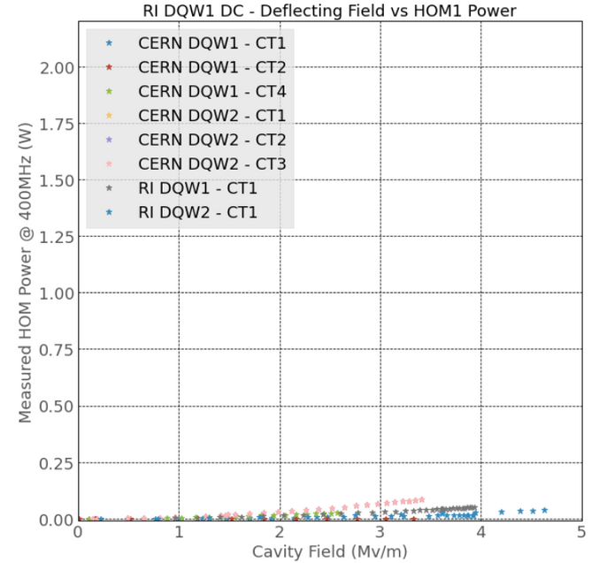
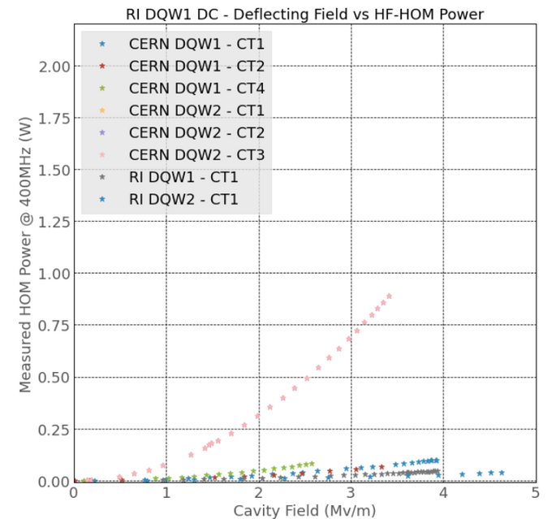
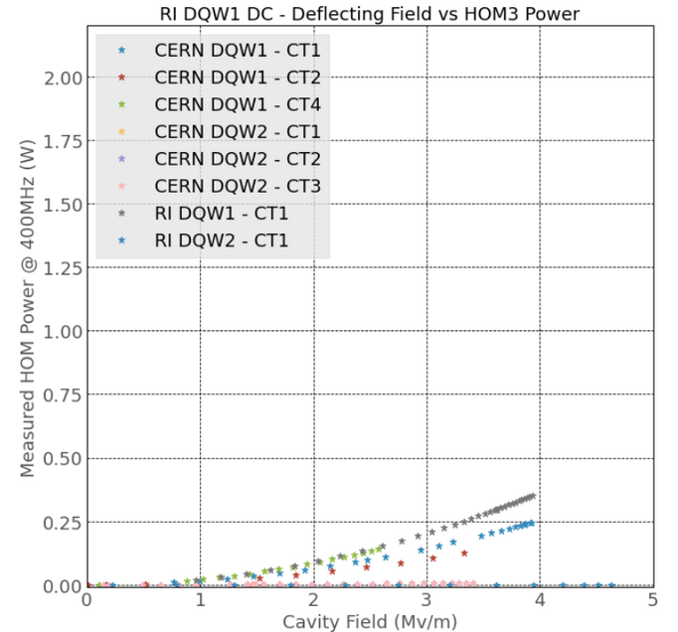
Fundamental Power Extraction
Acceptance Criteria:
Power @ 400MHz ± 0.15,
VT = 4.1MV
< 6.7W
(EDMS 2488213)​
Amelia Edwards
14th HL-LHC Collaboration Meeting - Genoa -
7th-11th October 2024

Slide 23
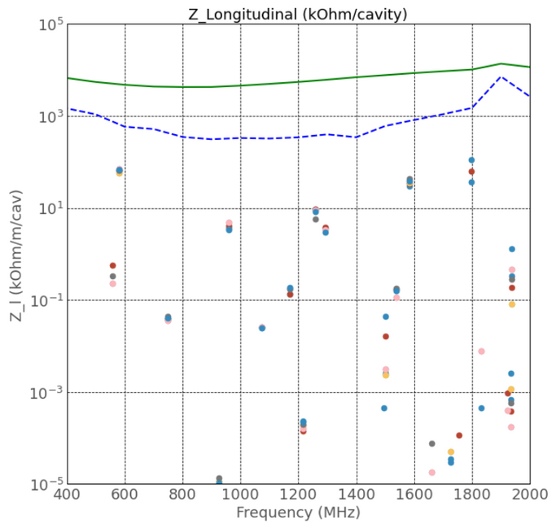
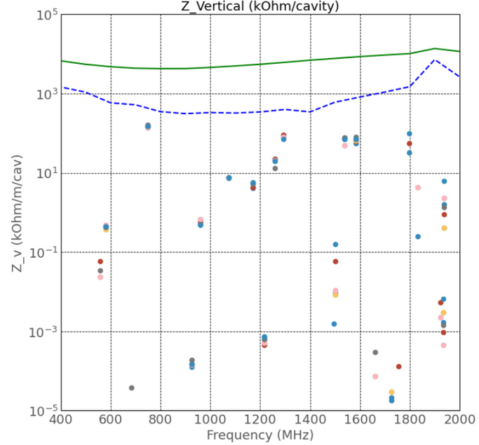
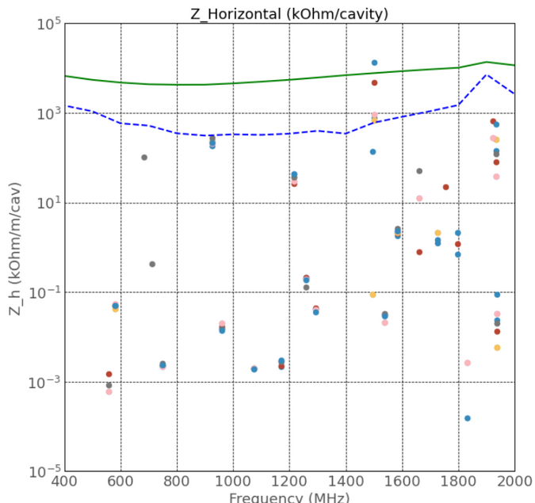
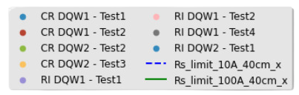
HOM Impedance at 2K
  Calculated from 2GHz HOM spectrum measured at 2K
  Successful use of 50Ω to 25Ω adapters​
  Impedance limits come from collision optics​
Amelia Edwards
14th HL-LHC Collaboration Meeting - Genoa -
7th-11th October 2024

Slide 24
Experience & Issues
Amelia Edwards
14th HL-LHC Collaboration Meeting - Genoa -
7th-11th October 2024

Slide 25
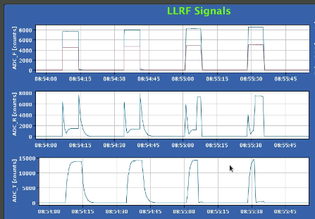
Experience from Dressed cavity tests
  Vacuum leaks occurring more often w.r.t bare & jacketed tests
  Logical as more couplers in the cavity
  HOM power @400MHz within specification but occasionally we see one coupler with higher power extraction
  The maximum field is often dominated by the escalation of field emission
  At which point we observe ‘quench-like’ behavior
Amelia Edwards
14th HL-LHC Collaboration Meeting - Genoa -
7th-11th October 2024
Notes:
Split into two slides, summarize field emission and show contrasting plot from Oct 23 where cavity failed without field emission
Not cleanliness issue only
As a precaution, due to frequent leaks dressed cavities are maintained at 2.5K when operator isn’t present and final measurements are made at 2K.​
120°C bakeout was implemented for dressed cavity configuration​
25Ω feed-throughs + adapters are installed without issue but must be checked with TDR ​
Heating on HOM couplers has been observed

Slide 26
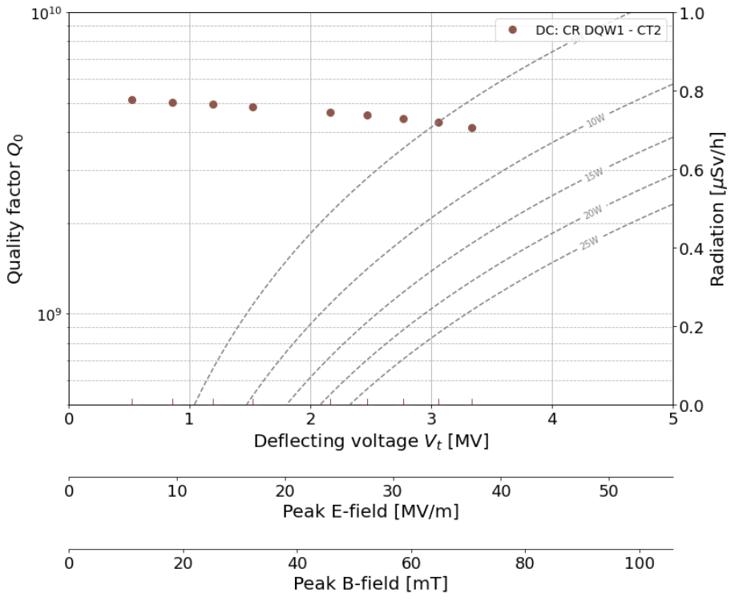
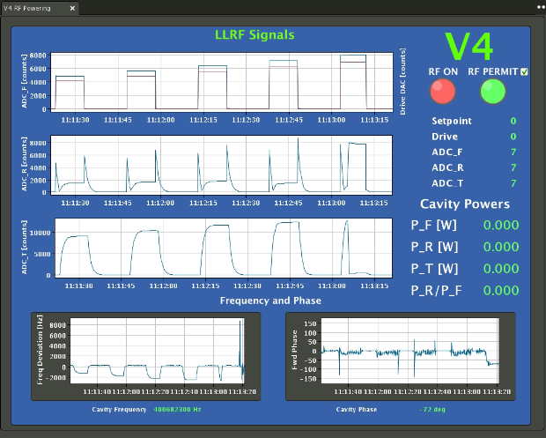
Experience from Dressed cavity tests
  Field emission behavior – this is not the case for every test which leads us to believe it is not just a cleanliness issue…
  On one occasion we observed quenching at 3.5MVwithout field emission (CERN DQW1 - October 2023)
Amelia Edwards
14th HL-LHC Collaboration Meeting - Genoa -
7th-11th October 2024
Notes:
Split into two slides, summarize field emission and show contrasting plot from Oct 23 where cavity failed without field emission
Not cleanliness issue only

Slide 27

Summary
  x10 Cavity tests since the last meeting,
  x2 successful tests (1 DC & 1 JC)
  Procedure for dressed cavity testing now well developed
  Validating the cavities CERN & RI DQW1 is quite challenging
  x2 Dressed cavities validated & shipped to UK - CERN #2 & RI #2
  HOMs consistently within specification from dressed cavity measurements at 2K
Field Emission
Superfluid Leaks
Quench
Notes:
BCP applied to RI#1 because we considered it to have the "worst" performance
It was very close to spec even as bare

Slide 28
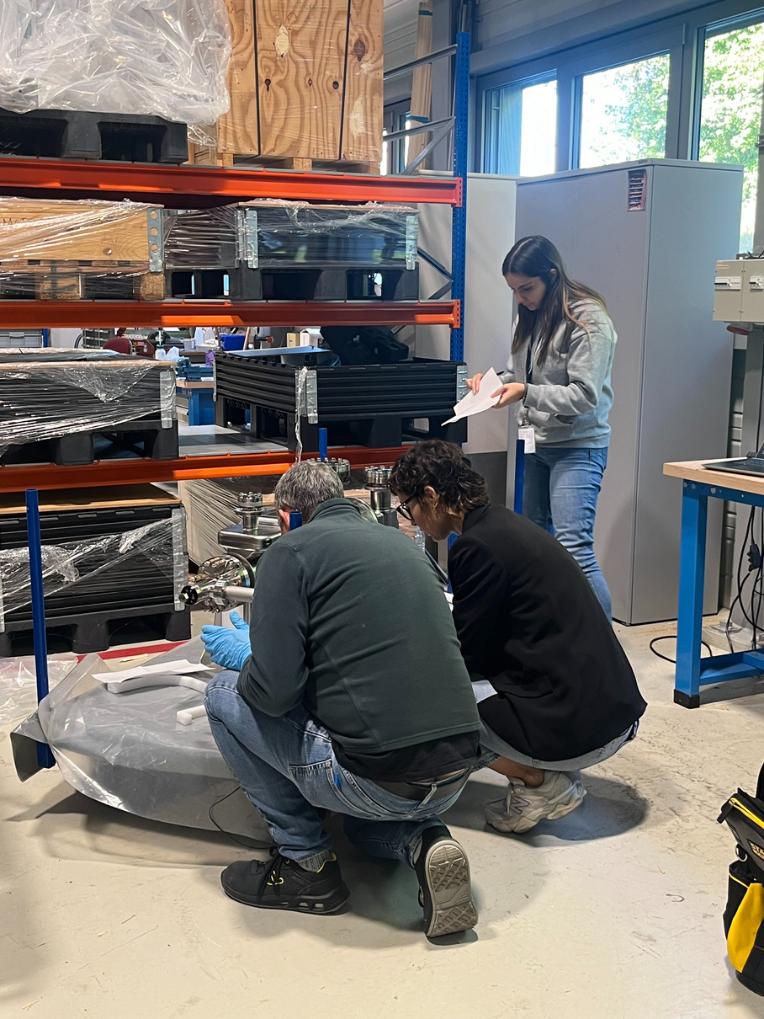
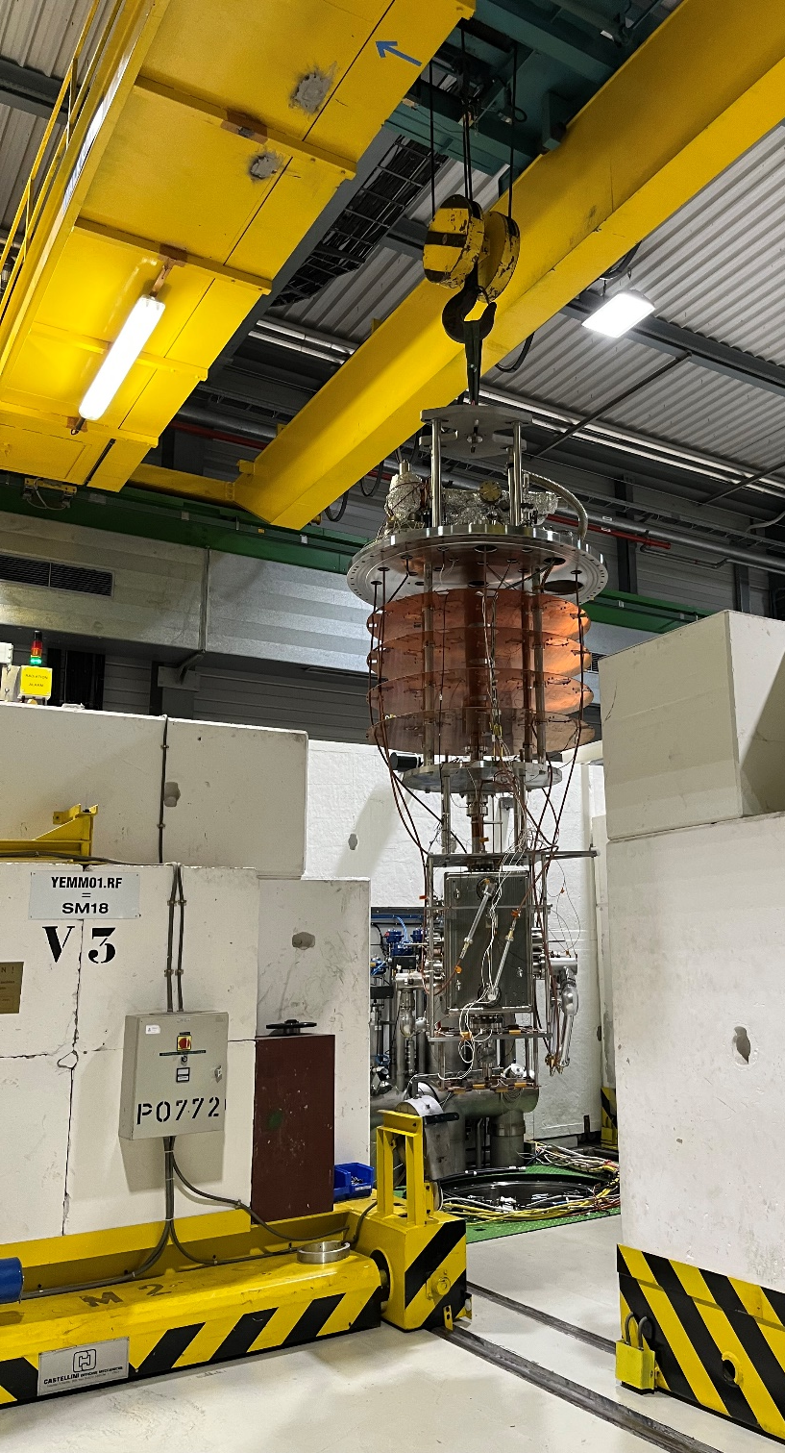
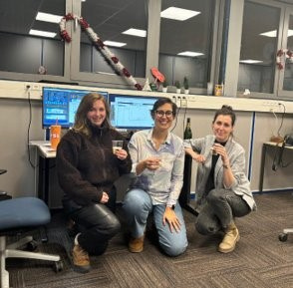
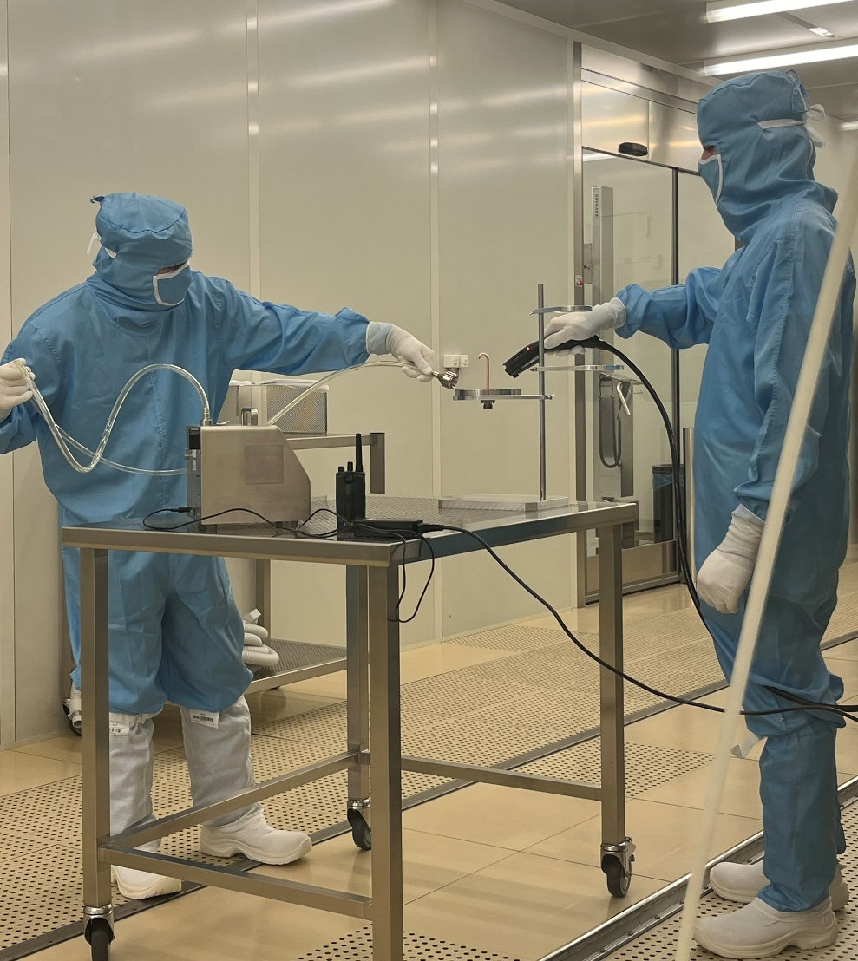
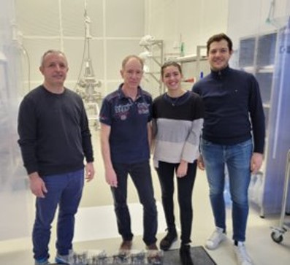
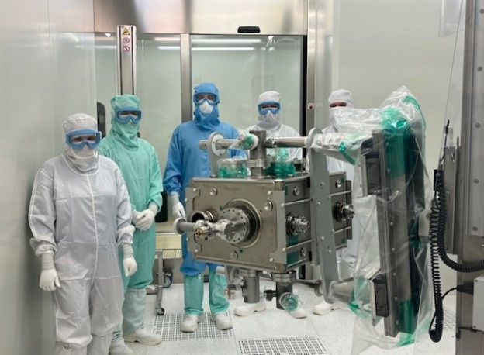
Thankyou for listening!
Any questions?
On behalf of WP4, SY-RF-SRF, SY-RF-AC,
EM-MME, TE-VSC, 4030.....

