Slide 1



RFD HOM Coupler Challenges
Naeem Huque – Jefferson Lab
14th HL-LHC Collaboration Meeting. – Oct. 7th–10th 2024

Slide 2
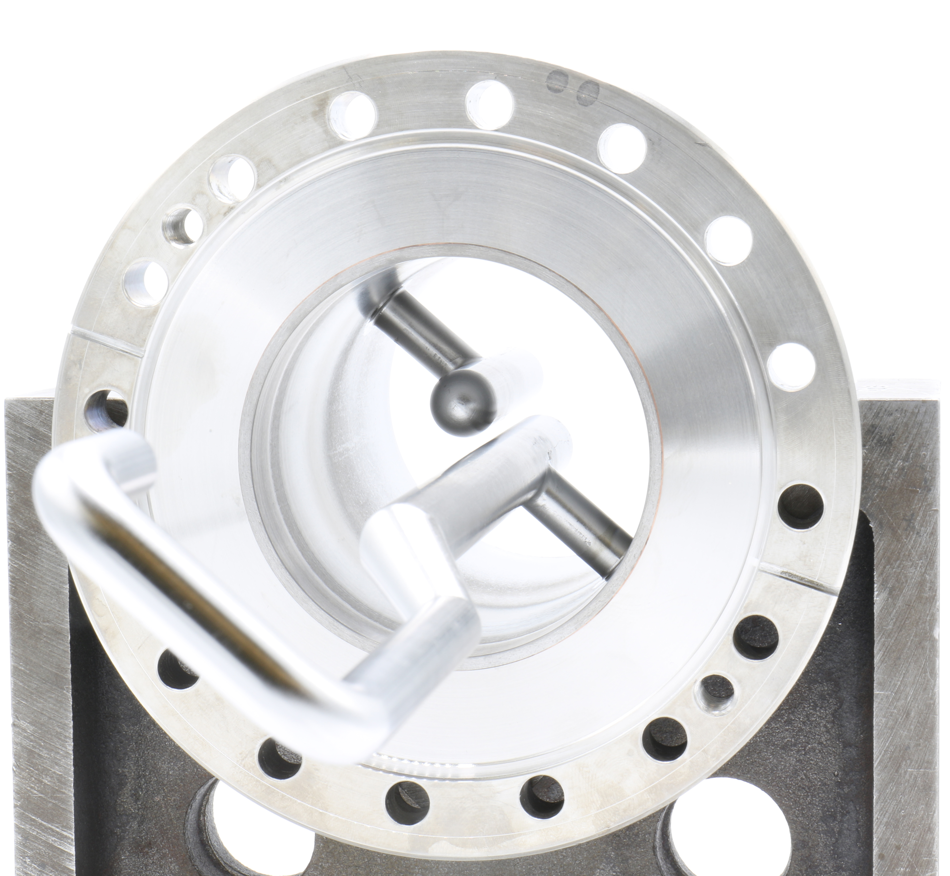
Outline
Scope
Interfaces
Current Challenges
  Niobium Material Testing
  Ceramic Brazes
  Helium Line Configuration
Series Production Status
Summary

Slide 3
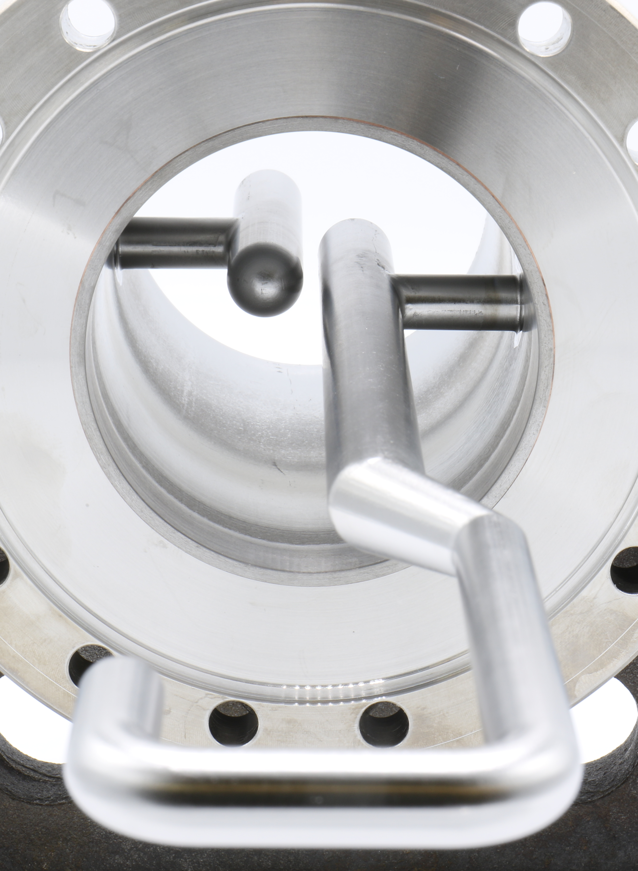
JLab Scope of Work
Fabricate sets of RFD Cavity Ancillaries
  Prototype: 3 sets (FY21/FY22) Complete
  Pre-Series: 3 sets of HHOM Dampers (FY23/FY24) Complete
  Series: 10 sets of HHOM Dampers (FY24/FY25)
RF design is provided by AUP; mechanical design proposed by JLab with CERN as the design authority
All activities are in full compliance with CERN Engineering Specification Document (EDMS 1389669 v2.6)
Develop manufacturing drawings and strategy
Develop brazing and welding processes and formal documents
Share production information with the CERN MTF

Slide 4
JLab Scope of Work: Interfaces
Interfaces are defined in LHCACFDC0001 - CERN EDMS 2420659
Drawings for JLab scope have been approved by CERN
HHOM-FT
DN40 CF
HHOM
DN100 CF
RFD Cavity
4

Slide 5
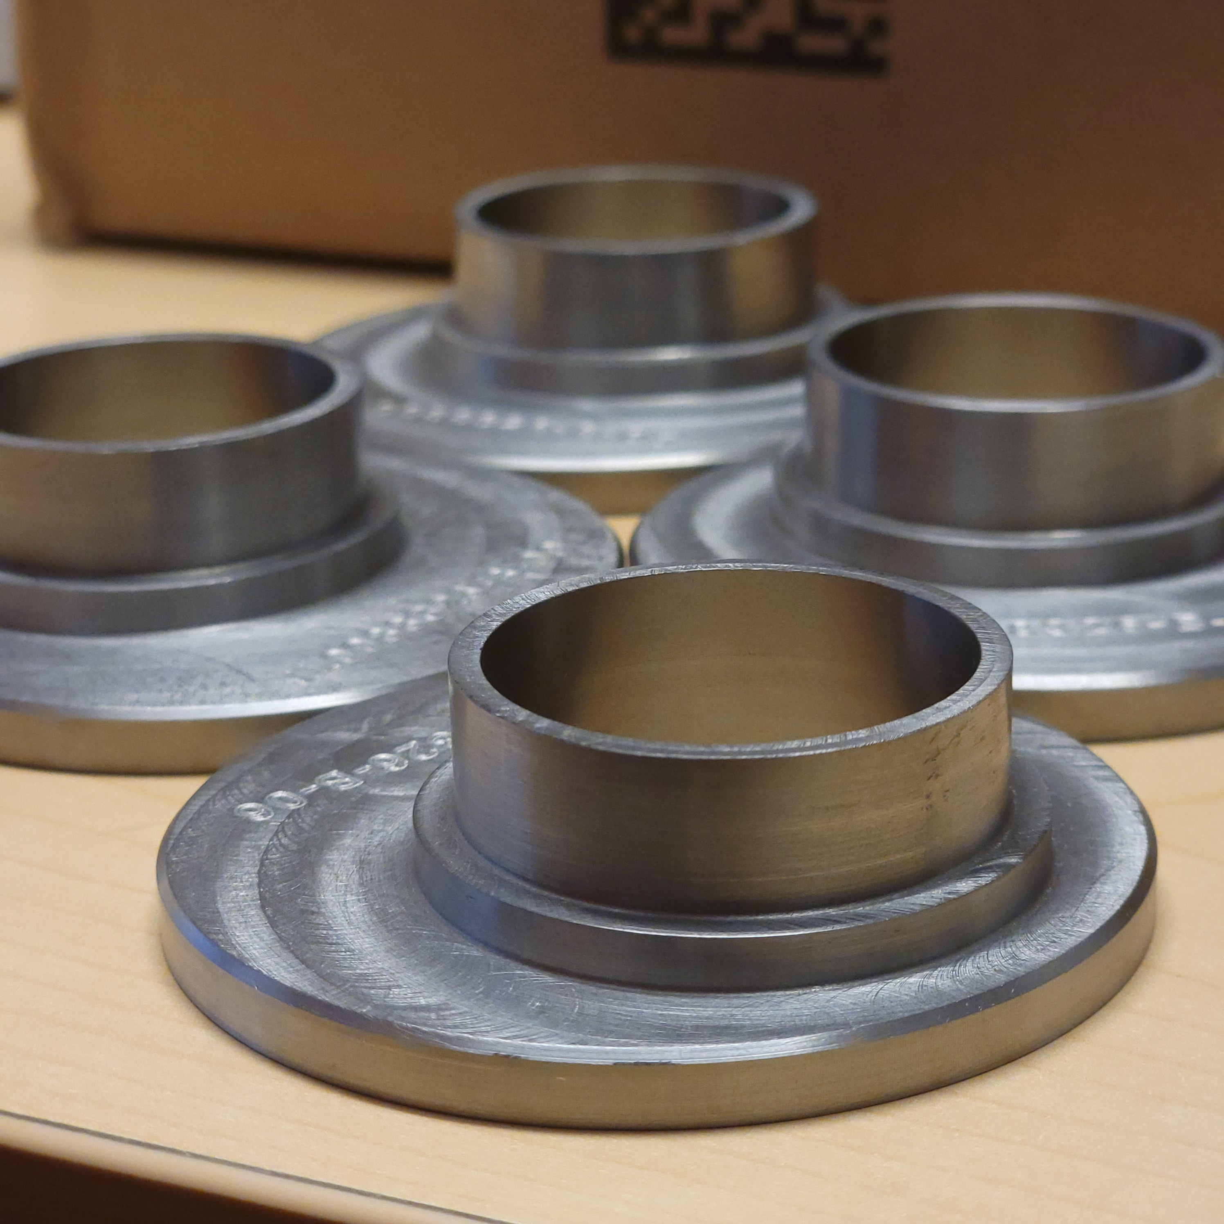
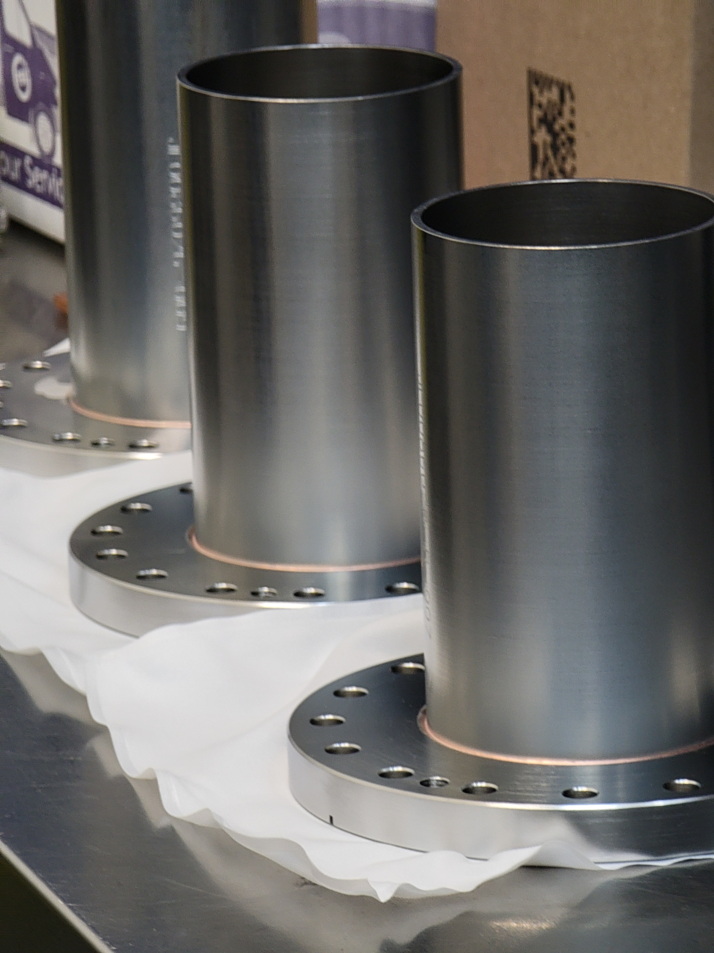
Current Challenges: Heat Treatment
In early 2024, several Nb parts were inadvertently heat treated.
  Inner can lids went through 950C for two hours (stress relief heat treatment for SS)
  The material properties would need to be tested to ensure mechanical and RRR compliance
Additional studies were carried out in reference to the two-step brazing process for the DN100 flange
The following was to be verified:
  The accidental heat treatment does not overly reduce the Nb RRR and yield strength
  The second step of the two-step braze does not overly reduce the Nb RRR and yield strength
Nb can lids (top) and DN100 braze assemblies which use 2-step brazing (bottom)

Slide 6
RRR Tests
Off-Normal 950C Heat Treatment
Sample | Temperature | Description | RRR
1 | None | Baseline | 312
2 | 1X 950 C 1X 1040 C | 2 hours dwell (same as SS HT) Same as brazing run | 329
3 | 1040 C | Same as brazing run | 332
 |  | RRR Spec | 300
Effect of Second Brazing Run
Sample | Temperature | Description | RRR
1 | None | Baseline | 270
2 | 1040 C | Same as brazing run | 282
3 | 2X 1040 C | Same as brazing run | 286
 |  | RRR Spec | 300
RRR values are acceptable to CERN
Furnace runs do not lower RRR

Slide 7
Tensile Testing
Off-Normal 950C Heat Treatment
# | Temp | Description | R_{P 0.2} (MPa) | R_{M} (MPa) | A_{g} (%) | A_{BREAK} (%)
1 | None | Baseline | 79.5 | 157.5 | 32.5 | 63.0
2 | 1X 950 C 1X 1040 C | 2 hours dwell (same as SS HT) Same as brazing run | 37.6 | 130.2 | 30 | 44
3 | 1040 C | Same as brazing run | 37.3 | 128.5 | 29.3 | 41.2
Effect of Second Brazing Run
# | Temp | Description | R_{P 0.2} (MPa) | R_{M} (MPa) | A_{g} (%) | A_{BREAK} (%)
1 | None | Baseline | 52.1 | 158.8 | 37.2 | 67.4
2 | 1X 1040 C | Same as brazing run | 48.3 | 136.0 | 27.8 | 35.6
3 | 2X 1040 C | Same as brazing run | 45.9 | 120.7 | 22.7 | 32.9

Slide 8
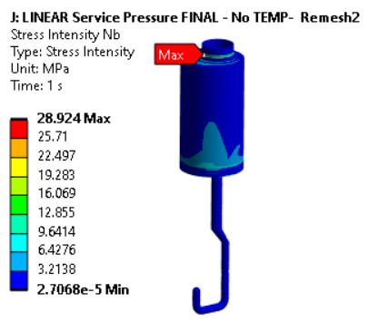
Mechanical Properties
The accidental heat treatment of the Nb did not affect the final yield stress (beyond the effect of the regular brazing run)
The second furnace run of the DN100 two-step brazing process did not deteriorate the mechanical properties of the Nb
The strength analysis was carried out using the lowest yield strength (EDMS 3086558) and was acceptable
Niobium
P_{m} < 150 MPa
P_{m+b} < 225 MPa
No stress above 29 MPa
Eduardo Cano-Pleite, CERN

Slide 9
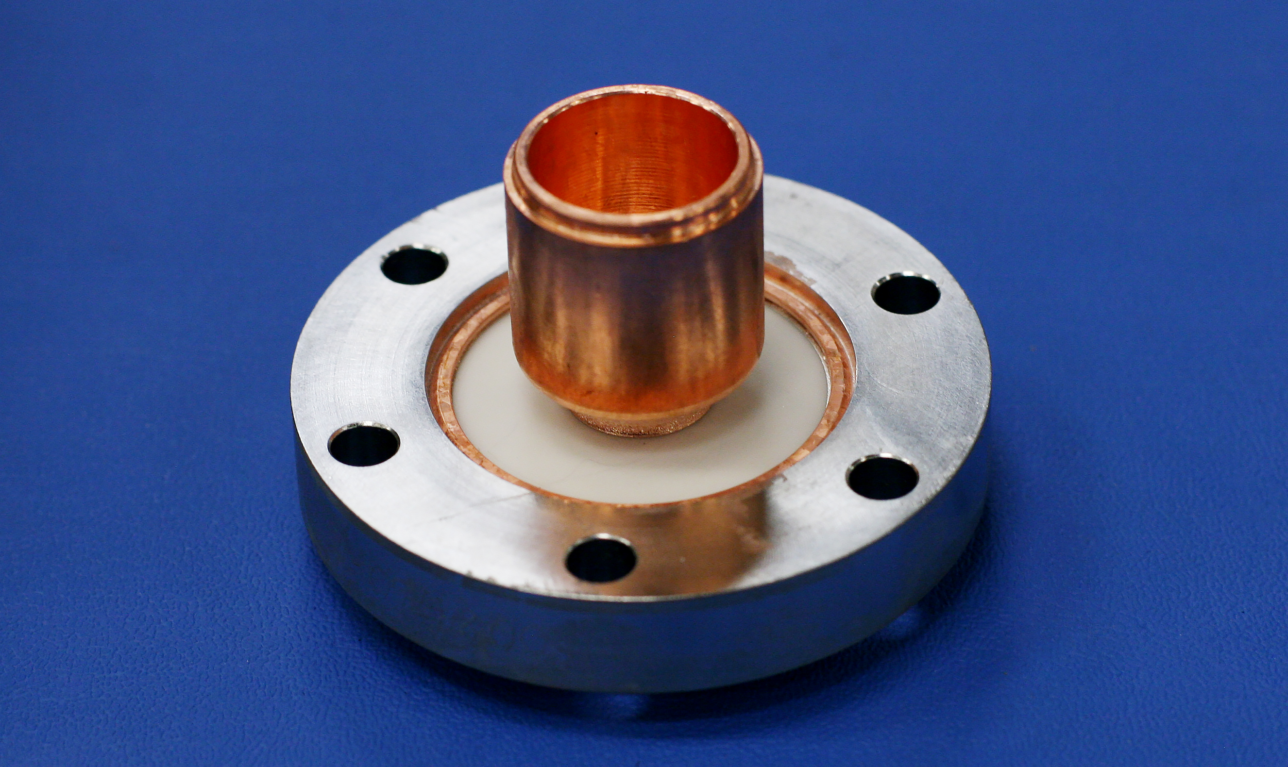
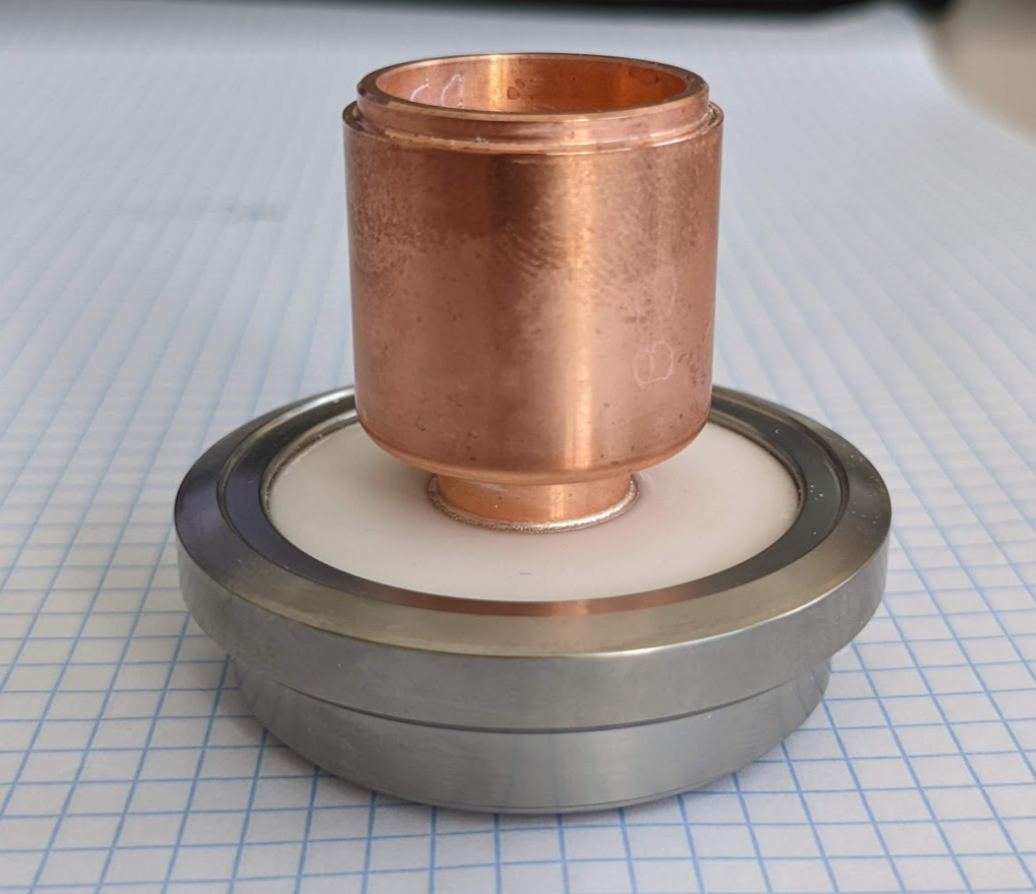
Current Challenges: Ceramic Brazes
CERN uses a rotatable titanium flange on the ceramic feedthroughs (below right)
JLab uses a copper interface ring between the ceramic and a 316LN non-rotatable flange (below left)
In particular, the concern is that the brazing/installation process will form cracks within the ceramic which will propagate over time
  Destructive section is the only way to identify cracks
The JLab design has been implemented on prototypes and has been included in a number of VTA cycles without failure
JLab Design
CERN Design

Slide 10
Ceramic Testing Conclusion
Ceramic braze qualifications and testing have been ongoing for three years
The presence of internal micro-cracks in the ceramic after brazing/mounting could not be measured with confidence.
A setback was a batch of ceramics, bought from the same vendor and the same specifications as others, which had unknown inherent defects and failed upon mounting
A final qualification run was held in January 2024
The JLab design met the qualification goals, but was found to crack if the torque was raised from the spec of 10 Nm to 12 Nm
Due to the risk of over-torquing occurring during the installation process, the CERN design was down-selected

Slide 11
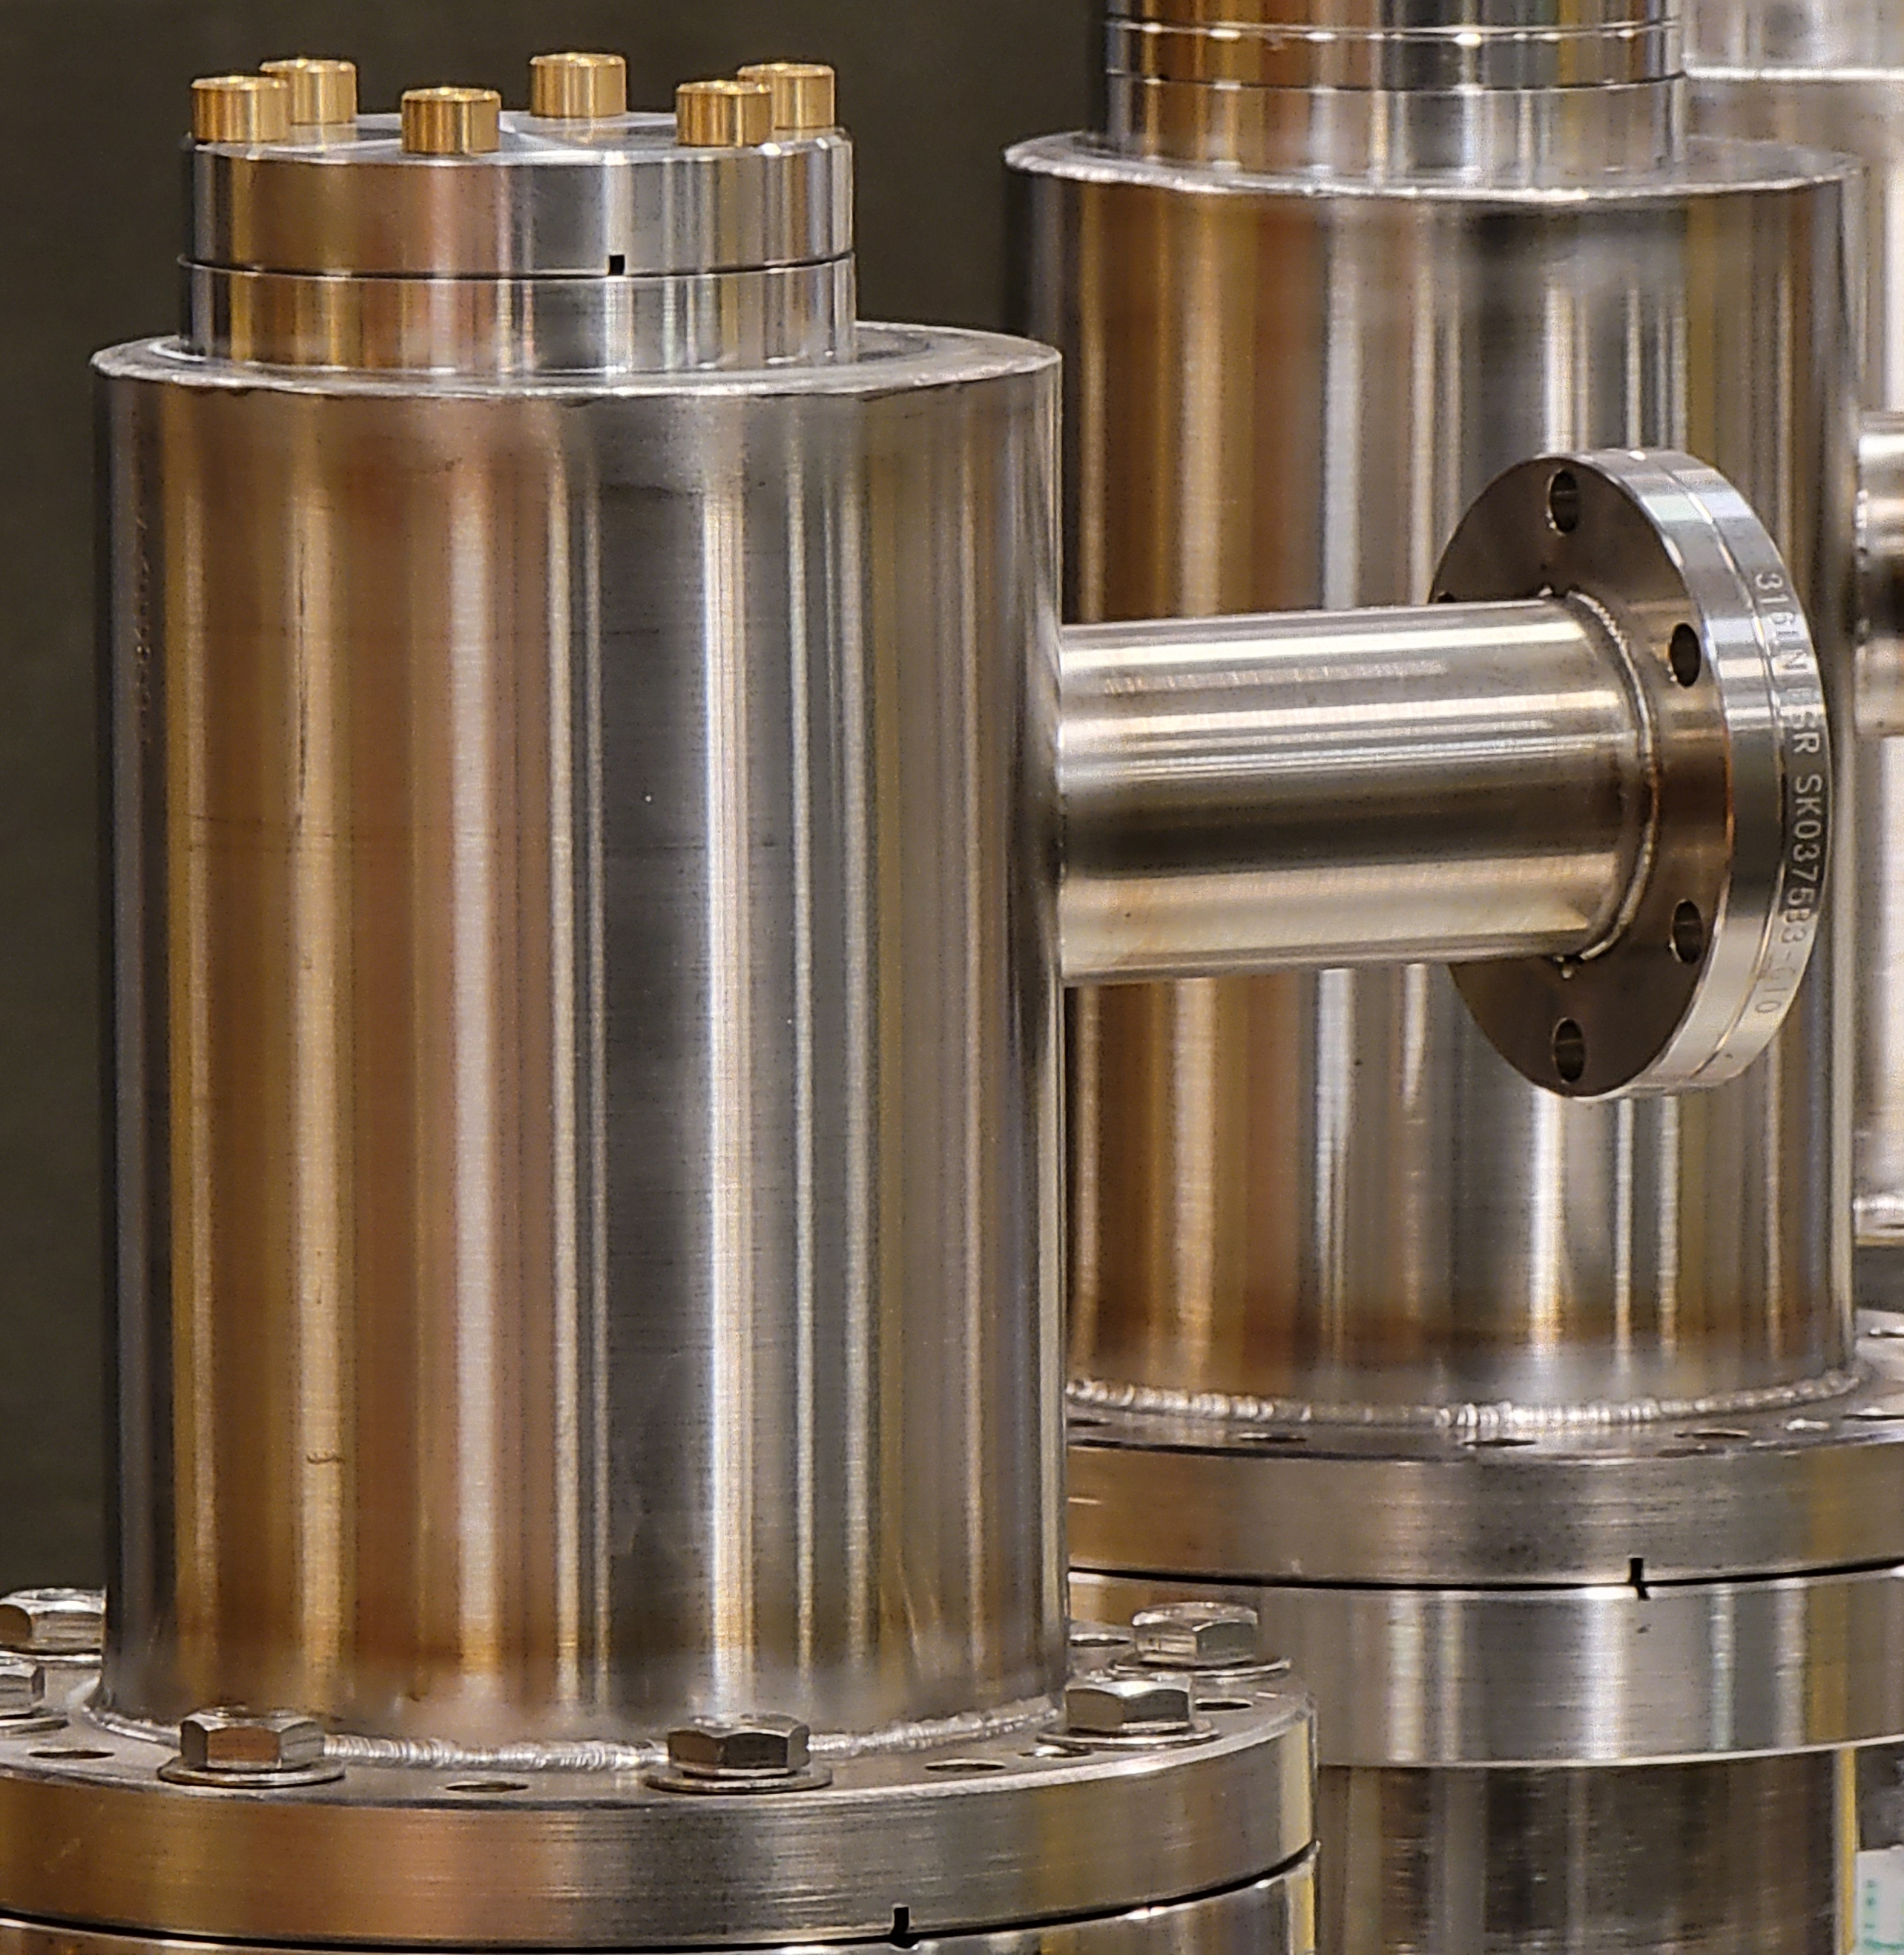
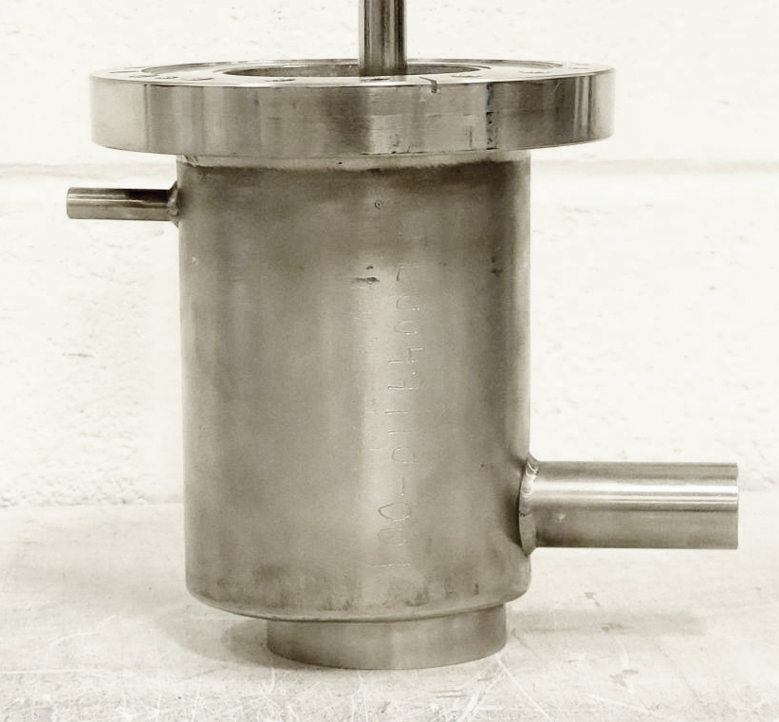
Current Challenges – Helium Line Issue
Helium line on HHOM damper’s SS jacket (left image) in the wrong position
Using this new position would result in changes to the cryomodule design
Issue was not discovered during CAD model and drawing approval process at CERN
Different design is possibly an artifact from an old LARP prototype (right image)
Modifying existing dampers is not practical
  The helium jacket is a pressure boundary and weld repairs would be subject to additional rules
  The proximity of the Nb can inside the SS jacket makes any cuts risky
  Additional welds on the part would cause distortion, bringing the dimensions out of tolerance
Outlet should be here

Slide 12
Reduced Scope
Feedthroughs will be delivered to JLab for installation on jacketed cavities
HHOM Dampers will be produced in advance of jacketed cavity delivery to JLab
Source | Feedthroughs | HHOM Dampers | Status
CERN | 2 sets | 2 | At JLab
CERN | 4 sets | - | Due Q1 FY25
JLab | - | 4 | Due Q2 FY25
JLab | - | 6 | Due Q3 FY25
CERN | 8 sets | - | Due Q3 FY25

Slide 13
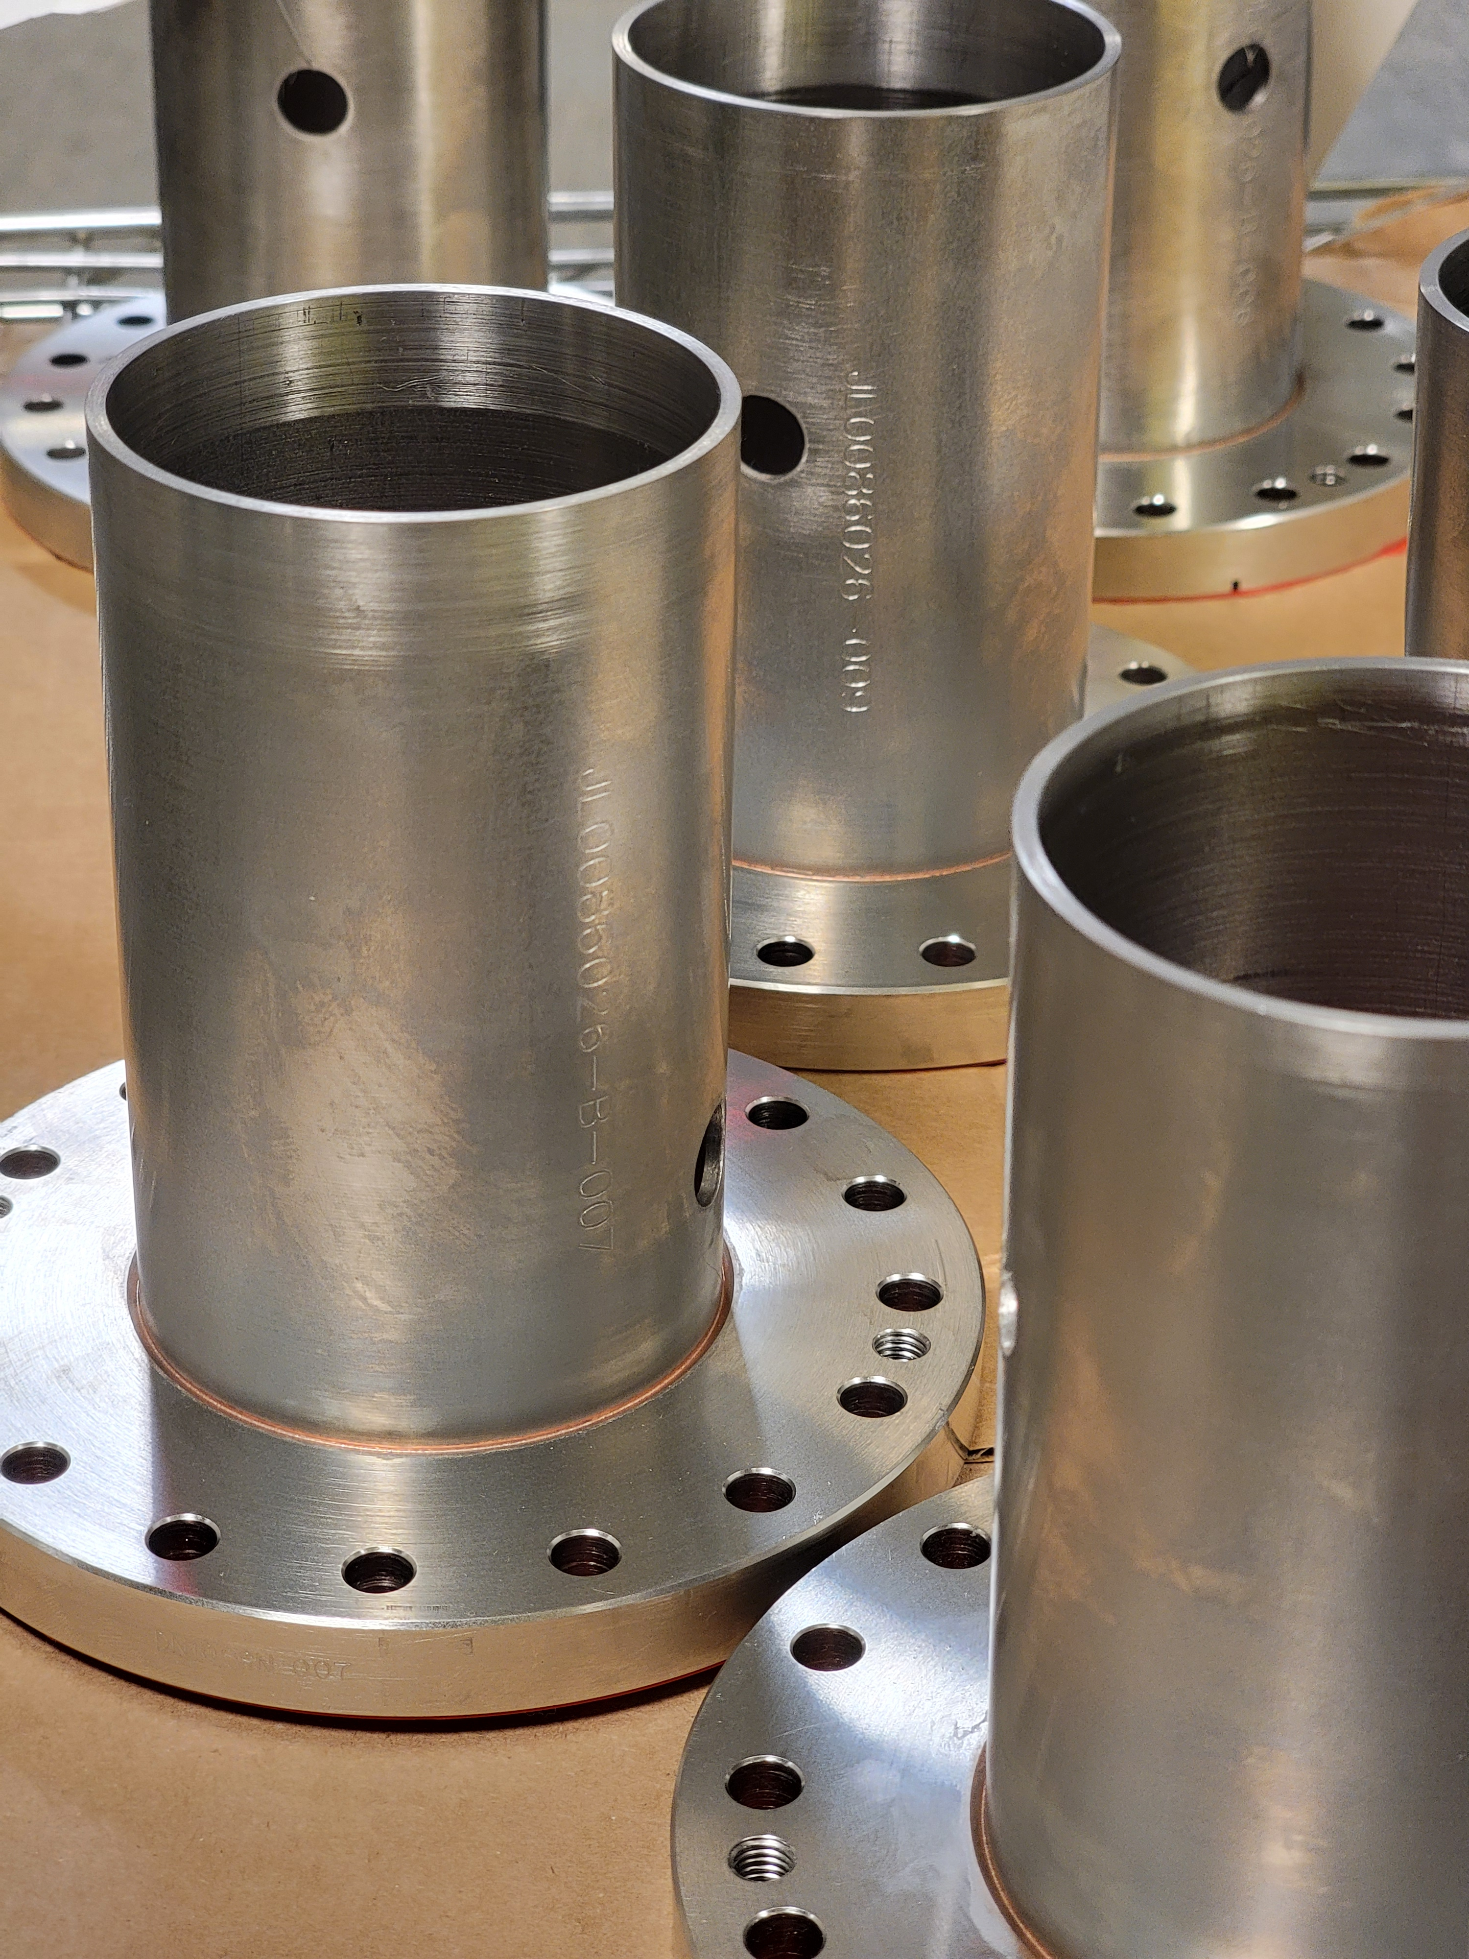
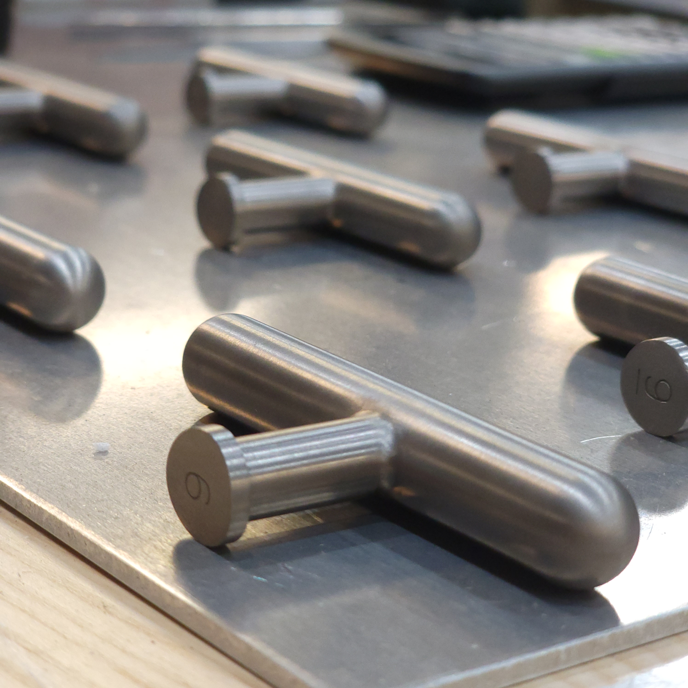
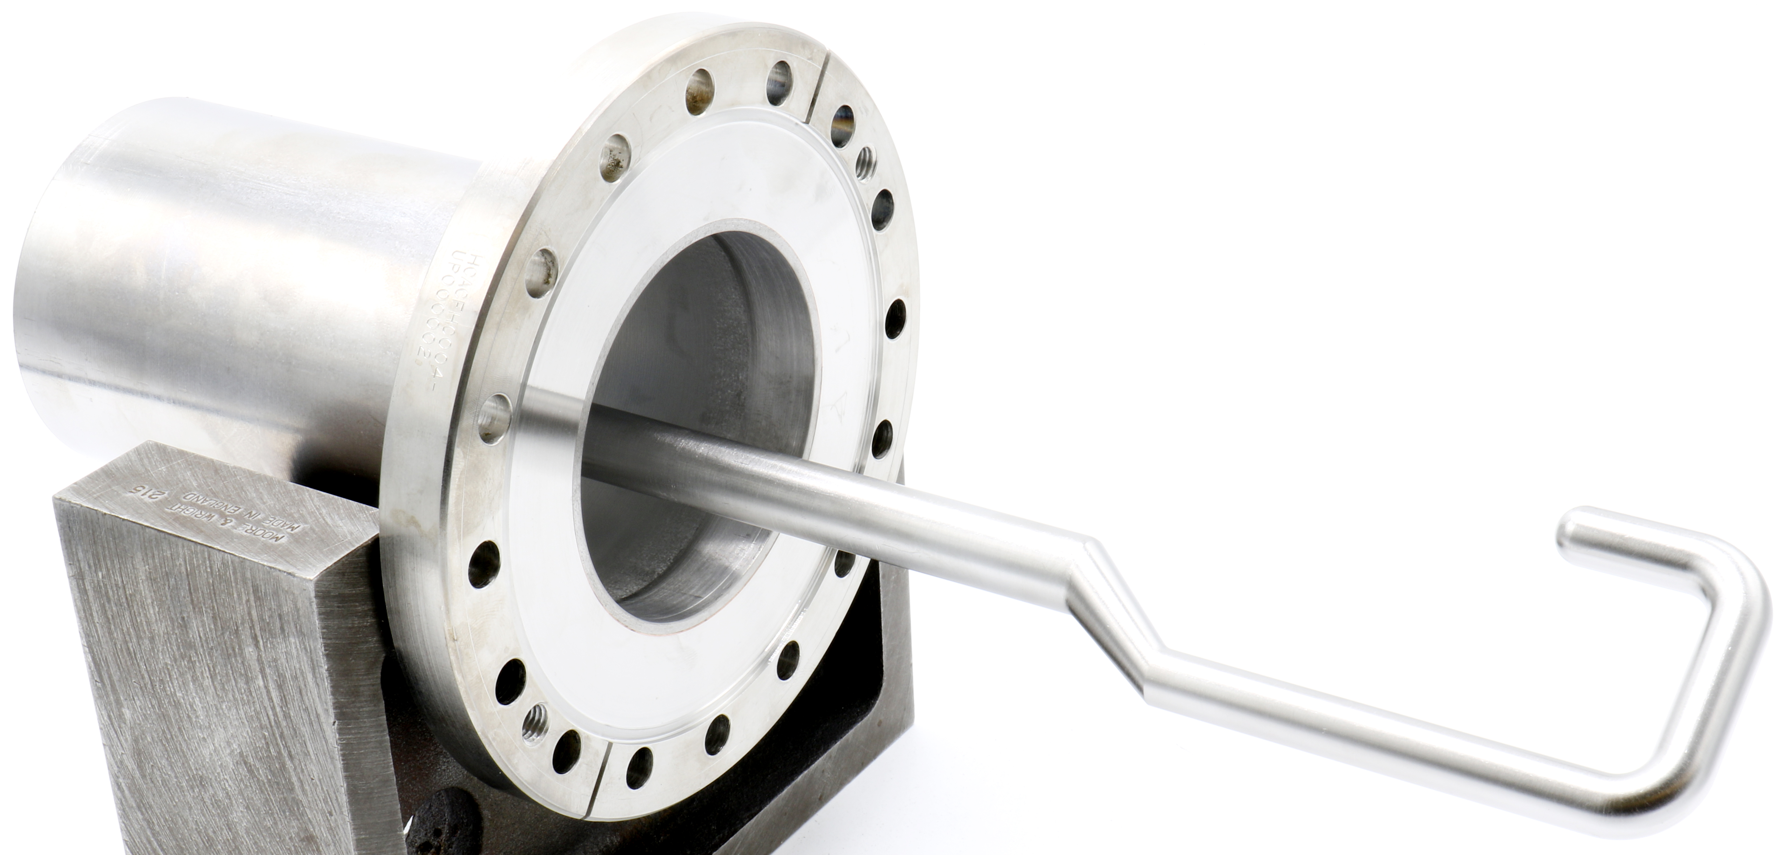
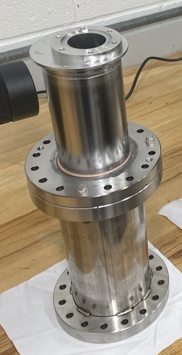
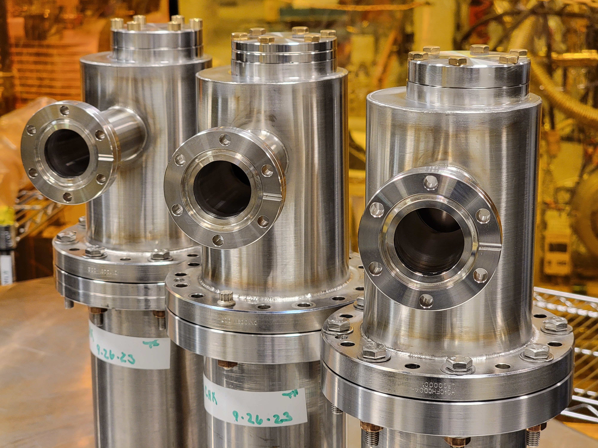
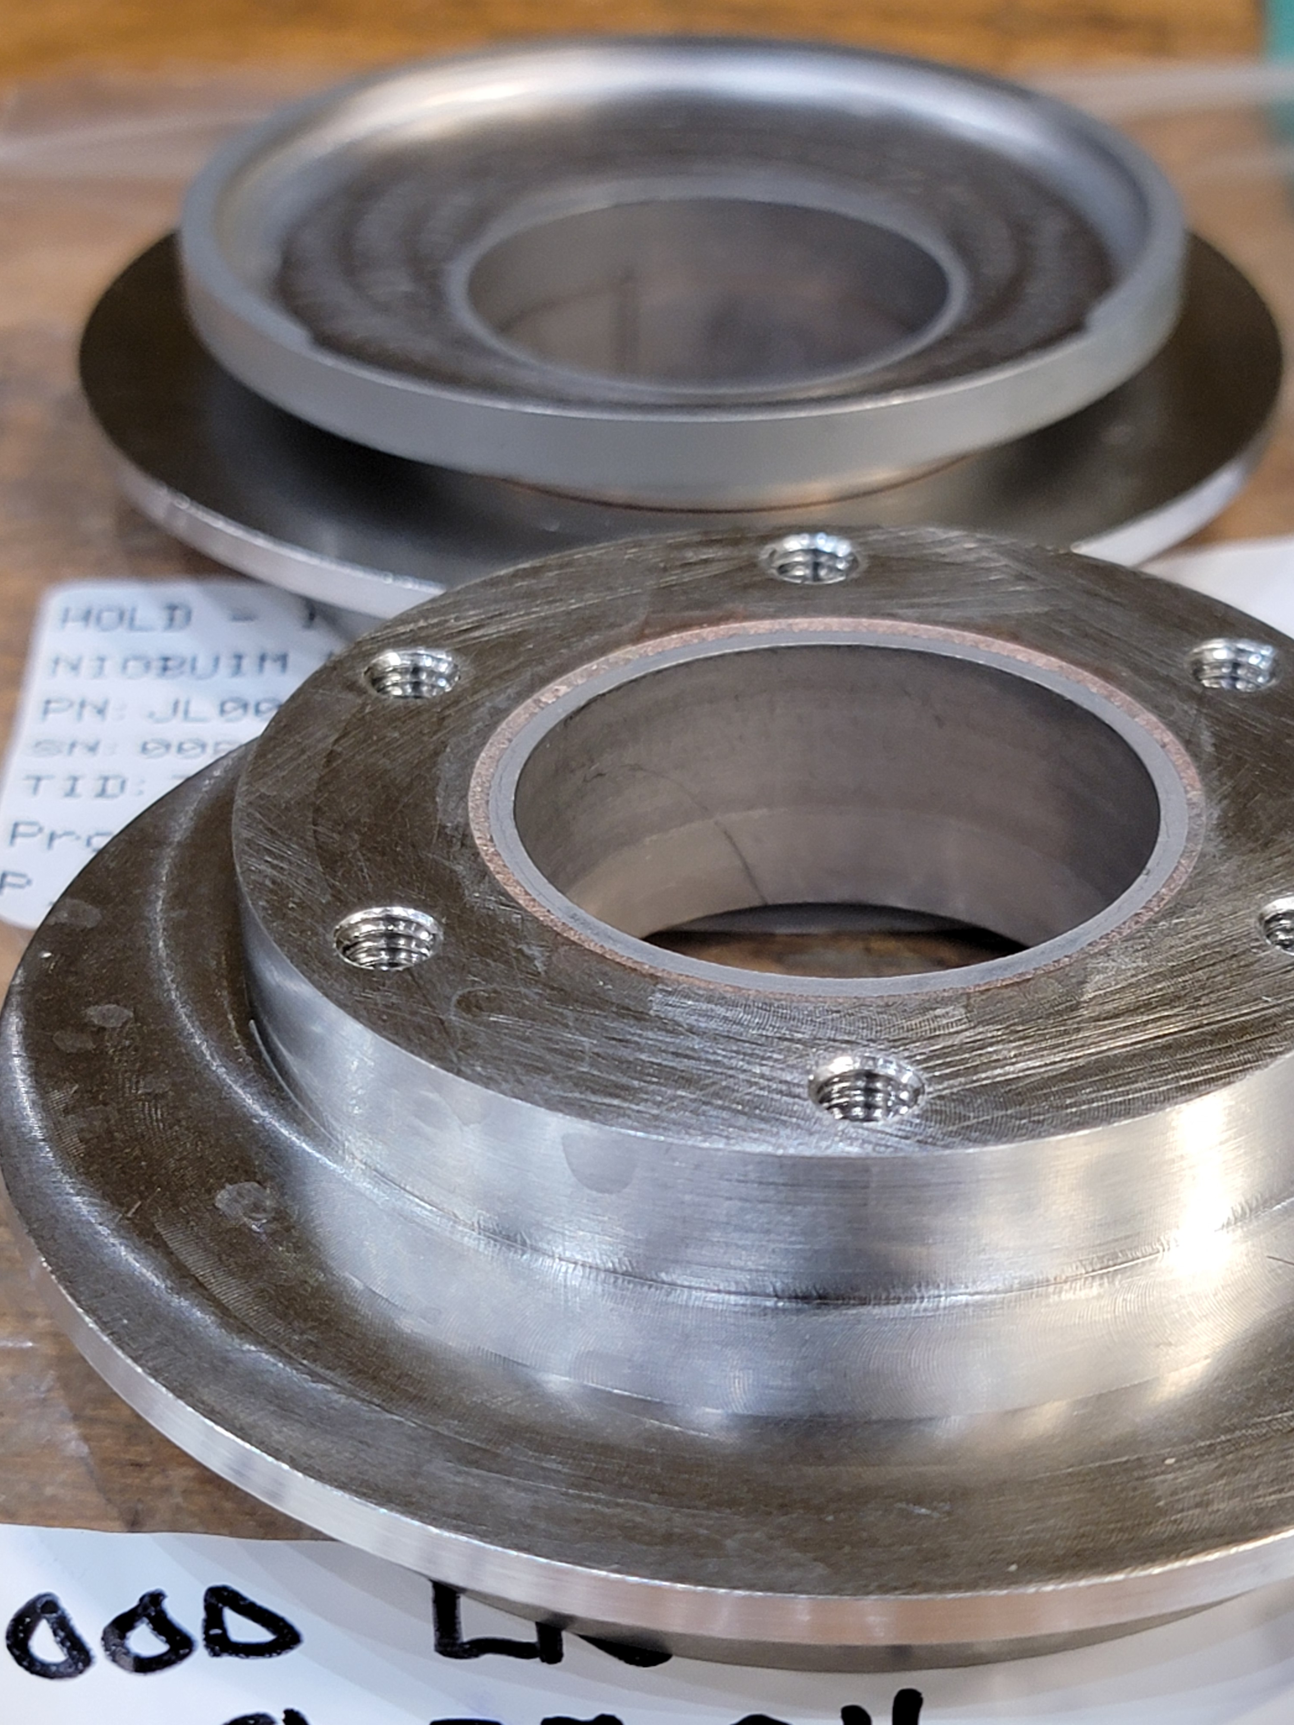
Production Status
Hooks/Tees
7 out of 10 complete
Hook and Tee Weldment
DN100 Brazements
5 out of 10 complete
DN40 Brazements
8 out of 10 complete
Final Assembly
Inner Can Assembly

Slide 14
Production Schedule
 |  | 2024 |  |  | 2025
 |  | Oct | Nov | Dec | Jan | Feb | Mar | Apr | May | Jun
HHOM 01 - 04 | Assembly
 | Testing
 | Acceptance
HHOM 05 - 07 | Assembly
 | Testing
 | Acceptance
HHOM 08 - 010 | Raw Material Procurement
 | Part Fabrication
 | Assembly
 | Testing
 | Acceptance

Slide 15
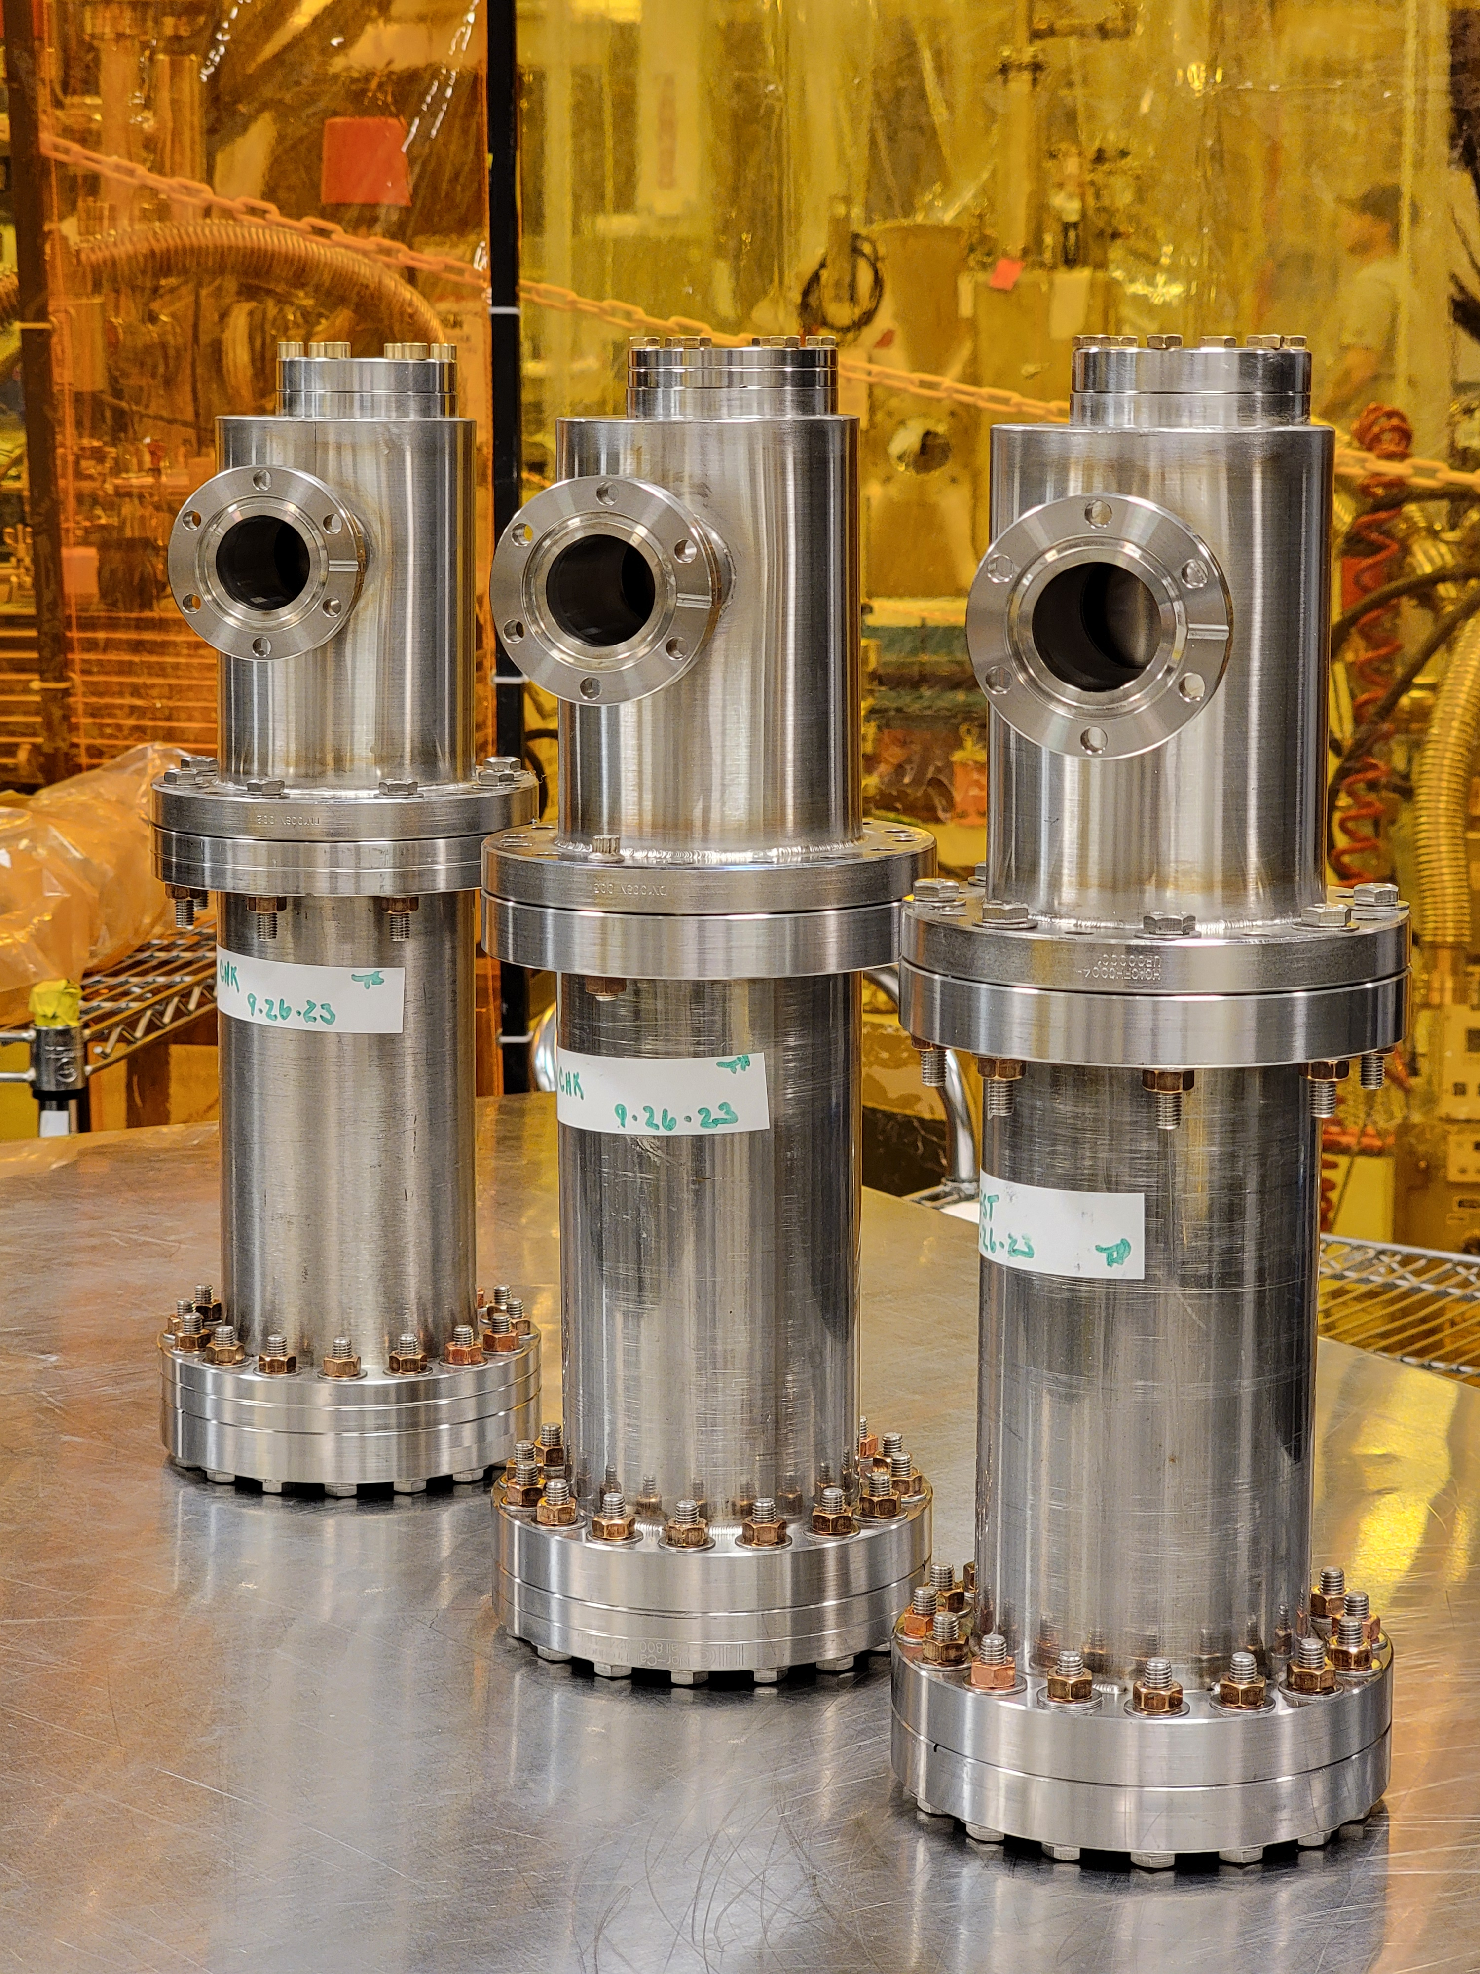
Summary
JLab scope now includes only fabrication of HHOM Dampers
  Three fabricated HHOM dampers are not usable due to interface issue.
Material tests on Nb have validated JLab furnaces and brazing run effects on properties
Ceramic brazing qualification was successful but CERN design will be used to reduce risk
  Ceramic feedthroughs will be provided by CERN
Procurement and assembly plans are in place at JLab to produce HHOM Dampers in time for installation on jacketed cavities

Slide 16
Thanks to the RFD Ancillary Team
Fermilab – Manuele Narduzzi, Colin Narug, Leonardo Ristori
ODU – Suba De Silva, Jean Delayen
SLAC – Zenghai Li
CERN – Nuria Valverde Alonso, Adria Gallifa Terricabras, Sara Domingo Gomez, Eric Montesinos, Simon Barre

