Slide 1

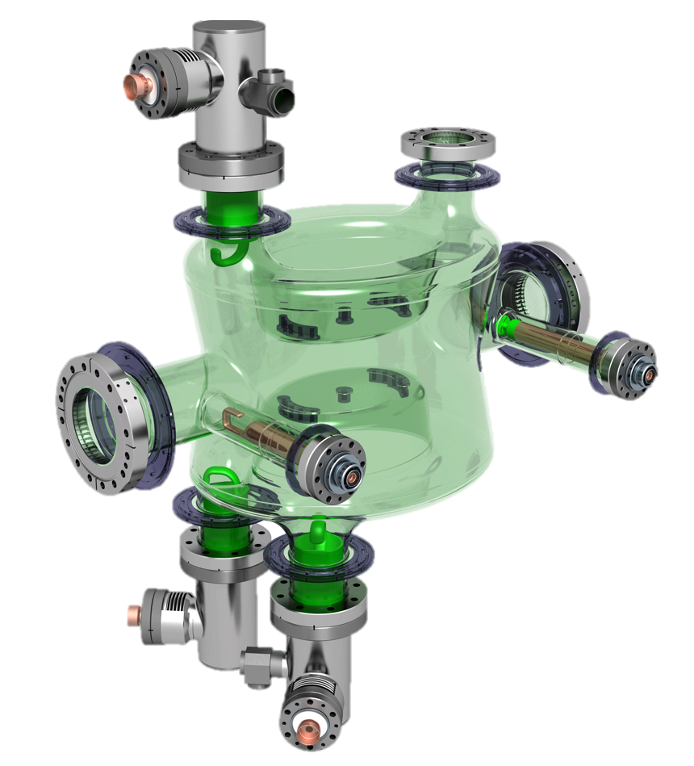
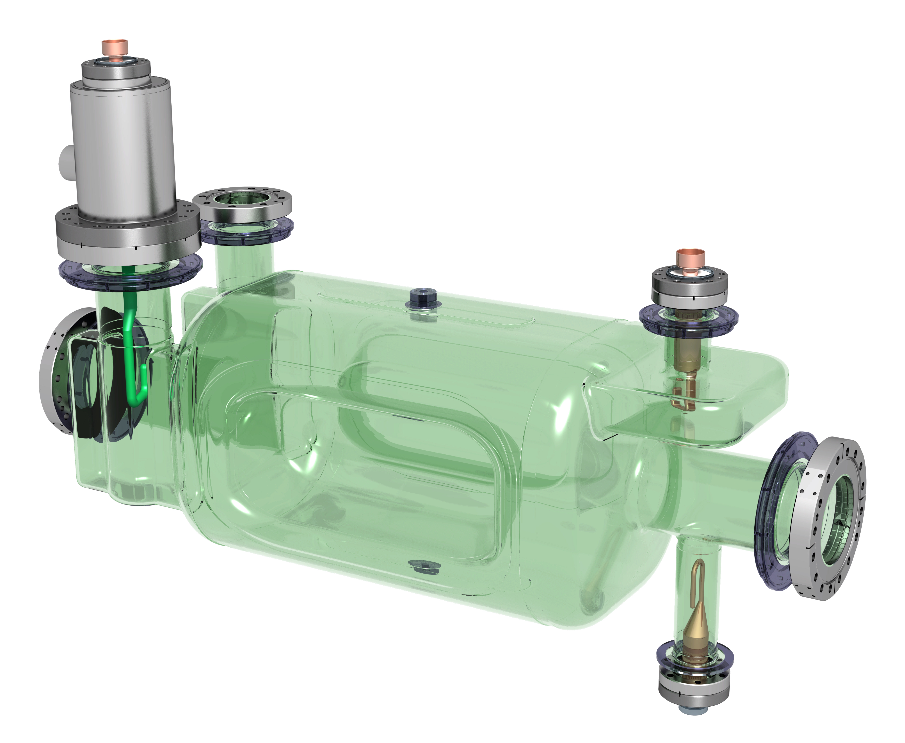
HL-LHC Crab Cavities:
DQW & RFD HOM couplers fabrication challenges
Simon Barrière, CERN
on behalf of the HL-WP4 team
14th HL-LHC Collaboration Meeting – Genoa, Italy – 09th October 2024

Slide 2
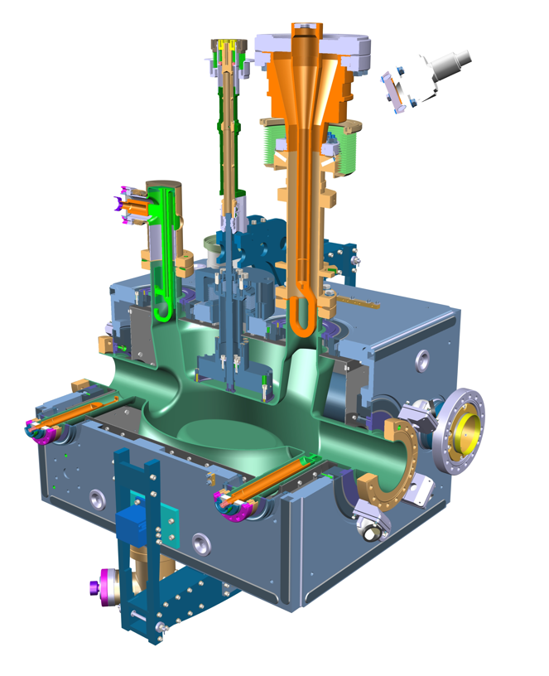
Outline
Scope of Production
Manufacturing Status
Latest Challenges & Lessons Learned

Slide 3
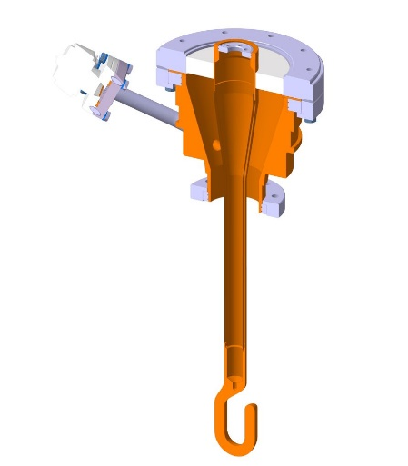
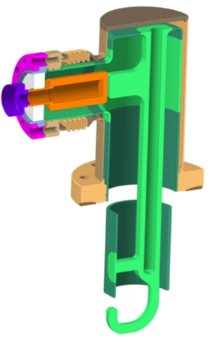
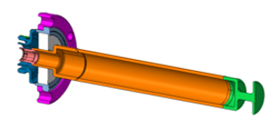
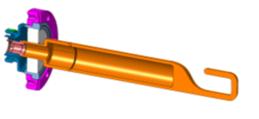
Production Scope: DQW series
  HOM Couplers, HOM Feedthroughs, HF-HOM Couplers and Field Antennas for LHC-series DQW Crab Cavities are being produced at CERN Main Workshop
HOM Coupler + Feedthrough
x 36 units*
Fundamental Power Coupler
x 14 units*
HF-HOM Coupler
x 12 units*
RF Field Antenna
x 12 units*
*initial scope, quantities for 8 cavities including spares

Slide 4
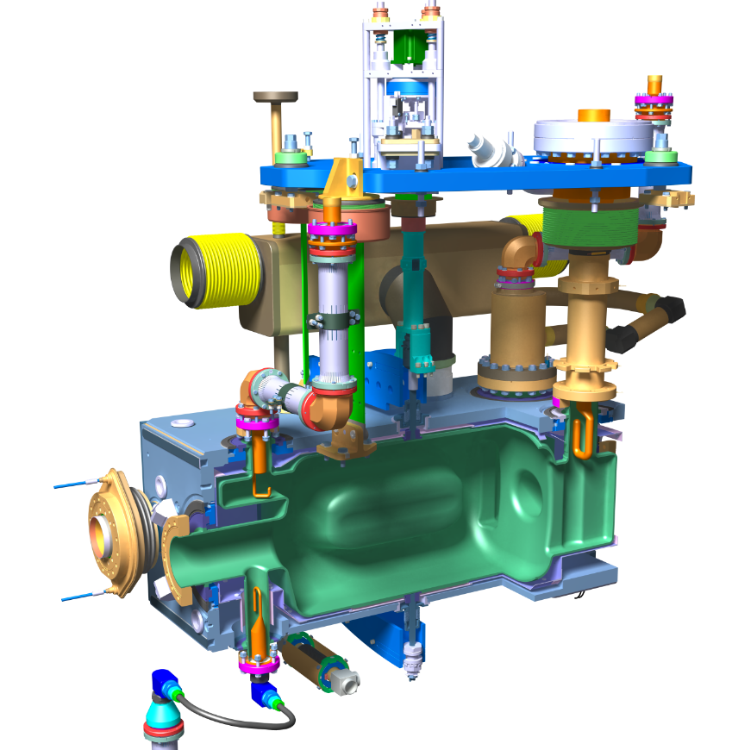
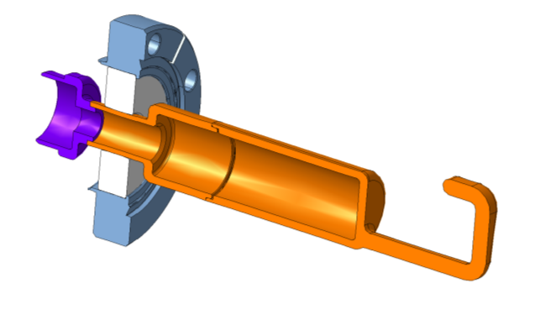
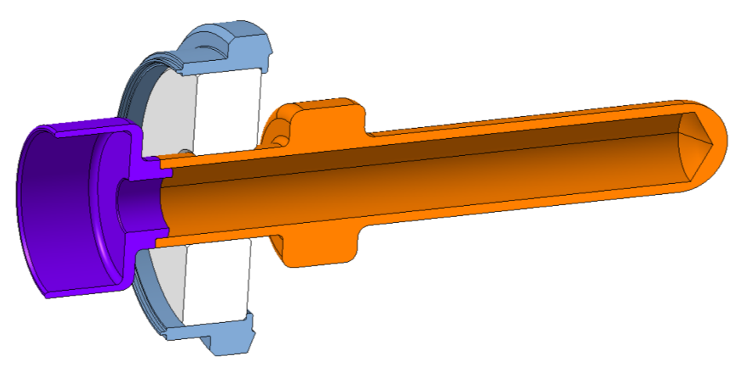
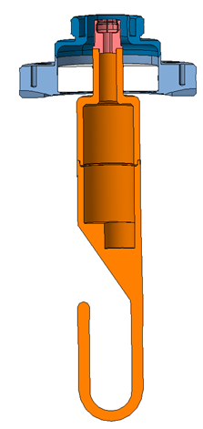
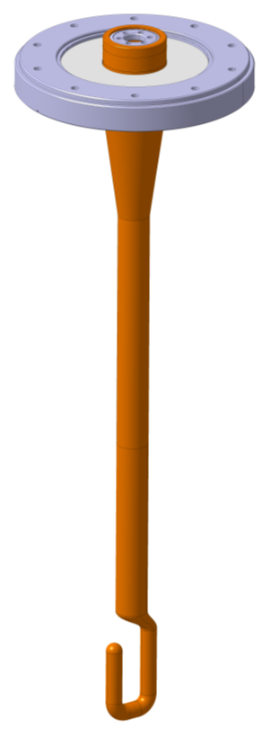
Production Scope: RFD series
June 2024: Request from US-AUP to produce at CERN:
  V-HOM Couplers, H-HOM Feedthroughs and Field Antennas for LHC RFD Crab Cavities
H-HOM Coupler still under US-AUP scope (see presentation by N. Huque)
H-HOM Feedthrough
x 12 units*
V-HOM Coupler
x 12 units*
RF Field Antenna
x 12 units*
Fundamental Power Coupler
x 14 units
*in several batches

Slide 5
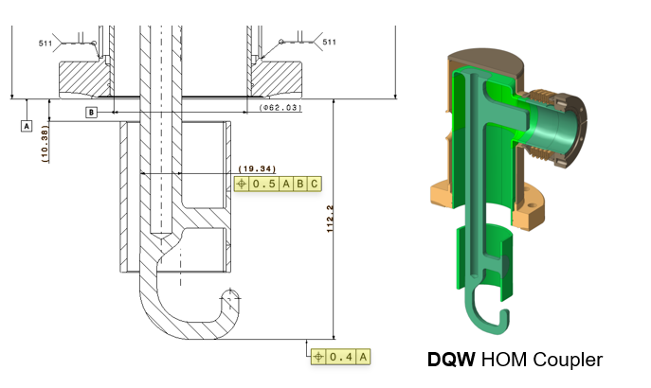
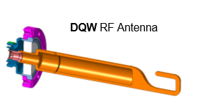
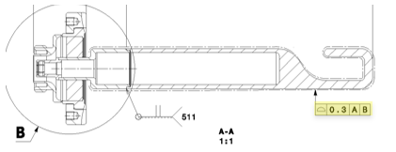
Why are these Objects a Manufacturing Challenge?
  Specific (and expensive!) materials
    Extra-pure niobium, OFE copper, titanium grade 23 (TA6V ELI), stainless steel 316LN
  (S)RF performance highly dependent on geometry and surface quality
    Final tolerances in few tenths of millimetres after many assembly (welding!) steps
    Machined and welded RF surfaces = specific parameters
  Multi-Technology components with pressure joints
    ~13 technologies involved and intertwined
    Multiple activities and actors in parallel in different groups
    Advanced follow-up to fulfil HL-LHC quality standards (PED-related normative, MTF steps, traceability)

Slide 6
  Manufacturing Status
  HOM Couplers & Antennas

Slide 7
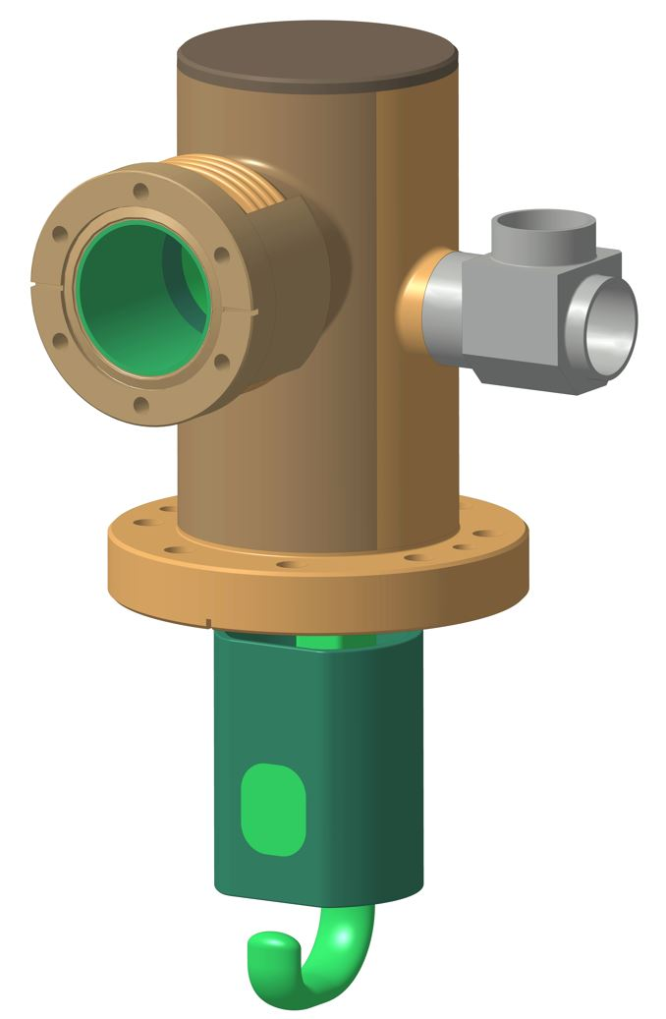
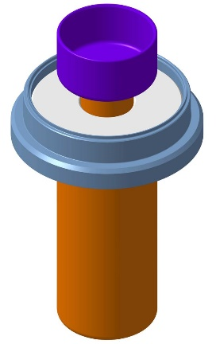
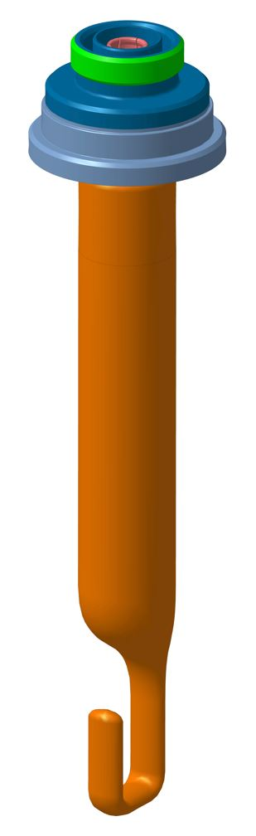
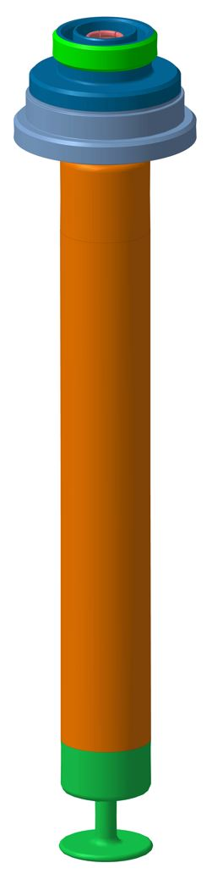
DQW – HOMC and Antennas
Pieces | Qty requested | Qty produced at CERN
HOM Coupler | 36 | 15 done 1 not conform 21 ongoing
HOM Feedthrough | 36 + 12* | 20 done 16 ongoing 12*
HF-HOM Coupler | 12 + 4* | 12 done 4*
Field Antenna | 12 + 4* | 12 done 4*
DQW
HOM FT
DQW
HOM Coupler
DQW
Field Antenna
  * : additional quantities to be produced following last PSM in Sept 2024 (spares)
DQW
HF-HOM Coupler

Slide 8
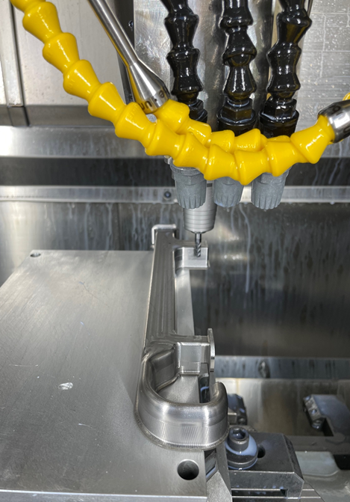
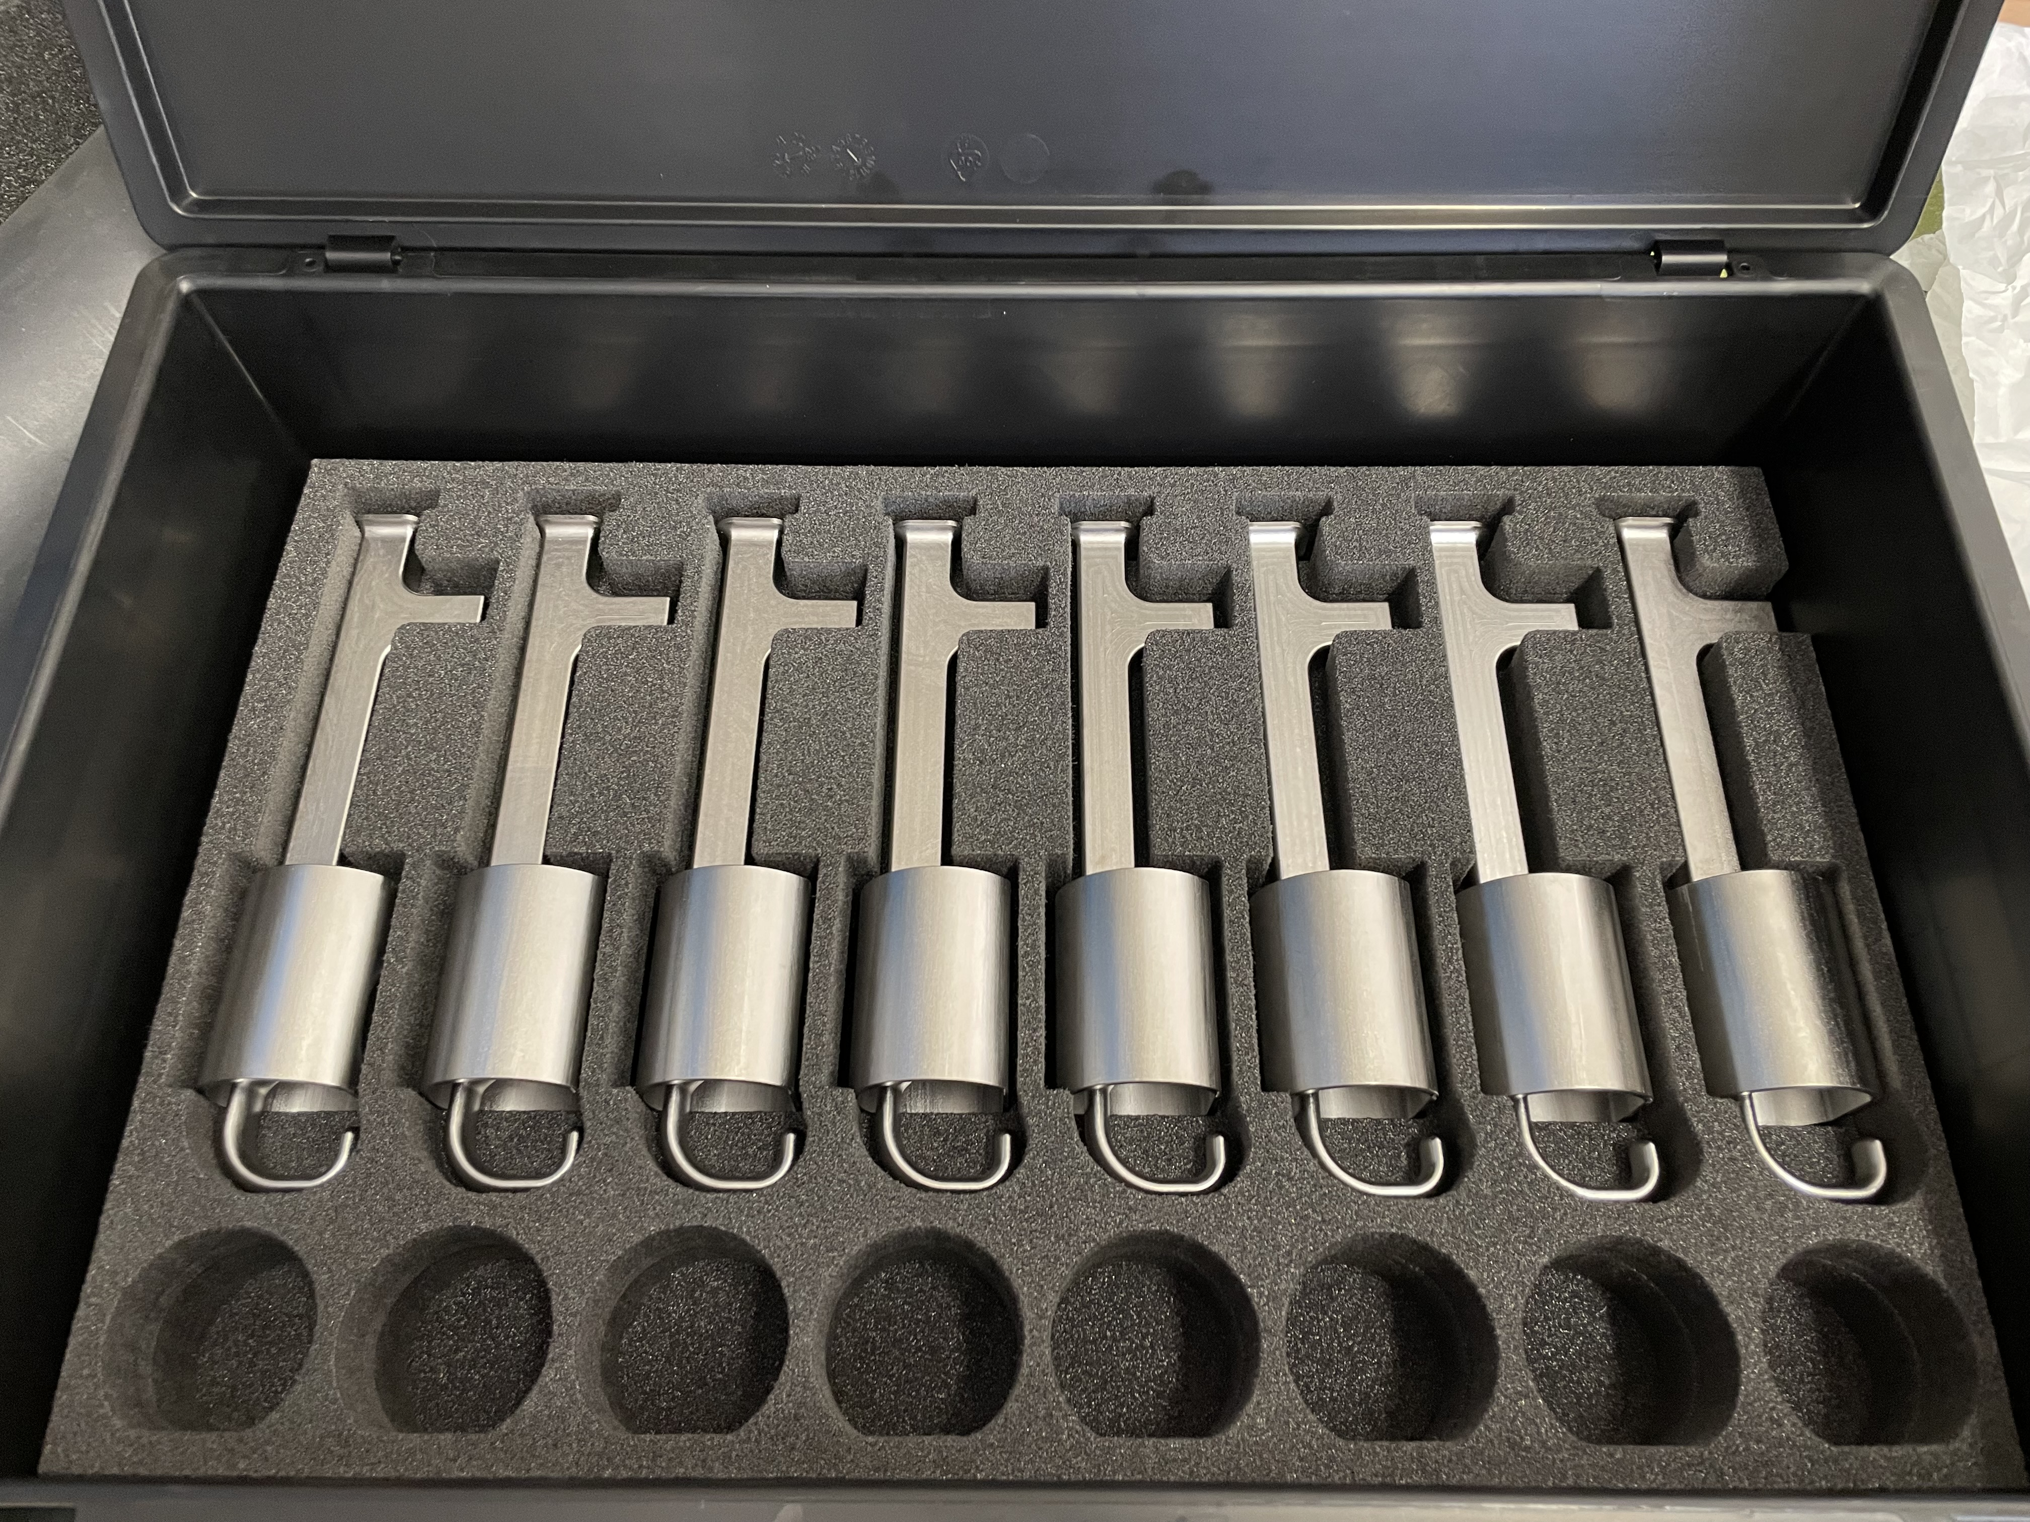
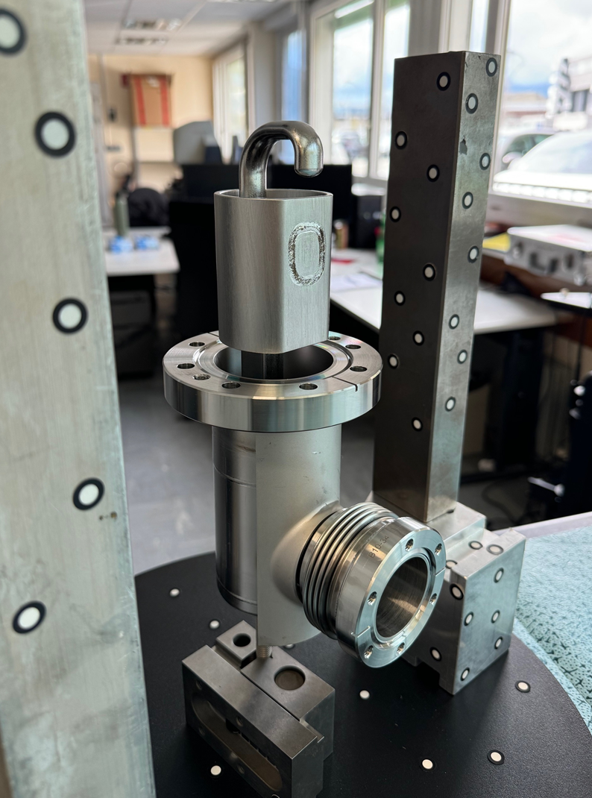
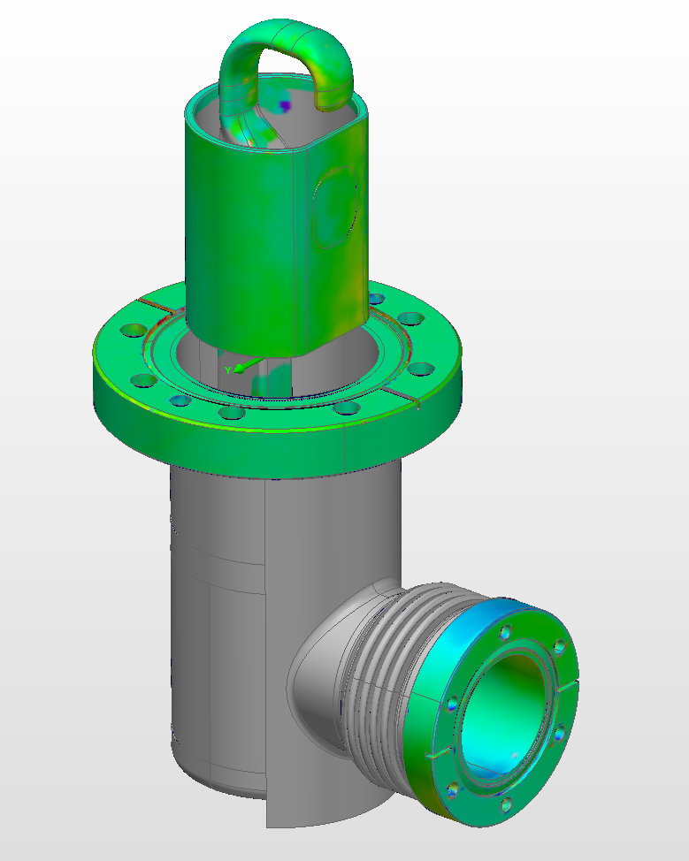
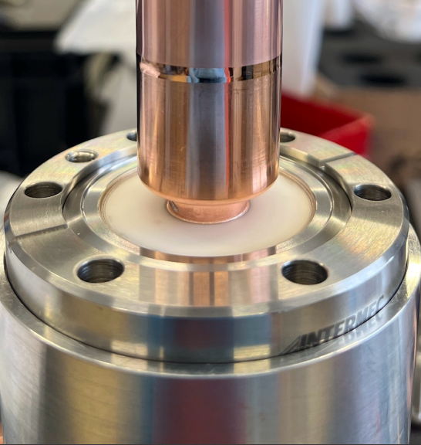
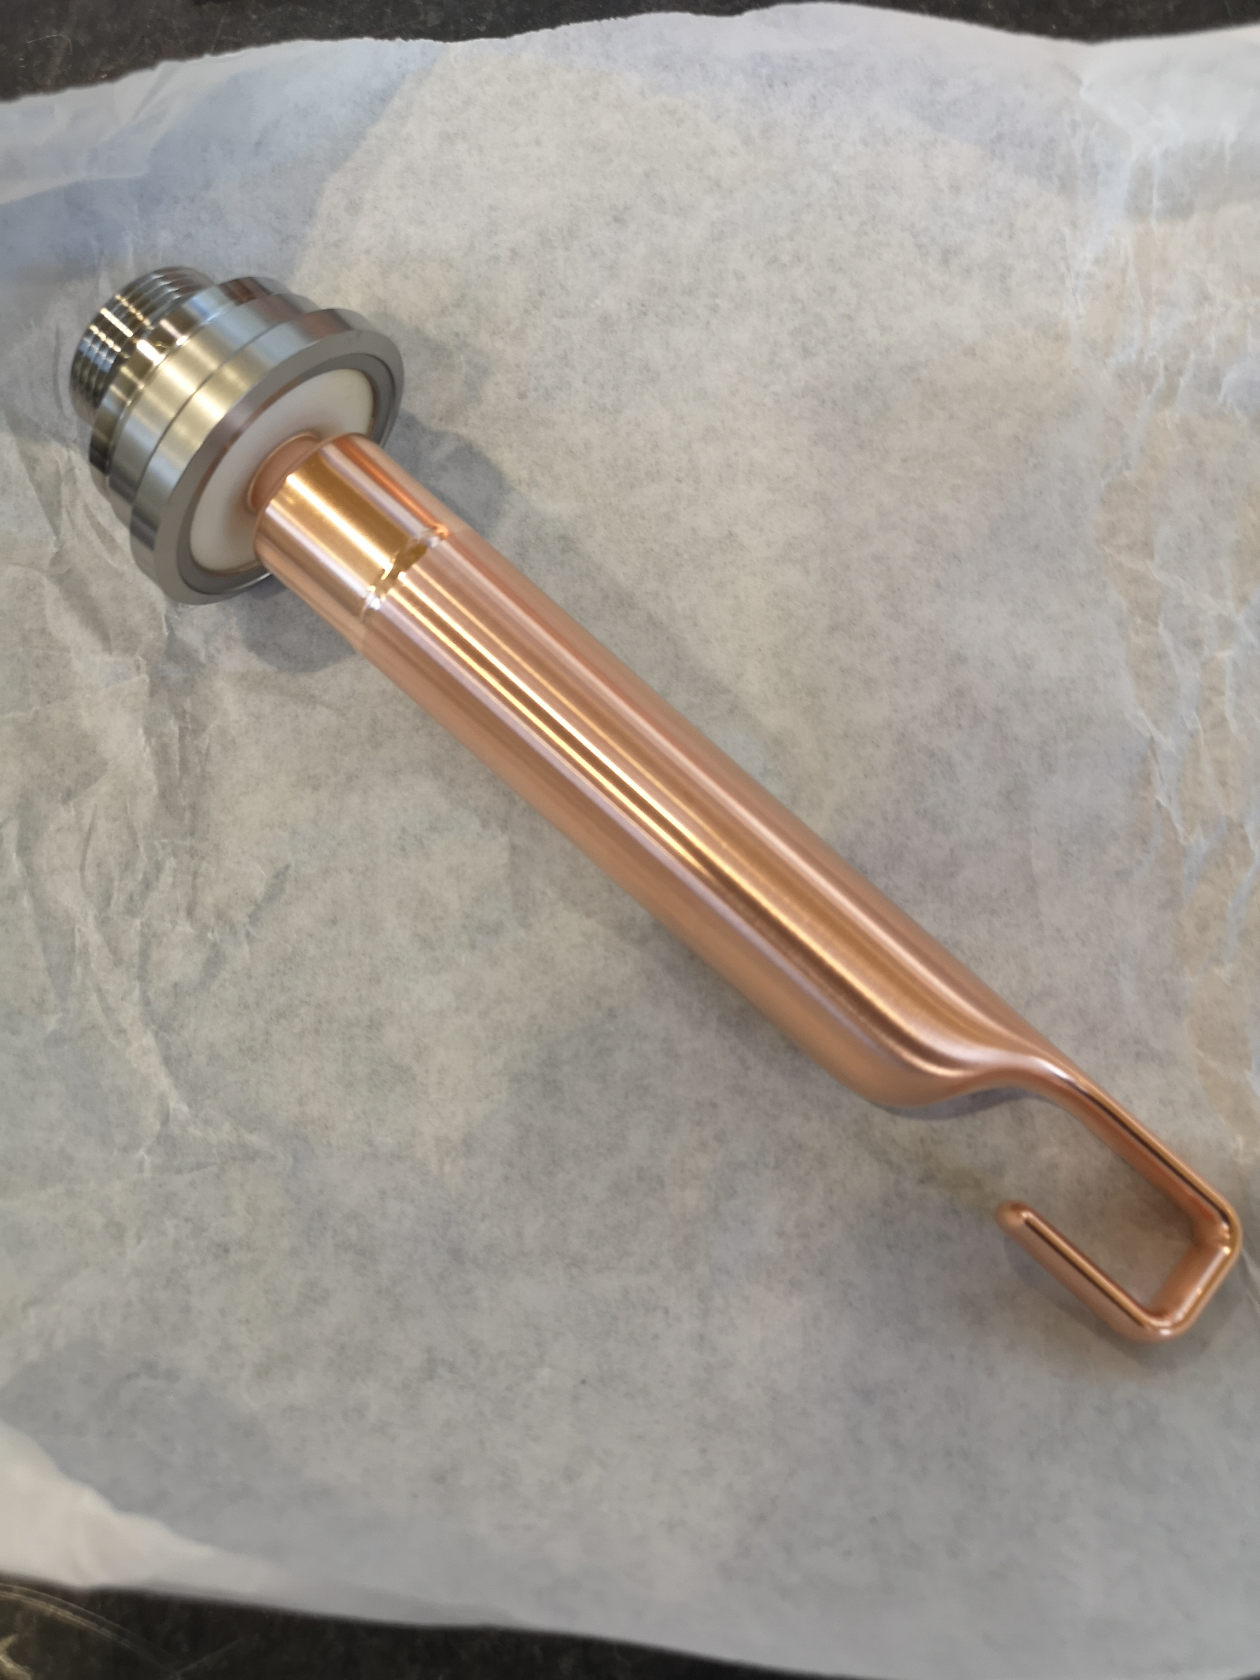
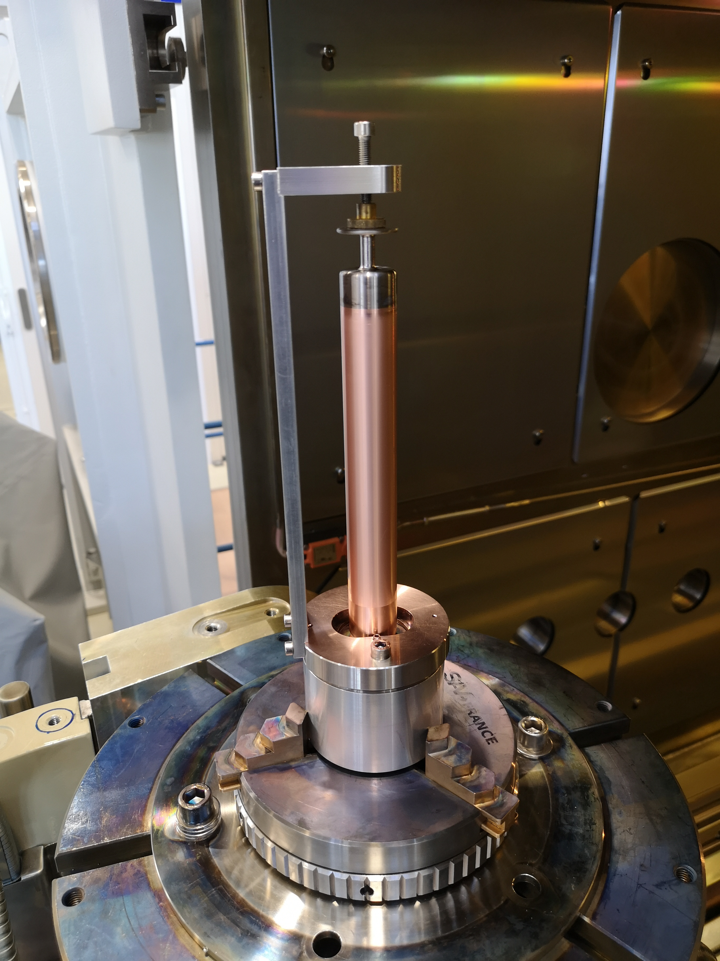
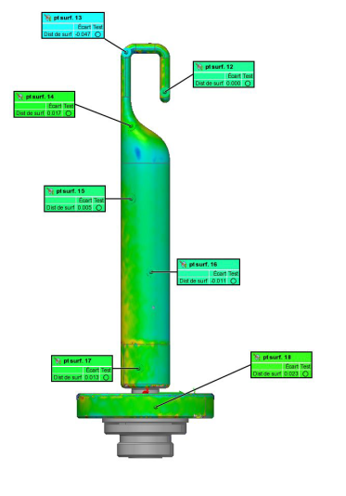
DQW – HOMC and Antennas
  Nb Hook Machining
  Welded Hooks Series
  Metrologies (3D Scans)
  HF-HOM Final Weld
  Field Antenna Assembly
  HF-HOM Final Weld

Slide 9
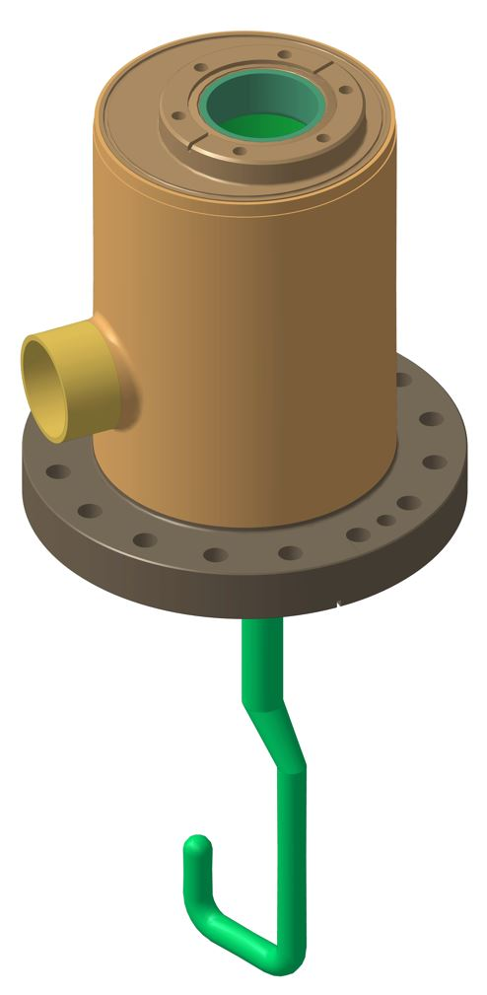
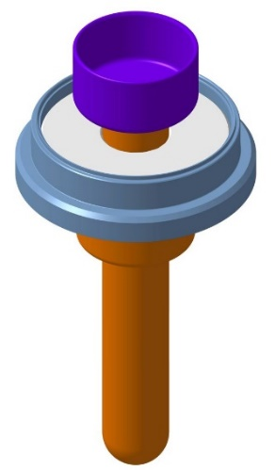
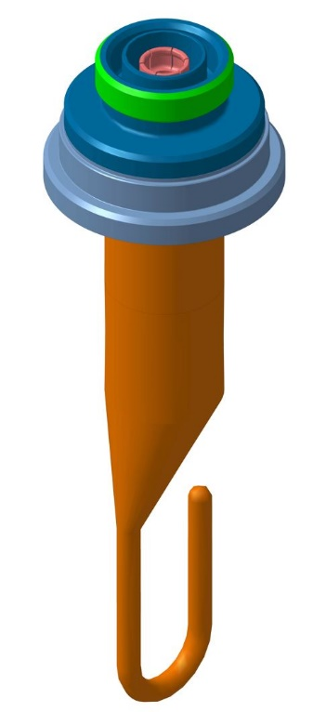
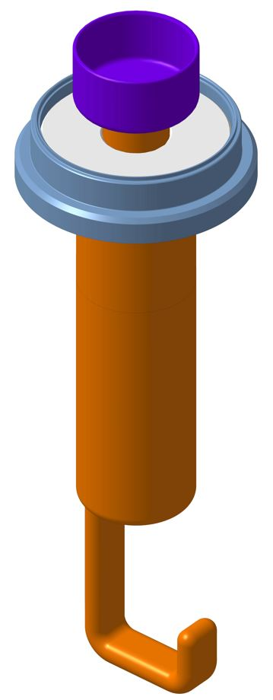
RFD – HOMC and Antennas (1st set)
RFD
H-HOM FT
Pieces | Qty requested | Qty produced at CERN
H-HOM Coupler | 2** | 2** shipped
H-HOM Feedthrough | 2** + 4 | 2** + 4 shipped
V-HOM Coupler | 2** + 4 | 2** + 4 shipped
Field Antenna | 2** + 4 | 2** + 4 shipped
RFD
H-HOM Coupler
  ** : prototypes built at CERN for RFD-SPS cryomodule
RFD
Field Antenna
RFD
V-HOM Coupler

Slide 10
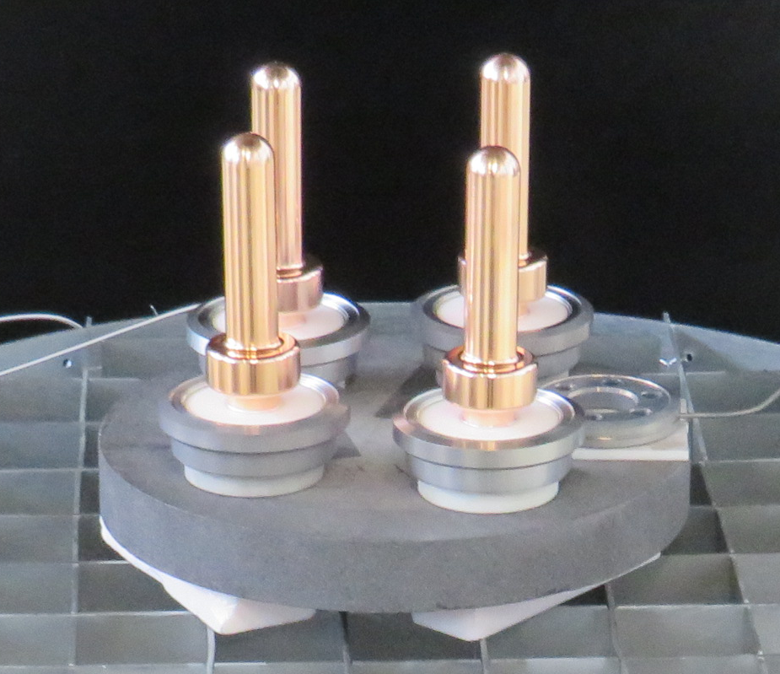
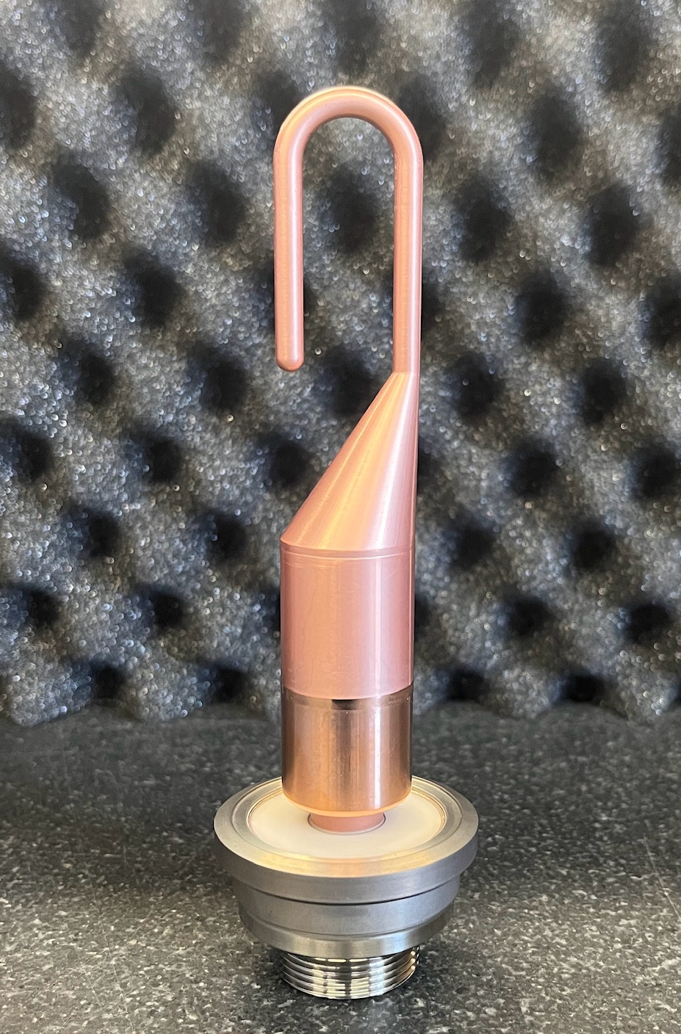
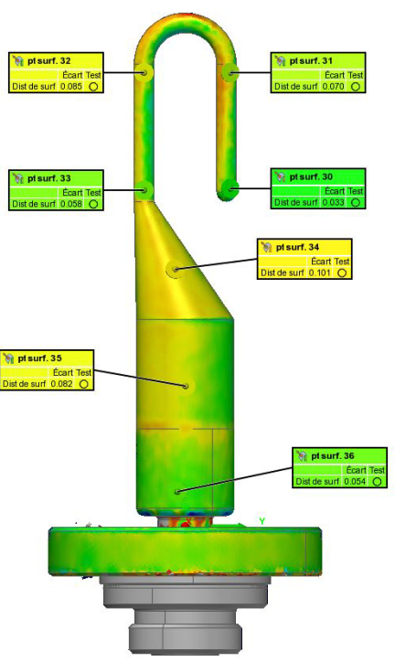
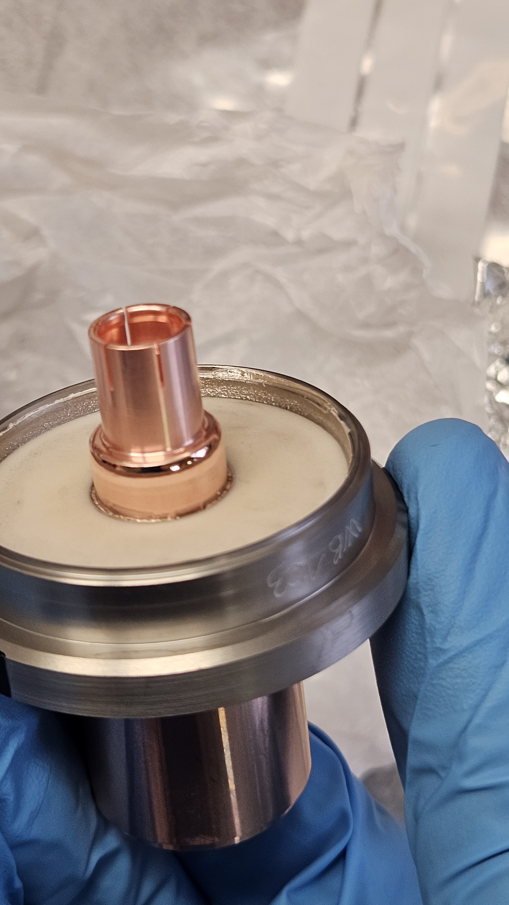
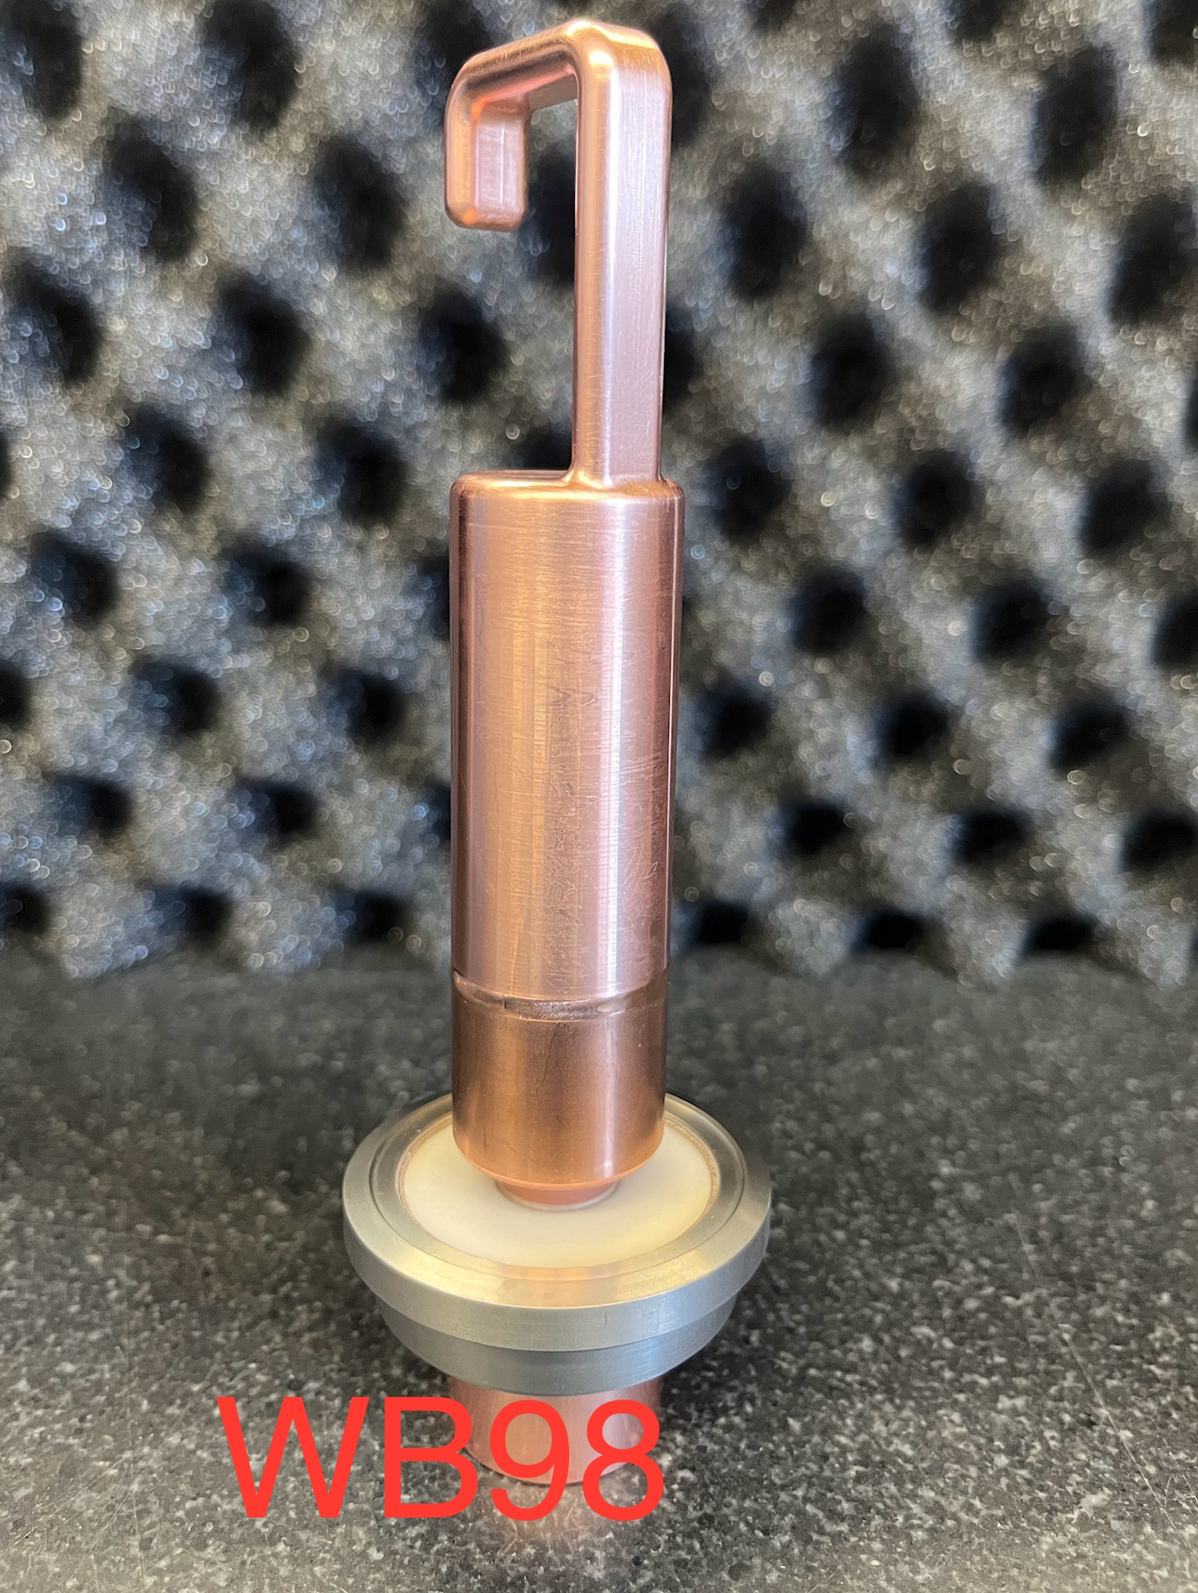
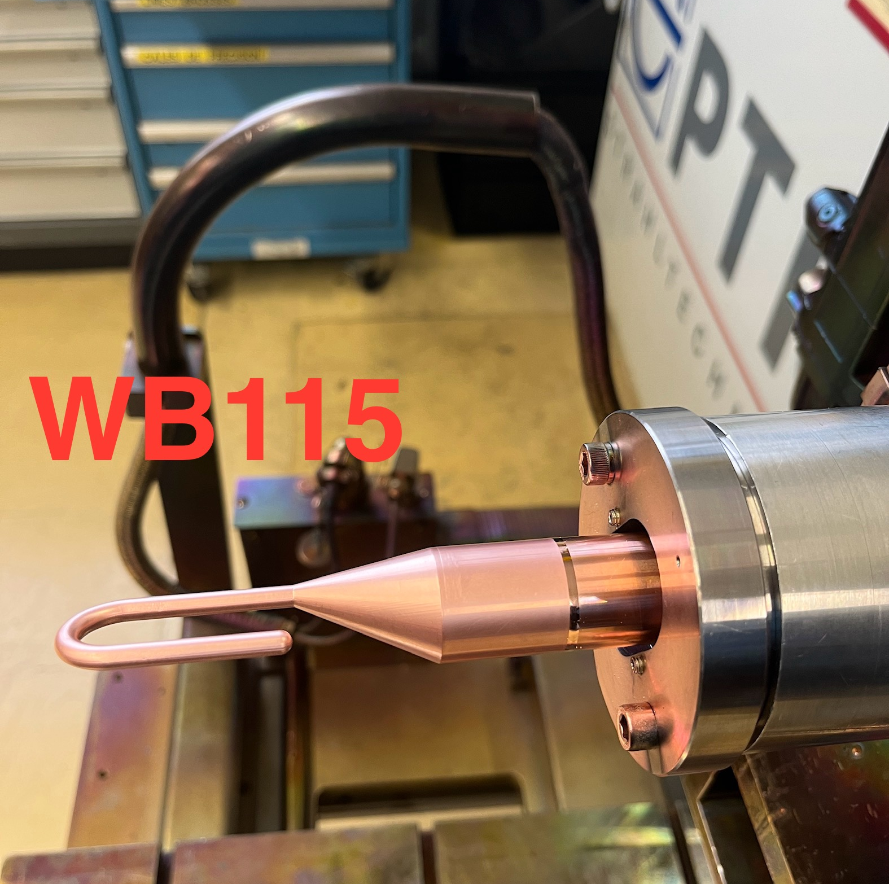
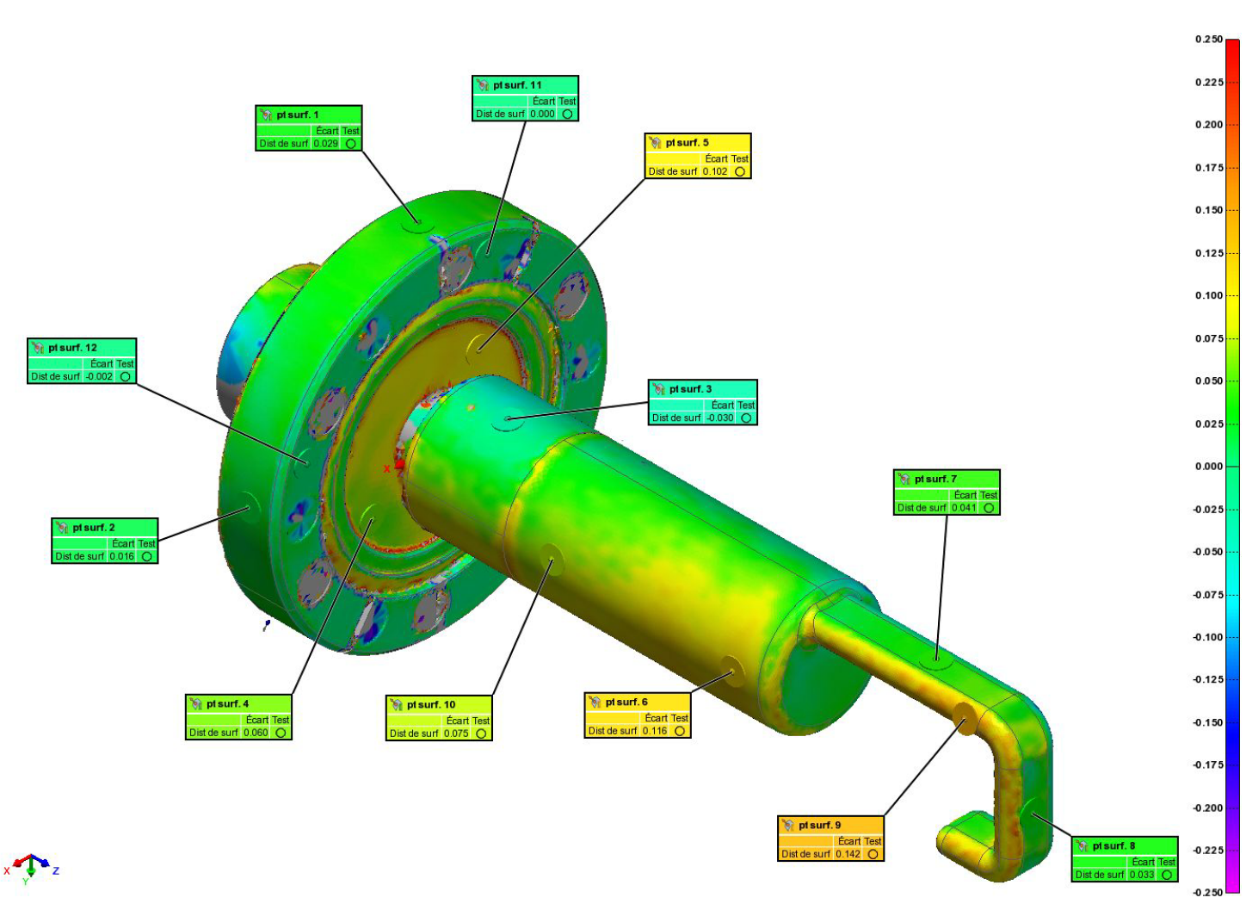
RFD – HOMC and Antennas (1st set)
  H-HOM Feedthrough brazed
  RF Clamp EB weld
  Field Antenna
  Final Assembly
  Field Antenna
  Final Weld
  Field Antenna Metrology
  V-HOM Final Assembly
  V-HOM Metrology

Slide 11
RFD – HOMC and Antennas (2nd set)
RFD
H-HOM FT
Pieces | Qty requested | Qty produced at CERN
H-HOM Feedthrough | 8 | 8 ongoing
V-HOM Coupler | 8 | 8 ongoing
Field Antenna | 8 | 8 ongoing
RFD
Field Antenna
  All raw materials received including ceramics, brazing and machining ongoing
RFD
V-HOM Coupler

Slide 12
  Manufacturing Status
  FPC

Slide 13
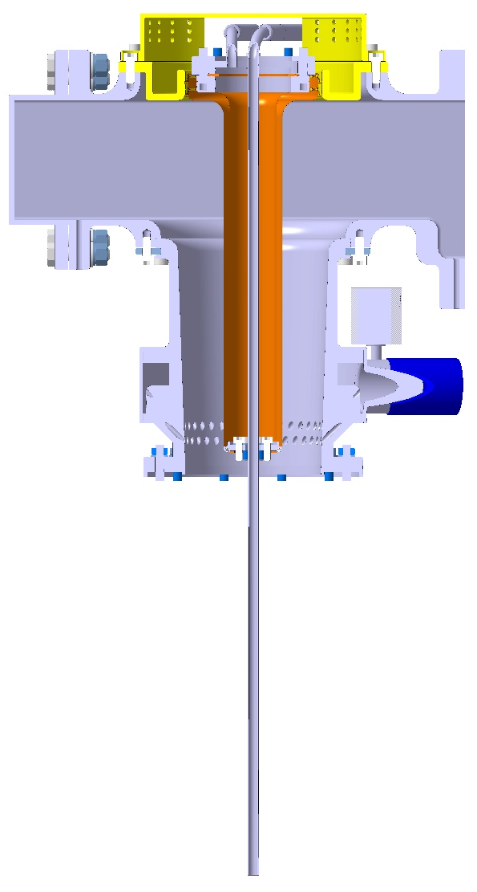
DQW & RFD – FPC Air Side
Pieces | Qty requested | Qty produced at CERN
Water Antenna | 28 | 28 done
Water Flanges In/Out | 30 | 30 done
Transmission Line (wevaguide, body) | 30 | 30 done

Slide 14
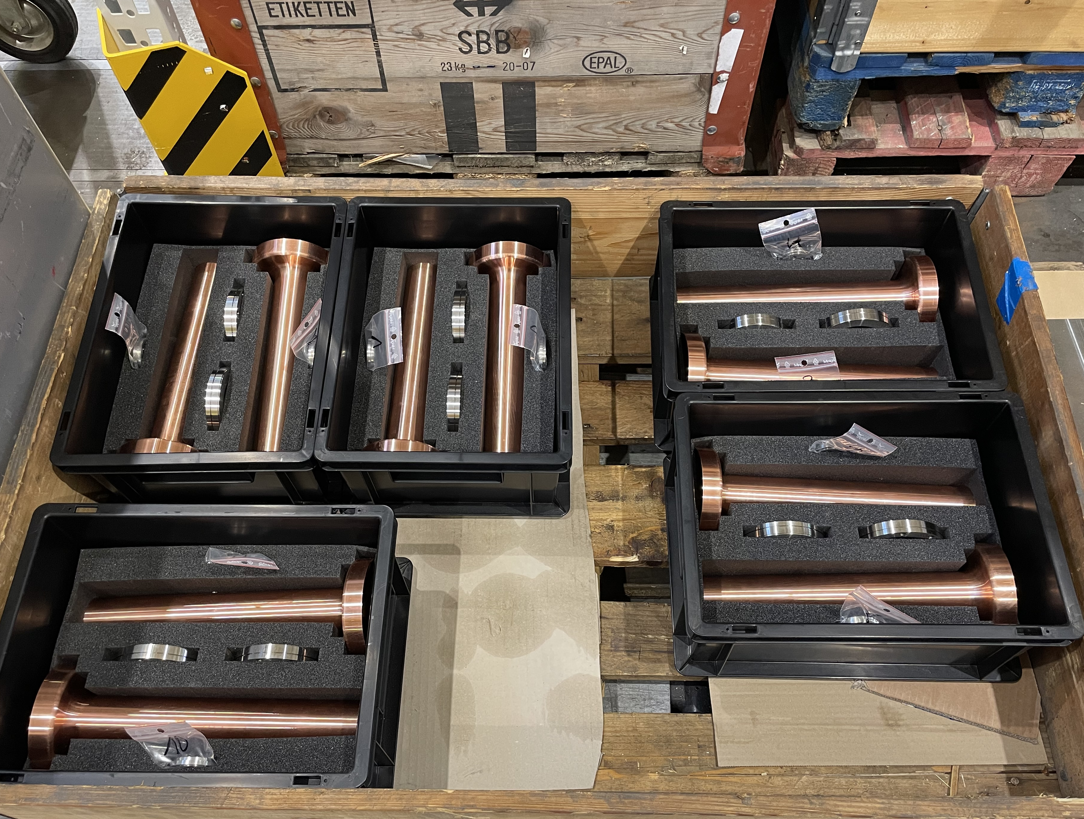
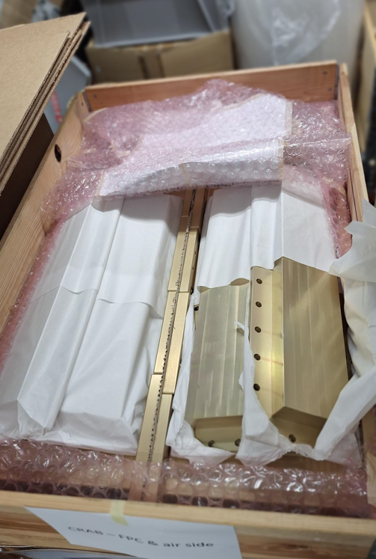
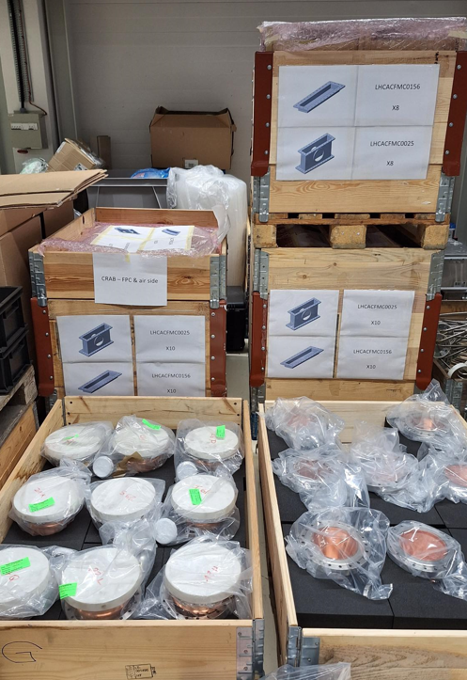
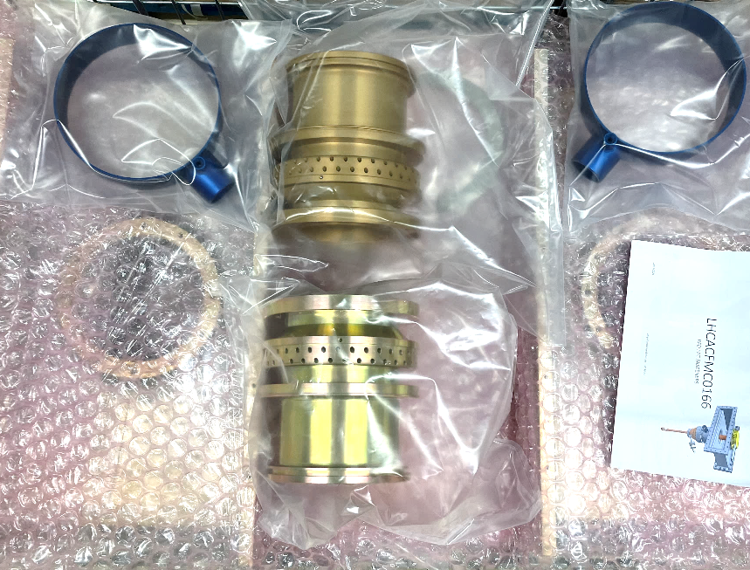
DQW & RFD – FPC Air Side
  Water Antennas
  Aluminum Waveguides
  Central Body and Cooling Collars

Slide 15
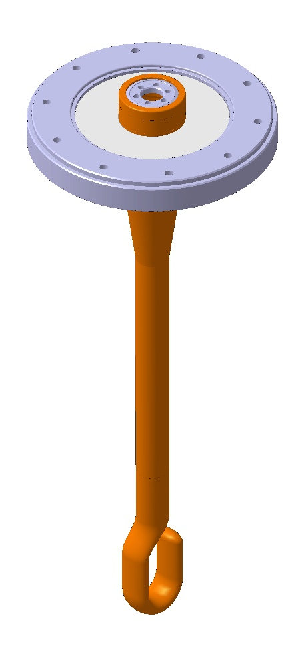
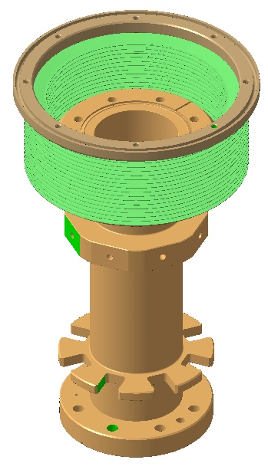
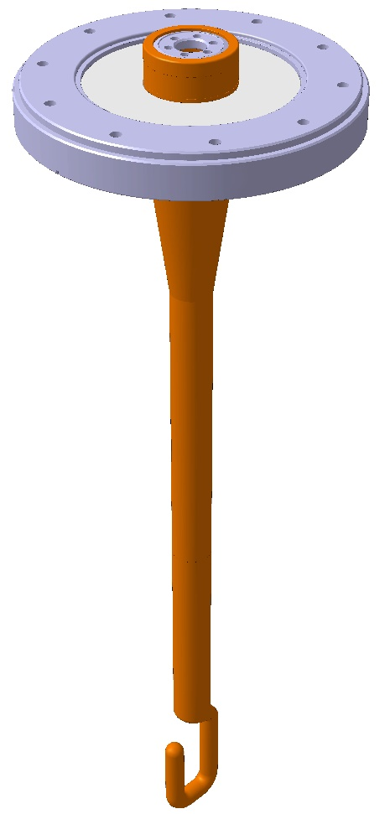
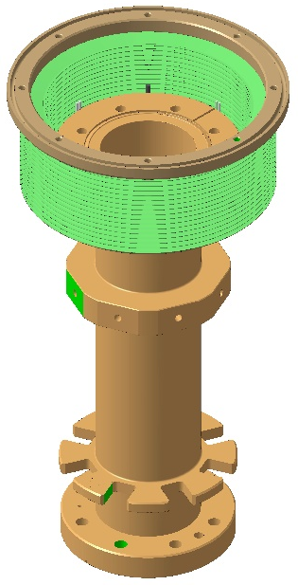
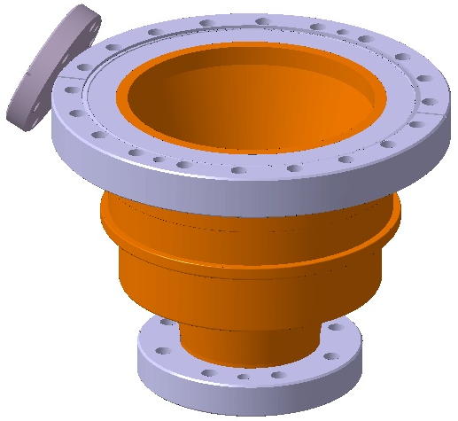
DQW & RFD – FPC Antenna
Pieces | Qty requested | Qty produced at CERN
DQW Antenna | 14 | 6 done 8 ongoing
DQW Double Tube | 14 | 8 done 6 ongoing
RFD Antenna | 14 | 8 done 6 ongoing
RFD Double Tube | 14 | 8 done 6 ongoing
Vacuum Body | 28 | 28 done
DQW
FPC Antenna
DQW
Double Tube
RFD
FPC Antenna
RFD
Double Tube
RFD / DQW
Vacuum Body
  All missing assemblies are at very latest steps of production

Slide 16
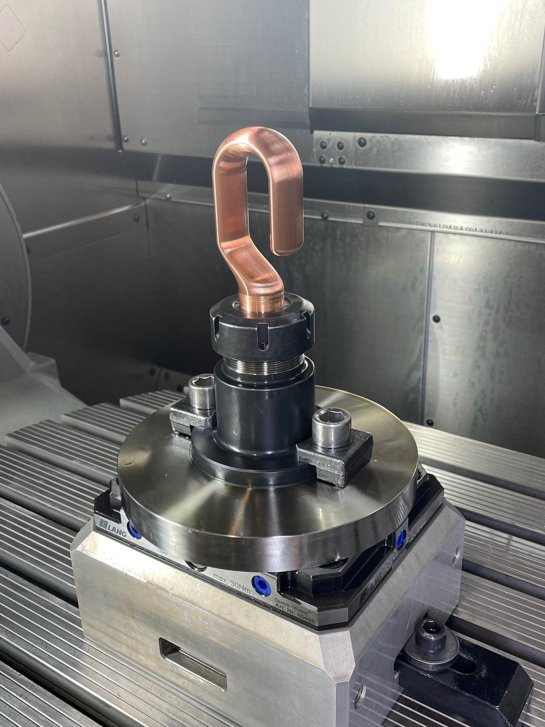
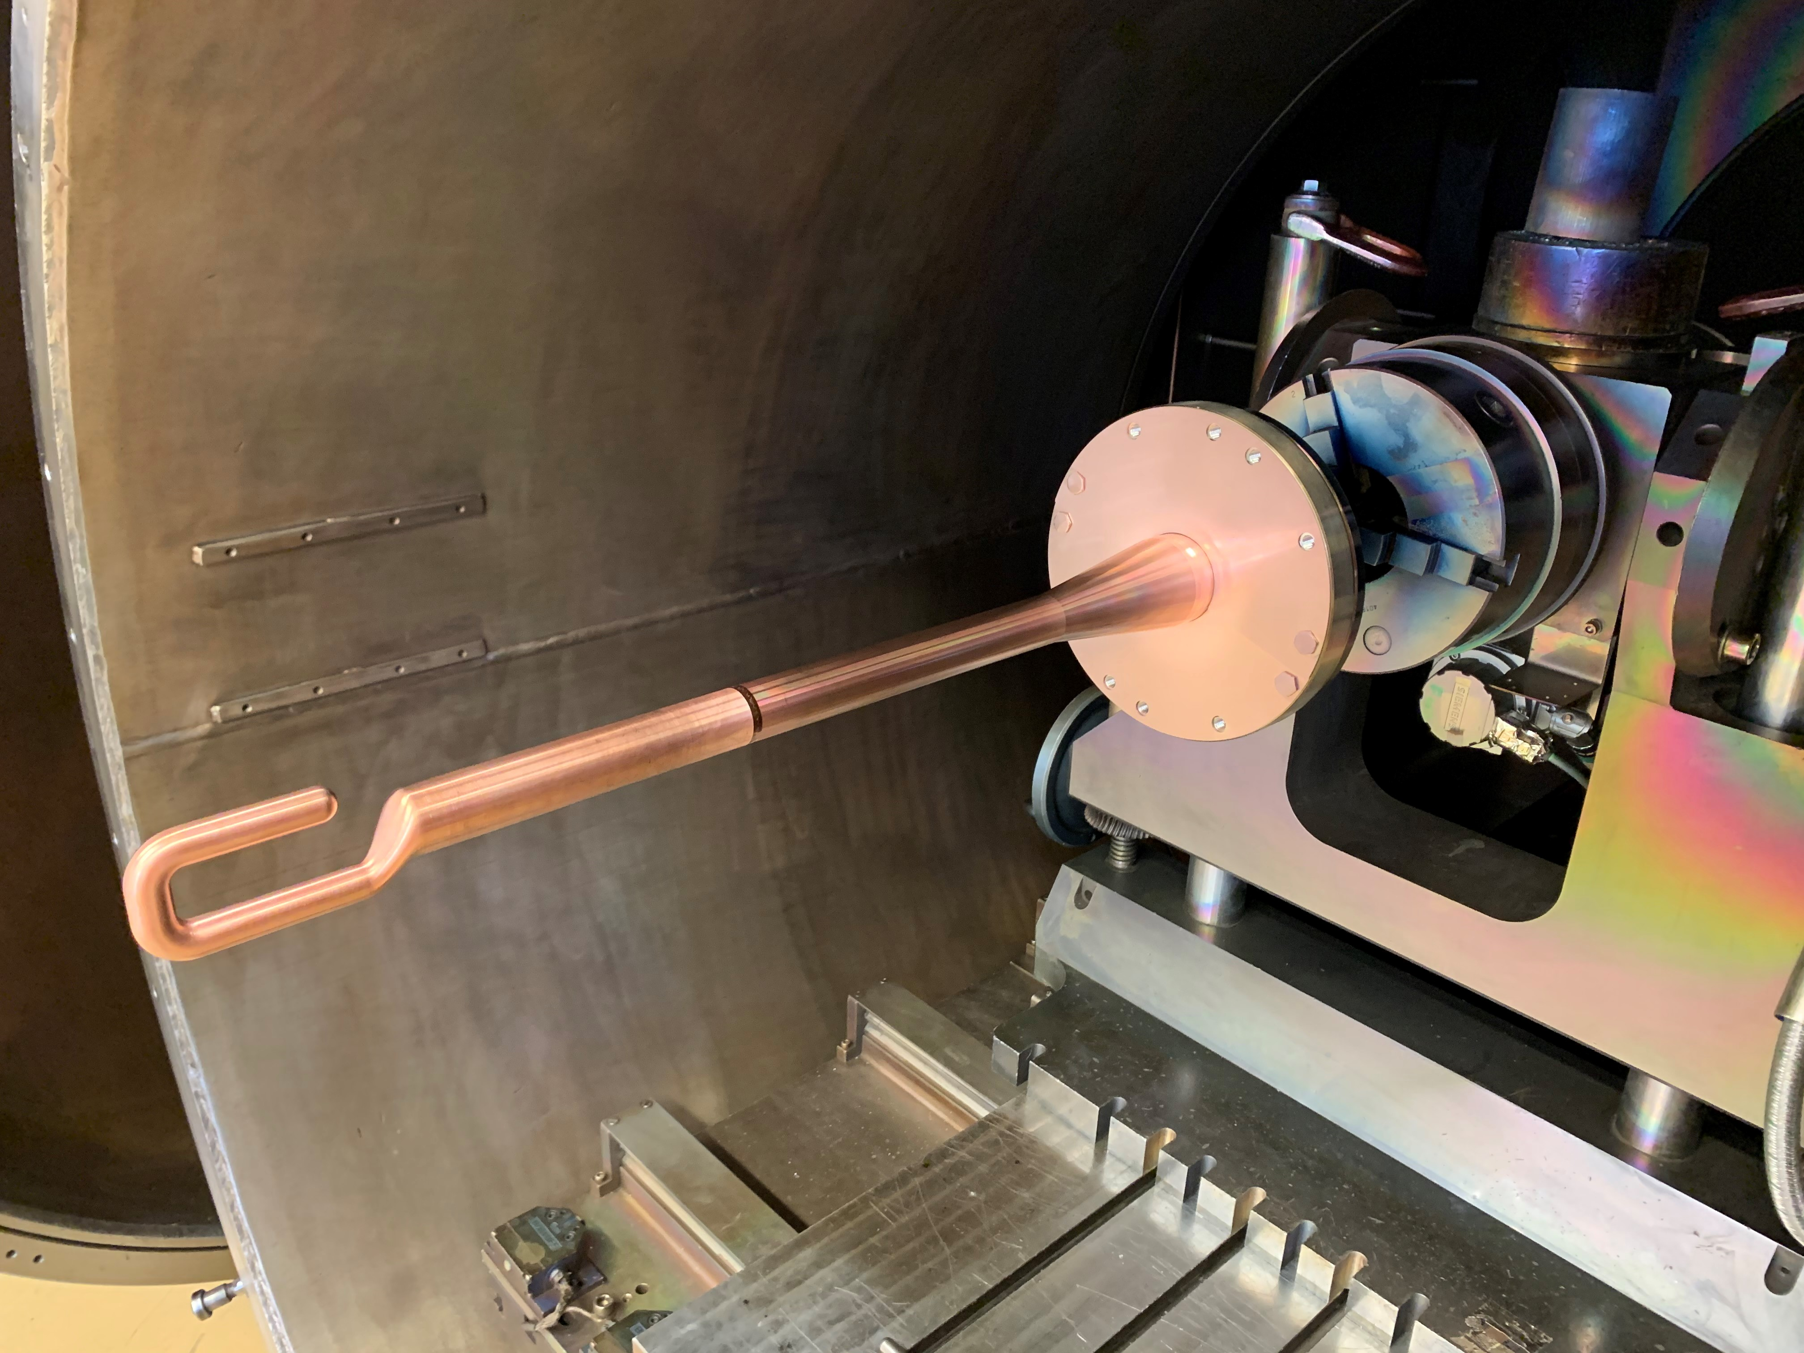




DQW & RFD – FPC Antenna
  Hook Machining
  Final EB Weld
  3D Laser Scans
  Assembled FPC
  FPC Final Metrology

Slide 17
  Manufacturing Status
  Coaxial Lines

Slide 18



DQW & RFD – Coaxial RF Internal Lines
DQW / RFD
LHCACFRL0261
Pieces | Qty requested | Qty produced at CERN
LHCACFRL0195 x2 for 1 CM RFD x1 for 1 CM DQW | 36 | 36 ongoing
LHCACFRL0198 x1 for 1 CM RFD x2 for 1 CM DQW | 36 | 36 ongoing
LHCACFRL0261 x2 for 1 CM DQW | 24 | 24 ongoing
DQW / RFD
LHCACFRL0198
  All pieces needed for 2x DQW cryomodules and 2x RFD cryomodules will be ready in Dec 2024
DQW / RFD
LHCACFRL0195

Slide 19




DQW & RFD – Coaxial RF Internal Lines
  Assembled Lines & Subcomponents for RFD Prototypes

Slide 20
Latest Challenges

Slide 21





Stains
We have been chasing stains (and their origin) the past few months
We have upgraded our procedures with more visual checks, systematic replacement of gloves after touching other objects, extended care and protections for transport
Fingerprints (!)
Old gloves
Chemistry
Drying
Long storage
…
Most of the traces appear after the cleanroom processing
We are questioning ourselves if this is really a problem for RF

Slide 22



Scratches
Mostly caused by insufficient care during handling & transport between all fabrication steps
New standardized process using silk paper + foam reduces the risk
Visual control between all critical steps
Repair is possible:
When identified after final steps, polishing process defined for removal (polishing stone grit 8000 with isopropyl alcohol)

Slide 23



Devil is in the Details
  Stainless steel and titanium knives are key element to ensure light tightness in operation and for validation tests at 2 K.
  Cold leaks (at 2 K with superfluid helium) are impossible
  to locate at warm root cause very difficult to assess
  All knives are inspected,
  defects or bumps systematically removed
  DQW HOM Flange
x70
x70
  Bump (depth 0,05 – 0,1 mm)
Repair

Slide 24


Knives repair
Polishing stone grit 8000 with isopropyl alcohol
Abrasive blocks with different grits

Slide 25
Conclusions & Lessons Learned
  Fabrication of RF couplers & antennas in CERN scope is currently on track
  Level of attention and care should remain the same in prototyping phase and series production, until the last object is built. While many eyes are put on prototypes (= low quantity of items), keeping the same level of attention in series production has proven to be challenging
  Manufacturing and delivery of high-quality (S)RF couplers requires extended care on all handling and transport operations
  Understand criteria linked to chemistry processes on multi-material objects is of paramount importance: is beautiful the best?

Slide 26




Many thanks to all the colleagues involved in the production of such beautiful objects!
Special thanks to the EN-MME Manufacturing Team,
and Sébastien, Francesco, Nuria & Eric (SY-RF)

Slide 28
Spare slides

Slide 29

Surface treatment of assembled heterogenous materials is a challenge
Courtesy Leonel Ferreira (CERN)
Pre-processing
Brazing
Reoxidation
Post -processing
Copper loses its passivation
Case by case choice of surface treatment and sequence
Experienced personnel
Rinsing with water or even ethanol without a fast-drying step
Degreasing / Chemical polishing /
Passivation
Use pre-processing chemicals is challenging and can make things worse
Dry processing (PVD) to be considered
Degreasing
Imperfections at the brazing interfaces leading to unspotted chemicals/water retention
Specific solvent degreasing with pickling effect
(copper remains non-passivated)
Mainly effective on copper-based oxidations
Treatment limited to relatively small components size
Degreasing /
Nickel plating

Slide 30
Quality & Documentation
TRAVELLER HOM COUPLERS & FEEDTHROUGHS |  |  |  |  |  | N°WB - __
 | CDD Number / Numéro CDD | Bld./ Lieu | Collaborator / Responsable | Signature | Date | Comments / Observations
Ceamic order number |  | 112 |  |  | __/__/20__
Visual inspection of ceramic discs |  | 112 |  |  | __/__/20__
Degreasing |  | 107 |  |  | __/__/20__
Metalization / Mo/Mn 20-45 µm + Ni 5-10 µm |  |  |  |  | __/__/20__
Visual inspection of ceramic discs |  | 112 |  |  | __/__/20__
Metrology |  | AP |  |  | __/__/20__
Machining Titanium flange (rough) |  | AP |  |  | __/__/20__
Machining Copper part (finishing) |  | AP |  |  | __/__/20__
Thermal stress relief treatment |  | 107 |  |  | __/__/20__
Machining final Titanium flange (finishing) |  | AP |  |  | __/__/20__
Etching flange + tube before brazing |  | 107 |  |  | __/__/20__
Visual control before brazing |  | 112 |  |  | __/__/20__
Vacuum brazing |  | 112 |  |  | __/__/20__
Visual control after brazing |  | 112 |  |  | __/__/20__
Ceramic n° engraving |  | 112 |  |  | __/__/20__
Leak test |  | 864 |  |  | __/__/20__
Sandblasting of ceramic |  | 864 |  |  | __/__/20__
Metrology of antenna’s height |  | AP |  |  | __/__/20__
EB Welding of back pieces |  | AP |  |  | __/__/20__
Visual control
Metrology |  | 100 |  |  | __/__/20__
Inspection finale SY-RF |  | 864 |  |  | __/__/20__
Leak test / Contrôle d'étanchéité |  | 864 |  |  | __/__/20__

Slide 31


Quality & Documentation
Strong commitment from WP4 teams to fulfil HL-LHC quality standards
  MTF, EDMS, Non-Conformities Reports… but also technical documentation
90+ assets to be followed-up, from materials traceability to all inspections and controls up to last steps. Challenging but of paramount importance!

