Slide 1

Crab cavity Frequency tuner
K. Artoos for WP4
Thanks to WP4 team!
09.10.2024 HL-LHC Collaboration meeting

Slide 2
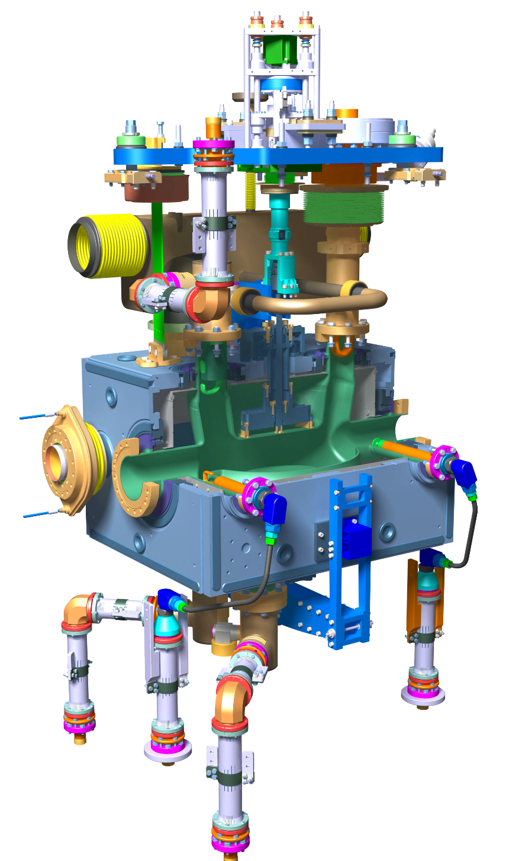
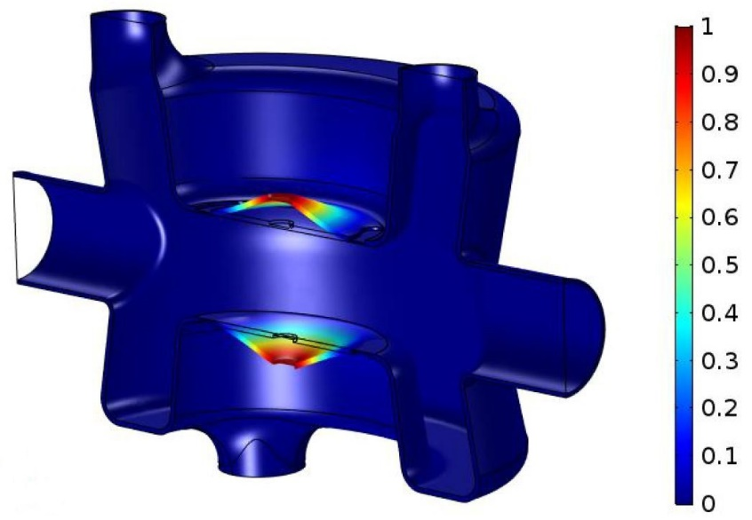
Reminder Tuning HL LHC Crab
DQW
Two vertical, concentric tubes moved in opposite direction by actuator
Inner deforms top cavity
Outer deforms bottom through tuning frame
Notes:
Tuning fundamental mode by a deformation of the cavity, symmetrical wrt the beam axis. On RFD it is an inductive part of the cavity that is deformed, on the DQW it is the poles (capacitive). Tuning rods are attached to a NbTi part welded to the cavity. Two concentric tubes are moved with respect to each other by an actuator installed outside of the vacuum vessel. The inner tube is connected to the top tuning rod, the outer tube is connected to the tuner frame surrounding the cavity , that is connected to the bottom tuning rod. The two tuner operate in the same way and have the same components, with some differences in shape or size for the frame.

Slide 3
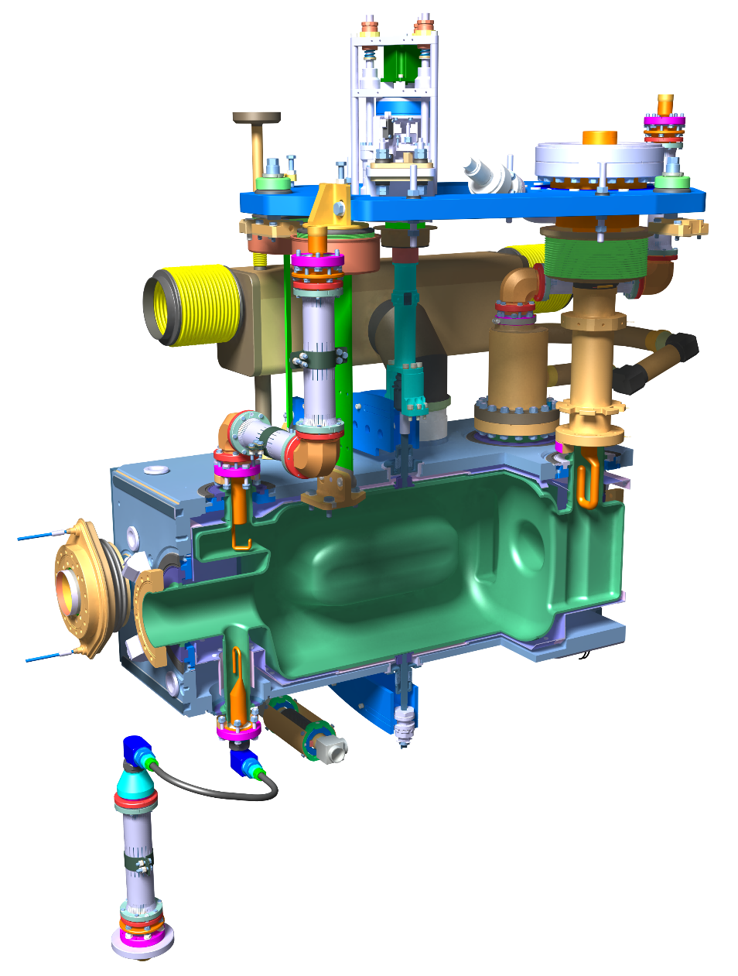
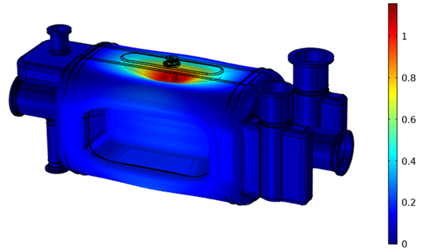
Reminder Tuning HL LHC Crab
RFD
Both tuners very similar
Differences only due to dimensions
And geometry
Same actuator
Notes:
Tuning fundamental mode by a deformation of the cavity, symmetrical wrt the beam axis. On RFD it is an inductive part of the cavity that is deformed, on the DQW it is the poles (capacitive). Tuning rods are attached to a NbTi part welded to the cavity. Two concentric tubes are moved with respect to each other by an actuator installed outside of the vacuum vessel. The inner tube is connected to the top tuning rod, the outer tube is connected to the tuner frame surrounding the cavity , that is connected to the bottom tuning rod. The two tuner operate in the same way and have the same components, with some differences in shape or size for the frame.

Slide 4
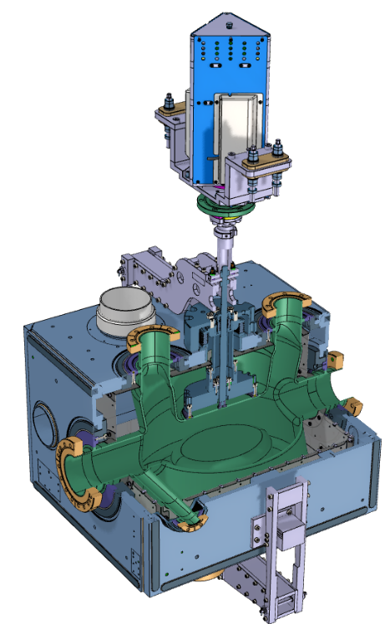
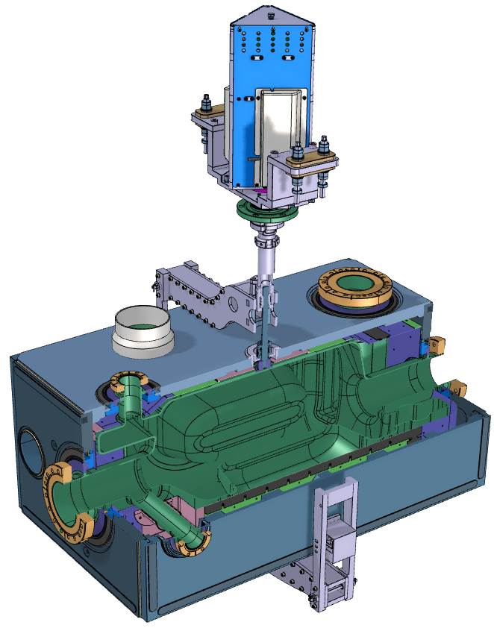
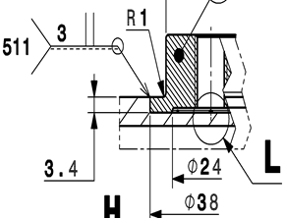
Tuning sensitivity and range (COMSOL+ ANSYS)
*Measured as change distance between 2 plates (≠ tuner actuator displacement)
DQW | RFD
Tuning Sensitivity:
318 kHz/mm* | 512 kHz/mm*
Cavity tuning stiffness:
2.6 kN/mm* | 2.8 kN/mm*
Specified tuning range at 2 K:
± 150 kHz | ± 150 kHz
Elastic limit range at 2 K:
± 454 kHz | ± 1.22 MHz
±1.44 mm* | ± 2.38 mm*
± 3.6 kN | ± 6.7 kN
Required unidirectional precision: ~80 Hz (~100 nm)
The elastic limit range are for both cavities determined by the welds between the cavity and the NbTi connection part and in second place by stresses in cavity
Important: tuner is a structural part of the cavity and adds to strength and stiffness, e.g. pressure test, PS, LFD

Slide 5
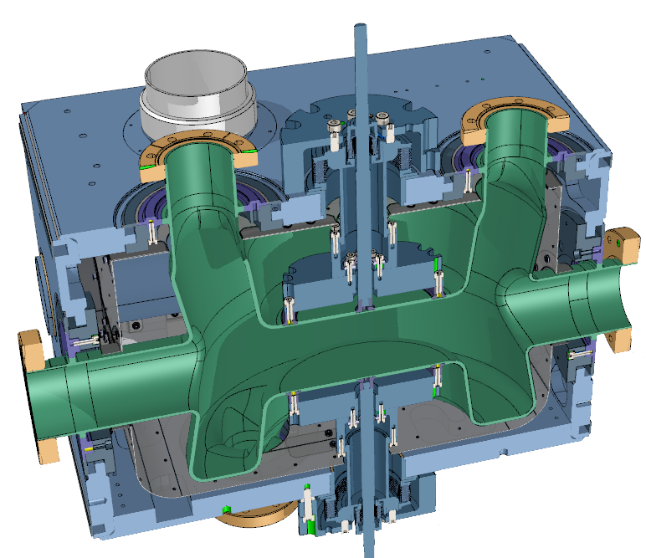
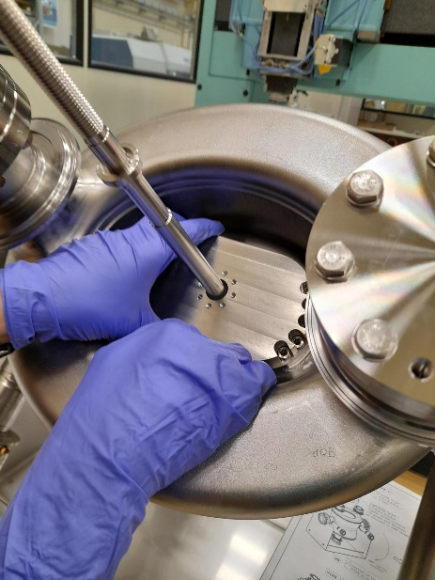
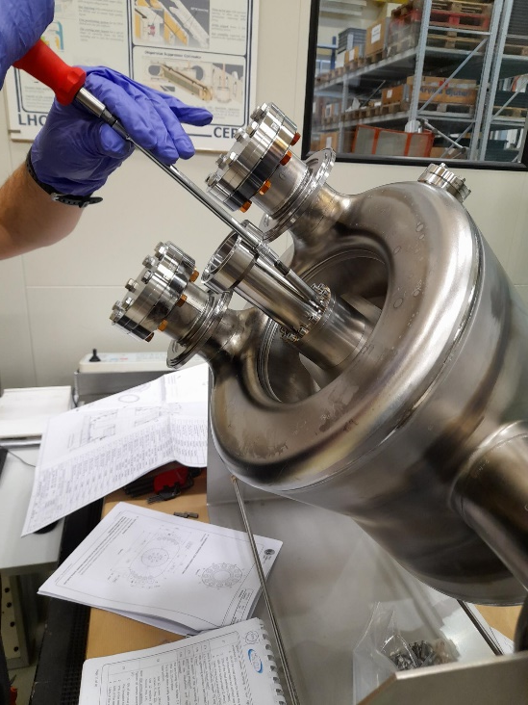
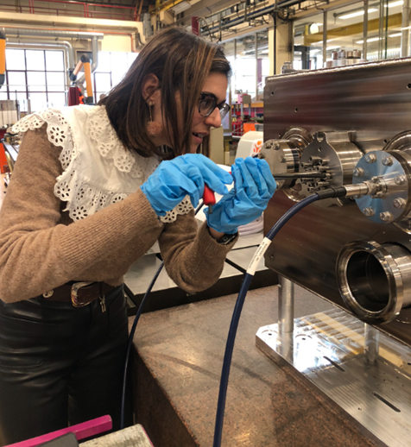
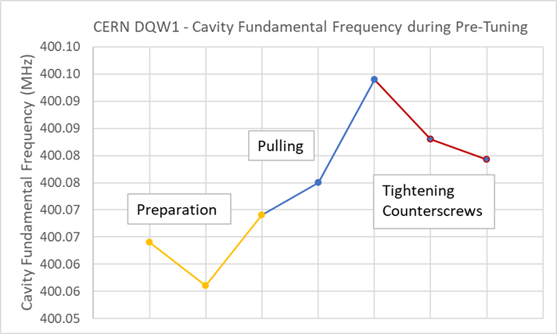
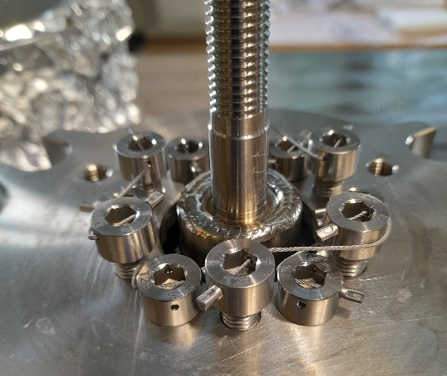
DQW Pretuner
Pre-tuning sensitivity: 1046 kHz/mm*
Pre-tuning range ± 300 kHz
Is limited by welds to NbTi connectors
Screws are cable locked after

Slide 6
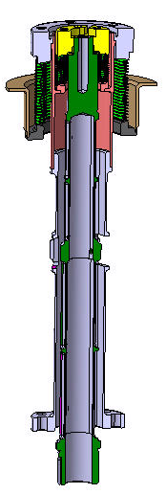
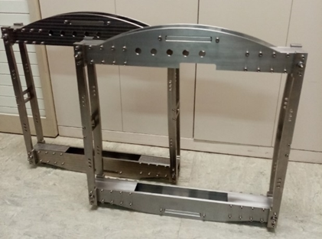
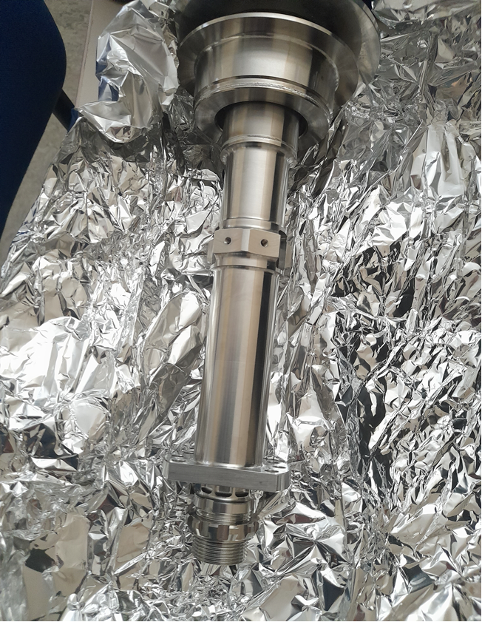
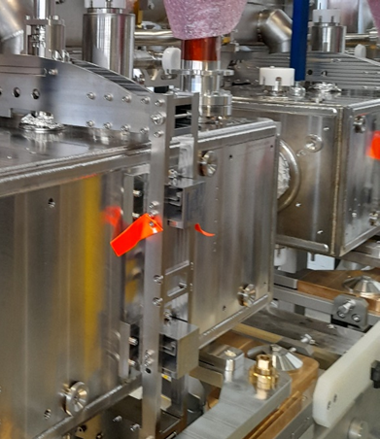
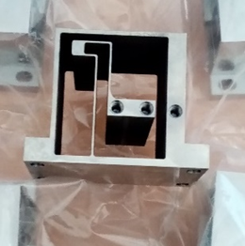
Tuner design/ assembly inside OVC
Notes:
The tuner design of the inside of the inside of the vacuum tank is mainly based on stiffness, absence of friction, thermal design, high vibrational and buckling modes.
The main challenge is to adapt to the actual geometry and dimensions of the cavity and to connect to the cavity without deforming it , and to align lower connection, top connection and vacuum feedthrough with the different offsets and few mm adjustment available and large lever arms. Access for making the connections is limited. Torque tightening with adapted tools + securing all connections.

Slide 7
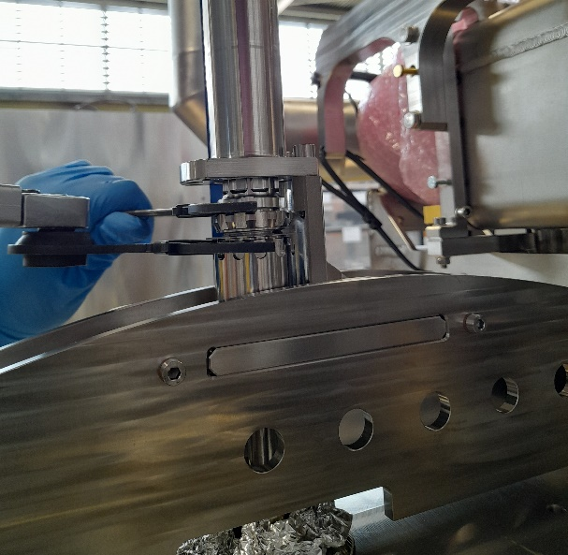
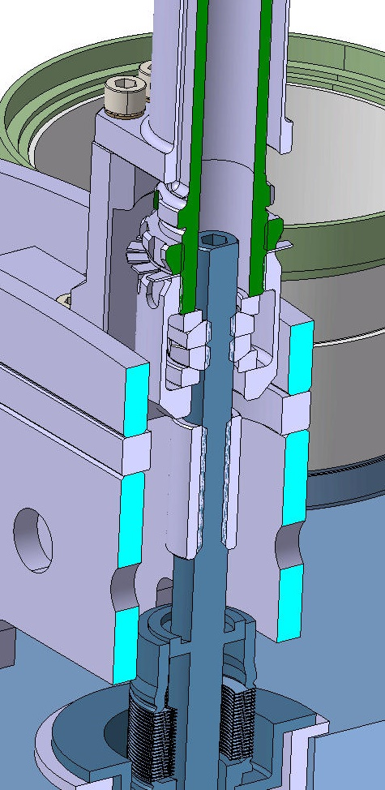
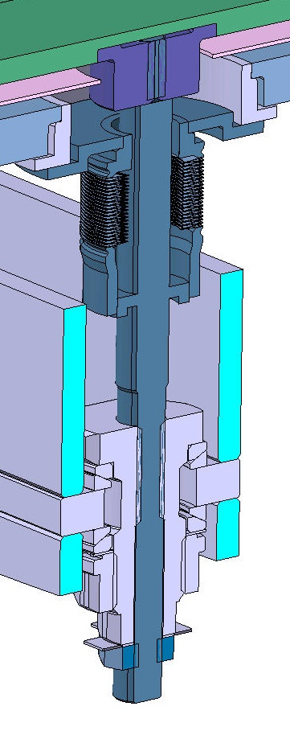
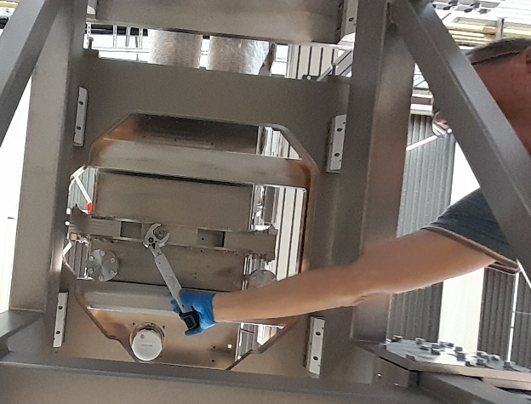
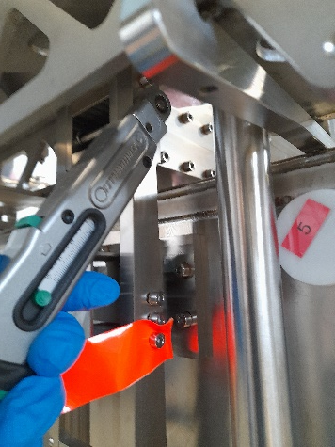
Tuner assembly inside vacuum tank (OVC)
Couplings Tuner to cavity
Deals with offsets nominal dimensions cavity
Connects tuner to cavity without deforming it
Torque tightening + custom lip washers(locking)
Heico locking washers instead of SChnorr
Design considers also access for torque tools

Slide 8
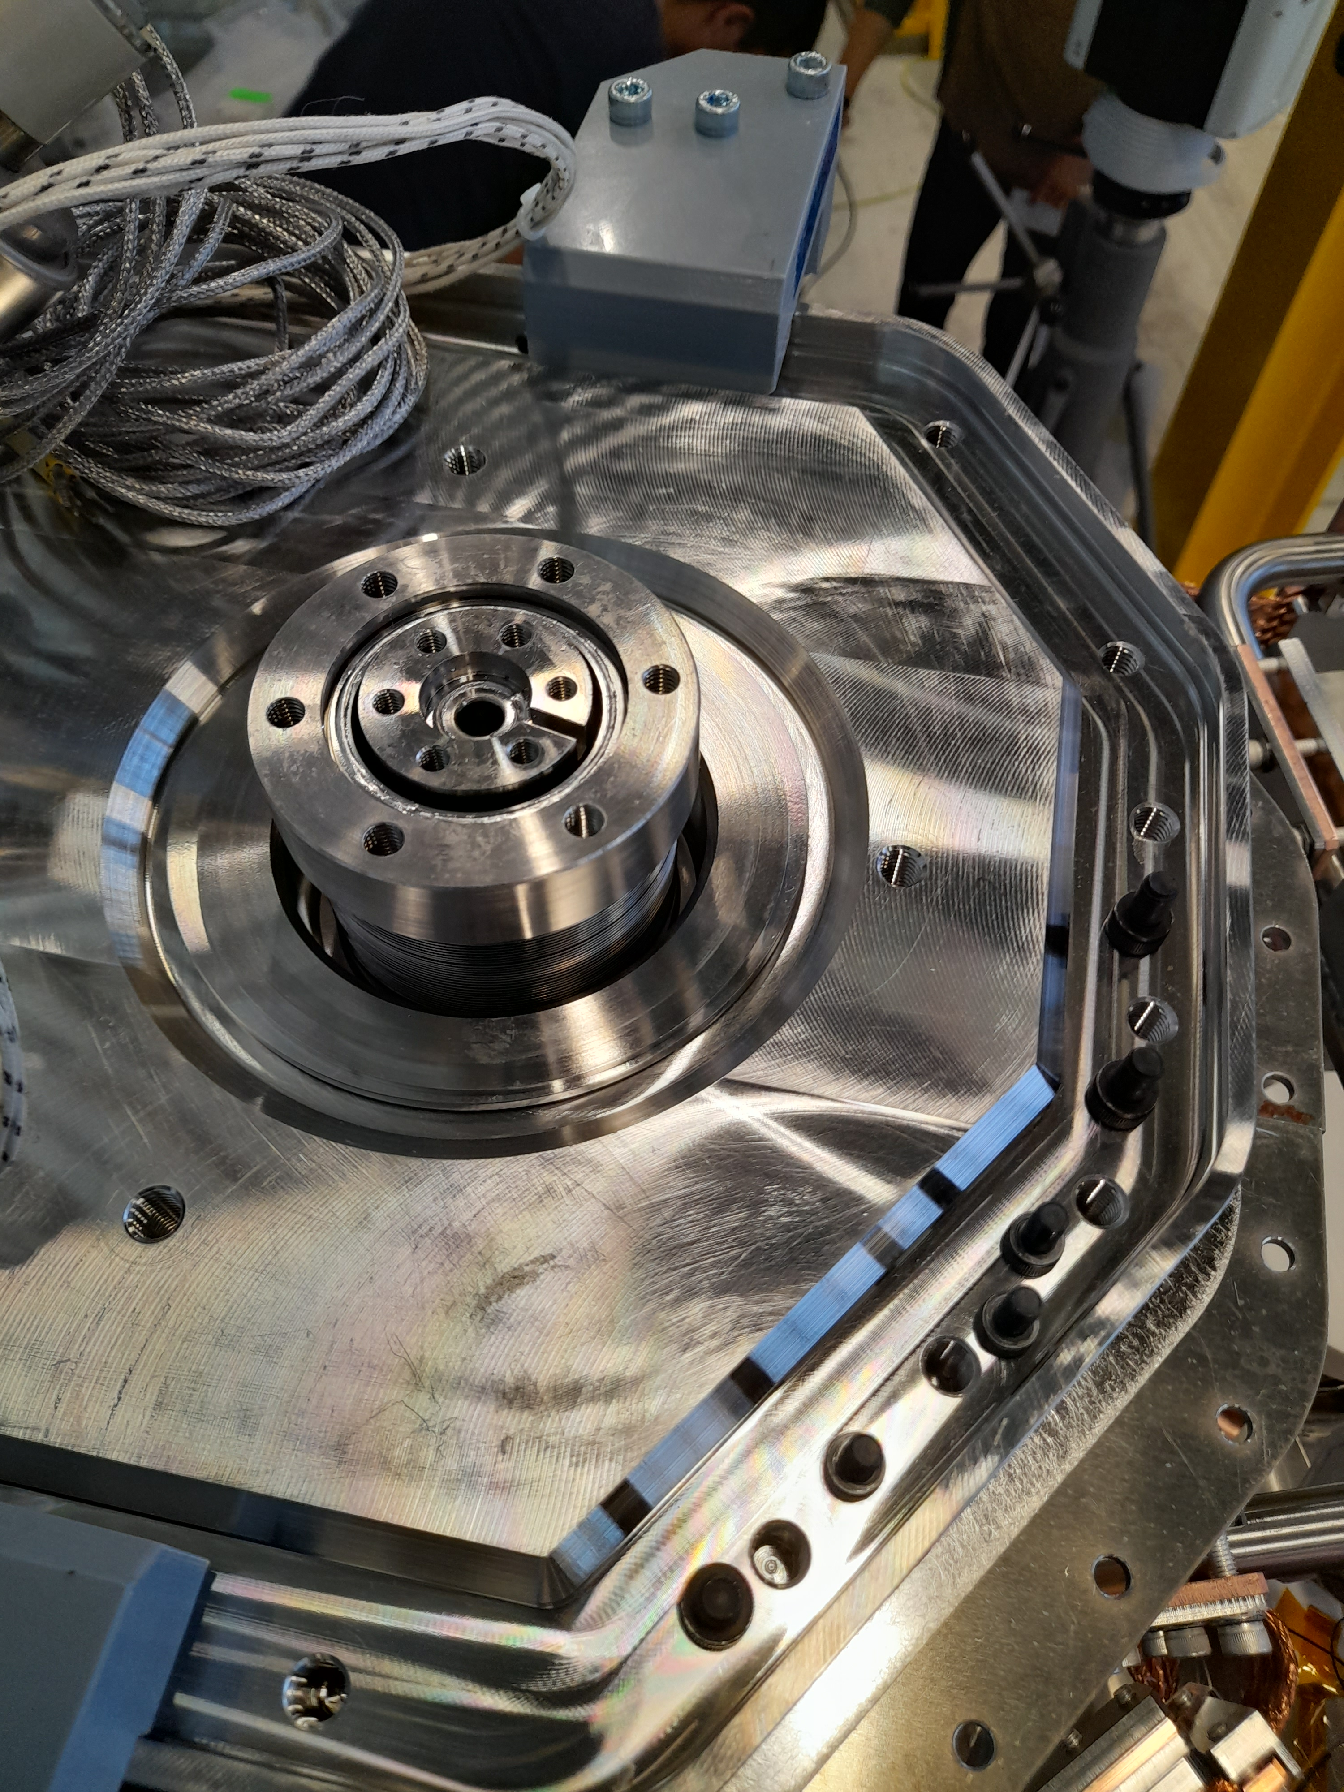
Tuner assembly inside OVC
Status for LHC:
Design tuner inside OVC released for DQW and RFD in 2024
This has improvements inside from SPS RFD lessons learnt
Where possible, RFD and DQW parts are the same
Fabrication ongoing both for DQW (CERN) and RFD (TRIUMF)
Installation procedure + tooling finalised
Notes:
STFC RFD assembly: The design for the inside was generally confirmed with some minor adjustments e.g. for the lip washers , the assembly sequence with respect to the tuner alignment, still increased some clearances

Slide 9
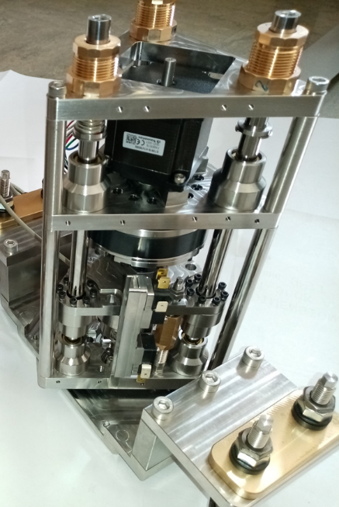
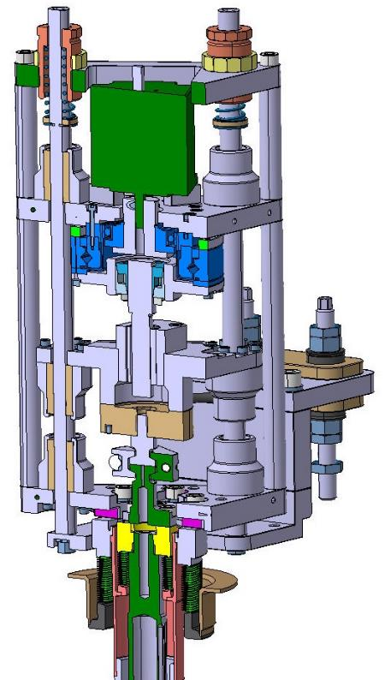
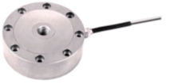
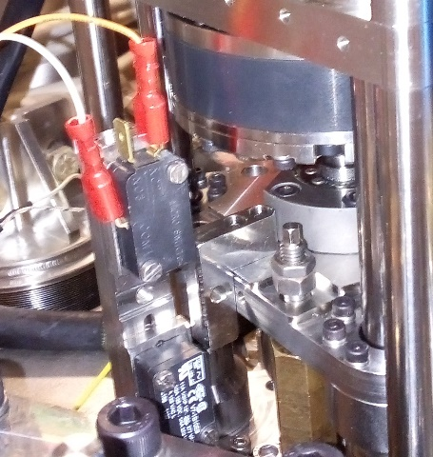
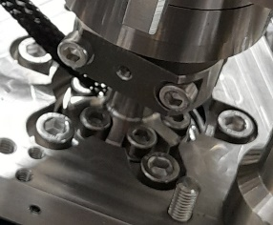
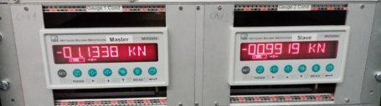
Overview components
ACTUATOR SPS RFD proto
Vertical Spring pre-load from alignment plate
Stepper motor
1.3 Nm bipolar, motor step 1.8 deg, micro stepping 8000/360 , not ramped open loop, limited to 2000 steps/sec
Harmonic drive HFUS-20-100-2SO
Ratio 100, Accuracy < 1 arcmin, precision <0.1 arcmin (5 nm)
Fa Dyn 7.7 kN
Radhard grease SYNRAD 1252
Roller screw
Rollvis RV 12 x 1 static load capacity 17 kN
coupling
Sferax Compact GBL 1219 bearings XA +A (all metal) and guides
Loadcell
So far: Kistler 10 kN 4576A55C1 class 0.1
Limit switches
Difficult to set, not so reliable
Mechanical end stops with max load interlock on load cell conditioner
Actuator coupling
Allows quick change of actuator + connection without frequency change
Incorporates heater

Slide 10
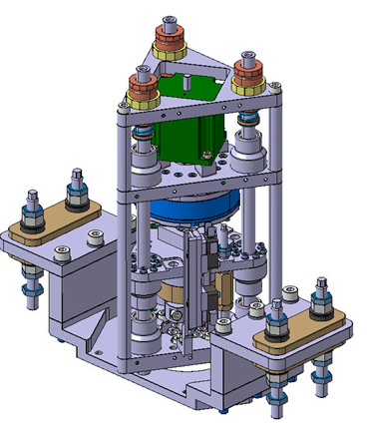
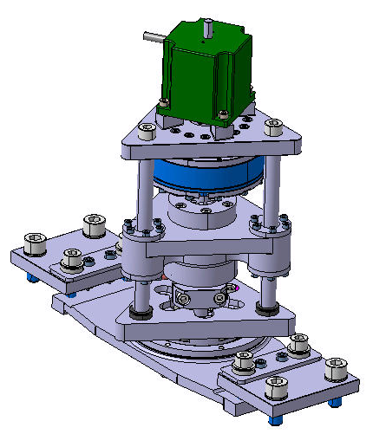
Actuator «re-looking»

Slide 11
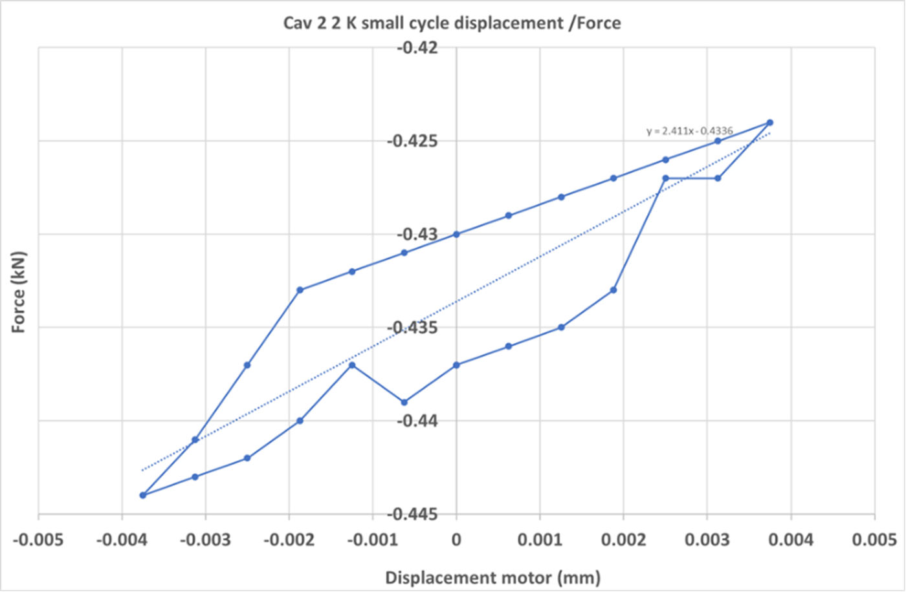
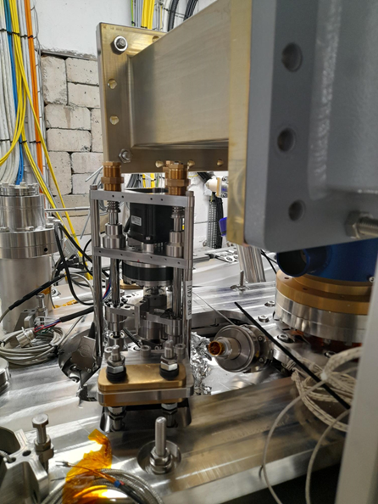
SPS RFD Assembly Actuators + CD1
“Hard points” in guides actuator
Assembly bearings over determined, planarity tolerances
Buttressing in actuator support
Precision 80Hz not reached for CD1
Interference actuator springs with turned and tilted waveguide (before repair)
Interference between cable gauge FPC with actuator support
Problem 1

Slide 12

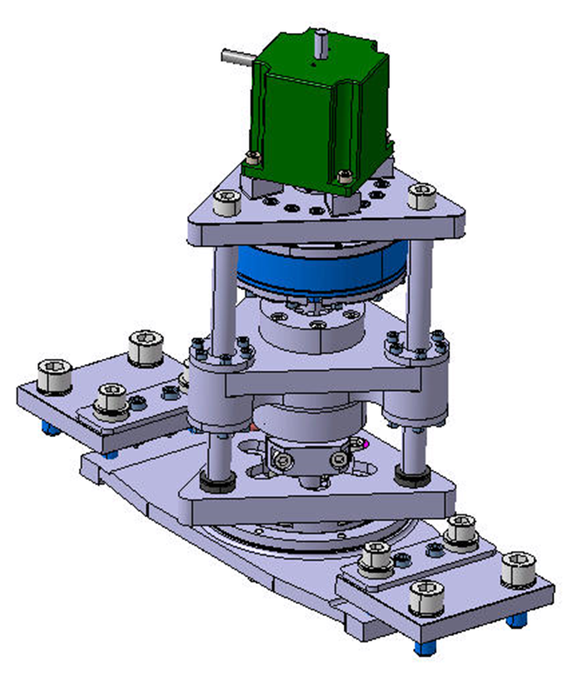
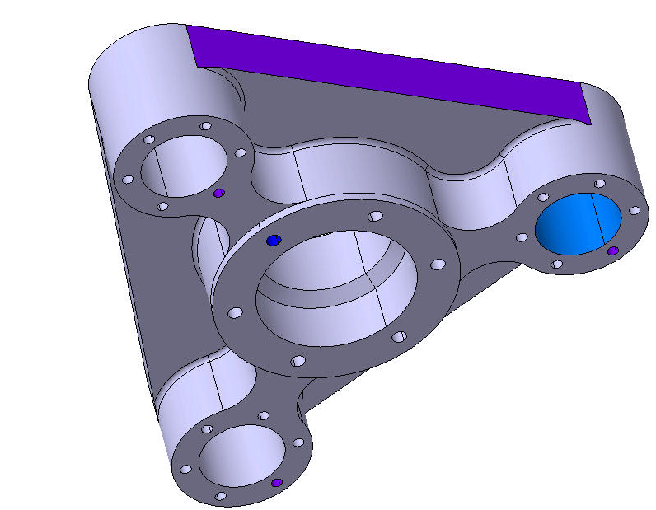
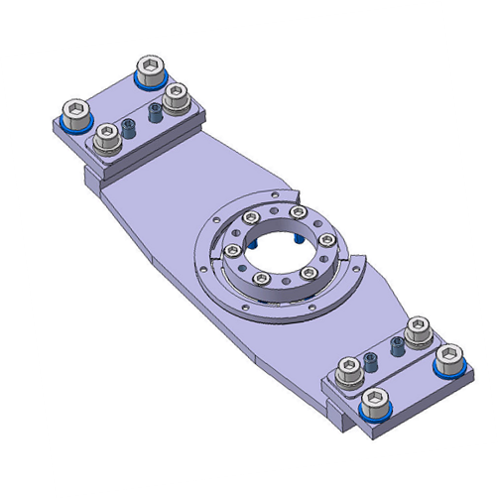
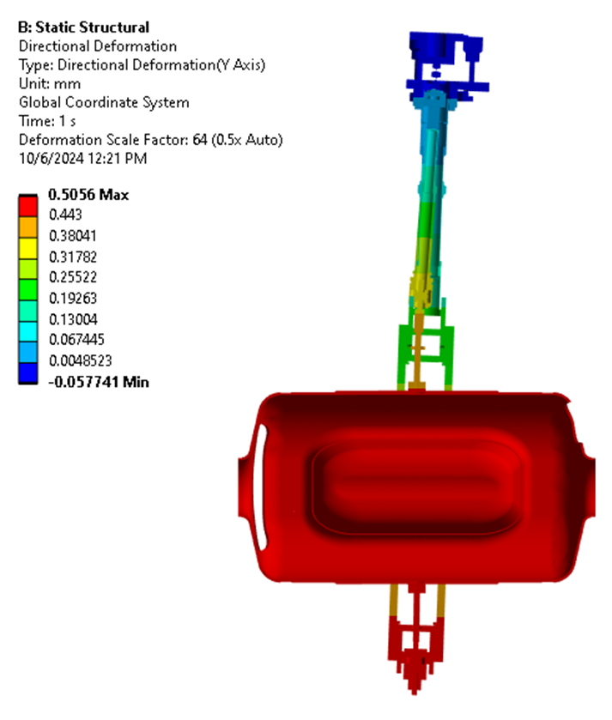
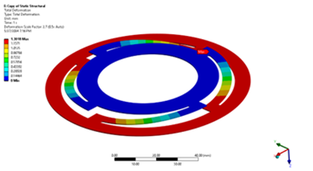
3 d.o.f.

Slide 13
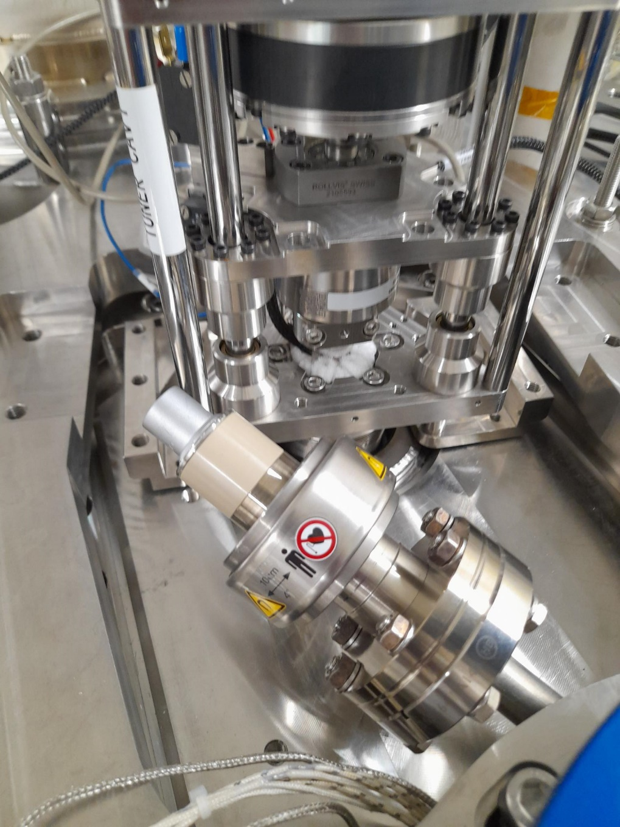
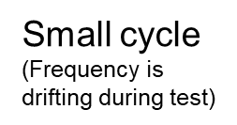
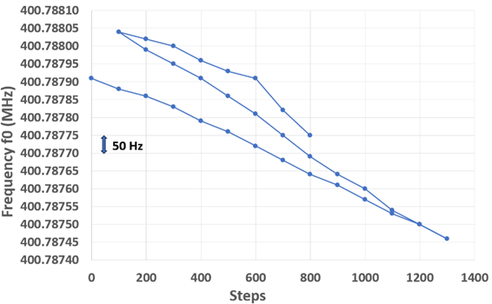
« Tested" for CD2 tuner tests
Acceptance testing tuner precision is long and difficult because of drifting frequency during tests + “noise” on frequency and force measurement
Notes:
From experience during the tests, the noise is probably due to the cryogenics, with phases very quiet followed by noisier phases

Slide 14

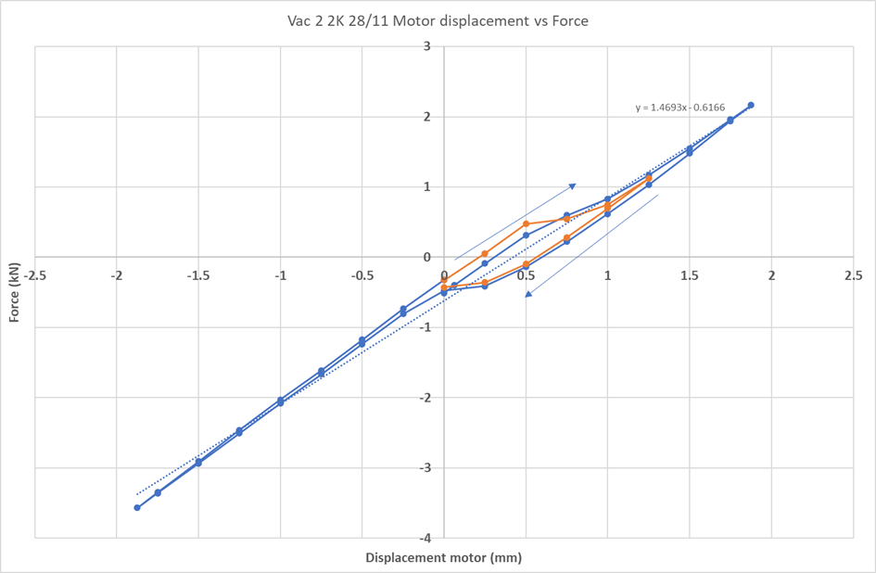
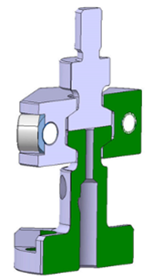
CD1 Backlash with a twist
Clearance with friction in actuator clamp due to tolerances
Easily solved, but asked for design improvement
Problem 2

Slide 15

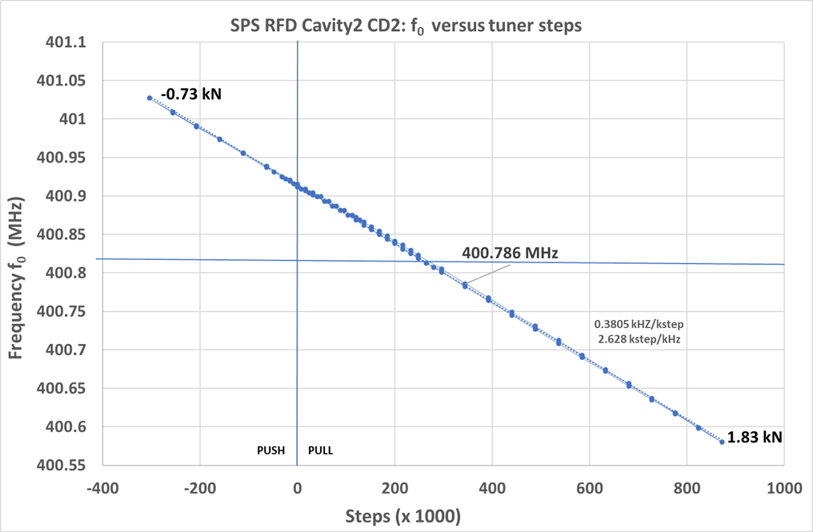

Slide 16
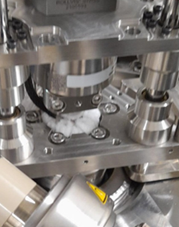
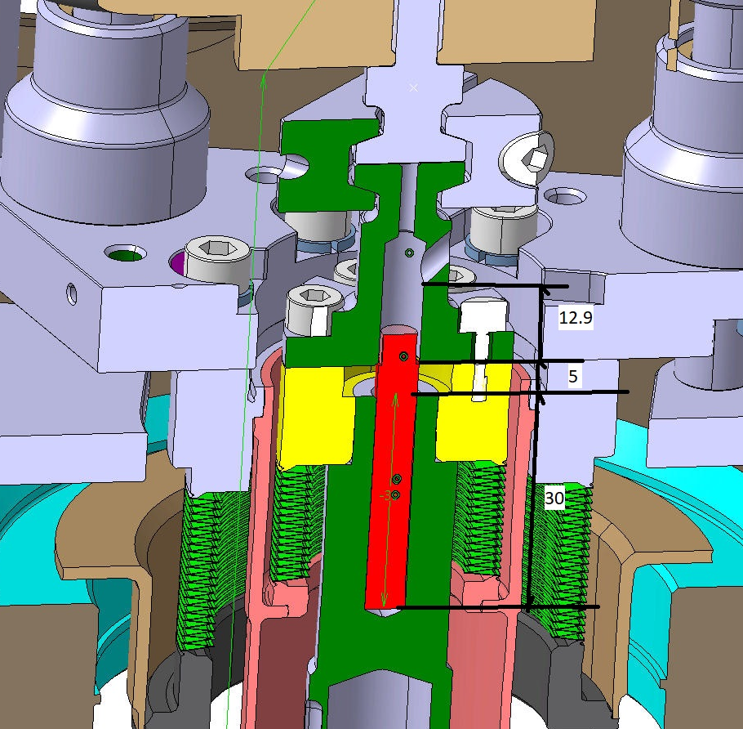
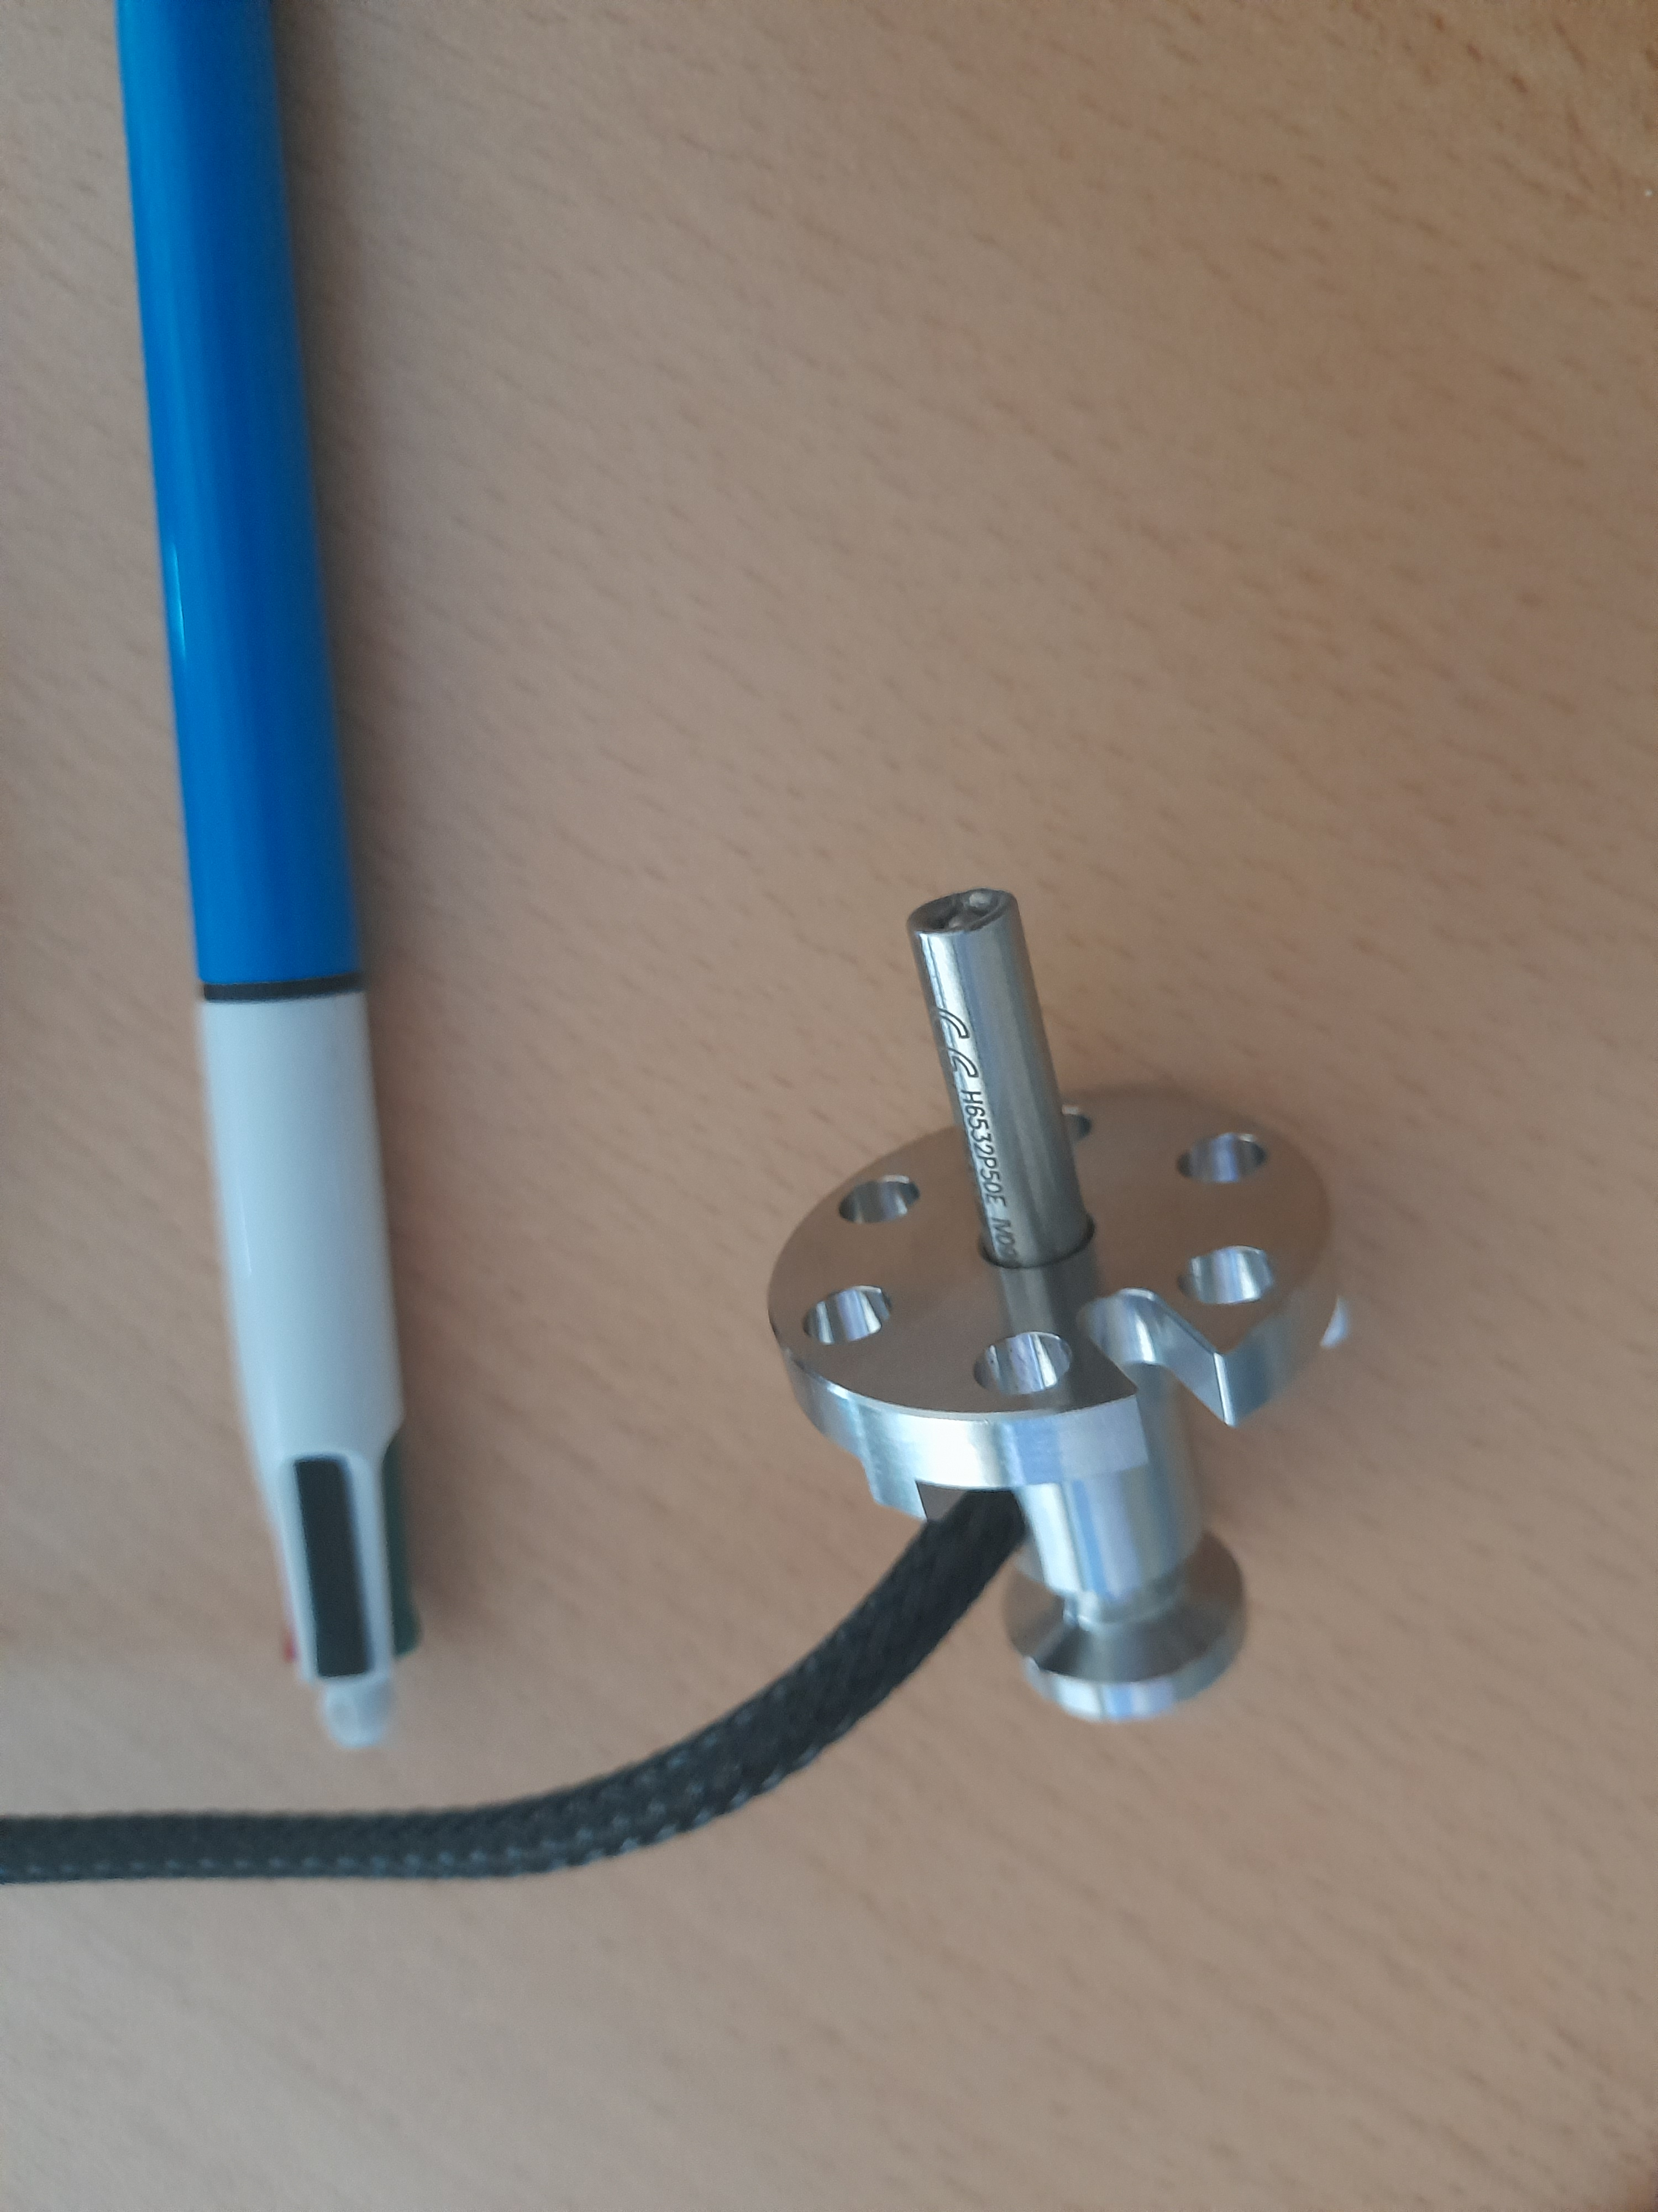
Tuner heater problem/ ICE inner connection
Heaters keep breaking or sometimes switched off, reason not sure
No place for a temperature gauge
Heaters difficult to replace (remove fully actuator)
Problem 3

Slide 17
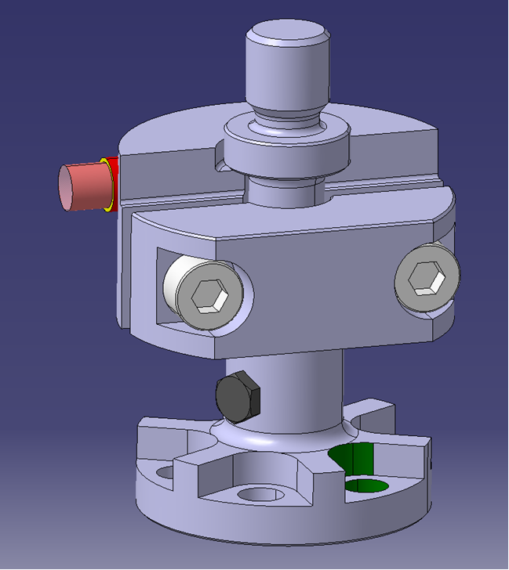
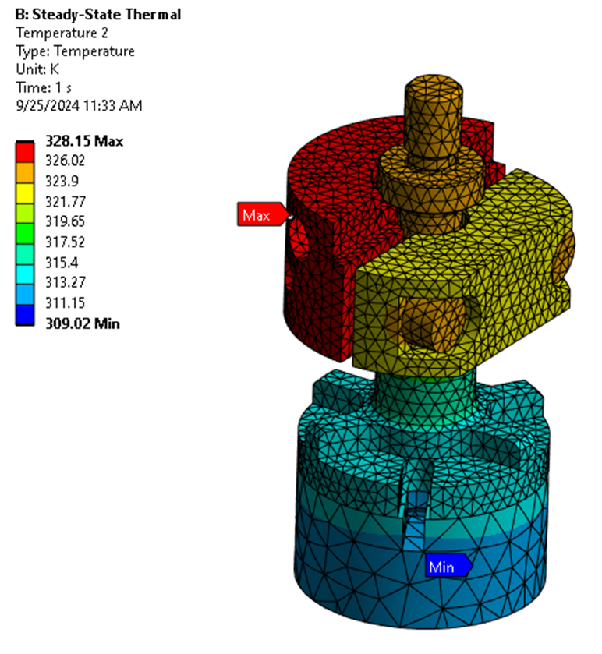
New Integration heater and temperature gauge
Place heater in tuner clamp
Temperature gauge M3 (commercial part) on inner connection part (ICP)
Clamps, screws and ICP in Cu Sn 8
2 to 4 W

Slide 18



Possible ice inside bellows
Work on adding heater patch on outer connection flange (cryo group)

Slide 19

Other ongoing work for actuator
Limit switches + mechanical stops: improve reliability + easier setting: on-going, looking for simple solution
Rad-hardness, lubrication and material adaptation commercial components: contacts and discussions with providers, preparation of technical specs for call for tender
Fast dismountability in situ + preventive maintenance scenarios
Adding of grease reservoirs
Improving the load cell + rad –hardness: in house CERN design

Slide 20
Conclusions
The SPS RFD cryomodule preparation and testing gave input for tuner improvements
The inside OVC tuner part design LHC DQW and RFD released Q1 2024 and in fabrication
For DQW the parts for 2 CM coming available
Tuner actuator part redesign 3D under last review, first drawings were already made.
Priority is for releasing drawings for TRIUMF provided parts for financial reasons.
Preparation of tendering gears, lead screw, motors, bearings is ongoing.

Slide 21
References
Comsol RF calculations:
E. Cano Pleite et al.; Numerical evaluation of the tuning frequency, pressure sensitivity and Lorentz Force detuning of RF superconducting crab cavities, Proceedings 2018 COMSOL Conference, Lausanne
T. Guillen Hernandez et al., Numerical calculation of the Lorentz Force Detuning and the pressure sensitivity for the HL-LHC CRAB Cavity, IPAC 2023

Slide 22

RT before CD 1, OVC open
Additional: 14/11/23 Tuner and HOM measurements at RT

Slide 23




Thermal contraction Cavity support

Slide 24

Cav 1 + 2, CD1 several cycles

