Slide 1
WP4-Series cryomodules design
14th HL-LHC Collaboration Meeting, CERN – 7-10 October 2024
Teddy Capelli on behalf of the WP4 collaboration

Slide 2
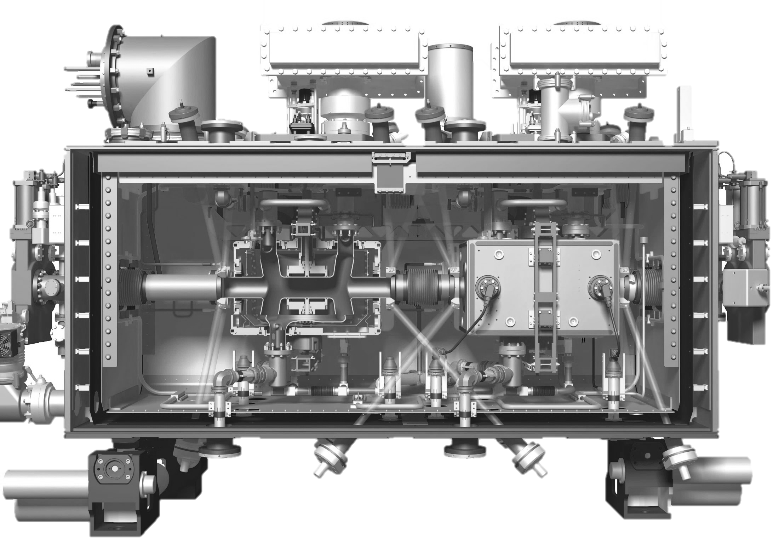
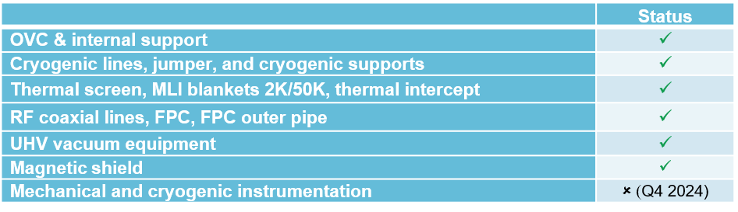


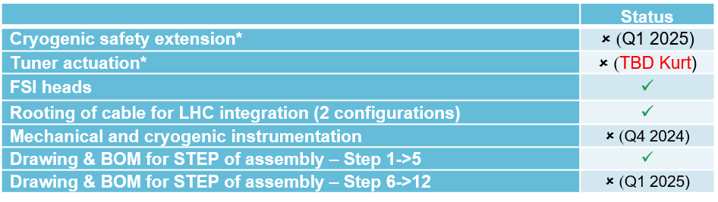
Status of drawing packages
RFD & DQW – Series
Status of drawing folders for cryomodule internal components :
Extracted from EDMS Docs 2730814 & 2801330
Status drawing folders for cryomodule external components :
Only needed for LHC
Only needed at CERN
* Improvement of the original design

Slide 3
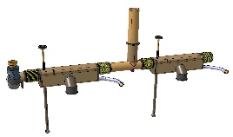
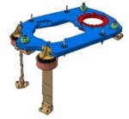
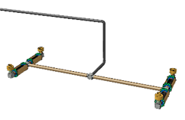
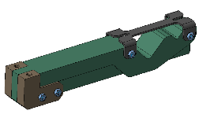

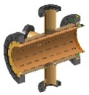


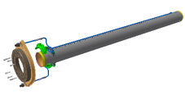
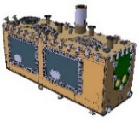
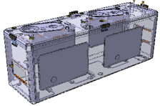
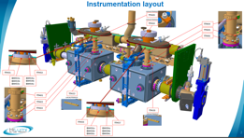
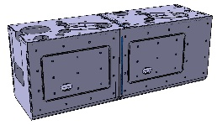
Summary of drawing status
Cavity support system:
  All drawing are released
Cryogenic lines :
  All drawing are released
Internal cryogenic support :
  All drawing released
Beam vacuum equipment:
  All drawing are released
Tuner:
  Improvement for external actuation
  Internal component released
  See presentation K.Artoos
Outer Vacuum Chamber:
  All drawing are released
Thermal screen, thermal intercept
& Multi Layer Insulation :
  All drawing are released
Cryogenic instrumentations:
  Design done and doc. Under review
Magnetic shield :
  All drawing are released
Cryomodule assembly:
  Iterative updates
  Design freeze step by step
  Step 1-6 done
  Step 7-12 on-going

Slide 4
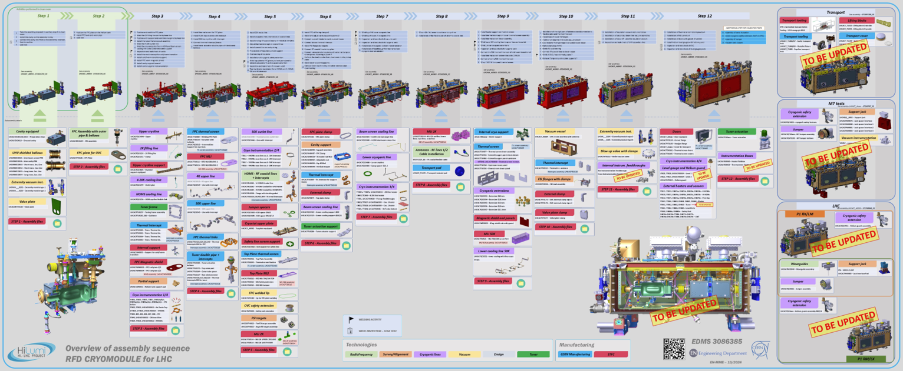
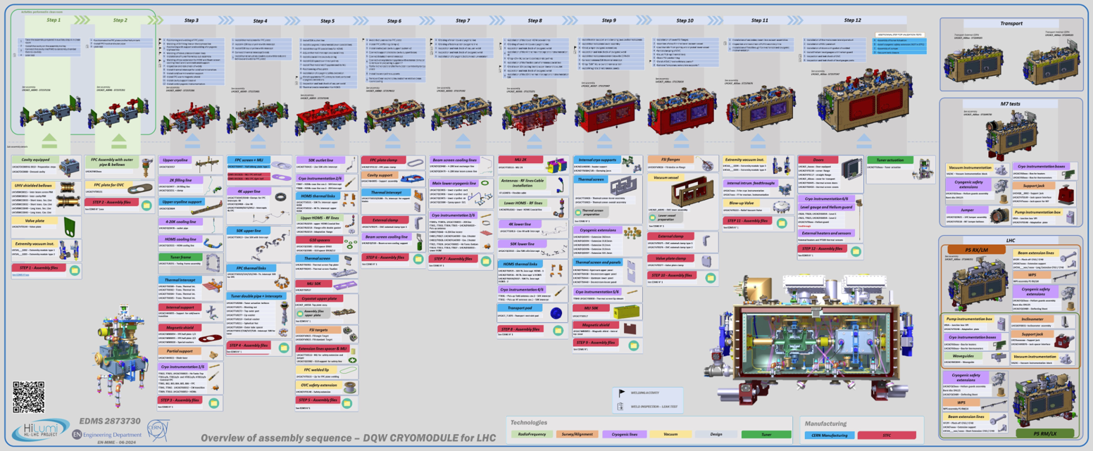
Assembly sequence updates
RFD Sequence : EDMS 3086385
BOM for assembly sequence : EDMS 3020997
Courtesy L.Giordanino
11500 components to be assembled (~950 2D drawings, 3500 3D part models not including tooling)
DQW Sequence : EDMS 2873730
BOM for assembly steps : EDMS 3020997
Courtesy J.Dequaire

Slide 5
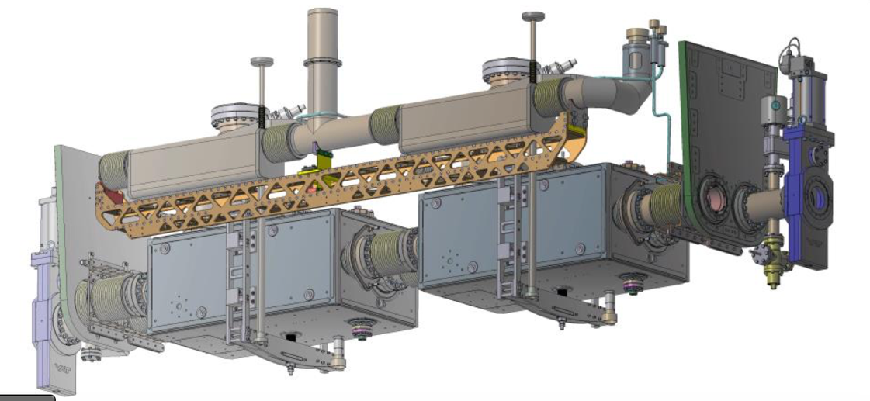
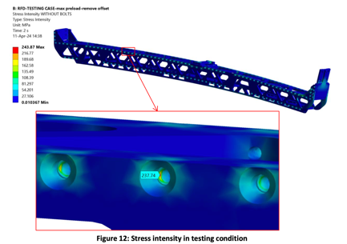
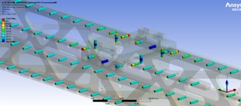
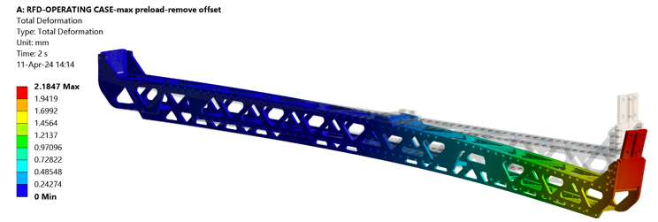
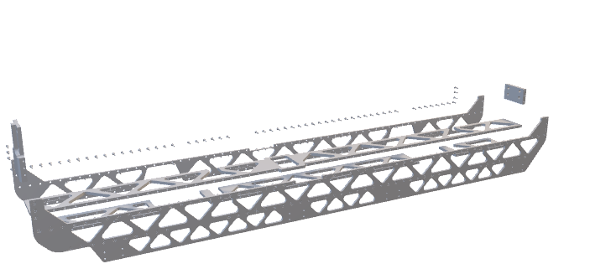
Cryogenic biphase support bolted design
Design released ✓
Manufacturing advantages:
  Bolted design (no welds required)
  Reduction of cost of manufacturing
  Modular design
Assembly advantages:
  Easier installation on cavities
  Free space for biphase welding
DQW Cryogenic support strength assessment
EDMS 3075772
Courtesy L.Giordanino
RFD Cryogenic support strength assessment
EDMS 3063725
Courtesy L.Giordanino
Stress and Buckling analysis
Maximum stress : stress below limit defined by EN13445-3 for each operating condition
Load multiplier of buckling : >40 for both design
Bolt stress
Minimum safety factor for both DQW and RFD design : 1.3 for M5 and 1.9 for M6 fasteners
Fastener A80 – not mandatory everywhere but safer to standardize in order to avoid mistake during assembly
Total maximum deformation : 1.9mm (DQW) / 2.7mm (RFD)
Directional deformation : 1.6mm (DQW) / 2.4mm (RFD) – target 3mm max
(for pressure testing load case)

Slide 6
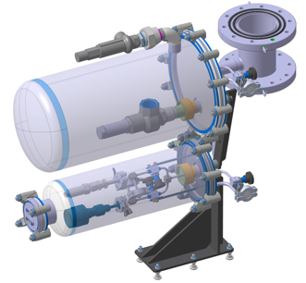
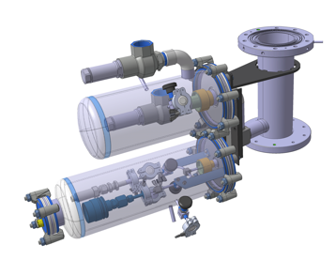
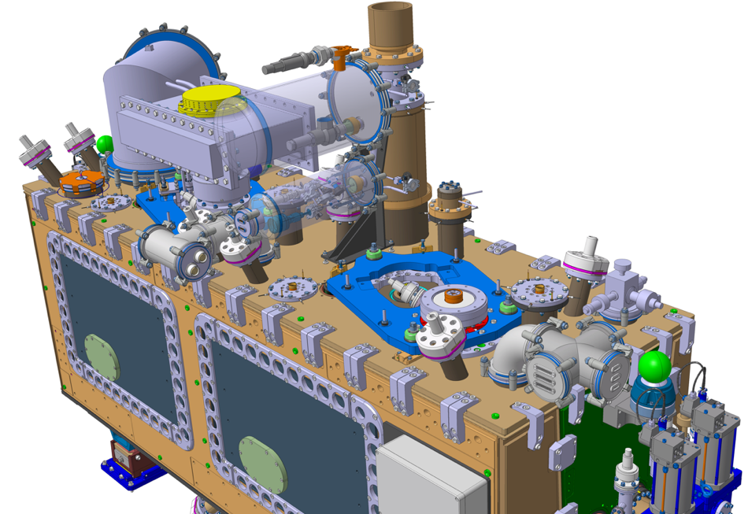
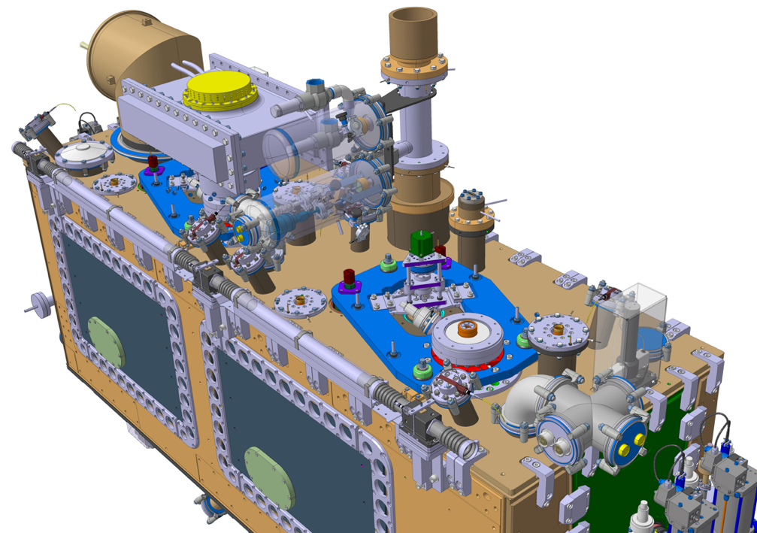
Cryogenic safety extension for series cryomodules
Design under review
Only needed for LHC
Detailed study of the cryogenic extension for LHC - with new input from CRG expert
  Change of design to protect burst from thermal cycles
  Change the layout of safety valve (under review with TE-CRG)
Definition and integration for the LHC 0 and 180° orientation
SPS version
LHC version

Slide 7
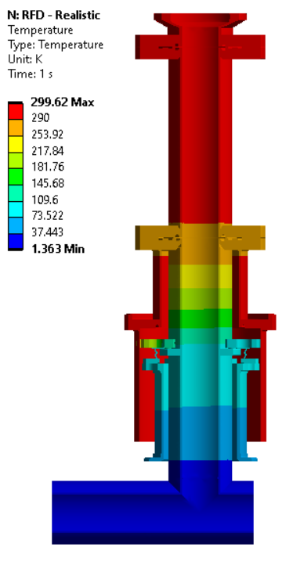
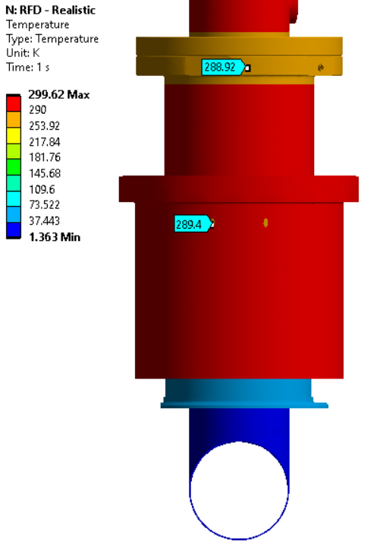
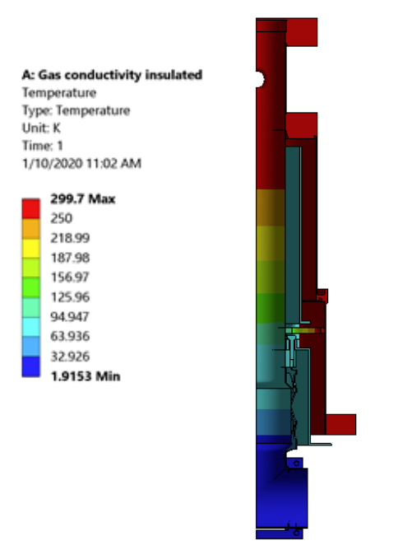
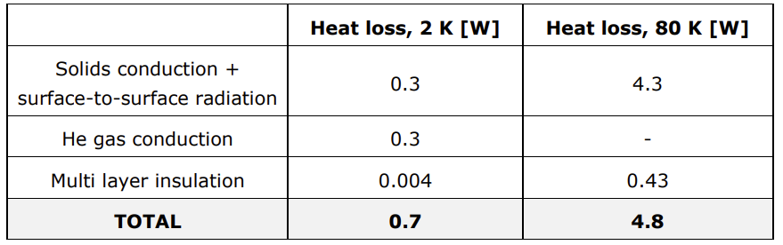
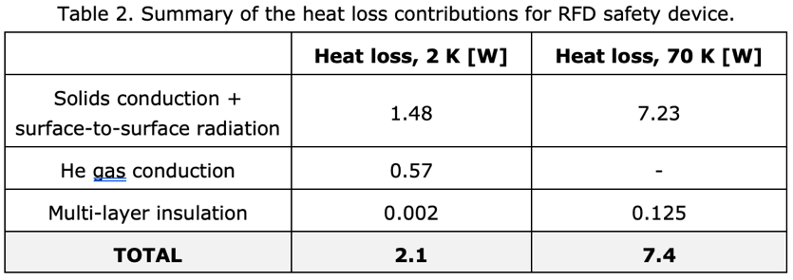
Safety extension thermal sim.
RFD / SPS design
LHC design
Thermal evaluation of Cryo. Safety extension (SPS)
See EDMS 2323043
Courtesy E.Cano Pleite
Cryogenic safety extension optimization (LHC) :
DQW : EDMS 3024965
RFD : EDMS 3024966
Courtesy E.Cano Pleite

Slide 8
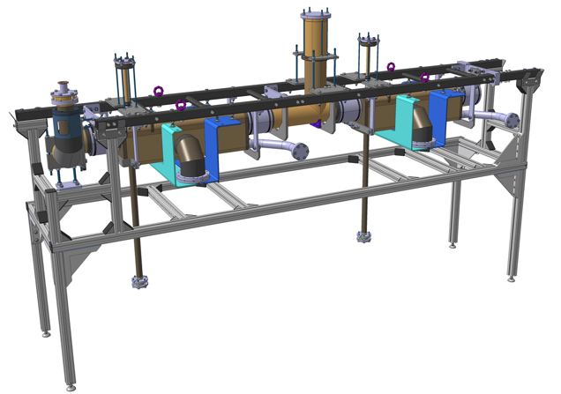
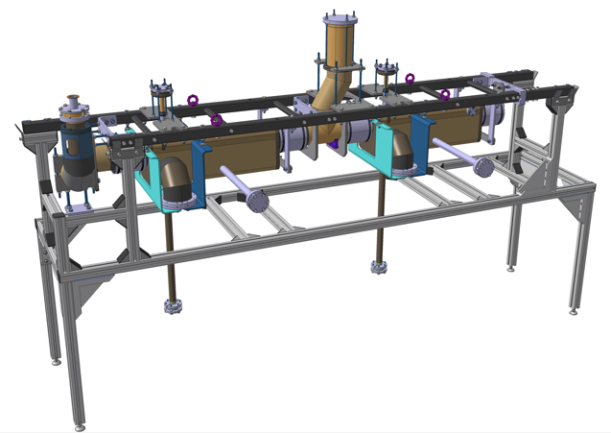
Cryoline stress assessment and pressure test tooling
Design released ✓
RFD
DQW
RFD Cryogenic lines stress assessment: EDMS 2477175
Courtesy T.GUILLEN HERNANDEZ – L. DASSA
document update on-going (design is really close to SPS’s)
DQW Cryogenic lines stress assessment: EDMS 3000051
Courtesy J.SWIESZEK
Design of a test bench for pressure test representing cryomodule config.
Design of several other tooling for lower lines and 4-20K lines
Analysis performed according to the Annex B of the EN 13445-3 “Design by analysis - Method based on Direct Route”, the testing condition for the Bi-phase line has been separately evaluated (see the full report)
  All the criteria from standard have been satisfied and the results are fully acceptable

Slide 9
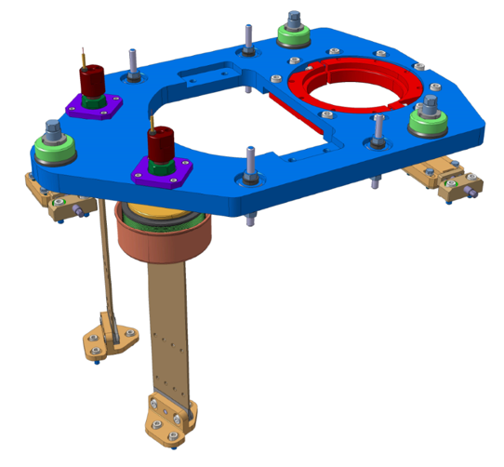
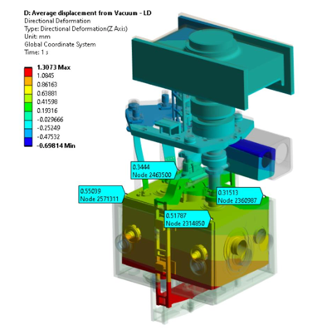
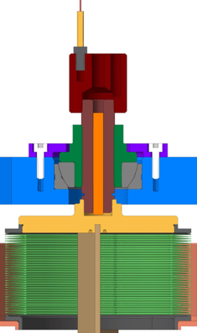
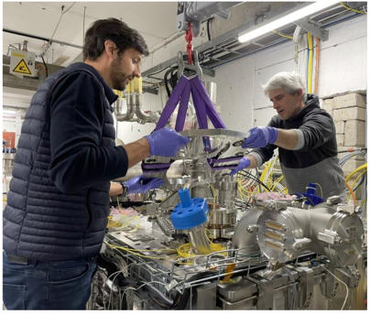
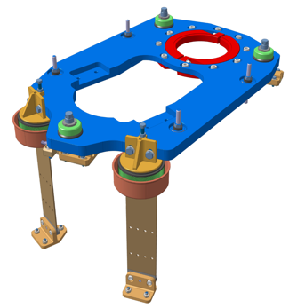
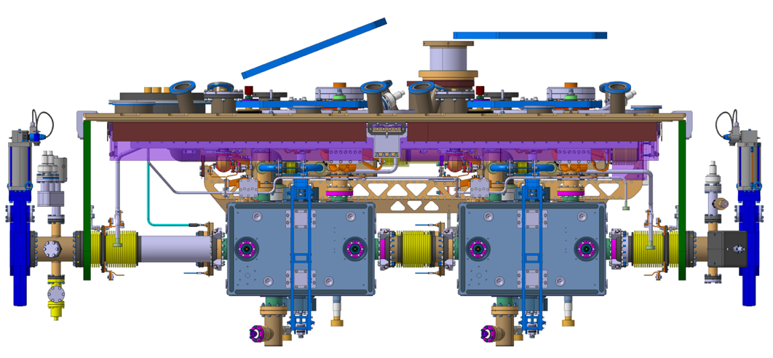
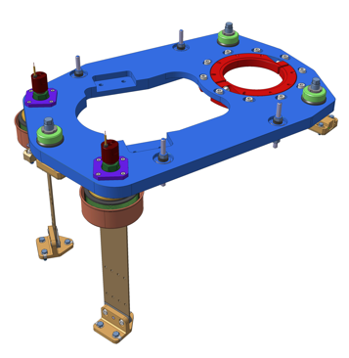
Cavity support DQW & RFD for LHC
Design released ✓
Material update for the 3 adjustment sets
Blade connexion head change
Improvement of assembly on CM
Cavity support simulation results are acceptable
  Both report done by E. Cano-Pleite
  to be uploaded on EDMS
  Anticipation of displacement for alignment of cavities
  No significant change in stress WRT previous design
Previous design
(SPS)
New design
(LHC)

Slide 10

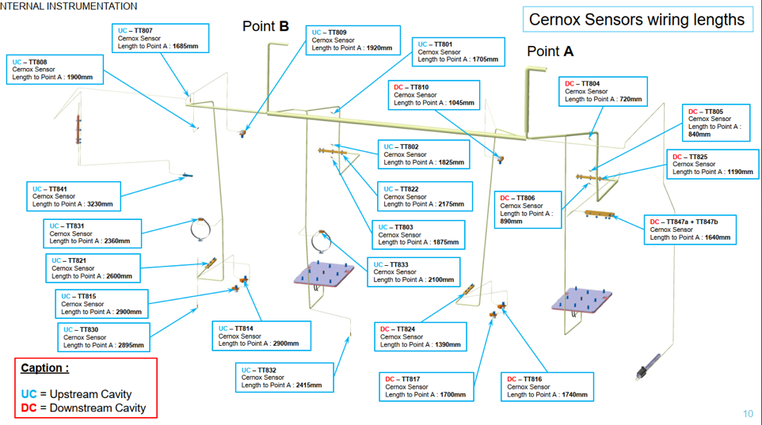
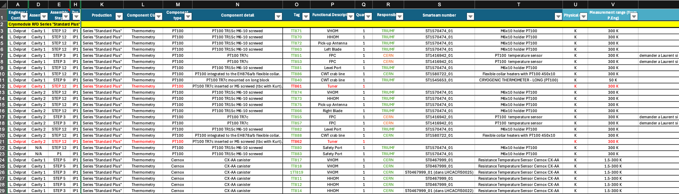
Cryogenic instrumentation
Design released ✓
List under review
Waiting for CRG validation
RFD cryogenic instrumentation : https://edms.cern.ch/project/CERN-0000181755
  https://edms.cern.ch/document/3161276
DQW cryogenic instrumentation : https://edms.cern.ch/project/CERN-0000181671
  https://edms.cern.ch/document/3167444

Slide 11
Other design activities
Modification of material requirements
  Lower grades requirement on some components
  Change of material for a better coherence between drawing packages
Component | Material spec
Jumper support (LHCACFQC0310) | Cryoline spec EDMS 2093032
4-20k cooling line support LHCACFQC0519 | Cryoline spec EDMS 2093032
Thermal screen ancillaries for thermal screen LHCACFTS0460 + LHCACFTS0425 | Thermal screen spec EDMS 2101922+ only for plate: spec EDMS 790774 (1002)
Cavity support system LHCACFAH0095 & 0101 | Vac vessel spec EDMS 2101924 + Cryoline spec EDMS 2093032 Fasteners in Stainless steel whenever possible
Jumper for LHC LHCACFQC0621 | No UK or Triumf production / CERN spec ONLY for internal use: EDMS 3055177
CWT Supports (LHCACFAH0055) | Vac vessel spec EDMS 2101924
Follow up NCRs & change request coming from the collaboration
Design of tooling for repairs & assembly
Check report from suppliers & collaboration (metrology, material properties, ISO GPS drawing checks…)
Follow up test and get feedback for potential improvement for series

Slide 12
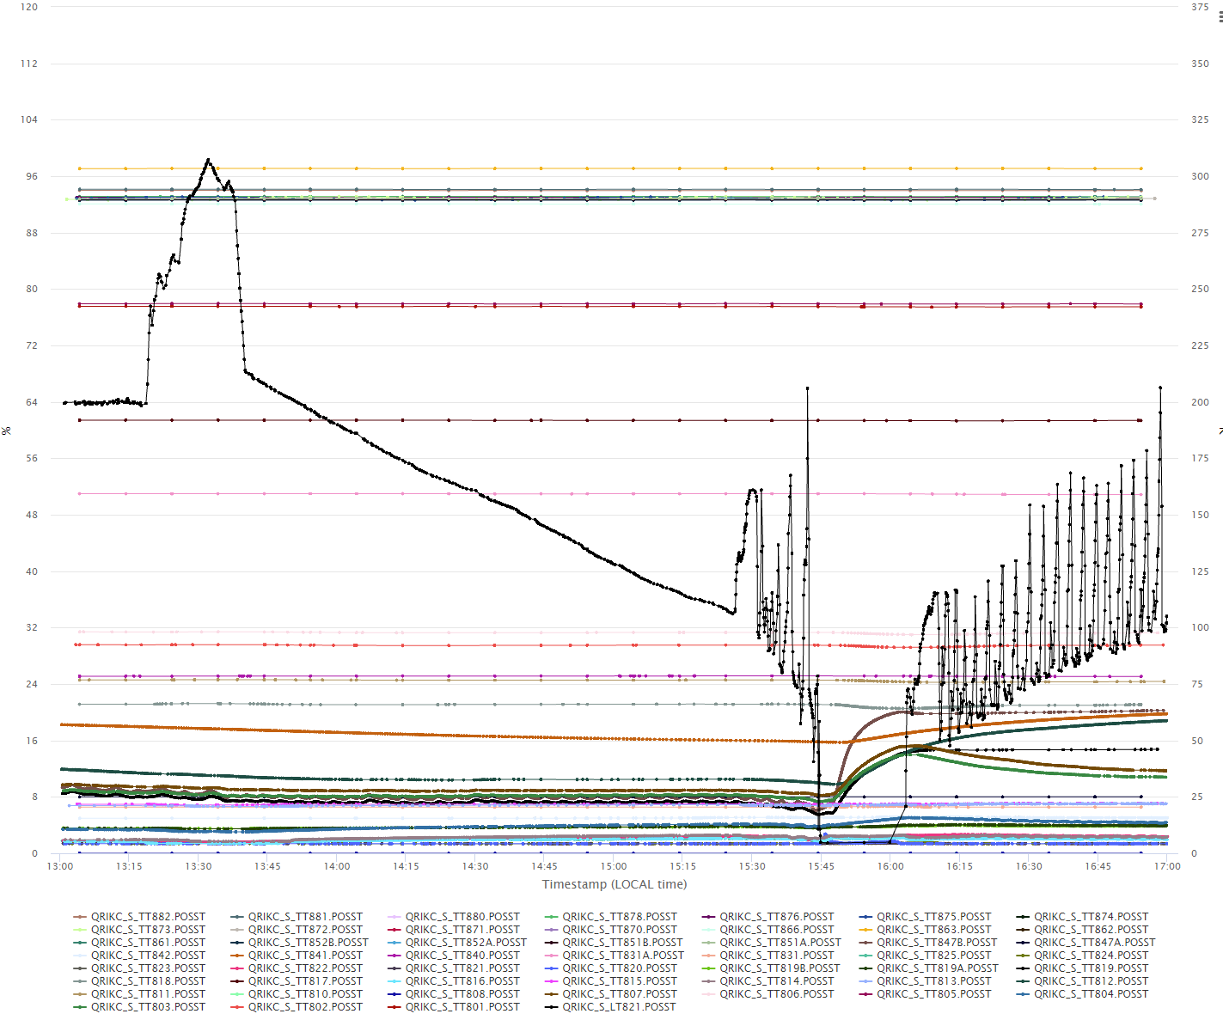
Cold test – static heat load @2K measurement
The static heat load at cold can be evaluated by stopping the liquid helium supply when all the temperatures are stabilized and checking the variation of the level in the cavities (the 4-20K and 50K thermalization line are kept in circulation)
In our case the level was at 68% when the 2K liquid helium supply was stopped and went down to 34% 105min later
These measurement gives us :
See the presentation by K. Turaj
68 to 34% : ~52.5L
Time : 105min
Load on 2K : ~21W
Load estimated : 23.7W
(See EDMS 2310389)
Lhe level in%

Slide 13
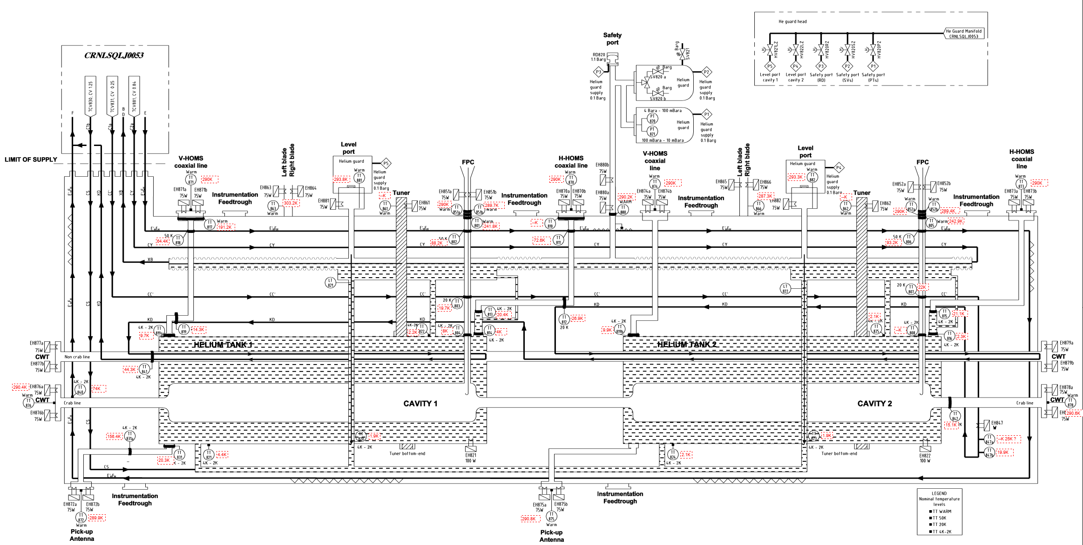
SM18 – M7 test T° measurement feedback
Good matching of the temp measured WRT simulation
Robustness of the simulation performed -> validation of design for LHC CMs

Slide 14




Conclusions
Engineering activities both cryomodules enter final phase
  Assembly BOMs & steps 6-12 -> adaptation for STFC and Triumf
  Follow up manufacturing and evaluation impact of CRs and NCRs
  Definition of missing design for LHC integration (cable rooting, transport, interfaces with surrounding equipment)
Preparation of CERN cryomodule assembly procedures
  Step 1-3 done – further steps are on-going
Update thermal budget evaluation for both cryomodule

Slide 15
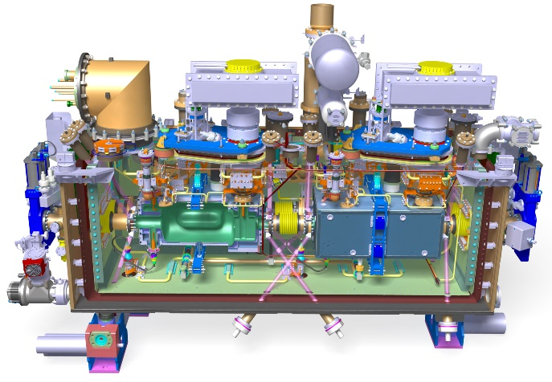
Thank you for your attention

Slide 16
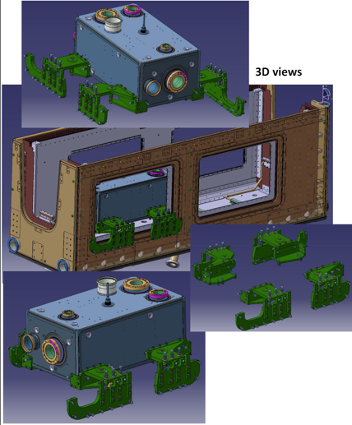
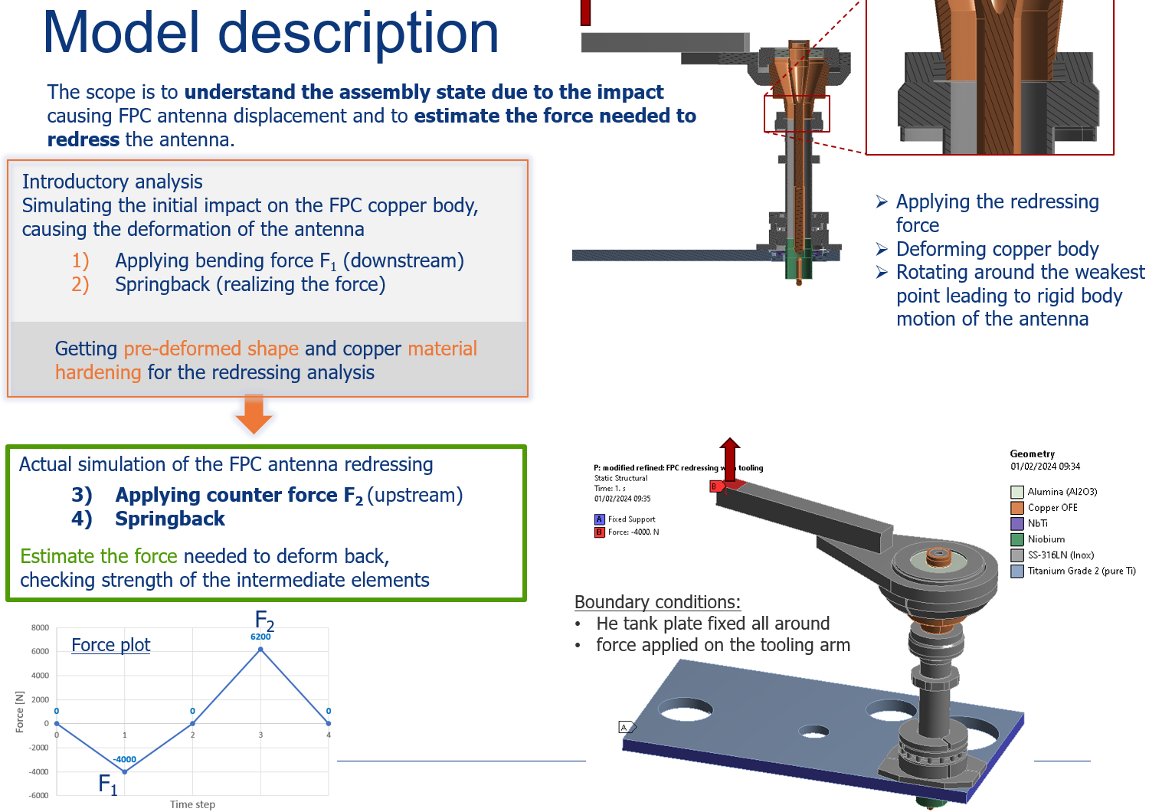
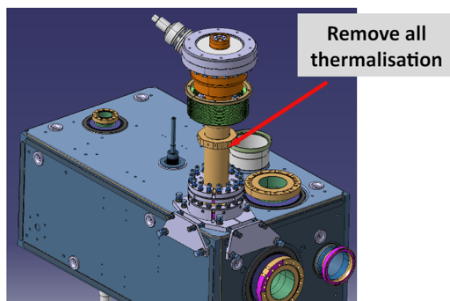
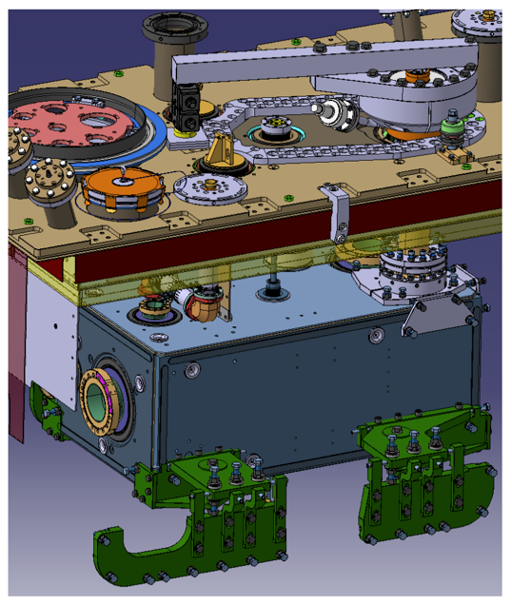
Design and Sim. Activities for FPC repair
Mechanical simulation : EDMS 2977959 – J.SWIESZEK
Tooling design to repair both cavities : EDMS 2977959 – P.MINGINETTE
See the dedicated presentation by Simon Barrières, Joanna Swieszek & Edward Jordan
courtesy P.Minginette
courtesy J.SWIESZEK
The calculation and the design were iterative and includes the inputs from S.Barrière, L.Prever Loiri and SY/RF (S.Calvo, E.Montesinos)

Slide 17
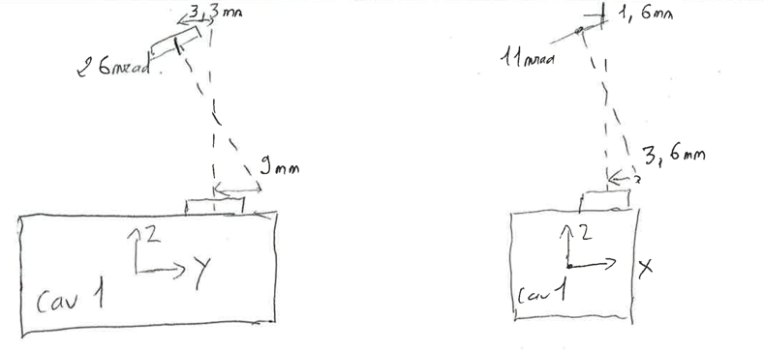
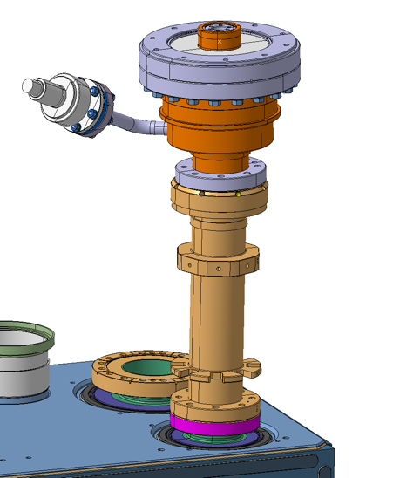
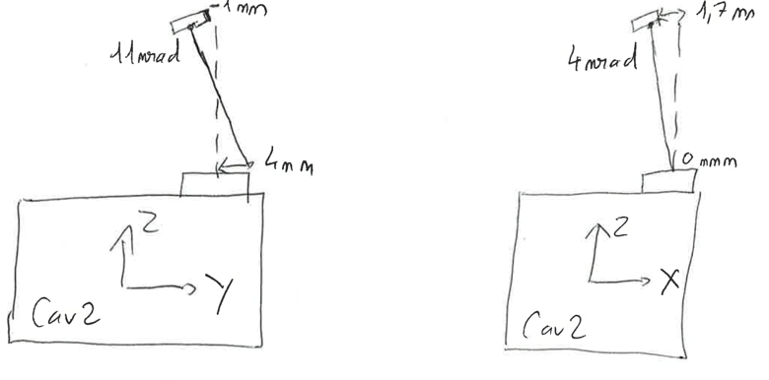
Virtual evaluation of deformation
FSI Measures – V.Rude
A measure of both the top FPC flange and the lower FPC outer pipe flange (Plane + axis for both) show a deviation as described on the sketches bellow :
CAVITY 1
Equivalent total angle = ~1.6°
Top flange plane
Top flange cylinder used to build axis
Fig .5
Measured using laser tracker – courtesy V.Rude
CAVITY 2
Equivalent total angle = ~0.7°
Lower plane FPC outer pipe flange
Lower flange cylinder used to build axis
Fig .6
Measured using laser tracker – courtesy V.Rude

Slide 18






Virtual evaluation of deformation
Radiographic measures – A.Porret
X-ray confirms our preliminary observations :
  The hook isn’t bended
  The deviation starts from the top
Set up preview - courtesy A.Porret
3D modelling of the deviation
Result of radiographic measure (see full results in EDMS 2995980)- courtesy A.Porret
Theoretical clash = 0.5mm
(Hook/cavity wall)

Slide 19




Bonus : Test of material for clean room tooling
Machining
Additive manufacturing
Non-anodized Aluminum
Accura25 (Polycarbonate)
PLA (Polylactic acid)
Cost of manufacturing :
  the Accura cost of manufacturing is 2 times the cost of the PLA
  Aluminium parts costs 4 times the PLA part
Results
 | 0,3µm | 0,5µm | 1µm | 5µm | ISO
Aluminum | 0 | 0 | 0 | 0 | 1
Accura25 | 211 | 194 | 158 | 17 | 5
PLA | 2818 | 741 | 194 | 0 | 5
  Extracted from report EDMS 3141216
  (courtesy Micaela Battista – Nuria Valverde)
Discussion about the possibility to use Accura if the part is not close to the working area
(i.e. : close to open SRF/UHV volume)

Slide 20




Thermal budget RFD
Thermal budget DQW
Static loads
Static loads (estimates)
Thermal budget estimate
DQW/SPS - 2016
EDMS 1729079
Revised estimation using measurements taken during cold tests
DQW/SPS – 2017/2018
Thermal budget report for RFD:
See EDMS 2310389 - Thermal budget RFD cryomodule
Courtesy J.Swieszek – L.Giordanino
Thermal budget report for DQW to be updated
Teddy Capelli CERN/EN-MME

Slide 21
Alignment / Survey activities during CM build
# | Task Name
0 | CM2
1 | Step Aux.A - Pre-Cleanroom
4 | Alignment of components on the trolley
6 | Step1 - Cleanroom String Assembly
22 | Step Aux.F Top Plate Equipped
23 | Attach fiducials to Top Plate
24 | Install FSI heads
25 | Fiducialization of top plate
33 | Step Aux.*G* Lower OVC
34 | Attach fiducials to lower OVC
35 | Install FSI heads
36 | Fiducialization of lower OVC
38 | Step3 BiPhase & Tuner Frame Assy & FPC Plate Weld
40 | Alignment of FPC plate
60 | Step 5 Top Plate Assy & Interfaces
64 | Alignment of top plate WRT string
72 | Step 6 Load Transfer
76 | Install FSI targets on cavity flanges
98 | Step 10 Lower OVC Integration
101 | Alignment between lower vessel and top assembly
105 | Check alignment of cavities -->Model for the movement of the cavities caused by vacuum and cooling
 | Installation FSI system + Optcal fibers
 | Measurement of the cryomodule + FSI Heads at ambient pressure
 | Intercomparison FSI versus laser tracker
106 | Step 11 OVC Welding & CM Ancillaries
118 | CM2 Acceptance Tests
119 | Pressure Tests
 | Measurement of the cryomodule + FSI Heads under vacuum
120 | Cold Cycling + Tuner Check
 | Measurement of the cryomodule + FSI Heads at cold

