Slide 1
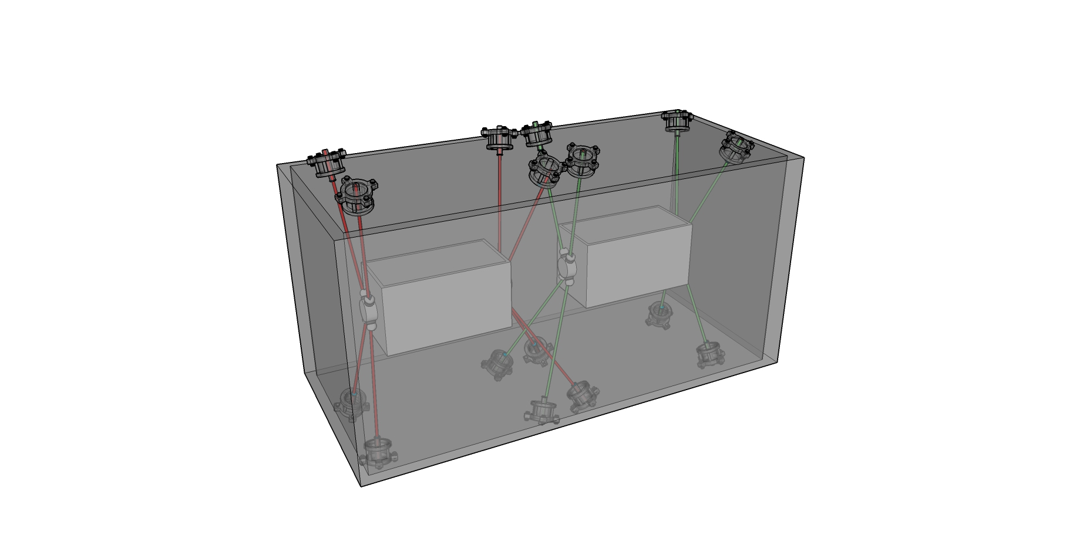
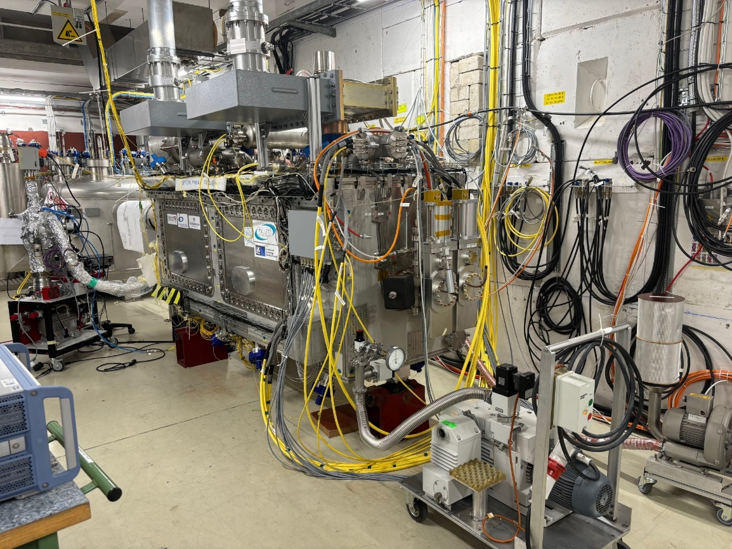
Alignment analysis of the RFD prototype during cold test at CERN
Vivien RUDE
2024-10-09
On behalf :
Mateusz SOSIN
Praneeth Sarvade,
Daniel Szarata
Clara Cala Franco
Julia Calmels
14th HL-LHC Collaboration Meeting, Genoa (Italy), 7-10 October 2024

Slide 2
Outline
Alignment objectives (3 objectives)
Internal monitoring configuration and challenges
Alignment RFD Prototype results
Conclusion and perspectives
Spare : FSI following during Cavity 2 repair

Slide 3
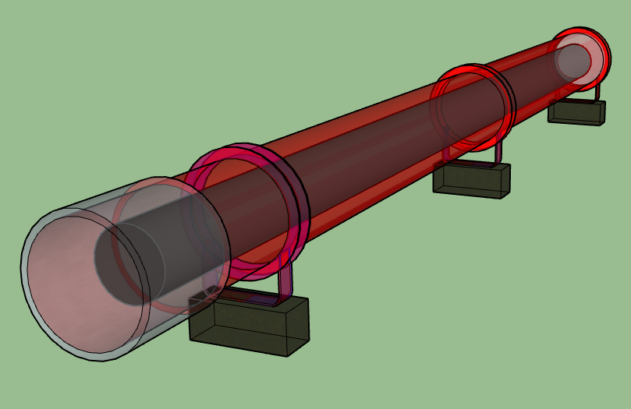
Internal monitoring for “special” components
Q1, Q2a, Q2b, Q3
Crab-Cavities
Cryomodule
Vacuum vessel
Cold mass
Crab cavities
Vacuum vessel
Cryomodule
Axis of the Cold mass
At cold
Nominal axis
Axis of the Crab cavities
At Cold

Slide 4
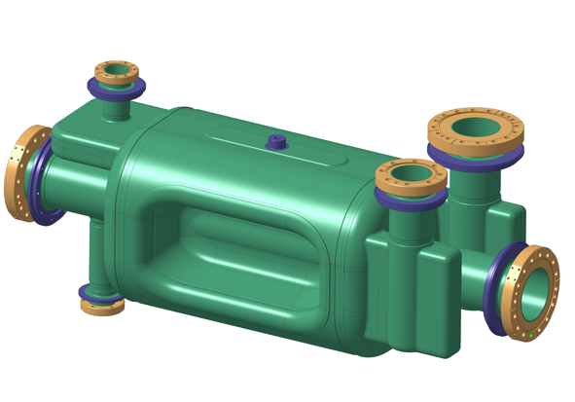
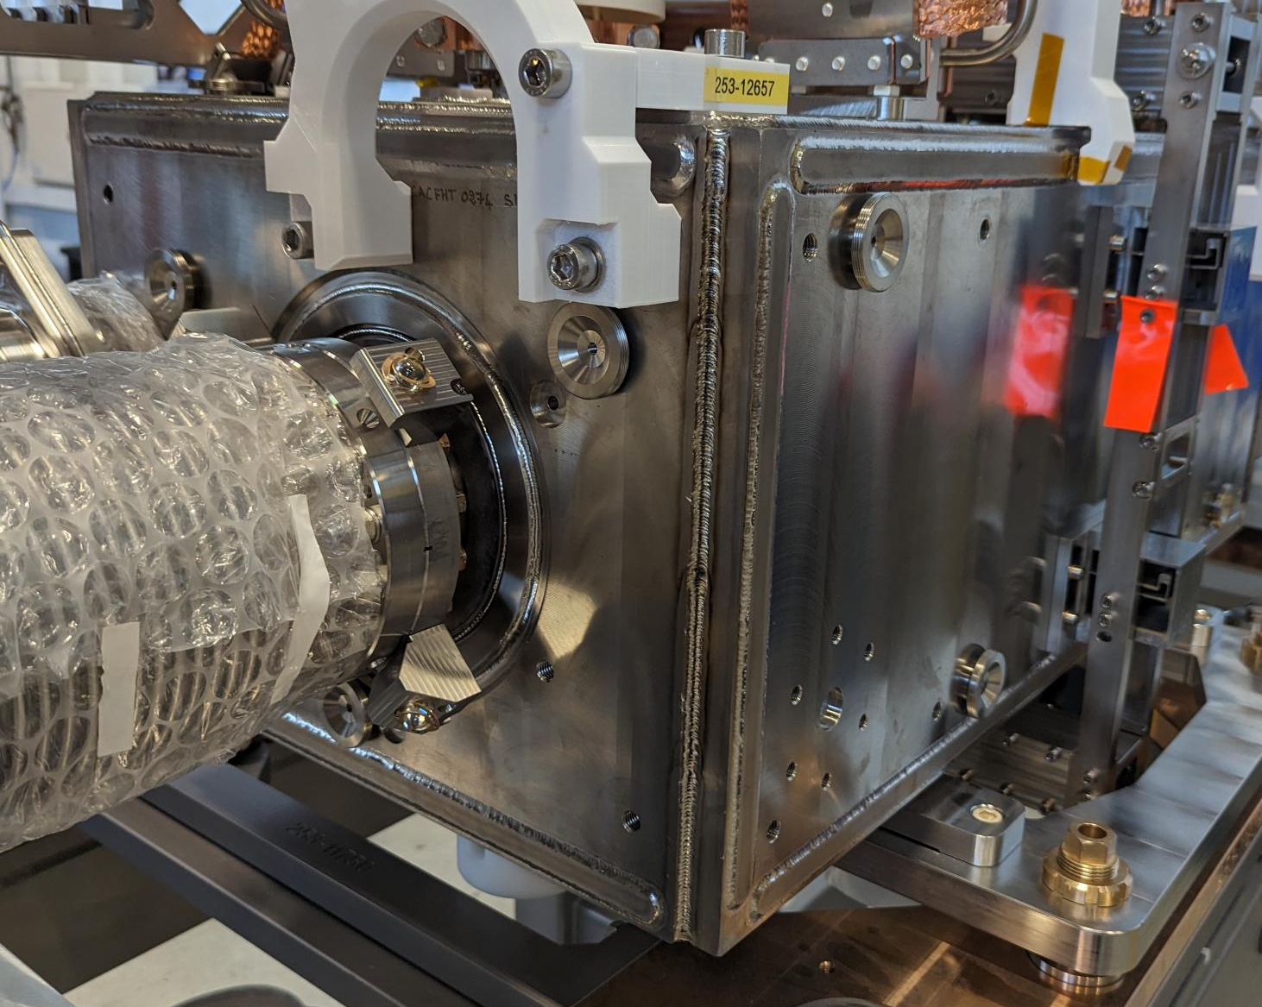
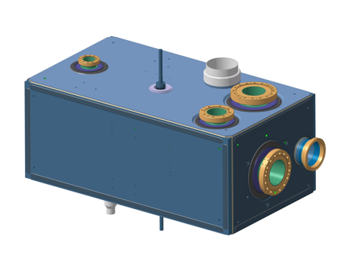
Alignment Objective n°1 : Fiducialisation
Cavity radio frequency axis → Approximated to mechanical axis of the capacitive plate
Bare Cavity
Axis of the
capacitive plate
Dressed Cavity
8 Alignment targets :
FSI targets
Axis of the
capacitive plate
Alignment requirement
Position : 50 μm (1σ)
Roll : 100 μrad (1σ)

Slide 5
Alignment Objective n°2 : Internal monitoring
Cryomodule
Alignment requirement
Position : < 100 μm (1σ)
Roll : < 400 μrad (1σ)
Cavities RF

Slide 6
Alignment Objective n°3 : External monitoring
UPS gallery
P1
P2
P3
P4
P5
P6
Alignment between Q5-left and Q5-right :
Vertical Limits : σ (1 sigma) < 0.17 mm
Radial Limits : σ (1 sigma) < 0.33 mm
Alignment between Q1 and Q5 :
Limits : σ (1 sigma) < 0.1 mm
Inner
Tracker
EXP.
Q5
Q4
CC2
CC1
D2
TCLX
TCTPH
TCTPV
TAXN
D1
CP
Q3
Q2b
Q2a
Q1
Q1
Q2a
Q2b
Q3
CP
D1
TAXN
TCTPV
TVTPH
TCLX
D2
CC1
CC2
Q4
Q5
Left
Right
R = 0.33 mm
R = 0.1 mm
R = 0.1 mm
Alignment requirement
Align all the components per IP side : < 100 μm (1σ)
Align all the components (Left and Right) : Vertical < 170 μm (1σ)
Align all the components (Left and Right) : Radial < 330 μm (1σ)
Roll : < 150 μrad (1σ)

Slide 7
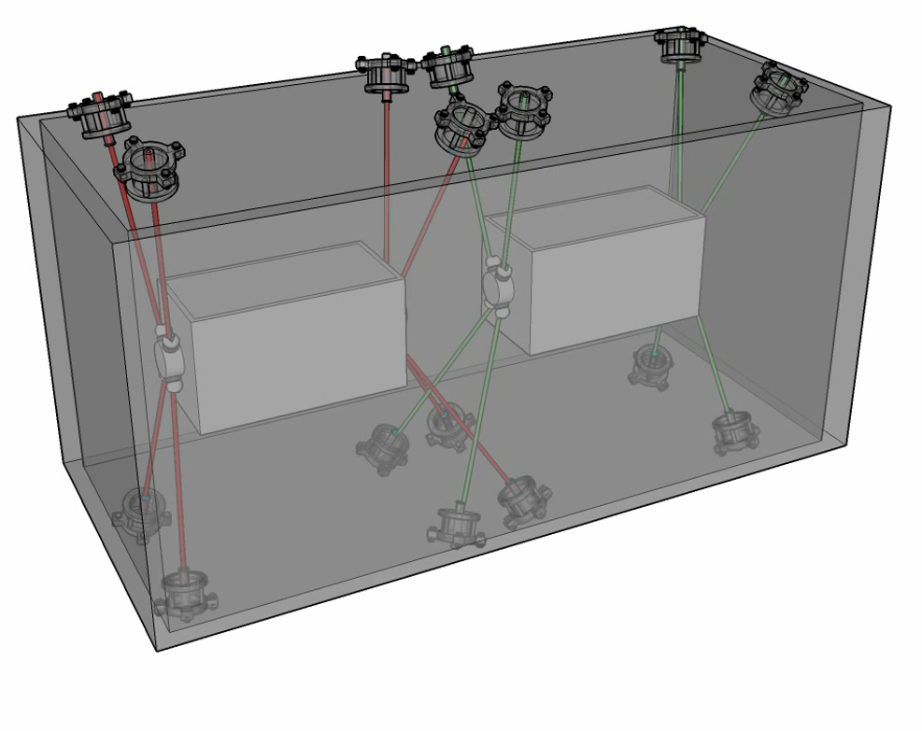
Internal monitoring
Alignment requirement
Position : < 100 μm (1σ)
Roll : < 400 μrad (1σ)

Slide 8
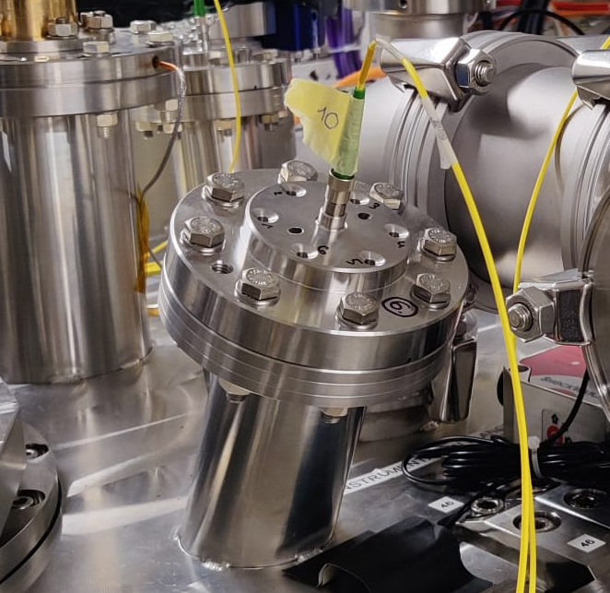
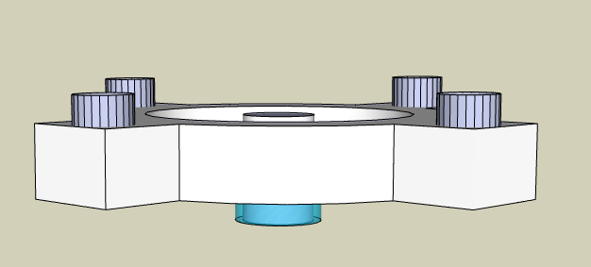
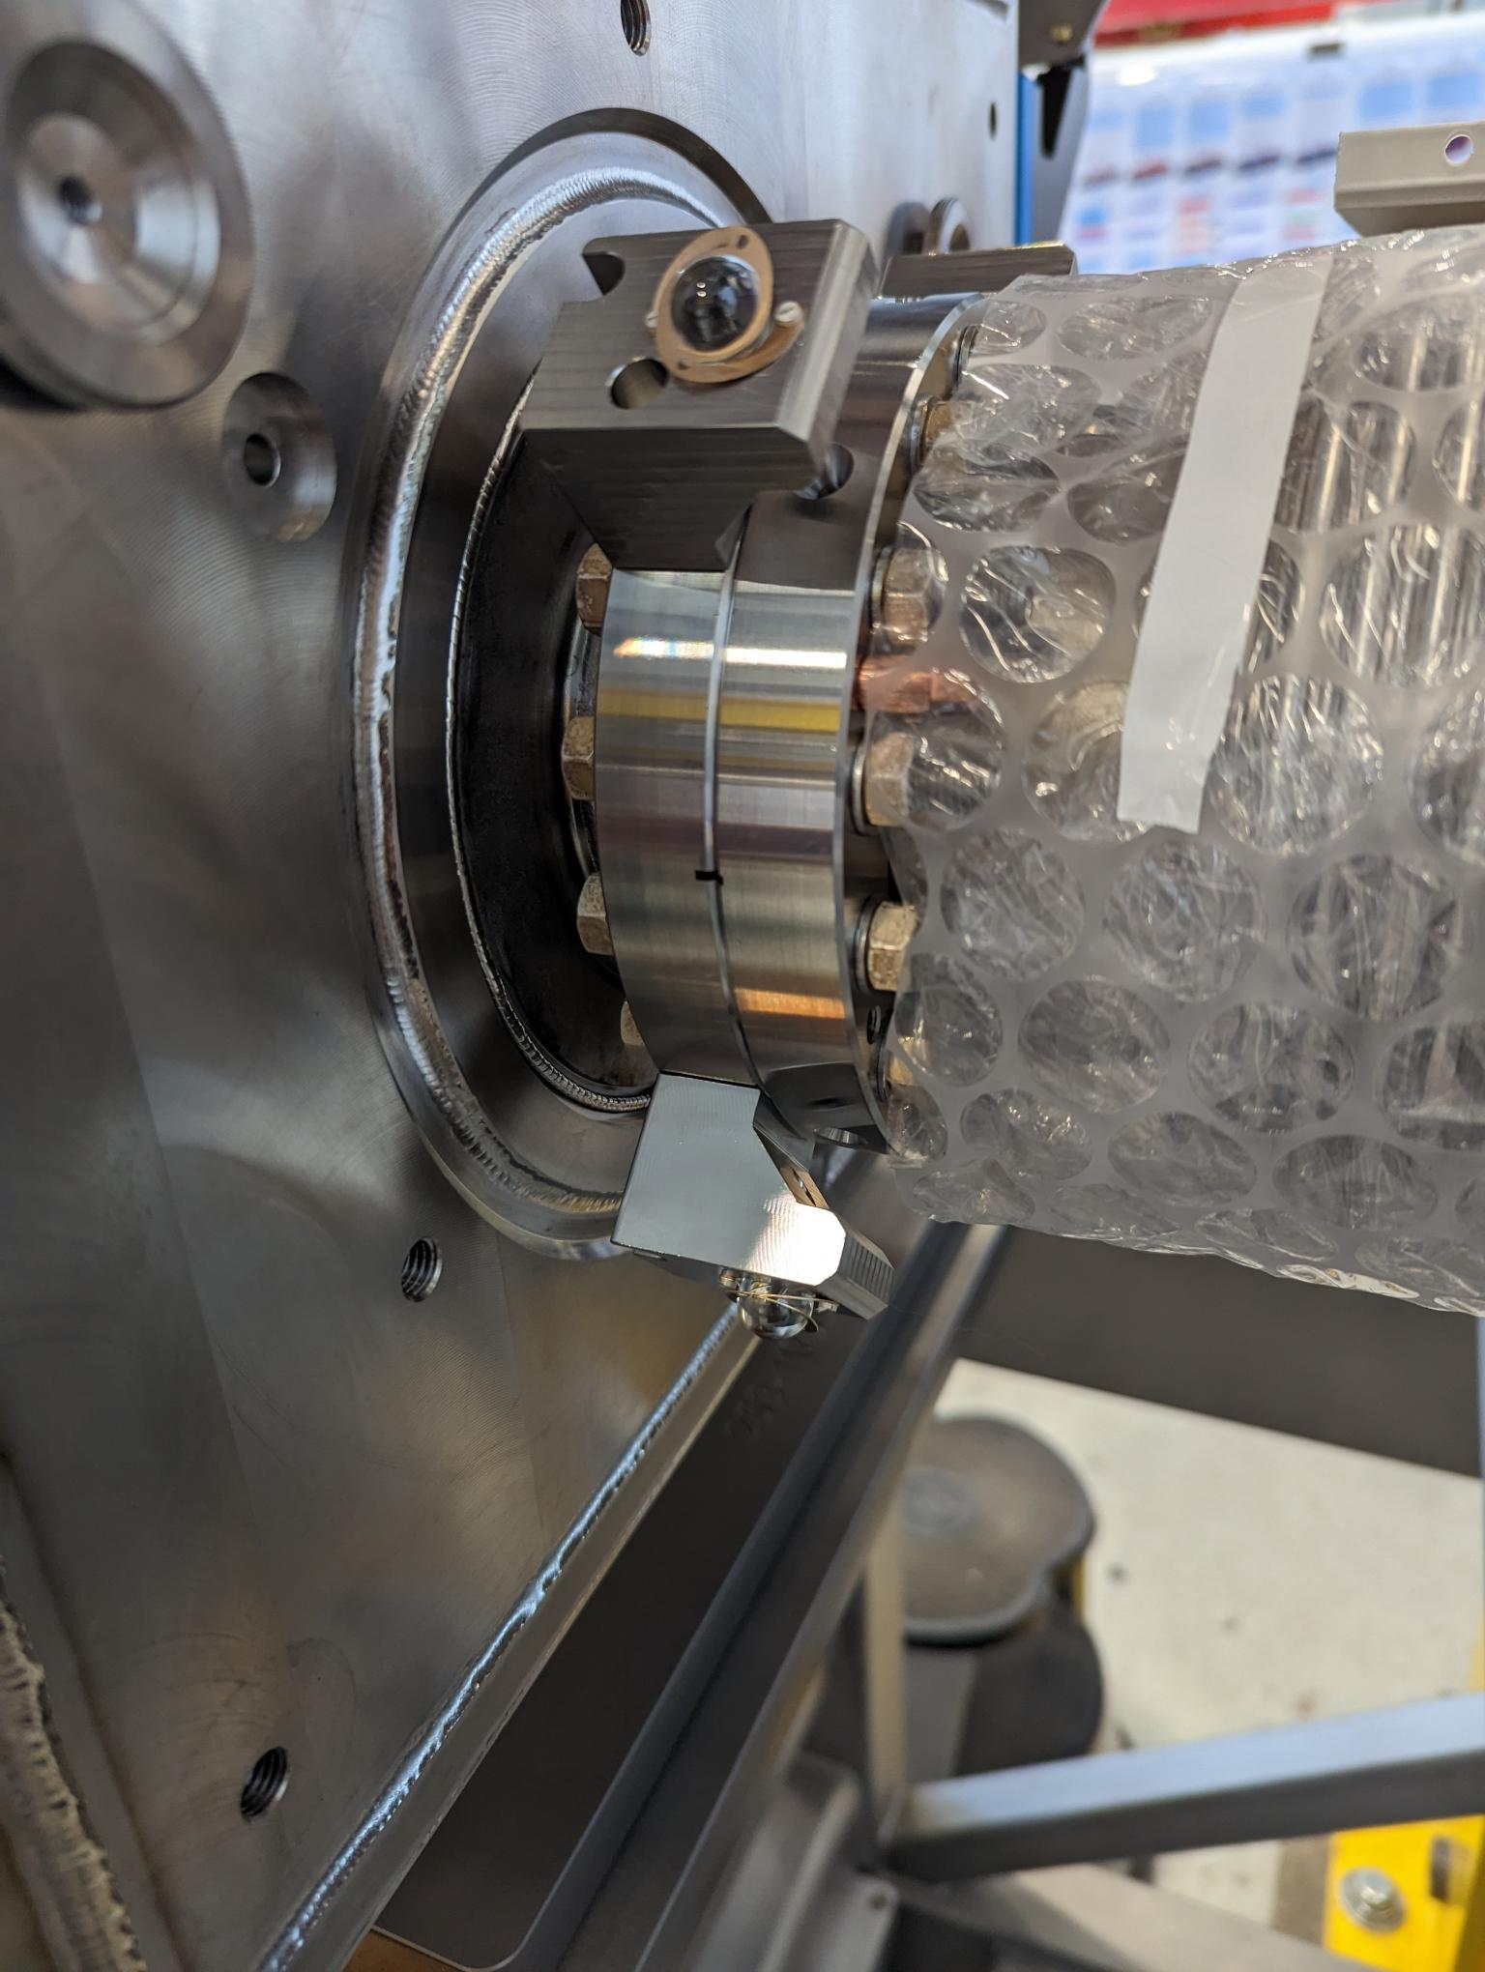
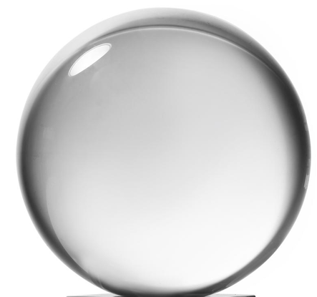
Internal monitoring : Configuration
Largest standard uncertainties | Uncertainty (1σ)
Position of the FSI Sensor in the framework of the cryomodule | 40 µm
Position of the FSI target in the framework of the crab-cavity | <15 µm
  FSI : Frequency Scanning interferometry
  → Absolute distance measuring interferometric technique
FSI Head (sensor)
on the Cryomodule
FSI Acquisition system
Optical fibre
Feedthrough
(FSI Head)
Fiber ferrule tip
8 FSI meas.
FSI target
on the flange of Helium TANK of the cavities
8 FSI meas.
Reflecting
glass sphere
(FSI target)
Total : 16 observations
(3D distances)
reflection
Support
FSI target
Flange of Helium Tank of RF Crab-cavities

Slide 9
Internal monitoring : Challenges and prerequisites
Ambient pressure
Measurement + Adjustment
Under vacuum
Anticipation
Cooling down
Anticipation
The position of the FSI sensors w.r.t. cryomodule must be measured with an accuracy of less than 40 microns.
Anticipation of the Deformation of the outer envelope with an accuracy of less than 40 microns
(deformation up to 1.2 mm)
Anticipation of the Movement of the cavities :
(Complex movement up to 0.4 mm
6 DOF)
Anticipation of the Deformation of the outer envelope with an accuracy of less than 40 microns
(deformation up to 0.1 mm)
Anticipation of the Movement of the cavities :
(Complex movement up to 1.2 mm
7 DOF)
The position of two cavities should be determined at cold at less than 0.1 mm (1sigma)
The position of two cavities at cold should be aligned at less than 0.1 mm (1sigma)
Two inner components
Non compensable misalignment
on the external envelope
No possibility to adjust
All adjustments should be carried out at ambient pressure.
ANTICIPATION : The position of the cavities should be at their nominal position at warm with an accuracy of less than 40 microns.
FSI Sensor
Cryomodule
Beam
RF cavity
RF cavity

Slide 10
Alignment analysis of the RFD prototype
during cold test at CERN

Slide 11
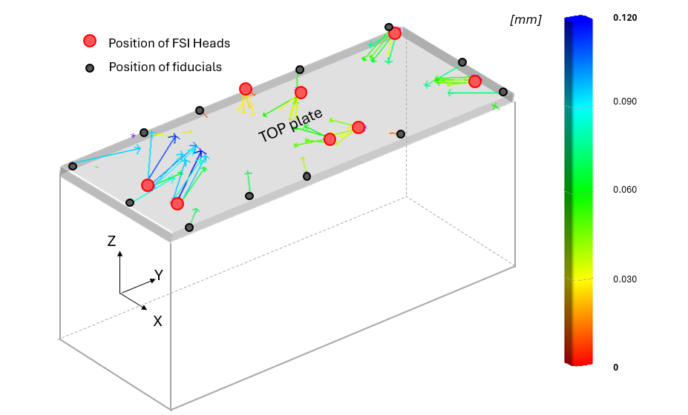
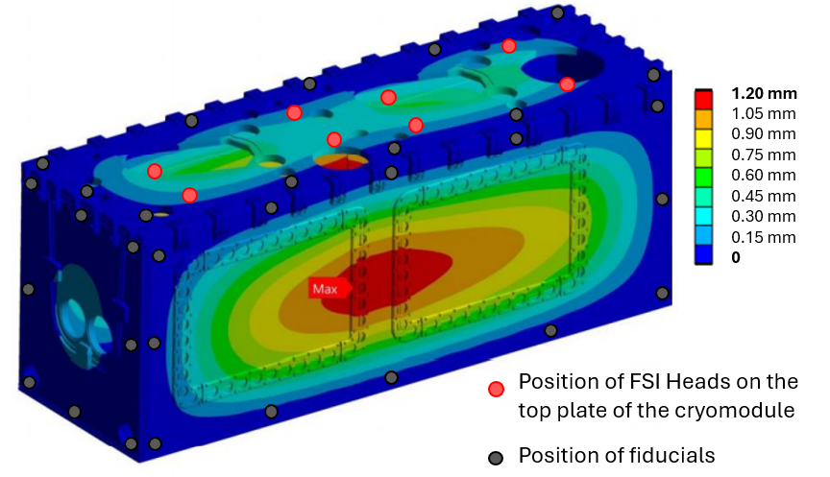
Deformations of the cryomodule (due to pumping and cooling down)
No deformation was observed on the edge of the top plate during pumping.
During cooldown, the top plate observed a thermal contraction due to thermal convection between the thermal screen and the top plate --> not expected but repeatable--> Can be anticipated
Ambient pressure
Max deformation :
1.20 mm
Under vacuum
Max deformation :
0.12 mm
Cold
Shape Repeatability
For 3 cycles :
Maximum dispersion : 67 μm
Average dispersion : 18 μm
Shape Repeatability
For 3 cycles :
Maximum dispersion : 57 μm
Average dispersion : 16 μm
Shape Repeatability
For 3 cycles :
Maximum dispersion : 68 μm
Average dispersion : 17 μm
Shape of the cryomodule at ambient pressure
Repeatable at +/- 0.040 mm (RMS)
Shape of the cryomodule under vacuum
Repeatable at +/- 0.040 mm (RMS)
Shape of the cryomodule at cold
Repeatable at +/- 0.040 mm (RMS)

Slide 12
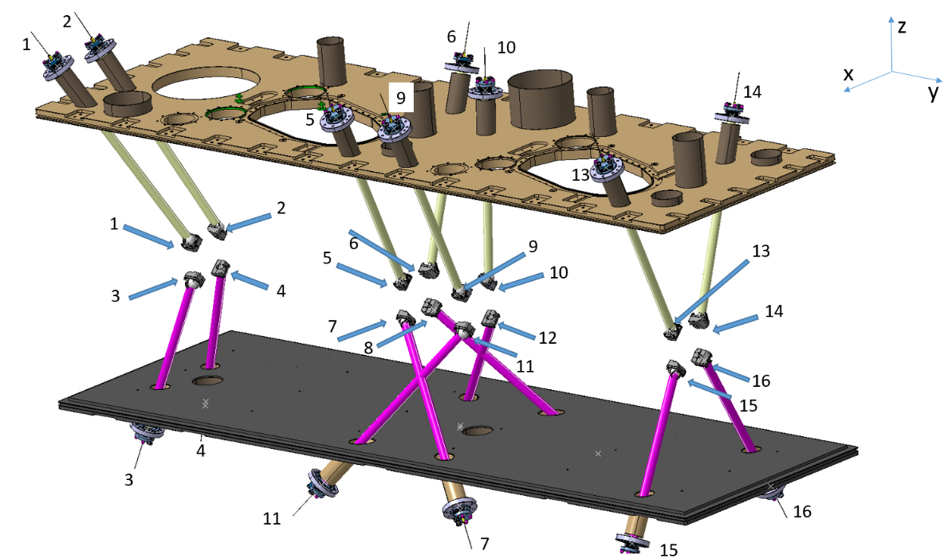
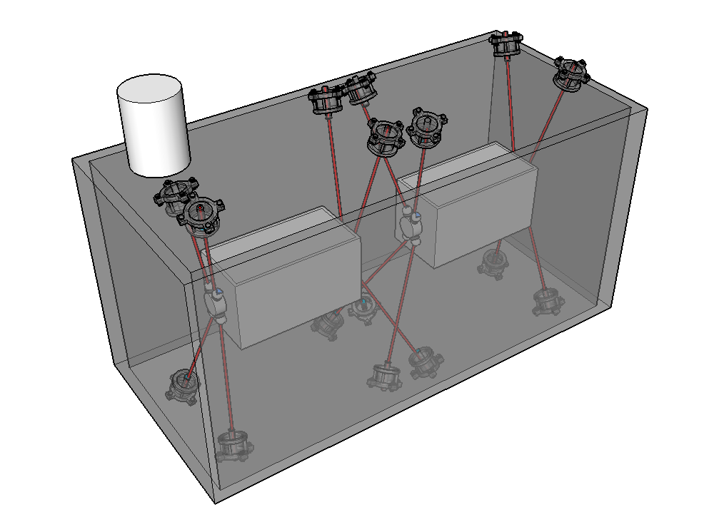
Uncertainty of position of cavities inside the cryomodule
Alignment requirement
Position : < 100 μm (1σ)
Roll : < 400 μrad (1σ)
A priori sigma : 0.04 mm | Parameter | Accuracy expected (simulation)
Cav1 | Tx (mm) radial | 0.16
 | Ty (mm) longitudinal | 0.08
 | Tz (mm) vertical | 0.08
 | Rx (mrad) pitch | 0.08
 | Ry (mrad) roll | 0.41
 | Rz (mrad) yaw | 0.41
Cav2 | Tx (mm) radial | 0.04
 | Ty (mm) longitudinal | 0.10
 | Tz (mm) vertical | 0.02
 | Rx (mrad) pitch | 0.04
 | Ry (mrad) roll | 0.36
 | Rz (mrad) yaw | 0.10
SCALE (mm/m) |  | 0.11
Bad geometry
for cavity 1
Jumper

Slide 13
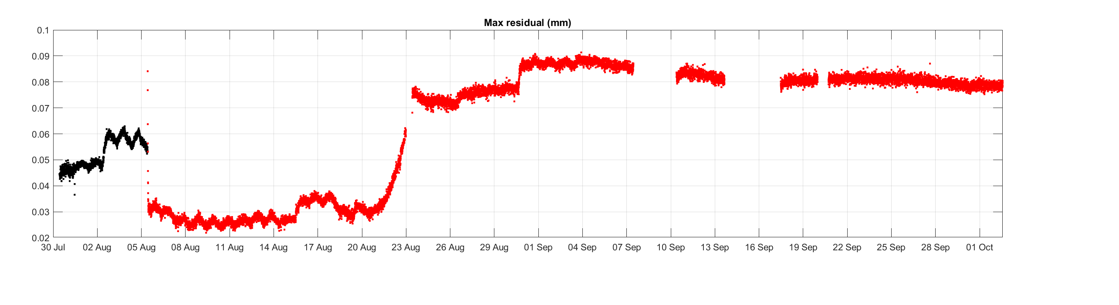
Uncertainty of position of cavities inside the cryomodule
Objective : RMS residual < 0.04 mm
Pumping
Cooling down
Maximum
Residual
[mm]
 | Parameter | Current accuracy (reality)
Cav1 | Tx (mm) radial | 0.20
 | Ty (mm) longitudinal | 0.20
 | Tz (mm) vertical | 0.15
 | Rx (mrad) pitch | 0.15
 | Ry (mrad) roll | 0.70
 | Rz (mrad) yaw | 0.50
Cav2 | Tx (mm) radial | 0.08
 | Ty (mm) longitudinal | 0.10
 | Tz (mm) vertical | 0.05
 | Rx (mrad) pitch | 0.05
 | Ry (mrad) roll | 0.40
 | Rz (mrad) yaw | 0.10
SCALE (mm/m) |  | 0.20
Alignment requirement
Position : < 100 μm (1σ)
Roll : < 400 μrad (1σ)
Issue with FSI Target Holder:
FSI targets are not making proper contact with the holder.
Different thermal contraction of glass and metal causes spring permanent deformation
→ Upgrade to spring frictionless fixation
The current uncertainties for cavity 2 stay within
the objective

Slide 14
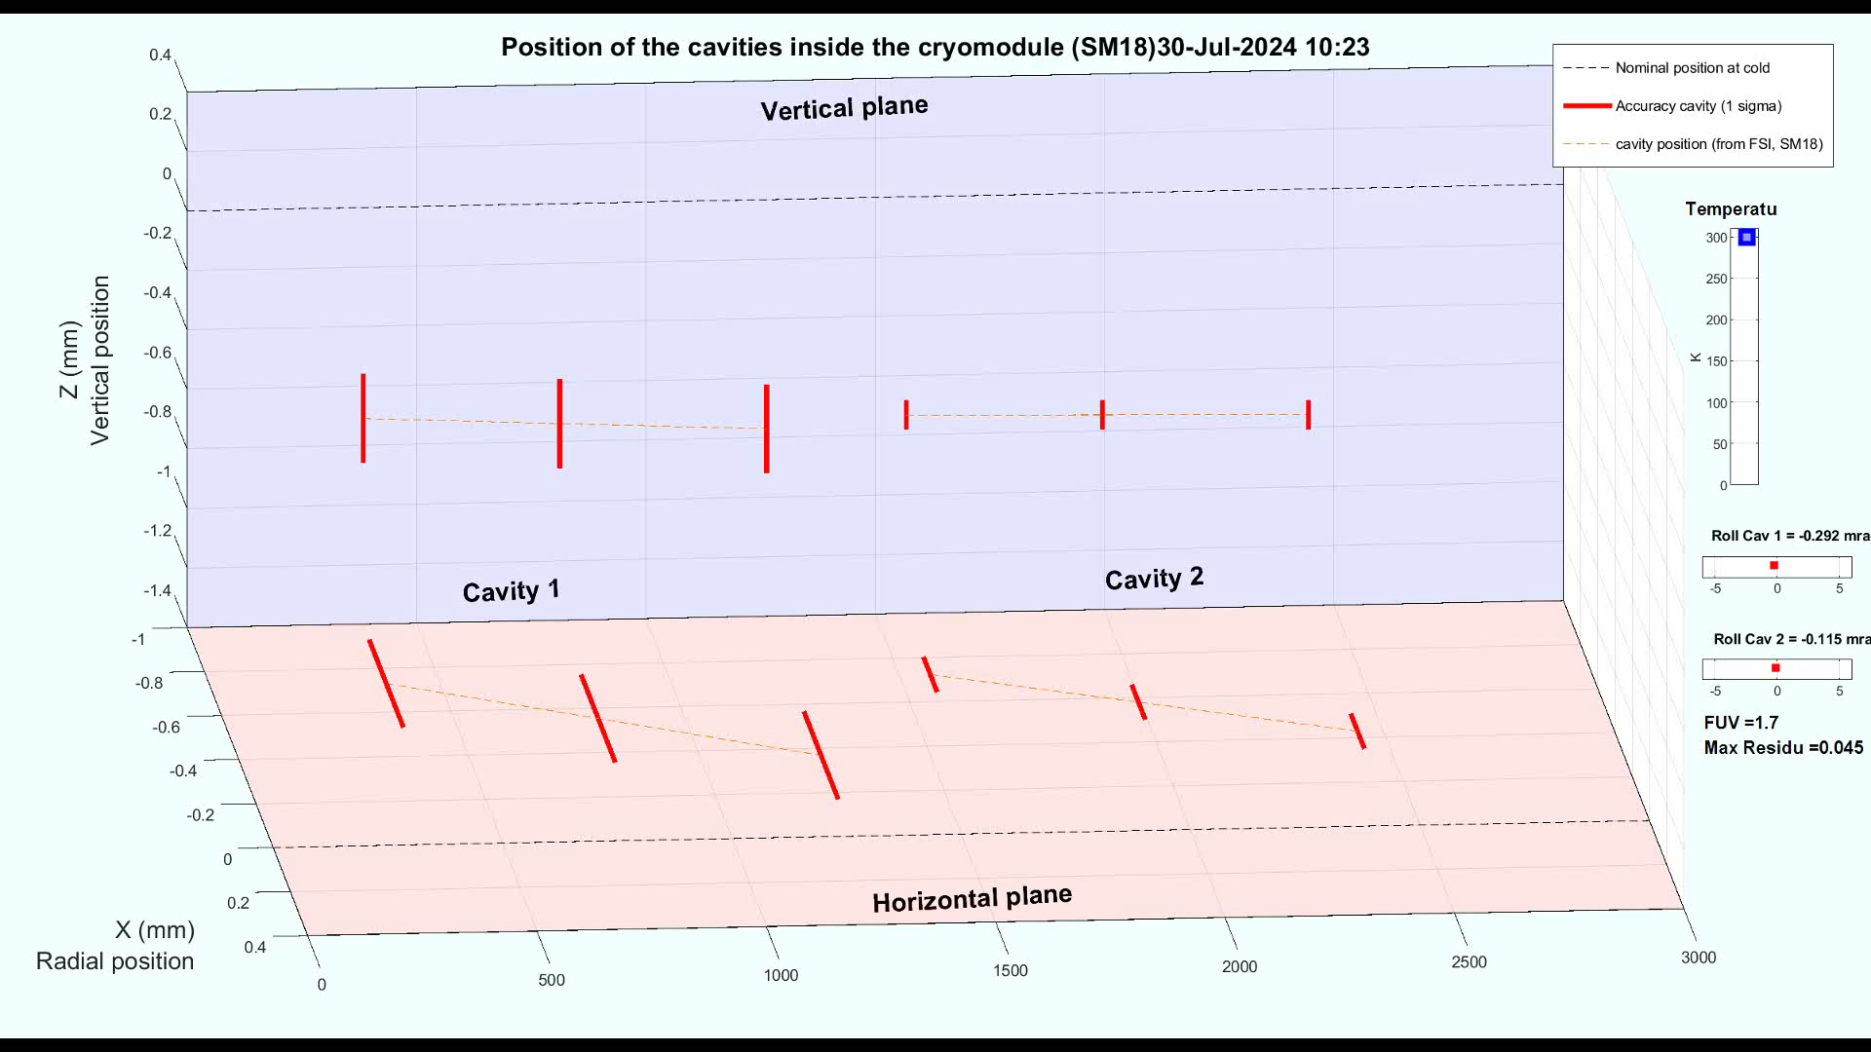
Motions of the cavities during the three states
Objective at cold
Objective at cold

Slide 15
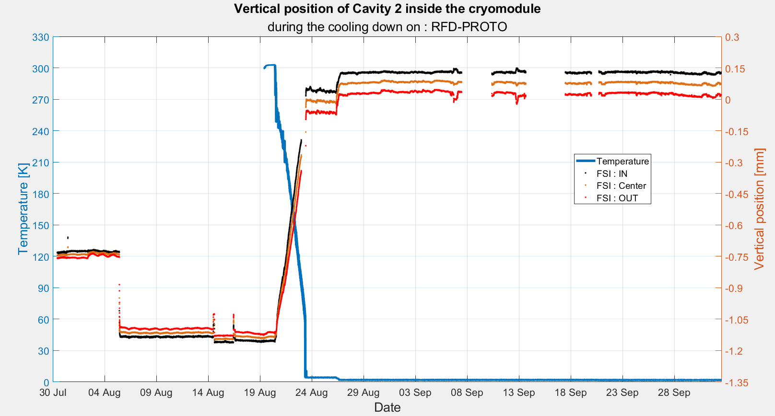
IN (cav 2)
Pumping
OUT (cav 2)
Objective : 0 mm +/- 0.1 mm
Cooling down

Slide 16
Current positions at cold (Sept 2024)
Radial
Vertical
Cavity 1
Cavity 2
Cavity 1
Cavity 2
Objective
at cold
Warm position
Cold position

Slide 17
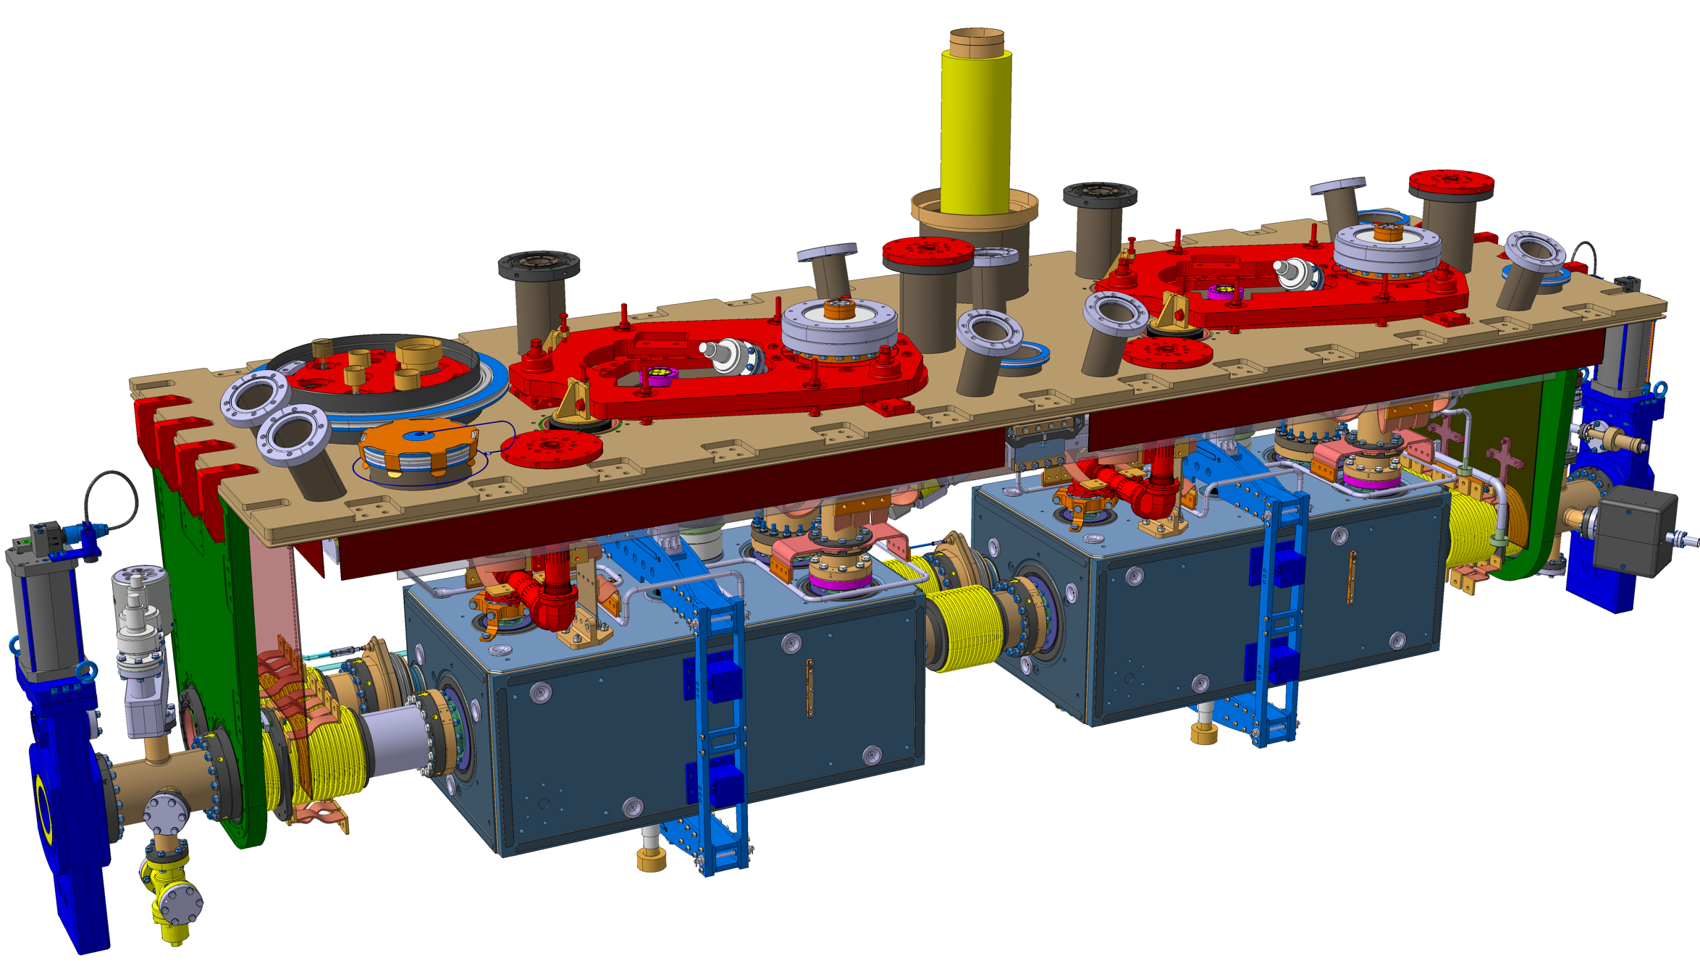
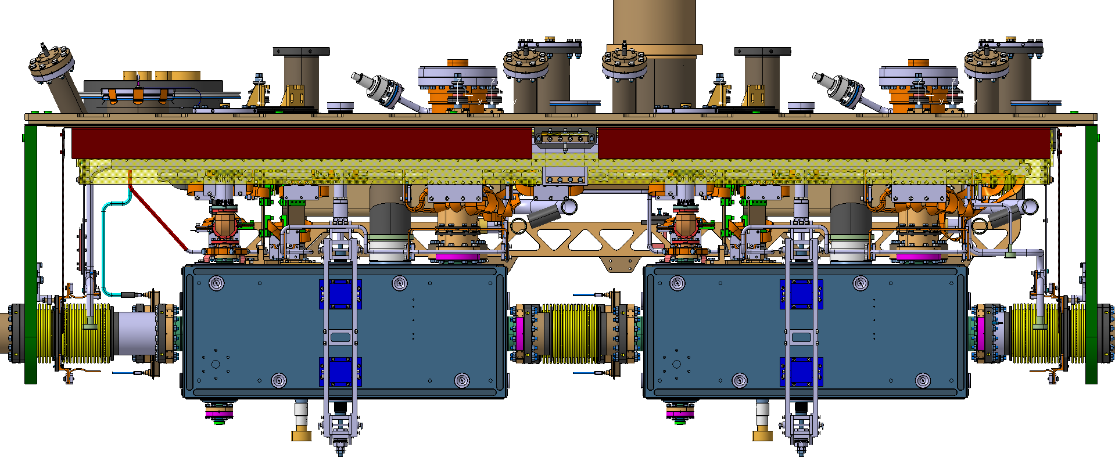
Relative Motions of the cavities
due to vacuum and cooling down (cycle 3)
Step 3 : Cavity with
cryomodule at cold
875 mm
Step 3 : Cavity with
cryomodule at cold
IN
OUT
Step 2 : Cavity with
cryomodule under vacuum
Step 1 :
Cavity with cryomodule
at ambient pressure
Step 1 :
Cavity with cryomodule
at ambient pressure
Step 2 : Cavity with
cryomodule under vacuum

Slide 18
Repeatability on the motions
Cycle 2 : 15/16 FSI observations are operational
Cycle 3 : 16/16 FSI observations are operational
Cold position
(after cycle 3)
 | Cavity 2
Impact of cold | Cycle 2 | Cycle 3
Tx [mm] (radial translation) | 0.60 | 0.57
 | +/-0.10 | +/-0.08
Ty [mm] (longi translation) | 0.15 | 0.27
 | +/-0.15 | +/-0.10
Tz [mm] (vertical translation) | 0.76 | 0.81
 | +/-0.05 | +/-0.05
Rx [mrad] (Pitch angle) | 0.05 | -0.08
 | +/-0.05 | +/-0.05
Ry [mrad] (Roll angle) | -0.74 | -0.41
 | +/-0.40 | +/-0.40
Rz [mrad] (Yaw angle) | 0.45 | 0.31
 | +/-0.15 | +/-0.10
Scale [mm/m] | -2.22 | -2.14
 | +/-0.20 | +/-0.20
Difference between motion of cavity 2 on cycle 2 and cycle 3
Radial : 30 μm
Uncertainty : 100 μm
Repeatable
Longitudinal : 120 μm
Uncertainty : 150 μm
Repeatable
Experience from cycle 2
Vertical : 50 μm
Uncertainty : 50 μm
Repeatable
Warm position
(before cycle 3)
Pitch : 130 μrad
Uncertainty : 50 μrad
Close to be
repeatable
Roll : 320 μrad
Uncertainty : 400 μrad
Repeatable
Yaw : 140 μrad
Uncertainty : 150 μrad
Repeatable

Slide 19
Conclusion
Cryomodule
The shape of the cryomodule must be repeatable at ambient pressure with an uncertainty of less than 40 μm.
The shape of the cryomodule must be repeatable under vacuum with an uncertainty of less than 40 μm.
The shape of the cryomodule must be repeatable under vacuum with an uncertainty of less than 40 μm.
Crab-cavities
The movement of the two cavities between warm (ambient pressure) and cold should be repeatable with an uncertainty of less than 40 μm
→ 50 μm for cavity 2 (Translations)
→ 150 μm for cavity 1 (difficult to confirm due to lack of accuracy for cavity 1
The accuracy of each FSI measurement must be validated within 40 μm
→ FSI targets holders to be improved

Slide 20
Next steps
RFD prototype : SPS installation
The installation of the cryomodule in the SPS is scheduled for the technical stop (TS) in 2024-2025
The impact of transport of the cryomodule will be tested to ensure that it does not affect the alignment
A new alignment of the cavities will be carried out in the SPS during this period (with experience results of cycle 3)
The position of the radio-frequency axis will be analysed using the beam, confirming the alignment and validating the assumption that the radio-frequency axis can be approximated to the mechanical axis of the capacitive plates.
Series
FSI targets holders will be improved

Slide 21
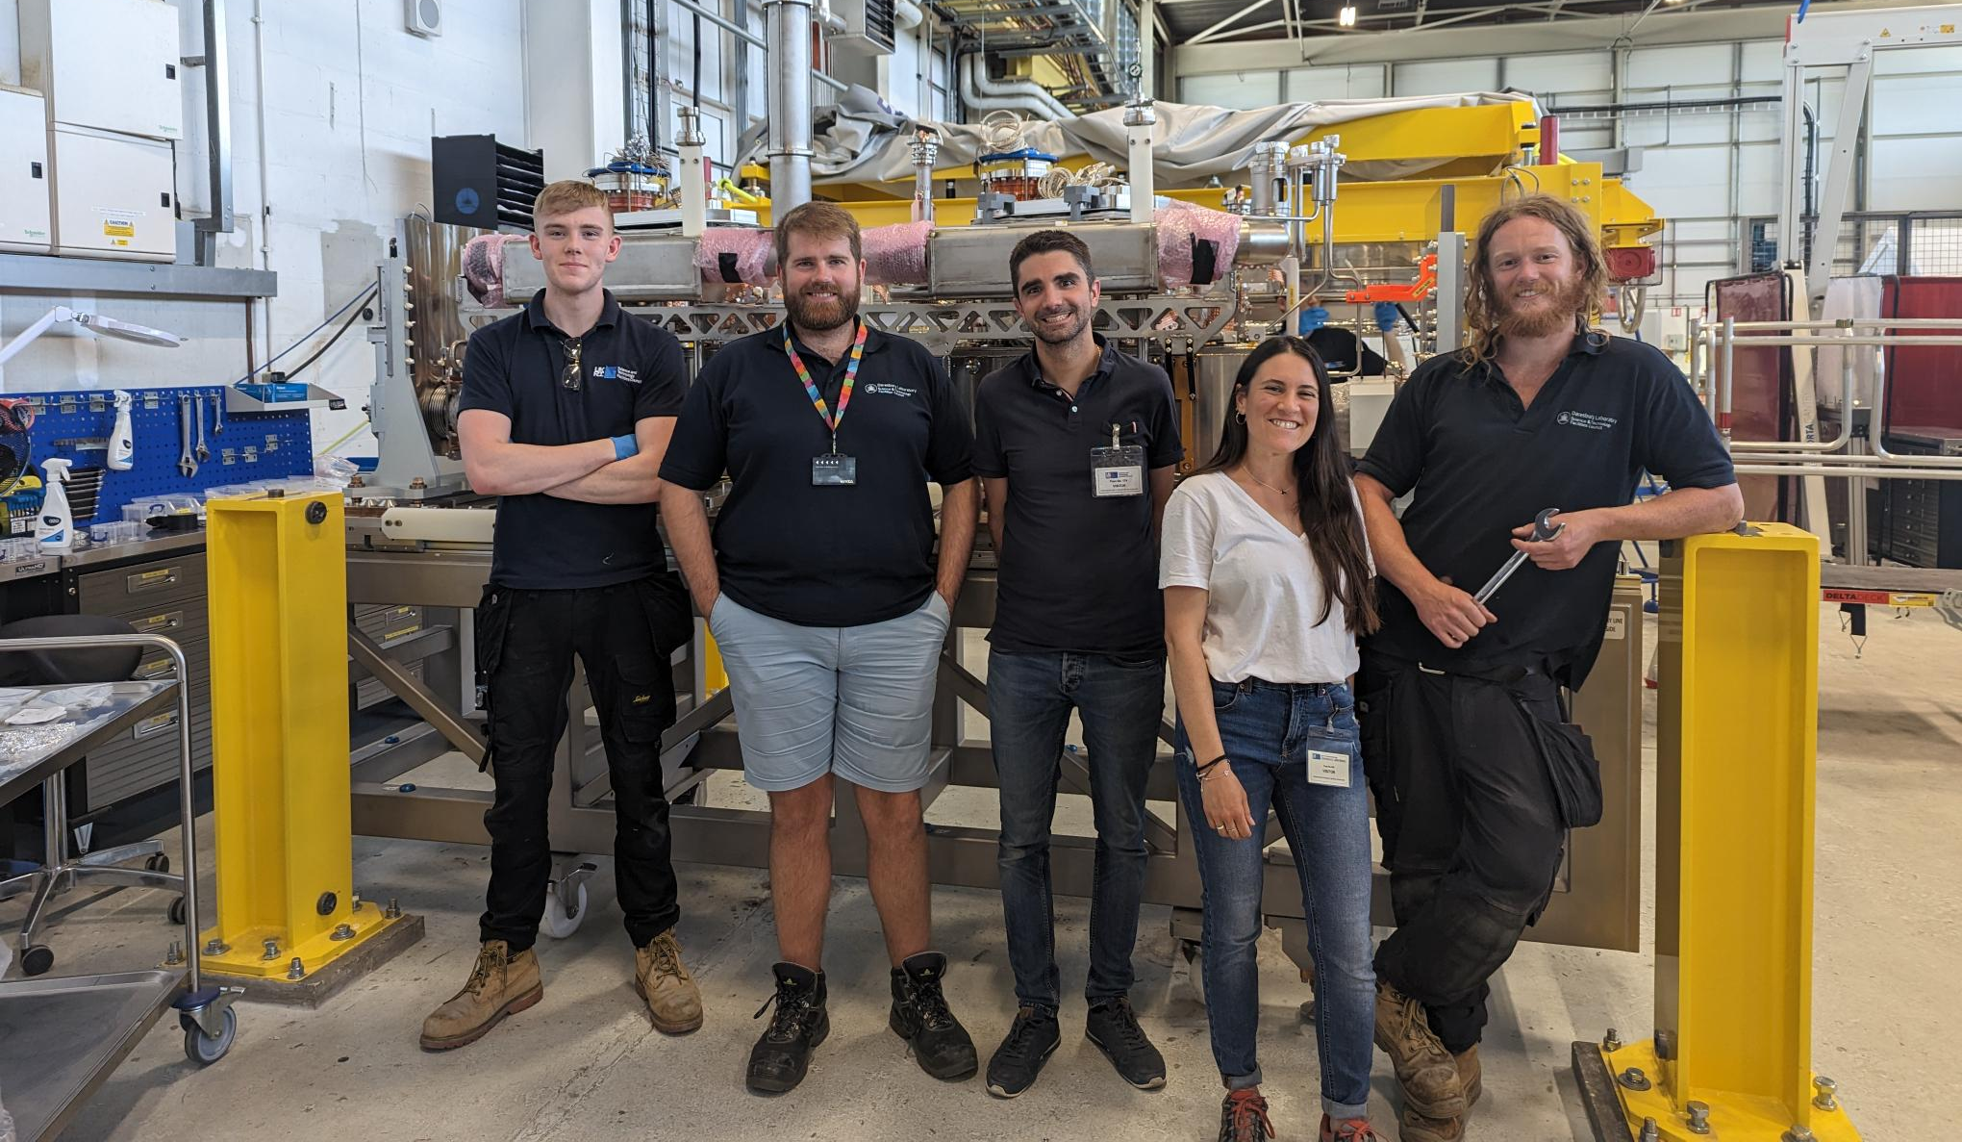
Conclusion
The RFD prototype is ready to go into the SPS accelerator !
Many thanks to STFC team :
Nik
Ed
Luke
Ryan
Carlos
Andy
…
Many thanks to CERN team :
Teddy
Simon
Marco
Nuria
Katarzyna
Kurt
Rama
Raphael
Luca
Ofelia
Julien
…
Thank you for your attention

Slide 22
FSI following
Cavity 2 repair

Slide 23
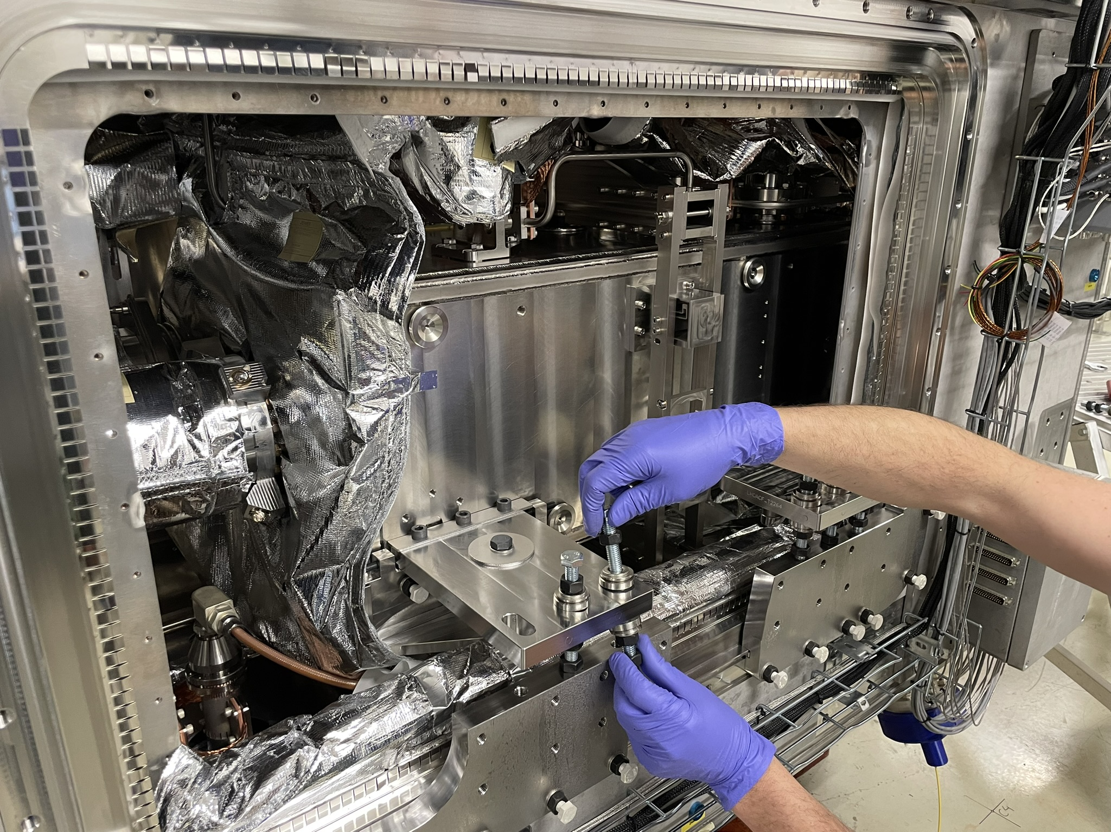
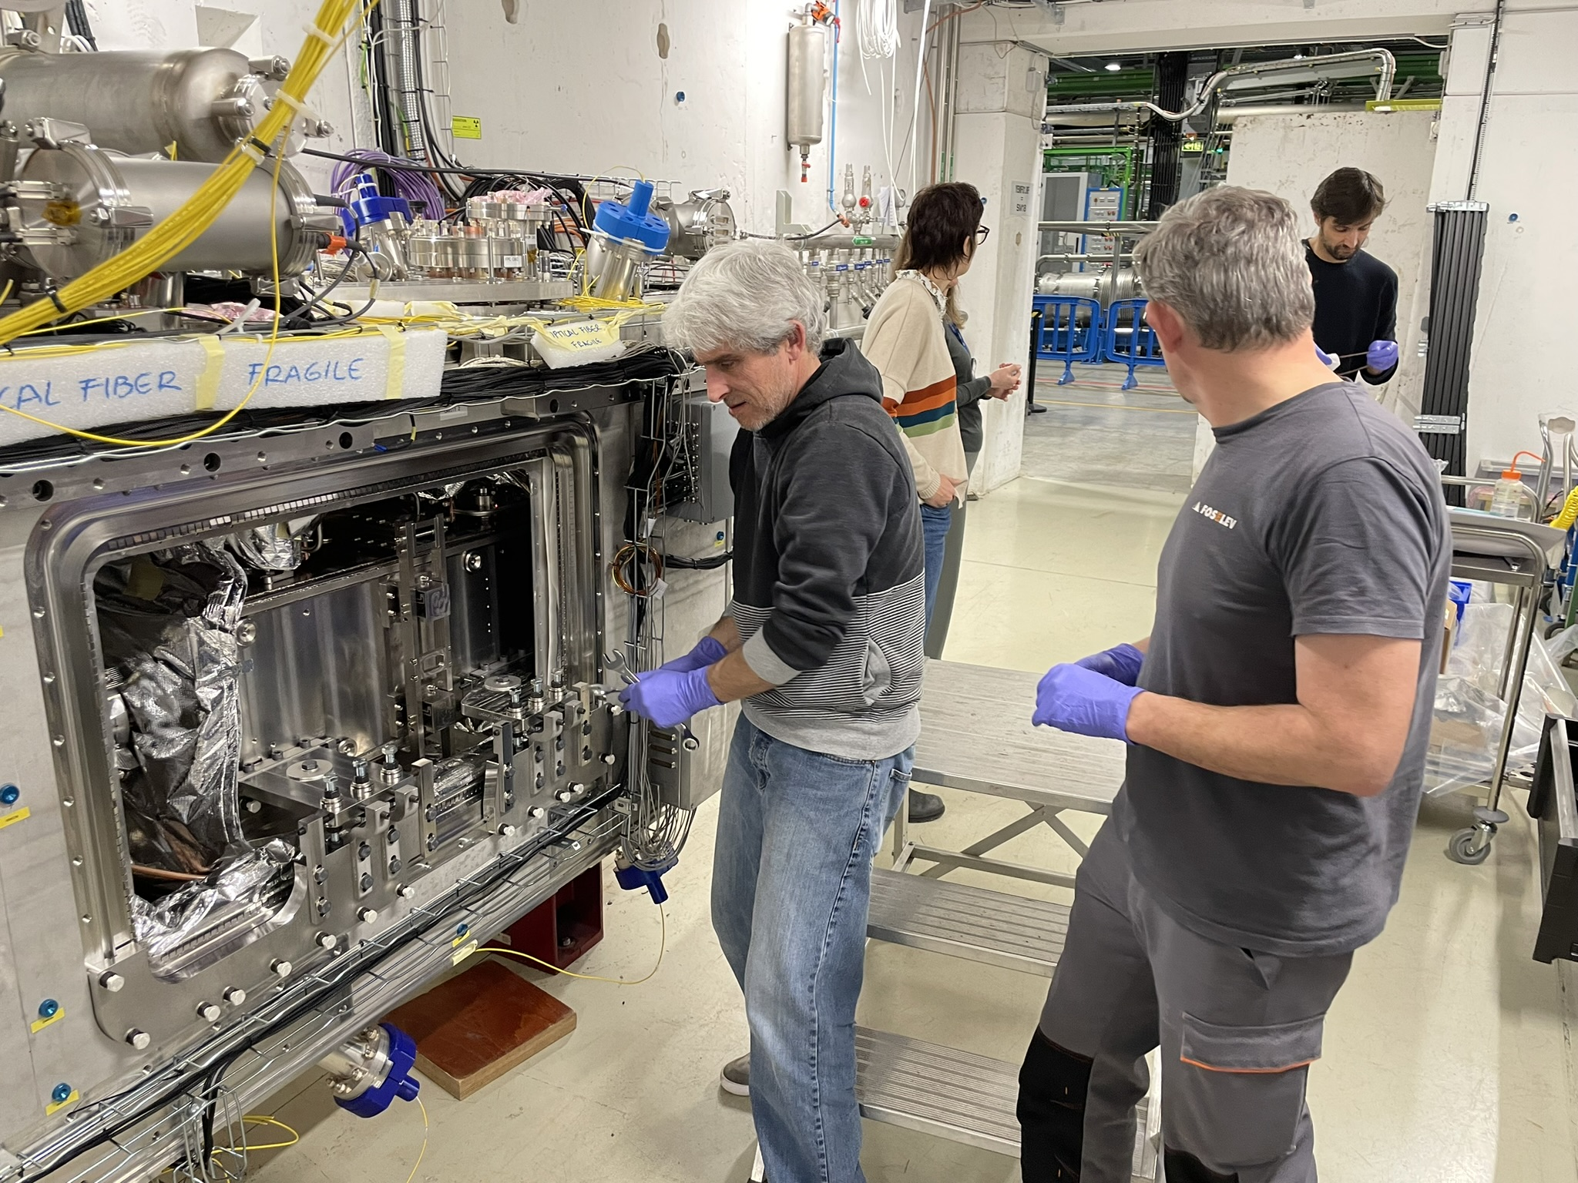
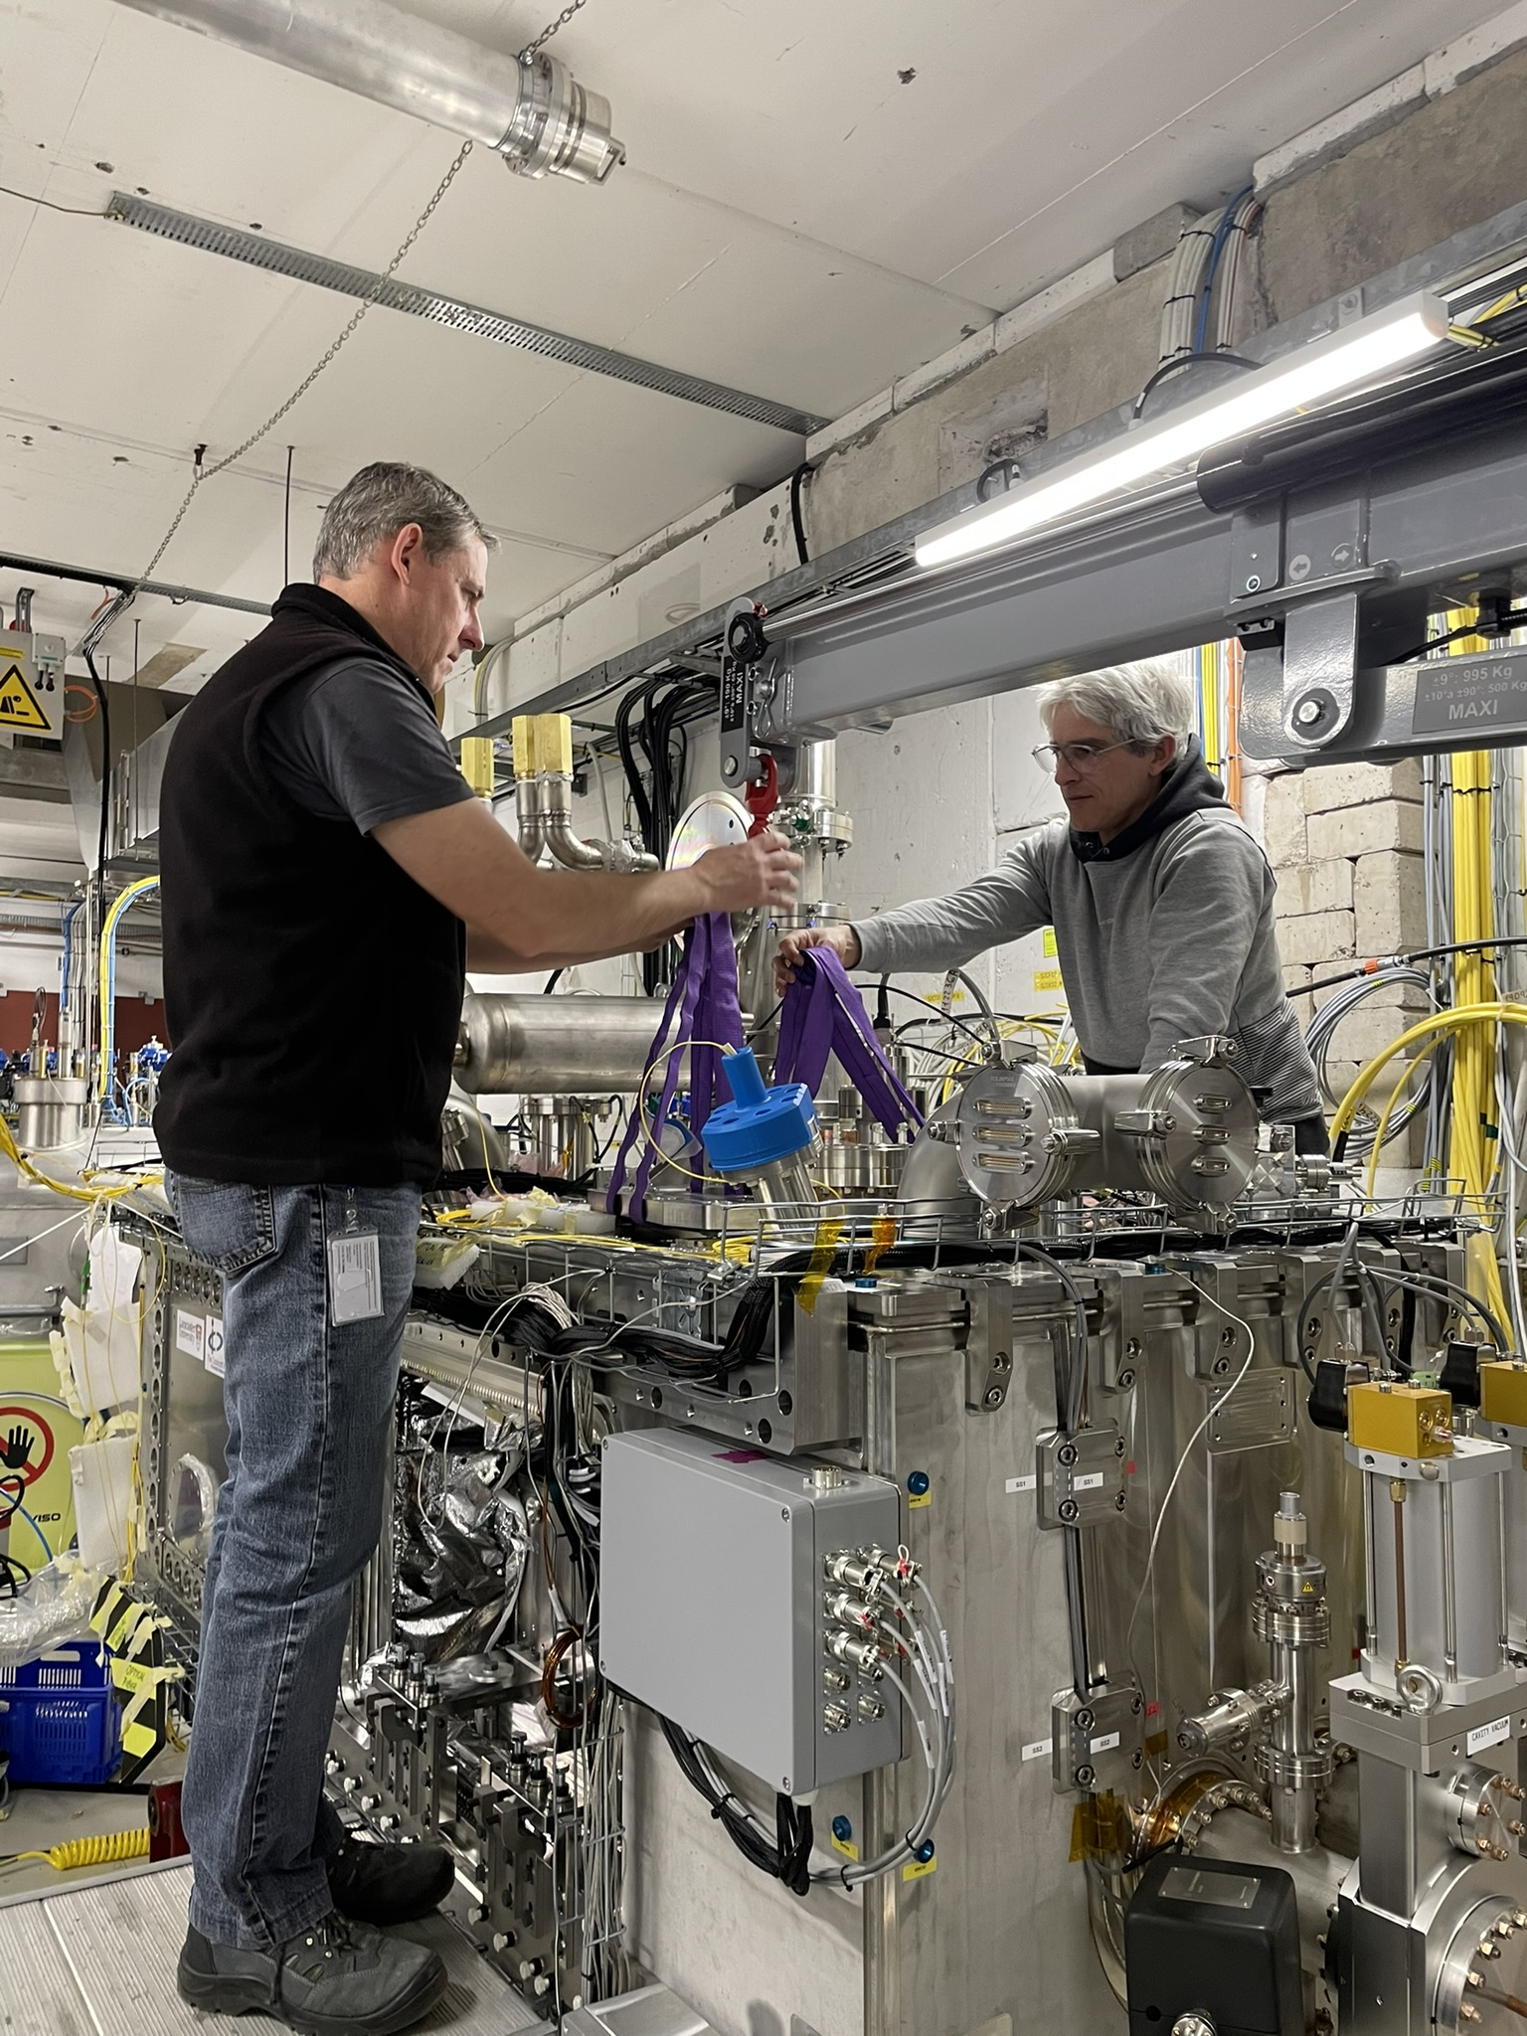
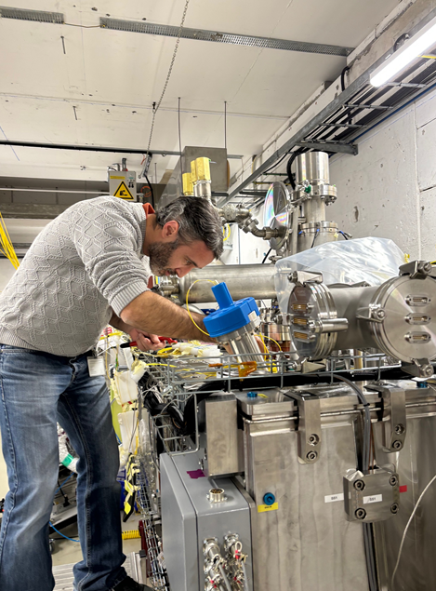
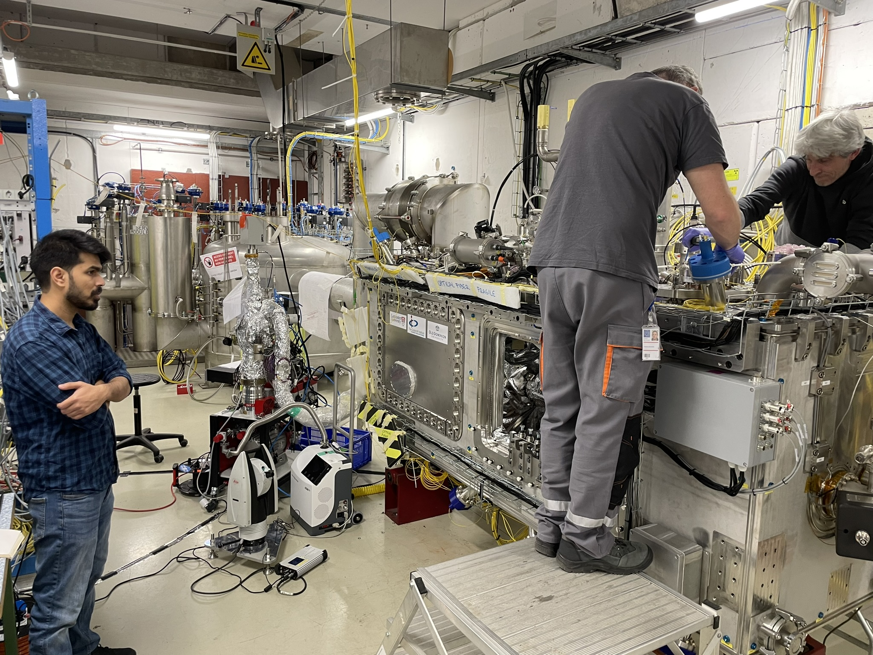
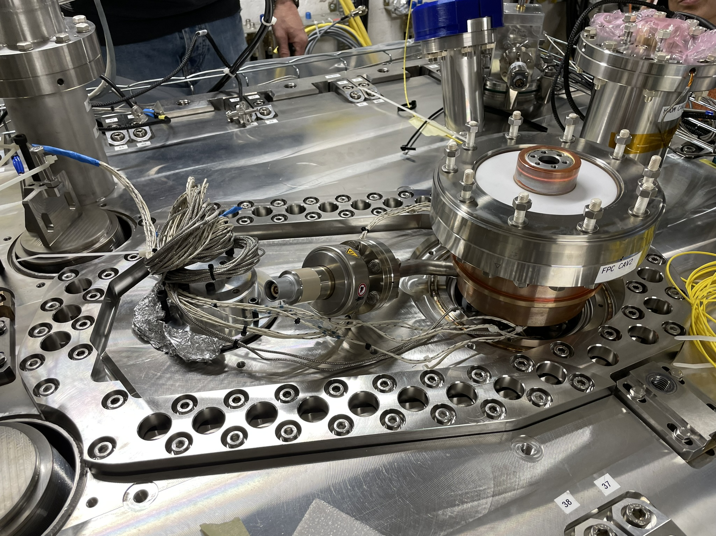

Survey measurement on load charge transfer of TANK2
  Removal of cavity supporting plate
Hands gymnastics to access this zone
  Doors removed & installation of tooling
  Check of position and torques
  Leak repair
  Live monitoring (survey) of cavity and FPC during all activities
  Access to leak zone (FPC copper body)

Slide 24
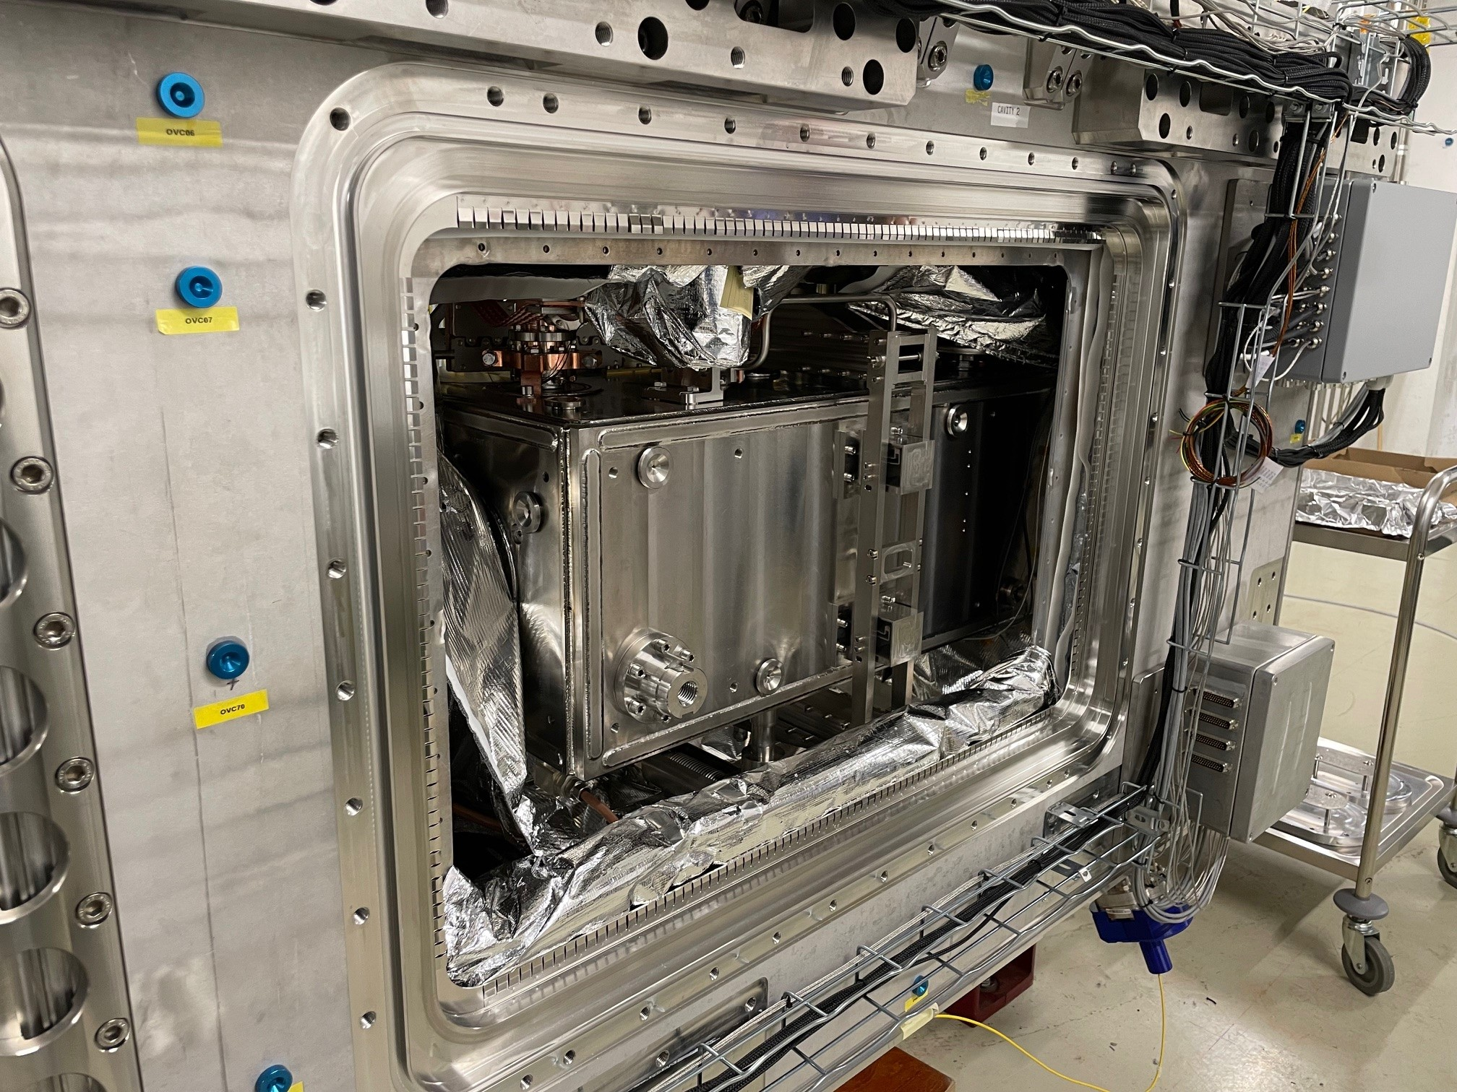
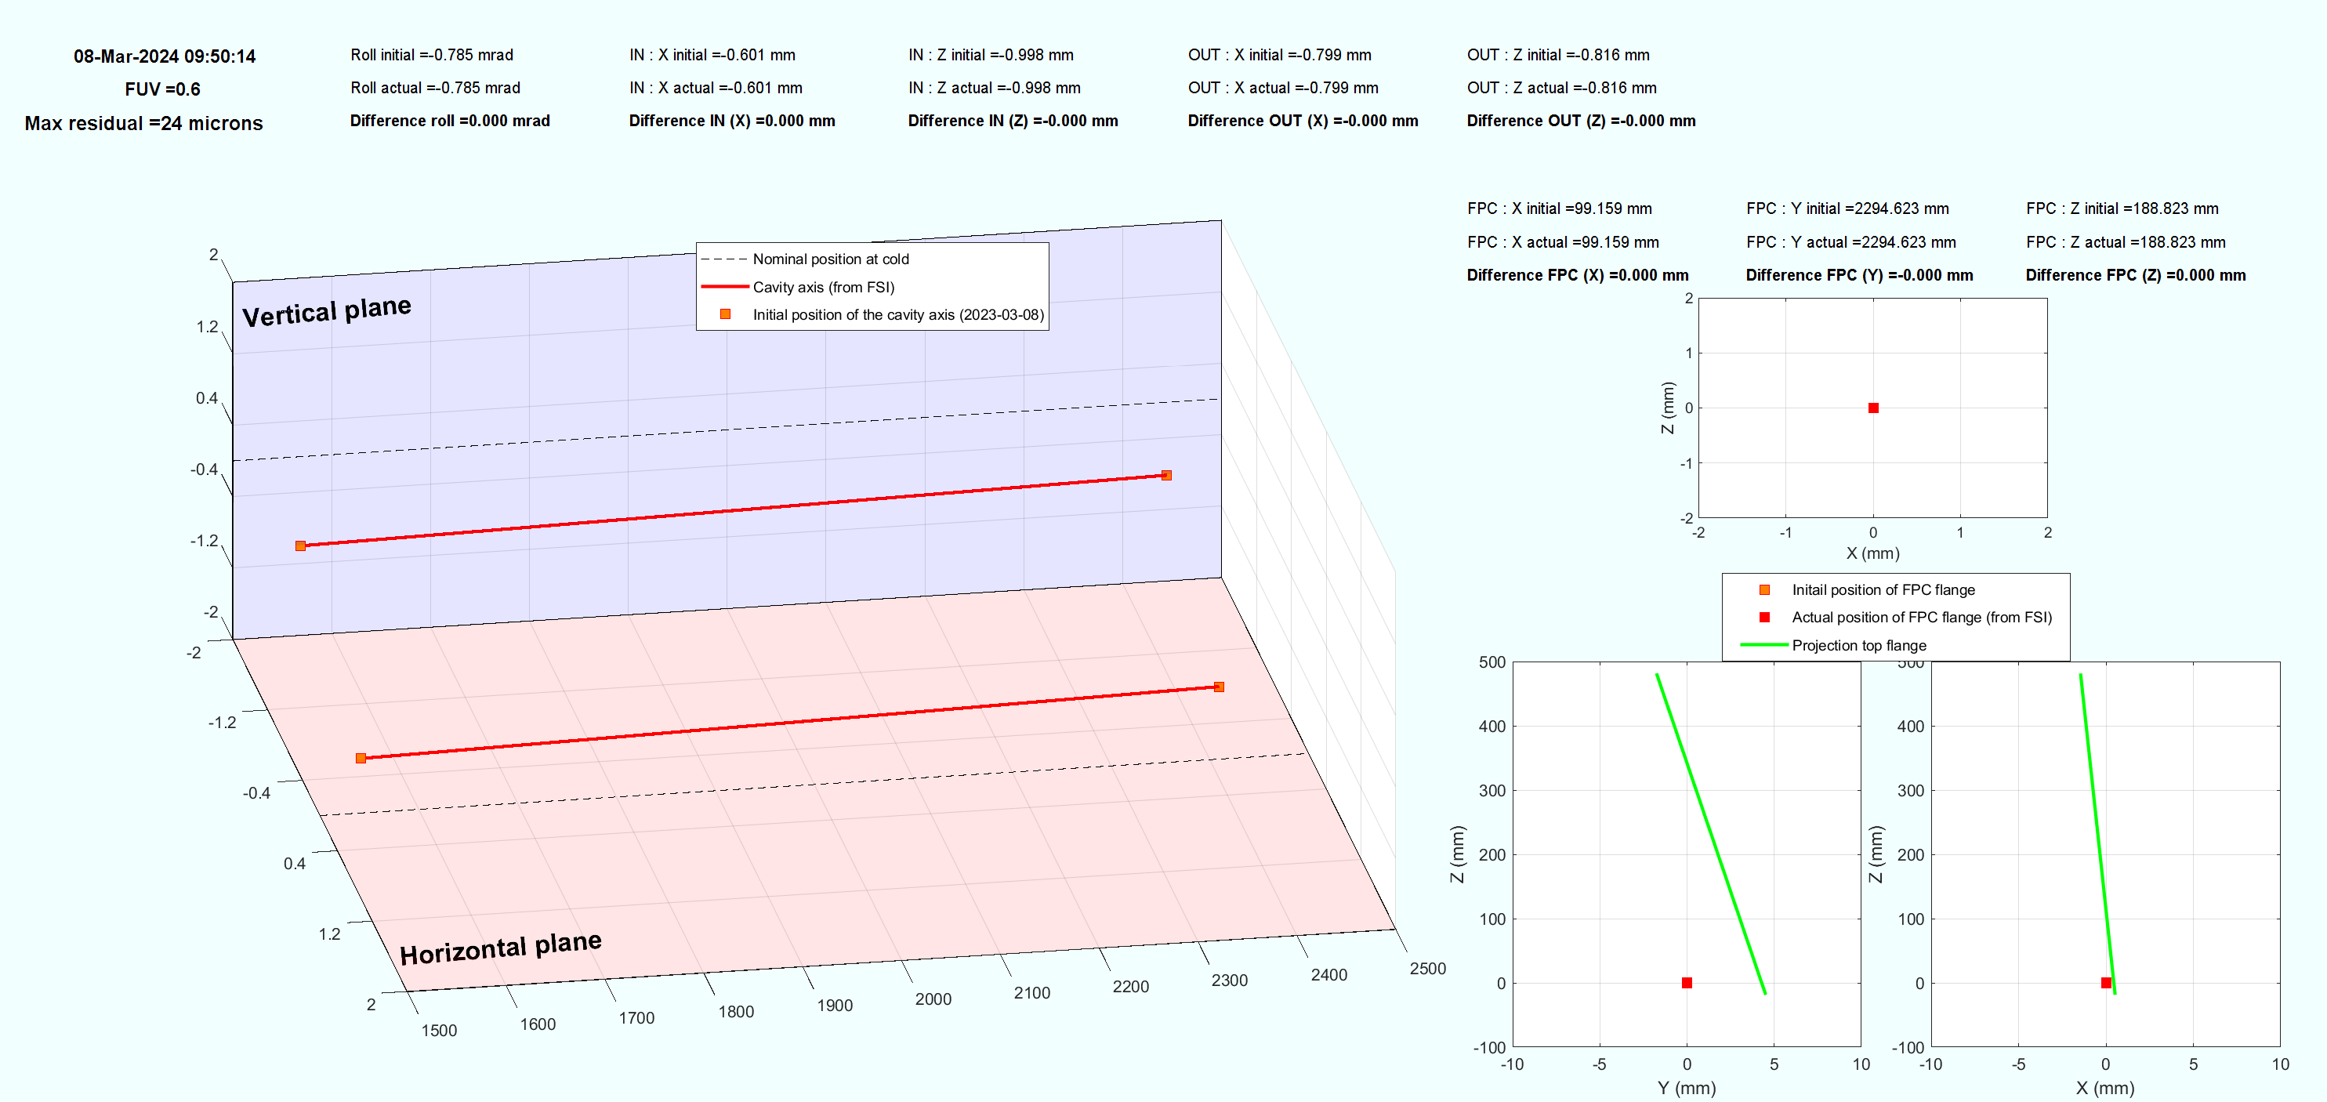
Situation before installation of tooling support of cavity 2
8 March 2024
EDMS : 3065222

Slide 25
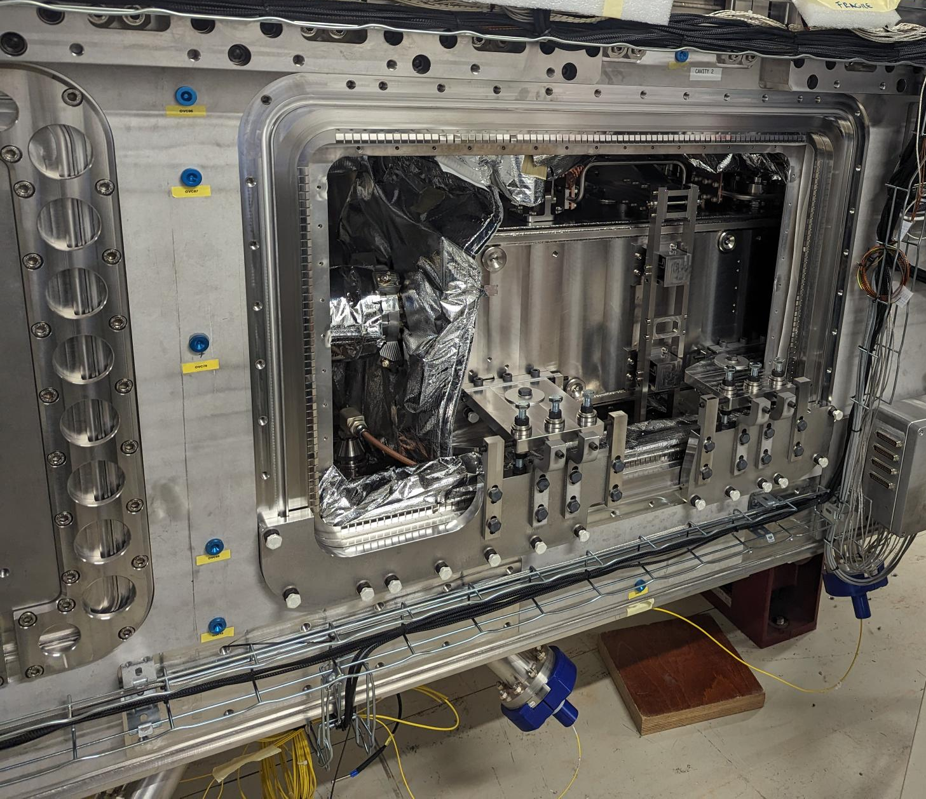

EDMS : 3065222
Situation after installation of tooling support of cavity 2
13 March 2024 : 9h12
Impact on cavity
Impact of installation tooling system : < 0.1 mm
Impact on
FPC flange

Slide 26
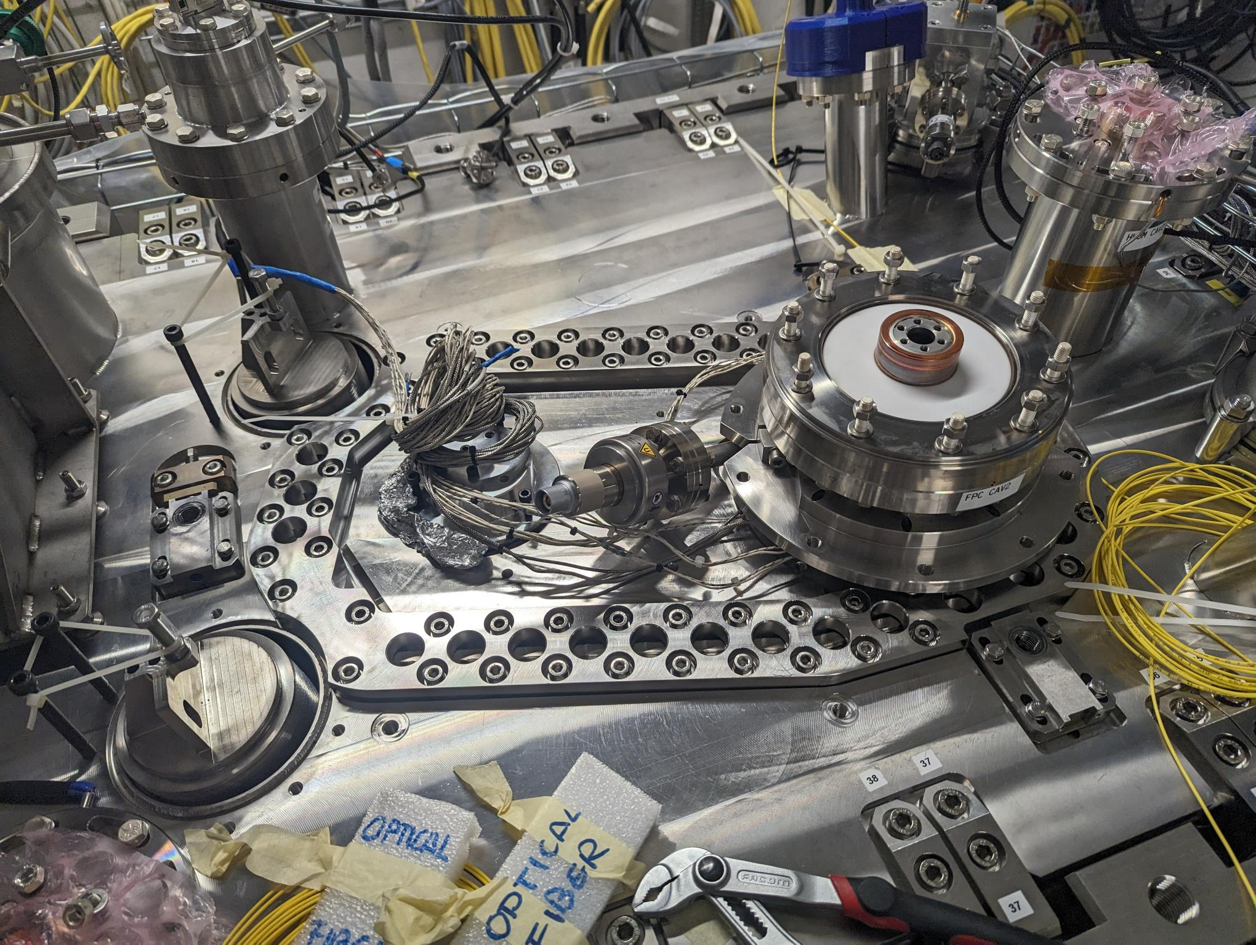
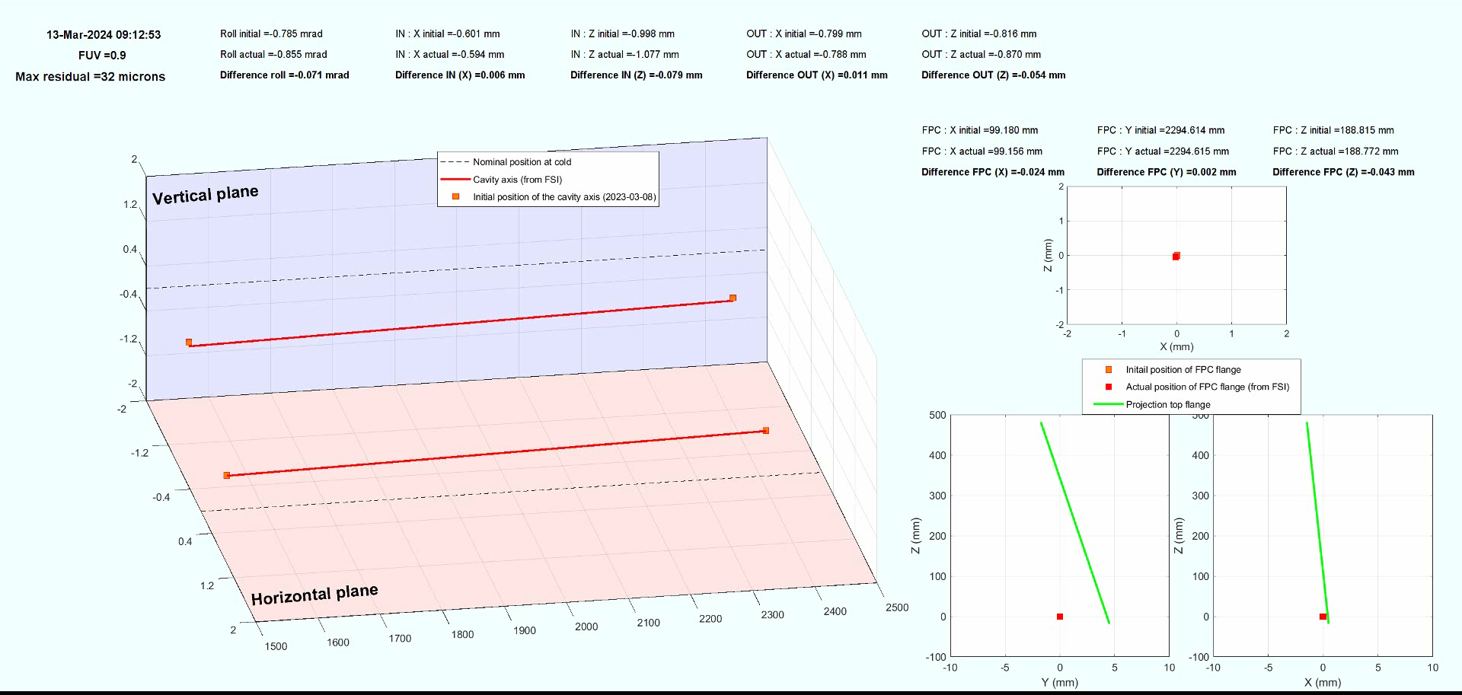
EDMS : 3065222
Movie during the load charge transfer
Impact on cavity
Impact of load transfer : ∼0.35 mm in vertical
Impact on
FPC flange

Slide 27
Spare

Slide 28
Repeatability on the motions
Cycle 1 : 12/16 FSI observations are operational
Cycle 2 : 15/16 FSI observations are operational
Cycle 3 : 16/16 FSI observations are operational
 | Cavity 1 |  |  | Cavity 2
Impact of cold | Cycle 1 | Cycle 2 | Cycle 3 | Cycle 1 | Cycle 2 | Cycle 3
Tx [mm] (radial translation) | 0.69 | 0.87 | 0.72 | 0.37 | 0.60 | 0.57
 | +/-0.30 | +/-0.20 | +/-0.20 | +/-0.20 | +/-0.10 | +/-0.08
Ty [mm] (longi translation) | 0.32 | 0.35 | 0.39 | 0.39 | 0.15 | 0.27
 | +/-0.30 | +/-0.20 | +/-0.20 | +/-0.20 | +/-0.15 | +/-0.10
Tz [mm] (vertical translation) | 0.75 | 0.62 | 0.71 | 0.76 | 0.76 | 0.81
 | +/-0.20 | +/-0.15 | +/-0.15 | +/-0.10 | +/-0.05 | +/-0.05
Rx [mrad] (Pitch angle) | -0.36 | -0.40 | -0.30 | -0.11 | 0.05 | -0.08
 | +/-0.20 | +/-0.15 | +/-0.15 | +/-0.10 | +/-0.05 | +/-0.05
Ry [mrad] (Roll angle) | -0.23 | -0.74 | -0.20 | -1.65 | -0.74 | -0.41
 | +/-1.00 | +/-0.70 | +/-0.70 | +/-1.00 | +/-0.40 | +/-0.40
Rz [mrad] (Yaw angle) | 0.08 | 0.41 | 0.21 | 0.12 | 0.45 | 0.31
 | +/-0.35 | +/-0.20 | +/-0.50 | +/-0.20 | +/-0.15 | +/-0.10
Scale [mm/m] | -2.06 | -2.22 | -2.14 | -2.06 | -2.22 | -2.14
 | +/-0.20 | +/-0.20 | +/-0.20 | +/-0.20 | +/-0.20 | +/-0.20

Slide 29
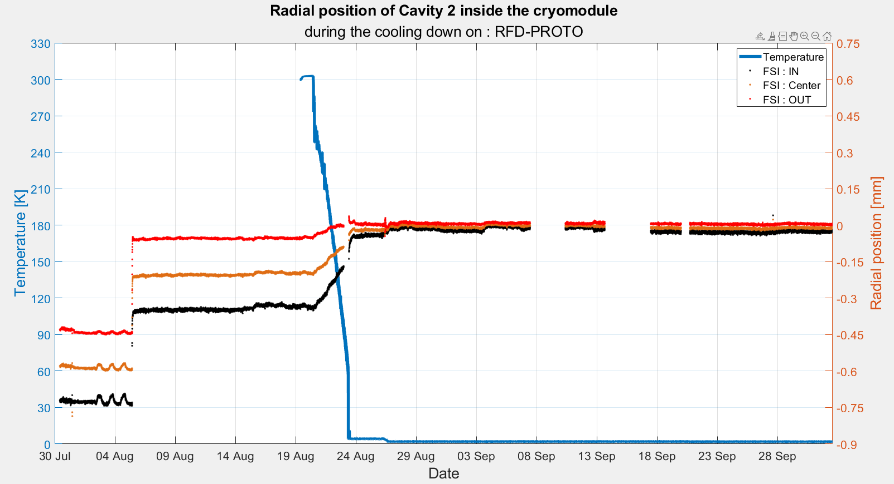
Pumping
Cooling down
Objective : 0 mm +/- 0.1 mm
OUT (cav 2)
IN (cav 2)

Slide 30
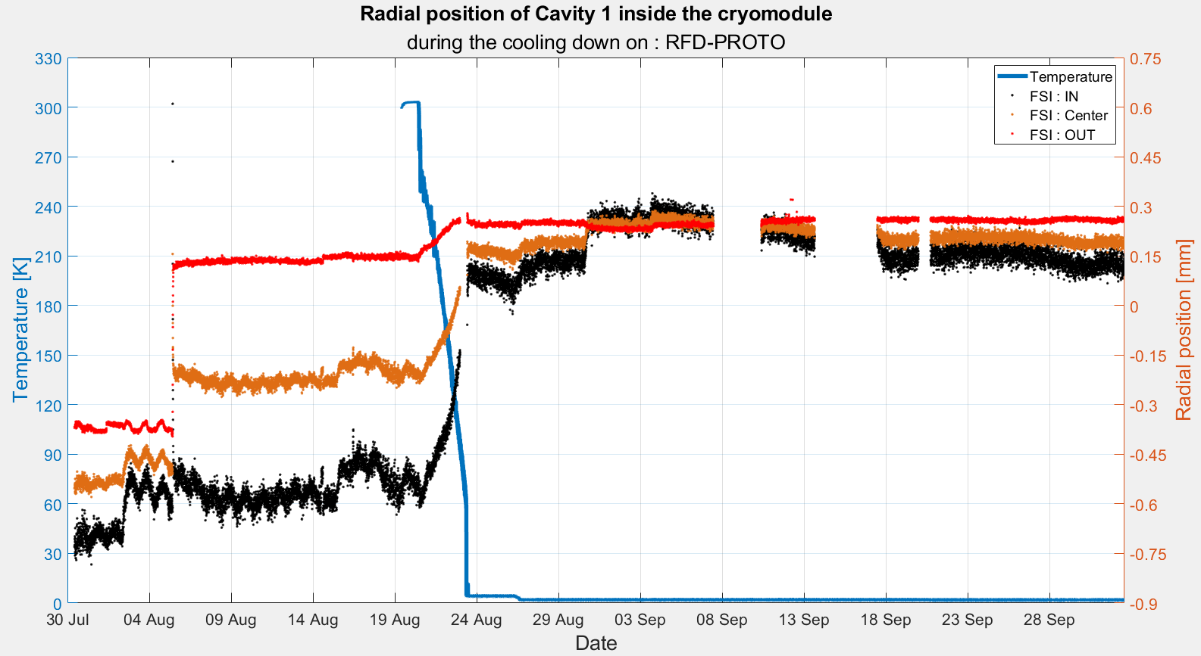
Pumping
OUT (cav 1)
Objective : 0 mm +/- 0.1 mm
IN (cav 1)

Slide 31
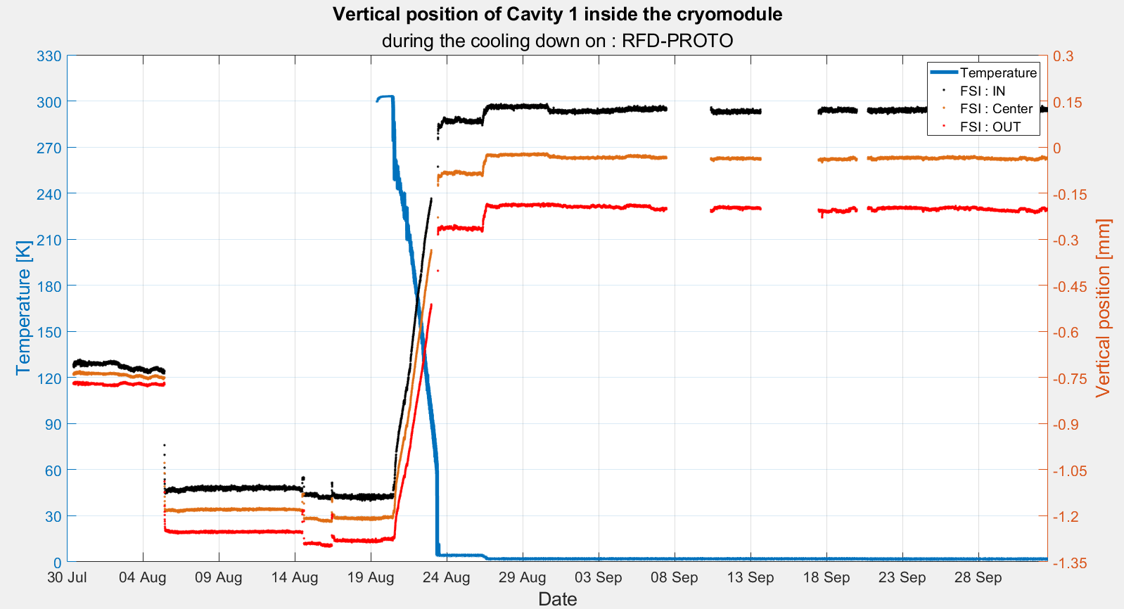
IN (cav 1)
Pumping
Objective : 0 mm +/- 0.1 mm
OUT (cav 1)

