Slide 1

Crab cavities cryogenic status of SM18, SPS and HL-LHC and challenges/open points
K. Brodzinski, L.Delprat and V. Gahier
with contribution from: L. Alaux, N. Alonso, O. Capatina, T. Capelli, R. Calaga, S. Claudet, J. Dequaire, T. Feniet, J. Gery, N. Guillotin, B. Ivens, R. Mauny, O. Pirotte and N. Vauthier
on behalf of HL-LHC WP4 and WP9 working teams
14th HL-LHC Collaboration meeting, Genoa, Italy
09.10.24

Slide 2
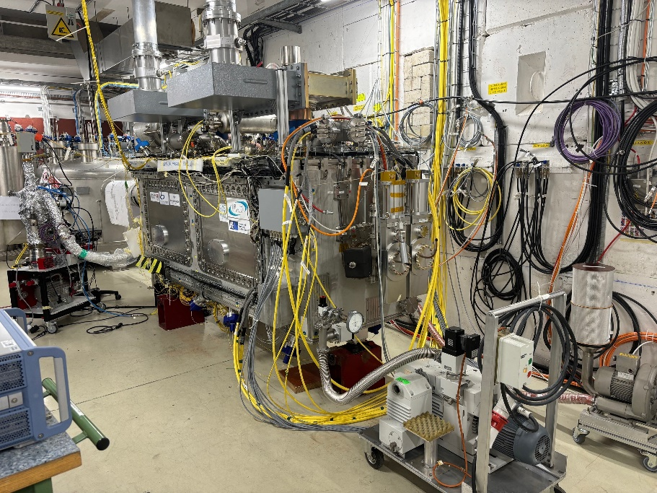
Agenda
Overview on RFD prototype operation in SM18 in 2024
Cryomodule design considering lesson learnt from M7
  Safety devices
  Instrumentation
BA6 readiness status
Conclusions
RFD prototype in M7 bunker

Slide 3
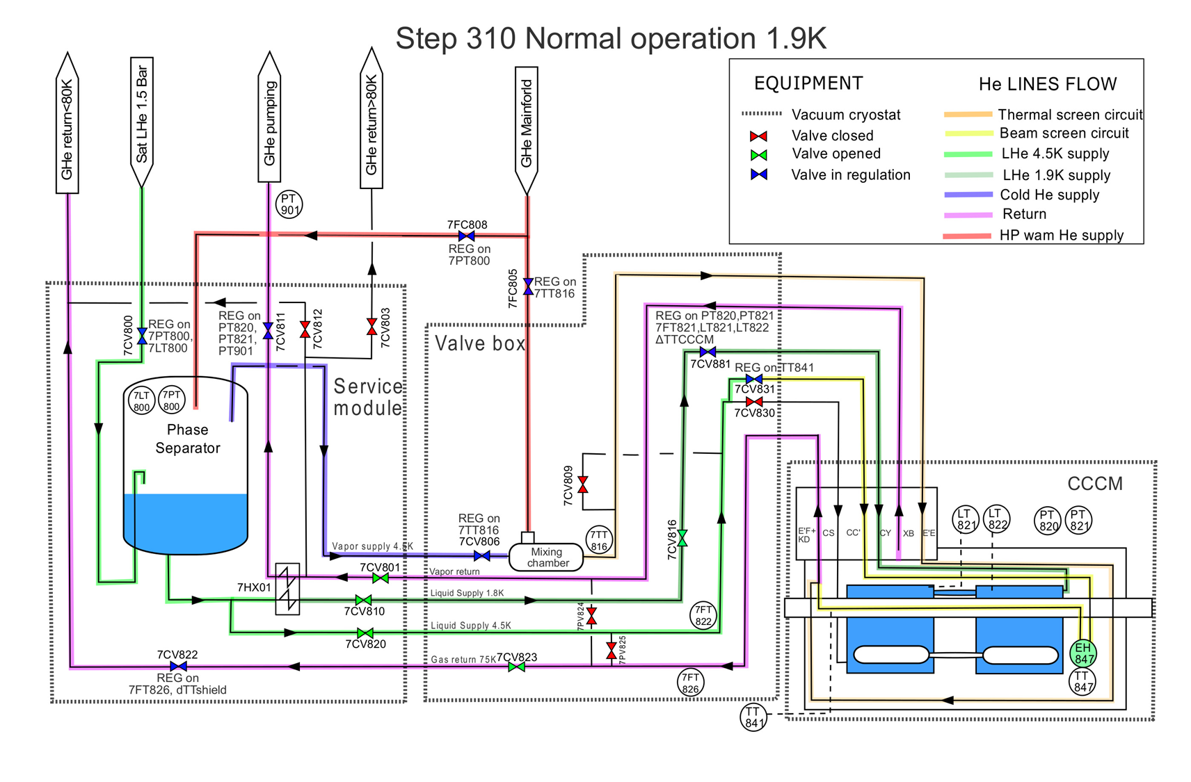
RFD Prototype Operation in SM18
Three operation periods of RFD prototype in SM18.
  21.11.2023 – 10.12.2023 (logbook 117205)
  11.04.2024 – 14.06.2024 (logbook 119101)
  20.08.2024 – Now (logbook 121043)
Cooldown
  300 K to 130 K: with controlled inlet temperature using a mixing chamber ; dTmax = 50 K.
  130 K to 4.5 K: by direct LHe injection into CCCM ; below TTmax = 130 K; cooldown as fast as possible (AFAP).
  Pumping phase from 4.5 K to 2 K: beam screen (BS) circuit put in service, then pumping for Nominal operation.
Nota : during phase 1, pressure to be carefully monitored and maintained below 1.5 bar.

Slide 4
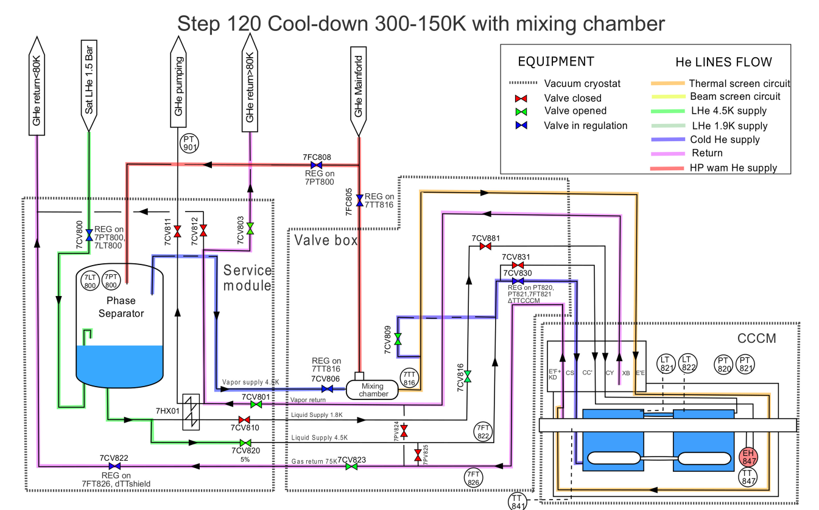
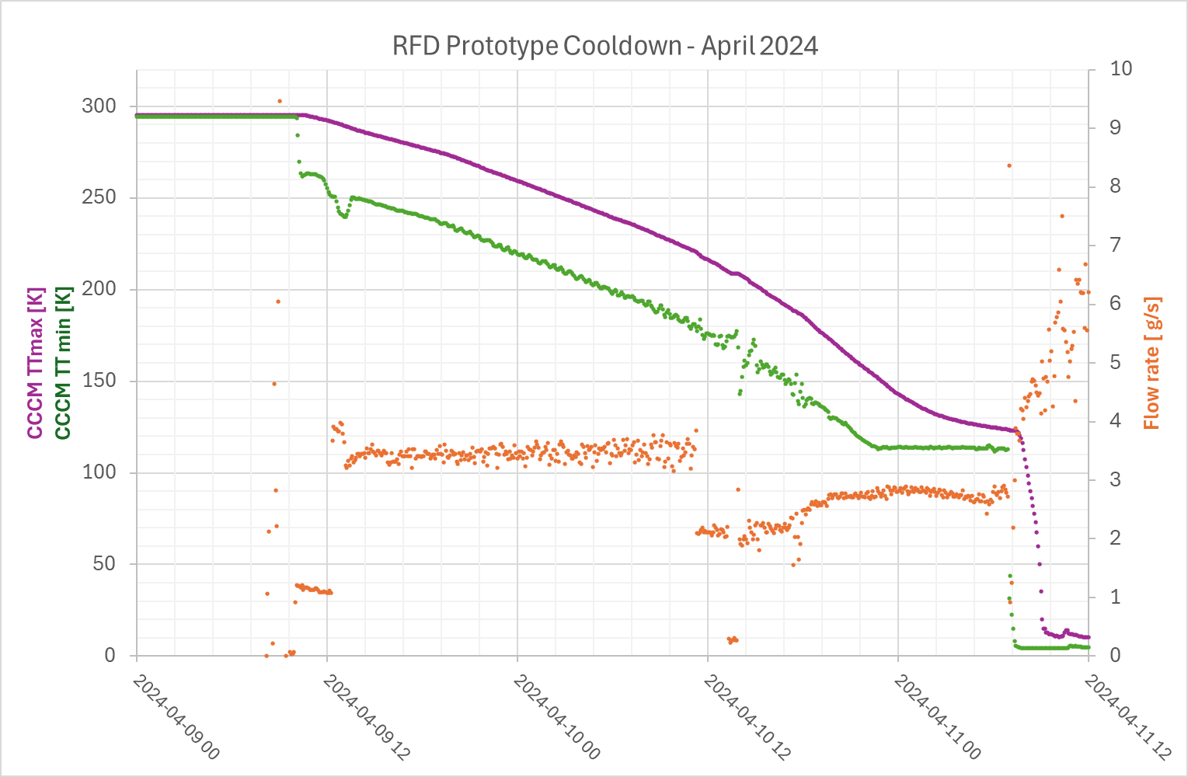
Cooldown Phase 1 – 300-130 K
CCCM TT max
CCCM TT min
<50 K
~3.2 g/s
Use of a mixing chamber to control DT @ 50 K
CD flow : 2.2 – 3.2 g/s
Pressure below 1.4 bara
CD from 300 to 130 K in 46 hours.
~2.2 g/s

Slide 5
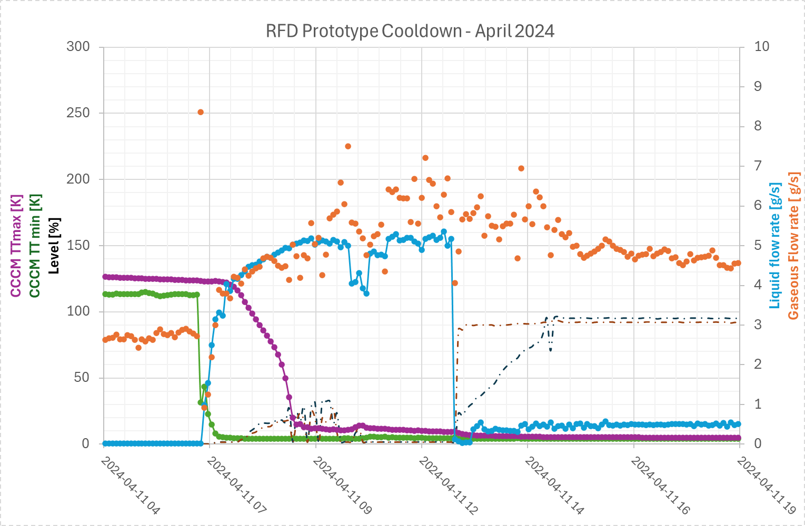
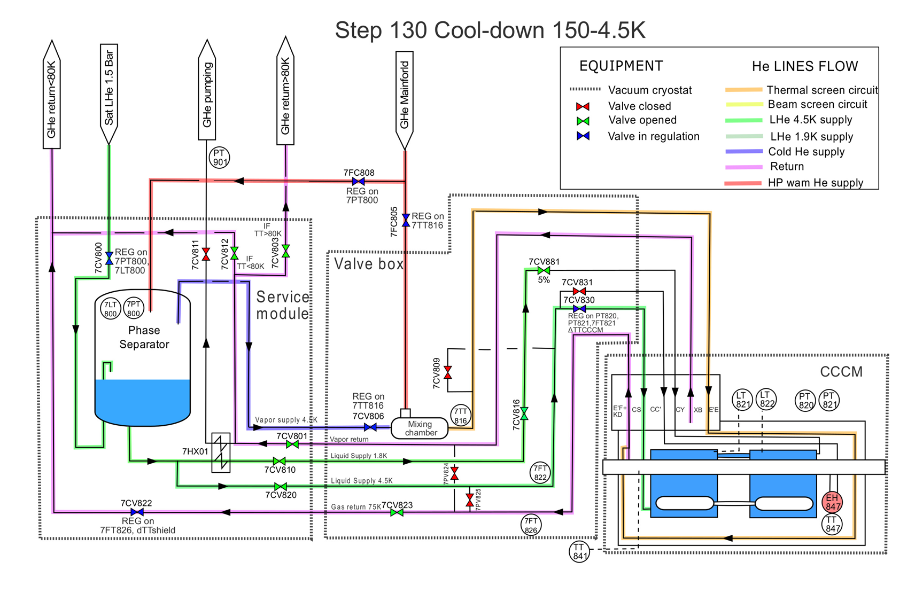
Cooldown Phase 2 : 130 K – 4.5 K
– Cooldown as fast as possible (AFAP) and filling
AFAP
Filling
TT max
TT min
LHe flow
Level @ 92 %
Injection of liquid helium
Filling flow : up to 5 g/s
From 130 to 10 K in 2 hours.
Filling in 6 hours

Slide 6
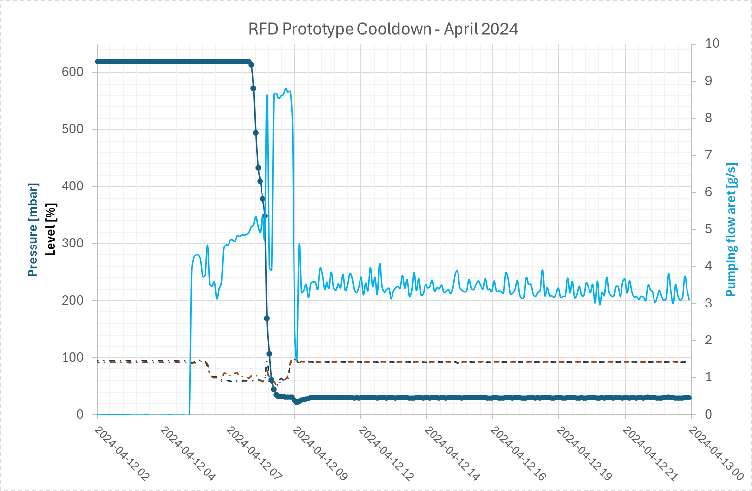
Cooldown Phase 3 : 4.5 K – 1.9 K
– Pumping and Nominal
Pumping
Nominal
Pumping flow
3.5 g/s in nominal (static)
Level controlled @ 92 %
Decrease of Lhe level down to 60% during the pumping step consolidated.
Pumping flow : 5 g/s
Pumping time in 6 hours
Total CD from 300 K to cryo OK : 2.5 days – operation fully mastered
Nominal flow ~ 3.5 g/s
Pressure at 30 mbar

Slide 7
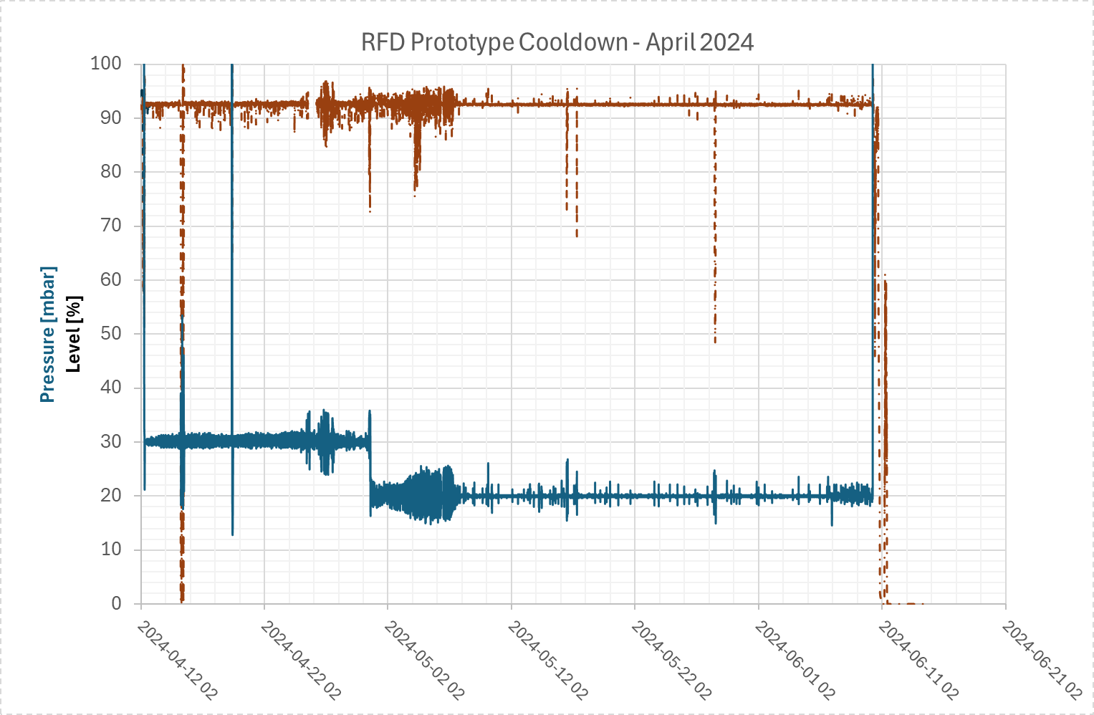
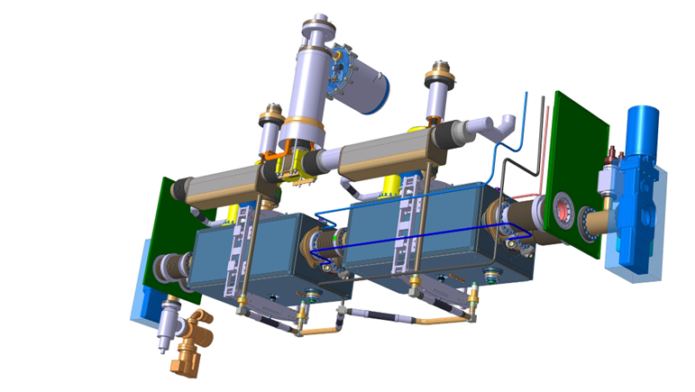
Nominal operation in dynamics
– RF Conditioning
Instabilities observed during RF Conditioning
LHe level difficult to maintain with fast dynamic heat load ramp. It can drop suddenly due to geometrical aspects of bi-phase line.
  Setting level controller with reactive PID parameters.
Adaptation of Cryo_Ok logic to gain margin
  Bigger margin with LT threshold (Low level set at 80% instead of 88% before)
  Pressure SetPoint lowered from 30 to 20 mbar
Level
New Cryo OK at 80%
Instabilities during conditioning
20 mbar
30 mbar
Bi-phase line tank

Slide 8
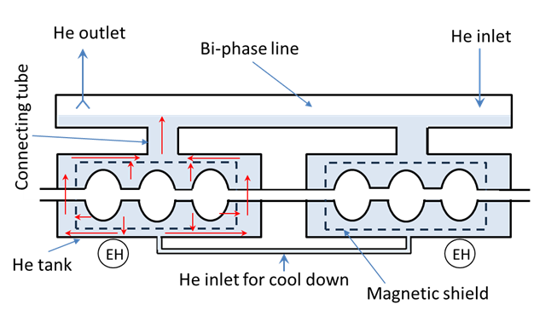
Thermal tests on RFD prototype
Two thermal performance tests are to be performed on the module during present test campaign.
Static heat load test measured by performing a boil off test.
Module performance test for dynamic heat load compensation test (using EH installed on the He tanks). Dedicated procedure is available in EDMS 3141384 -> action CRG.
(the figure is a sketch and does not represent real shape of the cavities or scale of parts)
Two days of tests agreed in November 2024
Thanks to all teams involved for flexibility!

Slide 9
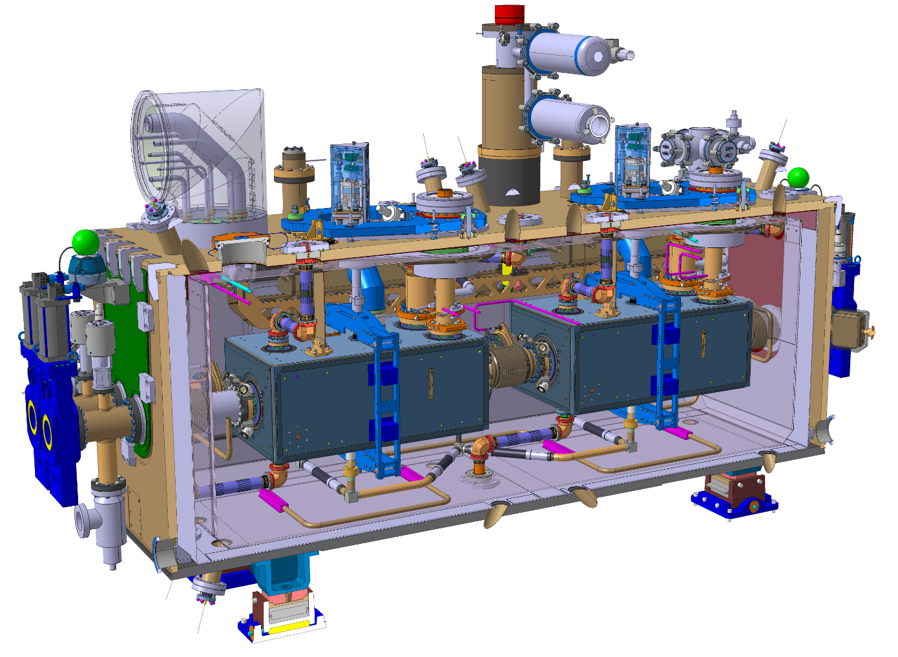
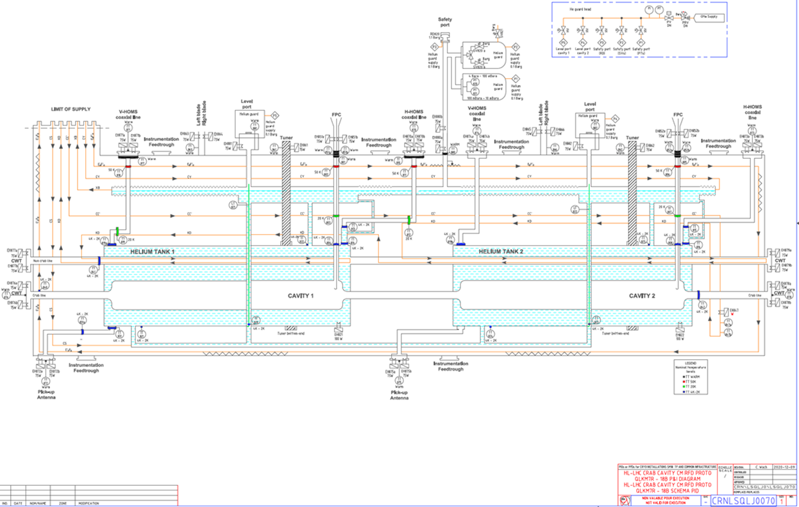
Cryomodule design – cryogenic circuits
Status of flow schemes for both types of the cryomodules :
  RFD Prototype in M7 : https://edms.cern.ch/document/2453574/AB
  RFD prototype in BA6 : to be issued.
  Series DQW : https://edms.cern.ch/document/2490810/AA
  Series RFD : https://edms.cern.ch/document/2489990/AA
RFD module

Slide 10
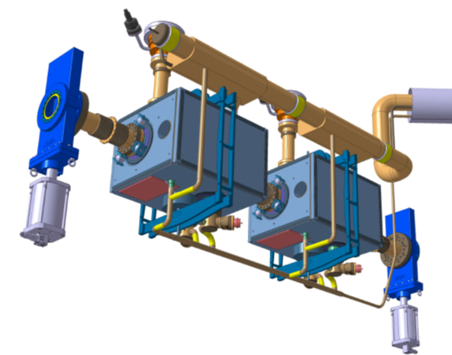
Bi-phase line tank volume
– Lesson learnt from M7 test
During RF powering of RFD Prototype, the helium level drops rapidly. This is an effect of fast heat load ramp and relatively small volume of liquid in the bi-phase line within its height. We applied some modification in PID He supply controller, but it is rather last solution to be applied. To stabilize the level, it would be good to increase bi-phase line “tanks” volume -> length and width are more important than height (DQW proto is more stable). Control level measurement resolution is ~5 mm.
RFD prototype module
DQW prototype module
Bi-phase line tank
Bi-phase line tank
According to preliminary discussion with EN-MME, it would be difficult to increase the bi-phase volume already optimized during the design phase.

Slide 11
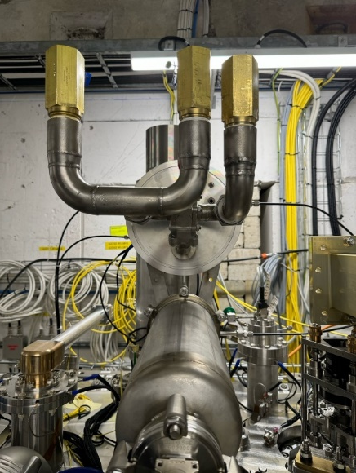
Relief valves - Lesson learnt from M7 test
Valves found leaky on Nov. 10th’24
  Reference: EDMS document 2998467 v0.1
  HSE test outcome: all 4 valves leaky between 160 mbarg and 220 mbarg (for a set pressure of 350 mbarg)
Mitigation for M7 operation in 2023-2024
  Removal of the PRV HeGuard
  Use of 1 single relief valve (Circle Seal) with set pressure of 700 mbarg
Retained setup
References of the Circle Seal relief valves used for the RFD prototype cooldown and warmup in M7

Slide 12
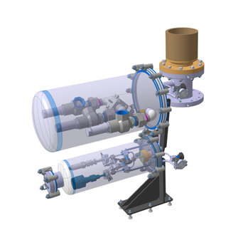
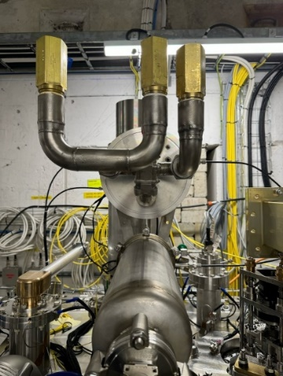
Relief valves– Lesson learnt from M7 test
Safety valves system is designed with He guard (standard approach for under atmospheric pressure cryogenic recipient – two stages SVs at 0.35 and 0.4 barg). It works fine in M7 and SPS where the return line pressure is ~1.05 bara) – tested with DQW module.
Original design
Option applied in M7
for RFD proto
0.4 barg
0.7 barg
He supply
at 50 mbar
0.35 barg
envelope
He guard
envelope
He tank
He tank
In the LHC the return line pressure will be ~1.3 bara and this will cause the problems to operate the module at 4.5 K. If we keep this solution, all transients including cool down and warm up will have to be done using pumping collector (line B) i.e. cold compressor will have to be in operation for any transient or stabilization of the crab modules.
Therefore, it is “very nice” to have now on RFD one stage SVs without He guard to test them for long term tightness against air inleak into the cryo system. If it works fine, we will propose to consider operation in the LHC with one stage SV w/o the helium guard but keeping possibility to convert the solution into two stages SVs as initially foreseen with He guard – for discussion with RF and MME.

Slide 13

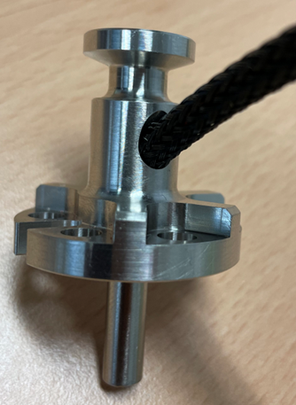
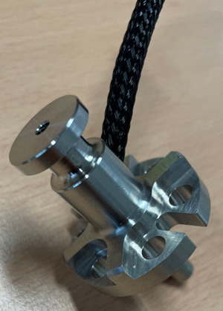
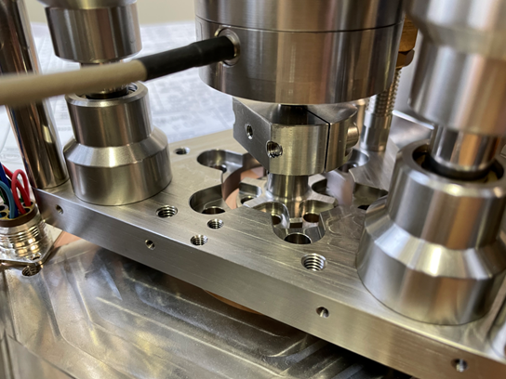
Focus on instrumentation – status
Installation on site by STFC
  Positive feedback on installation – few points to be improved with respect to Cables labels removed and pinning strategy.
3D integration model & drawings
  Instrumentation details to be included in the model (the sensor wire + its bending radius, the feedthroughs + the connectors, the cabling routing inside & outside the vacuum vessel, the electrical connecting box)
Tuner heaters :
Following problems on first DQW prototype during SPS run 2018 when we have lost both tuner heaters, the new concept of integration was developed by EN-MME and TE-CRG with dedicated assembly allowing for effective heating and optimized integration of the heating cartridges – see pictures.
Both tuner heaters were lost on RFD prototype in M7 : Investigation in progress.

Slide 14
Focus on instrumentation – status
RFD and DQW series modules:
All sensitive items (long delivery CERNOX) are available at CERN
Beam screen heaters: available at CERN
Helium tank heaters: produced and available at CERN
Level gauges: to be ordered
Pressure transducers: to be ordered
External heaters: to be ordered
Feedthroughs : DO released end of September.
Not critical for modules manufacturing, installed externally
Instrumentation list for all types of the cryomodules (proto and series for DQW and RFD) defined and validated between MME and CRG though still some value engineering to be performed.
Lesson Learnt from M7 test: RFD prototype module is quite generously equipped with external heaters to deal with potential condensation. Each suspected area is equipped with TT, EH and safety TT – this became very complex on this module. Dedicated analysis is to be done after M7 test to summarize which instrumentation was useful and which can be suppressed for the series modules -> action CRG and MME.

Slide 15
SPS – perspectives
For replacement DQW → RFD adaptation of instrumentation treatment chain is required (RFD has much more instrumentation than DQW) ➔ Action TE-CRG-IC (Rack ready to be installed from Dec’24)
Jumper interface to be connected between the Service Box and the cryomodule. Interface redesigned and adapted for next modules (EDMS 3139620) ➔ Action EN-MME
(applicable for next module RFD going to the SPS)
Safety valves strategy to be agreed.
However, tight planning for SPS RFD connection!
Notice: Beam Screen cooling loop can be tested in SM18 M7 but cannot be operated in SPS.
After first year of operation we noticed failure of the main helium flowmeter, caused by non-sufficient oil separation in the pumping system. In order to avoid migration of oil from the pump into other part of the system, additional separation device shall be installed close to flowmeter area. The equipment is present at CERN (ex-CMS coalescing filter), manpower and integration to be planned ➔ Action TE-CRG (LS)

Slide 16
Conclusions
SM18 M7 - RFD prototype operation: Cryogenic operation is fully mastered still some thermal tests to be performed. Several lesson learnt from RFD prototype operation.
Bi-phase line tank design to be reconsidered.
Cryomodule design :
  All flow schemes are available.
  Internal instrumentation for series modules is available.
  Externally installed instrumentation – to be ordered → value engineering to be performed after completion of M7 tests.
  Relief valves design to be finalized.
SPS BA6 operation of the RFD prototype
  Update of instrumentation treatment chain (new crates and electronic cards to be installed)
  Installation & Commissioning with cryogenic test facility at SPS BA6 in preparation
Great thanks to design / Operation team from EN-MME and SY-RF
for smooth and efficient collaboration !

Slide 17
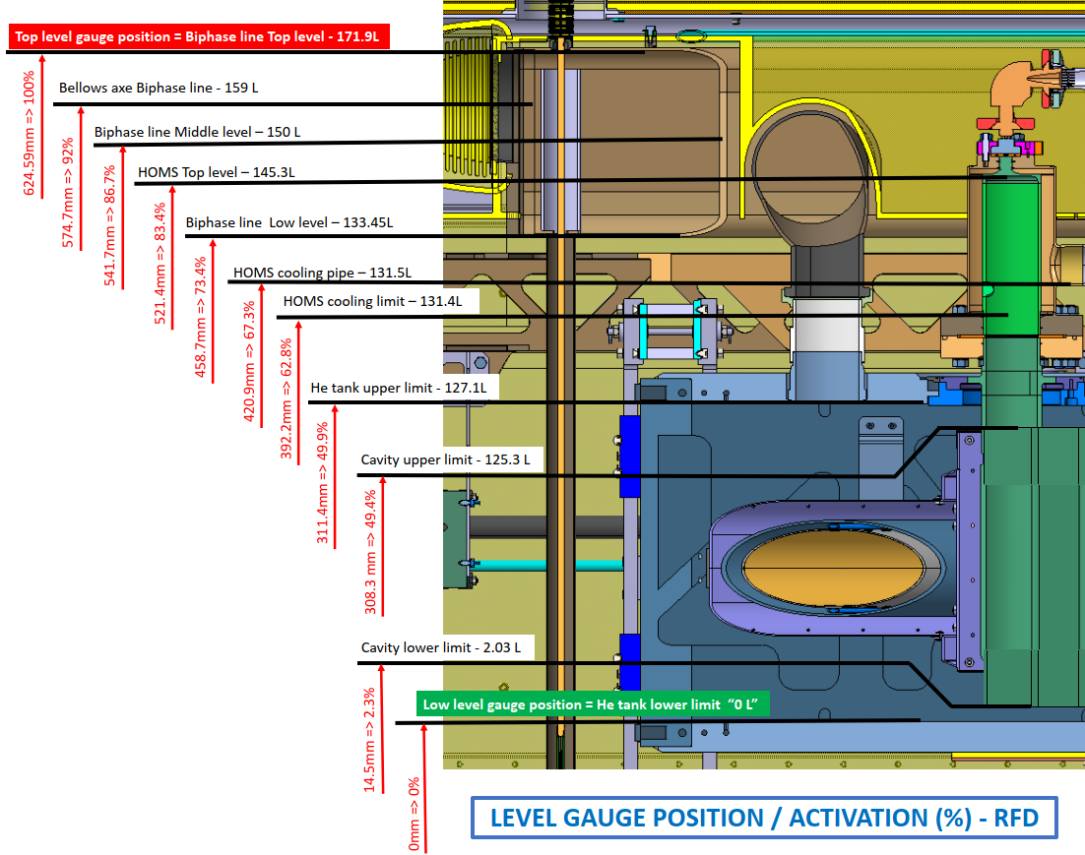
Level versus volume in RFD prototype
Helium level measurement vs real helium height and volume for RFD prototype module.
(data provided by Teddy Capelli EN-MME)

