Slide 1

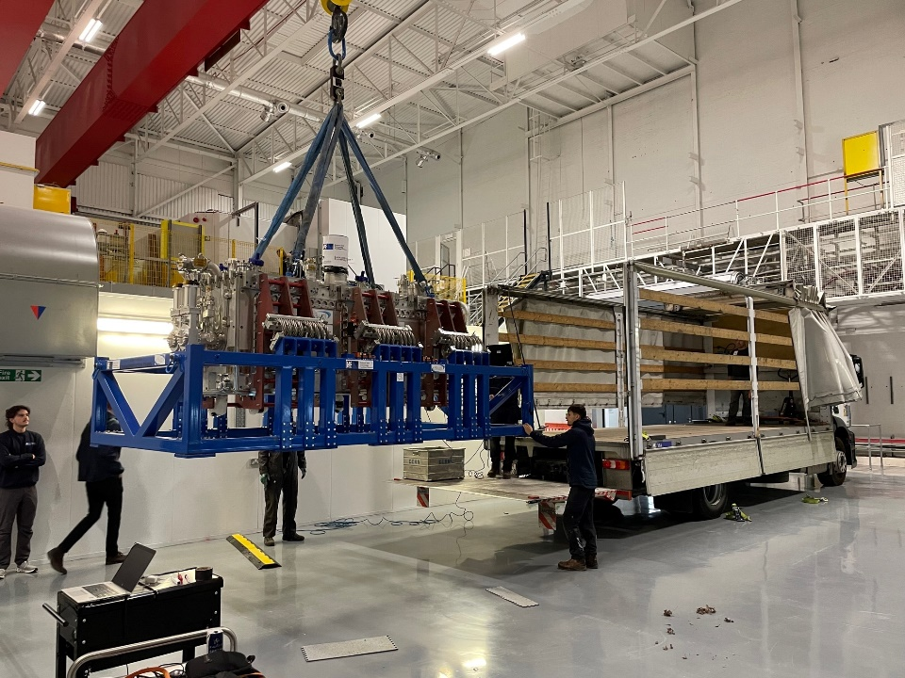
Mechanical measurements, experience during transport and testing of cryomodules
EN/MME Mechanical Measurement Lab
M. Guinchard, D. Thuliez

Slide 2
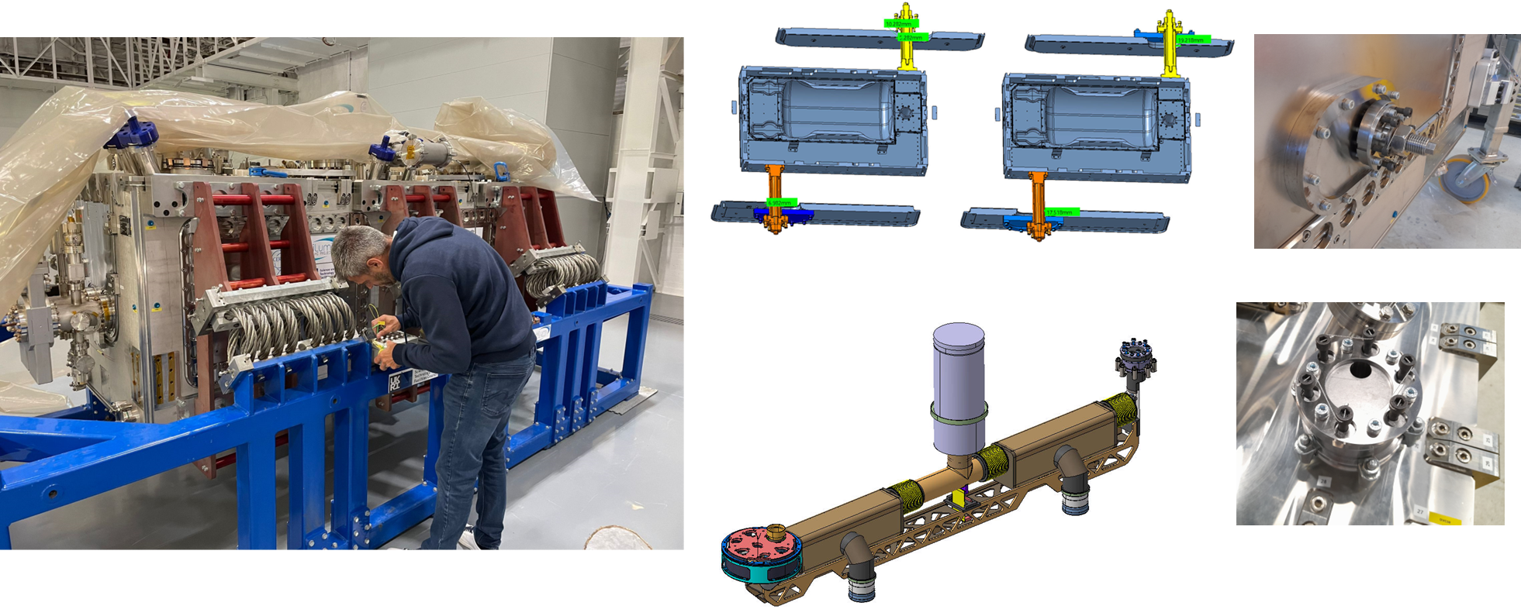
STFC Transport frame and Transport restraints
Z=Transverse
X= Longitudinal
Y= Vertical
*Installation of restraints was monitored with the mechanical instrumentation (optical fibres)

Slide 3
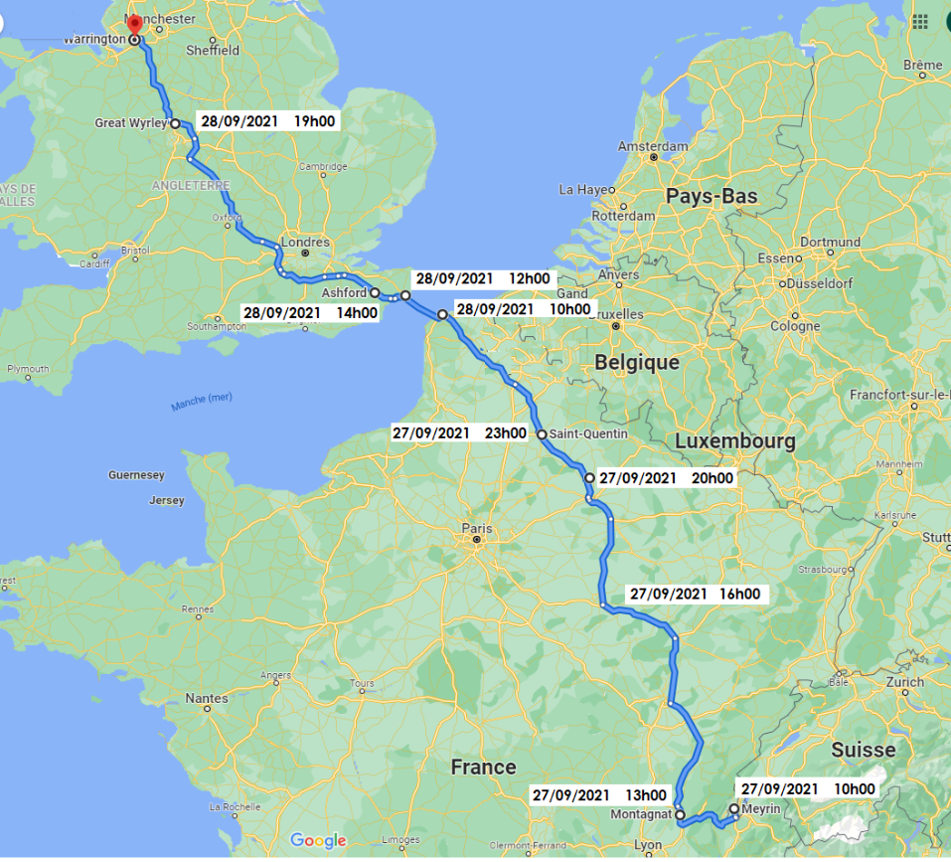
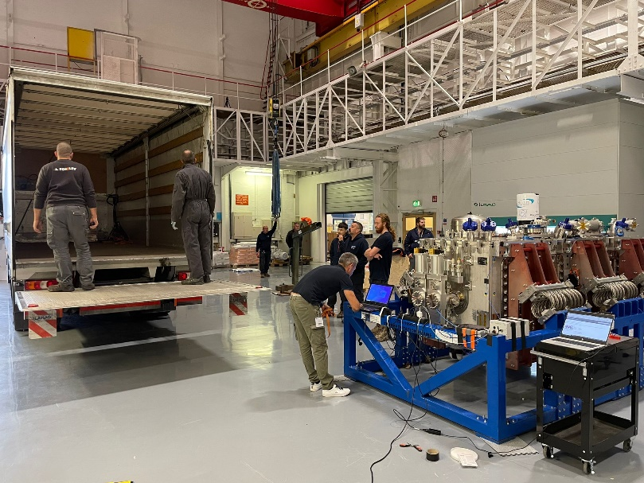
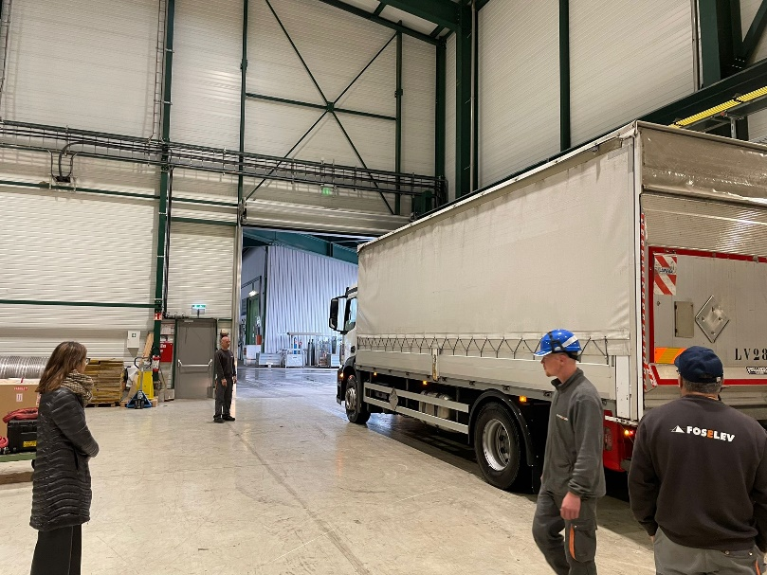
Timeline
18th October 2023@ 9h30 : Loading
18th October 2023@ 11h20 : Departure
18th October 2023@ 11h20 : Departure
18th October 2023@ 19h30 :
Ashford customs
18th October 2023@ 21h00 :
Departure Ashford customs
18th October 2023@ 22h00 : Tunnel
19th October 2023@ 01h00 : Hotel
19th October 2023@ 10h00 : Departure
Huge thanks to Pierre-Loic (driver), Christophe (driver) and David (instrumentation) for the efforts !
19th October 2023@ 12h00
19th October 2023@ 14h00
19th October 2023@ 17h00
19th October 2023@ 19h00 : Dole Hotel
20th October 2023@ 12h00 : CERN

Slide 4
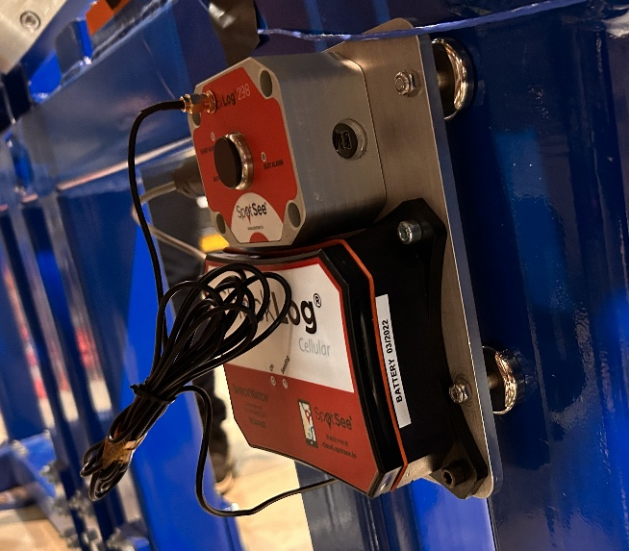
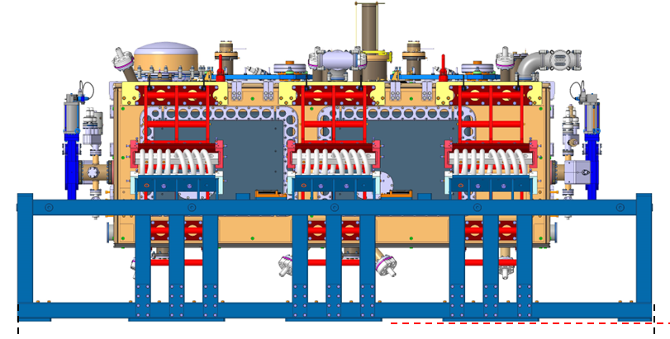
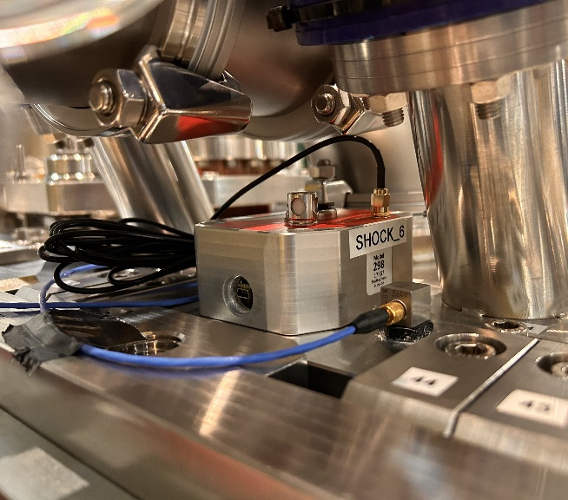
Baseline Vibration and shock instrumentation
2 Shocklog® Systems with GPS and GSM connections worldwide: shocks, Temp, HR, Tilt :
- Cryomodule (3 directions)
- Transport frame (3 directions)
Z=Transverse
X= Longitudinal
Y= Vertical
Z=Vertical
X= Lateral
Y= Longitudinal

Slide 5
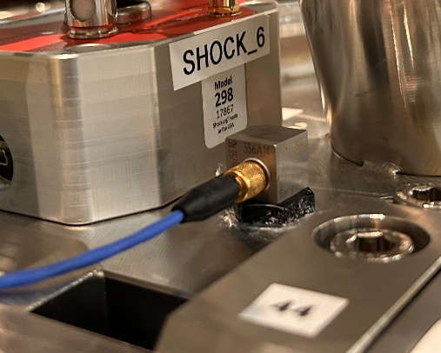
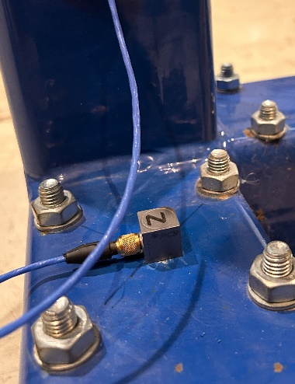
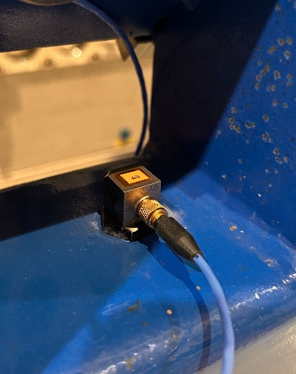
CERN Instrumentation – Extra
Continuous vibration monitoring system based on :
- 3 ICP triaxial accelerometers PCB-356A14
- Spectrum Analyzer with real time FFT analysis MicroQuantus®
    Online visualization
    Storage in an SSD hard drive
    Fs : 1024 Hz
Z=Vertical
X= Lateral
Y= Longitudinal

Slide 6
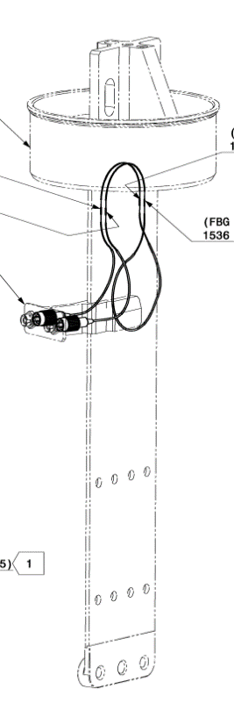
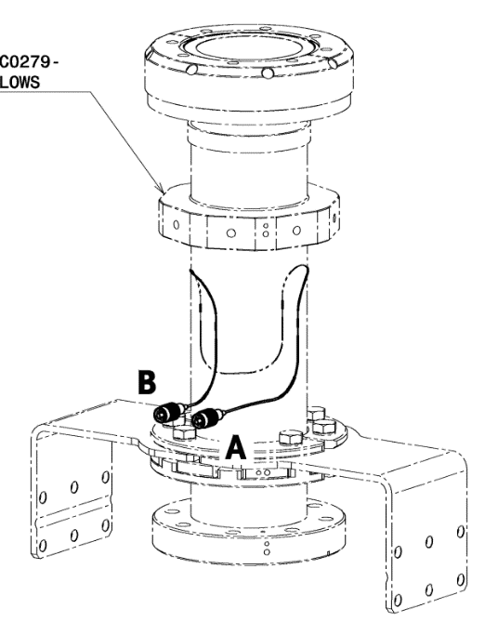
CERN Instrumentation – Cryomodule
Continuous strain measurements installed on blades and FPC tubes :
- Optical strain measurements based on FBG
- Online visualization with recording at 1000 Hz
Baseline
Z=Vertical
X= Lateral
Y= Longitudinal
Extra

Slide 7
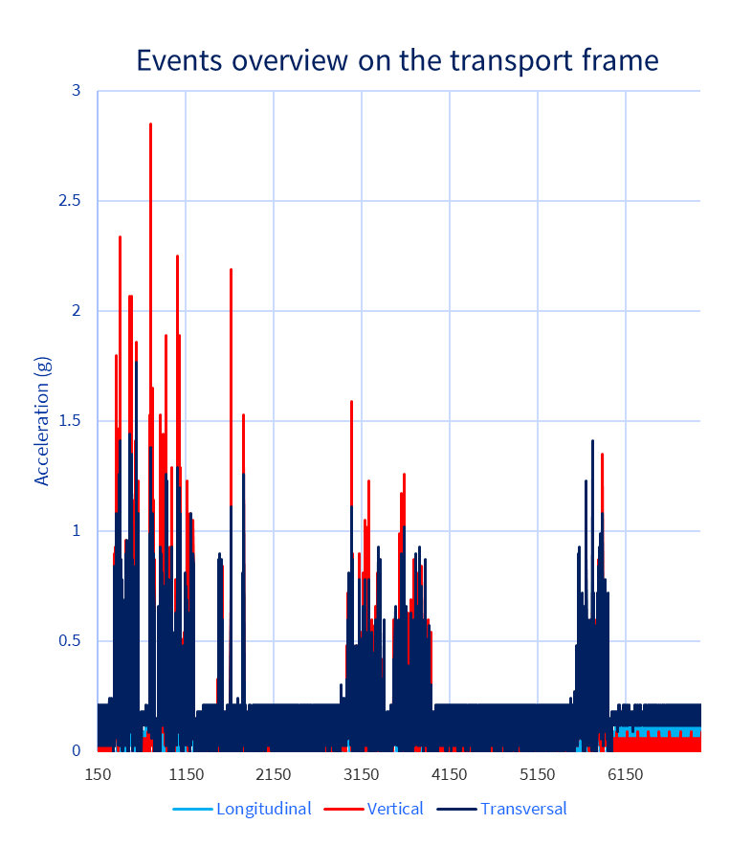
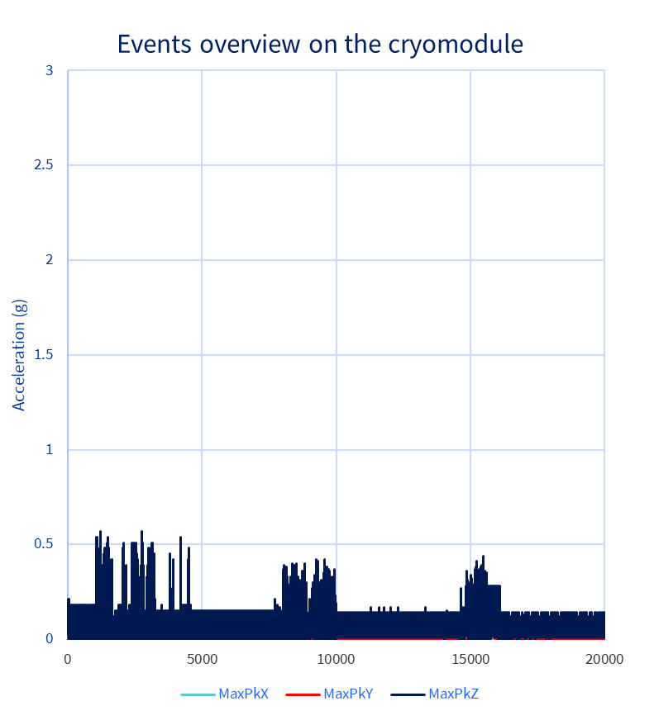

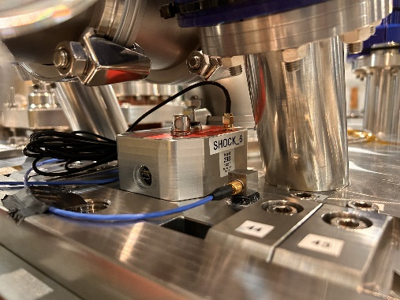
Results – Shocklog units

Slide 8

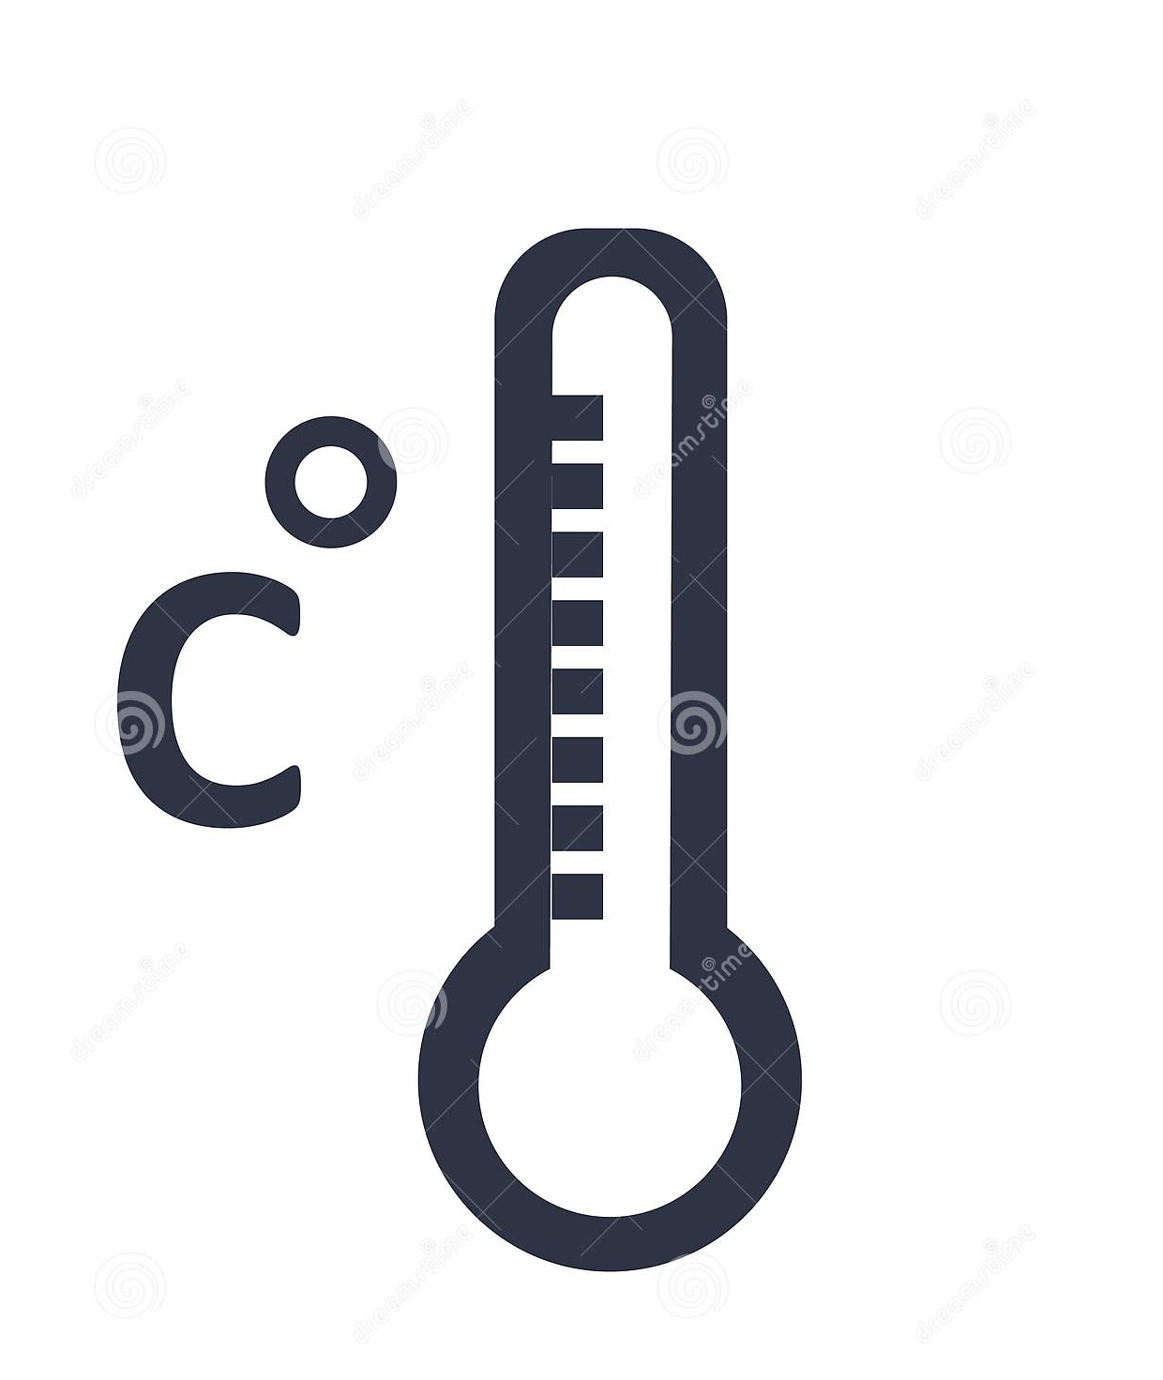


Results – Shocklog units

Slide 9
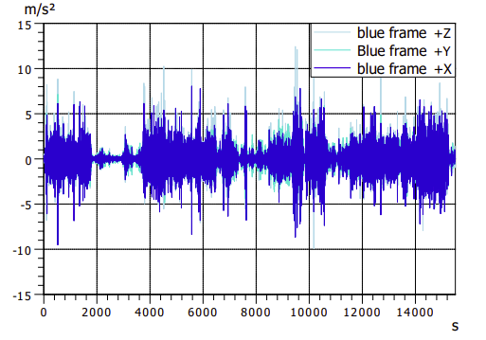
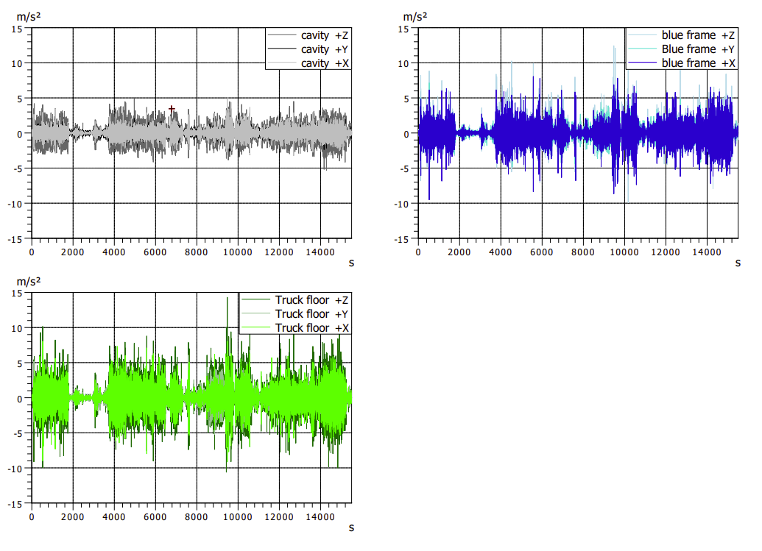
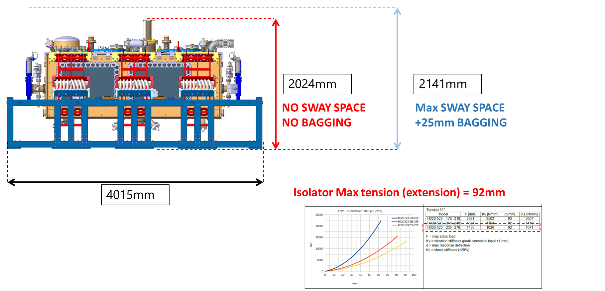
Results – Vibration monitoring system
Set of data from Warwick to Ashford Customs
Z=Vertical
X= Lateral
Y= Longitudinal

Slide 10
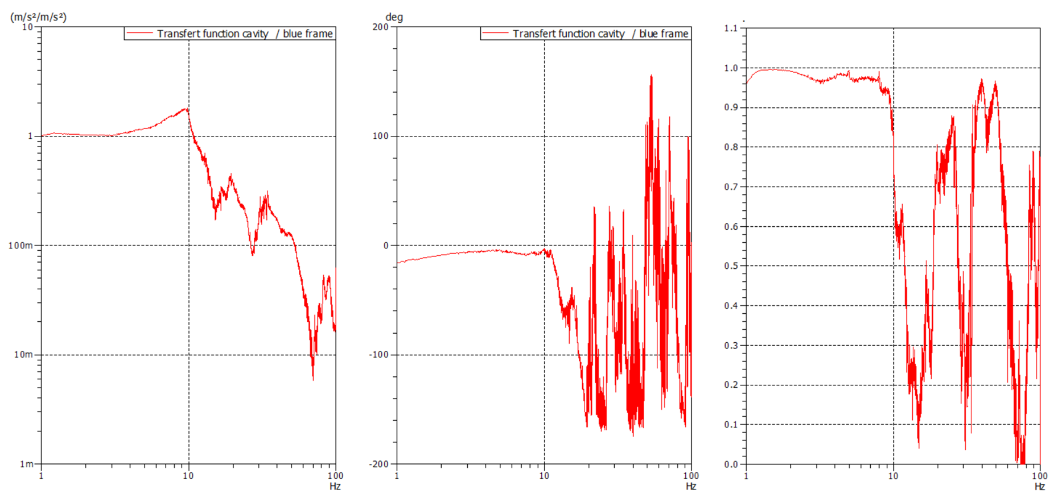
Results – Vibration monitoring system – Transfer function
Cut-off frequency ≅ 13 Hz

Slide 11
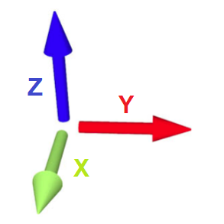
Results – Vibration monitoring system

Slide 12
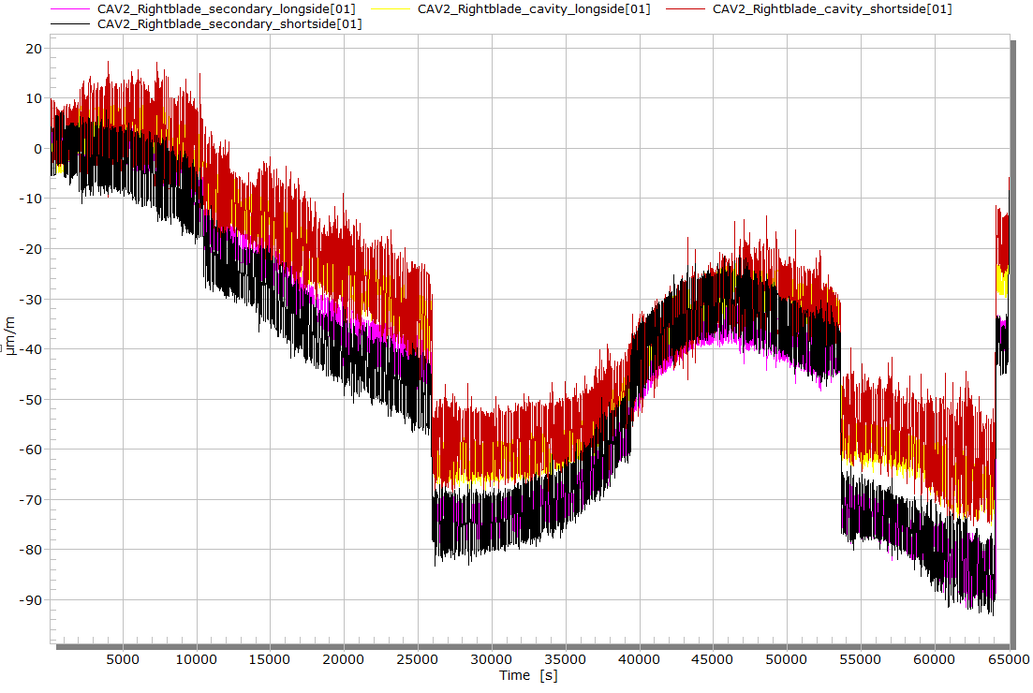
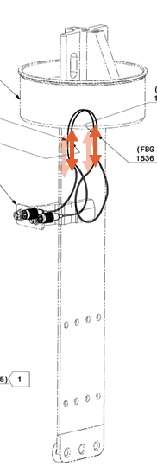
Results – Optical strain measurement system
Stop Measurement during the night
Transport effects
Low frequency effects are related to temperature
Full transport data

Slide 13
Results – Optical strain measurement system
Typical response of the blade instrumentation during transport event
Strain (μm/m)

Slide 14
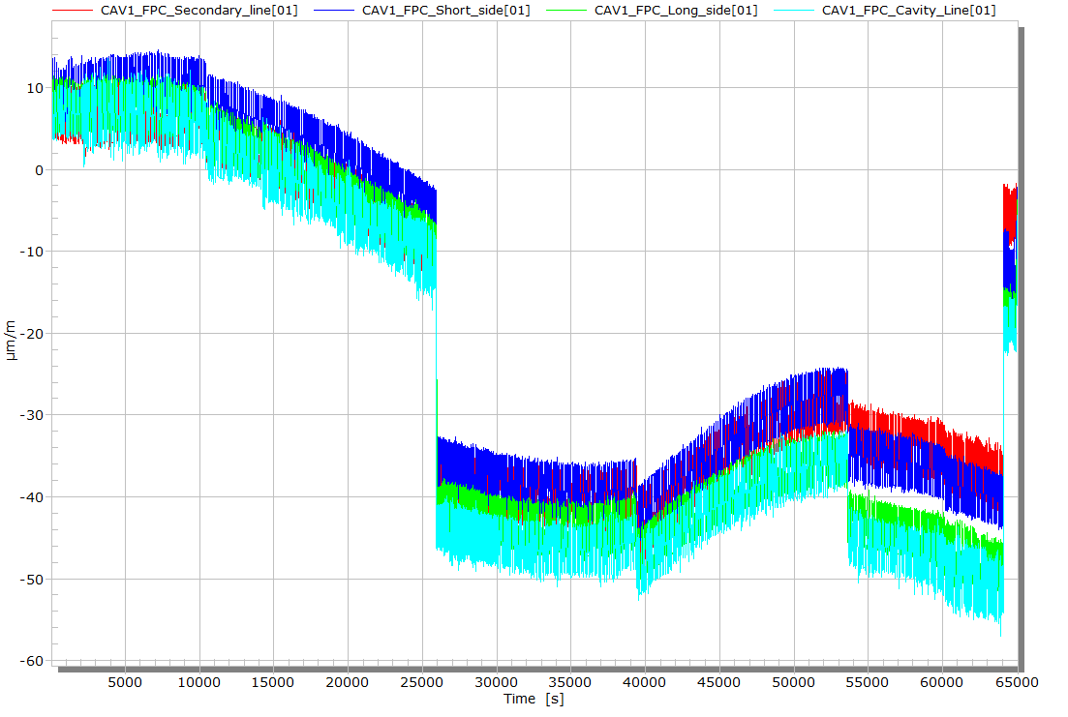

Results – Optical strain measurement system
Stop Measurement during the night
Full transport data

Slide 15
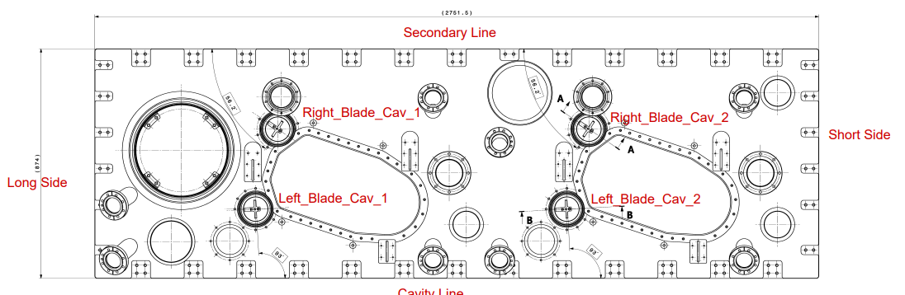
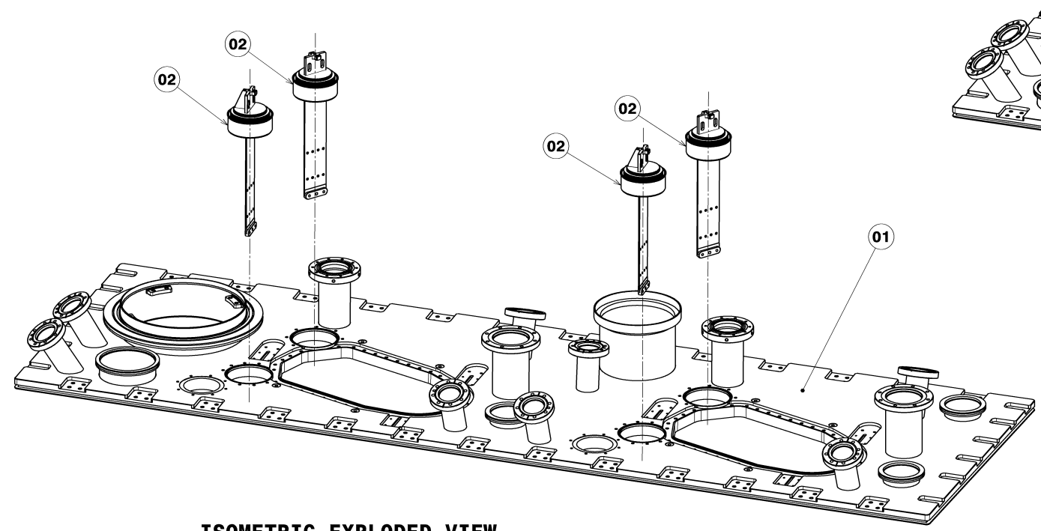
Results – Optical strain measurement system
 | 18th August 2023 | 17th October 2023 | 23th October 2023 | variation due to transport
 | Strain (µm/m) | Strain (µm/m) | Strain (µm/m) | Strain (µm/m)
CAV1_FPC_Secondary_Line | 29.12 | -13.4 | -23.8 | -10.4
CAV1_FPC_Short_Side | -29.91 | -43.41 | -59.47 | -16.06
CAV1_FPC_Long_Side | 17.97 | -76.33 | -99.1 | -22.77
CAV1_FPC_Cavity_Line | 104.7 | -24.16 | -46.58 | -22.42
CAV1_RightBlade_Cavity_Long Side | 299.1 | 281.62 | 262.4 | -19.22
CAV1_RightBlade_Secondary_Long Side | 22.24 | -43.96 | -52.49 | -8.53
CAV1_RightBlade_Secondary_Short Side | -268.3 | -418.47 | -447.9 | -29.43
CAV1_RightBlade_Cavity_Short Side | -388.7 | -489.43 | -519.1 | -29.67
CAV1_LeftBlade_Secondary_Long Side | 90.7 | 59.36 | 26.7 | -32.66
CAV1_LeftBlade_Cavity_Long Side | 6.579 | -47.39 | -41.57 | 5.82
CAV1_LeftBlade_Cavity_Short Side | -147.3 | -242.3 | -267.74 | -25.44
CAV1_LeftBlade_Secondary_Short Side | -103.3 | -146.14 | -161.43 | -15.29
CAV2_FPC_Secondary_Line | -73.02 | -129.23 | -141.69 | -12.46
CAV2_FPC_Short_Side | 41.06 | -19.99 | -29.3 | -9.31
CAV2_FPC_Long_Side | 168.6 | 64.92 | 53.54 | -11.38
CAV2_FPC_Cavity_Line | 48.74 | -44.96 | -58.38 | -13.42
CAV2_LeftBlade_Secondary_Long Side | -182.9 | -139.04 | -170.8 | -31.76
CAV2_LeftBlade_Cavity_Long Side | -34.94 | -153.79 | -169.67 | -15.88
CAV2_LeftBlade_Cavity_Short Side | -360.1 | -411.13 | -387.81 | 23.32
CAV2_LefttBlade_Secondary_Short Side | 48.44 | -23.51 | -42.46 | -18.95
CAV2_RightBlade_Cavity_Short Side | -44.86 | -97.98 | -118.8 | -20.82
CAV2_RightBlade_Secondary_Short Side | -184.1 | -321.01 | -354.98 | -33.97
CAV2_RigthBlade_Secondary_Long Side | 150.6 | 98.07 | 64.25 | -33.82
CAV2_RightBlade_Cavity_Long Side | 26.02 | -5.79 | -31.13 | -25.34
Notes:
Also validation of the restraint assembly method

Slide 16
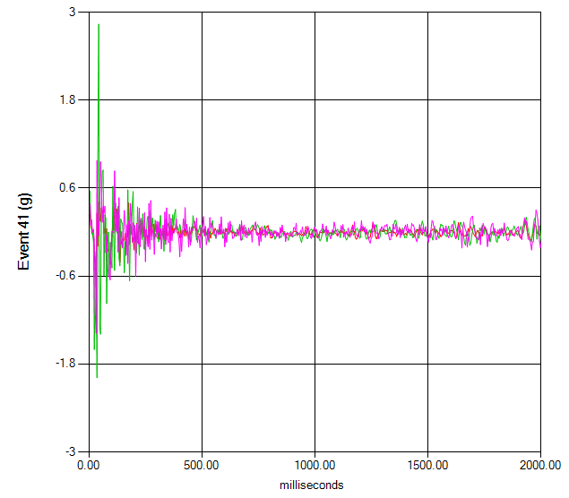
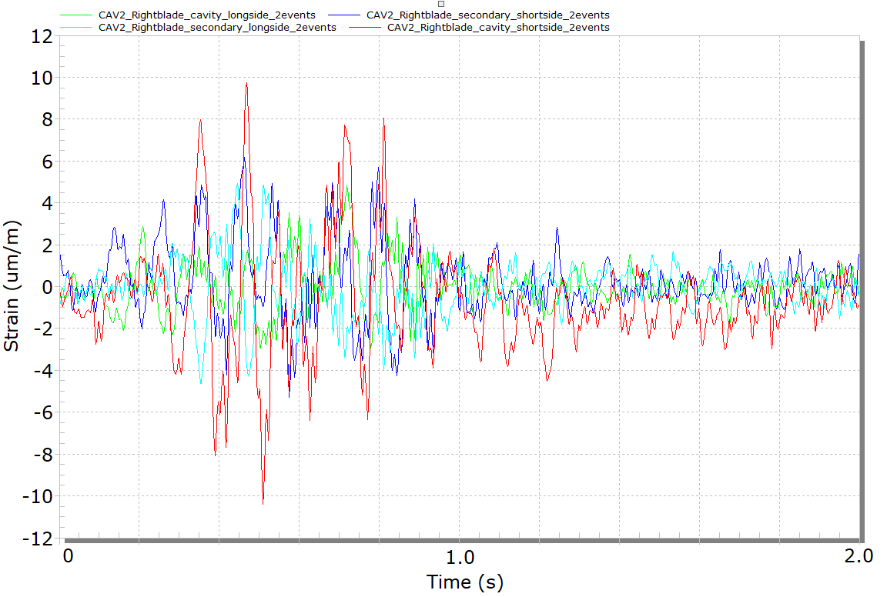
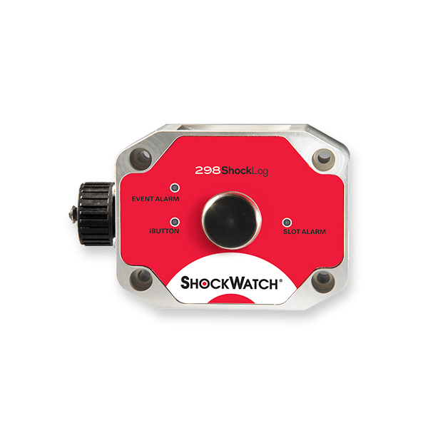

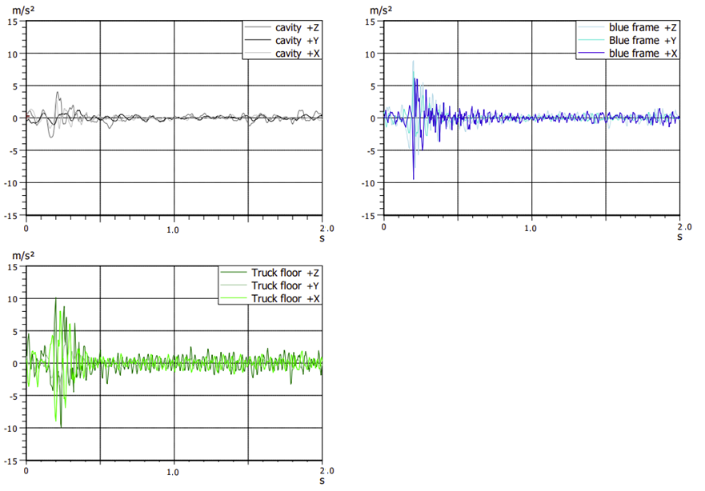
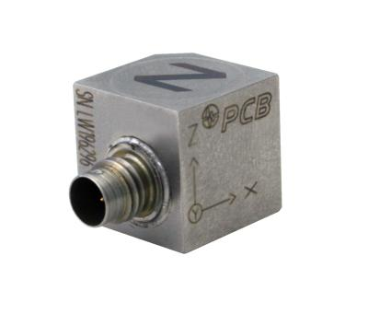
Results – Worst case event
Blue frame
Sample rate = 1000 Hz
Sample rate = 4096 Hz
18/10/23 11h30 19/10/23_10h00 20/10/23 8h30
Sample rate = 1024 Hz
Sample rate = 1024 Hz
Sample rate = 1024 Hz

Slide 17
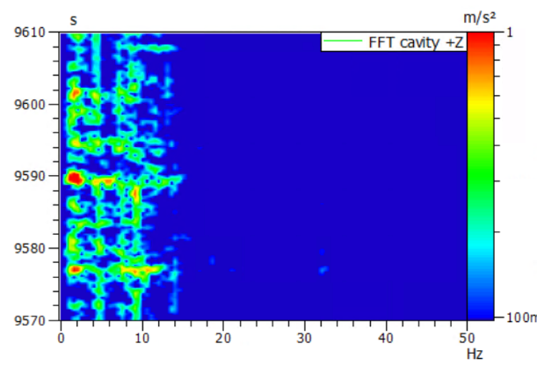
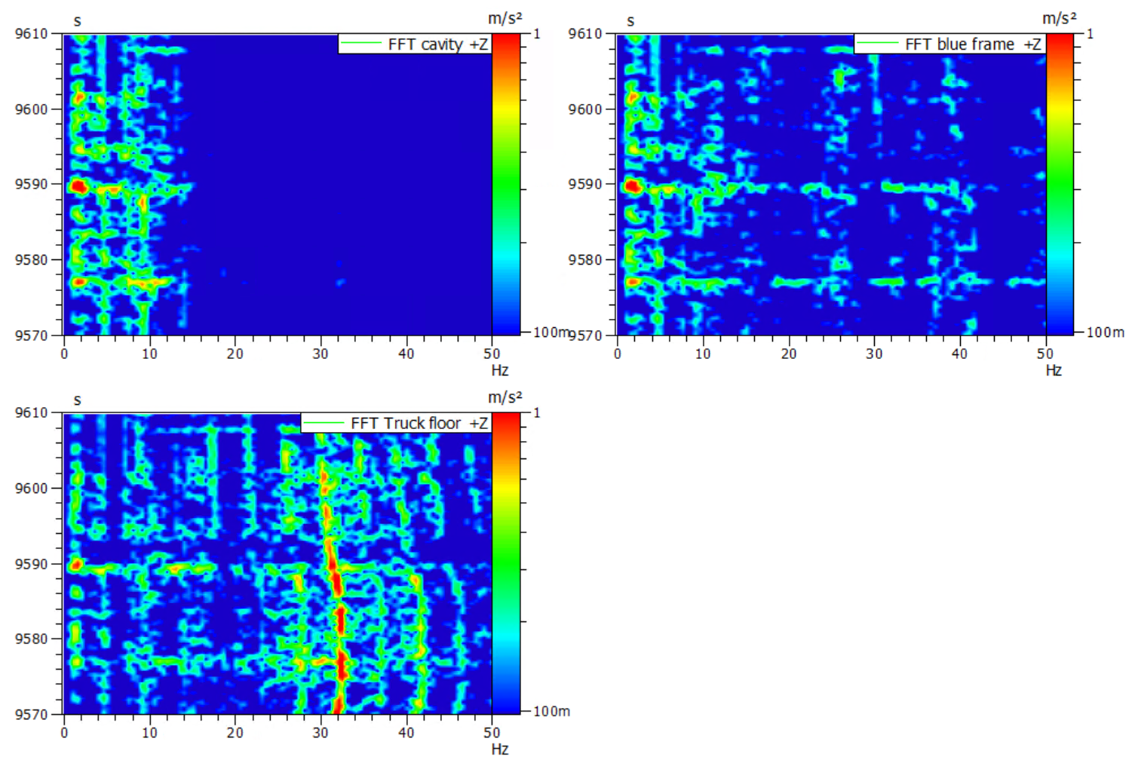
Results – Worst case event
Blue frame
Sample rate = 1000 Hz
Sample rate = 4096 Hz
18/10/23 11h30 19/10/23_10h00 20/10/23 8h30
0.2 g @ 2 Hz

Slide 18
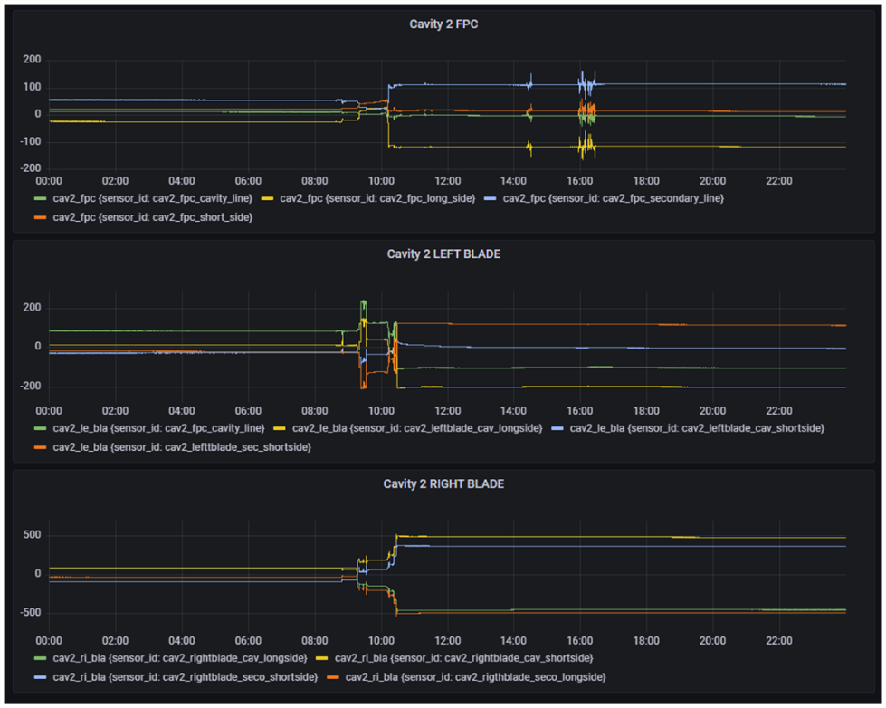
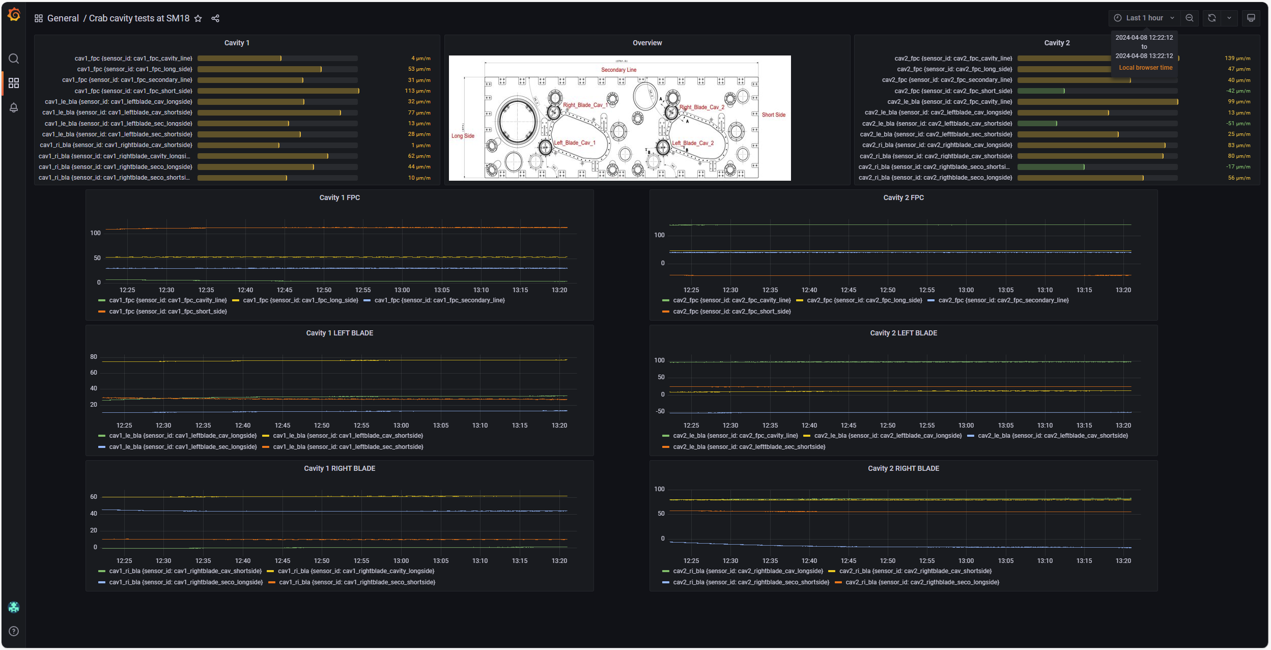
Use of the mechanical instrumentation during repair
Continuous optical strain monitoring : (https://mml.web.cern.ch/)

Slide 19
Summary Transport
 |  | Min value | Max Value
Shocklog Data | Temperature | 14 °C | 20 °C
 | Humidity | 55 % | 100 %
 | Tilt | - 7 ° | +15 °
 | Roll | -10 ° | +5 °
 | Vertical RFD acceleration (@4096 Hz) | / | < 0.6 g
 | Longitudinal RFD acceleration (@4096 Hz) | / | < 0.6 g
 | Lateral RFD acceleration (@4096 Hz) | / | < 0.6 g
Monitoring system | Vertical RFD acceleration (@1024 Hz) | / | < 0.5 g
 | Longitudinal RFD acceleration (@1024 Hz) | / | < 0.5 g
 | Lateral RFD acceleration (@1024 Hz) | / | < 0.5 g
 | Strains on blade components | / | +/- 20 μm/m
 | Strains on FPC components | / | +/- 20 μm/m

Slide 20
Summary Transport and Mechanical instrumentation
The transport of the SPS RFD cryomodule from STFC to CERN was a success.
Transport frame combined with transport restraints
No damage linked to transport was found
Two shock logs as baseline during transport
The extra instrumentation during the first DQW and RFD (from TRIUMF transport)
The strain measurements on the FPC pipe can/should be used more extensively during the assembly and recorded. Requires training + some preparation
FPC strain gauges > base line

