Slide 1



Canada RFD CM series challenges – procurements and schedule
Bob Laxdal
TRIUMF Hi-Lumi Technical Coordinator
Oct. 9, 2024

Slide 2

Project Strategy
The project strategy calls for procurement of parts for a single cryomodule, TCM0, followed by procurement of parts for the production series TCM1-4
Project slippages due to Covid and other forces vs. boundary conditions on project funds are having an impact on this strategy
  Shifting timelines for
    TCM0 cavities from AUP
    Released drawings, deliverables and parts lists from CERN
  Fixed timeline for spending the funds
The present strategy has been to procure series components as soon as drawings are released and strategically assign some scope to CERN in order to spend $$ within fixed timeline
2

Slide 3
Funding constraints
Due to the nature of the funding agreement ALL funds for the project must be spent and all parts received (to trigger payment) before April 2025
Over 5M$ has been committed over the last year - TRIUMF has presently spent or committed 97% of the funds – (now 98%)
Present risks
  Over 50% of funds are encumbered including 19% from CERN that need delivery to TRIUMF before April 2025
  Some drawing packages and procured parts lists are still not released
3

Slide 4
Schedule Discussion

Slide 5

Cryomodule Assembly Boundary Conditions
CM string assembly requires cavities from AUP, FPCs and beamline assemblies from CERN – first articles are required to assemble TCM0 and TCM1
The critical path runs through delivery of the prototype cavity (rigid) and CM design (coupled to parts fabrication schedule)
TRIUMF also requires delivery of CM parts from CERN for both in scope articles and added scope articles (at least for first units):
  Rf test adaptors – Jan 2024 - Dec 2024
  String assembly components – Mar 2024 - Mar 2025 – partial PIMs received
  CM assembly – April 2024 - May 2025
  CM test – May 2024 - Oct. 2025
* indicates requested dates as of Oct. 2023
AUP, CERN
TRIUMF
AUP Delivery Projection
Cavity Pair | Module | Delivery
Prototype | TCM0 | Feb 2025 | -
Caviies 1 and 2 | TCM1 | May 2025
Caviies 3 and 4 | TCM2 | Jun 2025
Caviies 5 and 6 | TCM3 | Jul 2024
Caviies 7 and 8 | TCM4 | Aug 2025
Caviies 9 and 10 | TCM5 | Sep 2025

Slide 6
The `TRIUMF’ Schedule Issue
The `TRIUMF’ schedule shown at the plenary is a reflection of a long list of dependencies, delays and lessons learned
  AUP/ZANON challenges with jacketing - delays TC0
  JLAB cavity testing shutdown - delays TC0
  CERN delays in final design, FPC/rf adaptors production and lessons learned from CM testing – impacts `bravery factor’ for TCM0 and CM production times
  UK lessons learned in the RFD prototype build timing – experience argues against being too aggressive with schedule
TRIUMF is the last in the queue but the slippages in the schedule to date are a WP4 issue and need understanding in that context
What follows is an attempt to rationalize and understand TRIUMF’s estimate of what is possible and critical path

Slide 7
Schedule Methodology
In preparing the estimate of the schedule update considering the TRIUMF 2026 SD we first estimated the present timeline without it
Finding: Project end date (without SD) anticipated as May 2028

Slide 8
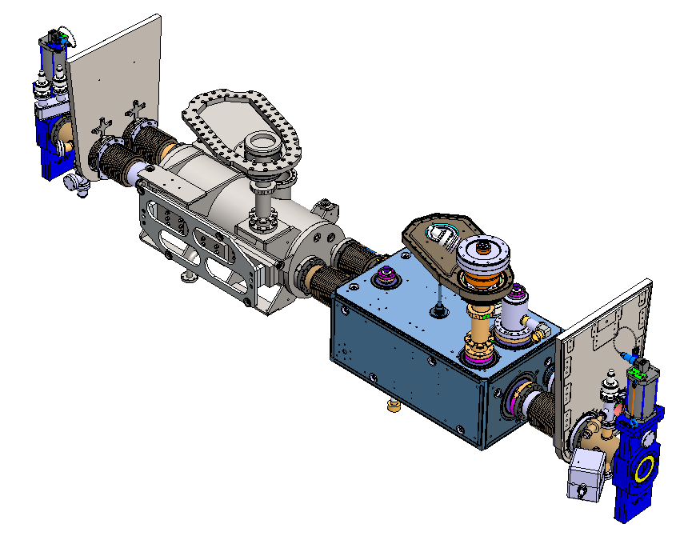
TCM0 strategy and string assembly qualification logic
The prototype cavity TC0 will be requalified after arrival from Jlab
  The test coupler will be removed and the FPC installed
The dummy cavity will be prepared for string installation
The string will be assembled and leak checked and then vented and disassembled
TC0 will be retested via cooldown to 2K
The successful test of TC0 after string assembly is a critical milestone for the project and is required before string assembly of TCM1
The arrival of TC0 at TRIUMF is on the critical path for all deliverables to CERN – the arrival has been steadily being pushed out over the last year

Slide 9
Timeline without SD2026 (First cavity)
1st cavity
milestone

Slide 10
Timeline without SD2026 (Cryomodule design)
Design

Slide 11
Timeline without SD2026 (Cold tests)

Slide 12
Schedule Methodology
In preparing the estimate of the schedule update considering the TRIUMF 2026 SD I first estimated the present timeline without it
Finding: Project end date (without SD) anticipated as May 2028
Fact: Estimated end date at Oct. 2023 meeting was Oct. 2026 (19 months earlier)

Slide 13
Timeline -Oct. 2023

Slide 14
Rationalization of dates
In Oct. 2023 collaboration meeting the end date was indicated as Oct. 2026
  so why now is it May 2028 (+19 months)?
Consider
  First cavity delayed by 11 months
  Cryomodule design delayed by 12 months
  TCM0 logic was not appropriately considered – recommend to add a characterization milestone – add +4 months
  First build (TCM1) too aggressive based on UK experience – add +4 months
 | Oct. 2023 | Oct. 2024 | Oct. 2024 ** | Oct. 2024 ****
TC0 arrival | March 2024 | Feb. 2025 (+11)
CM design frozen | Dec. 2023 | Dec. 2024 (+12)
Project complete | Oct. 2026 | Sept. 2027 (+11) | Jan 2028 (+4) | May 2028 (+4)
** consider to add a TCM0 qualification milestone
**** consider to increase time of TCM1 (first full build – based on UK experience)

Slide 15
Timeline -Oct. 2023
19 months

Slide 16
And ….. Impact of TRIUMF SD2026
TRIUMF management has decided (just) to implement a long shutdown in 2026 to focus effort on the completion of the ARIEL project
Technicians on HiLumi will be assigned tasks with ARIEL during 2026 that will slow effort on CM assembly
Qualification of arriving AUP cavities will not be impacted – cavity testing facilities will be supported
The actual impact on HiLumi will only be known once the ARIEL tasks are fully assigned – the goal will be to add sufficient effort to determine that all parts are in hand for the series starting in 2027
We estimate that this will push out project completion by ~6 months

Slide 17
Timeline without SD2026

Slide 18
Timeline with SD2026
Assuming 50% effort

Slide 19
What can be done?
Understand the dependencies
Stop the bleeding
  Deliver TC0 in Feb 2025 in order to make real progress before 2026
    Goal is to qualify string assembly and parts inventory before end of long shutdown
  Try to freeze the design as of Dec. 2024 – procurement impacts schedule
  Deliver all parts on time
Add risk – for discussion but not recommended
  Decouple TCM0 build from TCM1 (saves ~2 months)
  Assume a (more) success-based schedule (saves ~4 months)
    There is experienced gained that would indicate that the schedule is already somewhat success based – with little contingency – ie no expectation in schedule that CM fails test or cavity fails requalification
  Send last (spare) module without cold test (saves 3 months)

Slide 20
Other discussion points

Slide 21
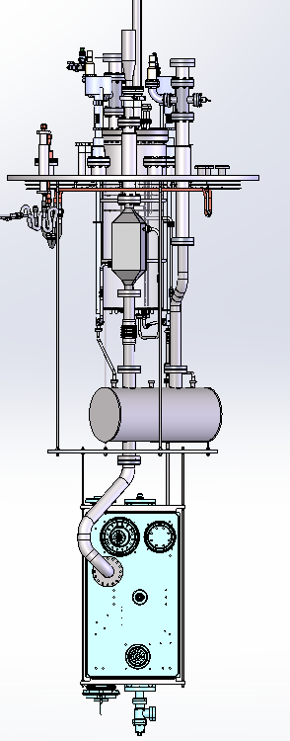
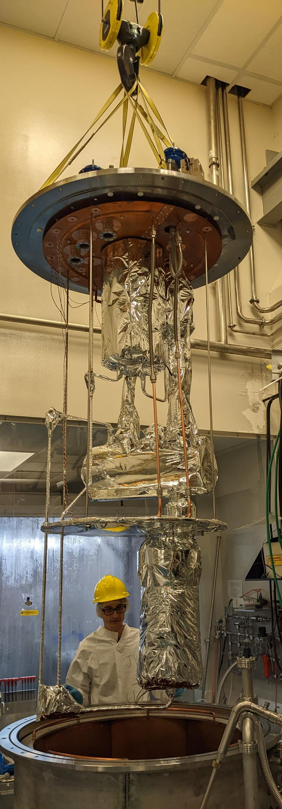
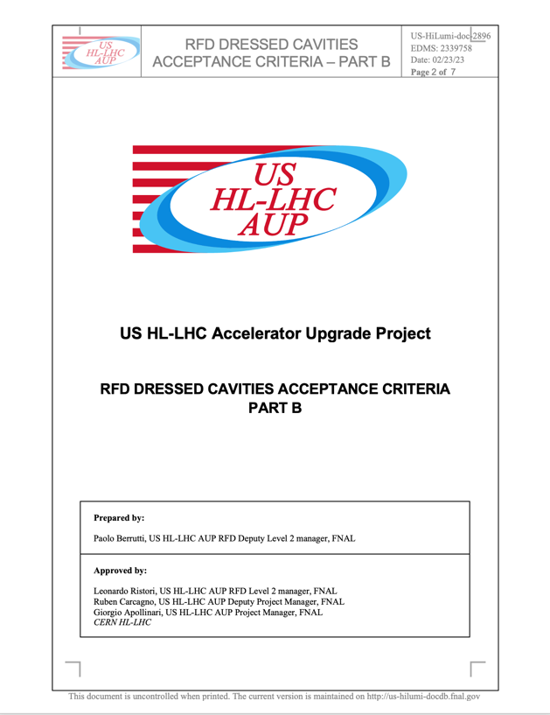
Preparation for cavity testing
TRIUMF will requalify the AUP cavities upon delivery from JLab
TRIUMF worked with AUP to draft cavity requalification test criteria
Important that this gets signed off soon

Slide 22
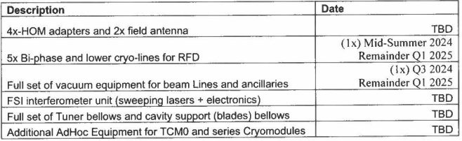
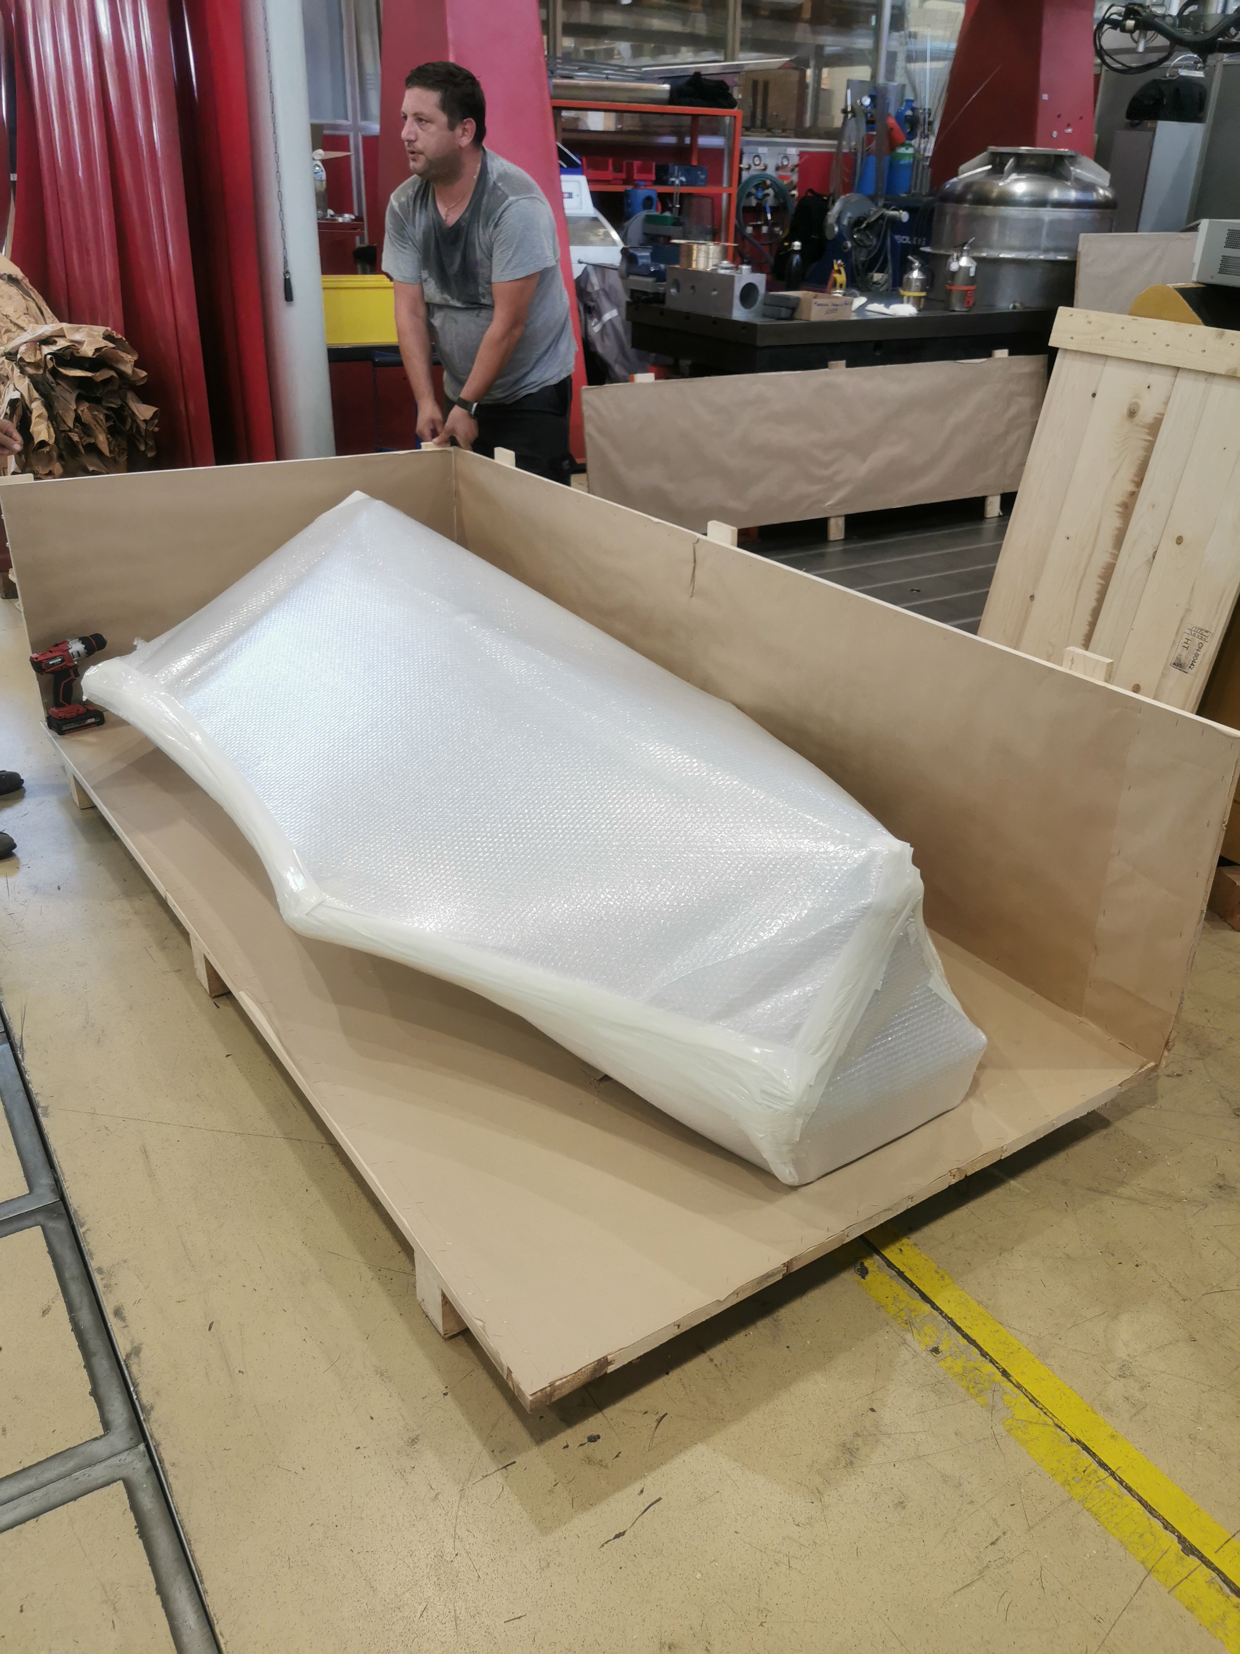
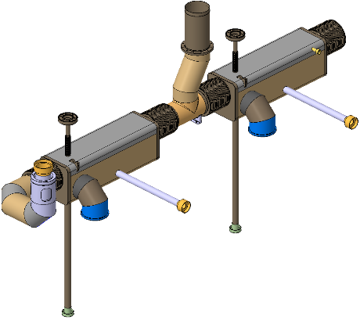
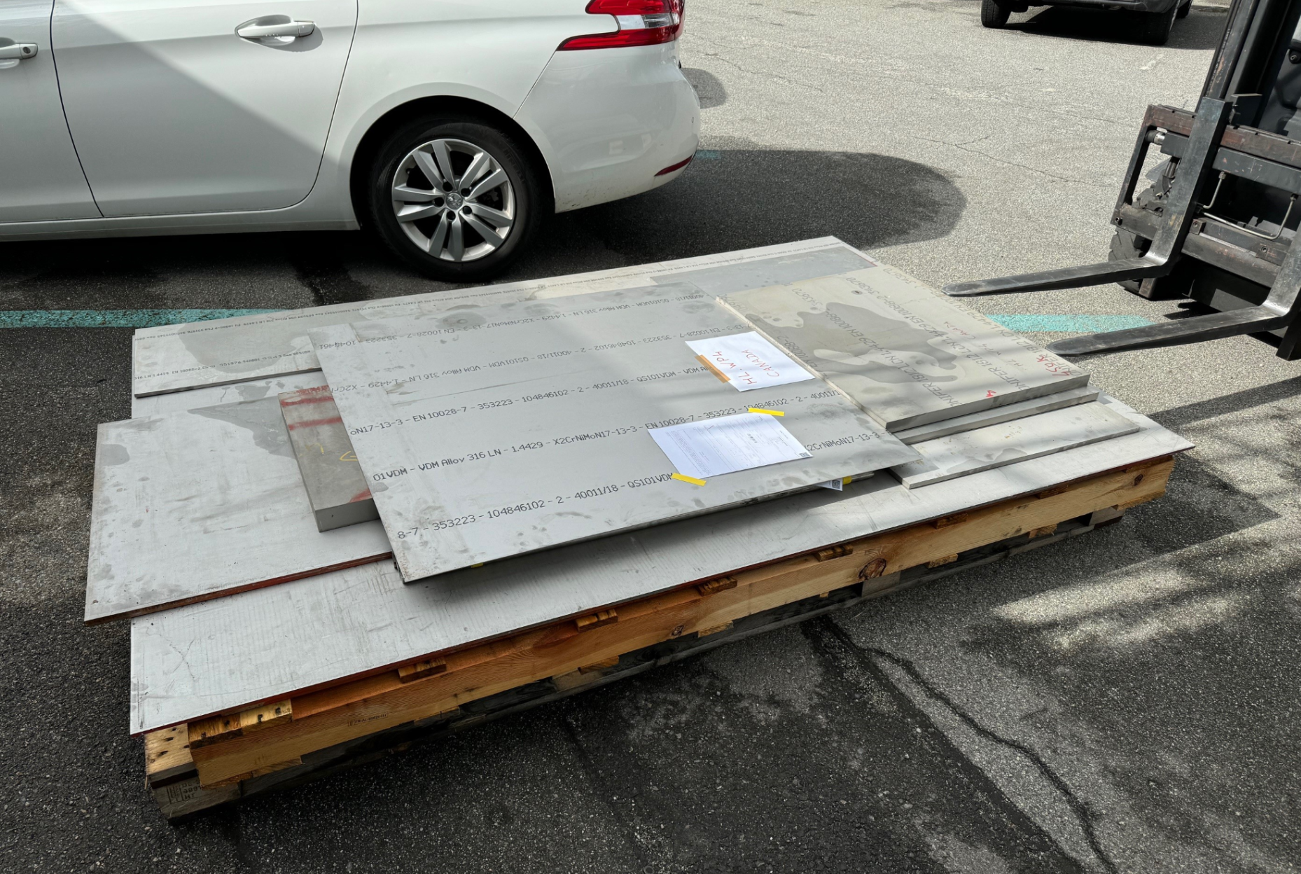
Procurement cooperation
CERN/TRIUMF agreement on parts exchange
excellent cooperation to help deal with NA material issues and
Bi-phase lines
Production well advanced at CERN with first article for TCM1 delivered – excellent cooperation
SS316 material
CERN sends TRIUMF material to overcome lack of certified material in NA
Hardware/Instrumentation
TRIUMF needs updated list of procured parts ASAP including fastener summary BOM
Invoicing
WP4 may need to coax the first invoices from CERN-> TRIUMF to get money flowing

Slide 23
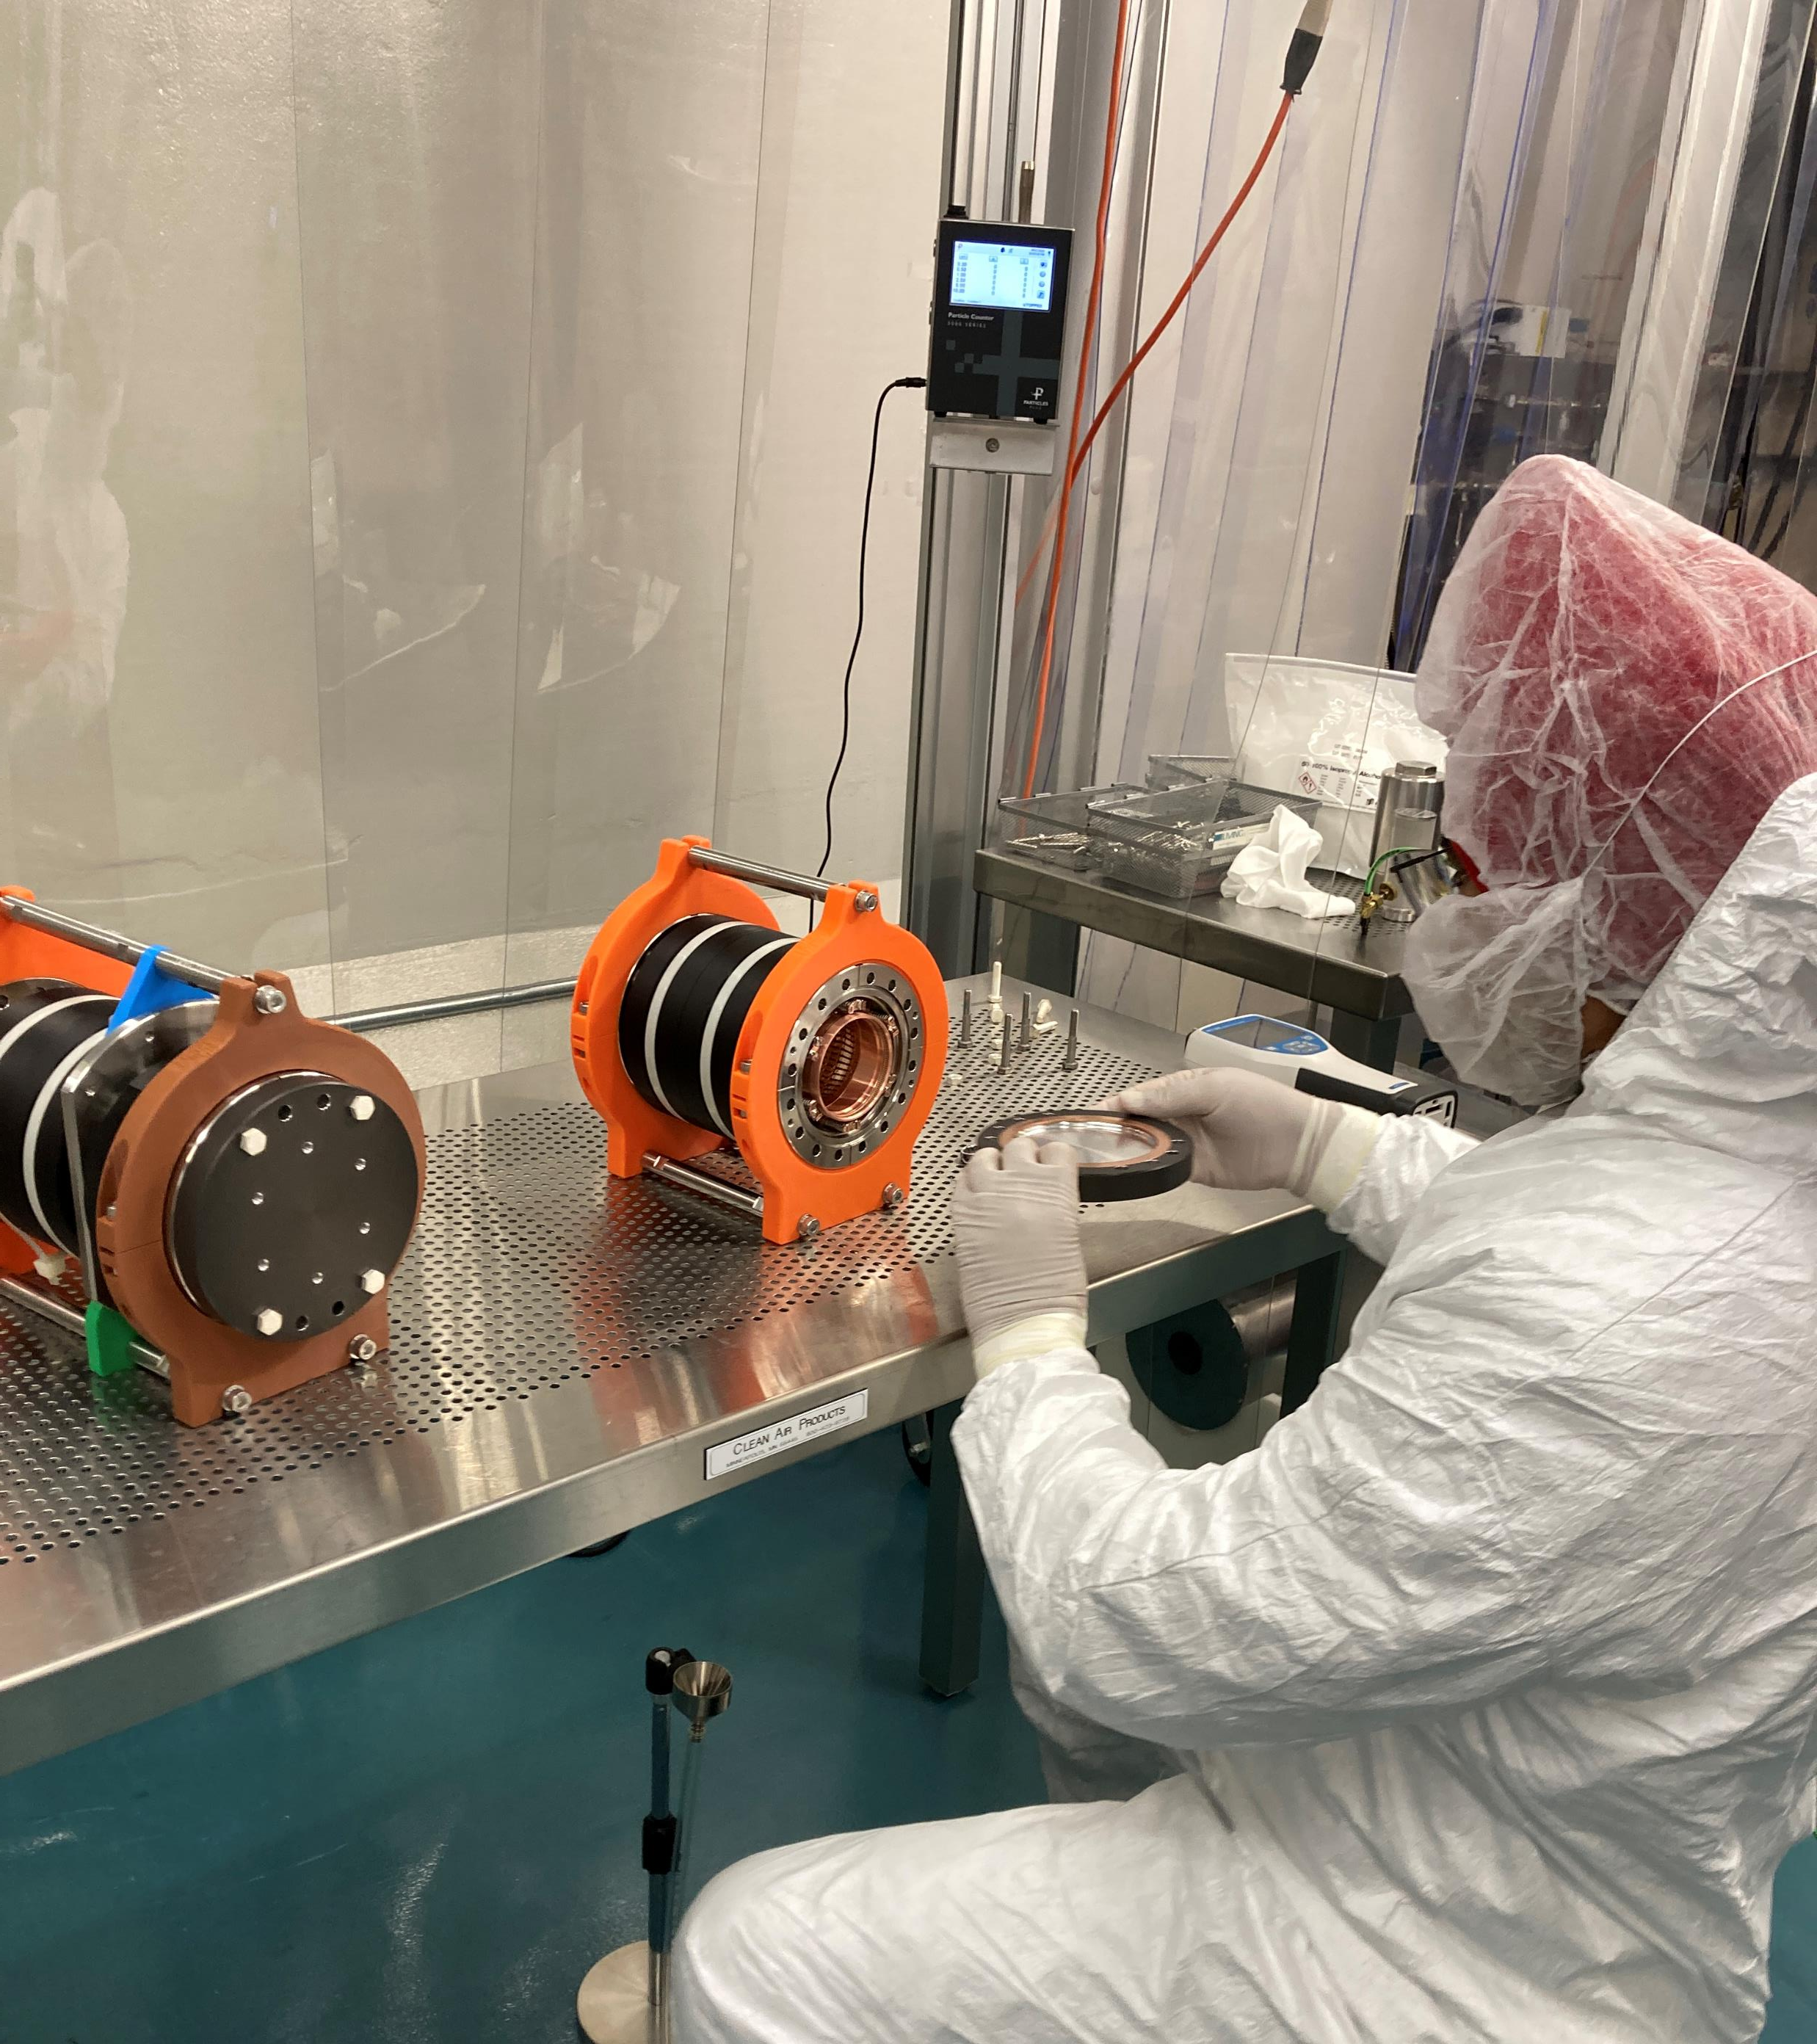
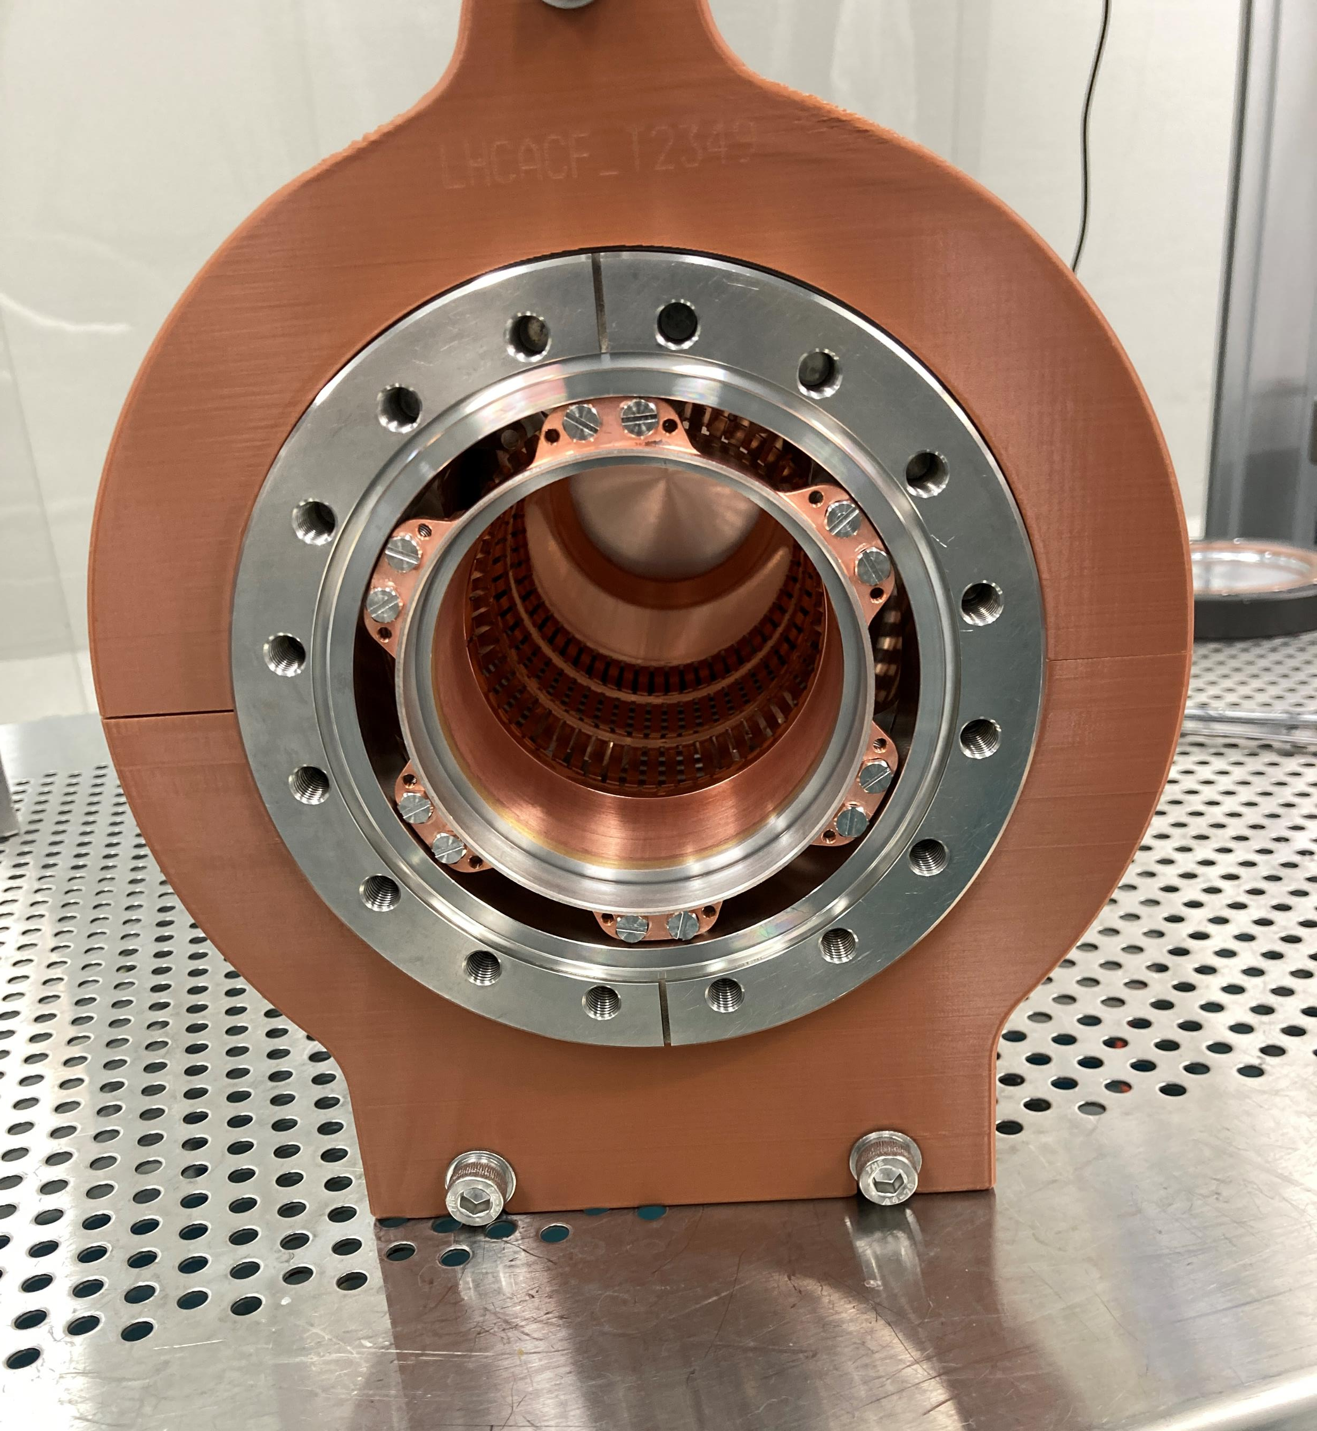
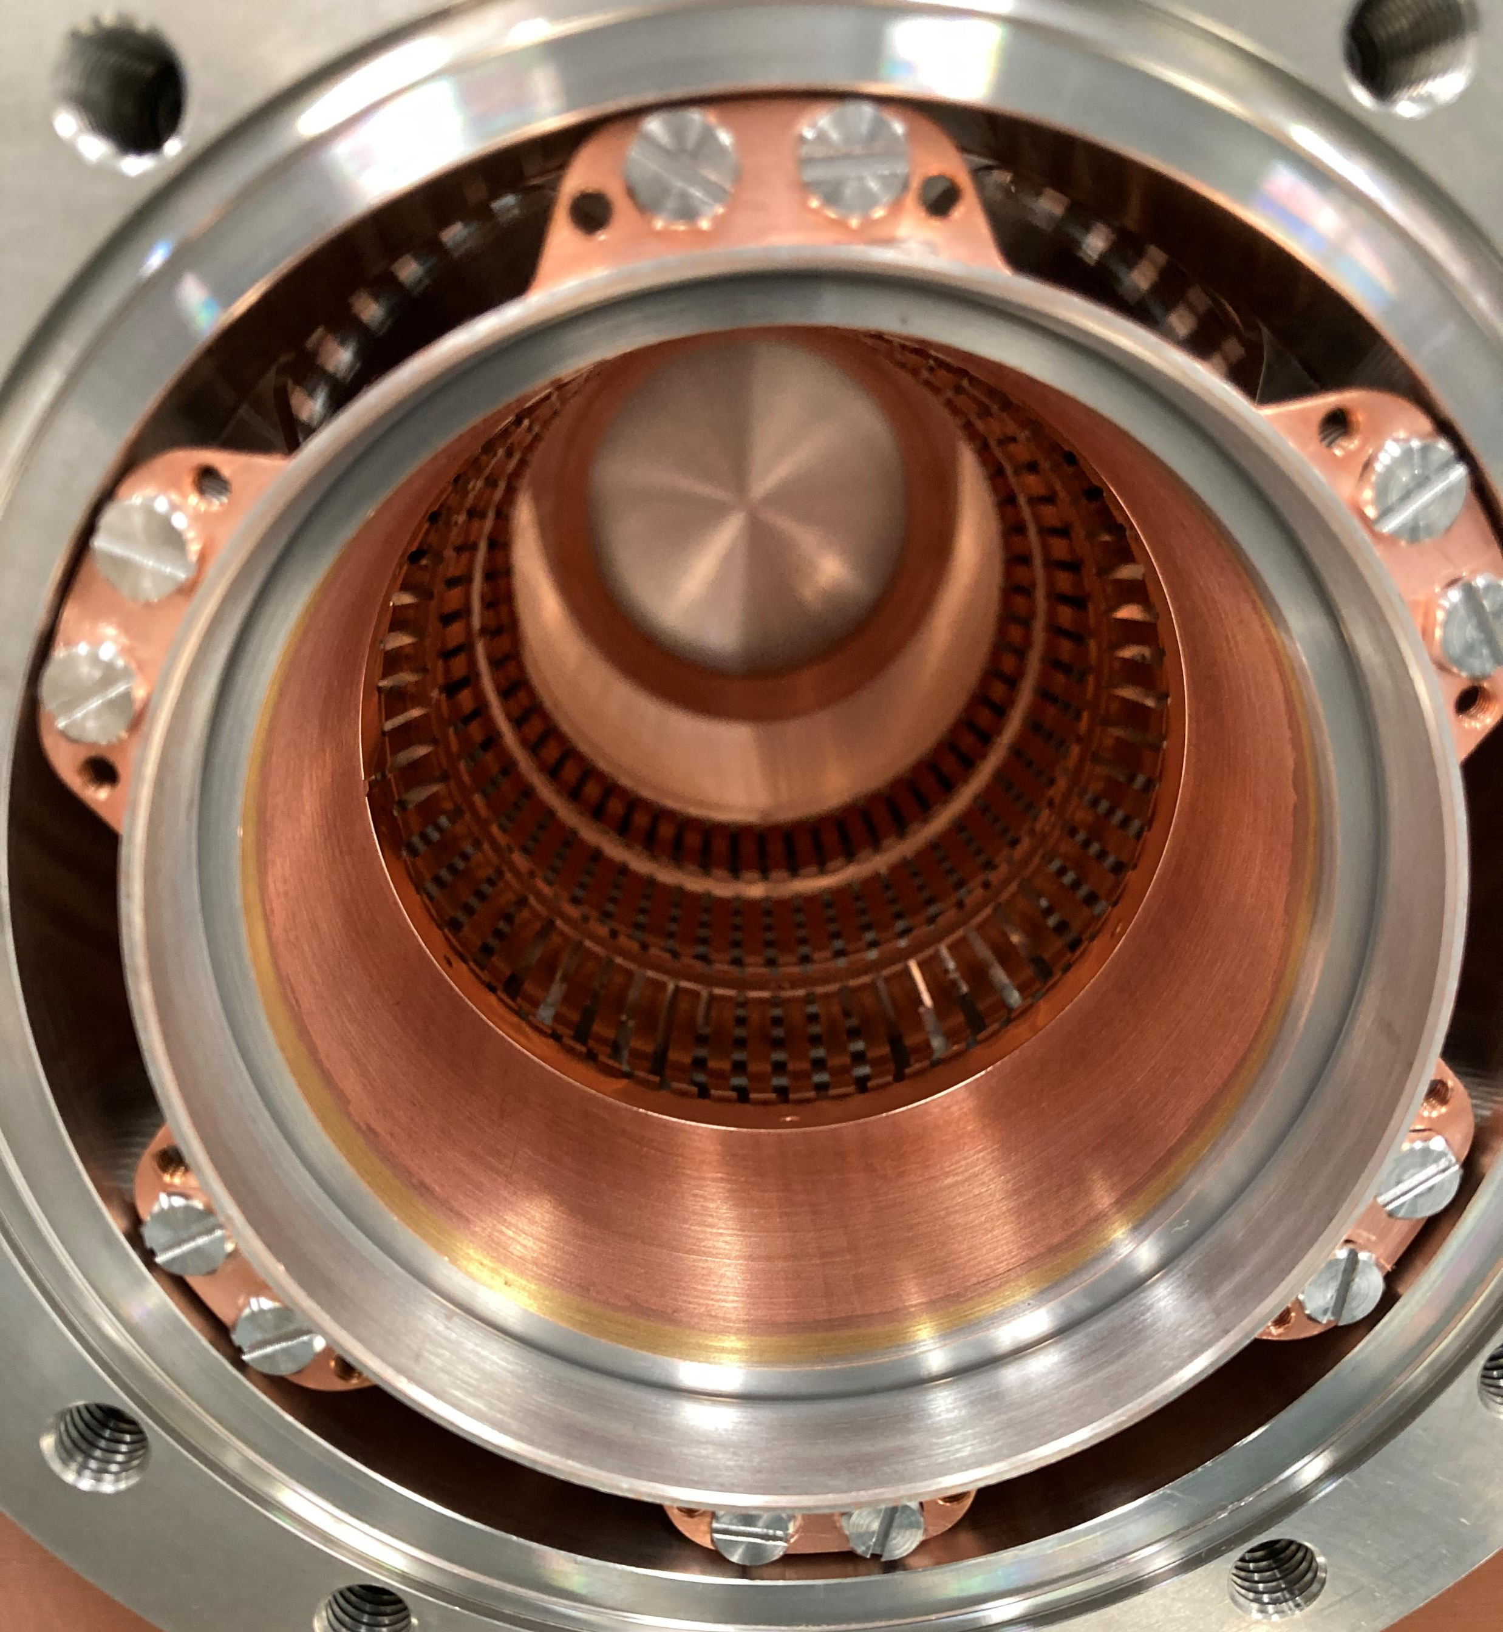
First PIMs received from CERN
Components for first string assembly
Tested in clean room for particulate
Results seem acceptable – good to compare with UK experience

Slide 24
RESULTS
SMALL BELLOW
LARGE BELLOW
Flanges had a particle count of 57 for 0.3 micron.
The assembly had a particle count of 1257 for 0.3 micron in the beginning.
The particle count decreased to <250 with continuous cleaning by filtered Nitrogen.
Flanges had a particle count of 39 for 0.3 micron.
The assembly had a particle count of 2282 for 0.3 micron in the beginning.
The particle count decreased to <100 with continuous cleaning by filtered Nitrogen.

Slide 25
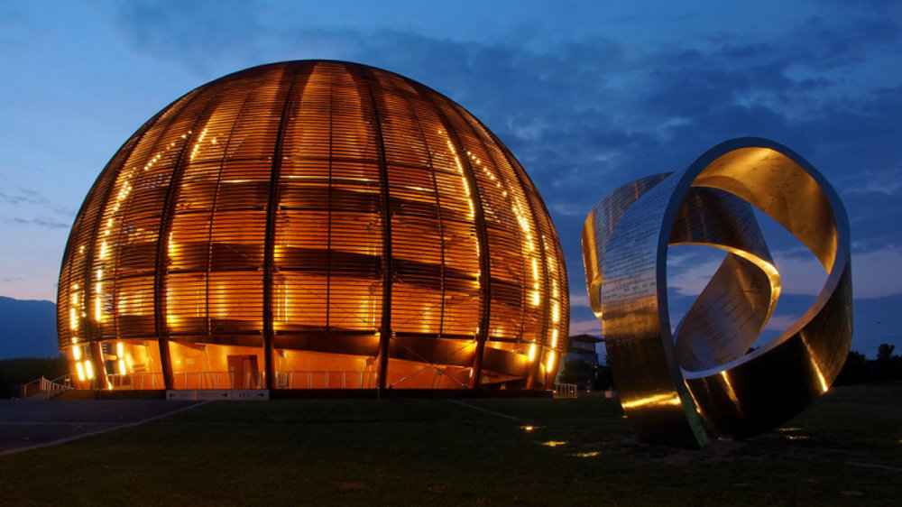
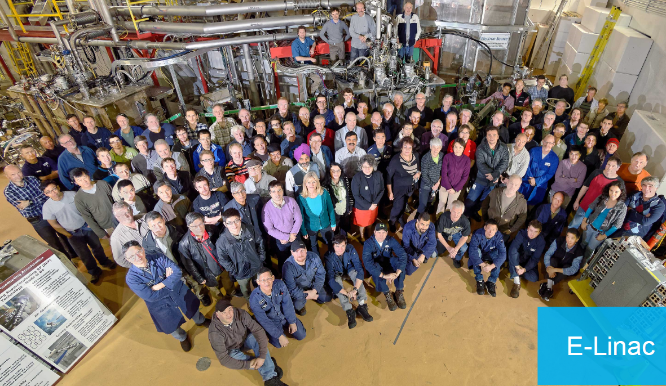

Summary
First cavity delivery and cryomodule design are both on the critical path for RFD completion
  Interdependencies of delivery times and RFD project end need to be added to schedule
  TRIUMF SD2026 estimated to have an impact of ~ 6 months
2024 strategy addresses finite time window for spending available funds
  Requires timely delivery from vendors (and CERN) of agreed deliverables in order to make payments
  ~1.6MCHF in CERN scope
  First out of scope fabricated parts received from CERN

