Slide 1
Studies for transport of crab cavities equipment
Teresa Guillén Hernández on behalf of WP4
14th HL-LHC Collaboration Meeting, Genoa (Italy), 7-10 October 2024

Slide 2
Outline
Introduction
Risk analysis
Risk mitigation
HOMs transport calculations
Conclusions
Teresa Guillen, 14th HL-LHC Collaboration Meeting

Slide 3
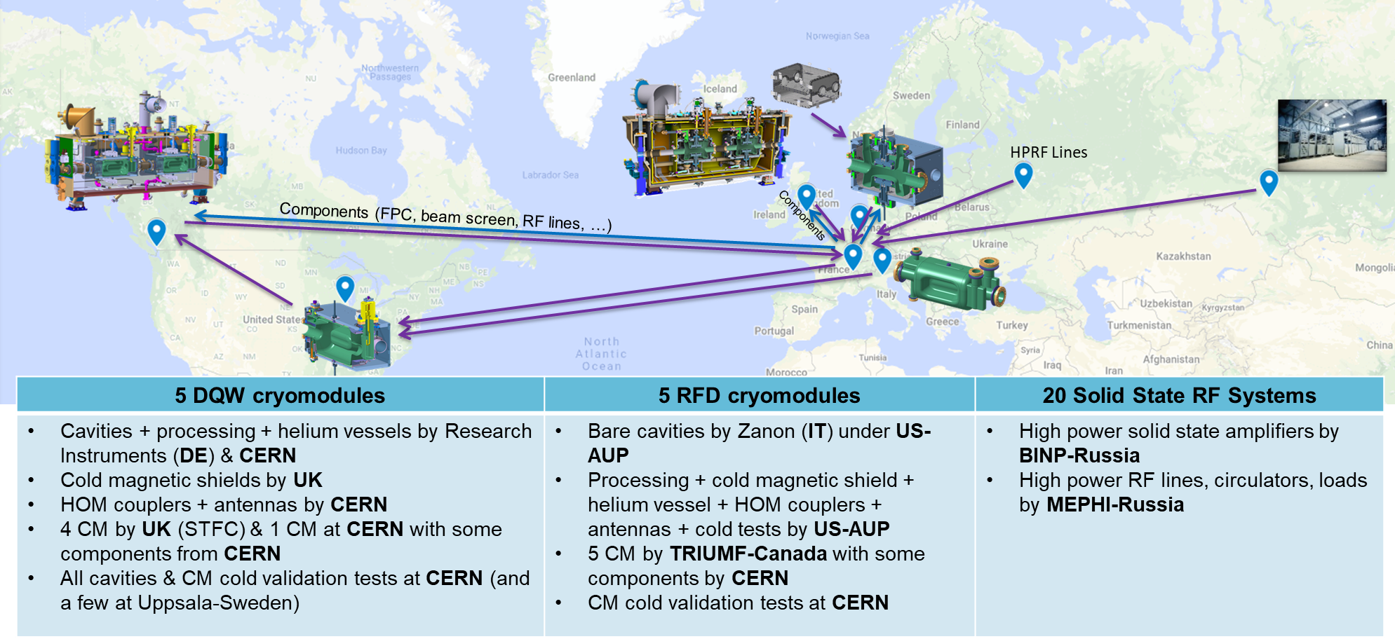
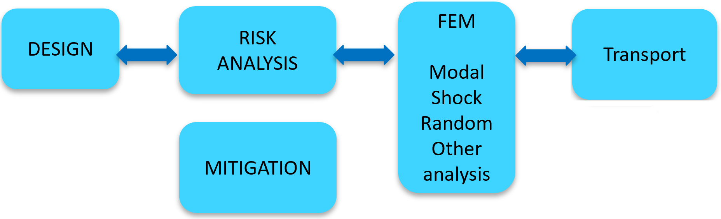
Introduction
M. Garlasche ¨Transport of RFD Equipment to UK¨ 11th HL-LHC Collaboration Meeting. 2021
Teresa Guillen, 14th HL-LHC Collaboration Meeting

Slide 4
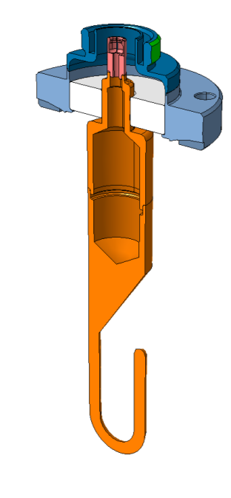
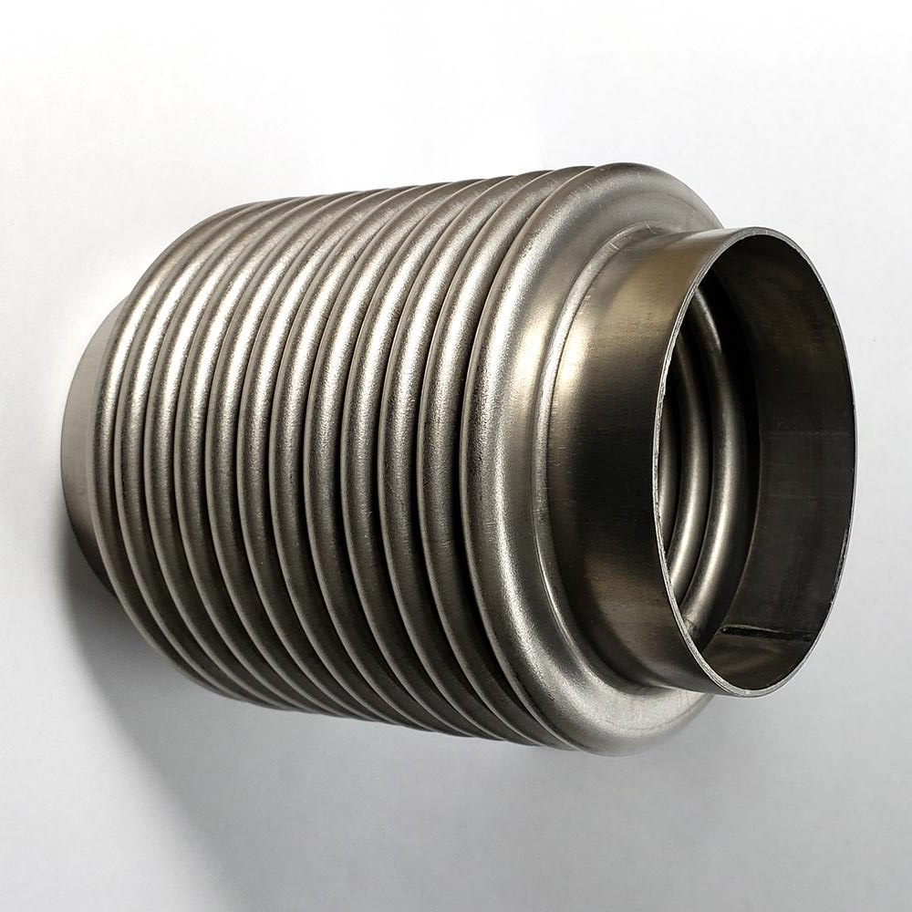
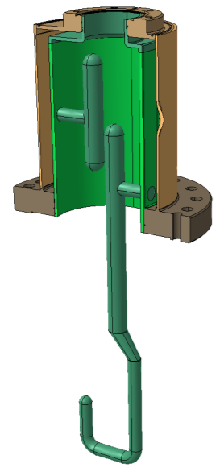
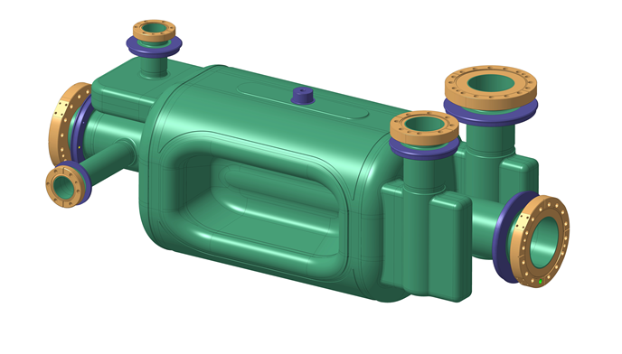
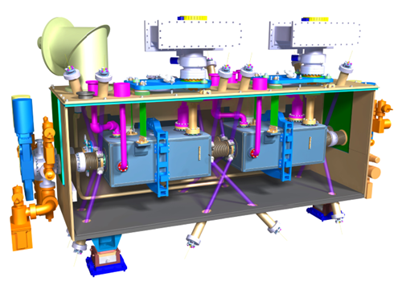
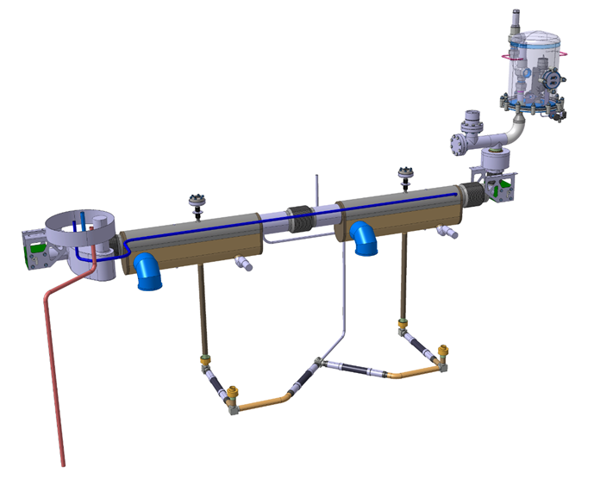
Risk analysis
    What issues can arise during transport
      Shock
      Vibration
      Contamination/humidity
      Untightening screws
      Misalignment
    What equipment is critical
      Manufacturing Cost/ delay
      Material properties
      Difficulty of risk detection
    Risk analysis on
      Components
      Assemblies
    Deep analyses of risks
      FEM
K. Artoos ¨Transport aspects¨ International review of the CRAB cavity system design and production plan for the HL-LHC. 2019
M. Garlasche ¨Transport of RFD Equipment to UK¨ 11th HL-LHC Collaboration Meeting. 2021
Teresa Guillen, 14th HL-LHC Collaboration Meeting

Slide 5
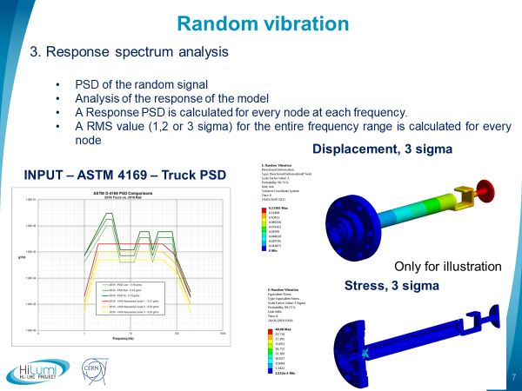
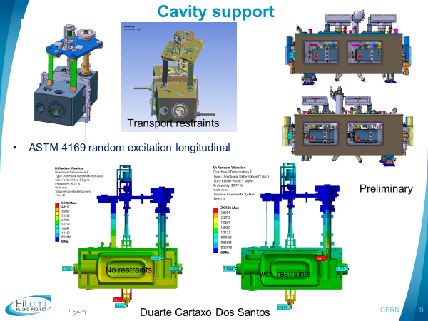
Risk mitigation
    Some mitigations are applied on the design of the equipment
Eduardo Cano-Pleite
K. Artoos ¨Transport aspects¨ International review of the CRAB cavity system design and production plan for the HL-LHC. 2019
M. Garlasche ¨Transport of RFD Equipment to UK¨ 11th HL-LHC Collaboration Meeting. 2021
Teresa Guillen, 14th HL-LHC Collaboration Meeting

Slide 6
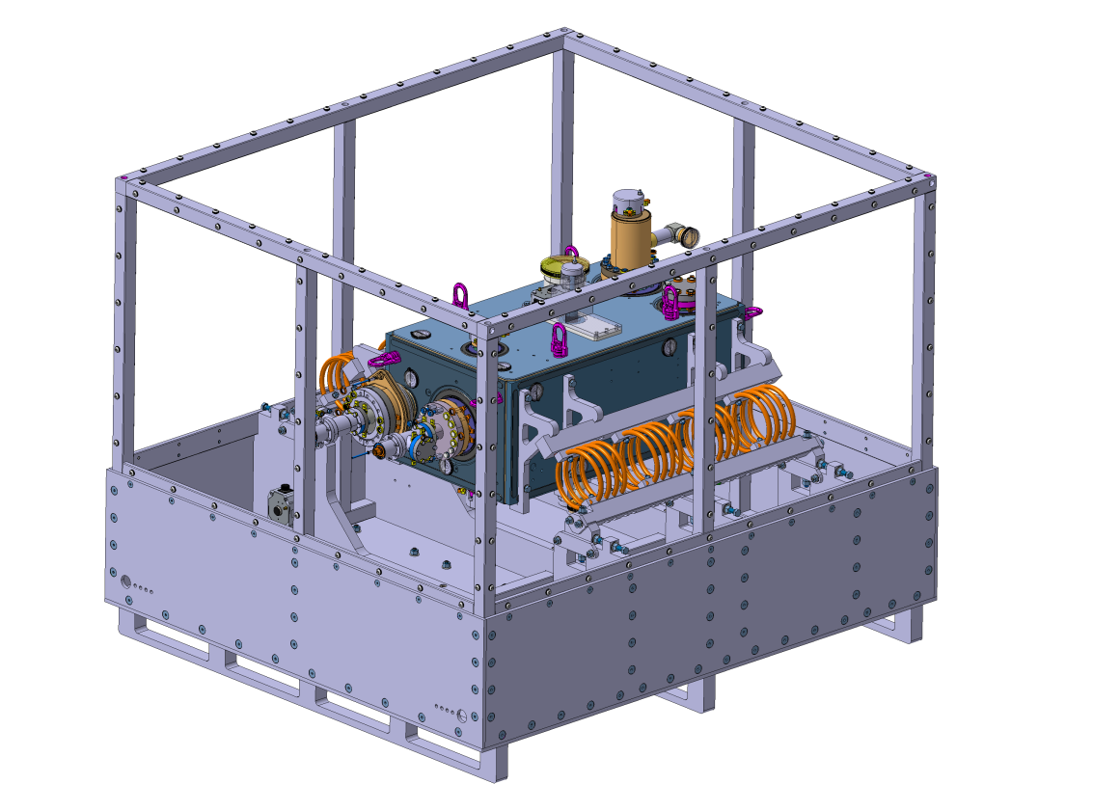
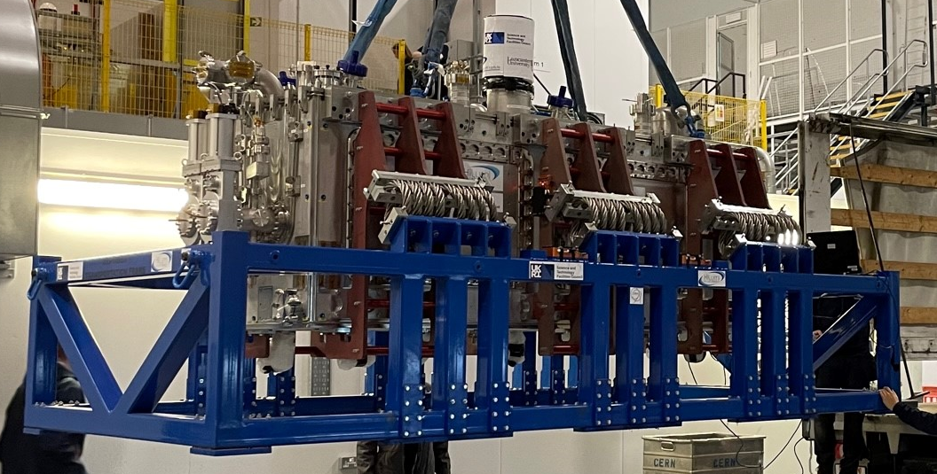
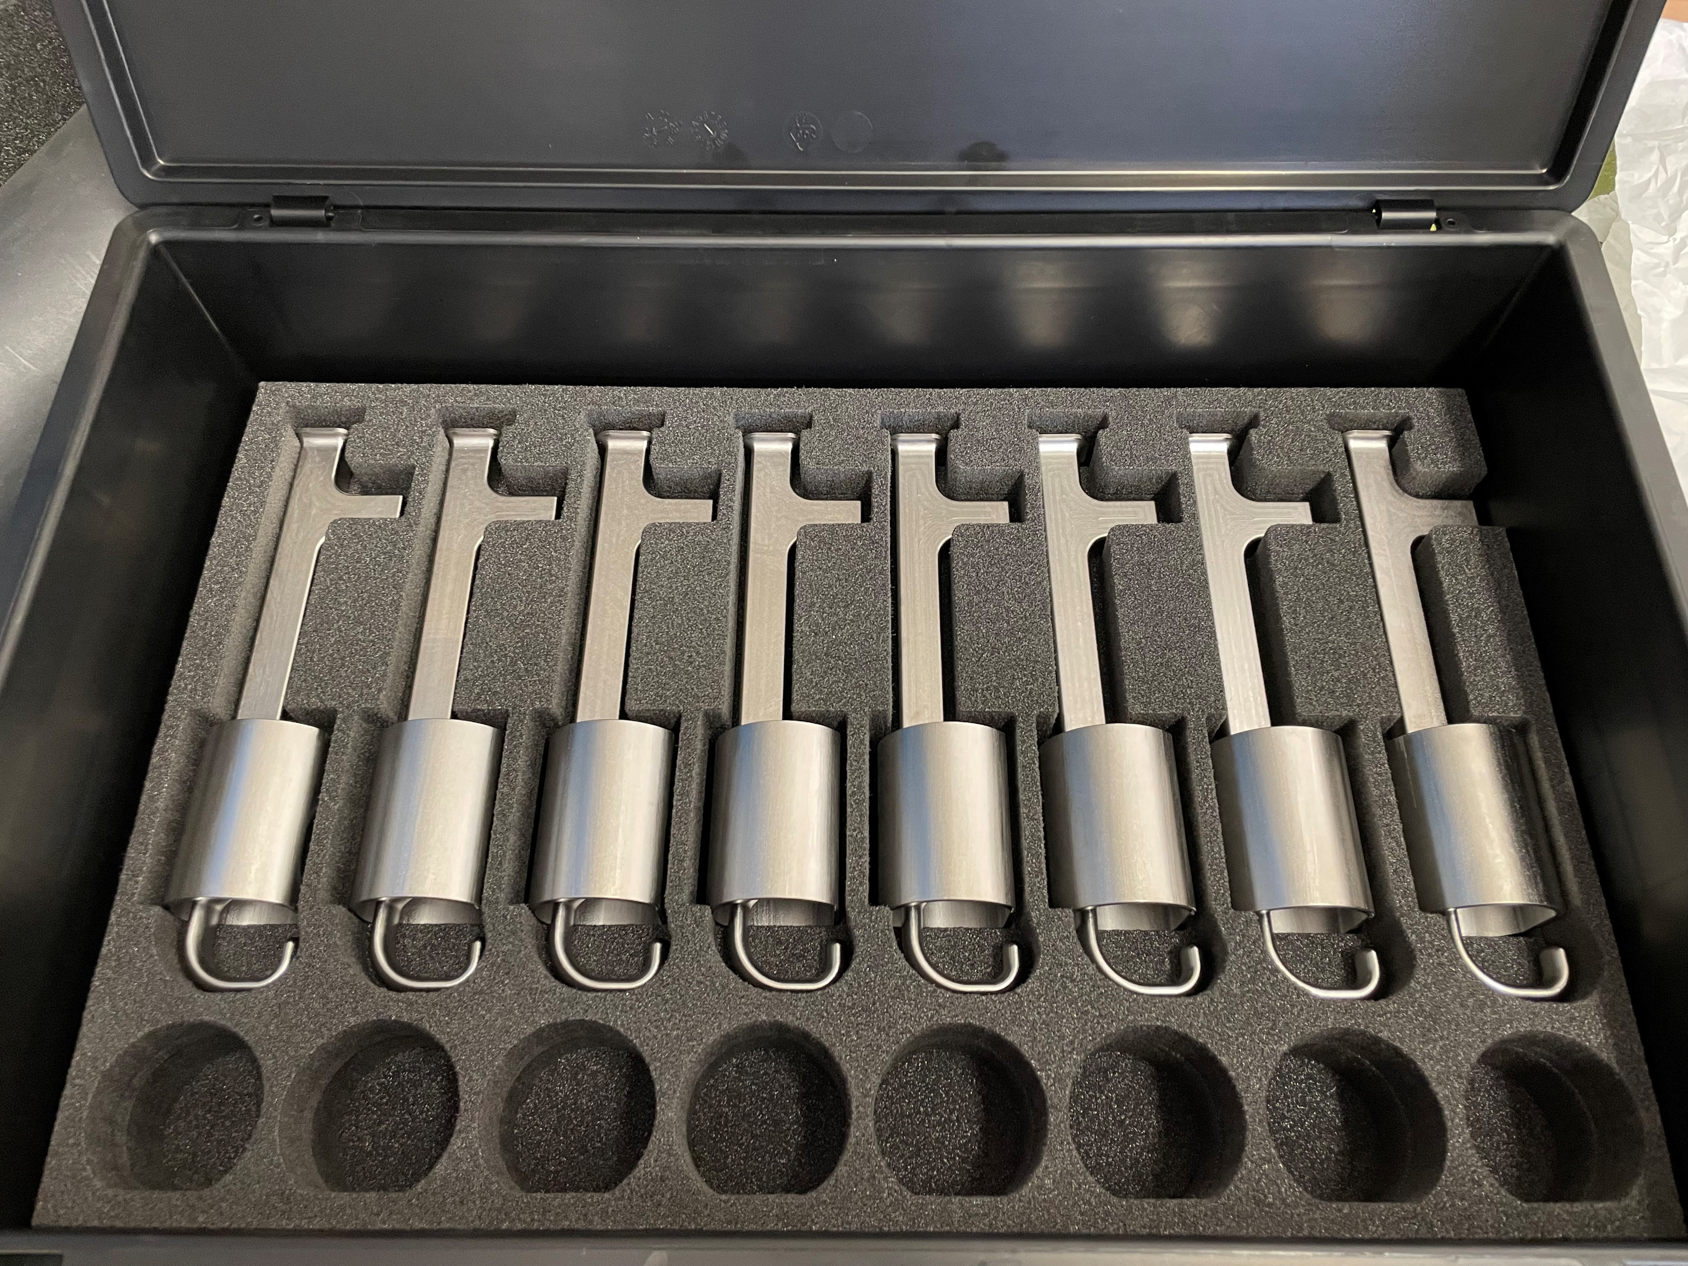
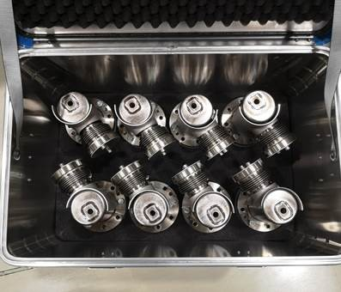
Risk mitigation
Other risks are mitigated designing transport equipment
    Transport frame for the Dressed Cavity
    Transport frame for STFC RFD cryomodule. Courtesy of T. Capelli
    Rigid boxes with foam for transport of HOMs antennas and HOMS assembled. Courtesy of S. Barriere.
M. Garlasche ¨Transport of RFD Equipment to UK¨ 11th HL-LHC Collaboration Meeting. 2021
Teresa Guillen, 14th HL-LHC Collaboration Meeting

Slide 7
HOMs transport calculations
  Verify the integrity of the HOMs during transport
  RFD AUP H-HOM
FEM analyses for transport
  Modal
  Shock
  Random vibration
  Fatigue
Calculations done on the components
without mitigation methods
Teresa Guillen, 14th HL-LHC Collaboration Meeting

Slide 8
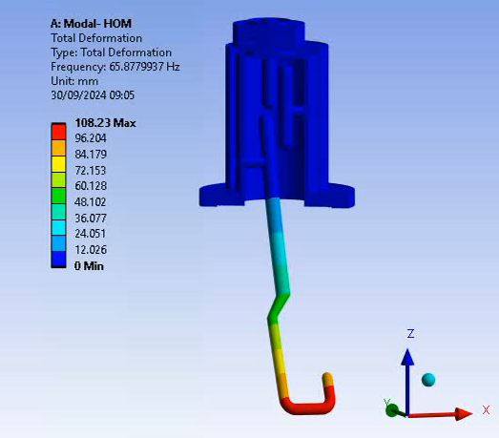
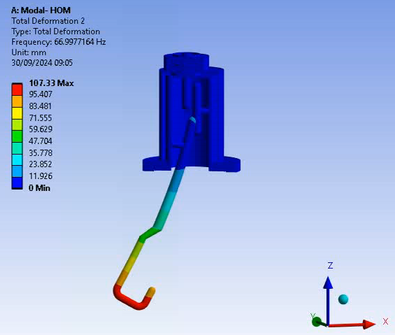
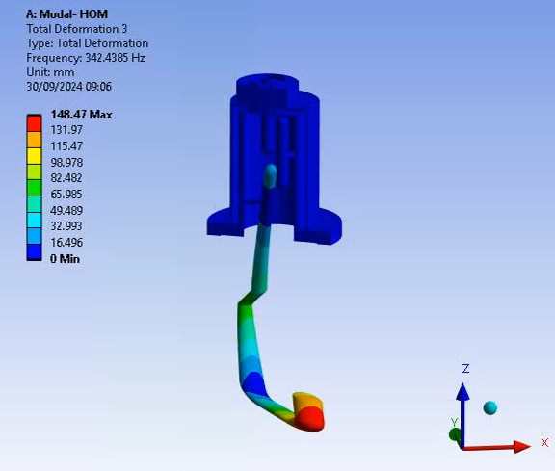
RFD AUP H-HOM transport calculations
1. Modal analysis
  It is a preliminary analysis needed before
    Response spectrum analysis
    Random vibration analysis
  Natural frequencies and modes
Mode 1
Mode 2
Mode 3
Mode | Frequency [Hz]
1 | 65.9
2 | 67.0
3 | 342.4
4 | 349.0
5 | 445.5
Teresa Guillen, 14th HL-LHC Collaboration Meeting

Slide 9
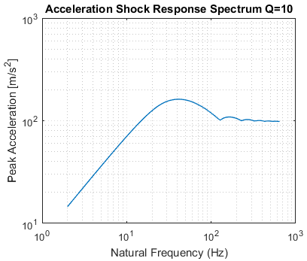
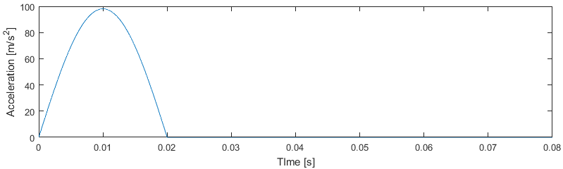
RFD AUP H-HOM transport calculations
2. Shock analysis
  Dynamic and non-deterministic load in a very short time
  2 approaches
    Response spectrum analysis - 10 g and 20 ms in the frequency domain
    Transient analysis - 10 g and 20 ms in time domain
Experimental value
More critical than MIL-STD-810H
Teresa Guillen, 14th HL-LHC Collaboration Meeting

Slide 10
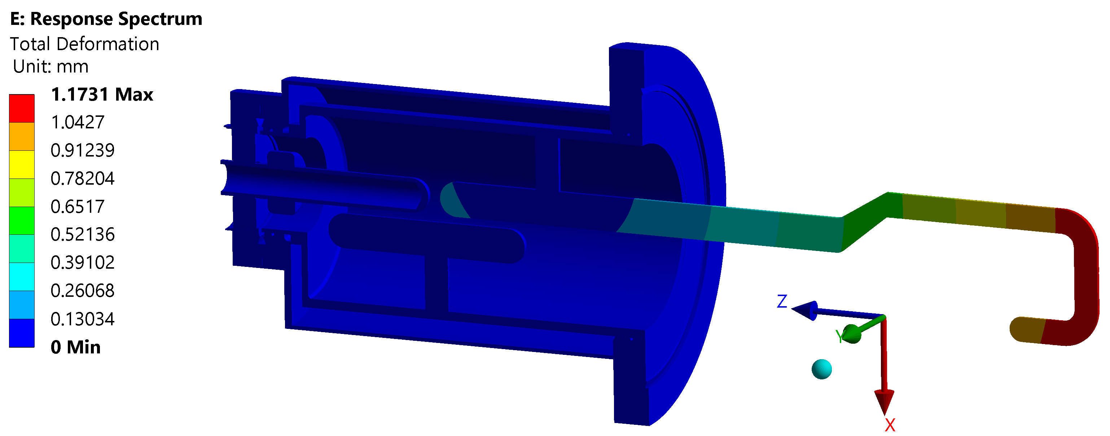
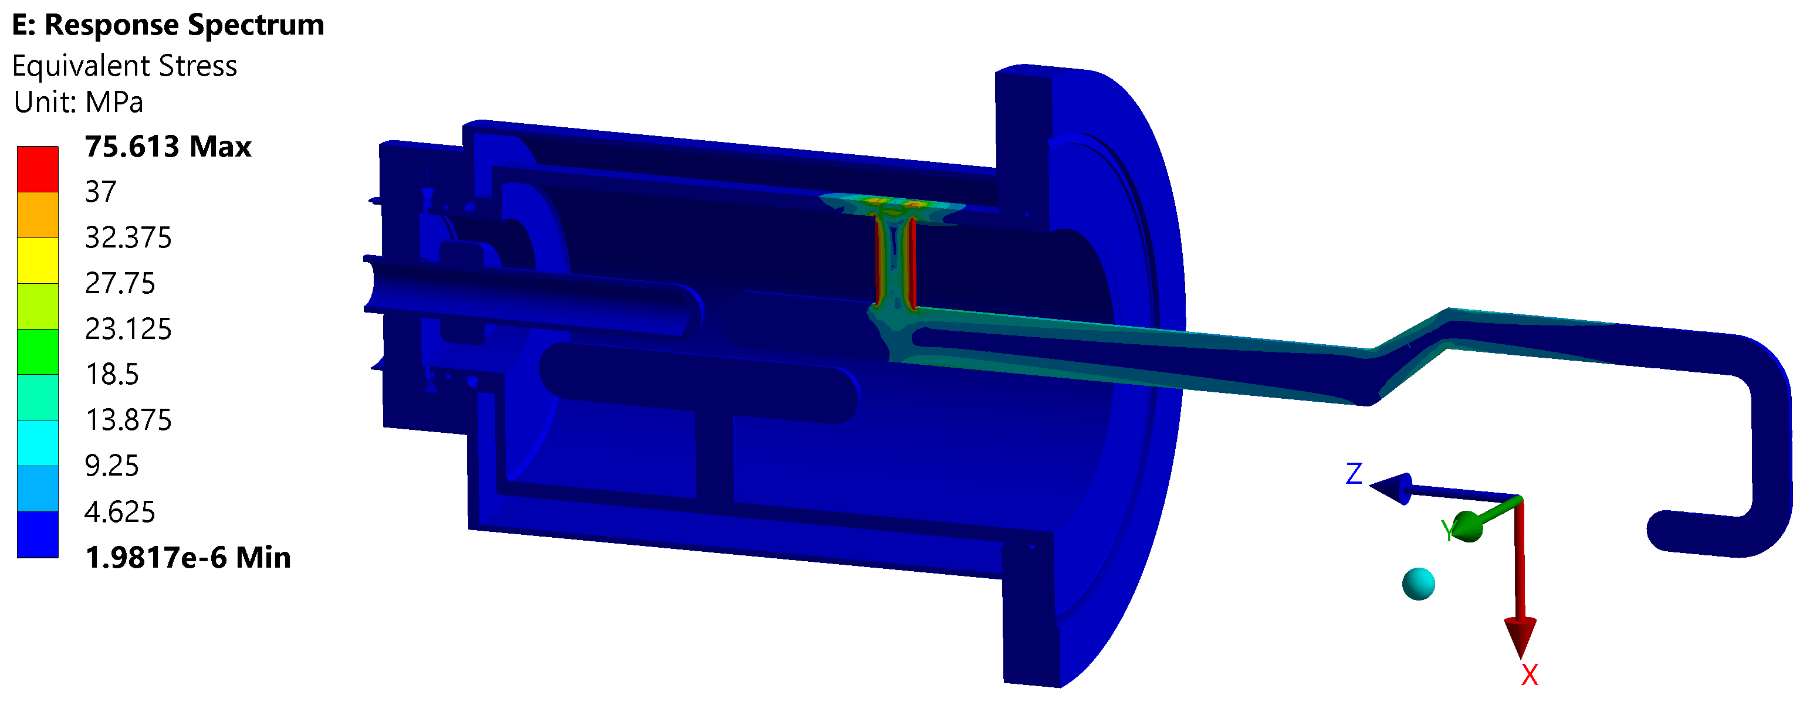

RFD AUP H-HOM transport calculations
2. Shock analysis – Response spectrum
  Results – X direction (most critical)
    Response spectrum – Max stress = 75 MPa > 37 MPa = $R_{P0.2}$
Plasticization
Transient analysis needed
Teresa Guillen, 14th HL-LHC Collaboration Meeting

Slide 11
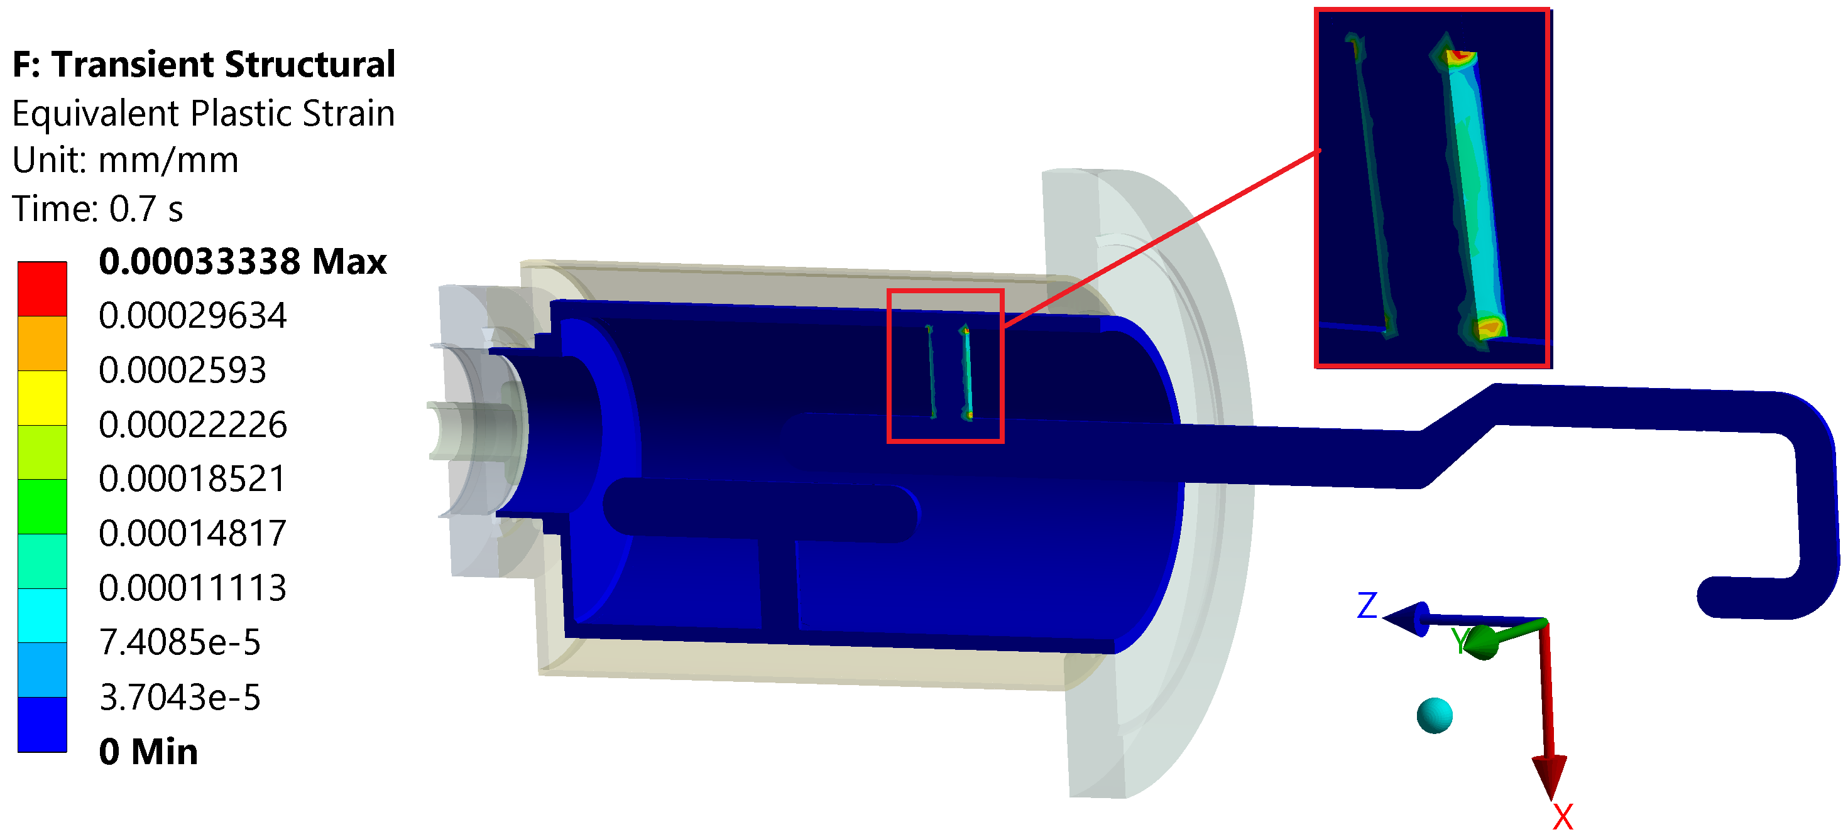
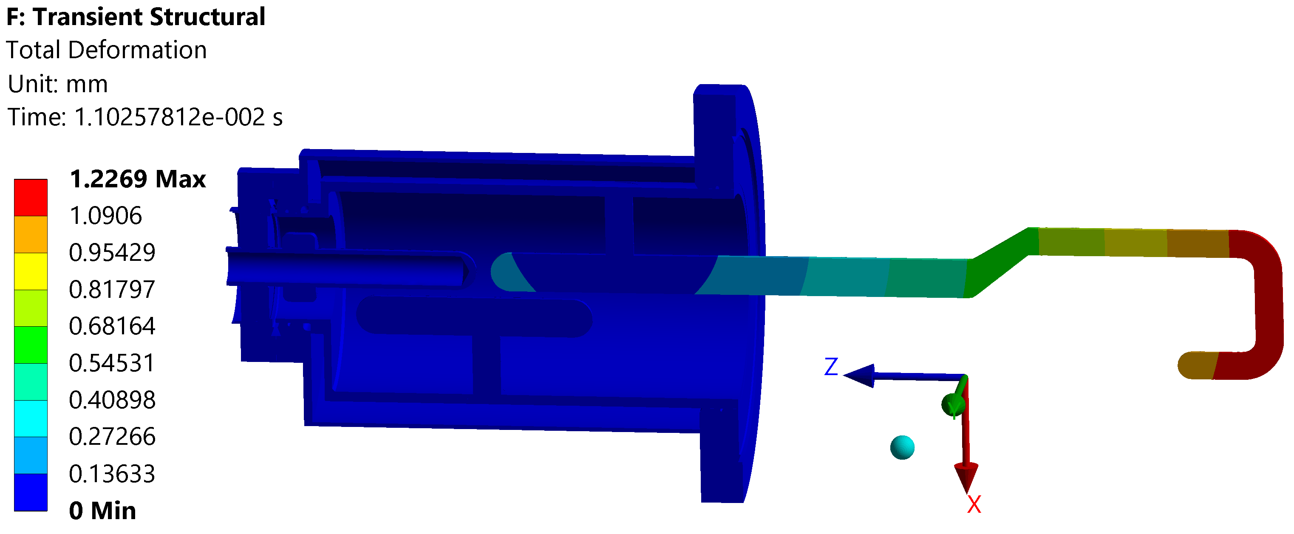
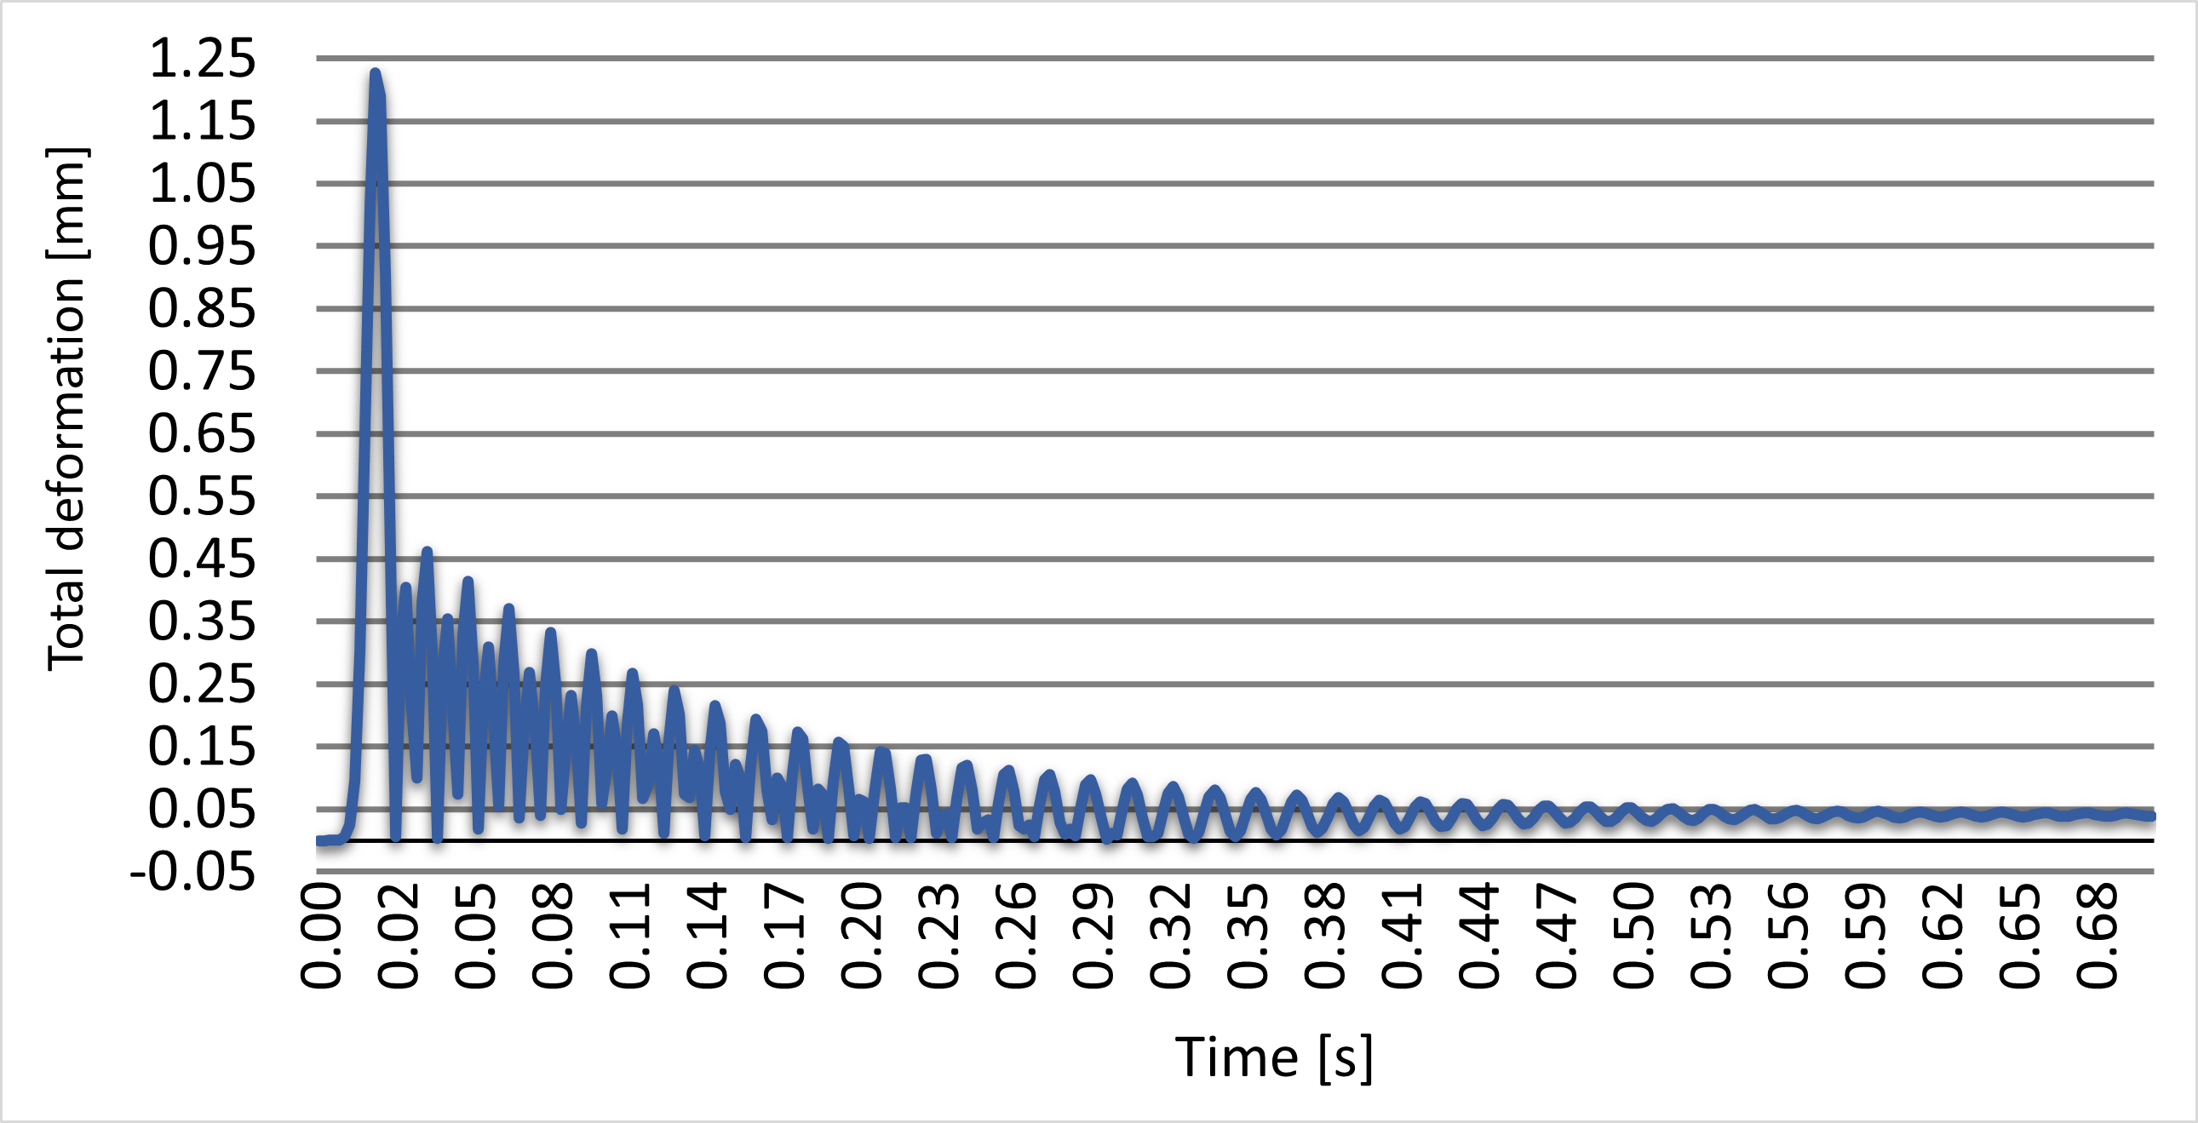
RFD AUP H-HOM transport calculations
2. Shock analysis - Transient
  Results -X direction (most critical)
      Time-dependant simulation needed to analyse the effect of the high stresses on the permanent deformation
      Important simulations parameters:
        Total time = 0.7 s – it is enough to damp most of the oscillations
        Damping ratio = 2% (standard value)
Plastic strain with a shock of 10g and 20ms in X direction
Peak deformation with a shock of 10g and 20ms in X direction
Evolution of the maximum deformation
Peak instantaneous deformation = 1.23 mm
<
Space hook-cavity = 9mm
Permanent deformation
⩽
0.04mm
Teresa Guillen, 14th HL-LHC Collaboration Meeting

Slide 12
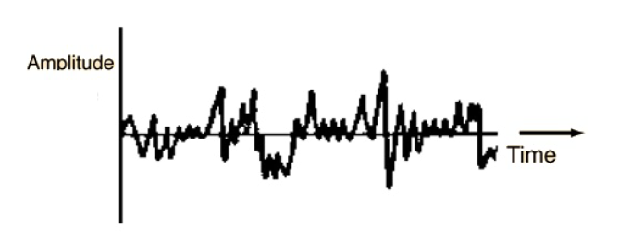
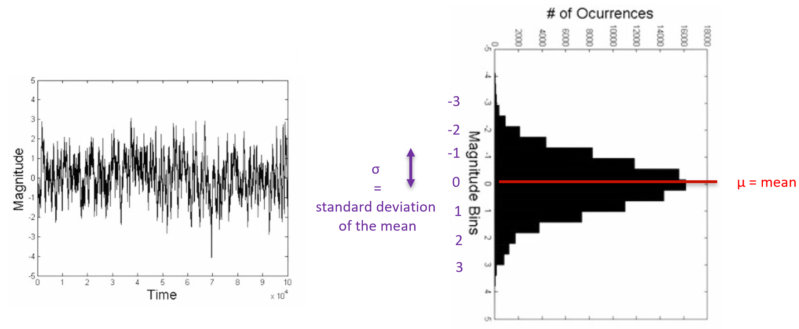
RFD AUP H-HOM transport calculations
3. Random vibration analysis
  Dynamic, non-deterministic loads in a long time
  RV = Gaussian process: stationary and zero mean
  Also the stresses
Amplitud-time history [1]
Gaussian random process [1]
Standard deviation RMS | Probability
1σ | 68%
2σ | 95%
3σ | 99.7%
Limit considered
[1] L.E. Ballesteros ¨Failure prediction of structures subjected to random vibrations¨ http://hdl.handle.net/10150/630147
Teresa Guillen, 14th HL-LHC Collaboration Meeting

Slide 13
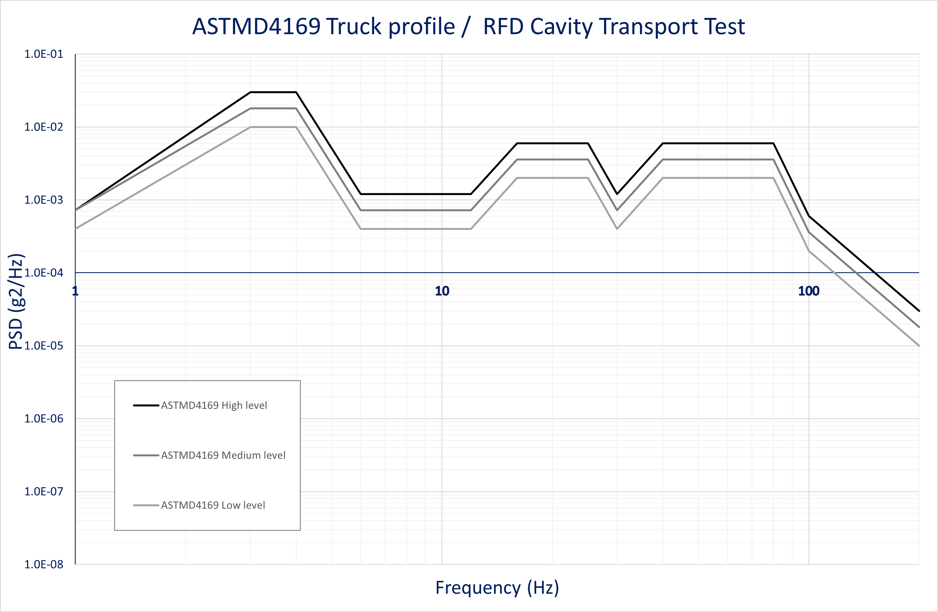
RFD AUP H-HOM transport calculations
3. Random vibration analysis
  Power Spectral Density (PSD) function
    From time domain – to frequency domain
    Average Power or energy of the vibration as a function of the frequency
PSD curve of truck transport [2]
[2] “ASM D4169 -16 - Standard Practice for Performance Testing of Shipping Containers and Systems,” ASTM International,
West Conshohocken, PA, 2016.
Teresa Guillen, 14th HL-LHC Collaboration Meeting

Slide 14
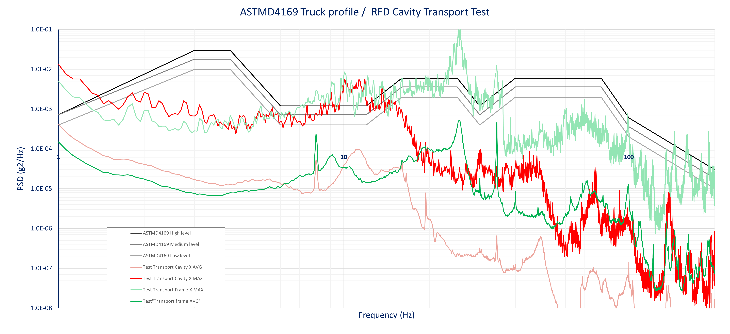
RFD AUP H-HOM transport calculations
Random vibration analysis
PSD curve of truck transport. From ASTM D-4169 [2] and CERN transport data from STFC to CERN in X direction [3]
Natural frequency ≈ 67Hz
[2] “ASM D4169 -16 - Standard Practice for Performance Testing of Shipping Containers and Systems,” ASTM International, West Conshohocken, PA, 2016.
[3] M. Guinchard, “Mechanical vibration and stress measurements on the RFD cryomodule during transport from UK” EDMS 2755675.
Teresa Guillen, 14th HL-LHC Collaboration Meeting

Slide 15
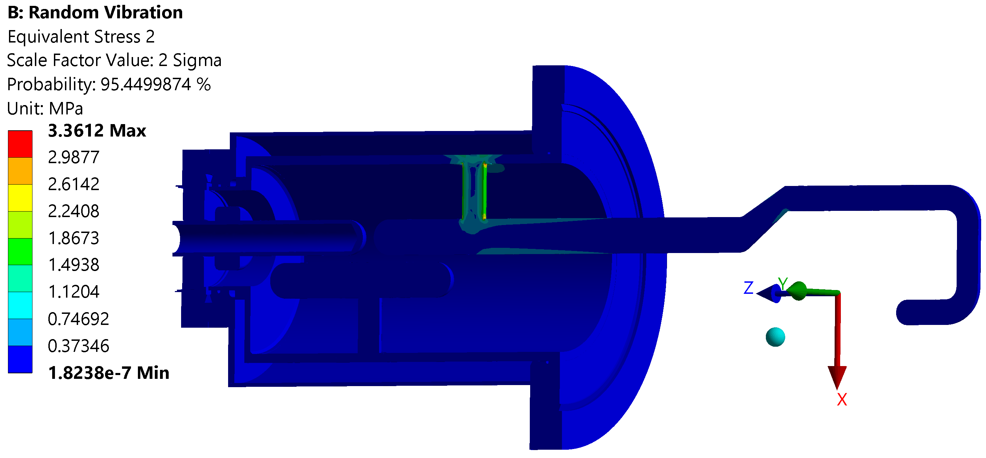

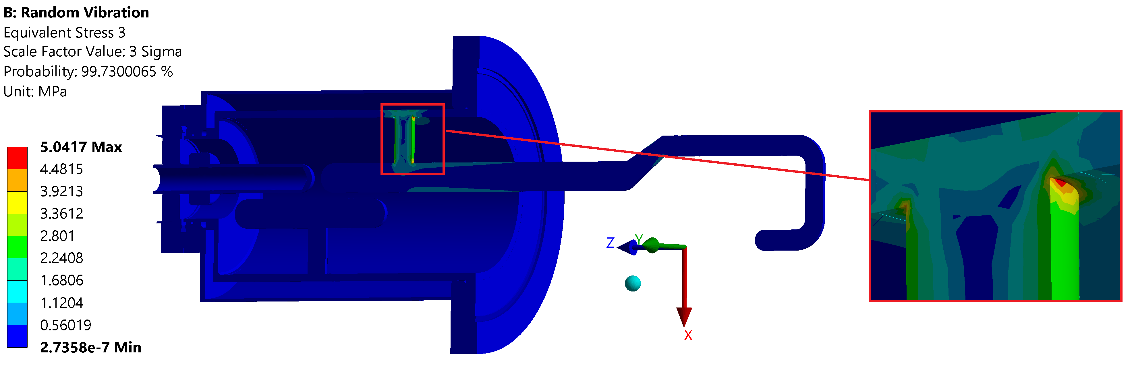
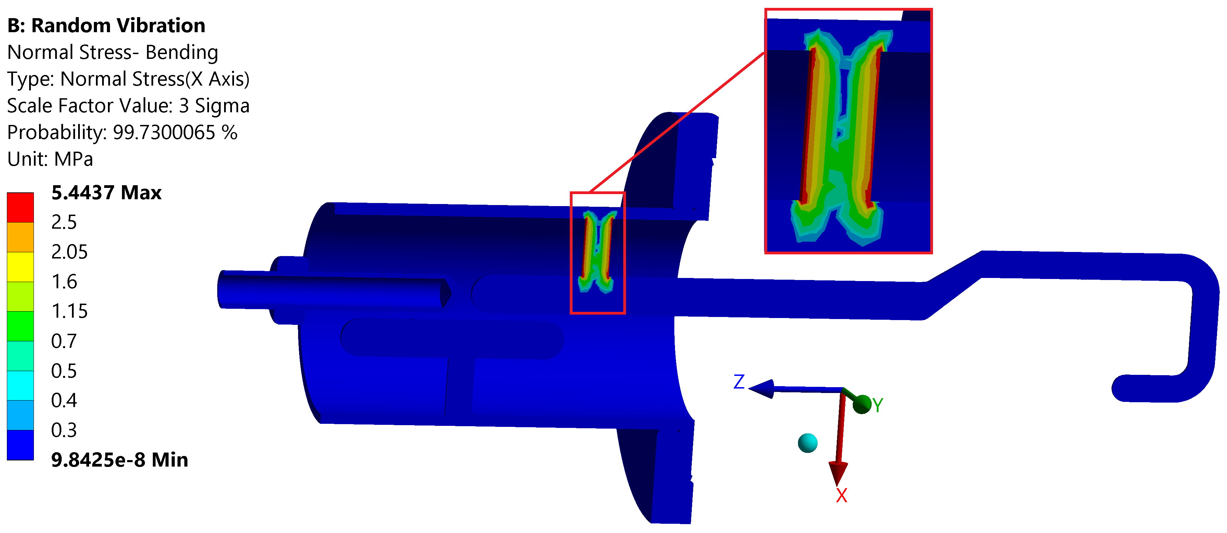
RFD AUP H-HOM transport calculations
Random vibration analysis
  Results – X direction is the most critical
Probability of occurrence 68.27%
68.25% of probability to not exceed 1.6 MPa
Probability of occurrence 27,18%
95.45% of probability to not exceed 3.4 MPa
No plasticization but Cyclic load.
Therefore, it could failure by:
– Fatigue (Assessed by the stress life method)
Probability of occurrence 4,28%
99.73% of probability to not exceed 5 MPa
Teresa Guillen, 14th HL-LHC Collaboration Meeting

Slide 16
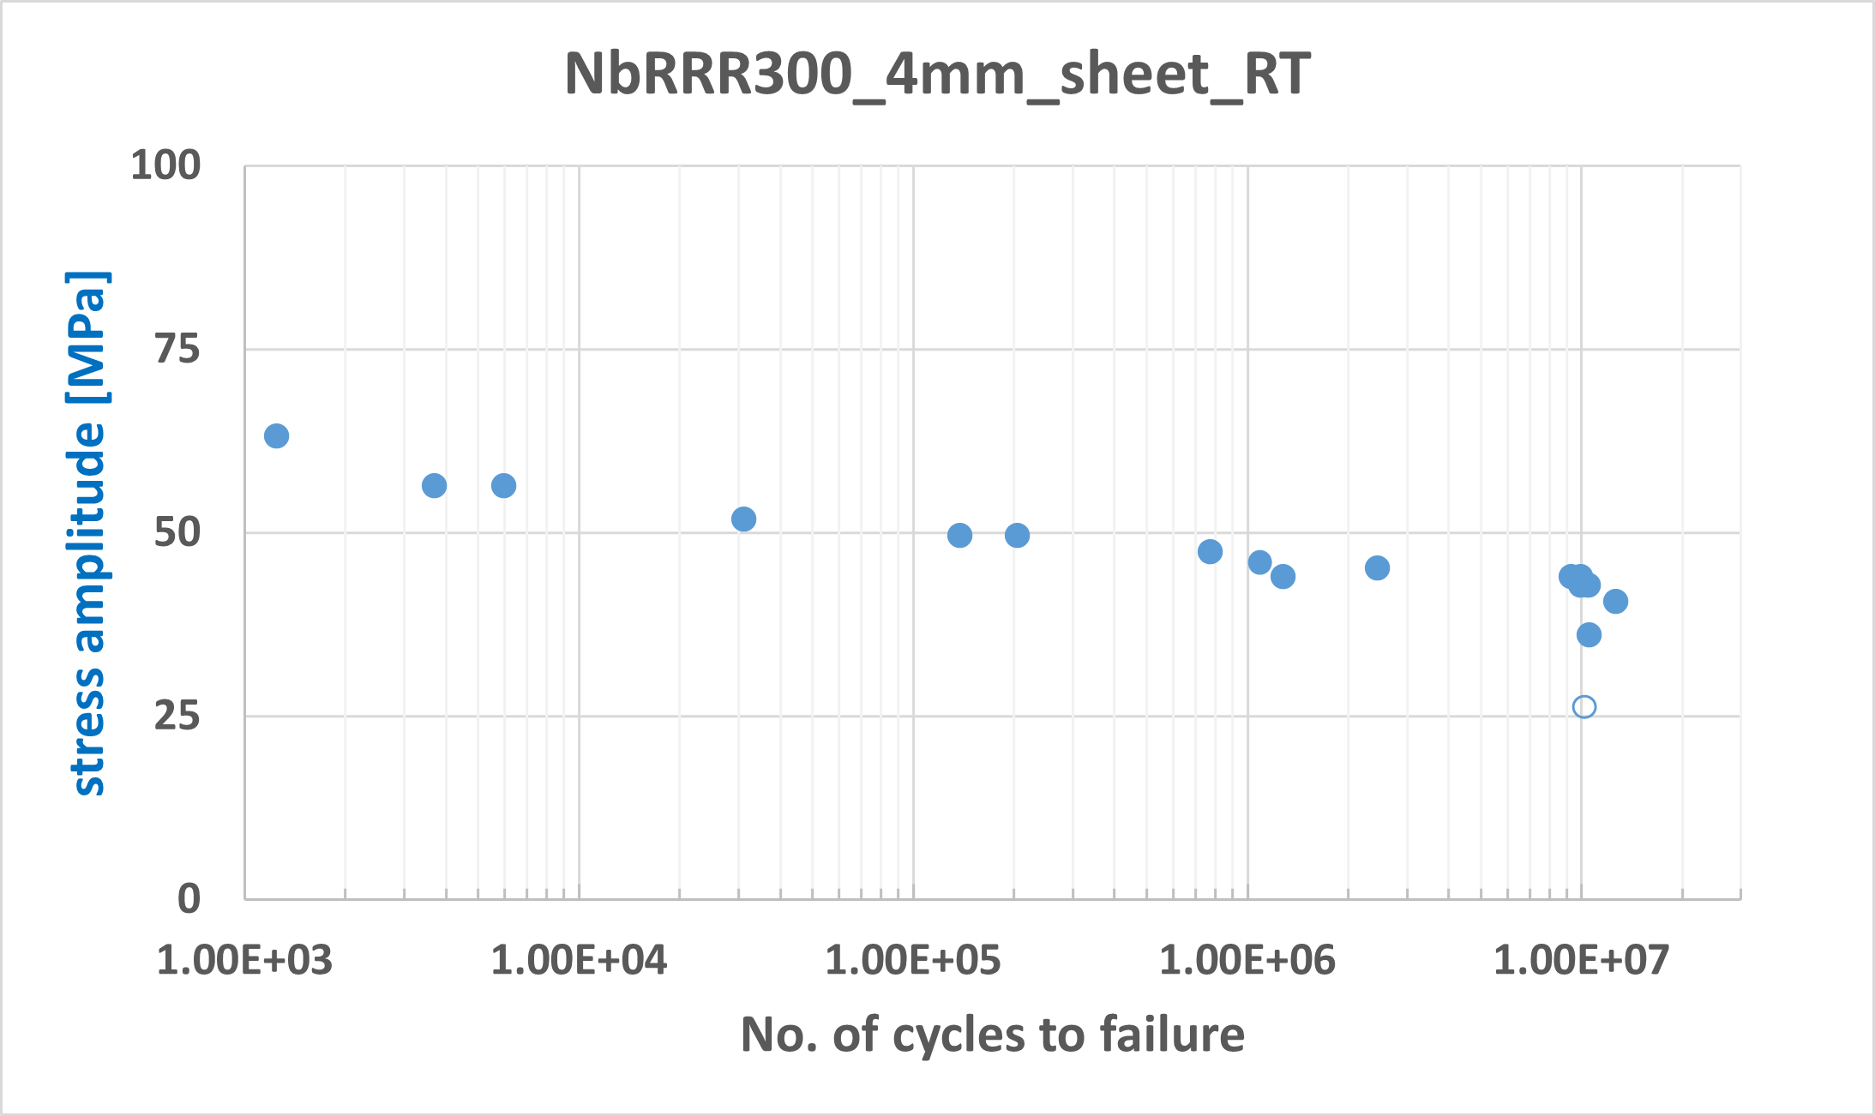
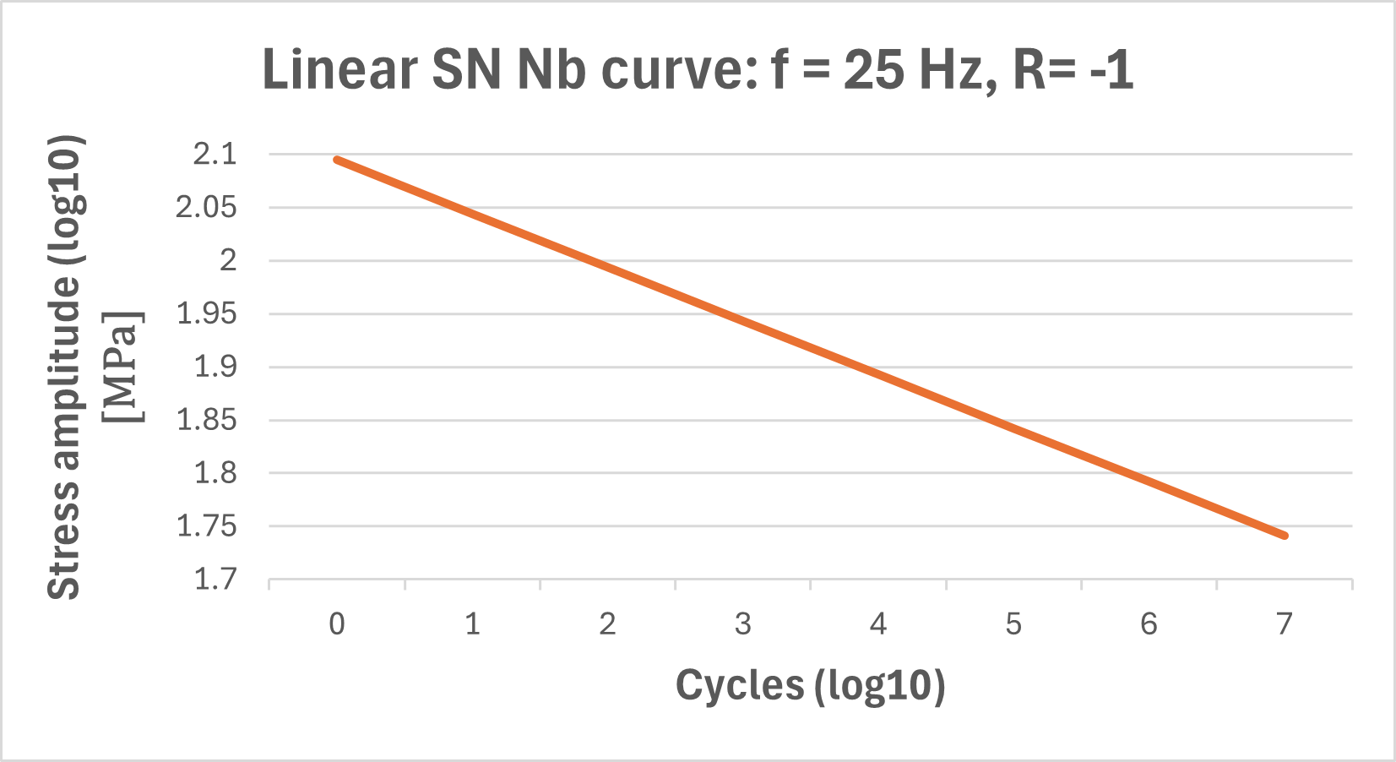
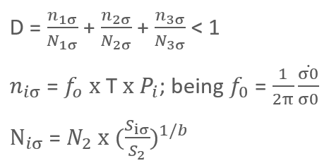


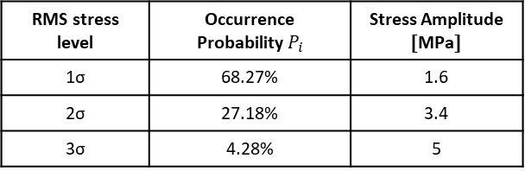
RFD AUP H-HOM transport calculations
Fatigue analysis
  Cyclic random vibration load
  ANSYS Fatigue tool RV – stress life (Whoeler)
    S-N curve of Nb
      Linear or bi-linear
      R = $σ_{min}$ / $σ_{max}$ = -1 (default)
      Strain rate (frequency)
    Three sigma method + Damage (Miner’s rule):
SN curve of Nb: f = 25 Hz and R = 0.1 (draft results, pending publication)
Courtesy of A. Galifa
Narrow band process assumption
(each zero up crossing = 1 cycle)
RMS stress level | Occurrence Probability $P_{i}$ | Stress Amplitude [MPa]
1σ | 68.27% | 1.6
2σ | 27.18% | 3.4
3σ | 4.28% | 5
Depends on the point considered
$\dot{σ0}$ = RMS stress velocity
$σ0$ = RMS stress
Teresa Guillen, 14th HL-LHC Collaboration Meeting

Slide 17
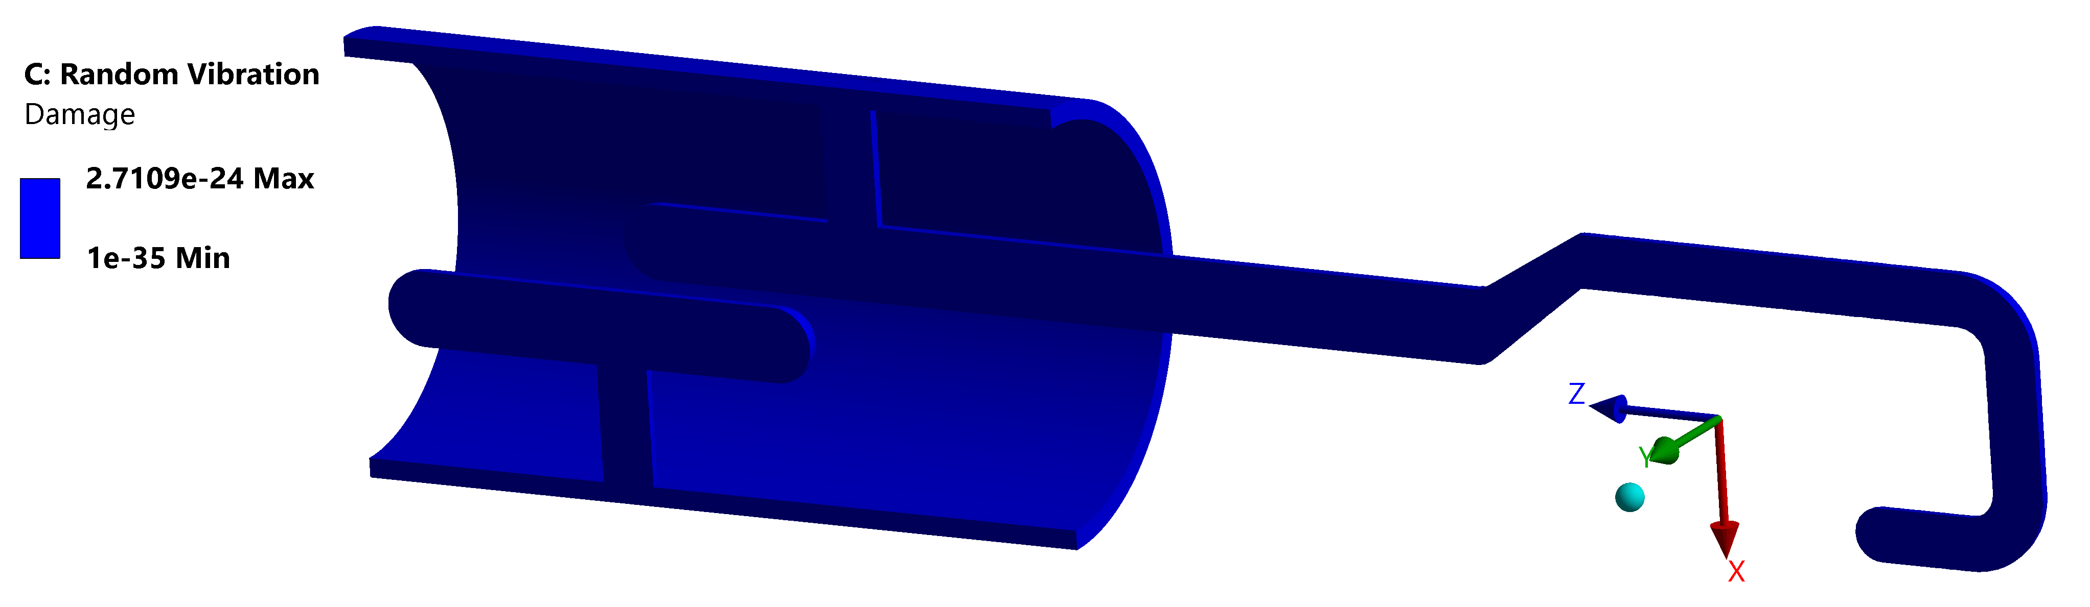
RFD AUP H-HOM transport calculations
Fatigue analysis
  Results
Time of transport
2.5 days
No fatigue fracture
Teresa Guillen, 14th HL-LHC Collaboration Meeting

Slide 18
Conclusions
Transport is a daily and challenging activity of the crab cavity project
To protect our components and assemblies during transport
  Risk analysis
  Risk mitigation
HOMs calculations: RFD AUP
  Shock
  Random vibration
  Fatigue
Results show no risk for the component ☺
Teresa Guillen, 14th HL-LHC Collaboration Meeting

Slide 19
Studies for transport of crab cavities equipment
Teresa Guillén Hernández on behalf of WP4
14th HL-LHC Collaboration Meeting, Genoa (Italy), 7-10 October 2024

Slide 20
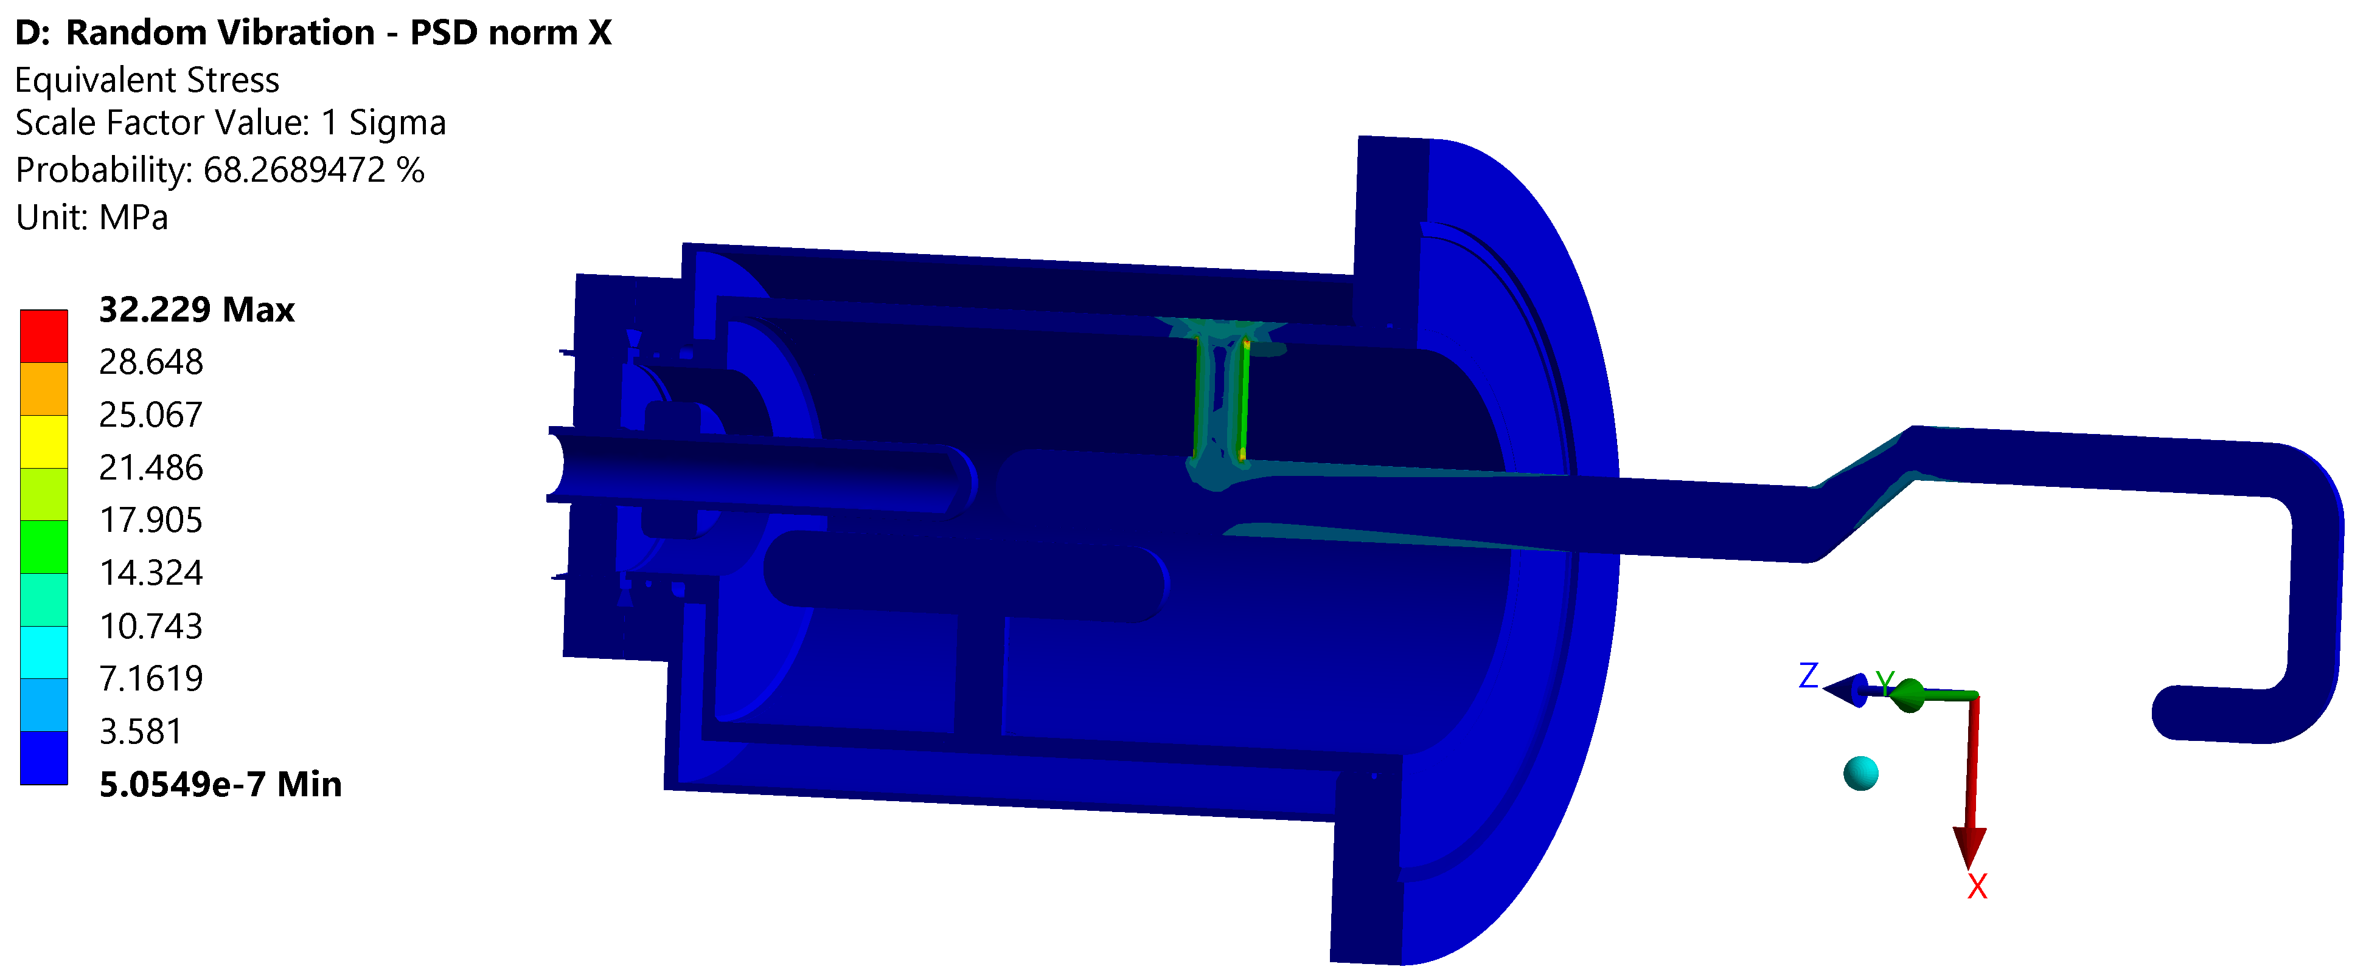
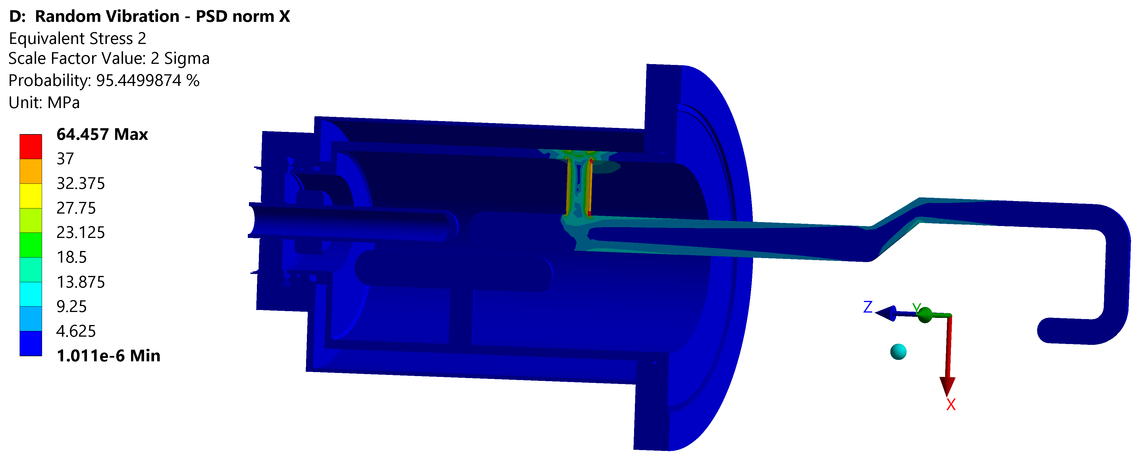
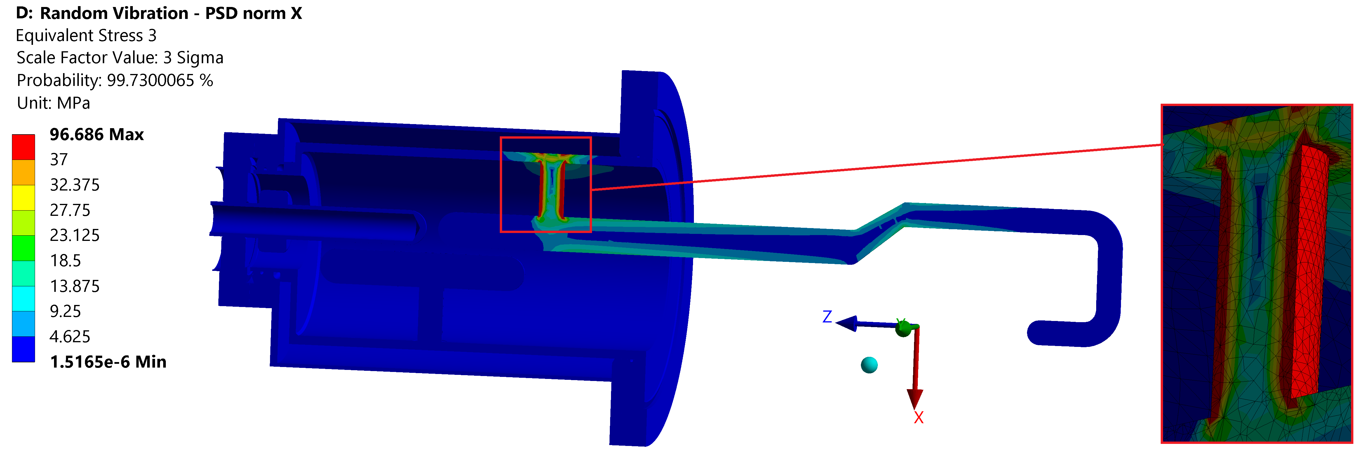
RFD AUP H-HOM transport calculations
Random vibration analysis – max PSD of the norm ASTM D-4169
  Results – X direction is the most critical
Probability of occurrence 68.27%
68.25% of probability to not exceed 32 MPa
Probability of occurrence 27,18%
95.45% of probability to not exceed 64 MPa
Probability of occurrence 4,28%
99.73% of probability to not exceed 97 MPa
Plasticization
Teresa Guillen, 14th HL-LHC Collaboration Meeting

Slide 21
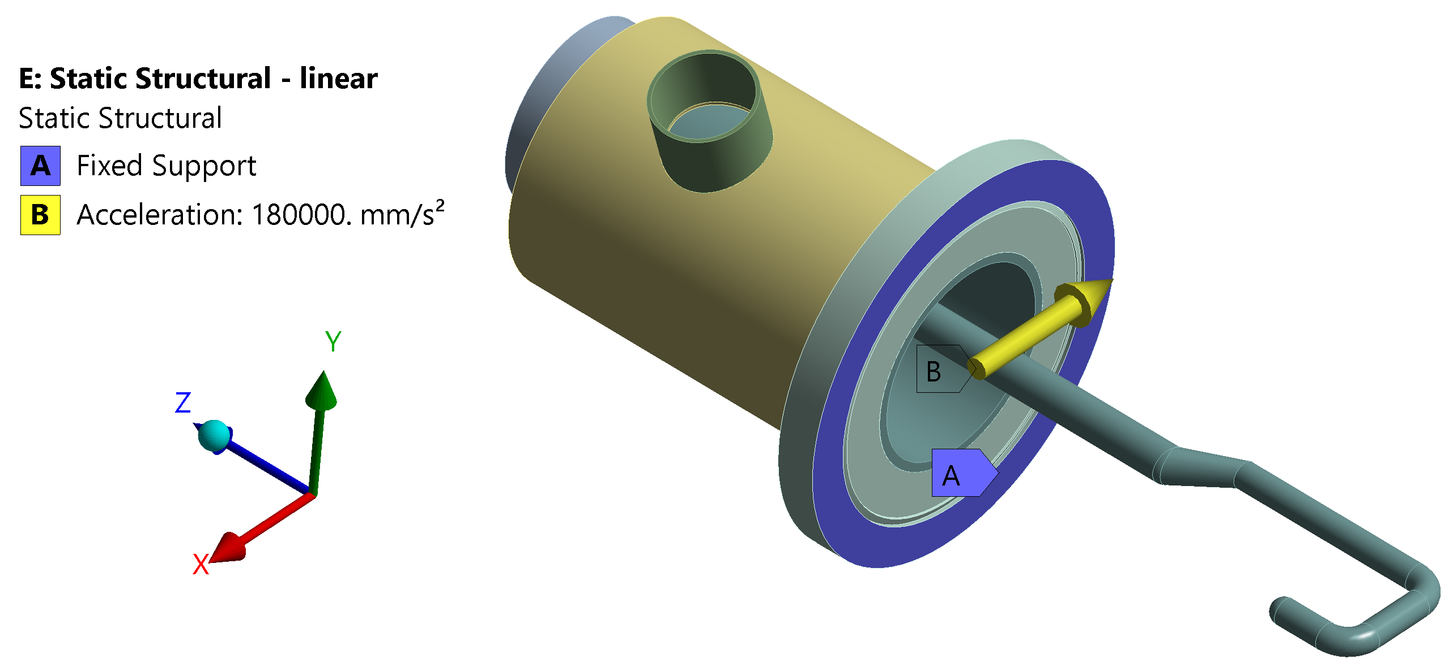
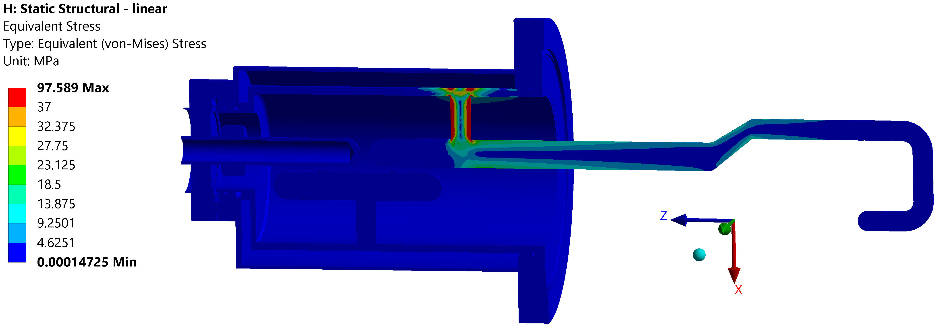
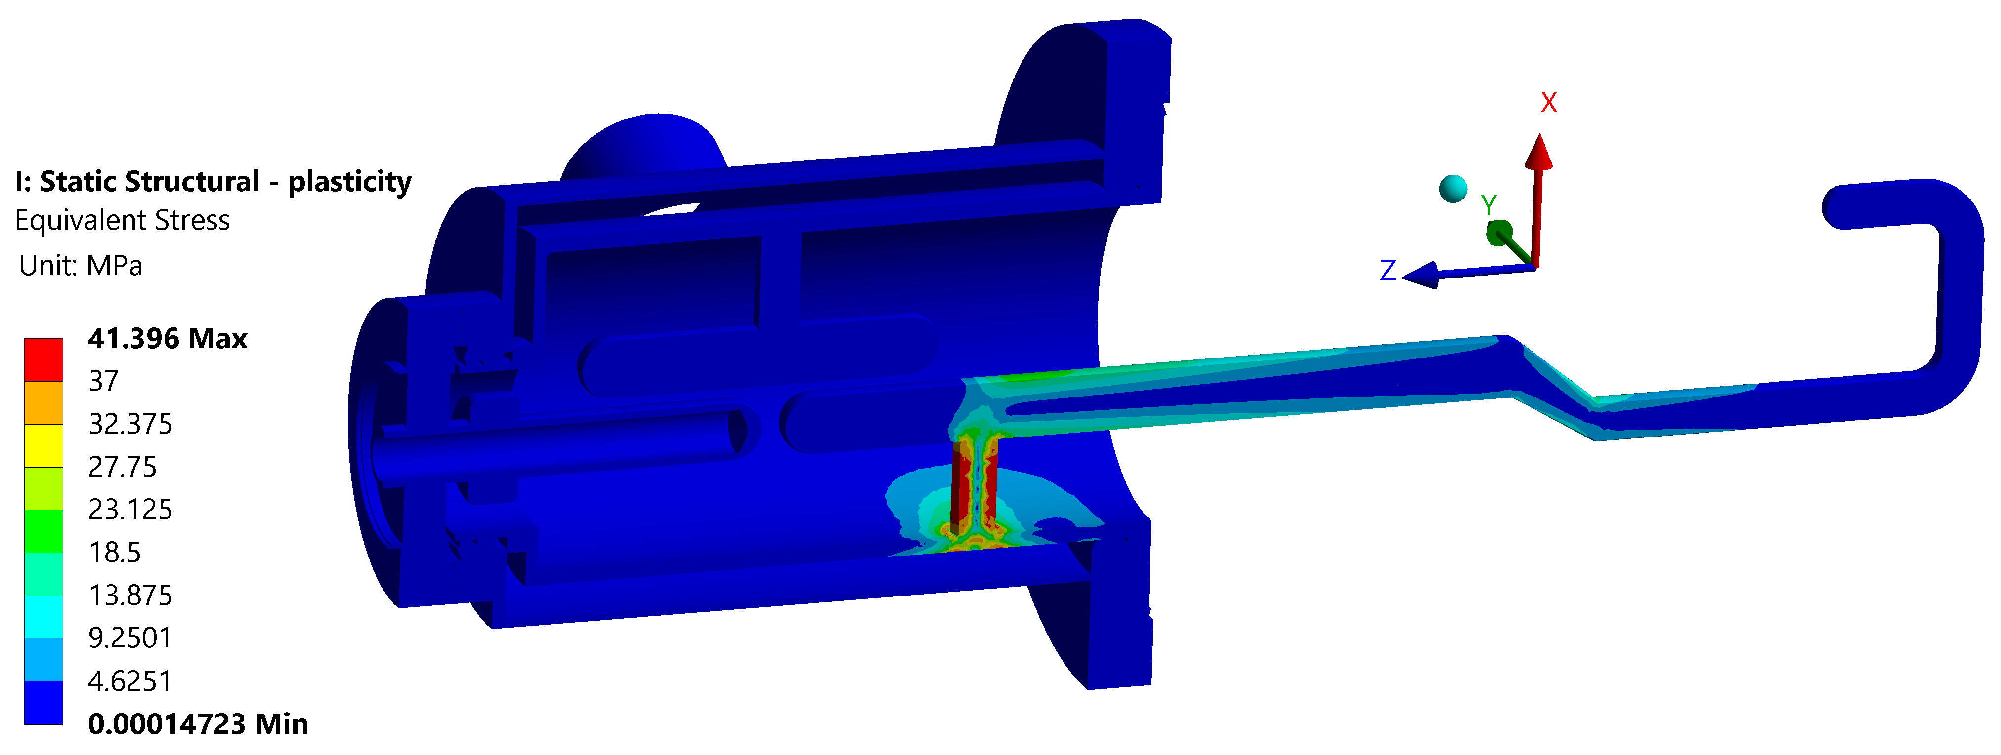
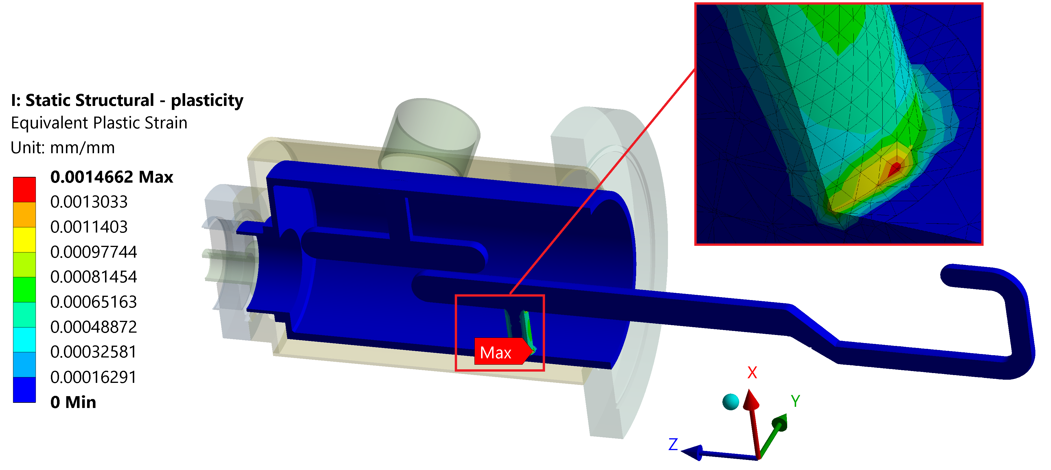
RFD AUP H-HOM transport calculations
Linear elastic static structural analysis
Elasto-plastic static structural analysis
0.1% of plastic strain and cyclic load.
Therefore, there could be two possible failures:
– Fatigue (Cannot be assessed for the moment)
– Ratcheting (It doesn’t happen when we have a Random vibration because the stress cycling is symmetric)
Teresa Guillen, 14th HL-LHC Collaboration Meeting

Slide 22
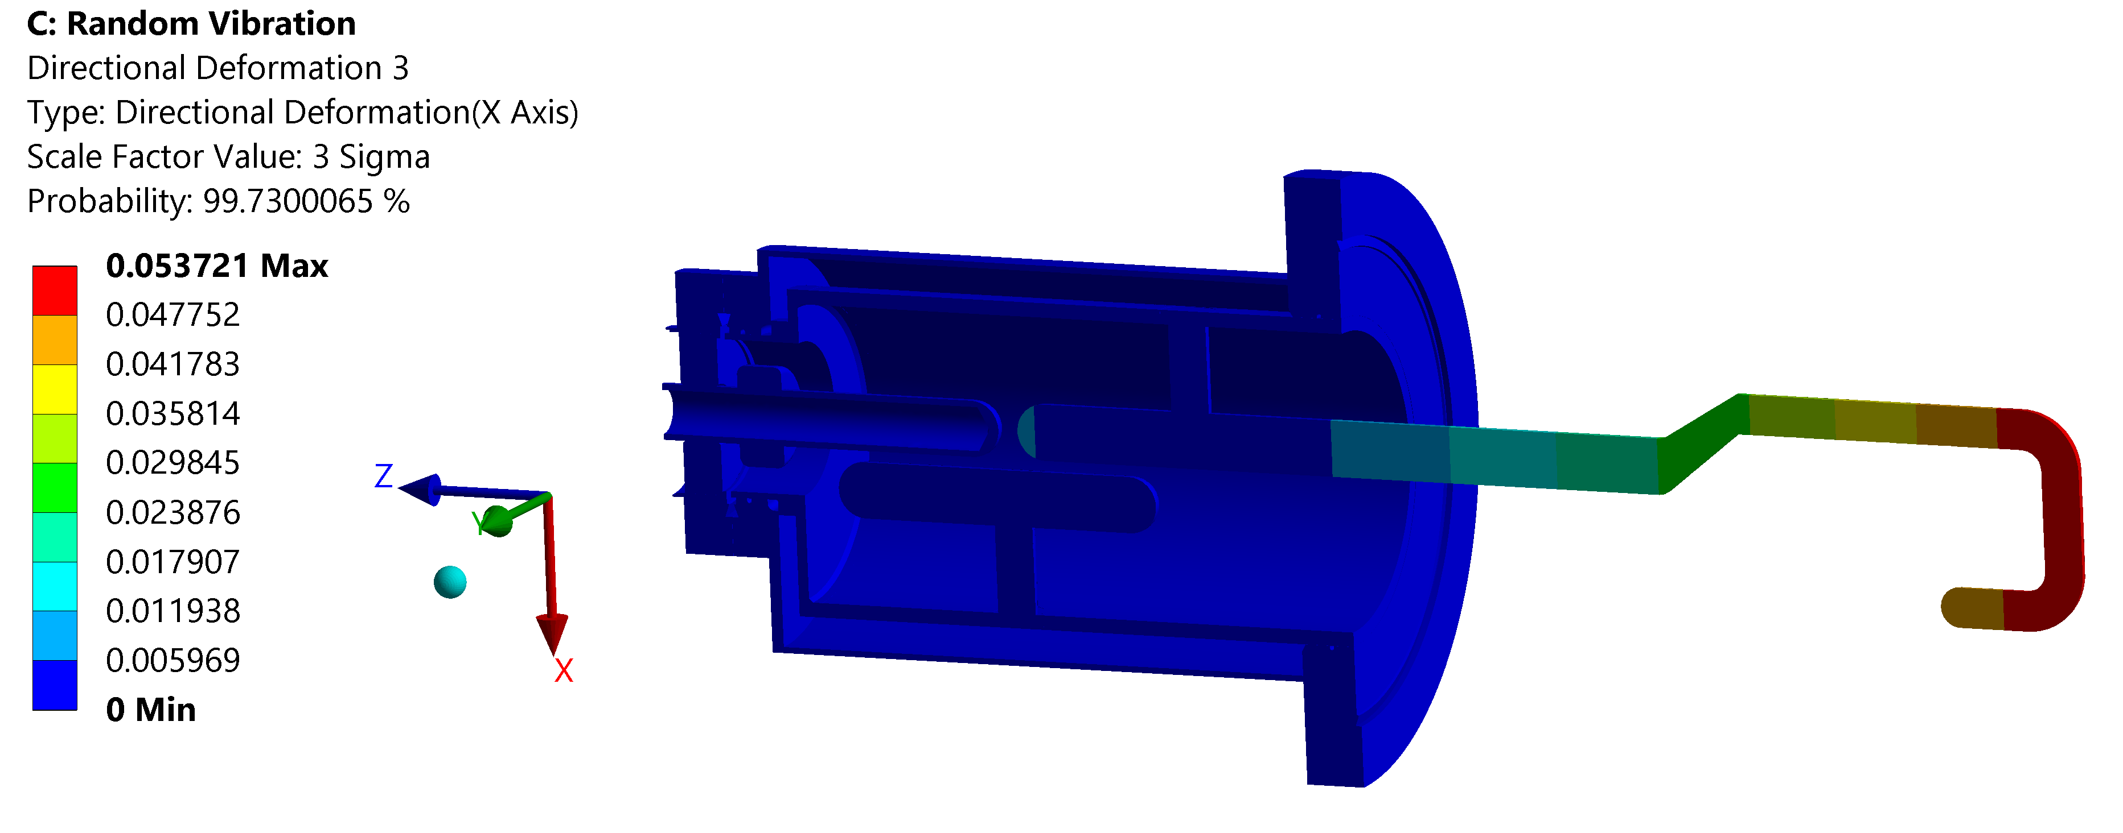
RFD AUP H-HOM transport calculations
Random vibration analysis
  Results – X direction is the most critical
Probability of occurrence 4,28%
99.73% of probability to not exceed 0.05 mm
0.05 mm << 9 mm (Space hook-cavity)
Teresa Guillen, 14th HL-LHC Collaboration Meeting

