Slide 1
LHC longitudinal impedance measurement through Schottky spectra
Christophe Lannoy, Kacper Lasocha, Diogo Alves, Nicolas Mounet
Acknowledgements: Tatiana Pieloni, Ivan Karpov, Theodoros Argyropoulos
14th HL-LHC Collaboration Meeting, Genoa, 10th October 2024

Slide 2
Outline
Introduction
  Longitudinal Schottky spectrum
  Transverse Schottky spectrum
Experimental Schottky spectra from the LHC
  Longitudinal impedance effect
  Estimate of the LHC longitudinal impedance
  Transverse impedance effect
Conclusion

Slide 3
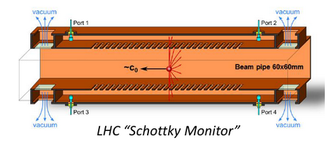
Introduction: The Schottky Monitor
The Schottky spectrum is based on the measurement of the beam fluctuations in the longitudinal and transverse planes.
The Schottky spectrum is the power spectral density of the beam current in the longitudinal plane and the dipole moment in the transverse planes.
Important non-invasive method for beam diagnostics (emittance, tune, chromaticity, bunch profile, …).
The Schottky monitor is one of the only instruments with the potential of measuring the LHC chromaticity in a non-invasive way.
However, impedance, non-linearities, and other collective effects can strongly affect the Schottky spectrum, preventing the extraction of beam and machine parameters.
  ➔ The distortion caused by impedance can also be used to estimate the impedance itself.
Details of the LHC Schottky system in
M. Betz et al., NIM, vol. 874, pp 113-126, 2017

Slide 4
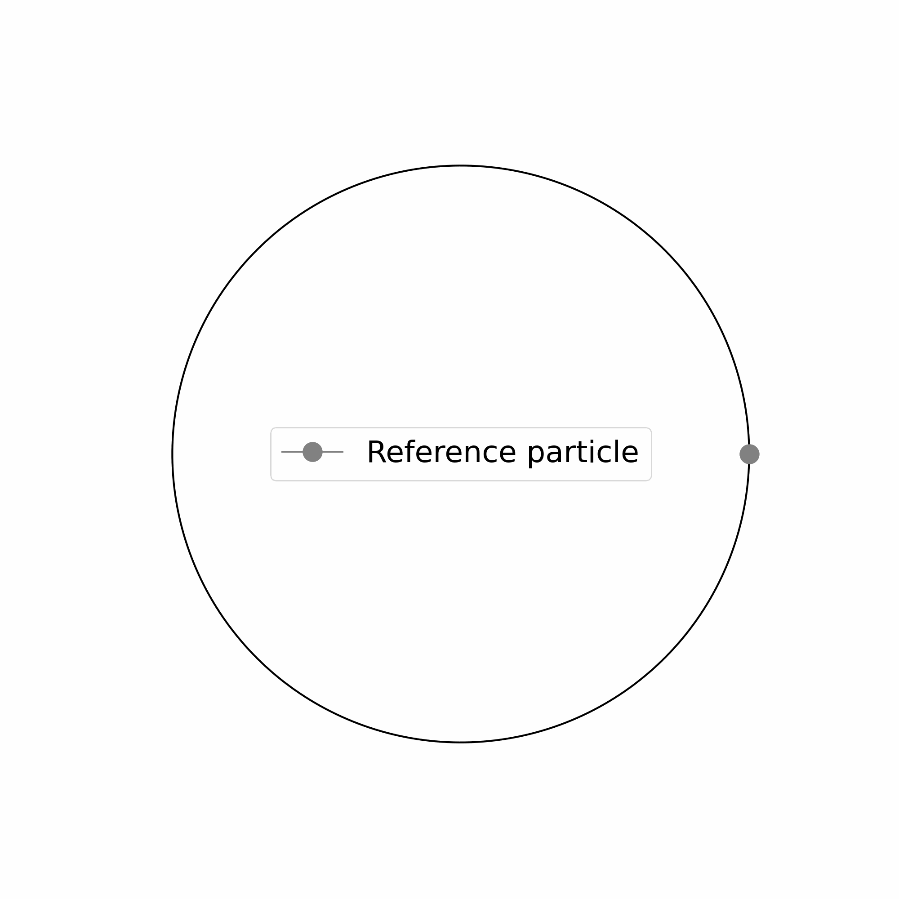
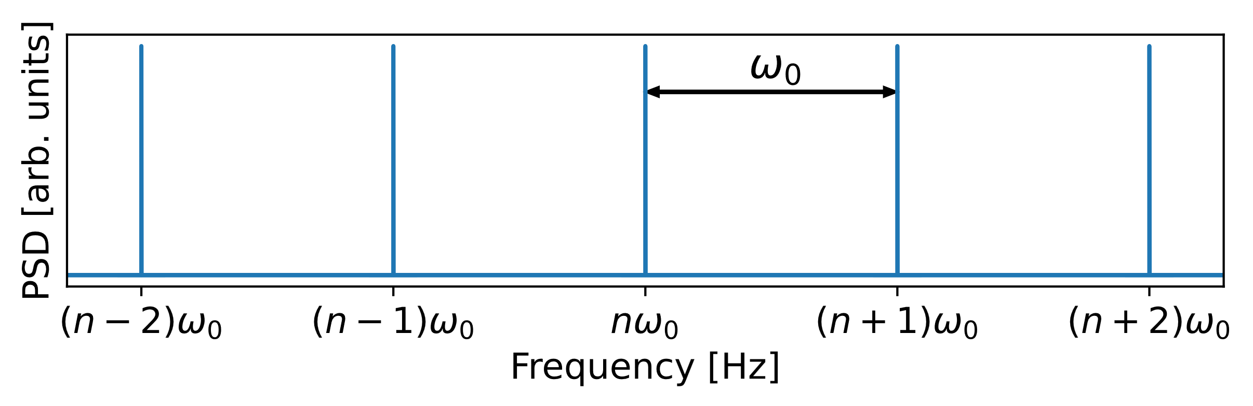
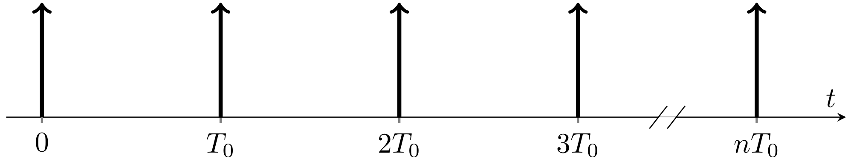
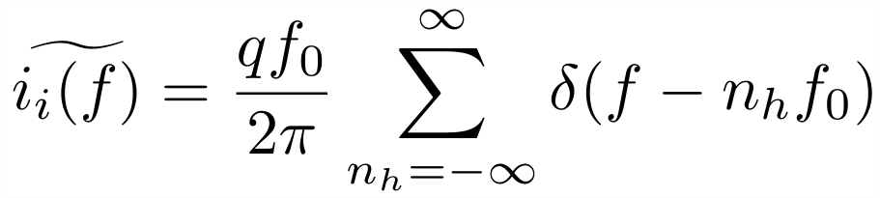
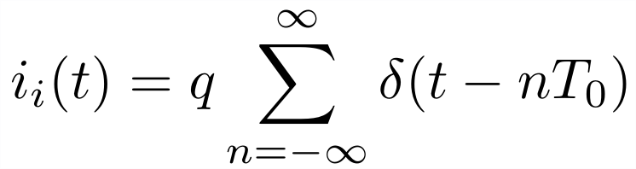

Longitudinal Schottky Spectrum (synchronous particle)
Time domain:
Frequency domain:
Schottky Monitor
Summation
over harmonic $n_{h}$

Slide 5
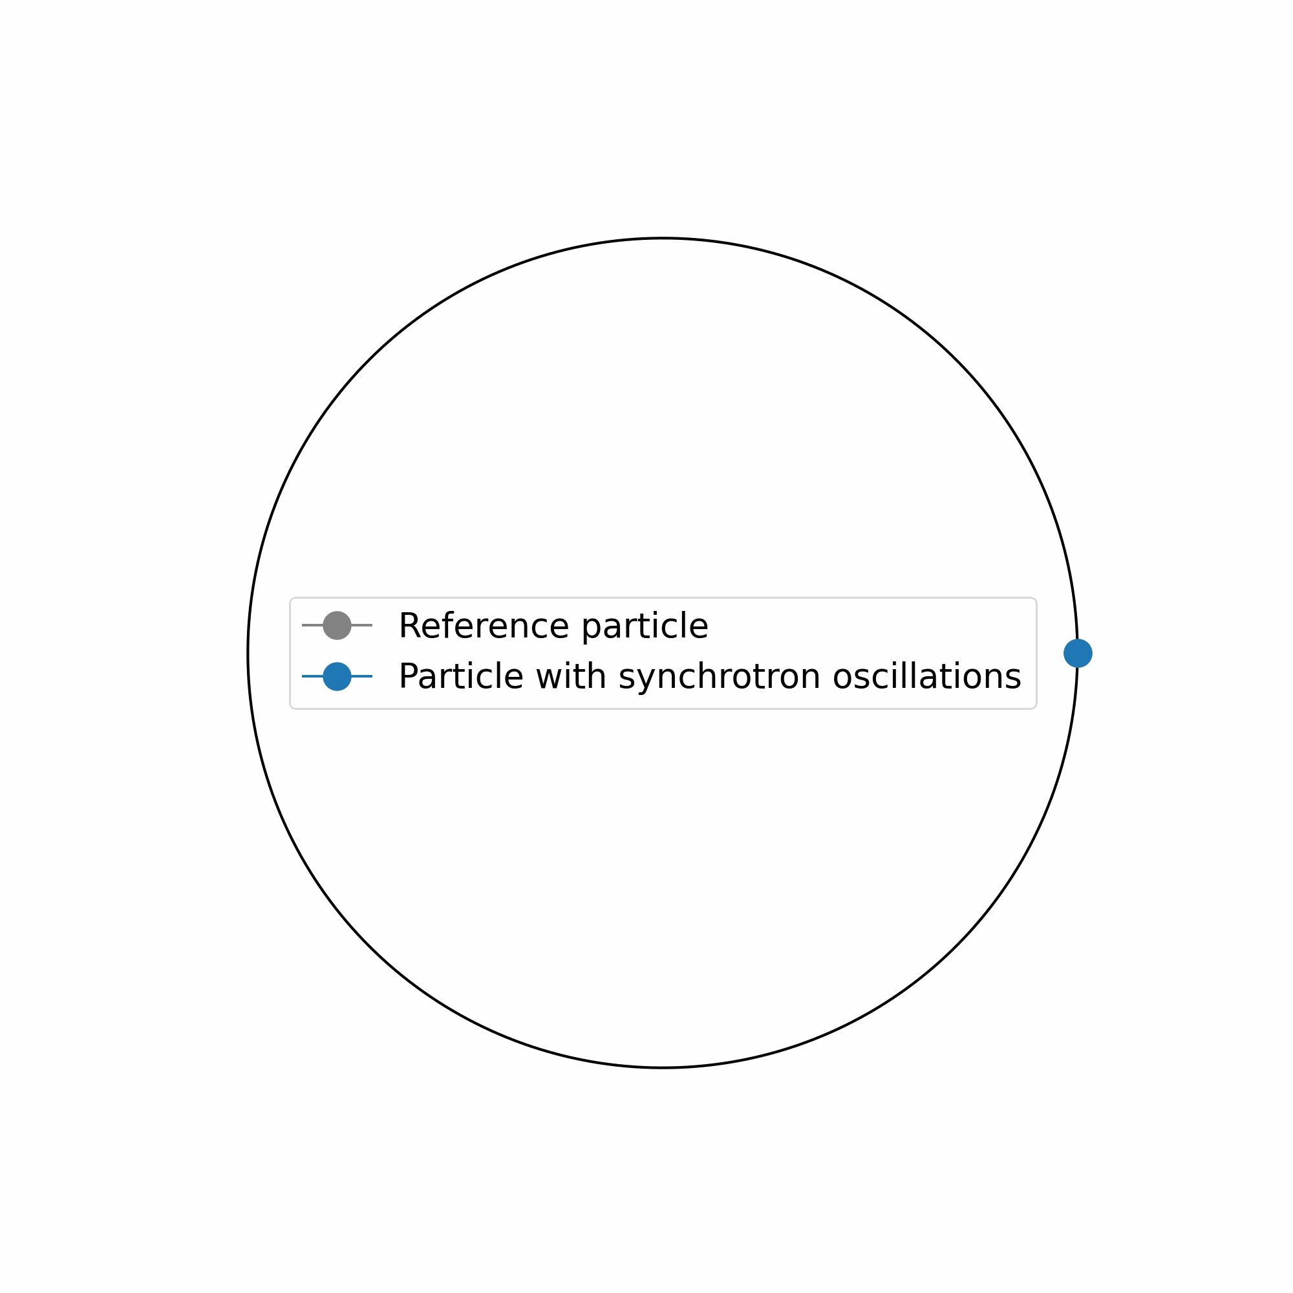
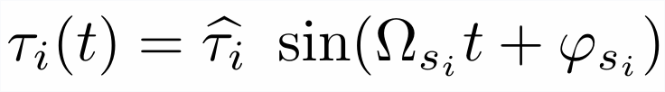
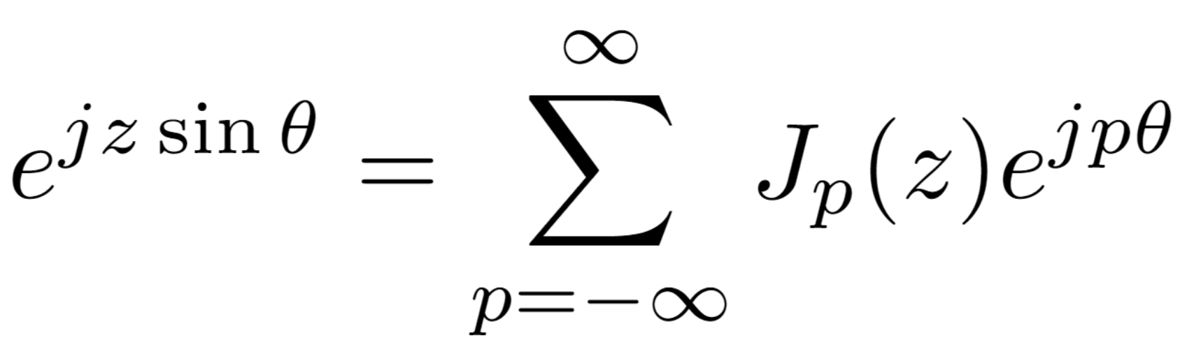
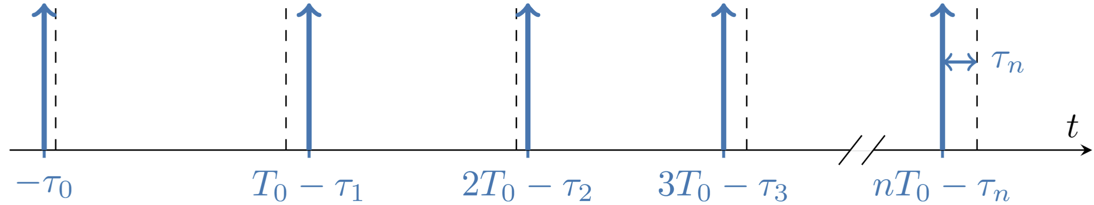
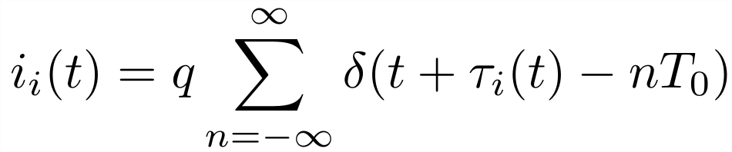
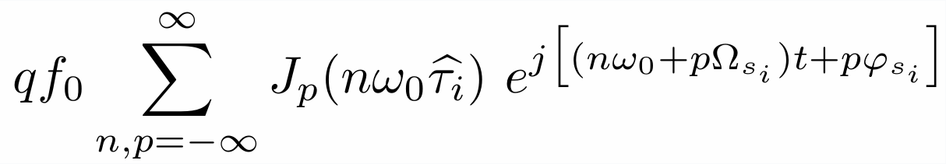

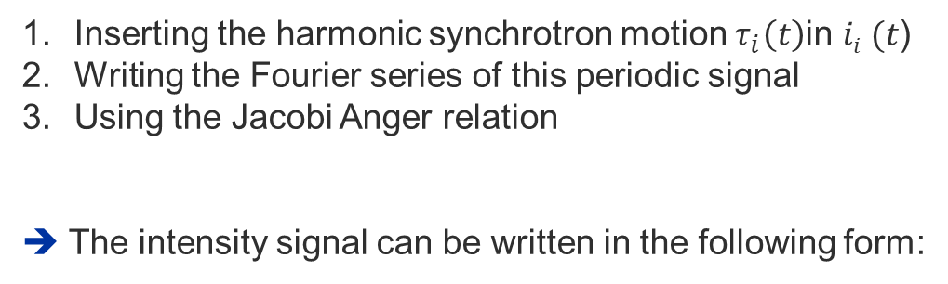



Longitudinal Schottky Spectrum
Time domain:
Frequency domain:
Schottky Monitor
$$τ_{i}= ?$$
Analytical expression for $τ_{i}\left(t\right)$
Inserting the harmonic synchrotron motion $τ_{i}\left(t\right)$in $ii (t$)
Writing the Fourier series of this periodic signal
Using the Jacobi Anger relation
➔ The intensity signal can be written in the following form:
Amplitude
Frequency
Phase
$τ_{i}$ : Time difference between particle $i$ and the synchronous particle
Summation
over harmonic $n$
Summation over
Bessel satellites $p$

Slide 6
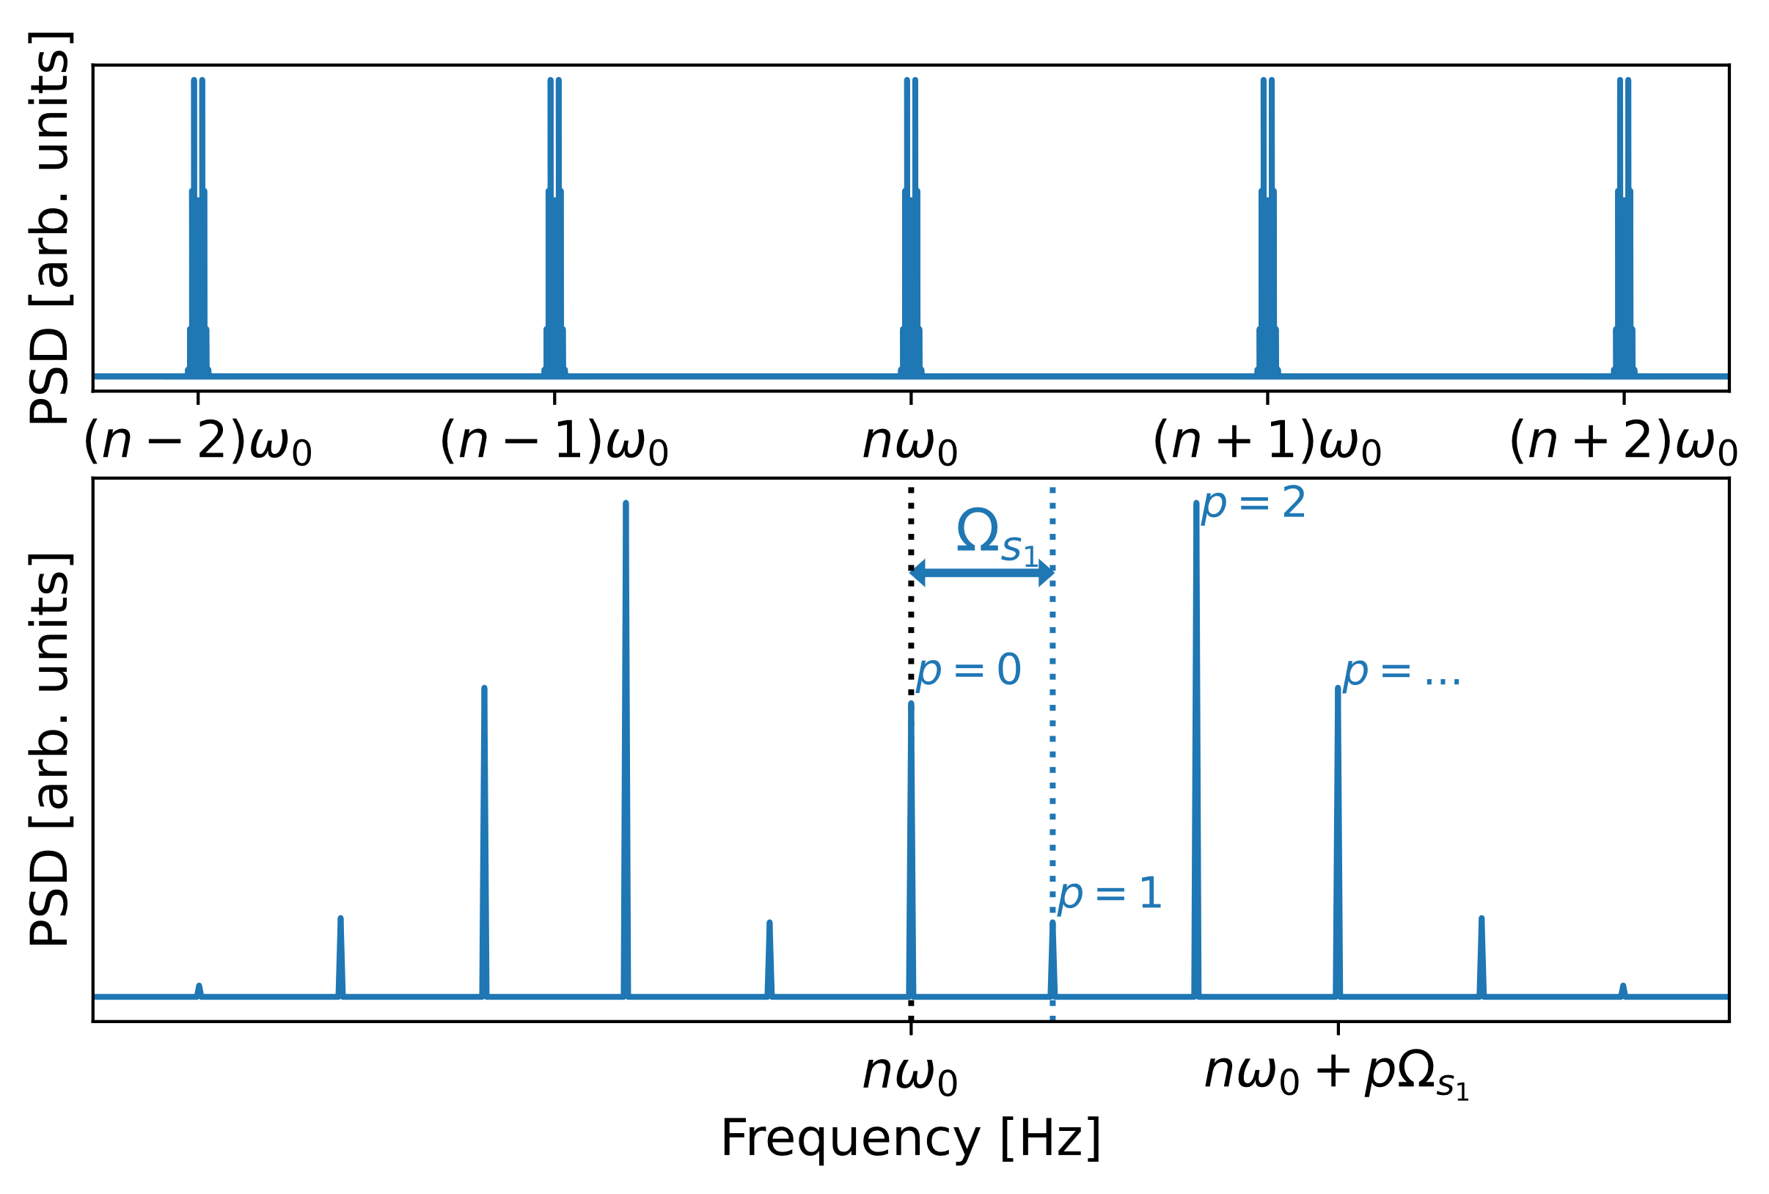
Longitudinal Schottky Spectrum
Time domain:
Frequency domain:
Schottky Monitor
Amplitude
Frequency
Phase
$τ_{i}$ : Time difference between particle $i$ and the synchronous particle
Summation
over harmonic $n$
Summation over
Bessel satellites $p$

Slide 7
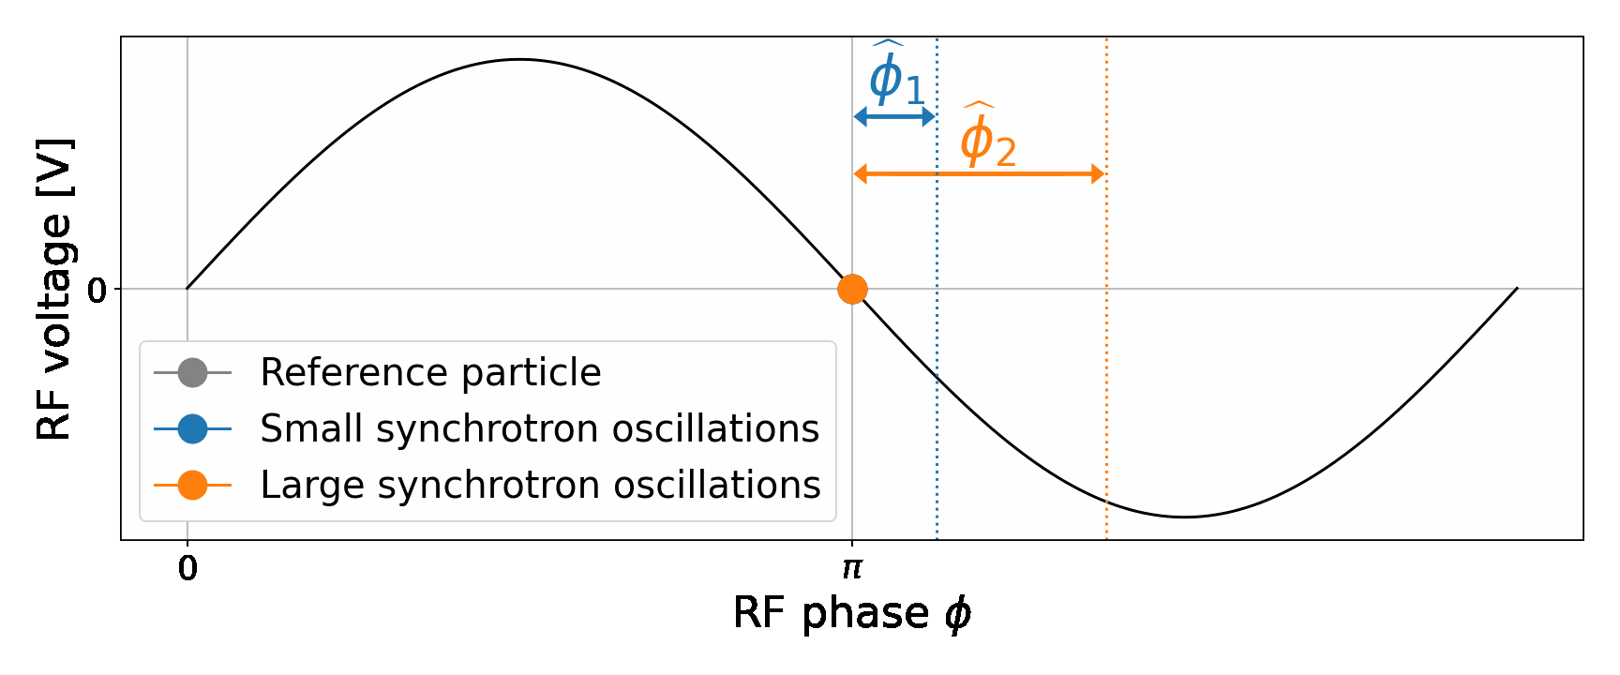
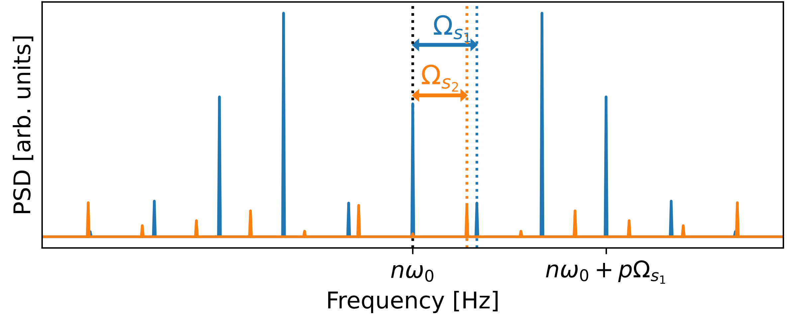
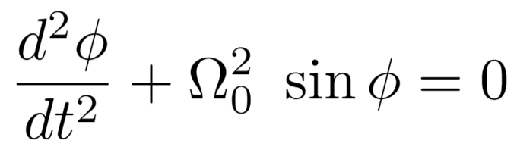
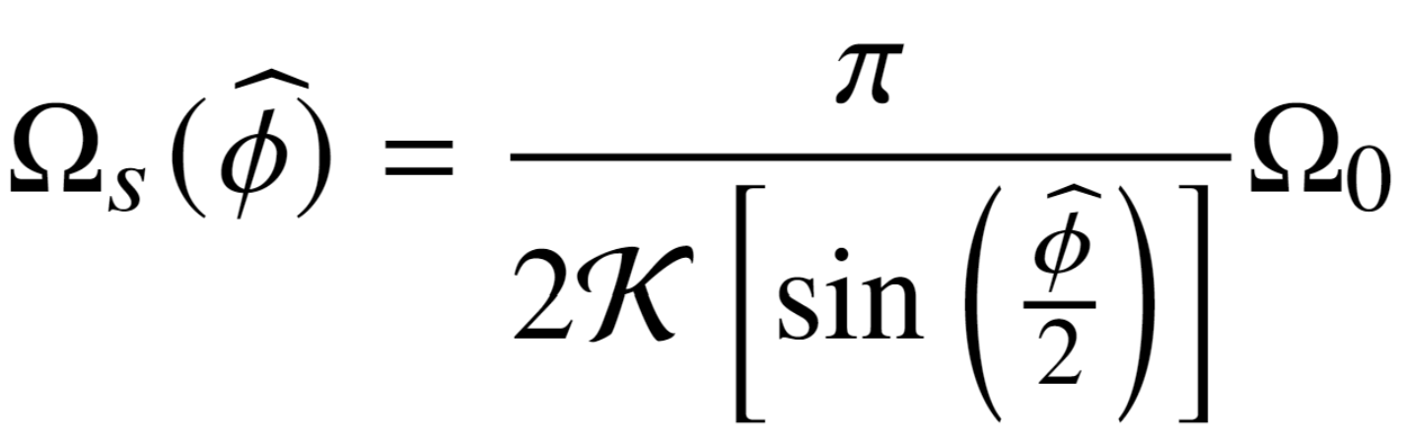
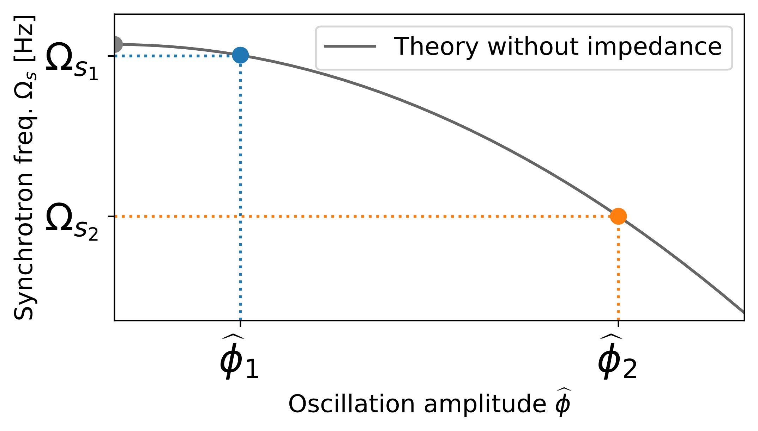
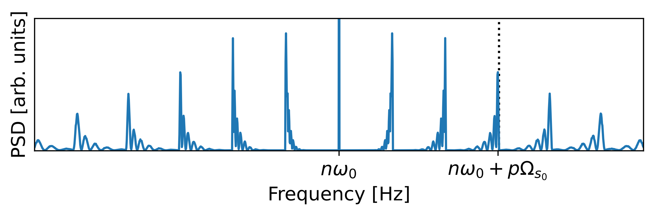
Longitudinal Schottky Spectrum
Synchrotron oscillations:
Spectrum for two particles with different synchrotron frequencies
From the theory of the non-linear pendulum:
к: Elliptic integral of the first kind
Spectrum for a bunch of particles

Slide 8
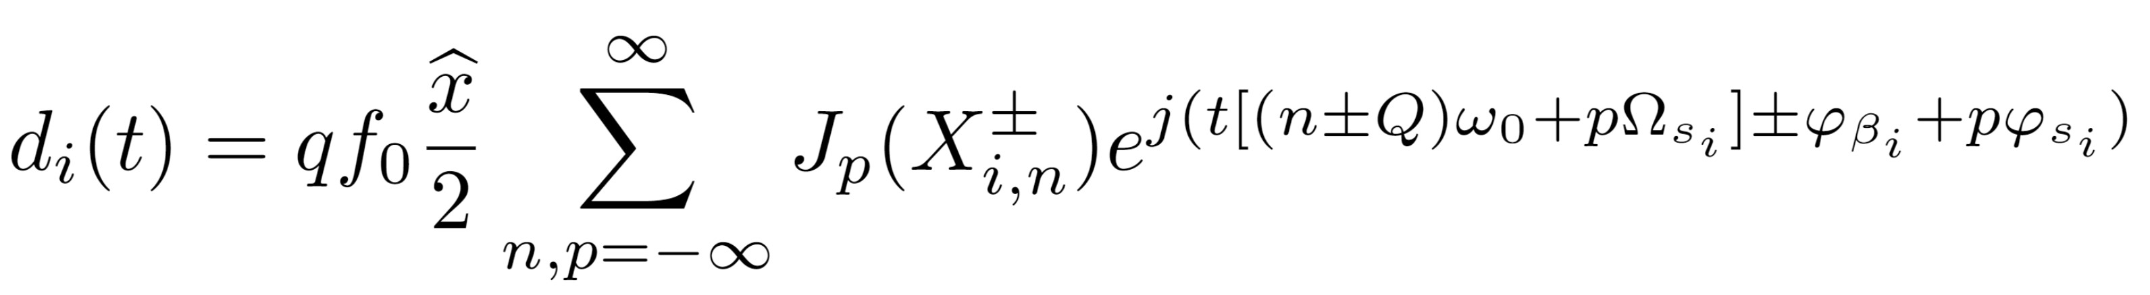
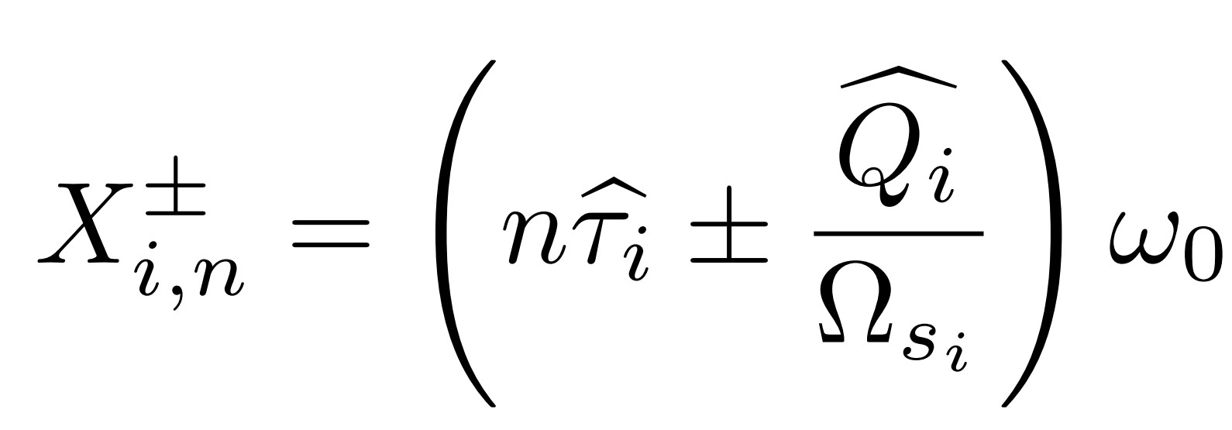
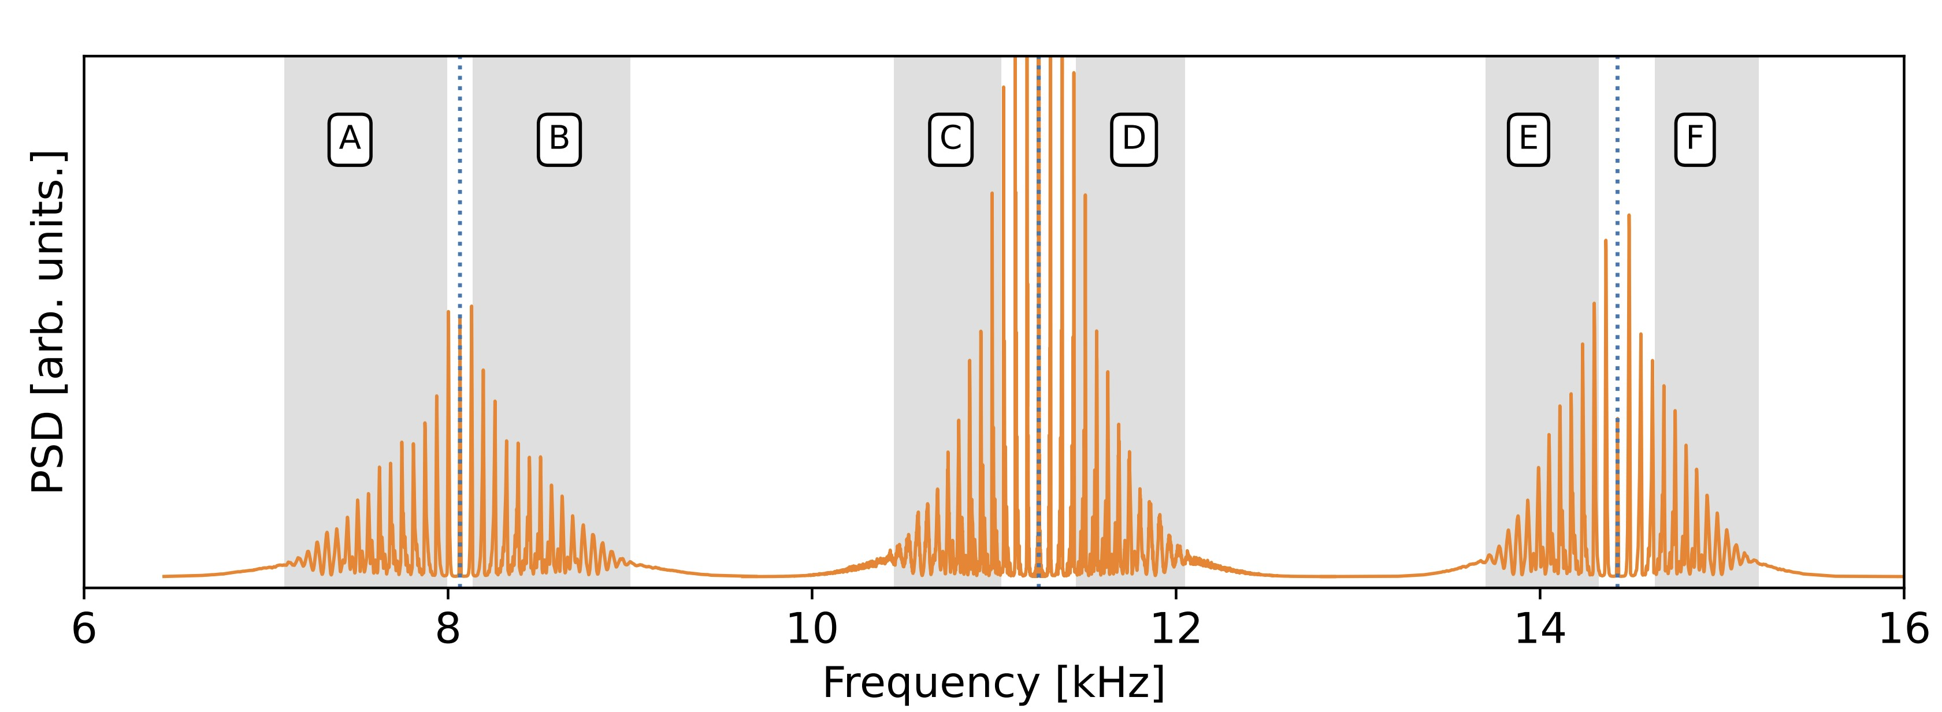
Transverse Schottky spectrum
Frequency
Amplitude
Phase
With
Lower transverse
side-band
Longitudinal band
Upper transverse
side-band

Slide 9
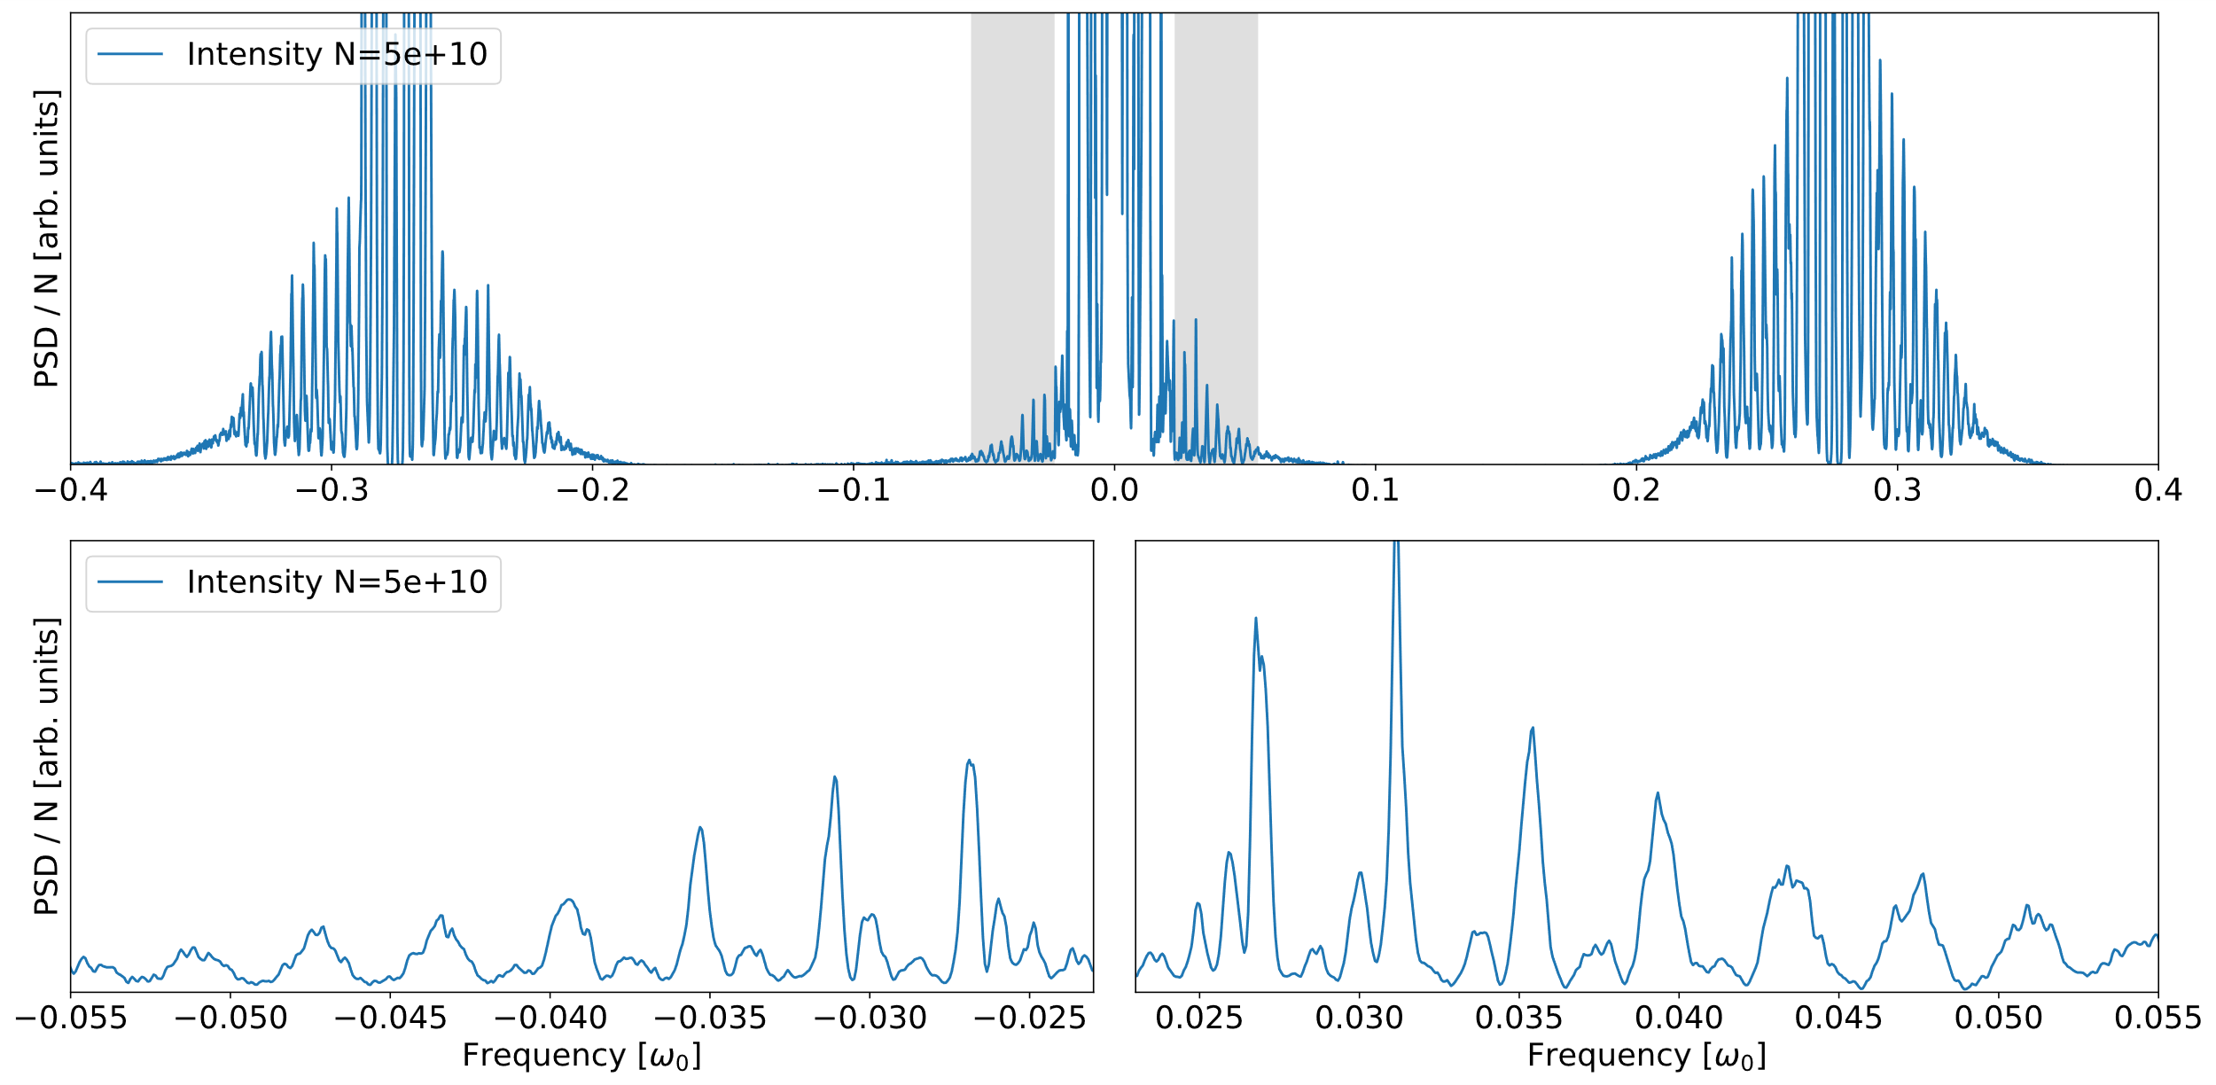
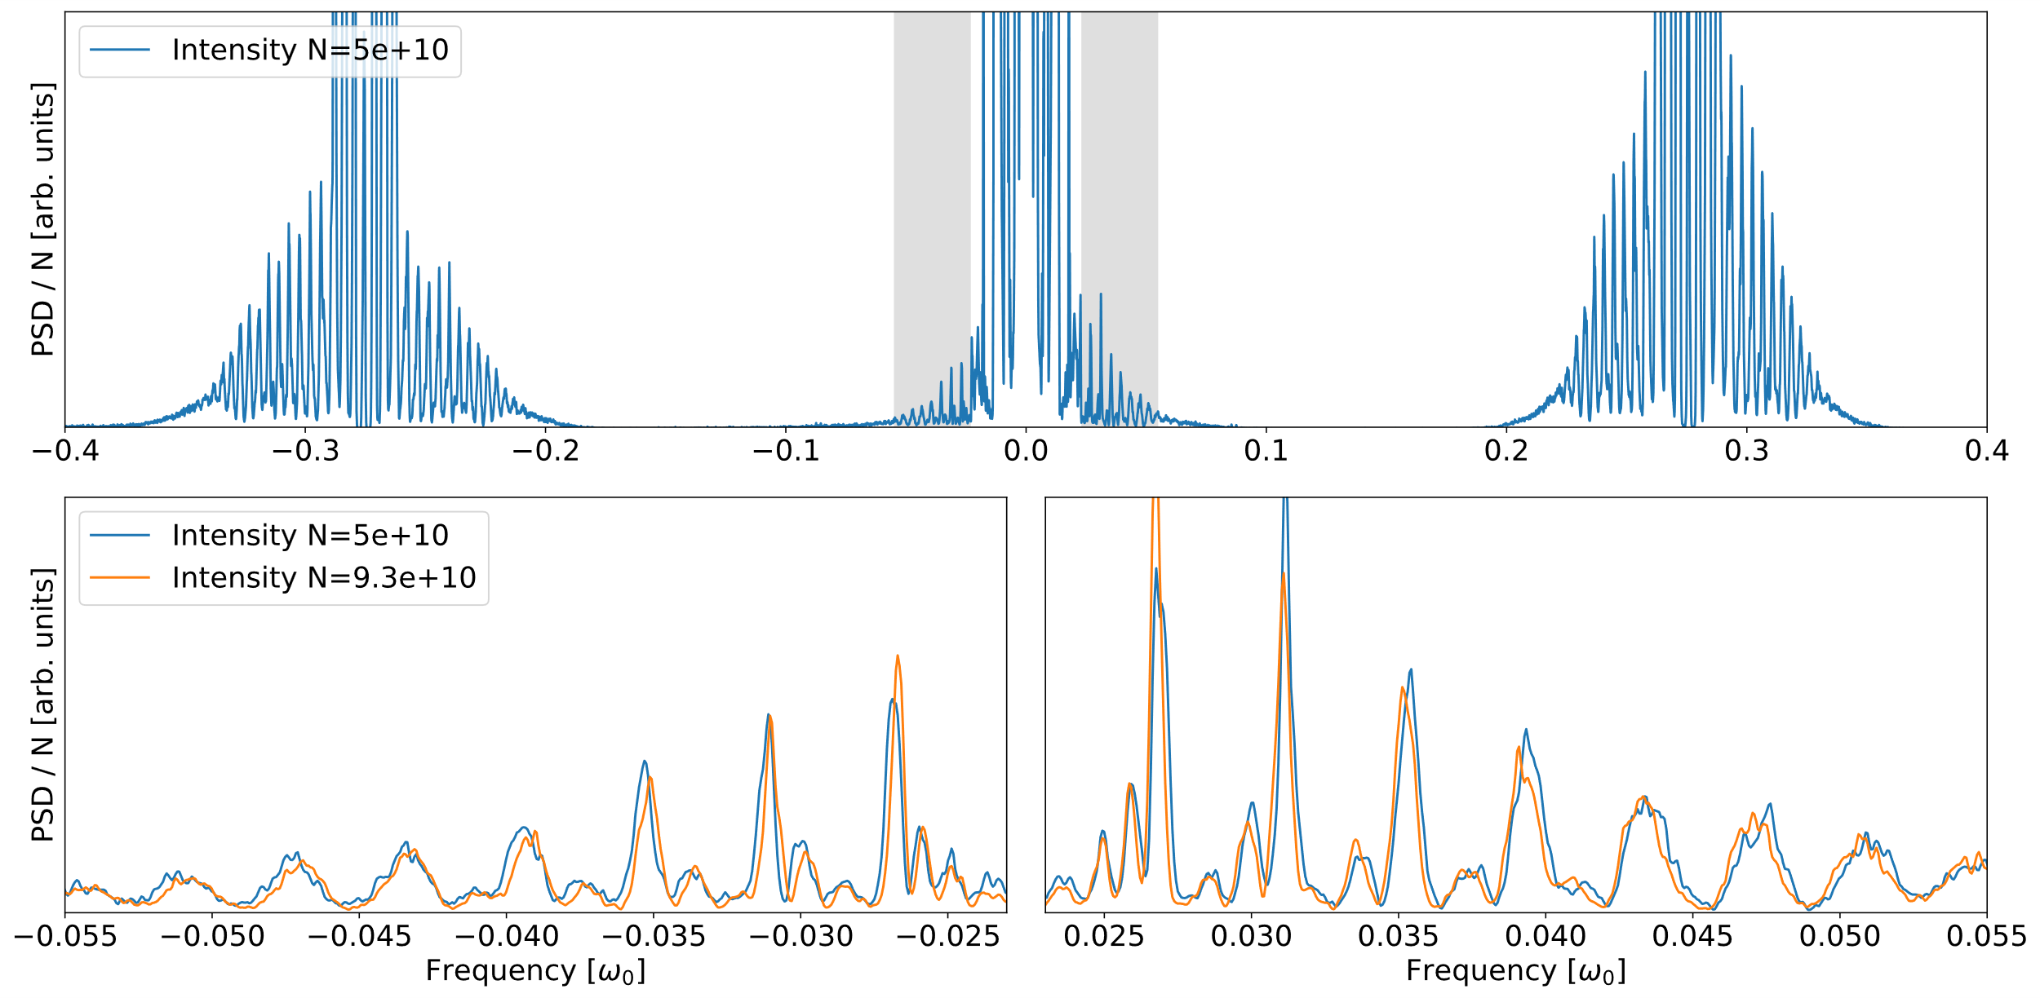
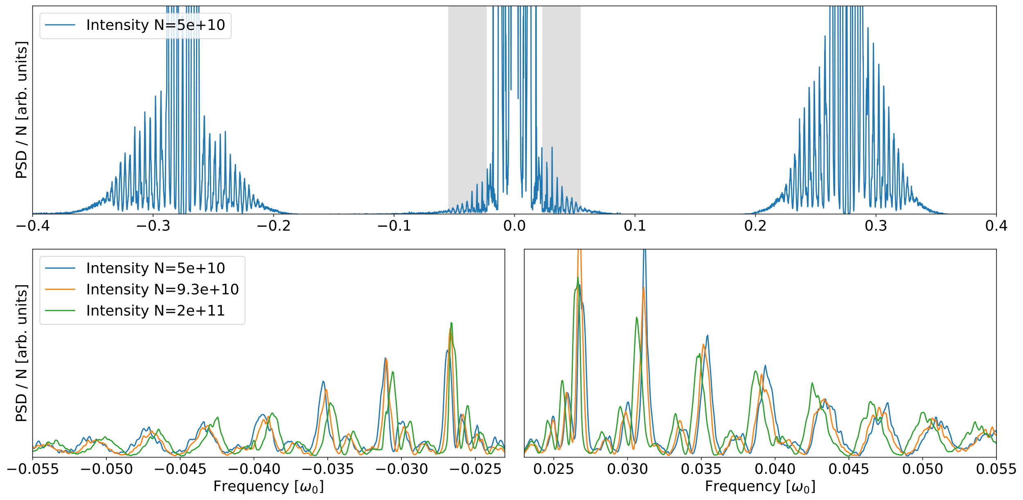
Experimental LHC spectra: Longitudinal Impedance Effects
Longitudinal impedance significantly affects proton Schottky spectra.
Spectra of bunches of different intensities (0.5e11 to 2e11 ppb) acquired at injection during MD block 1.
Schottky spectra from MD 11723
Longitudinal impedance
Synchrotron tune shift
Intensity dependent shift of the satellites.
Shift of Schottky satellites

Slide 10
Longitudinal Impedance Effects on LHC Schottky spectra
Impedance can be source of instabilities and can cause intensity limitation.
➔ Important to have a good knowledge of the machine impedance.
Current LHC longitudinal impedance model is a byproduct of the transverse impedance model. N. Mounet, PhD thesis, The LHC Transverse Coupled-Bunch Instability
Could be inaccurate. Main source of longitudinal impedance not necessarily the same as for transverse impedance.
Model re-evaluation is in progress (RF team, Michail Zampetakis, Ivan Karpov).
Can we extract information about the machine (longitudinal) impedance from the shift of the Schottky satellites?
Understand how impedance affects the dynamic of the particles (amplitude dependent tune shift).
How this new dynamic will be reflected in the Schottky spectrum.

Slide 11
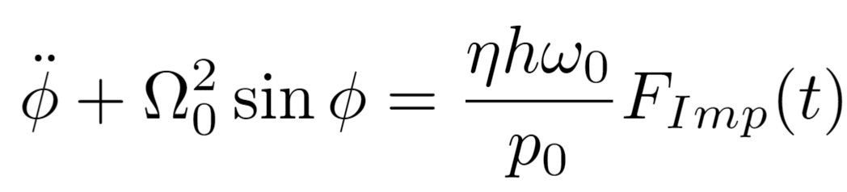
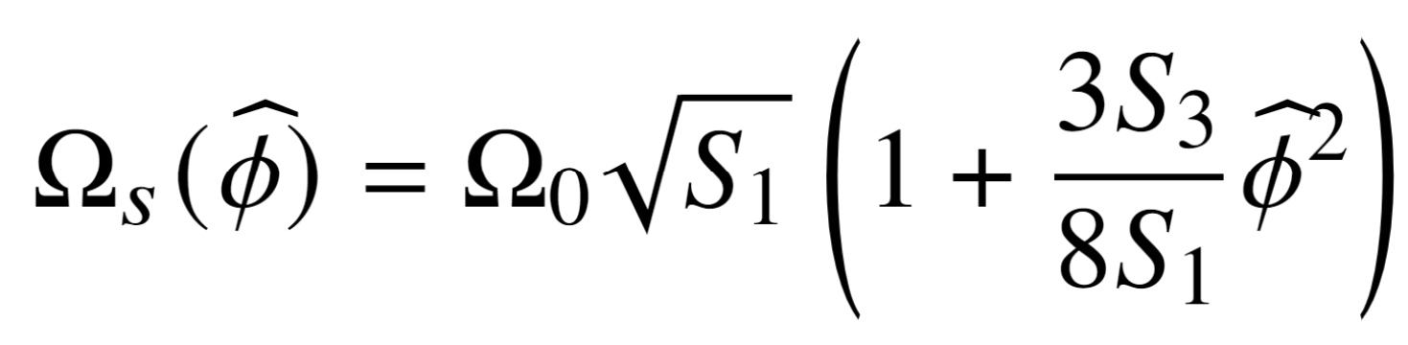
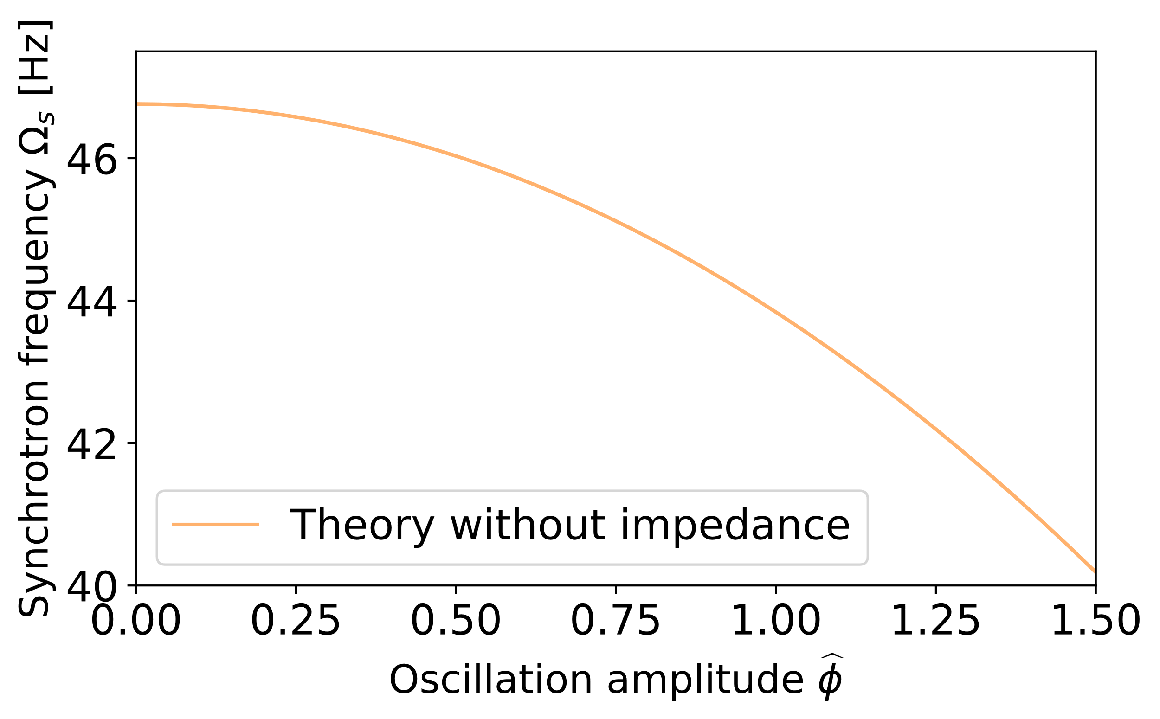
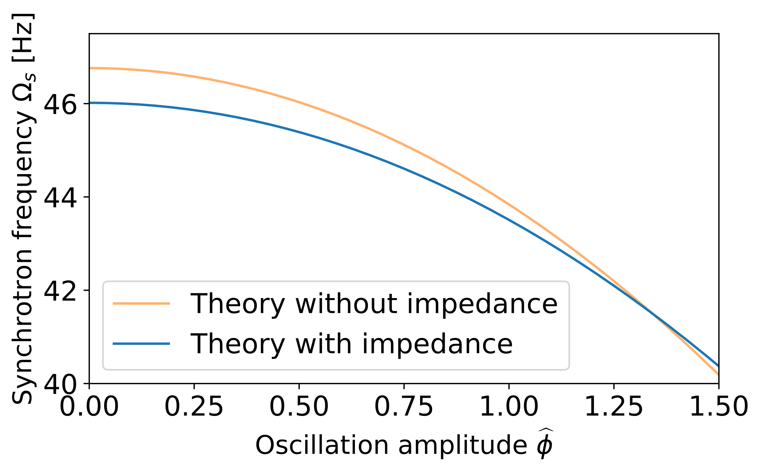
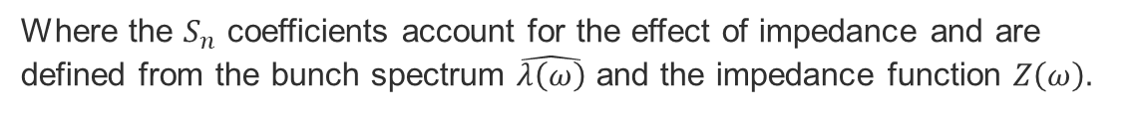
Longitudinal Impedance Effects on LHC Schottky spectra
Without impedance
With impedance
Longitudinal equation of motion.
Longitudinal equation of motion including forces coming from impedance:
With some approximations, a relation between synchrotron frequency and oscillation amplitude can be derived.
From the theory of the non-linear pendulum.
Where the $S_{n}$ coefficients account for the effect of impedance and are defined from the bunch spectrum $\hat{λ\left(ω\right)}$ and the impedance function $Z\left(ω\right).$
к: Elliptic integral of the first kind.
Details in: C. Lannoy et al 2024, JINST 19 P03017
Nominal tune shift
➔ Impedance is responsible of an amplitude-dependent synchrotron tune shift.

Slide 12
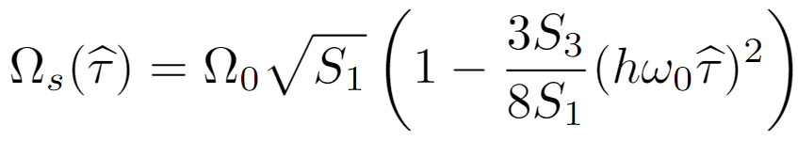
Longitudinal Impedance Effects on LHC Schottky spectra
The new relation between synchrotron frequency and amplitude can be inserted in the original theoretical expression of the Schottky spectrum:
Synchrotron frequency with impedance
This last expression allows to extend theoretical frameworks such as the Monte Carlo approach or the matrix formalism (K. Lasocha and D. Alves).
Notes:
Shunt resistance
Cut-off frequency
Quality factor

Slide 13
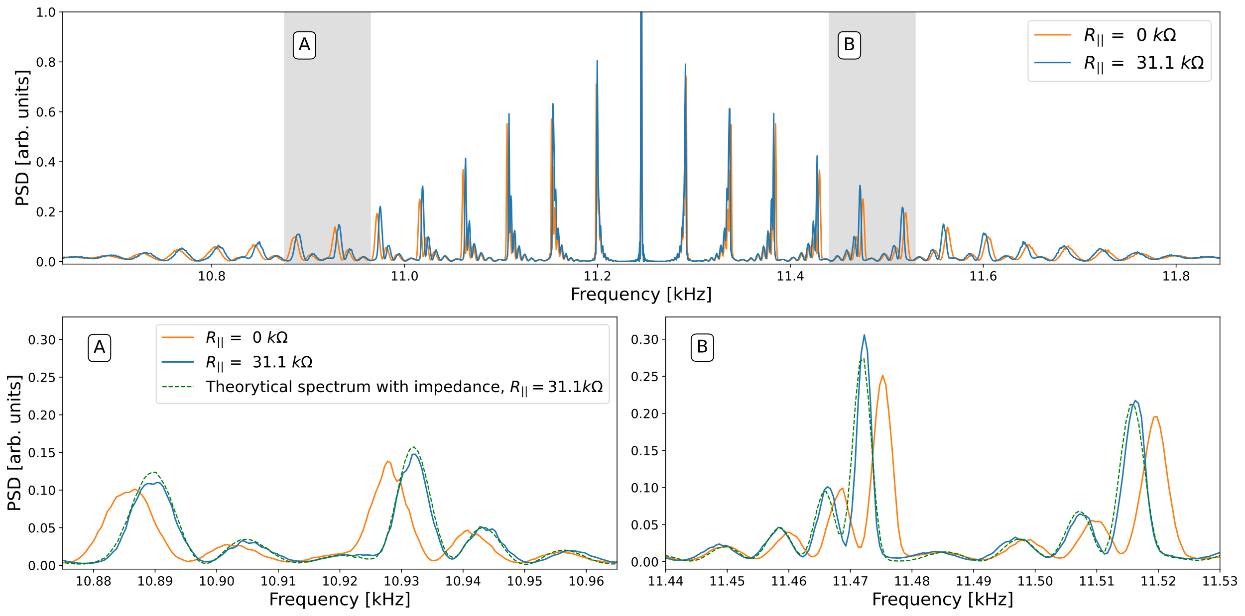
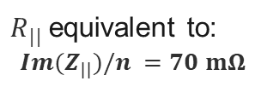
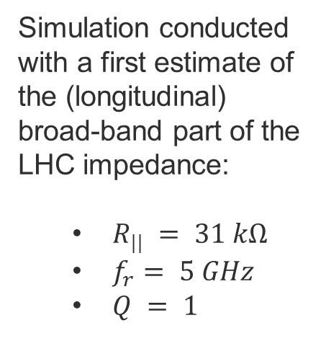
Longitudinal Impedance Effects on LHC Schottky spectra
Benchmark of the theory against macro-particle simulation (PyHEADTAIL).
Simulated Schottky spectra
Simulation conducted with a first estimate of the (longitudinal) broad-band part of the LHC impedance:
  $R_{||} = 31 kΩ$
  $f_{r}= 5 GHz$
  $Q = 1$
e
$R_{||}$equivalent to:
$$Im(Z_{||})/n =70 mΩ$$

Slide 14
Fitting of experimental LHC Schottky spectra
Fitting of Schottky spectrum is not trivial as it depends on many parameters:
Longitudinal band
Transverse bands
RF voltage
Long. bunch profile
Long. impedance
Intensity
All longitudinal parameters
Betatron tune
Chromaticity
Transverse profile
Transverse impedance
Lattice non-linearities
…
➔ The longitudinal band is easier to fit as it depends on less parameters.

Slide 15
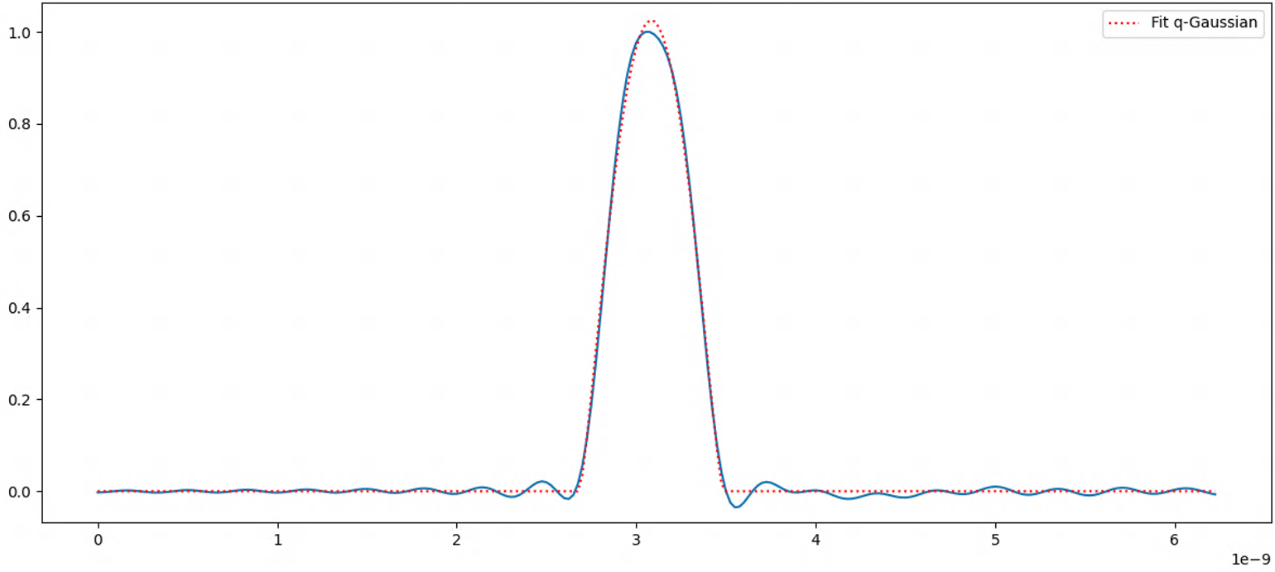

Fitting of experimental LHC Schottky spectra
Fitting of Schottky spectrum is not trivial as it depends on many parameters:
Fitted once on low intensity bunch where impedance effect is low. Agree with measured RF voltage within 0.5%.
Longitudinal band
RF voltage
Long. bunch profile
Long. impedance
Intensity
Measured precisely with the WCM (if measurement available, else supposed Gaussian with length from BQM):
Bunch spectrum
(impedance calculation)
Fitted with a q-Gaussian
Measured with BCT.
Analytical calculation
Synchr. amplitude distribution
(Schottky theory)
  Only variable left:
  Impedance - Modeled as a broadband resonator of parameters:
        $Im(Z_{||})/n$: Scanned variable
        $f_{r}= 5 GHz$
        $Q = 1$

Slide 16
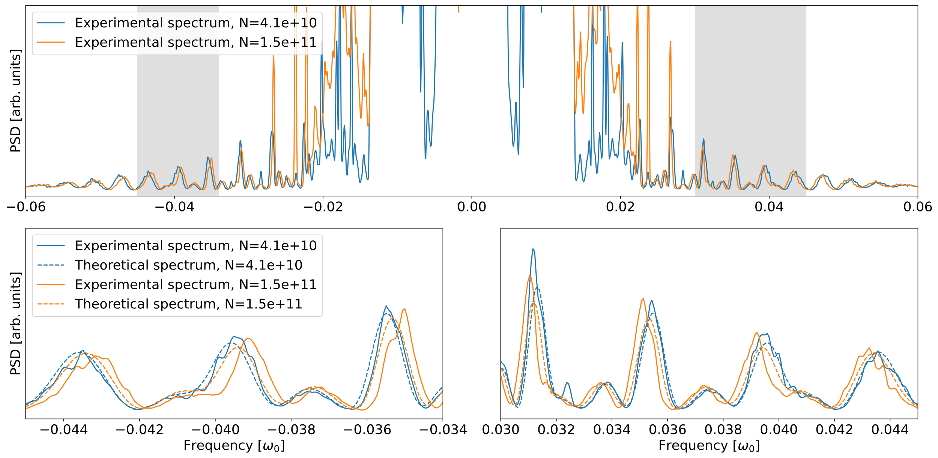
Fitting of experimental LHC Schottky spectra
Schottky spectra from MD 11723: Nominal Gaussian bunch, fit with$Im(Z_{||})/n =70 mΩ$
Notes:
Bunch profile assumed Gaussian with length given by BQM. (Spectra from 13h45 – 14h05)

Slide 17
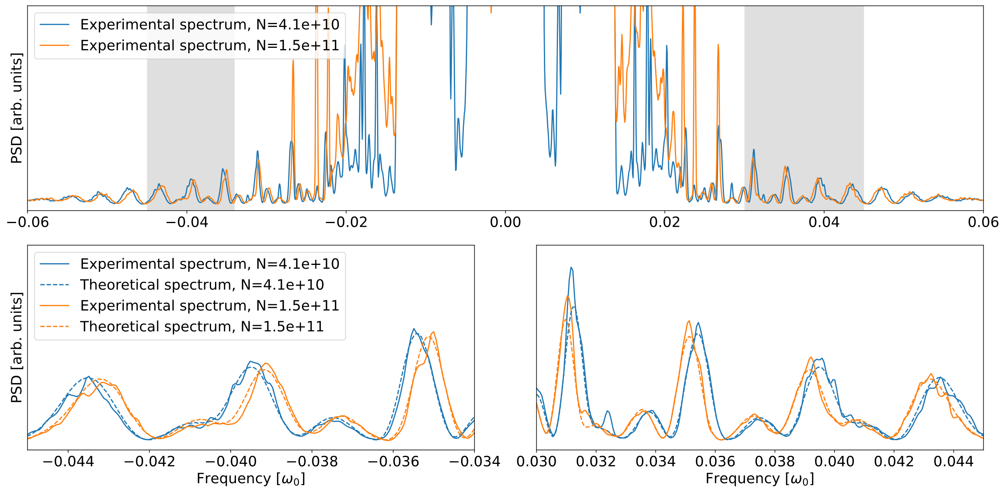
Fitting of experimental LHC Schottky spectra
Schottky spectra from MD 11723: Nominal Gaussian bunch, fit with$Im(Z_{||})/n =135 mΩ$
Notes:
13h45 – 14h05

Slide 18
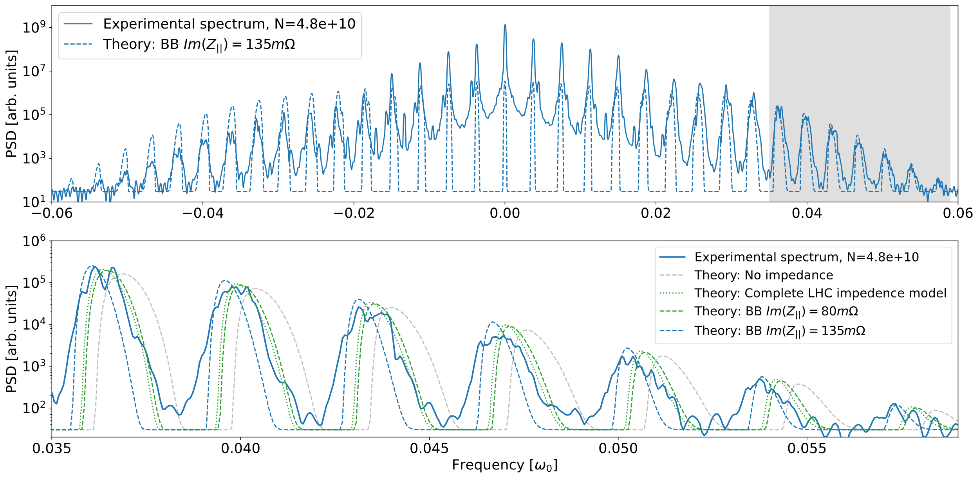
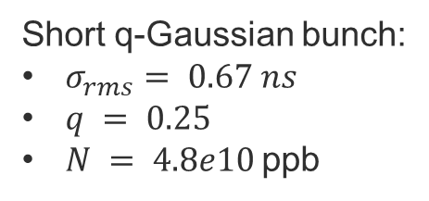
Fitting of experimental LHC Schottky spectra
Schottky spectra from MD 11786: Short q-Gaussian bunch
Short q-Gaussian bunch:
$σ_{rms}= 0.67 ns$
$q = 0.25$
$N = 4.8e10$ppb
a
Fitting less obvious ➔ Neither the full LHC impedance model nor a BB resonator can reproduce closely the measurement.
Better agreement might be obtained by fitting both shunt impedance and cutoff frequency (study ongoing).

Slide 19
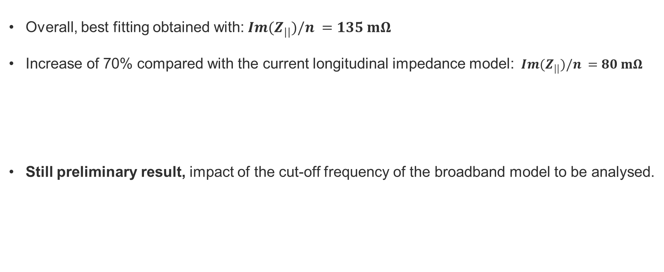
Fitting of experimental LHC Schottky spectra
Overall, best fitting obtained with:$Im(Z_{||})/n =135 mΩ$
Increase of 70% compared with the current longitudinal impedance model: $Im(Z_{||})/n =80 mΩ$
Still preliminary result, impact of the cut-off frequency of the broadband model to be analysed.
N. Mounet, PhD thesis, The LHC Transverse Coupled-Bunch Instability
I. Karpov and L. Giacomel IWG talks, https://indico.cern.ch/event/1422663/

Slide 20
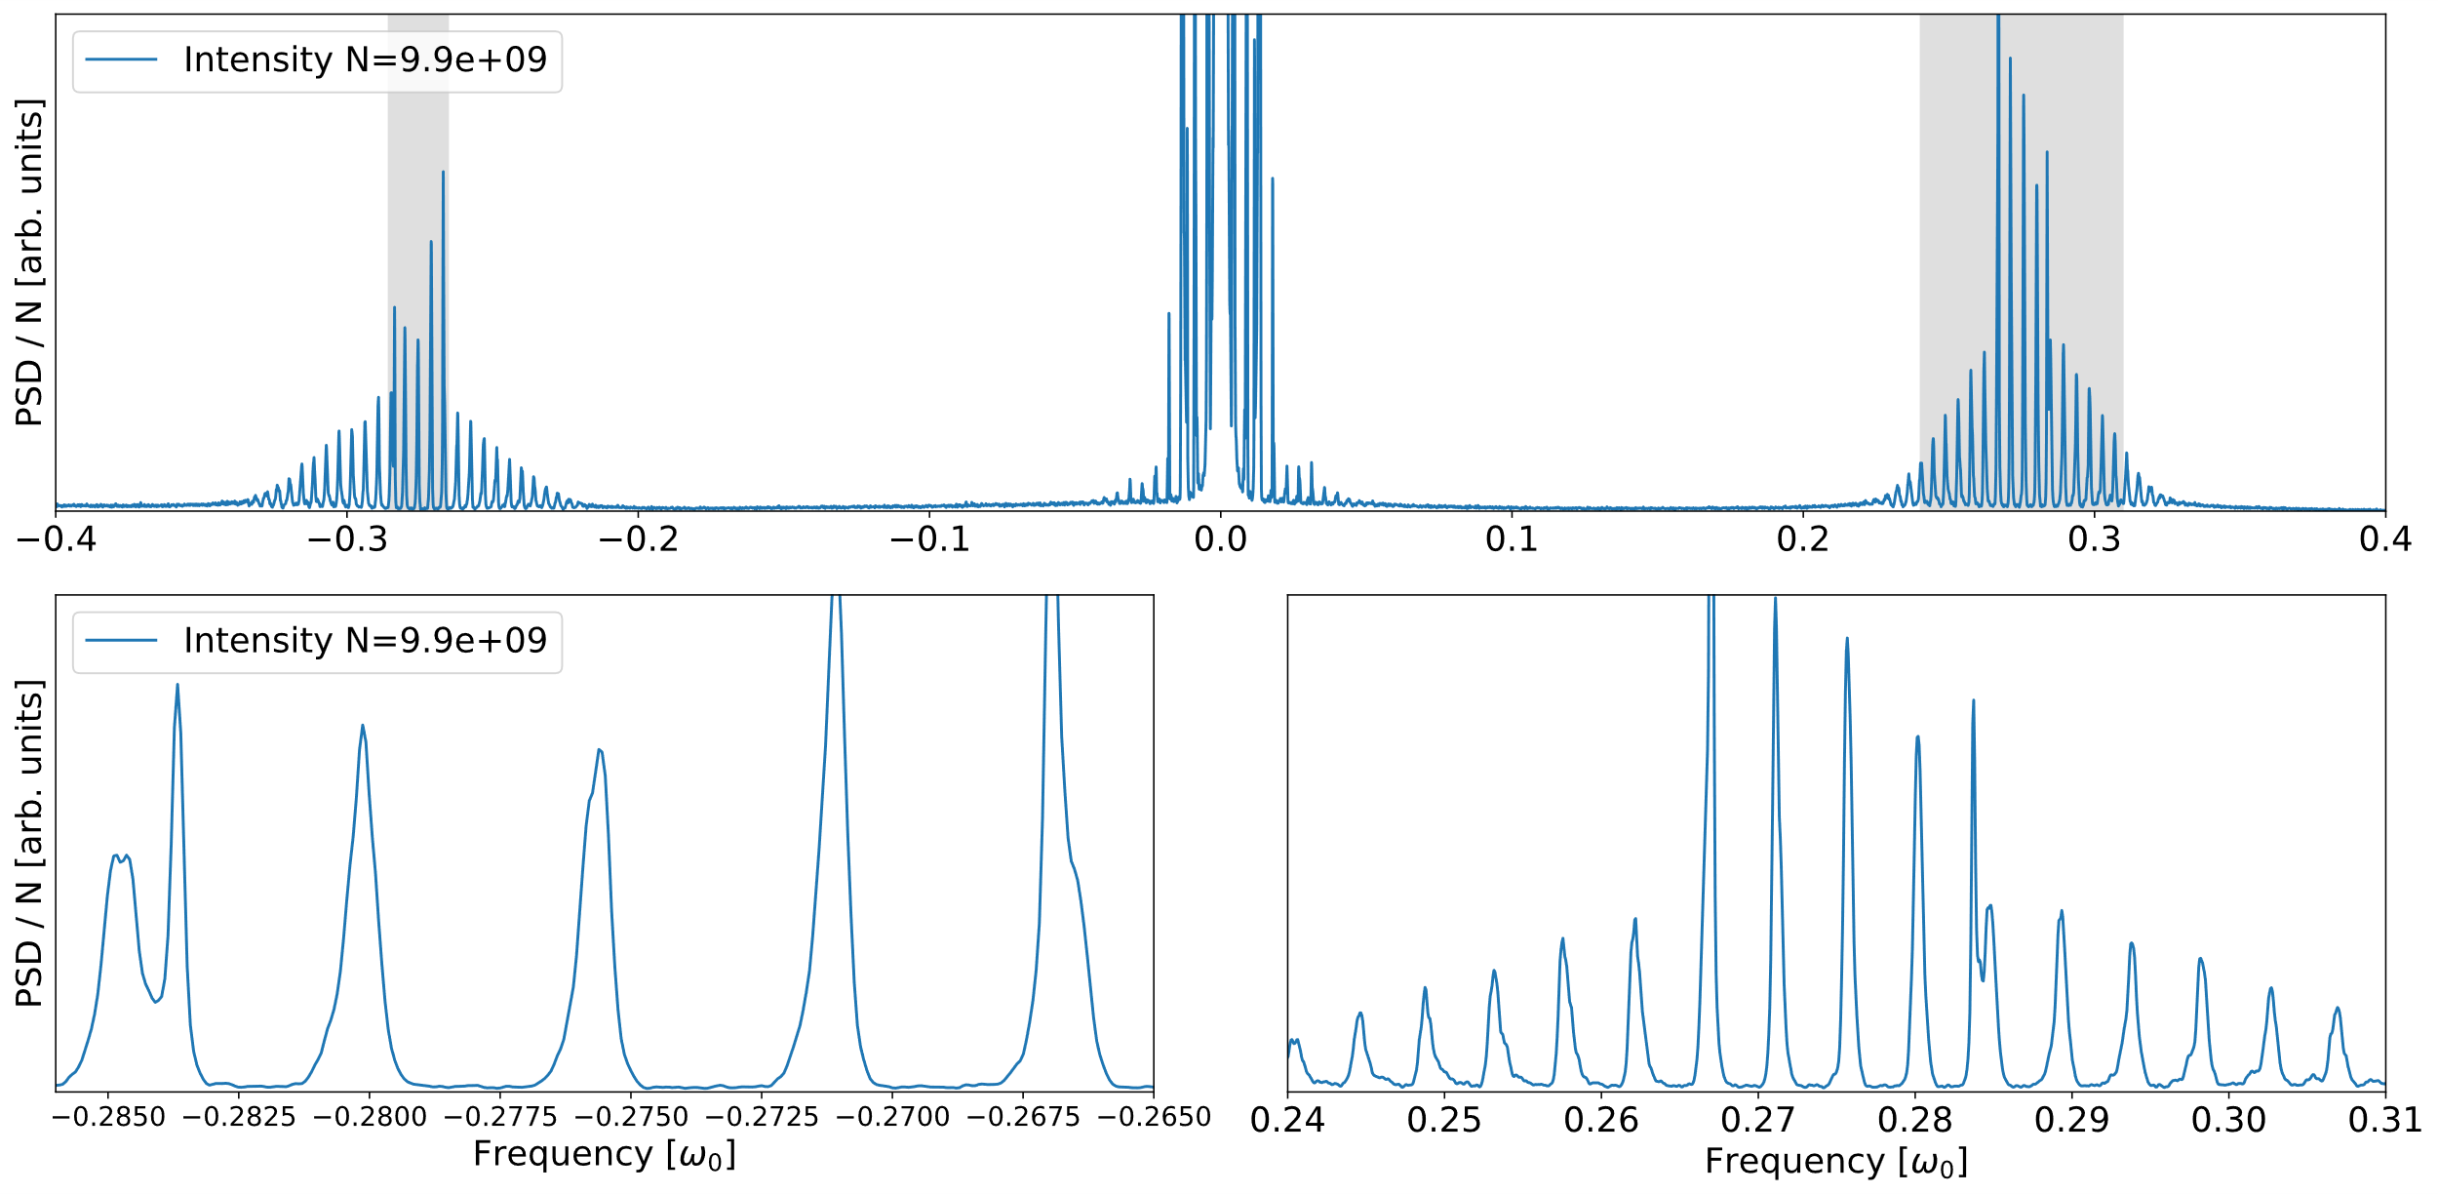
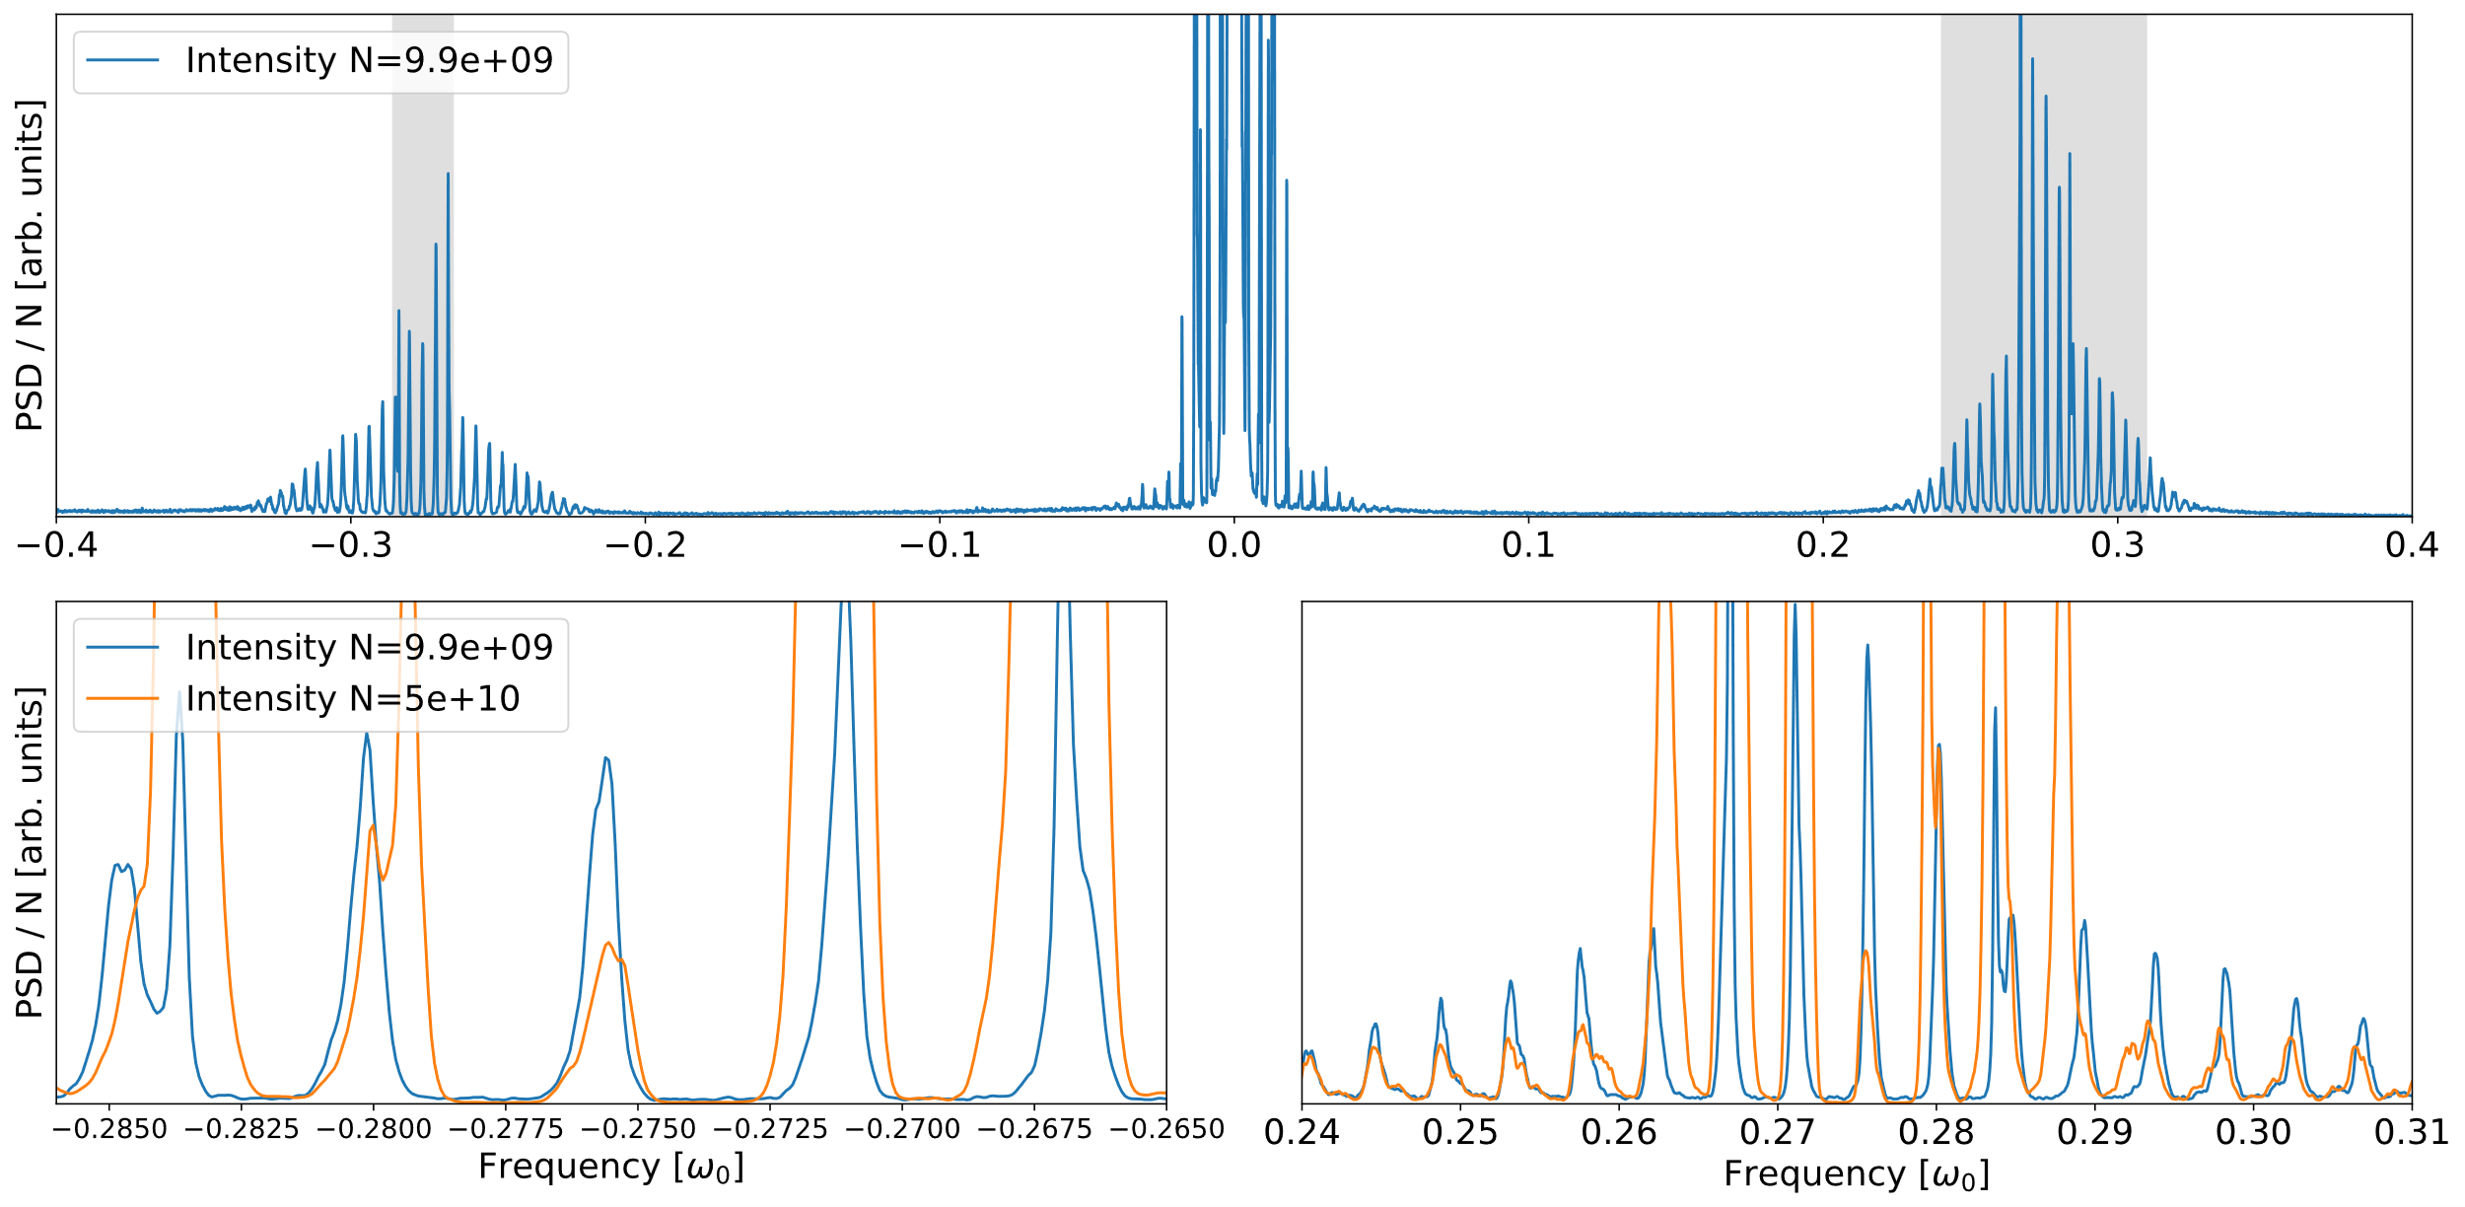
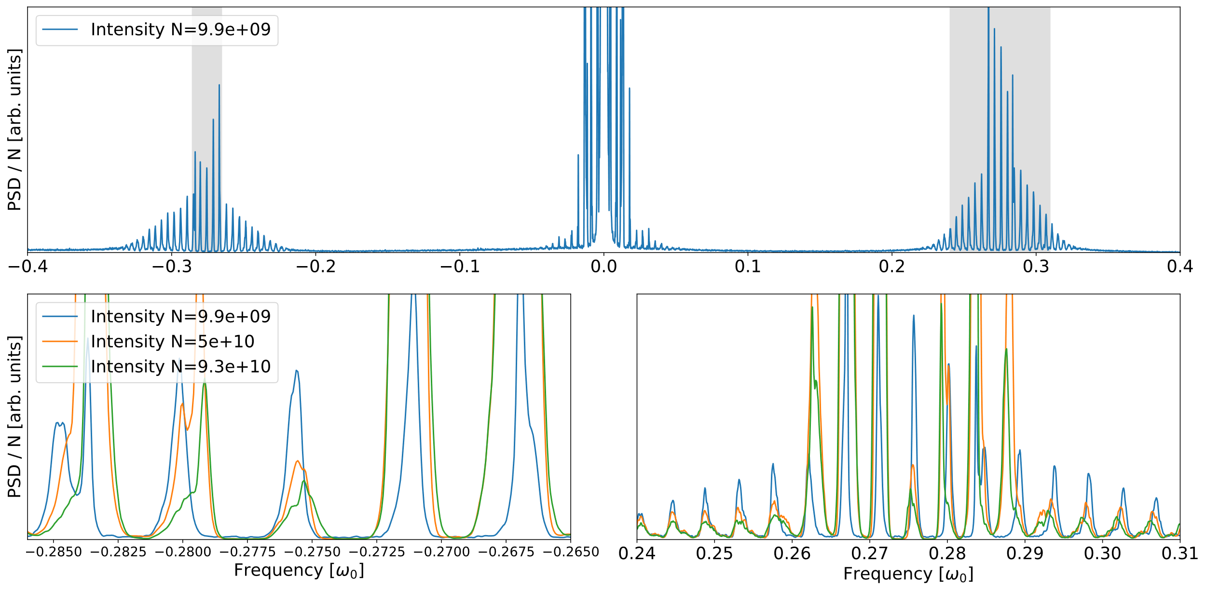
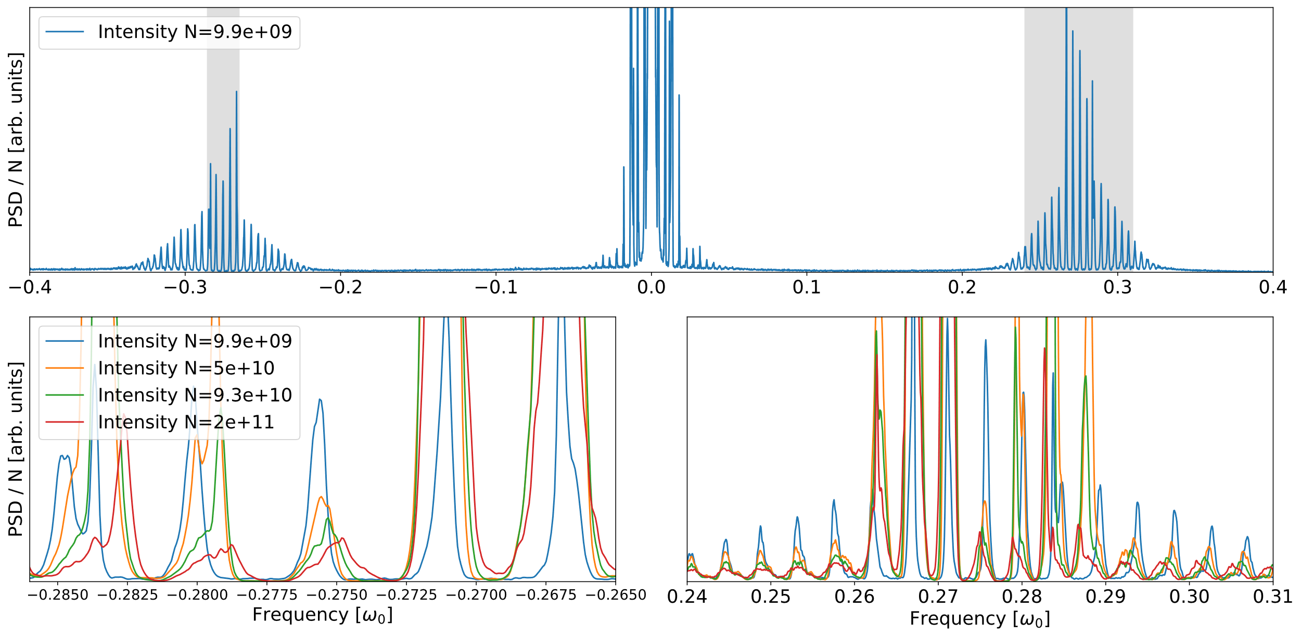
Experimental LHC spectra: Transverse impedance effects
Transverse impedance significantly affects proton Schottky spectra.
Spectra of bunches of different intensities (0.1e11 to 2e11 ppb) acquired at injection during MD block 1.
Schottky spectra from MD 11723
Transverse impedance
Betatron tune shift and tune spread
Central satellite
Shift and spreading of Schottky satellites
Notes:
11h05 – 11h25

Slide 21
Conclusion
  Summary of the talk:
  Longitudinal impedance.
    Shift of synchrotron satellites observed experimentally.
    Theory available allowing fitting of impedance.
    First measurements seem to indicate an increased impedance w.r.t. current model.
    Further studies needed to analyse the impact of cut-off frequency.
  Transverse impedance.
    Tune shift observed in experimental spectra.
    Theory available for quadrupolar impedance and still to be developed for dipolar impedance.

