Slide 1
NextGen Triggers
Project Overview
Alberto Di Meglio
Project Coordinator
On behalf of the NextGen Project Management Committee

Slide 2

A LITTLE
BACKGROUND STORY
2022
A group of private donors, visits CERN to know more about its missions and programmes.
This first visit eventually evolves into an agreement with the Eric and Wendy Schmidt Fund for Strategic Innovation, approved by the CERN Council in October 2023, to fund a project to support advanced research for the future trigger systems at the HL-LHC and beyond.
2023
2024
2024
January kick-off. NextGen Triggers was born!

Slide 3

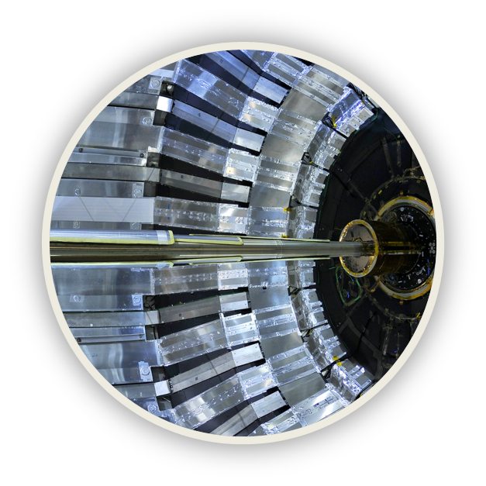
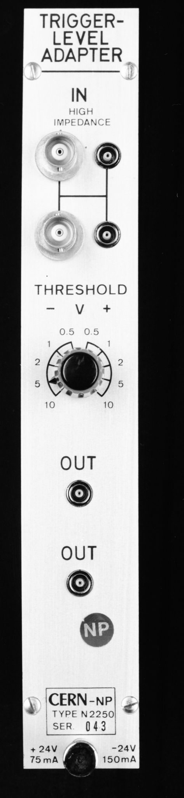


WHAT IS
NEXT GENERATION TRIGGERS?
Five years: 2024-2028 supported by an external donation, combining
ATLAS, CMS;
limited participation of ALICE, LHCb
CERN’s Theory & IT departments
CERN’s Exp Physics Software group
Project goals (proposal)
opportunity for wider R&D
improve LHC experiments in 2028+
invest in community education and training
In just a few microseconds, the complex triggers system can determine whether the information about a given collision event is worth keeping or not, but today we still discard the vast majority of raw data. Is it possible to do better?

Slide 4
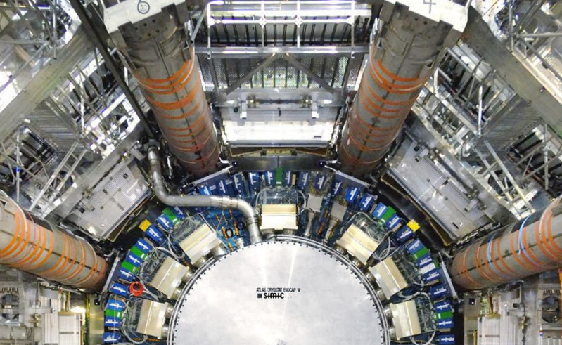
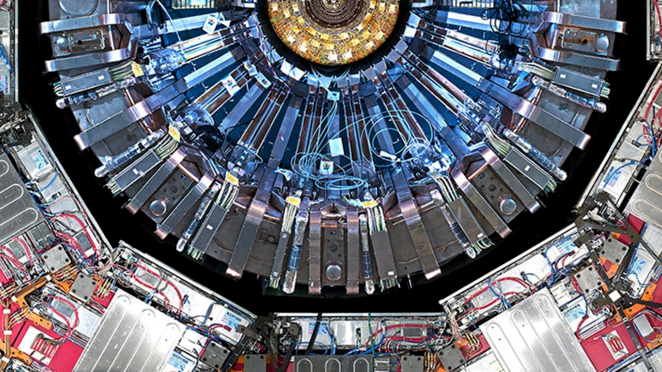
HOW
Experiment-specific R&D
      ATLAS+CMS define their R&D requirements
      Benefitting from common R&D, training
Common R&D + Training
      Combining all parties: 2 (+2) experiments, IT, theory, experimental physics software
    Results are open
      Open access, open source, including training
      Embedded in experiments

Slide 5



THE KEY OBJECTIVES
More than technical work
Goals
Technologies
Community
To get more physics information out of the HL-LHC data.
Define common objectives across different experiments and Institutes
Train future researchers on new computing techniques for real applications
Promote Open Science principles and contribute to open source development of AI/ML technologies
ML and classical algos: invent, optimize, benchmark
To uncover as-yet-unseen phenomena by more efficiently selecting exotic and rare physics events thanks to better models and data processing techniques.
Quantum-inspired algorithms and new physics simulations
FPGAs, GPUs, high-performance computing, more efficient architectures

Slide 6
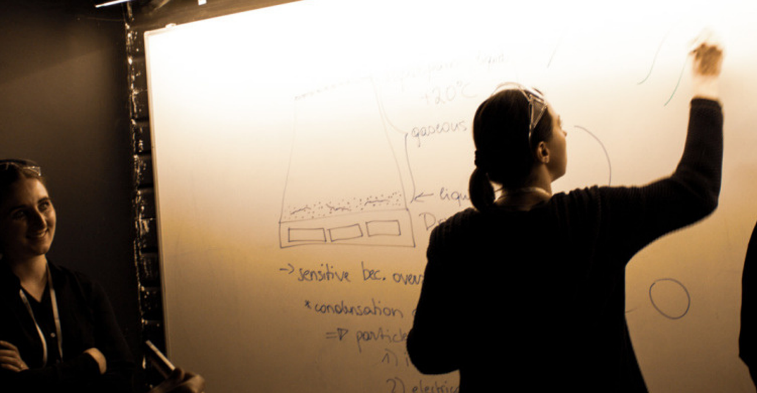

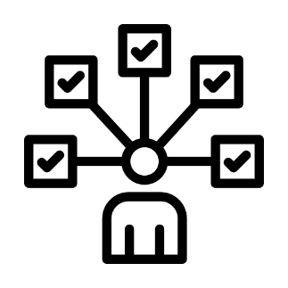



THE SUPPORTING STRATEGY
Of The Five-Year NextGen Triggers Projects
NextGen will collaborate with experts in academia and industry.
The work builds on CERN’s Open Science and knowledge-sharing principles.
A unique multidisciplinary education program for NextGen researchers is included.
Targeted events and conferences for the wider scientific community will be organized.
Intellectual property from the NextGen Triggers project, owned by CERN, will be released and shared under open licenses, in compliance with the CERN Open Science Policy.

Slide 7
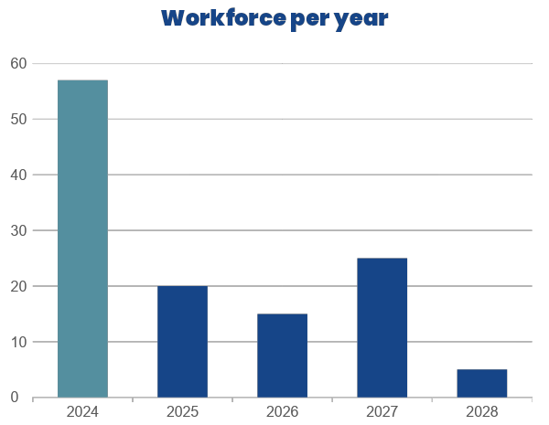

First action? Hire the Experts!
Target effort
~280 FTEs planned in total across 5 years
57 new hires for 2024
Mixed profiles: master, PhD, post-doc, staff

Slide 8

THE NEXT GENERATION TRIGGERS
PROJECT IS BROKEN DOWN INTO FOUR WORK PACKAGES:
WP1
WP2:
Infrastructure, Algorithms and Theory
01
02
Enhancing the ATLAS Trigger and Data Acquisition
WP4:
WP3:
Education Programmes and Outreach
04
03
Rethinking the CMS Real Time Data Processing
9

Slide 9
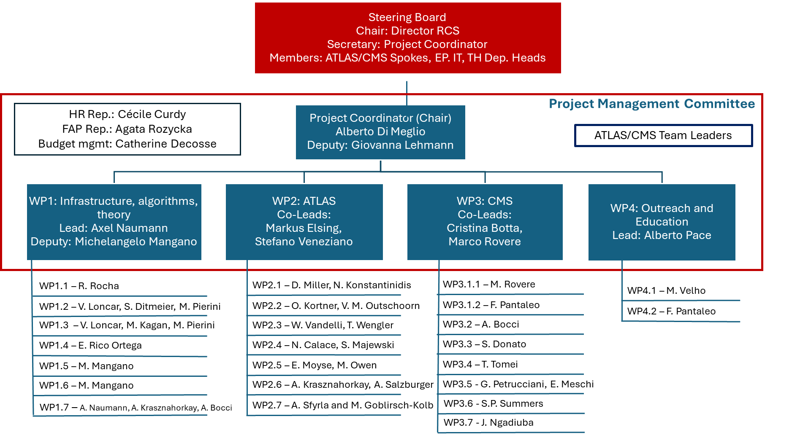
THE PROJECT GOVERNANCE

Slide 10
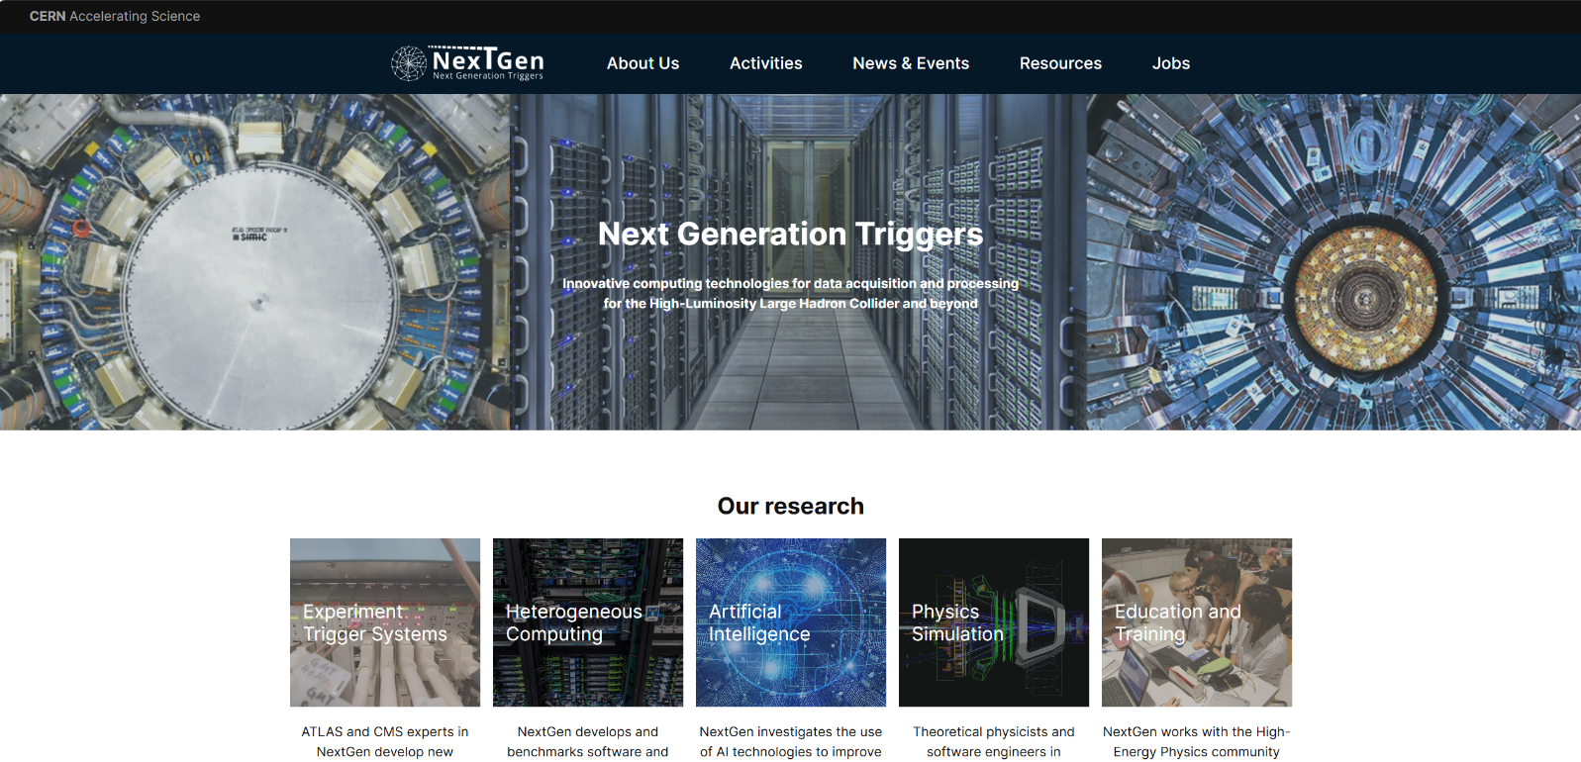
THE WEB SITE
https://nextgentriggers.web.cern.ch/

Slide 11
DELIVERABLES, MILESTONES AND PLANS
The yearly ER (Evaluation Report, including the Financial Report) and all “proofs of evidence” for the previous year must be submitted by January 30th of the following year.
For 2024 we are starting now to collect technical information and financial (use of resources) information. The final version of all material must be ready at the latest in January 2025 as a public report.
In addition to the “contractual” milestones listed in the proposal, we have internal milestones (check-points) in June/July and Nov/Dec every year to assess progress and take any necessary corrective actions.
Formal deliverables
The Grant Agreement requires the submission of a number of formal deliverables every year
There are in total 70 deliverables, 14 per year
Each deliverable has an associated “proof of evidence”

Slide 12
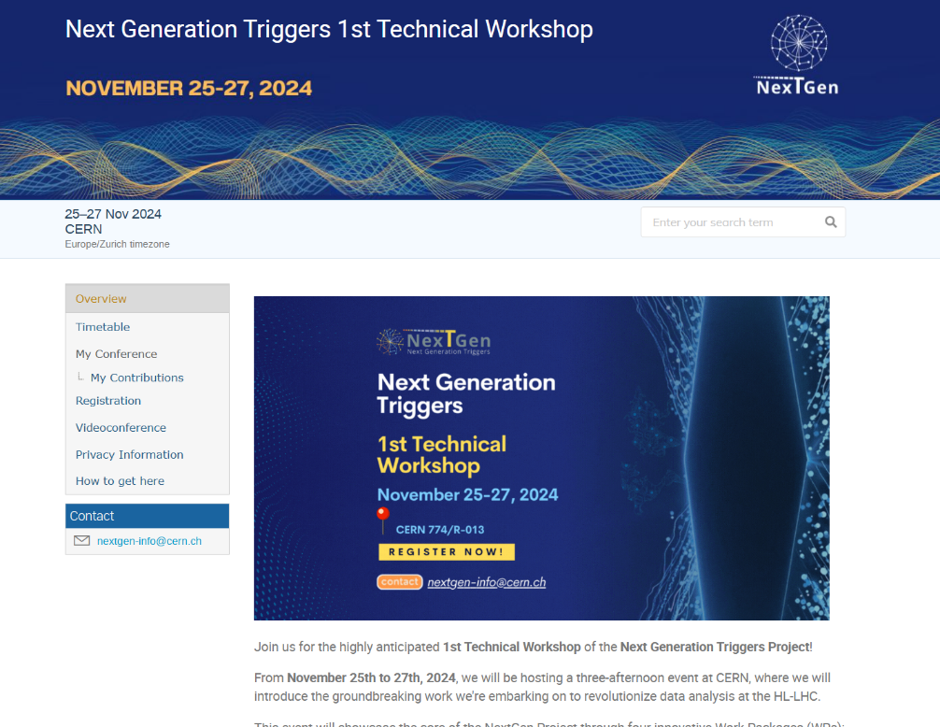
THE YEARLY NEXTGEN WORKSHOP
The yearly NextGen Workshop is the main technical event (see WP4 presentation for more on exchange and outreach plans).
Open to any interested person in the community to be informed on activities and progress, exchange ideas, ask questions, make suggestions
Technical presentation from all Tasks
Help us to shape the programme for the next years!

Slide 13
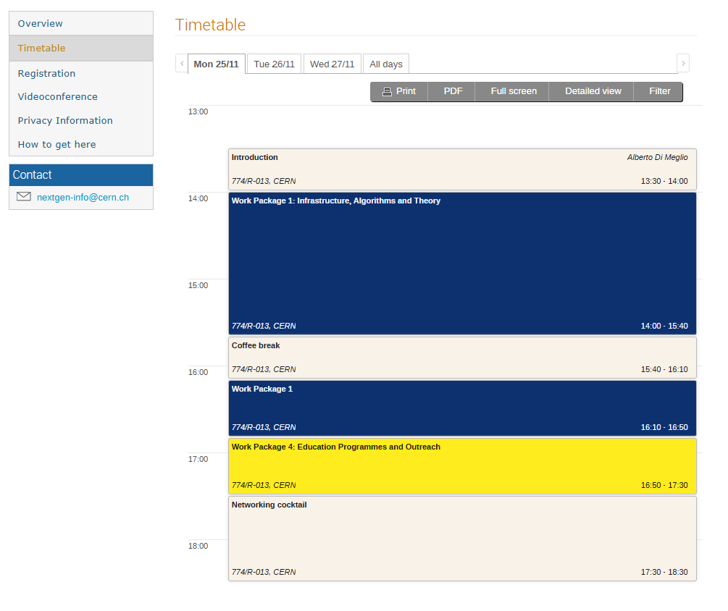
Agenda

Slide 14
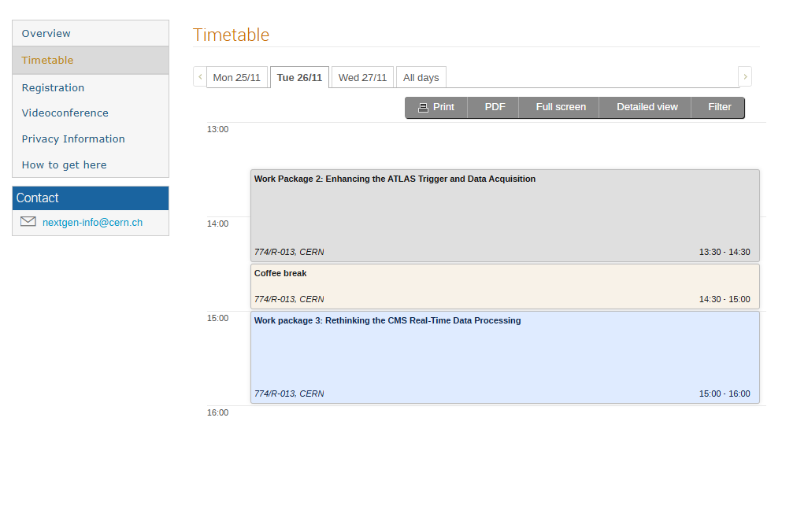
Agenda

Slide 15
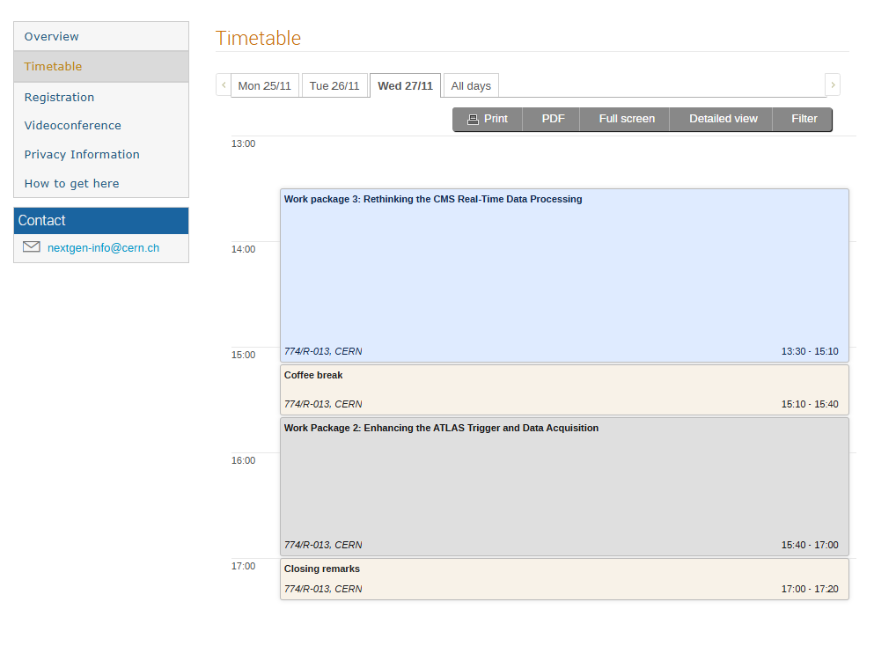
Agenda

Slide 16
Thanks and enjoy!

