Slide 1
NextGen Triggers
Outreach and Communication
Alex Lasa Lamarca
NGT Outreach and Communication Officer

Slide 2
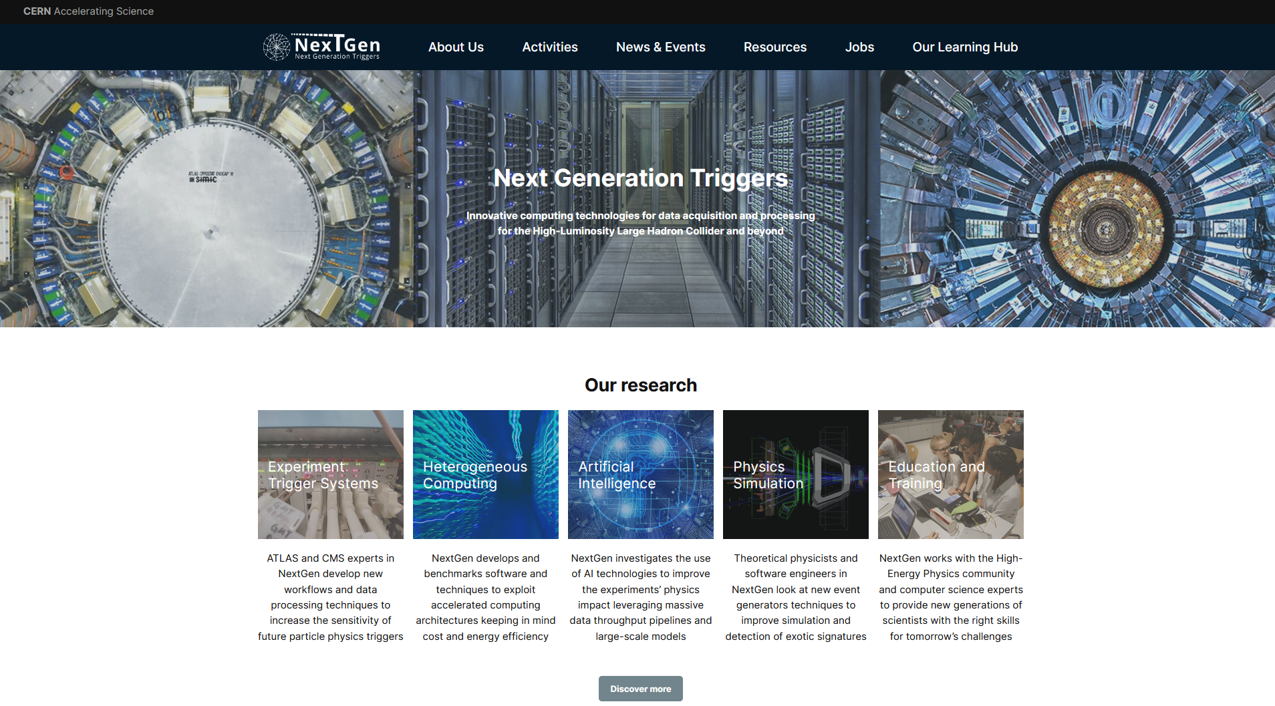

Main channel
https://nextgentriggers.web.cern.ch

Slide 3
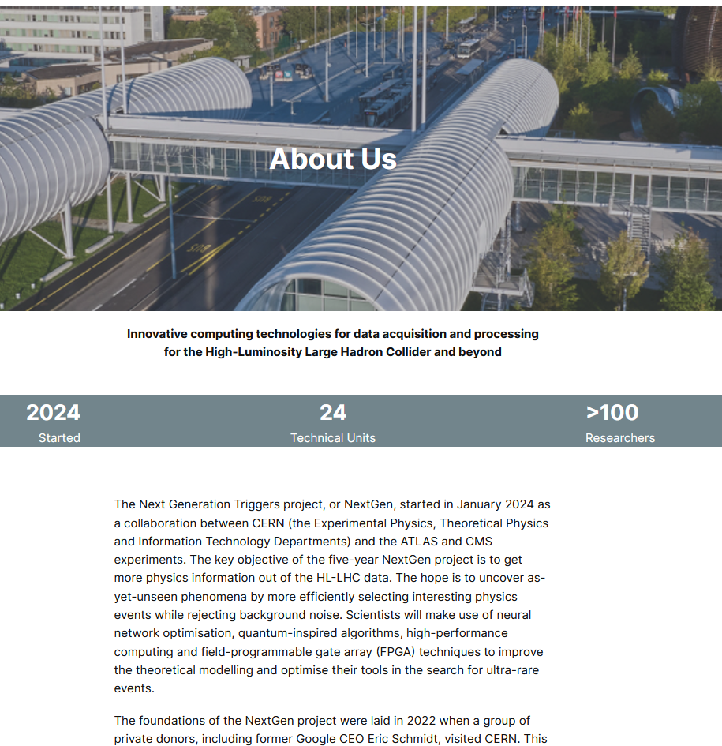
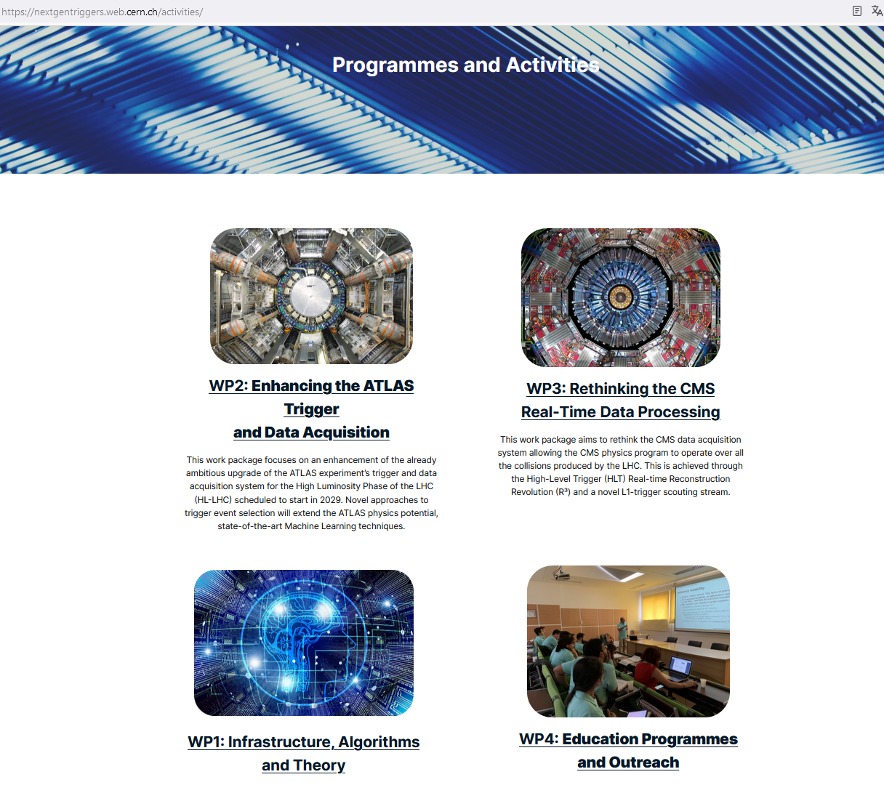
Main channel
About Us
Activities

Slide 4
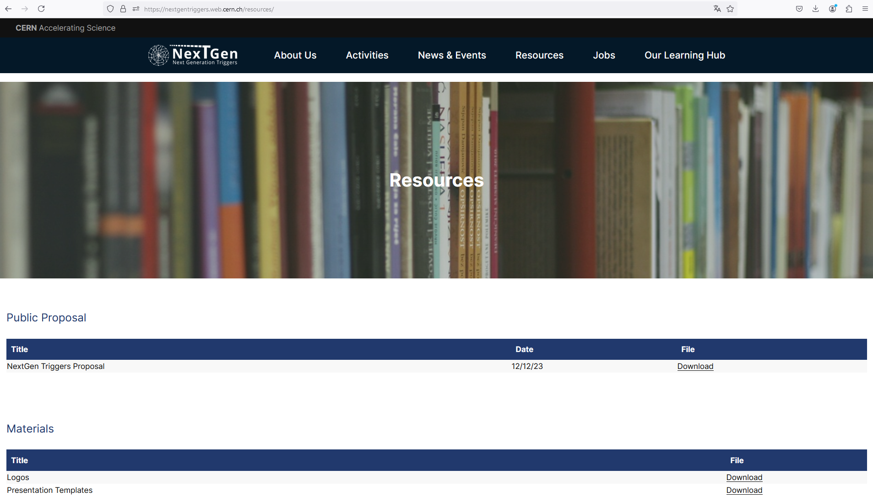
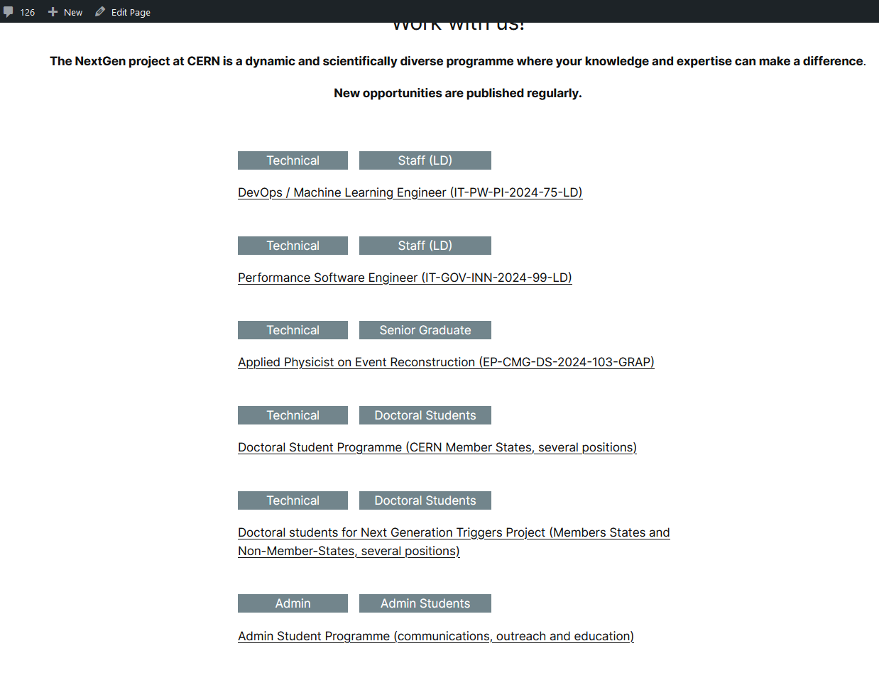
Main channel
Resources
Jobs

Slide 5
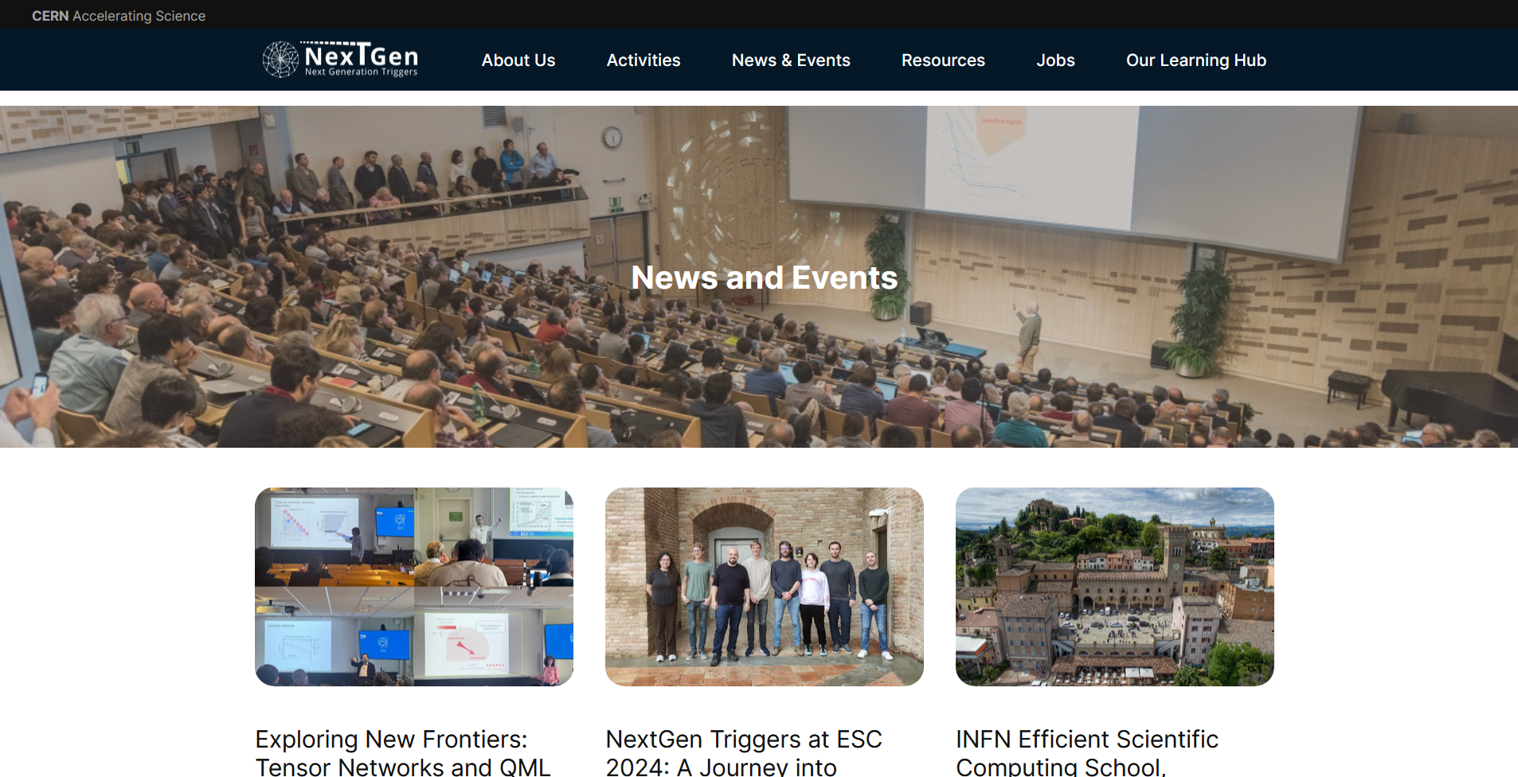
Main channel
News & Events

Slide 6
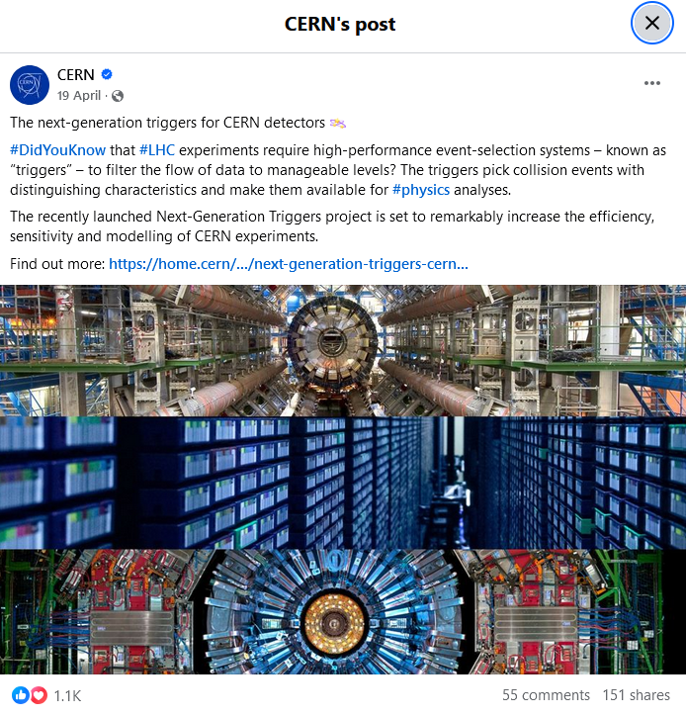
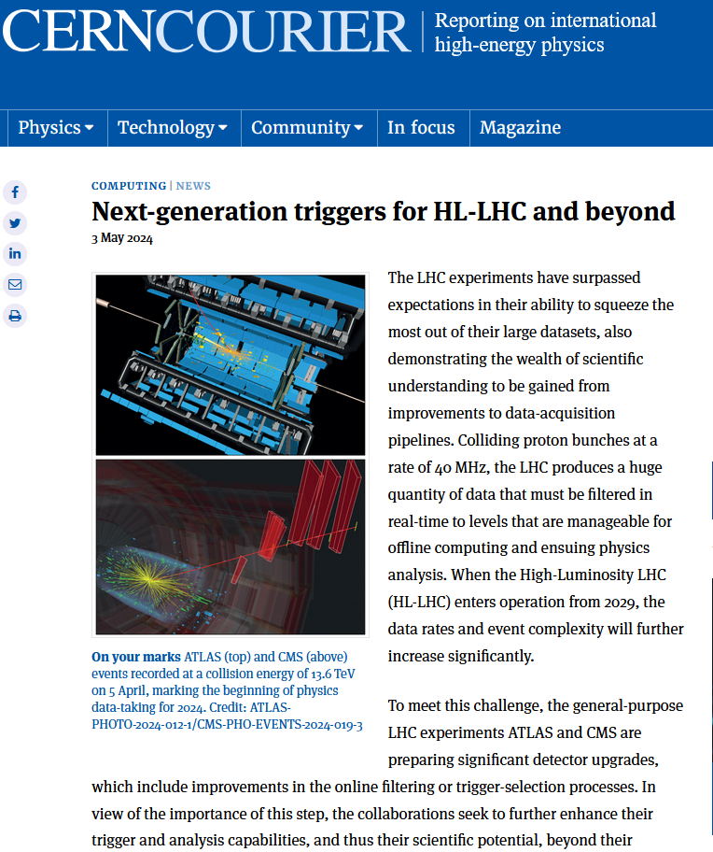
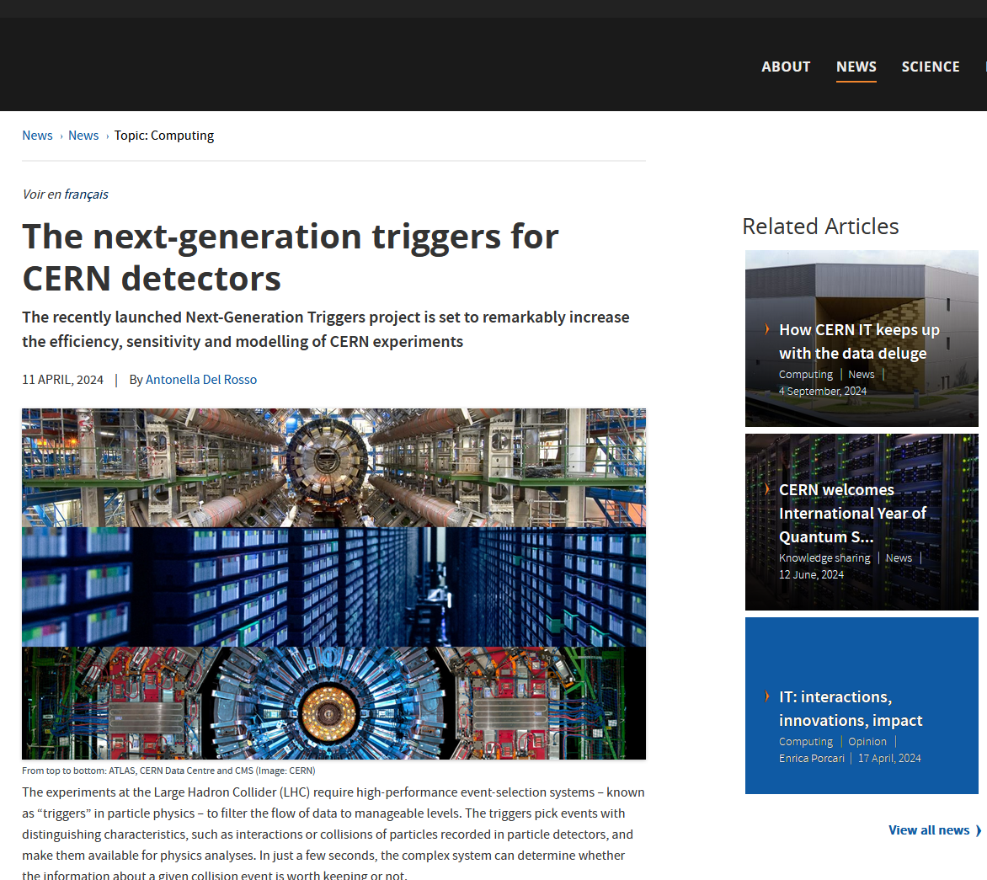
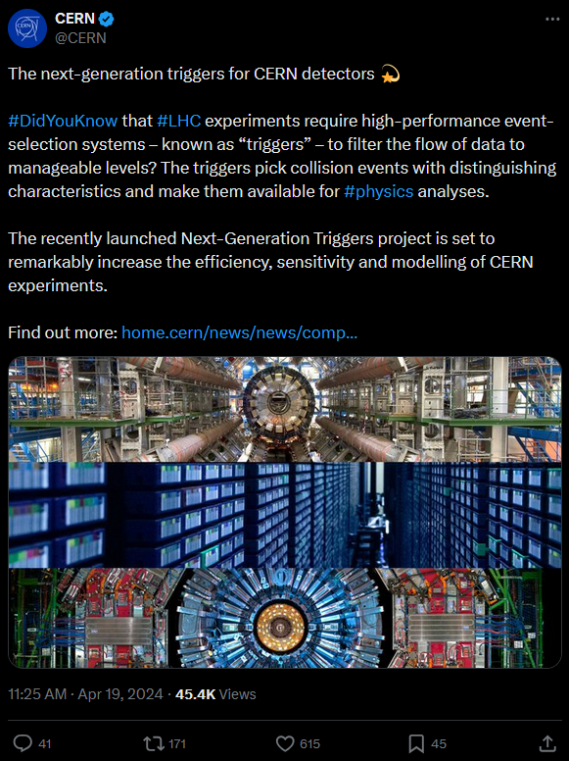

Secondary, but still strong channels
CERN MAIN WEBPAGE ARTICLE
CERN COURIER ARTICLE

Slide 7
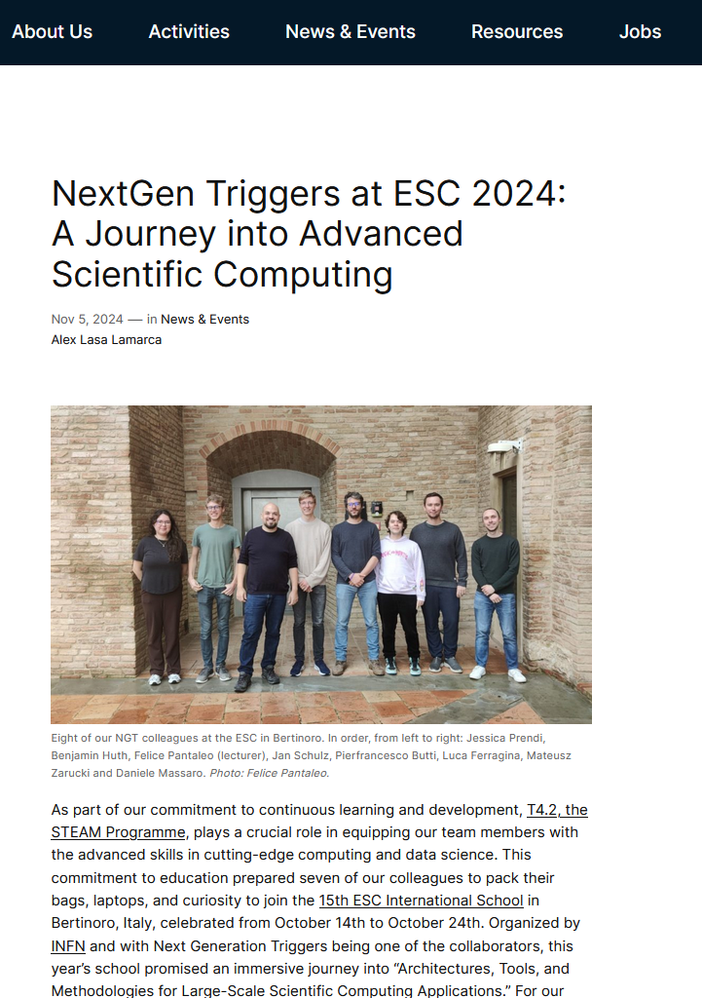
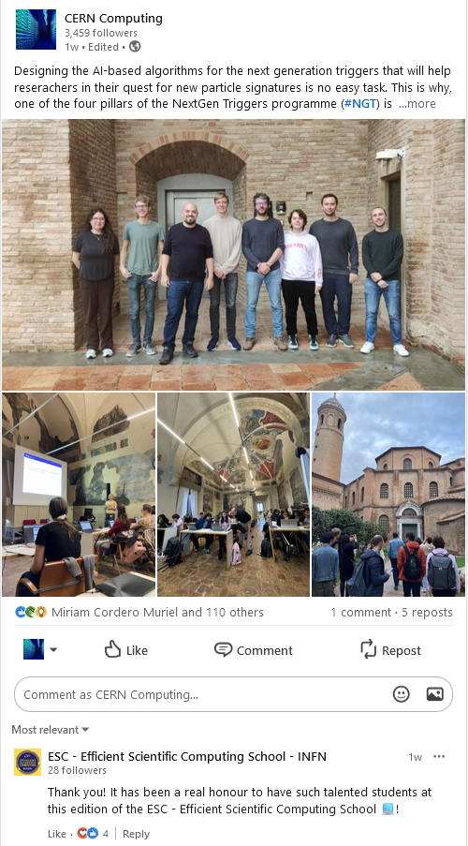
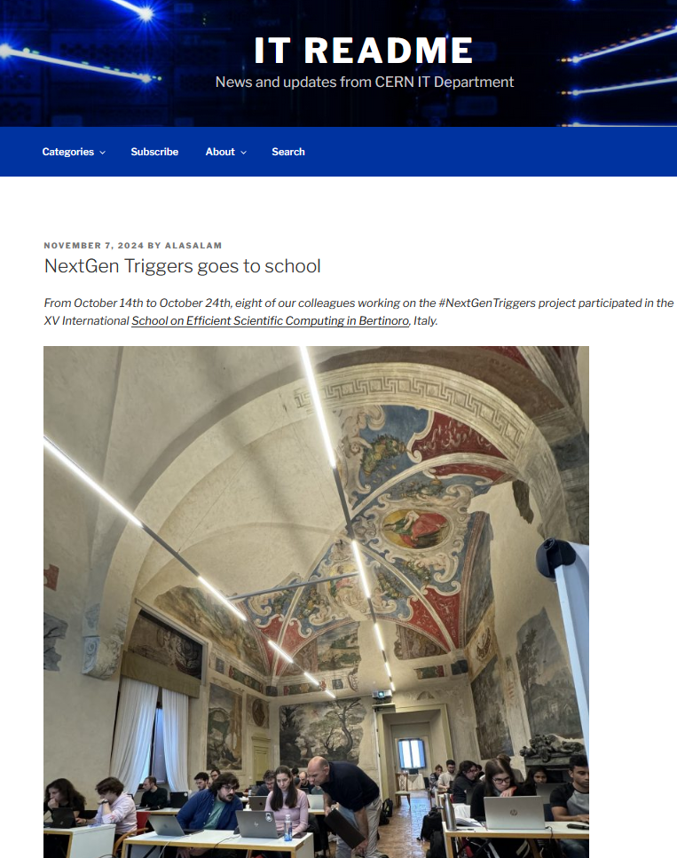
Example
NextGen webpage article
LinkedIn post
IT Readme blog post

Slide 8
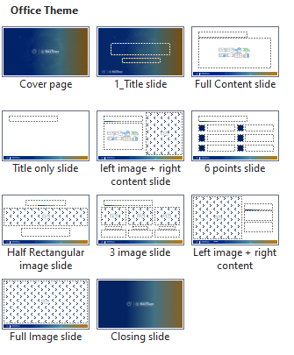








Templates, presentations etc.
https://nextgentriggers.web.cern.ch/resources

Slide 9



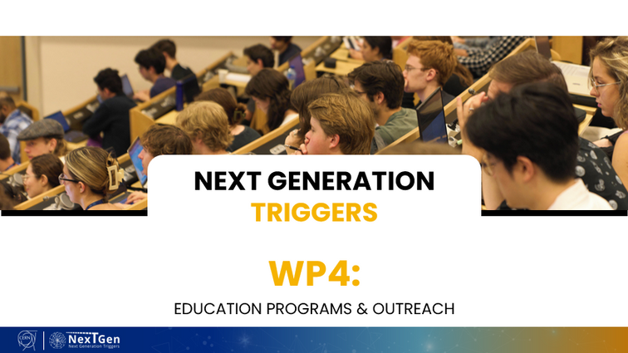
Templates, presentations etc.
https://nextgentriggers.web.cern.ch/resources

Slide 10

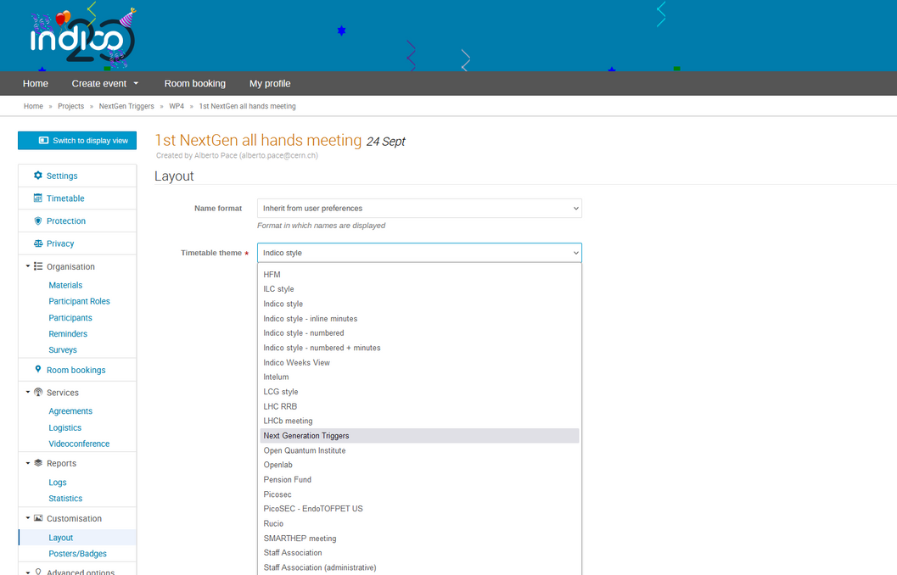

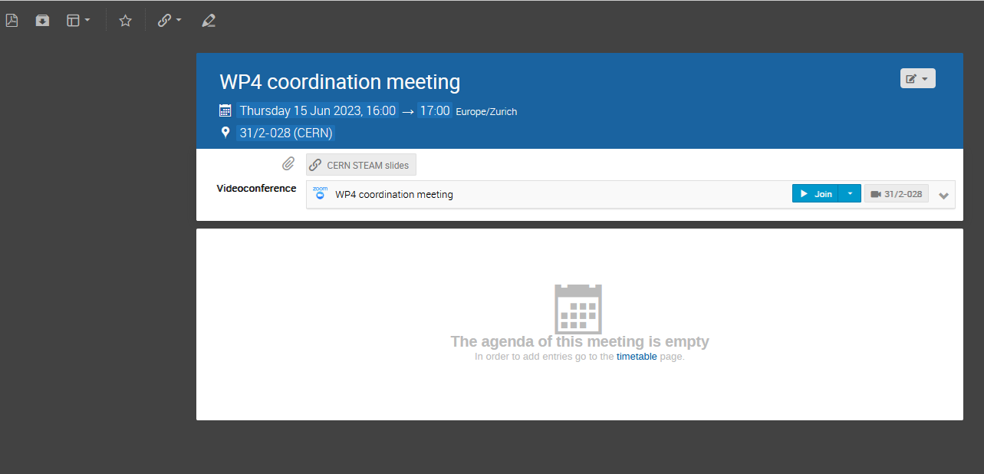

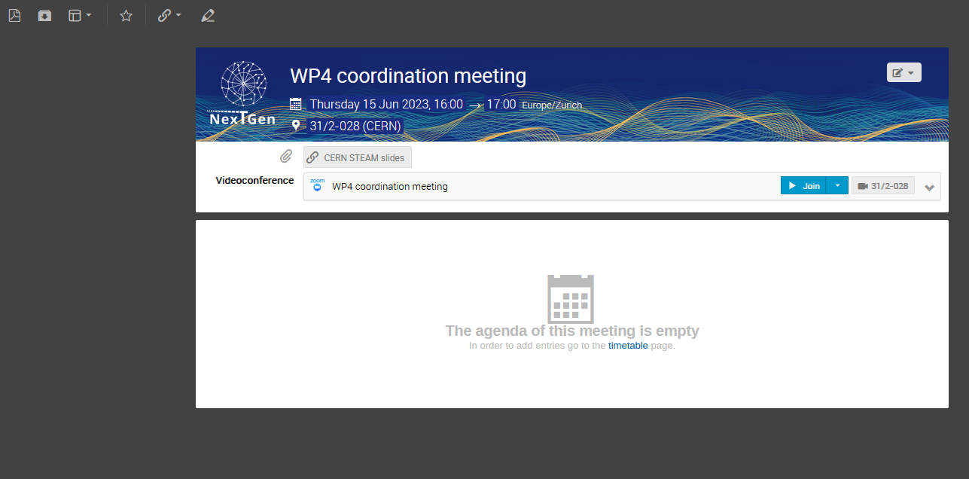
New
Indico banner!

Slide 11
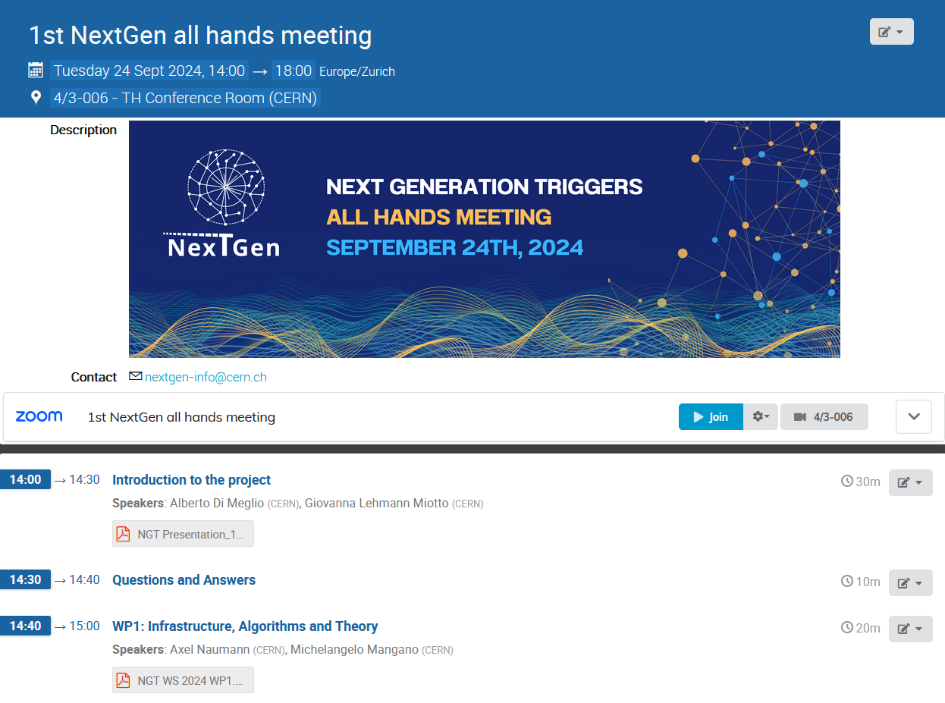
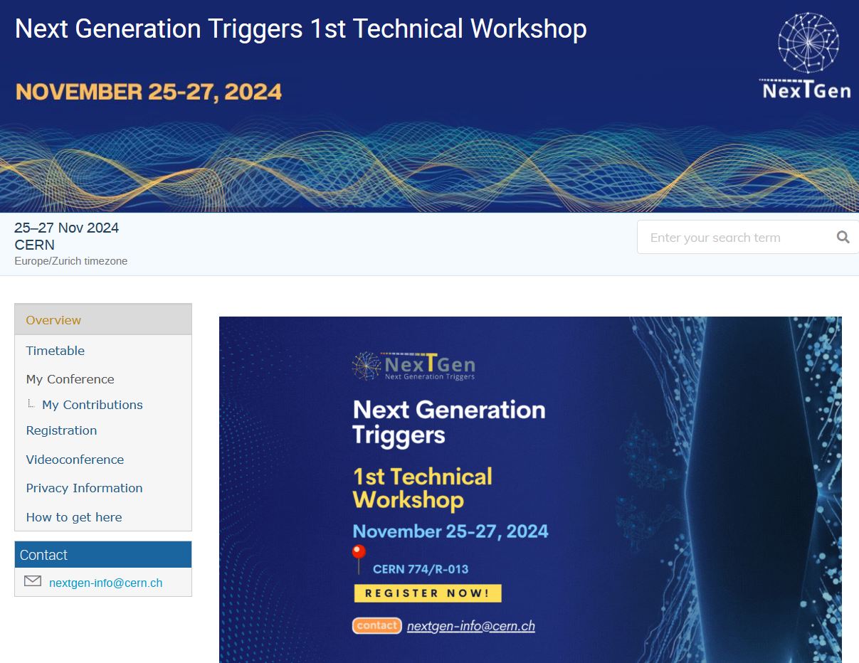
Yearly event
And what’s to come next year?

Slide 12







WHY AND HOW TO REACH US
Are you attending a conference and giving a talk about your project related to NextGen Triggers? Or maybe you are releasing a technical document? Whatever is the case, please do reach us!
cern-nextgen-communications@cern.ch
To give them visibility and to ensure that this section remains comprehensive and up-to-date, all papers, presentations, etc. will be uploaded to their corresponding category in the “Resources” section of the web page. Again, please do reach us!
Join our Mattermost!

Slide 13
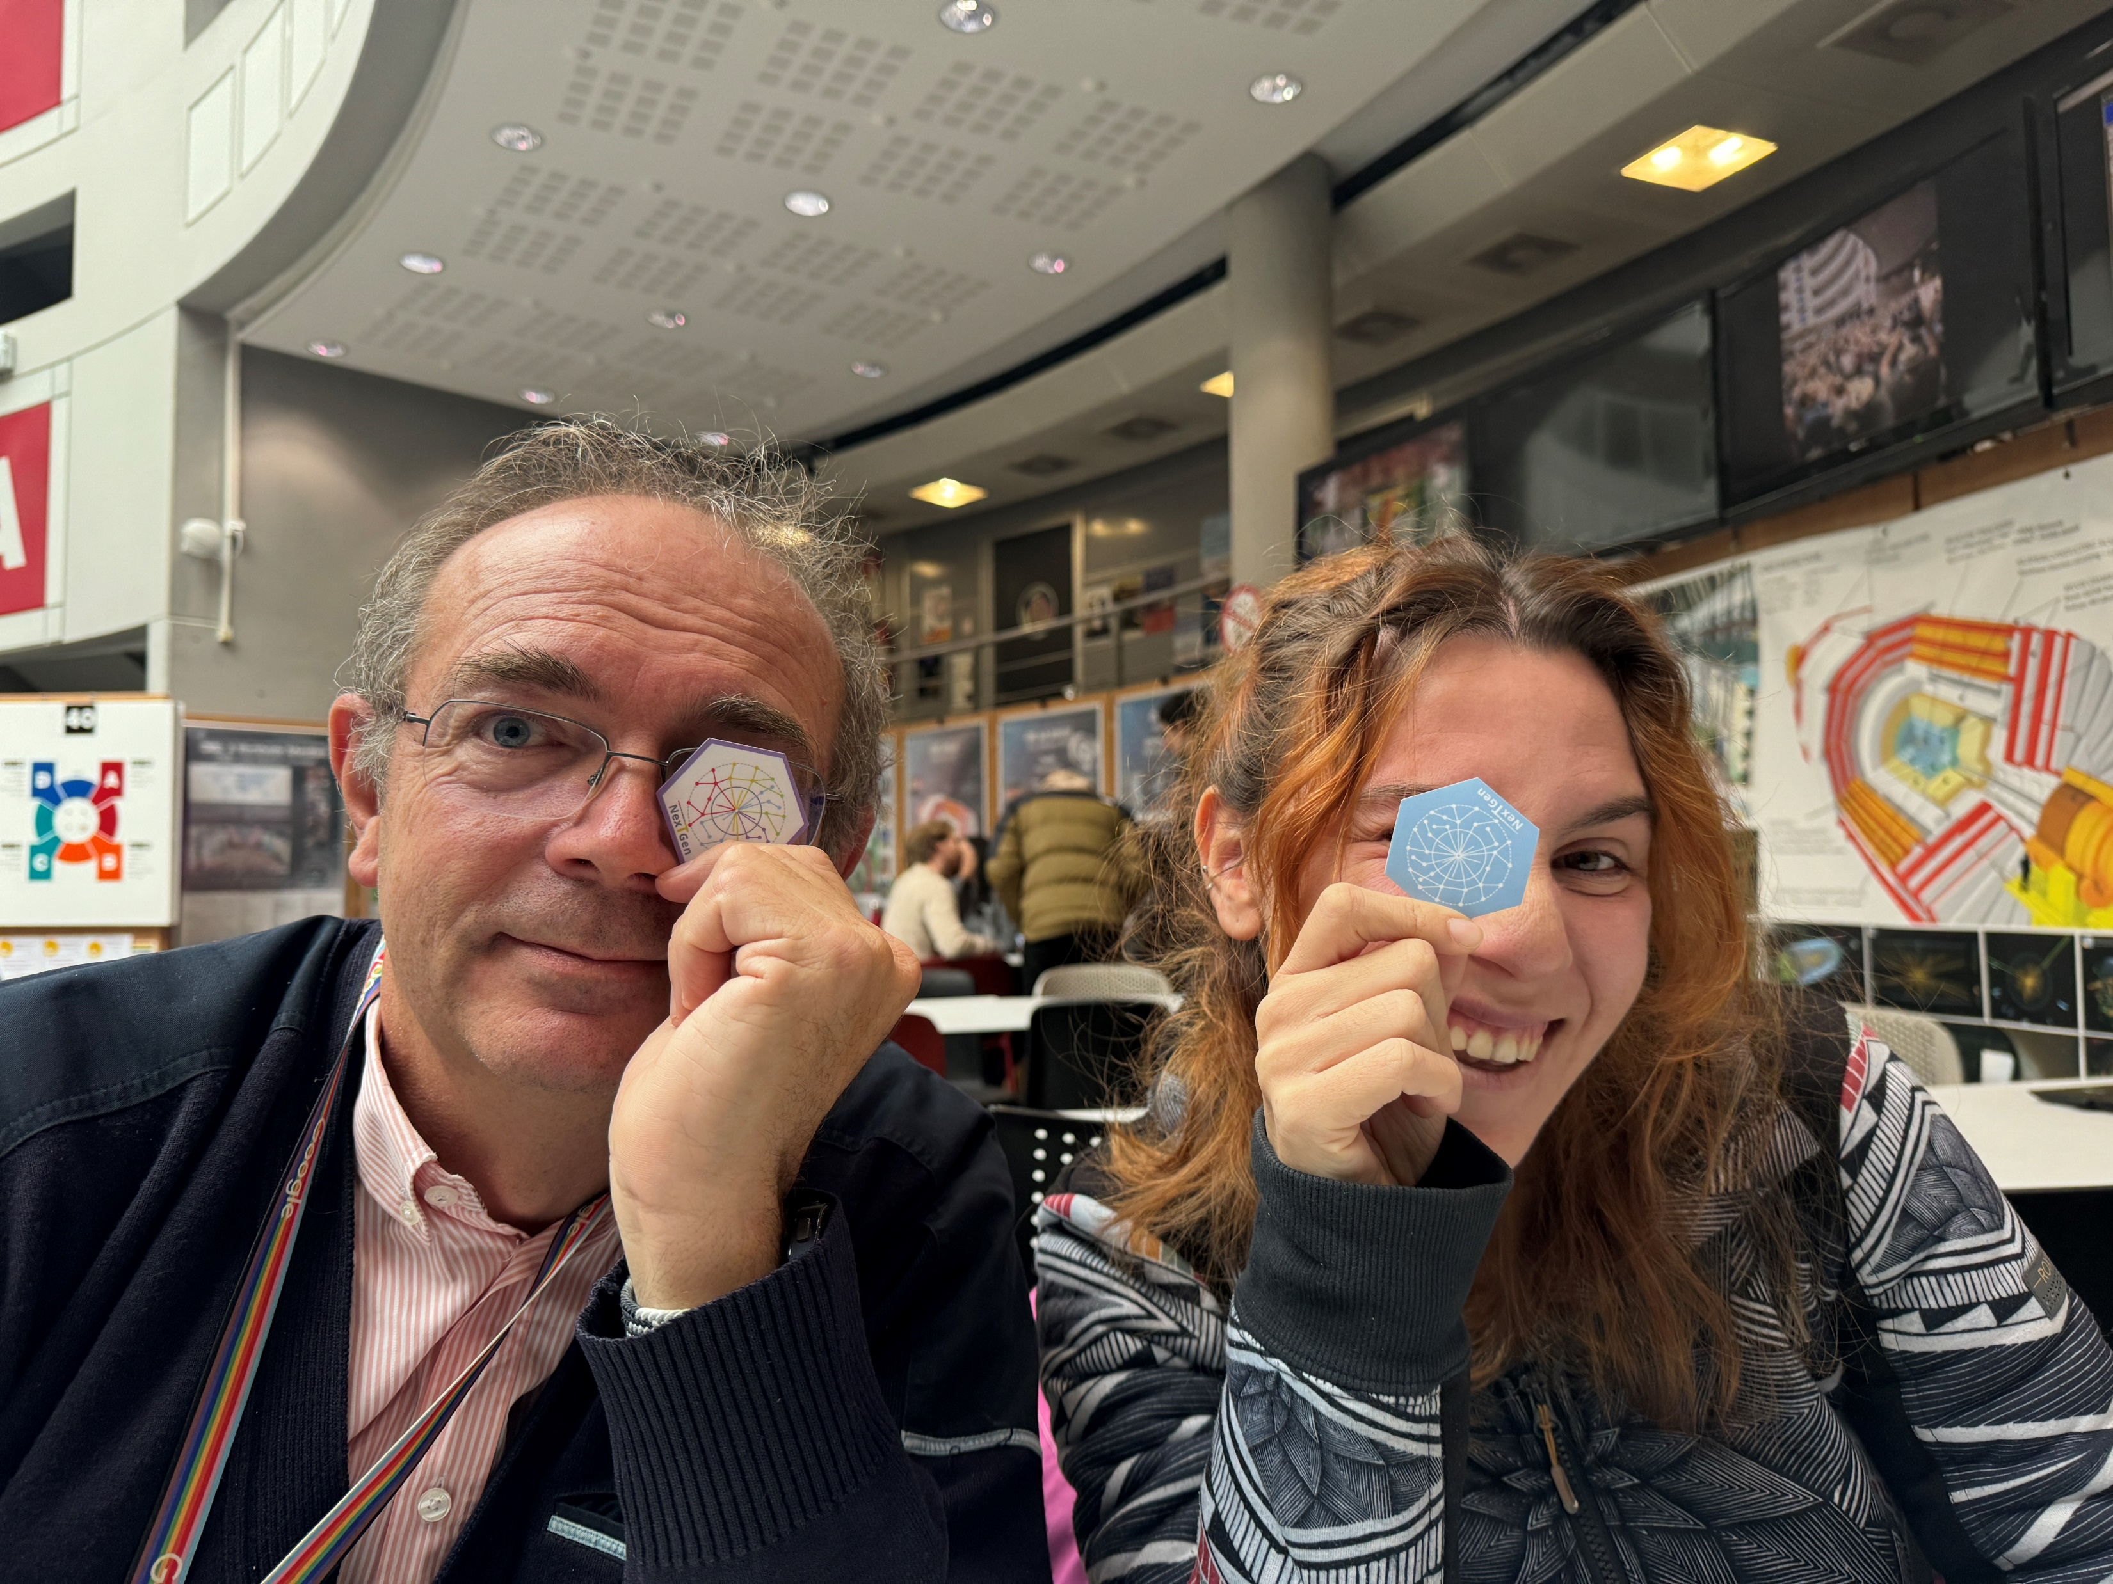


FRESH STICKERS
OUT OF THE OVEN!

Slide 14
Thanks!
Questions?

