Slide 1
HI-ECN3 WP4 coordination meeting #1
Jean-Louis GRENARD
07-06-2024

Slide 2
Agenda
Target station
Trolley system updates
Target complex building
BDF/SHiP Power converters
Dismantling of TCC8
Target cooling systems → Nikola/ Francesco
TCC8 crane specification → Roberto
AOB

Slide 3
Target station
Definition of target vessel gaskets ongoing (Michal)
  Evaluation of material
  Proposition of a design Including the grove design
Target station inventory of shielding blocks to extract

Slide 4
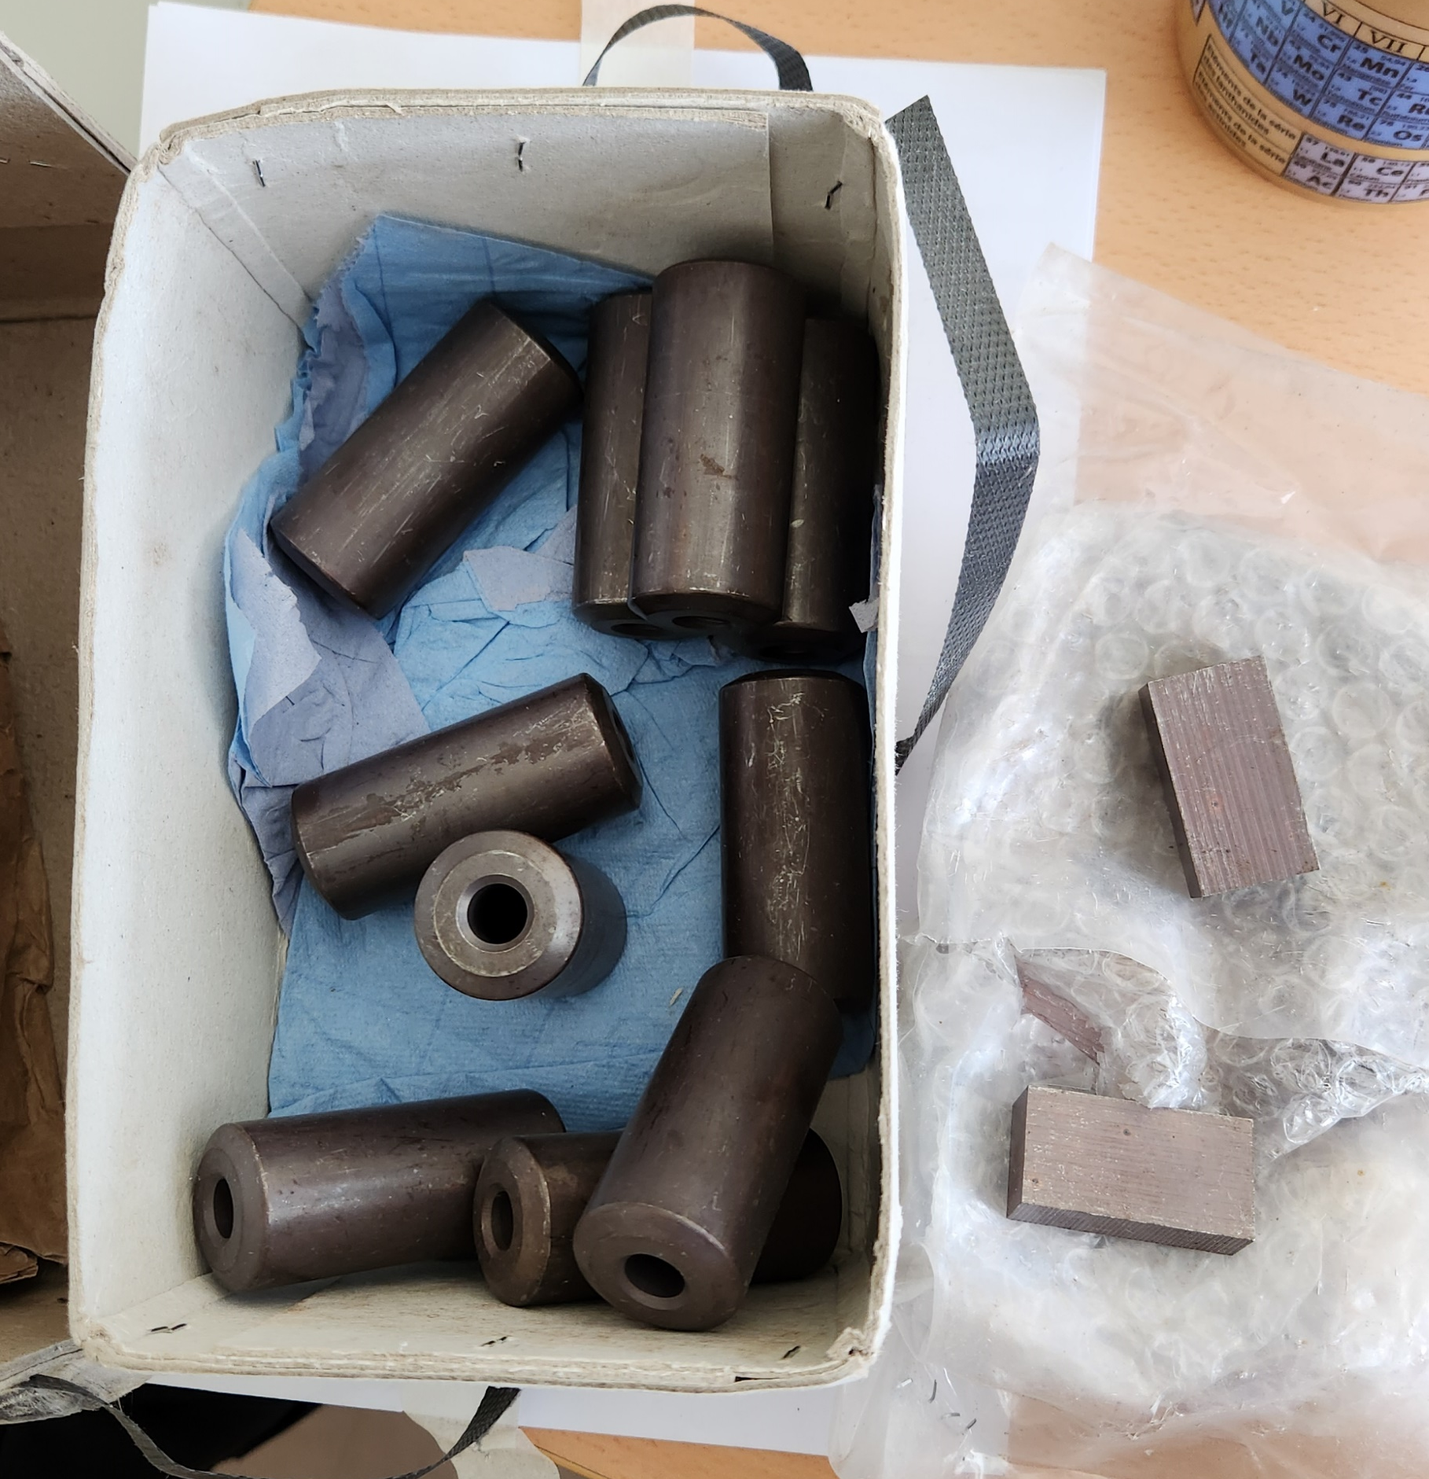
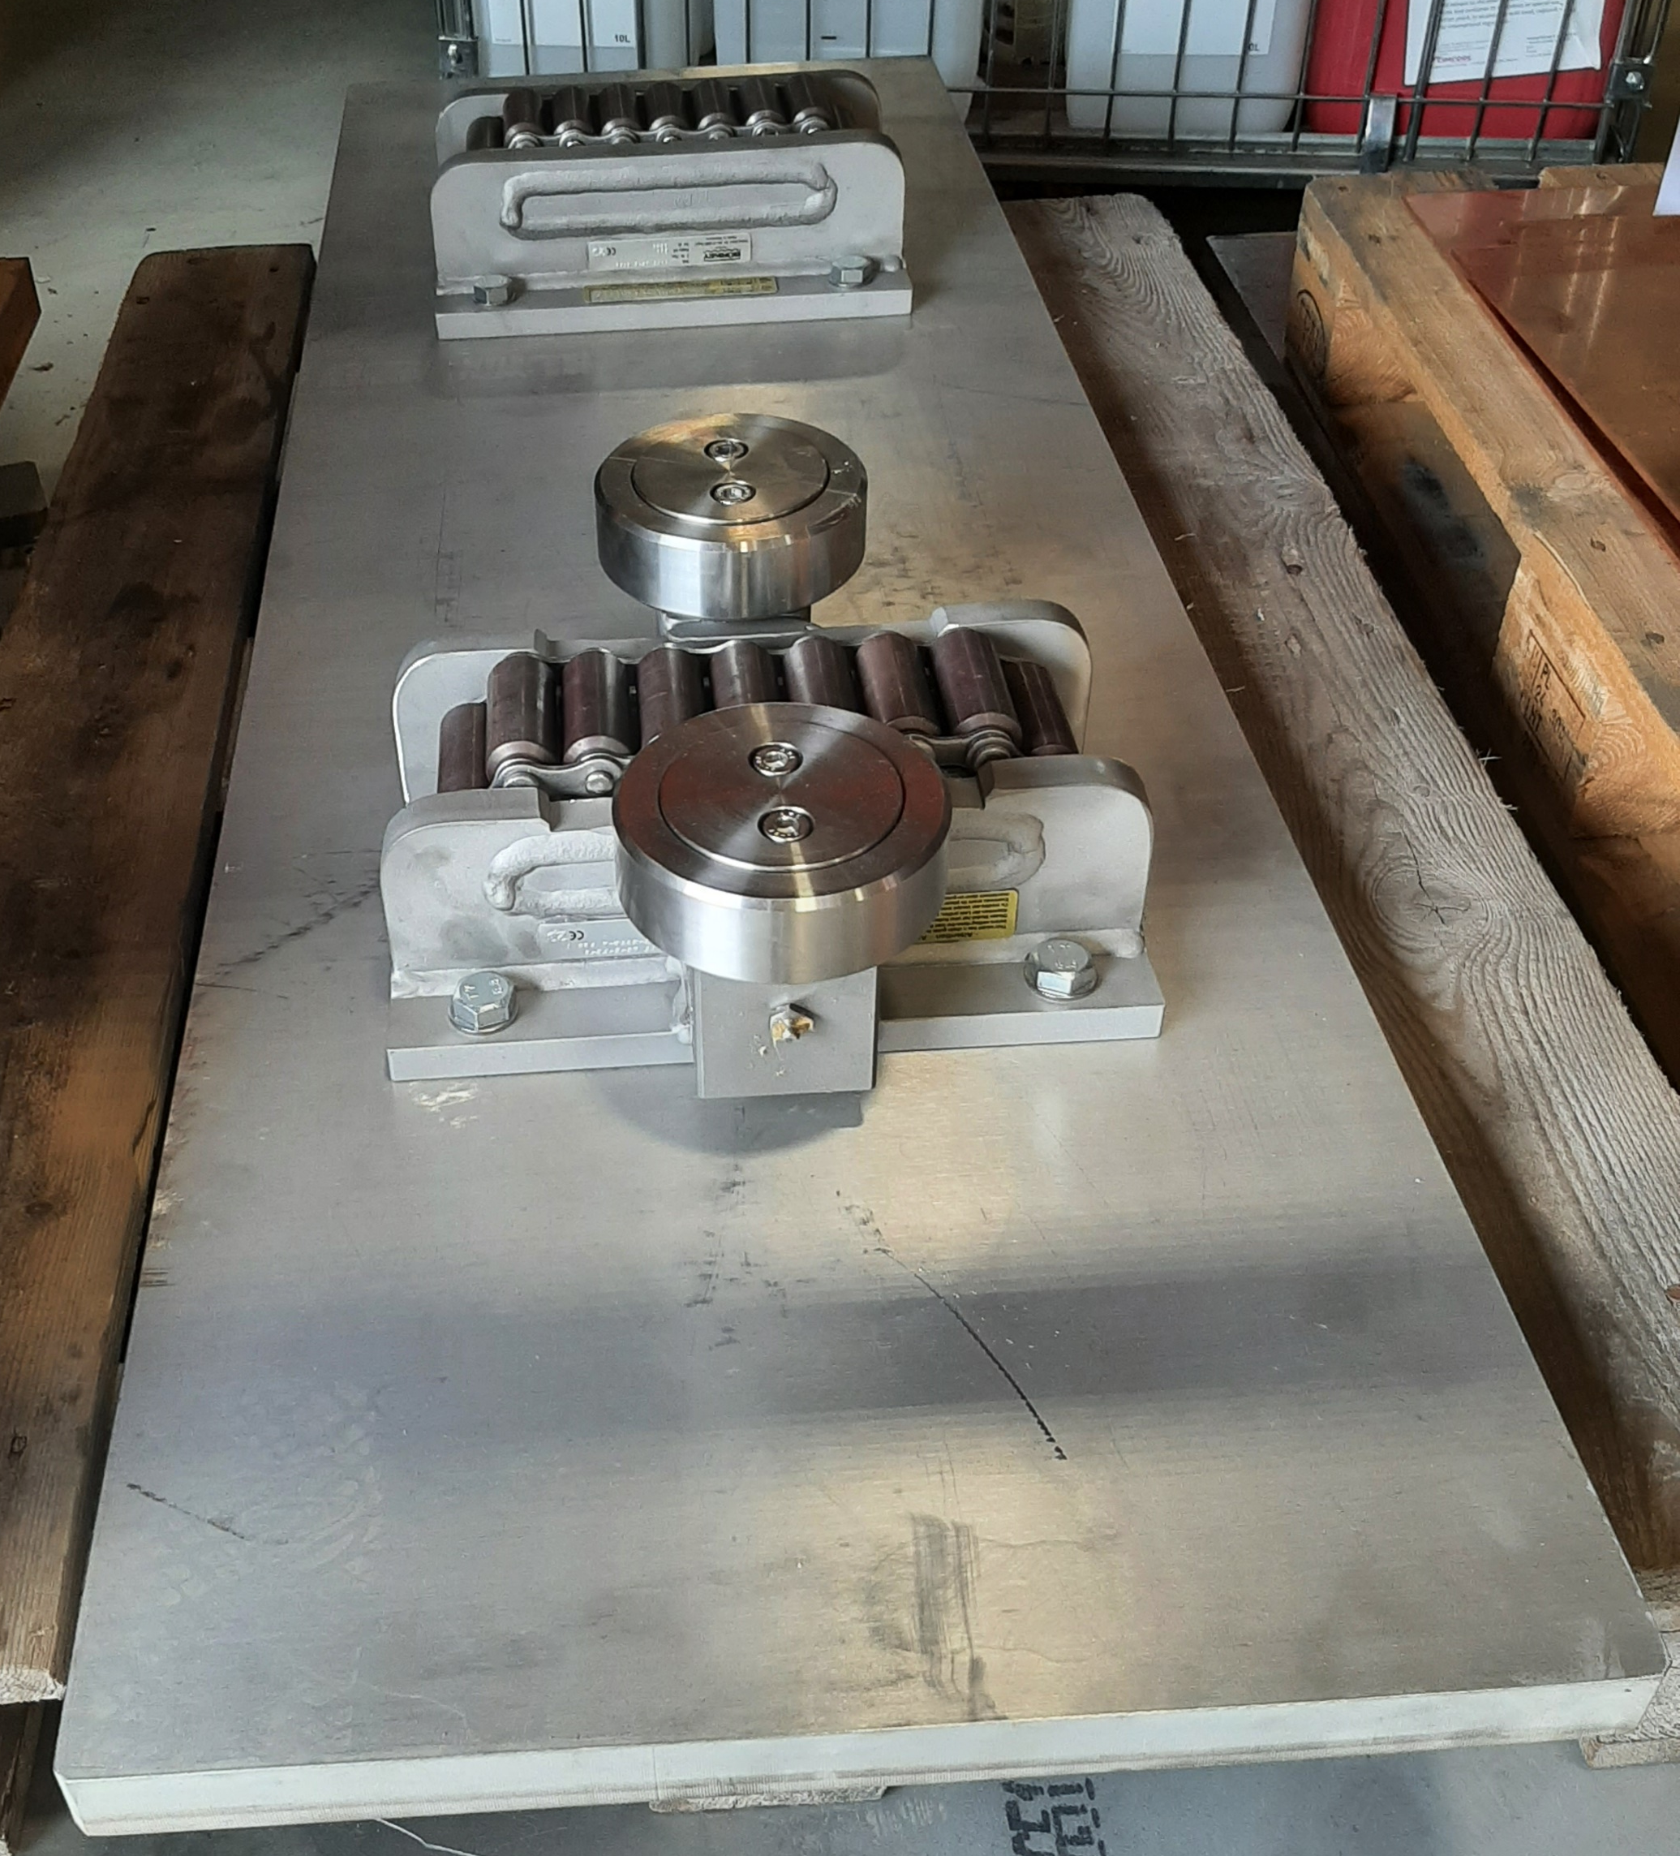
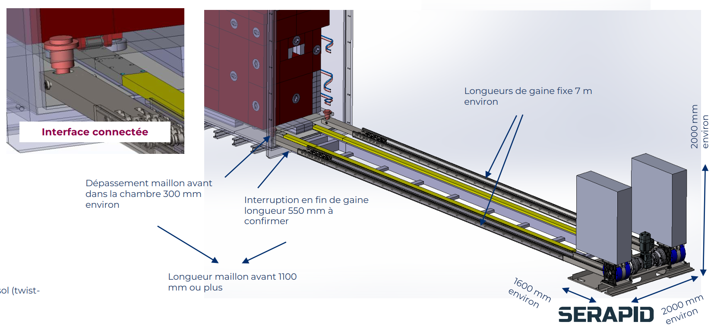
Trolley systems -updates
Ongoing investigation chain action rollers (Michal)
  Material characterisation ongoing with MME
  Coating tests
  Test setup preparation for characterisation of chain action rollers
Discussion with rigid chain supplier for the push pulls system for the trolley
  Preliminary technical
  Budget proposal
  Further discussion foreseen in the coming weeks (risk assessment, detail design)

Slide 5
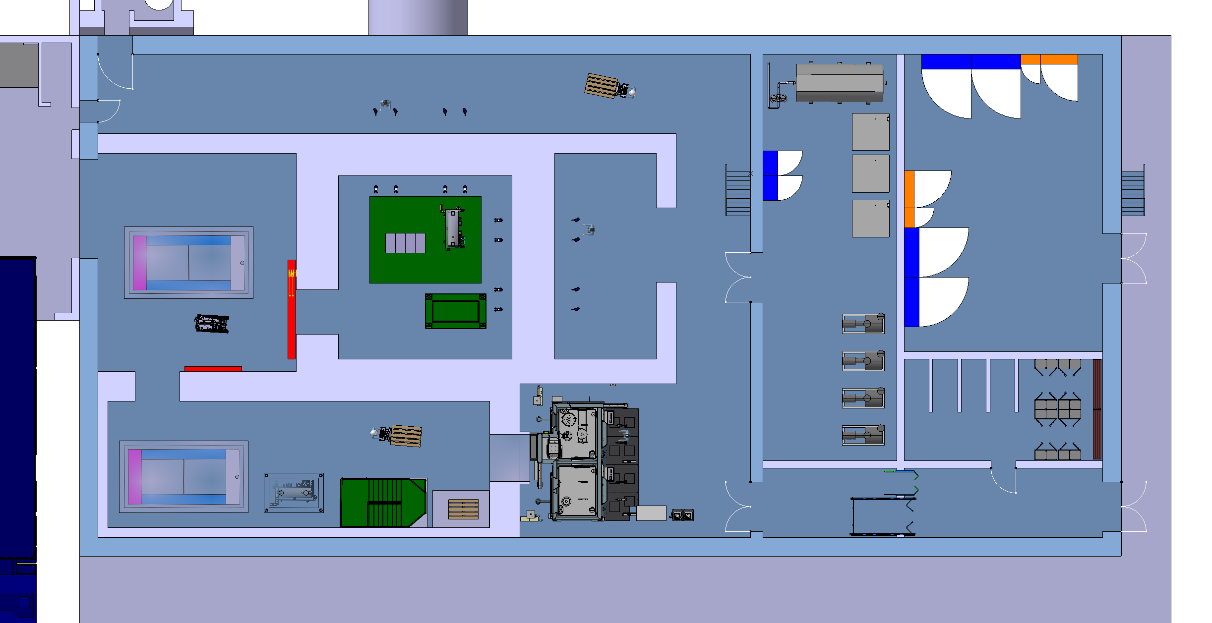
Target complex building
Target
and
Target
Building
CV
Optimizing the impact on the retaining wall of TCC8 hill
Draft identification of material hazard (Melania)
https://indico.cern.ch/event/1421948/
Design of the building by separating the hazards
Building become more scalable
2 floors for CV equipment
  Ground floor cooling systems
  1rst floor ventilation room (filters)
Implementation of a changing room and a SAS
Target process
Electrical
equipment
Changing room

Slide 6
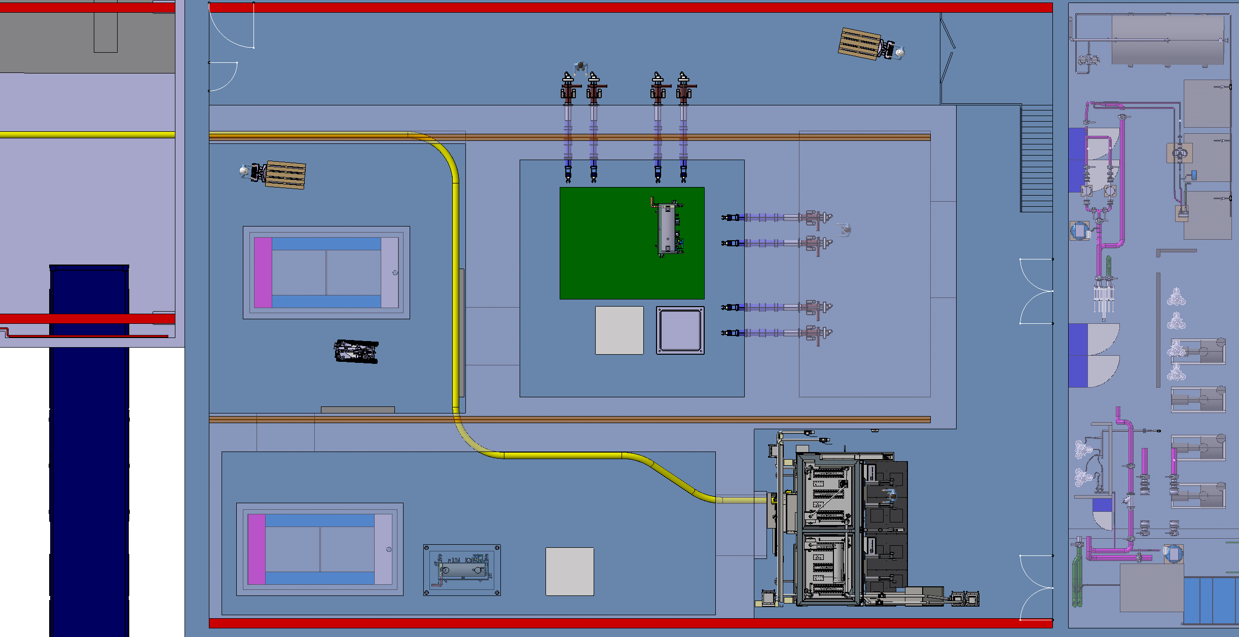
Target complex building
Integration of final disposal container KC12, target, hadron stopper coil in hot cell and buffer zone
Hot cell integration
Preliminary space reservation of an irradiation rabbit (not baseline)

Slide 7
Target complex building – 911 modification
SCE design office revising feasibility (so far not showstopper)
EL (Eva) already provided an estimate
CV no showstoppers
HE no showstoppers
Timeline
  Modification of critical services during YETS 24-25
  Door opening before LS3

Slide 8
Target complex building – points to address
Building classification definition
  Will define applicable standards especially for ventilation requirements
Assessment of internal and external wall(s) thickness and service cell lead window(s)
Assessment of needs for evaporators
Definition of crane and associated crane coverage
Definition of sumps

Slide 9
BDF/SHiP Power converters
Slowly converging to a new baseline
  Joint effort between HI-ECN3 and NA-CONS
  Most likely no need to have PCs in/attached to the new target complex building
  Reusing existing PCs
  New Power Converters located in BA82 and ECN3
  New baseline aimed by end of June

Slide 10
Dismantling of TCC8
Detail list of equipment being extracted from 3d models and processed (Beatriz/Sylvain)
To be defined timeline with WP5 and WP7and what can/should stay in the tunnel for future reused or before long term storage
  We should think using part of TCC8 as a buffer zone during LS3
    Shielding blocks
    Magnets

Slide 11
AOB
Target station pre-assembly surface definition of needs

