Slide 1
TCC8 crane specification
HI-ECN3 WP4 - Coordination meeting #1 – R. Rinaldesi – EN-HE
2024-06-07

Slide 2
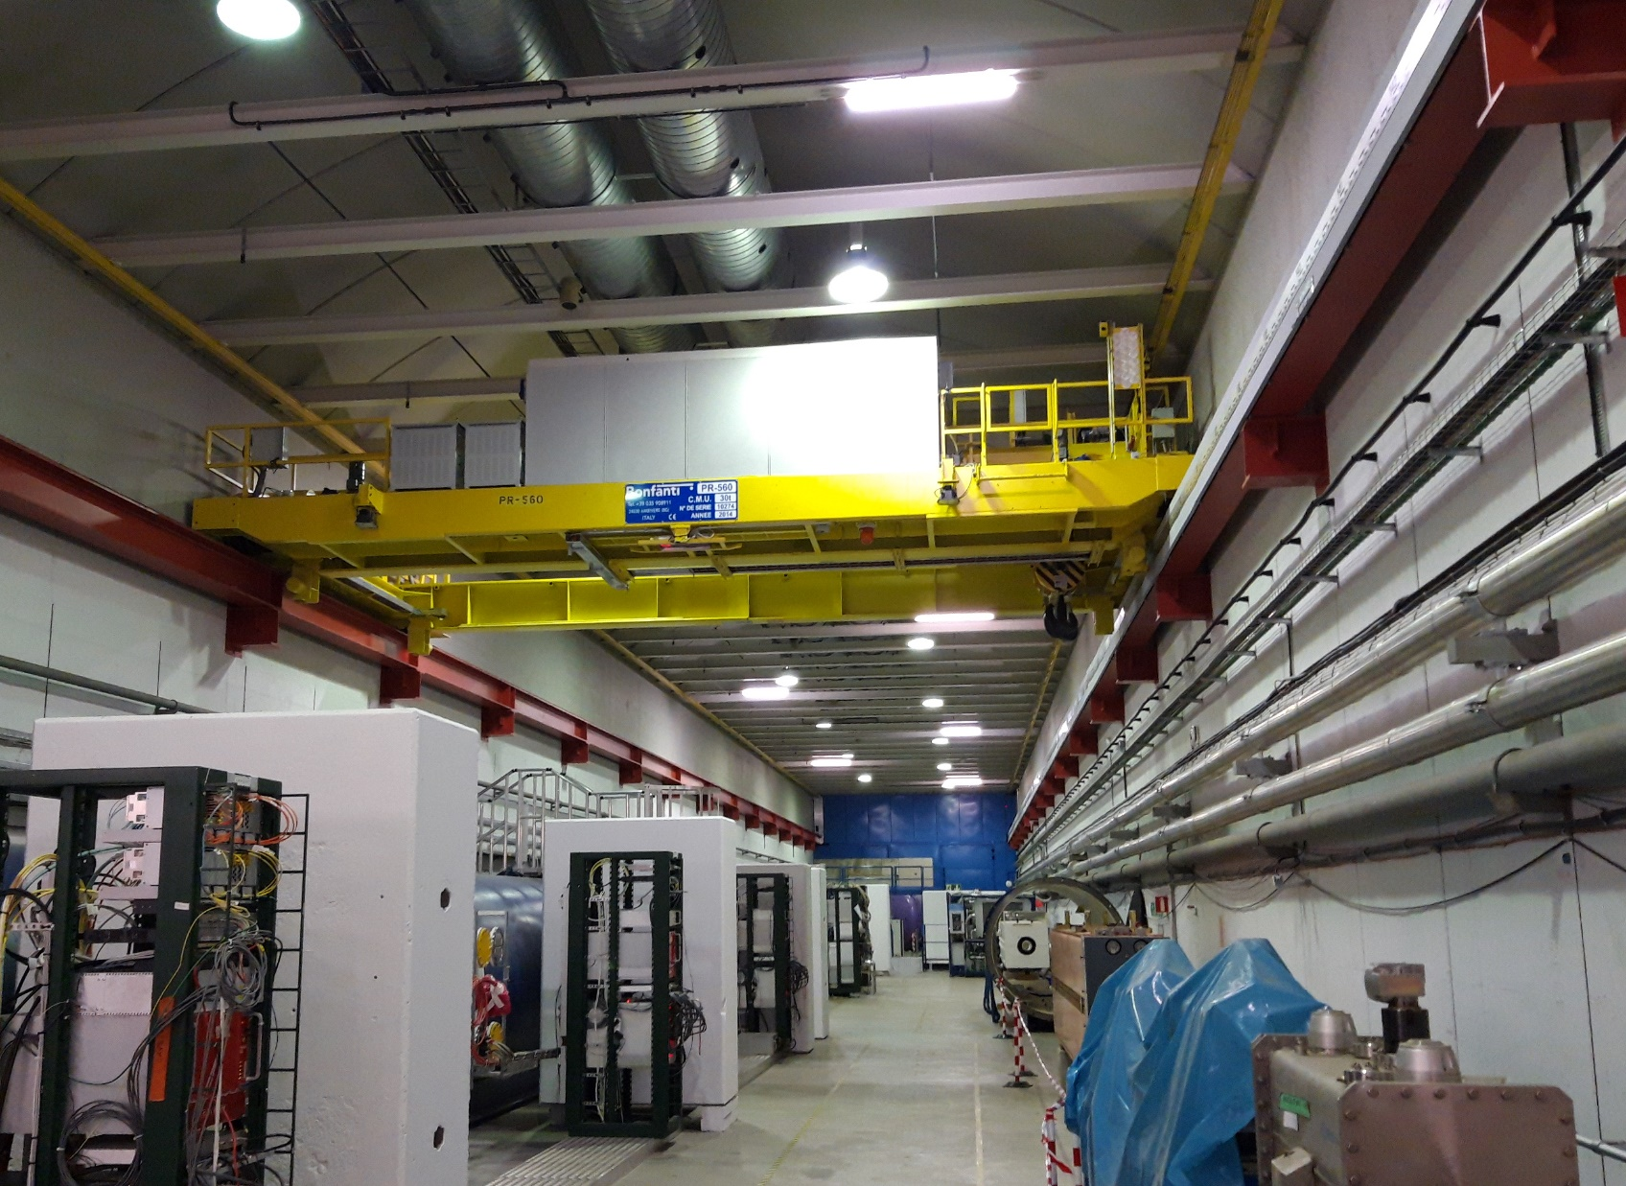
Overhead crane in TCC8
Crane installed in 1978 and refurbished in 2014
Generally in good conditions
Upgrade is needed to meet the future needs of the project:
  Remotely controlled operations
  No electronic components on-board
  Emergency brake
Replacement is preferred to another refurbishment because:
  Cost will be similar
  Overall duration of the on-site intervention much shorter (procedure for paint containing lead…)
  Design can be optimized for the new needs (addition of an auxiliary hoist)
  Possibility to test the entire crane at the contractor’s facility
  Higher number of expected bidders

Slide 3

Technical features 1/4
Specific aspects of a crane working in a harsh environment:
Mechanical redundancies (double motor with differential unit) on all motions
Emergency brake
Remote control panel – no electronic components on-board (except load cell)
At least 4 (removable) cameras on-board

Slide 4
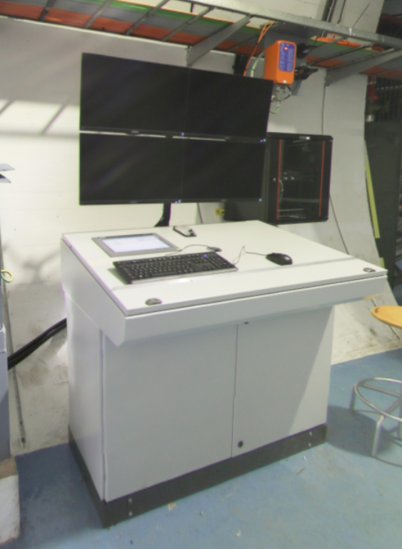
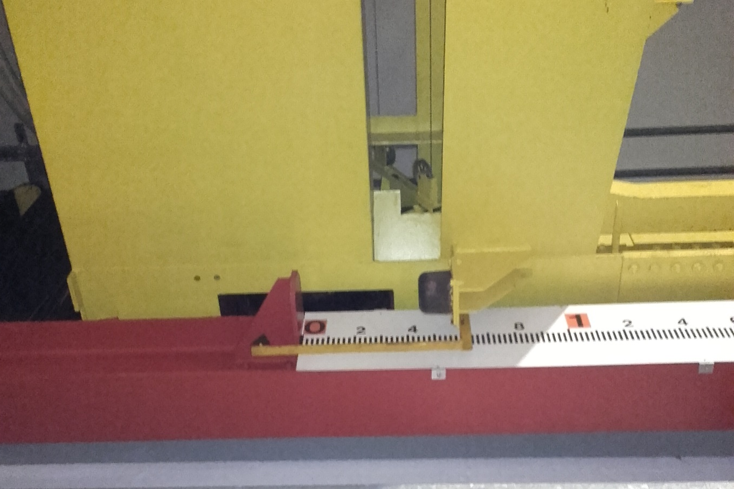
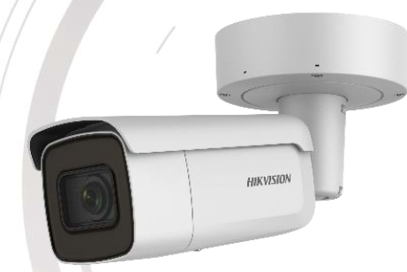
Technical features 2/4
Remote control desk with 4 screens
Redundant position detection system: cameras+rulers and resolvers
Cable reel to install a motorized device on the hook

Slide 5
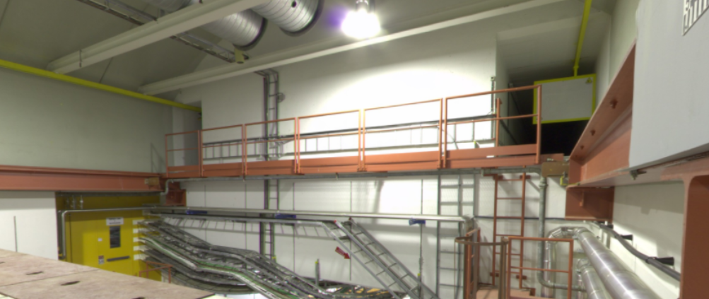
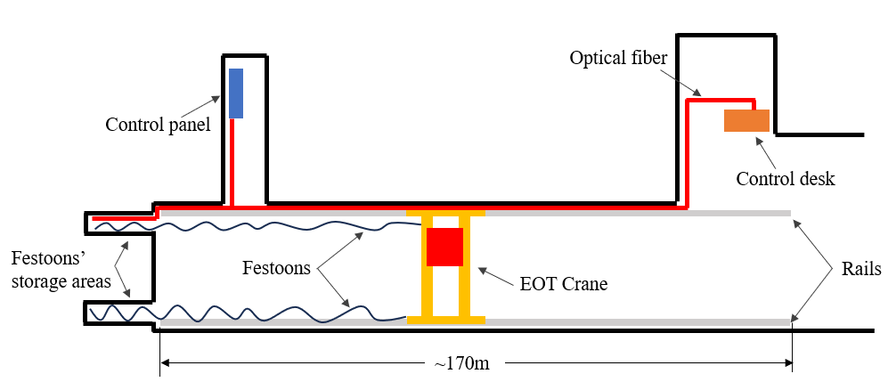
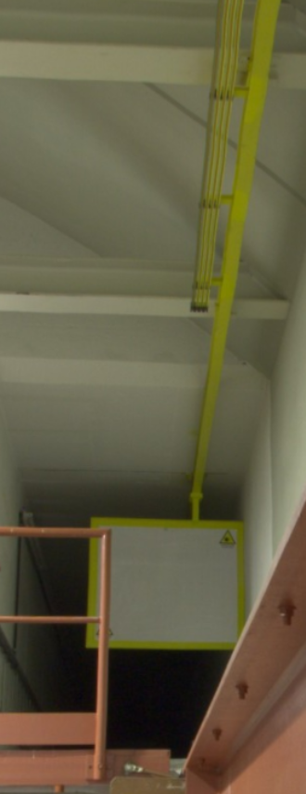
Technical features 3/4
PP851
PA852
TCC8
Festoon rails
Festoon storage areas
ECN3
Festoon storage areas, rails and cable trays will be reused
2 optical fibres connecting the control desk to the control panel and the crane
Overall cable length between control panel and hoist: 250m!
Existing busbar to be dismantled, support brackets to be cut

Slide 6
Technical features 4/4
Open points:
Auxiliary hoist: capacity (5-10 tons), hook coverage
Interface with below-the-hook device (hook size, lockable hook, electrical power, signals, optical fibre)
Exact location of control desk
How to deal with the confinement wall?
Which measures shall be taken to cut the crane girder at the bottom of the shaft?
Parking area for crane maintenance: ECN3 side?
Area for camera installation/dismounting, accessible with working platform

Slide 7
Schedule
Dispatch of Market Survey documents: mid-July ’24
Draft version of the specification: end of July ‘24
Dispatch of Invitation to Tender documents: mid-October ‘24
Bidders’ conference with on-site visit: beginning of December ‘24
Submission deadline: mid-January ‘25
Finance Committee: March ‘25
Contract signature: April ‘25
On-site intervention: January-March ‘26

