Slide 1
HI-ECN3 - Target Complex and surface building
Preliminary hazard identification
JL- Grenard HI-ECN3 WP4
31-05-2024

Slide 2
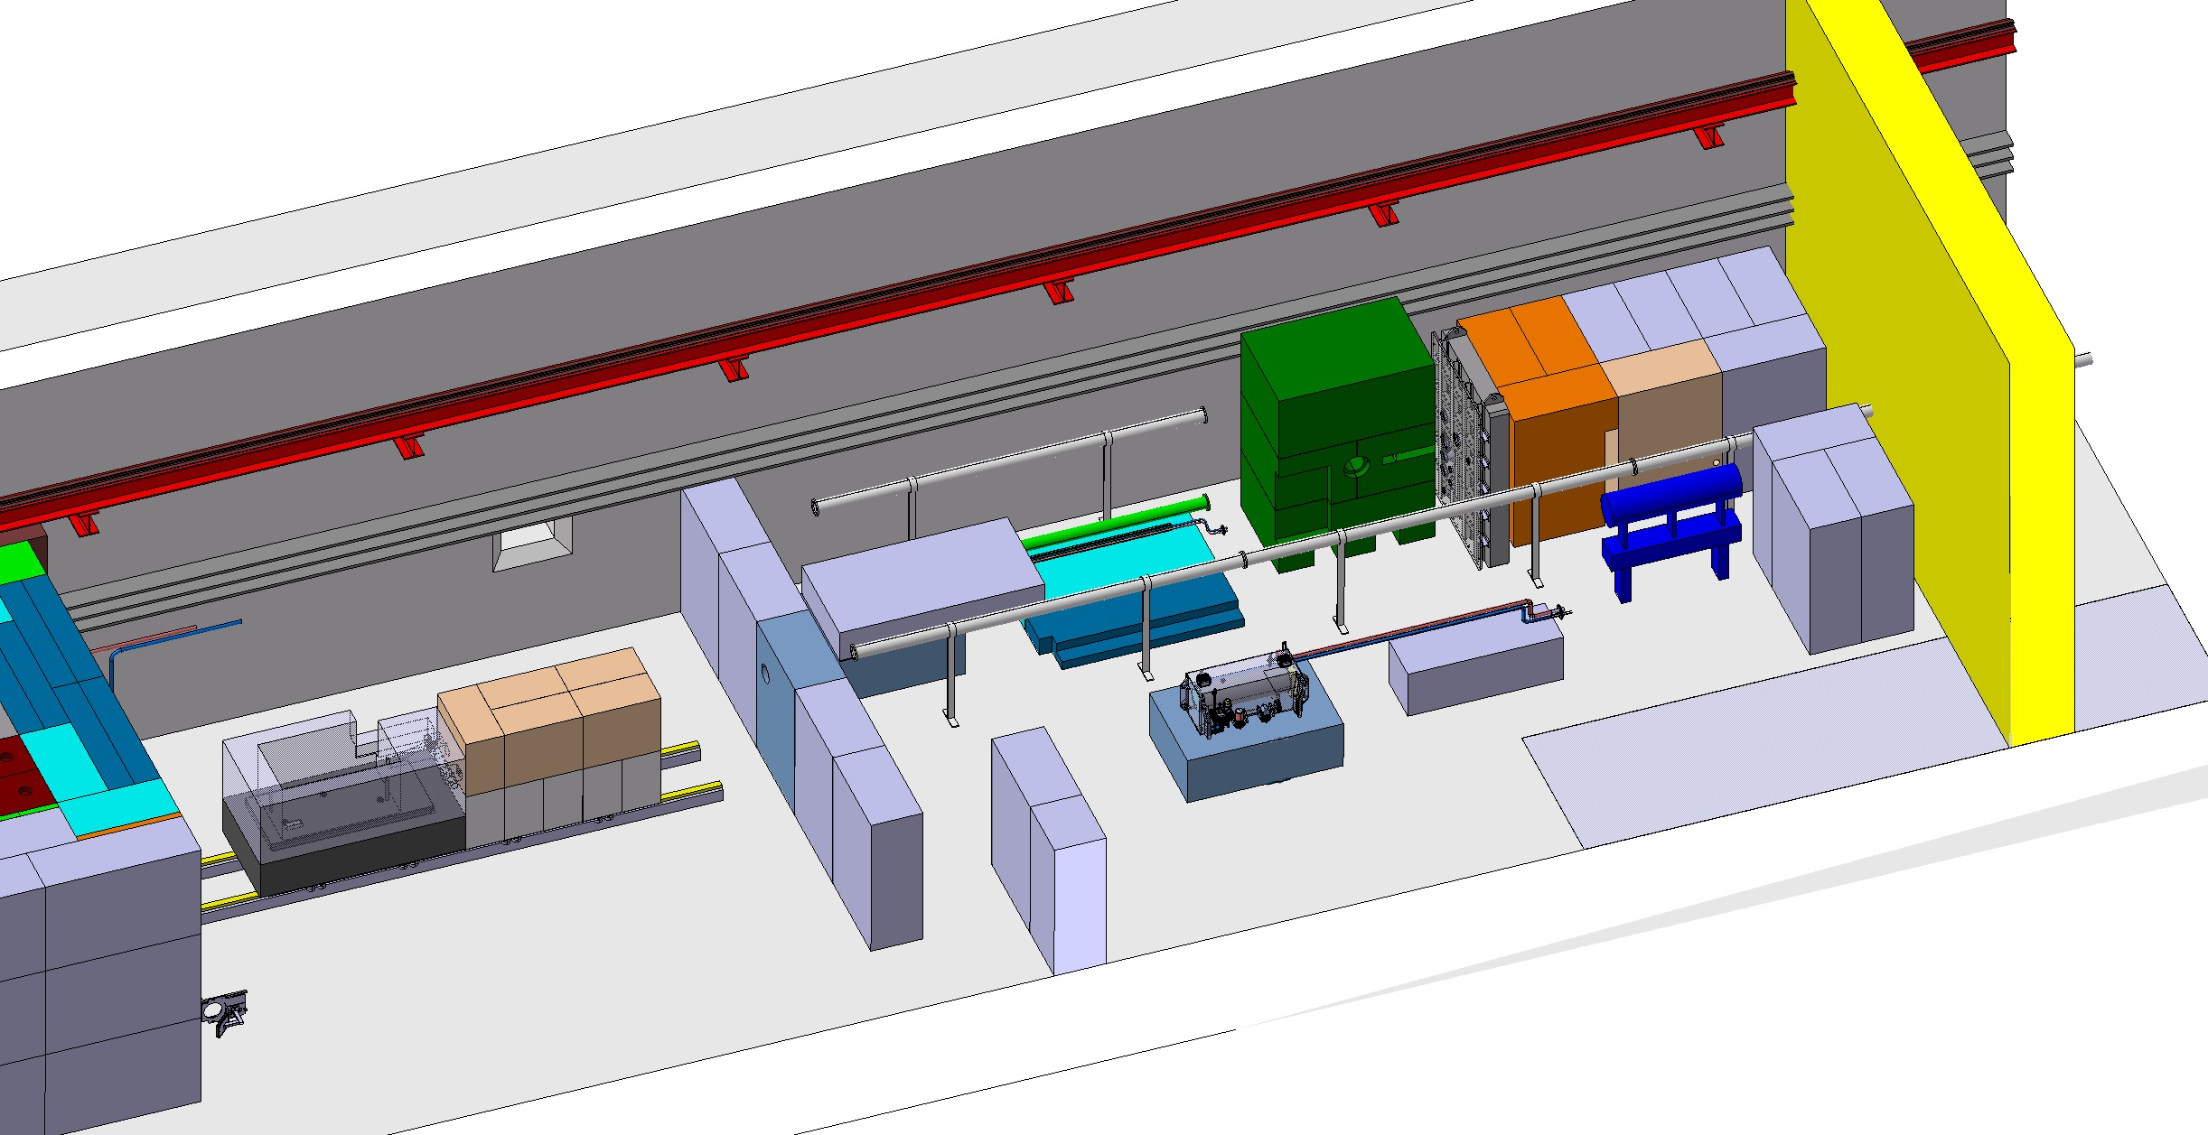
Target dismantling process - TCC8
Target draining (removal, drying cooling fluid(s)
Handling with overhead travelling crane from trolley to a stand
Pipes shearing destructive work with possibly dust creation (larges chips)
Handling with overhead travelling crane from a stand to a shielded container
Handling from underground to surface via 911

Slide 3
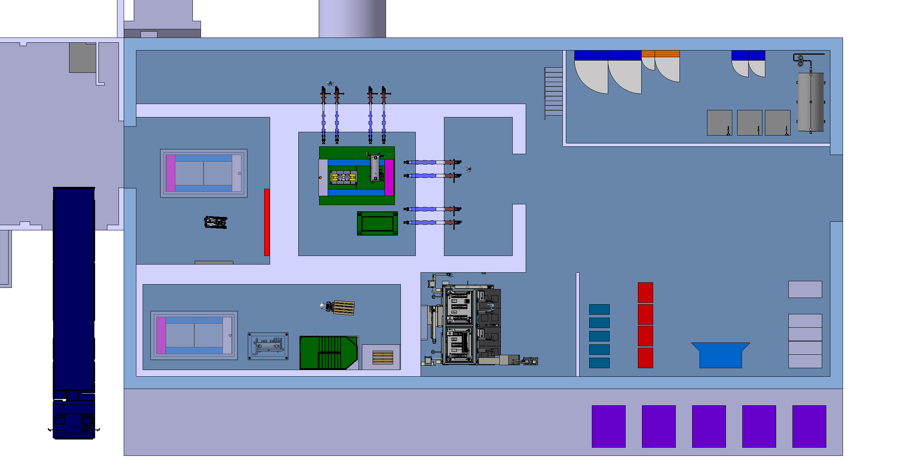
Target dismantling process – surface buidling
Extraction of target from shielded cask in service cell
Target material separation (core removed from vessel) destructive work with possibly dust creation
Packing on final repository containers

