Slide 1
ILC Beam dump experiment (H2)
D. Bozzato¹, R. Froeschl¹, H. Iwase², T. Lorenzon¹, N. Nakao³, F. Pozzi¹, Y. Sakaki², T. Sanami², K. Sugihara², M. Tisi¹
¹ CERN HSE/RP-AS, ² KEK (Japan), ³ Shimizu Corp.
PS/SPS User Meeting (30 mai 2024) · Indico (cern.ch)
30/05/2024
EDMS 3094537

Slide 2
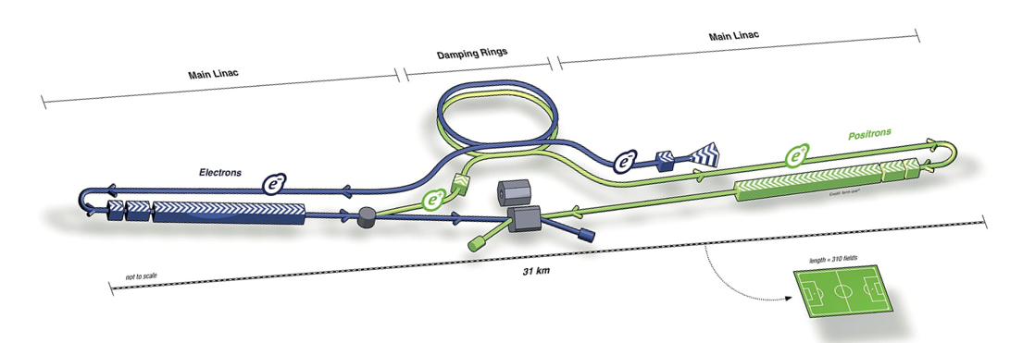
Physics goal
Context:
ILC Beam dumps
Main beam dumps of ILC (International Linear Collider) have been proposed as irradiation facilities (Sakaki et al, NIMA 1050 (2023) 168144 https://doi.org/10.1016/j.nima.2023.168144)
Goal of the present experimental activity:
Obtain experimental benchmark data of secondary particles from ILC-like beam dump targets irradiated by multi-GeV e- and e+ beams:
  Forward µ pairs produced from the interaction between e+ and atomic e-
  Neutrons

Slide 3
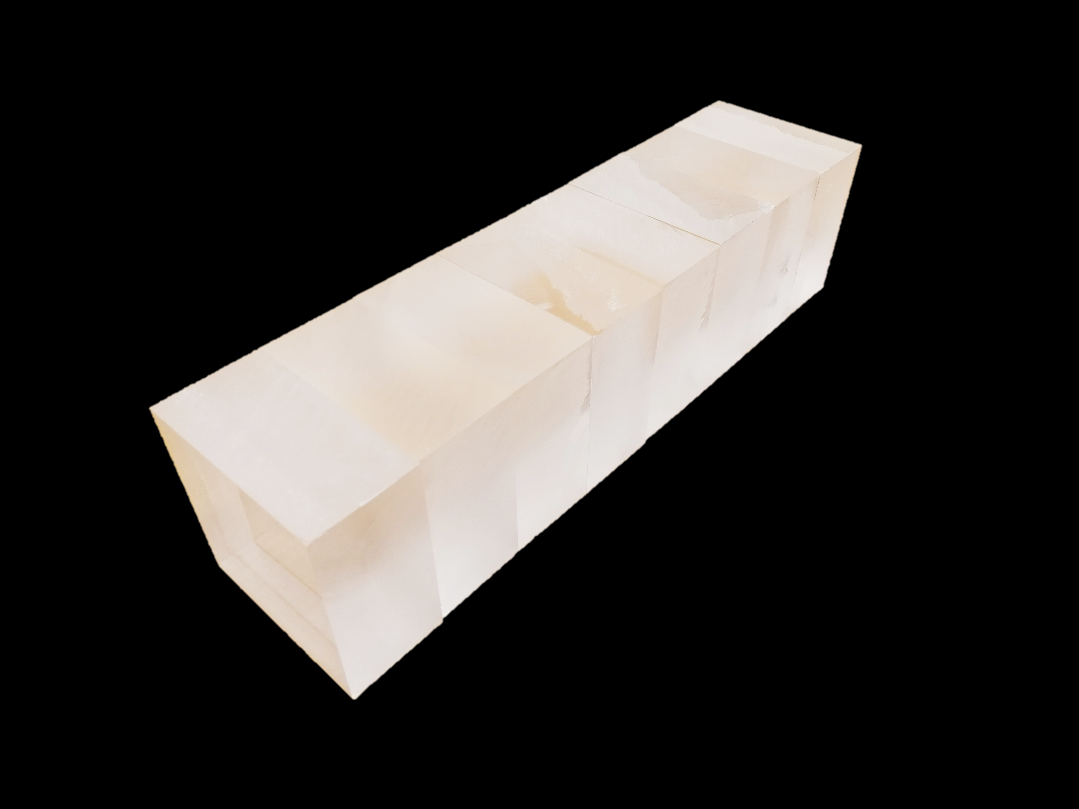
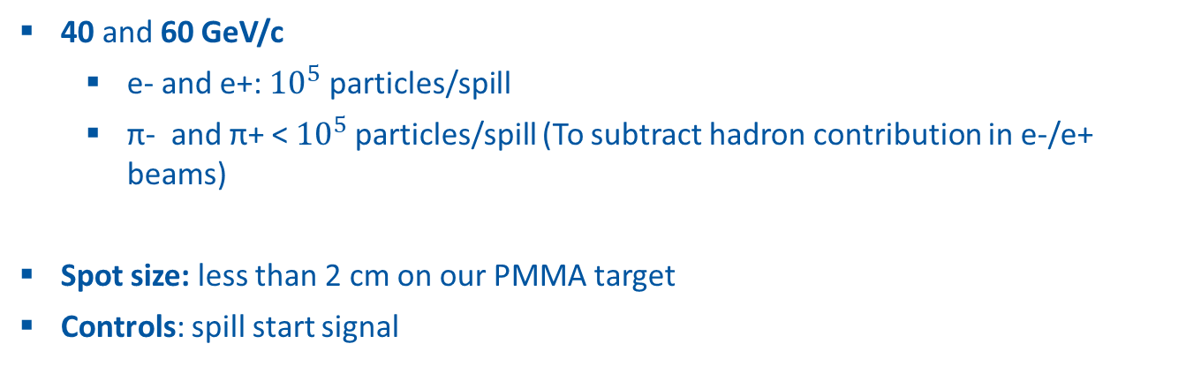
beam parameters and installation (1)
Coordinates:
PPE172, H2 – we initially applied for beamtime in H4
June 5-12, 2024 – available to start installation earlier (Monday June 3)
Control Room HNA383
Beam parameters:
40 and 60 GeV/c
  e- and e+: ${10}^{5}$ particles/spill
  π- and π+ < ${10}^{5}$particles/spill (To subtract hadron contribution in e-/e+ beams)
Spot size: less than 2 cm on our PMMA target
Controls: spill start signal
10 cm
40 cm
10 cm
beam
PMMA target

Slide 4
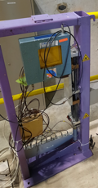
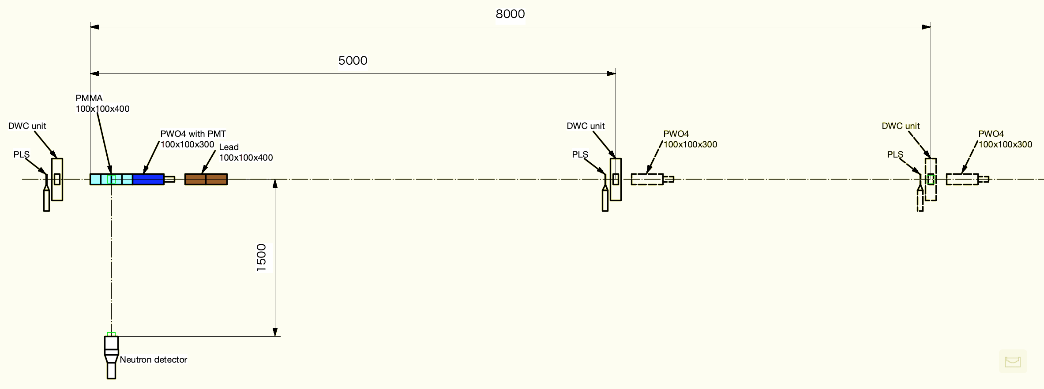

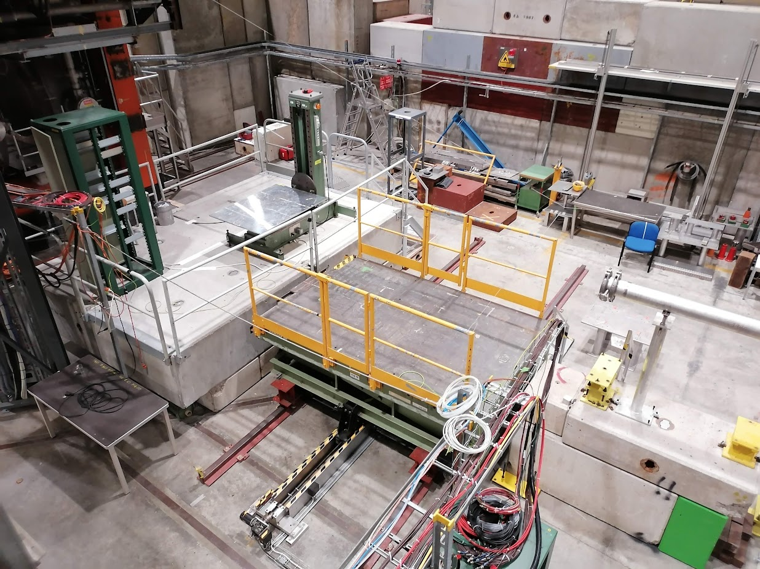
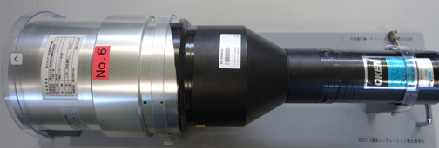
beam parameters and installation (2)
40 cm
beam
Additional conc. platform
Conc. platform
PPE172
beam
Movable platform
Conc. platform
Schematic layout in PPE172

Slide 5

Current status
Experimental equipment from KEK
  Shipped to CERN
  Currently landed in France and on its way to CERN (Prevessin)
Equipment from CERN
  PMMA Target and Pb shielding blocks available
  2 DWC and 2 PCS requested and reserved
  Signal, HV and power cables requested and reserved
  PbWO4 calorimeter with PMT requested and reserved
  NIM frames and electronics modules already retrieved from electronics pool
Preparation is on track!
Infrastructure
  Coordination with Michael Lazzaroni and Silvia Schuh (BE-EA) for additional concrete platform, target/detector stands, and setup modifications during the exp. week.
  Early installation (Mo. June 3) of DWC, supports, and zone preparation to be decided with BE-EA

Slide 6

marco.tisi@cern.ch
EDMS 3094537

