Slide 1


ᑐ ᑌ ᑎ ᕮ
Supernova Pointing
Background Study Update
Harry Akins 30/05/2024

Slide 2
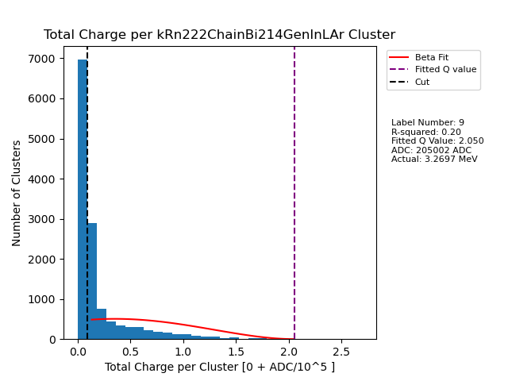
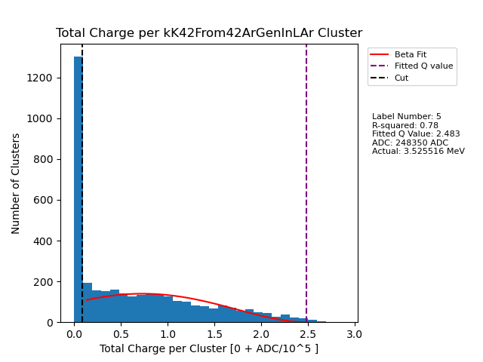
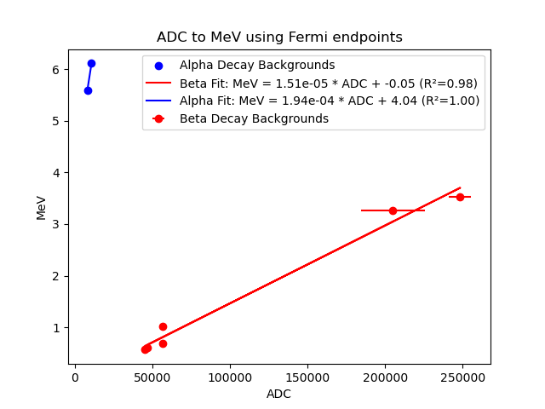

Linear Interpolation Using FD Backgrounds ADC MeV
Compare distribution endpoints in ADC to known MeV endpoints, determine conversion factor
Found endpoints using beta spectrum fit
Large spikes around 0 uncharacteristic of Beta Decay

Slide 3
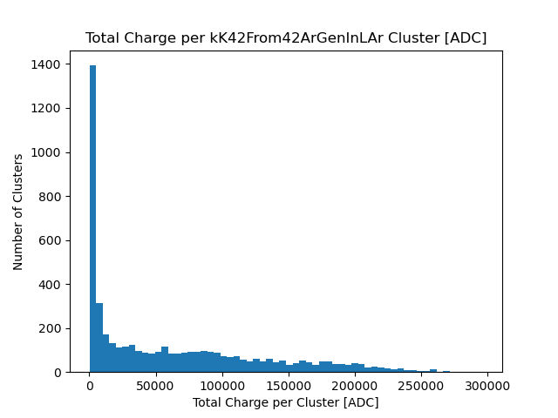
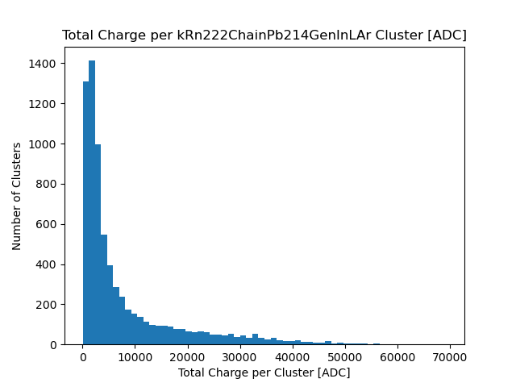
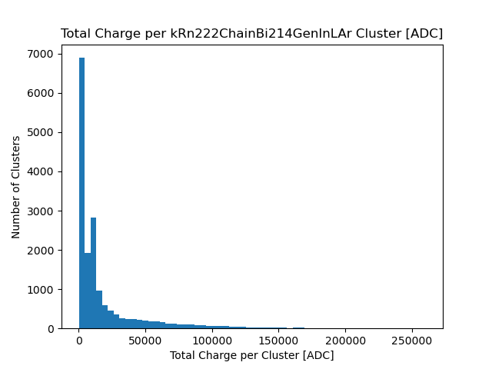
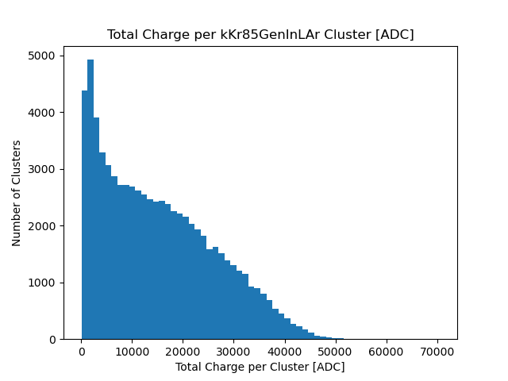
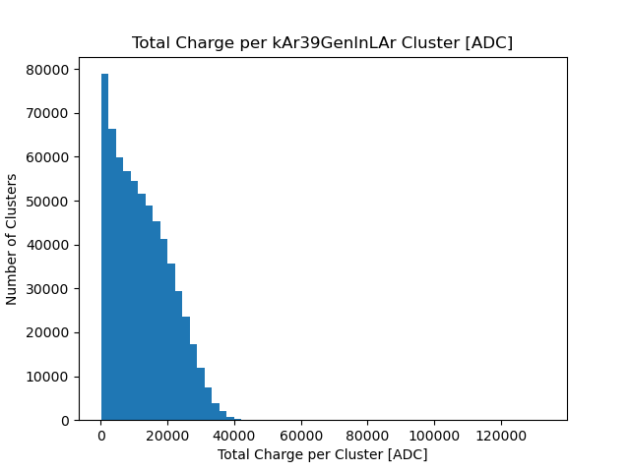
Backgrounds in FD: Beta Decay
Spike near 0, why?

Slide 4
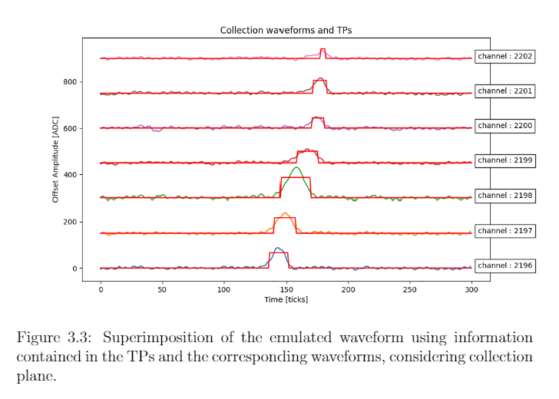
Lost ADC
Many ADC counts lost for lower energy signals

Slide 5
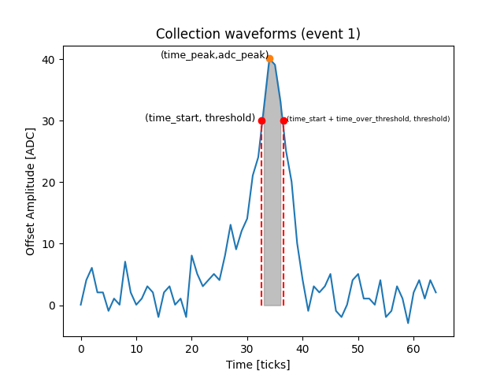
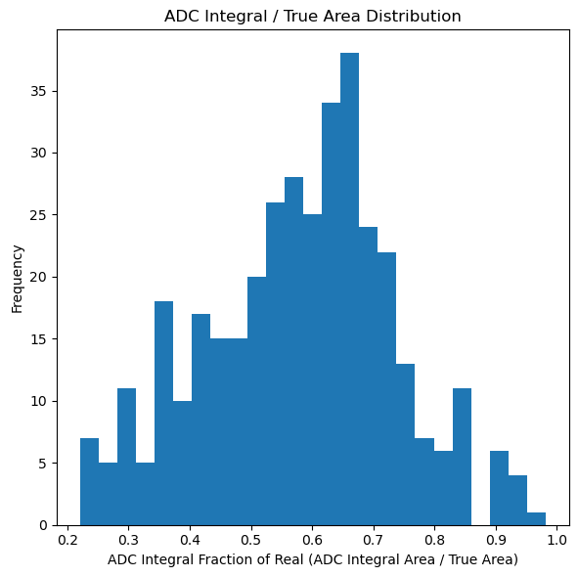
Lost ADC
adc_Integral
True Area Threshold
True Area Threshold: Average of 15 ticks before last zero before threshold

Slide 6
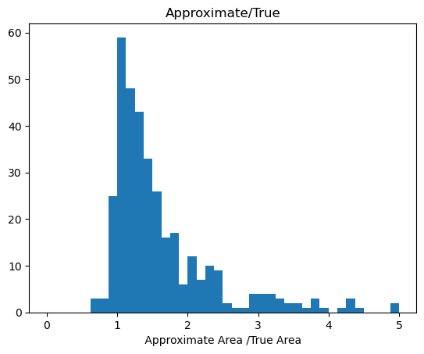
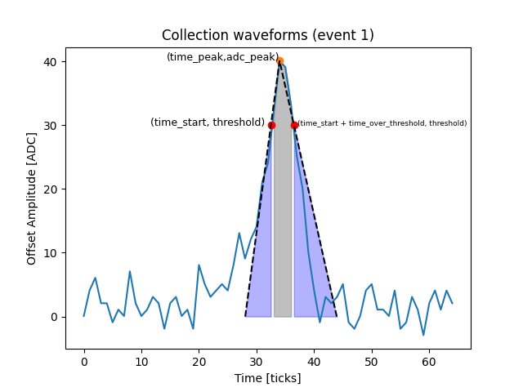
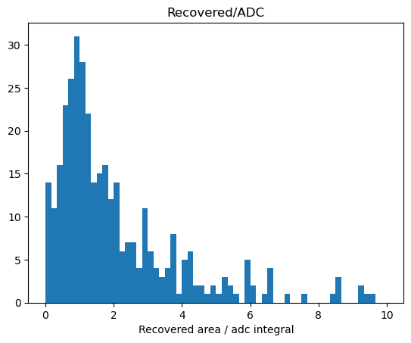
ADC Recovery: Triangle
True Area Threshold
(Approximate = adc_integral + recovered)

Slide 7
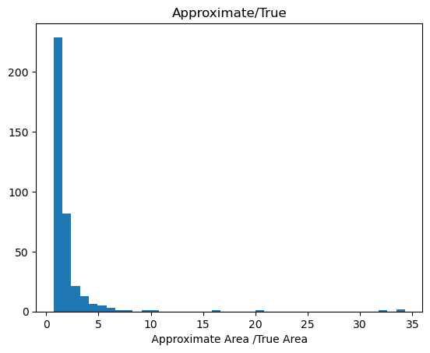
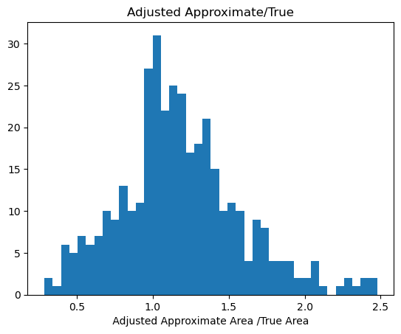
Limit the Approximate Area
If predicted area > adc_integral*4 Adjusted Approx. = adc_integral / .6
0.6 is the average of the adc/true distribtuion (below)

Slide 8
Next Steps
Compare adc integral for individual backgrounds
Different recovery technique
  Gaussian with 3 points

Slide 9
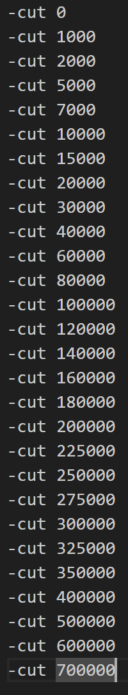
Main Track identifier with Cuts
Created script to create, mix data then train model
Changed scripts so that they could run in parallel
For a few cuts, hyperopt failed

