Slide 1
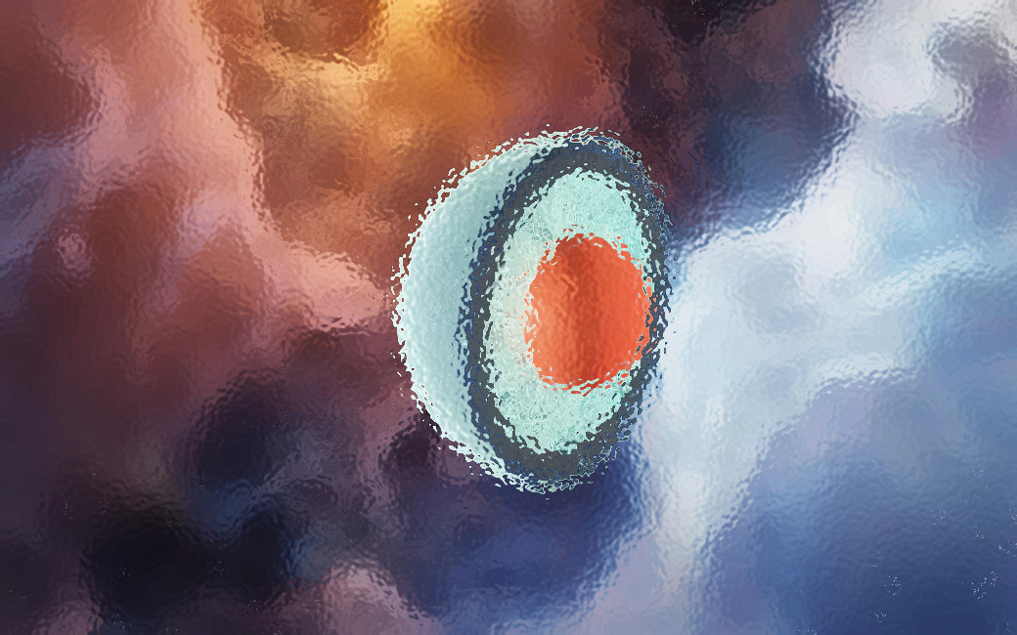




Dense QCD matter and neutron stars: inside Nature’s most extreme particle-physics laboratory
Aleksi Vuorinen
University of Helsinki & Helsinki Institute of Physics
pQCD at high density:
Gorda, Kurkela, Paatelainen, Säppi, AV, PRL 127, 2103.05658
Gorda, Paatelainen, Seppänen, Säppi, PRL 131, 2307.08734
Neutron-star applications:
Annala, Gorda, Kurkela, Nättilä, AV, Nature Phys. 16, 1903.09121
Annala et al. (incl. AV), PRX 12, 2105.05132
Annala et al. (incl. AV), Nature Comms. 14, 2303.11356
Lecture notes: AV, Acta Phys. Polon. B 55 (2024), 2405.01141
Spåtind 2025
Skeikampen, 3-4 January 2025

Slide 2
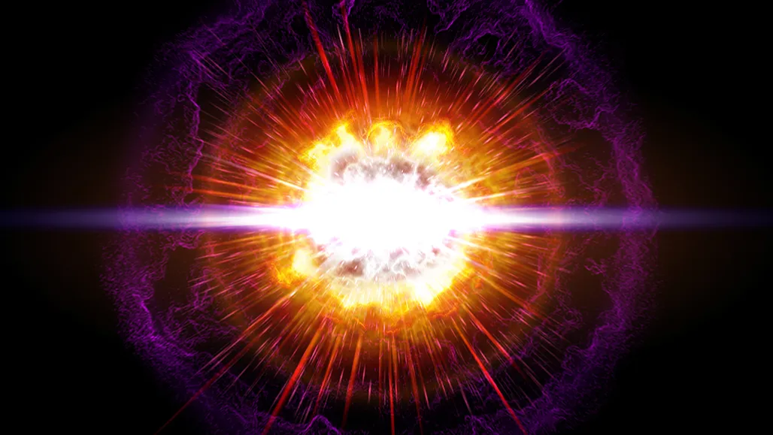
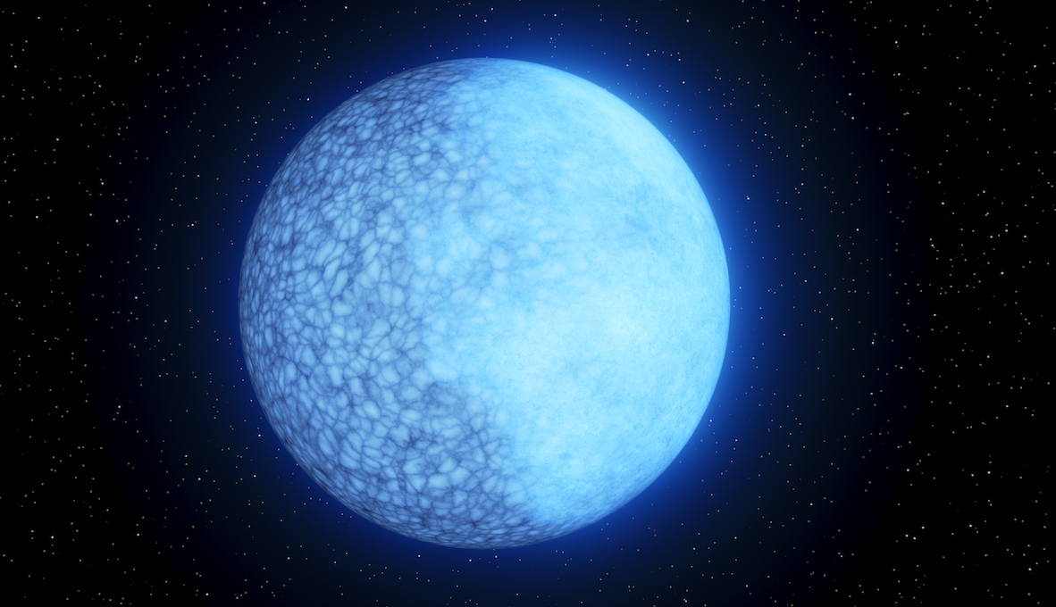
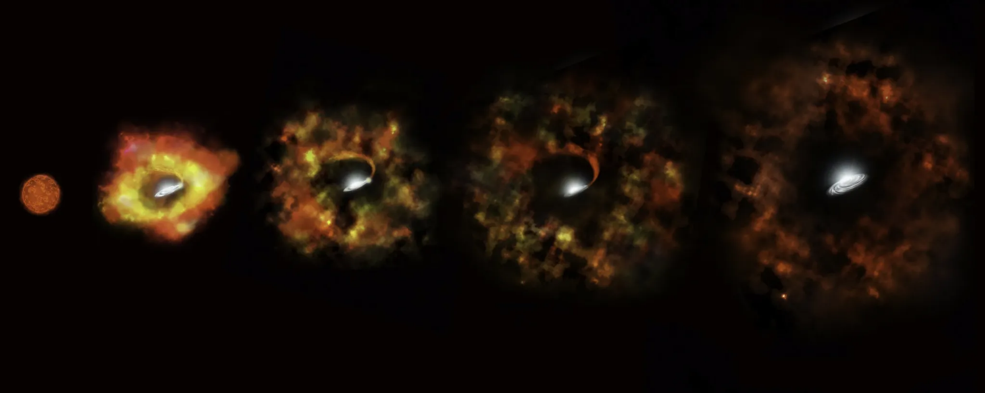

When a hydrogen-burning star runs out of fuel, several possible scenarios:
$M≲10M_{sun}≡10M_{⊙}→$ White dwarf
$M≳10M_{⊙}→$ Supernova explosion
  $M≳25M_{⊙}→$ Gravitational collapse into black hole
  $M≲25M_{⊙}→$ Gravitational collapse into something even stranger…

Slide 3
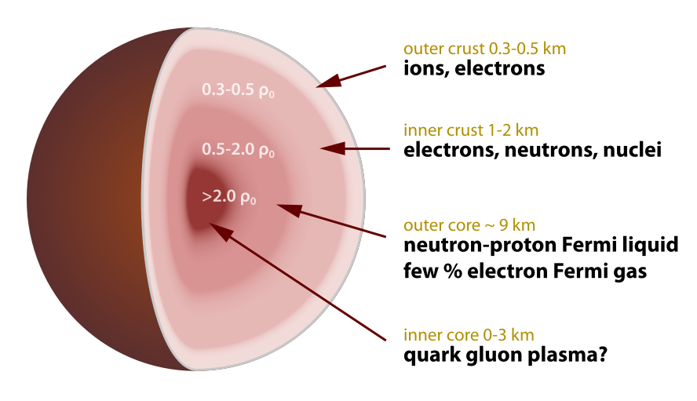
?
$ρ_{0}≡n_{s}≈0.16$baryons/${\text{fm}}^{3}=$ nuclear saturation density

Slide 4
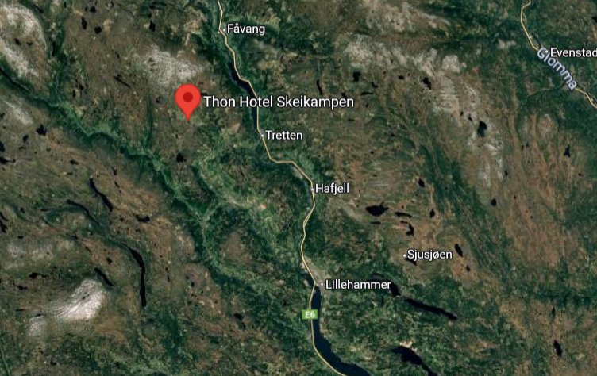
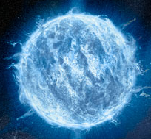
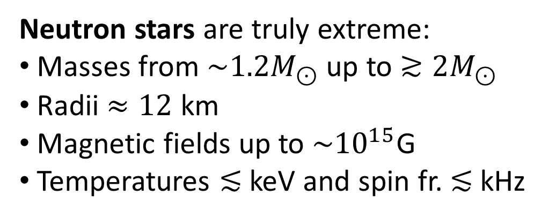
Neutron stars are truly extreme:
Masses from $\sim 1.2M_{⊙}$ up to $≳2M_{⊙}$
Radii $≈12$ km
Magnetic fields up to ${\sim 10}^{15}$G
Temperatures $≲$ keV and spin fr. $≲$ kHz
?

Slide 5
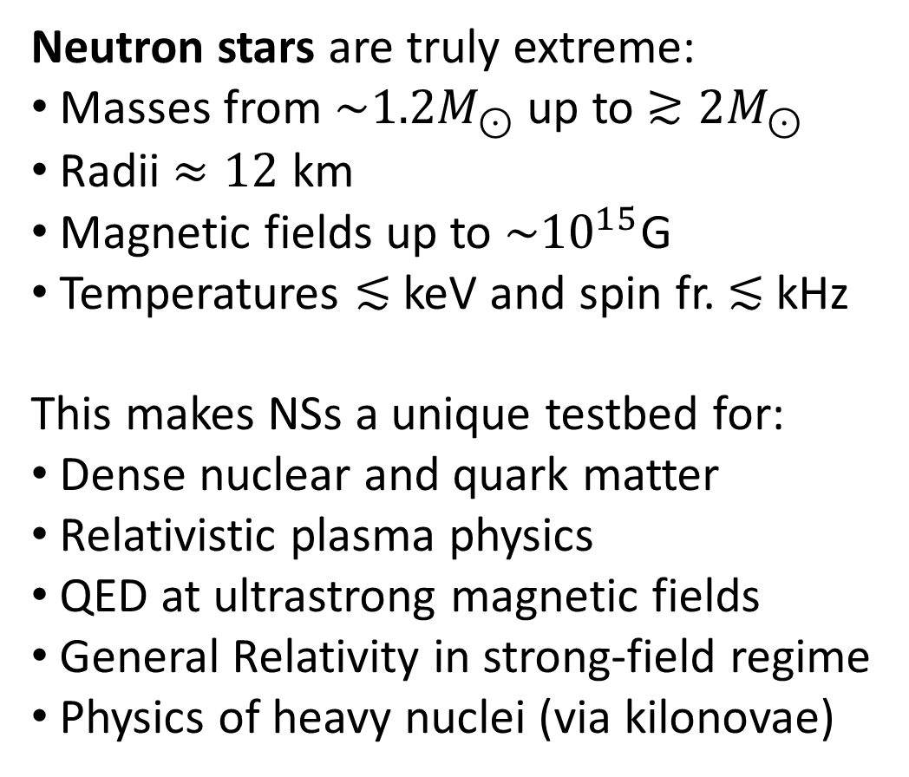
Neutron stars are truly extreme:
Masses from $\sim 1.2M_{⊙}$ up to $≳2M_{⊙}$
Radii $≈12$ km
Magnetic fields up to ${\sim 10}^{15}$G
Temperatures $≲$ keV and spin fr. $≲$ kHz
This makes NSs a unique testbed for:
Dense nuclear and quark matter
Relativistic plasma physics
QED at ultrastrong magnetic fields
General Relativity in strong-field regime
Physics of heavy nuclei (via kilonovae)
?

Slide 6
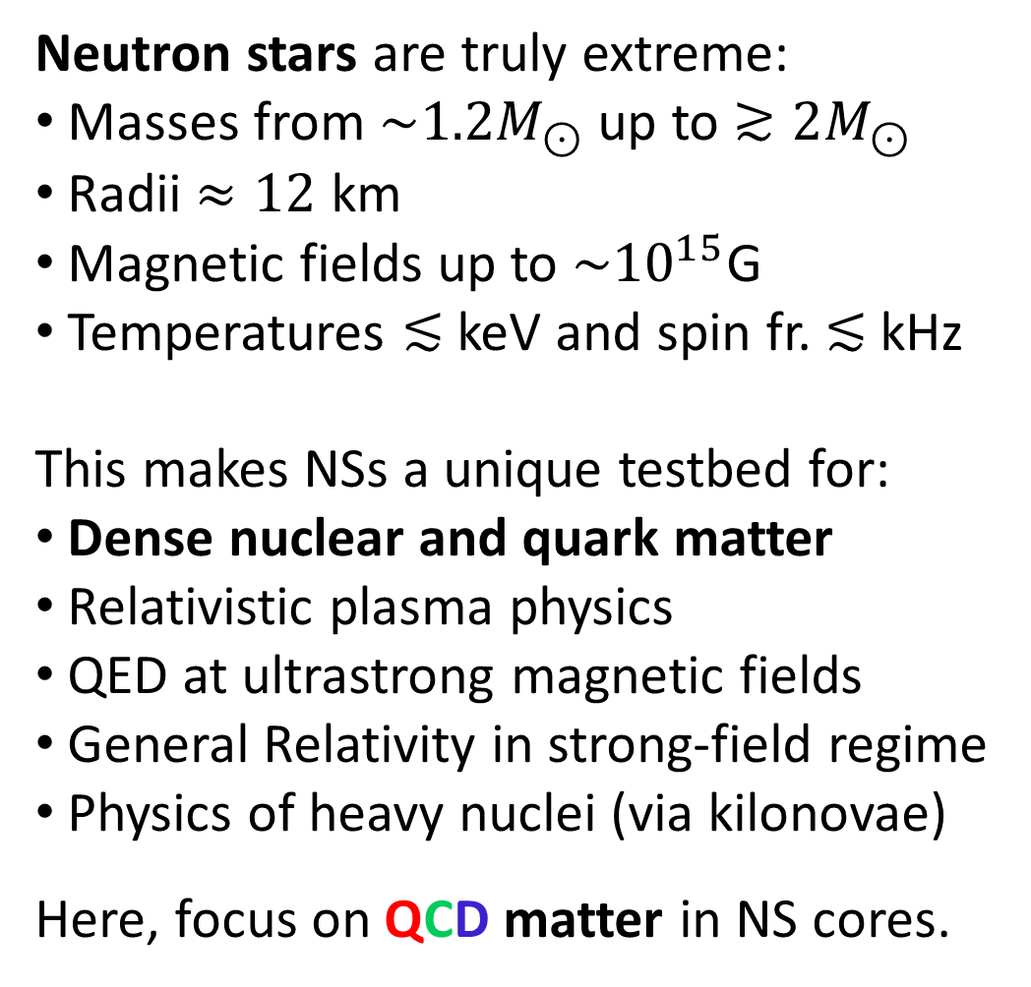
Neutron stars are truly extreme:
Masses from $\sim 1.2M_{⊙}$ up to $≳2M_{⊙}$
Radii $≈12$ km
Magnetic fields up to ${\sim 10}^{15}$G
Temperatures $≲$ keV and spin fr. $≲$ kHz
This makes NSs a unique testbed for:
Dense nuclear and quark matter
Relativistic plasma physics
QED at ultrastrong magnetic fields
General Relativity in strong-field regime
Physics of heavy nuclei (via kilonovae)
Here, focus on QCD matter in NS cores.
?

Slide 7
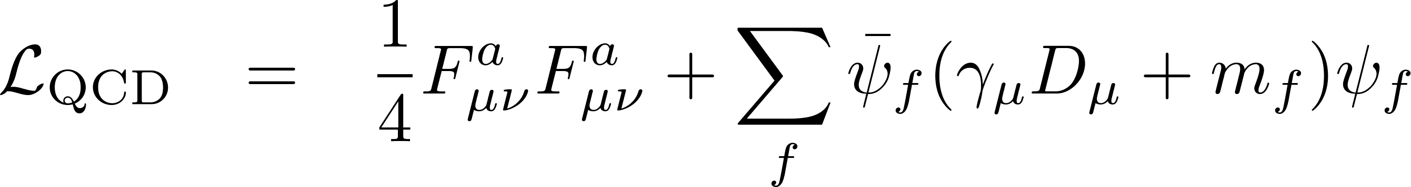
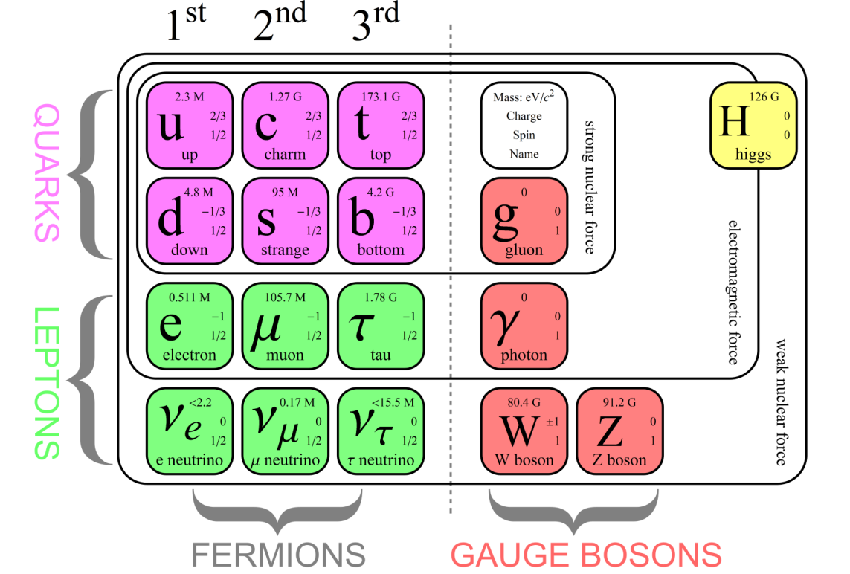
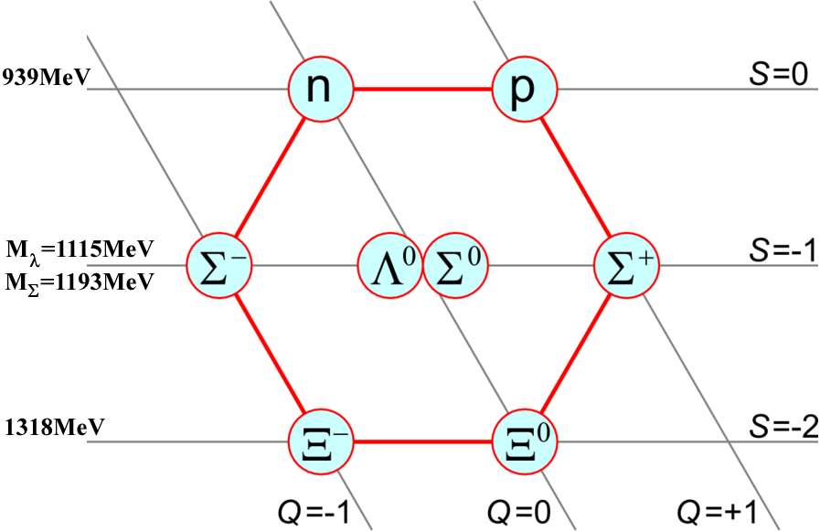

Slide 8
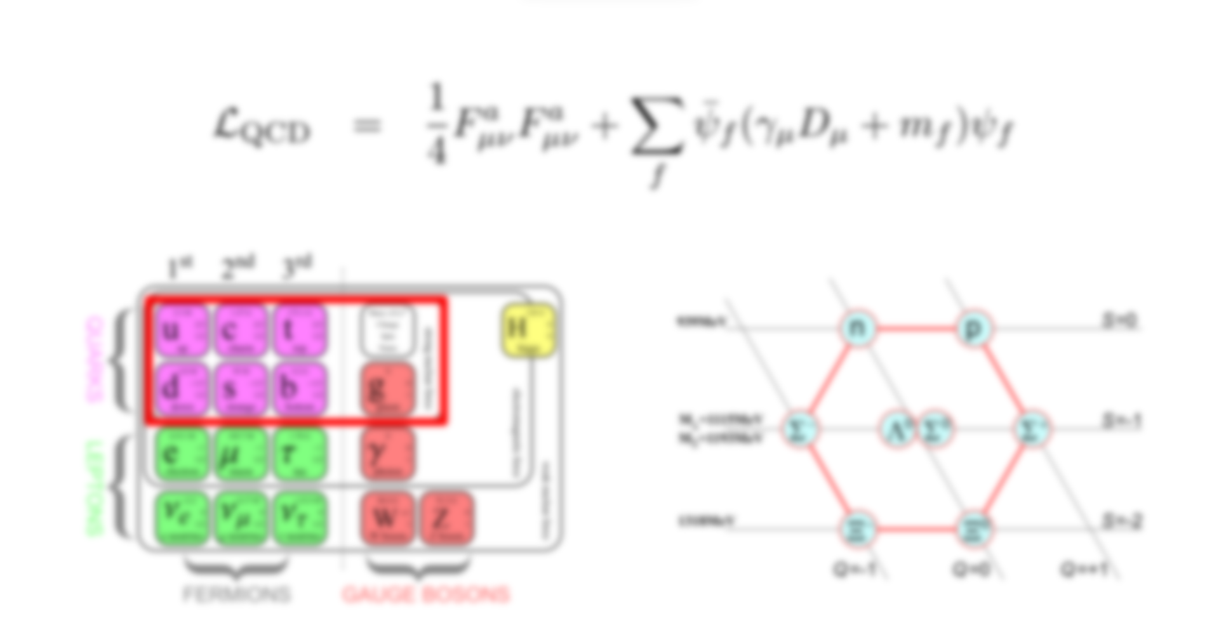
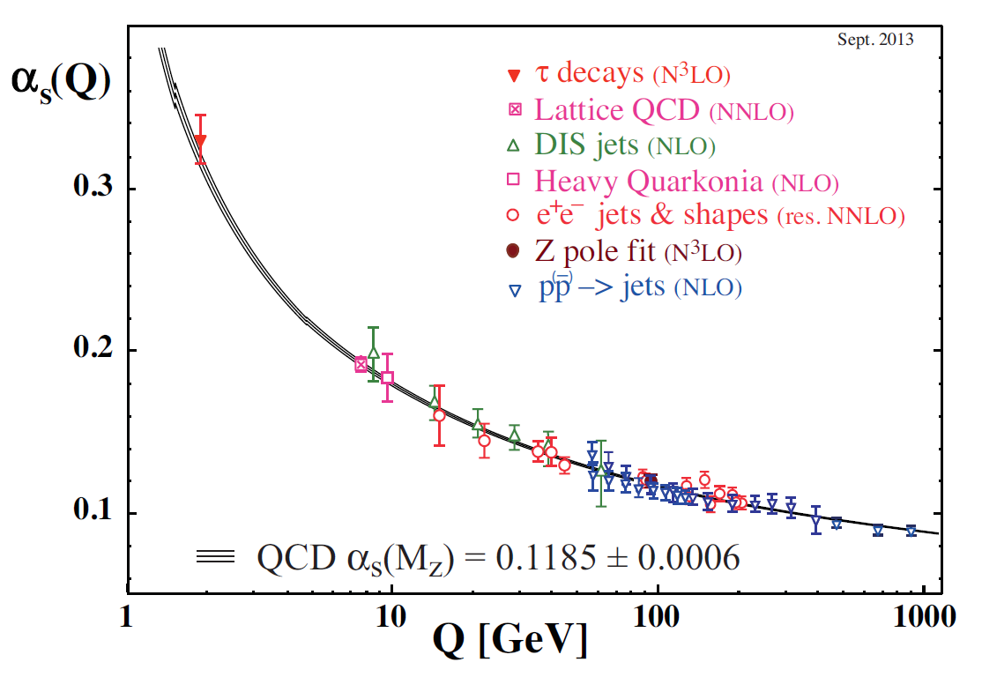

Slide 9
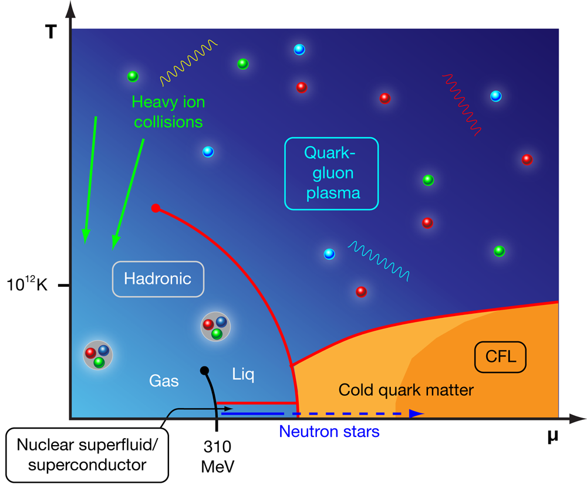
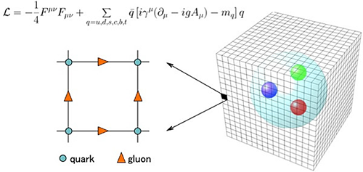
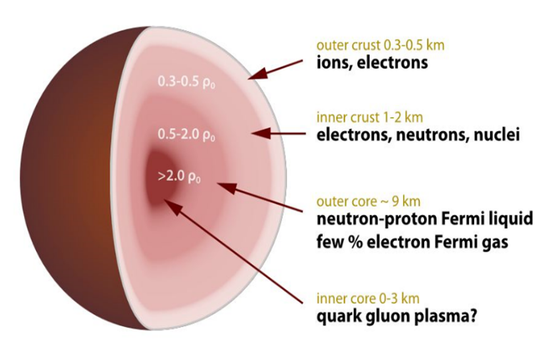
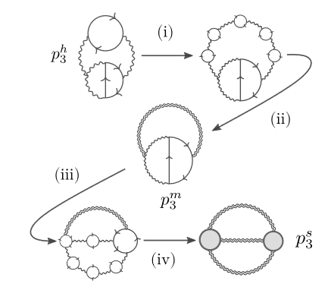
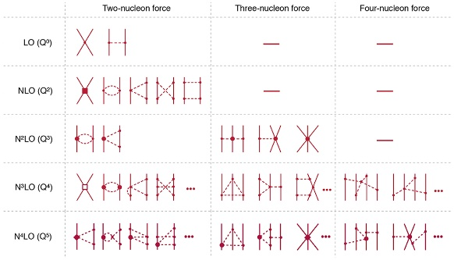
?

Slide 10
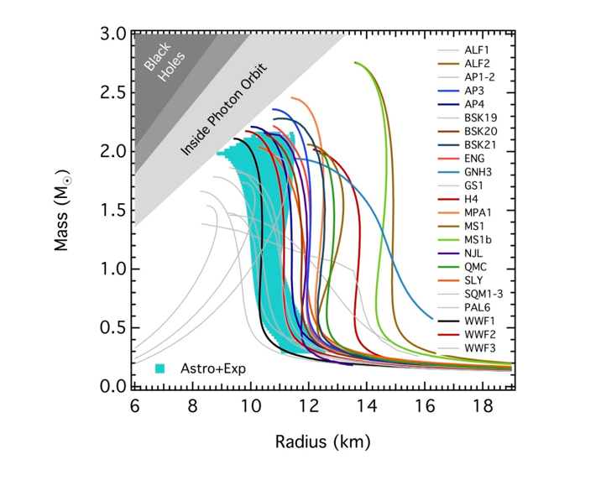

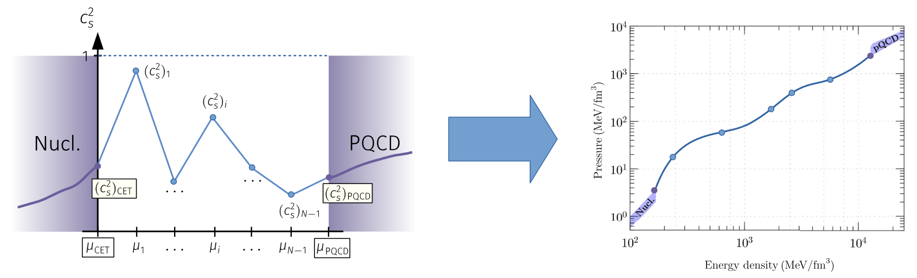
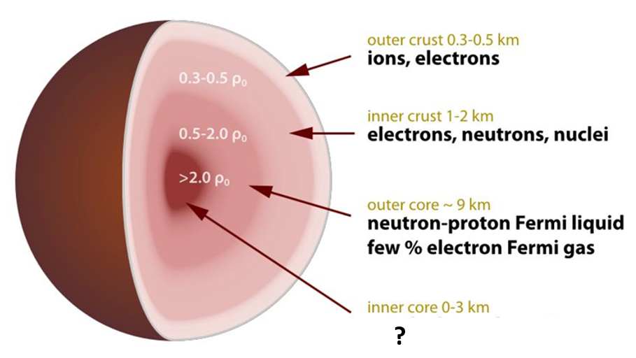
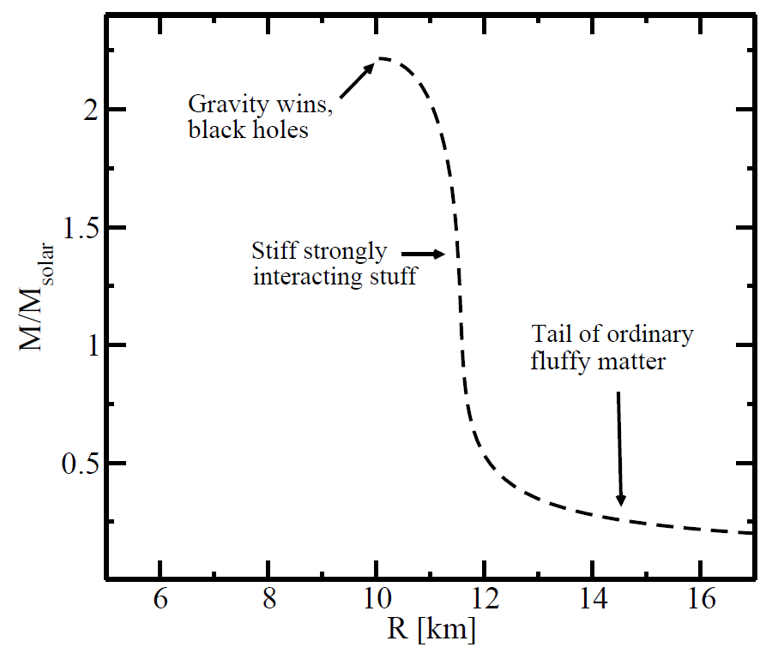
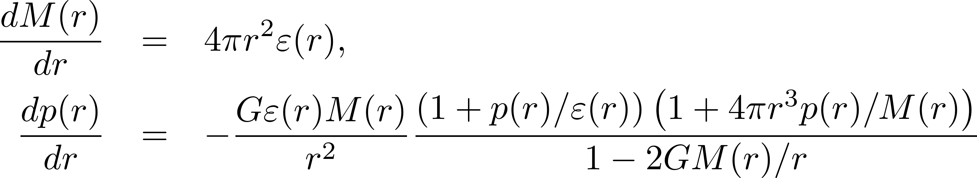
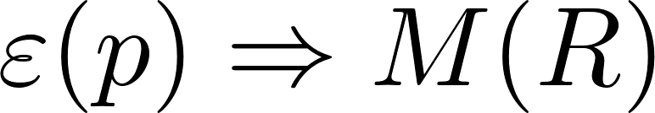
Dense QCD challenge: can we solve NS properties and composition using only first-principles theory tools and robust observational data? Do some NS cores contain deconfined matter?
Link between micro and macro from GR and Equation of State (EoS):
[Ozel et al., ApJ 820 (2016)]

Slide 11
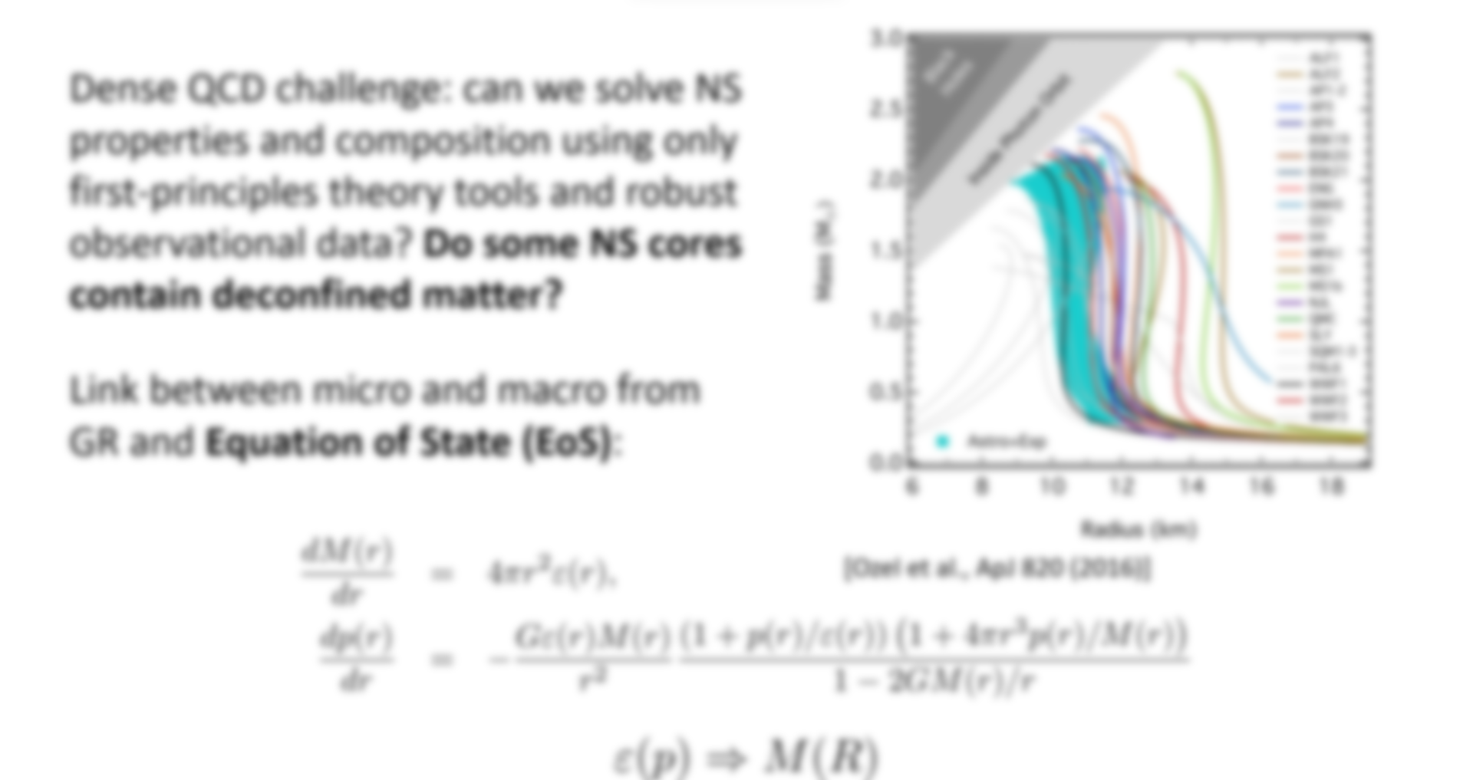
Clear need for systematic and model-independent approach to the microphysics of neutron stars, with EoS inference playing a special role

Slide 12
Plan of the lectures:
Introduction
NS matter: what do we know robustly?
Brief review of NS observations
Some lessons from heavy-ion physics
NS-matter Equation of State: how to patch things together consistently
Quark-matter cores: are there any?
Today
Tomorrow

Slide 13
NS interiors: from dilute crust to ultradense core

Slide 14
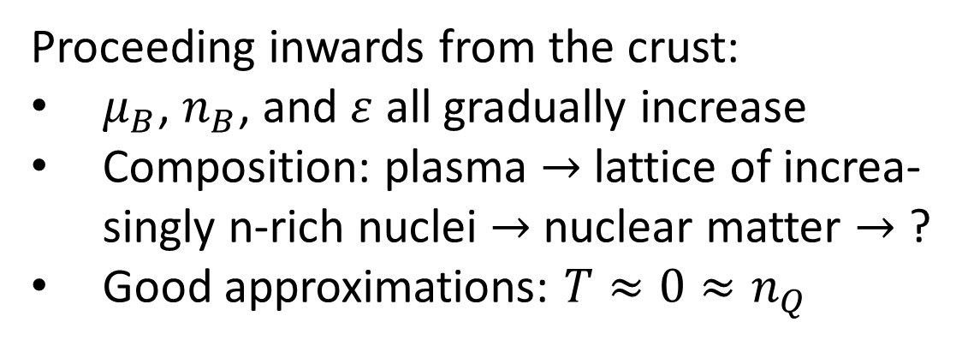
Proceeding inwards from the crust:
$μ_{B}$, $n_{B}$, and $ε$ all gradually increase
Composition: plasma $→$ lattice of increa-singly n-rich nuclei $→$ nuclear matter $→$ ?
Good approximations: $T≈0≈n_{Q}$

Slide 15
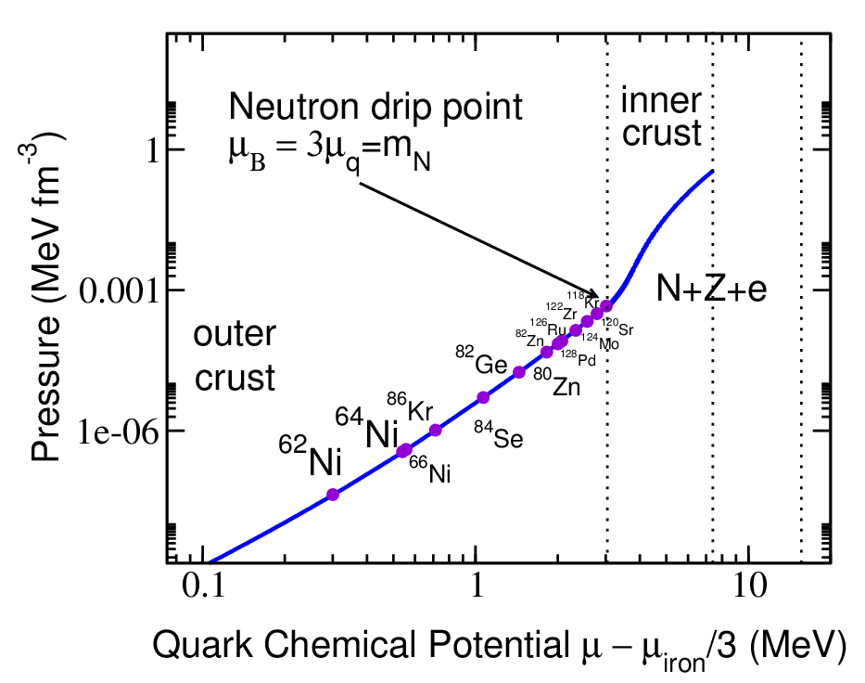
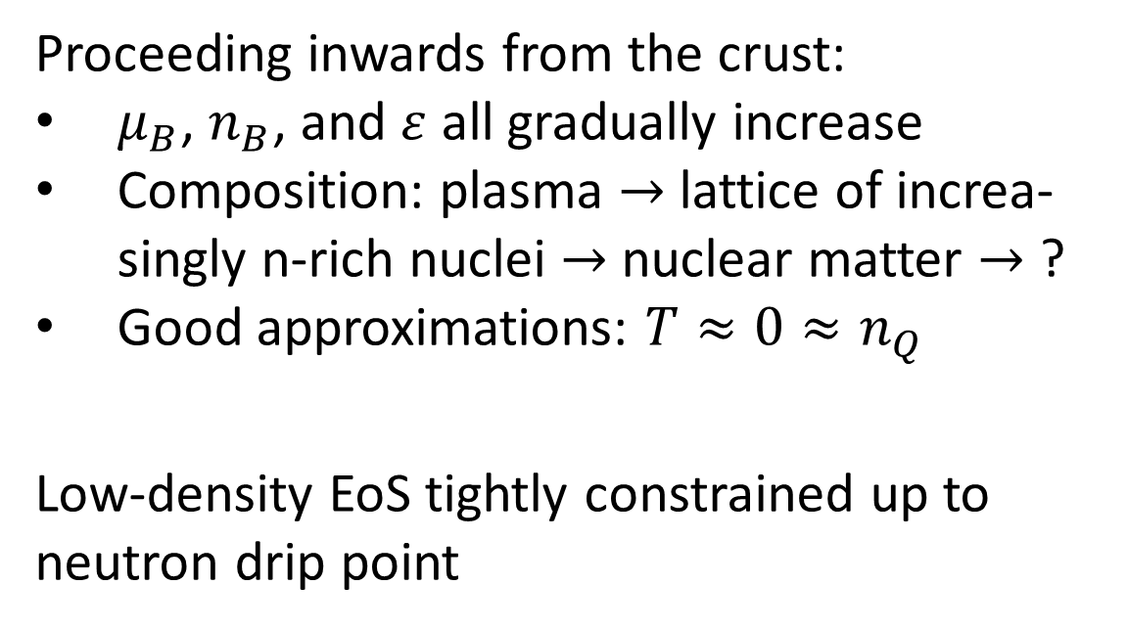
Proceeding inwards from the crust:
$μ_{B}$, $n_{B}$, and $ε$ all gradually increase
Composition: plasma $→$ lattice of increa-singly n-rich nuclei $→$ nuclear matter $→$ ?
Good approximations: $T≈0≈n_{Q}$
Low-density EoS tightly constrained up to neutron drip point

Slide 16
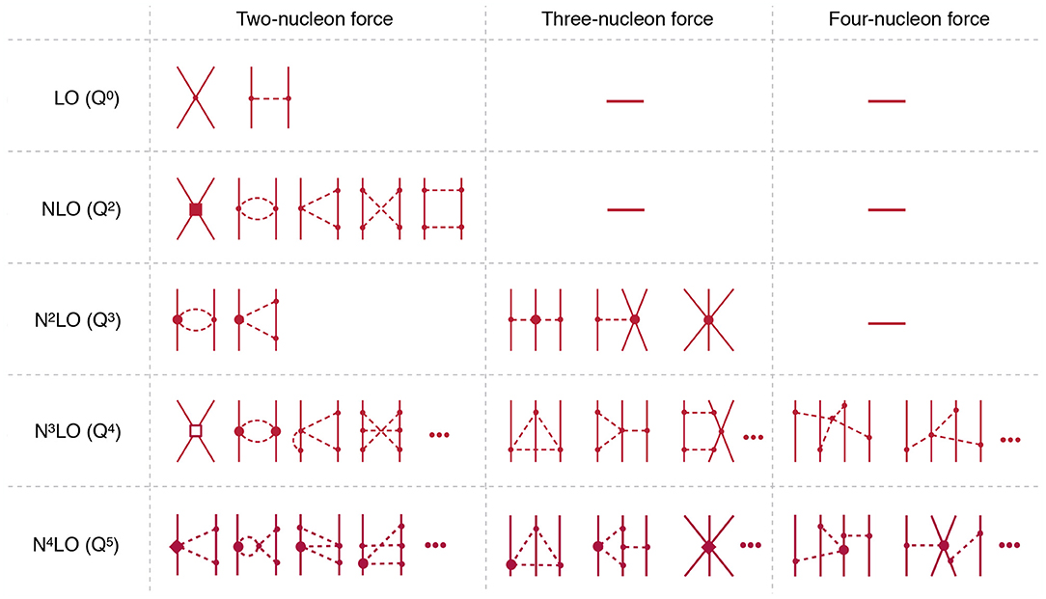
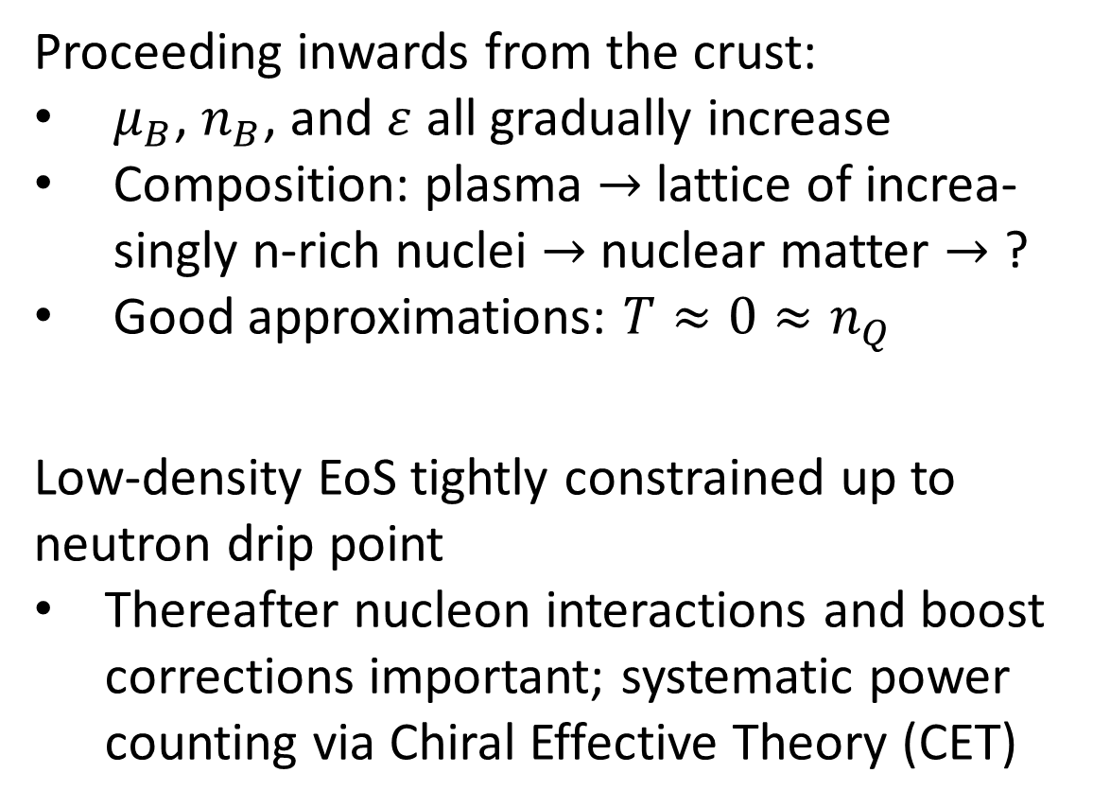
Proceeding inwards from the crust:
$μ_{B}$, $n_{B}$, and $ε$ all gradually increase
Composition: plasma $→$ lattice of increa-singly n-rich nuclei $→$ nuclear matter $→$ ?
Good approximations: $T≈0≈n_{Q}$
Low-density EoS tightly constrained up to neutron drip point
Thereafter nucleon interactions and boost corrections important; systematic power counting via Chiral Effective Theory (CET)

Slide 17
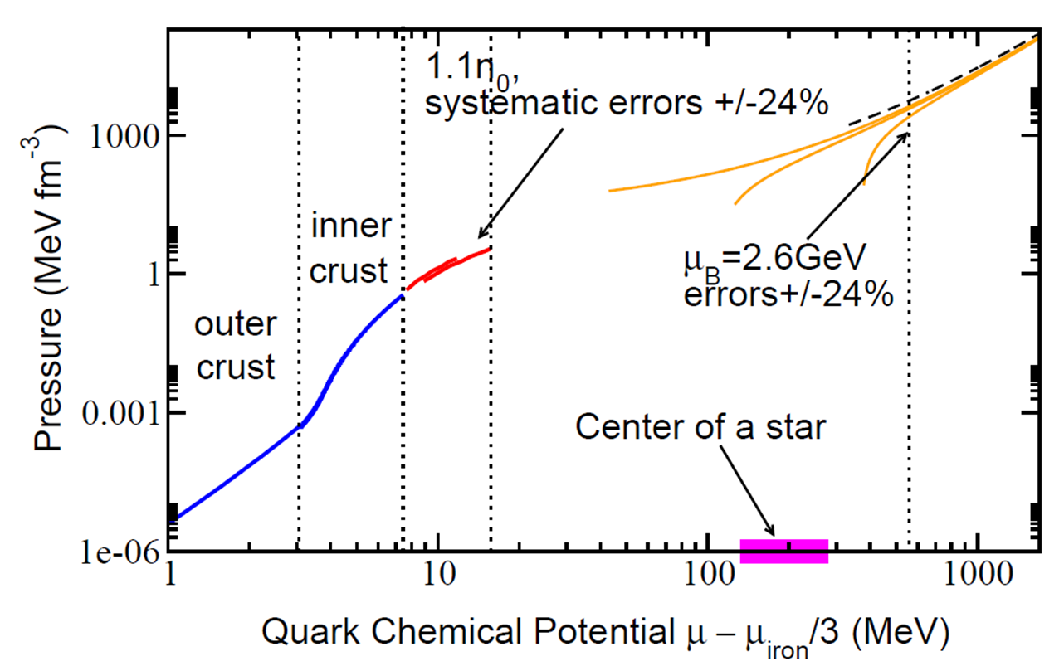
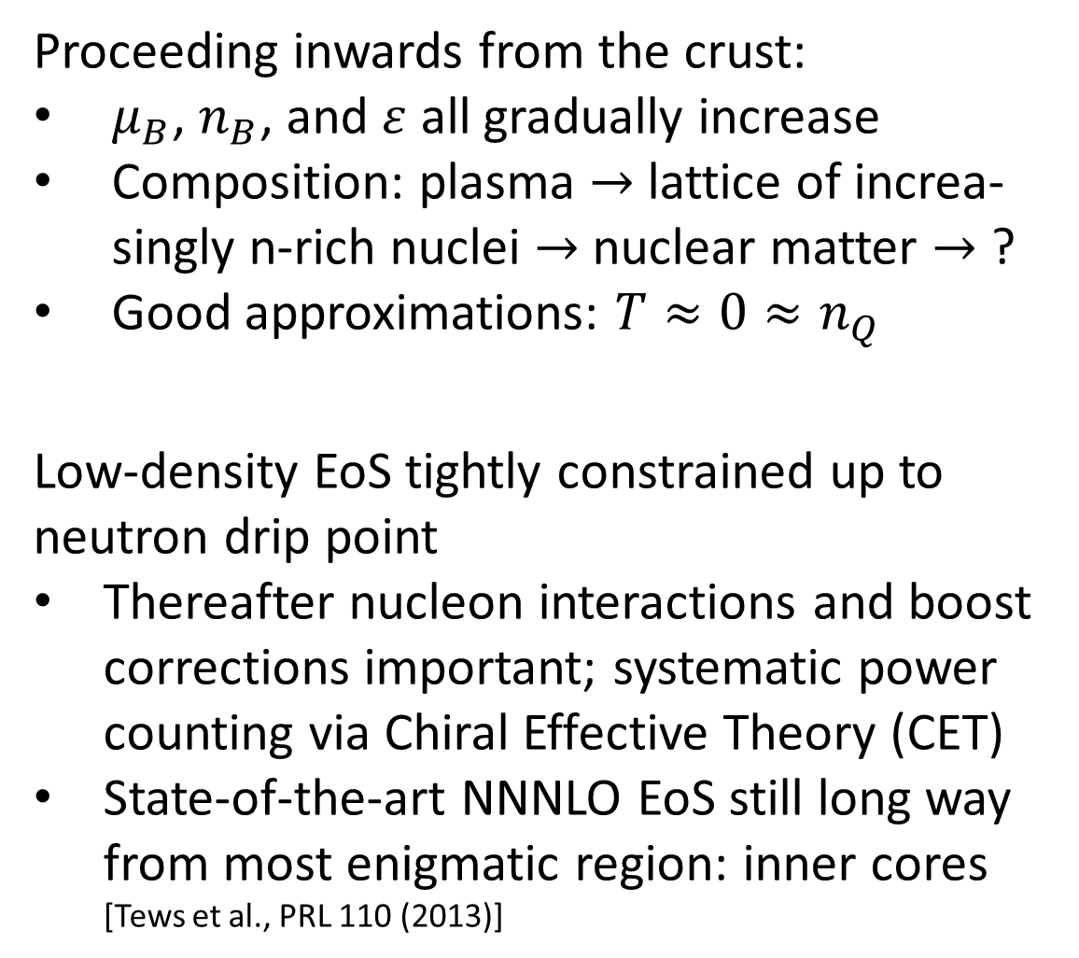
Proceeding inwards from the crust:
$μ_{B}$, $n_{B}$, and $ε$ all gradually increase
Composition: plasma $→$ lattice of increa-singly n-rich nuclei $→$ nuclear matter $→$ ?
Good approximations: $T≈0≈n_{Q}$
Low-density EoS tightly constrained up to neutron drip point
Thereafter nucleon interactions and boost corrections important; systematic power counting via Chiral Effective Theory (CET)
State-of-the-art NNNLO EoS still long way from most enigmatic region: inner cores [Tews et al., PRL 110 (2013)]

Slide 18
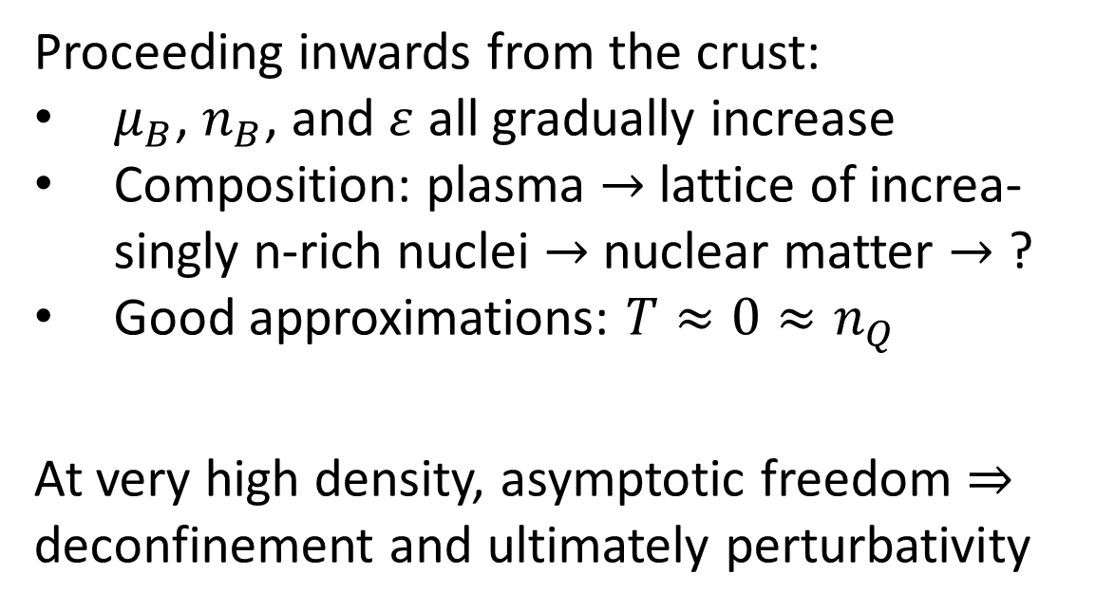
Proceeding inwards from the crust:
$μ_{B}$, $n_{B}$, and $ε$ all gradually increase
Composition: plasma $→$ lattice of increa-singly n-rich nuclei $→$ nuclear matter $→$ ?
Good approximations: $T≈0≈n_{Q}$
At very high density, asymptotic freedom $⇒$ deconfinement and ultimately perturbativity

Slide 19
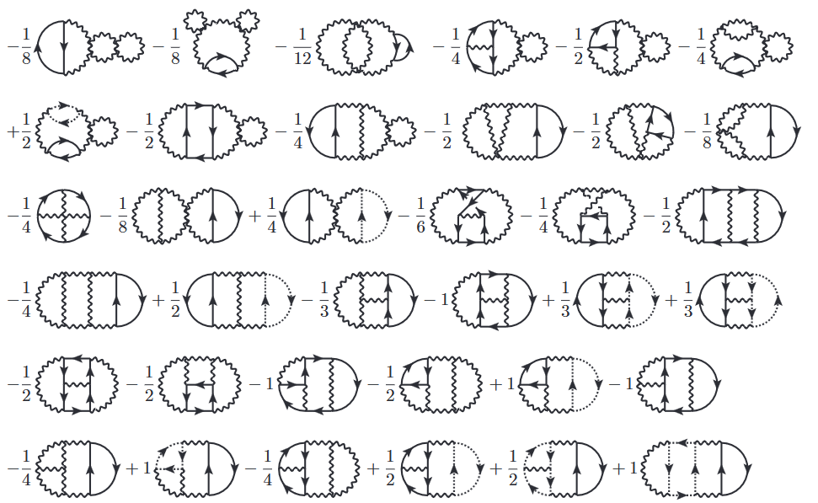
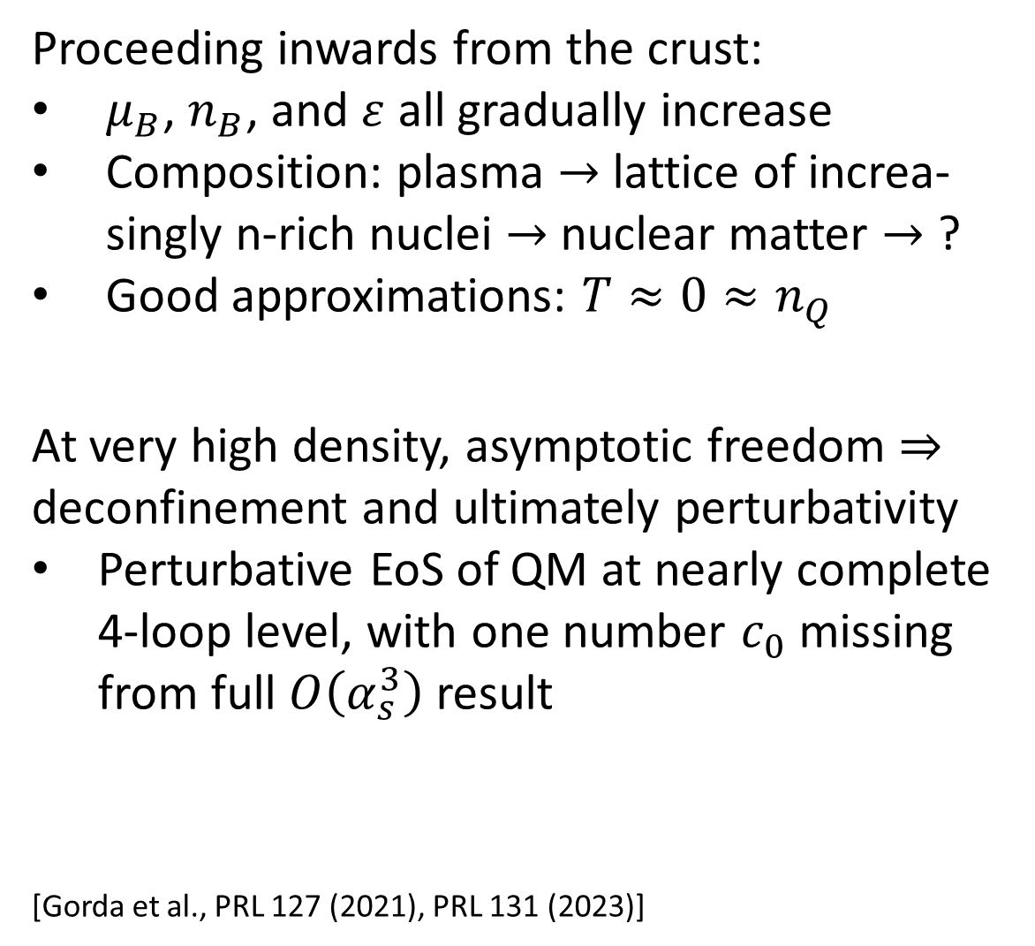
Proceeding inwards from the crust:
$μ_{B}$, $n_{B}$, and $ε$ all gradually increase
Composition: plasma $→$ lattice of increa-singly n-rich nuclei $→$ nuclear matter $→$ ?
Good approximations: $T≈0≈n_{Q}$
At very high density, asymptotic freedom $⇒$ deconfinement and ultimately perturbativity
Perturbative EoS of QM at nearly complete 4-loop level, with one number $c_{0}$ missing from full $O\left(α_{s}^{3}\right)$ result
Accuracy dramatically improved, but result strongly dependent on the value of $c_{0}$
[Gorda et al., PRL 127 (2021), PRL 131 (2023)]

Slide 20
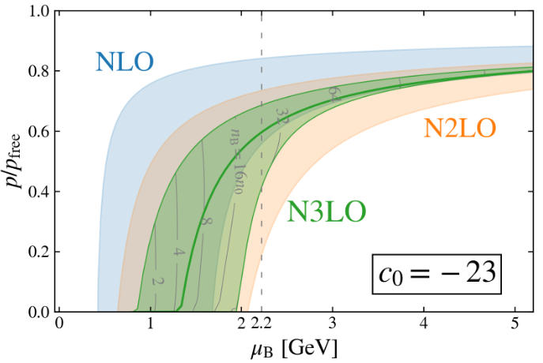
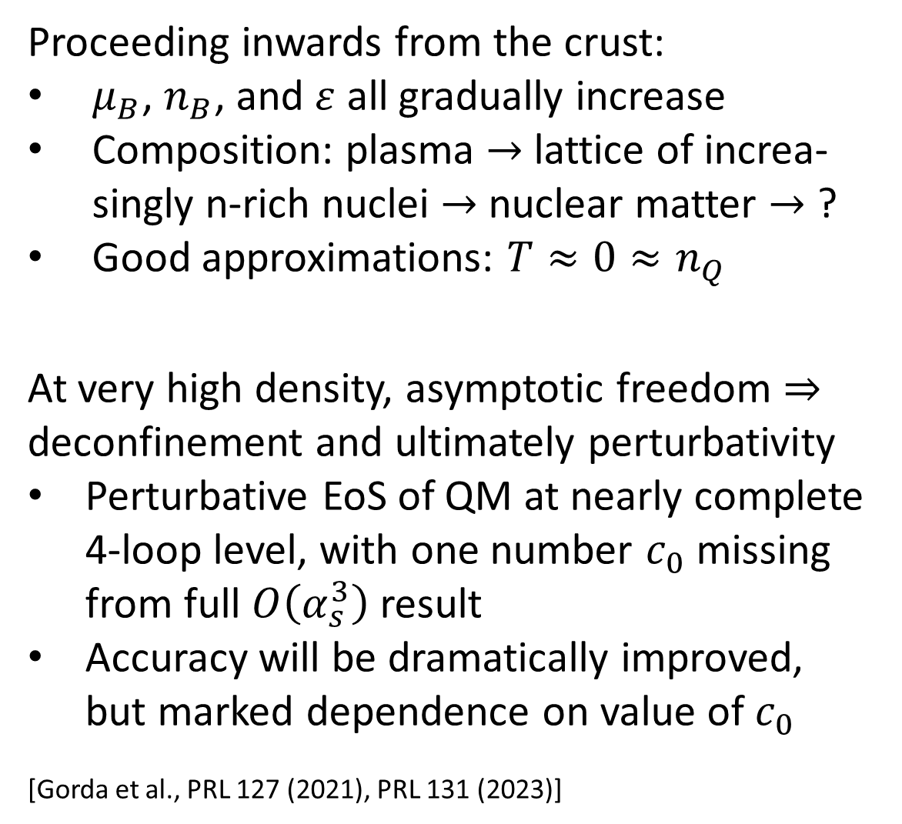
Proceeding inwards from the crust:
$μ_{B}$, $n_{B}$, and $ε$ all gradually increase
Composition: plasma $→$ lattice of increa-singly n-rich nuclei $→$ nuclear matter $→$ ?
Good approximations: $T≈0≈n_{Q}$
At very high density, asymptotic freedom $⇒$ deconfinement and ultimately perturbativity
Perturbative EoS of QM at nearly complete 4-loop level, with one number $c_{0}$ missing from full $O\left(α_{s}^{3}\right)$ result
Accuracy will be dramatically improved, but marked dependence on value of $c_{0}$
[Gorda et al., PRL 127 (2021), PRL 131 (2023)]

Slide 21
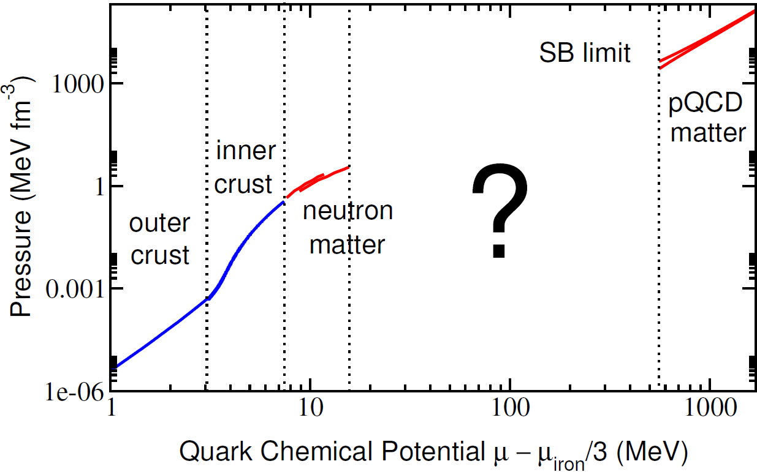
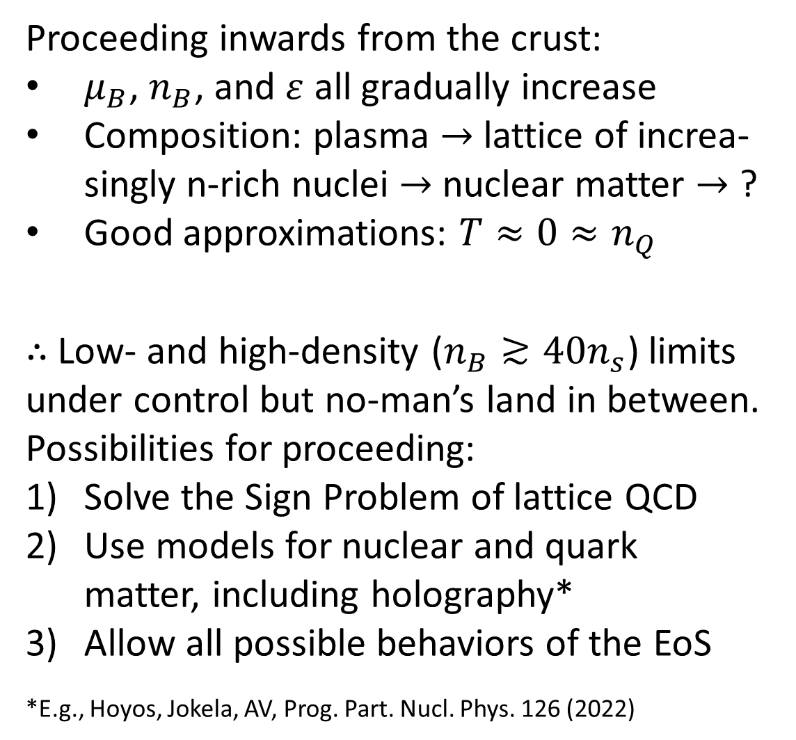
Proceeding inwards from the crust:
$μ_{B}$, $n_{B}$, and $ε$ all gradually increase
Composition: plasma $→$ lattice of increa-singly n-rich nuclei $→$ nuclear matter $→$ ?
Good approximations: $T≈0≈n_{Q}$
$∴$ Low- and high-density ($n_{B}≳40n_{s}$) limits under control but no-man’s land in between. Possibilities for proceeding:
Solve the Sign Problem of lattice QCD
Use models for nuclear and quark matter, including holography*
Allow all possible behaviors of the EoS
*E.g., Hoyos, Jokela, AV, Prog. Part. Nucl. Phys. 126 (2022)

Slide 22
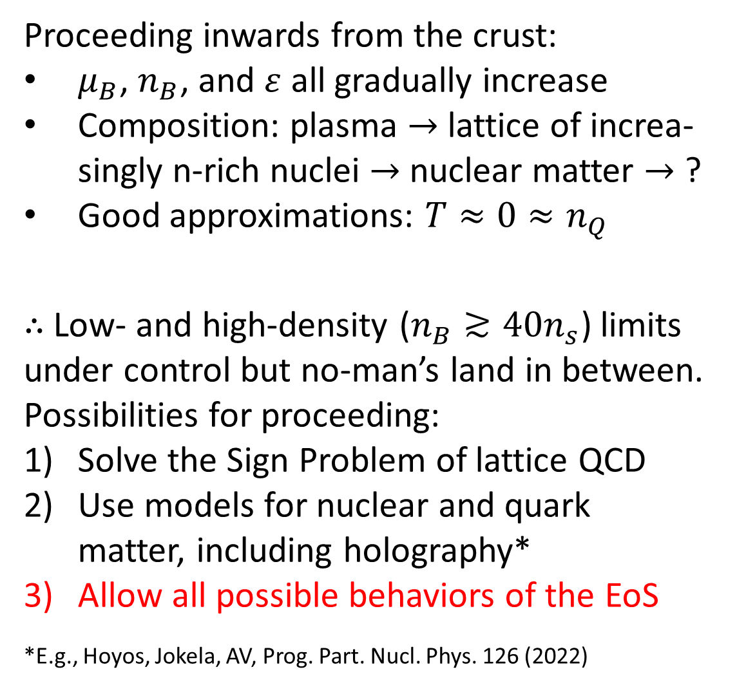
Proceeding inwards from the crust:
$μ_{B}$, $n_{B}$, and $ε$ all gradually increase
Composition: plasma $→$ lattice of increa-singly n-rich nuclei $→$ nuclear matter $→$ ?
Good approximations: $T≈0≈n_{Q}$
$∴$ Low- and high-density ($n_{B}≳40n_{s}$) limits under control but no-man’s land in between. Possibilities for proceeding:
Solve the Sign Problem of lattice QCD
Use models for nuclear and quark matter, including holography*
Allow all possible behaviors of the EoS
*E.g., Hoyos, Jokela, AV, Prog. Part. Nucl. Phys. 126 (2022)

Slide 23
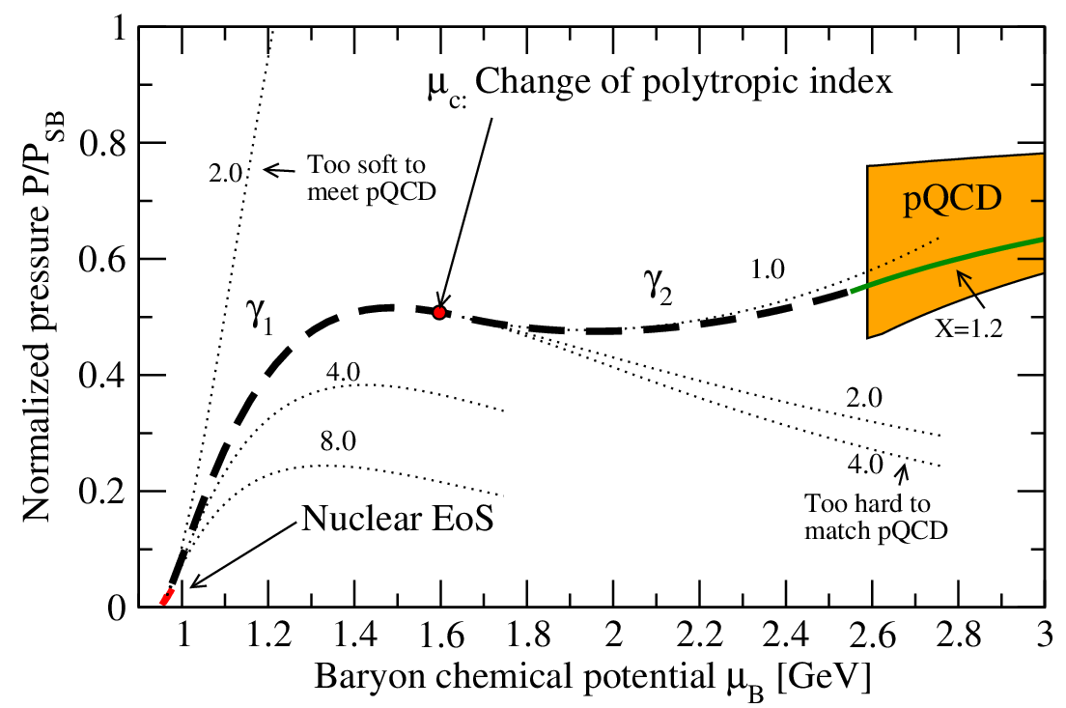
Possible way to proceed: build ensembles of randomly generated interpolators with piecewise-defined basis functions – or use nonparametric Gaussian Process regression

Slide 24
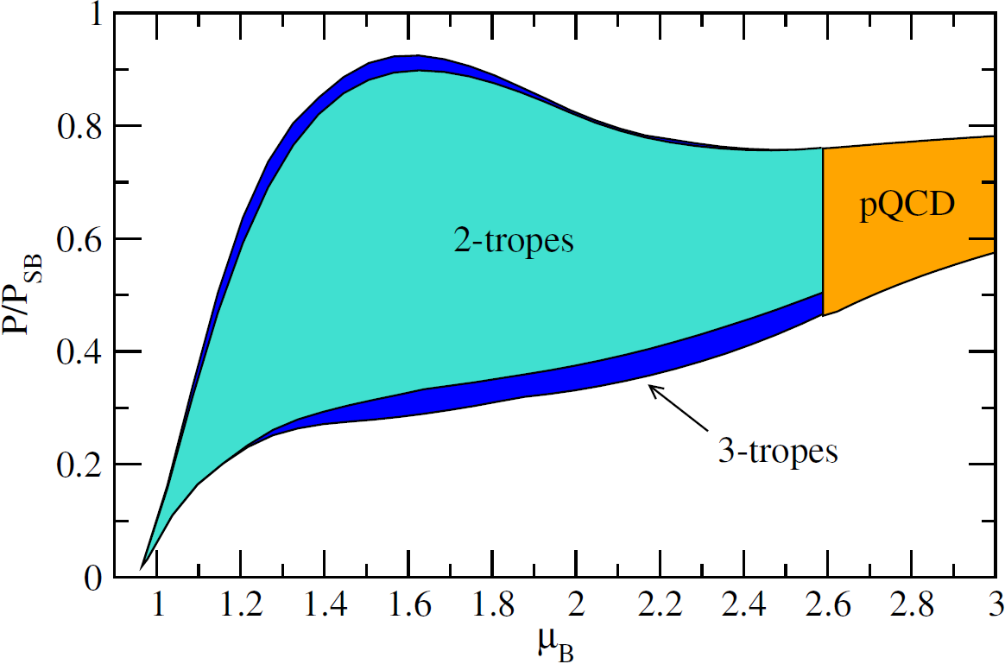
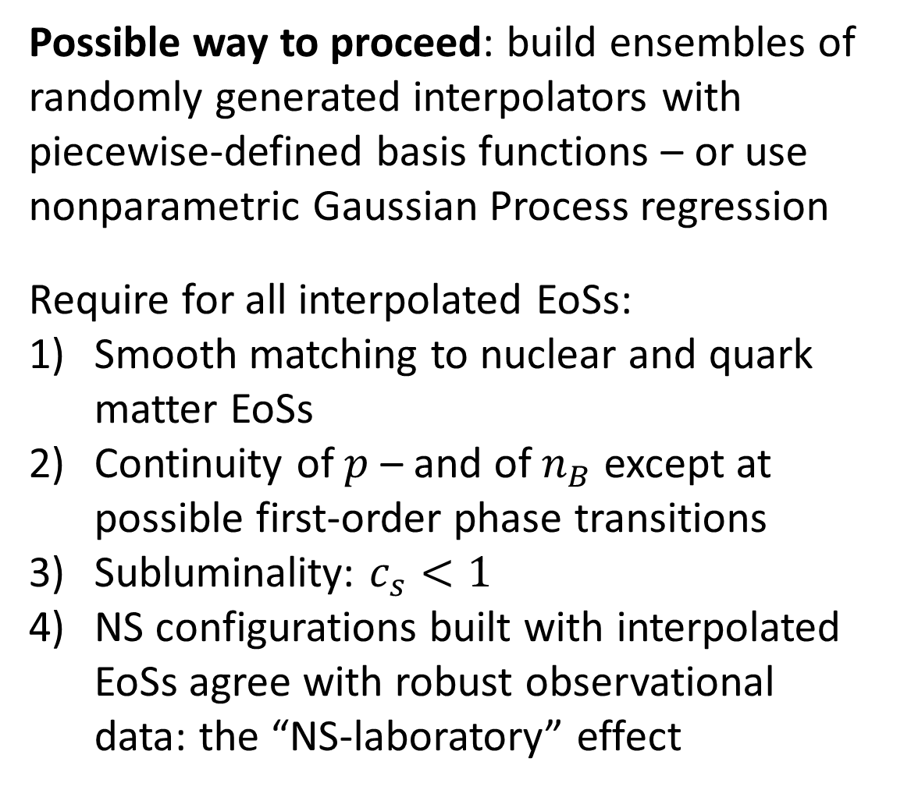
Possible way to proceed: build ensembles of randomly generated interpolators with piecewise-defined basis functions – or use nonparametric Gaussian Process regression
Require for all interpolated EoSs:
Smooth matching to nuclear and quark matter EoSs
Continuity of $p$ – and of $n_{B}$ except at possible first-order phase transitions
Subluminality: $c_{s}<1$
NS configurations built with interpolated EoSs agree with robust observational data: the “NS-laboratory” effect
[Kurkela et al., ApJ 789 (2014), Gorda et al., ApJ 950 (2023)]

Slide 25
What do we know from NS observations?

Slide 26
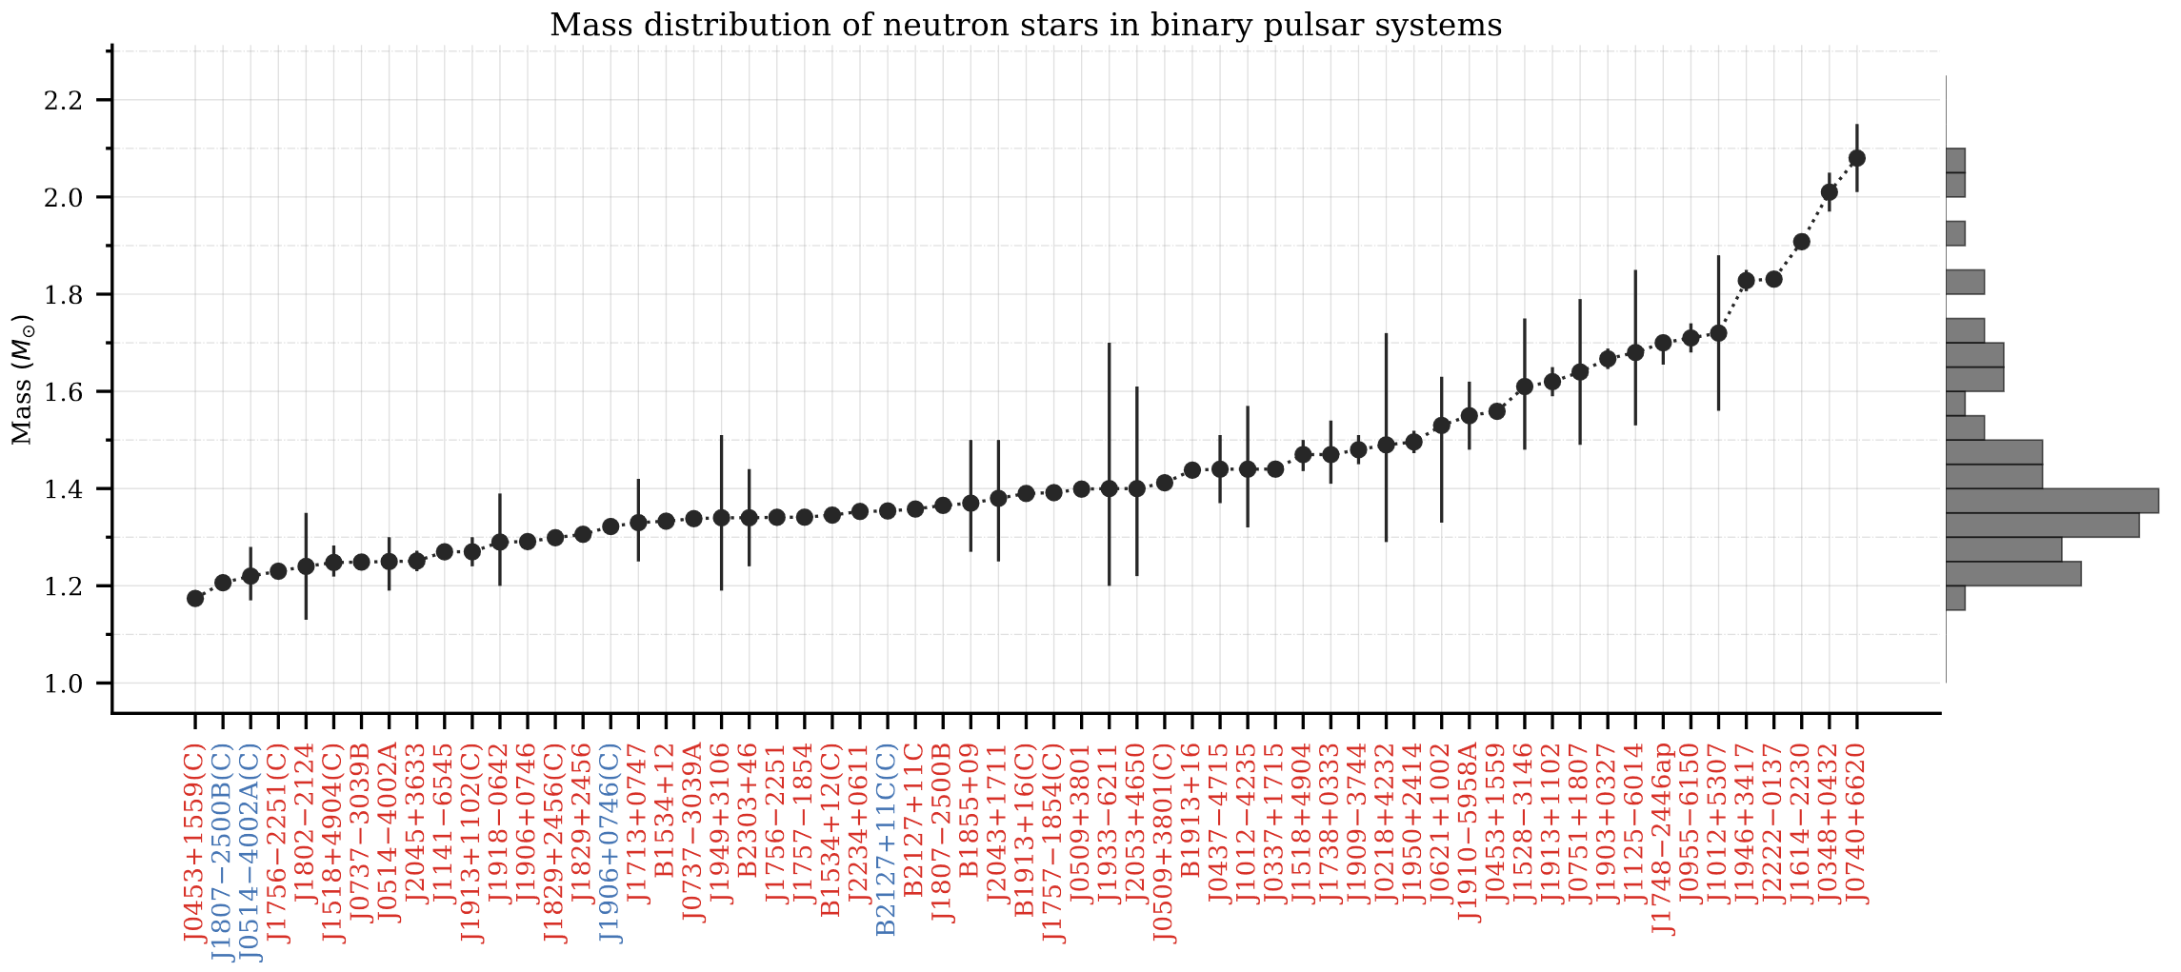
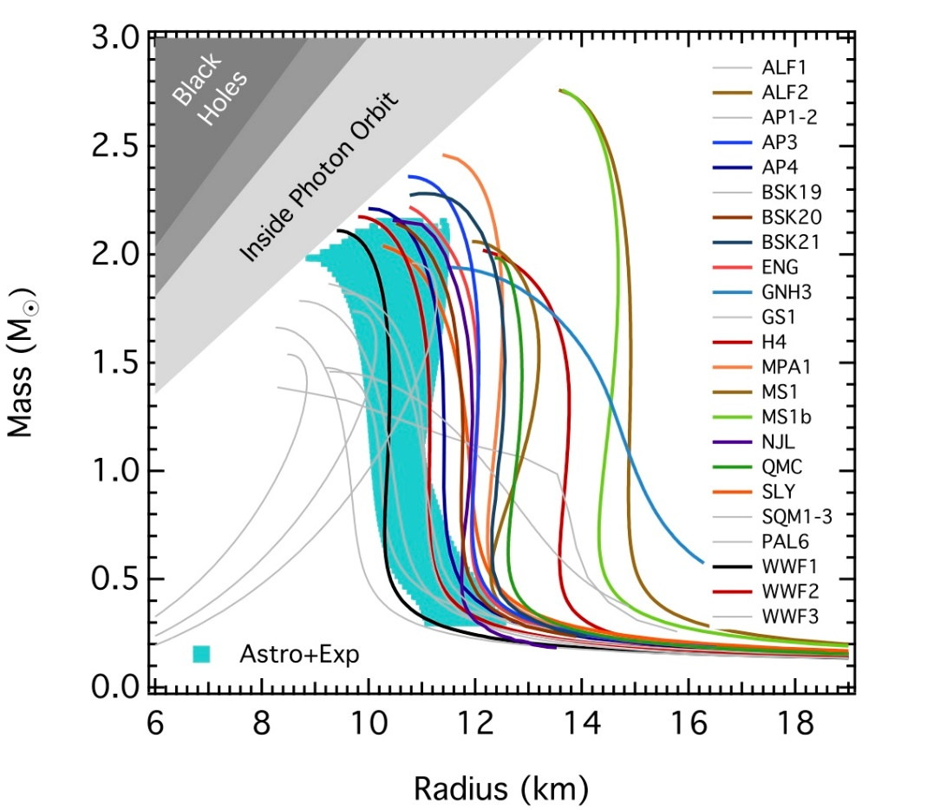
Source: Paulo Freire
Two Shapiro-delay measurements of two-solar-mass NSs [Demorest et al., Nature 467 (2010) Antoniadis et al., Science 340 (2013) Cromartie et al., Nature Astronomy 4 (2019)]: $M_{TOV}≳2M_{⊙}$

Slide 27
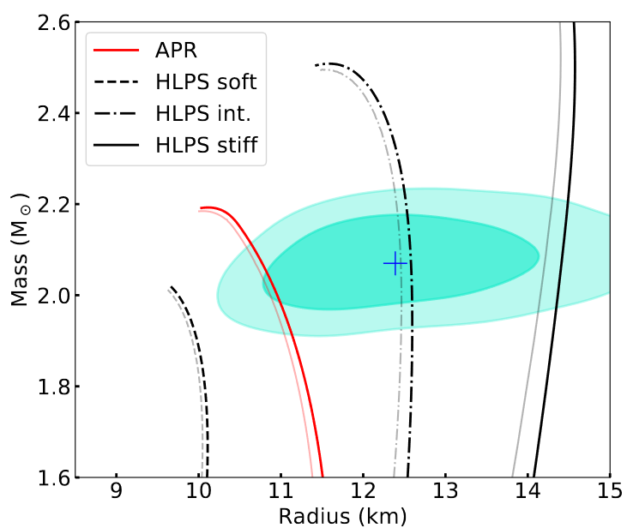
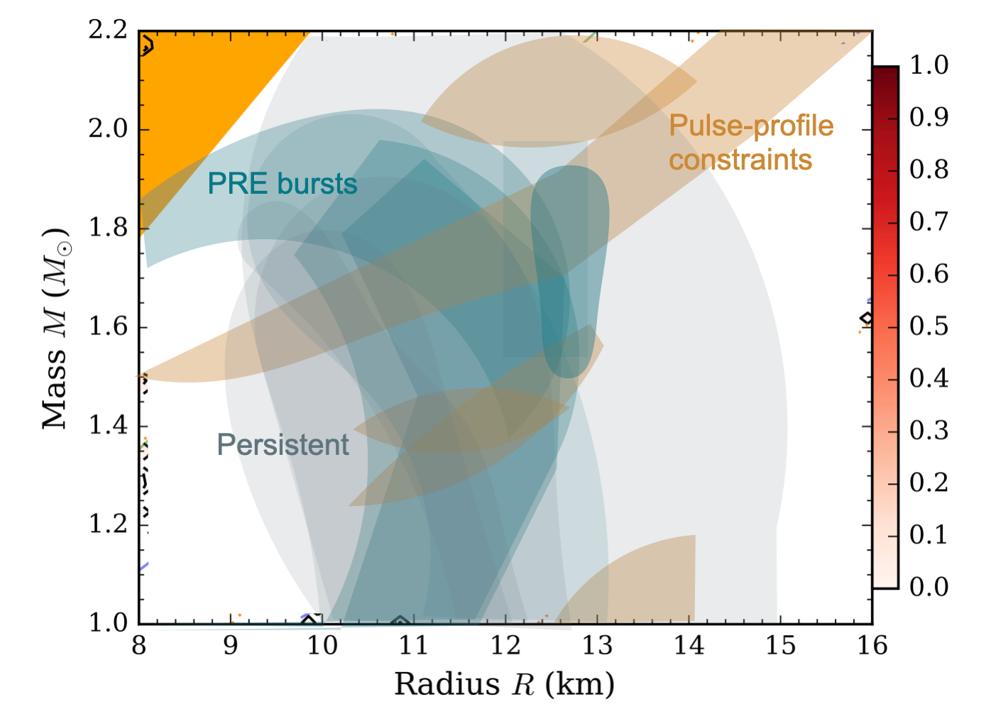
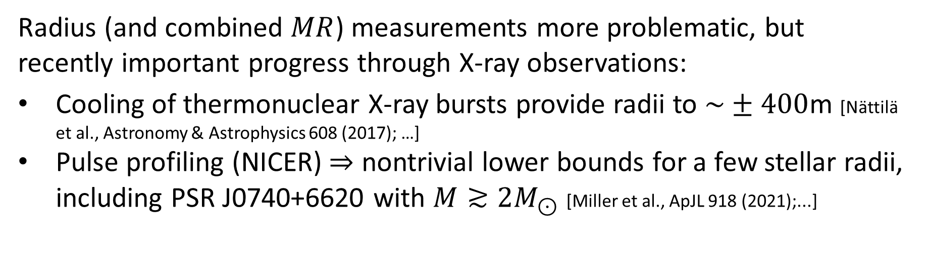
Radius (and combined $MR$) measurements more problematic, but recently important progress through X-ray observations:
Cooling of thermonuclear X-ray bursts provide radii to $\sim ±400$m [Nättilä et al., Astronomy & Astrophysics 608 (2017); …]
Pulse profiling (NICER) $⇒$ nontrivial lower bounds for a few stellar radii, including PSR J0740+6620 with $M≳2M_{⊙}$ [Miller et al., ApJL 918 (2021);...]
Source: Joonas Nättilä

Slide 28


Gravitational wave breakthrough: First observed binary NS merger GW170817 by LIGO & Virgo in 2017 (and many since then)
Three types of potential inputs:
Tidal deformabilities of the NSs during inspiral – good measure of stellar compactness
Postmerger waveform – sensitive to EoS and transport, but frequency too high for LIGO
EM counterpart – indirect information on merger product
Gravitational wave breakthrough: First observed binary NS merger GW170817 by LIGO & Virgo in 2017 (and many since then)
Three types of potential inputs:
Tidal deformabilities of the NSs during inspiral – good measure of stellar compactness
Postmerger waveform – sensitive to EoS and transport, but frequency too high for LIGO
EM counterpart – indirect information on merger product
[LIGO and Virgo collaborations, PRL 119 (2017), PRL 121 (2018)]

Slide 29


Tidal deformability: How large a quadrupolar moment NS’s gravitational field develops due to an external quadrupolar field
$$Q_{ij}=−Λℰ_{ij}$$
Substantial effect on observed GW waveform during inspiral phase.
[Read et al., PRD 88 (2013)]

Slide 30



Tidal deformability: How large a quadrupolar moment NS’s gravitational field develops due to an external quadrupolar field
$$Q_{ij}=−Λℰ_{ij}$$
LIGO & Virgo bound $70<Λ(1.4M_{⊙})< 580$ at 90% credence using low spin prior: useful test for EoSs [LIGO and Virgo, PRL 121 (2018)]

Slide 31
Gravitational wave breakthrough: First observed binary NS merger GW170817 by LIGO & Virgo in 2017 (and many since then)
Three types of potential inputs:
Tidal deformabilities of the NSs during inspiral – good measure of stellar compactness
Postmerger waveform – sensitive to EoS and transport, but frequency too high for LIGO
EM counterpart – indirect information on merger product
[LIGO and Virgo collaborations, PRL 119 (2017), PRL 121 (2018)]

Slide 32

Ringdown pattern: Unlike in BH mergers, binary NS mergers expected to feature complex period of relaxation characterized by GW spectrum sensitive to both initial NS masses and the EoS
Scenario 1: prompt collapse
Scenario 2: collapse during hyper-massive phase (differential rotation)
Scenario 3: collapse during supra-massive phase (uniform rotation)
Scenario 4: no collapse
[Baiotti, Rezzolla, Rept.Prog.Phys. 80 (2017)]

Slide 33

Relativistic MHD simulations show sensitivity of postmerger waveform to first-order phase transitions, other EoS features and even transport effects.
Frequencies too high for existing GW-experiments, but future 3rd-generation observatories expected to improve the situation.
[Takami, Rezzolla, Baiotti, PRD 91 (2015)]

Slide 34
Gravitational wave breakthrough: First observed binary NS merger GW170817 by LIGO & Virgo in 2017 (and many since then)
Three types of potential inputs:
Tidal deformabilities of the NSs during inspiral – good measure of stellar compactness
Postmerger waveform – sensitive to EoS and transport, but frequency too high for LIGO
EM counterpart – indirect information on merger product
[LIGO and Virgo collaborations, PRL 119 (2017), PRL 121 (2018)]

Slide 35

In GW170817, short gamma-ray burst 1.7s after GWs, followed by optical signal: Delayed collapse to a black hole

Slide 36

In GW170817, short gamma-ray burst 1.7s after GWs, followed by optical signal: Delayed collapse to a black hole
Important constraint for the maximal TOV mass of stable NSs:
In the supramassive scenario, $M_{remnant}≥M_{TOV}$
In the hypermassive scenario, $M_{remnant}≥M_{Kepler}>M_{TOV}$

Slide 37

In GW170817, short gamma-ray burst 1.7s after GWs, followed by optical signal: Delayed collapse to a black hole
Important constraint for the maximal TOV mass of stable NSs:
In the supramassive scenario, $M_{remnant}≥M_{TOV}$
In the hypermassive scenario, $M_{remnant}≥M_{Kepler}>M_{TOV}$
Hypermassive scenario considered more likely and leads to stronger constraints for $M_{TOV}$ & EoS [Rezzolla et al, ApJ 852 (2018)]

Slide 38
Summary of lecture 1
Outside black holes, neutron stars house highest-density matter in the observable Universe, providing unique laboratory for QCD
  Key question: do NS cores house stable deconfined matter?
In the last ~10 years, NS observations have advanced not only via GW observatories, but with mass and radius measurements of unprecedented accuracy
Tomorrow: how to deduce core properties through combination of robust theoretical results and reliable observations?

Slide 39
Lessons from heavy-ion physics

Slide 40


Some lessons from heavy-ion experiments & lattice studies of hot QGP:

Slide 41

Some lessons from heavy-ion experiments & lattice studies of hot QGP:
In dilute limit, deconfinement transition a crossover at $T\sim 155$ MeV, $ε\sim 400$ MeV/${fm}^{3}$

Slide 42

Some lessons from heavy-ion experiments & lattice studies of hot QGP:
In dilute limit, deconfinement transition a crossover at $T\sim 155$ MeV, $ε\sim 400$ MeV/${fm}^{3}$
Soon thereafter rapid but smooth approach towards conformal behavior: $γ≡\frac{d\ln{p}}{d\ln{ε}}≈1$, $c_{s}^{2}≲1/3$

Slide 43

Some lessons from heavy-ion experiments & lattice studies of hot QGP:
In dilute limit, deconfinement transition a crossover at $T\sim 155$ MeV, $ε\sim 400$ MeV/${fm}^{3}$
Soon thereafter rapid but smooth approach towards conformal behavior: $γ≡\frac{d\ln{p}}{d\ln{ε}}≈1$, $c_{s}^{2}≲1/3$
Strong coupling machinery useful for transport & dynamics, but bulk thermo-dynamic properties of hot QGP consistent with resummed pQCD from $T\sim 2.5T_{c}$

Slide 44

Some lessons from heavy-ion experiments & lattice studies of hot QGP:
In dilute limit, deconfinement transition a crossover at $T\sim 155$ MeV, $ε\sim 400$ MeV/${fm}^{3}$
Soon thereafter rapid but smooth approach towards conformal behavior: $γ≡\frac{d\ln{p}}{d\ln{ε}}≈1$, $c_{s}^{2}≲1/3$
Strong coupling machinery useful for transport & dynamics, but bulk thermo-dynamic properties of hot QGP consistent with resummed pQCD from $T\sim 2.5T_{c}$
Presence of deconfined matter confirmed indirectly through presence of a near-thermal medium with $T>T_{c}$

Slide 45



NS-matter EoS: model-independent interpolation
$$+$$
$$→ ???$$

Slide 46

Useful strategy in interpolation: Start from the speed of sound as a function of $μ_{q}$ and classify results in terms of maximal value $c_{s}^{2}$ reaches at any density [Annala et al., Nature Physics (2020) and PRX (2022)]

Slide 47



Useful strategy in interpolation: Start from the speed of sound as a function of $μ_{q}$ and classify results in terms of maximal value $c_{s}^{2}$ reaches at any density [Annala et al., Nature Physics (2020) and PRX (2022)]
Allows accurate tracking of $c_{s}^{2}$ – an interesting quantity with tension between expectations from nuclear theory and experience from other contexts

Slide 48


Useful strategy in interpolation: Start from the speed of sound as a function of $μ_{q}$ and classify results in terms of maximal value $c_{s}^{2}$ reaches at any density [Annala et al., Nature Physics (2020) and PRX (2022)]
Allows accurate tracking of $c_{s}^{2}$ – an interesting quantity with tension between expectations from nuclear theory and experience from other contexts
$$c/\sqrt{3}$$
[Hoyos, Jokela, Rodriguez, Vuorinen, PRD 94 (2016)]

Slide 49

On top of the usual low- and high-density limits, always require:
EoS must support $2M_{⊙}$ stars
LIGO/Virgo 90% tidal deformability limit must be satisfied
[Annala et al., Nature Physics (2020)]

Slide 50
On top of the usual low- and high-density limits, always require:
EoS must support $2M_{⊙}$ stars
LIGO/Virgo 90% tidal deformability limit must be satisfied
[Annala et al., Nature Physics (2020)]
In addition, can also take into account:
NICER data for PSR J0740+6620:
  $R\left(2M_{⊙}\right)>11.0$km (95%)
  $R\left(2M_{⊙}\right)>12.2$km (68%)
BH formation in GW170817 via
  Supramassive or hypermassive NS
[Annala et al., PRX 12 (2022)]

Slide 51




On top of the usual low- and high-density limits, always require:
EoS must support $2M_{⊙}$ stars
LIGO/Virgo 90% tidal deformability limit must be satisfied
[Annala et al., Nature Physics (2020)]
In addition, can also take into account:
NICER data for PSR J0740+6620:
  $R\left(2M_{⊙}\right)>11.0$km (95%)
  $R\left(2M_{⊙}\right)>12.2$km (68%)
BH formation in GW170817 via
  Supramassive or hypermassive NS
[Annala et al., PRX 12 (2022)]

Slide 52


On top of the usual low- and high-density limits, always require:
EoS must support $2M_{⊙}$ stars
LIGO/Virgo 90% tidal deformability limit must be satisfied
[Annala et al., Nature Physics (2020)]
In addition, can also take into account:
NICER data for PSR J0740+6620:
  $R\left(2M_{⊙}\right)>11.0$km (95%)
  $R\left(2M_{⊙}\right)>12.2$km (68%)
BH formation in GW170817 via
  Supramassive or hypermassive NS
[Annala et al., PRX 12 (2022)]

Slide 53





The EoS band features clear two-phase structure, with polytropic index $γ≡\frac{d\ln{p}}{d\ln{ε}}$ transitioning from hadronic ($γ≳2.5$) to near-conformal ($γ≈1$) behavior below TOV densities: evidence for QM cores?
[Annala et al., Nature Physics (2020)]
$1.4M_{⊙}$ NSs
QM criterion
TOV stars

Slide 54

The EoS band features clear two-phase structure, with polytropic index $γ≡\frac{d\ln{p}}{d\ln{ε}}$ transitioning from hadronic ($γ≳2.5$) to near-conformal ($γ≈1$) behavior below TOV densities: evidence for QM cores?
[Annala et al., Nature Physics (2020)]

Slide 55

The EoS band features clear two-phase structure, with polytropic index $γ≡\frac{d\ln{p}}{d\ln{ε}}$ transitioning from hadronic ($γ≳2.5$) to near-conformal ($γ≈1$) behavior below TOV densities: evidence for QM cores?
[Annala et al., Nature Physics (2020)]
However, obvious questions remain:
Do other quantities display similar signs of conformalization?
Does conformalization necessarily imply onset of deconfinement?
How likely are QM cores in TOV stars?
What is the role of the pQCD limit?

Slide 56
NS-matter EoS and QM cores: Bayesian analysis

Slide 57


Improvements in recent work:
  Use Bayes’ theorem to factor in statistical uncertainty $⇒$ Ability to include more data
  Track also conformal anomaly and its log derivative $∆ ≡\frac{ε−3p}{3ε}$, $∆′≡\frac{d∆}{d\ln{ε}}$
  Use also non-parametric Gaussian Process regression in EoS construction
$$P\left(EoS | data\right)=\frac{P(data|EoS)P(EoS)}{P(data)}$$
[Annala, Gorda, Hirvonen, Komoltsev, Kurkela, Nättilä, AV, Nature Communications 14 (2023)]
57

Slide 58


Improvements in recent work:
  Use Bayes’ theorem to factor in statistical uncertainty $⇒$ Ability to include more data
  Track also conformal anomaly and its log derivative $∆ ≡\frac{ε−3p}{3ε}$, $∆′≡\frac{d∆}{d\ln{ε}}$
  Use also non-parametric Gaussian Process regression in EoS construction
  Goal: Using known ab-initio limits for quantities studied, obtain numerical likelihoods for different scenarios concerning QM cores
$$P\left(EoS | data\right)=\frac{P(data|EoS)P(EoS)}{P(data)}$$
[Annala, Gorda, Hirvonen, Komoltsev, Kurkela, Nättilä, AV, Nature Communications 14 (2023)]
58

Slide 59


Main results:
All quantities studied – $γ, c_{s}^{2}, ∆, ∆′$ – consistently approach their conformal limits close to (but below) the central densities of maximal-mass stars
[Annala, Gorda, Hirvonen, Komoltsev, Kurkela, Nättilä, AV, Nature Comm. 14 (2023)]
59

Slide 60

Main results:
Optimal quantity to track: “conformal distance” $d_{c}≡\sqrt{∆^{2}+{\left(∆^{′}\right)}^{2}}$
  Given $Δ=\frac{1}{3}−\frac{c_{s}^{2}}{γ}$, $∆^{′}=c_{s}^{2}\left(\frac{1}{γ}−1\right)$, $d_{c}→0$ implies conformalization of all quantities considered
  Values in dense NM and perturbative QM sufficiently far apart
  In first-order phase transitions (FOPT), $d_{c}≥1/(3\sqrt{2})≈0.24$
[Annala, Gorda, Hirvonen, Komoltsev, Kurkela, Nättilä, AV, Nature Comm. 14 (2023)]
60

Slide 61


Main results:
With conservative* criterion $d_{c}<0.2$, likelihoods for having near-conformal matter in centers of different NSs:
$1.4M_{⊙}$ NSs: 0%
$2.0M_{⊙}$ NSs: 11%
$M_{TOV}$ NSs: 88%
Crucial: All EoSs in the remaining 12% bin feature FOPT-like behavior!
*With old $γ<1.75$ criterion, 88% $→$ 99.8%
[Annala, Gorda, Hirvonen, Komoltsev, Kurkela, Nättilä, AV, Nature Comm. 14 (2023)]
61

Slide 62


Main results:
For weak coupling and CFTs, normalized pressure $∝$ # active degrees of freedom.
In centers of TOV stars, $p/p_{FD}$ at approx.
2/3 of its pQCD value, while at high T the crossover transition from hadron gas to QGP at much smaller values of $p/p_{SB}$.
$∴$ “Near-conformal“ very likely implies “deconfined”.
[Annala, Gorda, Hirvonen, Komoltsev, Kurkela, Nättilä, AV, Nature Comm. 14 (2023)]
62

Slide 63



Main results:
Results independent of the details of interpolation, with those from Gaussian Process regression well in line with the $c_{s}^{2}$ ones.
With GP method, possible to show it is precisely the pQCD constraint that softens the EoS in the cores of TOV stars.
[Gorda, Komoltsev, Kurkela, Astrophys. J. 950 (2023)]
[Annala, Gorda, Hirvonen, Komoltsev, Kurkela, Nättilä, AV, Nature Comm. 14 (2023)]
63

Slide 64


Remaining caveat: strong first-order PTs
Most current results approximate PTs as rapid crossovers, but some preliminary results with discontinuous transitions exist:
In hard-limit setups, possible to exit EoS bounds based on rapid crossovers
  Destabilizing solutions often extreme, but not unreasonably so
Implications for likelihood of QM cores inconclusive so far
[Gorda, Hebeler, Kurkela Schwenk, AV, Astrophys. J. 955 (2023)]
[Komoltsev, arXiv:2404.05637]
[Blomqvist, Ecker, Gorda, AV, In preparation]
64

Slide 65
Conclusions

Slide 66

Next years will bring exciting developments:
Einstein Telesc. & Cosmic Explorer hope- fully sensitive to postmerger waveform
Dramatic improvement to pQCD limit via Loop Tree Duality [Paatelainen, Seppänen et al.]
Similar advances in CET EoS and radius measurements to be expected
66

Slide 67

Next years will bring exciting developments:
Einstein Telesc. & Cosmic Explorer hope- fully sensitive to postmerger waveform
Dramatic improvement to pQCD limit via Loop Tree Duality [Paatelainen, Seppänen et al.]
Similar advances in CET EoS and radius measurements to be expected
The current setup already constrains novel non-perturbative physics, such as the quark pairing gap*. Once QCD part of the problem fully solved, NSs can be turned into labs of even more exciting new physics!
*Kurkela, Rajagopal, Steinhorst, PRL 132 (2024)
67

