Slide 1



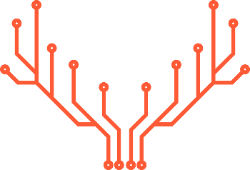
DAQ Pilot User Project
New Firmware Architecture
Caribou Boreal
DRD3/MPW-Caribou-CERN-University of Seville
J. Jiménez-Sánchez¹, Y- Otarid², D. Dannheim², F.R Palomo Pinto ¹, J.M. Hinojo-Montero¹ , F. Muñoz-Chavero¹
¹ Electronic Engineering Department, University of Seville (Spain)
² CERN
DRD3-WG1 Internal Meeting
June 6 - 2024
DRD3

Slide 2



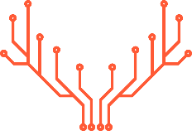
INDEX
DRD3
INTRODUCTION |  | 3
CONTEXT |  | 4
PROJECT DESCRIPTION |  | 8
PHASES |  | 12
CONCLUSIONS |  | 13
June 6, 2024, RD50 Meeting
jjsanchez@us.es

Slide 3





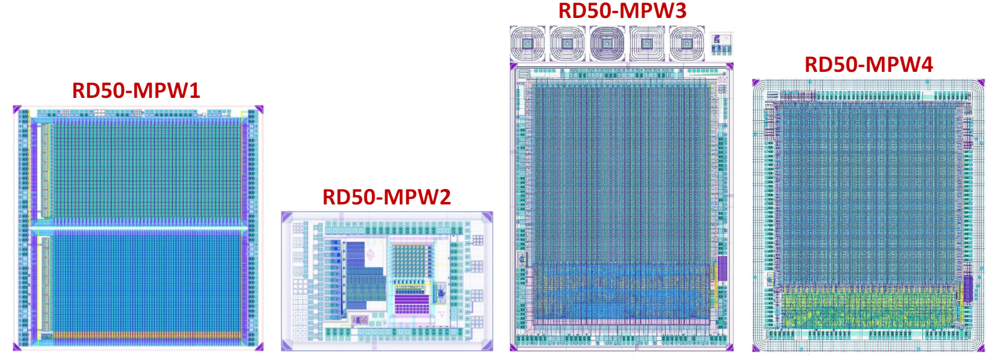


1. INTRODUCTION
DRD3
Pilot project New Boreal modular architecture from DAQ Caribou using MPWx chips
The objective of this pilot project is to modularize and adapt the firmware MPW4 developed by HEPHY in the user part of Caribou's new Boreal firmware architecture with Peary software integration.
This project is presented as a collaboration between the following institutions:
MPW
CHIPS
CARIBOU
USER PROJECT PILOT
FIRMWARE
June 6, 2024, RD50-CMOS Meeting
jjsanchez@us.es

Slide 4
2. CONTEXT
DRD3
Caribou Boreal
A unified, modular and configurable firmware
*Younes Otarid - Caribou Developers Meeting – 14.05.2024
Currently:
Block design recreated and reconfigured for each project (GIT repository for each chip integrated with Caribou)
Common IPs (Git repository with common IPs), sometimes copied and modified locally
No HDL simulation/verification
No CI/CD workflow and without documentation
Objective:
Optimized Workflow: Design of common blocks and IPs along with a base architecture (microprocessor, common blocks and AXI interface).
Starting from the base architecture, integration into the single project of the specific user block for each chip.
A single Git project for all devices
Enhanced HDL simulation/verification
Optimized CI/CD workflow and documented code
June 6, 2024, RD50 Meeting
jjsanchez@us.es

Slide 5
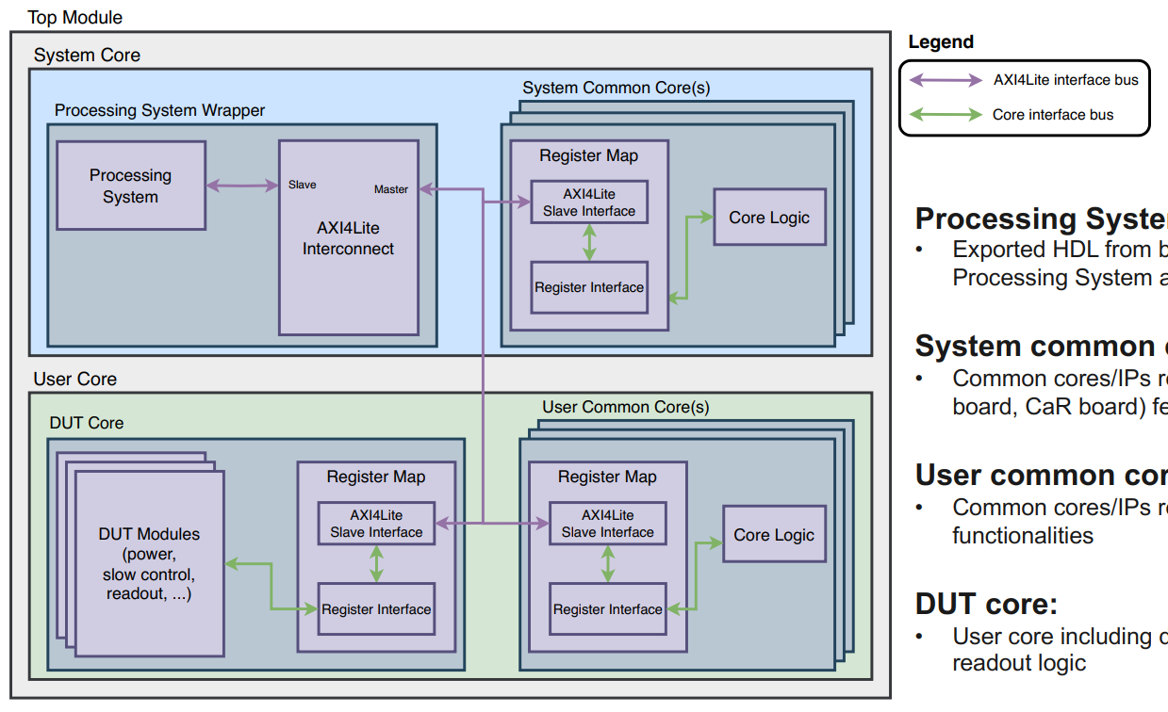
2. CONTEXT
DRD3
Caribou Boreal Firmware
Caribou Boreal
*Younes Otarid - Caribou Developers Meeting – 14.05.2024
Processing System wrapper:
Processing System and Reset IP (VHDL file)
Pre-configured for the Caribou Zynq board (ZC706)
One AXI4Lite interface per block (system/user core) with a unique address
System evolution and features extension (ZCU102 UltraScale+)
System common core(s):
Common cores/IPs related to the system (Zynq board, CaR board) features
DUT core:
User core including device-specific control and readout logic
User common core(s):
Common cores/IPs related to external or user functionalities
June 6, 2024, RD50 Meeting
jjsanchez@us.es

Slide 6


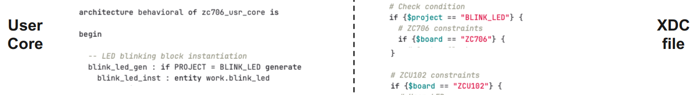

2. CONTEXT
DRD3
Caribou Boreal Firmware
*Younes Otarid - Caribou Developers Meeting – 14.05.2024
Project Configuration
Through Constants in the VHDL: supported SoC, supported devices and AXI interface
Simulation
Cocotb (VHDL and SystemVerilog RTL using Python) and Questa simulator
June 6, 2024, RD50 Meeting
jjsanchez@us.es

Slide 7
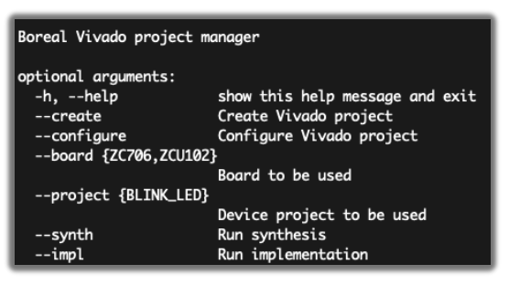
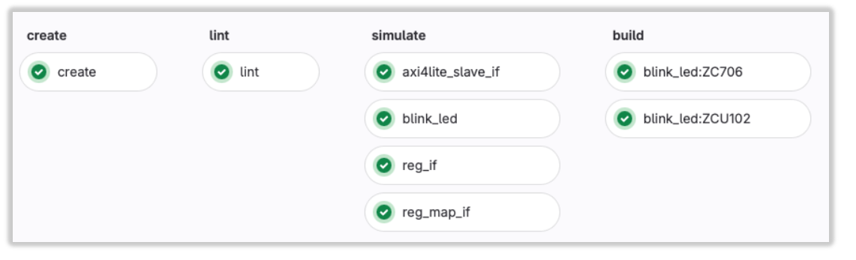
2. CONTEXT
DRD3
Caribou Boreal Firmware
*Younes Otarid - Caribou Developers Meeting – 14.05.2024
Boreal Manager
Python Script: Create Vivado, Configure the Vivado Project (chose SoC and device) and Build (Synthesis + Implementation + bitstream generation)
CI/CD Workflow
Single instance of project creation
Code linting using vhdl-linter and verible-format
Cocotb simulation of all cores
Bitstream generation for all supported devices and for all supported boards
June 6, 2024, RD50 Meeting
jjsanchez@us.es

Slide 8
3. PROJECT DESCRIPTION
DRD3
Caribou Boreal Firmware - Project Pilot (MPW4)
June 6, 2024, RD50 Meeting
jjsanchez@us.es

Slide 9
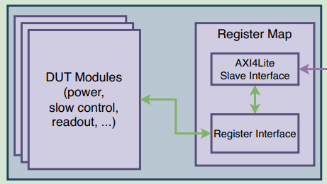
3. PROJECT DESCRIPTION
DRD3
Caribou Boreal Firmware - DUT Core Project Pilot (MPW4)
Modular Blocks – DUT Core:
Register map accessible via AXI interface, with configurable number of registers
Core logic connected to register map and to the core IO interface
Starting from the original MPW3/4 firmware provided by HEPHY, ADAPT AND MODULARIZE BLOCKS for each of the tasks:
MPW4 Slow Control
MPW4 Slow Readout (SoC)
MPW4 Fast Readout (GBE-SFP)
TLU Control
June 6, 2024, RD50 Meeting
jjsanchez@us.es

Slide 10
3. PROJECT DESCRIPTION
DRD3
Caribou Boreal – Integration and Software
Project Configuration
Integrate the necessary constants and configuration into the vHDL for the integration of the MPW4 device into the project.
Simulation
Simulation of the different modular blocks of MPW4 separately and in conjunction with Cocotb.
CI/CD Workflow
Add the simulation of the MPW4 blocks and verify in the workflow the code linting and construction with MPW4 in the global project.
Peary Modular Software
Configuration of the Caribou feeds necessary for the MPW4.
Integrate libraries in the new version of peary modular software for the MPW4 device.
June 6, 2024, RD50 Meeting
jjsanchez@us.es

Slide 11
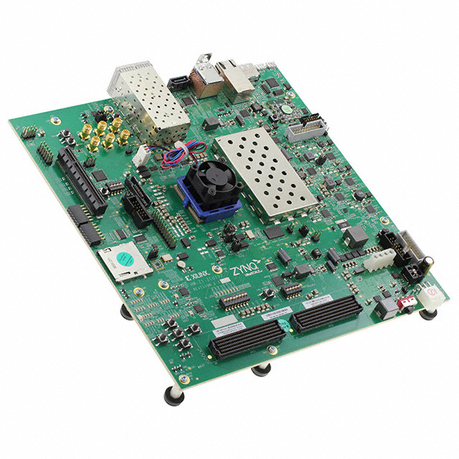
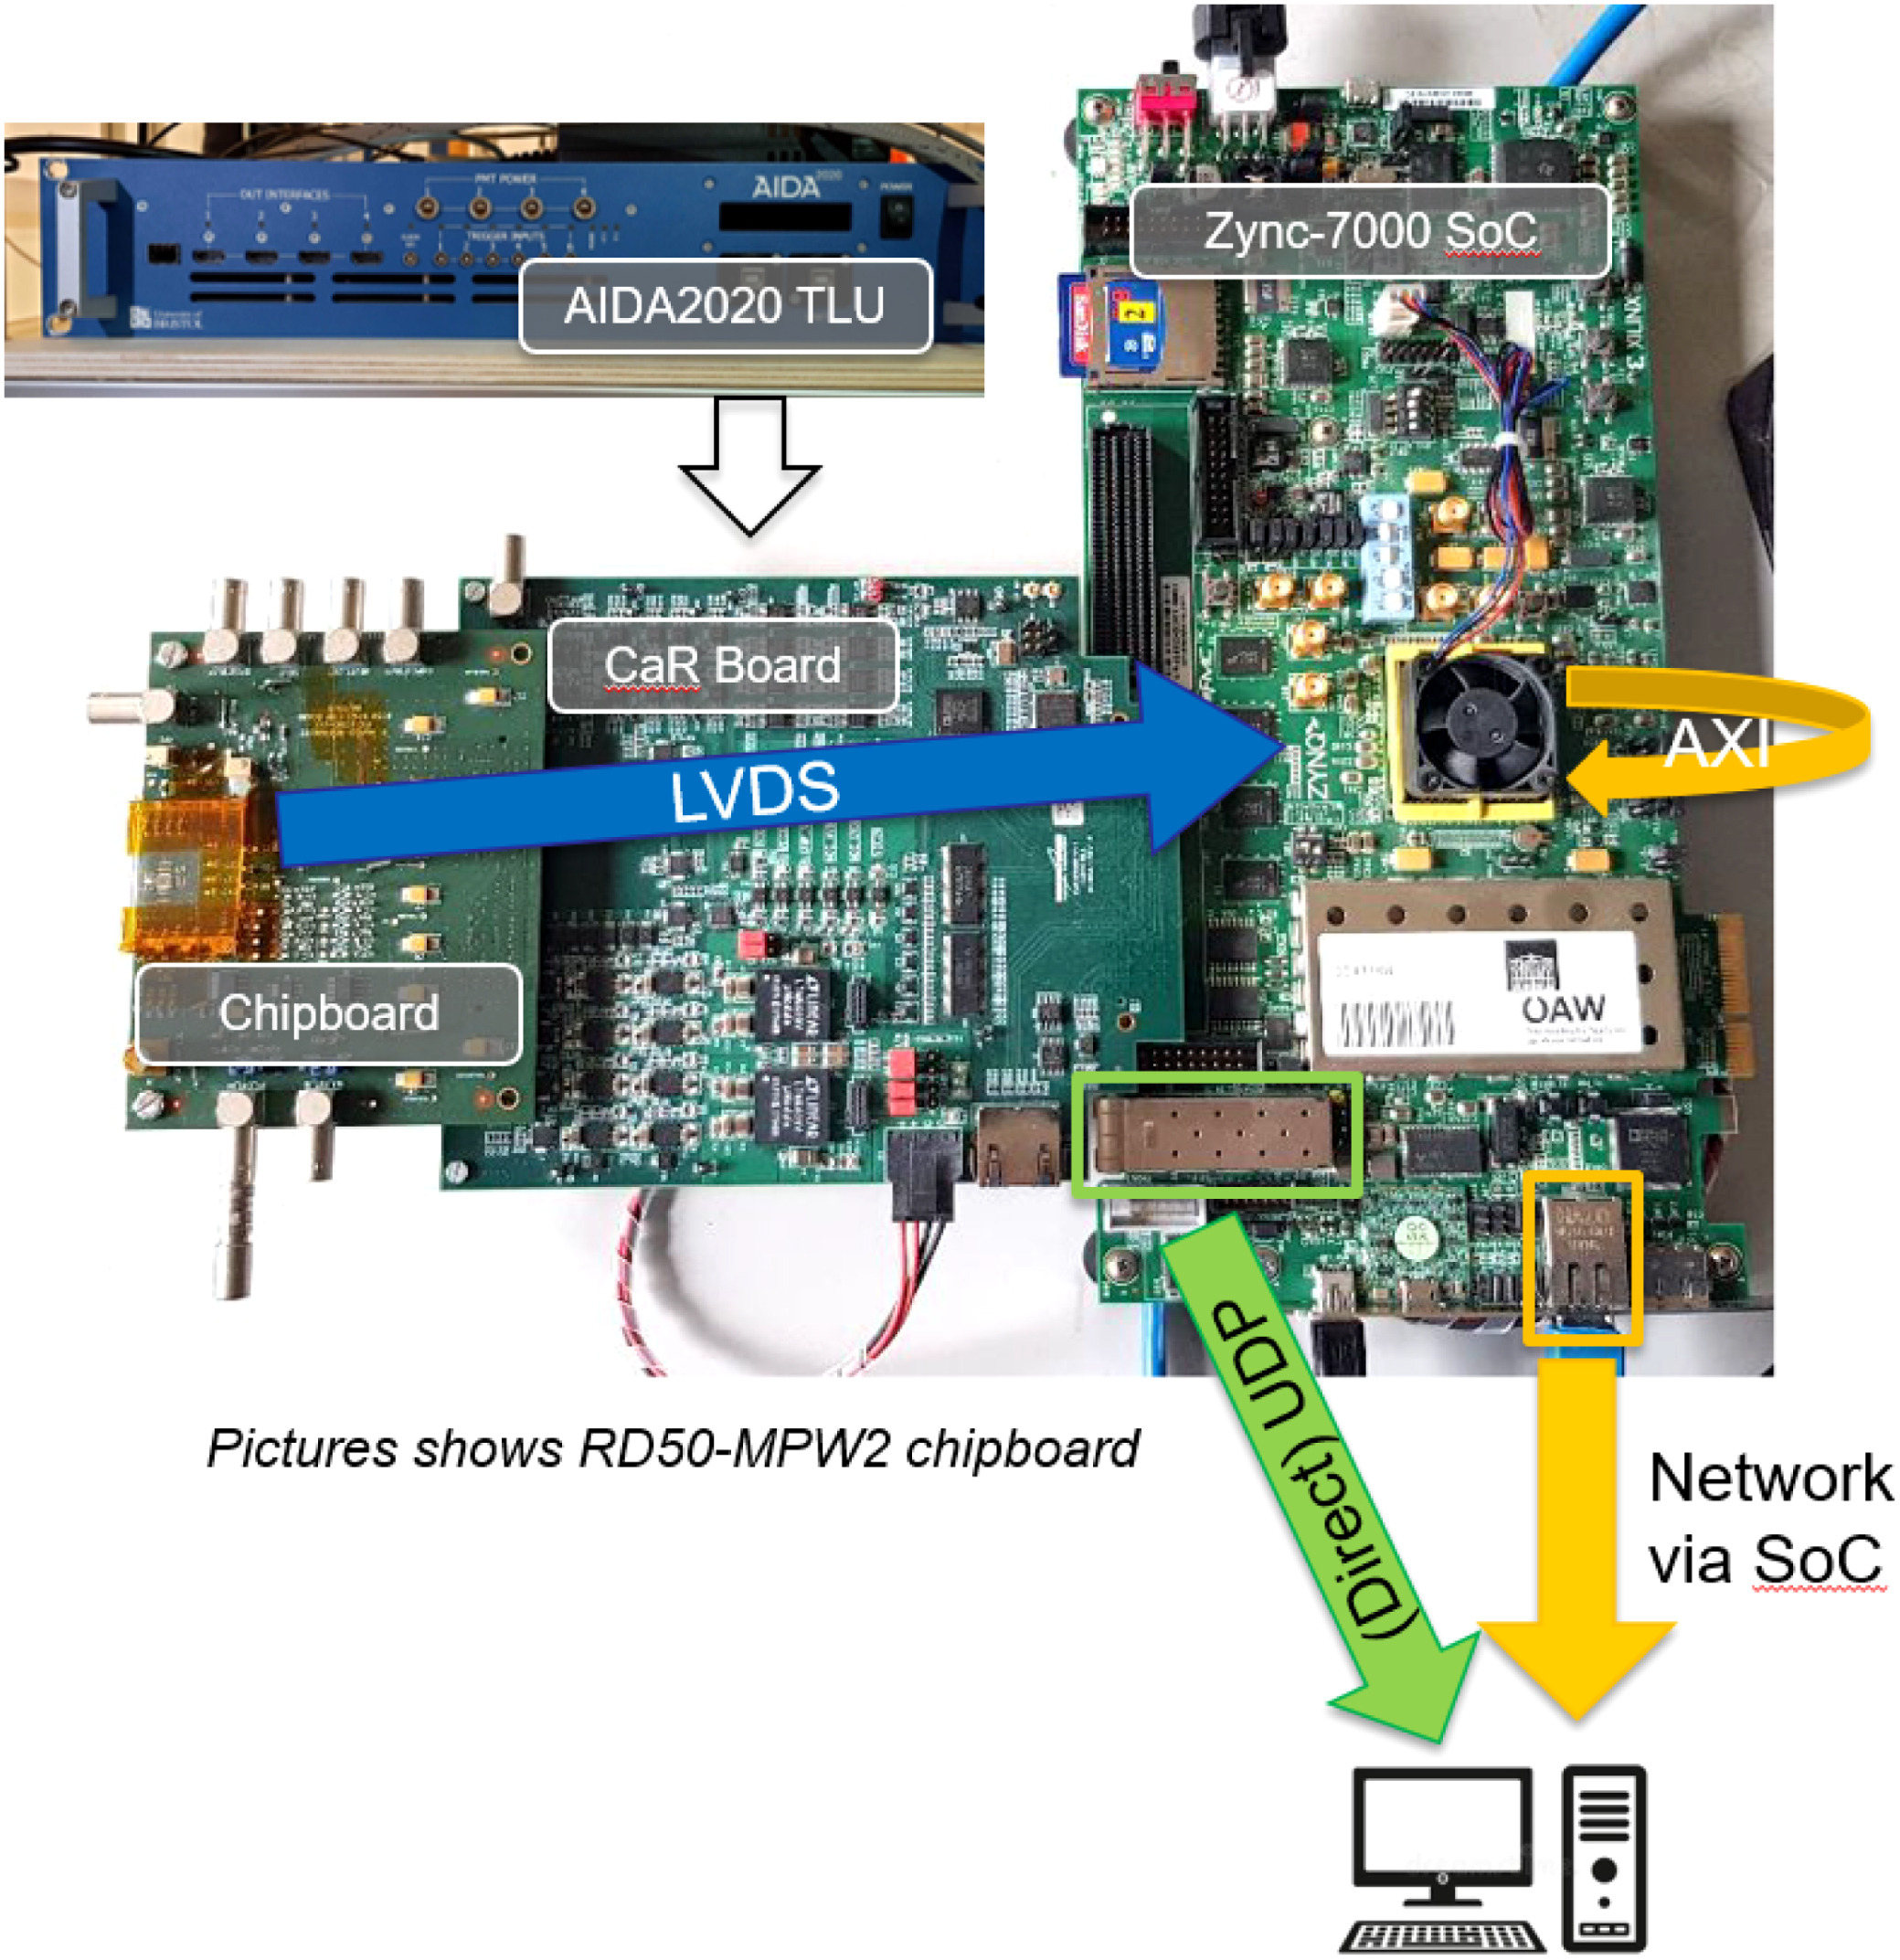
3. PROJECT DESCRIPTION
DRD3
Caribou Boreal – Verification
Test the complete system on both the ZC706 board and the
ZCU102 board (UltraScale+)
June 6, 2024, RD50 Meeting
jjsanchez@us.es

Slide 12
4. PHASES
DRD3
Phase 0: Study, analyze, and divide the original HEPHY firmware code into functional components.
Phase 1: example base Boreal architecture (blink LED developed by Younes) and integrate the slow control of MPW4 chip.
Phase 2: Cocotb Simulation and CI workflow of slow control MPW4 chip.
Phase 3: Slow control and configure the Caribou power supplies in the Peary software. Verify the slow control with the system and MPW4.
Phase 4: Integrate module firmware TLU control and readout MPW4 chip.
Phase 5: Cocotb Simulation and CI workflow of TLU an readout MPW4 chip.
Phase 6: Integrate the libraries for readout and TLU Peary software
.
Phase 7: Conduct a test with the complete systems (ZC706 and ZCU102).
June 6, 2024, RD50 Meeting
jjsanchez@us.es

Slide 13
5. CONCLUSIONS
DRD3
The new Boreal firmware architecture allows, based on a single, modularized and configurable base architecture, to simplify the integration of chips in the Caribou system.
This project involves using the MPW4 as the first chip in the new Boreal architecture.
For the above objectives, this pilot project aims to modularize and adapt the MPW4 firmware developed by HEPHY into the user part of Caribou's new Boreal firmware architecture. Additionally, the following tasks will be carried out:
  Add Automation in the Boreal project Vivado configuration
  Simulations with Cocotb and Questa of the modular blocks.
  Integration in CI Workflow
  Adaptation of Peray software libraries for the use of MPW4 in Boreal.
  Verification in ZC706 and the UltraScale+ ZCU102.
June 6, 2024, RD50 Meeting
jjsanchez@us.es

Slide 14
6. ACKNOWLEDGMENT
DRD3
Caribou Collaboration
Institute of High Energy Physics
DRD3(RD50)-MPW Collaboration
DRD3
June 6, 2024, RD50 Meeting
jjsanchez@us.es

Slide 15
DRD3
Thank you for your attention
Correspondence mail
Jorge Jiménez-Sánchez jjsanchez@us.es
DRD3
June 6, 2024, RD50 Meeting
jjsanchez@us.es

