Slide 1
Caribou 2
Eric Buschmann
AUG 6, 2024

Slide 2
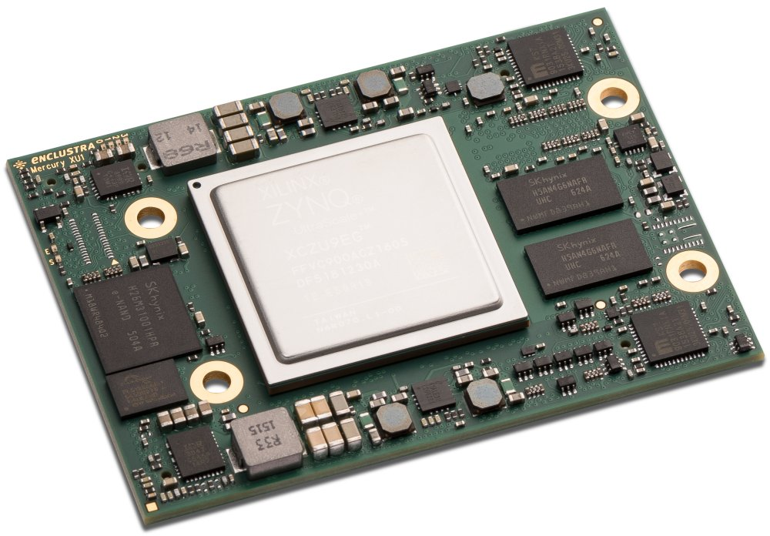
Caribou 2
Redesign of the Caribou system
Targets the Enclustra Mercury+ XU1 system-on-module, same as FETBv2
Requirements are not set in stone but ‘nice to have’ based on experience with V1.x
V1.x as baseline but should be an improvement over V1.x if the improvement is worth the effort / complexity
Taking some of the requirements and material collected by Max into account

Slide 3
Test Board
Small test board with only a few channels and without SoM
Goals:
  Test and verify analog circuits, power supplies, and other periphery
  Compare different designs and pick best option
Focus on power supplies
Goals:
  Verify stable operation over full range (input/output voltage, load)
  Verify output voltage adjustment
  Measure performance (load regulation, noise, efficiency…)

Slide 4
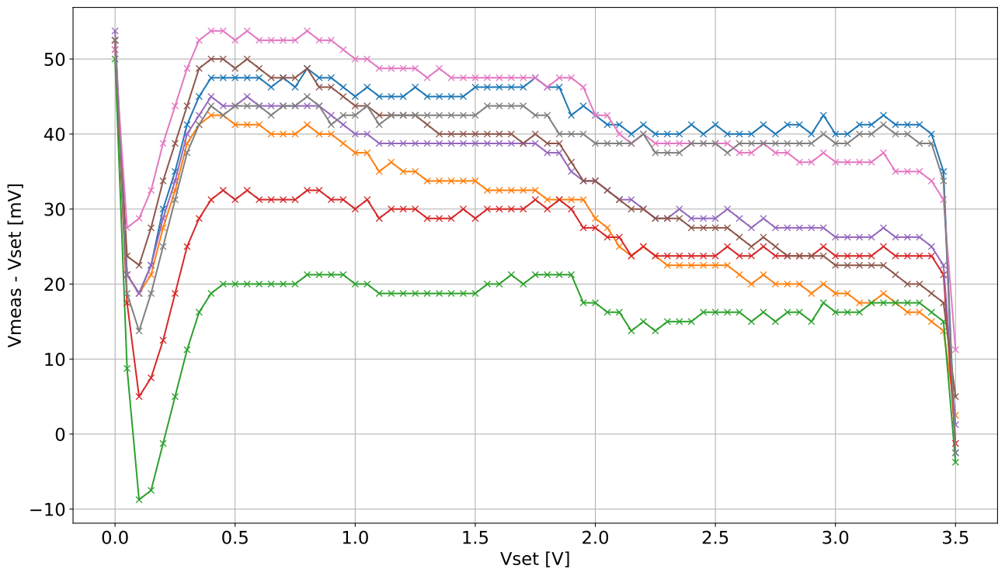
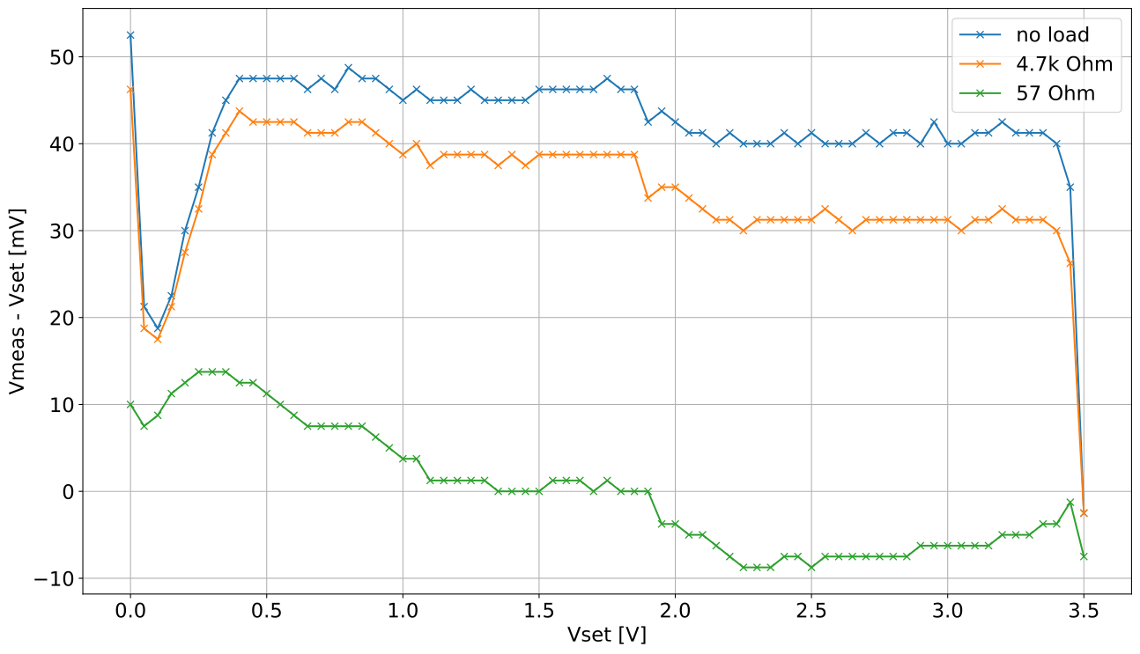
Power Supplies
Power supplies on V1.x have poor load regulation at low currents
Likely limitation of TPS74401 (0.013%/mA below 50mA)
ch 1
ch 1-8

Slide 5
Power Supplies
DC-DC converter followed by LDO
  “High” voltage positive (5..15V)
  “High” voltage negative (-5..-15V)
  Low voltage positive (<5V)
Baseline: add a few fixed HV rails to the v1.x design
Second option: make the DC-DC and LDO on the HV rails adjustable
Third option: use same adjustment scheme for both LV and HV
 | “High” voltage (Caribou + chipboard) |  | Low voltage (chipboard)
 | DC-DC | LDO | DC-DC | LDO
Baseline | fixed | fixed | fixed, shared | adjustable
Add adjustable high voltage | adjustable | adjustable | fixed, shared | adjustable
Increased LV range | adjustable | adjustable | adjustable | adjustable
 | positive |  |  | negative
 | DC-DC module | DC-DC regulator | LDO | DC-DC module | DC-DC regulator | LDO
HV | LTM8002 or LTM8065 | LM63635 | TPS73801 | LTM4651 | LM7600x | TPS7A33
LV | LTM8060 | (TPS62933F) | MAX38904B (or MAX25302B)

Slide 6
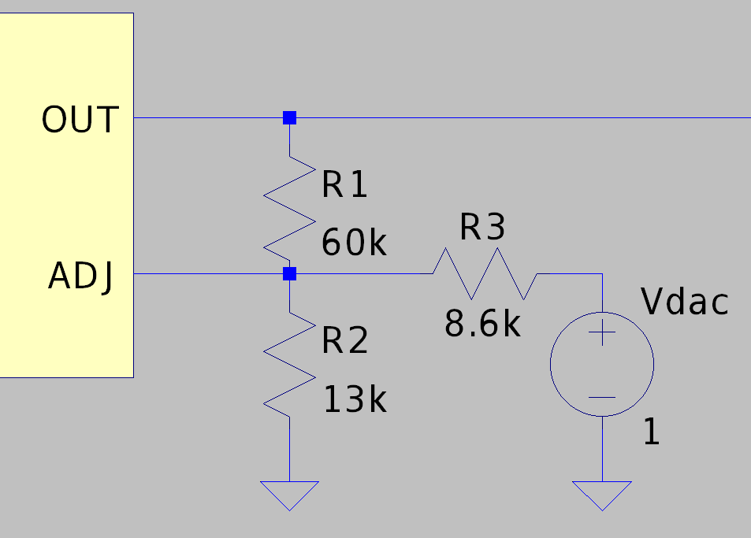
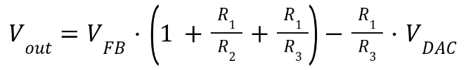
Power Supplies: Positive Adjustment
Injecting current into feedback node to adjust output voltage (positive LDO and DC-DC)
Output voltage is:
Adjustment also works for negative LDO regulators
  Positive DAC voltages can not adjust |Vout| below |Vfb|
  Negative voltages restore the range down close to 0V
Concerns about stability for Vout < Vfb
  Additional current from DAC to Vout: (Vfb-Vout)/R1
  Expected current is very small (<10 uA), should only be an issue with very small loads
  Can be avoided with dummy load on output

Slide 7
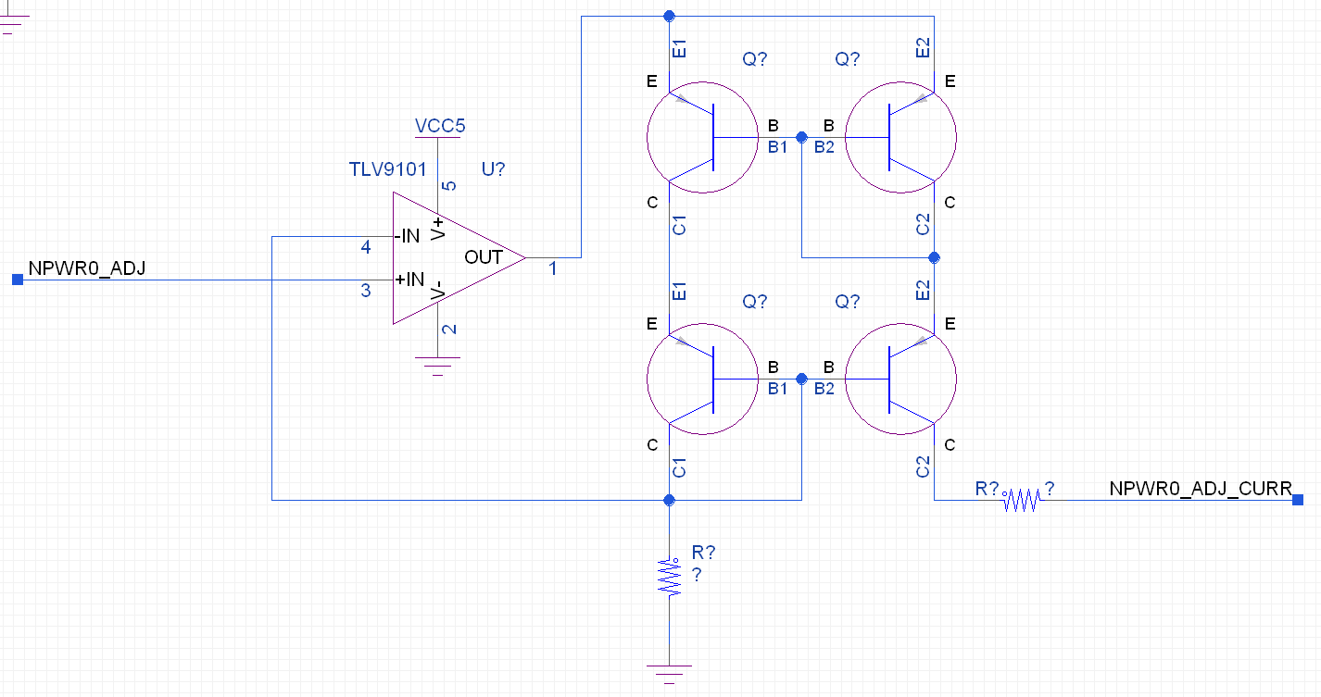

Power Supplies: Neg DC-DC Adjustment
For inverting DC-DC: Reference voltage is relative to Vout instead of 0V
Direct adjustment with DAC voltage is no longer feasible
Can use a current source to set the output voltage instead:

Slide 8
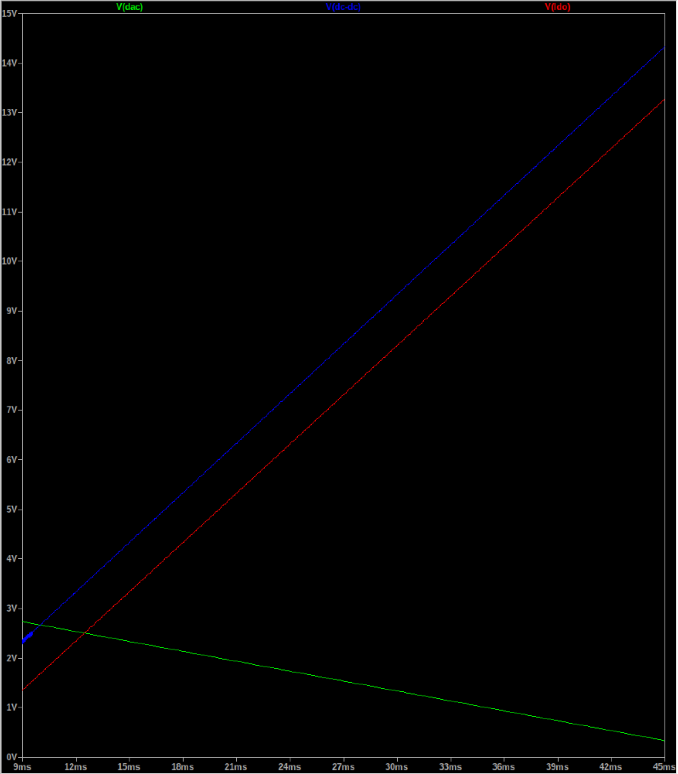
Power Supplies
DC-DC and LDO are controlled by the same DAC voltage
The voltage difference between both is fixed (depending on slope), limiting the power dissipation of the LDO
DC-DC
LDO
DAC

Slide 9
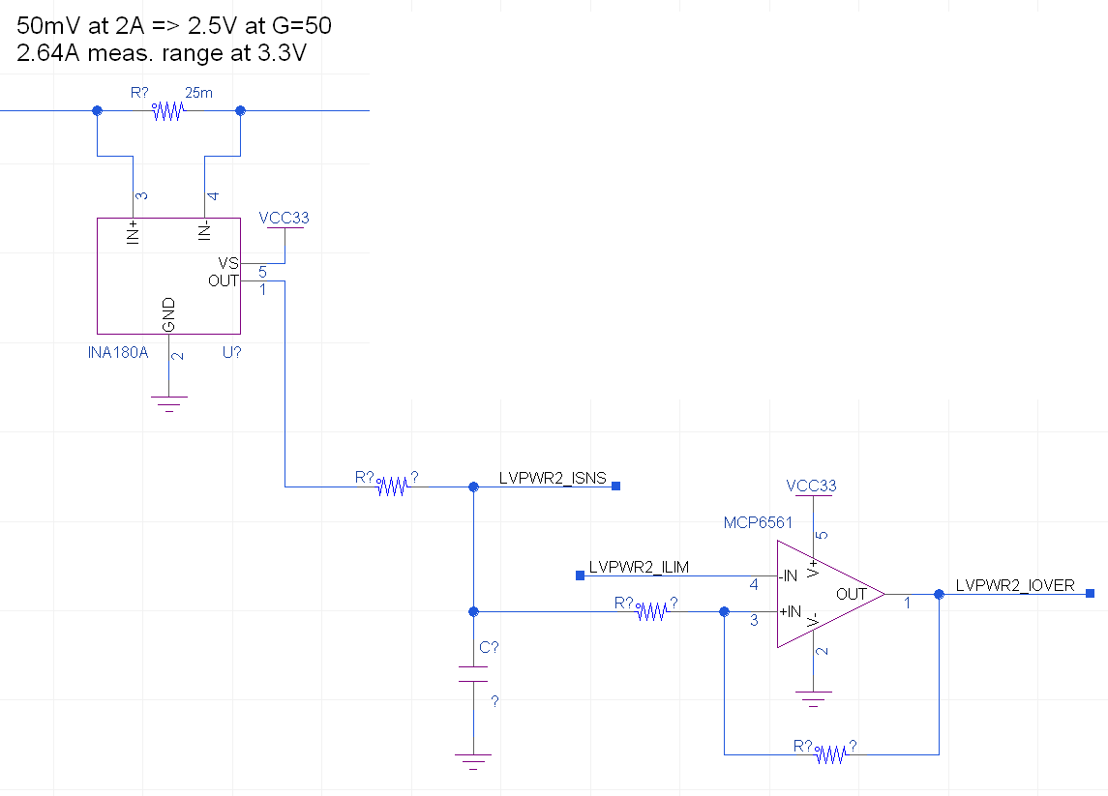
Power Supplies: Overcurrent
The V1.x design uses relatively slow (>100 us) overcurrent protection
Channels are only switched off individually
Use current sense amplifier + comparator
Current limit is set via DAC
Small FPGA (iCE40) to sample comparator outputs and control single or multiple channels

Slide 10
Bias Sources
V1.x uses DAC7678 (12bit, 0-4V, 20mA/ch) as bias supply
Consider alternatives with larger voltage and current range:
  LTC2686: 8 channels, ±15V, ±55 mA / ch, 12 or 16bit
  LTC2688: 16 channels, ±15V, ±20 mA / ch
  There are a few other DAC with ±10V to ±15V range, but most with <5 mA / ch
Best option seems to be LTC2686 (output current, cap. loads)
Very compact solution
Better accuracy than DAC + external buffer
8 channel version can be compensated for capacitive loads <10uF
No current limit, but current, voltage, and temperature monitoring
Likely limited thermally
  Up to 7.5W with 8 channels at 55mA, ±17V supply (5.5W for 16 ch)
  Worst-case scenario (without shorts), but not a realistic use case
  Operating voltage and range can be adjusted: ±5V, ±10V, ±15V, +5V, +10V

Slide 11
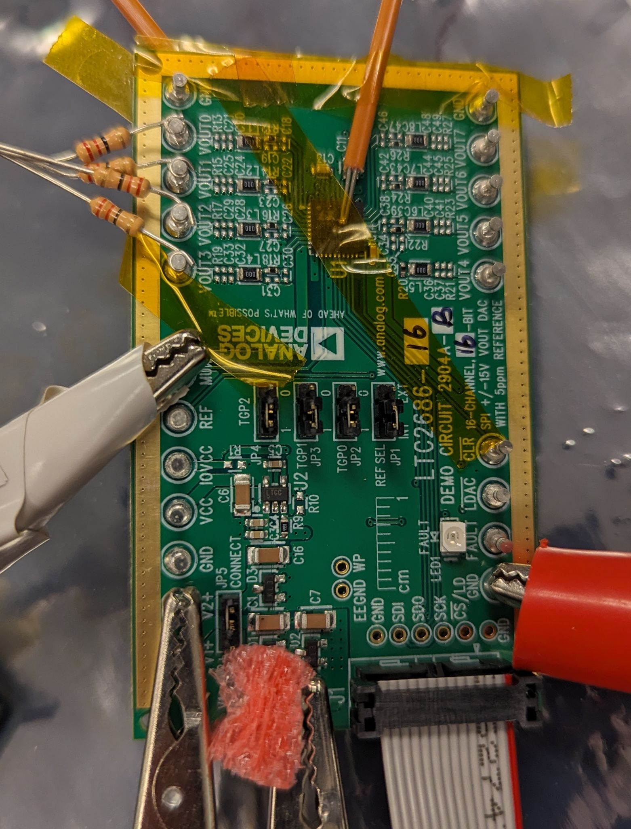
Bias Sources
Running half the channels with max power dissipation exceeds 100°C Tdie
Running all channels at max dissipation seems challenging, even with extra cooling
 | No load | 4ch at 27mA, 0.6V | 4ch at 55mA, 1.2V | 4ch at 27mA, 0.6V, with fan | 4ch at 55mA, 1.2V, with fan
Power [W] | 0.17 | 1.9 | 3.5 | 1.9 | 3.5
Tdie [℃] | 30 | 70 | 106 | 53 | 77
Ttop [℃] | 27 | 49 | 71 | 36 | 31
Tbot [℃] | 26 | 45 | 60 | 32 | 28
Max junction temperature 150°C, shutdown at 160°C
Tamb=25℃

Slide 12
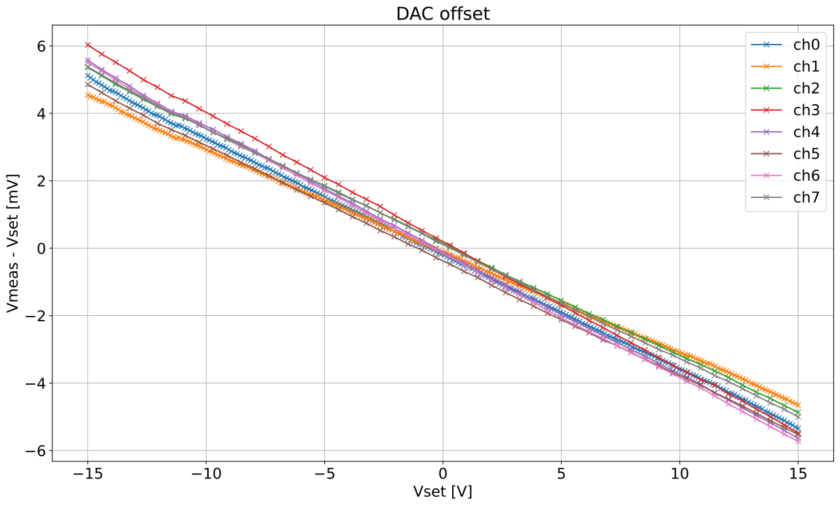
Bias Sources
no load
All LTC2686 channels within 2mV across ±15V range
Mean zero offset of 175uV
Absolute offset within the expected ±0.05% of the voltage reference (assuming no calibration error from the multimeter)

Slide 13
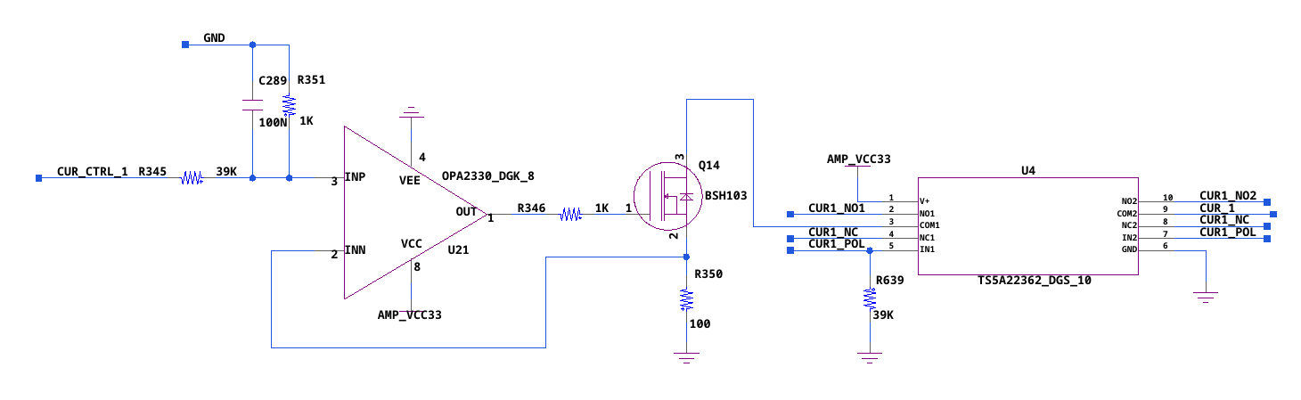
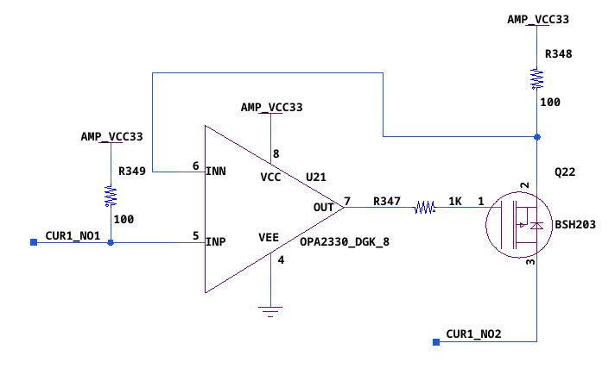
Current Sources
V1.x uses two current sources with 1mA range and analog switch for sourcing and sinking current
Increasing range to ±100mA
Uses differential amplifier + high current driver + analog switch
Analog switch to select ranges and maintain resolution at low currents

Slide 14
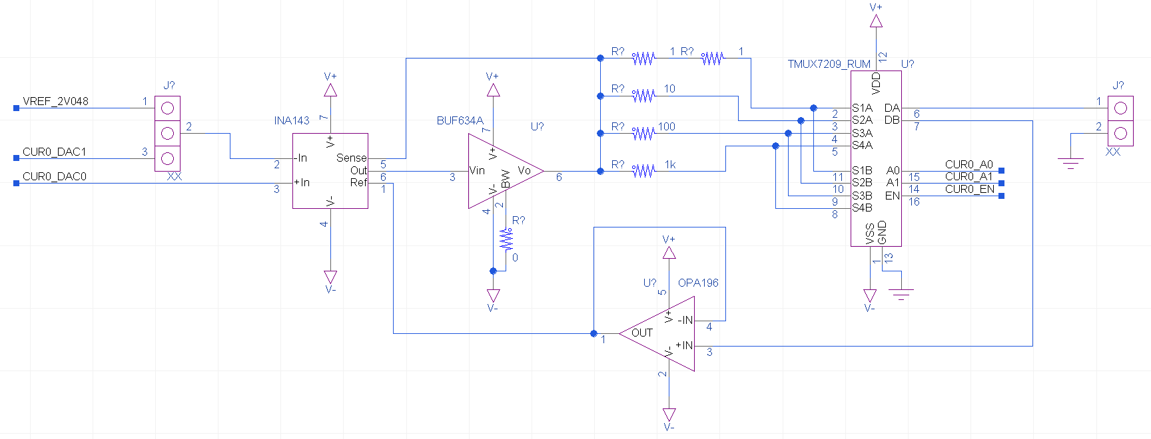
Current Sources
Version with ±100 mA range
Diff. amplifier: INA143
Driver: BUF634A
Switch: TMUX6209/TMUX7209
Rs [Ohm] | Range [mA] | Step size (12 bit) | Rs power [mW]
2 | ±102.4 | 50 uA | 21
10 | ±20.48 | 10 uA | 4.2
100 | ±2.048 | 1 uA | 0.42
1000 | ±0.2048 | 100 nA | 0.042

Slide 15
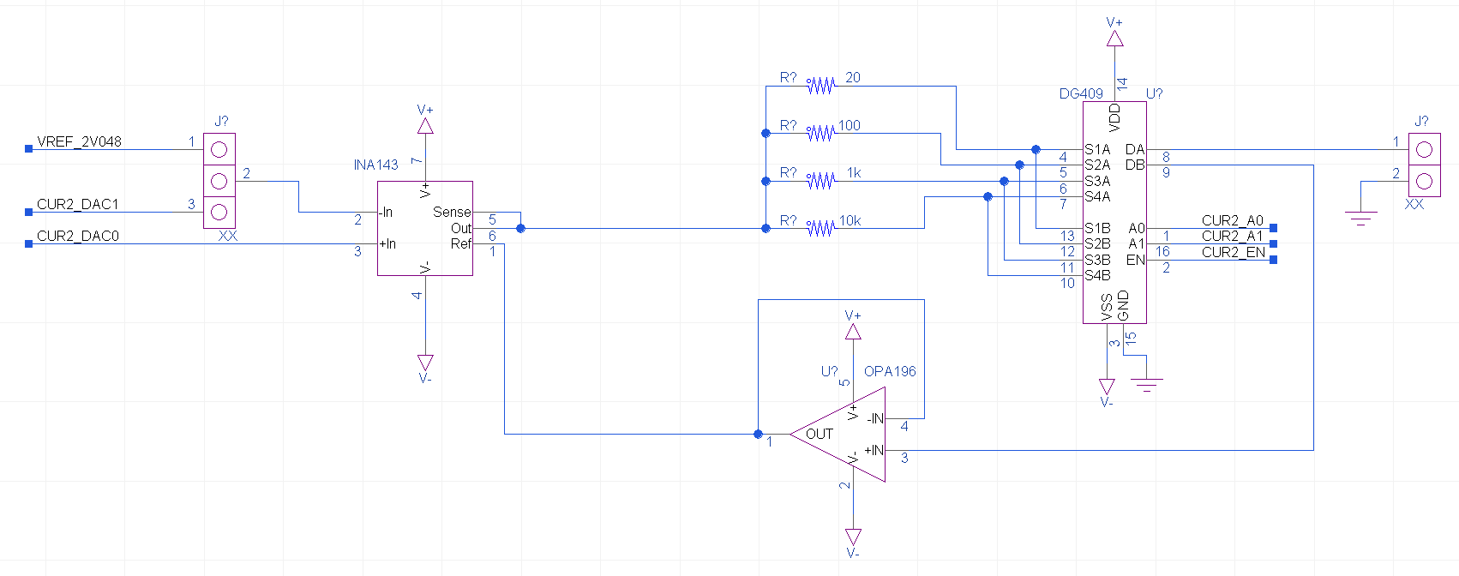
Current Sources
Simplified version with ±10 mA range
Diff. amplifier: INA143
Switch: DG409
Rs [Ohm] | Range [mA] | Step size (12 bit) | Rs power [mW]
20 | ±10.24 | 5 uA | 2.1
100 | ±2.048 | 1 uA | 0.42
1000 | ±0.2048 | 100 nA | 0.042
10000 | ±0.02048 | 10 nA | 0.0042

Slide 16
Current Sources
Voltage range is set by supply voltage (up to ±15V)
Open outputs will go to the supply voltage
No other protection

Slide 17
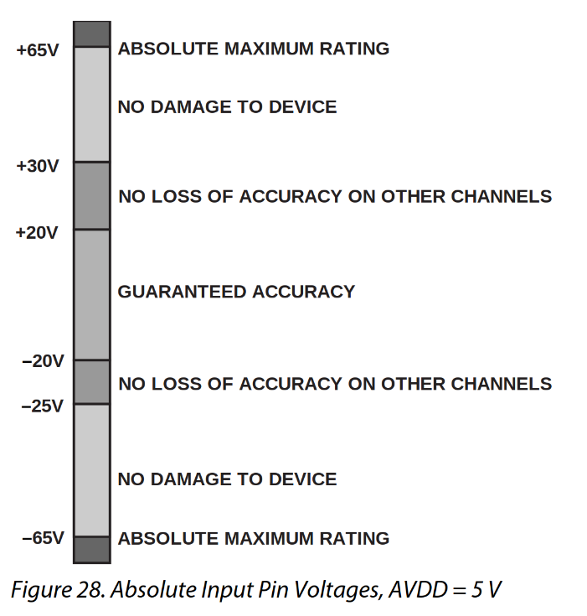
Monitoring ADC
V1.x uses an ADS7828 ADC as ‘slow’ monitoring ADC
  8ch, 0V - 4V, 12-bit, 50 kSPS
The test board has two ADCs for local (and remote) monitoring
‘High’ voltage replacement: AD4114
  16ch single-ended, 8ch diff, ±20V, 24-bit sigma-delta, 31.25 kSPS
  Rated up to ±65V
  Easy remote sensing of PSU channels
Low voltage replacement: LTC2495
  16ch single-ended, 8ch diff, 16-bit sigma-delta with PGA

