Slide 1
Overview on shielding approach at the Volumetric Neutron Source
EUROfusion-CERN collaboration meeting
D. Leichtle and Neutronics Team
KIT and EUROfusion DCT/WPDES Neutronics

Slide 2
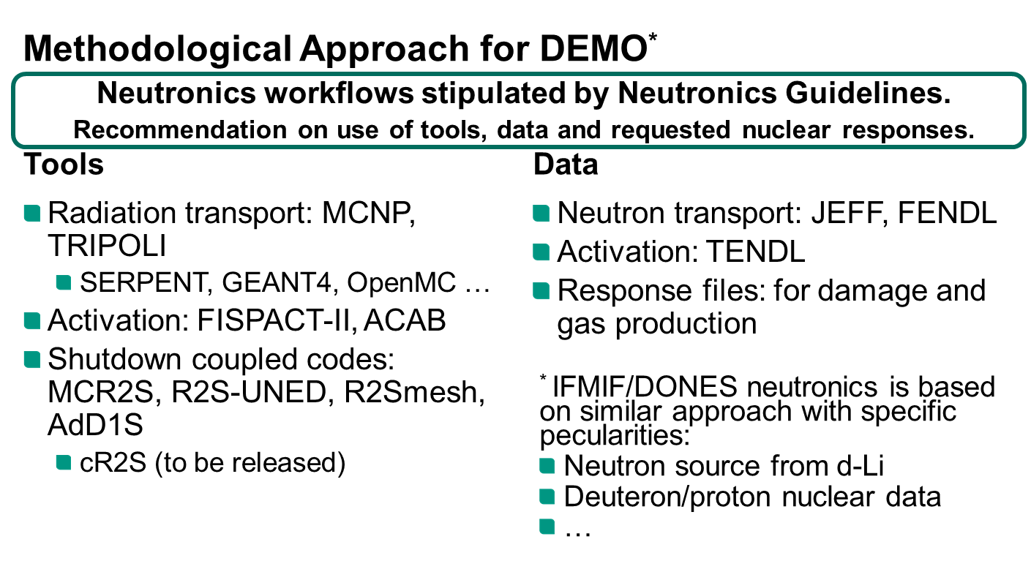

Slide 3
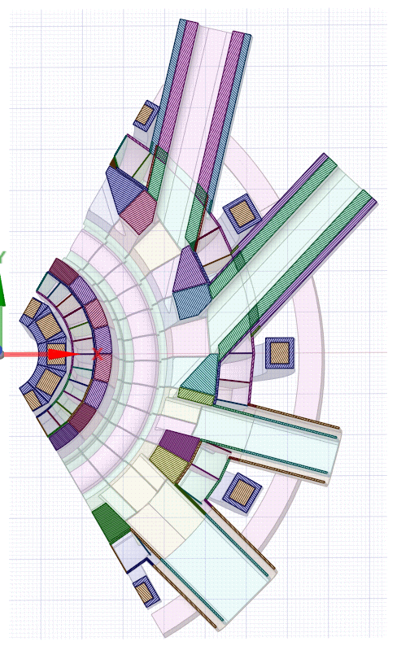
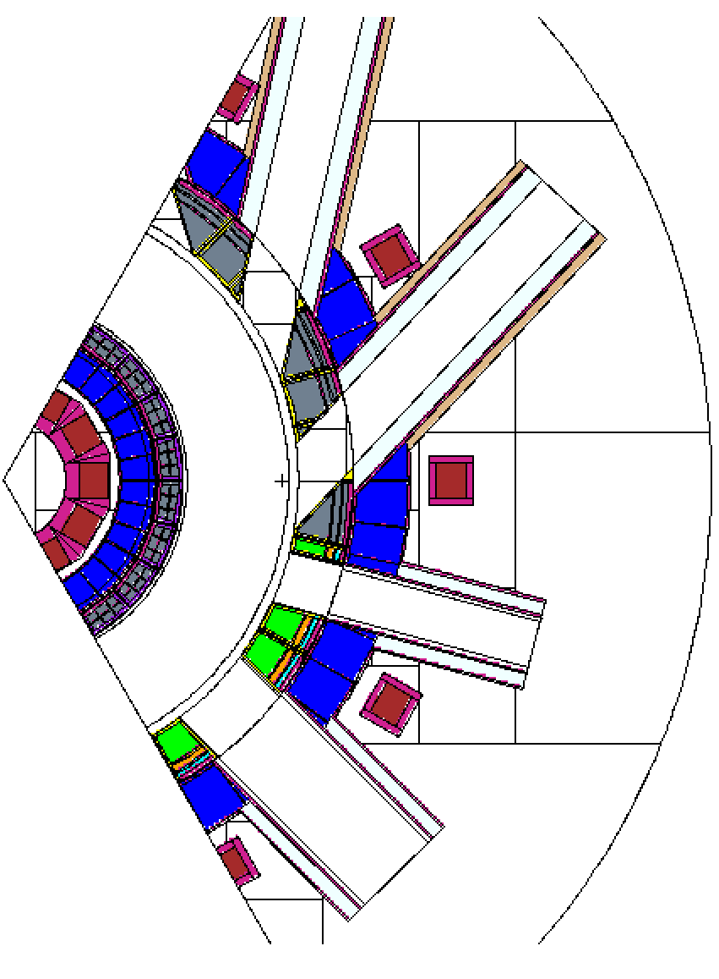
Status of the generic geometry model
CAD
MCNP
MCNP generic model includes:
120° toroidal sector
2 NBI ports
1 supplementary port (EC, …)
1 TBM port
8 IB shielding blankets (with initial segmentation)
OB blankets are filled with WCLL simplified layout
Divertor trivial block
Upper and divertor ports
VV (initially segmented)
Status 14.02.2024
Status 02.04.2024

Slide 4
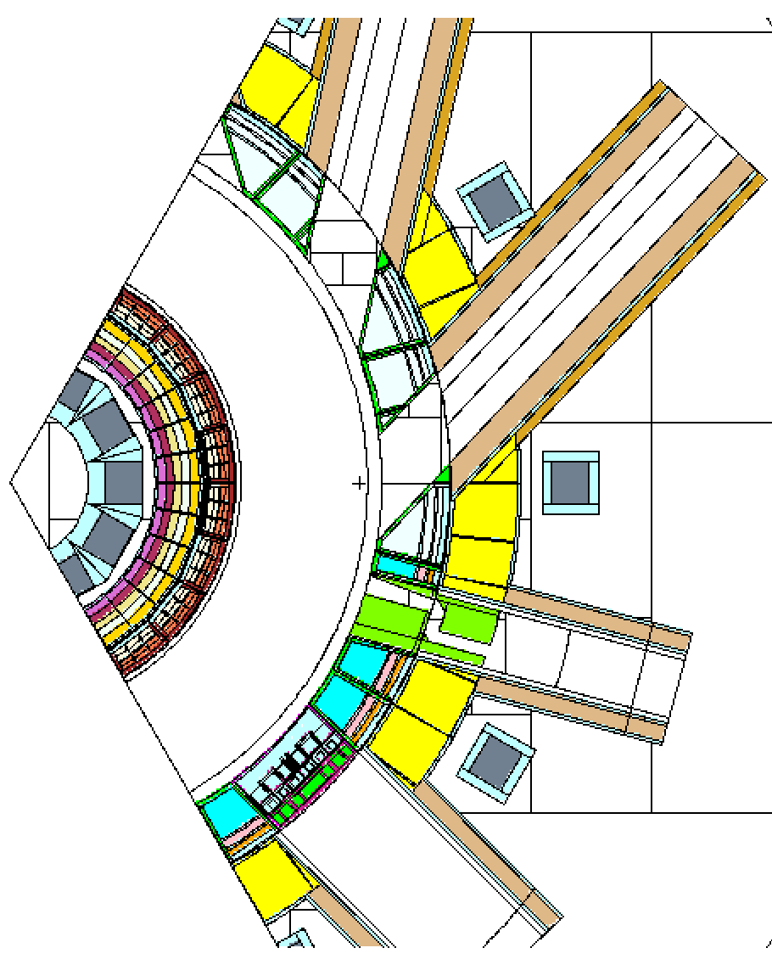
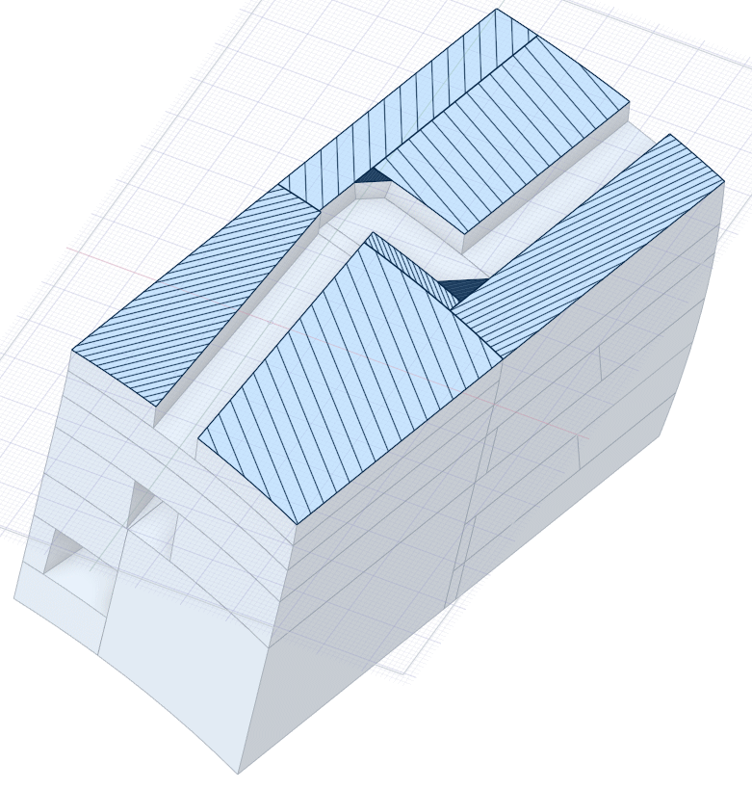
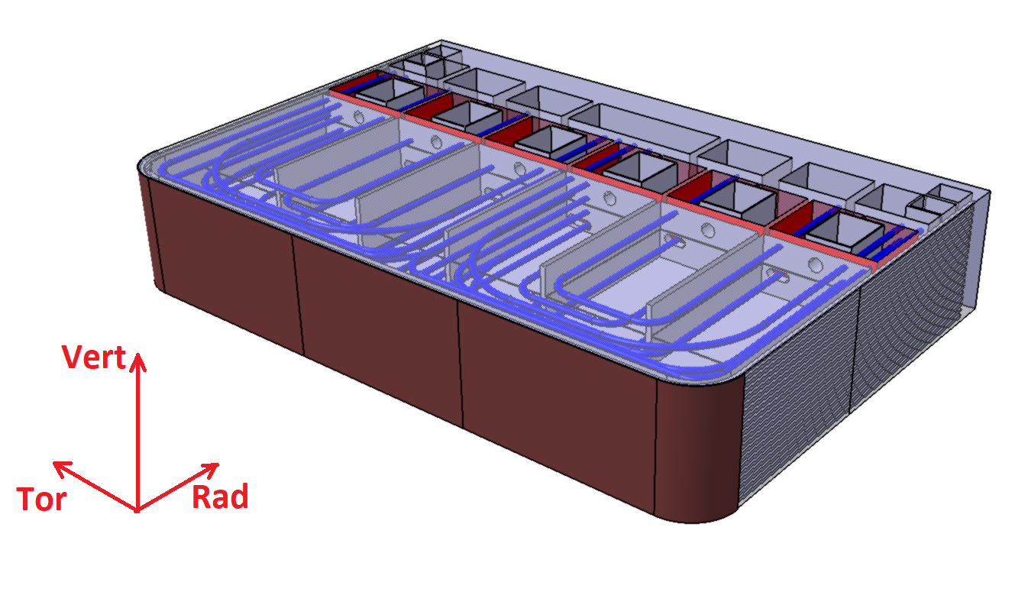
Additional modifications
MCNP
EC plug (simplified)
CAD
WCLL TBM (simplified)
PbLi manifold
PbLI
BSS
W
Plate
Eurofer

Slide 5
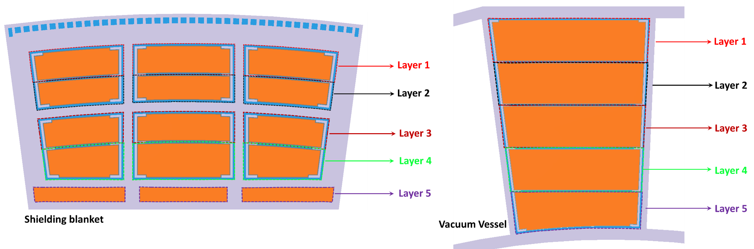
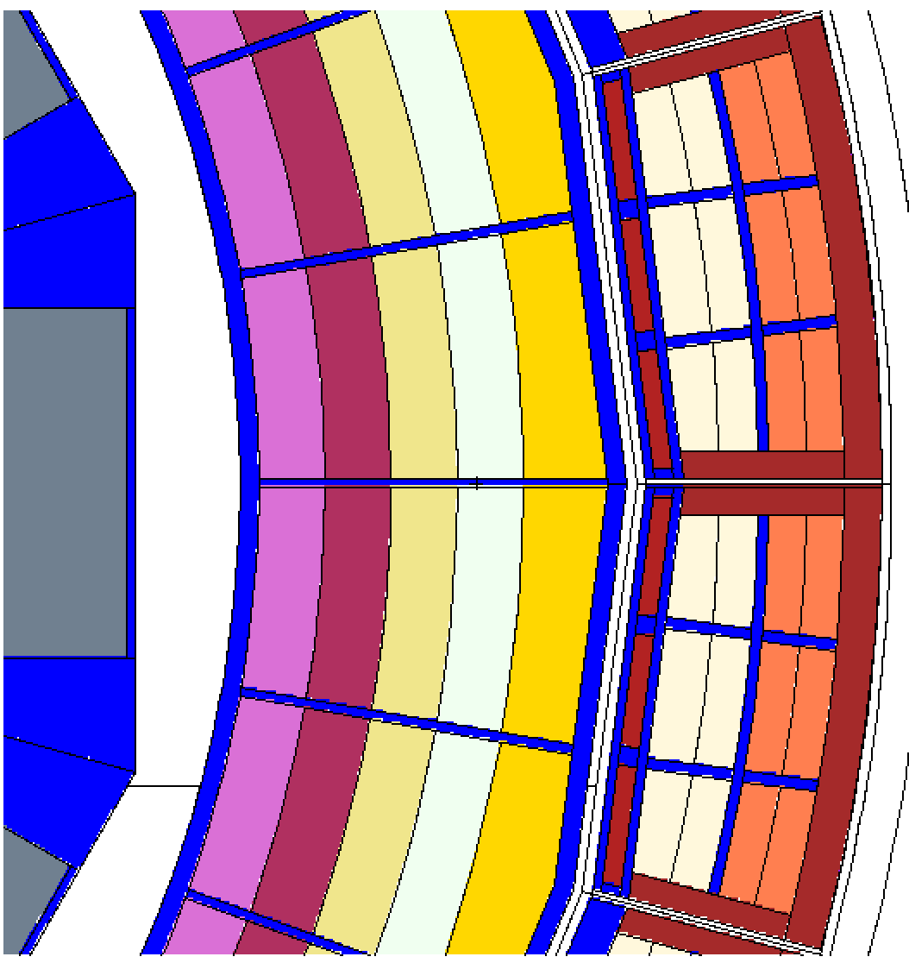
Present status
Shielding blankets study TS
MCNP shielding blankets layout
TS shielding blankets:
Shielding materials to study are divided in 3 groups (high, medium and low priority)
1st: W compounds, hydrates, B₄C
2nd: Hf hydrate
3rd: Gd oxide, Ta
Different combinations of the materials in layers
In total ~ more than 50 cases
Challenges:
Particle spectra (n, γ) have a significant attenuation in the shielding materials
A strong variance reduction technique must be applied to decrease statistical errors
MCNP run takes several hours with ~1000 CPUs

Slide 6
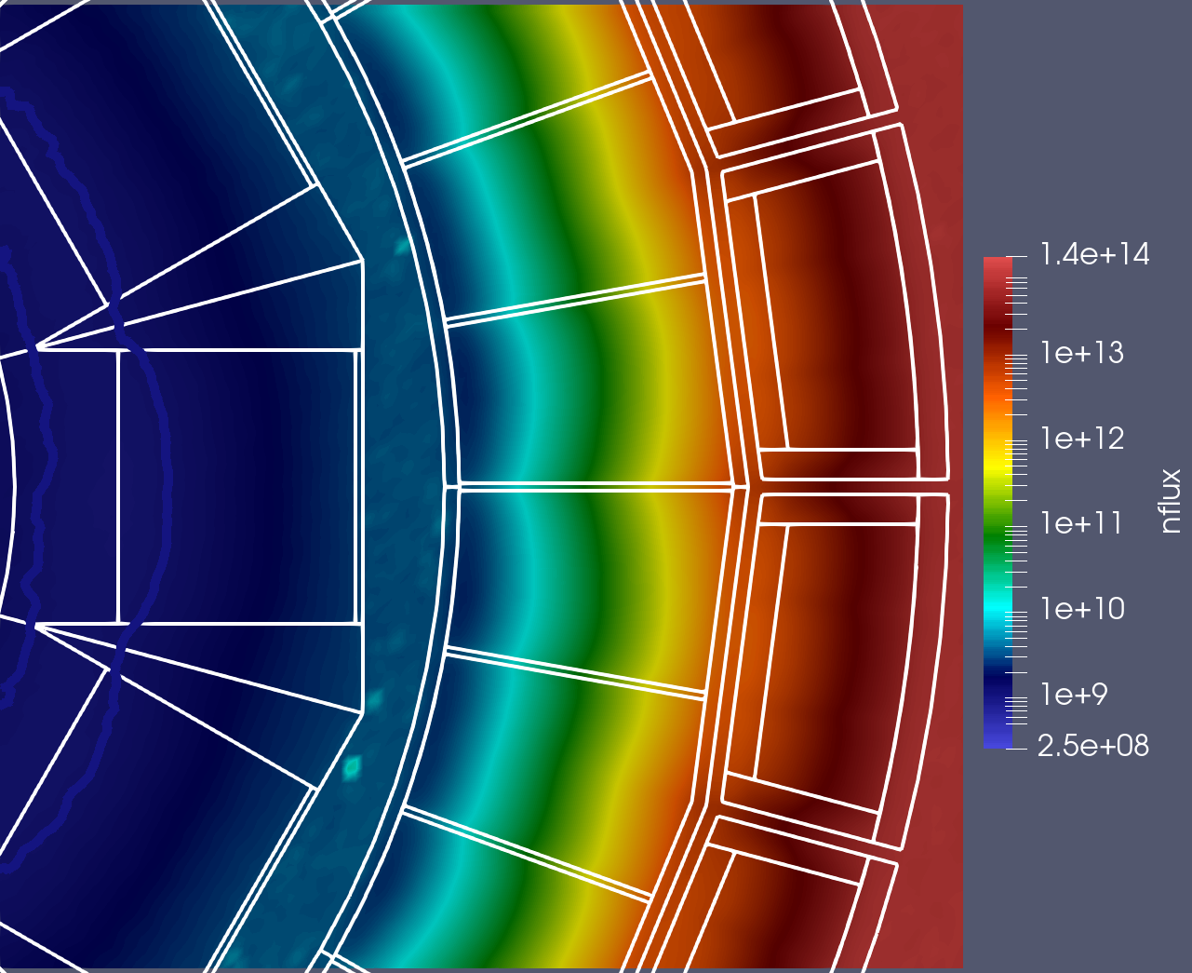
Neutron flux mapping at Inboard
Case 0 – 1
(W₂B₅ in SB and VV)
Data pick-up point
1E+9 cm⁻²s⁻¹
Neutron streaming
following VV ribs

Slide 7
Previous studies: Approach to shield conceptual choices
Starting assumption: SB (W2B5), VV (B4C)
Effect of new geometry
Variations: SB materials
Variations: VV materials
Swapping material radial configuration
Thickness reduction with optimized SB/VV material configuration
Based on SB (W2B5), VV (B4C)
Cylindrical VV provides more mass attenuation (at same nominal radial thickness).
VV: B4C is significantly less effective than W2B5 (or WC). Improvement by ca. factor 20 (or 3).
SB: here also use of B4C is not recommended.
SB: replacing the Eurofer backplate by e.g. WC provides a 10% effect.
Use of W2B5 in rear parts is recommended: better in VV than in SB.
Water content in VV with lot of W2B5 is not important.

Slide 8
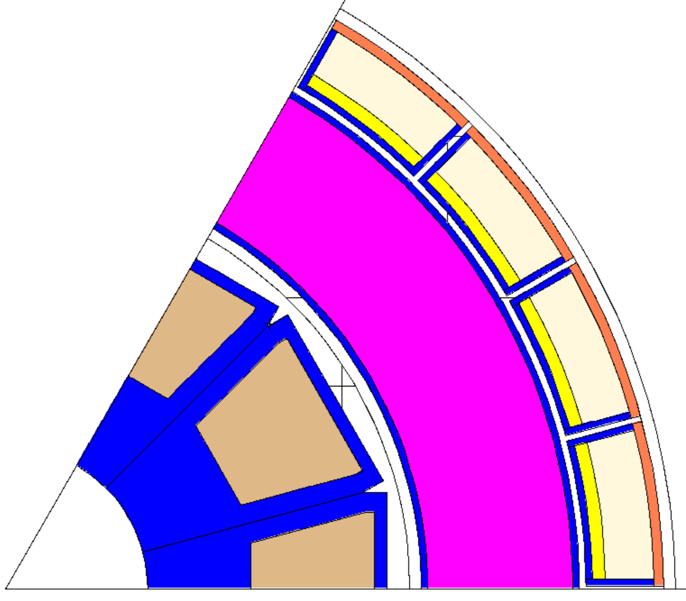
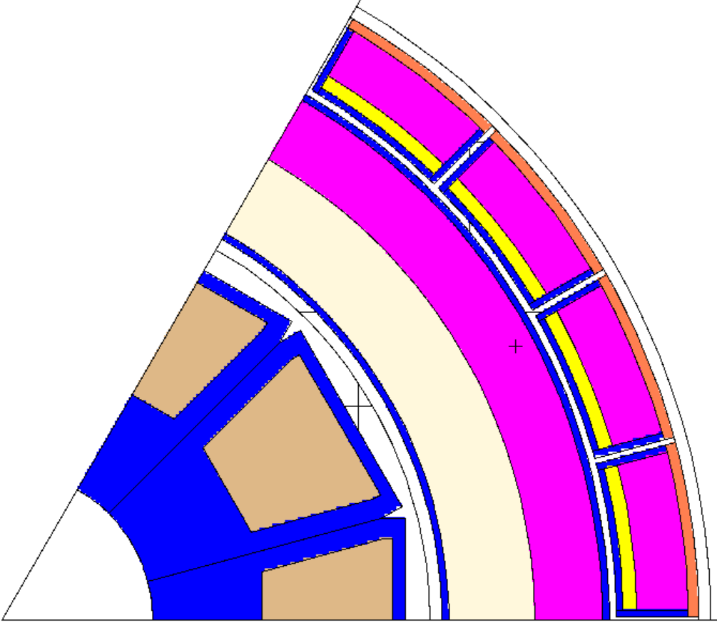
Previous studies: Promising options
Case 1: optimum SB with B4C in VV as primary suggestion; W2B5 as optimum material but with high costs.
Max/Opt: reverting to WC in SB, using W2B5 in VV
Optimum adopts finding regarding benefit of W2B5 in rear position
Case 1:
SB: W₂B₅(87%)+Water(8%)+SS316L(5%)
VV body: B₄C(92%)+Water(8%)
Maximum:
SB: WC(87%)+Water(8%)+SS316L(5%)
VV body: W₂B₅(87%)+Water(8%)+SS316L(5%)
Optimum:
SB: WC(87%)+Water(8%)+SS316L(5%)
VV body: (1st(balanced) + 2nd(25cm))
1st layer: WC(87%)+Water(8%)+SS316L(5%)
2nd layer: W₂B₅ (87%)+Water(8%)+SS316L(5%)

Slide 9
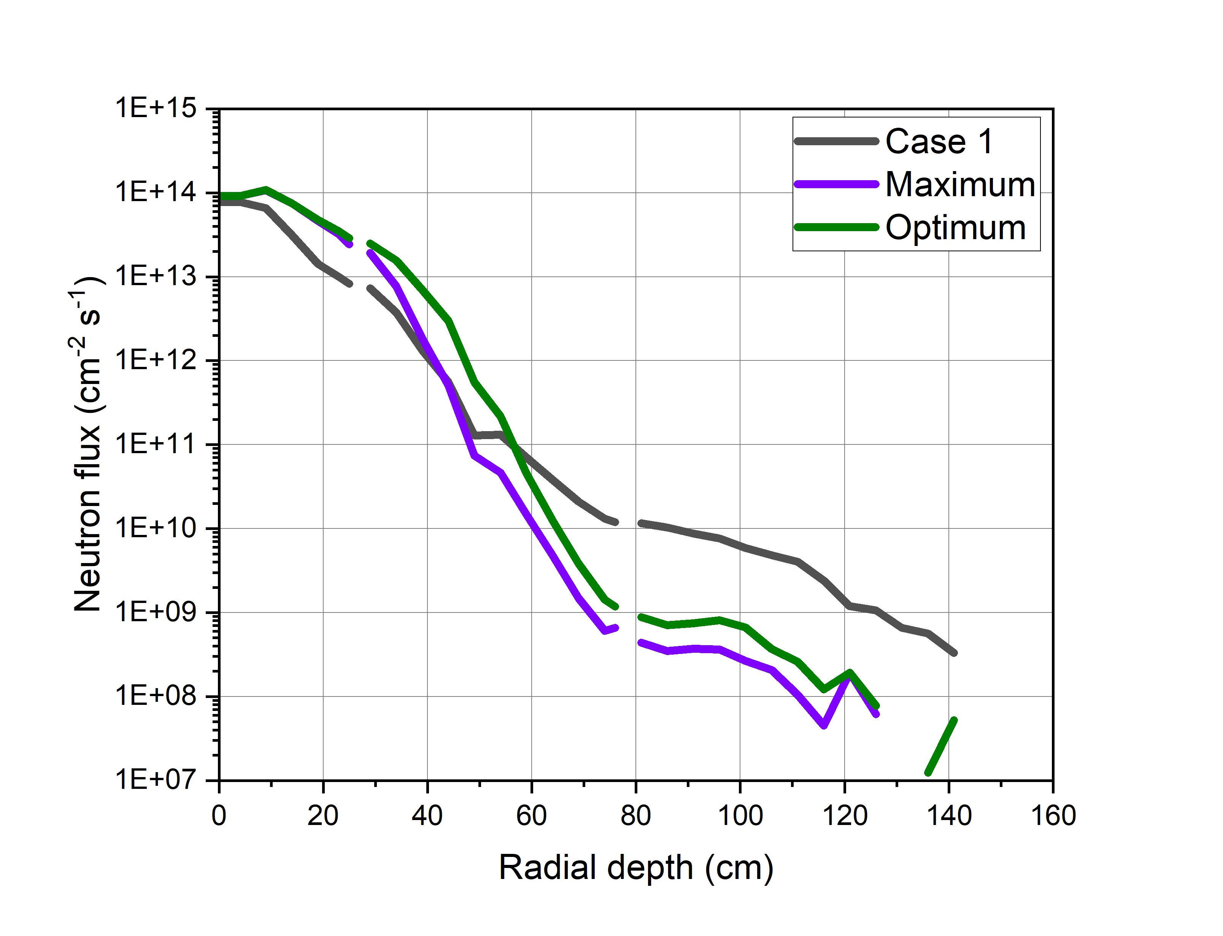
Previous studies: Promising options
SB
VV
TFC
Neutron flux radial profile
Neutron flux on TFC
Case 1 : 1.03E+10
Maximum: 3.51E+8
Optimum : 7.09E+8

Slide 10
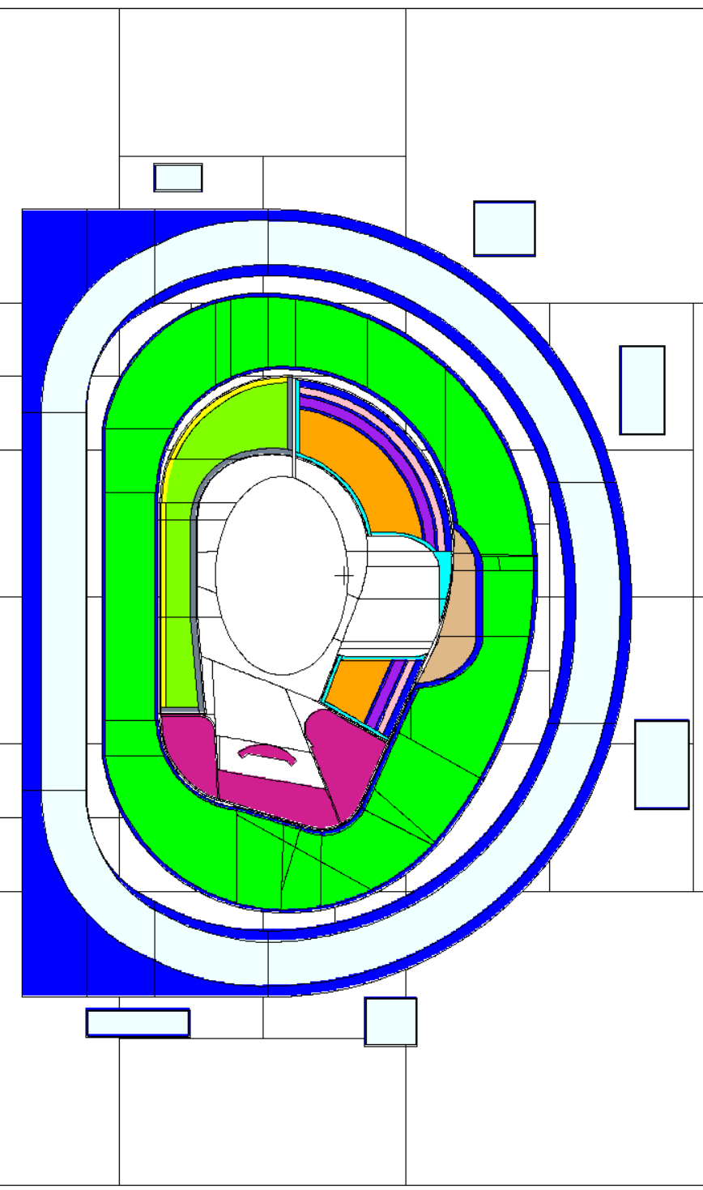
Outlook
The 1st simulation:
W₂B₅ everywhere in shielding blankets
It looks promising but unrealistic
Further modifications (cases) are already prepared

Slide 11
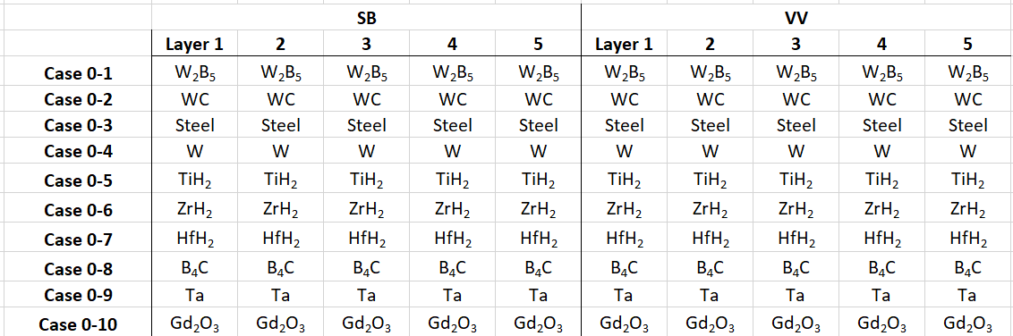
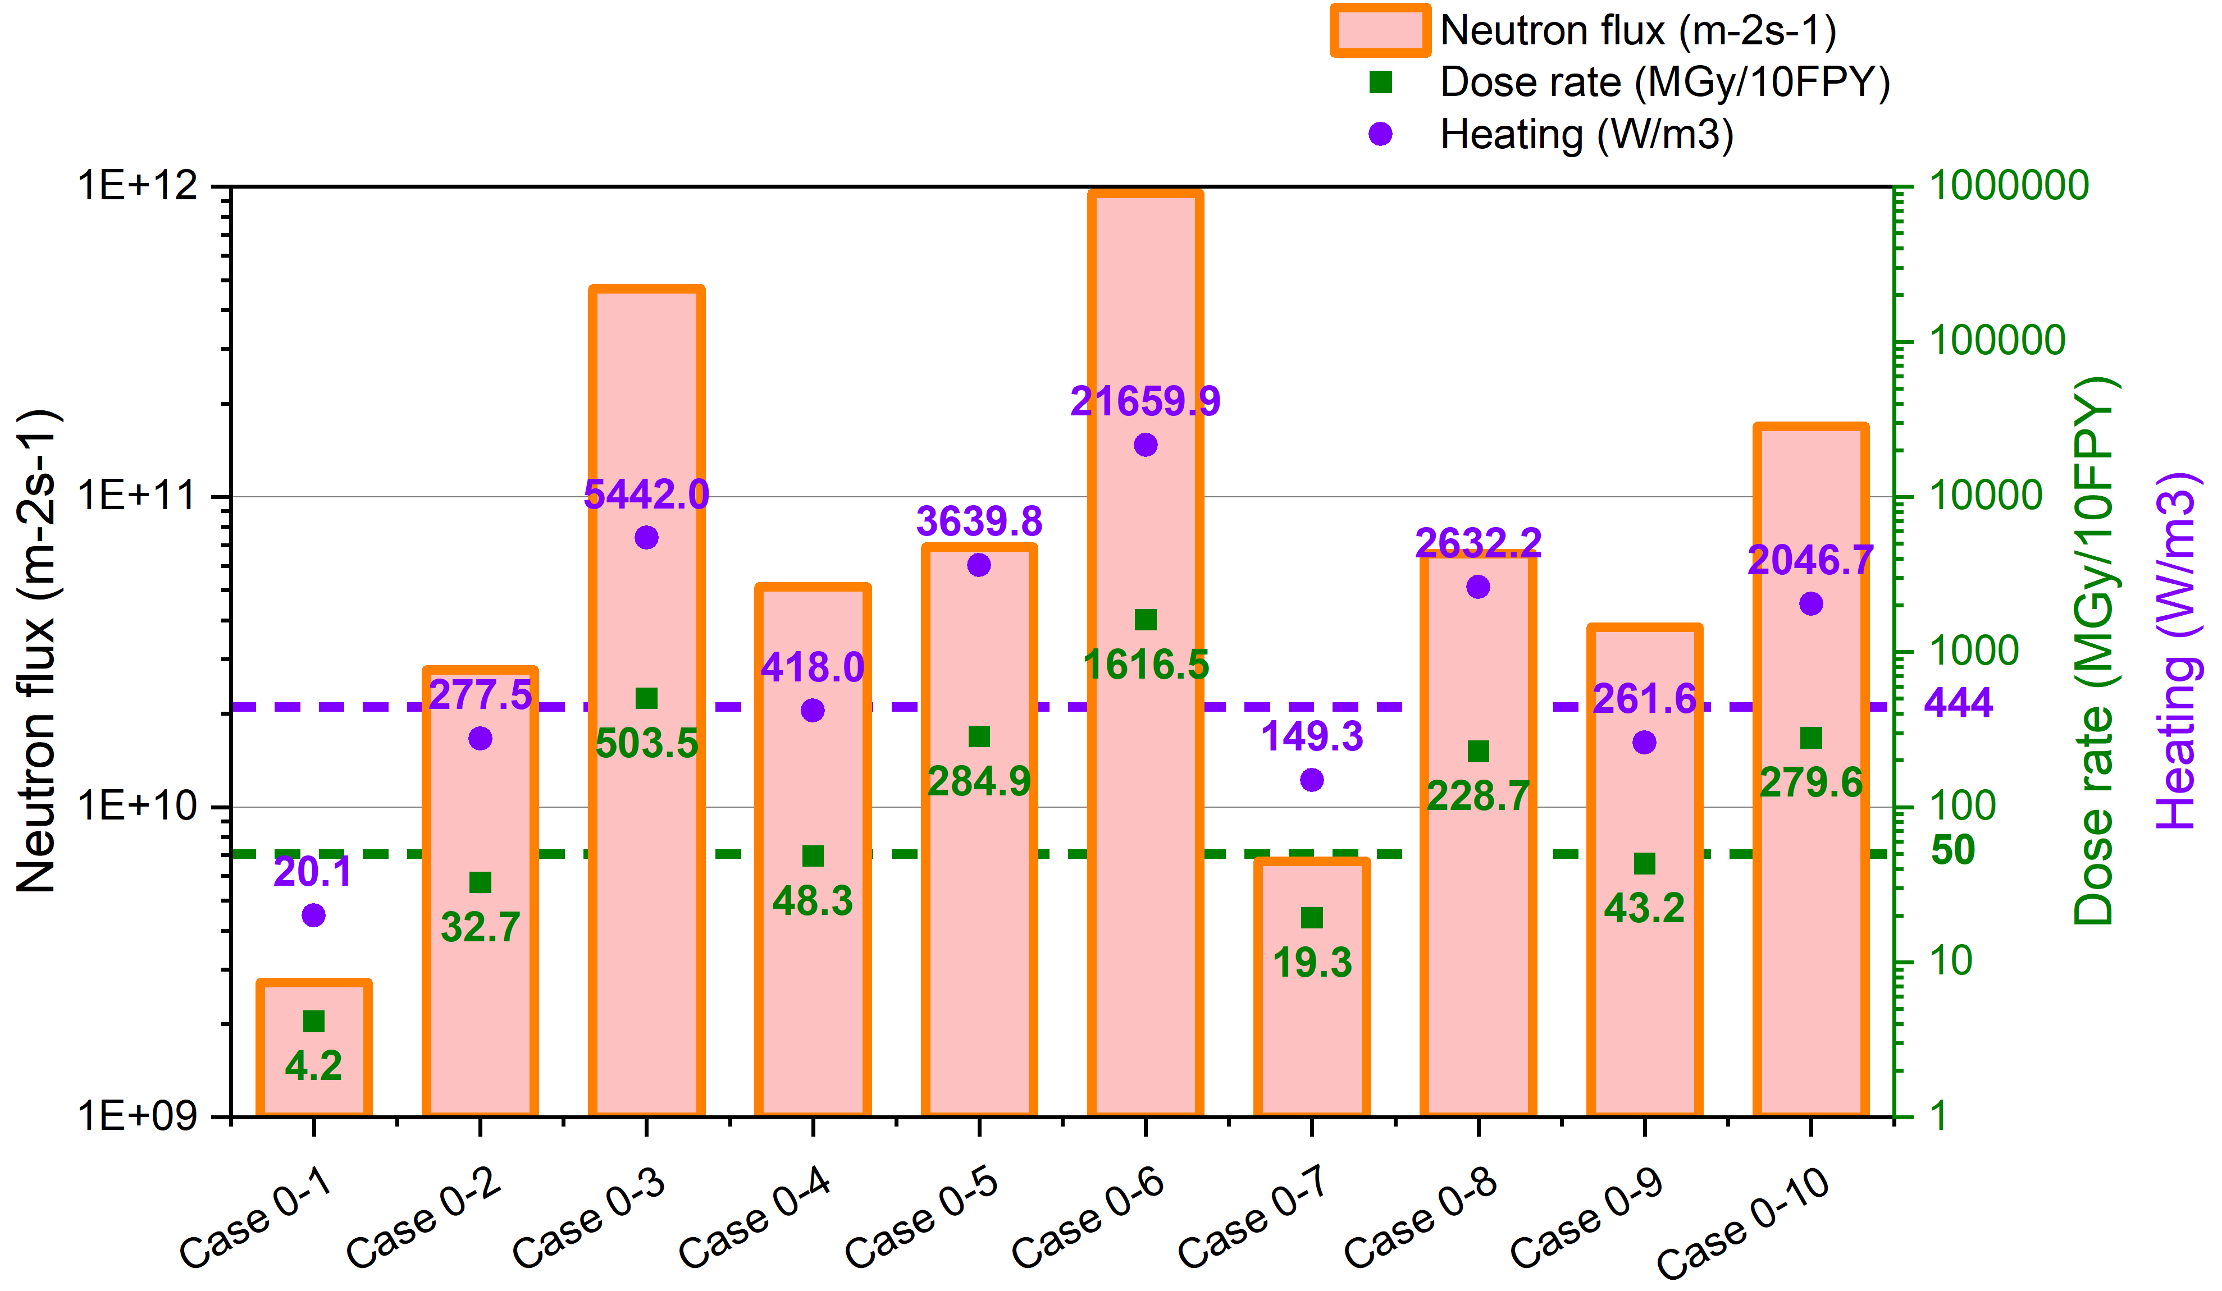
Outlook: Preliminary results

