Slide 1
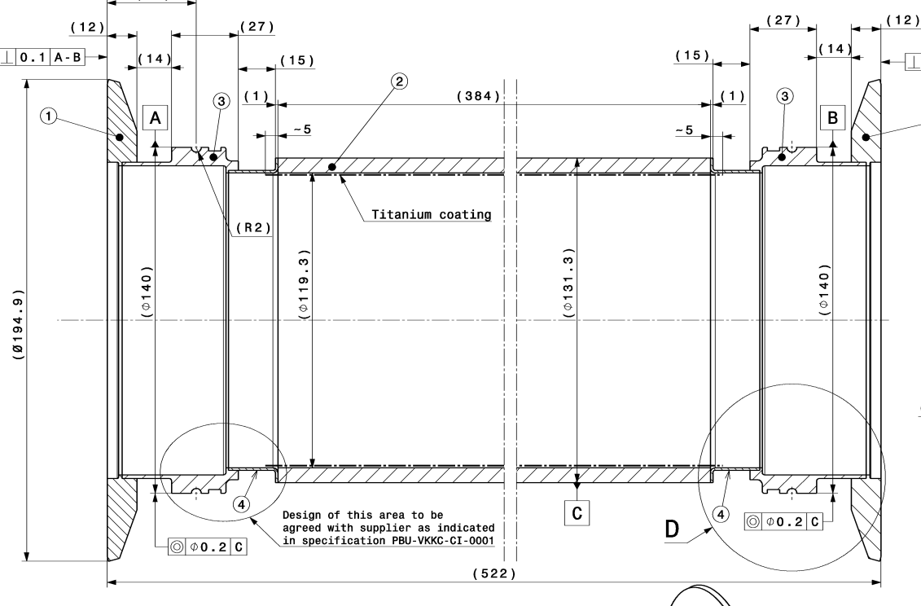
Example PSBVKVCB0001 (KSW)
522 mm vacuum chamber (384 ceramic) for new kickers PSB LIU (produced by SY-ABT)
11 kCHF/chamber in 2012 (flanges supplied by CERN!)
Delivery 18 months
2µm Ti coating for image current

