Slide 1
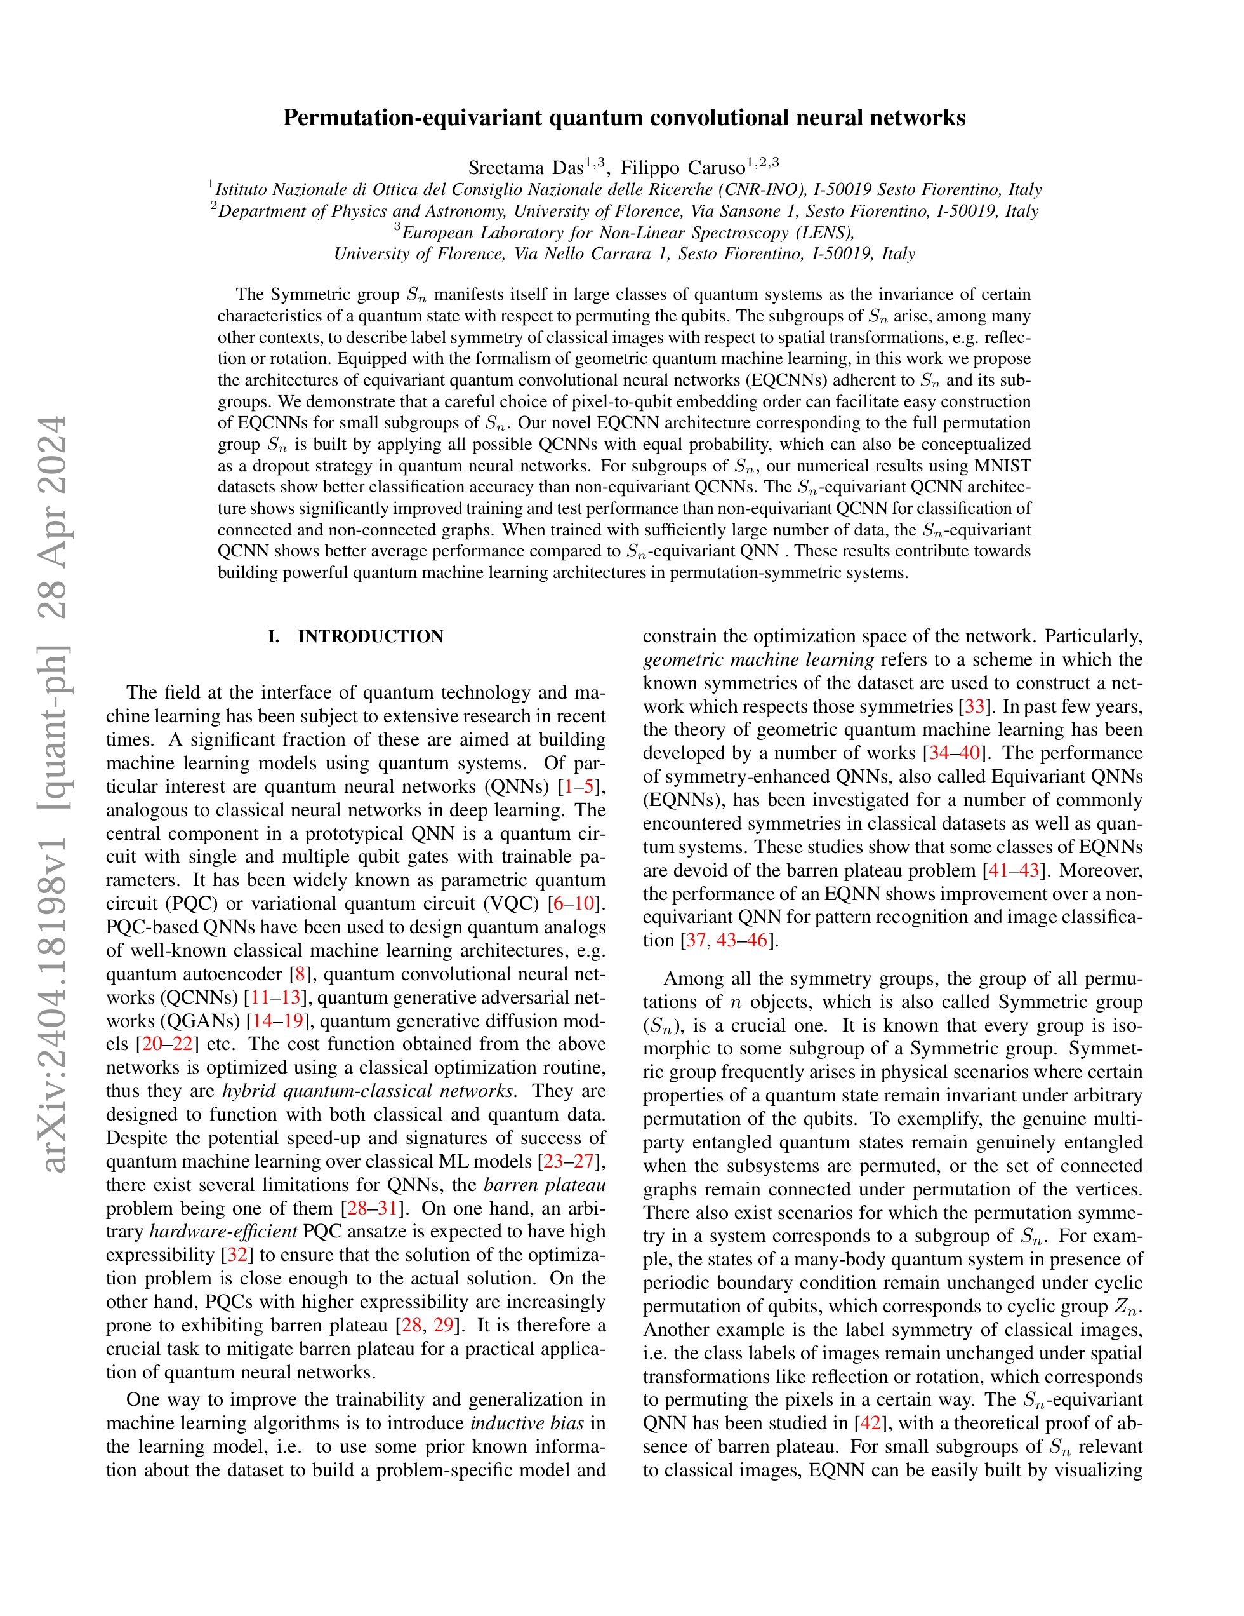
Permutation-equivariant quantum convolutional neural networks
Saverio Monaco
06 June 2024

Slide 2
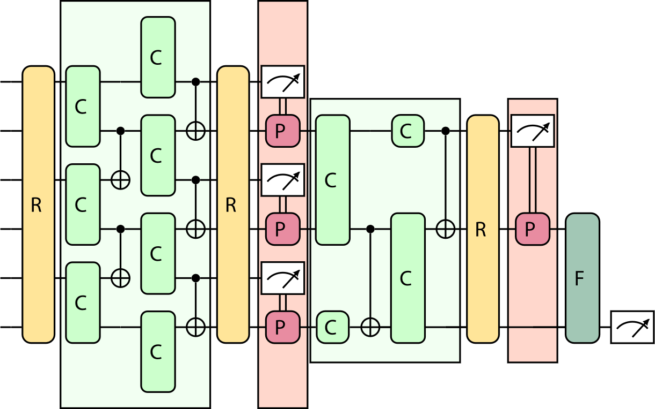

Idea
Develop a QCNN-like classifier that takes into account the symmetries of the training data
Reflection
Rotation
Permutation
Notes:
Applying a symmetry to the input = to th output

Slide 3
Idea
Develop a QCNN-like classifier that takes into account the symmetries of the training data
Reflection
Rotation
Permutation
Notes:
Applying a symmetry to the input = to th output

Slide 4
Idea
Develop a QCNN-like classifier that takes into account the symmetries of the training data
Reflection
Rotation
Permutation
Notes:
Applying a symmetry to the input = to th output

Slide 5
Idea
Develop a QCNN-like classifier that takes into account the symmetries of the training data
Reflection
Rotation
Permutation
Notes:
Applying a symmetry to the input = to th output

Slide 6
Idea
Develop a QCNN-like classifier that takes into account the symmetries of the training data
Reflection
Rotation
Permutation
Notes:
Applying a symmetry to the input = to th output

Slide 7
Idea
Develop a QCNN-like classifier that takes into account the symmetries of the training data
Reflection
Rotation
Permutation
Notes:
Applying a symmetry to the input = to th output

Slide 8
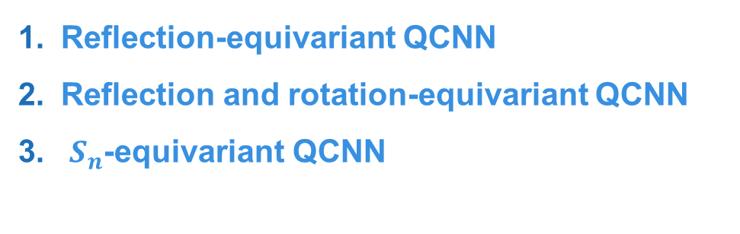
Roadmap
Introduction to QCNNs
Label symmetries
EQCNNs + Results
Reflection-equivariant QCNN
Reflection and rotation-equivariant QCNN
$S_{n}$-equivariant QCNN
Notes:
Applying a symmetry to the input = to th output

Slide 9
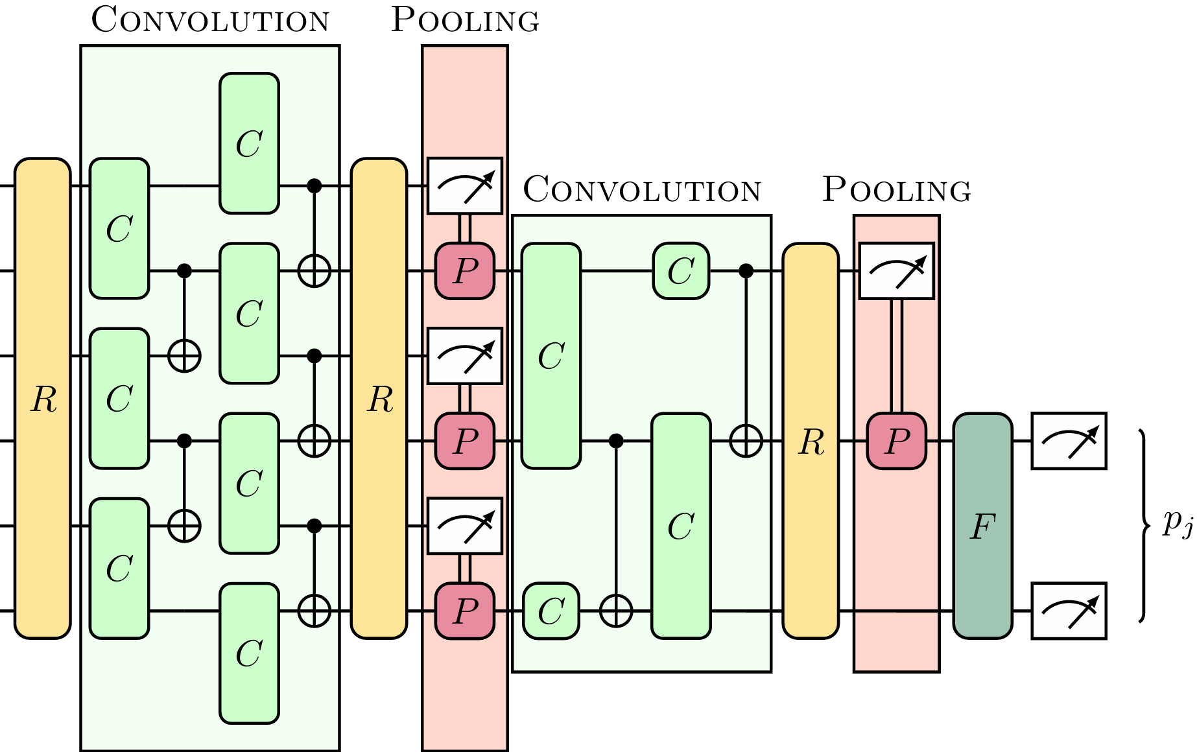

1. QCNNs
[1] Absence of Barren Plateaus in Quantum Convolutional Neural Networks
[2] A Review of Barren Plateaus in Variational Quantum Computing
Convolution: Two-qubit convolutional Ansätze
Pooling: Mid-circuit measurement / ignoring qubits
Quantum counterpart of CNNs:
[3] Quantum phase detection generalisation from marginal quantum neural network models
Notes:
Applying a symmetry to the input = to th output

Slide 10



1. QCNNs
[1] Absence of Barren Plateaus in Quantum Convolutional Neural Networks
[2] A Review of Barren Plateaus in Variational Quantum Computing
Quantum counterpart of CNNs:
Free from Barren Plateaus [1]
Local measurements
Shallow depth
Architecture classically simulable [2]
[3] Quantum phase detection generalisation from marginal quantum neural network models
Notes:
Applying a symmetry to the input = to th output

Slide 11







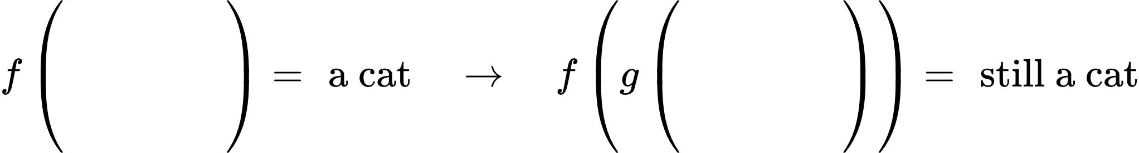

2. Label symmetries
Let:
be the input dataset with data points
be the class labels set with elements , we suppose exists
is a set of operations that form a label symmetry
Goal: Find
Notes:
Applying a symmetry to the input = to th output

Slide 12
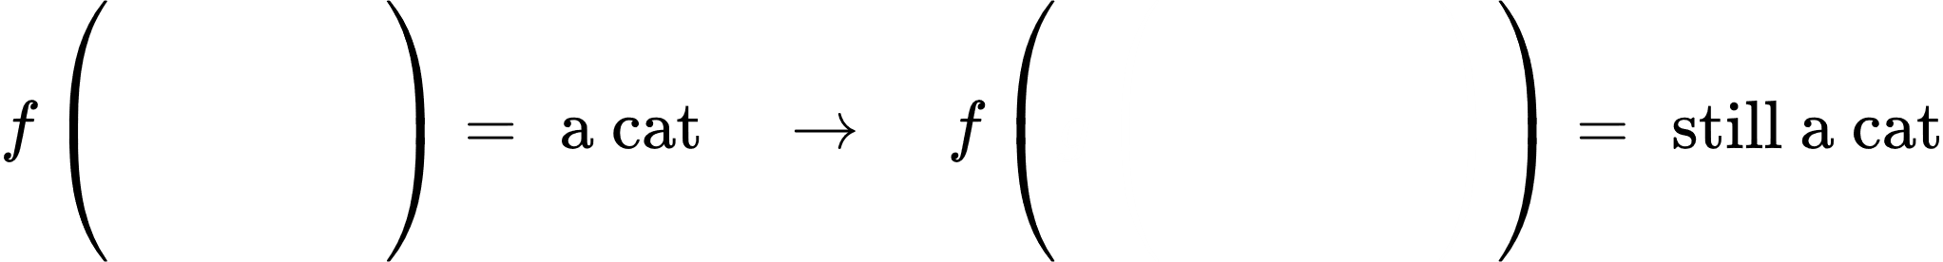
2. Label symmetries
Let:
be the input dataset with data points
be the class labels set with elements , we suppose exists
is a set of operations that form a label symmetry
Goal: Find
Notes:
Applying a symmetry to the input = to th output

Slide 13
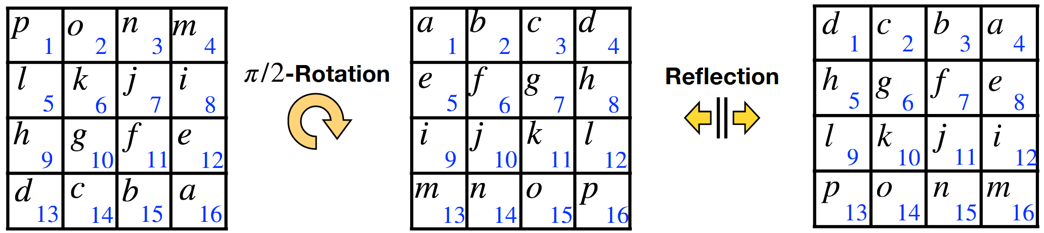


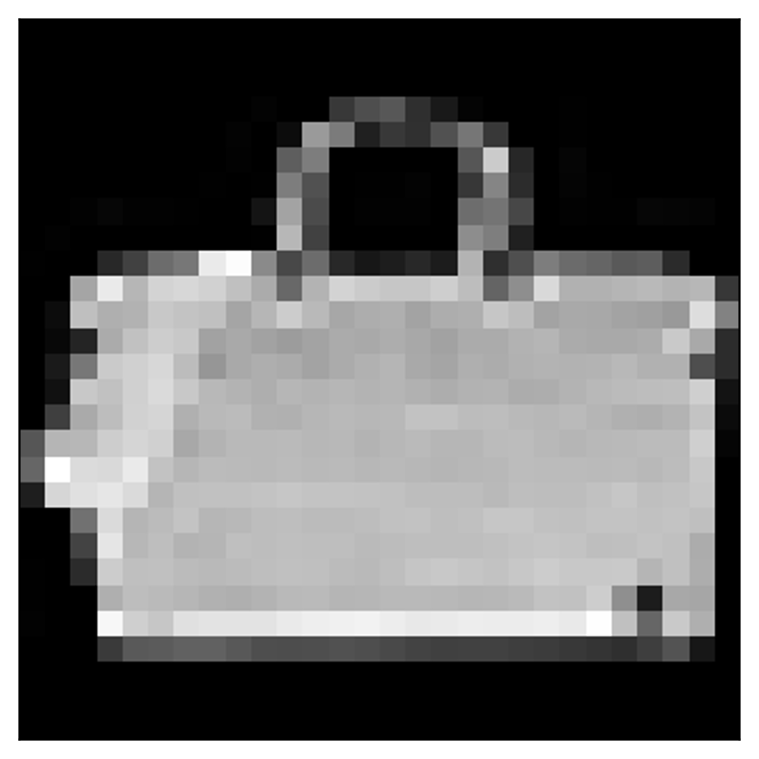
2. Label symmetries: Reflection
Classification: T-Shirt vs Handbag (Fashion MNIST)
Class 0 (T-Shirt)
Class 8 (Handbag)
Notes:
Applying a symmetry to the input = to th output

Slide 14
2. Label symmetries: Reflection
Classification: T-Shirt vs Handbag (Fashion MNIST)
Class 0 (T-Shirt)
Class 8 (Handbag)
Notes:
Applying a symmetry to the input = to th output

Slide 15
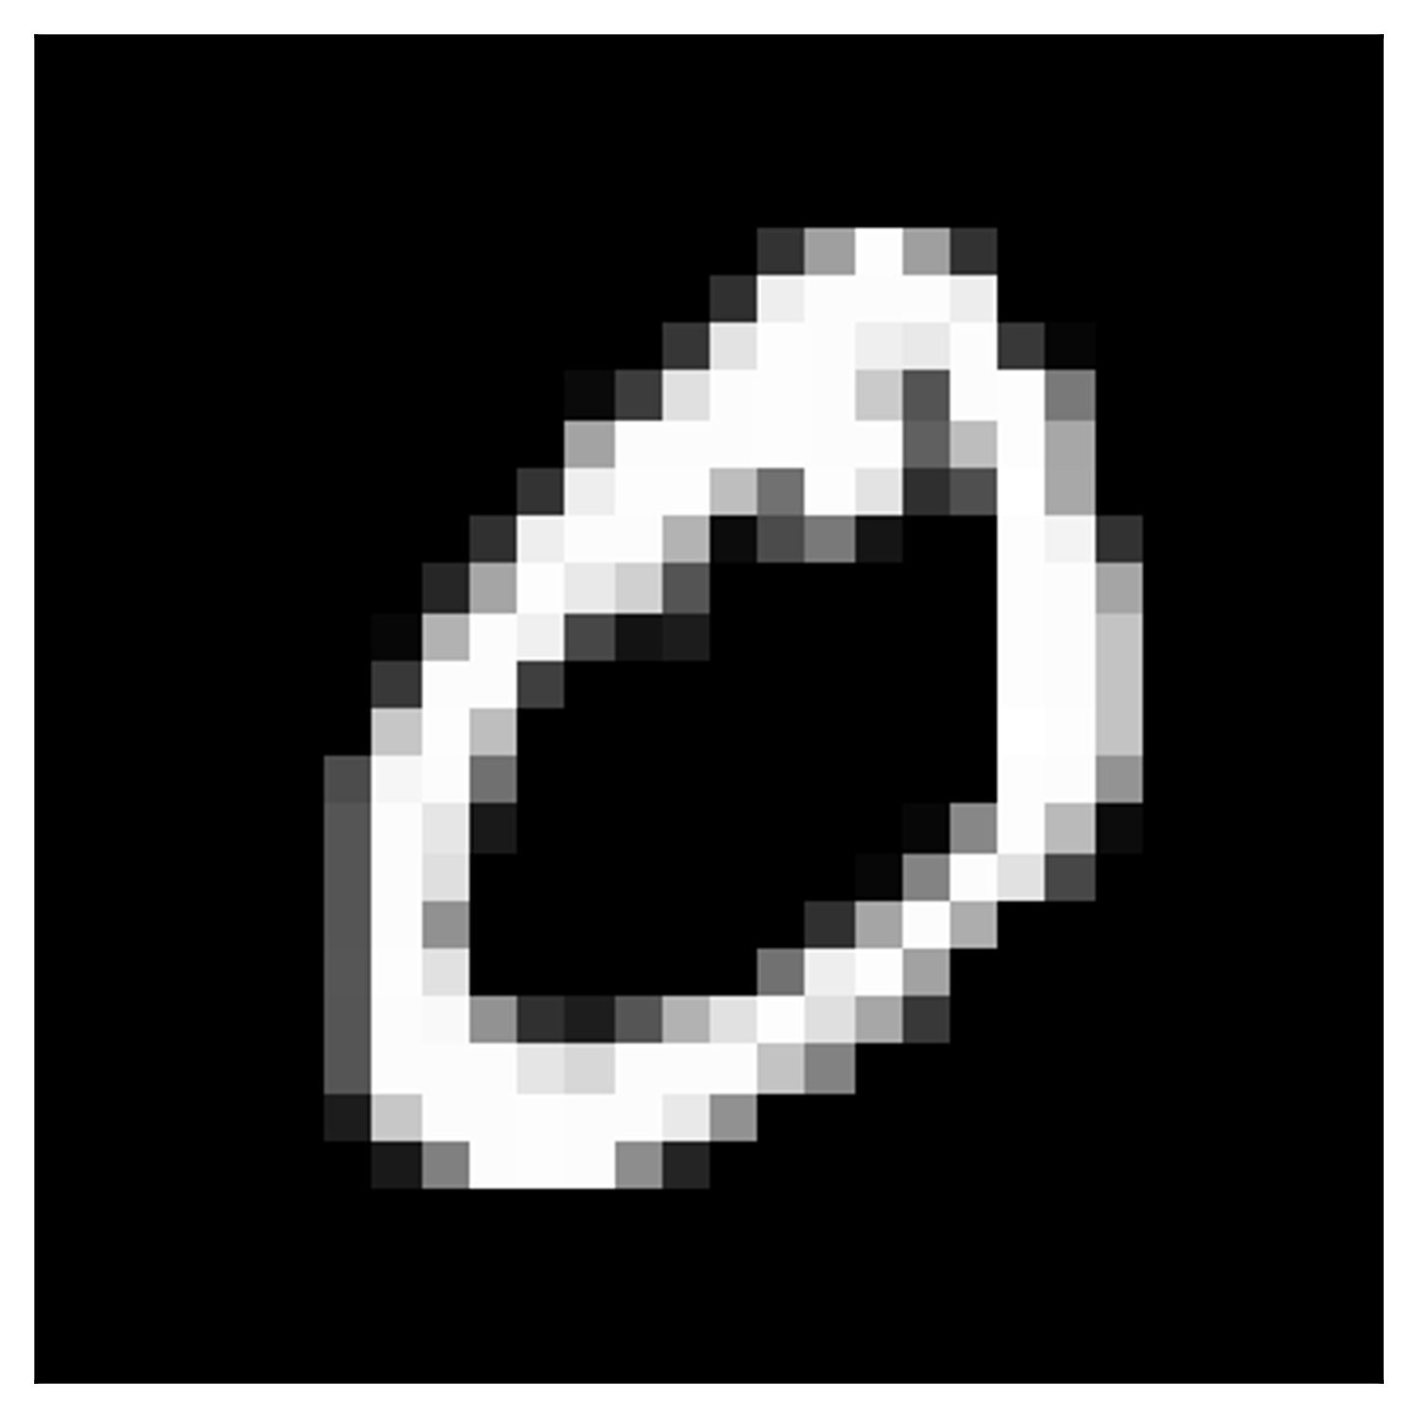
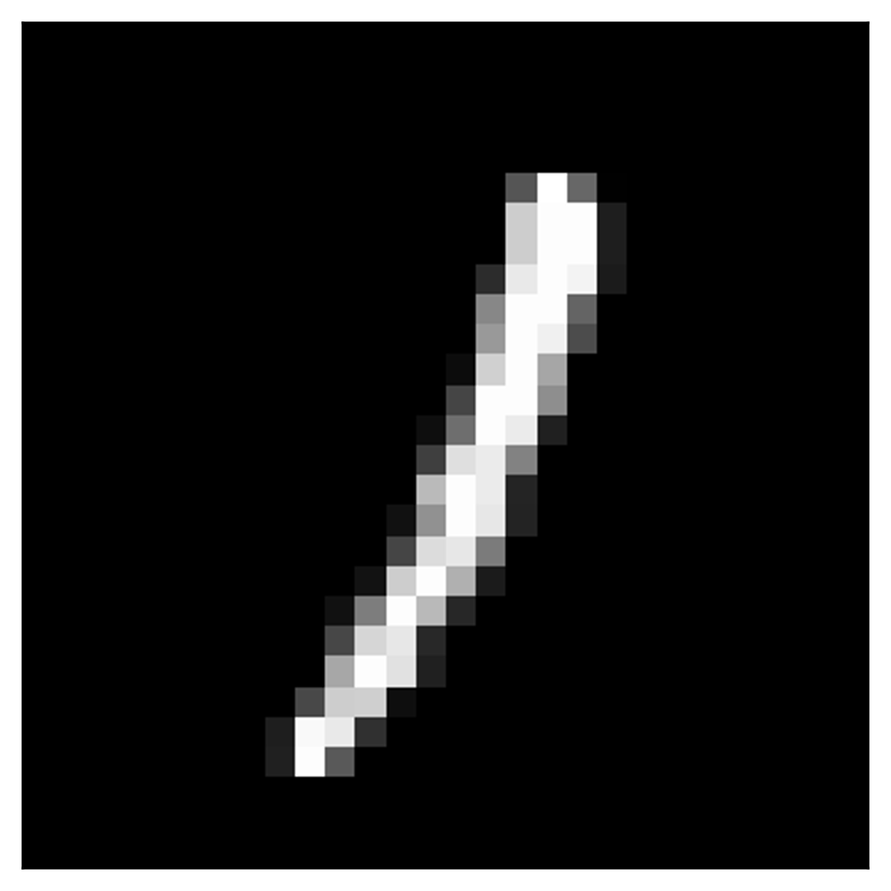
2. Label symmetries: Reflection & $π/2$- rotation
Classification: 0 vs 1 (MNIST)
Class 0
Class 1
Notes:
Applying a symmetry to the input = to th output

Slide 16
2. Label symmetries: Reflection & $π/2$- rotation
Classification: 0 vs 1 (MNIST)
Class 0
Class 1
Notes:
Applying a symmetry to the input = to th output

Slide 17
2. Label symmetries: Reflection & $π/2$- rotation
Classification: 0 vs 1 (MNIST)
Class 0
Class 1
Notes:
Applying a symmetry to the input = to th output

Slide 18
2. Label symmetries: Full permutation
Any swap between two qubits
Classification: Graphs
Connected graph
Non-connected graph
Notes:
Applying a symmetry to the input = to th output

Slide 19
2. Label symmetries: Full permutation
Any swap between two qubits
Classification: Graphs
Connected graph
Non-connected graph
Notes:
Applying a symmetry to the input = to th output

Slide 20
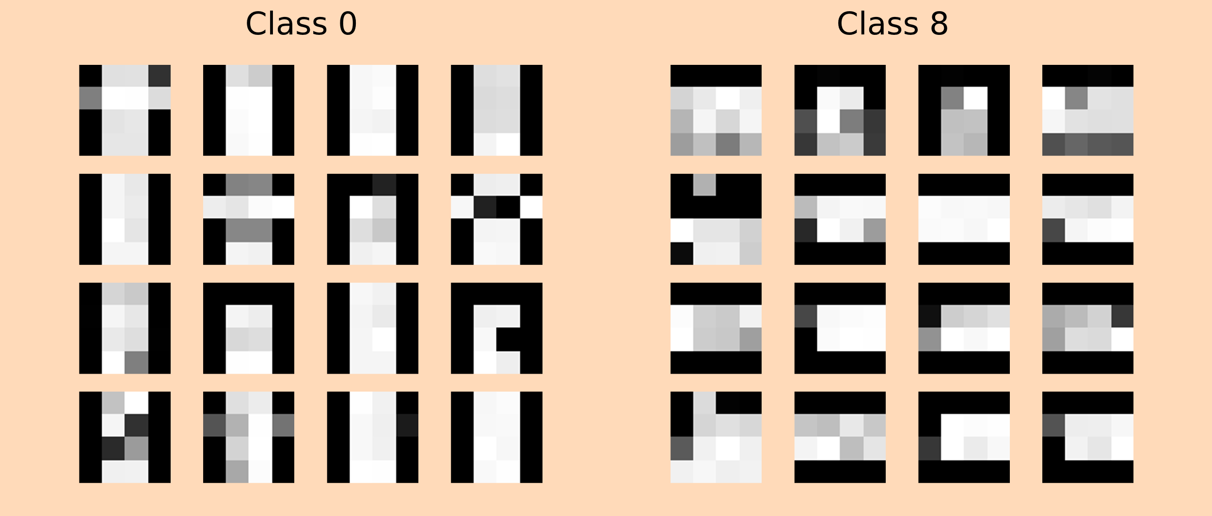

Note on the Datasets
Downsampled MNIST: $28×28→4×4$
Class 0 (T-Shirt)
Class 8 (Handbag)
Notes:
Applying a symmetry to the input = to th output

Slide 21
3. Reflection-equivariant QCNN
Notes:
Applying a symmetry to the input = to th output

Slide 22
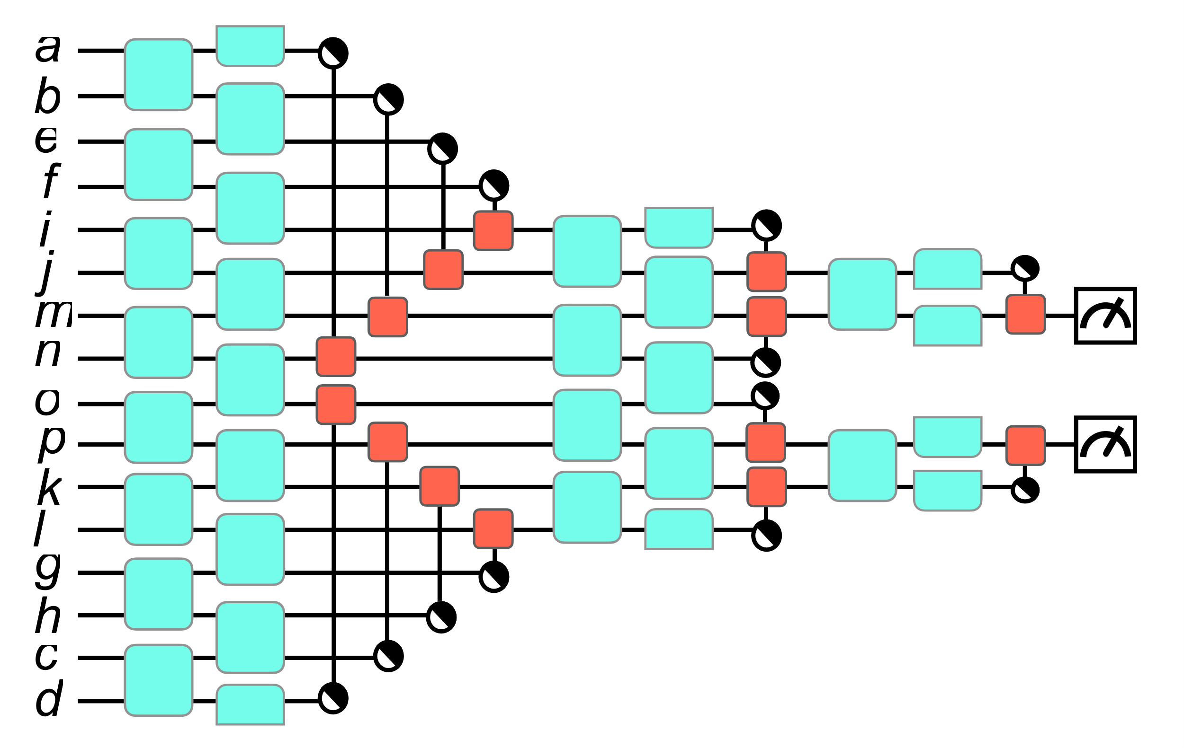
3. Reflection-equivariant QCNN
a
b
c
d
e
f
g
h
i
j
k
l
m
n
o
p
Notes:
Applying a symmetry to the input = to th output

Slide 23
3. Reflection-equivariant QCNN
d
c
b
a
h
g
f
e
l
k
j
i
p
o
n
m
Notes:
Applying a symmetry to the input = to th output

Slide 24
3. Reflection-equivariant QCNN
d
c
b
a
h
g
f
e
l
k
j
i
p
o
n
m
⚠️This is not equivariant!⚠️
Notes:
Applying a symmetry to the input = to th output

Slide 25
3. Reflection-equivariant QCNN
d
c
b
a
h
g
f
e
l
k
j
i
p
o
n
m
a
b
c
d
e
f
g
h
i
j
k
l
m
n
o
p
⚠️This is not equivariant!⚠️
Notes:
Applying a symmetry to the input = to th output

Slide 26
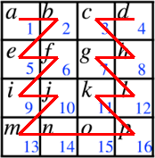
3. Reflection-equivariant QCNN
a
b
e
f
i
j
m
n
o
p
k
l
g
h
c
d
Notes:
Applying a symmetry to the input = to th output

Slide 27
3. Reflection-equivariant QCNN
a
b
e
f
i
j
m
n
o
p
k
l
g
h
c
d
d
c
h
g
l
k
p
o
n
m
j
i
f
e
b
a
Notes:
Applying a symmetry to the input = to th output

Slide 28
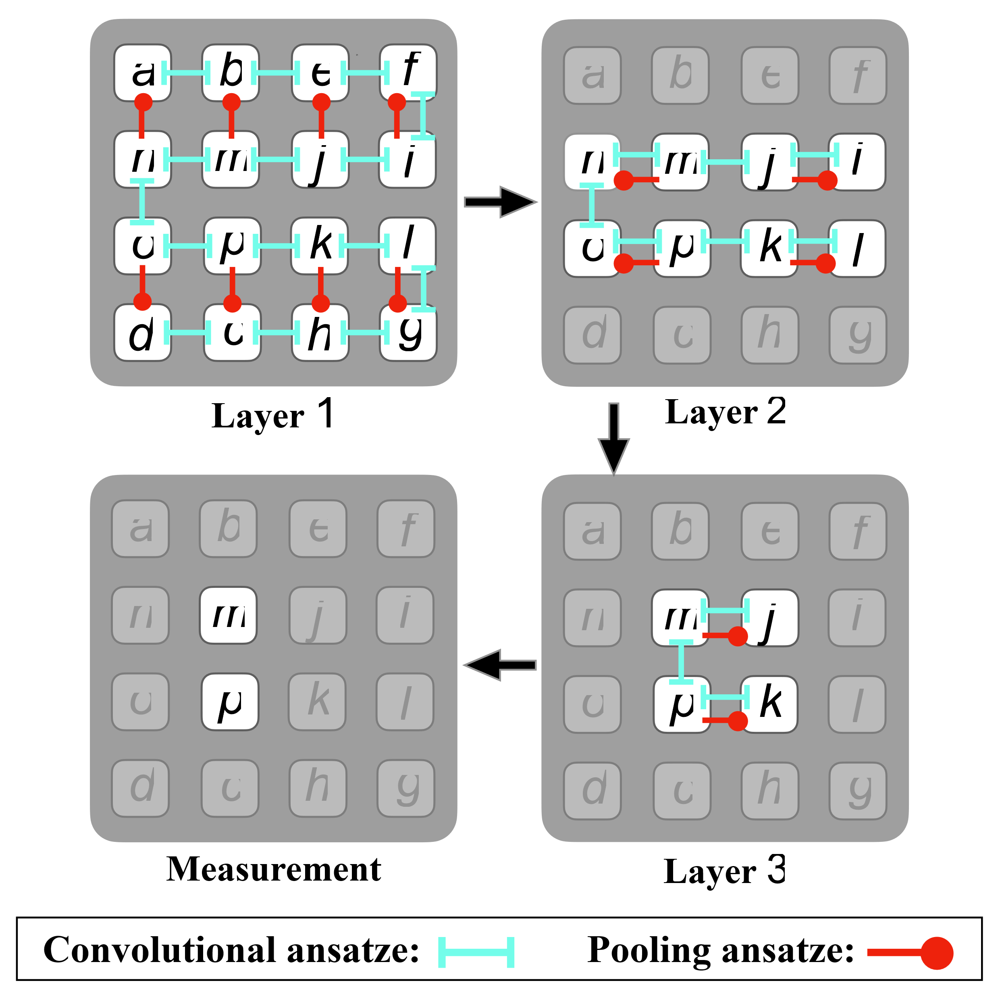
3. Reflection-equivariant QCNN
Highly efficient on a 2D square lattice architecture
a
b
e
f
i
j
m
n
o
p
k
l
g
h
c
d
Notes:
Applying a symmetry to the input = to th output

Slide 29
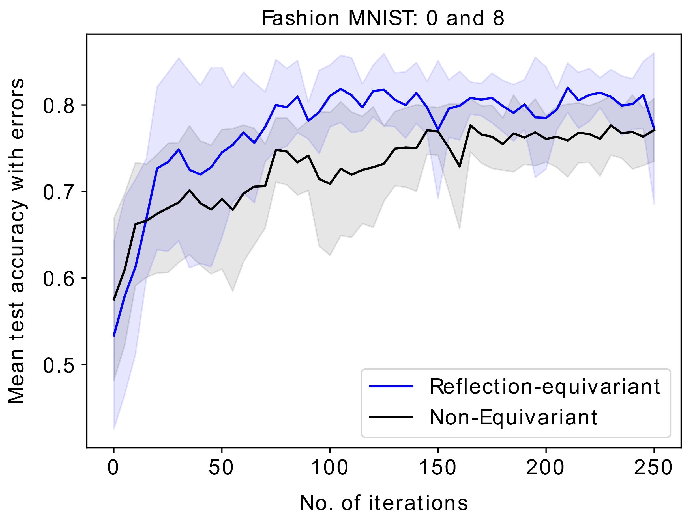
3. Reflection-equivariant QCNN
Statistics: Averages and deviations from over 10 identical runs with different initial parameters
Reflection-equivariant QCNN shows a slightly higher classification accuracy than non-equivariant QCNN
Notes:
Applying a symmetry to the input = to th output

Slide 30
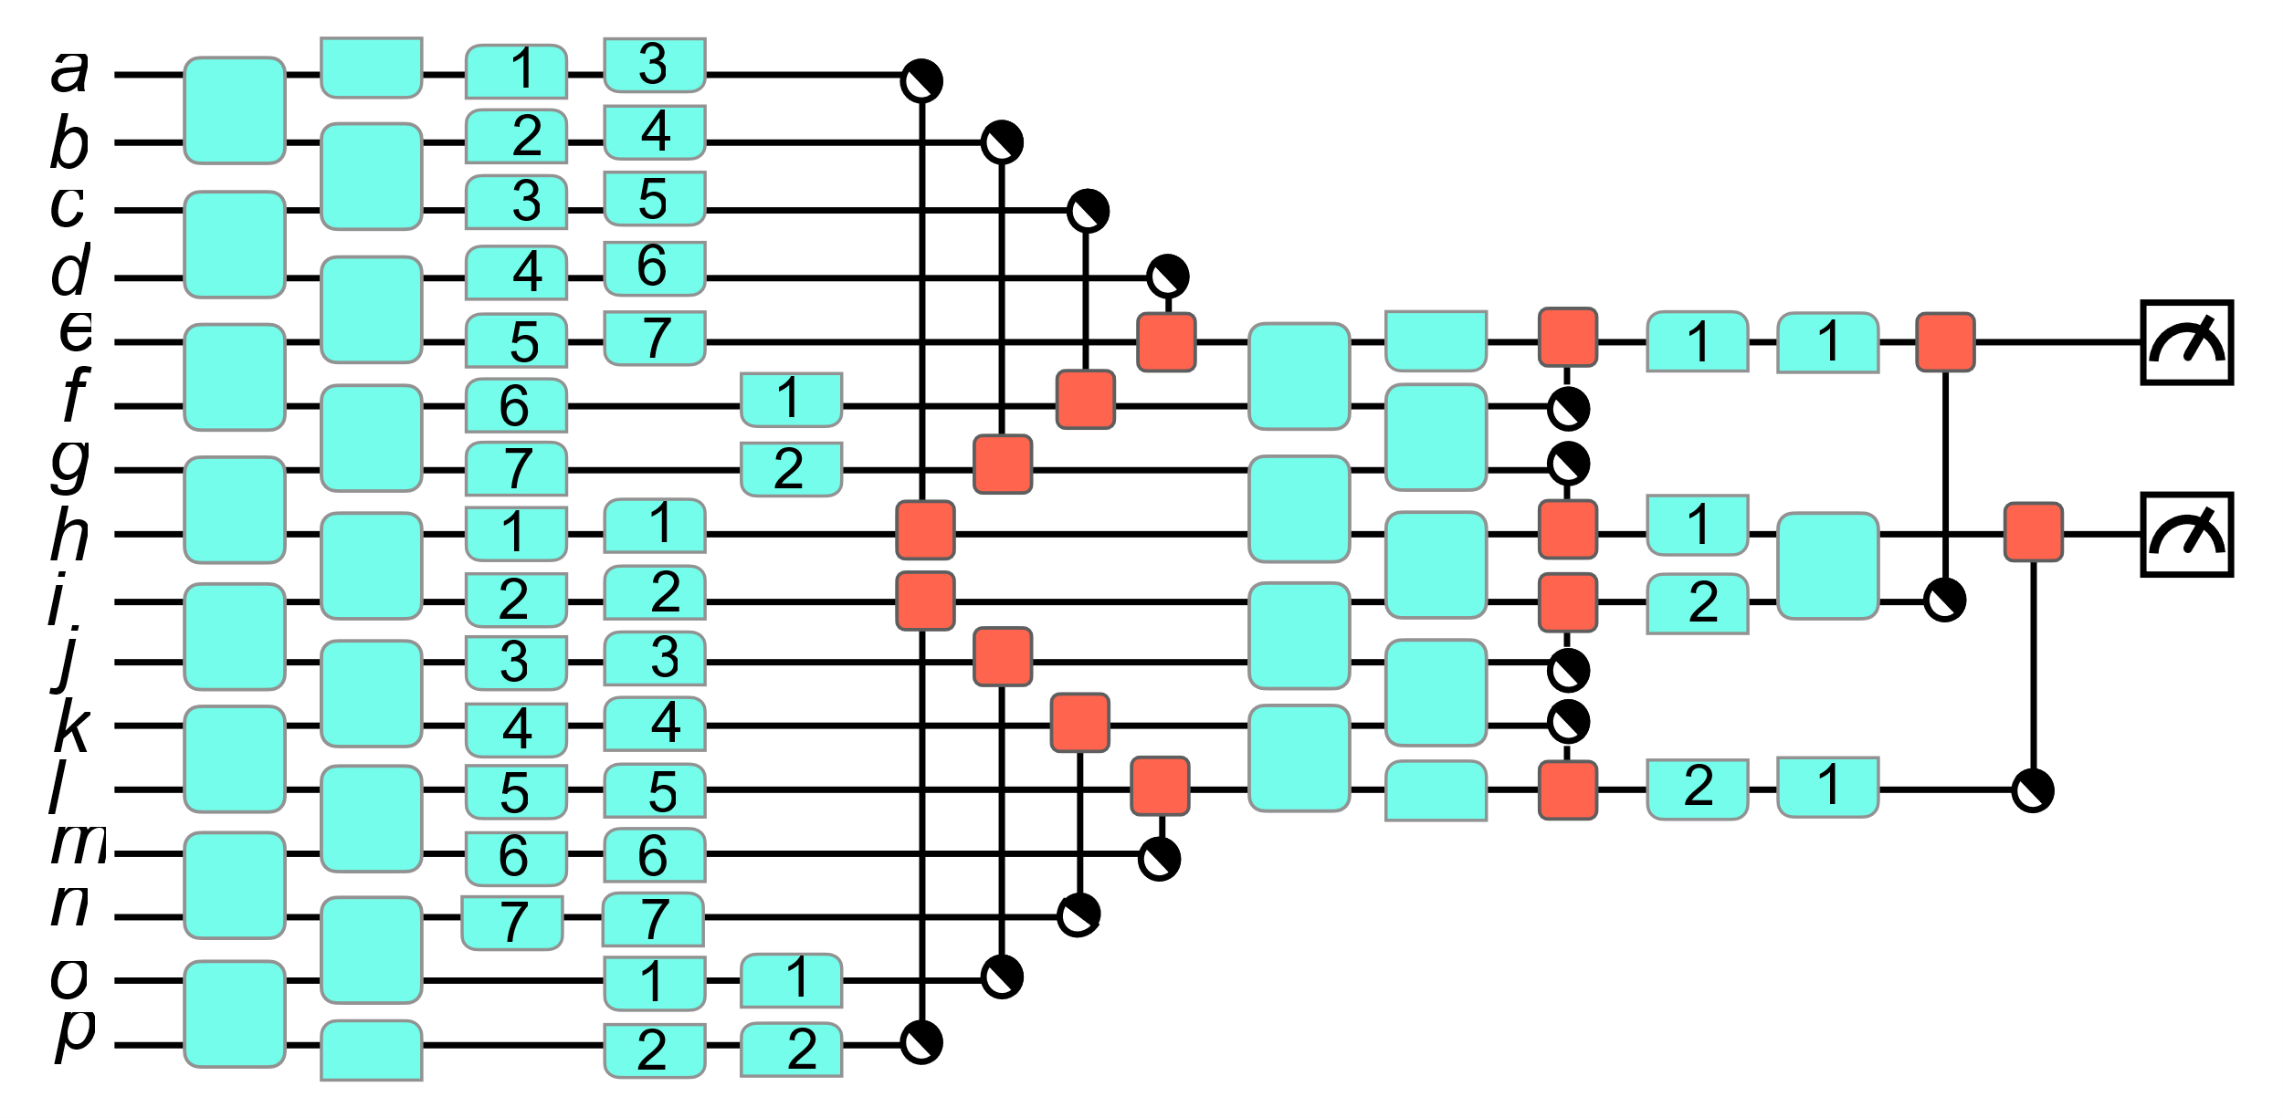
3. Reflection and $\frac{π}{2}$-rotation equivariant QCNN
Notes:
Applying a symmetry to the input = to th output

Slide 31
3. Reflection and $\frac{π}{2}$-rotation equivariant QCNN
✅This is equivariant!✅
Notes:
Applying a symmetry to the input = to th output

Slide 32
3. Reflection and $\frac{π}{2}$-rotation equivariant QCNN
p
o
n
m
l
k
j
i
hg
f
e
d
c
b
a
Notes:
Applying a symmetry to the input = to th output

Slide 33
3. Reflection and $\frac{π}{2}$-rotation equivariant QCNN
Notes:
Applying a symmetry to the input = to th output

Slide 34
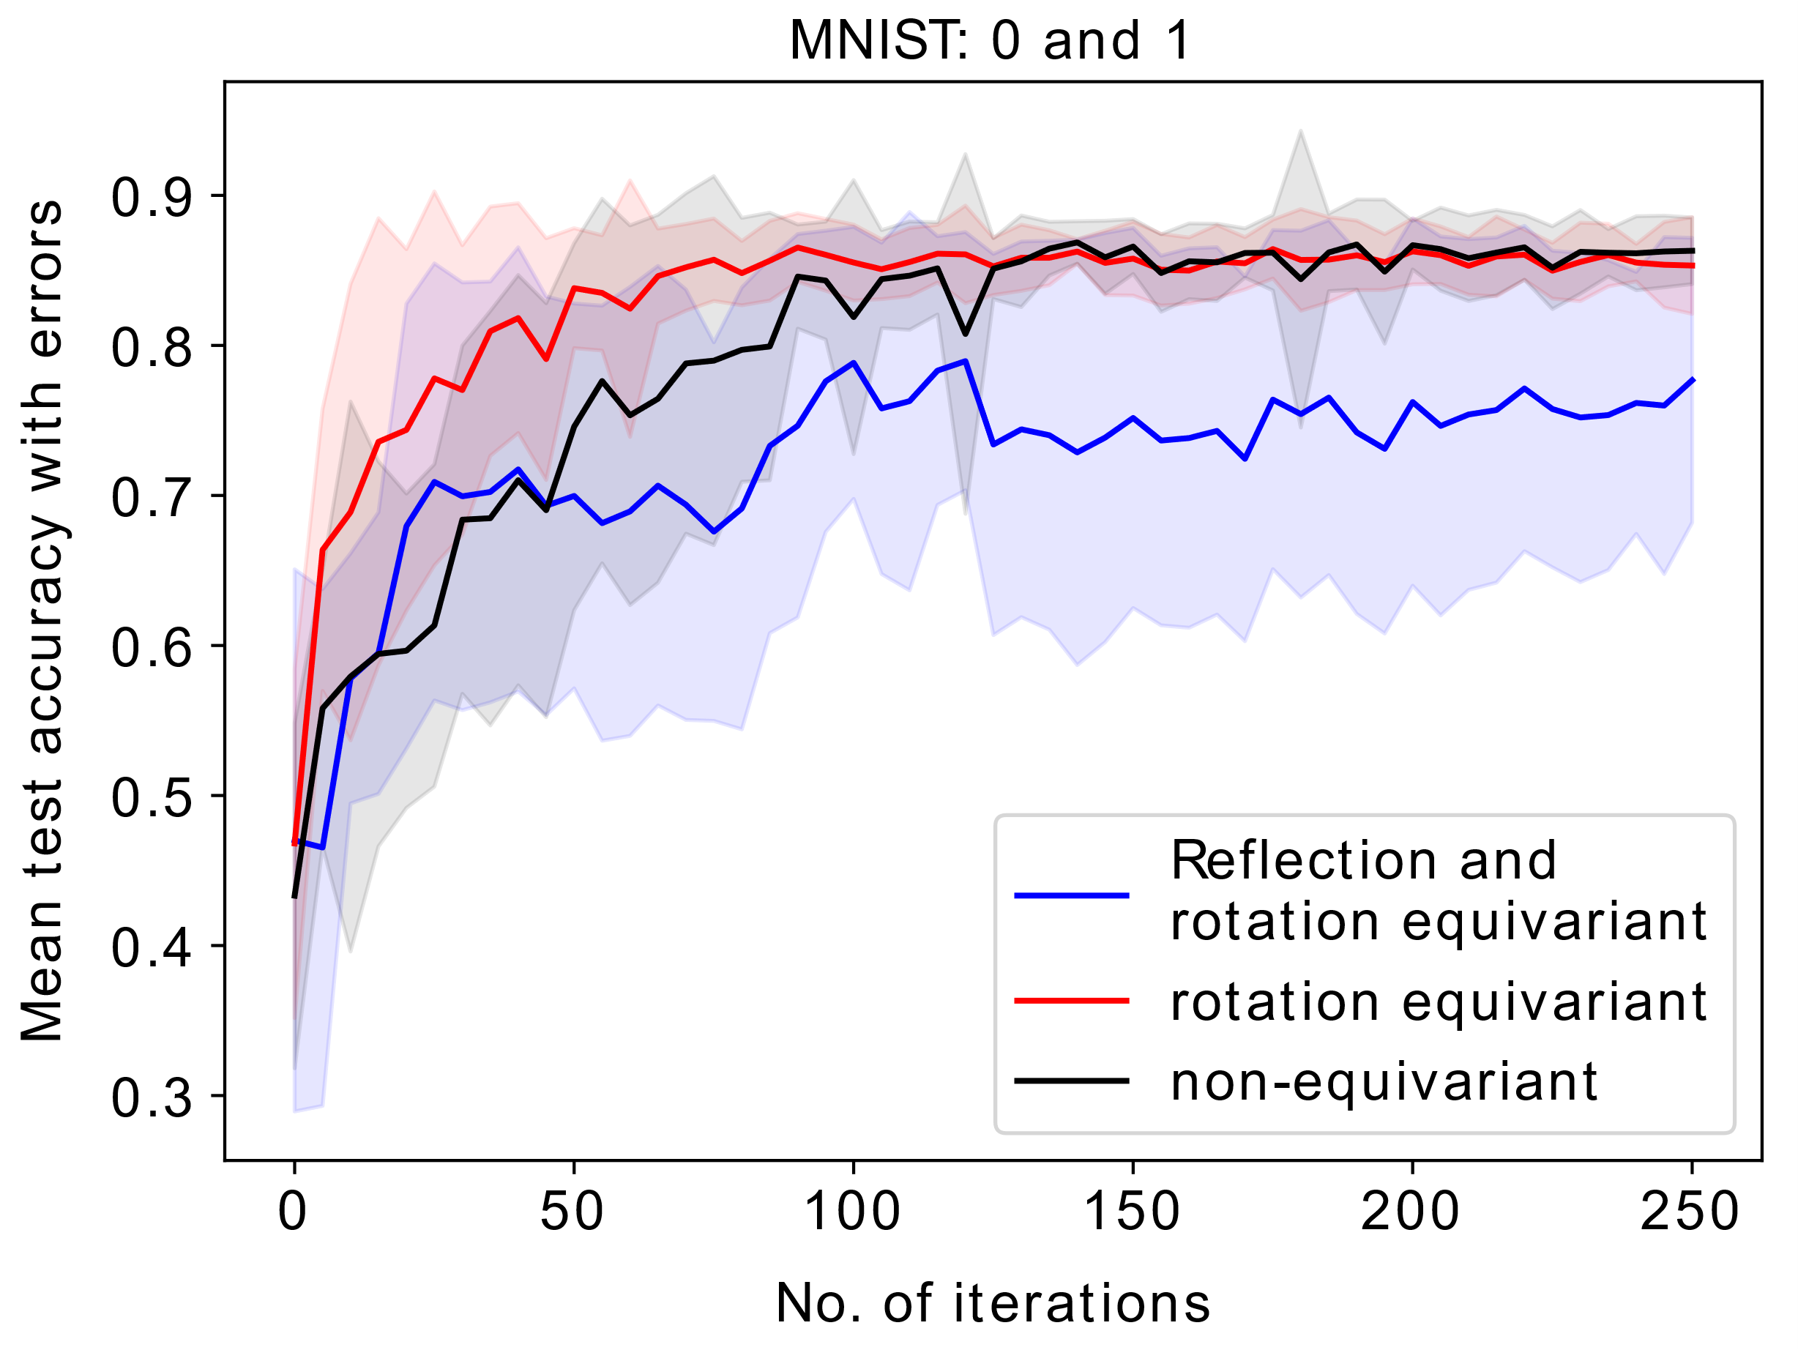
3. Reflection and $\frac{π}{2}$-rotation equivariant QCNN
Statistics: Averages and deviations from over 10 identical runs with different initial parameters
Rotation-equivariant QCNN does reach a high accuracy faster than non-equivariant QCNN, but ultimately score the same.
Reflection and rotation equivariant results in a significant reduction in accuracy, “this can be due the highly constrained structure of EQCNN under both symmetries, for which the expressibility degrades significantly.”
Notes:
Applying a symmetry to the input = to th output

Slide 35
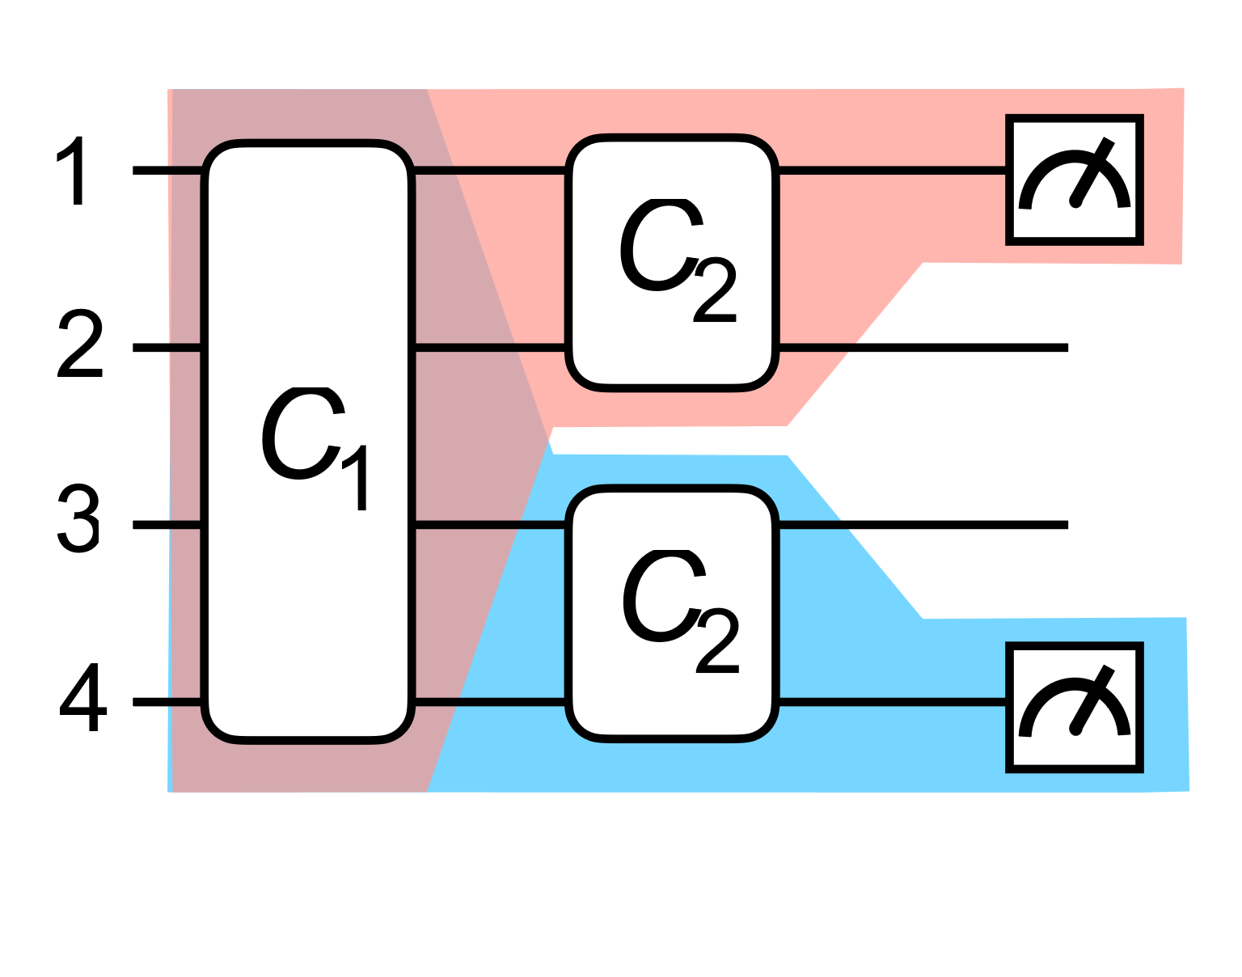
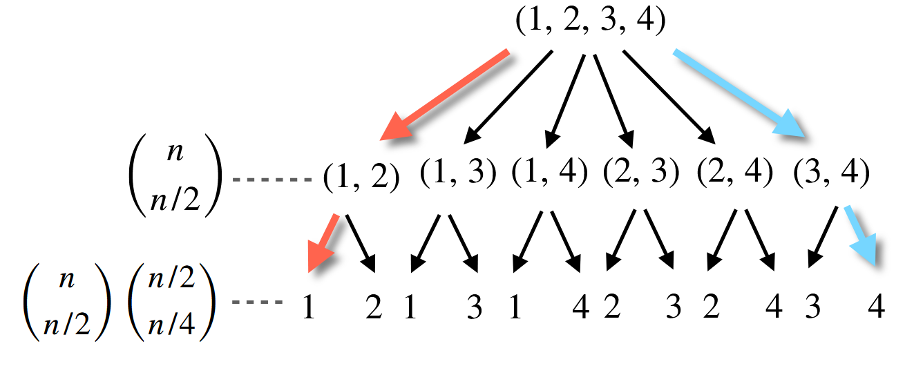
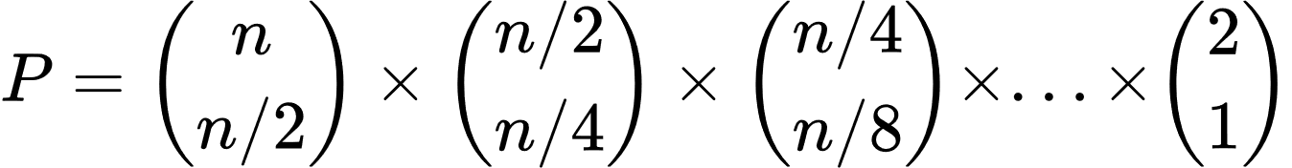
3. $S_{n}$equivariant QCNN
Idea:
Total possible QCNNs:
Notes:
Applying a symmetry to the input = to th output

Slide 36
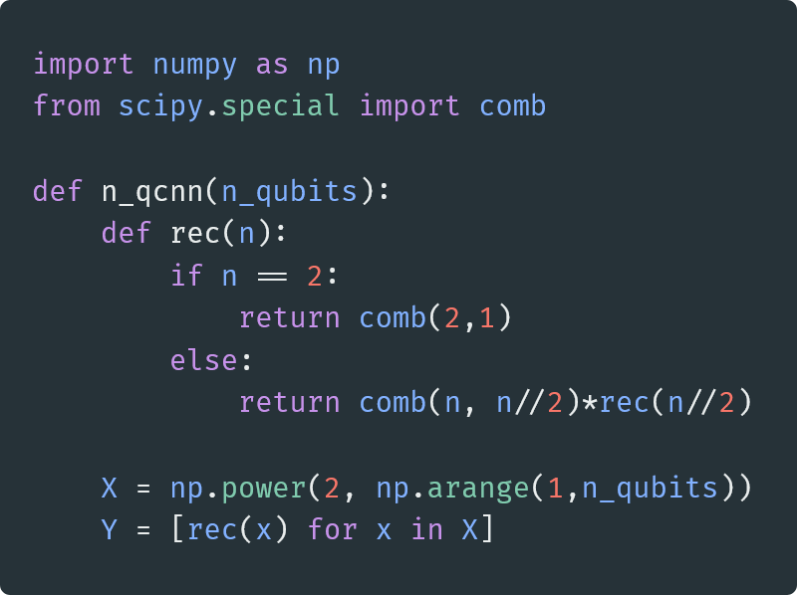
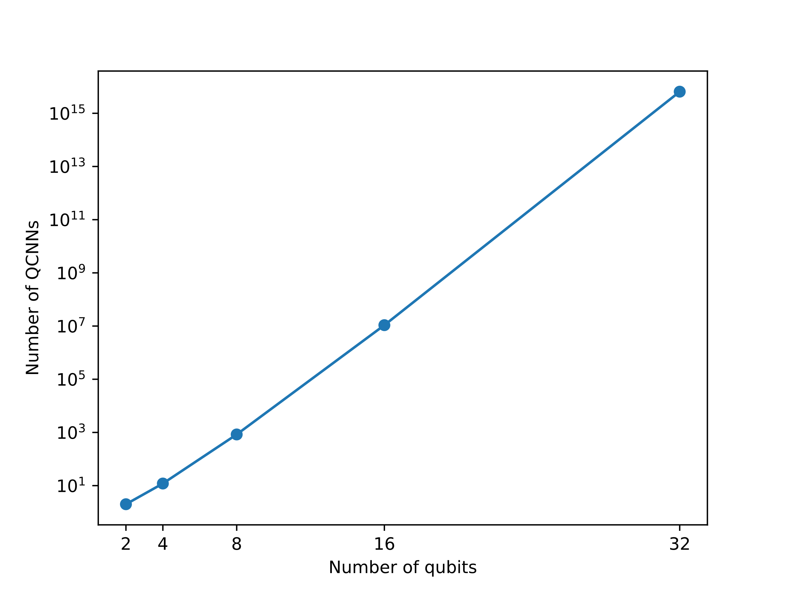
3. $S_{n}$equivariant QCNN
Idea:
Notes:
Applying a symmetry to the input = to th output

Slide 37
3. $S_{n}$equivariant QCNN
Idea:
Total possible QCNNs:
Notes:
Applying a symmetry to the input = to th output

Slide 38
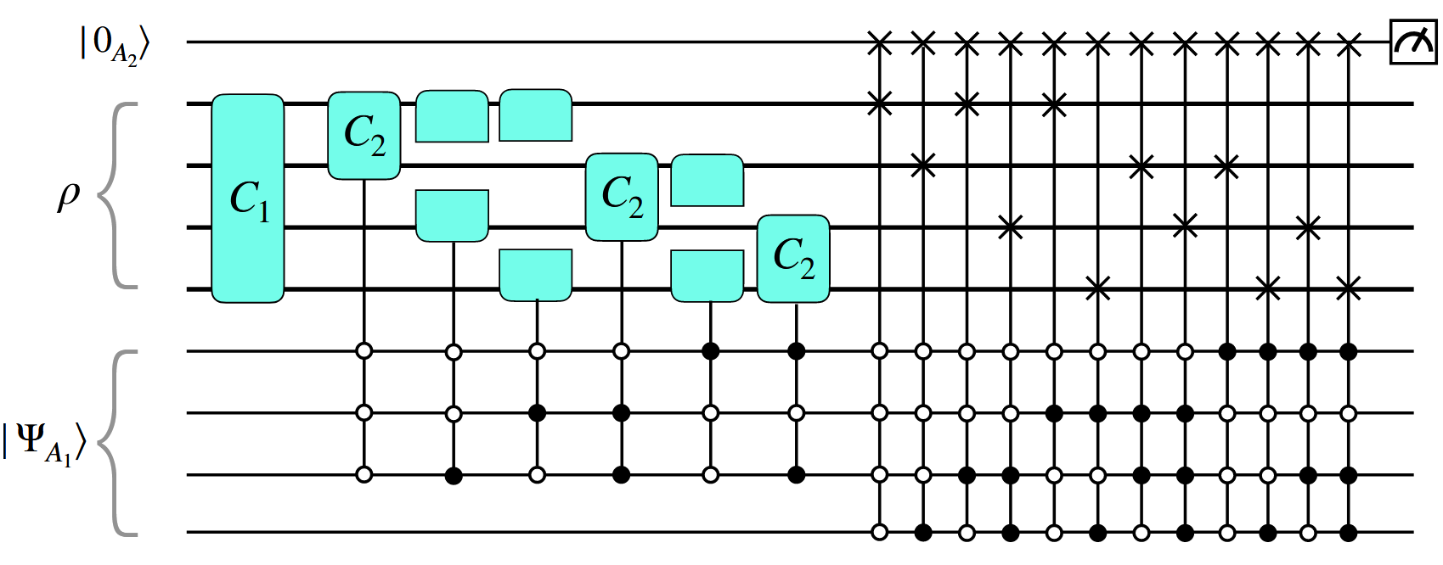
3. $S_{n}$equivariant QCNN
Notes:
Applying a symmetry to the input = to th output

Slide 39
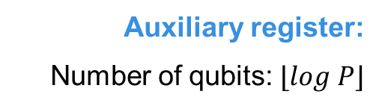
3. $S_{n}$equivariant QCNN
Input state:
Auxiliary register:
Number of qubits: $⌊log P⌋$
Notes:
Applying a symmetry to the input = to th output

Slide 40
3. $S_{n}$equivariant QCNN
Input state:
Auxiliary register:
Number of qubits: $⌊log P⌋$
First Convolution
Second Convolution
(6)
Notes:
Applying a symmetry to the input = to th output

Slide 41

3. $S_{n}$equivariant QCNN
$$ρ$$
(Input state)
Notes:
Applying a symmetry to the input = to th output

Slide 42

3. $S_{n}$equivariant QCNN
$$ρ$$
$$ρ_{1}=C_{1}ρC_{1}^{+}$$
Notes:
Applying a symmetry to the input = to th output

Slide 43

3. $S_{n}$equivariant QCNN
$$ρ$$
$$ρ_{1}=C_{1}ρC_{1}^{+}$$
$$ρ_{2}$$
Notes:
Applying a symmetry to the input = to th output

Slide 44
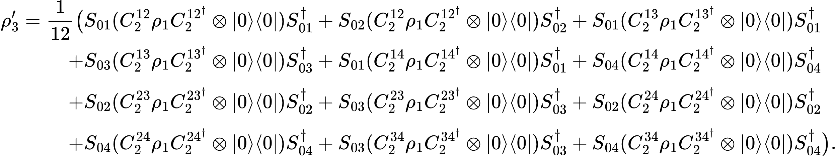

3. $S_{n}$equivariant QCNN
Now considering the top auxiliary register as well
$$ρ$$
$$ρ_{1}=C_{1}ρC_{1}^{+}$$
$$ρ_{2}$$
$$ρ_{3}^{′}$$
Notes:
Applying a symmetry to the input = to th output

Slide 45



3. $S_{n}$equivariant QCNN
Now considering the top auxiliary register as well
Convolution
Involved qubits
Convolution order
Swap
Swapped qubit indexes
$$ρ_{3}^{′}$$
Notes:
Applying a symmetry to the input = to th output

Slide 46
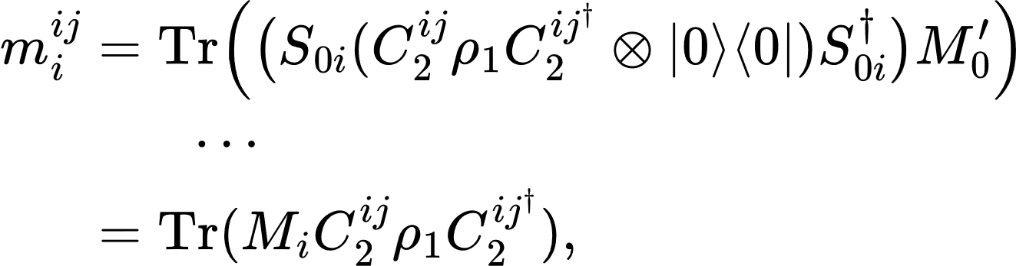
3. $S_{n}$equivariant QCNN
Now considering the top auxiliary register as well
Convolution
Involved qubits
Convolution order
Swap
Swapped qubit indexes
The expectation value of the measurement on $A_{2}$ (top single-qubit auxiliary register) is:
Which can be decomposed into the sum of:
Notes:
Applying a symmetry to the input = to th output

Slide 47
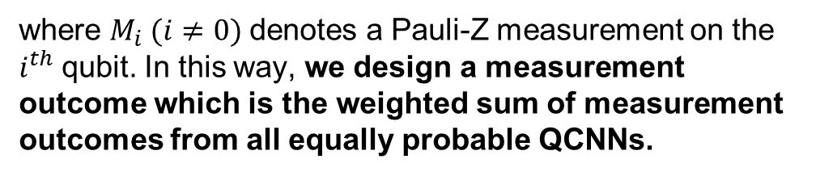
3. $S_{n}$equivariant QCNN
Now considering the top auxiliary register as well
Convolution
Involved qubits
Convolution order
Swap
Swapped qubit indexes
The expectation value of the measurement on $A_{2}$ (top single-qubit auxiliary register) is:
Which can be decomposed into the sum of:
where $M_{i} (i≠0)$denotes a Pauli-Z measurement on the $i^{th}$qubit. In this way, we design a measurement outcome which is the weighted sum of measurement outcomes from all equally probable QCNNs.
Notes:
Applying a symmetry to the input = to th output

Slide 48
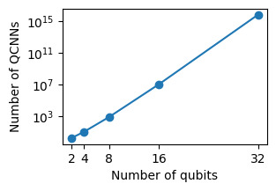
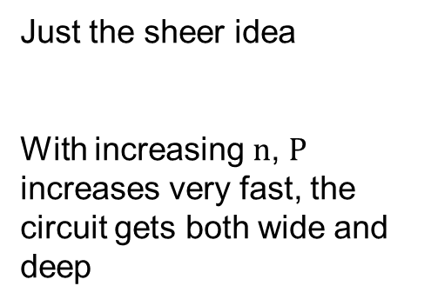
3. $S_{n}$equivariant QCNN
Just the sheer idea
With increasing $n$, $P$ increases very fast, the circuit gets both wide and deep
💡
Can be avoided tracing out a constant number of qubits
Notes:
Applying a symmetry to the input = to th output

Slide 49
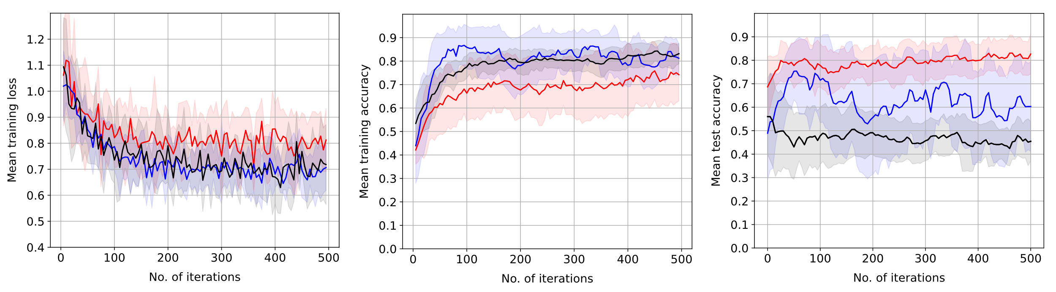
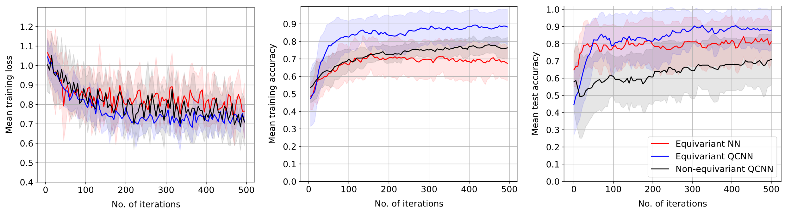
3. $S_{n}$equivariant QCNN
Case 1: 5:3
Case 2: 5:1
Notes:
Applying a symmetry to the input = to th output

Slide 50

QUESTIONS?
ENGAGE has received funding from the European Union’s Horizon 2020 Research and Innovation Programme under the Marie Skłodowska-Curie Grant Agreement No. 101034267.

Slide 51
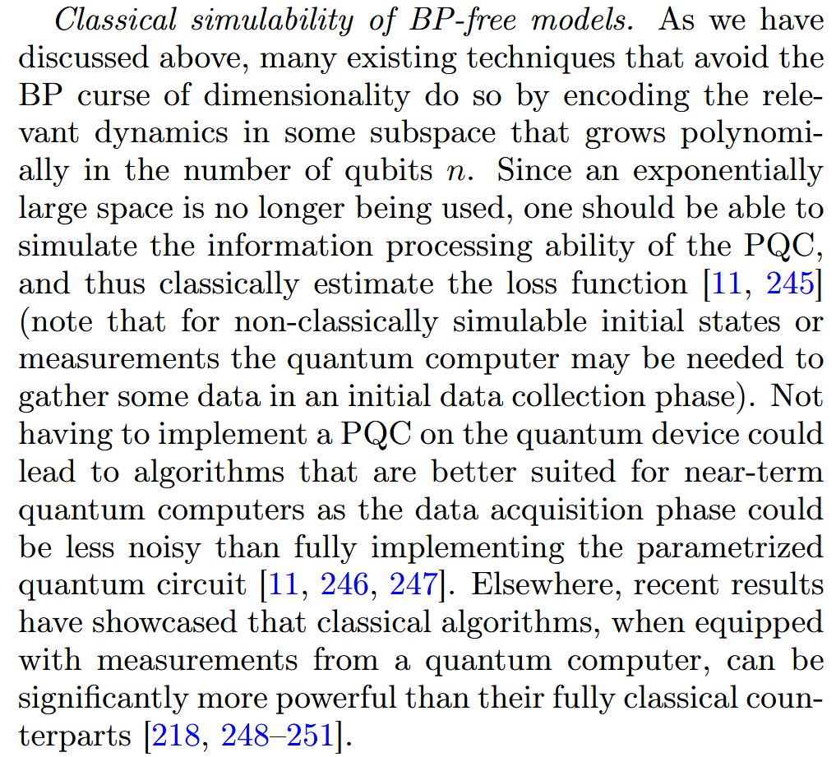
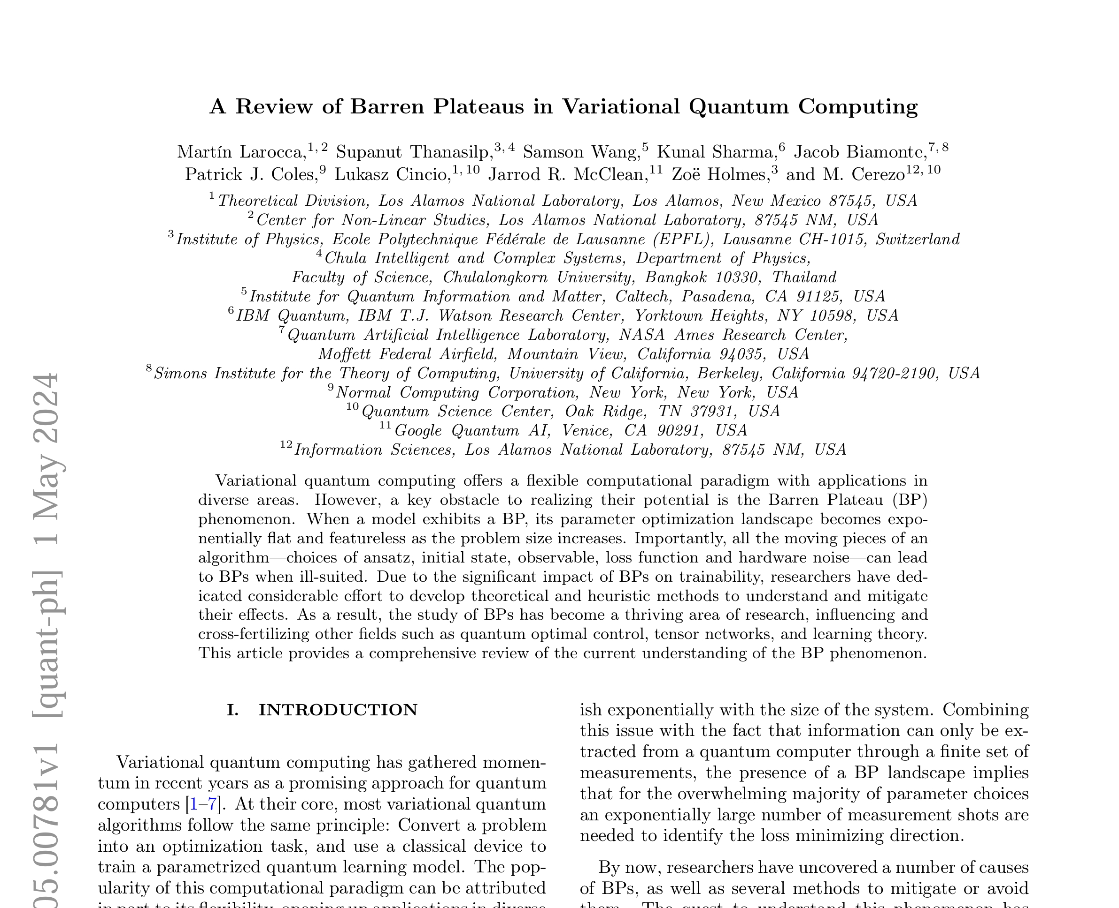
Extra: End of QCNN?
Notes:
Applying a symmetry to the input = to th output

Slide 52
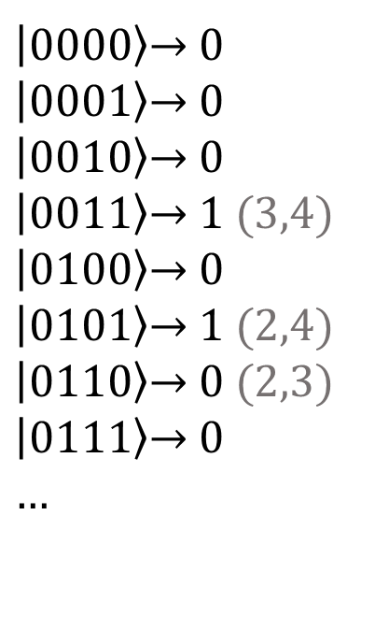
Note on the Datasets
Graph Dataset:
Amplitude embedding on a 4-qubits system for a 4-vertexes graph
$\left|\text{0000}\right\rangle \text{→ 0}$
$\left|\text{0001}\right\rangle \text{→ 0}$
$\left|\text{0010}\right\rangle \text{→ 0}$
$\left|\text{0011}\right\rangle \text{→ 1 }\text{(3,4)}$
$\left|\text{0100}\right\rangle \text{→ 0}$
$\left|\text{0101}\right\rangle \text{→ 1 }\text{(2,4)}$
$\left|\text{0110}\right\rangle \text{→ 0 }\text{(2,3)}$
$\left|\text{0111}\right\rangle \text{→ 0}$
$\text{…}$
1
2
My guess
3
4
Notes:
Applying a symmetry to the input = to th output

Slide 53
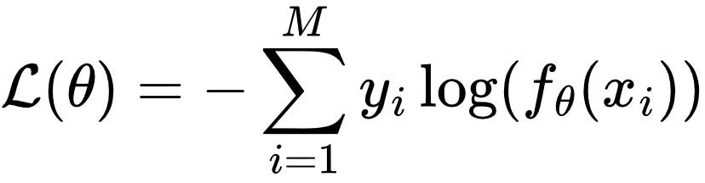
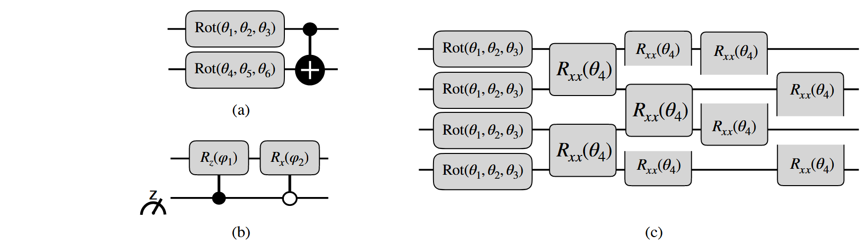
Extra: Training details
Optimizer: Nesterov (Momentum) Optimizer with learning rate 0.005
Loss function: Cross Entropy
Batch size: 32
Statistics: Averages and deviations from over 10 identical runs with different initial parameters
Reflection and Rotation
equivariant QCNNs
Pixels: 16 (4x4)
Convolution
Pooling
Notes:
Applying a symmetry to the input = to th output

Slide 54
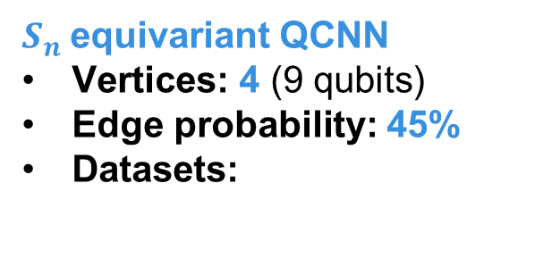
Extra: Training details
Optimizer: Adam Optimizer with learning rate 0.01
Loss function: MSE
Statistics: Averages and deviations from over 10 identical runs with different initial parameters
$S_{n}$equivariant QCNN
Vertices: 4 (9 qubits)
Edge probability: 45%
Datasets:
Convolution
Case 1: 45 (Training) and 18 (Testing)
Case 2: 52 (Training) and 11 (Testing)
Pooling
Notes:
Applying a symmetry to the input = to th output

