Slide 1
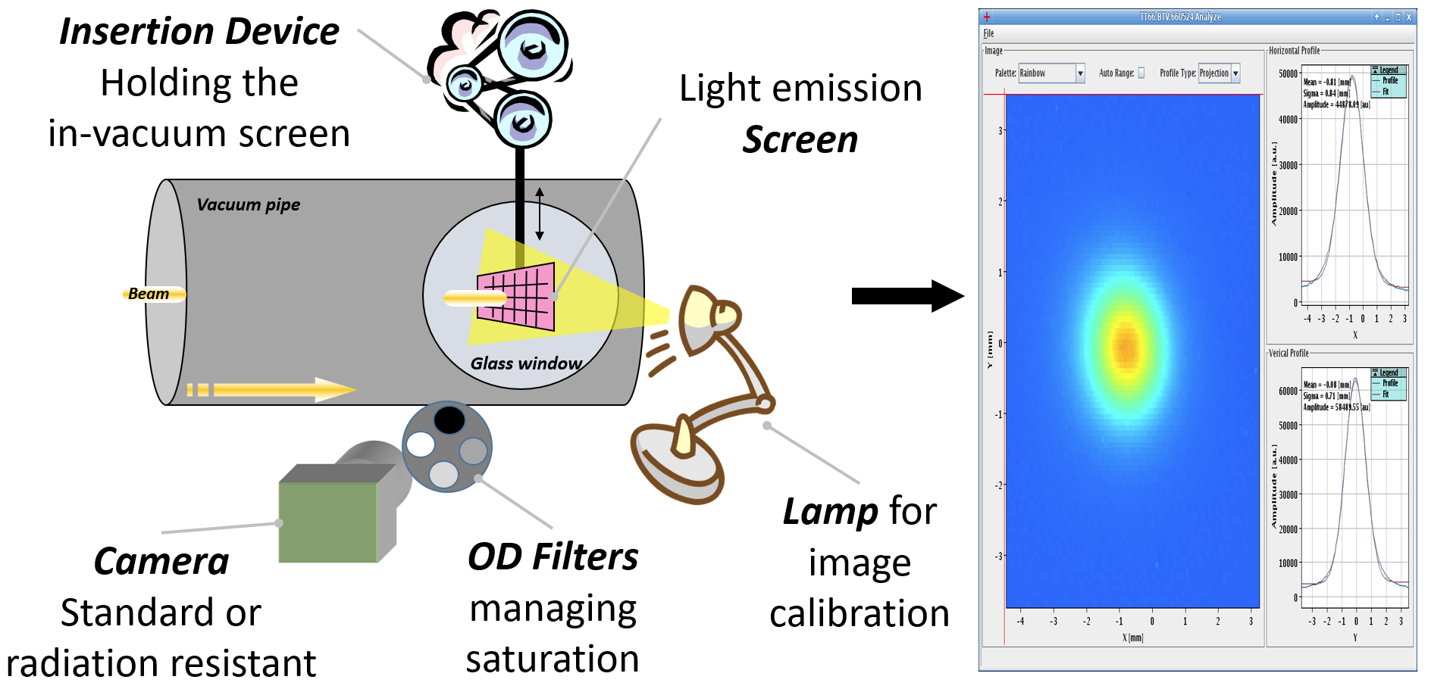
Beam Instrumentation for Fixed Target (BIFT) facilities working group - 1st meeting
2023_02_20
BTV NACONS
S.Burger
Introduction
Status/Needs
Consolidation
Upgrade: BTV230925
Specific thanks to
B.Moser / S.Girod / M.Lazzaroni / N.Charitonidis
F.Velotti / G.Lerhner / Y.Aguiar / F.Roncarolo / J.Tan

Slide 2
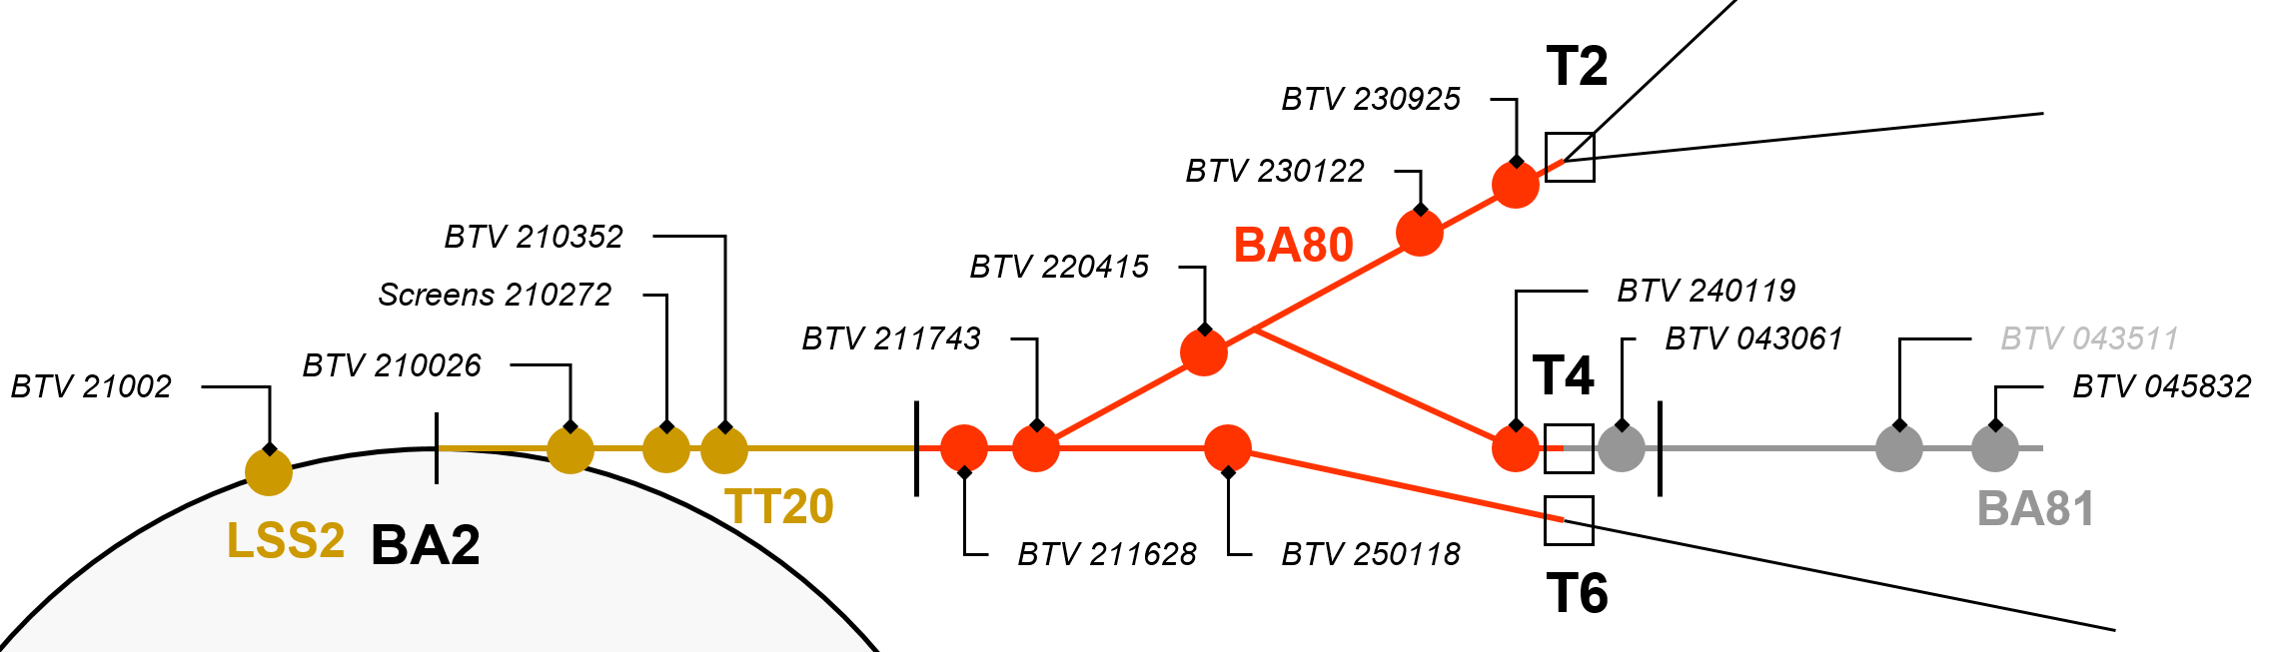
INTRODUCTION (1)
Layout
BA80
TCC2
No BTV
TDC2
S.Burger BIFT 2023_03_13

Slide 3
INTRODUCTION (2)
BTV Hardware
BTV | Line | Detector | Actuator type | Screen type
 |  |  |  | 1 | 2 | 3
21002 | LSS2 | Camera CCD | Maltese Cross – 4 positions | ALUMINE AF995 | SCINT. 31NSG | Ti 12um
210026 | TT20 | Camera Tube | Maltese Cross – 4 positions | ALUMINE AF995 | QUARTZ SIO2 | ALUMINE AF995
210272 | TT20 | PMT | Maltese Cross – 4 positions | ALUMINE AF995 | QUARTZ SIO2 | Ti 12um
210352 | TT20 | Camera Tube | Maltese Cross – 4 positions | ALUMINE AF995 | QUARTZ SIO2 | ALUMINE AF995
211628 | TDC2 | Camera Tube | Maltese Cross – 4 positions | ALUMINE AF995 | QUARTZ SIO2 | ALUMINE AF995
211743 | TDC2 | Camera Tube | Linear stepper – 2 positions | ALUMINE AF995 | - | -
220415 | TDC2 | Camera Tube | Maltese Cross – 4 positions | ALUMINE AF995 | QUARTZ SIO2 | ALUMINE AF995
230122 | TDC2 | Camera Tube | Maltese Cross – 4 positions | ALUMINE AF995 | SCINT. 31NSG | ALUMINE AF995
240119 | TDC2 | Camera Tube | Maltese Cross – 4 positions | ALUMINE AF995 | QUARTZ SIO2 | ALUMINE AF995
250118 | TDC2 | Camera Tube | Maltese Cross – 4 positions | ALUMINE AF995 | QUARTZ SIO2 | ALUMINE AF995
230925 | TDC2 | Camera Tube | Linear stepper – 2 positions | ALUMINE AF995 | - | -
TT20
TDC2
S.Burger BIFT 2023_03_13

Slide 4
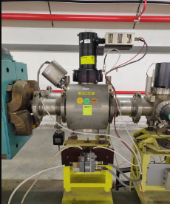
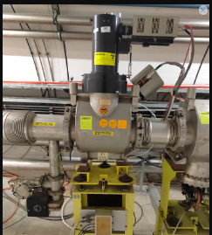
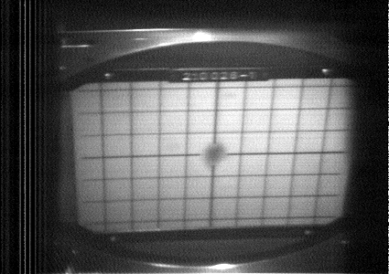
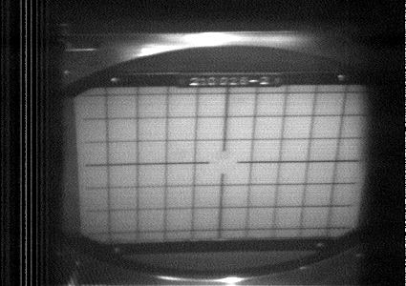
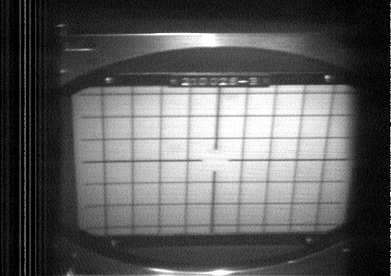
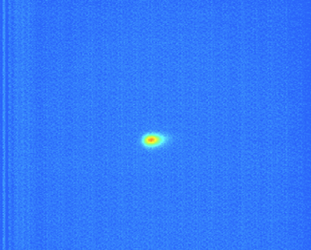
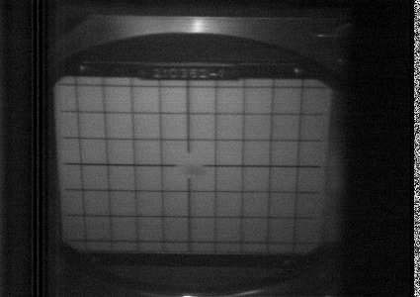
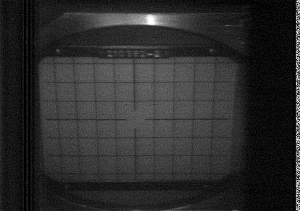
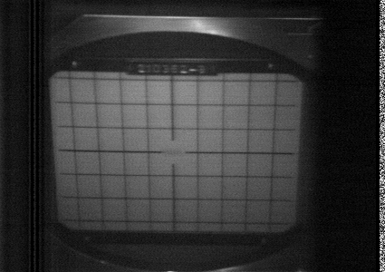
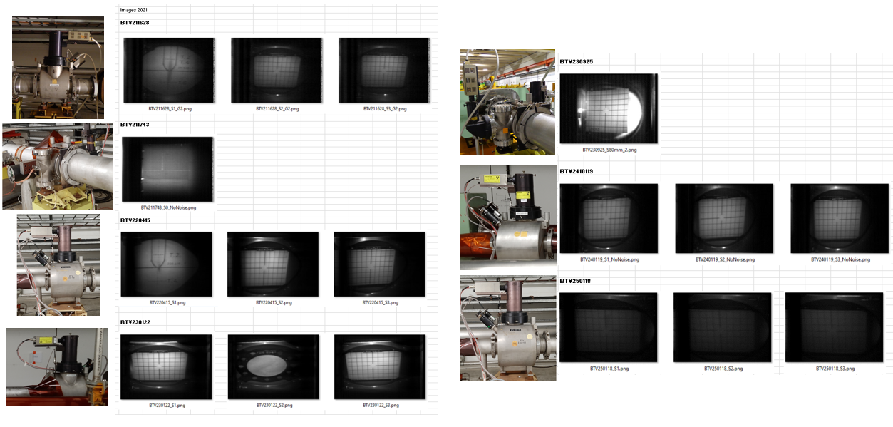
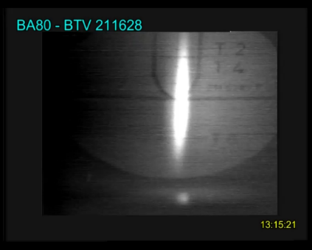
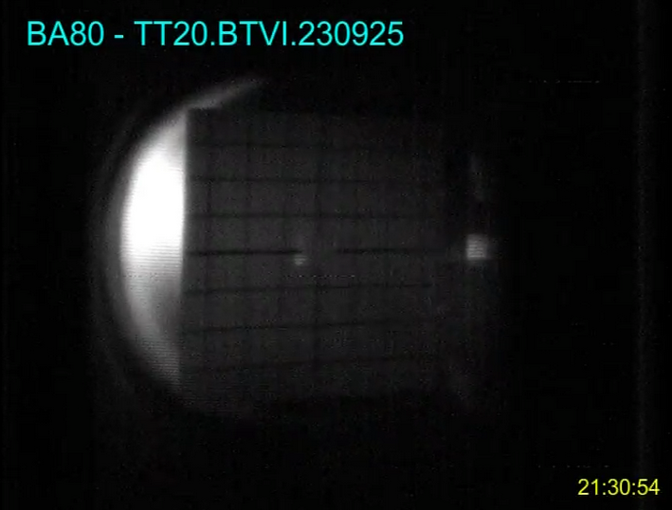
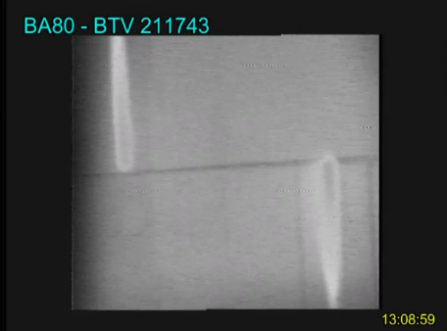
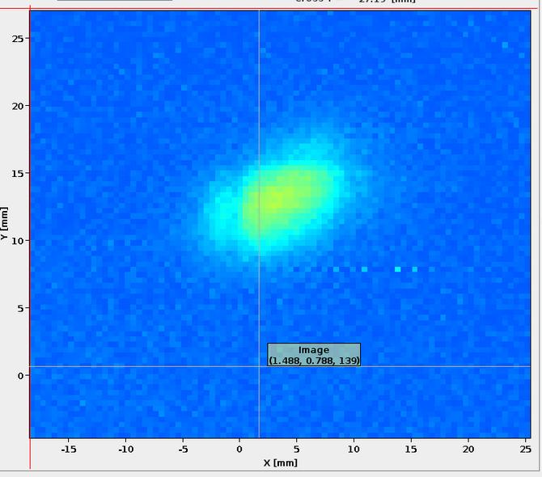
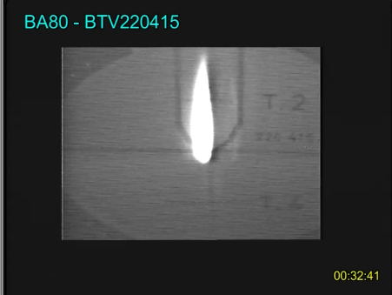

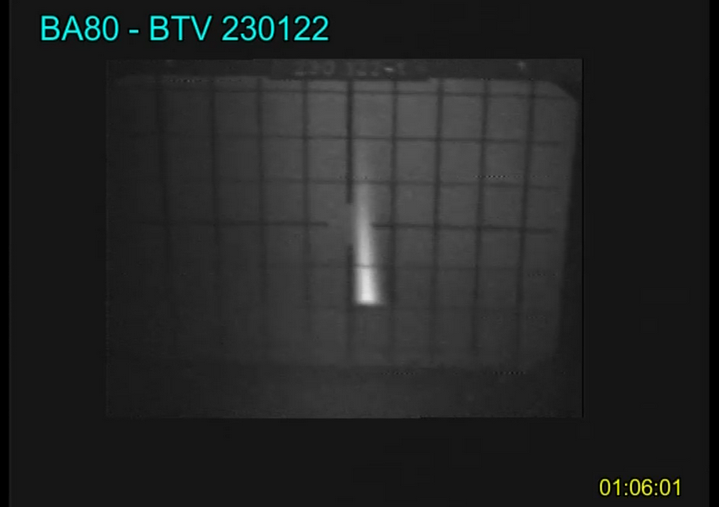
BTV210026
BTV210352
TT20
TDC2

Slide 5
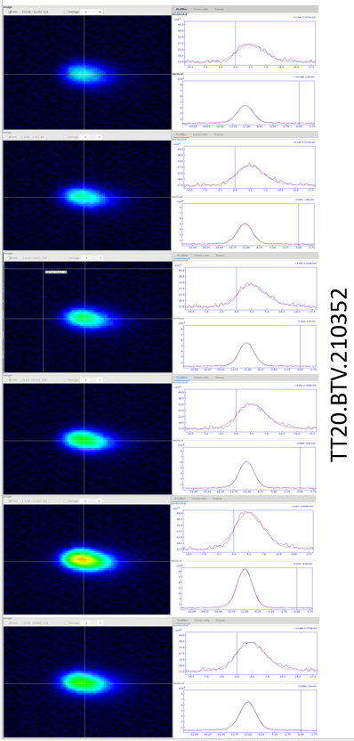
STATUS (1)
BTVs used ~regularly (every year at least at startup and debugging) but not much
During 2022, the multimages acquisition mode was tested on the BTVI application
Image check with low intensity beam over 4.8s Logbook images SPS (cern.ch)
no need to deal with saturation
Can rely on Chromox material decay time ~1.23ms (very little overlap of light in ‘slices’ of 20ms)
Intensity profile, beam size and position along spill could be observed
For higher intensity, saturation may appear, and beam size measurement will no longer be possible → Need filter wheel to mitigate this.
S.Burger BIFT 2023_03_13

Slide 6
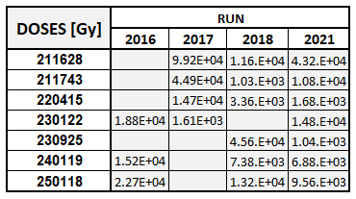
STATUS (2)
Dosimetry
Data from our yearly BTV radiation survey (RPL)
Few kGy < Dose < few 10 KGy
→ Very harsh environment !
S.Burger BIFT 2023_03_13

Slide 7
STATUS (3)
R2E expertise requested to better understand the radiation environment, checking:
the possibility to use other camera type than tube based ones
the possibility to put the cameras at safer locations
how shielding could help
→ Monitoring of BTV locations in the North Area - TDC2 | Document 2753520 (v.0.5) (cern.ch)
Radiation Performances | TD [Gy] | HeH [cm2]
Commercial camera | 100 | 1e8
BeamCam (rad tol / development ongoing) | 250 | 1.5e9
Environment TDC2 | TD [Gy] | HeH [cm-2]
Commercial camera | Should be x10 to 400 less | Should be x1k to 40k less
Rad tol. | Should be x3 to 100 less | Should be x3k to 1k less
Previous study (EDMS 2761320) has shown that an Iron wall of 40cm can reduce the TID levels by approximately a factor of 20, the HeH being reduced by a factor of 5 only
→ For most of the BTVs, optical line would not be feasible in this environment + integration not easy or feasible. As of today, no other choice than tube based camera
S.Burger BIFT 2023_03_13

Slide 8
CONSOLIDATION (1)
Summary of the BTV work to be done
For 8x BTVs: 210026, 210352, 216628, 216743, 220119, 230122 & 250118
  Replace screens (new markings)
  Check for rust on the vacuum chamber (vac advise)
    → see with vac if a replacement is needed
    → if mechanical changes/repairs are to be done, separate bellows from the instrument (interface modules to ease vacuum maintenance)
  New ‘Cloche’ (camera support) / illumination system
  New viewports (standardization)
  New interface box (standardization)
S.Burger BIFT 2023_03_13

Slide 9
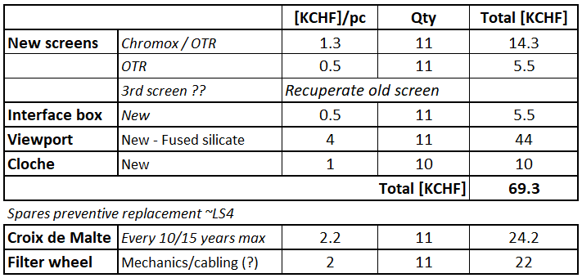
CONSOLIDATION (2)
Budget
For 8x BTVs: 210026, 210352, 216628, 216743, 220119, 230122 & 250118
S.Burger BIFT 2023_03_13

Slide 10
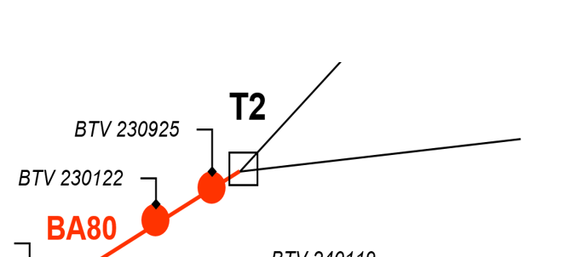
BTV230925 UPGRADE (1)
  Specifications:
    Screen size: Min 15x5cm
      to be able to see as much as possible of the wobbling (protons) + ion beam (only instrument there)
    Resolution <250um
    → New vacuum chamber
        Viewport dimension needed CF250 → ~197mm view diam.
        Keep or similar stepper insertion device
    digital camera i.e. optical line
S.Burger BIFT 2023_03_13

Slide 11
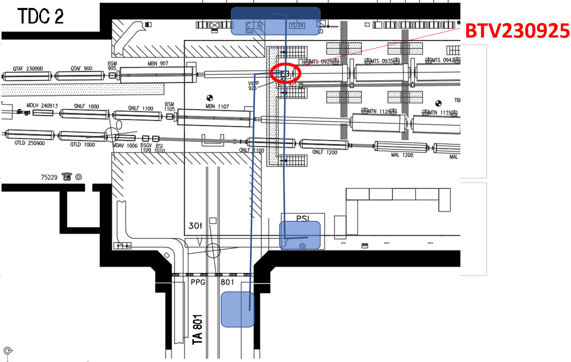
BTV230925 UPGRADE (2)
Proposal for camera location
220Gy
Looking for a ‘safe’ location for the camera
Also taking into account the feasibility of the installation of an optical line
1KGy
68.8KGy
27.6KGy
1.2KGy
→ TBC, location could be in the TA801 tunnel
S.Burger BIFT 2023_03_13

Slide 12
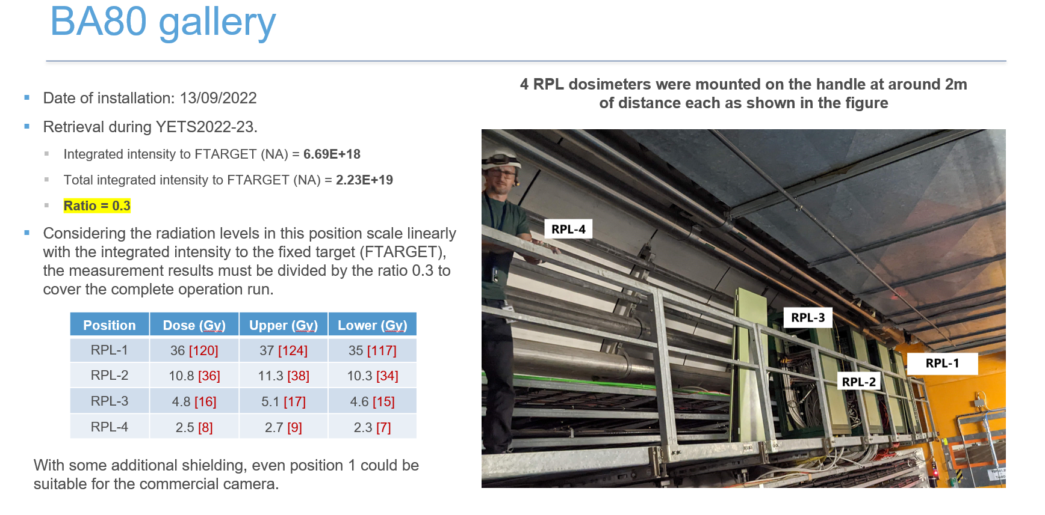
BTV230925 UPGRADE (3)
- Radiation survey
Distance from the door
2m
4m
6m
8m
S.Burger BIFT 2023_03_13

Slide 13
BTV230925 UPGRADE (4)
Camera radiation limits
 | TD [Gy] | HeH [cm2]
Commercial camera | 100 | 1e8
BeamCam (rad tol / development ongoing) | 250 | 1.5e9
/20
/5
Radiation map in TA801
 | No shielding | HeH [cm-2]
 | TD [Gy] | *HeH [cm-2]
RPL1 | 120 | 1.2e11
RPL2 | 36 | 3.6e10
RPL3 | 16 | 1.6e10
RPL4 | 8 | 8e9
Iron Shielding 40cm
TD [Gy] | HeH [cm-2]
6 | 2.4e10
1.8 | 7.2e9
0.8 | 3.2e9
0.4 | 1.6e9
Distance from the door
High-Energy Accelerator and Space Environments:
Comparison of Radiation Effects on Electronic Components HMEE405
Document prepared by Arnaud MONTEUUIS
Supervised by Ruben Garcia ALIA
2m
4m
6m
8m
*HeH values estimation:1Gy → 1e9HeH [cm2]
+ extra shielding
+ extra distance
→ With 40cm iron:
All locations are OK regarding TD
All locations are still not safe enough while using commercial digital camera
→ OK See slide annexe
S.Burger BIFT 2023_03_13
13

Slide 14
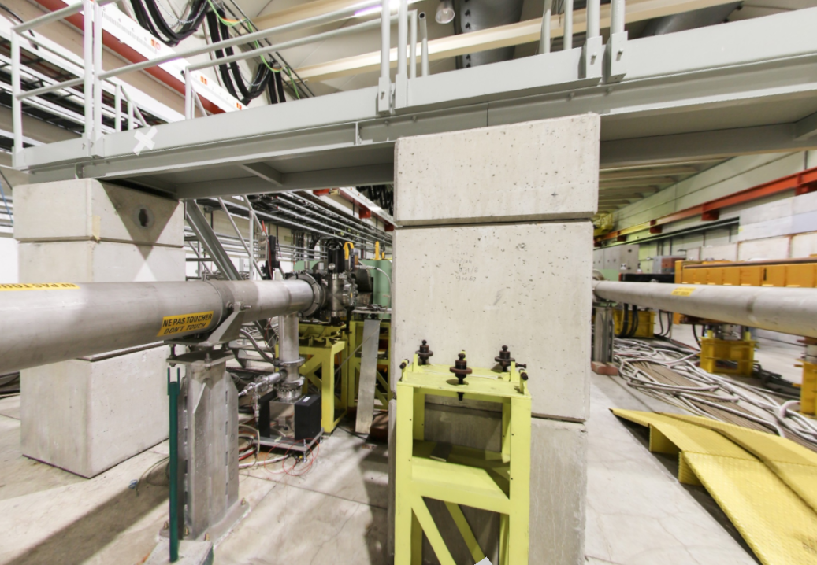
To TA801 door
13.8 m
1.8 m
0.7 m
BTV.230925
Beam ht 1.2 m
Relocation of the BTV230925:
Leave some room for the future BSG
Reduce the optical distance
Reduce the number of mirrors (maintenance)

Slide 15
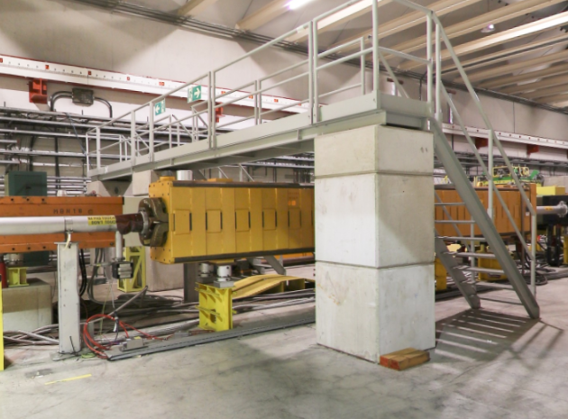
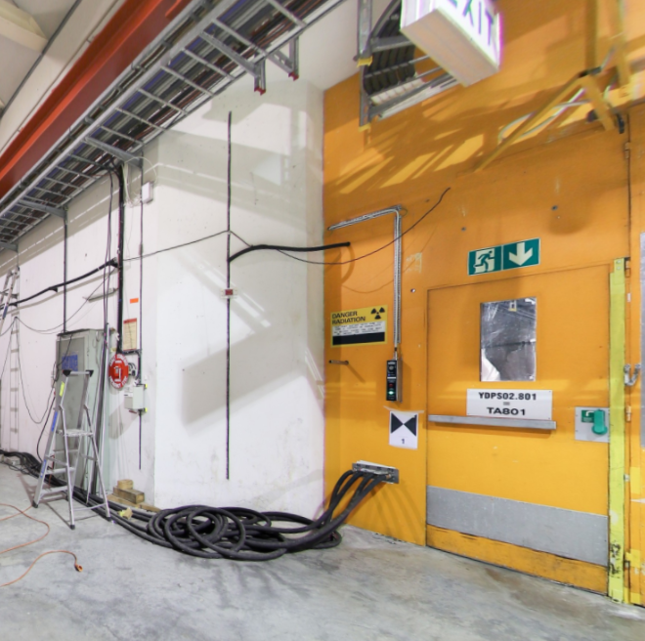
TDC2/TCC2 frontier
(13.8 m)
Ht 1.9 m
Relocation of the pipes on the wall
Drill hole through the door

Slide 16
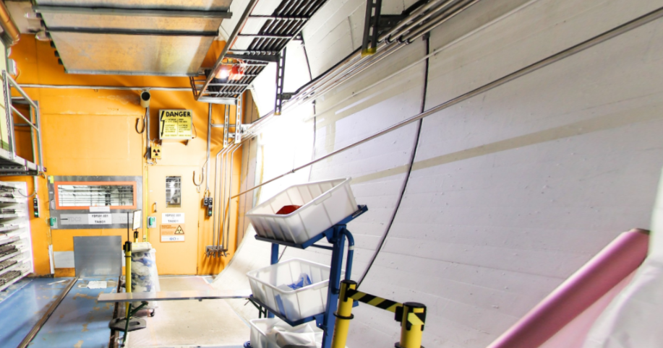
TA 801
10/12 m
BTV camera + shielding
1.9 m
Relocation of the pipes on the wall
Drill hole through the door
Excavate the round shape tunnel for a vertical/flat location for shielding and camera/optics

Slide 17
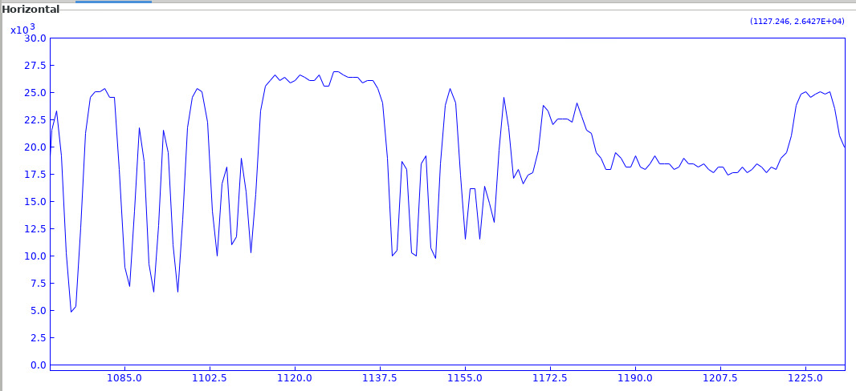
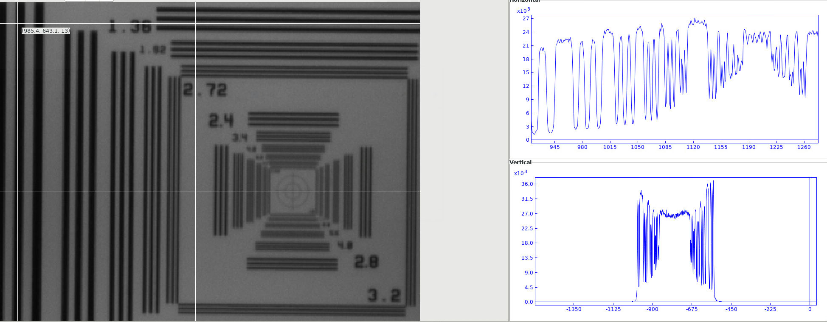
BTV230925 UPGRADE (5)
Check resolution @25m for BTV230925 optical line
Camera lens: F600mm + focal doubler → F1200mm
30%
20%
18mm
100%
Optical resolution
3.4lp/mm (150um)→ 22/110
→ Visibility 20%
2.4lp/mm (200um)→ 33/110
→ Visibility 30%
Spatial resolution
18mm for 176px → ~100um/px
S.Burger BIFT 2023_03_13

Slide 18

BTV230925 UPGRADE (6)
Summary
  New BTV location → straight in front of TA801 door
  New vacuum chamber
    separated bellows from the instrument (interface modules to ease vacuum maintenance)
    New screen, viewport
  New optical line (mirrors, hole in door, shielding, etc…)
  Use Digital camera @25m + shielding
  Cabling
S.Burger BIFT 2023_03_13
18

Slide 19
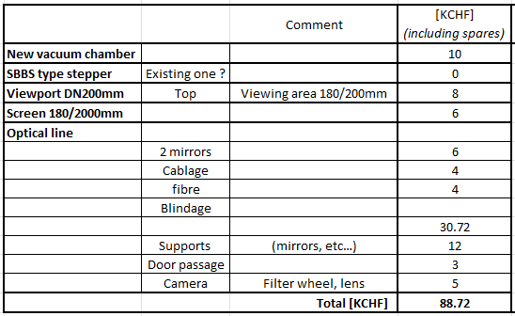
BTV230925 UPGRADE (7)
Budget
S.Burger BIFT 2023_03_13
19

Slide 20
CONCLUSION
Information collected about radiation was mandatory !
Work on the BTVs was identified during 2022
→ Consolidation program + budget is proposed for 8 BTVs
Upgrade was studied for the BTV230925:
  Need of a new tank
  Possibility to use digital system in TA801
    Integration of an optical line and shielding
EVM should be reviewed
(total budget stays of the same order)
THANKS
S.Burger BIFT 2023_03_13
20

Slide 21
ANNEXE

Slide 22
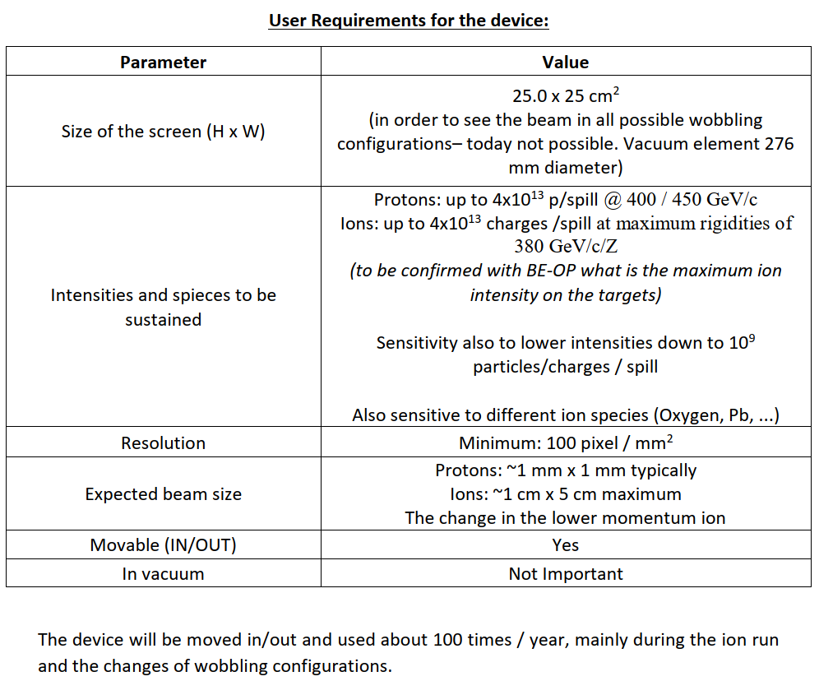
BTV230925 Upgrade first tentative specs (Nikos)
Need
→ New vacuum chamber + new design needed with 250mm long stroke (not existing in BI standard
→ i.e. 10x10px/mm2
→ This is too demanding …
→ Does it mean that we can remove the present BTV and install a new (simpler) setup is air?

Slide 23
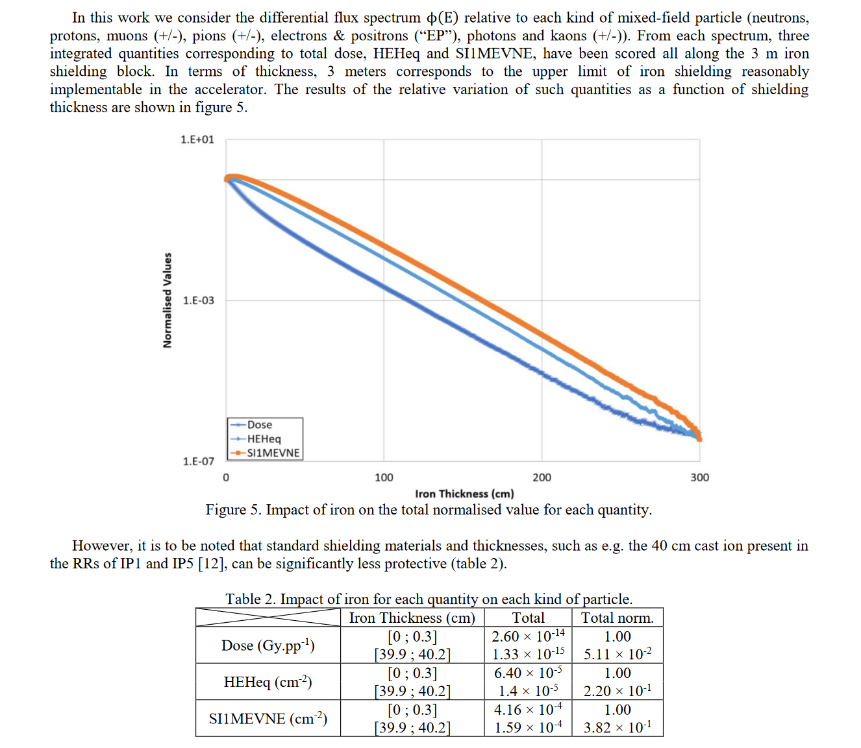
High-Energy Accelerator and Space Environments:
Comparison of Radiation Effects on Electronic Components HMEE405
Document prepared by Arnaud MONTEUUIS
Supervised by Ruben Garcia ALIA
https://edms.cern.ch/ui/file/2761320/1/Monteuuis_2017_docx_cpdf.pdf

Slide 24
Estimation distance and shielding needed to be below HeH 2e8 [cm-2]
 | With shielding 40cm |  | With shielding 60cm
Distance [m] | TD [Gy] | *HeH [cm-2] | TD [Gy] | *HeH [cm-2]
2 | 120 | 1.20E+11 | 12 | 4.80E+10
4 | 36 | 3.60E+10 | 3.6 | 1.44E+10
6 | 16 | 1.60E+10 | 1.6 | 6.40E+09
8 | 8 | 8.00E+09 | 0.8 | 3.20E+09
10 | 4 | 4.00E+09 | 0.4 | 1.60E+09
12 | 2 | 2.00E+09 | 0.2 | 8.00E+08
14 | 1 | 1.00E+09 | 0.1 | 4.00E+08
16 | 0.5 | 5.00E+08 | 0.05 | 2.00E+08

