Slide 1
Update Personnel Return, Outreach, Employer Branding and Sourcing DE
Sabrina Holthausen (HR Talent Acquisition)
June 19, 2024

Slide 2

Agenda
Current Status Personnel Return DE
Review of Employer Branding, Outreach and Sourcing Strategy
Recap of 2023 - What has been done and return on investment
Outlook/Targets 2024 - Ongoing actions and focus areas

Slide 3
Germany @ CERN – a closer look on today’s representation
(Primary Nationality DE)
The Data is as of 01.06.2024
Staff (LD+IC): 10.6%
Students (TECH, DOCT, ADMIN, TRNE): 4.76%
Graduates (FELL+ TTE + GRAE + GRAF + GRAP): 5.8%
TRNE | 2
ADMIN | 1
TECH | 30
DOCT | 41
FELL | 44
TTE | 3
GRAE | 18
GRAP | 10
GRAF | 16
STAFF | 165
PJAS | 3
SASS | 5
COAS | 25
USER | 1127
VISC | 64
Total | 1554
Notes:
3 TRNE STAG

Slide 4
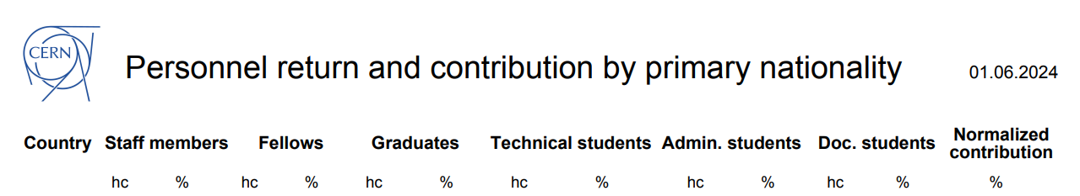
Germany @ CERN – Personnel Return and Contribution

Slide 5
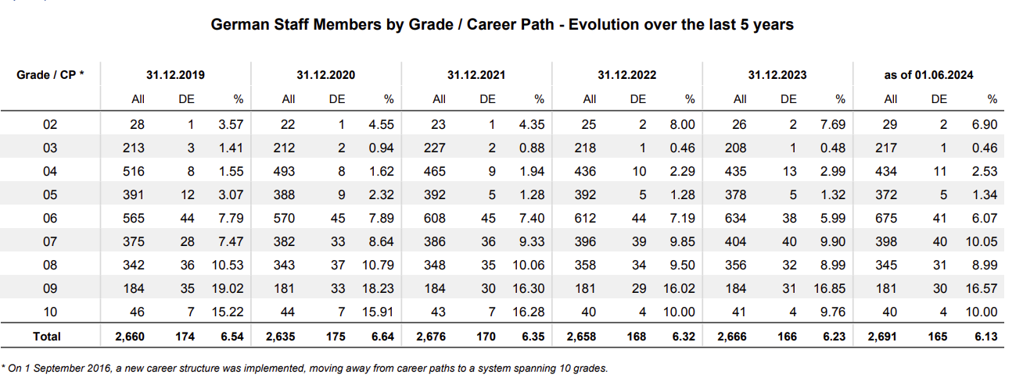
Germany @ CERN – a closer look on staff members
Decrease by 5.72% in staff members (LD and IC) since 2020

Slide 6
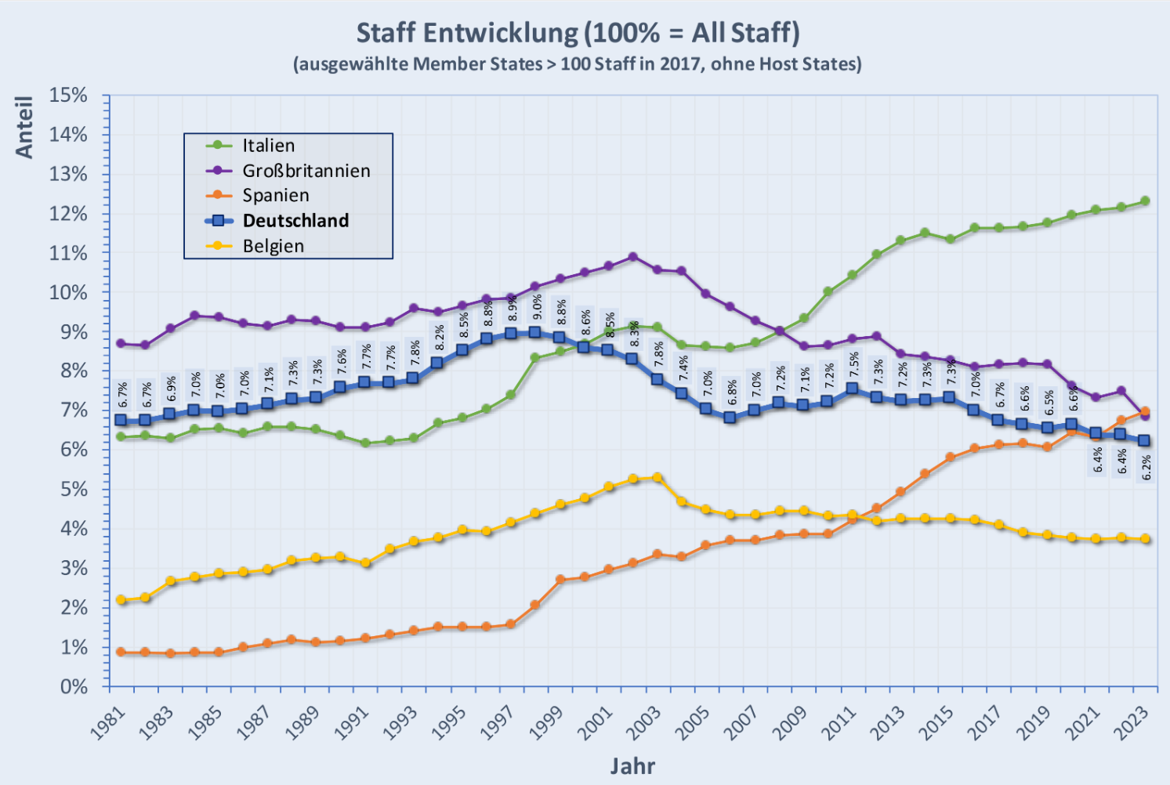
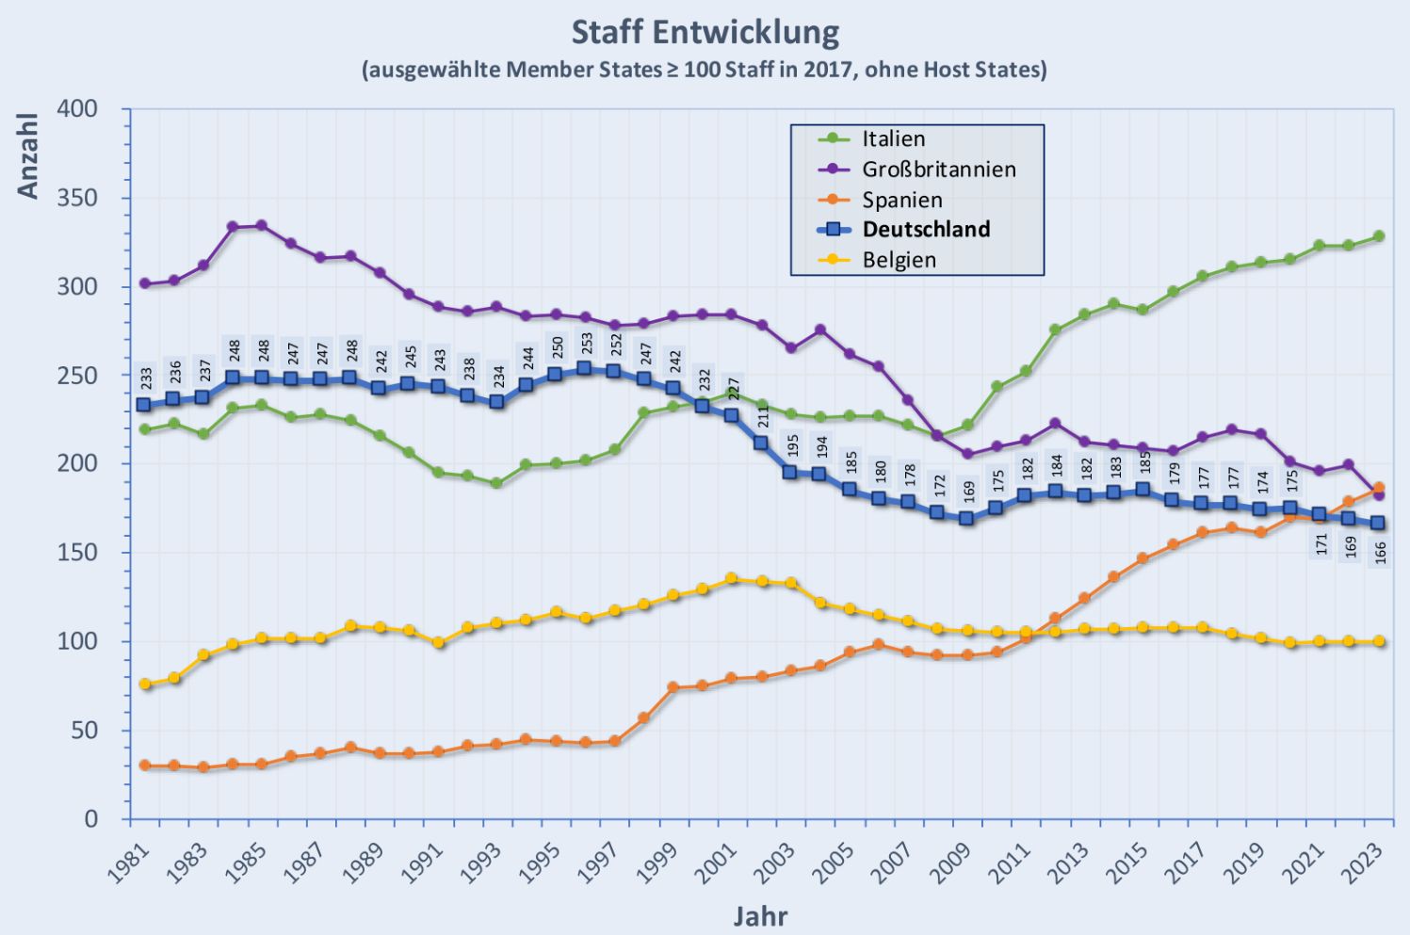
Development staff numbers selected member states (1981-2023)
Lowest level in staff members since 1981!
Source: https://german-dac.web.cern.ch/statistiken (M.Hausschild)

Slide 7
Distribution DE Staff (LD+IC) by age
The Data is as of 01.06.2024
46 LDs, 119 ICs
41.81% > 55
<25 | 0
25-29 | 3
30-34 | 7
35-39 | 19
40-44 | 23
45-49 | 21
50-54 | 23
55-59 | 43
>60 | 26
 | 165

Slide 8
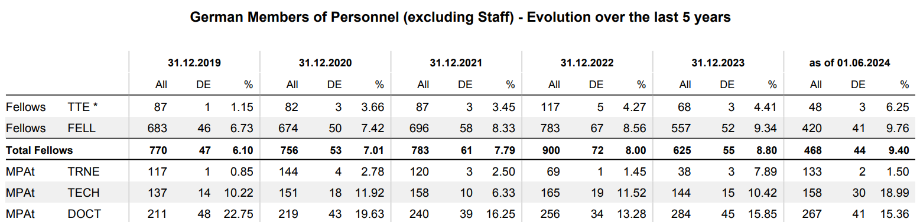
Germany @ CERN – a closer look on non-staff members
Number of Technical Students Doubled from Dec 2023-June 2024
Consistently good numbers for Doctoral Students
Positive trend for all Graduate Programmes (Origin, Quest, Research Fellows)

Slide 9

Outreach, Employer Branding and Sourcing Strategy
Strategy put into place starting November 2022 has proven to be very successful in 2023 - not only for DE but across all underrepresented countries → will follow the same overall strategy in 2024
CERN HR Talent Acquisition
Close collaboration with internal and external stakeholders (DAC, BMBF, DESY, VDI, CERN Alumni etc.)
Partnerships with Universities and Technical Schools
Push advertisement of job opportunities via various channels
Outreach Events
Direct Sourcing via LinkedIn
Overall aims
Increase number of German applicants and members of personnel at CERN in the long term by
  Raising awareness of CERNs various career opportunities in general
  Promote CERNs employer brand and especially accentuating that we don’t only hire physicists – strong focus on attracting talent from non-physicist domains (engineers, technicians, admins)
  Current Focus: Build up the talent pipeline by attracting and recruiting more students and graduates from DE to hopefully having Students becoming Graduates and Graduates converting into Staff members and staying at CERN in the mid and long term

Slide 10

Success of outreach strategy reflected in concrete numbers
Total Applications from DE (Primary Nationality)
Total number of applications from DE increased by 68.87%* in 2023
Total Applications by years and programmes | 2021 | 2022 | 2023 | 2024
Administrative Students | 13 | 23 | 40 | 28
Corresponding Associates |  | 1 | 2 | 1
Doctoral Students | 12 | 28 | 45 | 12
Early Career Professionals |  | 25 | 204 | 305
Experienced Project Graduates |  | 18 | 219 | 208
Fellows | 48 | 102
Limited Duration Staff | 297 | 274 | 379 | 182
Research Fellows |  | 42 | 68 | 15
Scientific Associates | 6 | 2 | 8 | 6
Summer Students | 58 | 98 | 136 | 149
Technical Students | 126 | 128 | 232 | 80
Trainees | 47 | 178 | 220 | 99
Grand Total | 607 | 922 | 1557 | 1085
Specifically number of applicants for Student and Graduate Programmes increased significantly due to outreach activities incl. partnerships with universities, direct sourcing efforts, career fairs etc. + switch to continuous hiring for QUEST (Experienced Project Graduates):
  Technical Student Applications: +81%
  Administrative Student Applications: +74%
  Doctoral Student Applications: +61%
  Summer Student Applications: +38%
  Limited Duration Staff Applications: +38%
Total applications in 2024: 1085 ~70% of 2023
(FELL – transitioned to GRAD in 2022)
*Overall CERN applications increased in 2023 (record of over 100.000) but attracting talent from certain countries is way more difficult due to factors such as local competition, contract duration, salary etc. + without Outreach activities numbers would have been significantly lower.

Slide 11
Recap of 2023 + Status Quo 2024
Total Application Numbers vs. Selected from German Nationals (Primary Nationality)
 | 2022 |  | 2023 |  | 2024
 | Applied | Selected | Applied | Selected | Applied | Selected
Administrative Students | 23 | 4 | 40 | 1 | 28 | 1
Corresponding Associates | 1 | 1 | 2 | 1 |  | 1
Doctoral Students | 28 | 11 | 45 | 15 | 12 | 6
Early Career Professionals | 25 | 1 | 204 | 16 | 305 | 11
Experienced Project Graduates | 18 |  | 219 | 8 | 208 | 10
Fellows | 102 | 21
Limited duration Staff | 274 | 6 | 379 | 4 | 182 | 4
Research Fellows | 42 | 6 | 68 | 9 | 15 | 3
Scientific Associates | 2 |  | 8 | 4 | 6 | 3
Summer Students | 98 | 23 | 136 | 20 | 149 | 19
Technical Students | 128 | 26 | 232 | 22 | 80 | 8
Trainees | 178 | 22 | 220 | 11 | 99 | 9
Positive Trends in Student and Graduates Selections
in 2023:
  Doctoral Students Selections +36%
  Research Fellow Selections +50%
  Selections for Summer and Technical Students on a stable good level
  Very good evolution for Early Career Professionals with 16 selections in 4 rounds in 2023 (University Graduates + Technical/Administrative Field)
  Overall good number of applications and selections for Early Career Professionals and Experienced Project Graduates
While number of Staff applications increased by 38% in 2023, the number of hires did not! But we do see a positive trend so far in 2024.
(FELL – transitioned to GRAD in 2022)

Slide 12

Recap of 2023 – Positive Trend in Student and Graduate Selections
Technical and Doctoral Students
We have not only seen a positive effect in the total number of applications from DE but also in the amount of selections – especially for the last two rounds of Technical and Doctoral Student Committees and the last selection round for Early Career Professionals.
In the last 2 rounds of selections for the Technical and Doctoral Student Programmes, selected candidates from Germany made up the majority by nationality with ~ 20% and ~26%
TSC 2023-3
TSC Selection Committee October 19, 2023
Total number of selected candidates: 91
18 candidates selected from DE = 19.78%
14 Technical Students, 4 Doctoral Students
Italy had the second most selections with 16
TSC 2024-1
TSC Selection Committee February 1, 2024
Total number of selected candidates: 70
18 candidates selected from Germany = 25.7%
11 Technical Students, 7 Doctoral Students
Italy had the second most selections with 11 followed by Spain, France and Greece with 5 each

Slide 13

Recap of 2023 – Direct Sourcing as Powerful Tool
Direct Sourcing
Direct Sourcing = Using linkedin Recruiter license to strategically screen linkedin profiles for matching profiles and contacting them via direct message, tracking in SmartRecruiters through individual links
Focus on Early Career Professional Programme (University Graduates (Bachelor/Master) + Technician/Administrative Fields) but also for QUEST and Staff positions, 2779 DE profiles contacted in 2023
Direct Sourcing is essential part of the overall strategy and has proven to be a very effective tool in order to attract more applicants from targeted countries and increase the talents pool diversity and quality
Early Career Professionals | Number of people contacted
ECP 2023/2-Technicians Germany | 178
ECP 2023/2 - University Grads Germany | 383
ECP 2023/3 - Technicians Germany | 67
ECP 2023/3 - University Grads Germany | 634
ECP University Grads Germany 2023-4 | 426
ECP Technicians 2023-4 Germany | 213
Technical + Administrative Student Programmes
Technical Student Programme 2023-3 Germany | 249
Administrative Student Programme 2023-3 Germany | 200
Technical Student Programme 2024-1 Germany | 429
Grand Total | 2779

Slide 14
Return on Investment
Direct Sourcing - Total Applications Overall DE vs. Total Applications from Direct Sourcing DE
 | 2022 |  | 2023 |  | 2024
 | Total Applications DE | Direct Sourcing | Total Applications DE | Direct Sourcing | Total Applications DE | Direct Sourcing
Administrative Students | 23 |  | 40 | 5 | 28
Corresponding Associates | 1 |  | 2
Doctoral Students | 28 |  | 45 |  | 12
Early Career Professionals | 25 | 1 | 204 | 55 | 305 | 79
Experienced Project Graduates | 18 |  | 219 | 27 | 208 | 16
Fellows | 102
Limited duration Staff | 274 | 18 | 379 | 31 | 182 | 9
Research Fellows | 42 | 2 | 68 |  | 15
Scientific Associates | 2 |  | 8 |  | 6
Spontaneous Applications
Summer Students | 98 |  | 136 |  | 149
Technical Students | 128 |  | 232 | 30 | 80 | 11
Trainees | 178 |  | 220 | 2 | 99 | 1
Grand Total | 922 | 21 | 1557 | 150 | 1085 | 116
150/1557 Overall Applications through Direct Sourcing in 2023 = 9.63%
Staff Applications: 31/379 = 8.18%
10 Hires of Directly Sourced Candidates in 2023:
  5 Early Career Professionals
  4 Technical Students
  1 Short Term Intern (Trainee)
No DE hires from Direct Sourcing in 2021+2022
Total Applications from Direct Sourcing
  2022: 21 vs. 2023: 150 (714%)
  2024: 116 total applications through Direct Sourcing already by June 17 (10.7%)

Slide 15



Ongoing Actions in 2024
Partnerships with Universities, Universities of Applied Sciences and Technical Schools
Keep expanding network with contacts at universities and technical schools (professors, career services etc.) to find out about opportunities for collaboration and advertising CERN’s career opportunities for students and graduates – constantly screening reference letters from student and graduate applications and contacting professors.
Current list has 64 contacts from 36 universities/schools, 93 more were contacted recently
Main action points:
  Distribute job ads once they are published via mailing list, newsletters etc.
  Publish our job opportunities on the universities’ career pages and have CERN company profile on their websites
  Attend career events organized by and at universities
  Run webinars with the universities on a regular basis to inform students about our opportunities + careerfairy webinar to target many universities at the same time
  Organize university visits by country ambassadors to share their experience in info sessions/workshops with the students

Slide 16




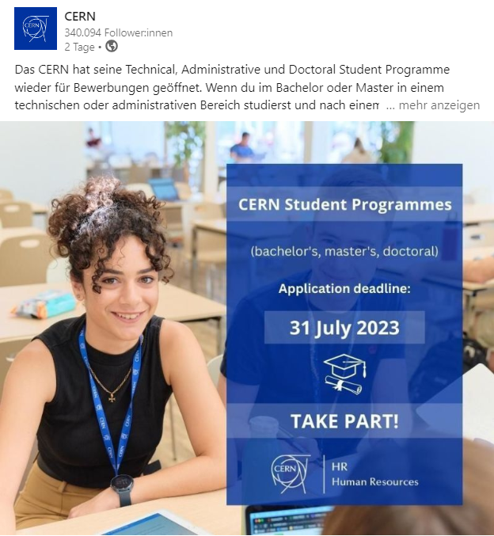
Ongoing Actions in 2024
Advertisement on German Jobportals
LinkedIn, Hochschuljobbörse, jobteaser accounts at 23 German Universities/Universities of Applied Sciences, Stepstone, Indeed (contracts for Stepstone and Indeed contracts renewed for 2024)
Company accounts created on various jobteaser websites of German Universities and Universities of Applied Sciences where student and graduate opportunities will continuosly be published
Targeted Social Media Posts
Targeted posts from CERN linkedIn account – posts about Graduation and Student Programmes, Events CERN is participating in Germany etc. are send to targeted audiences (region, location, language German) to specifically target linkedIn members from Germany/DACH – 11.000 people can be reached on average

Slide 17
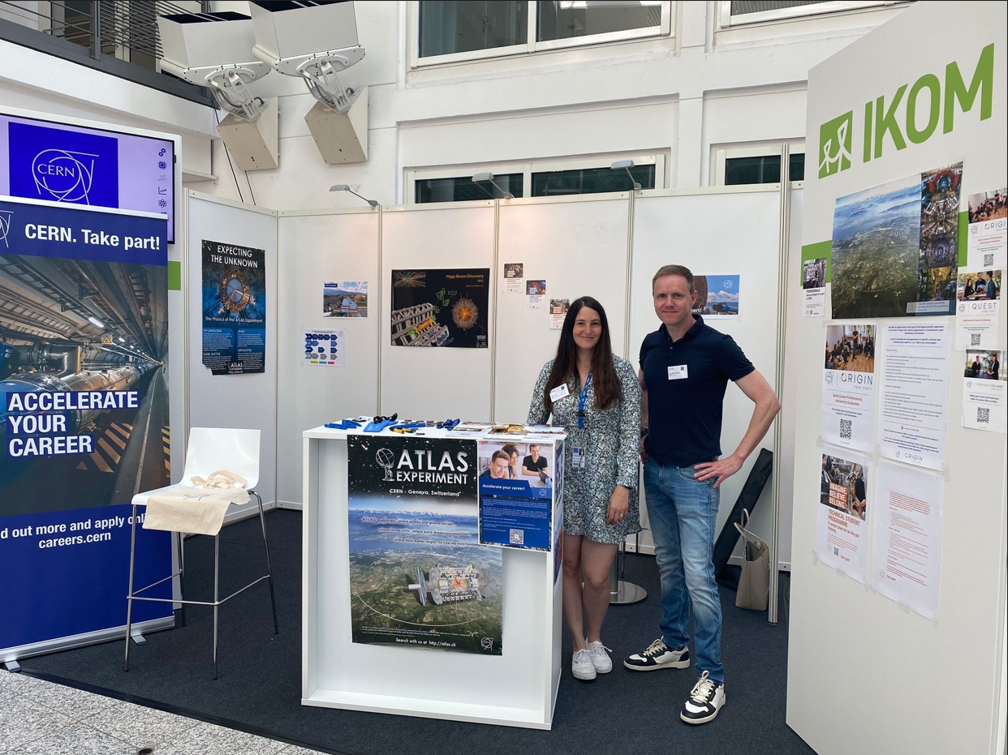
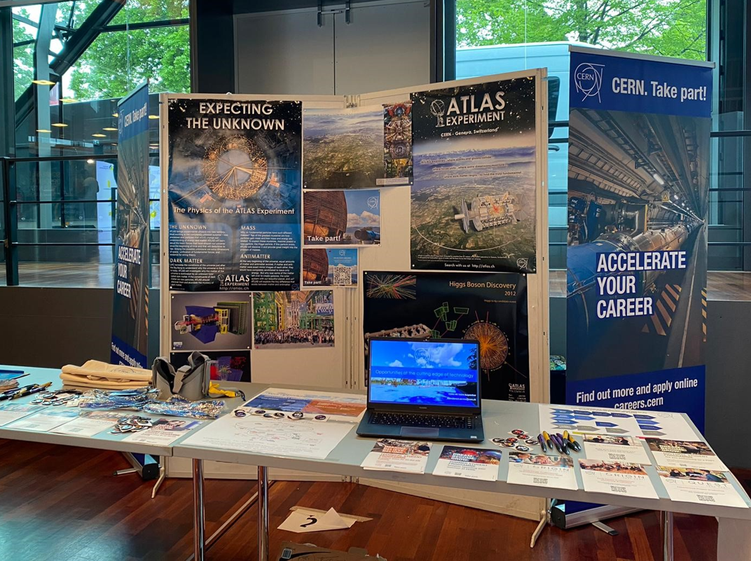
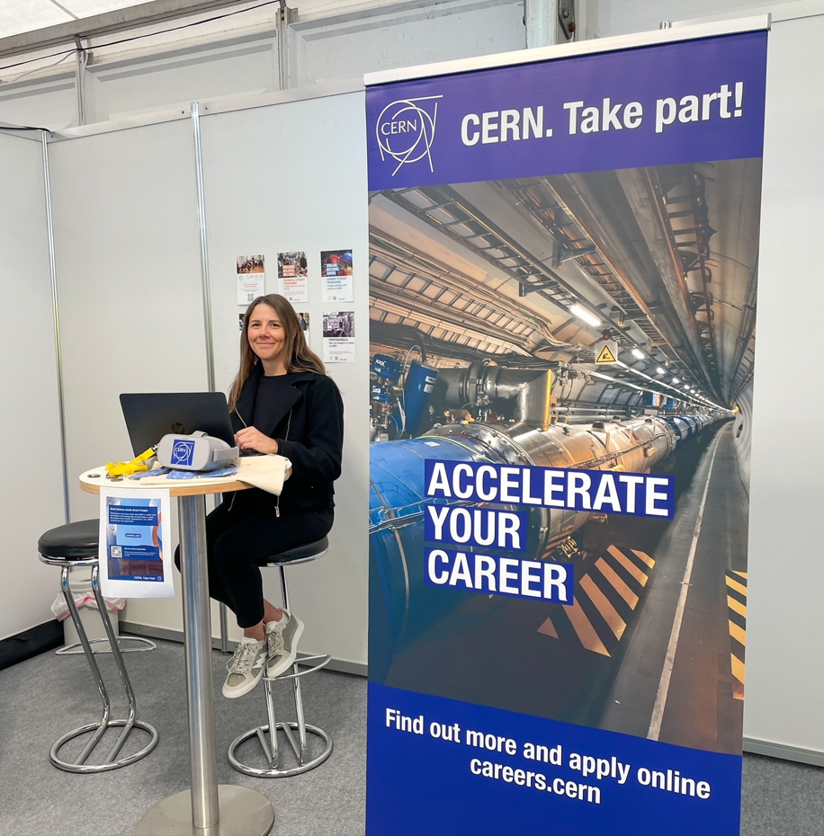
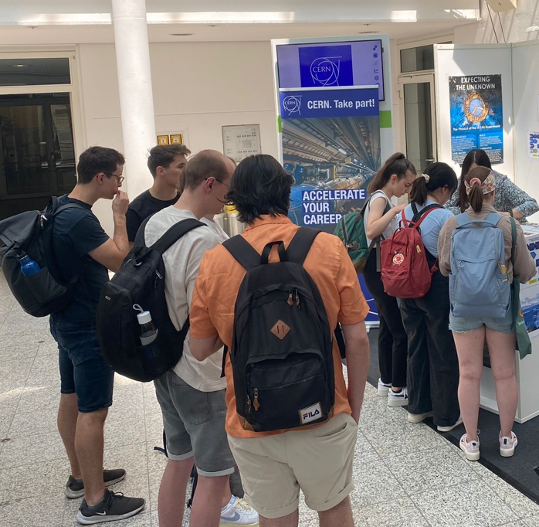





Outreach Events 2024
Career Fairs
Career Fair International Organizations (organized by the Federal Foreign Office Germany – February 1, virtual
Jobbörse Eckert Schulen (Technician Schools) – March 7, Regenstauf
CERN Spring Campus - CERN x TH Deggendorf, March 12
Bonding Dresden @Technical University Dresden, April 23-25
IKOM @Technical University Munich - June 24-27
Jobwunder @TU Berlin - May 28-30
CERN 70 Event Berlin - September 2-4
CrossING @ Ruhr-Universität Bochum – September 26
Webinars + Visits
Hochschule Karlsruhe (participating universities from
Länderprogramm Baden-Württemberg), February 28 + Fall
Webinar series Eckert-Schulen (technical schools) from
mid-October 2024
Visit students Hochschule Heilbronn (Fall 2024)
Visit VDI Young Engineers August 2
Digital Internship Fair Uni Mainz – Nov 14
Webinar University of Münster – Dec 5

Slide 18

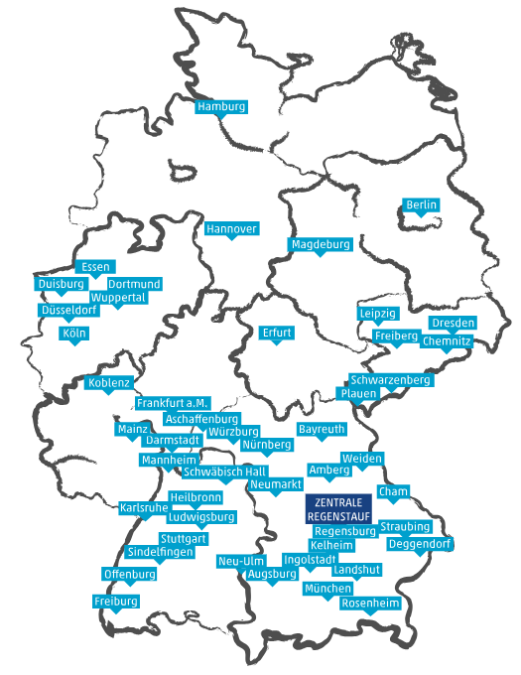





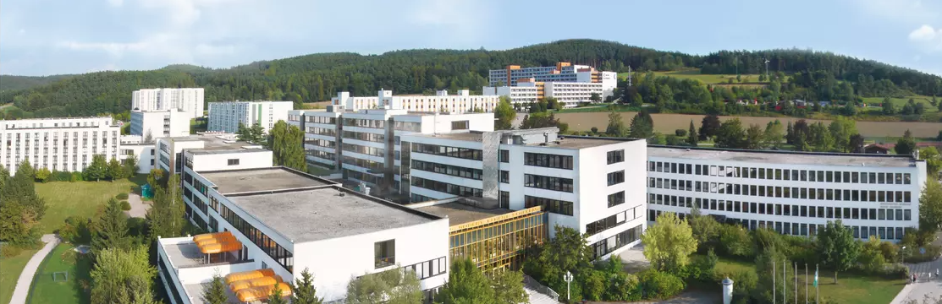

Collaboration with Eckert Schulen (Technician Schools)
Over 40 locations in DE, main Campus in Regenstauf
Approx. 9,000 students are currently being trained in full-time or part-time programs as well as distance learning courses
Technical diplomas (incl.state certified technicians) in different domains (Electronics, Mechatronics, Mechanics, IT etc.)
Contact in place who regularly receives our job ads and shares them with the students
Participation in annual career fair Eckert Schulen Jobbörse on site
Webinar series (4 per year) from mid-October 2024 – Call for volunteers/topics. Please reach out to me or Frank Gerigk!

Slide 19


Outlook 2024/Targets Outreach, Employer Branding & Sourcing
Same overall Employer Branding, Outreach and Sourcing strategy will be followed in 2024
Distribute job ads to university contacts + CERN Alumnis for student and graduate opportunities
Extend distribution list with contacts at universities/schools and CERN Alumnis to push job advertisement
Keep monitoring return on investment of outreach activities by checking numbers of applications from Germany regularly
Analyze from which German universities we received most applications to track return on investment of advertising at universities
Keep high rate of direct sourcing to increase number of applications, diversity and quality of talent pool
Even more focus on attracting talents from Technical and Administrative Field + IT
Launch of CERN career website upgrade
Attend most relevant career fairs in Germany – especially those organized by universities & technical schools

Slide 20

Conclusion Trend Personnel Return
Number of German applications increased across programmes. Positive trends also in selections for Students and Graduates but number of staff continues to decline.
It won’t be sufficient to rely solely on gradually building up the talent pipeline and hopefully being able to retain students and graduates as staff as this is a long-term strategy and won’t change numbers quick enough. In parallel the number of Germans directly hired as staff must also be significantly increased.
Thus, topic of demographic change and talent retention from underrepresented countries will become more and more important.
Look into implementation of potential measures to increase hires from underrepresented countries.

Slide 21
Thank you for your attention and for your ongoing support in our outreach activities!

