Slide 1
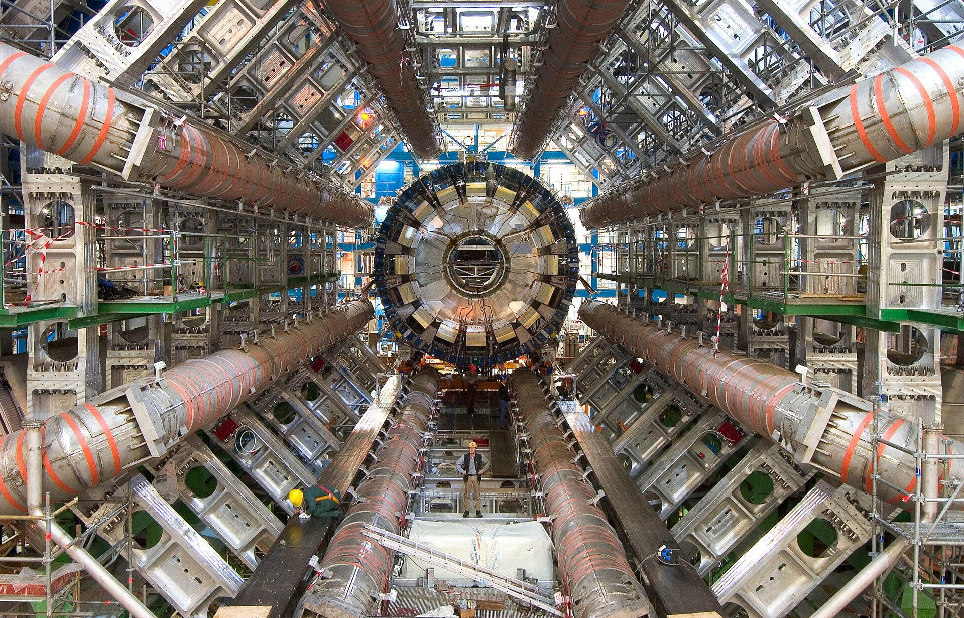

On superconducting magnets
Eino Tiirinen
19.03.2025

Slide 2
Outline
Introduction
Principles of superconductivity
Timeline of historic events in superconductivity
Superconducting materials
Superconducting magnets
The Split Coil Solenoid demonstrator
Recent developments in the superconducting magnets field
Other applications

Slide 3
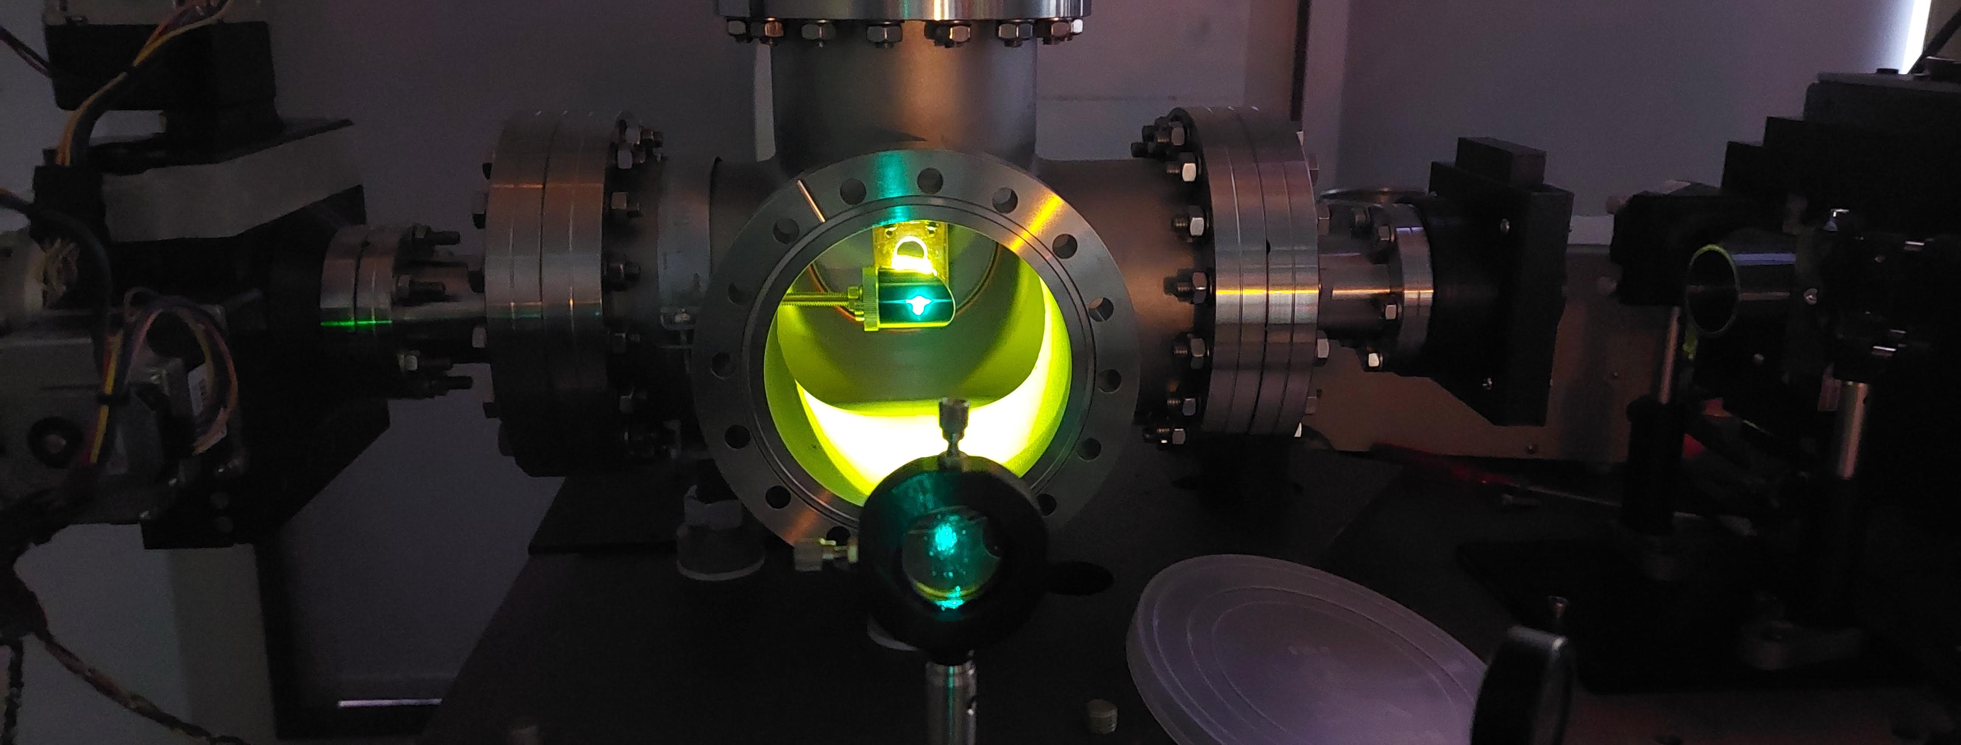
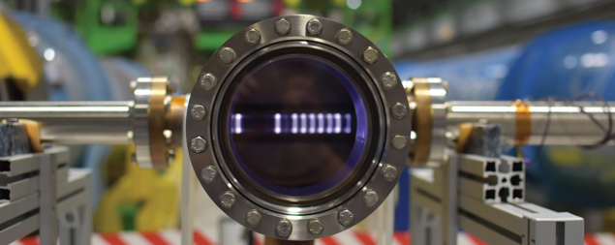
Academic background
Experimental physicist
BSc University of Tartu – Material science 2022
  Laboratory of Ionic Crystals (Marco Kirm), supervisors Vitali Nagirnõi, Ivo Romet
  Recent advances in time-resolved luminescence spectroscopy at MAX IV and PETRA III storage rings
CERN Technical studentship 2022-2023
  Vacuum group, surface physics
  Estimation of the thermal radiation induced desorption yield for hydrogen and helium at liquid helium temperatures, Journal of Vacuum
Currently : MSc Physics UT (in progress)
“Design and commissioning of a superconducting demonstrator magnet with Rapid quench transformation, a novel quench detection and protection concept.”
Justifying an optical system by maximising luminesence signal from YAG-crystal (personal photo)
Ar-plasma glow during carbon-coating deposition with magnetron sputtering, Photo: Giovanni Marinaro,CERN

Slide 4
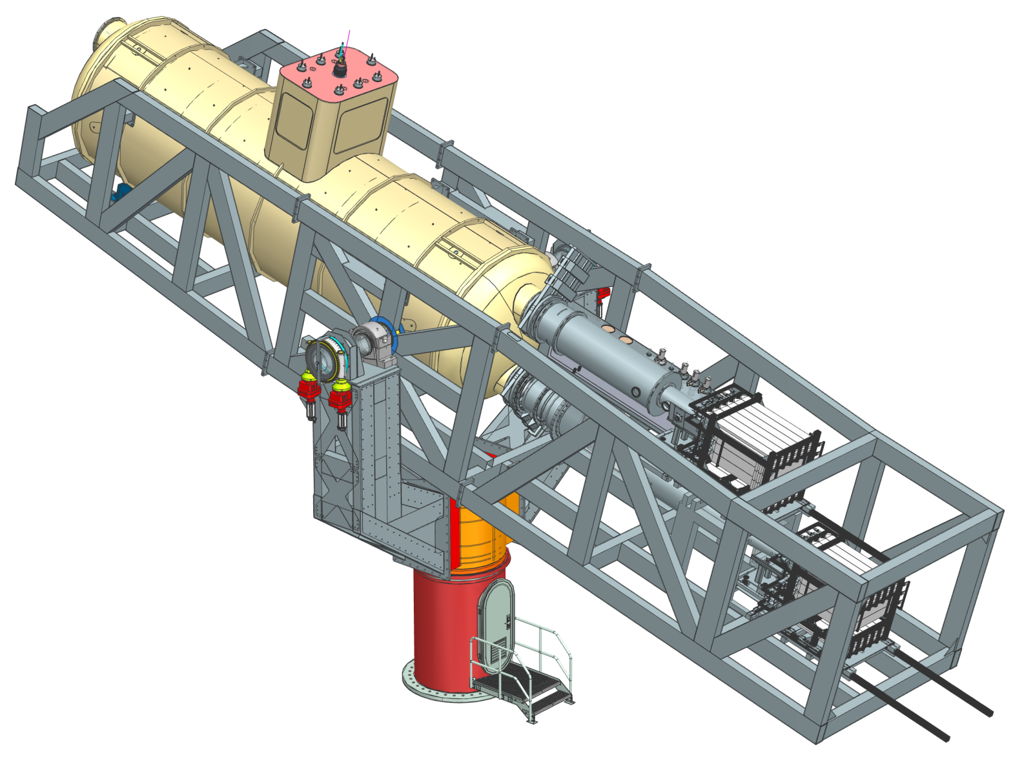
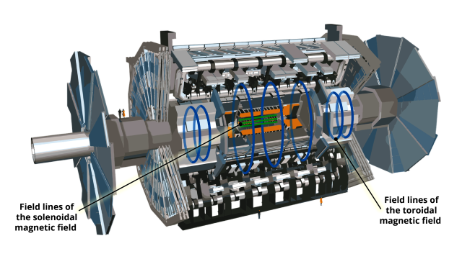
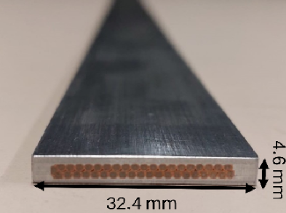
EP Research & Development group
Figures. M.Mentink
et al. BabyIAXO Axion Helioscope Superconducting Dipole
Programme:
  European Committee for Future Accelerators 2021 roadmap
  Key detector technologies that will be needed for the next generation of experiments
  Work Package 8: Focus on technologies for superconducting detector magnets
Fields:
  Advanced magnet powering – current leads, busbars for SC magnets
  Aluminium-Stabilized reinforced superconductors
  Demonstrator magnets
  Control and instrumentation
Superconducting dipole inside vacuum vessel
~20 m
BabyIAXO experiment, to be hosted at DESY
Photo: Ana Maria Rodriguez Vera, ATLAS
Re-introduction of the Al-stabilised NbTi-Cu conductor
2024 EP R&D annual report

Slide 5
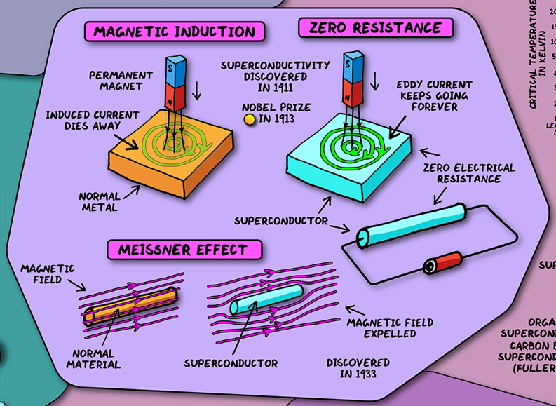
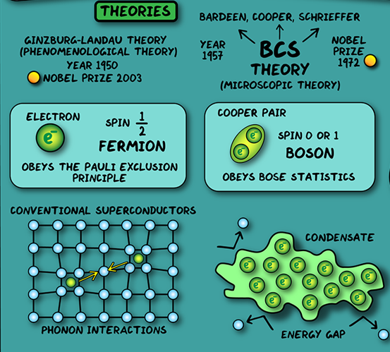
Principles of superconductivity
Dominik Walliman, Domain of Science

Slide 6
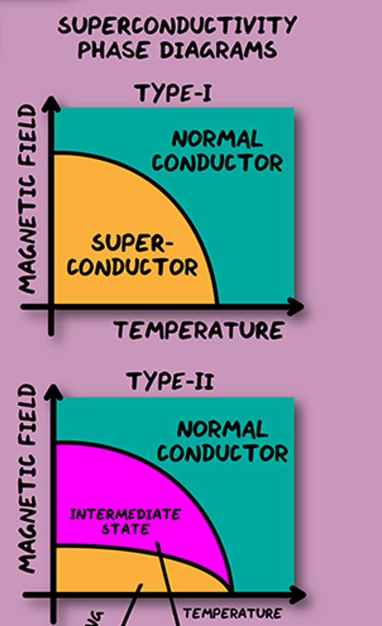
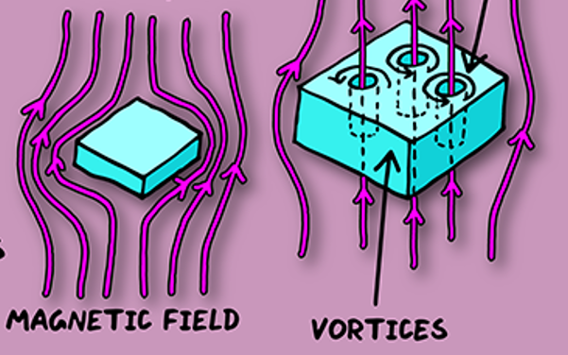
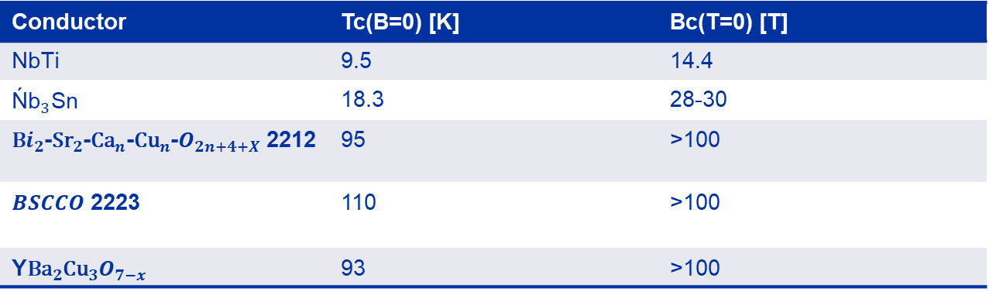
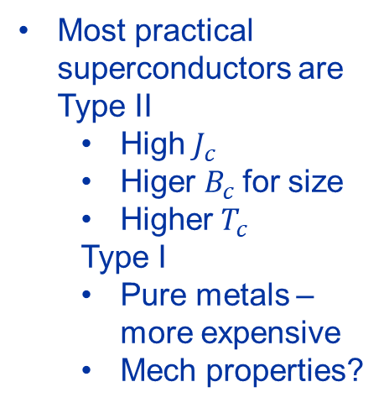

On the matter of superconductors
Quench!
Conductor | Tc(B=0) [K] | Bc(T=0) [T]
NbTi | 9.5 | 14.4
${\text{Ń}\text{b}}_{3}$Sn | 18.3 | 28-30
${\text{B}i}_{2}$-${\text{Sr}}_{2}$-${\text{Ca}}_{n}$-${\text{Cu}}_{n}$-$O_{2n+4+X}$ 2212 | 95 | >100
$BSCCO$2223 | 110 | >100
Y${\text{Ba}}_{2}{\text{Cu}}_{3}O_{7−x}$ | 93 | >100
Dominik Walliman, Domain of Science
Most practical superconductors are Type II
  High $J_{c}$
  Higer $B_{c}$for size
  Higher$T_{c}$
  Type I
  Pure metals – more expensive
  Mech properties?

Slide 7
Timeline of superconductivity
1908 – Heike Kammerligh Onnes liquifies helium in Leiden, NL
1913 – Superconductivity (Type 1) is observed in Hg by Onnes - Nobel prize in Physics in 1913
1928-1930 – Three new superconductors discovered Ta (Tc= 4.4K), Th (Tc=1.4 K), Nb (Tc = 9.2 K) at PTR Berlin
1933 – Meissner-Ochsenfeld effect discovered -> Type II superconductivity Lev Shubnikov
1935 – London equations, supplement to Maxwell equations, theory of Type II superconductors
1950 – Ginsburg-Landau modify London equations – Nobel prize in 2003
1954 – Construction of first superconducting magnet G.Yntema University of Illinois, USA
1957 – BCS theory for microscopic explanation of Low Temperature Superconductivity – 1972 Nobel prize
1960 – Josephson effect, Nobel prize in 1973
-----------------------------------------------------
1986 – Müller, Bednorz discover High Temperature superconductivity at 35 K in Ba-La- copper oxide, Nobel prize 1987
1987 – new HTS „YBCO“ material at Tc= 92 K is found (Liquid Nitrogen T=77 K)
1987 – P.W Anderson theory of HTS
?
Notes:
If field is applied when the superconductor is is in the superconducting state, currents must be produced near the surface in order to maintain constant flux. The currents near the surface, counteracting the external field, must then be a stable. Just two years later, brothers Fritz and Heinz London developed a set of electrodynamic equations, now known as the London equations, which described the Meissner effect by supplementing Maxwell's equations.(10) A consequence of these equations in the London penetration depth, λ_{L}, which is the maximum depth that magnetic field can penetrate into a type I superconductor. See article: High-T_{c} Superconductors, Physical Structures, and Role Of Constituents, Section: Common Features Of High-T_{c} Superconductors And Magnetic Noise, And Barkhausen Effect, Section: Flux Pinning And Losses In Superconductors.
An important new material parameter, the coherence length, x, was defined as the distance over which the density of the superconducting electrons decreases at a superconducting-normal interface. The Ginzburg-Landau formulations were able to predict the conditions under which Type I and Type II behavior would occur using the parameter κ= λ/x. From this work came the now familiar flux line lattice description of Type II superconductors by Landau's student Aleksei Abrikosov eventually published in 1957(14). See Superconducting Critical Current. In type II superconductors, the flux tube has a radius λ with an internal normal core of radius x. A has Ginzburg–Landau order parameter ψ A = n A e i ϕ A , and superconductor B ψ B = n B e i ϕ B , which can be interpreted as the wave functions of Cooper pairs in the two superconductors
the Josephson effect is a phenomenon that occurs when two superconductors are placed in proximity, with some barrier or restriction between the conductors
It was first proposed by an American physicist P. W. Anderson and Indian theoretical physicist Ganapathy Baskaran in 1987.^{[1][2]} The theory states that in copper oxide lattices, electrons from neighboring copper atoms interact to form a valence bond, which locks them in place. However, with doping, these electrons can act as mobile Cooper pairs and are able to superconduct. Anderson observed in his 1987 paper that the origins of superconductivity in doped cuprates was in the Mott insulator nature of crystalline copper oxide.

Slide 8
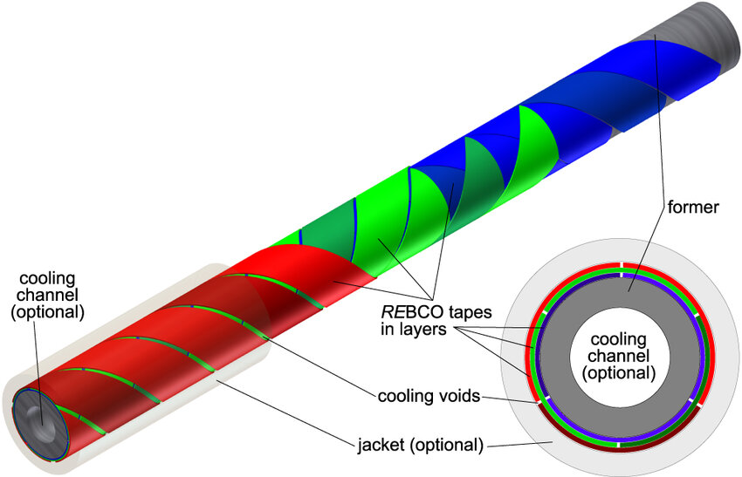
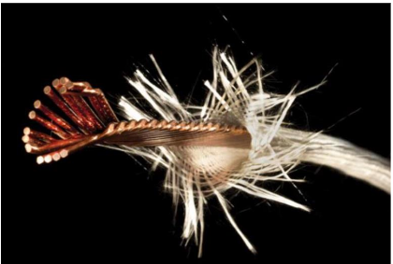
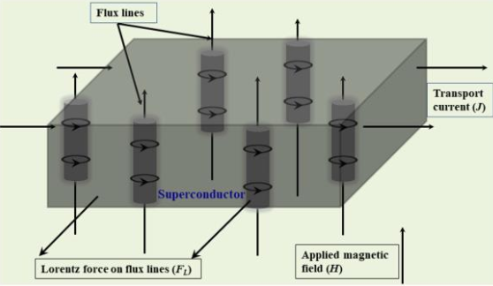
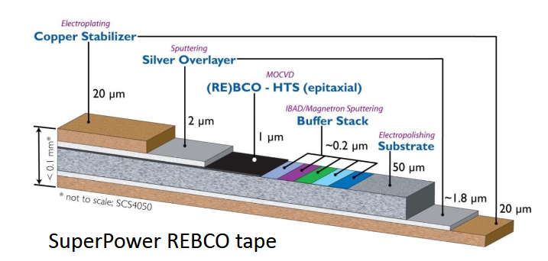
Why not HTS?
J. Fleiter „Rutherford cables for HL-LHC magnets, CERN“
C.Barth et al., „Temperature- and field-dependent characterization of a conductor on round core cable“
Thermomechanical concerns –
  Brittleness
Wire vs manufactured conductor
  Large bending radius
Wire 1D, tape 2D, cable 3D
HTS Delamination, strain limit 0.4%
Flux pinning → current redistribution
Poor heat conductivity → slow quench propagation
A. K. Jha, K. Matsumoto „Superconductive REBCO Thin Films and Their Nanocomposites: The Role of Rare-Earth Oxides in Promoting Sustainable Energy“
1 % HTS

Slide 9
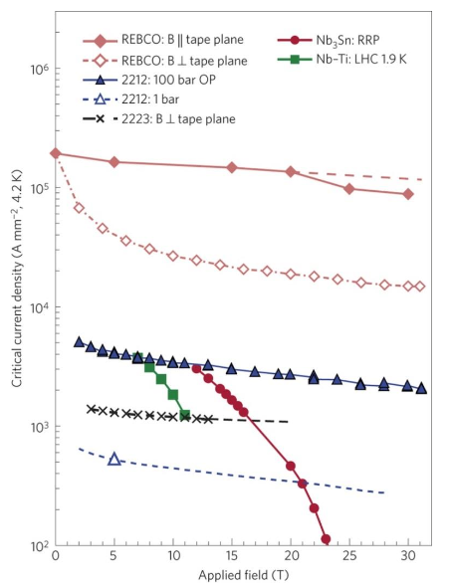

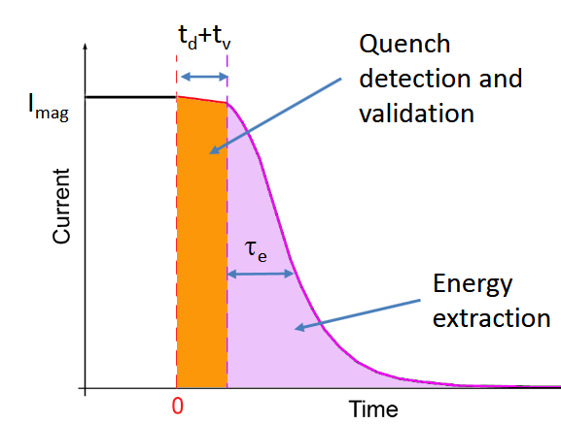


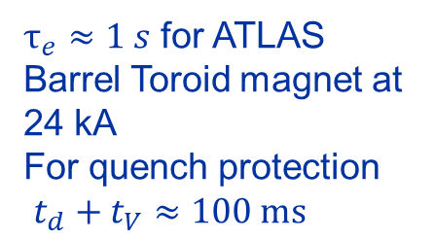
Ensuring magnet longevity
No current sharing in LTS
In HTS current sharing over whole temperature range
Adiabatic hotspot and quench load
M. Marchevsky, „Quench detection and protection for HTS accelerator magnets“
$T_{max}$=100 K
$τ_{e}≈1 s$ for ATLAS Barrel Toroid magnet at 24 kA
For quench protection
$t_{d}+t_{V}≈100 ms$
D. C. Larbalestier et al., “Isotropic round-wire multifilament cuprate superconductor for generation of magnetic fields above 30 T”

Slide 10
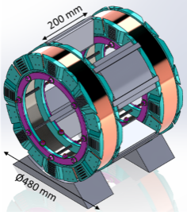
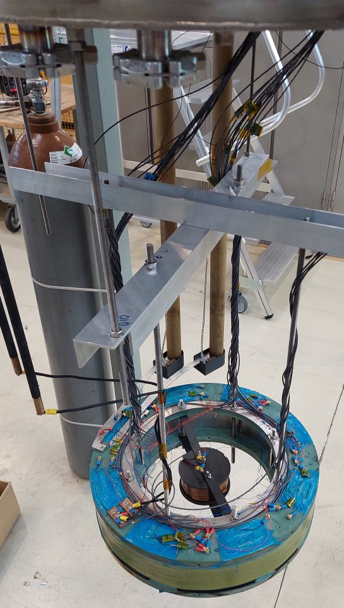
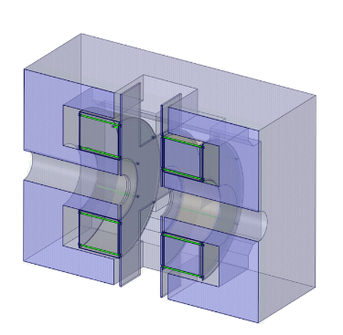
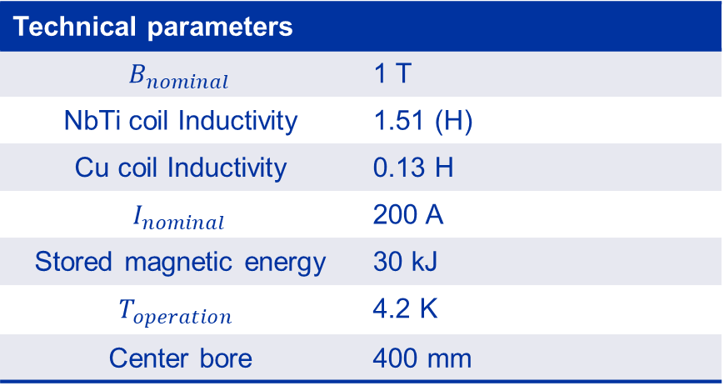
The Split Coil Solenoid Demonstrator
A versatile configuration -> axial or transverse
Co-wound from NbTi and Cu
Motivation
  To demonstrate novel quench protection and detection principle – Rapid Quench Transformation
  To keep expertise of magnet manufacturing in EP R&D group
Technical parameters
$$B_{nominal}$$ | 1 T
NbTi coil Inductivity | 1.51 (H)
Cu coil Inductivity | 0.13 H
$$I_{nominal}$$ | 200 A
Stored magnetic energy | 30 kJ
$$T_{operation}$$ | 4.2 K
Center bore | 400 mm

Slide 11
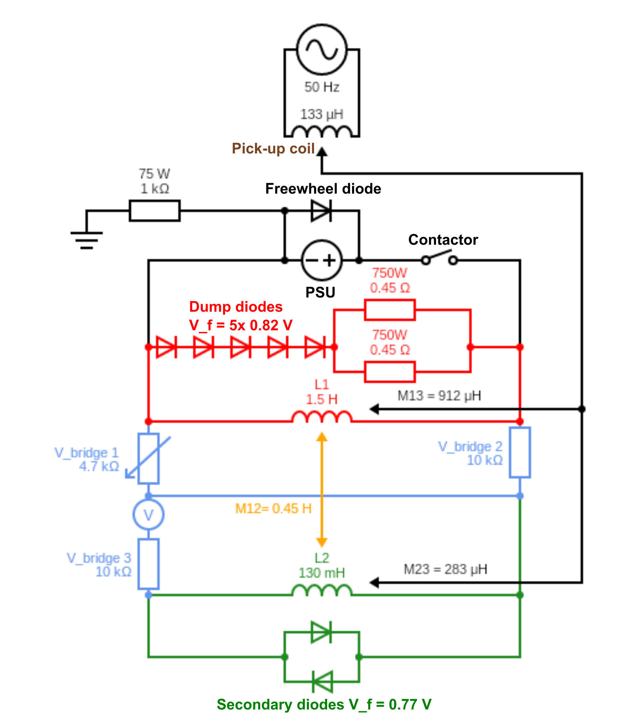
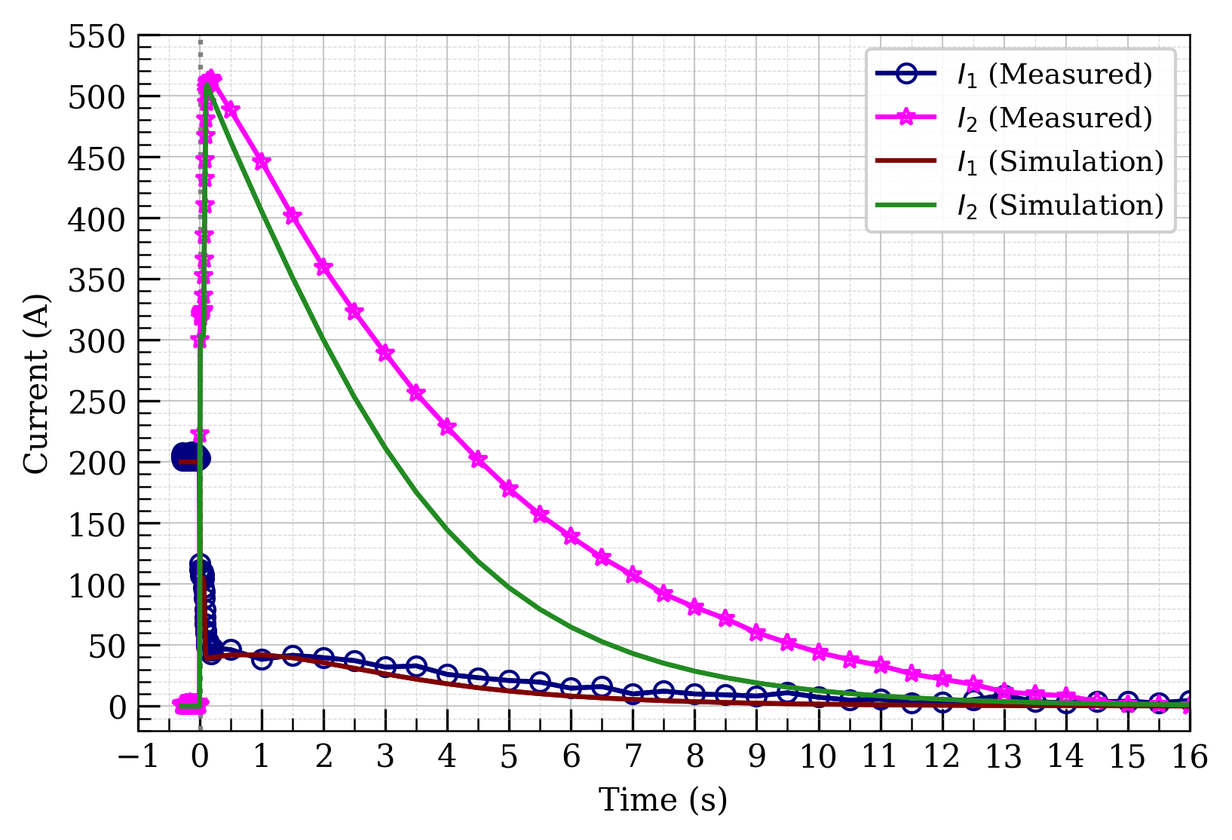
Discharge measurements
Drop to 25%
in 100 ms
Measured vs Finite-Element simulation of coil disharge over time
T = 0 represents a magnet quench
Secondary coil extracts most of the stored energy

Slide 12
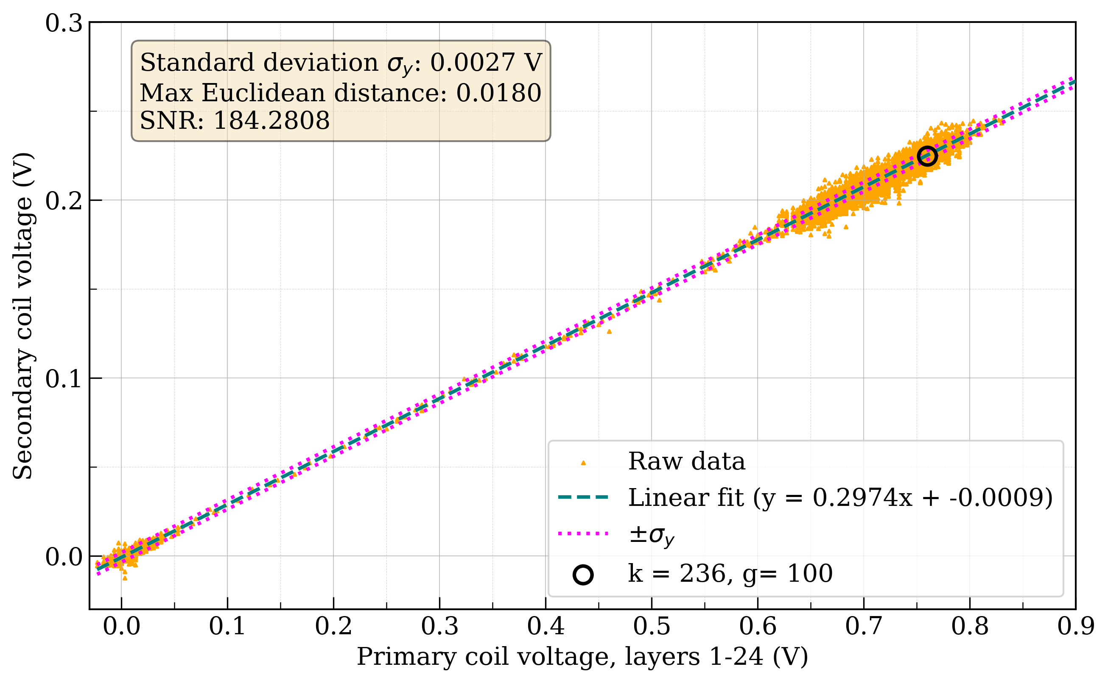
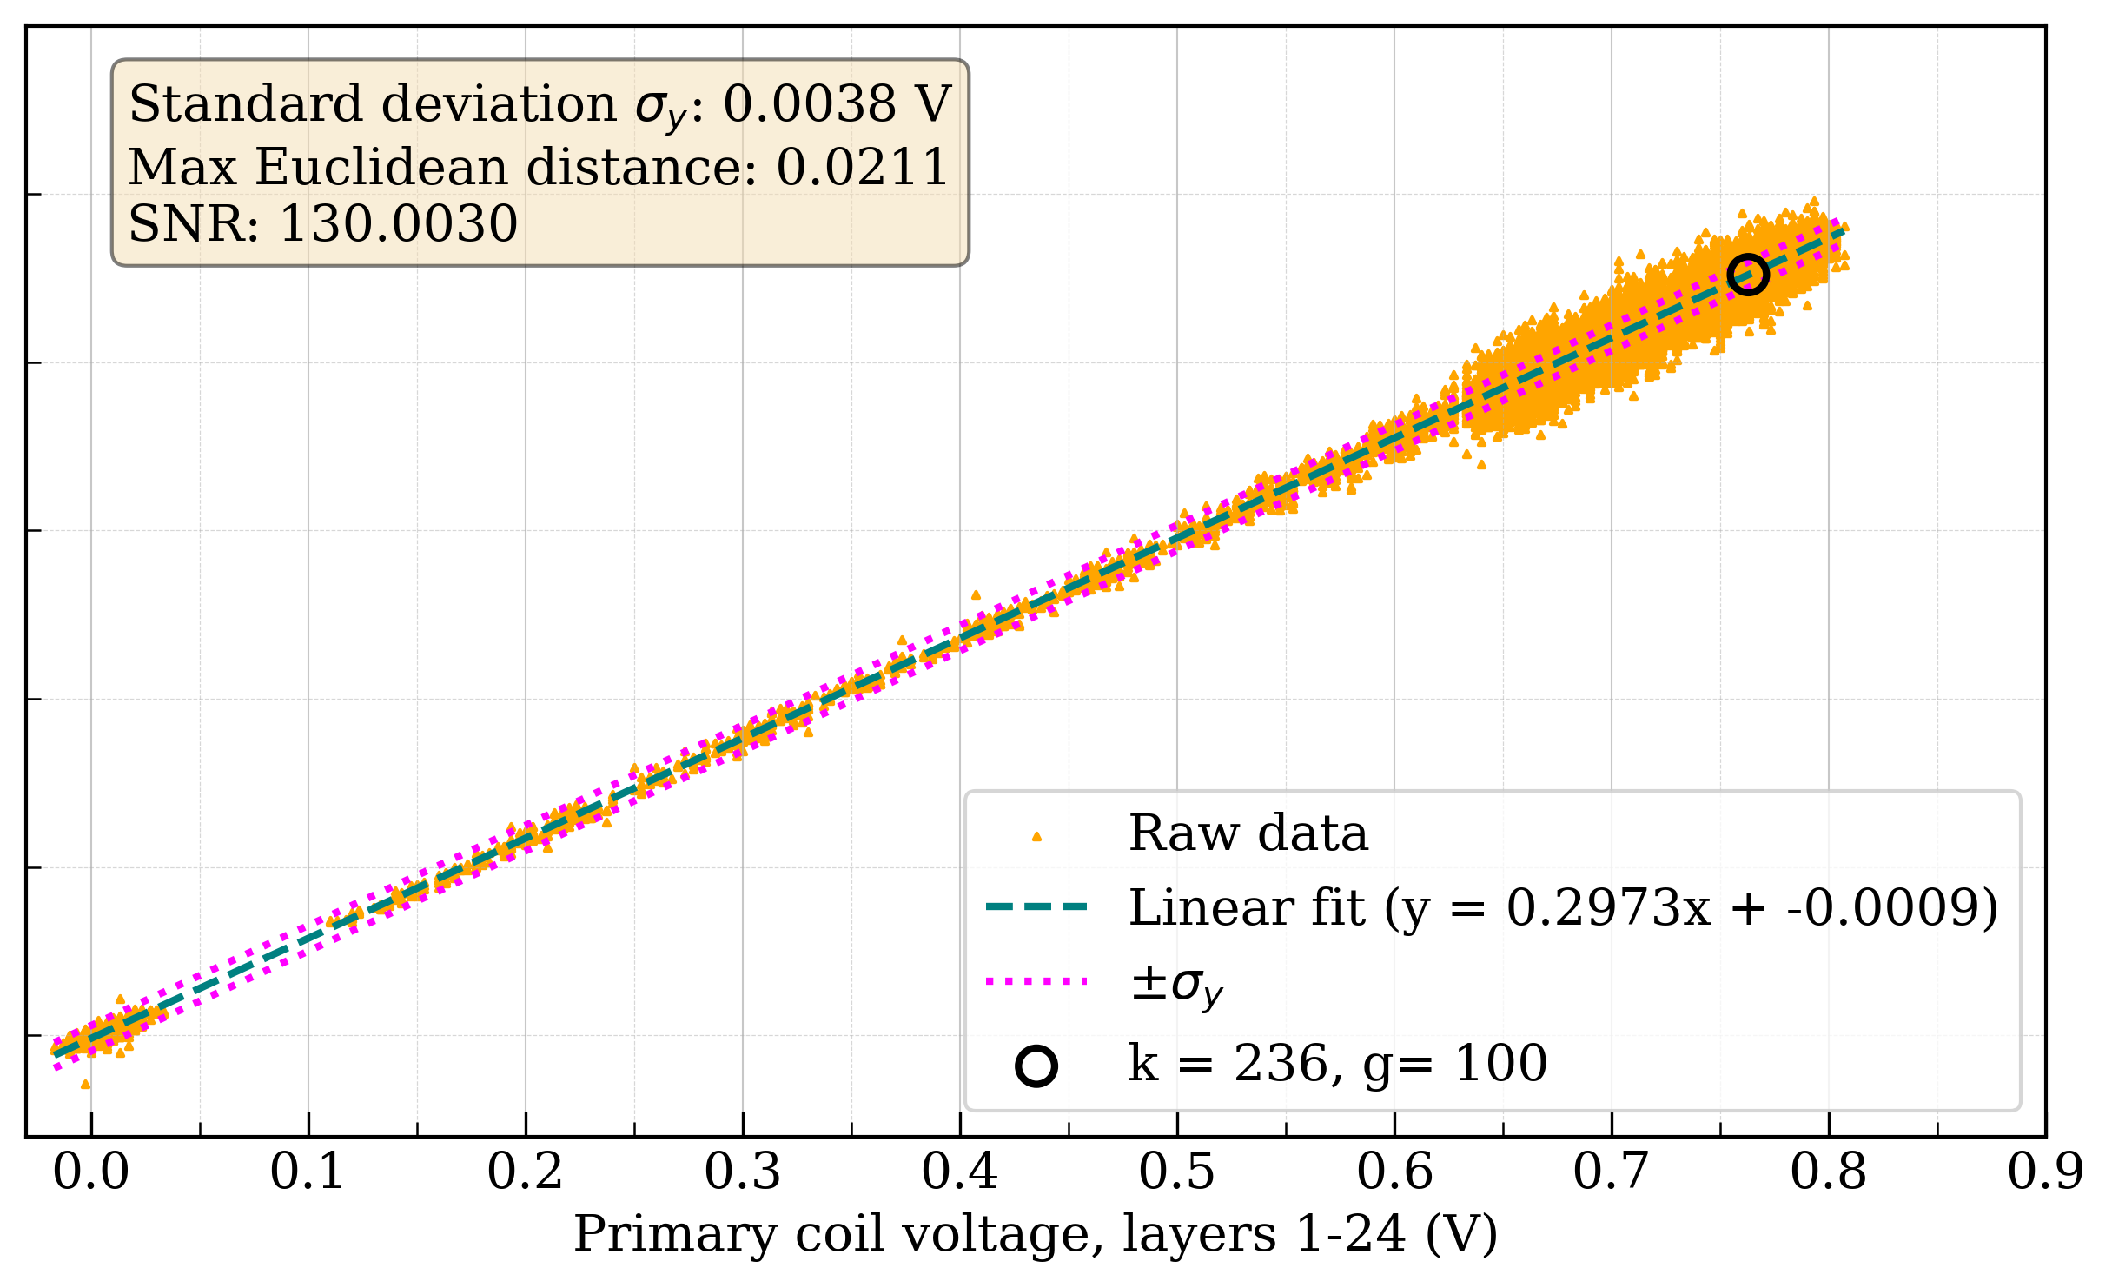
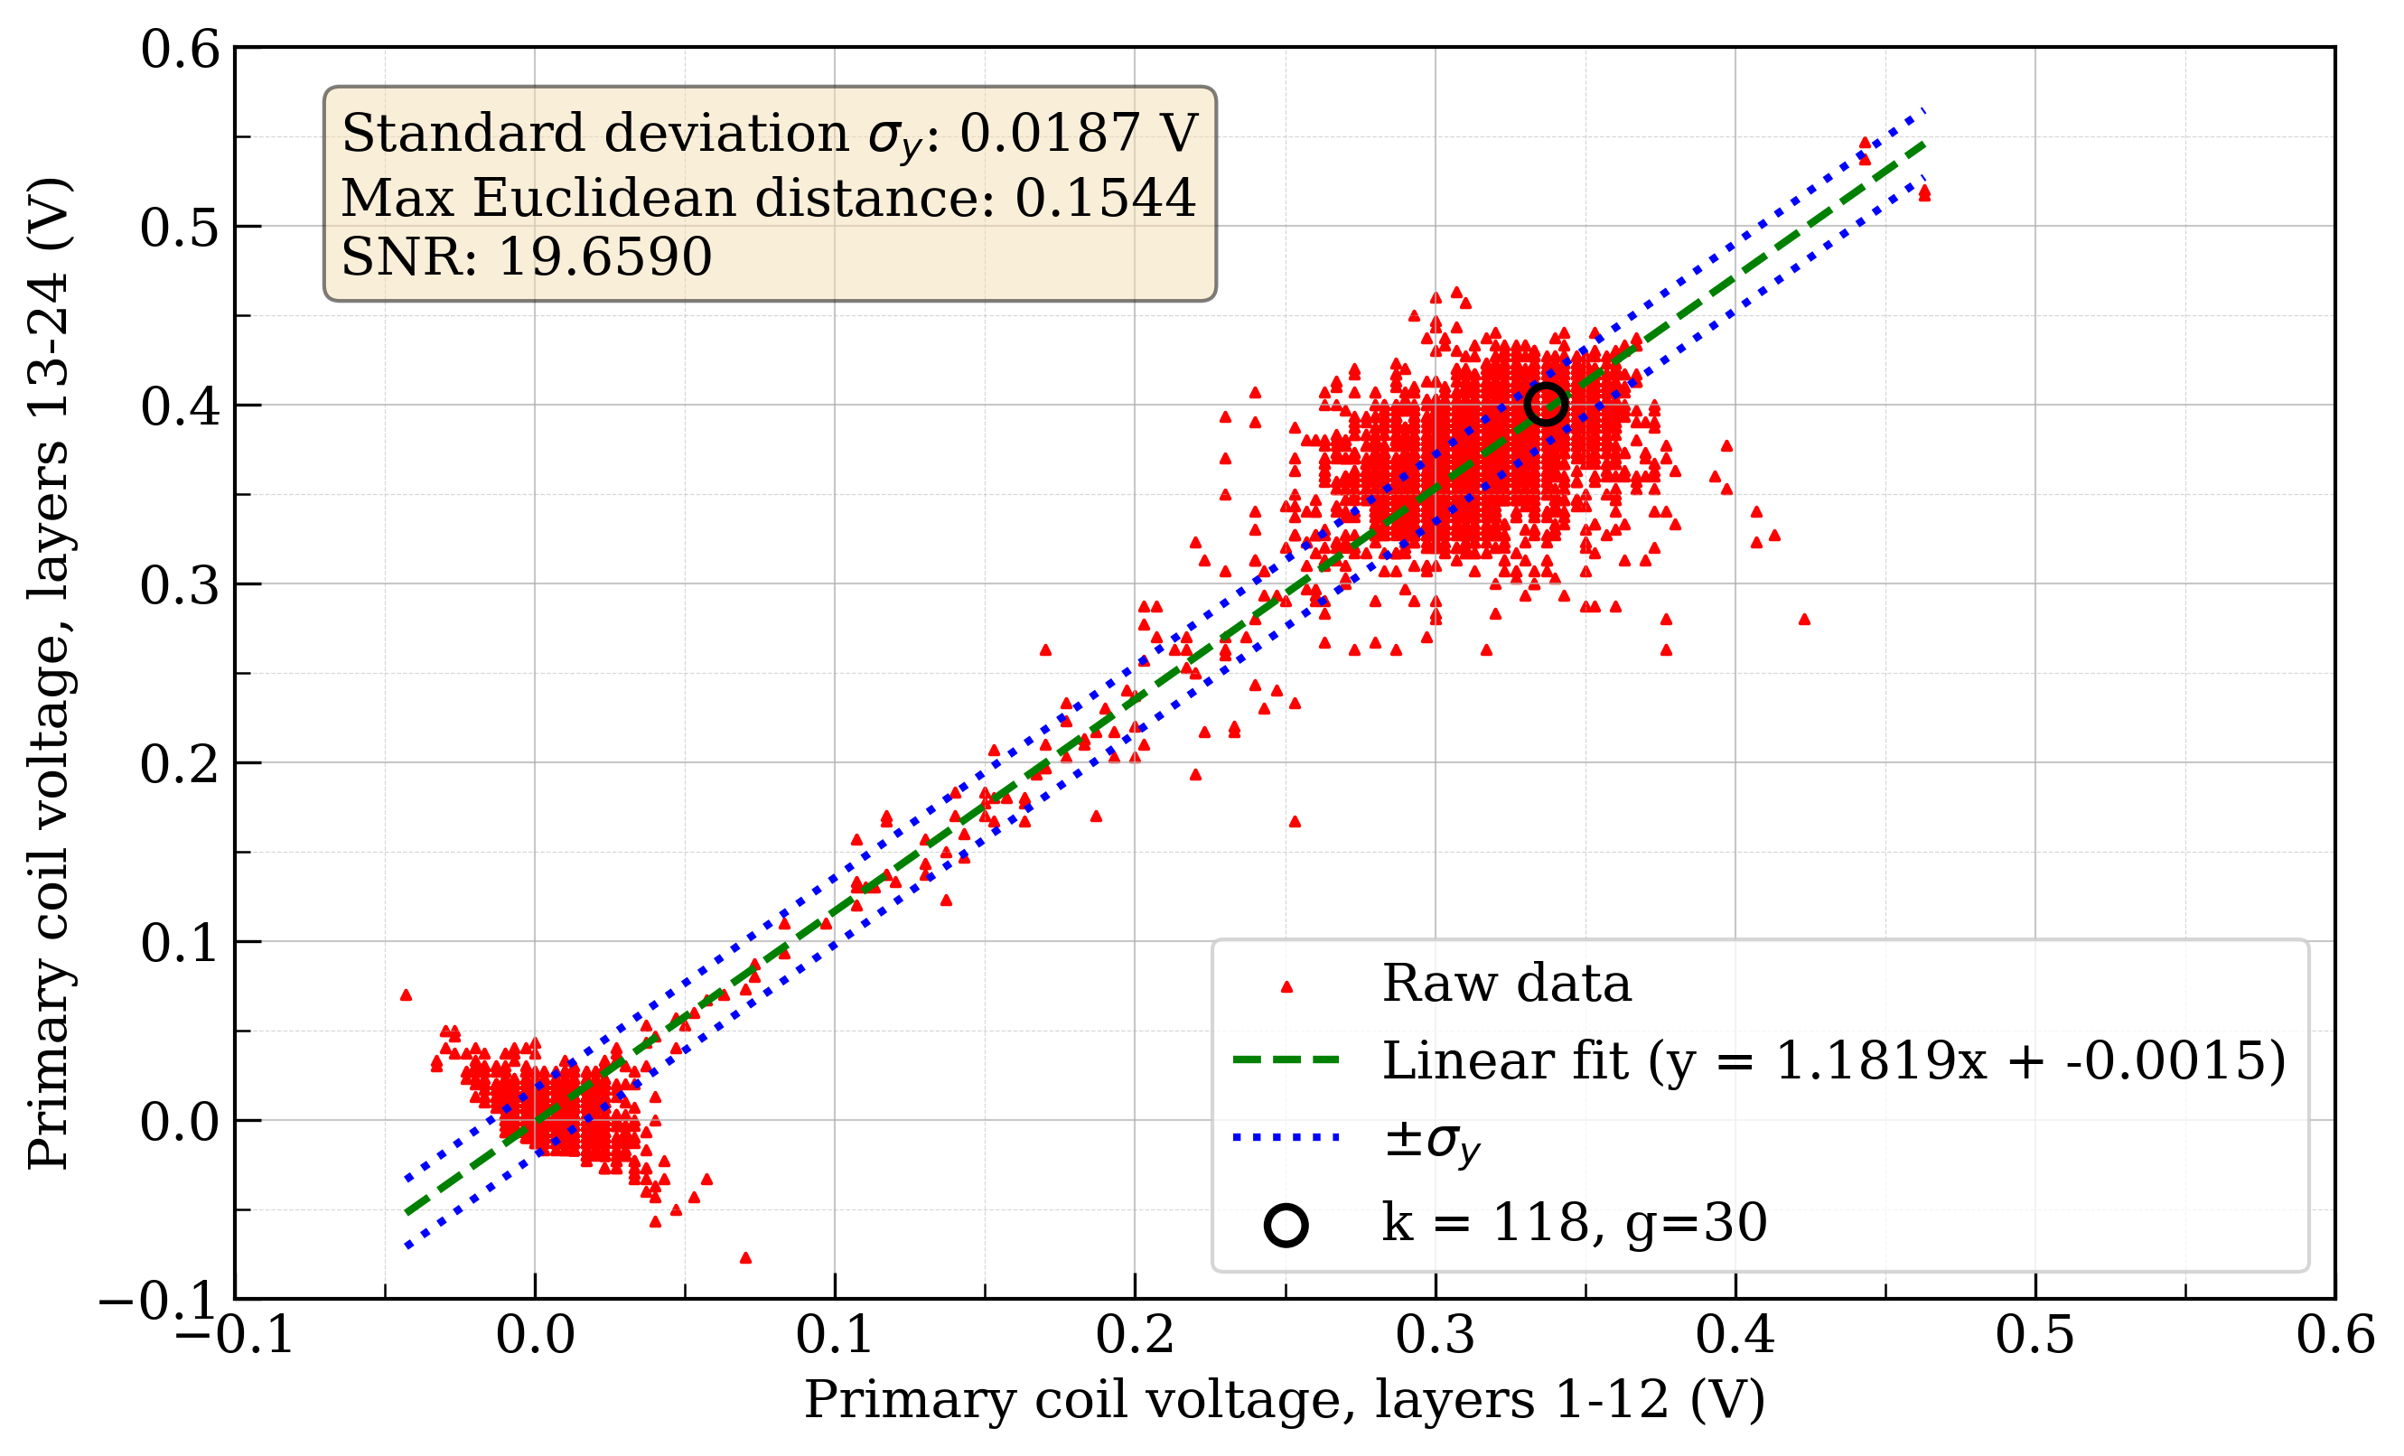
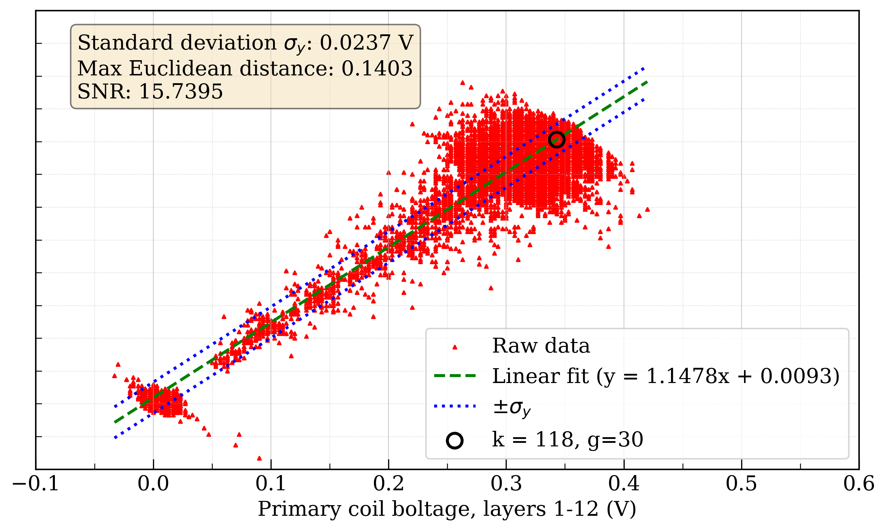
Notes:
Bottom row: Inductive voltage of primary coil compared to total voltage of secondary coil.\\Left column: $I_1 = 40 \, A $, no induced noise.\\ Right column$I_1 = 60 \, A$, induced noise from signal generator. \\For all figures: $\frac{dI}{dt}= 0.5 \, A/s$. Signal-to-noise ratio is calculated from the datapoint highlighted with a black circle.

Slide 13
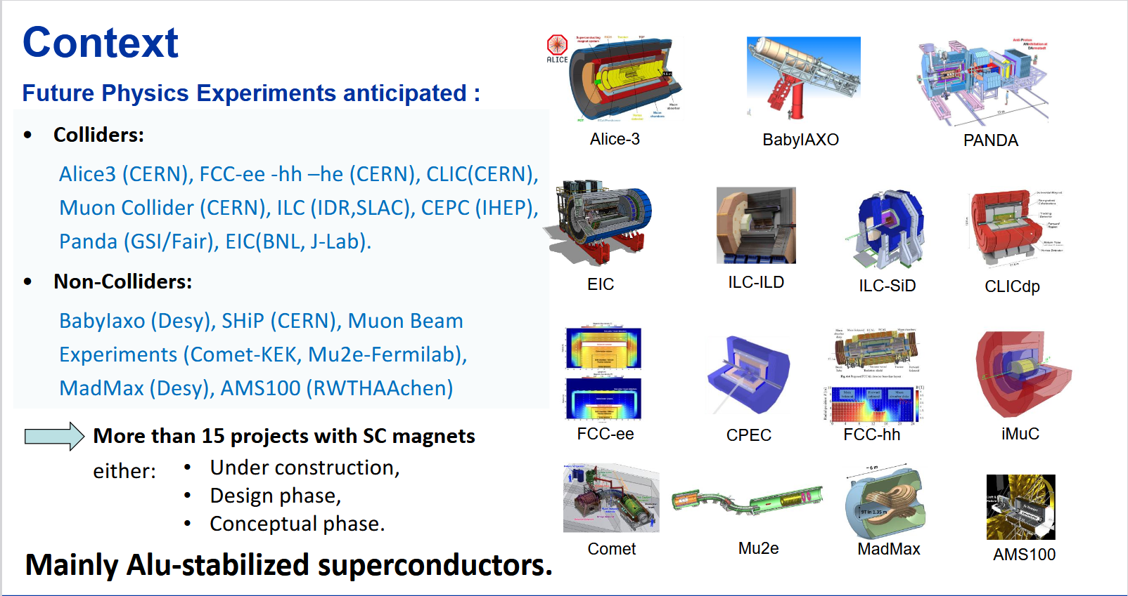
M.Mentink &B.Cure EP R&D Day - WP8 Detector Magnets
Notes:
Alice 3 heavy ion detector
FCC-ee LHC successor normal conducting
CLIC – alternative to FCC linear
ILC – International Linear Collider
CEPC – Circular electron positron collider China
Panda - antiProton ANnihilation at DArmstadt.
EIC – electron ion collider quantum chromodynamics (QCD) interactions of quarks by gluons
Ship - The Search for Hidden Particles (SHiP) experiment proposal dipole magnet for its scattering and neutrino detector.
AMS100 - AMS-100: The Next Generation Magnetic Spectrometer in Space -- An International Science Platform for Physics and Astrophysics at Lagrange Point 2

Slide 14
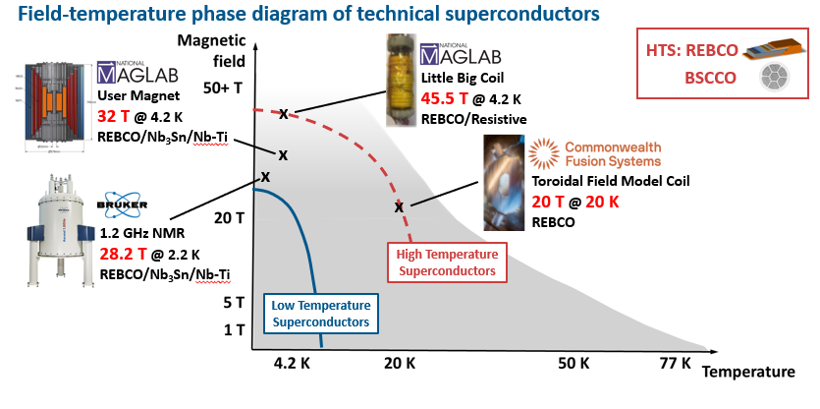
High-field magnets
C. Senatore „ Progress in REBCO Conductor Technologies for Ultra-High Field Applications“

Slide 15
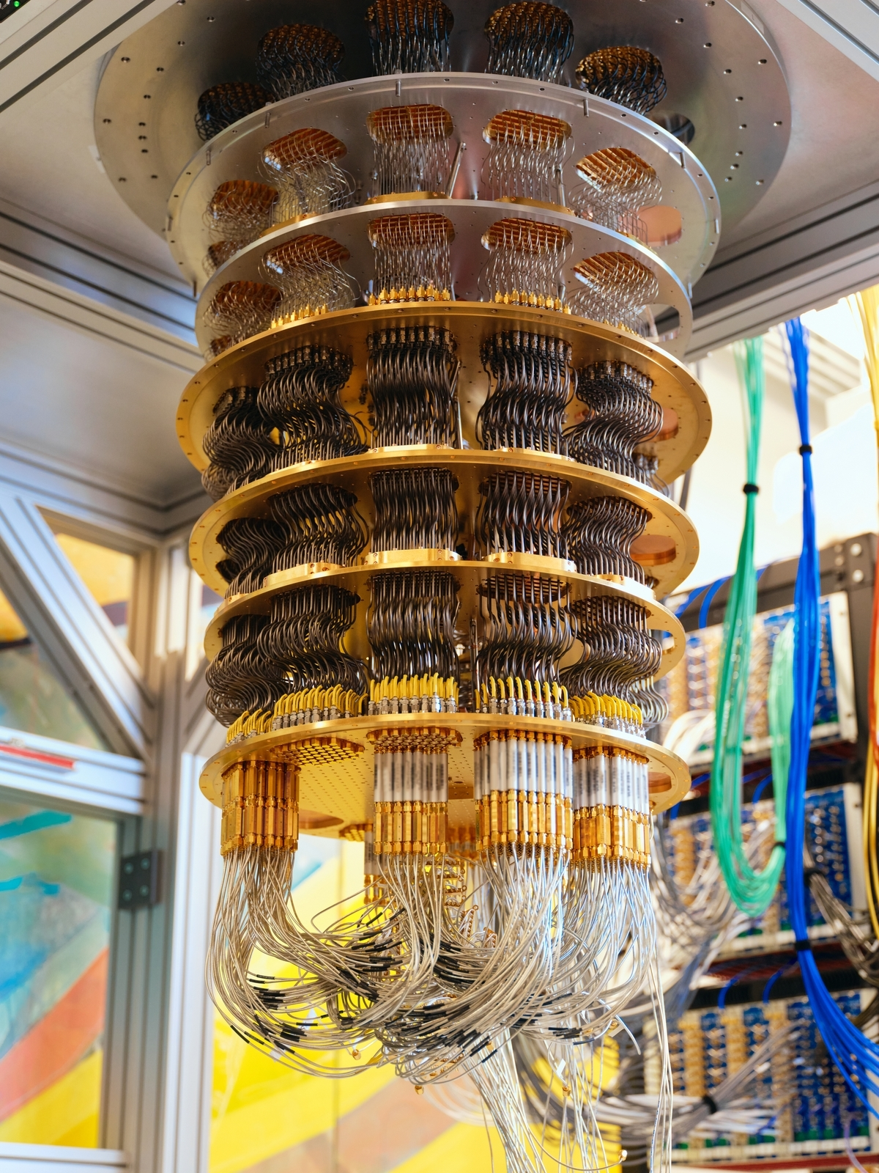
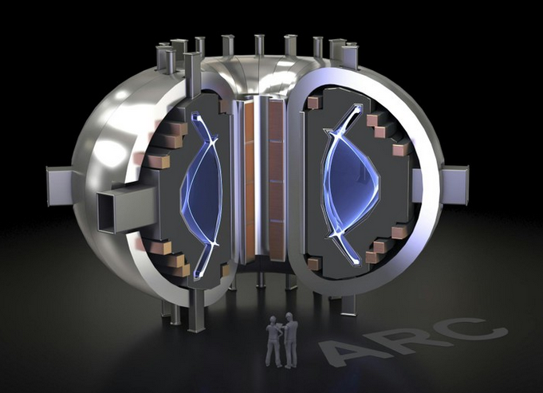
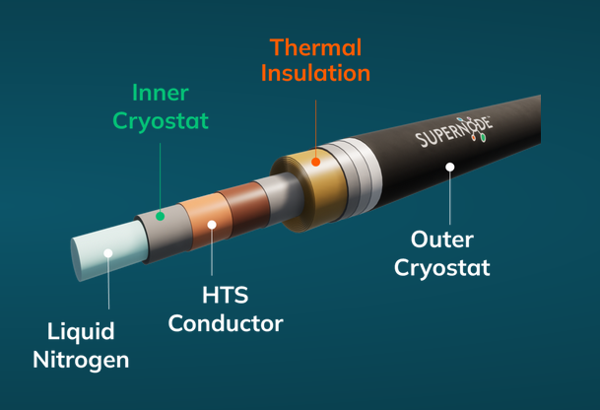
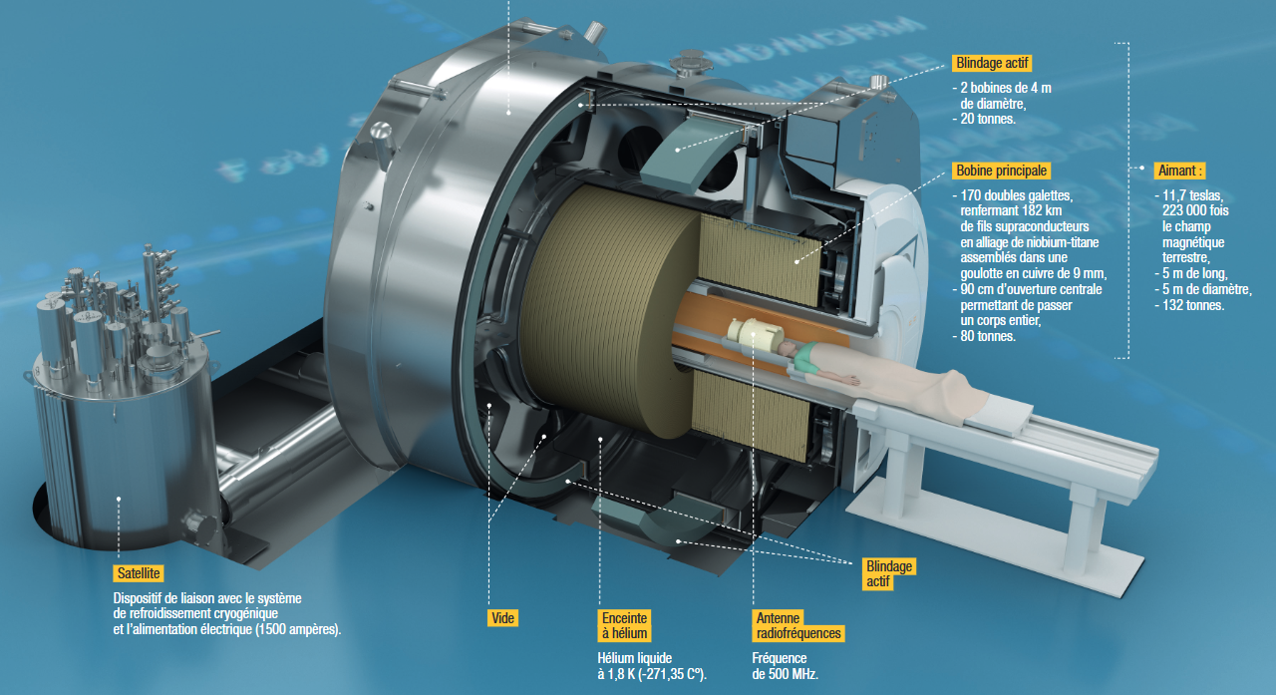
Other applications
Google Quantum AI
LHe dilution refrigerator for
a quantum processor
  Fusion
  Superconducting power transmission – SuperNode, English Channel
  Quantum computers – IQM, IBM, Google, Dwave
  SQUIDs – very sensitive magnetometers
    MRI sensing elements
    For gravitational wave research
    Axion Dark Matter Experiment
  High-field MRI magnets – CEA Paris-Saclay 11.7 T for studies of the human brain
  NIMMs – a proposed synchrotron facility for Hadron Therapy
11.7 T MRI magnet at CEA Paris-Saclay
CFS ARC tokamak
CFS Tokamak
SuperNode Ltd. transfer cable

Slide 16
References
EP R&D 2024 annual report, CERN
Dominik Walliman, Domain of Science Youtube channel 2021, „Map of superconductivity“
Engineering Superconductivity," ed. Peter J. Lee, Wiley-Interscience, New York, 200
Superconductivity Revised Edition V L Ginzburg / E A Andryushin
Phys.org „How electrons split: New evidence of exotic behaviors“
J. Fleiter Rutherford cables for HL-LHC magnets, CERN
C.Barth et al., „Temperature- and field-dependent characterization of a conductor on round core cable“
SuperPower brochure, Rebco SC4050
A. K. Jha, K. Matsumoto „Superconductive REBCO Thin Films and Their Nanocomposites: The Role of Rare-Earth Oxides in Promoting Sustainable Energy“
M. Marchevsky, „Quench detection and protection for HTS accelerator magnets“
D. C. Larbalestier et al., “Isotropic round-wire multifilament cuprate superconductor for generation of magnetic fields above 30 T”
B. Maddock and G. James, “Protection and stabilisation
of large superconducting coils,”
M.Mentink et al „BabyIAXO Axion Helioscope Superconducting Dipole“
M.Mentink &B.Cure EP R&D Day - WP8 Detector Magnets
C. Senatore „ Progress in REBCO Conductor Technologies for Ultra-High Field Applications“
SQUID, Wikipedia
https://supernode.energy/technology/
https://cfs.energy/
https://quantumai.google/quantumcomputer
https://www.cea.fr/presse/Pages/actualites-communiques/sante-sciences-du-vivant/voyage-aimant-IRM-projet-iseult.aspx

Slide 17
Questions?

