Slide 1
SHiP 2D model for field homogeneity optimization
Lucie Baudin
31/05/2024

Slide 2
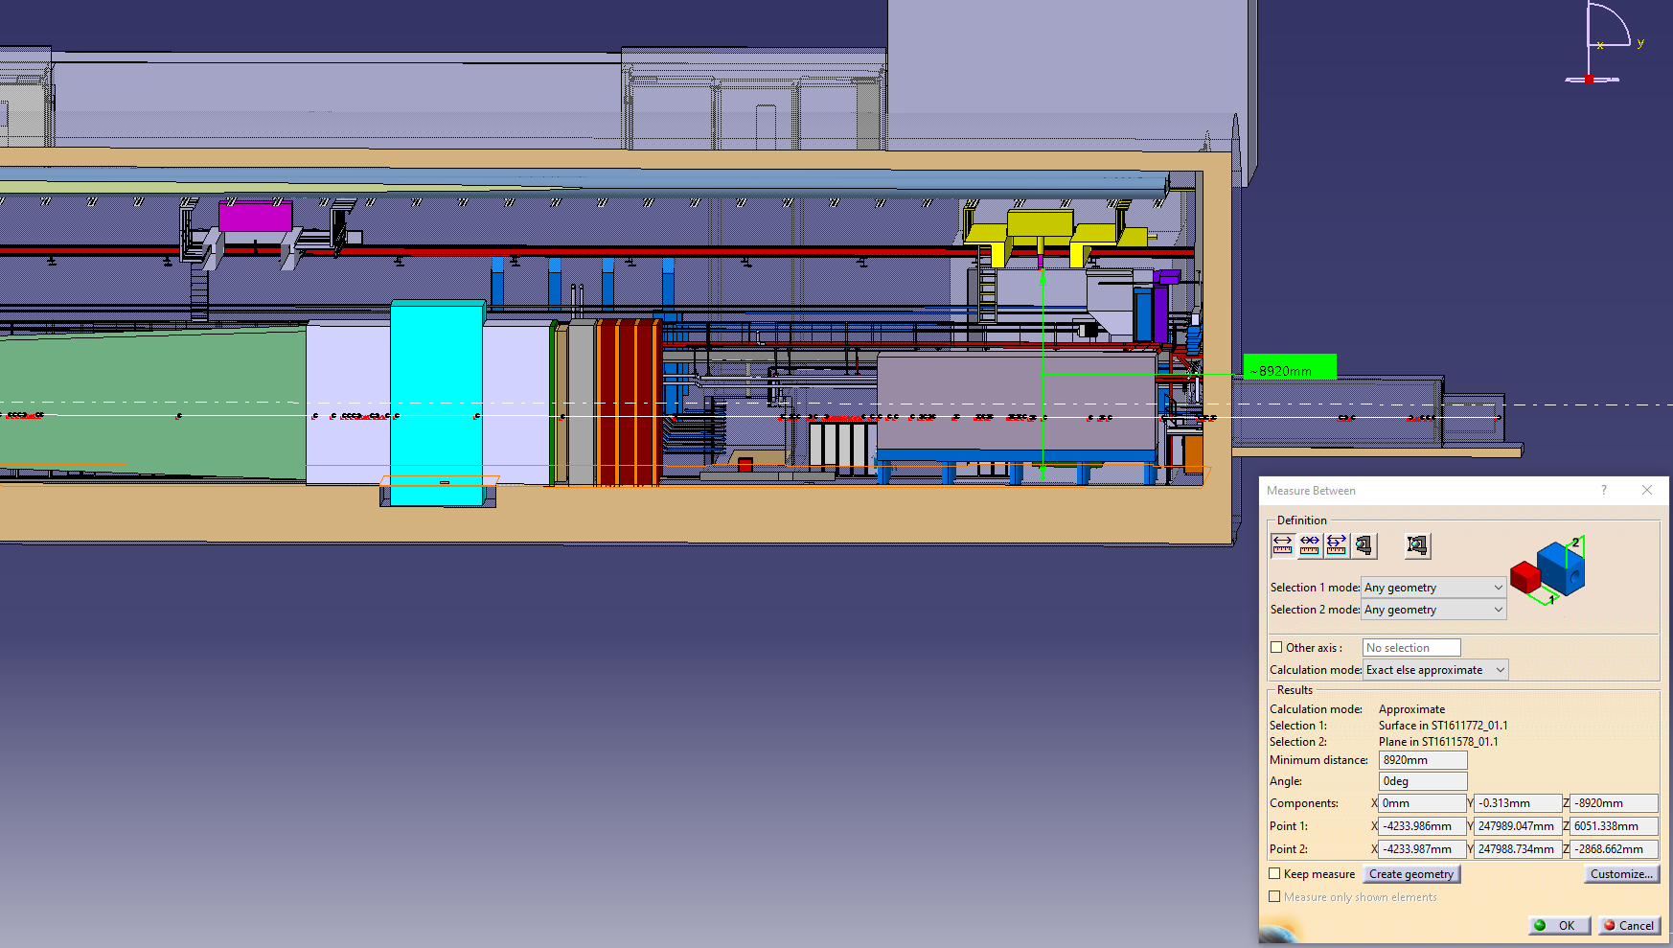
Maximal space allocation on spectrometer yokes in ECN3 cavern

Slide 3
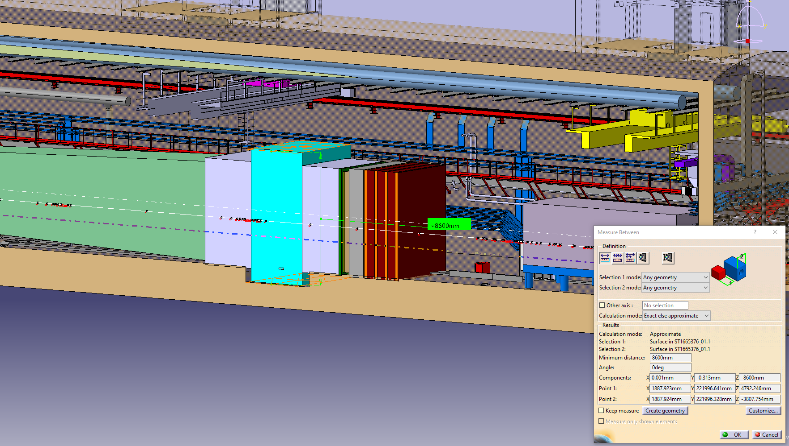
1 m excavation

Slide 4
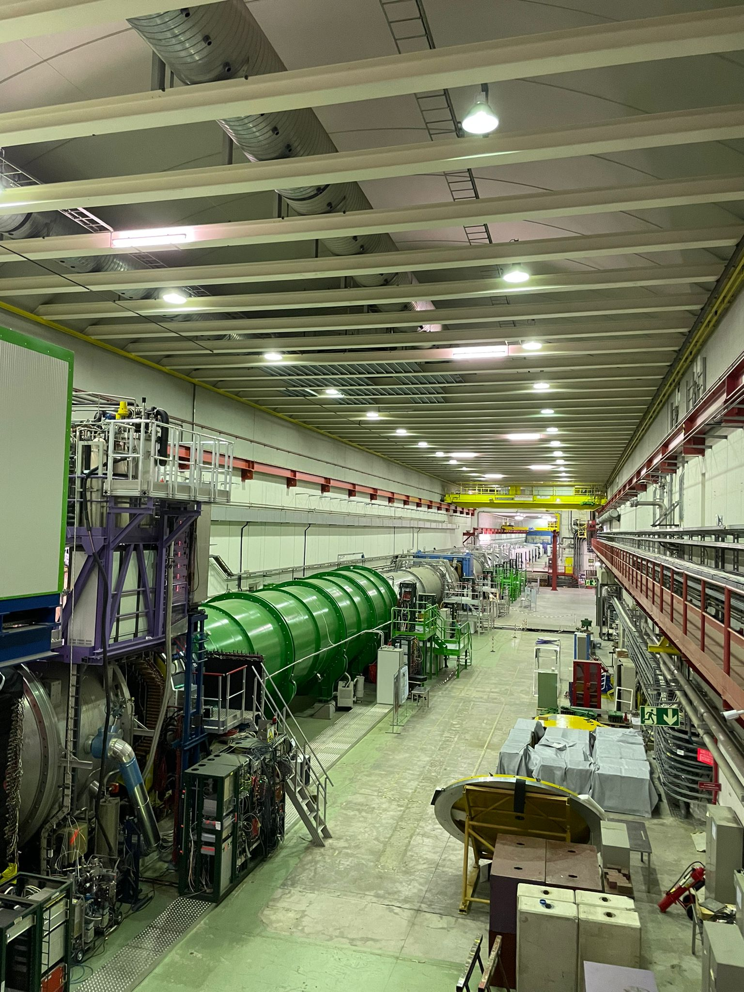
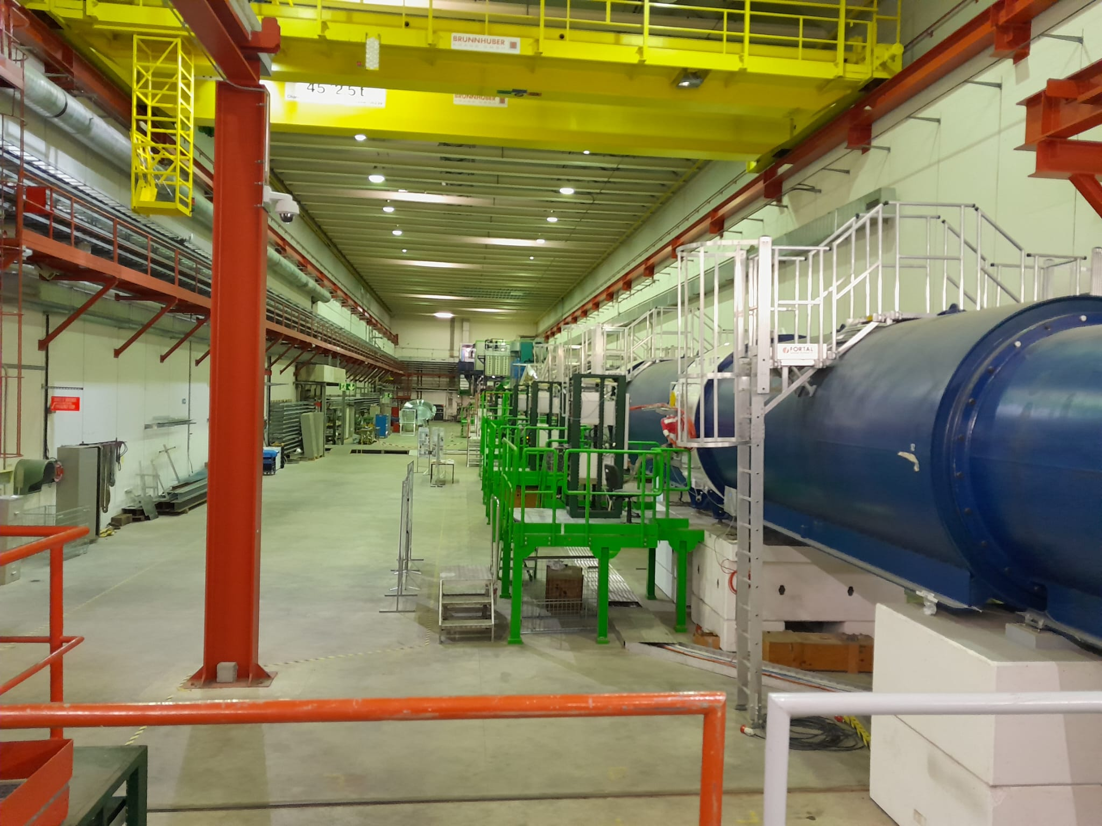
ECN3 Visit

Slide 5
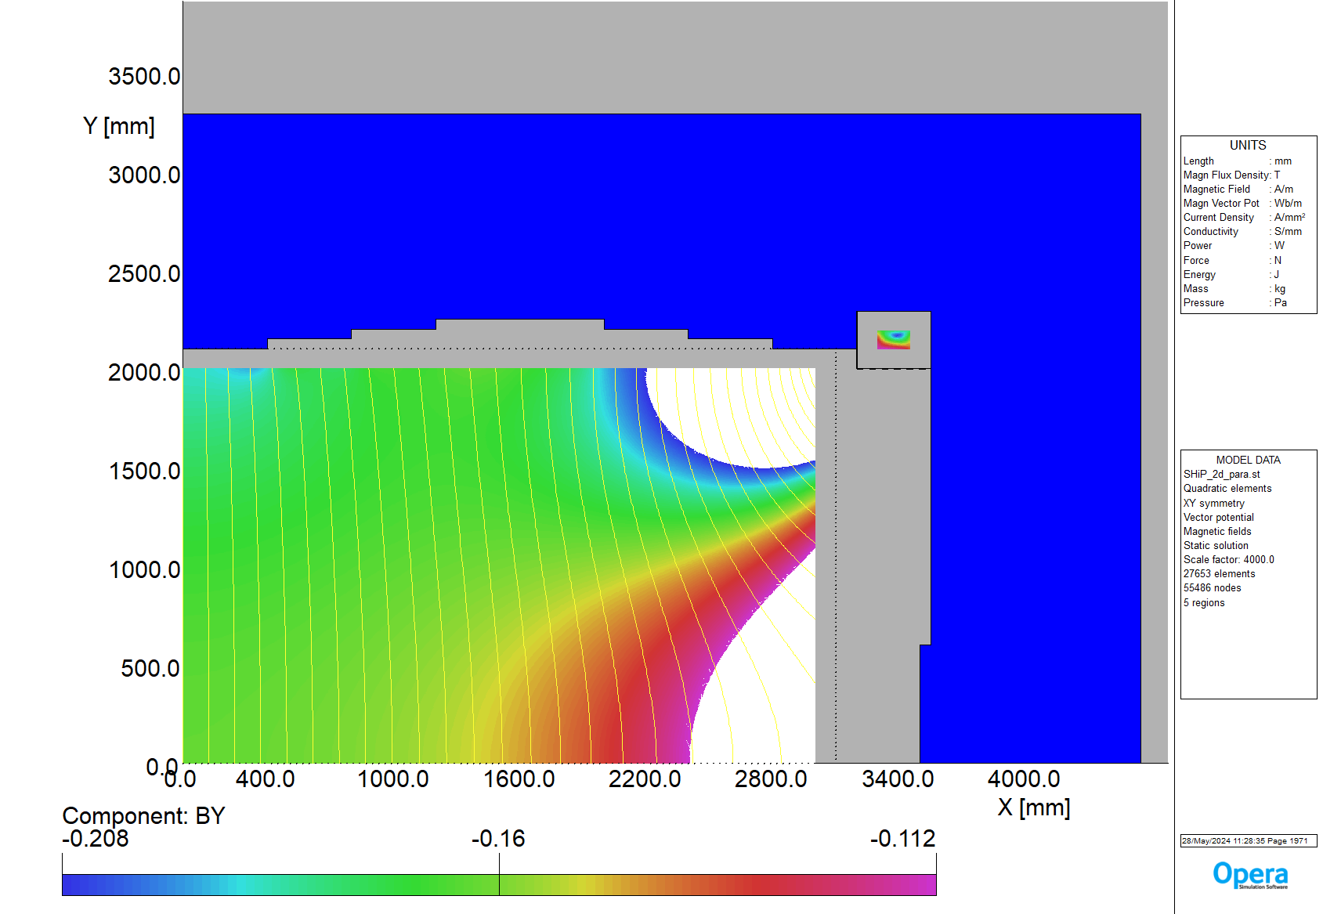
SHiP 2D model for field homogeneity optimization
Requirements:
Acceptance: 6 m x 4 m
Coil dimensions: 150 mm x 90 mm (I = 72 x 4000 A)
Space allocation for cryostat: 100 mm
Space allocation for vacuum chamber : 100 mm
BY0 > ~0.15
Max Yoke Dimension X = 4300 mm
Input parameters for yoke optimisation:
Back leg Y
Shim 5
Shim 1
Back leg X
Shim 7
Shim 6
Shim 2
Shim 3
Coil off set Y
Coil off set X
Parameters displayed:
Output parameters:
#coiloff_X=100
#coiloff_Y=-100
#backleg_X=1000
#backleg_Y=1000
#pole_Y=250
#shim1_X=1200
#shim1_Y=50
#shim2_X=800
#shim2_Y=100
#shim3_X=400
#shim3_Y=100
#shim4_X=100
#shim4_Y=1000
BY field map
On radius R=2000mm b3, b5, b7
BY average on Y=0, Y= 250 mm and Y= 500 mm
Harmonics: B3, B5, and B7
Bmax iron
Bmax coil
Shim 4
BY 0 -30%
BY 0
BY 0 +30%

Slide 6
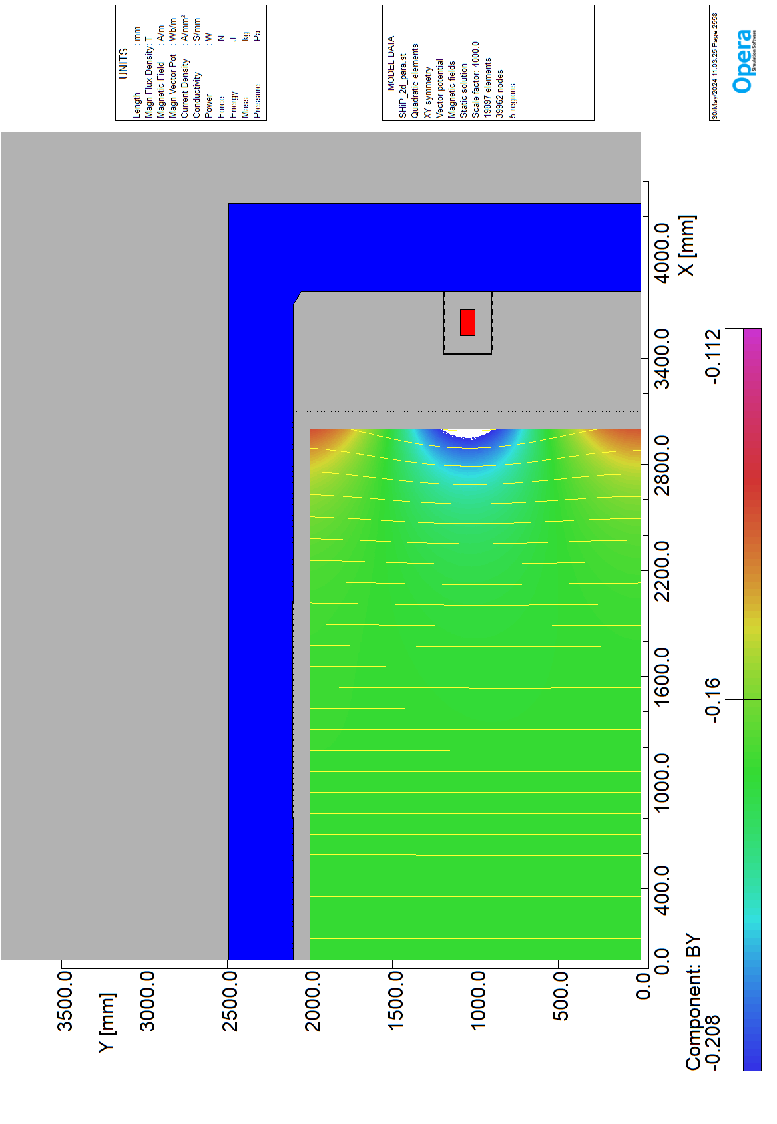
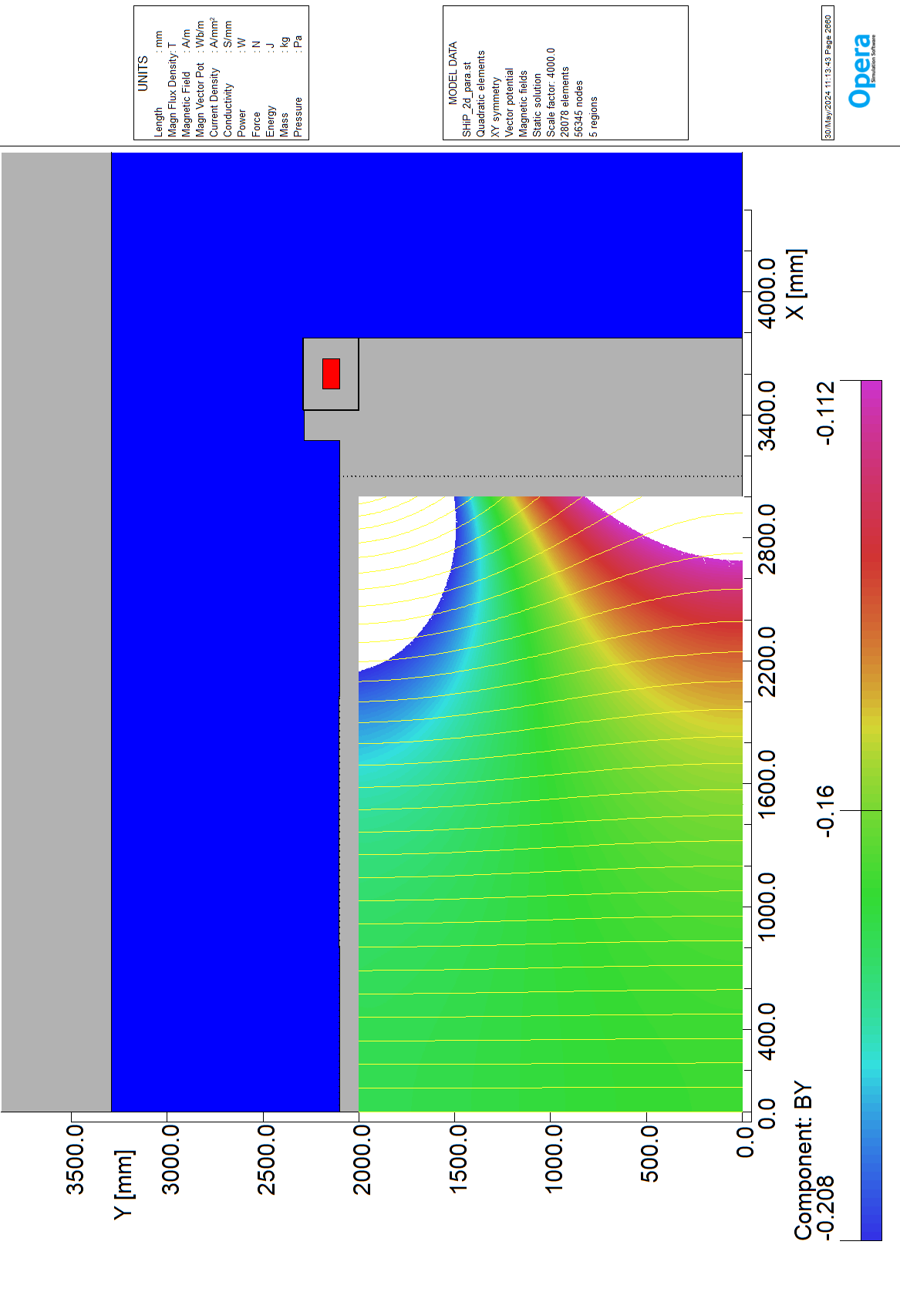
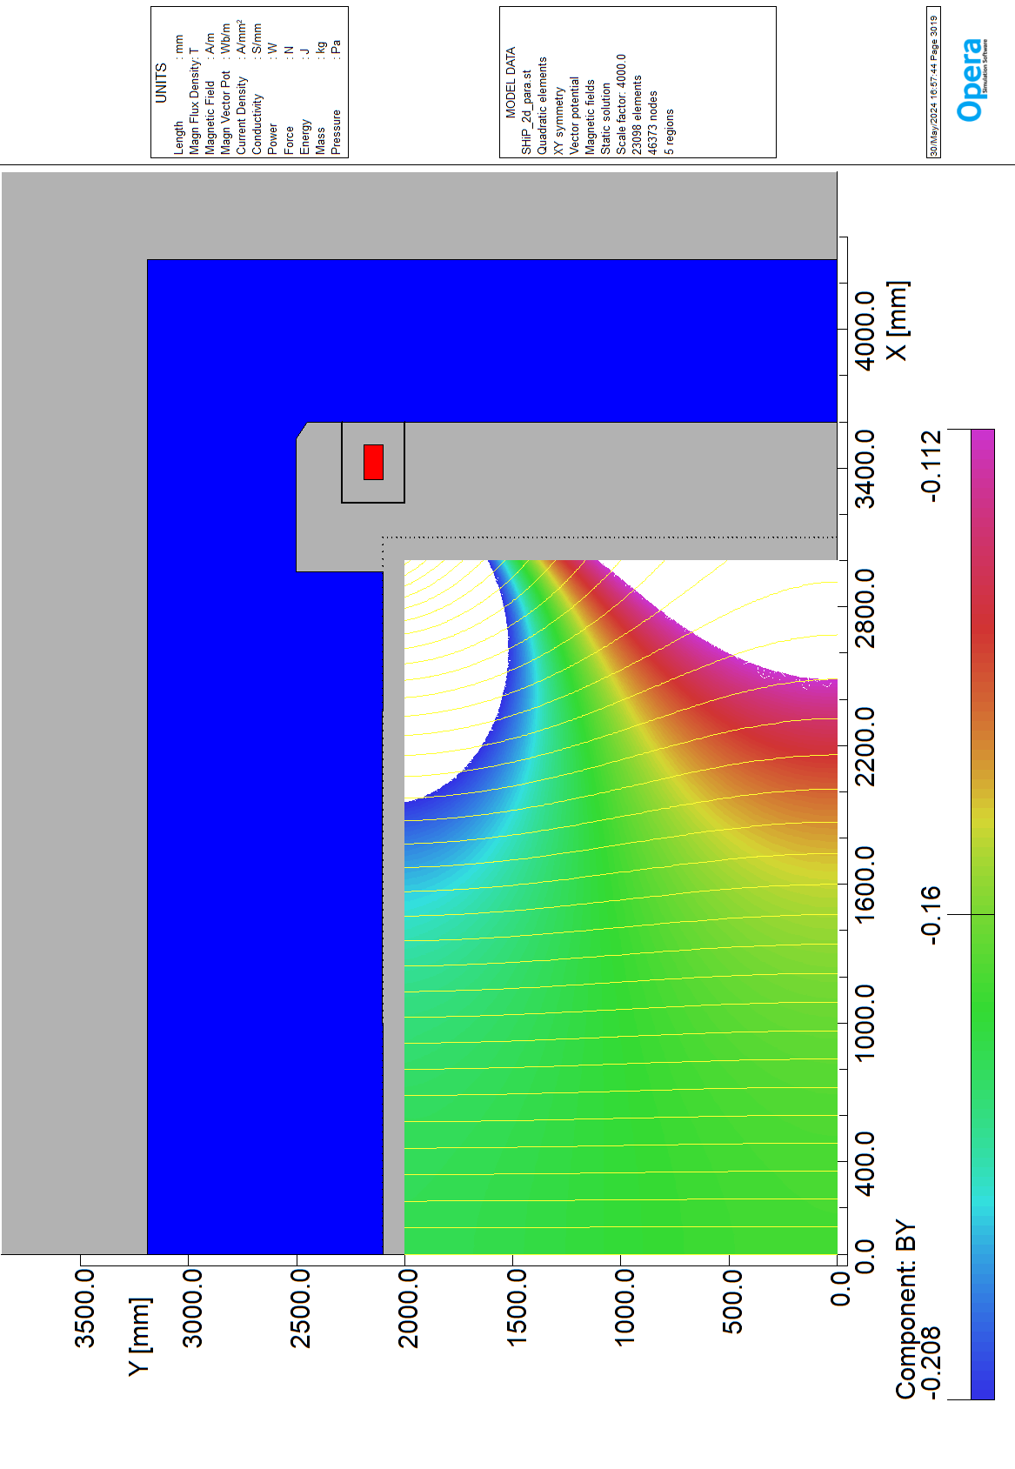
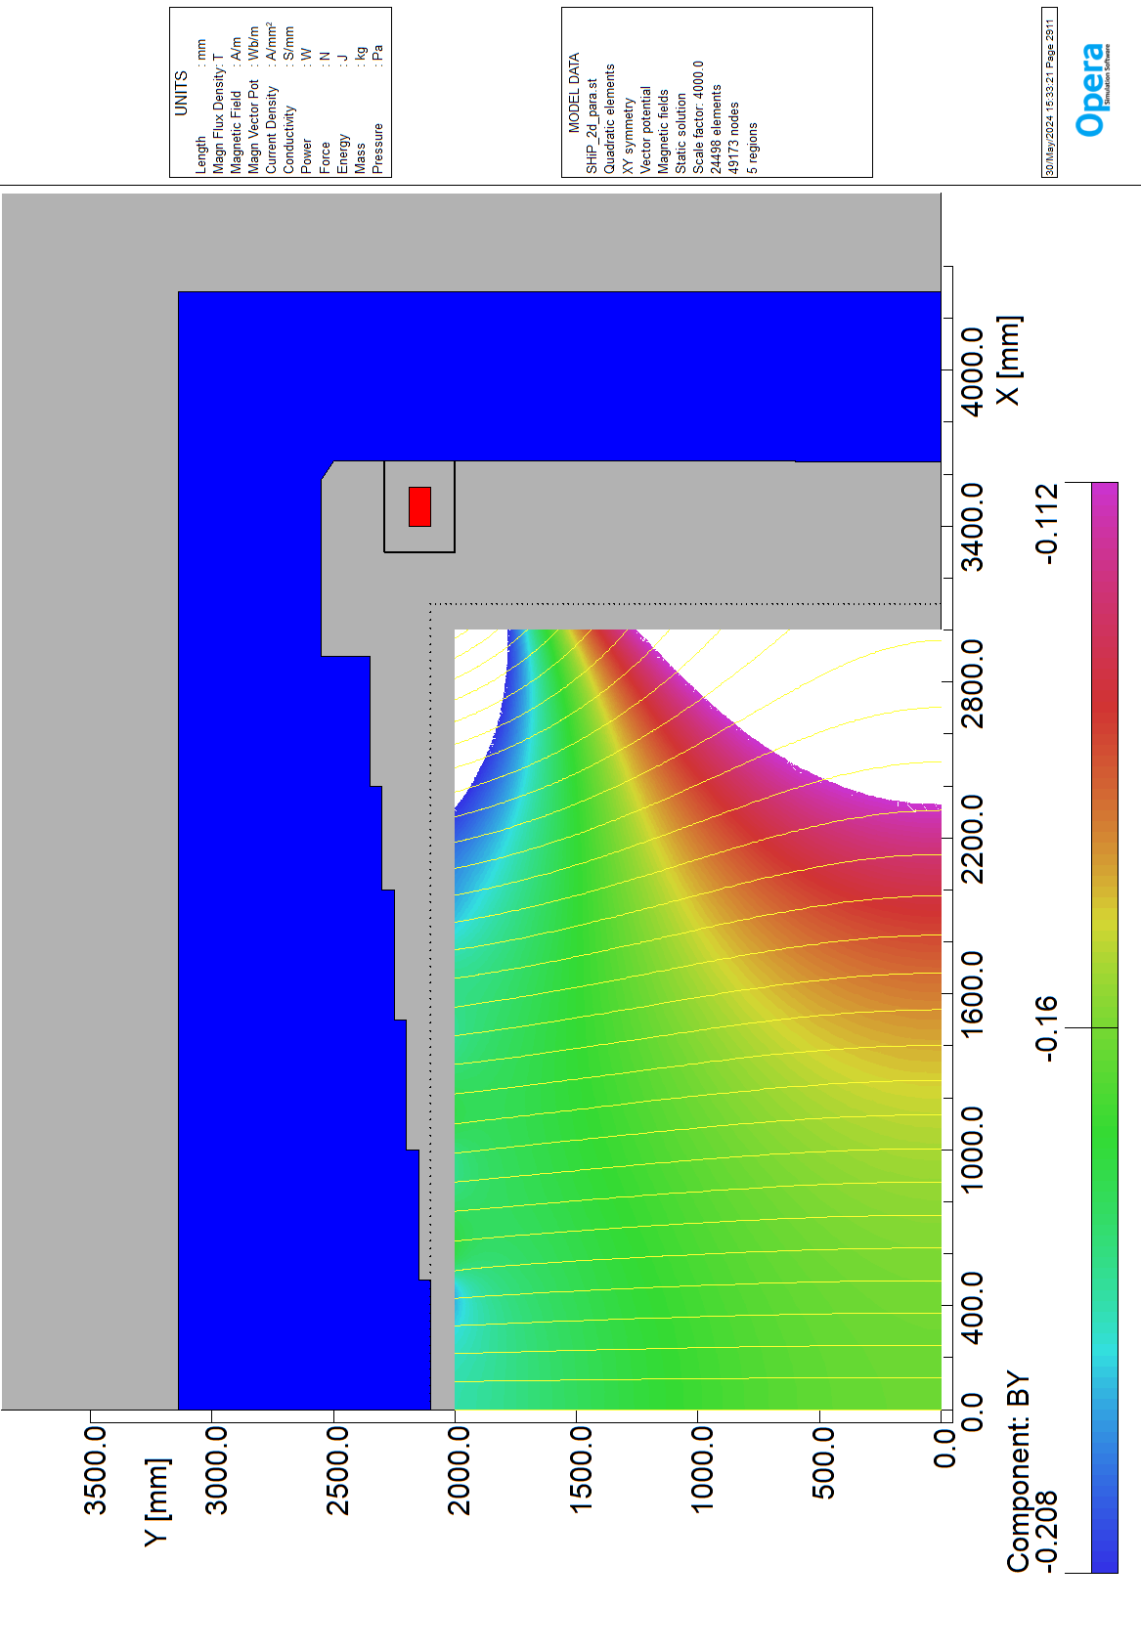
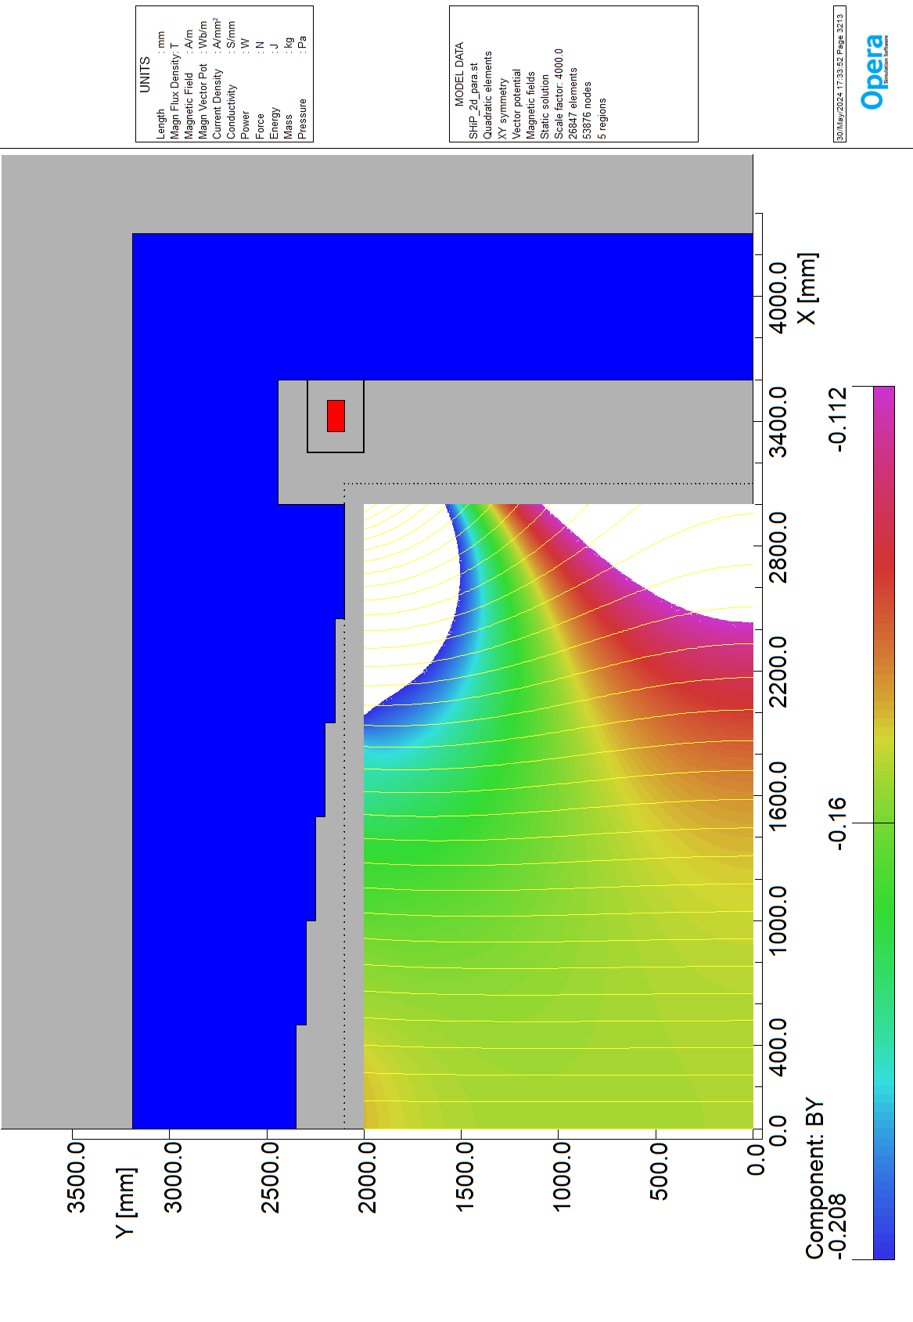
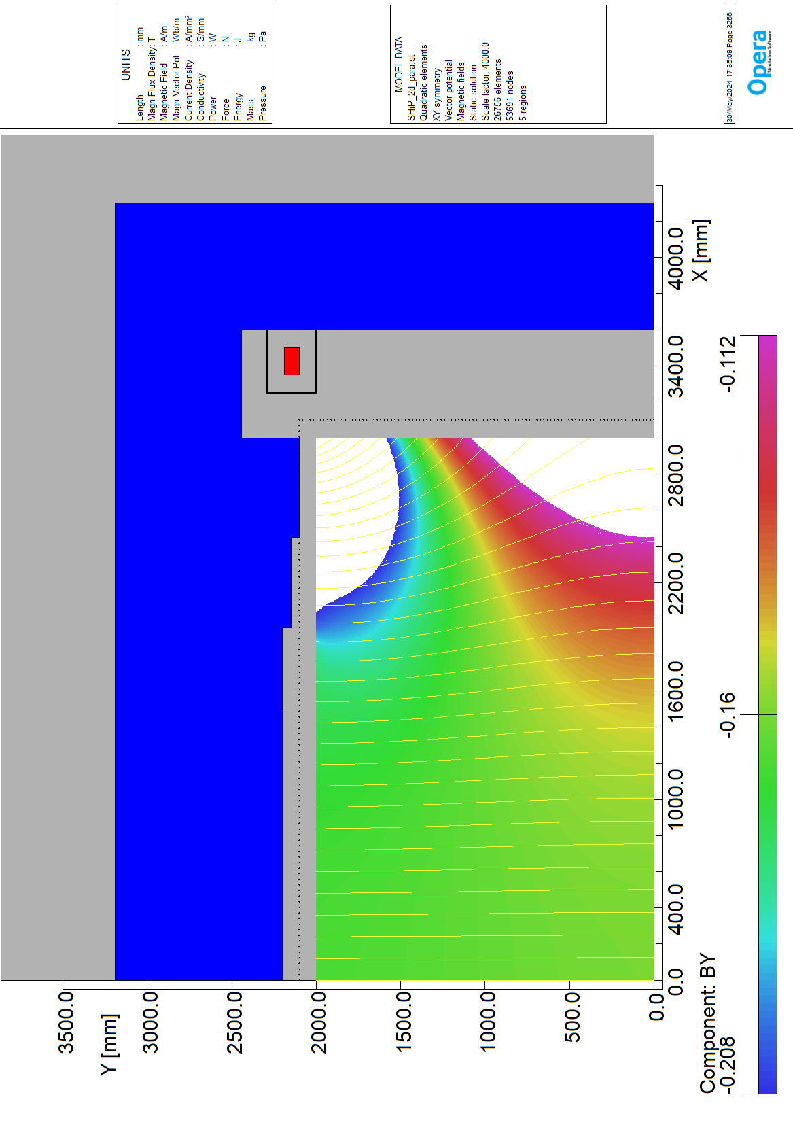
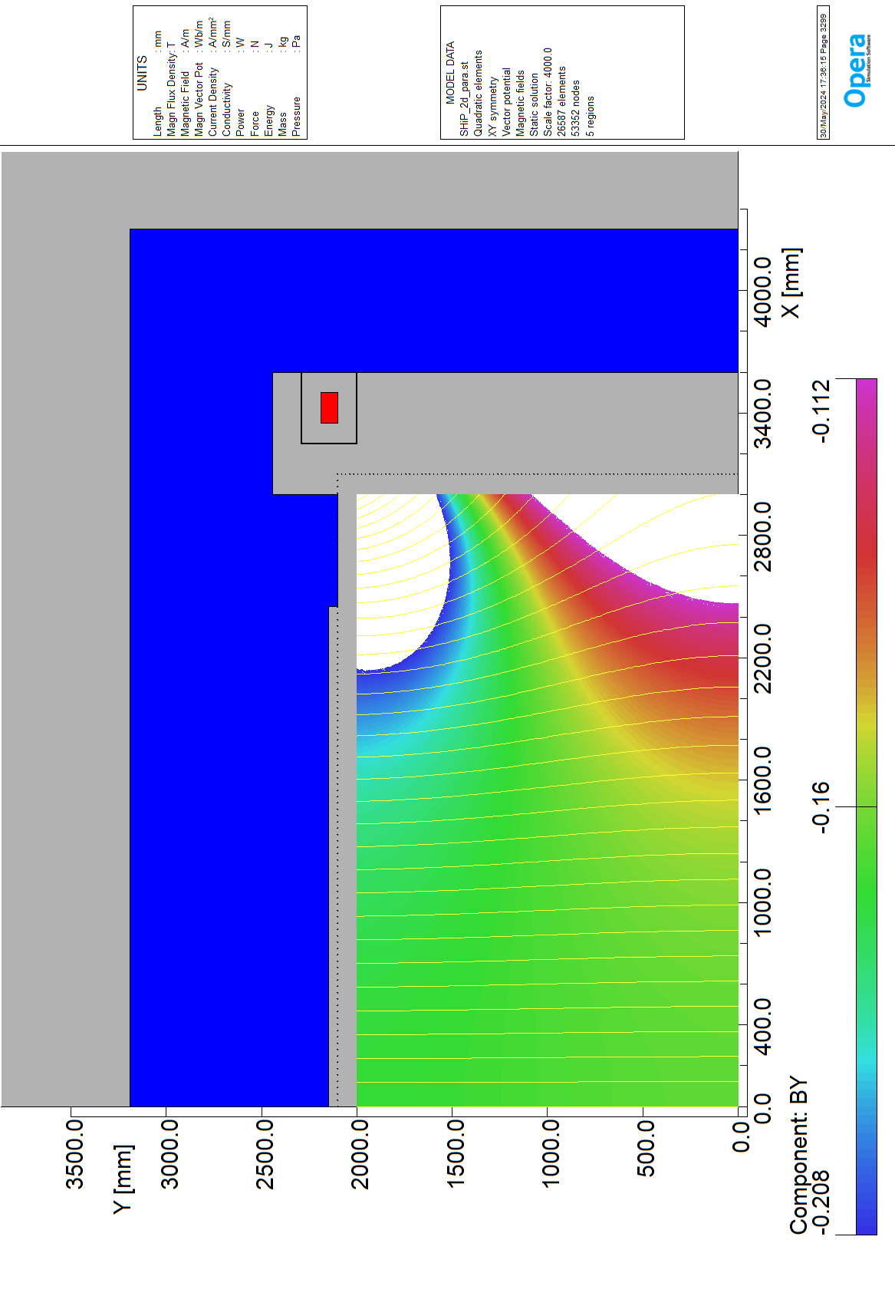
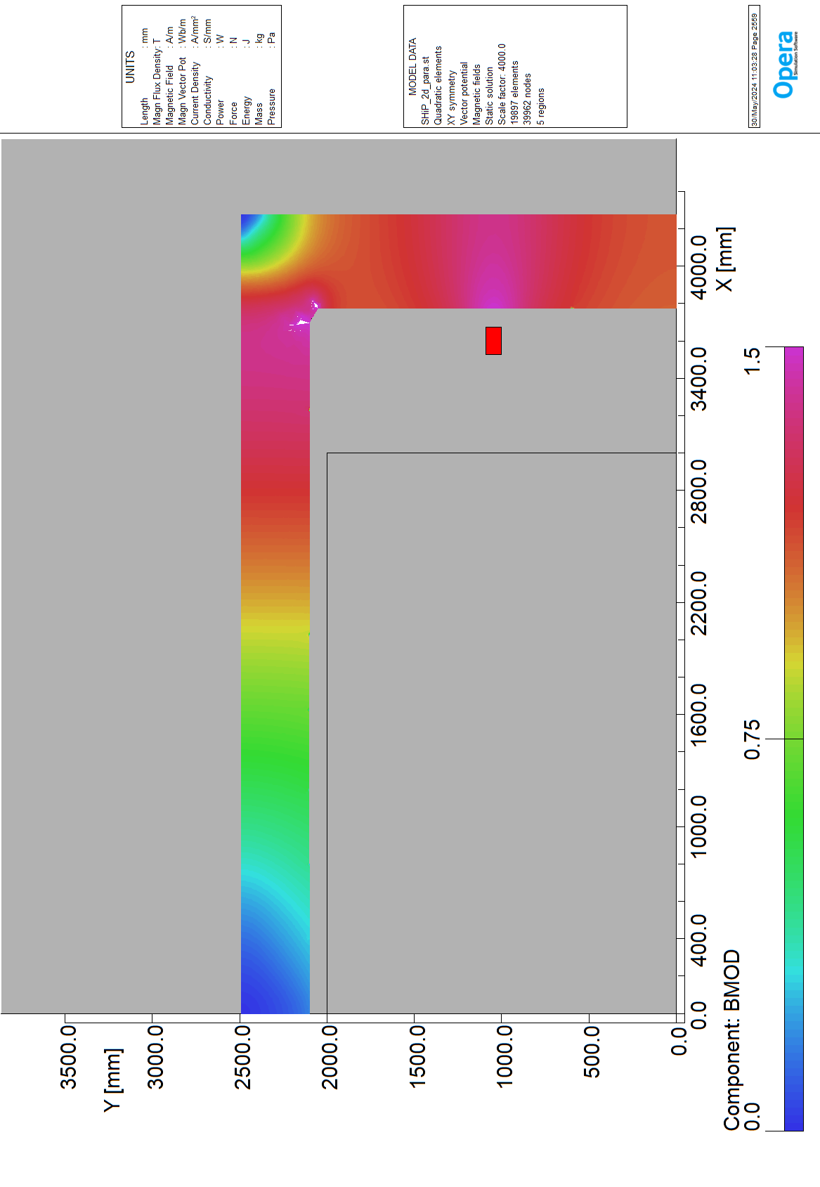
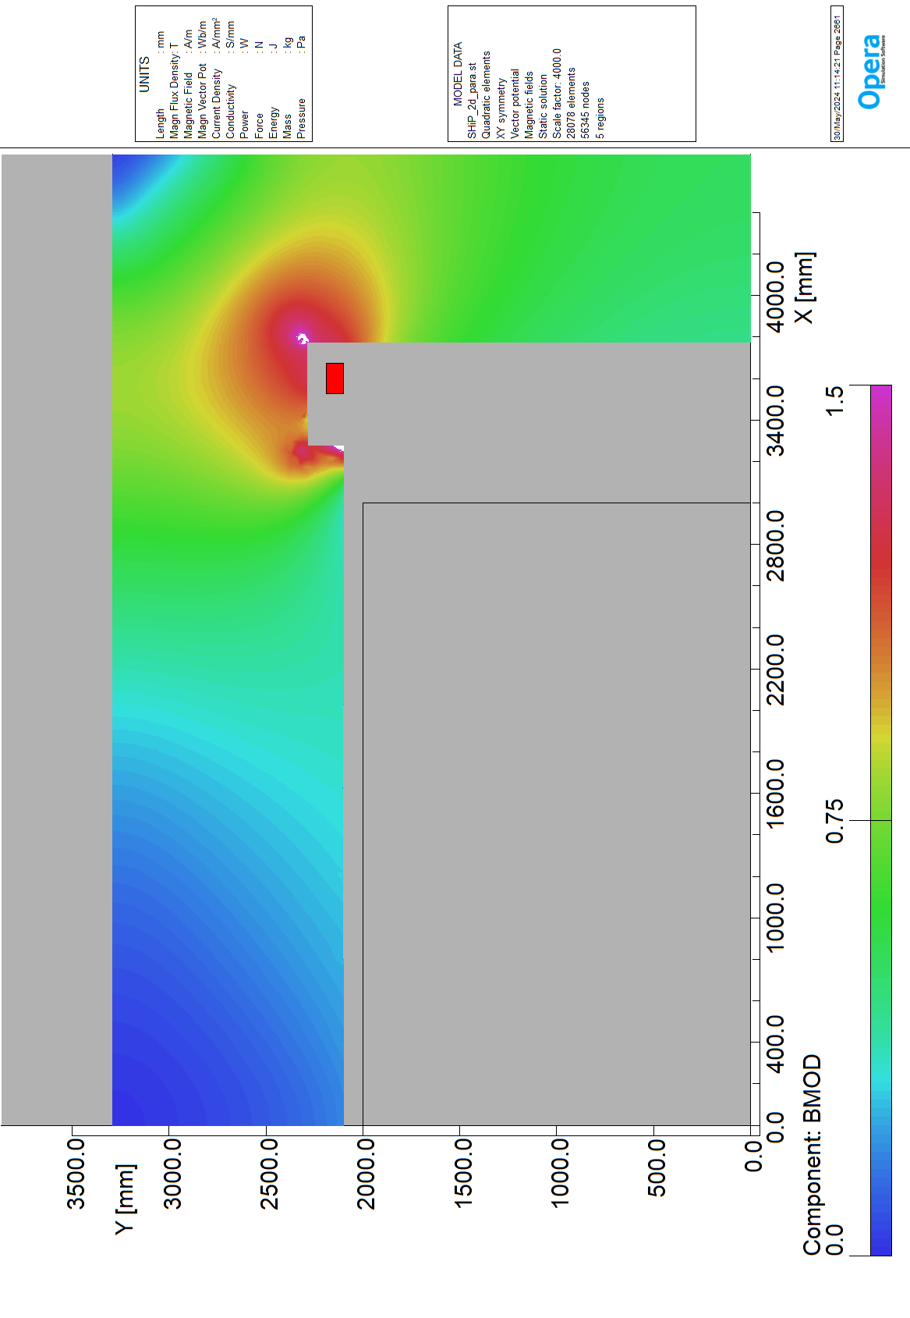
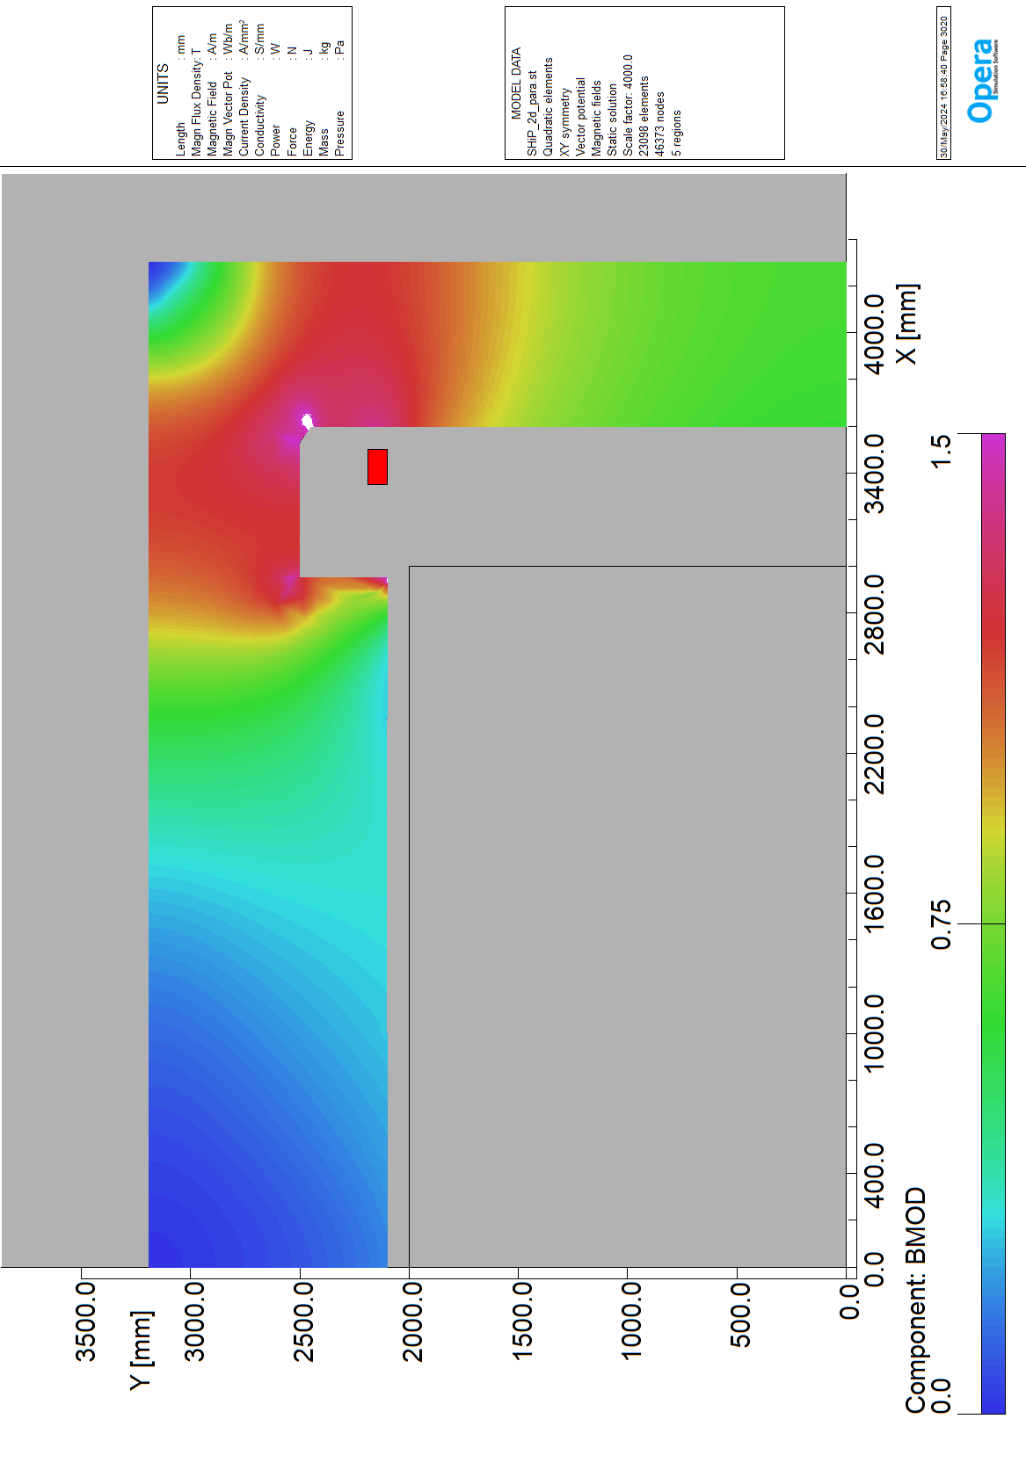
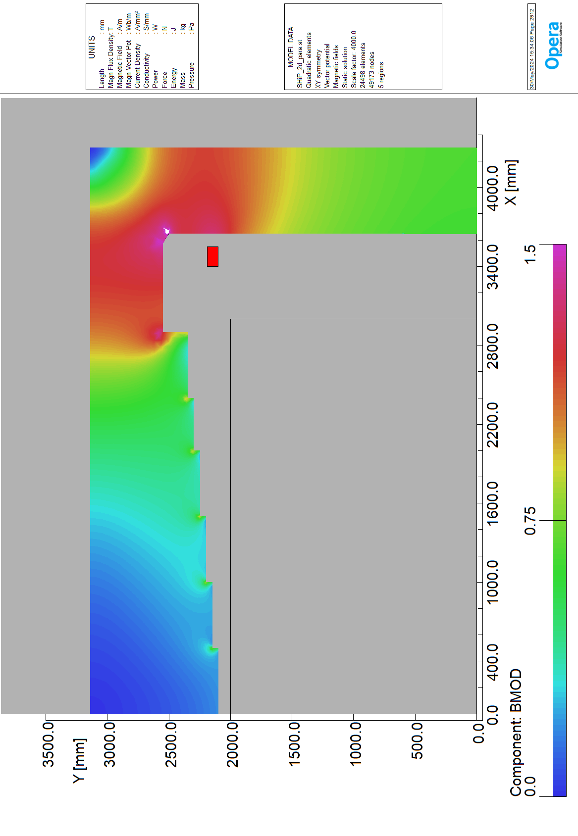
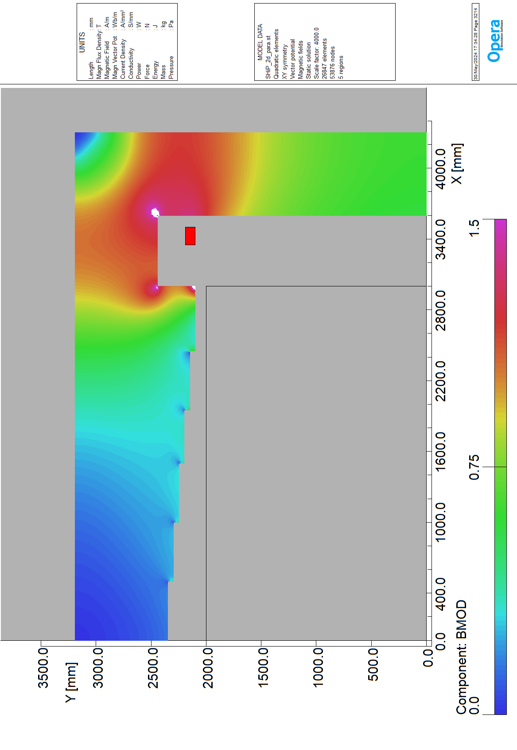
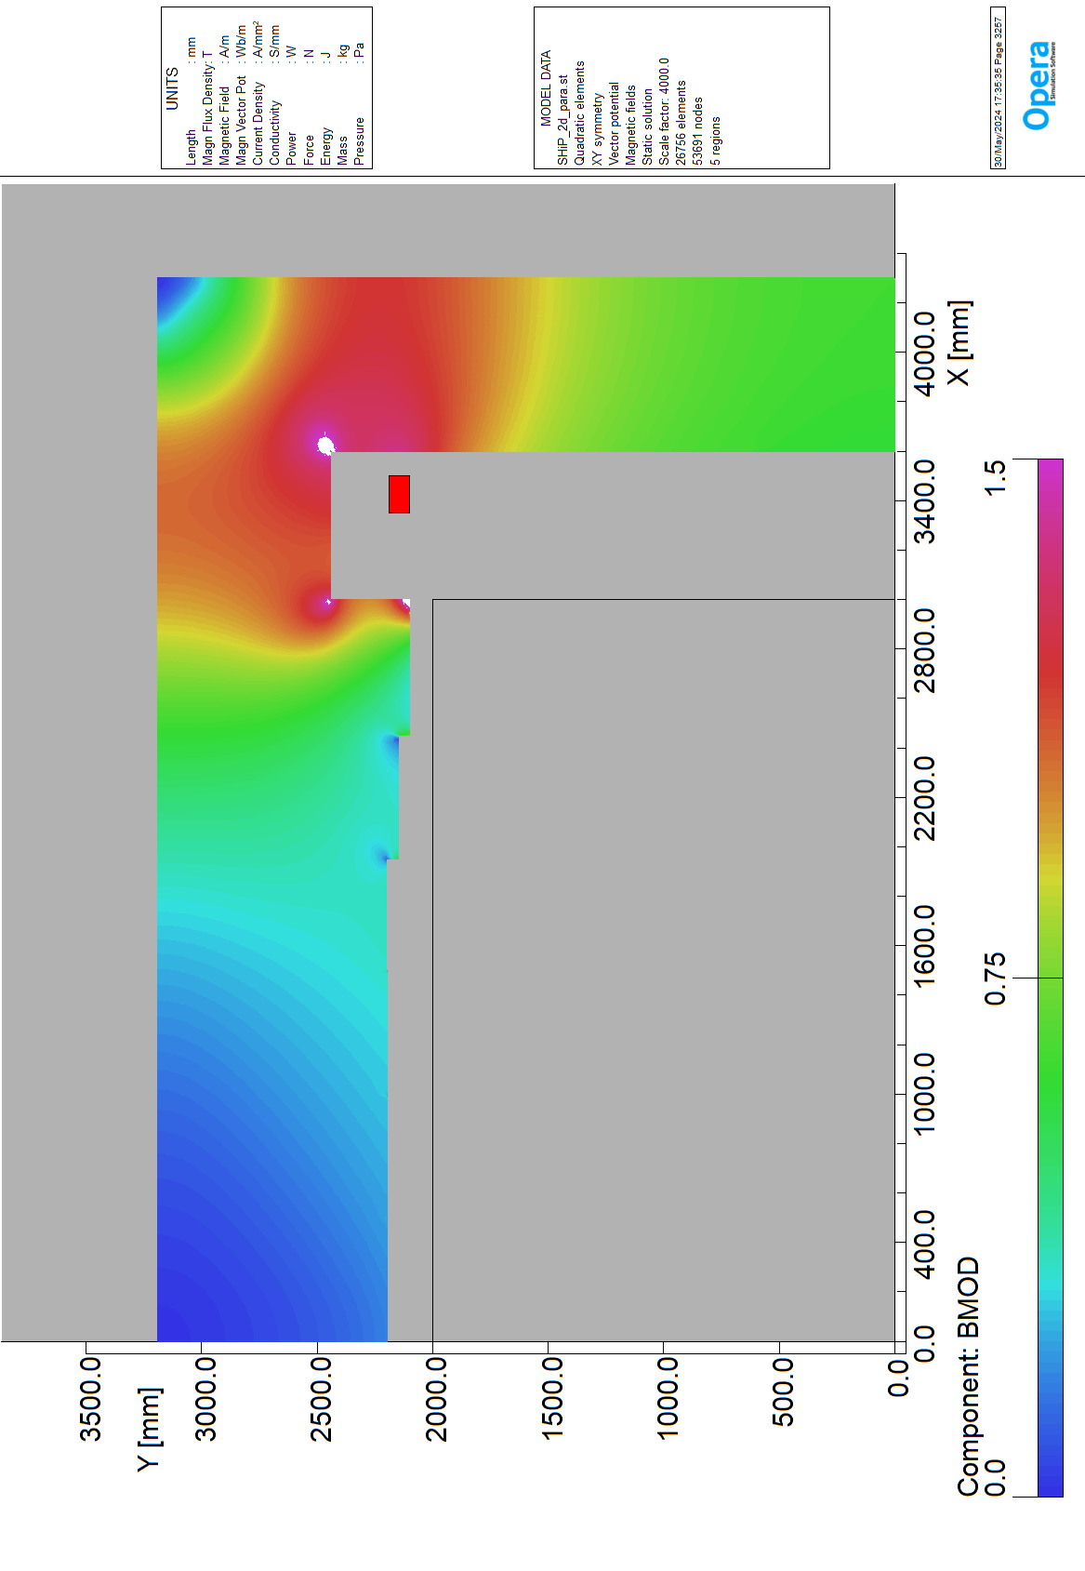
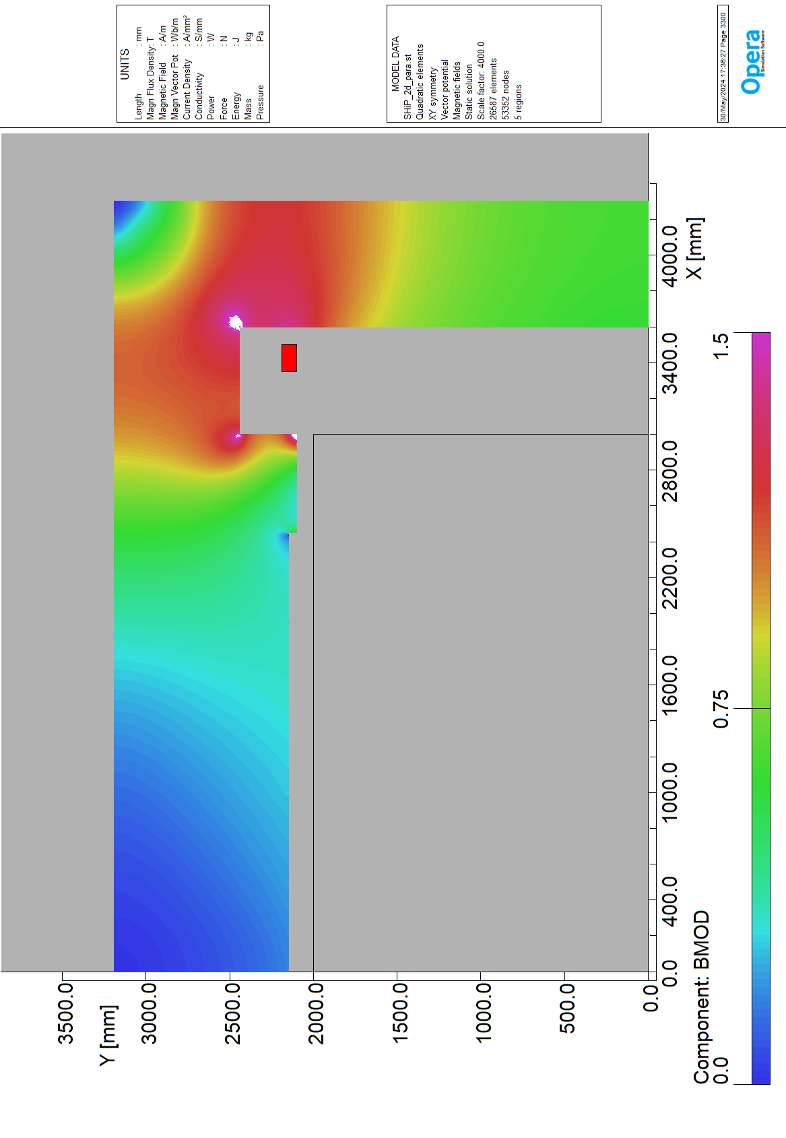
Config | 2 | 3 | 6 | 5 | 8 | 9 | 10
BY0 | -0.17 | -0.17 | -0.17 | -0.16 | -0.15 | -0.16 | -0.16
Bmodcoil | 1.00 | 1.21 | 1.10 | 1.04 | 1.12 | 1.12 | 1.12
Bmodiron | 1.54 | 1.82 | 1.65 | 1.56 | 2.26 | 2.26 | 2.25
BYavgY0000 | 0.98 | 0.88 | 0.85 | 0.83 | 0.87 | 0.86 | 0.86
Harm_B3 | -4.00E-05 | 3.27E-03 | 4.42E-03 | 7.43E-03 | 1.87E-03 | 3.73E-03 | 4.17E-03
Harm_B5 | 4.39E-05 | 1.27E-03 | 1.69E-03 | 7.95E-04 | 2.09E-03 | 1.49E-03 | 1.57E-03
Harm_B7 | 6.12E-05 | 1.78E-04 | 1.97E-04 | 2.71E-04 | 1.19E-04 | 2.37E-04 | 2.00E-04
BY Field
B Mod Iron

Slide 7
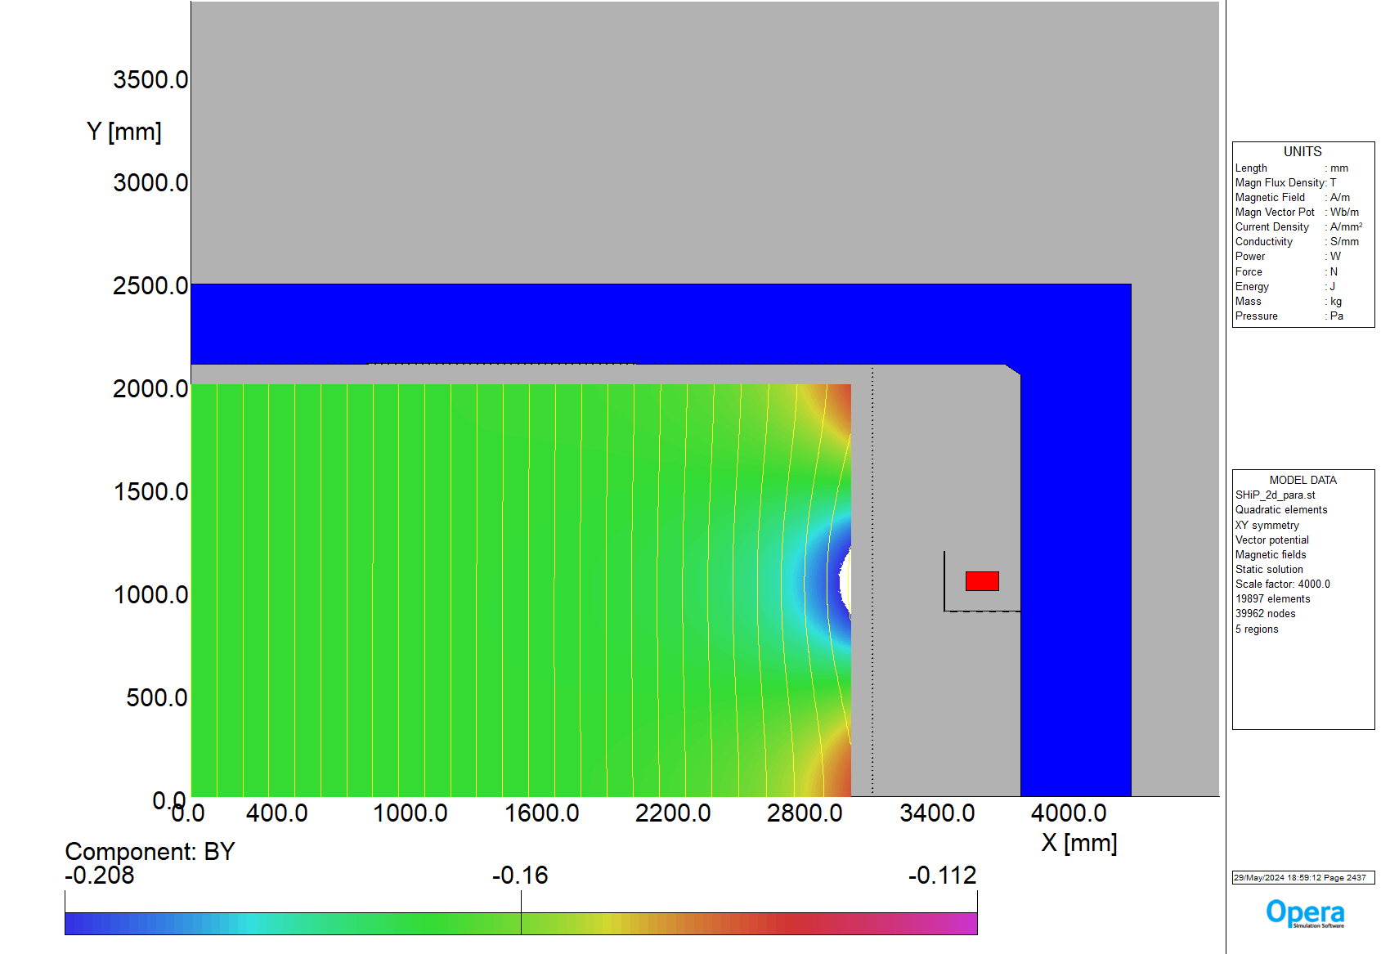

Best candidate from 2D analysis: flaired ends coils
Bcoil= 0.99 T

