Slide 2
Counter-flow Heat Exchangers as Option for Dry Current Leads
Torsten Koettig, Patricia Borges de Sousa, Rik Zegers

Slide 3
Content
HFM WP 4.6: cryogenic study of novel cooling schemes
Requirement for dry current lead cooling => 4 kA (3 kA) to fully explore the topic
CL cooling of the resistive part to 60 K (50 K)
  Passive flexible link with Sapphire insulator
  Active He circulation loop at ≤10 bar, tube HEXs
  Active He circulation loop with novel mesh-based HEXs at ≤10 bar
Cu mesh material characterization
Novel idea of rolled Cu mesh as a CFHEX, warm vs. cold circulator with He?

Slide 4
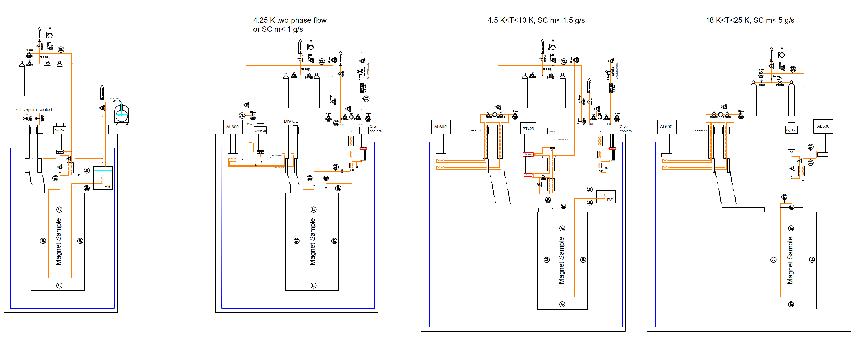
PID of the possible HFM setups

Slide 5
HFM WP 4.6 Cryolab test stands
  Setups to perform tests of cooling schemes, two-phase vs. super critical flow, higher temperatures
  A tube cooling system will be used to evaluate the heat transfer performance, pressure and temperatures etc.
  The hybrid current leads would be needed to supply current to a mock-up "magnet" of up to 3-4 kA (electrically insulated CIF at 60 K (50 K)),
  The current leads need to be cooled with a dry cooling system (absence of evaporated 4.5 K He stream).

Slide 6
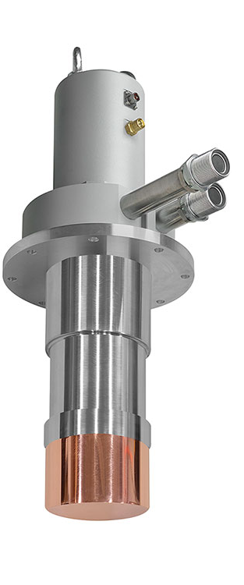
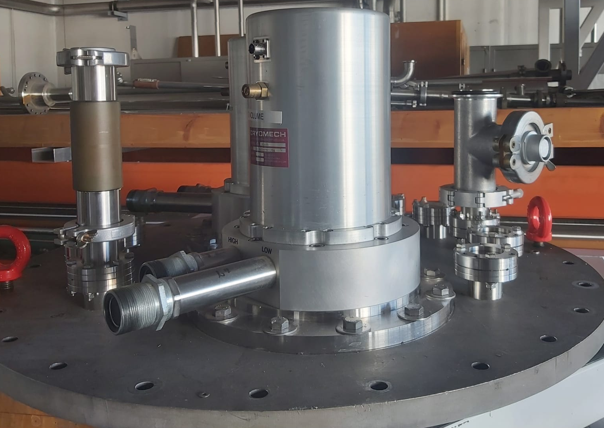
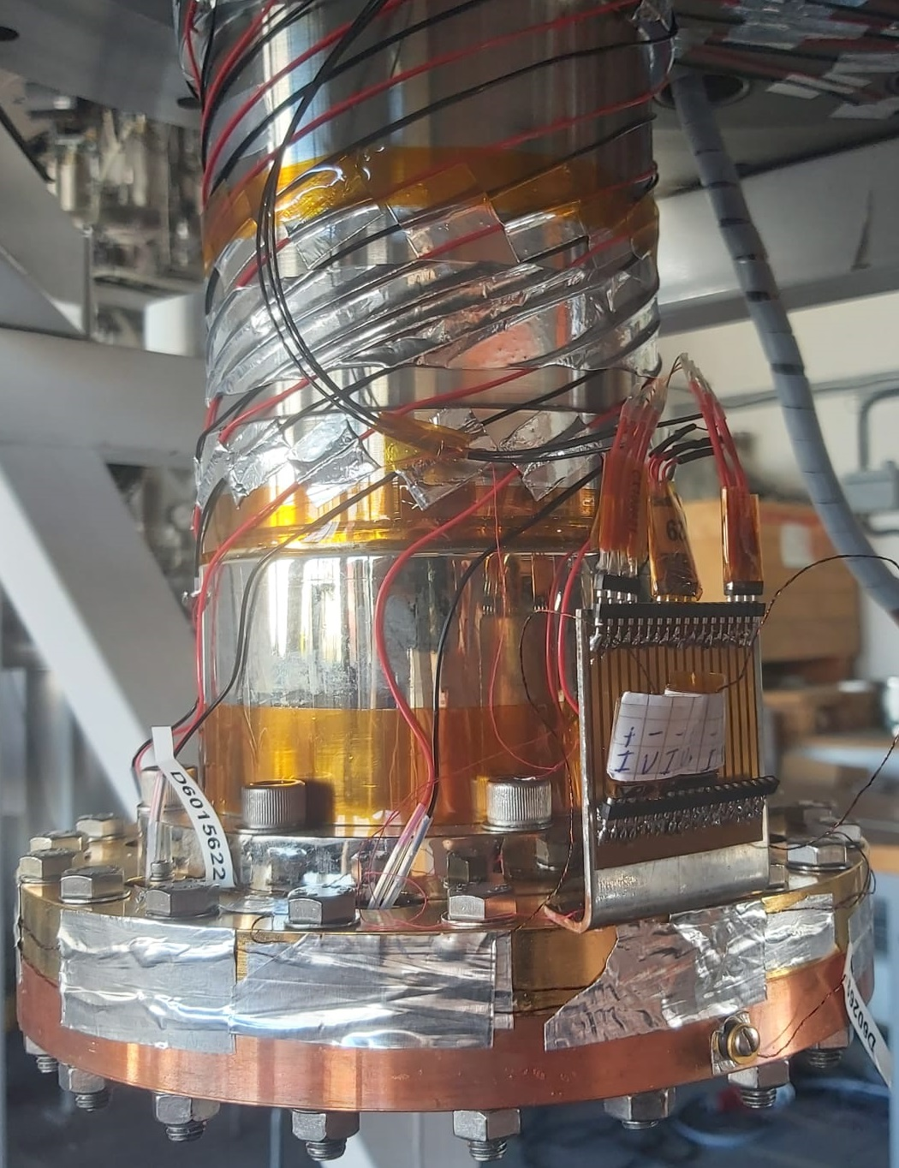
Possible cooling source GM cryocooler
  The performance of two AL600 cryocoolers was tested.
  Resistive heaters are placed on the cold tip of the cold-head.
  Silicon diodes from Lakeshore are used for the temperature measurement.
  The power at the heaters is varied and the temperature measured.
  Measured values are deposited heat load vs. temperature
Picture source: Cryomech Inc.

Slide 7
AL 600 performance measurements results
Performance of cryocooler 1
Performance of cryocooler 2
480 W
415 W
If we consider thermal conduction path + interfaces and insulators we need to operate well below 50 K at the cryocooler level!

Slide 8
Resistive Current Lead Design
A Python model is made to calculate the ideal dimensions and heat flow to the cold end of the resistive part of the current lead.
Model Inputs
  Thermal conductivity of the material fct.(T)
  Electrical resistivity of the material fct.(T)
  Length of the lead
  Temperatures at both ends
Model Outputs
  Ideal length to cross sectional area => ratio
  Heat load at the cold end of the lead => to be extracted at the heat intercept
Optimization is balancing self-heating vs. conduction heat flow

Slide 9
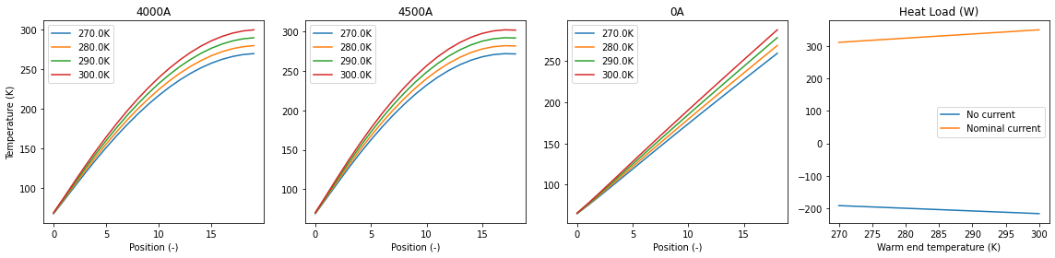
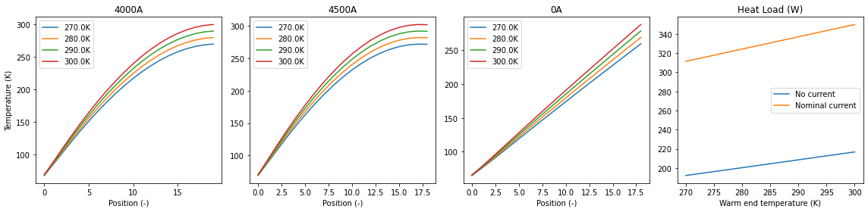
Simulation results e.g. Cu - RRR 10, I=4 kA, T_{cold}= 60 K
Temperature at of the current lead when no current is flowing.
Temperature distribution at the current lead at a current of 4 kA
Heat load at the cold end of the lead for warm end temperature

Slide 10
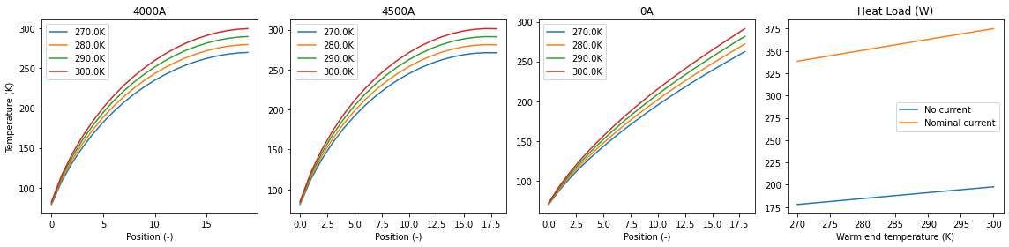
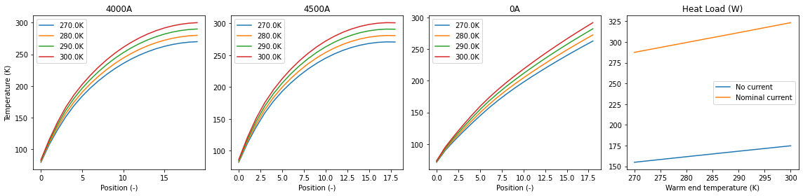
Resistive CL part, I=4 kA, T_{cold}=60 K
Copper RRR10
345 W per CL pair
Heat load in W
Bronze CuSn₆
375 W per CL pair
Heat load in W
Brass Cu₆₀Zn₄₀
324 W per CL pair
Heat load in W
Notes:
Cu = 344 W D = 3
Brass = 323 W D = 6
Bronze = 375 W D = 7

Slide 11
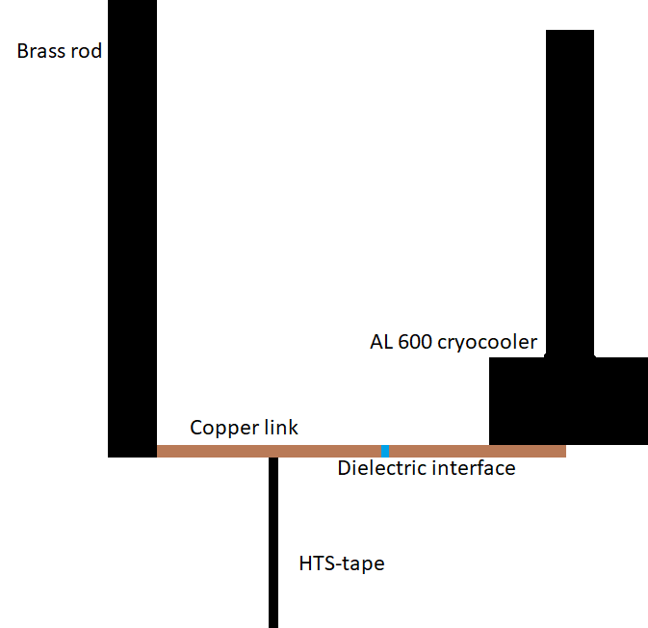
Conduction cooling of the current leads (A)
Brass CL
Room temperature flange 293 K
Version (A) conduction cooling,
A Sapphire disk will be used to electrically insulate the thermal interface,
Indium depositions will form a wetted interface when pressed => “full” microscopic contact area,
Cryocooler needs to be in very close vicinity of the CLs, vibrations and integration issue?
Minimum required cold head temperature is 47.5 K (365 W available by the AL 600). => 324 W required for CL => OK
60 K
(50 K?)
4.5 - 20 K
Notes:
A = 20 cm^2
R sap = 4 cm^2 K / W
R cu in = 2.88 cm^2 K / W
Copper link in disregarded
HTS tape is minimal 60 K
Q = 2 X 161.5 W
the cooling power at 47.5 K is 366 ± 10 W for cryocooler 1 and 372 ± 10 W for cryocooler 2.

Slide 12
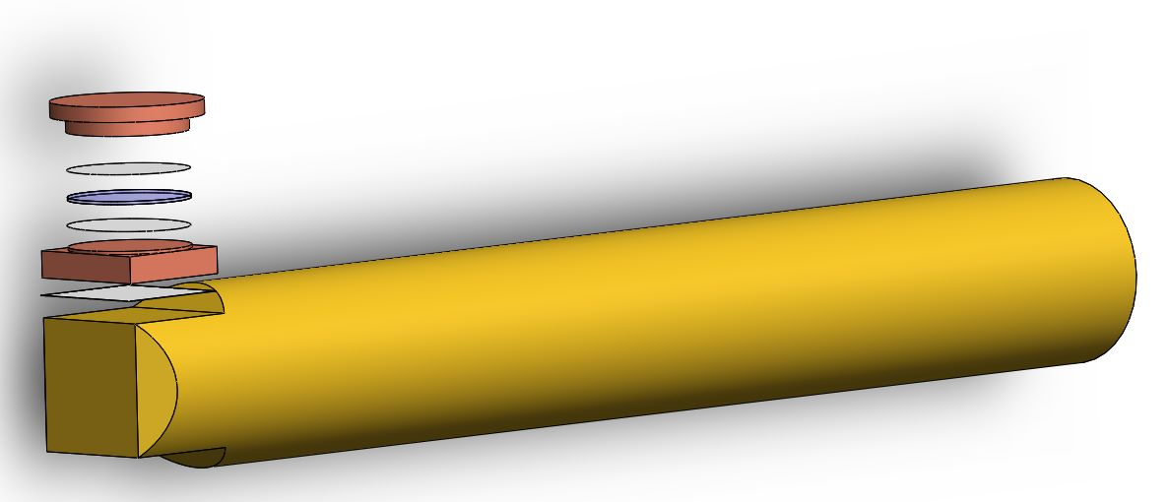
Conduction cooling of the current leads (A)
Version (A) conduction cooling,
A Sapphire disk will be used to electrically insulate the thermal interface,
Indium depositions will form a wetted interface when pressed => “full” microscopic contact area,
Minimum required cold head temperature is 47.5 K (365 W available by the AL 600).
Resistive CL
Sapphire
Indium …
Cryocooler
CIF
HTS lead
HTS
Notes:
A = 20 cm^2
R sap = 4 cm^2 K / W
R cu in = 2.88 cm^2 K / W
Copper link in disregarded
HTS tape is minimal 60 K
Q = 2 X 161.5 W
the cooling power at 47.5 K is 366 ± 10 W for cryocooler 1 and 372 ± 10 W for cryocooler 2.

Slide 13
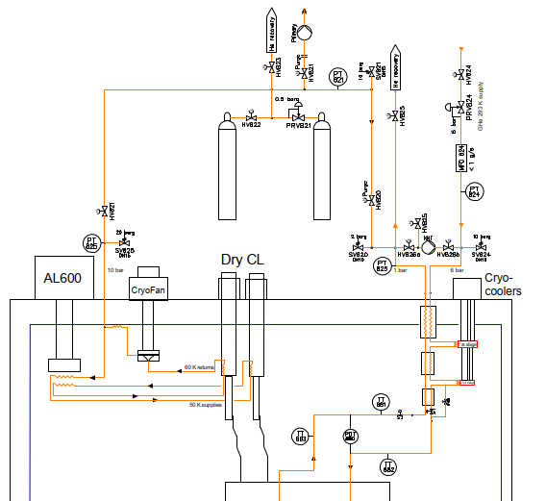
Fluid circulation loop cooling of the current leads (B)
Version (B) fluid circulation loop,
Circulating He gas with two local HEXs,
Thermal design of the cooling loop and its components => proposal and options.
  B1) high helium pressure loop with cold circulator,
  B2) CFHEX CL option => He circulation with e.g. AL600.

Slide 14
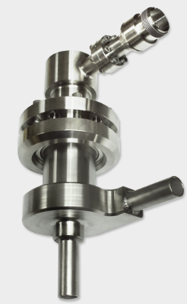
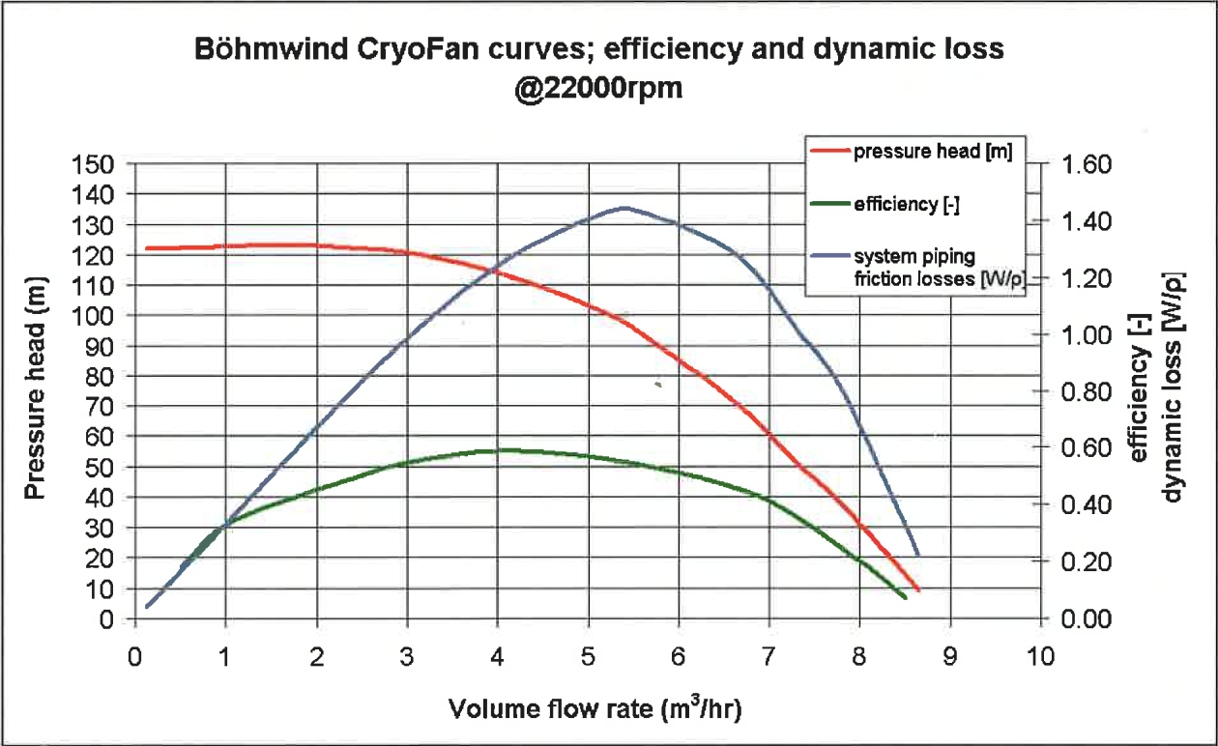
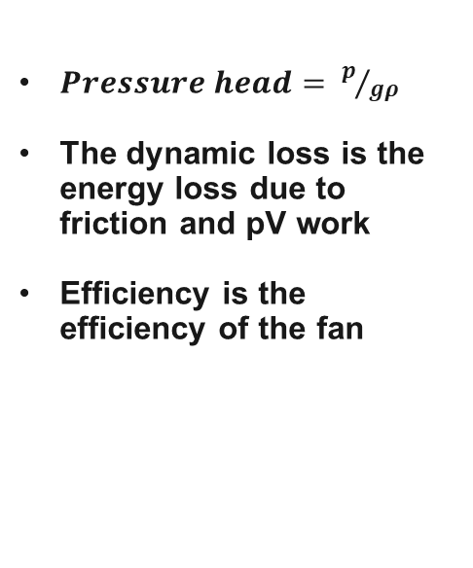
Fluid circulation loop cooling of the current leads (B1)
$Pressure head= p/{gρ}$
The dynamic loss is the energy loss due to friction and pV work
Efficiency is the efficiency of the fan

Slide 15
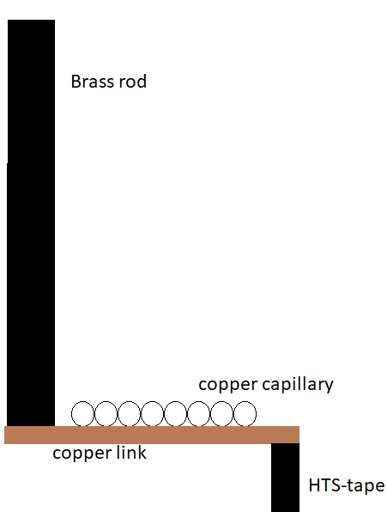
Fluid circulation loop cooling of the current leads (B1)
A Python code calculates the temperature and pressure drop of the flow over the length of the capillary
The capillary is divided into nodes
A solver of scripty.optimize seeks the inflow temperature to extract 162 W from one copper link
The capillary wall is set to a constant temperature of 60 K
Electrical insulators in the capillary connections
Notes:
a constant temperature of 60 K for the copper capillary and copper link. Capillary is welded using an Ag solder. Helium properties are from NIST. The link is 10 cm long no matter the capillary size.

Slide 16
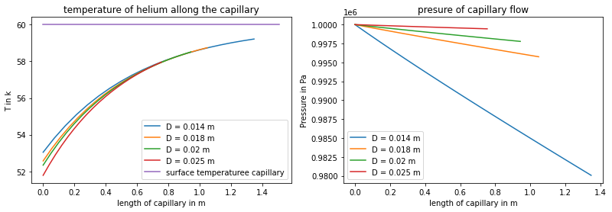
Fluid circulation loop cooling of the current leads (B1)
Mass flow = 5 g/s
Inflow pressure is set to 10 bar
Heat flow to the capillary is set to 162 W per single current lead
Consider the additional heat load from the CryoFan ~ 30 W
162 W x2 +30 W = 354 W 420 W @ 52 K available => OK
Helium temperature along the capillary
Pressure drop of the capillary flow
0
25
50
75
100
125
150
175
200
T in K
Pressure drop in mbar
Surface temperature capillary
Length of capillary in m
Length of capillary in m
Minimum required inflow temperature at the CL CIF is 52 K to exit with max. 60 K.
Maximum pressure head of the CryoFan is 120 m or a pressure difference of 92.4 mbar
Notes:
52.4 K for D = 0.018 m ; 414 ± 10 W and 413 ± 10 W for cryocooler 1 and 2, respectively ; phead = 54 m
42.6 K for D = 0.02 m ; phead = 28 m

Slide 17

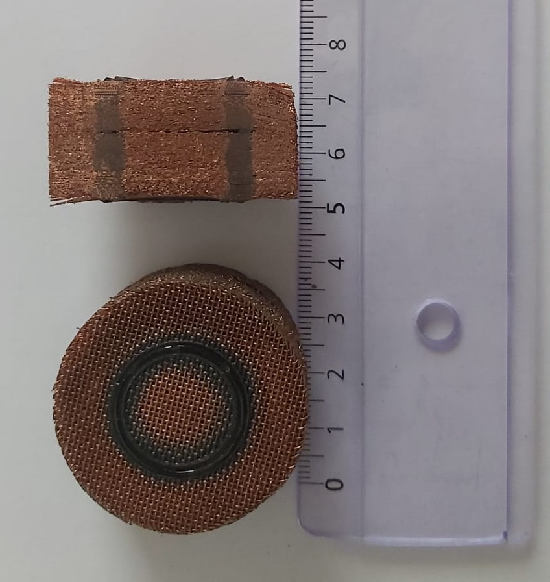
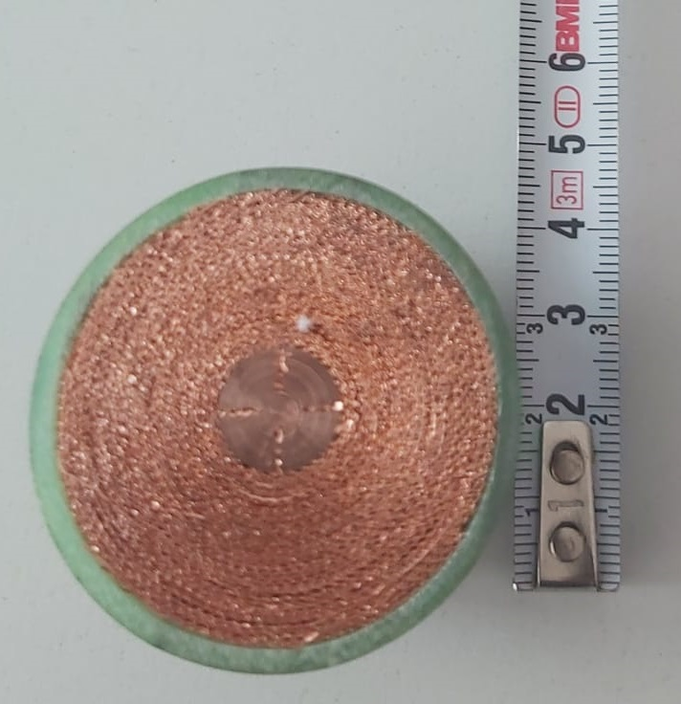
Fluid circulation loop cooling of the current leads (B1* and B2)
Brass rod, which is filled with tightly stacked or rolled mesh at the cold end,
Helium flow through the mesh,
Numerical simulation of the effectiveness and pressure drop of the HEX
He

Slide 18
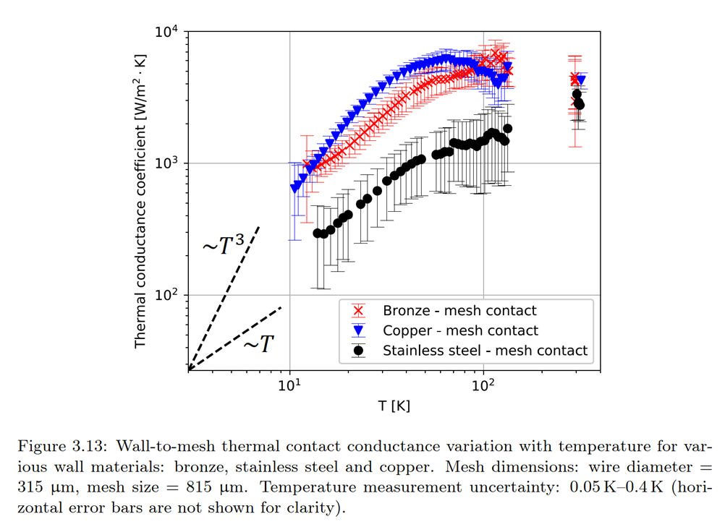
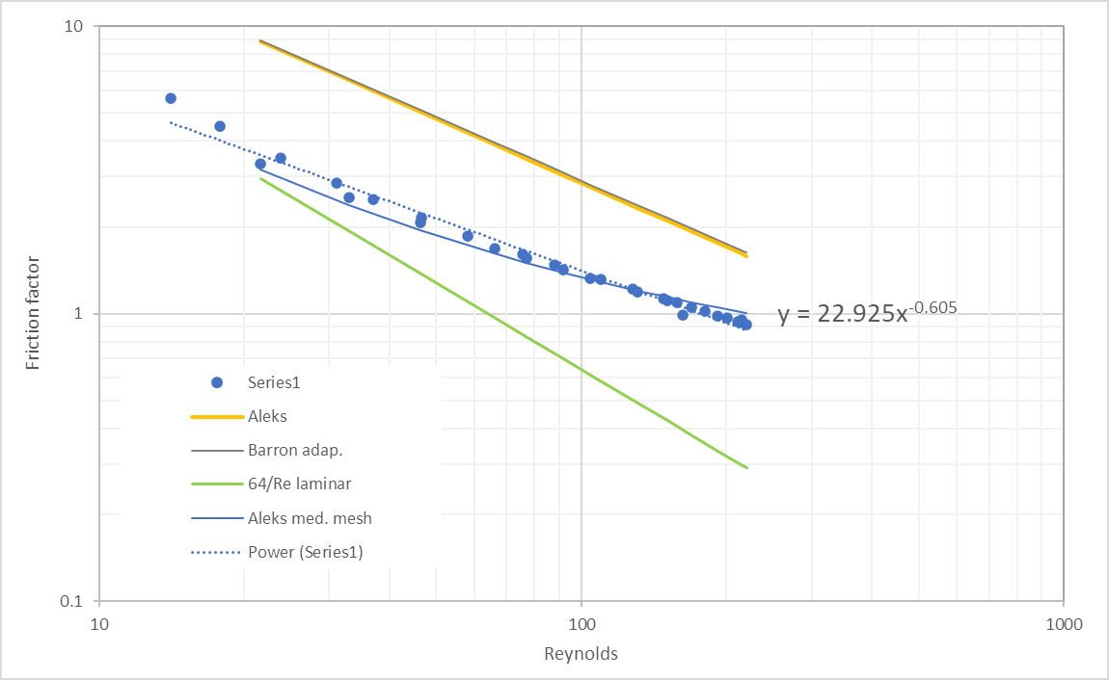
Fluid circulation loop cooling of the current leads (B1*)
Stacked mesh HEX pressure drop evaluation
Heat transfer of stacked mesh to outer wall
Friction factor of stacked mesh
Source: A. Onufrena, Design of Compact High-Effectiveness Cryogenic Counter-flow Heat Exchangers for Remote Cooling and Space Reverse Turbo-Brayton Applications, PhD thesis, 2023.
Notes:
Inflow temperature is 58 K
Delta P = 16 mbar and 11 mbar for 5 and 4 g/s
5 g/s = 2.3 m3/h

Slide 19
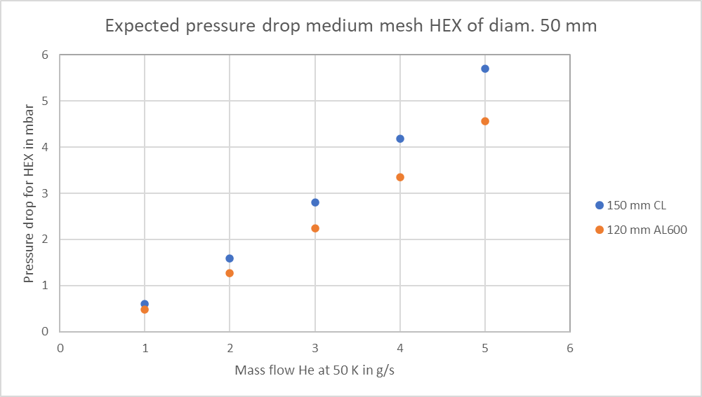
Fluid circulation loop cooling of the current leads (B1*)
Stacked mesh HEX pressure drop evaluation
Inputs:
T = 50 K, medium Cu mesh (d_{w}=180, MD=315 microns)
Friction factor of stacked mesh
Promising results for a cold circulator version (CryoFan Bise®, 10 bar He, 50 K with 4 HEX of medium mesh).
=> Baseline design Aug. 2023
Notes:
Inflow temperature is 58 K
Delta P = 16 mbar and 11 mbar for 5 and 4 g/s
5 g/s = 2.3 m3/h

Slide 20
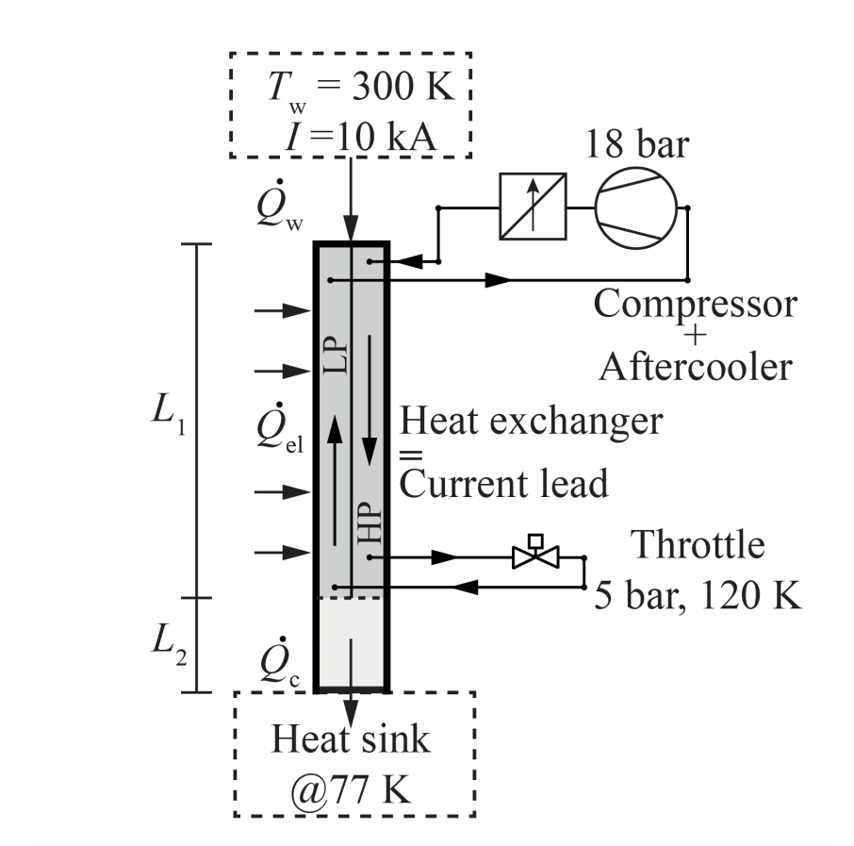

Counterflow CL (B2)
Basic idea is to have a warm pump/circulator and possible use of JT cooling effect (Neon)
Building up a CFHEX with stacked mesh will be difficult 2500 mesh layers additive assembled inner transparent wall
Axially rolled mesh 4x90 deg. technology demonstrator has been built
$\dot{Q}$_{c} is reduced to 60 % compared to a cold CIF alone
Source: Shabagin-Development of 10 kA Current Leads Cooled by a Cryogenic Mixed-Refrigerant Cycle, ICEC 2018, IOP Conf. Series: Materials Science and Engineering 502 (2019) 012138.
Notes:
Inflow temperature is 58 K
Delta P = 16 mbar and 11 mbar for 5 and 4 g/s
5 g/s = 2.3 m3/h

Slide 21
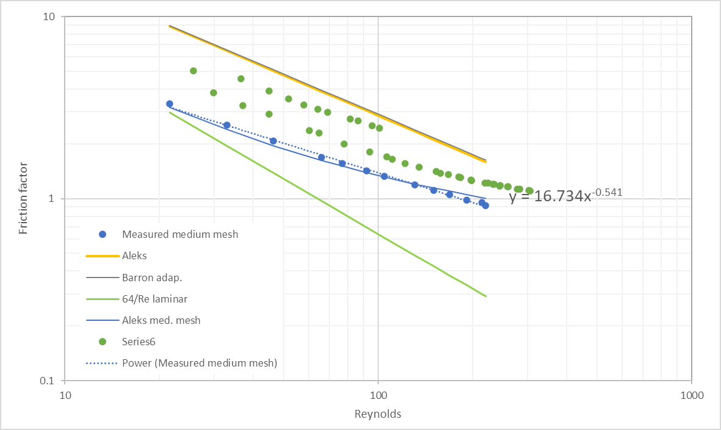
Fluid circulation loop cooling of the current leads (B2)
Axially rolled mesh HEX pressure drop evaluation
Friction factor of stacked and axially rolled mesh
PID of the CFHEX CL with AL600 for Helium circulation 50 K or 60 K
CFHEX option should require only 60 % cooling power at the CIF at T?
Warm vs. cold circulator (mass flow vs. dp)
Notes:
Inflow temperature is 58 K
Delta P = 16 mbar and 11 mbar for 5 and 4 g/s
5 g/s = 2.3 m3/h

Slide 22
Can the mesh contribute to carry el. current?

Slide 23
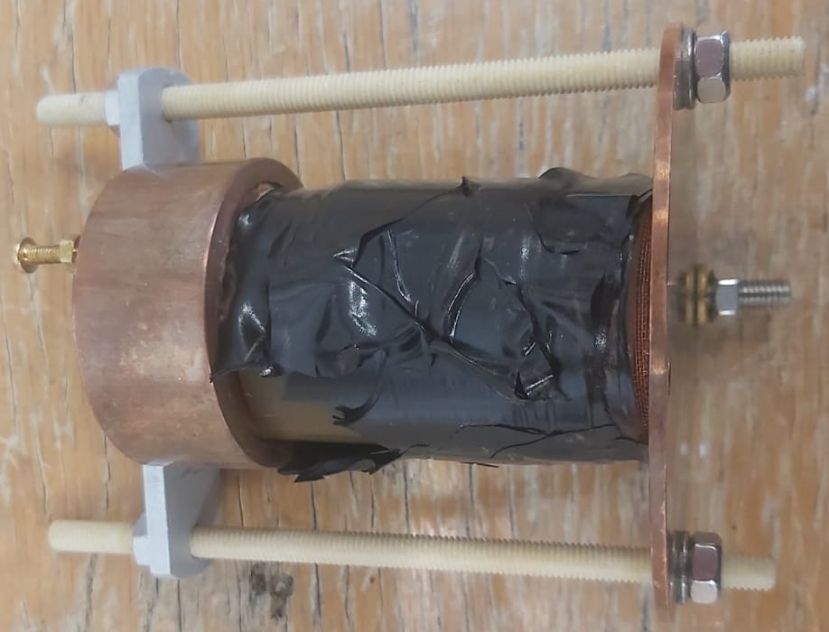
Electrical resistivity of woven copper mesh
  Copper mesh is pressed between 2 copper plates,
  Indium is used for a good electrical contact at the extremities,
  The sample is tested at room temperature and cooled down with liquid nitrogen,
  VI curve is plotted, resistance ratio is checked.

Slide 24
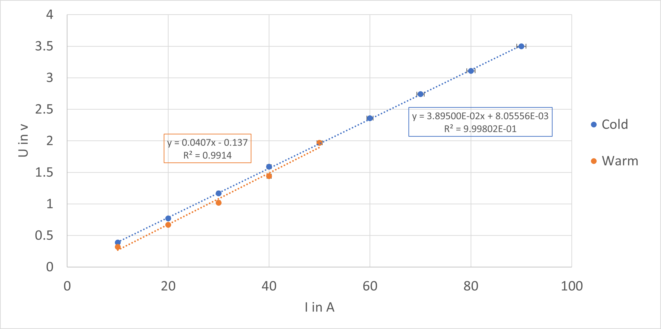
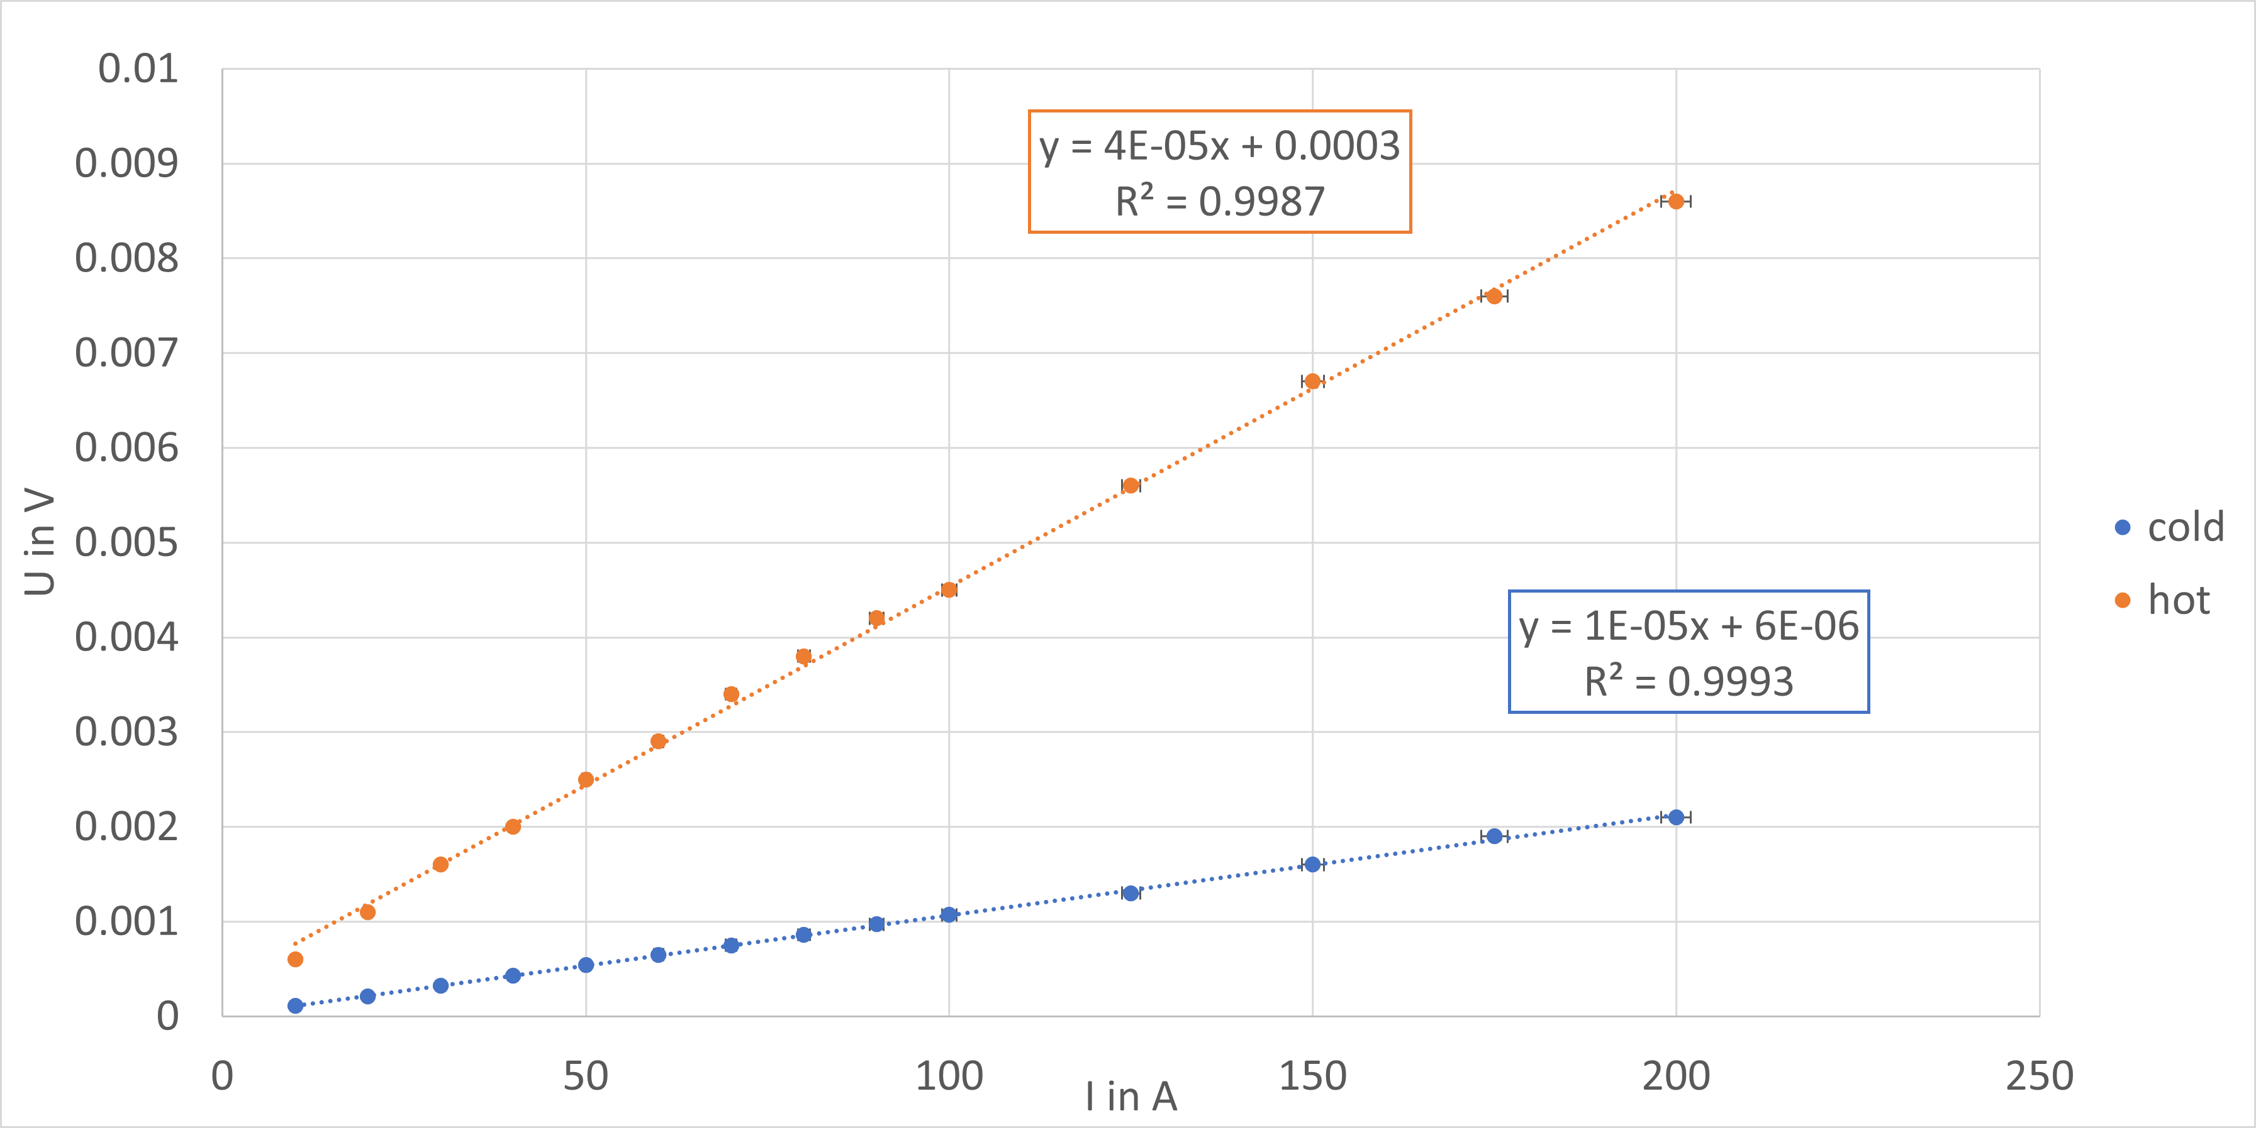
Resistivity of woven copper mesh
Stacked mesh
Axially rolled mesh
No significant change in resistance
interfaces of the mesh layers dominate the overall resistance
Resistance ratio is 4.2 => 295 K and 78 K
RRR ~10

Slide 25
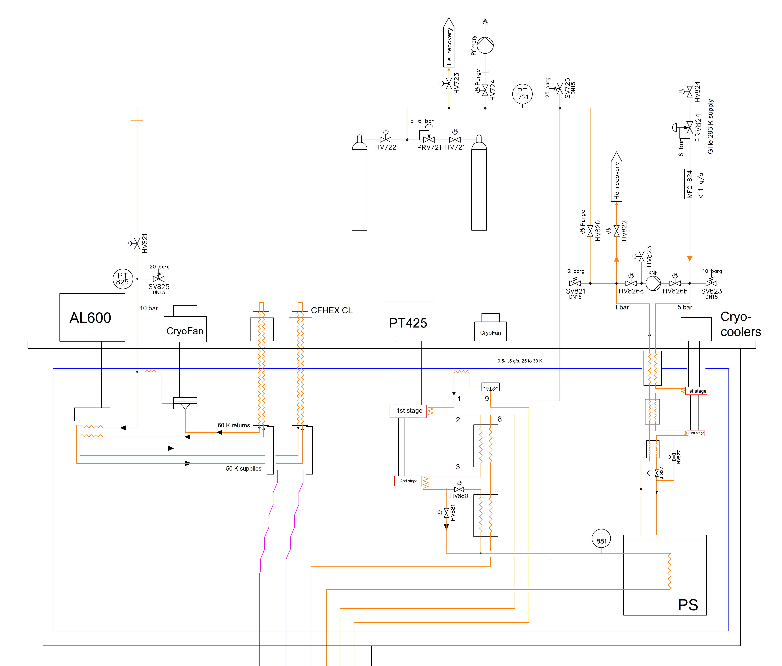
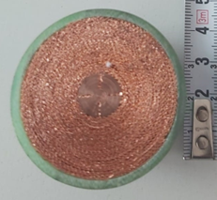
Conclusion
Conduction cooling is a feasible option
Helium circulation is an overall better performing option
The mesh heat exchanger shows potential
CFHEX option is under study for feasibility, numerical code is being developed
- External Brass wall carrying most of the el. current
- Cu mesh CFHEX, rolled configuration with center rod
- Transparent wall design (Stycast epoxy layer)
L~0.6 m, A_{Brass} ~4 cm²,
Optimization study has started

Slide 27
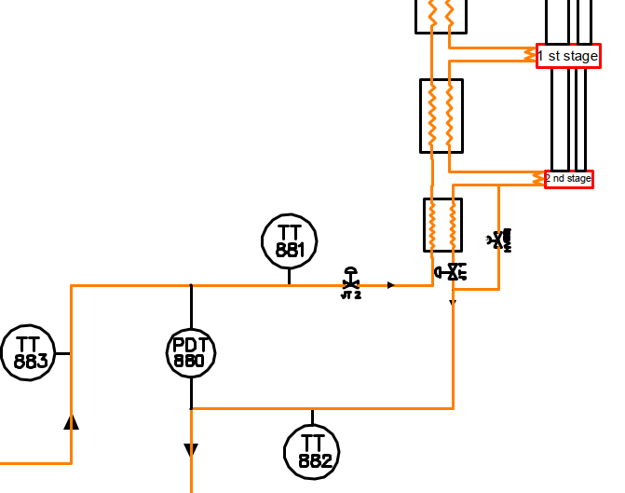
Two parallel cooling circuits in the magnet?
Bypass in our experimental system for cooldown
or
two cooling circuits in a magnet one for cooldown one for operation
PID shows supply bypass
Bypass
for cooldown
Magnet cooling for operation

Slide 28
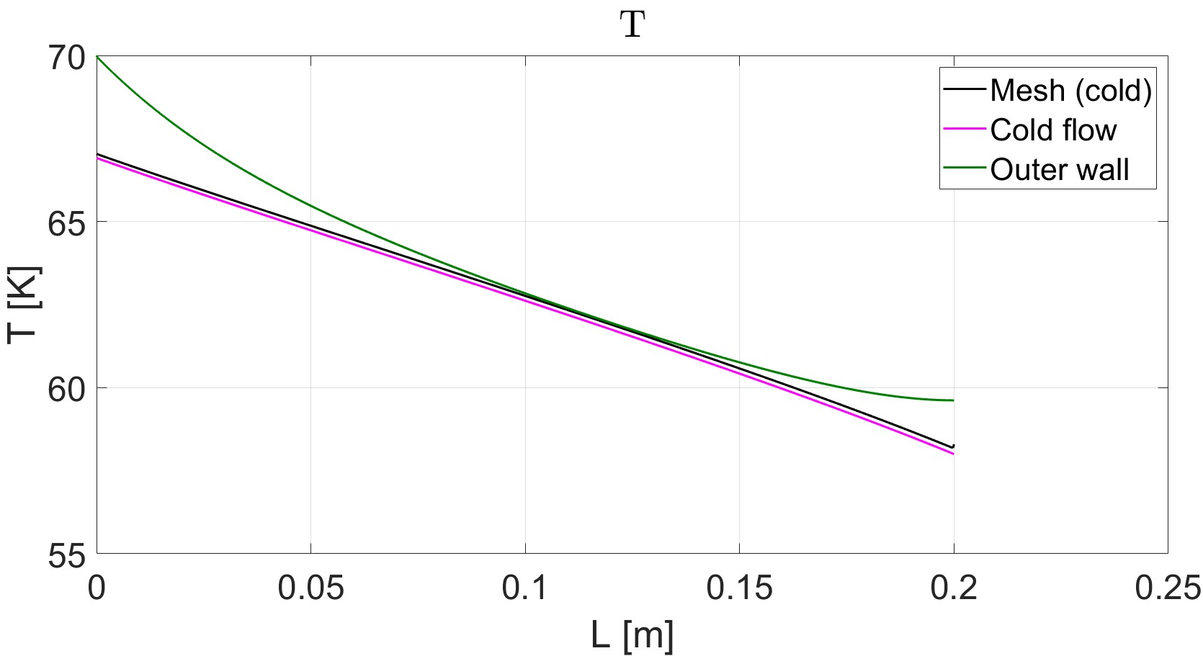
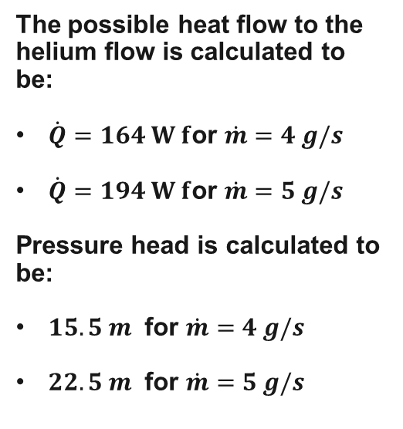
Fluid circulation loop cooling of the current leads (B2)
The possible heat flow to the helium flow is calculated to be:
$\dot{Q}=164 W f$or $\dot{m}=4 g/s$
$\dot{Q}=194 W f$or $\dot{m}=5 g/s$
Pressure head is calculated to be:
$15.5 m$ for $\dot{m}=4 g/s$
$22.5 m$ for $\dot{m}=5 g/s$
Notes:
Inflow temperature is 58 K
Delta P = 16 mbar and 11 mbar for 5 and 4 g/s
5 g/s = 2.3 m3/h

