Slide 1
SHiP magnet team meeting:
A few thoughts and numbers on how to support the coils given the expected Lorentz forces
D. Ramos, 17/5/2024

Slide 2
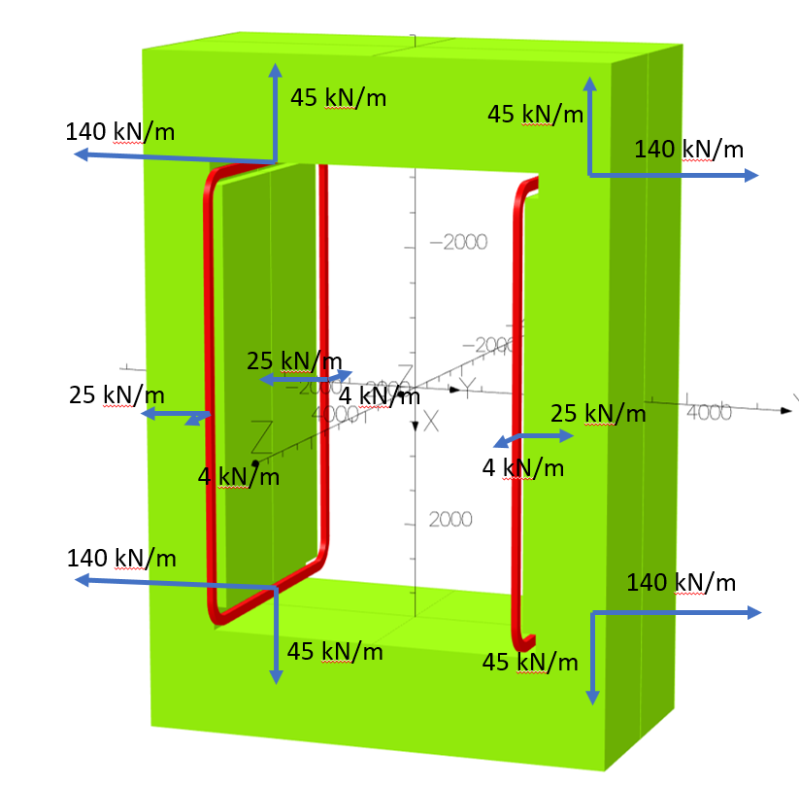
Lorentz forces perpendicular to the coil plane
The largest component of the Lorentz force is perpendicular to the coil plane
  140 kN/m on the 3.5 m long horizontal sections <=> 490 kN .
  25 kN/m on the 6.2 m long vertical sections <=> 155 kN
  1300 kN total force.
Can be supported on the iron yoke, through the vacuum vessel.
Columns distributed along the coil perimeter are an option. They can be arranged to constrain displacements perpendicular to the coil plane but allow in-plane relative movement for thermal contraction.

Slide 3
Column supports
Assuming pure compression, the minimum material cross section is determined by
  Total force/Allowable compression stress for the material.
  Instability limits and shear forces may lower the load capacity of the support. This will depend on geometry and how other forces are constrained.
To minimise heat load we can play with
  Height of the columns, with influence on the overall size of the cryostat.
  Choice of material for best ratio of allowable stress to thermal conductivity.

Slide 4
Common materials for cold supports
 | ∫kdT 20-80 K [W/m] | ∫kdT 80-300 K [W/m] | Strength [MPa] | Strength/ ∫kdT 20-80 K [MPa/W/m]
Stainless steel 316 | 331 | 2680 | Compression or tensile, yield: 205 | <1
Titanium | 205 | 1370 | Compression or tensile, yield: 830 | 4
Glass fibre reinforced epoxy | 19 | 146 | G10 tensile, ultimate: 310 G10 compression, ultimate: 450 Moulded parts tensile, ultimate : ~300 | 16 23
Stainless steel
  Ductile. Isotropic. Weldable. Lowest cost. Readily available.
Titanium
  Better performance than stainless steel but requires more engineering benefit from the higher strentgth. Higher cost. Less ductile.
  Often used in tie-rods under very high load (ex. Atlas and CMS).
GFRE
  Best performance, even if it requires higher safety margin on strength than a ductile metal like stainless steel
  G10 available in rods, tubes and plates. Bonded joints may be weak points impacting strength and reliability over time.
  Monolithic moulded parts are best but expensive. Long manufacturing time. Requires extensive QC.

Slide 5
Heat load through the columns
(order of magnitude)
Example of 85 mm columns with 2x10 mm flanges and a 5 mm heat intercept at 80 K, i.e. 60 mm insulation length
  20 mm for 300 to 80 K
  40 mm for 20 to 80 K
Assuming a design stress of 100 MPa*
Total material cross section needed = 1300 kN/100 MPa = 130 cm^2
Heat load, if made from G10 tubes
  20 K level: 6 W
  80 K level: 95 W
Heat load, if made from stainless steel
  20 K level: 110 W
  80 K level: 1700 W
*To be seen if 100 MPa is achievable at this column height. In LHC it’s below 50 MPa but there is a significant shear load in addition to compression.
20 K
85
80 K
300 K

Slide 6
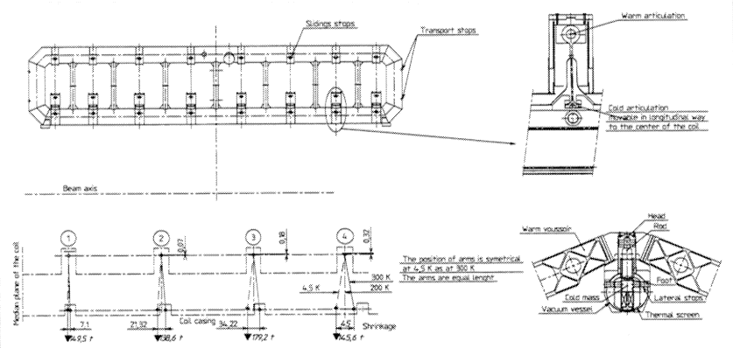
In-plane Lorentz forces
Bending of the coil structure cannot be prevented with supports connecting to the vacuum vessel because we would be restraining thermal contraction movement as well.
For example, in the CMS barrel toroid the long coil sections are connected with ribs to prevent in-plane bending. In our magnet, this would complicate the design of the cryostat and require removing material from the poles.
ATLAS Barrel Toroid: Ribs connect the two long sections together. Titanium suspension rods hold unbalanced Lorentz forces in the coil plane. Stoppers prevent lateral movement but allow sliding for thermal displacement.

Slide 7
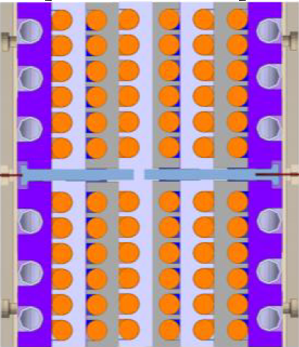
In-plane Lorentz forces
The pancake construction works favourably if designing a coil frame that is “rigid” for in-plane loads.
We may add material to the former plates and take benefit from an increase in stiffness proportional to H^3
H

Slide 8
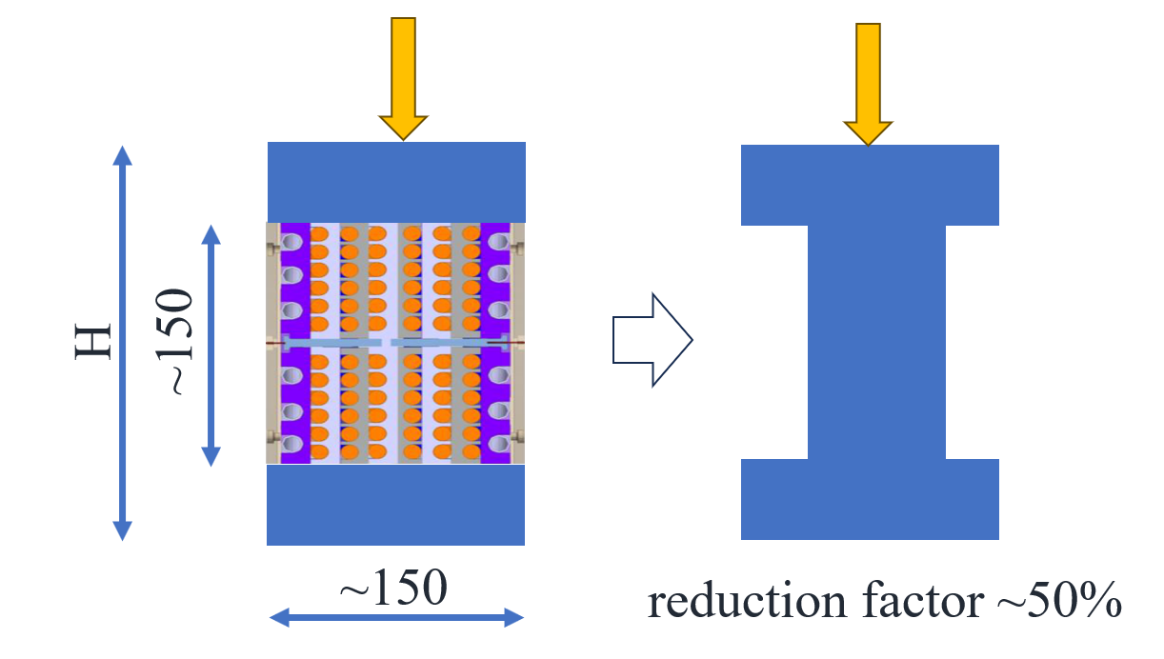
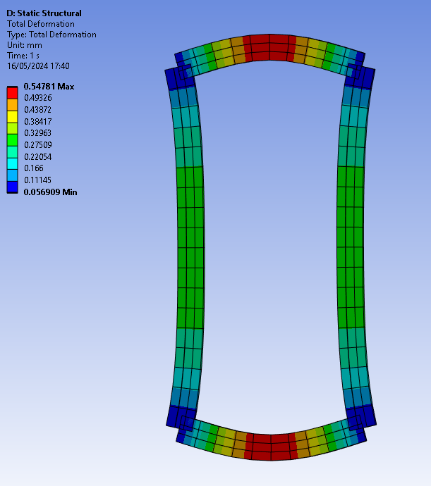
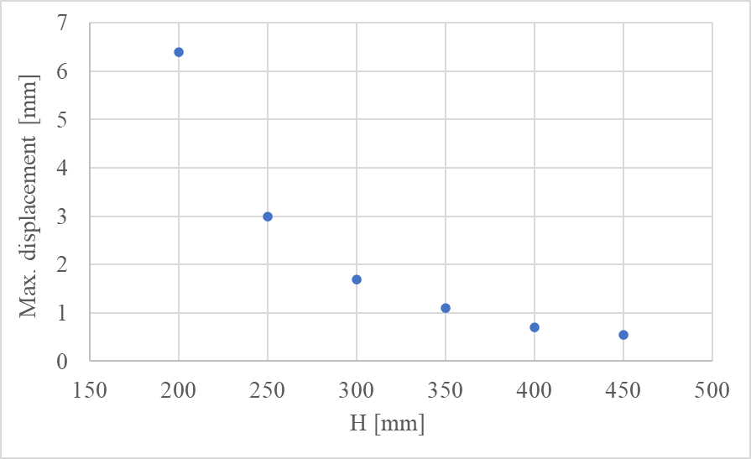
Example with coil structure modelled with beams
Stiffness of the cable is not considered. As a first order approximation we can consider the effective moment of area equal to that of a rectangle with same height as the coil but a reduced width.
Let's assume 50% for now.
How much displacement can we accept?
In-plane displacement creates friction and wear at the interface between the columns and the vacuum vessel, at each powering cycle.

Slide 9
Conclusion
The highest forces are perpendicular to the coil plane ~1300 kN
  Can be supported by the yoke, through the vacuum vessel
  Multiple columns needed to prevent bending, because the stack of former plates is rather flexible unless they are bonded together
  Heat load to 20 K in the ~10 W order of magnitude if columns in GFRE (10x more if in stainless steel)
Forces in the coil plane may be sustained in the coil structure itself
  Add material to the former plates to reach the acceptable displacement
  Friction and wear at the columns must be taken into account
Other loads
  Weight; transport&handling accelerations; unbalanced electromagnetic forces due to misalignment…
  Tie-rod suspensions or columns might possible solutions depending on force magnitude and direction

