Slide 1
An introduction to CERN Beams
Controls Software & Services
Chris Roderick
21-06-2024

Slide 2
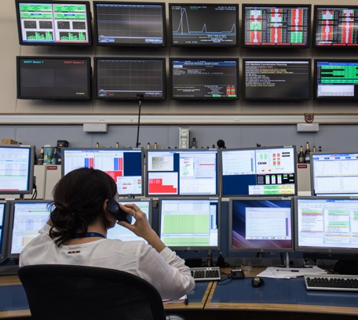
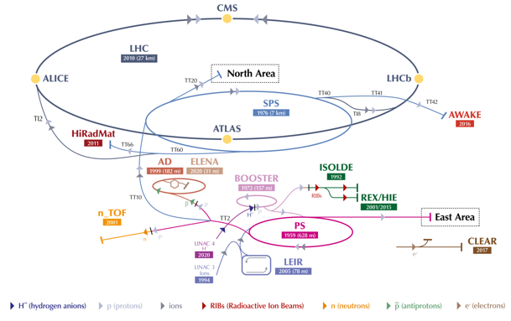
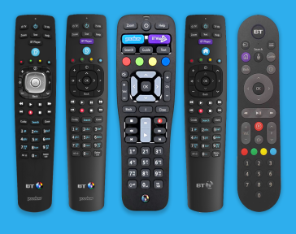
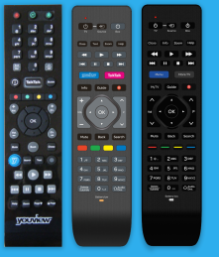
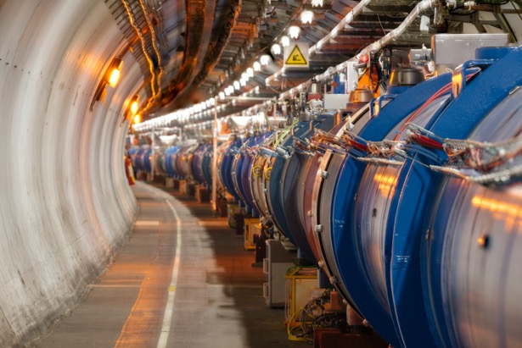




CERN Beams Controls Software & Services
“Provides Control & Monitoring solutions for all CERN particle accelerators, transfer lines, associated experimental areas & various supporting technical infrastructure services.”
Key aims:
As simple as possible
High usability, stability, availability
Common approach
12 in 1
∙LINAC3/4 ∙PS ∙PSB ∙SPS ∙LHC ∙LEIR ∙ISOLDE ∙AD/ELENA
12 in 1

Slide 3


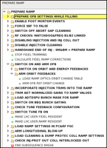
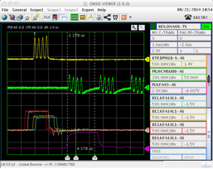
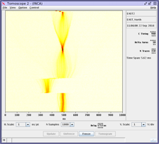
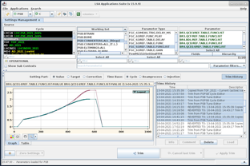
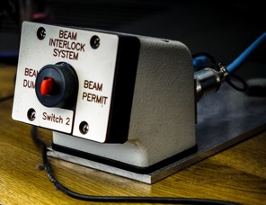
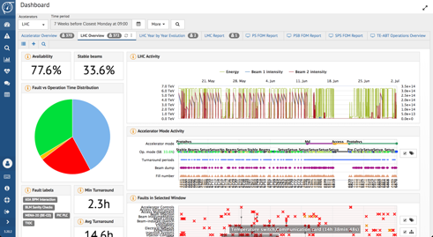

CERN Beams Controls Software & Services
The Control System's job is to provide physicists and operators with a means to remotely:
Configure & Set states & reference values (aka settings) in active elements
Generate initial values, automate sequences, feedback loops, etc.
Monitor elements (instruments & actuators)
Time-tagged acquisitions with post-processing for quick detection of abnormal situations
Long-term memory of Settings & Acquisitions
Years of data with performant data extraction & analysis tools
Ensure machine protection & operational availability
High-level fast-reaction interlocks & role-based access to prevent wrong actions
Health & Diagnostics monitoring for the multitude of sub-systems
Online failure detection, remote interventions (e.g. power cycle), failure prediction (Machine Learning) etc.
& much more…

Slide 4
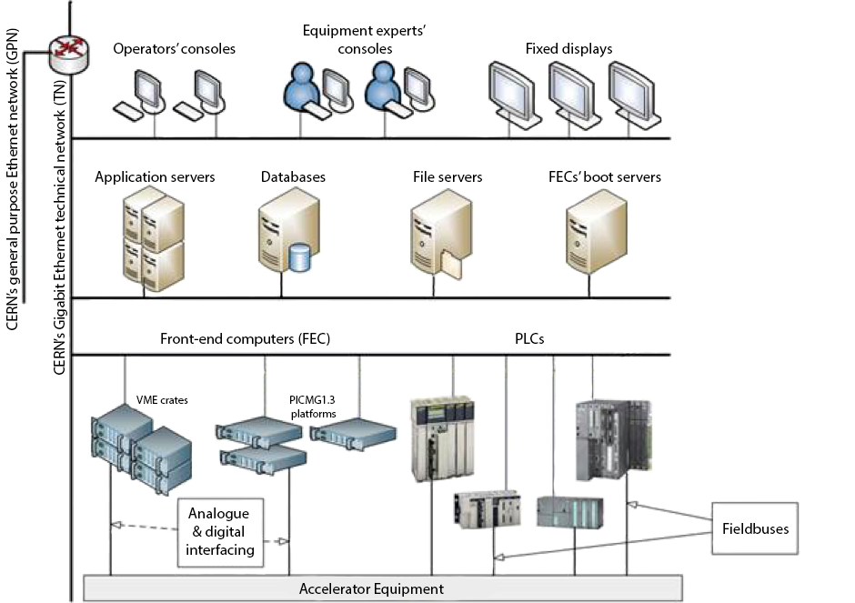


High-Level Software Architecture
Front-end Tier
Real-time control and acquisition
Limited, local scope
Fast reaction possible (interrupts)
Limited computing power (compared to other tiers)
Equipment processing to provide a high-level view of hardware
Real-time (RT) applications rely on frameworks, which capture recurring aspects (react to events, publish new data, etc.)
Based on technologies close to HW (C for drivers, C++ for RT, etc.)
RT Application
(e.g. Kicker system control)
RT Frameworks
(e.g. FESA)
Device Drivers *
(e.g. Timing receiver kernel module)
Operating System
(Linux)
Notes:
FESA (Front-End Software Architecture): CERN’s real-time application fram ework.

Slide 5
High-Level Software Architecture
Server Tier
General purpose services
& Specific business logic
Broader scope; able to coordinate across entire accelerator
Powerful computers
Less reactive (network) and at a higher-level of abstraction
Based on technologies suited for higher-level logic (e.g. Java)
Settings Management
(InCA/LSA)
Long-term Logging
(NXCALS)
Automation
(Sequencer, SIS)
Etc.
Notes:
Today the services are deployed “bare metal” but as Remi explains we’re looking at containers and container orchestration
LSA (LHC Software Archeticture): CERN’s settings management system.
NXCALS (CERN Accelerator Logging System): CERN’s long-term storage for acquisitions and, soon, settings.
SIS (Software Interlock System): CERN’s non-real-time interlock system based on software decision trees.

Slide 6
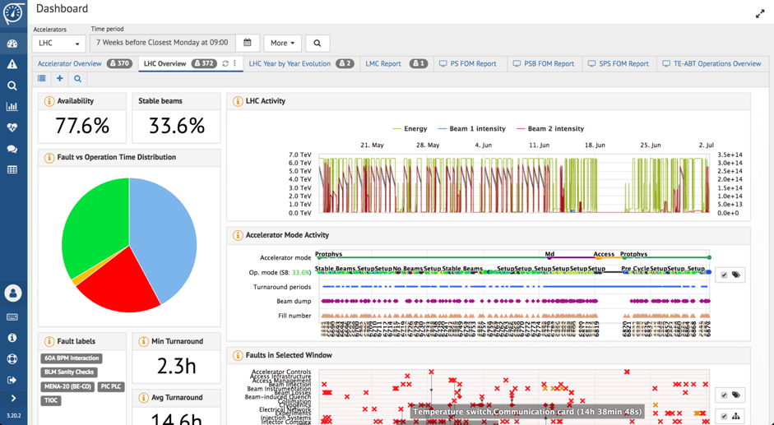
High-Level Software Architecture
Client Tier
Graphical applications
Different technologies in use
Java Swing, Java FX
PyQt
Web ecosystem (Angular)
Controls Middleware & more generic solutions
Controls Middleware
Communication
Accelerator-specific protocols for the lower layers
  Controls Middleware (CMW)
More generic technologies for the higher layers
  RMI/JMS
  REST
  gRPC
  …
Notes:
Presentation layer (see Hermann 14) - In its own slide cite != techno Java, Python, Web and show a few pictures from Hermann

Slide 7

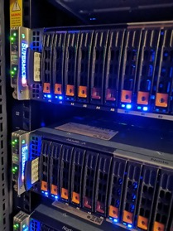
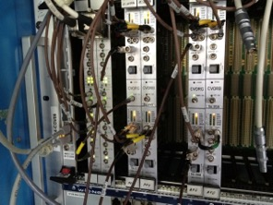
High-Level Hardware Architecture
Client Tier
e.g. Control Room infrastructure
Server Tier
Central computing infrastructure
Resource Tier
Electronics close to the accelerator
Notes:
HW – 3 tiers but going for a physical 4 tier w/ the DIOT

Slide 8


Examples – Accelerator Control
New value = x
GUI
x
Server
x, a, b, c
Database
Oracle Database
x ➔ a, b, c
InCA/LSA Server
a
b
c
FESA Class
RT Application
RT Application
RT Application
Control now!
0x61
0x62
0x63
VMEBus board
Hardware
Hardware
Hardware
Timing System
General Machine Timing (GMT)
Notes:
HW – 3 tiers but going for a physical 4 tier w/ the DIOT

Slide 9
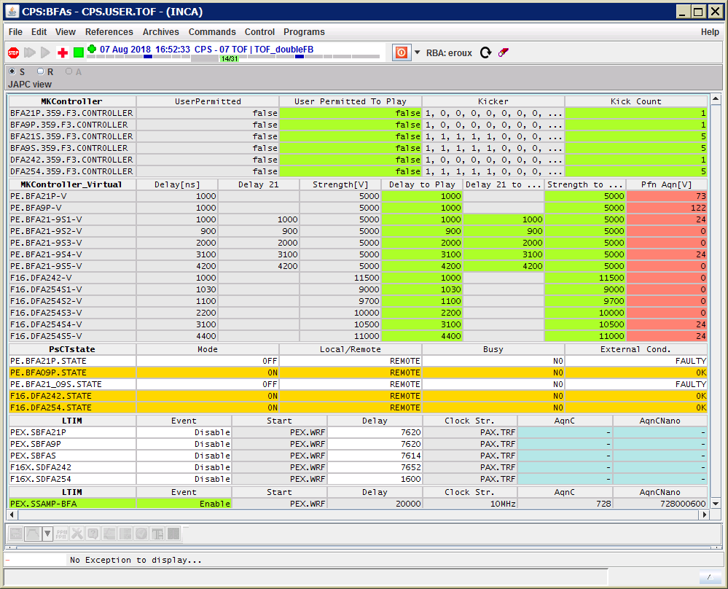


Examples – Equipment Monitoring
Here are a, b, c, and Everything is OK
GUI
a’, b’, c’ @ t_{i}
UCAP* Server
a @ t_{i}
b @ t_{i}
c @ t_{i}
FESA Class
RT Application
RT Application
RT Application
Read now!
(time = t_{i})
0x61
0x62
0x63
VMEBus board
Hardware
Hardware
Hardware
Timing System
Measure now!
General Machine Timing (GMT)
*UCAP: Unified Controls Acquisition & Processing framework
Notes:
HW – 3 tiers but going for a physical 4 tier w/ the DIOT

Slide 10
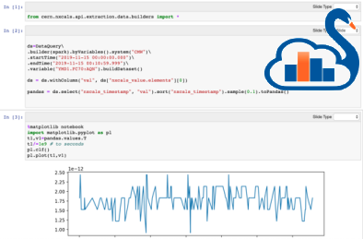

Examples – Timeseries Data Logging
Values on the 06/06/2021 ?
SWAN Notebook
a, b, c @ 06-06-21
a, b, c @
06-06-21
NXCALS
Hadoop
a, b, c @ t_{i}
a @ t_{i}
b @ t_{i}
c @ t_{i}
FESA Class
RT Application
RT Application
RT Application
Read now!
(time = t_{i})
0x61
0x62
0x63
Hardware
Hardware
Hardware
Measure now!
Timing System
General Machine Timing (GMT)
VMEBus board
*SWAN: Service for Web based ANalysis
Notes:
HW – 3 tiers but going for a physical 4 tier w/ the DIOT

Slide 11
Questions?
“Provides Control & Monitoring solutions for all CERN particle accelerators, transfer lines, associated experimental areas & various supporting technical infrastructure services.”
Key aims:
As simple as possible
High usability, stability, availability
Common approach
12 in 1
∙LINAC3/4 ∙PS ∙PSB ∙SPS ∙LHC ∙LEIR ∙ISOLDE ∙AD/ELENA
12 in 1

Slide 12
Additional Slides
Notes:
HW – 3 tiers but going for a physical 4 tier w/ the DIOT

Slide 13
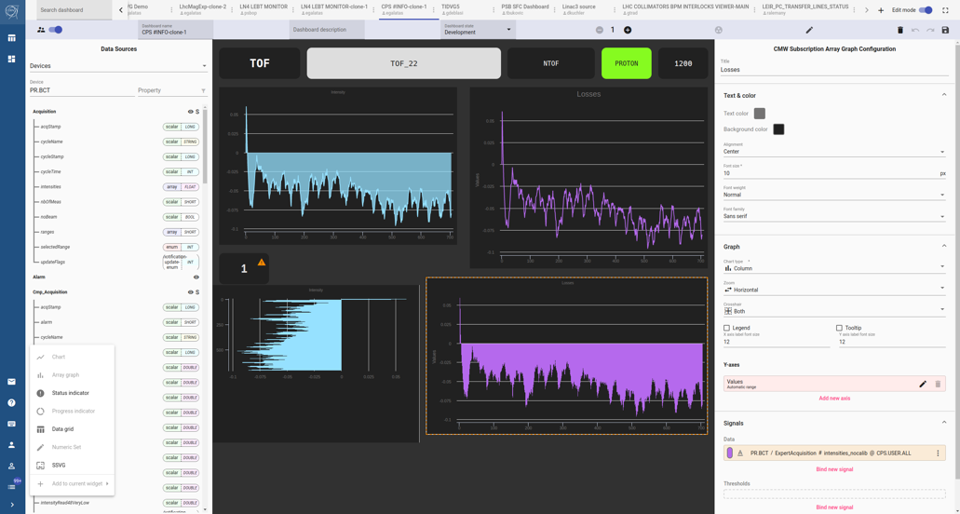
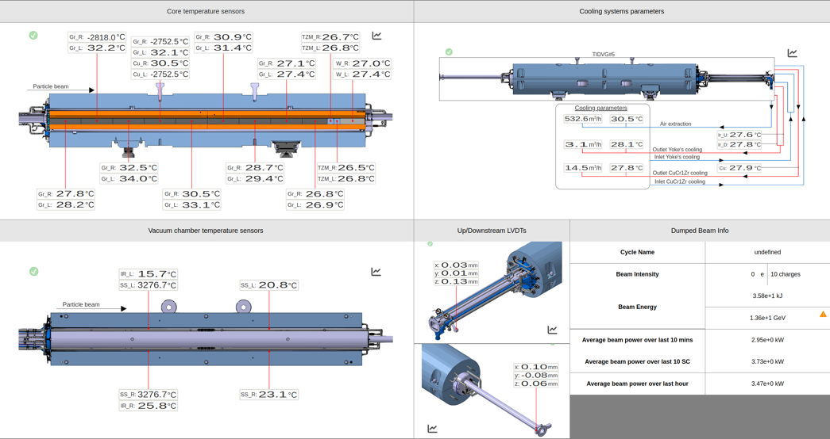
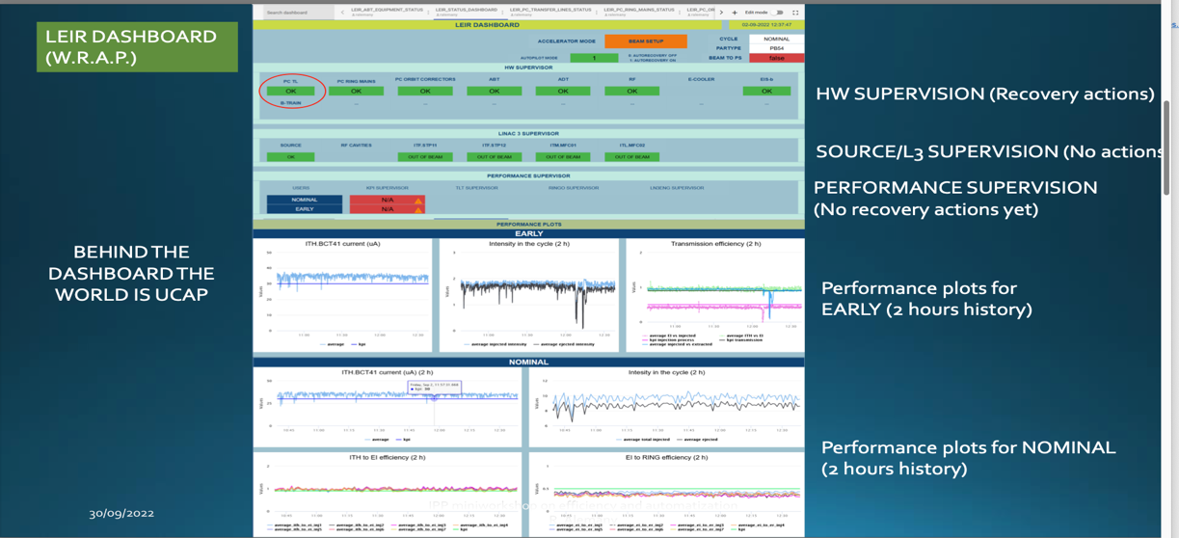
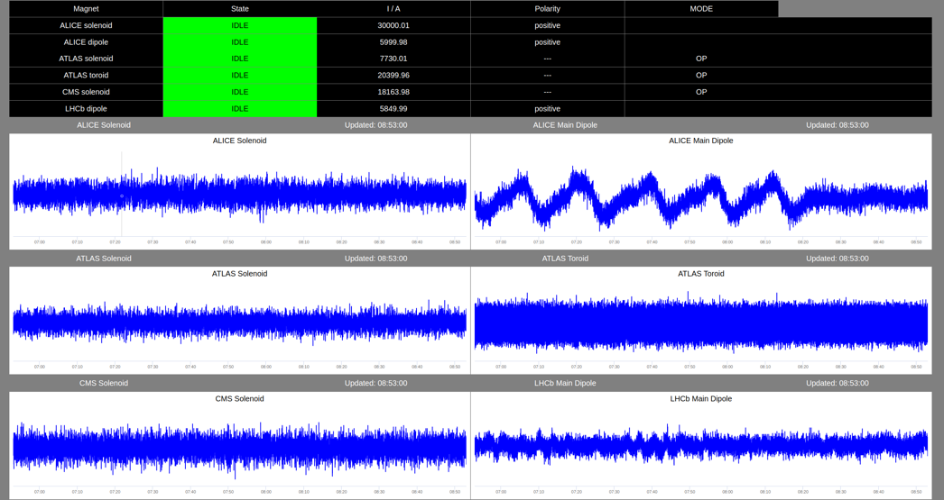

WRAP
Notes:
HW – 3 tiers but going for a physical 4 tier w/ the DIOT

Slide 14
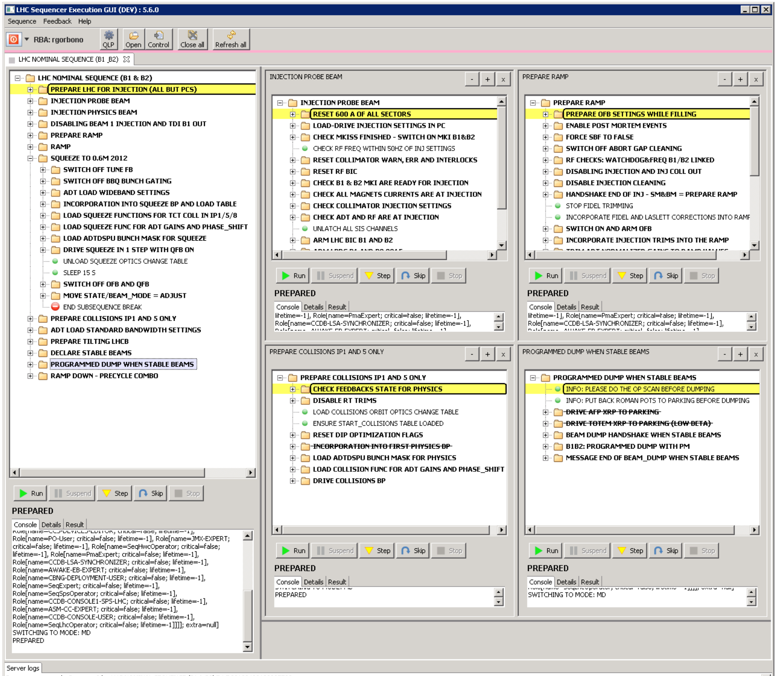
Sequencer
Notes:
HW – 3 tiers but going for a physical 4 tier w/ the DIOT

Slide 15
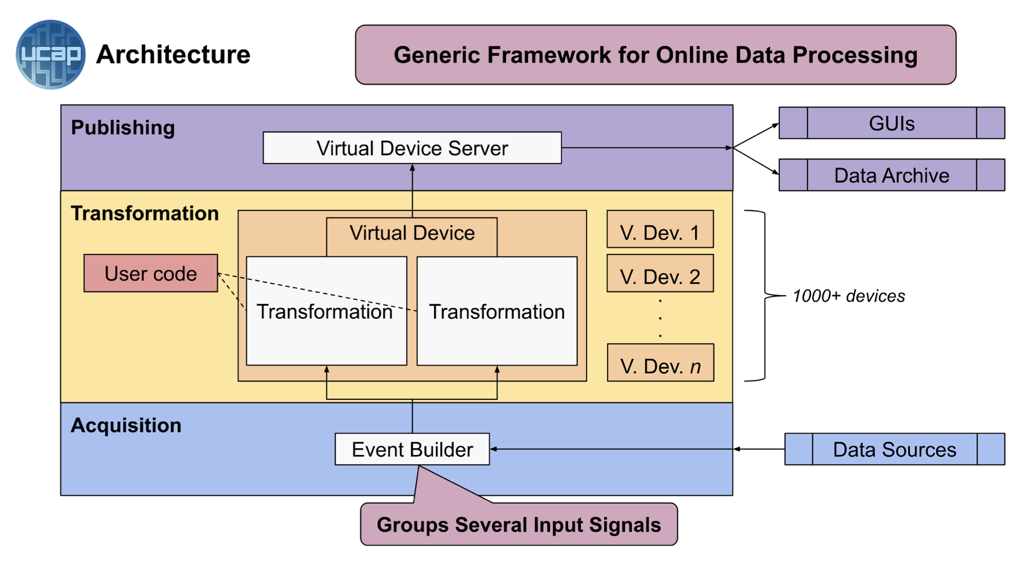
UCAP
Find more at:
JACoW-ICALEPCS2021-MOPV039_Poster
JACoW-ICALEPCS2021-MOPV039_Paper
Notes:
HW – 3 tiers but going for a physical 4 tier w/ the DIOT

Slide 16
Fault Tracking & Availability
Notes:
HW – 3 tiers but going for a physical 4 tier w/ the DIOT

Slide 17


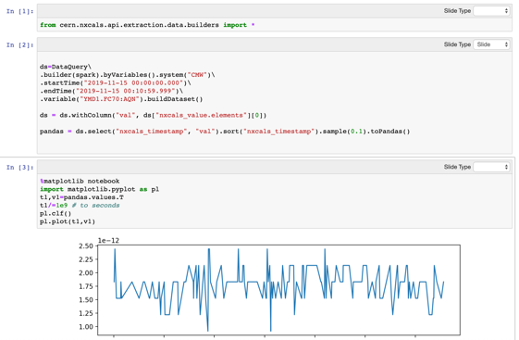



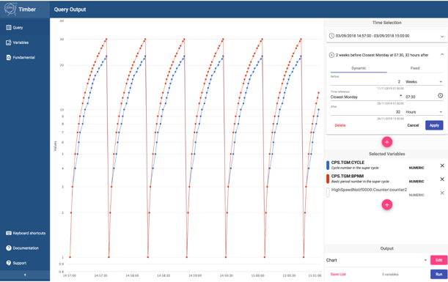

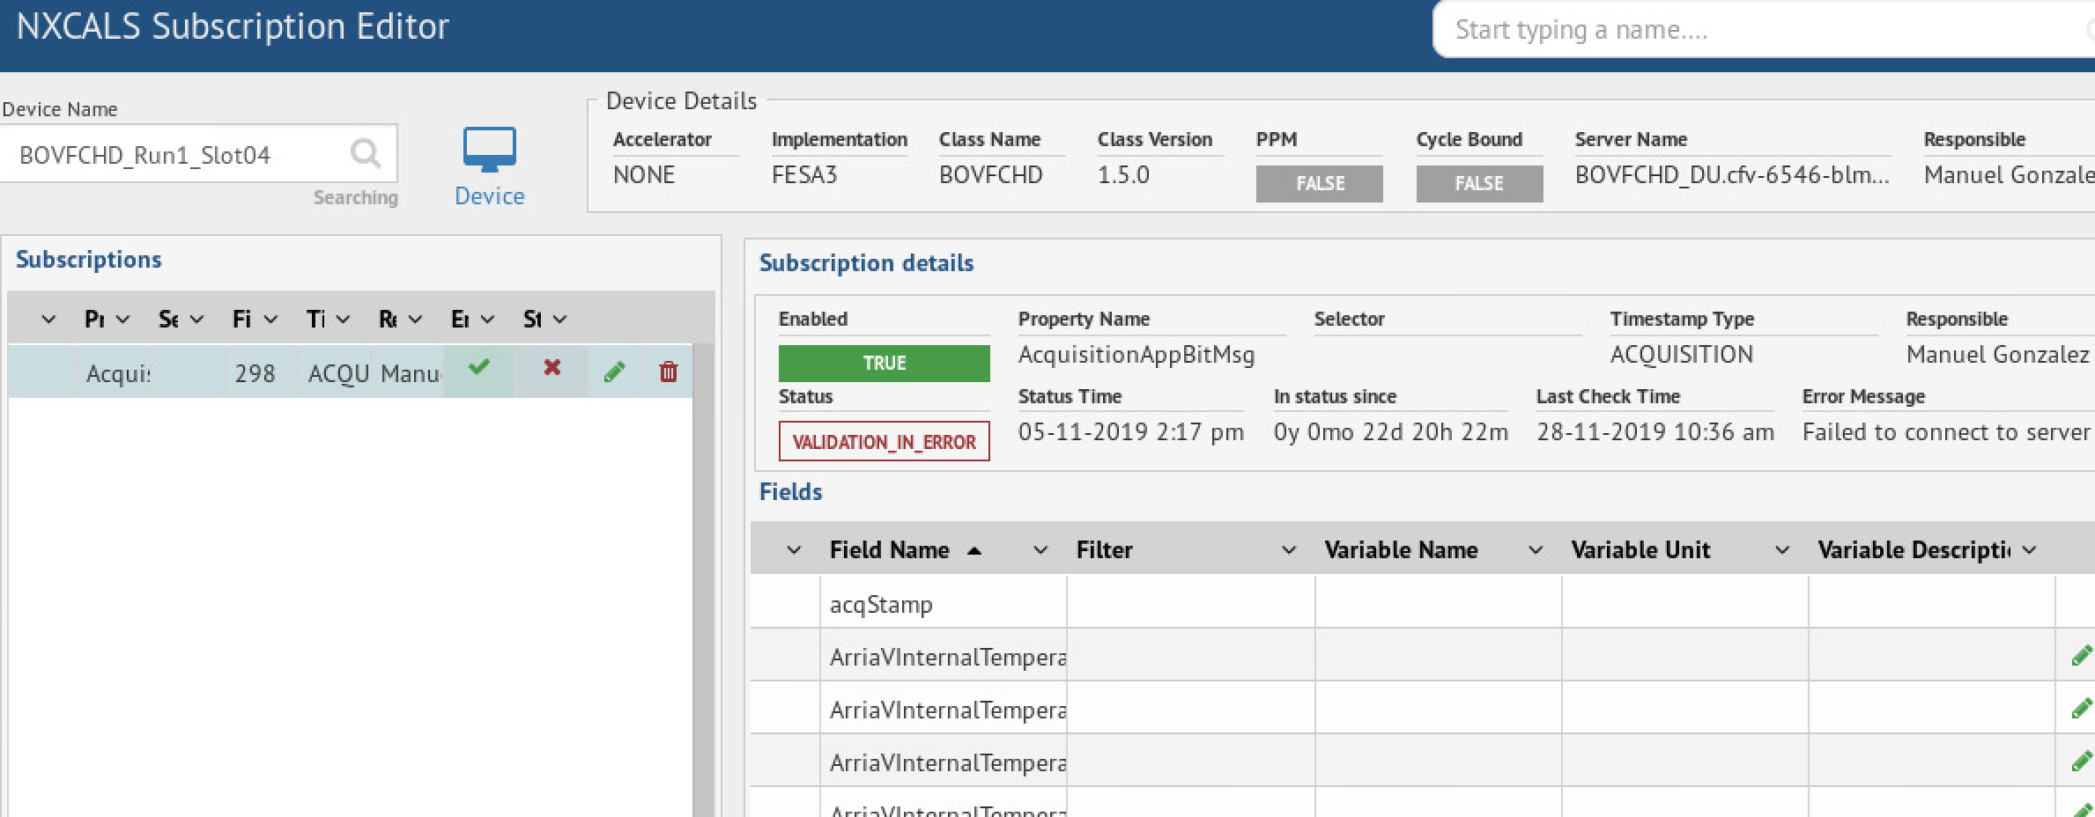

NXCALS – Data Logging System
Data Sources
Data Storage
Data Extraction
NXCALS
Data Access
API
SWAN (Jupyter)
TIM & REMUS Datasources
ETL
cluster
ETL
ETL
ETL
API
WinCC OA Datasources
TIMBER - GUI
CERN Specific
API
CMW Datasources
ETL
ETL
ETL
ETL
Settings, PM, etc
MetaData
API
Spark Bundle
“pip install nxcals”
Configuration via CCDE
Heterogenous Inputs
Extensive Set of APIs & Tools
Notes:
HW – 3 tiers but going for a physical 4 tier w/ the DIOT

Slide 18





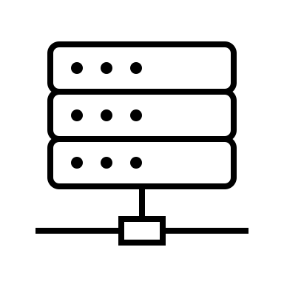









Machine Learning Platform (MLP)
Machine Learning Platform (MLP) is the new central platform for storing, versioning and deploying ML models in the CERN Control Centre
create, update and deploy models with minimal effort
automate seamless model updates as machines characteristics evolve
focus on domain & ML by abstracting the infrastructure
model.fit(training_data)
client.publish_parameters_version(
model,
name = “ion_beam”,
version = AUTO # generated
)
Training environment
VCS, CI
Model registry
$ git tag v2.0.0
Metadata DB
Physicist
Object Storage DB
Controls application
model = client.create_model(
model_type = BeamLineModel,
model_parameters = “ion_beam“,
params_version = AUTO
)
result = model.predict(input)
Find more at:
JACoW-ICALEPCS2021-MOBL03
https://indico.cern.ch/event/1175862/
Accelerators
ATS-IT
Collaboration!
Serving cluster (TN)

