Slide 1

ECS recap. and stability studies
29/05/24

Slide 2
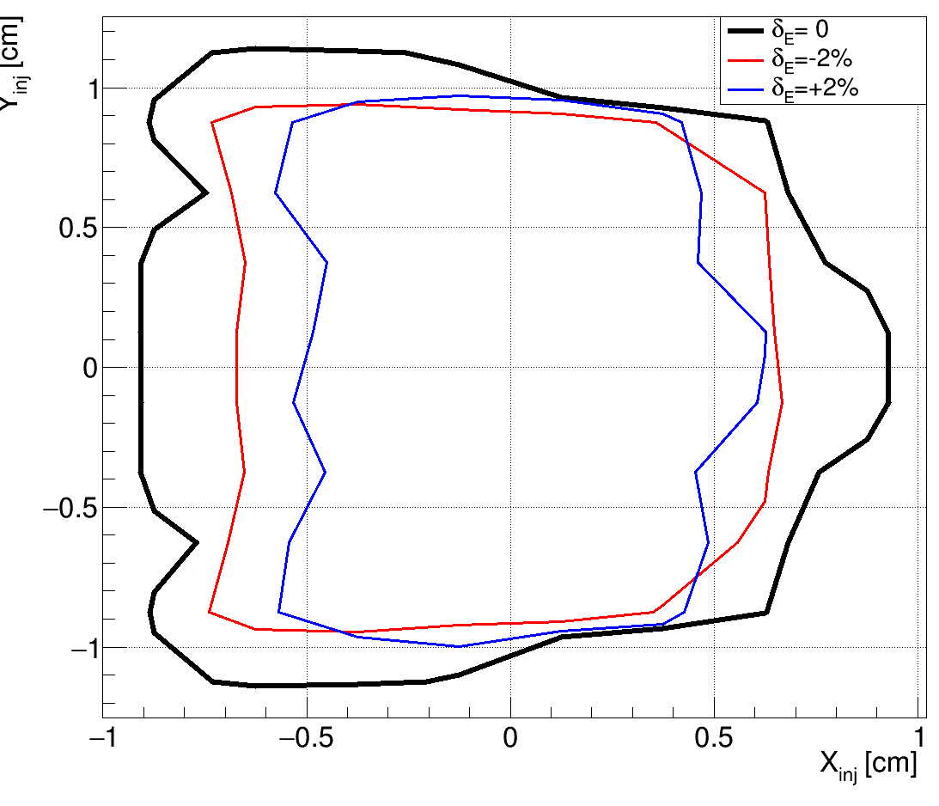
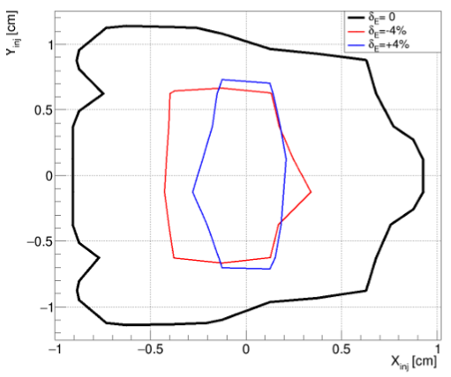
DR dynamical aperture
Tracking has been performed with PTC (MAD-X interface) over ~15% damping time neglecting radiation damping. The estimated loss of accuracy is below 1% at the nominal energy.
The stability region in the transverse plane has been evaluated for different energy
deviations. Contours represent regions where >90% of the initial conditions lead to
successful tracking
The transverse stable region is shown for the nominal beam energy (1.54 GeV - black) and for ±2%(left), ±4%(right) energy relative deviation (blue and blue). The stable region is kept quite constant within 2% energy spread. It shrinks significantly for higher deviations

Slide 3
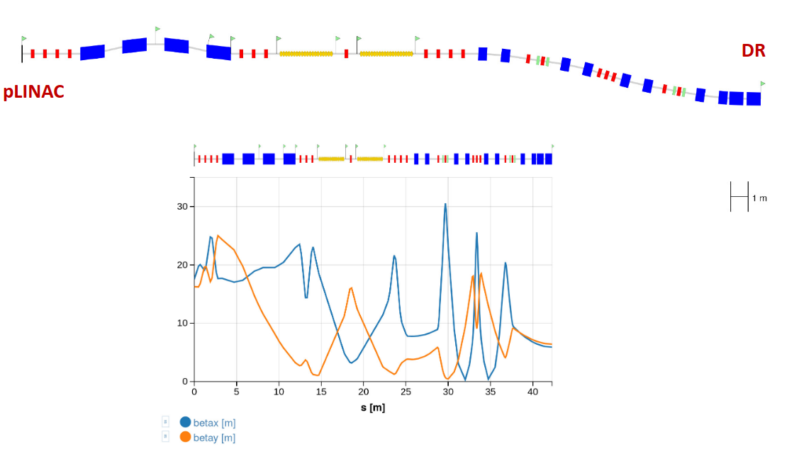

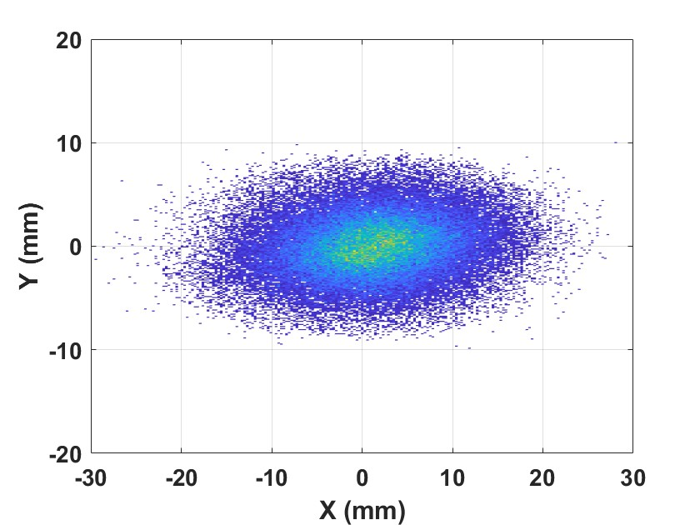
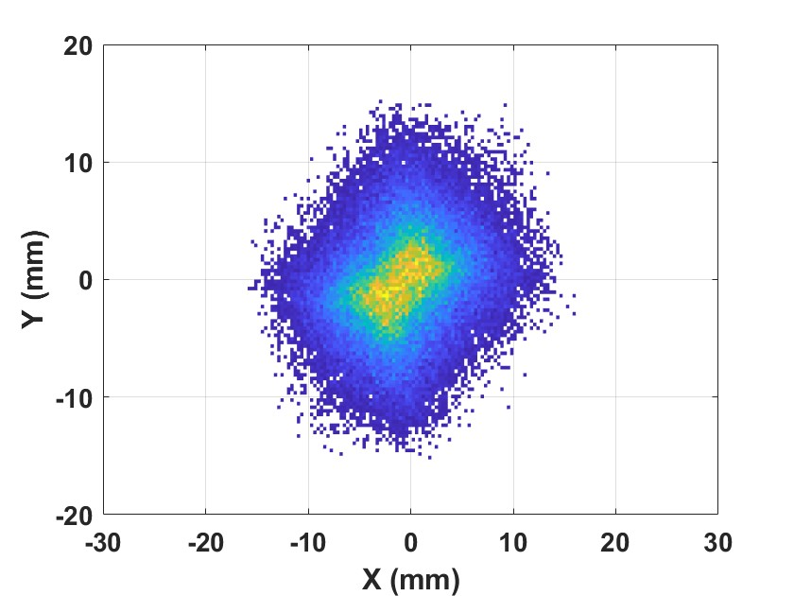
Transfer lines pLINAC - DR
Transverse emittance is preserved in both planes

Slide 4
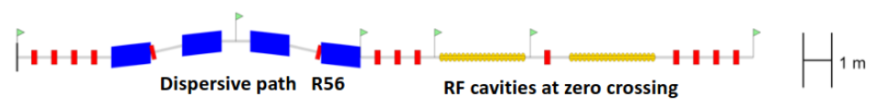
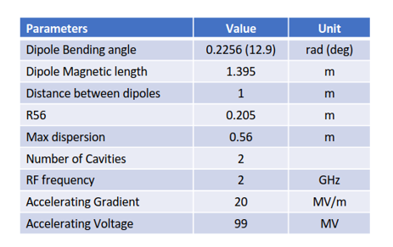
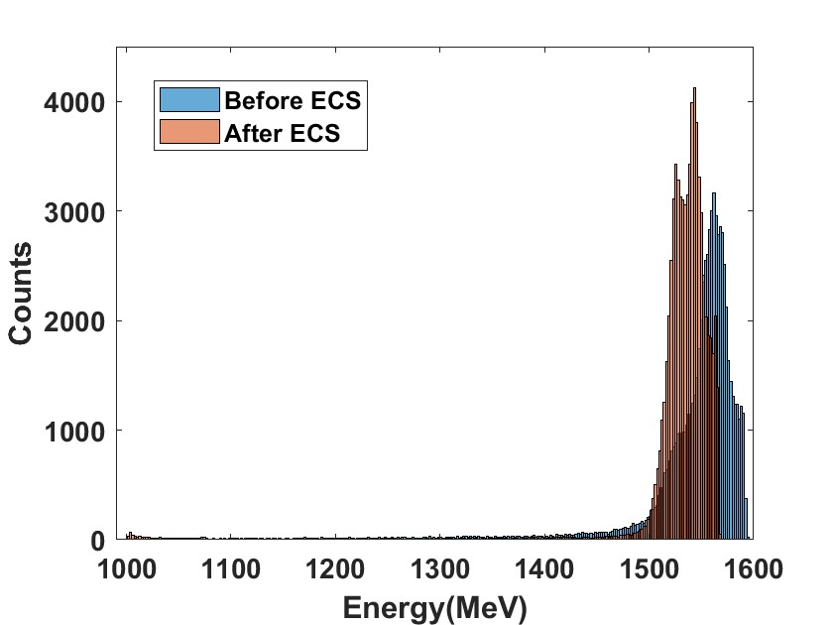
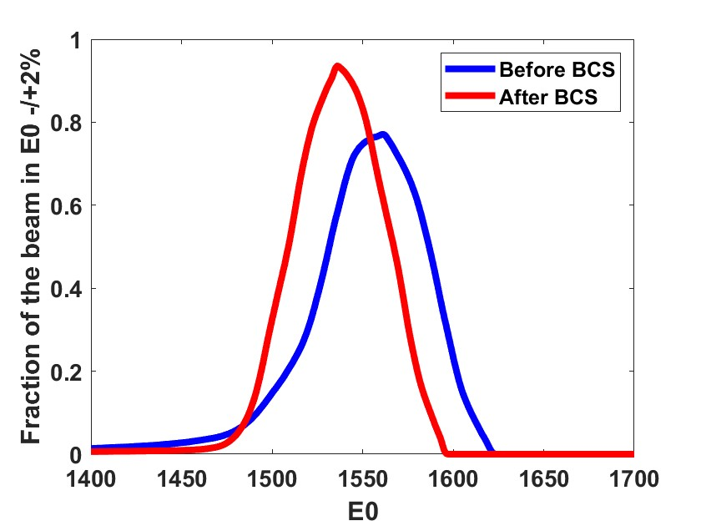
Energy compressor
The aim of the energy compressor is to maximize the number of particles accepted in energy by the DR ( 1.54 -/+ 2% )
A four-bending C-shape chicane. Dispersion and second order dispersion closed by symmetry.
Two cavities of the type used for the positron LINAC ( LINAC 2022) THPOJO08)
Distribution at the end of the pLINAC provided by M. Schaer
Energy distribution
Beam fraction in E0-/+2%

Slide 5
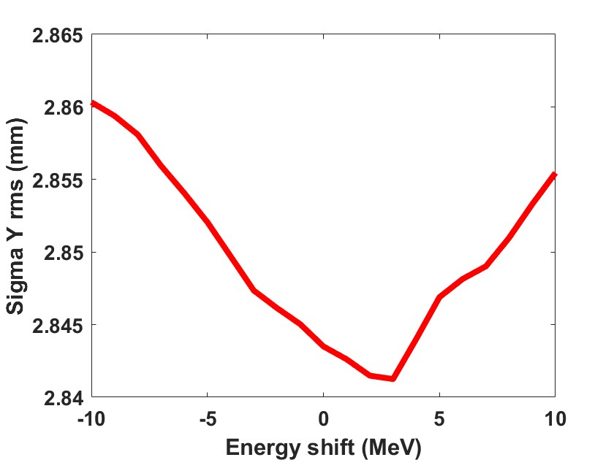
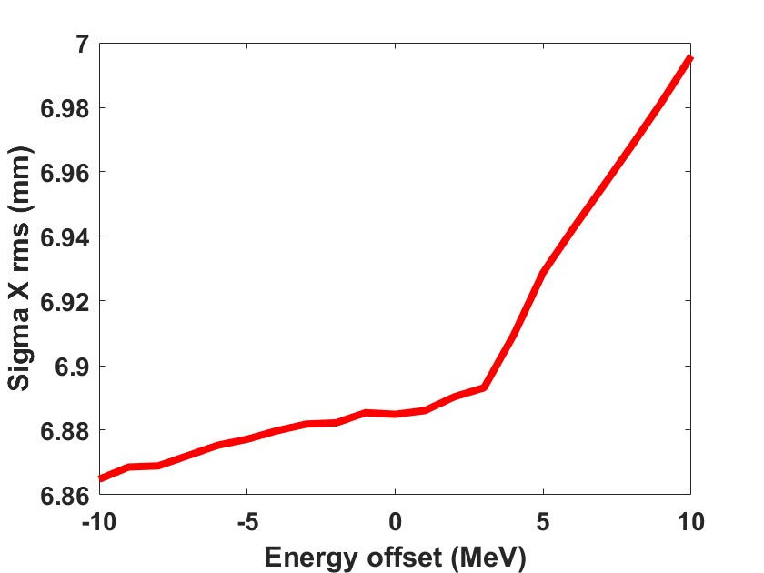
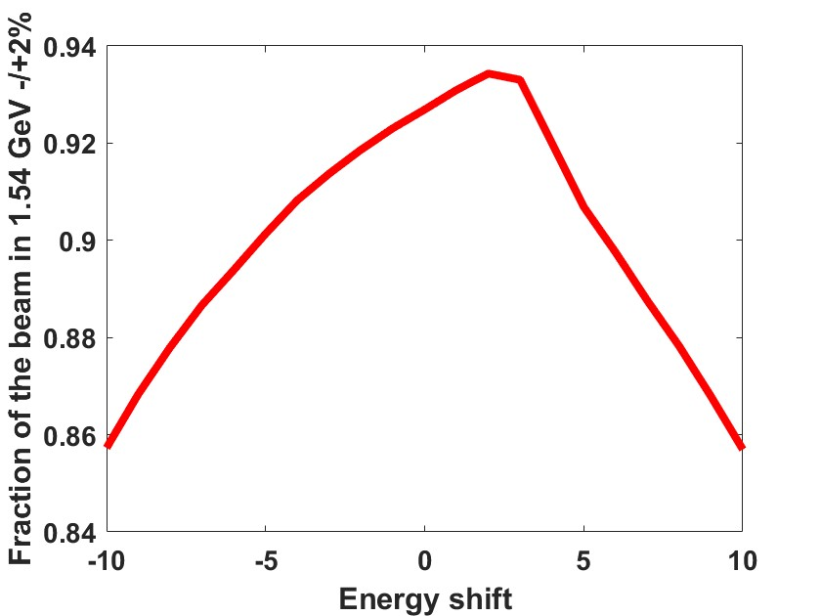
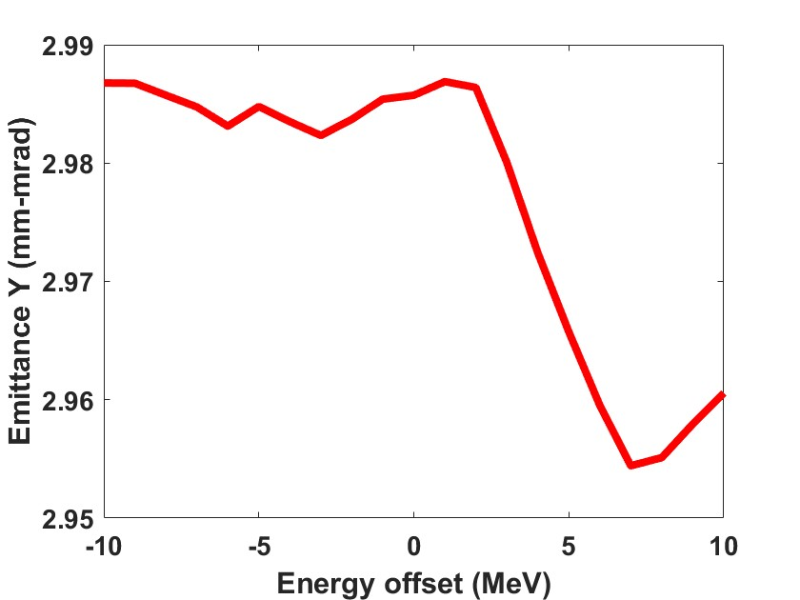
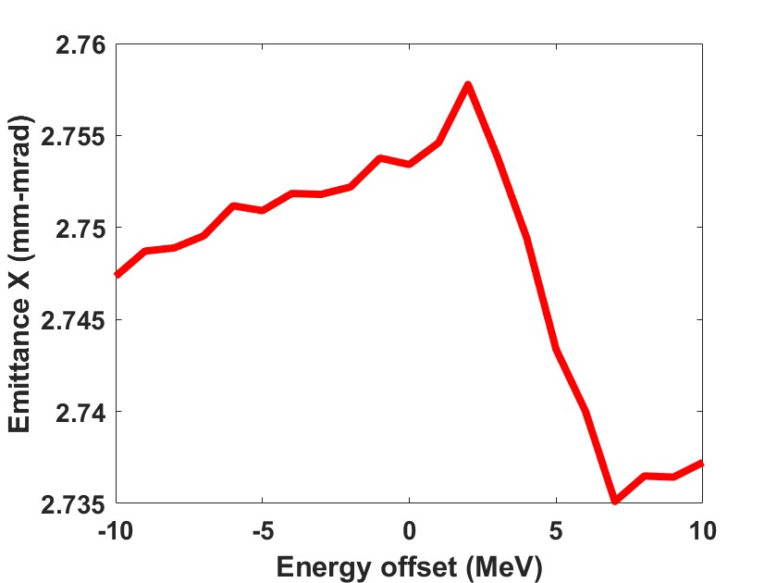
Tolerance on E0
Distribution at the end of the pLINAC provided by M. Schaer
Rigid shift applied

Slide 6
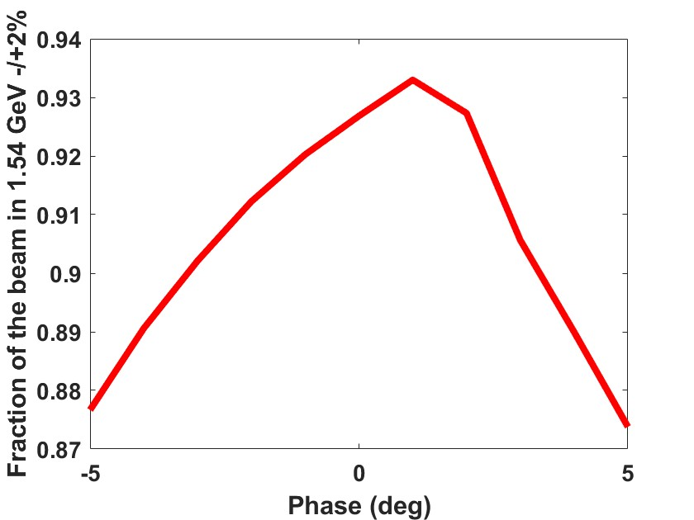
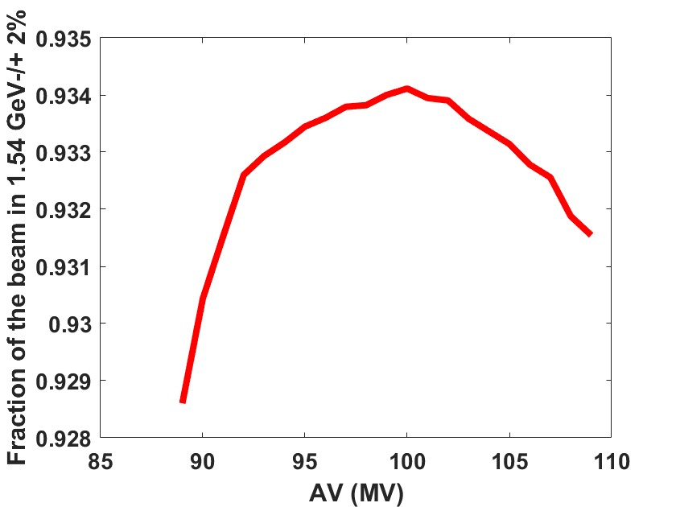
Tolerance on RF
Tolerance of Amplitude and phase variation relaxed

Slide 7
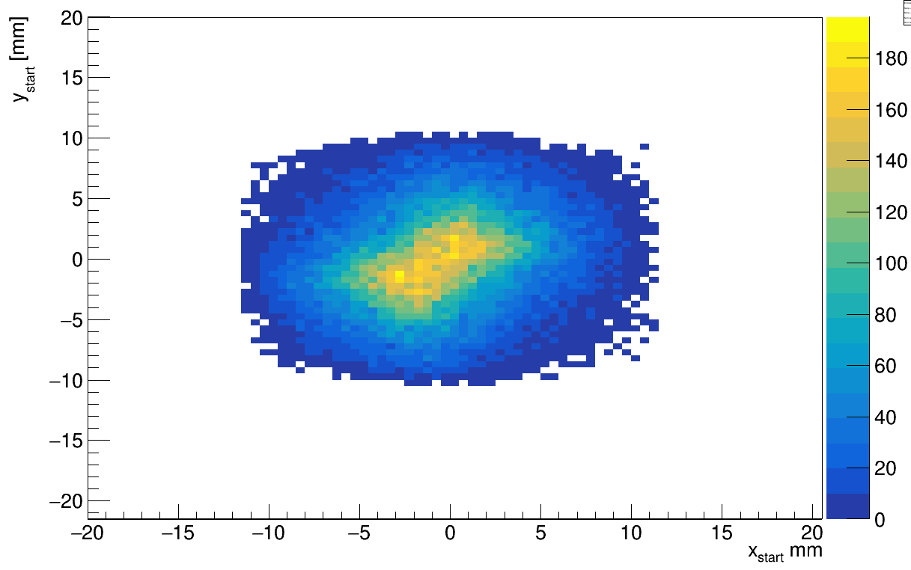
pDR acceptance of the pLINAC particles
Particle beam beam prepared with a start-to-end simulation. Positron linac simulated with RF_TRACK. Energy compressor and injection TF are simulated with elegant
DR acceptance: Survived particles at 10k turns (PTC-MADX): 59794/71800 = 83%
The picture shows the transverse distribution of the survived particles according to their positions at e+ linac exit.
The coordinate of the dead particles can be used to study a possible reduction and collimation of the positron beam coming from the source

