Slide 1

Requirements for design studies
The complete filling for Z running => Requirement ~2.75 ⨯ 10¹⁰ e⁺/bunch (4.4 nC) at the linac end or 5.4 nC accepted in the DR
50% losses for injection in the DR (assumed) + 20% additional losses from target up to the end of the e+ linac (assumed)
N_{e-}/bunch ⨯ η^{e+}_{Accepted} ≥ 5.4 nC/bunch ⨯ 2.5
*A safety margin of 2.5 is currently applied for the whole studies (60% losses for transport, collimation and injection into the DR).
20% additional losses from target up to the end of the e+ linac
  e+ linac simulations (including chicane) will provide more realistic estimation of the accepted yield
  Include the ESC in the linac start-to-end simulations
  Still a reasonable safety margin
50% losses for injection in the DR
  To be discussed/fixed with the WP4 (studies including ESC from 2023 => DR acceptance ~ 80% )

Slide 2
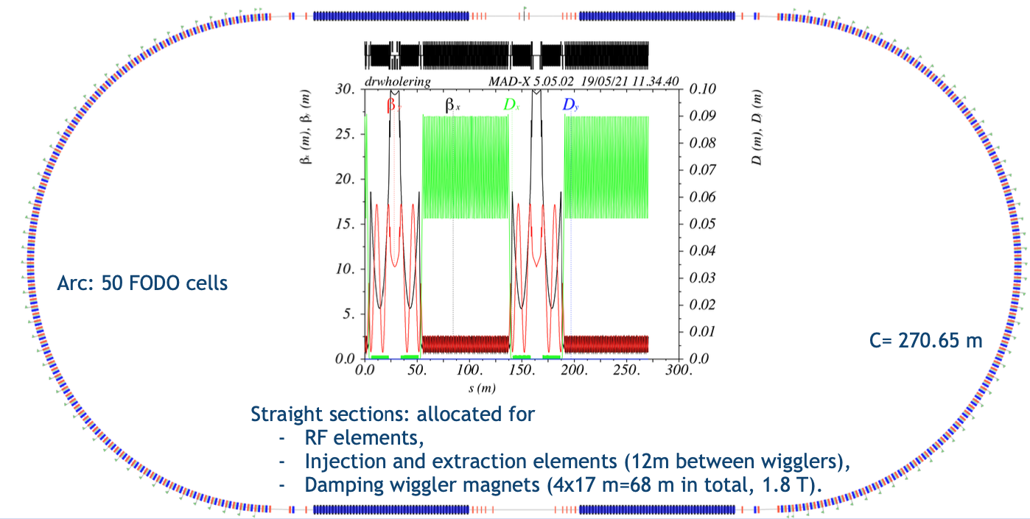
Positron source physics design (current baseline)
E = 1.54 GeV
Q = 13.5 nC (considering 60% losses for transport, collimation and injection into DR)
HTS solenoid – based option
6 GeV electron beam
from common linac
Capture linac 2 GHz, 20 MV/m
200 Hz, 5 RF structures
Positron linac 2 GHz, 20 MV/m
200 Hz, 23 RF structures
Positron/Electron
Separation at 200 MeV
Target & cryostat
DC solenoid
Injection section
E = 6 GeV
Q = 1.9-2.1 nC
DR C = 242 – 271 m
E = 1.54 GeV
Q_{b} = 5.4 nC
DC solenoid
Electron/Photon? dumps
Energy collimator
and compressor
Capture system -version 1
Does FLUKA model include short “tuning” solenoid?
346 - 259 – 72 = 15 mm available ?? Or it is installed upstream?
295 – 36 = 259 mm
106 m
509.5 mm
105 mm
72 mm
3000 mm
200 mm
53 m
Damping ring
240 mm
1846 – 1500 = 346 mm
Positron production: conventional scheme (e- beam size on target = 1 mm rms ). Target exit located at 40 mm w.r.t. peak field.
Matching Device is based on the SC solenoid (5 HTS coils, 72 mm bore including shielding)
Capture Linac is based on the L-band TW RF structures ( 2 GHz, 60 mm, 3-m long)
NC long solenoid B = 0.5 T (realistic conventional design based on the short coils B = 0.31 T) + short “tuning” solenoid B = 0.124 T before the 1st RF structure
Shielding made of W before the 1st RF structure (position tbc)

