Slide 1
WP3A status
Oliver Kortner, Junjie Zhu
June 12, 2024

Slide 2
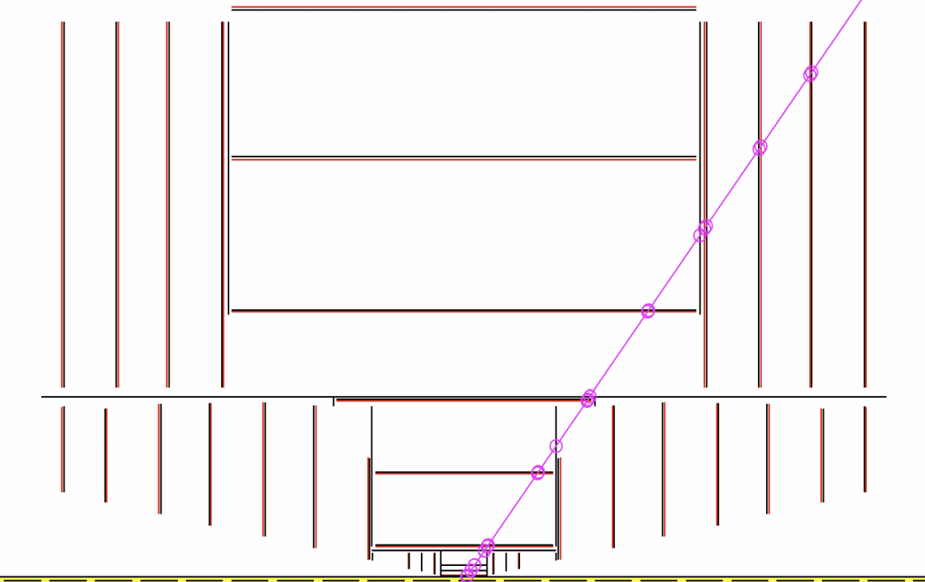
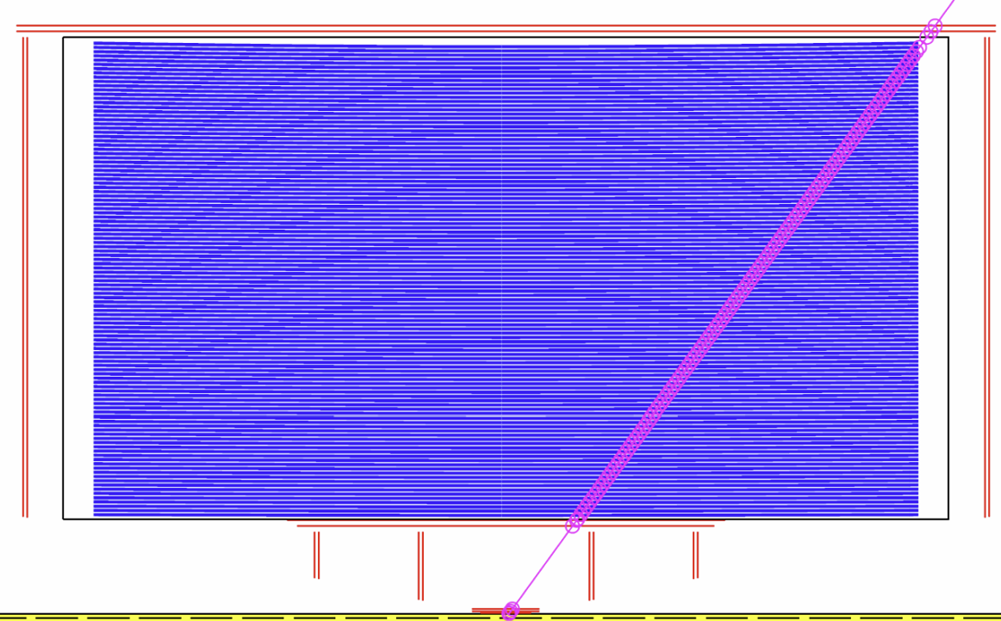
Straw tracker
2
We propose to have a straw tracker (combined with pixel and silicon wrapper) for an FCC-ee inner tracker:
  Reasonable single hit resolution: 100~120 µm, similar or better momentum resolution than the pixel detector due to more hits detected and longer lever arm
  Low material and less multiple scattering
  Pattern recognition
  Particle identification (π-K, K-p identifications)
  Long-lived particle searches
  Capable of triggering
CLD
IDEA

Slide 3
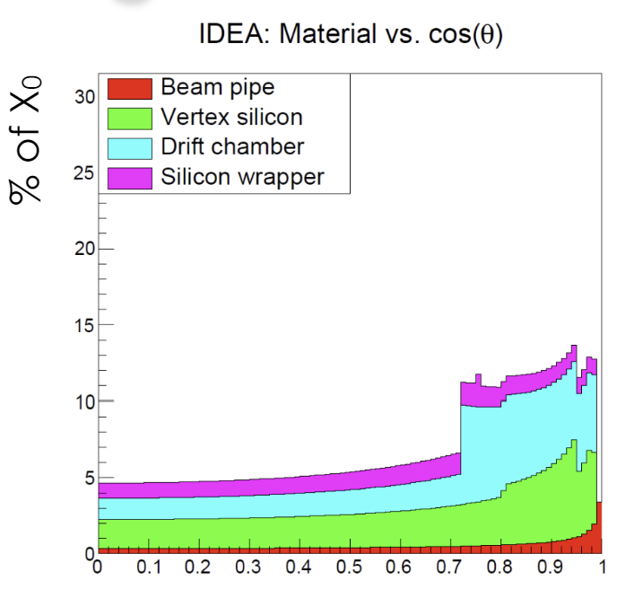
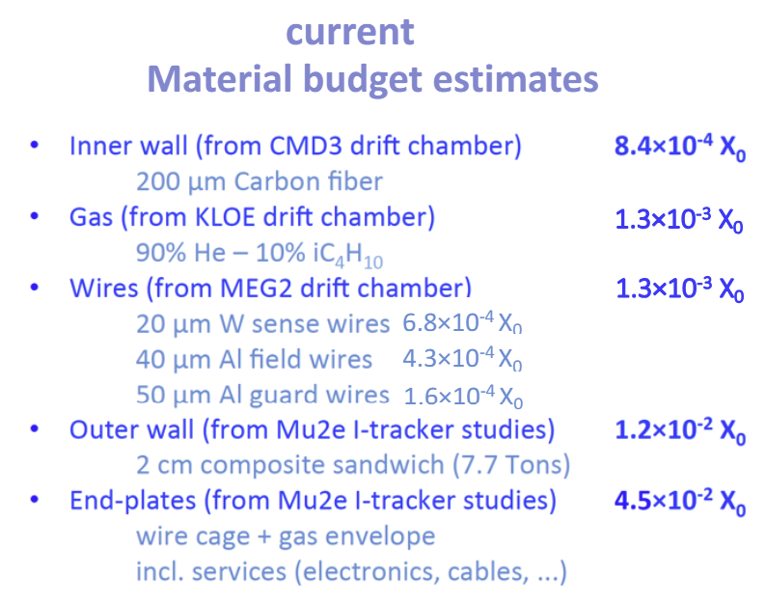
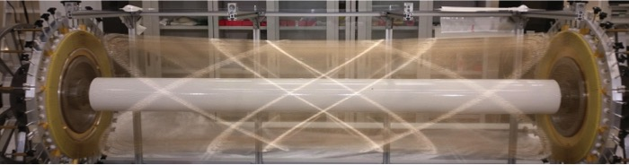
Material budget for a straw tracker
3
The straw tracker for Mu2e experiment at Fermilab:
  two layers of 6 µm mylar and 3 µm adhesive, in total the wall thickness is 15 µm (5 mm diameter, 0.44-1.14 m in length)
  ~100 layers means in total ~3 mm mylar films ~1% X₀
  0.05 µm Aluminum coating on the outer wall and 0.05 µm Au coating on the inner wall, negligible contribution to the material budget
  Endplate supporting structure could be similar to DCH, but outer wall material could be reduced
IDEA drift chamber material estimate (slides):
  Using similar techniques developed for the MEG-II drift chamber
MEG-II drift chamber

Slide 4
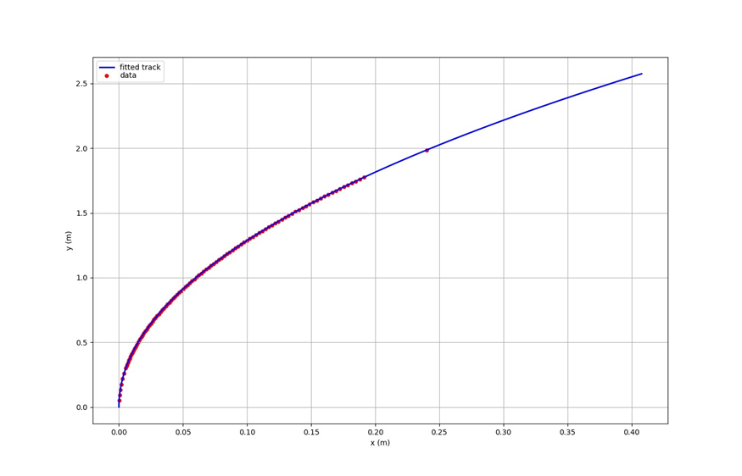
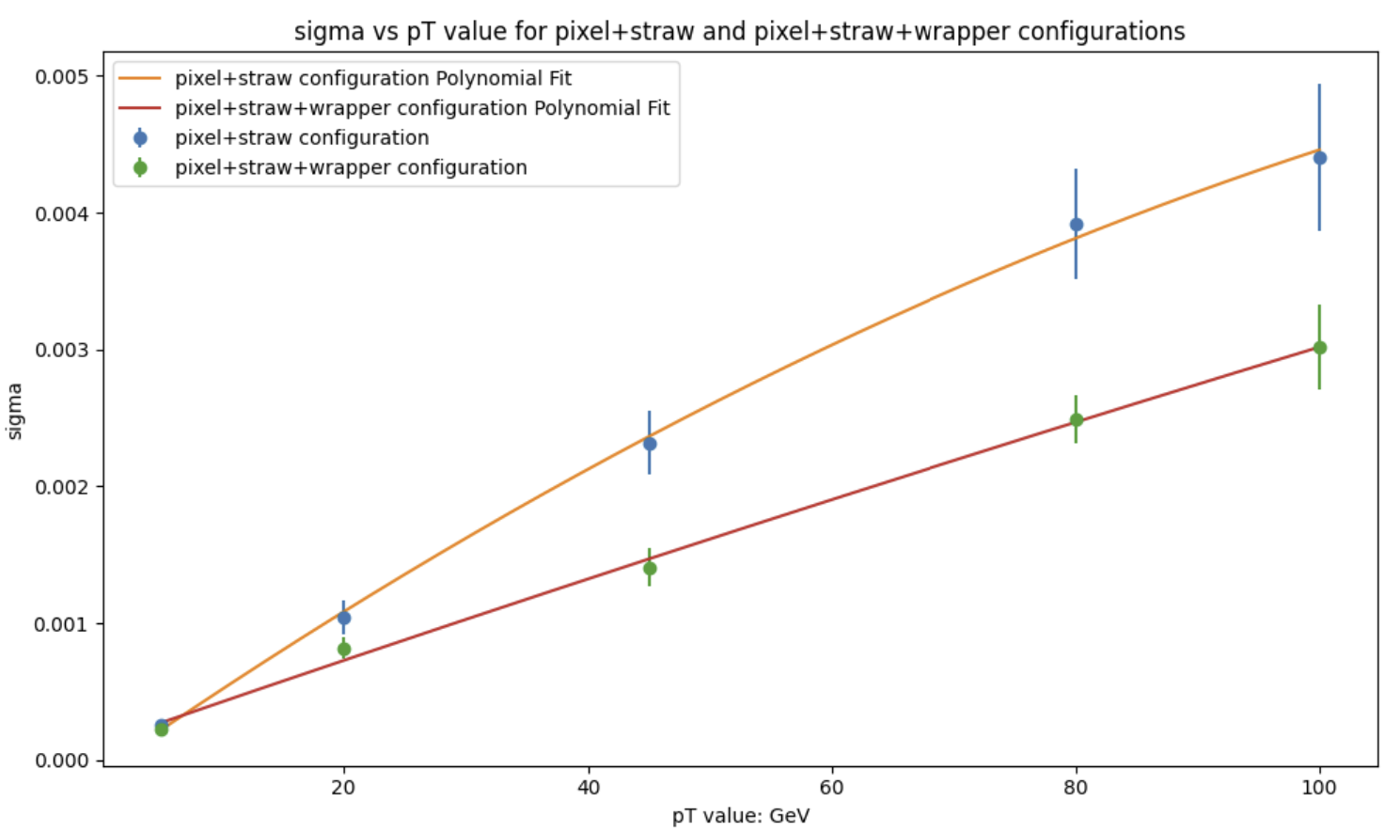
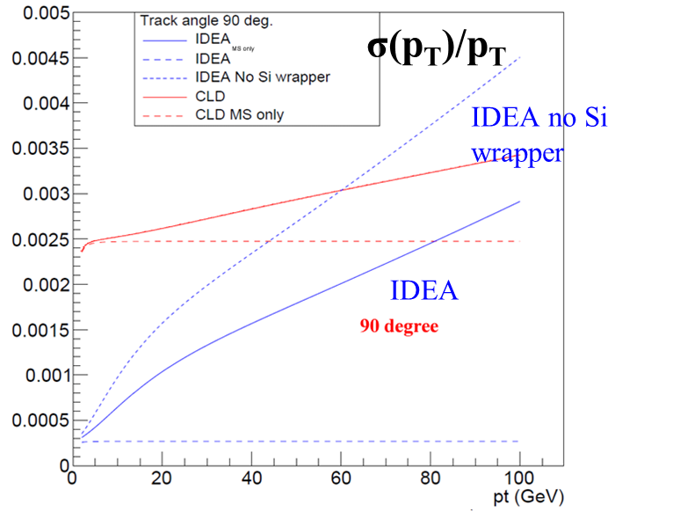
Understanding the momentum resolution
4
A simple python simulation program developed to understand the effect of hit locations and resolution on the track momentum resolution
  2 Tesla magnetic field
  5 layers of pixel from 5 cm to 30 cm (σ=5 µm), 112 layers of straws from 30 cm to 180 cm (σ=120 µm), and a silicon wrapper layer at 200 cm (σ=10 µm)
  Smear hit φ according to the resolution in the respective layer
  A scipy minimization code developed to minimize the Chi2 to find the measured track p_{T}
Can use this code to optimize tube counts, locations, resolution
5 GeV
Pixel+straw+silicon wrapper
Pixel+straw

Slide 5
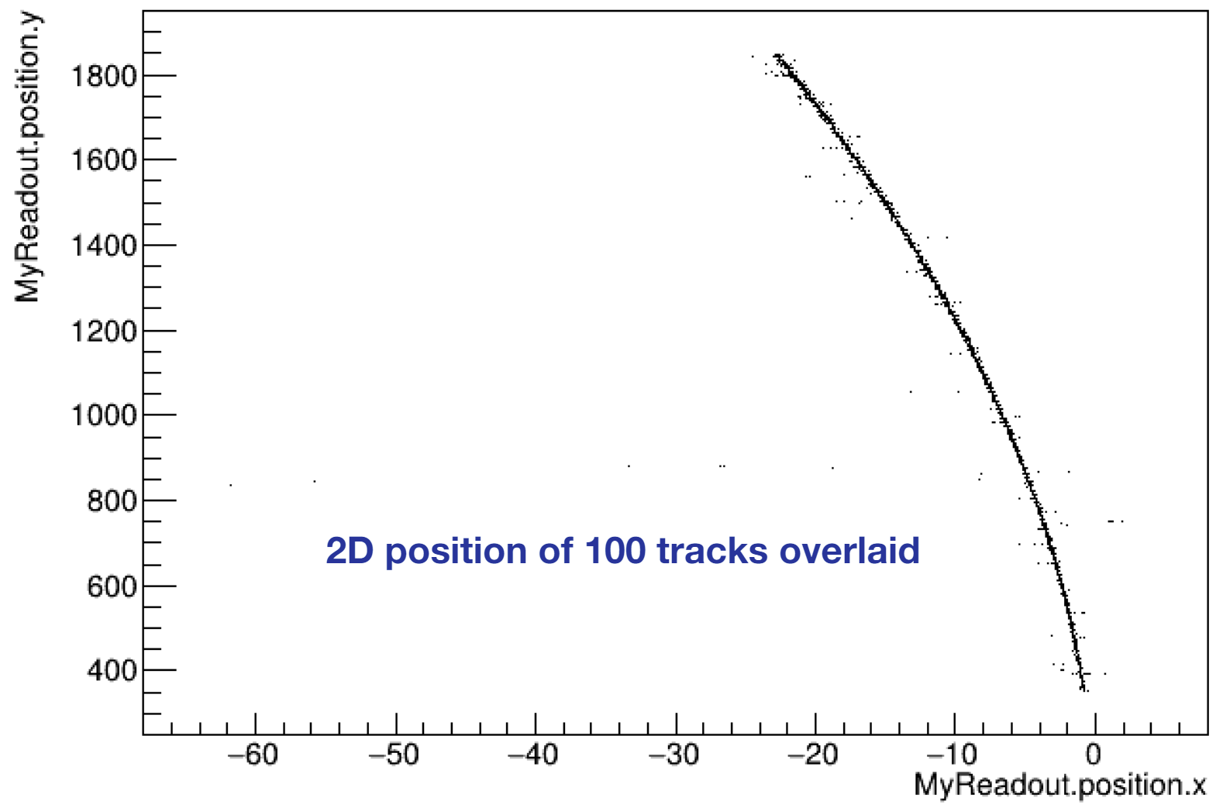
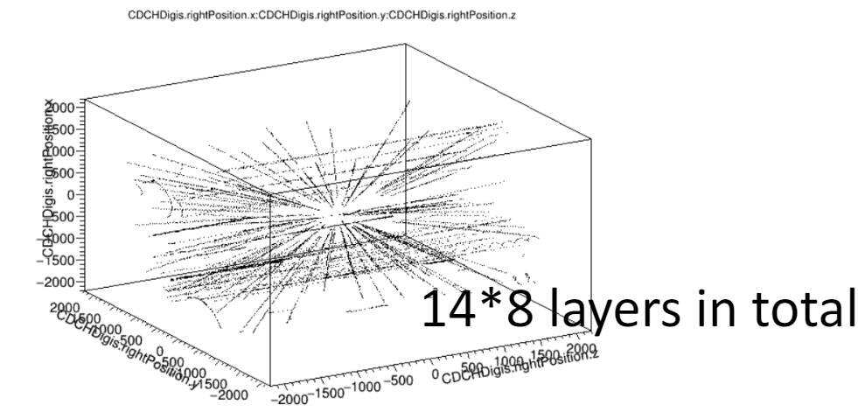
GEANT simulation
5
Learned to run the FCC-ee detector simulation to generate pixel and drift chamber hits (IDEA-like DCH for ALLEGRO) for 10 GeV electrons
Modified the FCC-ee ALLEGRO simulation and replaced the drift chamber with a perfect tracker made of only air. Multiple scattering effects included, the FCC-ee track fitting is not ready yet

Slide 6
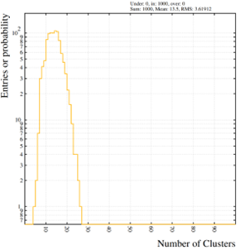
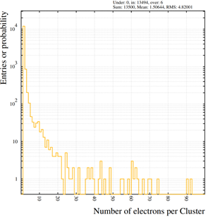
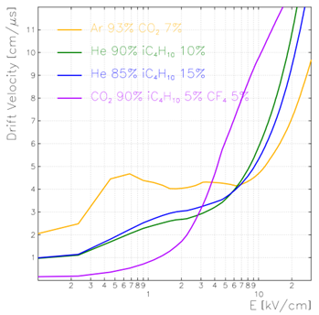
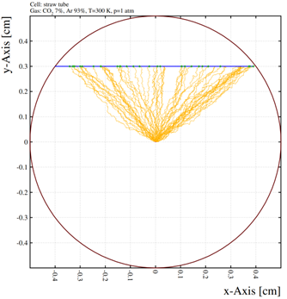
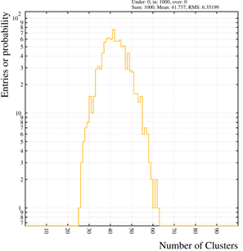
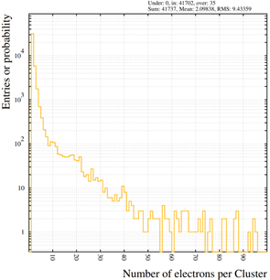
Gas simulation with Garfield
6
Simulated primary ionization cluster number (left) and size (right) for 4GeV muon in a 10 mm-diameter tube
Ongoing Garfield simulation:
  Ionization statistics in several gas mixtures
  Electron and ion transportation properties
  Signal induction and timing structure
Provide essential inputs for the gas optimization and dN/dX measurement for PID
Low-z gas
He-90-iC4H10-10
Typical drift tube gas
Ar-93-CO2-7
Simulated ionizations created by a muon track and primary electron drift towards wire
Electron drift velocity vs. e-field

Slide 7
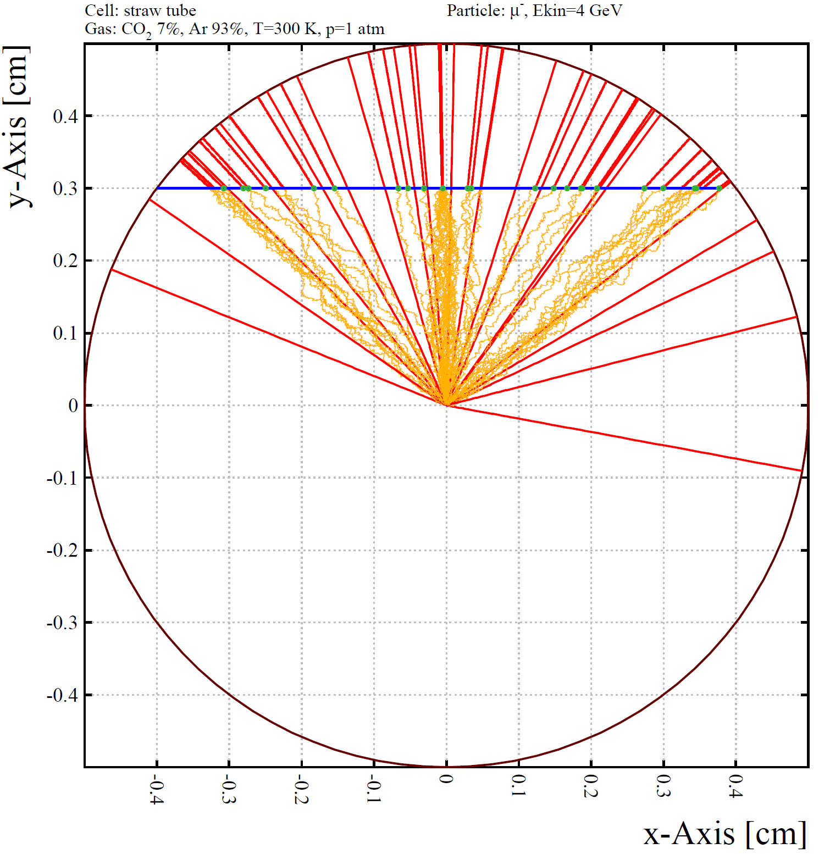
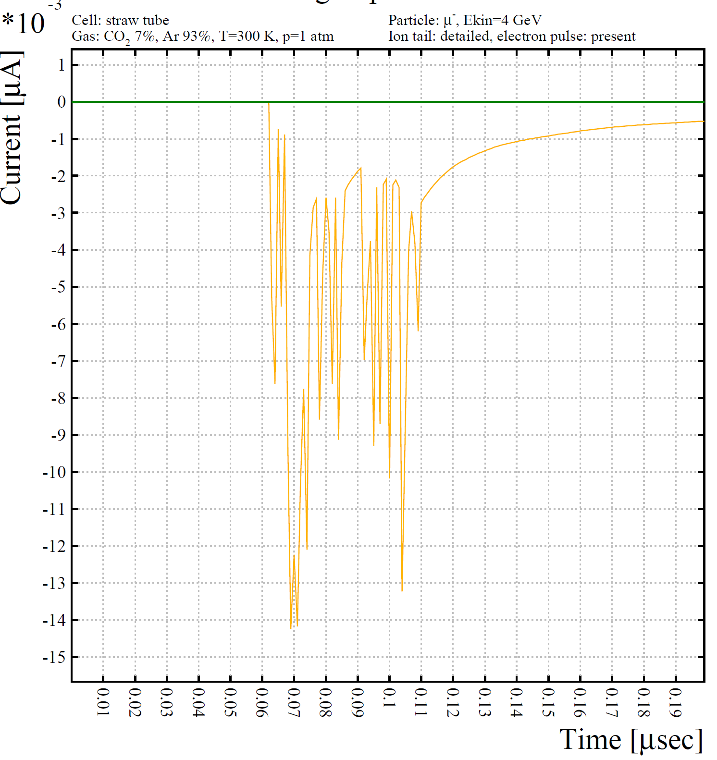
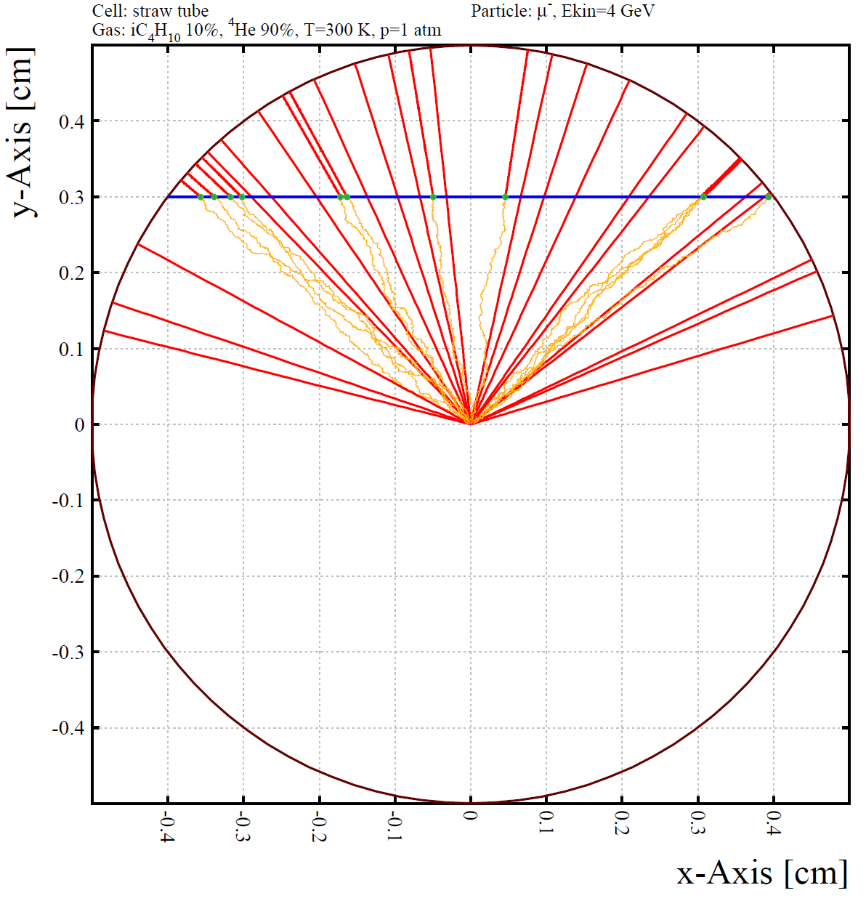
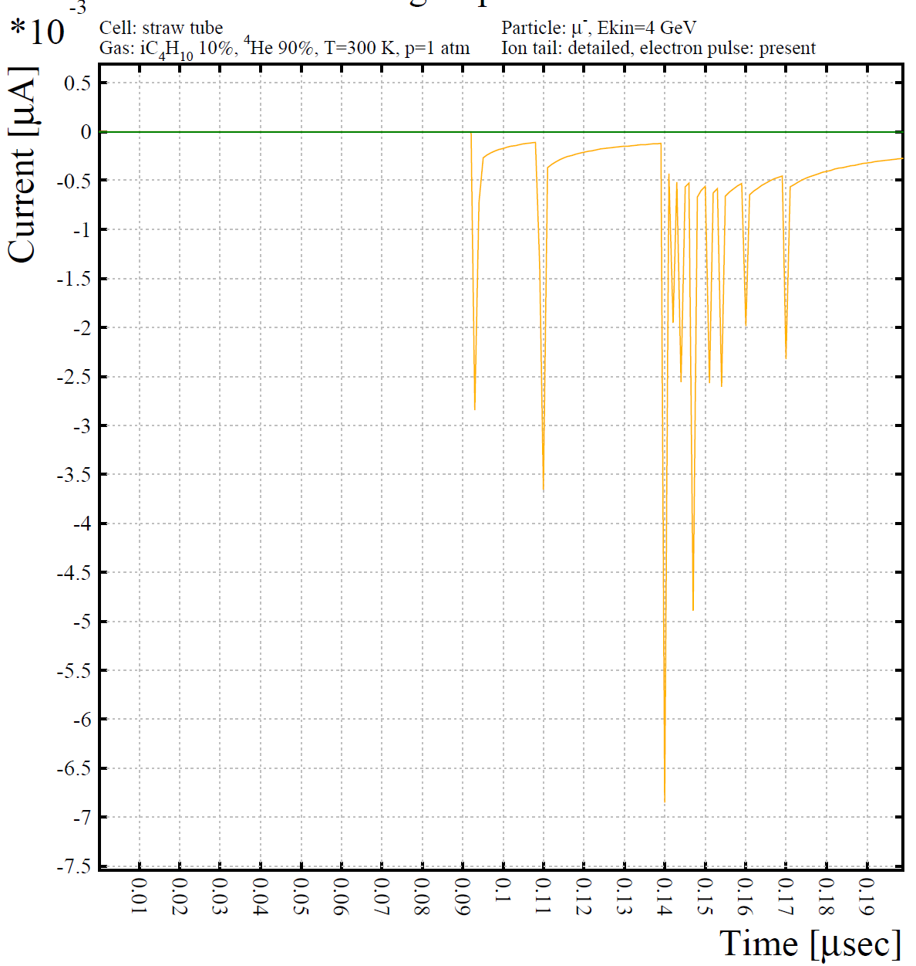
Simulation of signals in different gas mixtures
7
  dN/dx expected to improve dE/dx PID based on traditional charge measurements
  Ar-based gas: high ionization density (~40/cm) and moderate electron drift velocity 50 mm/ns (@E~2kV/cm). Mean cluster arrival time separation: ~5ns.
  He-based gas: lower ionization density (~20/cm) and 30 mm/ns (@E~2kV/cm). Mean cluster arrival time separation: ~15ns.
  Operation of straw tube at sufficient gain for efficiency single cluster detection and development of fast low-noise frontend electronics are instrumental for the application.
65 ns
Ar:CO₂ (93:7) 1bar
Difficult to count individual clusters...
r=5mm
90 ns
9
Primary electrons
ions
1
10
clusters
2
4-8
He:iC₄H₁₀ (90:10) 1bar
r=5mm
3

Slide 8
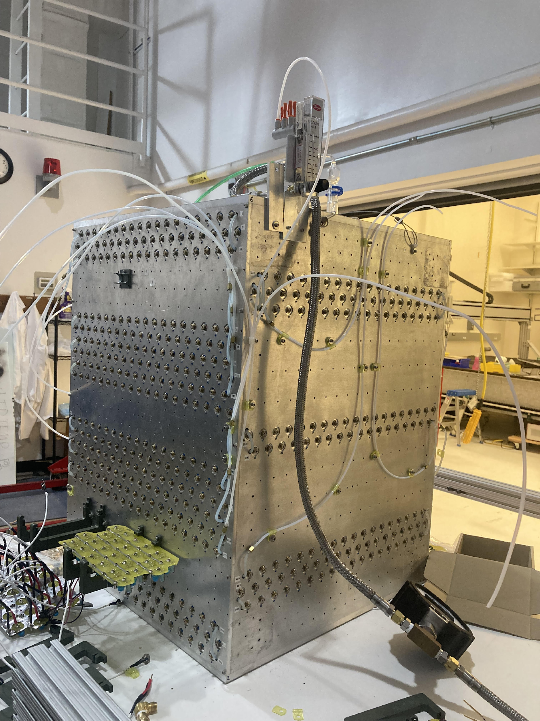
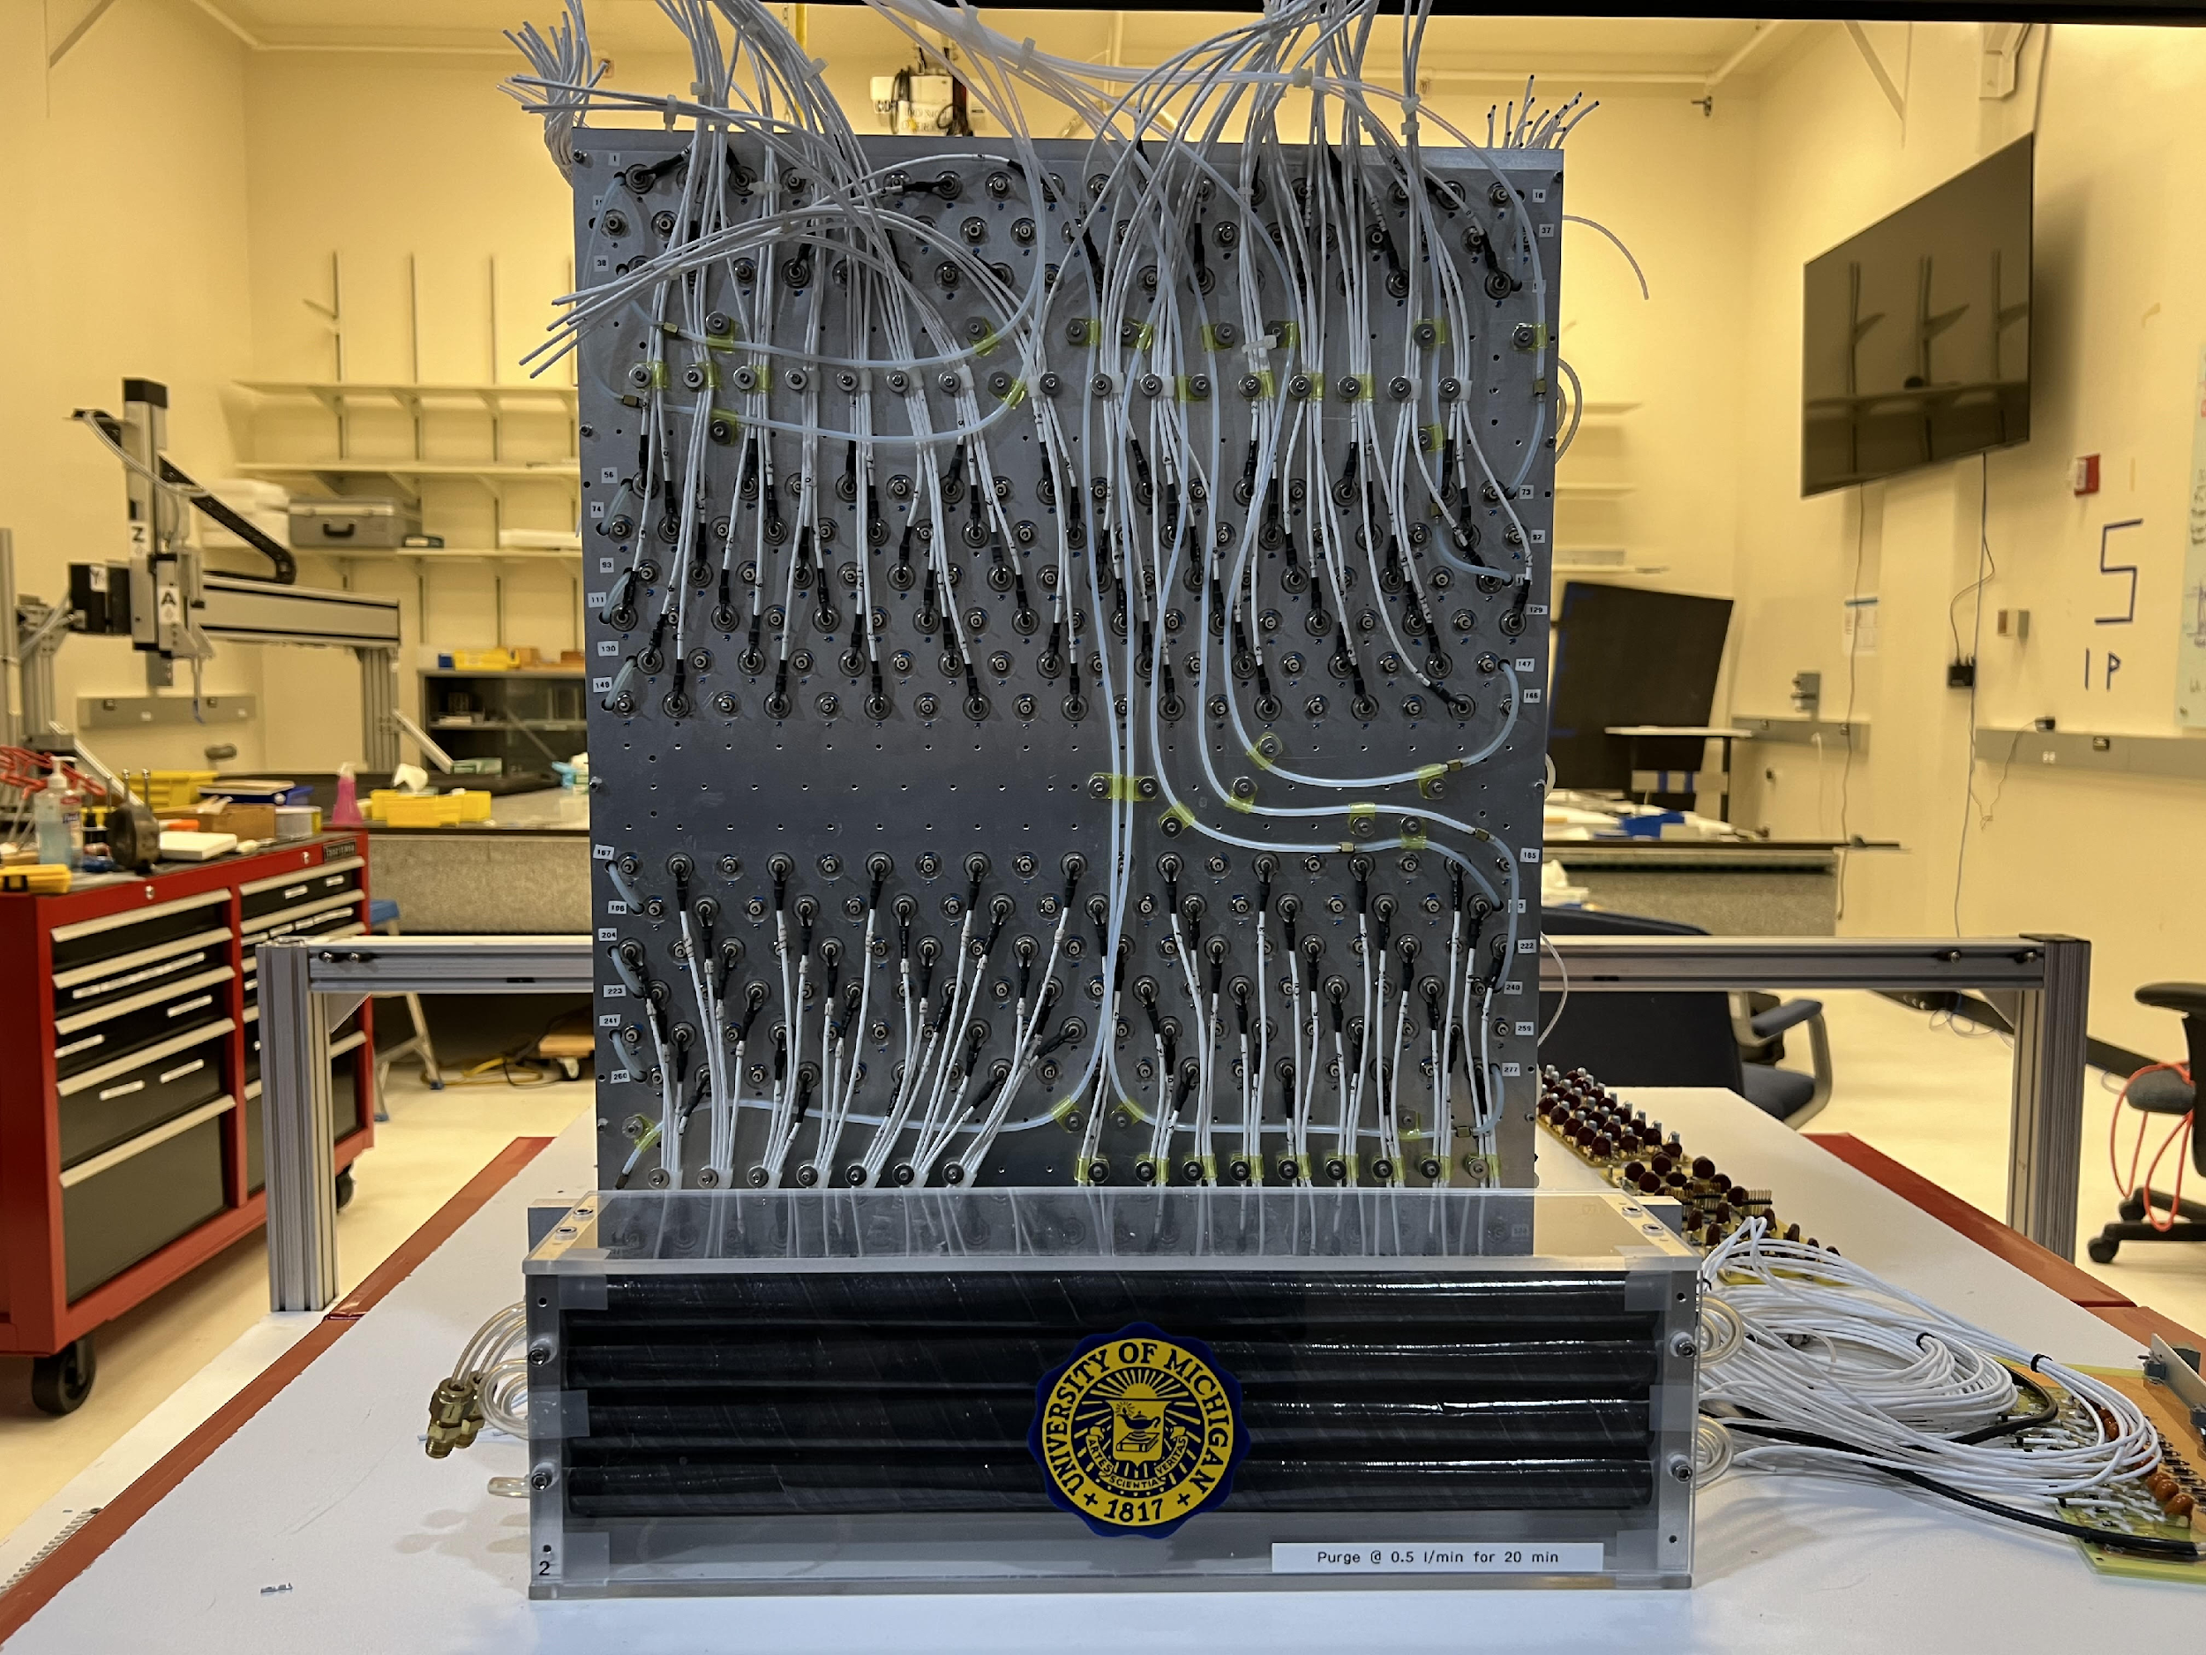
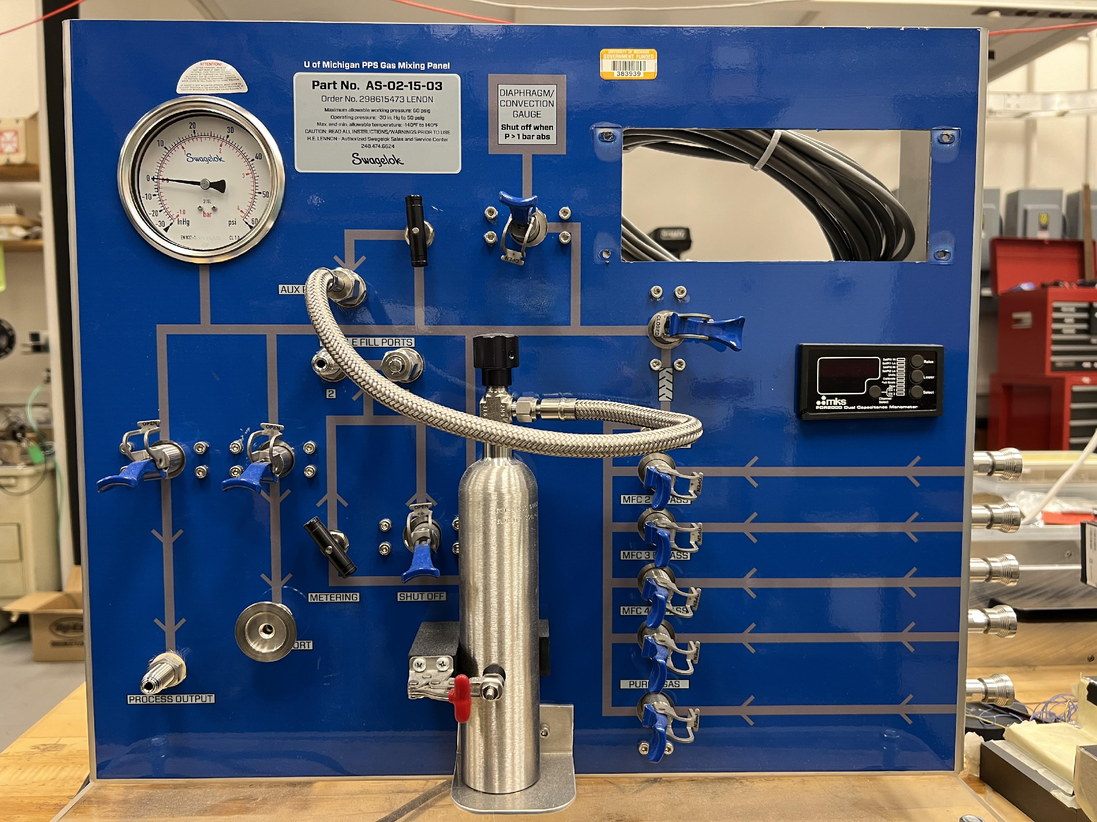
Straw tracker at Michigan
8
1.2 cm radius
~500 straw tubes
Only three shorten wires found
Gas flow tested for all straws
Cables remade so that they can be inserted into the ATLAS MDT hedgehog cards
MDT mezz, CSM and miniDAQ system ready
A new 4-channel gas mixture ready to be used

Slide 9
News
9
We are working together on the studies of a straw tracker for the FCC-ee
Institutions expressed interests: MPI, Michigan, Tufts, UMass-Amherst, Harvard
Plan to have regular meetings between these institutions in the future
Updated project description from Oliver
Temur will bring some straws for us to perform some studies
              A mini-workshop to discuss the FCC-ee straw tracker option on Oct 14-15 at the University of Michigan https://sites.google.com/umich.edu/strawtracker2024/home

