Slide 1
ILC Beam dump experiment (H2)
D. Bozzato¹, R. Froeschl¹, H. Iwase², T. Lorenzon¹, N. Nakao³, F. Pozzi¹, Y. Sakaki², T. Sanami², K. Sugihara², M. Tisi¹
¹ CERN HSE/RP-AS, ² KEK (Japan), ³ Shimizu Corp.
PS/SPS User Meeting (June 6, 2024) · Indico (cern.ch)
06/06/2024
EDMS 3103404

Slide 2
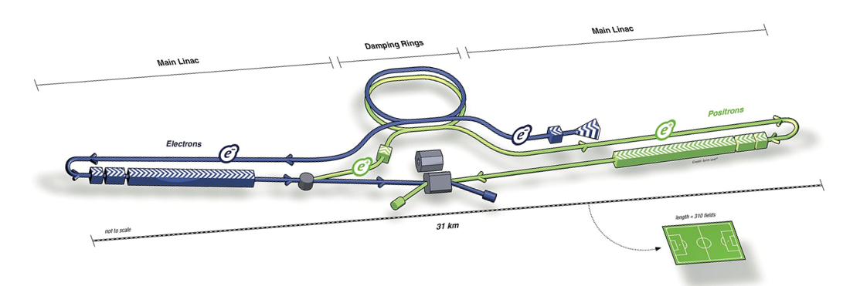
Physics goal
Context:
ILC Beam dumps
Main beam dumps of ILC (International Linear Collider) have been proposed as irradiation facilities (Sakaki et al, NIMA 1050 (2023) 168144 https://doi.org/10.1016/j.nima.2023.168144)
Goal of the present experimental activity:
Obtain experimental benchmark data of secondary particles from ILC-like beam dump targets irradiated by multi-GeV e- and e+ beams:
  Forward µ pairs produced from the interaction between e+ and atomic e-
  Neutrons

Slide 3
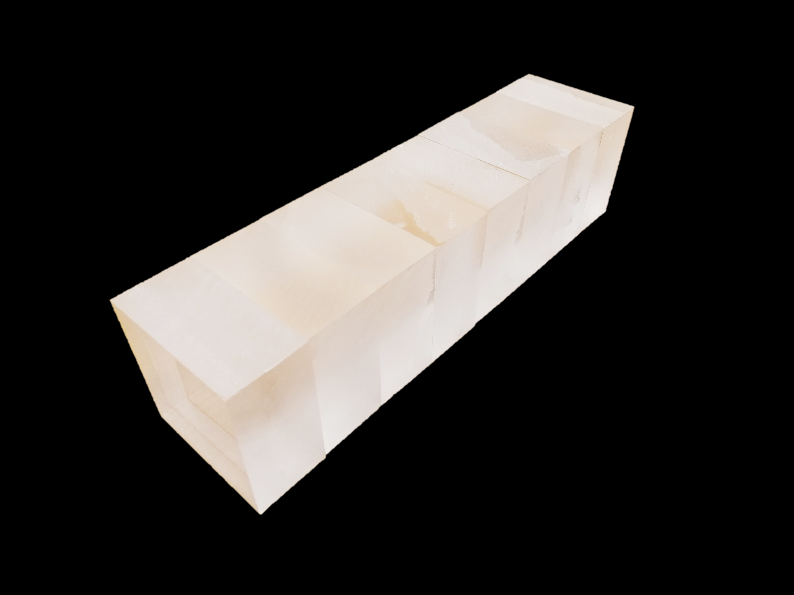
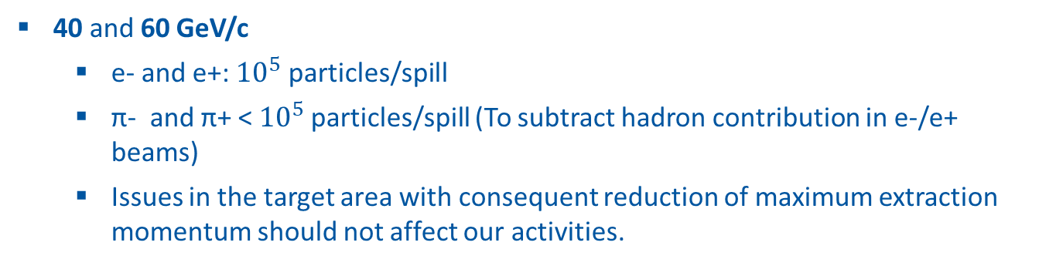
Location and beam parameters
Coordinates:
10 cm
40 cm
PPE172, H2
June 3-12, 2024 – beam time was extended to start earlier
Control Room HNA383
10 cm
Beam parameters:
beam
PMMA target
40 and 60 GeV/c
  e- and e+: ${10}^{5}$ particles/spill
  π- and π+ < ${10}^{5}$particles/spill (To subtract hadron contribution in e-/e+ beams)
  Issues in the target area with consequent reduction of maximum extraction momentum should not affect our activities.

Slide 4
Current status (1)
People
  All colleagues from Japan have arrived, last registration procedures were completed yesterday morning
Infrastructure and beam
  BE-EA installed DWCs, additional concrete blocks and calorimeter already last week
  We were shown how to operate the movable tables/platform in PPE172
  Many thanks to Michael and the BE-EA team for the prompt support!
  Nikos prepared the beam files and showed us how to use them – Many thanks!
Experimental equipment
  All equipment has been installed in PPE172 and HNA383 from Monday to Wednesday
  Many thanks to Dragoslav and Inaki for providing support with the setup of the DWCs (gas, voltage, connections, etc.)!
Safety inspection
  Carried out on Wednesday mid afternoon --> recommendations were implemented --> got safety clearance.
  Many thanks to James for the availability!

Slide 5
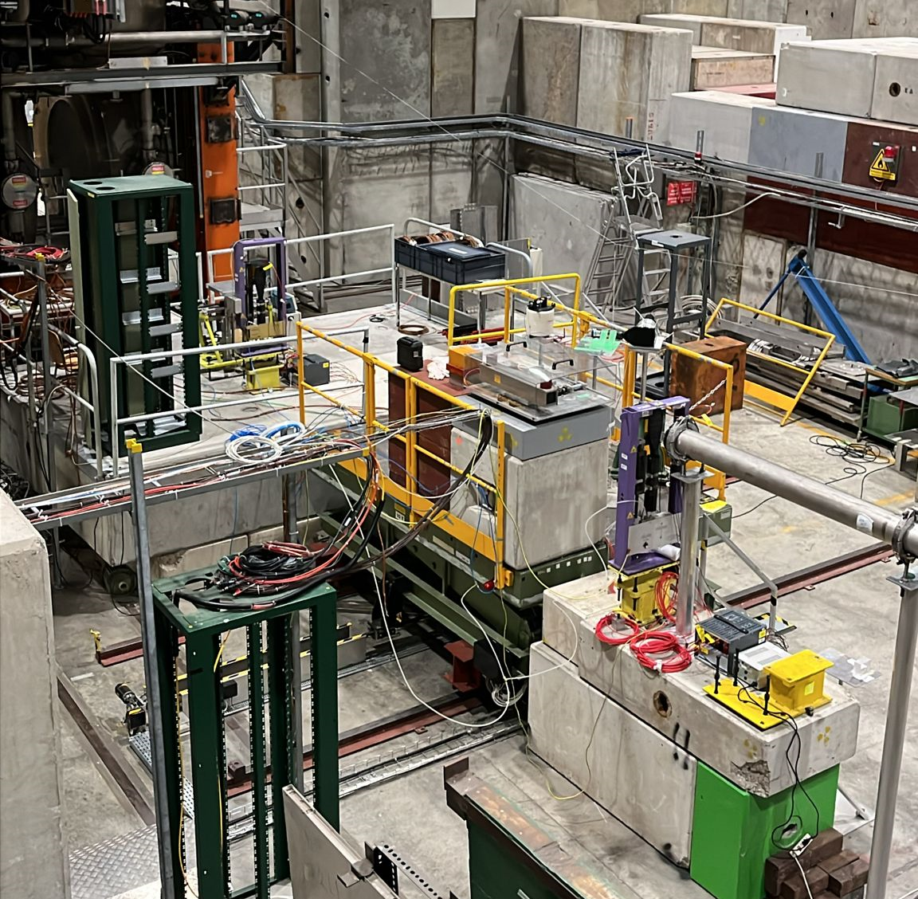
Current status (2)
H2 - PPE172
Next steps
  Alignment of equipment with respect to the beam
  Manual placement of the PMMA target
  Start of first tests and experimental activities (afternoon?)
DWC3
Neutron monitors
DWC2
shielding – calorimeter - target
BEAM
DWC1

Slide 6

marco.tisi@cern.ch
EDMS 3103404

Slide 7
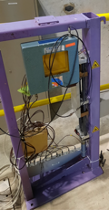
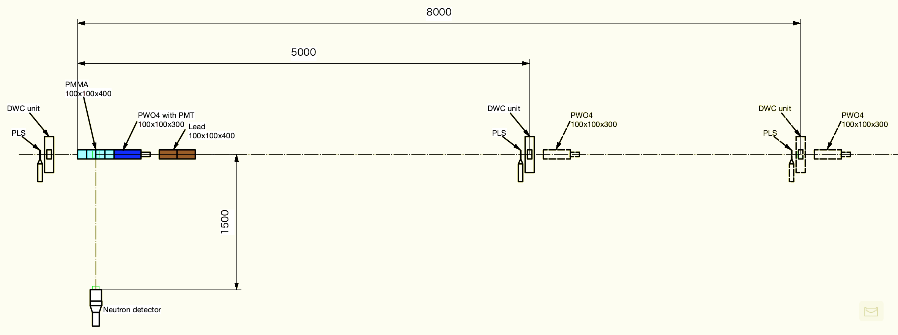

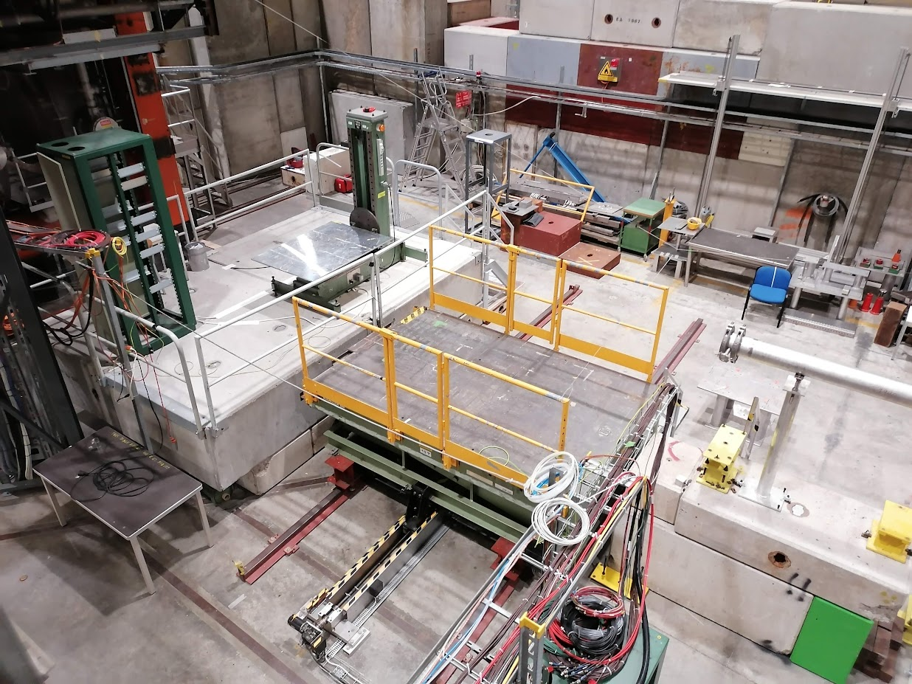
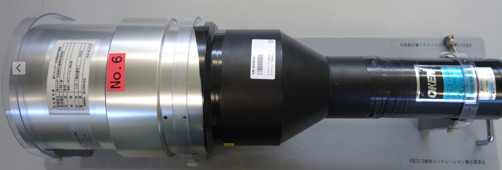
beam parameters and installation (2)
40 cm
beam
Additional conc. platform
Conc. platform
PPE172
beam
Movable platform
Conc. platform
Schematic layout in PPE172

