Slide 1
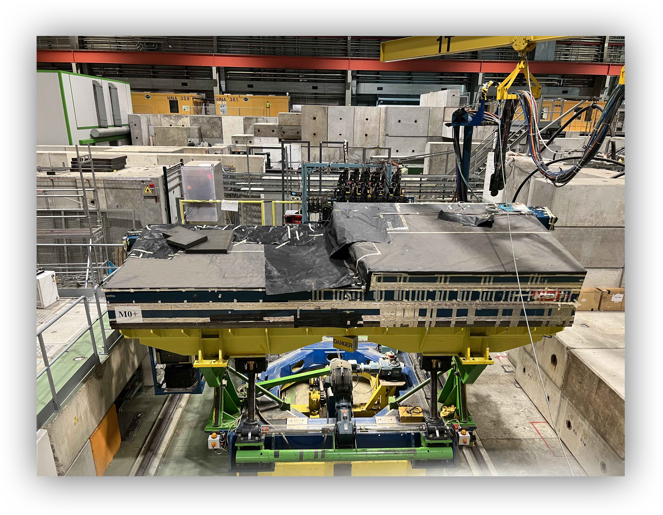
ATLAS TileCal Test-Beam
G.Usai , T. Mkrtchyan
for the ATLAS TILE group

Slide 2
Goals of the test beam
Validation of electronics for the HL-LHC
  Full vertical slice test with upgraded component and integration with the ATLAS infrastructure (FELIX)
  integration/test of:
    Daughterboard v6.4 (FDR in Q2/Q3),
    trigger pre-processor (CPM and TDAQi (FDR in Q3)
    HV regulation system (FDR follow up)
    LV power system (PRR in end Q2)
  Particle response, EM scale setting, linearity and resolution,
Improve ATLAS performances with validation/modeling of hadronic showering models (collaboration with G4 team)
  Many hadron-based analysis in the high and low energy regimes
  Muon and electron calibration studies of great importance to have precise energy scale
Two run periods
  W21, W22: from 22nd May to 4th June
  W37, W38: from 11th to 24th September

Slide 3
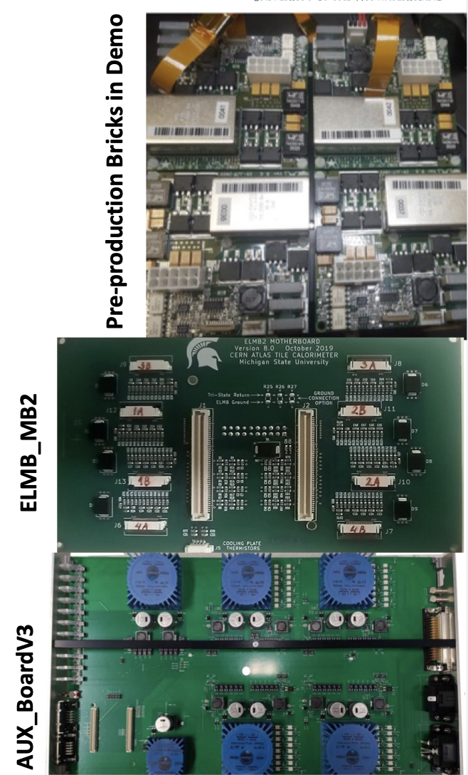
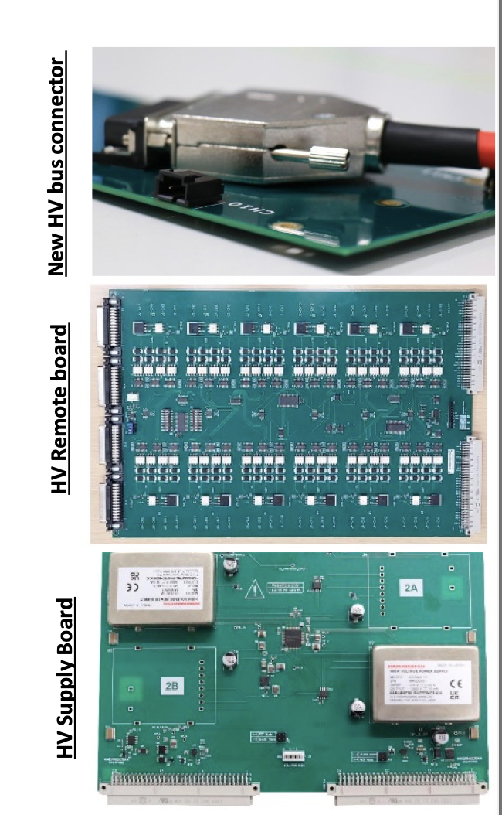
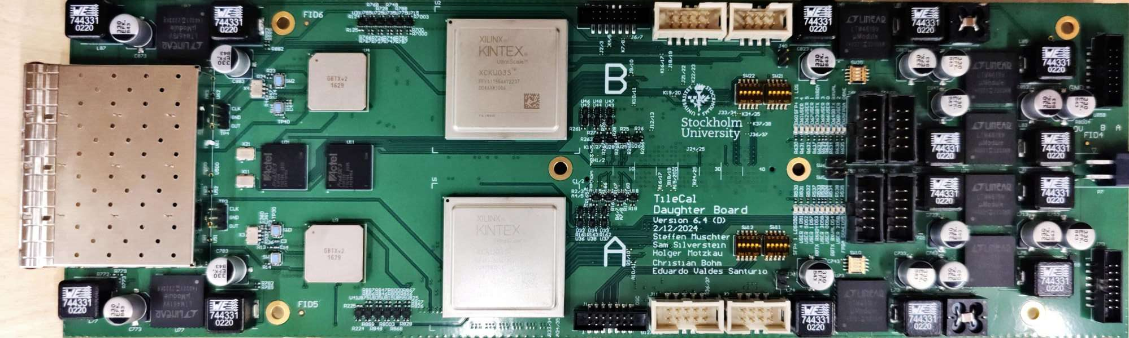
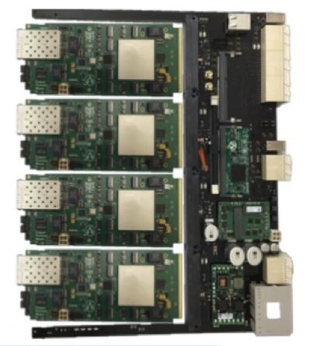
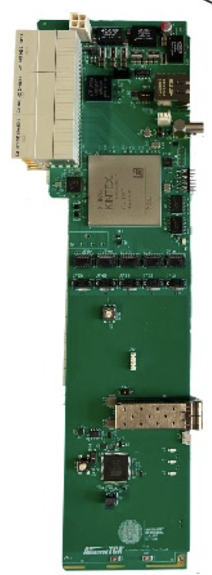
Goals of the test beam
Ready for the PRR
New prototypes
didn’t make it,
September!
Not fully integrated
In track for September!
Only one board,
but it worked great
Daughterboard v6.4
CPM and ATCA carrier
TDAQi v3

Slide 4
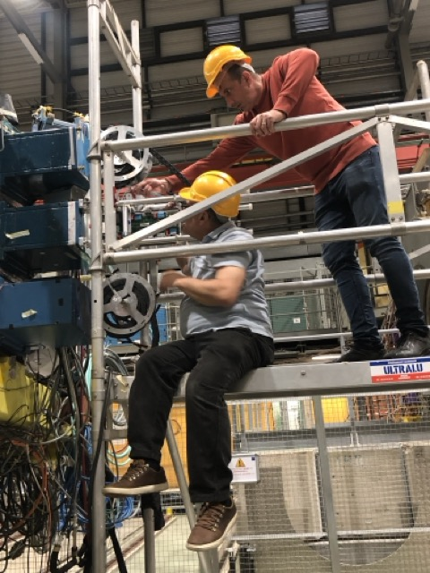
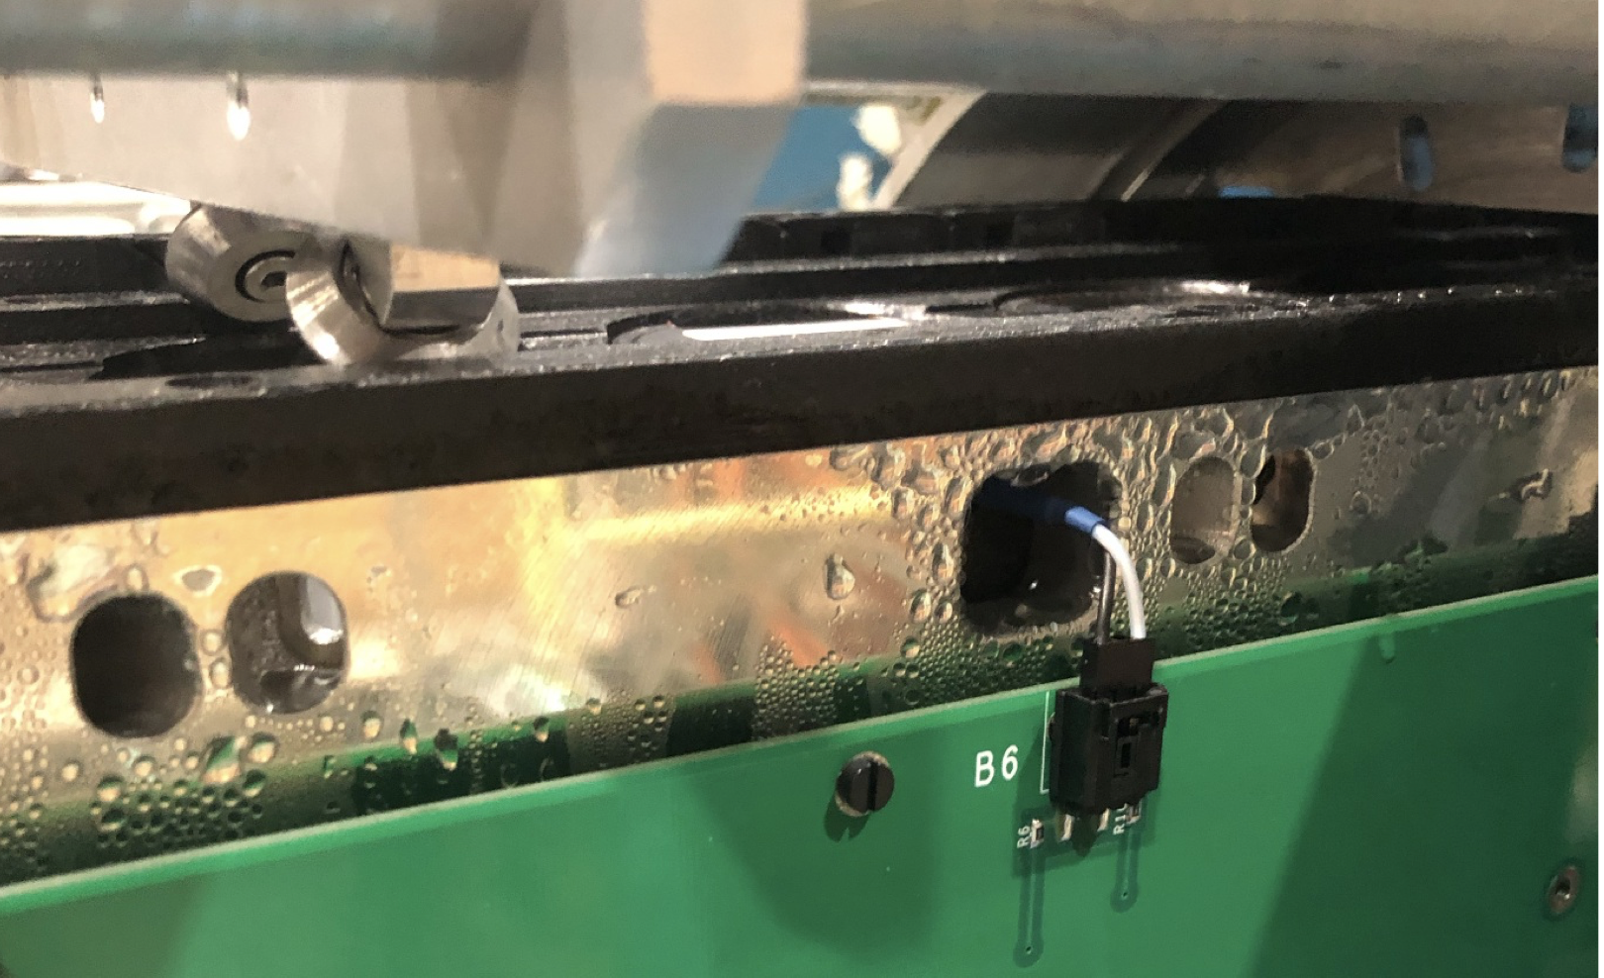
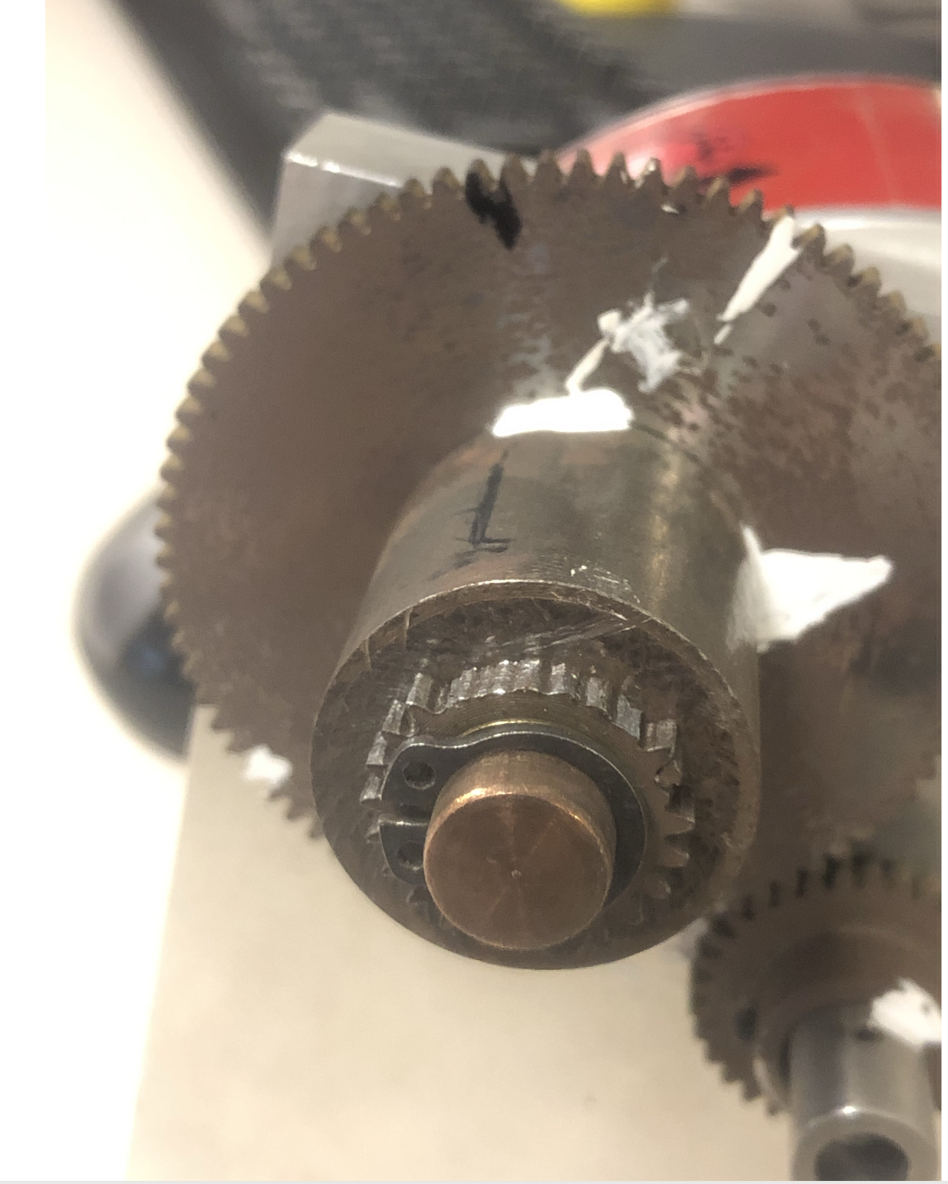
Plenty of A&I activities and operational experience

Slide 5
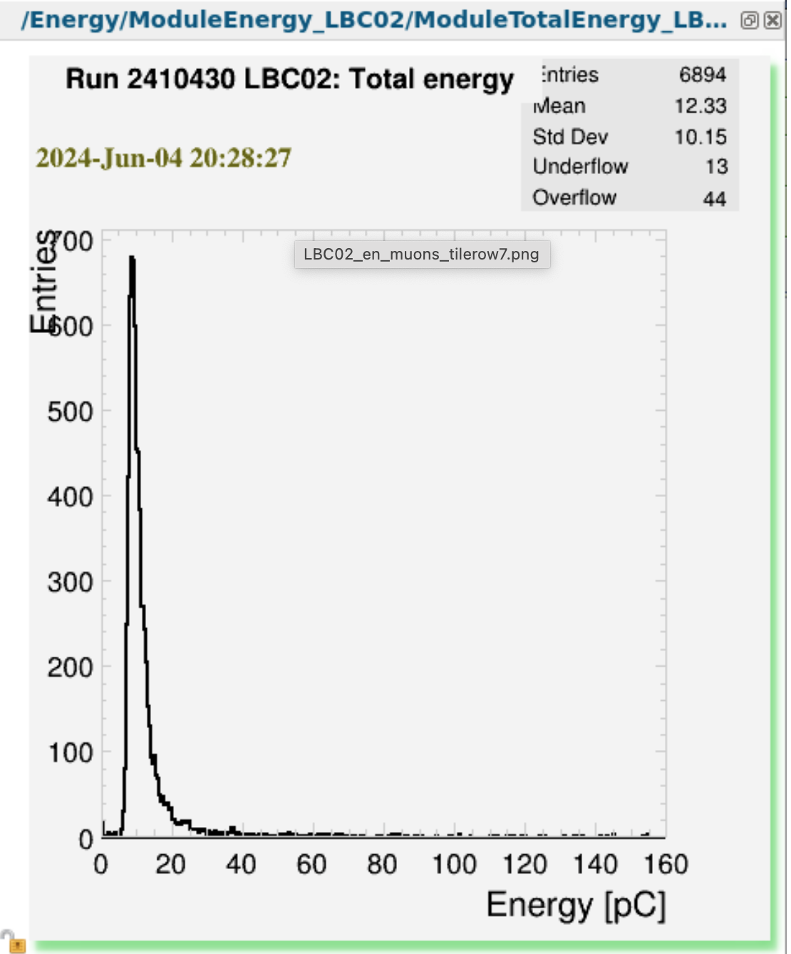
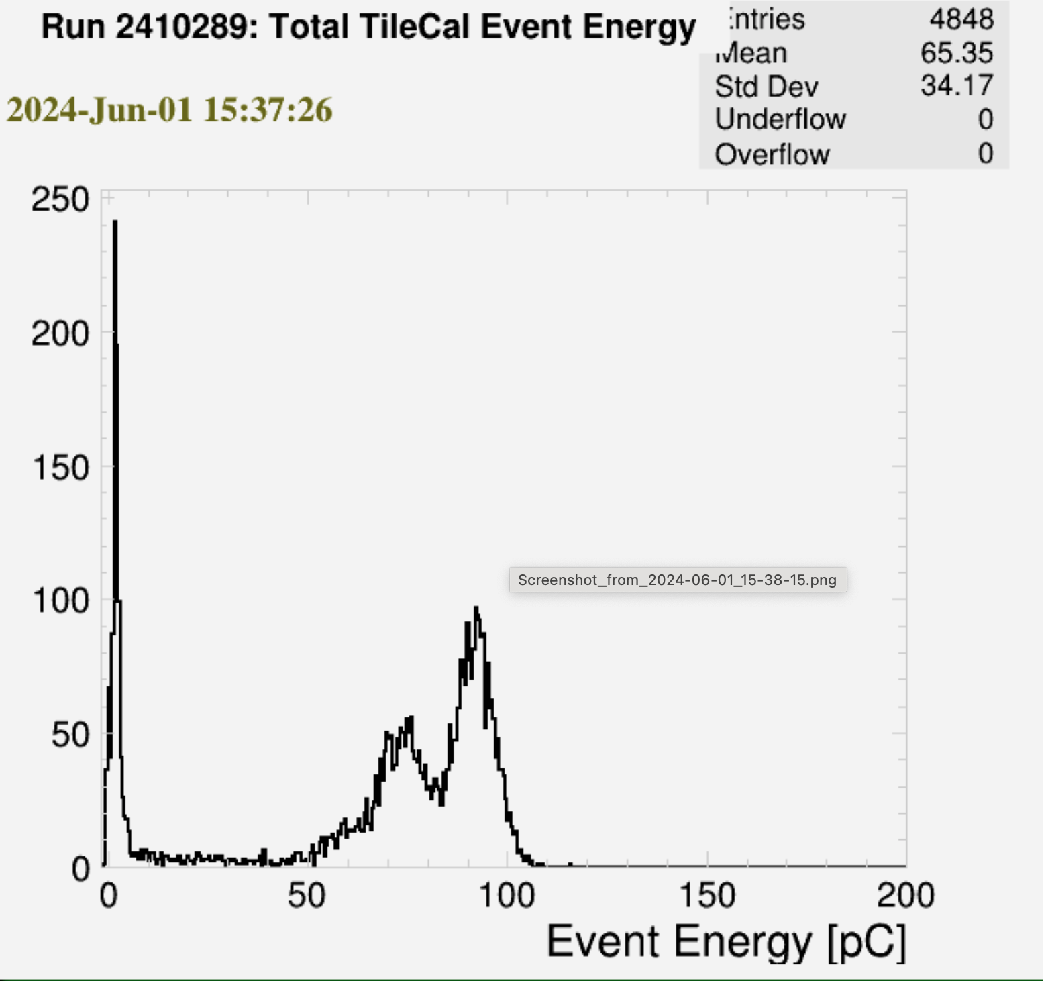
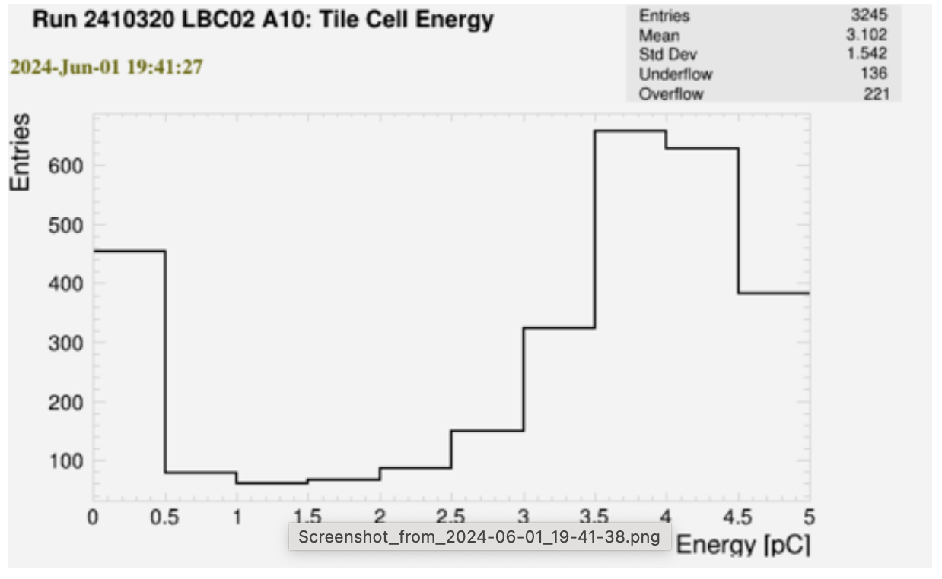
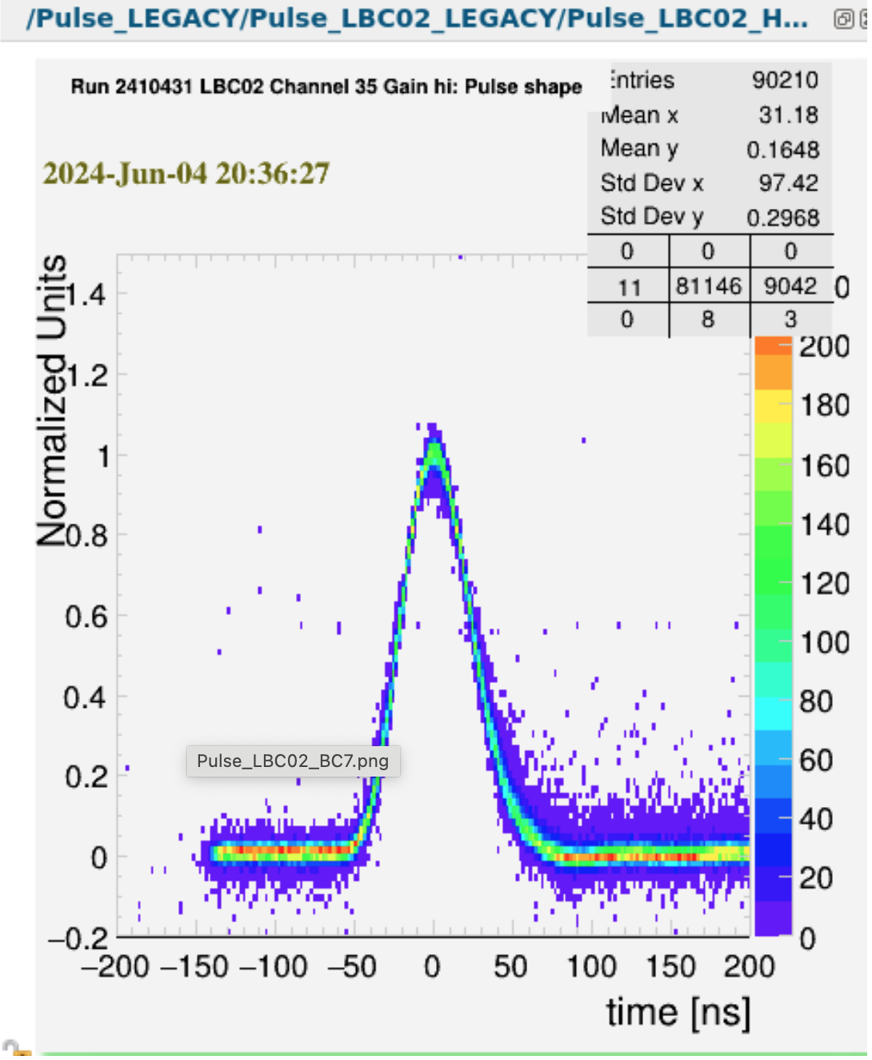
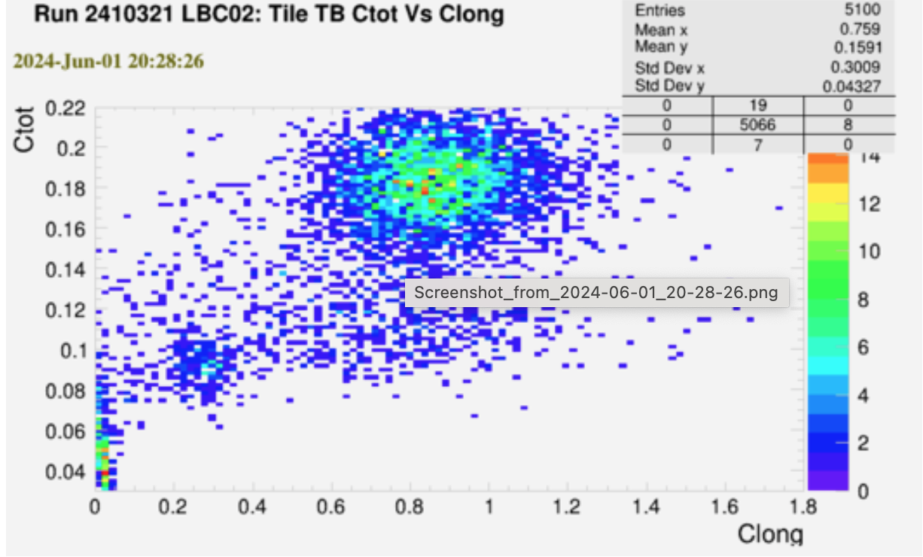
Few examples of online monitoring plots
Positrons beam seems spectacular!
Will provide more feedback on purity ASAP
Overall we had large down time but
We do manage to collect 25 M events.

Slide 6
MANY Thanks to ALL personnel of the accelerators and North Area that make always the TB experience pleasant, important and worthwhile, particularly for the young colleagues

